Slide 1
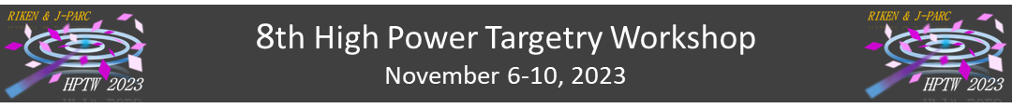
Summary of Topic 6
Construction, fabrication, inspection, QA of HPT
Takashi Naoe, Katsuya Yonehara

Slide 2
Timetable
NuMI record beam power experiences: George Lolov
Current developments of the LBE spallation target for the CiADS project: Tao Wan
Upgrades, fabrication and QA of 1.3 MW HK target: Mike Fitton
LHC Beam Dumps: Marco Calviani
Positron source and target in KEK: Yoshinori Enomoto
Development of ILC positron production target: Yu Morikawa
Blue: Upgrade existing facility
Red: Future beam facility

Slide 3
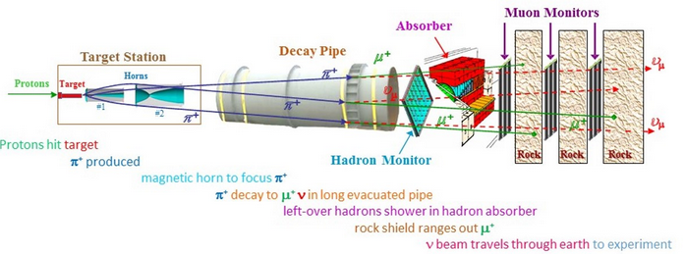
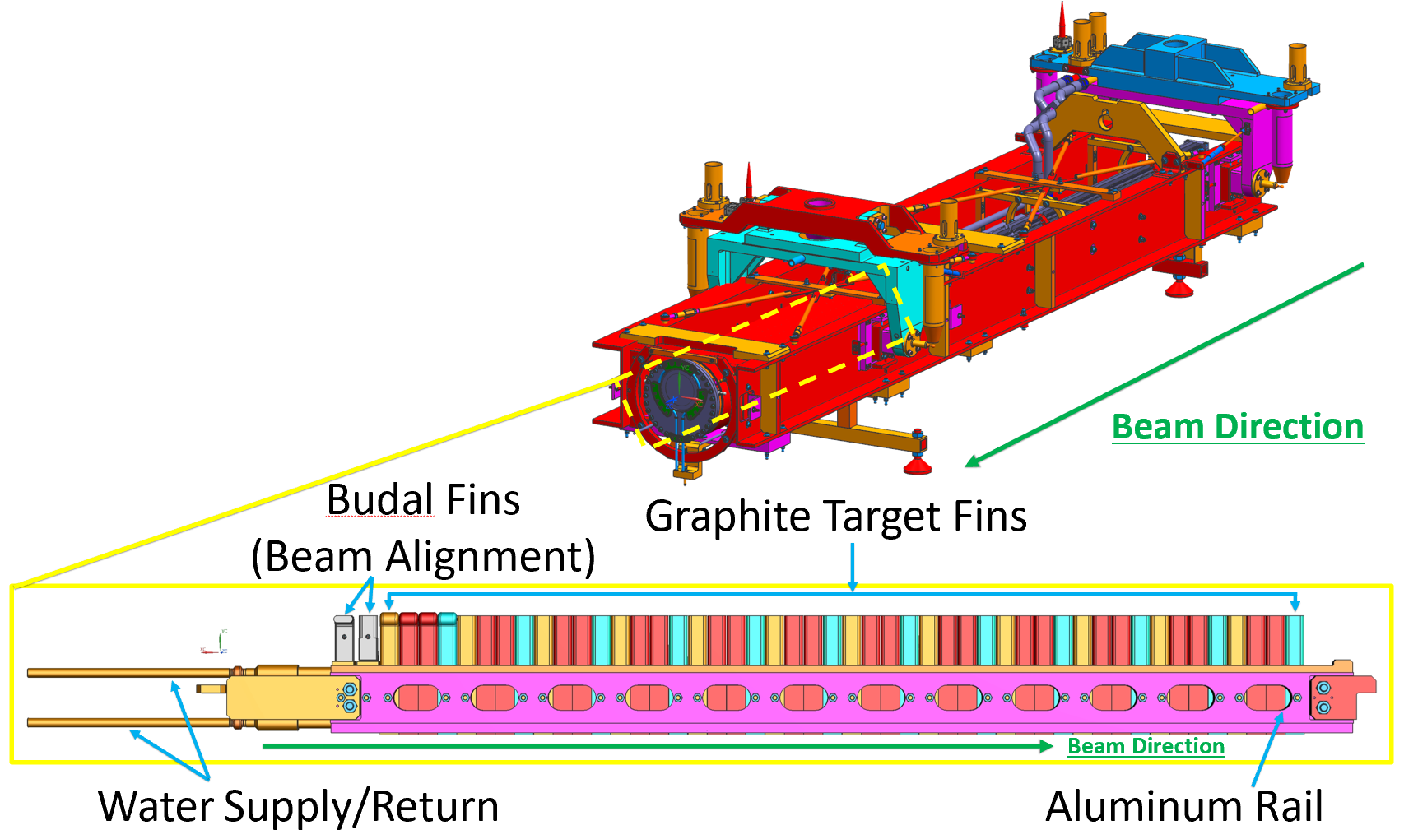
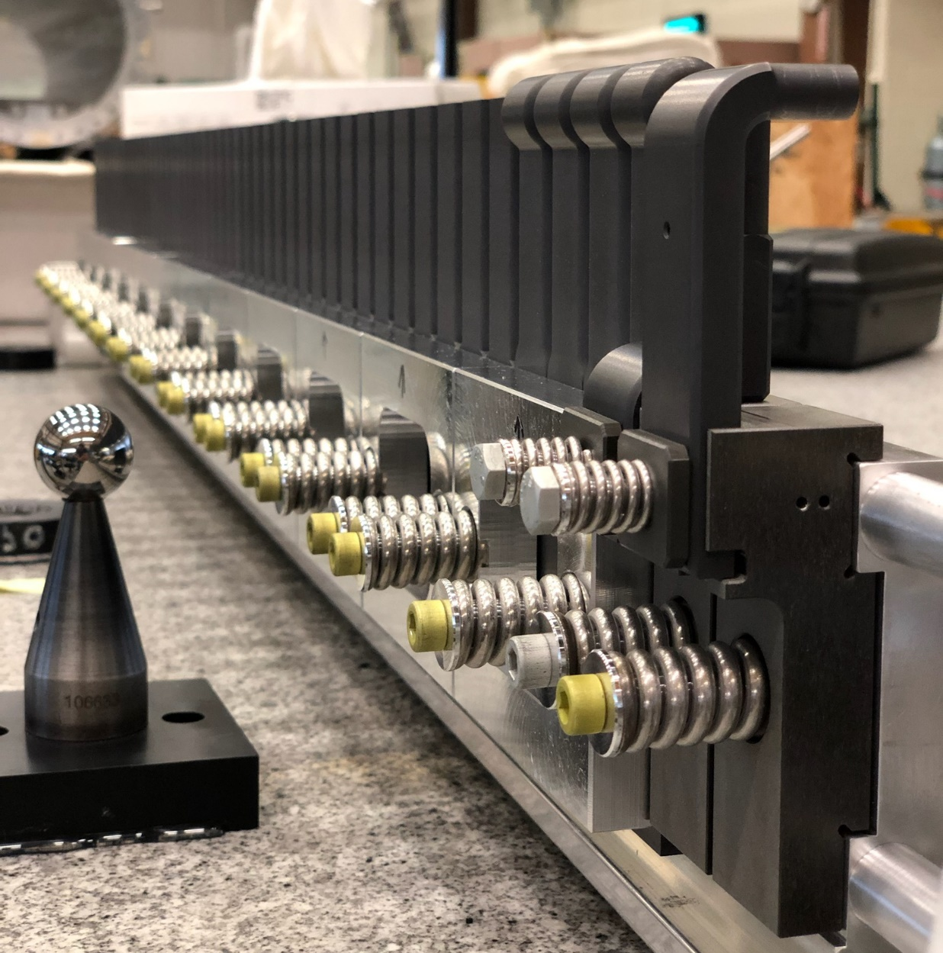
NuMI
1 MW capable neutrino production target
TA-06 achieved average beam power of 923kW in 2023
Next 3 targets currently in production – possibly the last targets that will ever be built for NuMI
Run to 1MW will be attempted in FY24
Challenges:
Achieving 1MW+ power
  Beam rep rate will need to be reduced to 1.067s
Beam spot size needs to be held to 1.5mm sigma to avoid rupturing Be windows at high power
50 Graphite Target Fins of grade POCO ZXF-5Q
The hottest location on the fins reaches a temperature of 997 degrees Celsius
G. Lolov

Slide 4
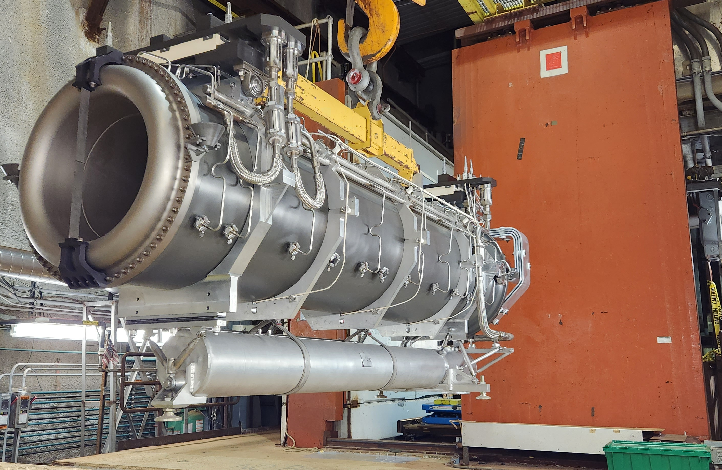
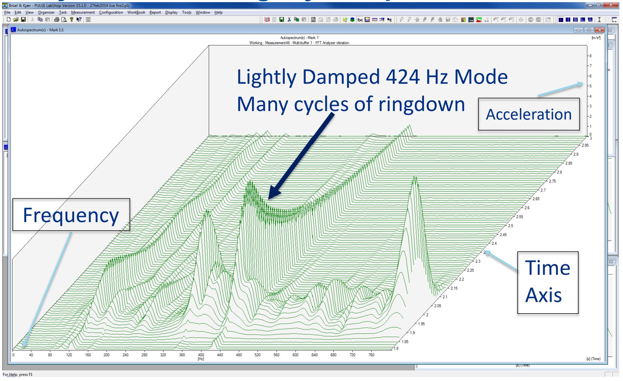
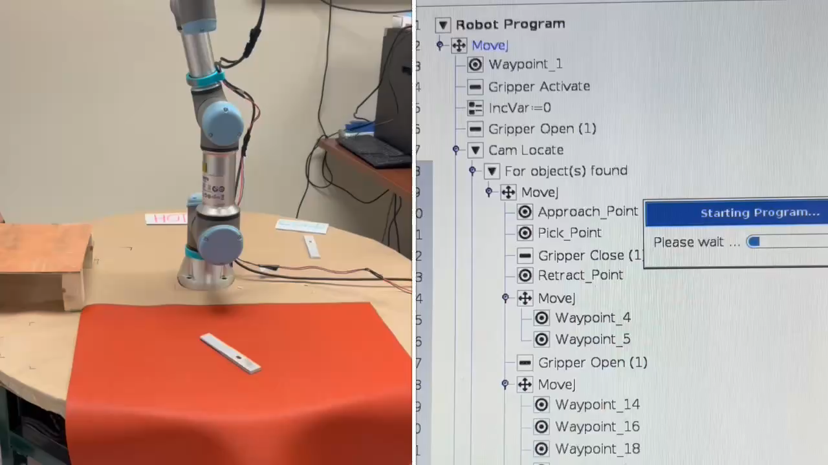
Conclusion
Many challenges on the road to achieving 1MW operation
  Beam lattice optimization requiring re-evaluation of target components
  Horn 2 failure
Opportunity to exceed 1MW has presented itself
Plans to incorporate different grades of graphite in future targets for potential use in LBNF
Target autopsy capabilities are being expanded with robotics R&D efforts
G. Lolov

Slide 5
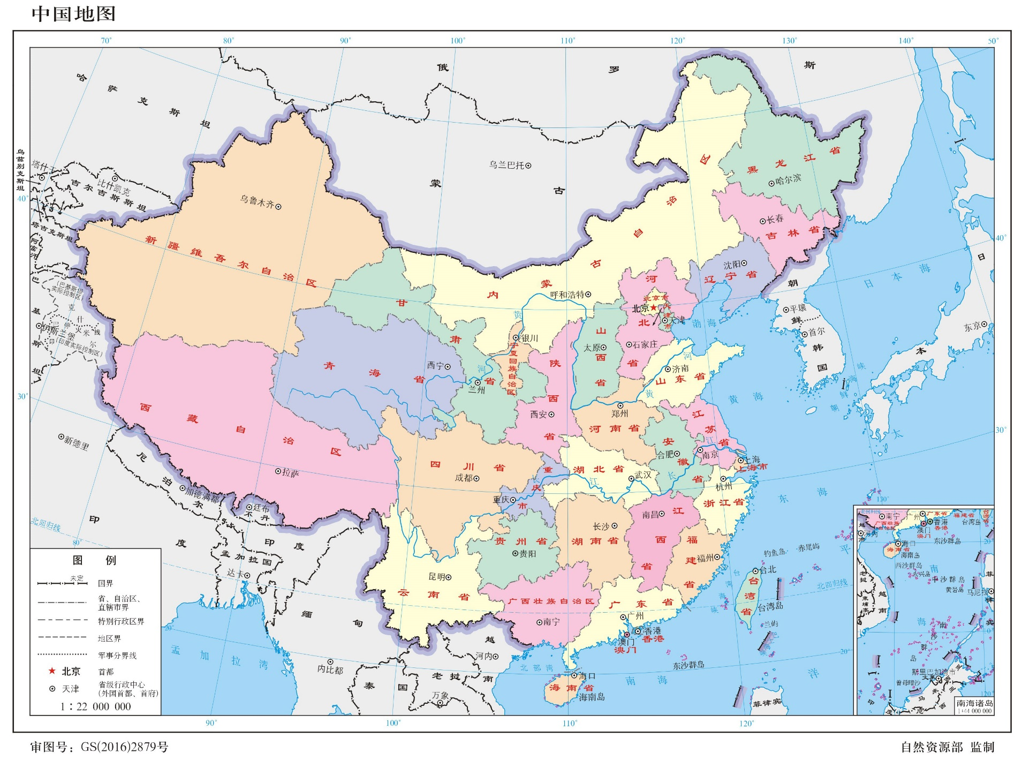
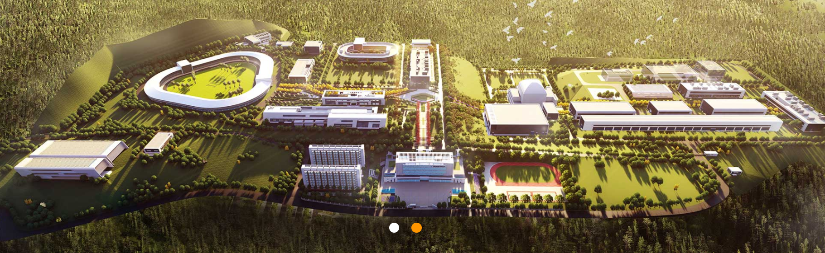
The CiADS project
Project | China initiative Accelerator Driven System (CiADS)
Commision | National Development and Reform Commission
Authority | Chinese Academy of Scicences (CAS)
Constructor | Institute of Modern Physics (IMP) China Institute of Atomic Energy (CIAE)
Site | Huizhou City, Guangdong Province
Floorage Area | 42658 m²
Cons. Cycle | 6 years (2021-2027)
CiADS
T. Wang

Slide 6
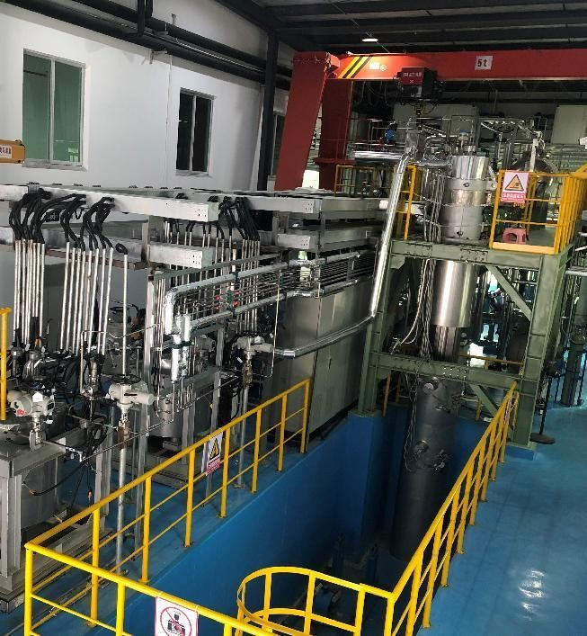
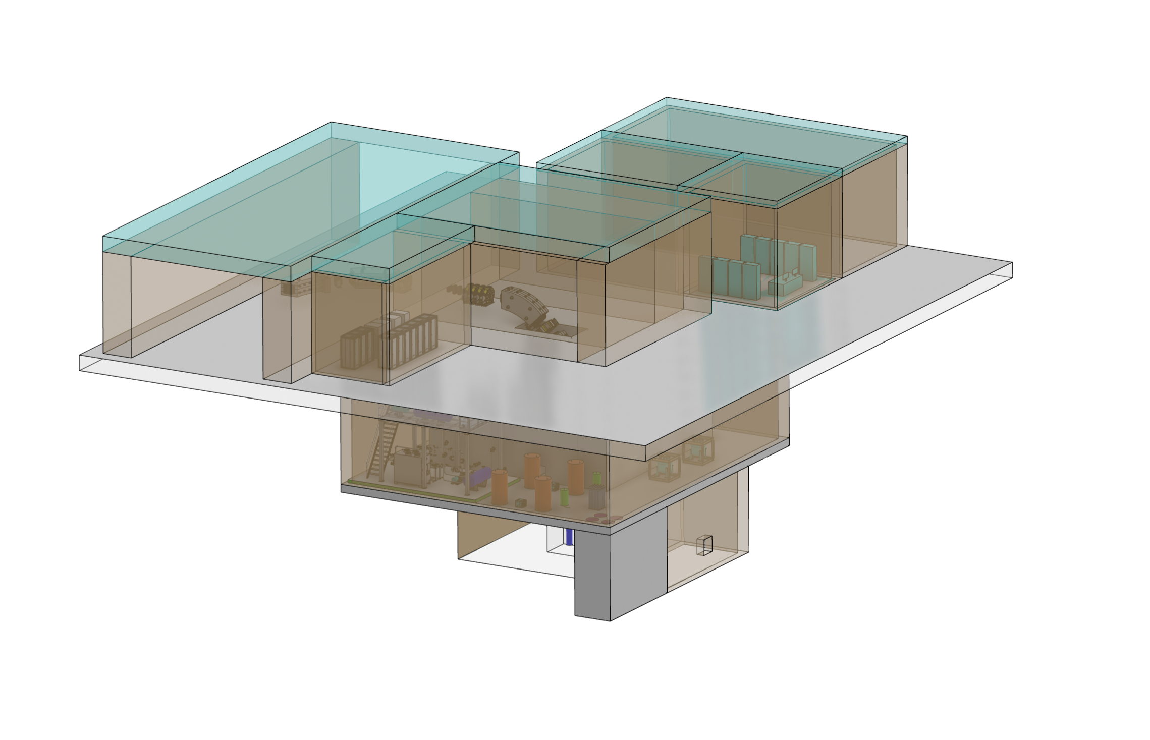
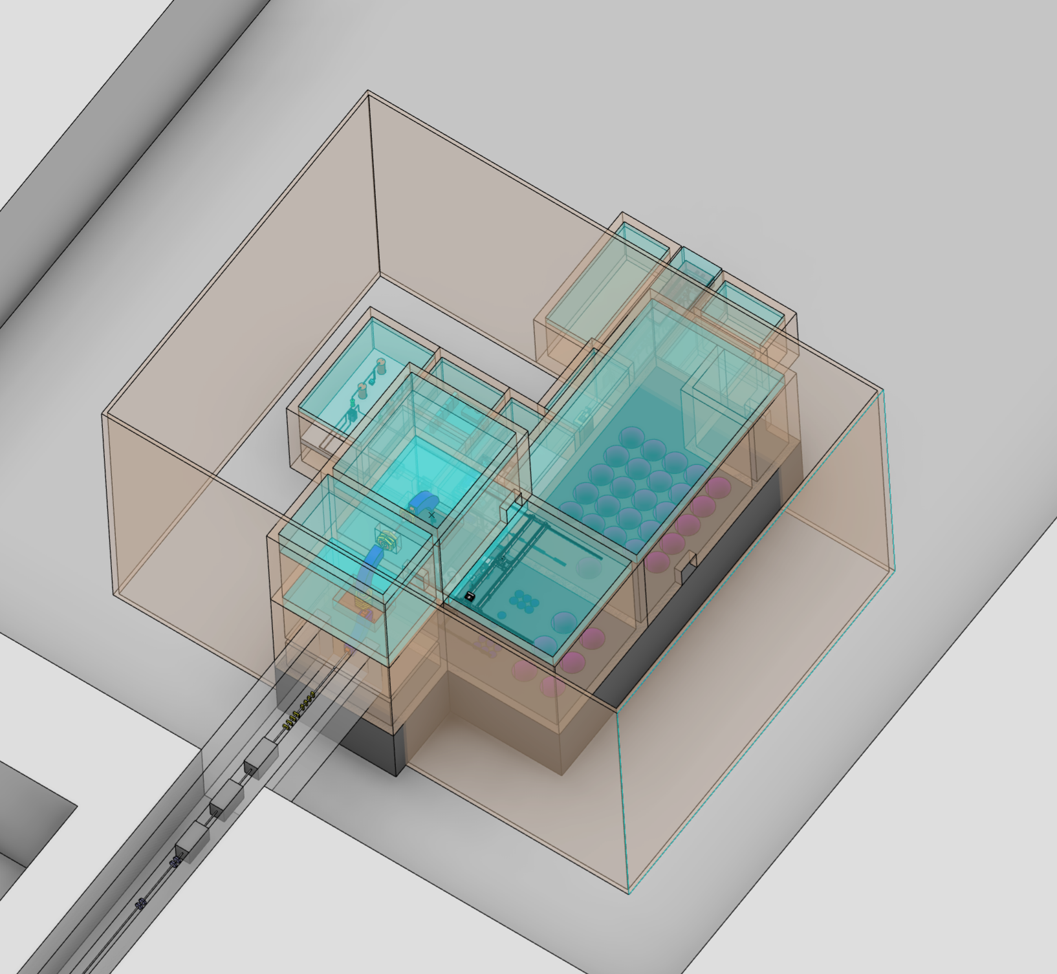
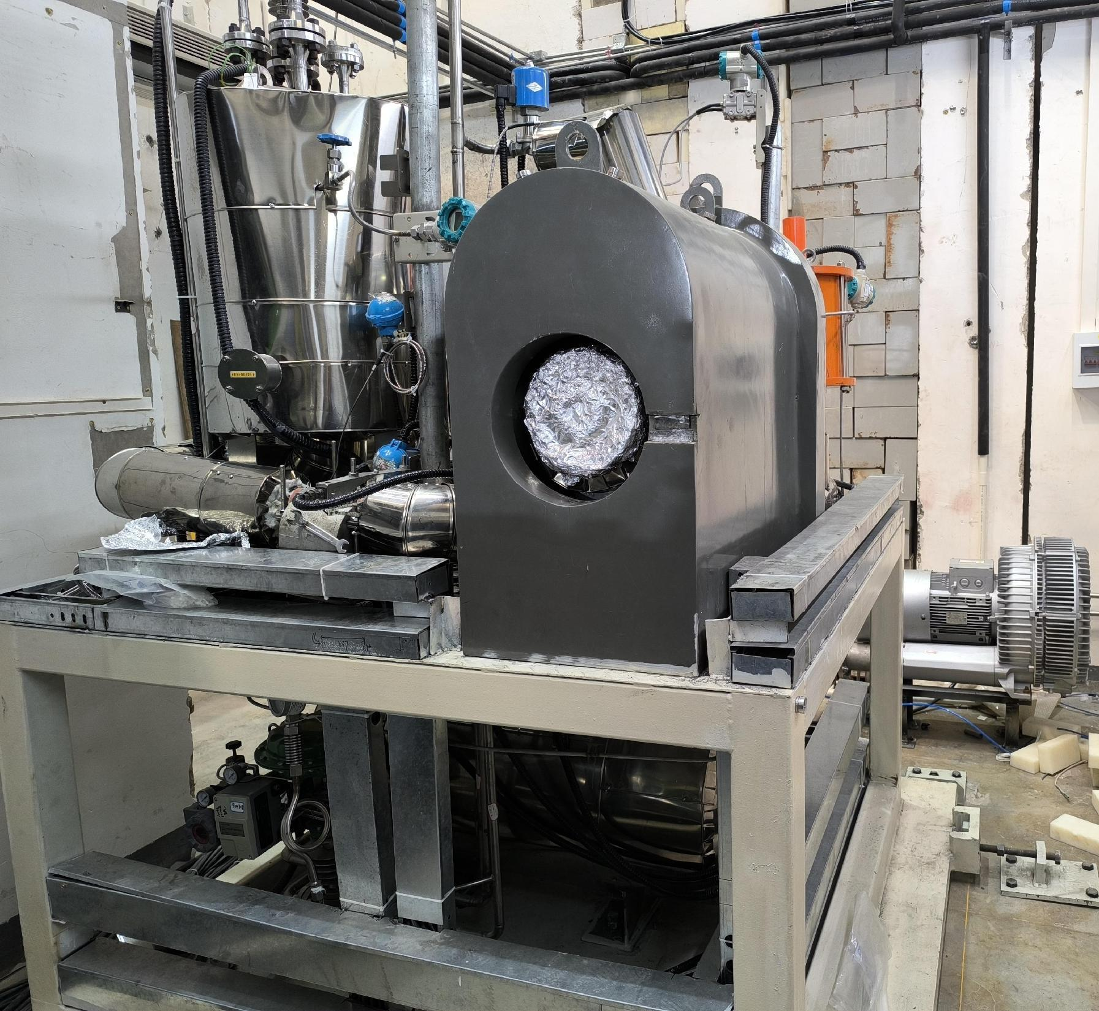
Roadmap of CiADS Spallation Target
2022年
2023年
2025年
2027年
Prototype Target
BW Test Loop
(140 W)
On-Beam Test Target
(T2, 250 kW)
CiADS Target
(T1, 250 kW / 2.5 MW)
Real size prototype
Off-line test
System reliability
Coulpling to the accelerator with a low power
Estimate performance of target Beam Window (BW)
Accelarator-Target coupling tech.
Various target techniques
Accelarator-Target-Reactor couple
(CiADS: 10MW)
T. Wang

Slide 7
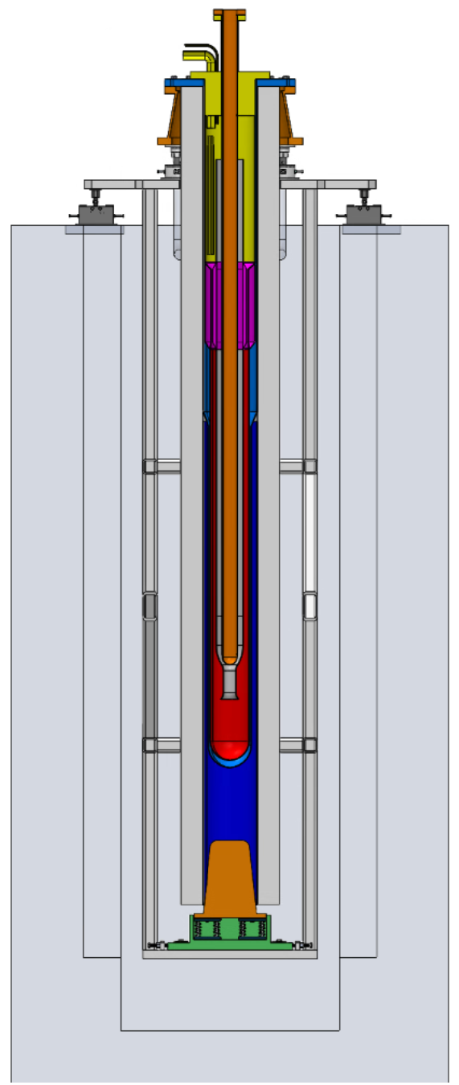
Conclusion
Remarks:
IMP-CAS is now responsible for constructing the CiADS project in Huizhou, Guangdong.
According to the development goal of CiADS, a roadmap of four stages was drawed up to realize the LBE spallation target step by step.
Key components are being developed for the CiADS LBE spallation target system.
At present, the progress of the target development is in line with the CPM plan.
Prototype target: already constructed and operated over 400 hrs;
BWTL: installed, and will be operated in Nov.;
On-beam test target: engineering design completed, will be fabricated soon;
CiADS target: Physical design/Conceptual design is being performed.
Challenges:
With increasing of beam power, the target system trends to be much more complex and sophisticated.
Lack of on-beam LBE target operation experiences.
Target station
For on-beam test
Welcome to visit IMP for discussions and collaborations on target techniques
T. Wang

Slide 8
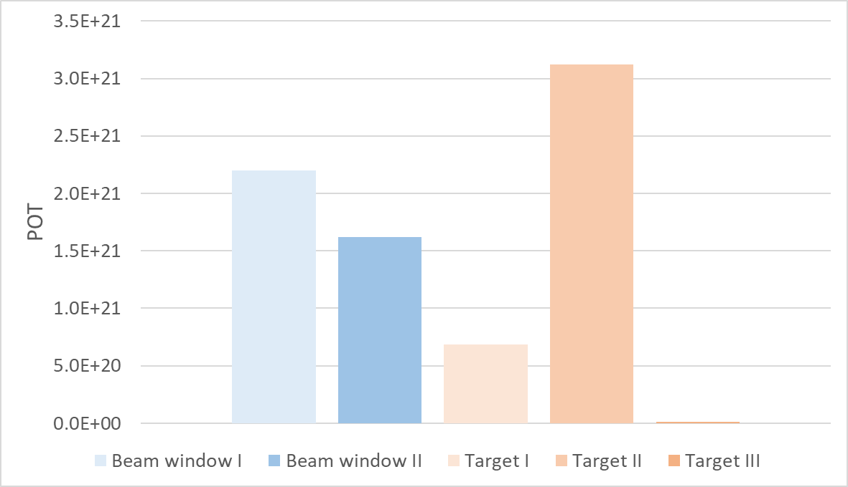
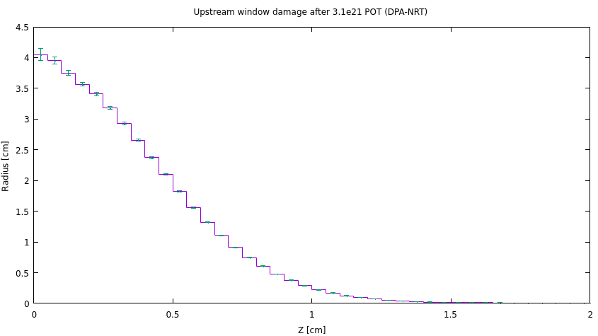
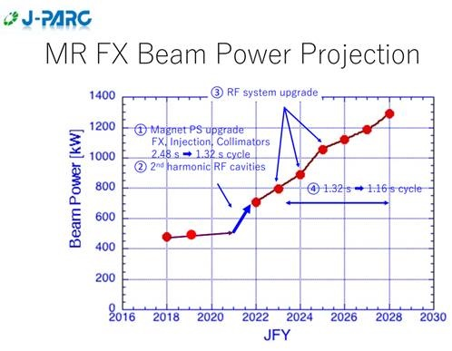
T2K Experience of target and beam window lifetime (POT and DPA)
How long will a Ti-6Al-4V target/window last?
    No titanium failures observed to date
    No indications of graphite failure
Target II has highest POT 3.1 x 10²¹ POT → 4 DPA-NRT
DPA higher than BLIP irradiated samples! → 0.95DPA-NRT
3.1x10²¹
1.6x10²¹
FLUKA estimate current target window @ 4DPA-NRT
Damage threshold = 40eV
Replaced before failure
Replaced before failure
Work underway to irradiate titanium alloys using 28MeV protons @ Birmingham university MC40 cyclotron
2.5-3 DPA-NRT damage of high cycle fatigue samples with ~30days irradiation.
See poster by Richard Cowan
“Testing high-DPA irradiated titanium alloys for high-cycle fatigue”
Replaced before failure
In service
In service
HK upgrade
Current upgrades to accelerator should result in a rapid increase in rep rate and beam power.
1.3MW beam around 2026
(3.2x10¹⁴ppp @ 1.16Hz) – 19% increase
In HK era we can expect around 3 x 10²¹ POT/yr
Ideally a target & beam window will not need to be replaced more than 1 time per year. More data needed!
M. Fitton

Slide 9
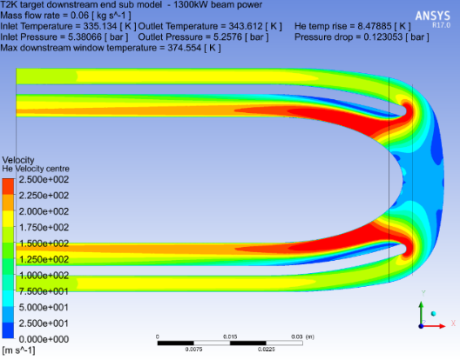
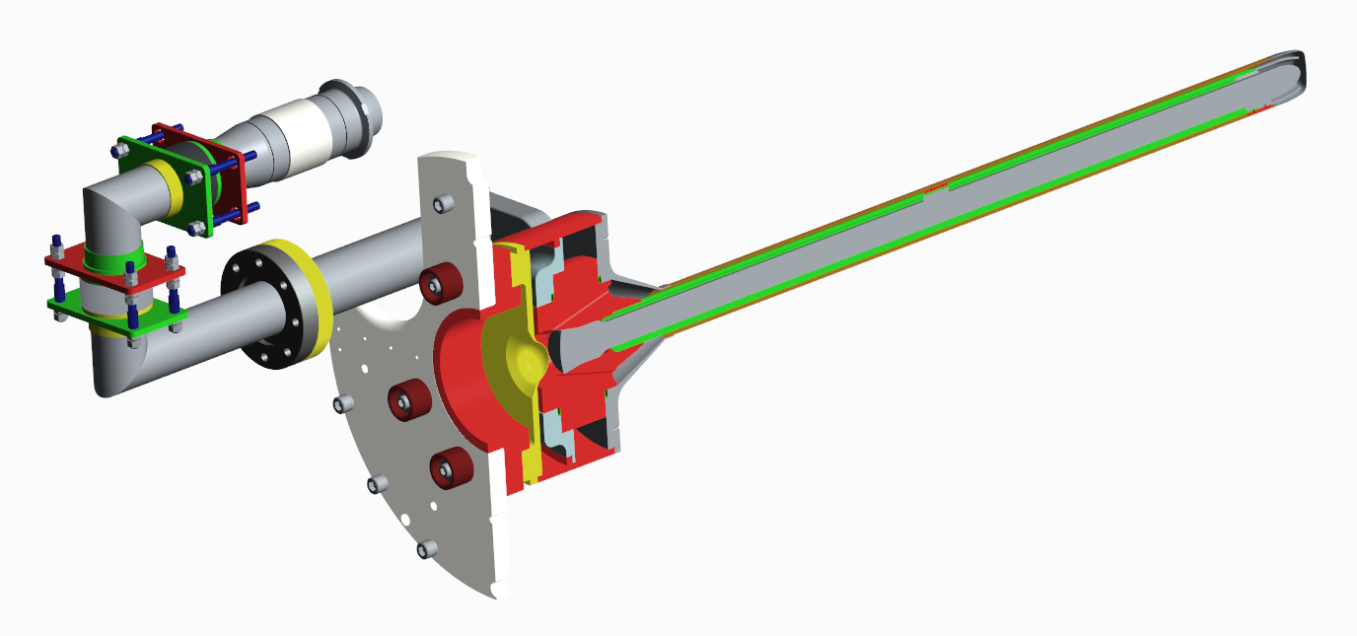
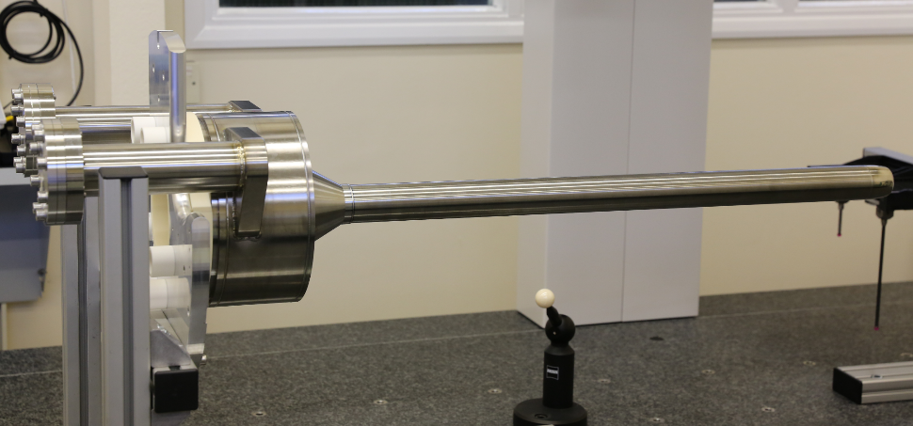
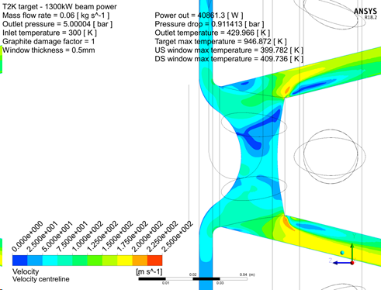
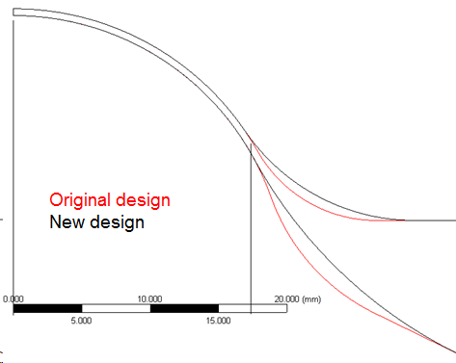
Required Target upgrades for operation at higher pressure
1.3MW design
Thrust force 1.4kN @ 5bar (per pipe)
Need to remove to prevent target deflections from 2.8kN force
Redesign target pipes for 5 bar operation. Increase pressure rating and remove thrust force
Full penetration EB weld at downstream target window
Outercover welds increased to full penetration (~5mm)
Re-optimise downstream target window to reduce pressure stress & maintain good cooling
Increased beam power → Increased chance of target failure Enhanced QA testing and traceability required
Re-optimise upstream target window to reduce pressure stress & maintain good cooling
M. Fitton

Slide 10
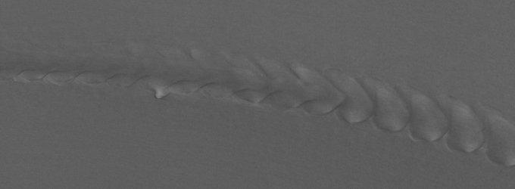
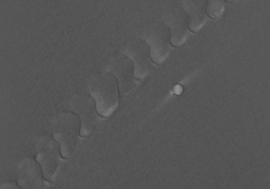
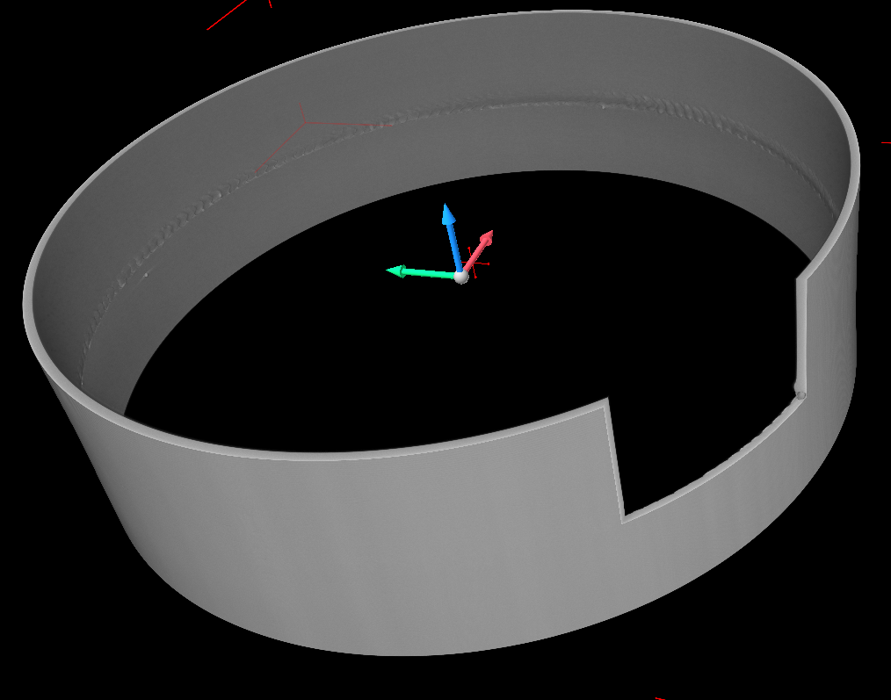
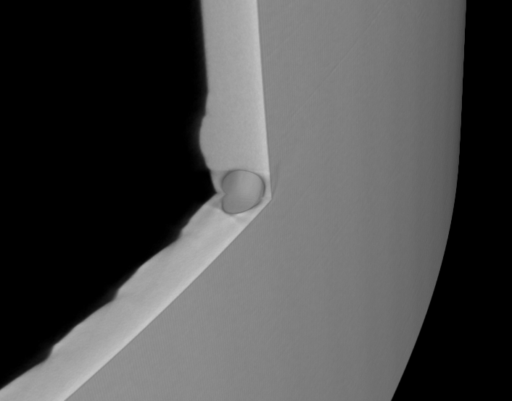
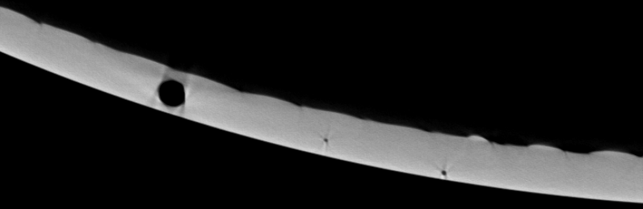
Target QA – CT reconstruction -> Much better contrast and detail + 3D information
3D Visualisation of underbead
Can differentiate weld splatter from inclusions
Much small defects visible than radiographs (20-30um)
M. Fitton
3D viewing of pores/inclusions

Slide 11
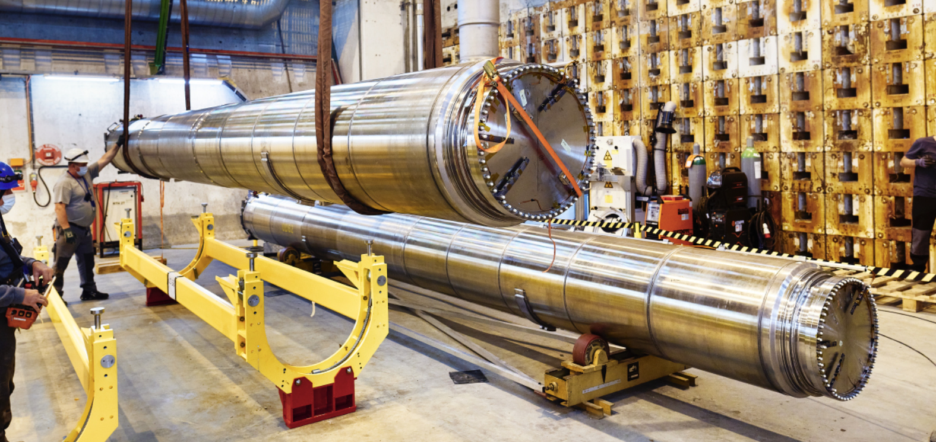
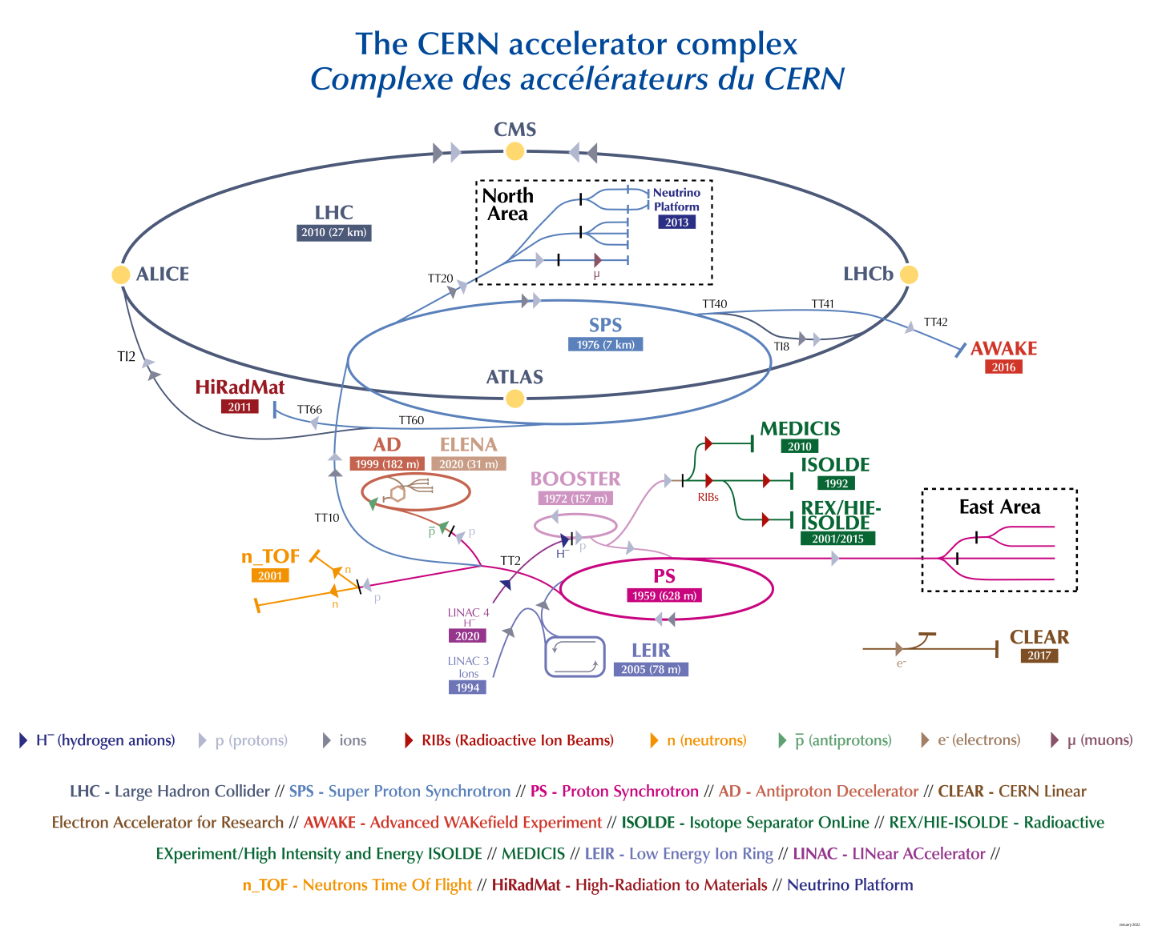
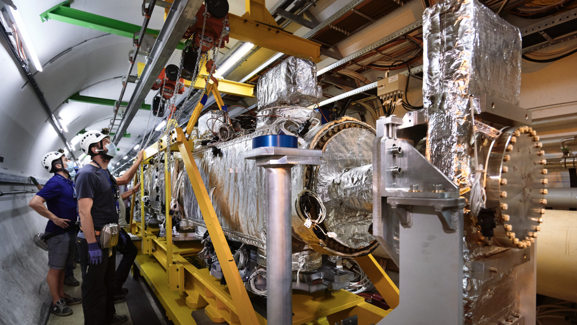
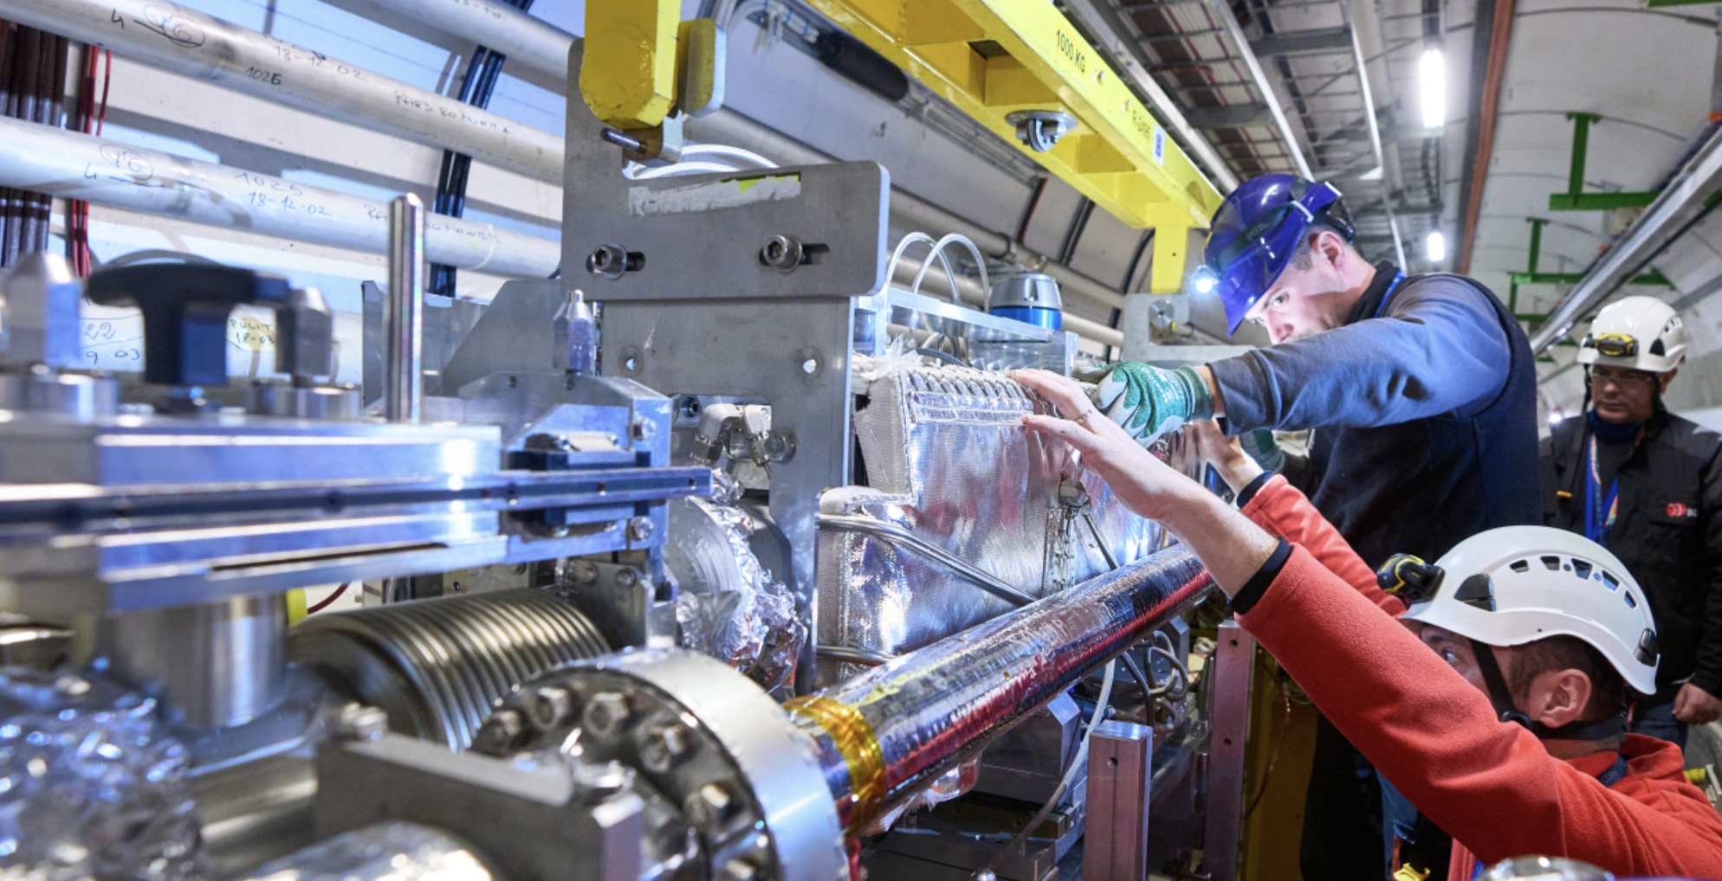
Large Hadron Collider beam-intercepting devices
Beam dump
collimation
See also A.-P. Bernardes
collimation
Injection
Injection
M. Calviani
See A. Perillo-Marcone

Slide 12
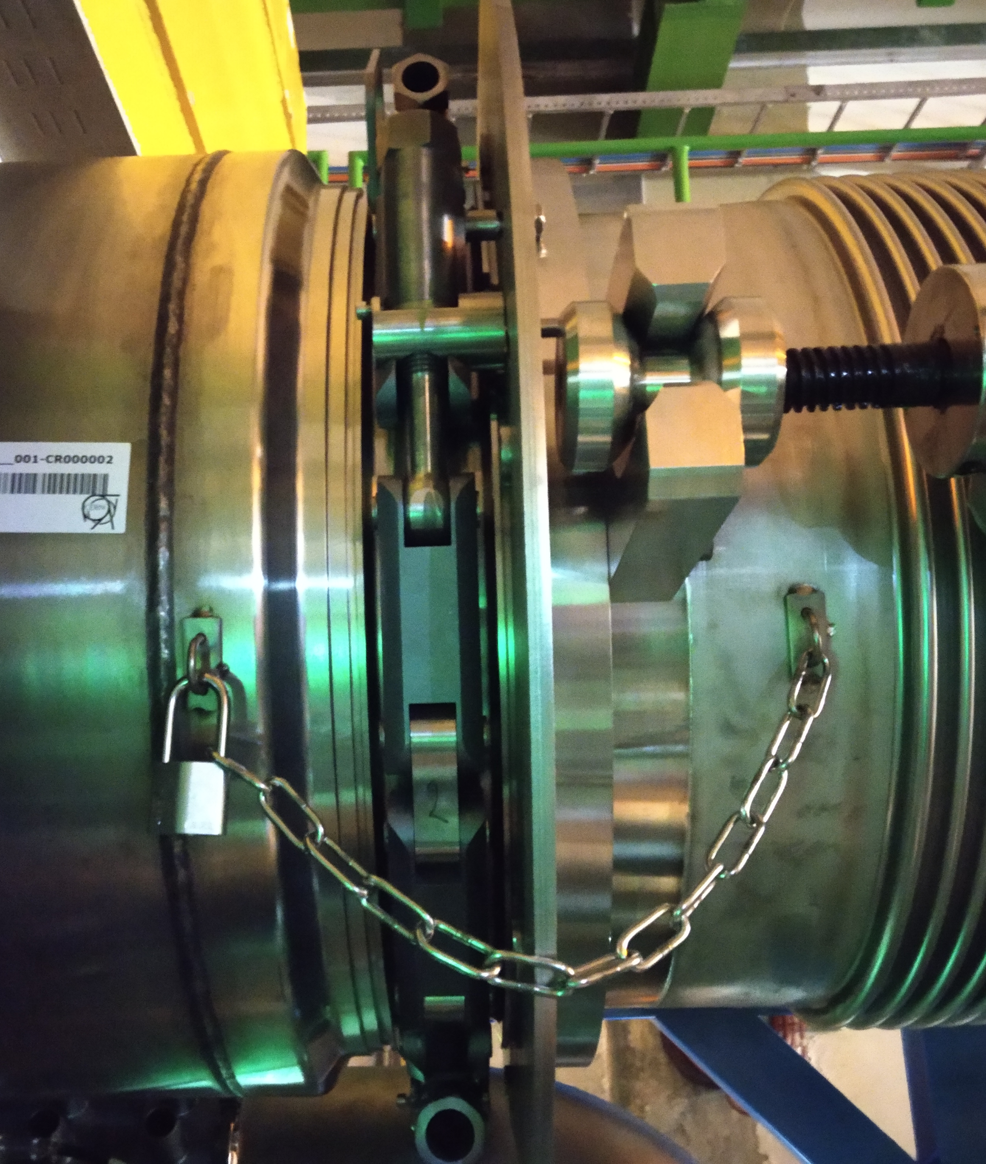
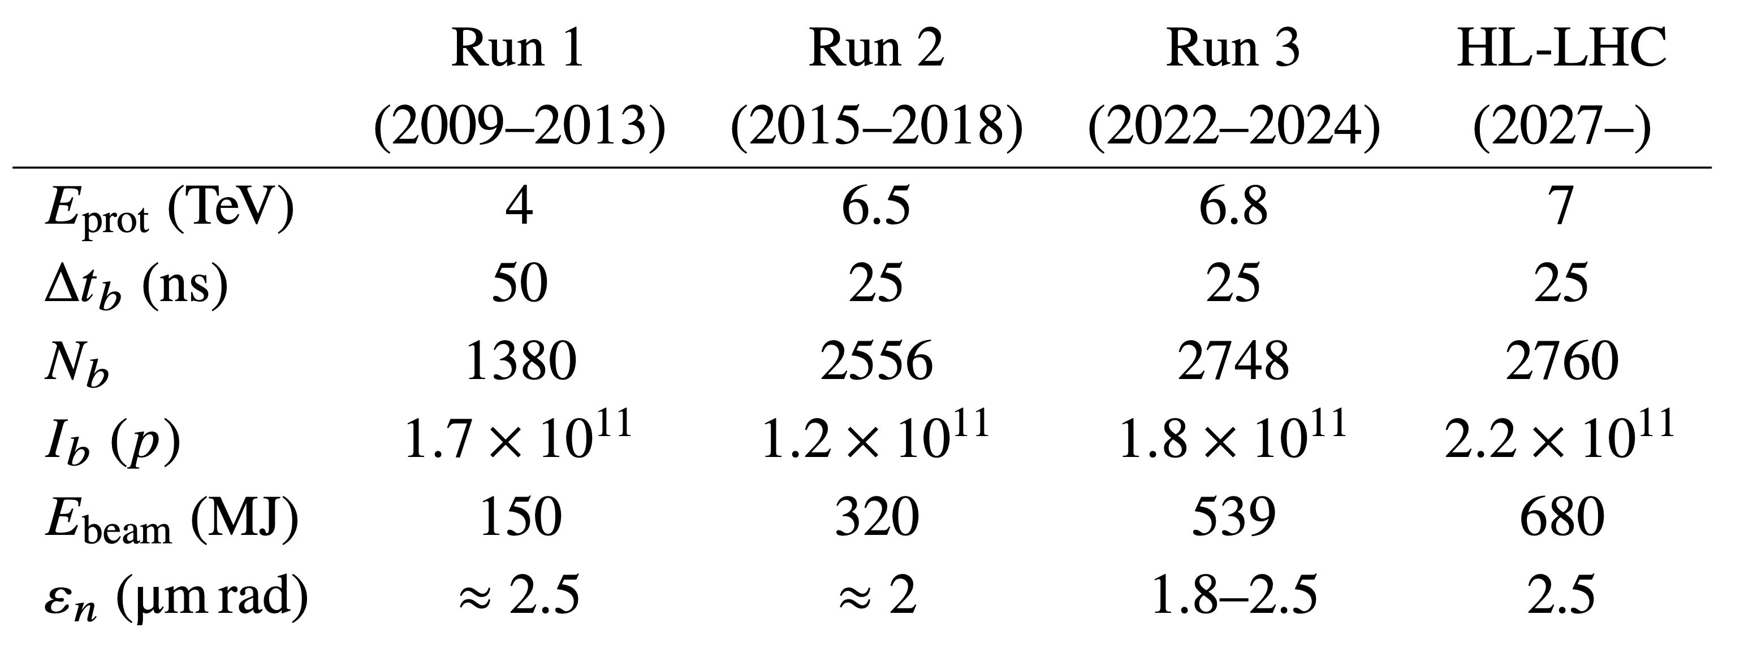
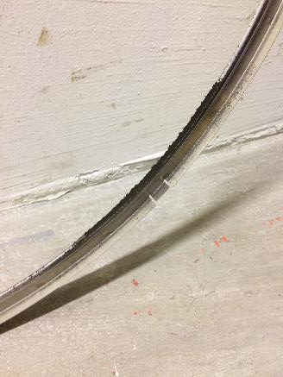
LHC beam characteristics
N2 gas leak in
the connection
(2022-2025)
(2029→)
Graphite power
in leaking gasket
LHC beam kinetic energy reaching several hundreds of MJ
  Sufficient to melt more than 2.5 tons of Cu
How do we safely dispose of this energy without damaging equipment?
M. Calviani

Slide 13
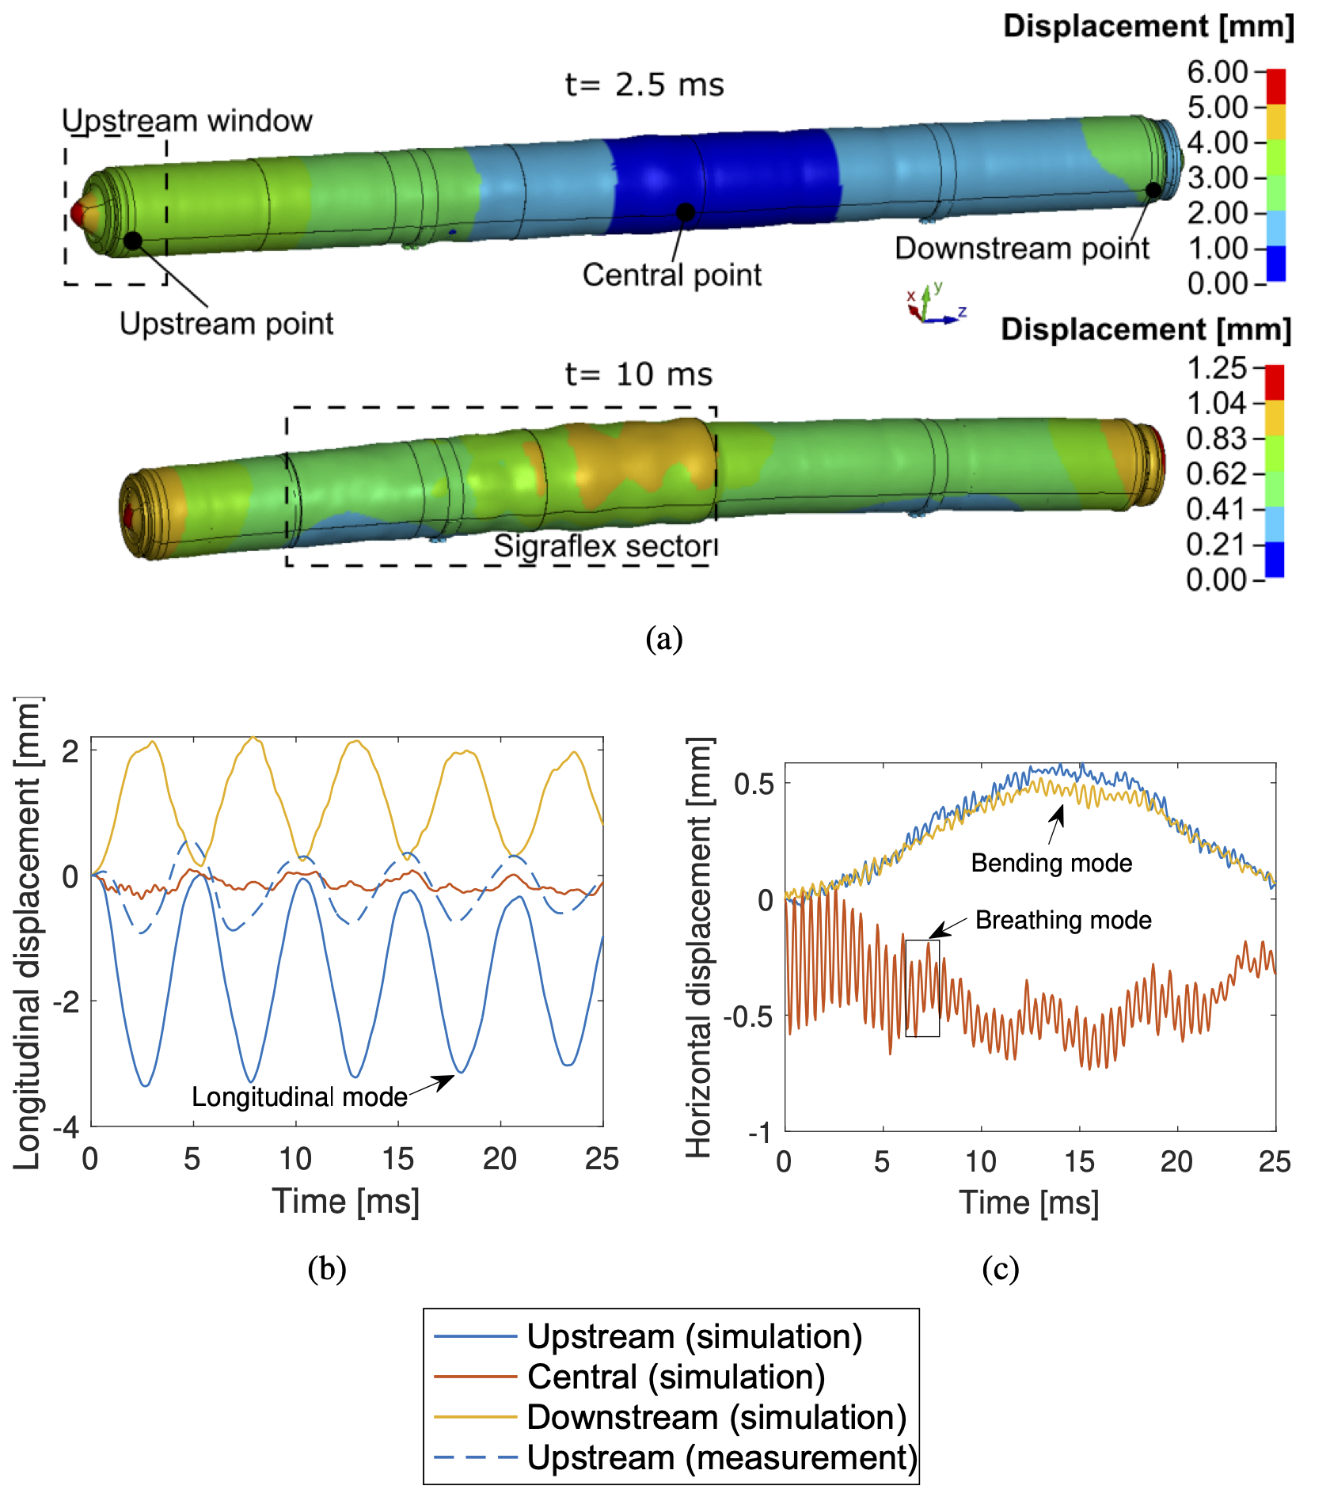
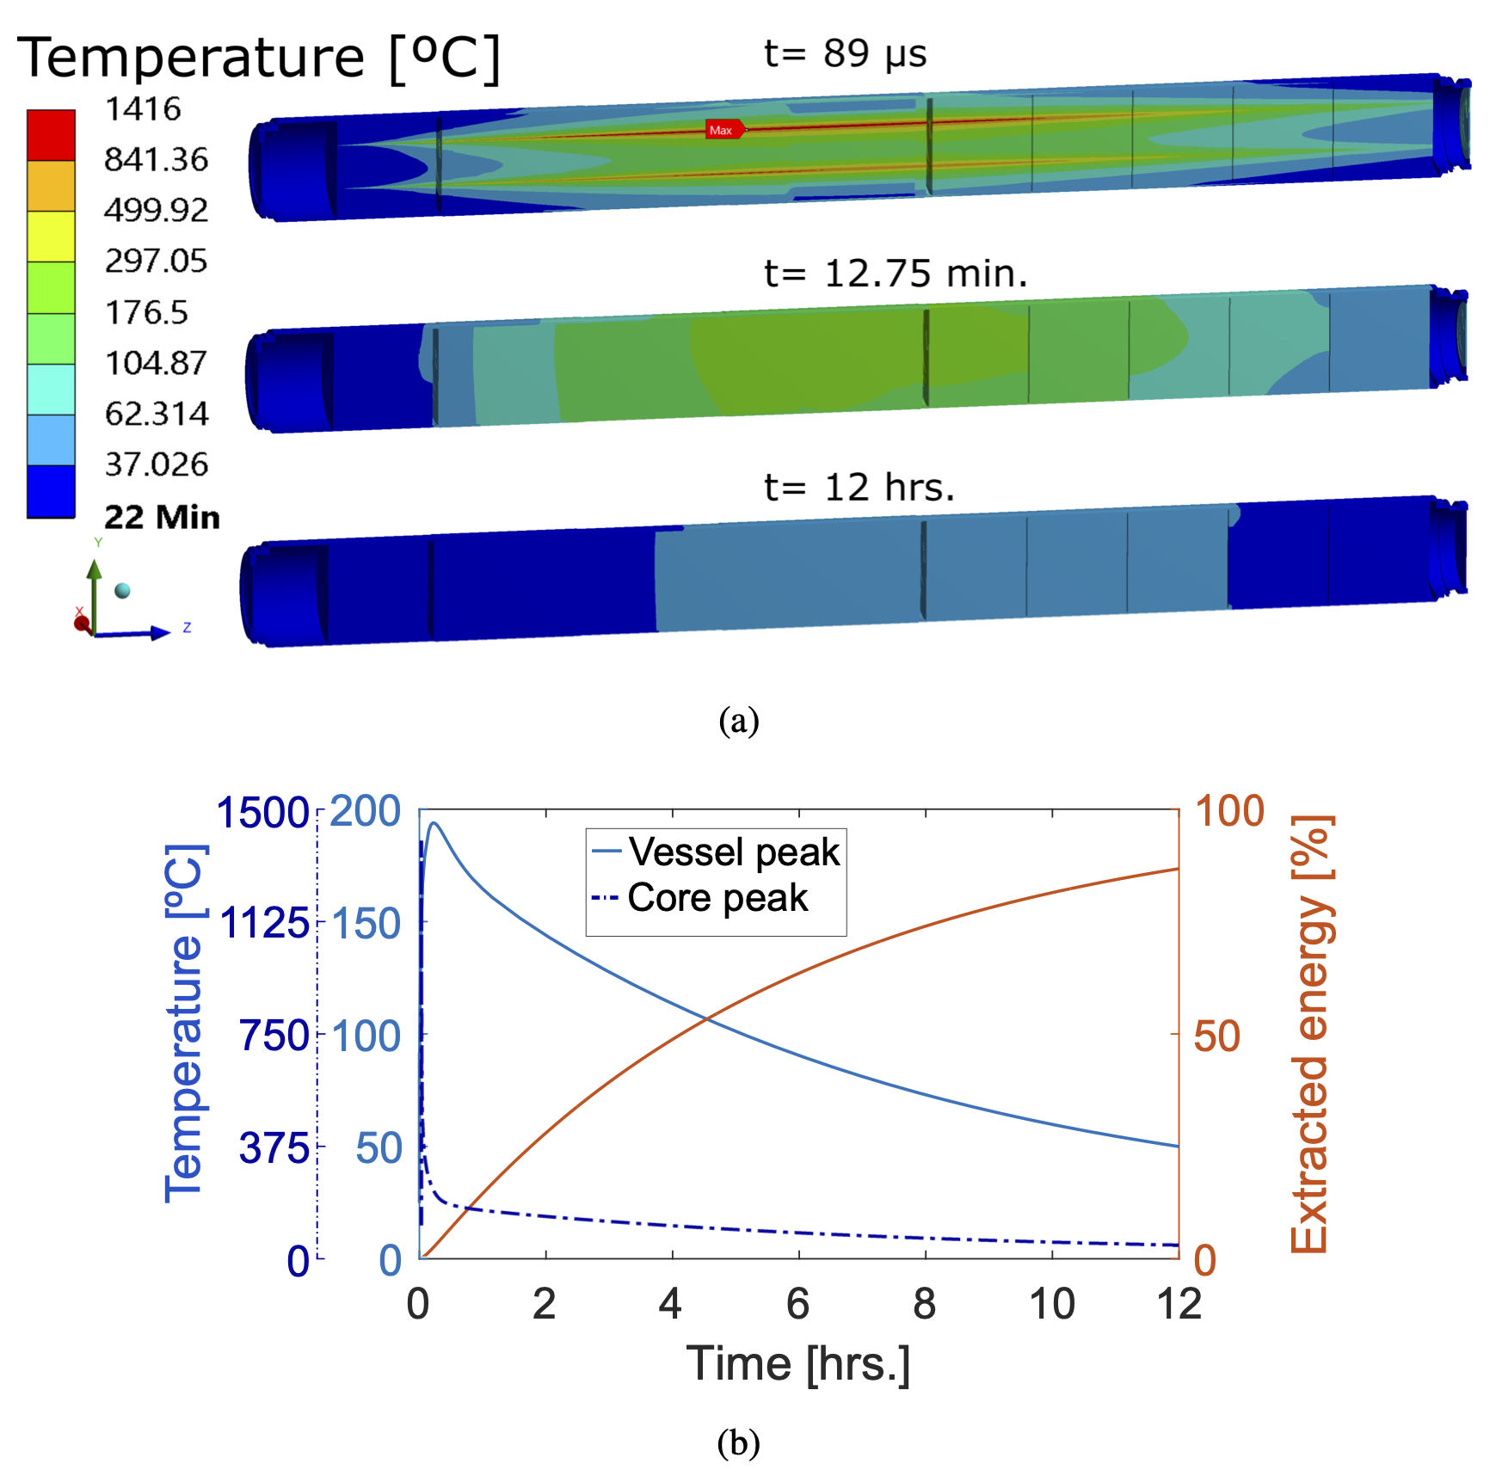
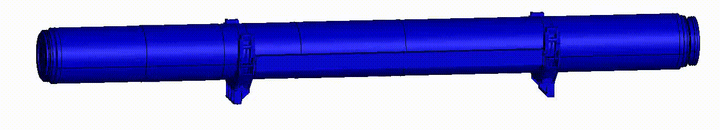
Timescale of a dumping event
ms
10 h
M. Calviani

Slide 14
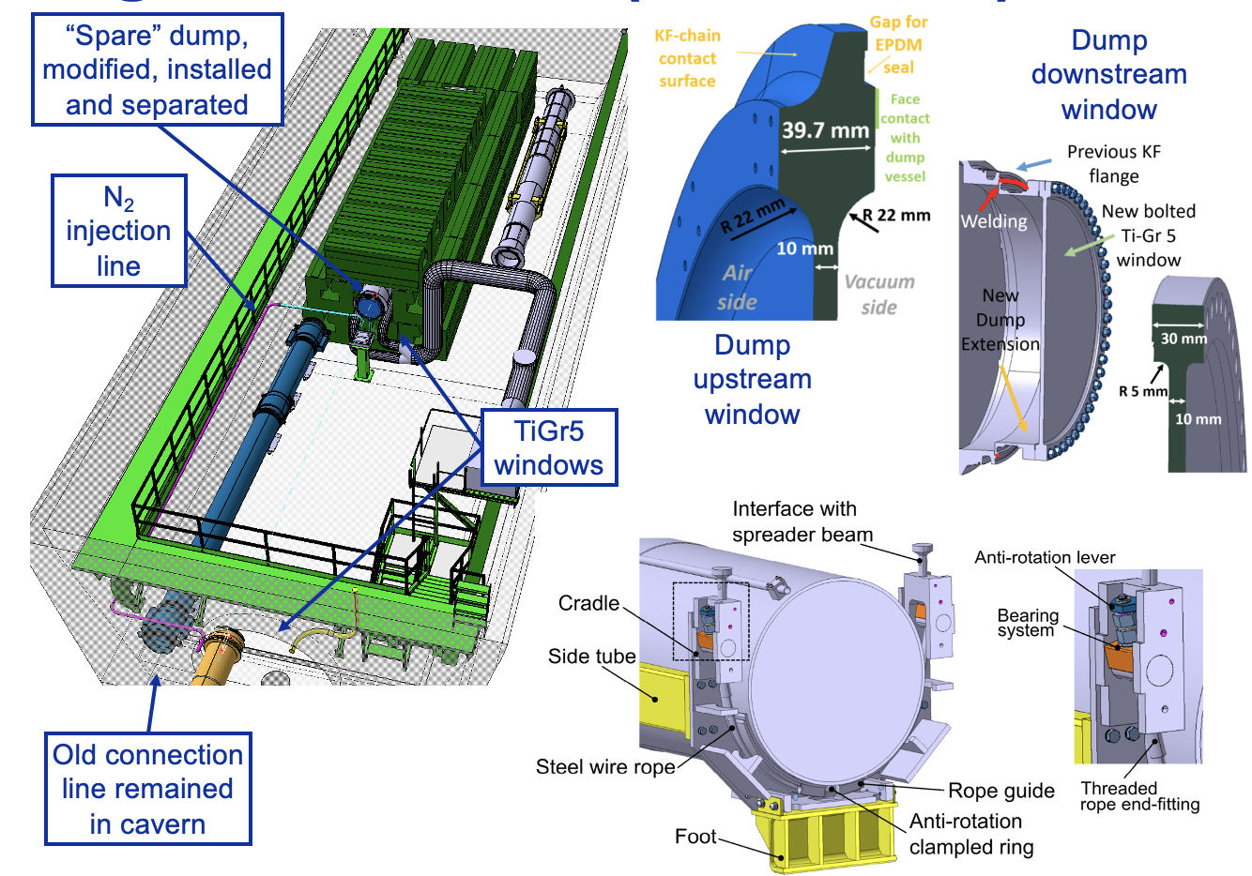
Conclusions
Unexpected operational limitations for LHC from beam dump observed starting from 2017
Full understanding of dump behavior acquired during 2019
Major upgrade in view of Run3 implemented during LS2 (2020-2021), resulting in smooth operation
Further upgrade to be completed for HL-LHC (LS2, 2026-2028)
Thanks to all the CERN teams for the incredible response and reactivity
M. Calviani

Slide 15
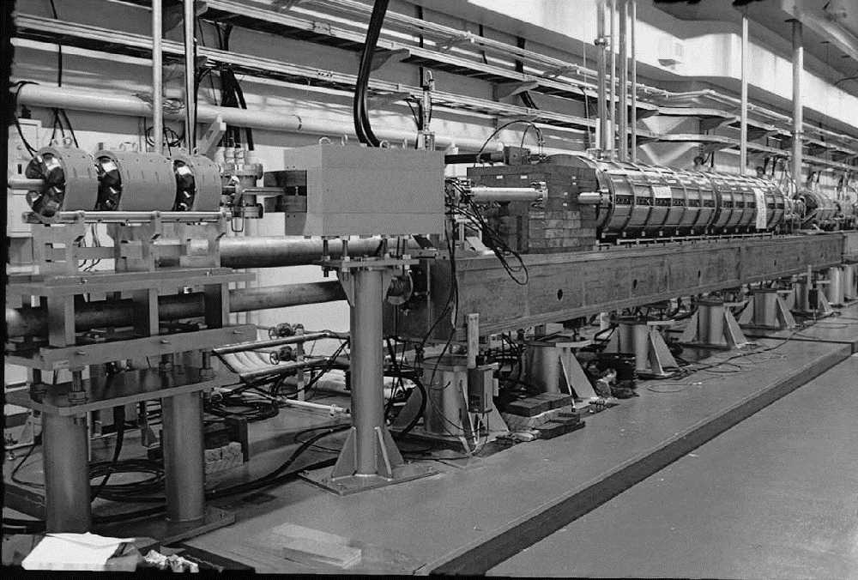
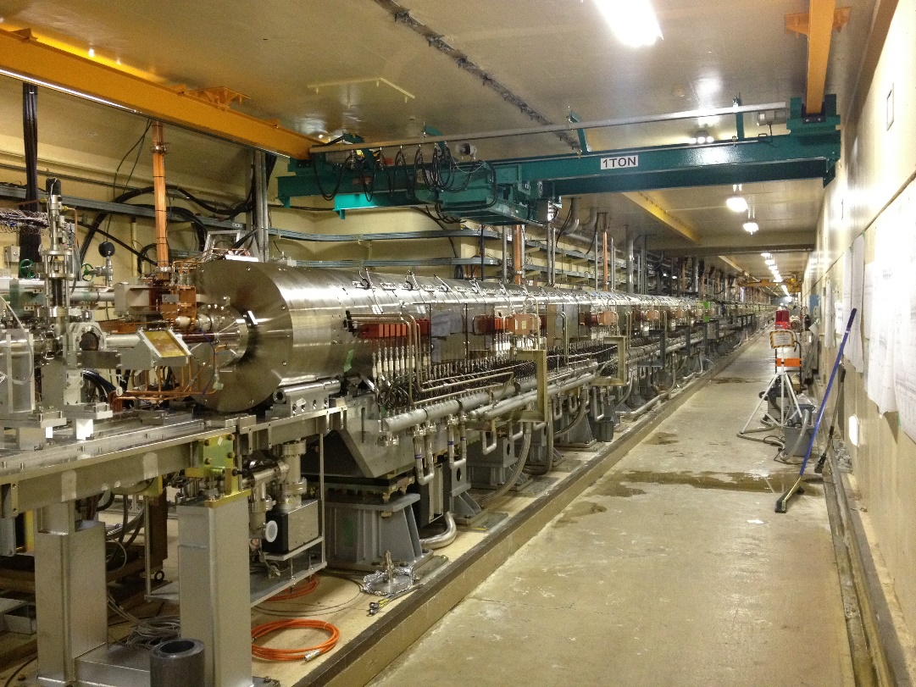
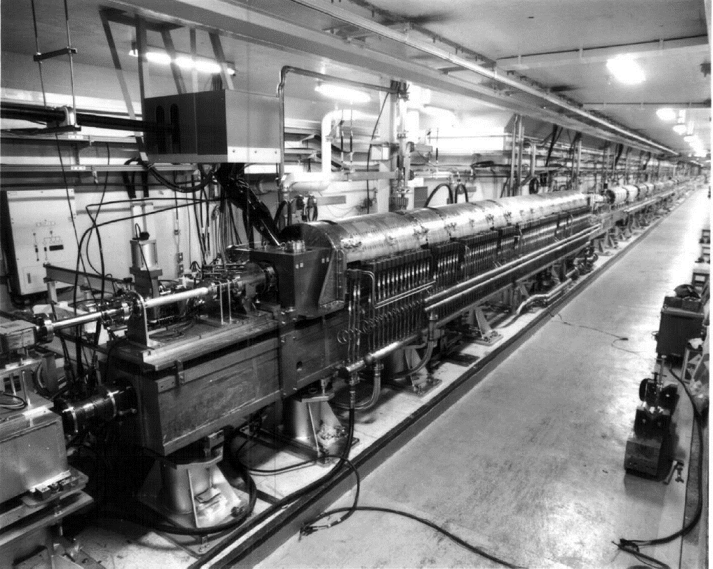
KEK and positron
From TRISTAN to ILC
  KEK LINAC has keep providing positron beam to e⁺e⁻ collider experiment since 1980s.
  Positron source for SuperKEKB is world’s most intense positron source in operation.
  We play an important role to develop future positron source for ILC.
TRISTAN
SuperKEKB
KEKB
Y. Enomoto

Slide 16
Comparison of high-power targets in Japan
 | e⁺ | e⁺ | μ | n | Neutrinos | Hadrons | RIBF
Institute | KEK (SuperKEKB) | ILC (e-driven) | J-PARC | J-PARC | J-PARC | J-PARC | RIKEN
Primary particle | e⁻ | e⁻ | p | p | p | p | C~U
Target material | W | W | C | Hg | C | Au | Be, W
Energy [GeV] | 3 | 3 | 3.5 | 3 | 30 | 30 | 0.345/u
Charge/pulse [nC] | 10 ✕ 2 | 3.7 ✕ 66 | 13300 | 13300 | 52900 | 16470 | CW
Repetition [Hz] | 50 | 100 / 300 | 25 | 25 | 0.47 | 0.19 | CW (1puA)
Beam Power [kW] | 3 | 74 | 1000 | 1000 | 750 | 95 | 82
Beam size σ_{x} ✕ σ_{y} [mm] | 0.5 ✕ 0.5 | 2 ✕ 2 | 3.5 ✕ 3.5 | 37 ✕ 17 | 4.2 ✕ 4.2 | 2.5 ✕ 1.0 | 0.42 ✕ 0.42
Thickness [mm] | 14 | 16 | 20 | 2000 | 909 | 66 (6 ✕ 11) | ~mm
Deposited power [kW] | 0.5 | 18.8 | 3.1 | 480 | 20 | 7.4 | 18
PEDD [J/g] | 27.5 | 33.6 | 20 | 1.1 | 190 | Slow extraction | CW
Cooling | Water | Water | Radiation | Water | He | Water | Water
structure | Fixed | Rotating | Rotating | Liquid | Fixed | Fixed | Rotating
■■ beam power
■ deposited power
Power (kW)
Y. Enomoto
SKEKB
ILC
μ
n
H
ν
RIBF
SKEKB
ILC
μ
n
H
ν
RIBF

Slide 17
Summary
Say hello to the high-power target community from positron group
Different requirement and limitation from proton machine
  Most of the technologies are still useful for us
Requirements of the ILC, linear collider, are very high
We started development for ILC recently
  Details about rotating target → next talk
Y. Enomoto

Slide 18
ILC rotating W target for positron source
2023-2027 R&D phase
  Issue to maintain UHV at rotating axis
    Required gap for sealing 100 μm with tolerance 10 μm
  W-Cu connection
    Consider Hot Isostatic Pressuring (HIP) method
    Or Spark Plasma Sintering (SPS)
  Optimize rotating structure
Y. Morikawa

