Slide 1
Topic 1:
R&D to Support Concepts
Frederique Pellemoine
Drew Winder

Slide 2
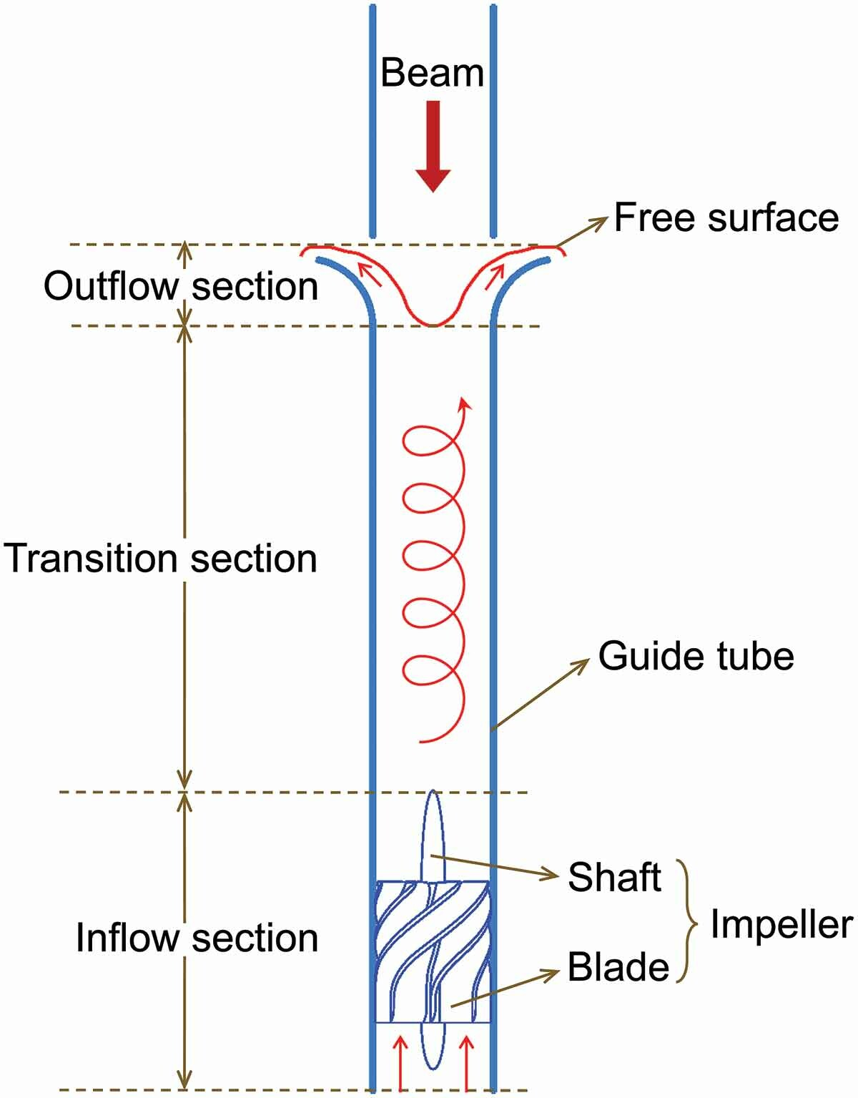
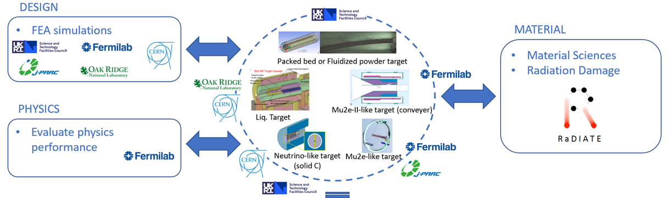
Multi-MW target concepts
Katsuya Yonehara – 133
Weifeng Yang – 111

Slide 3
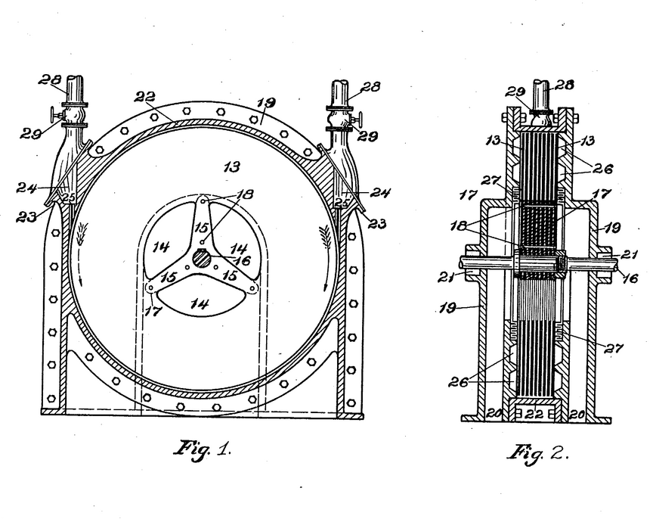
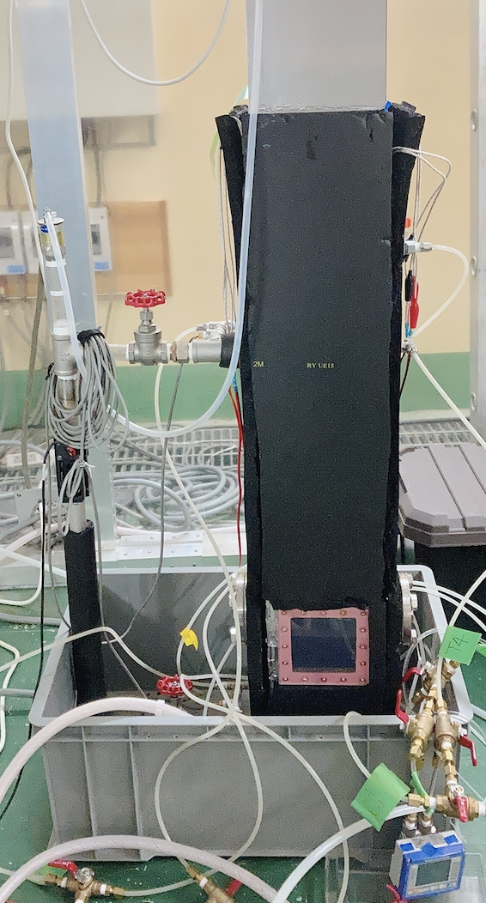
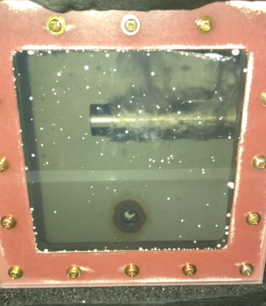
Heat transfer improvements
Matthia Lüthi – 56
Naoya Kamei – 99

Slide 4
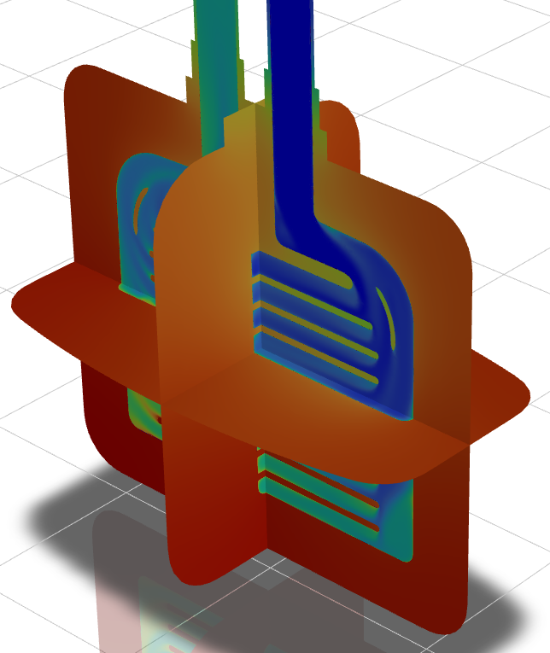
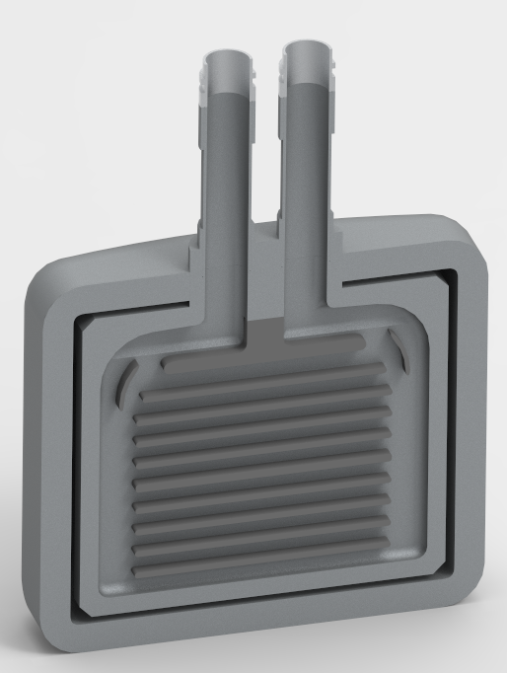
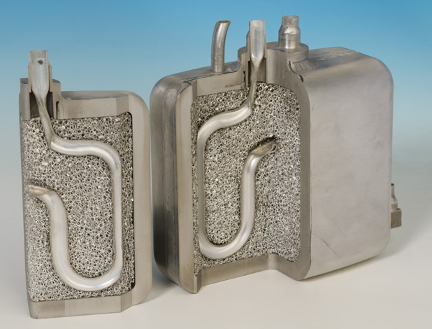
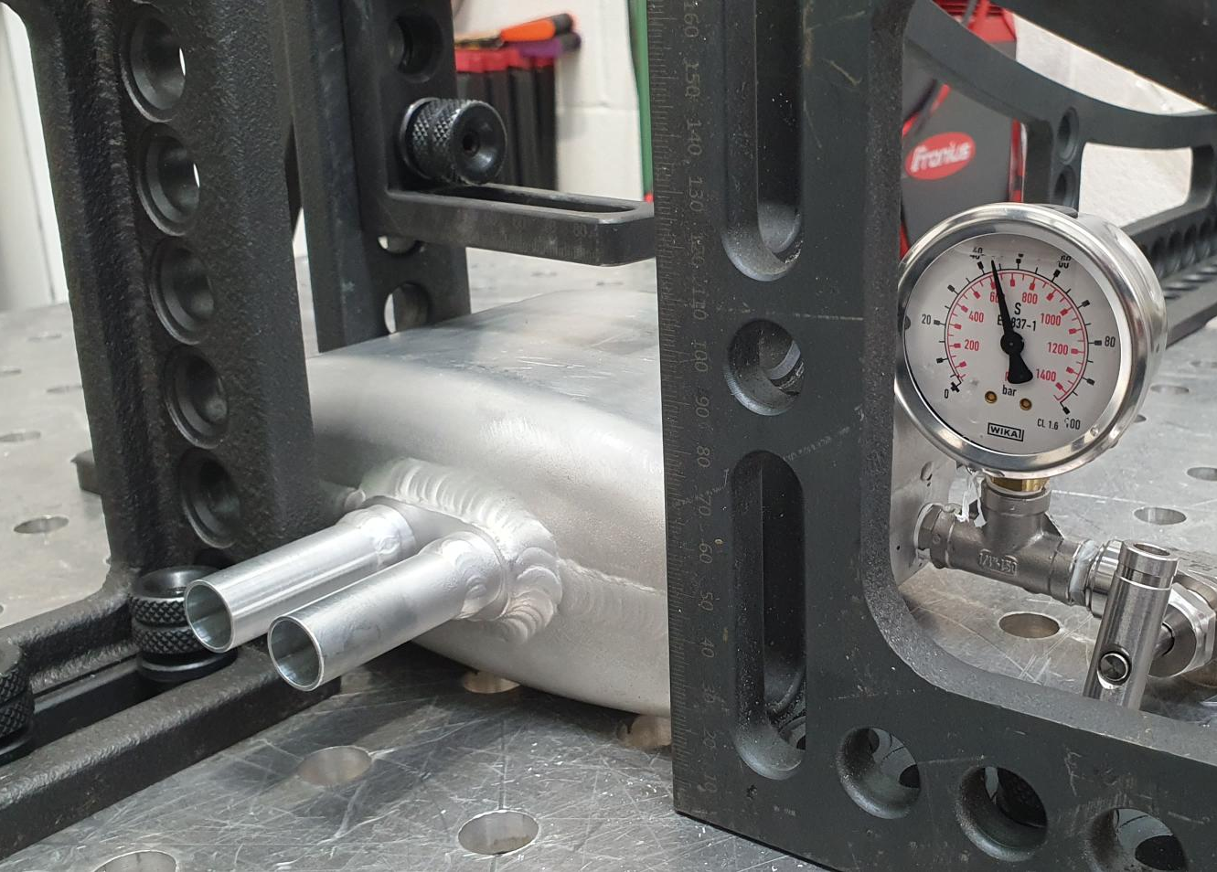
Heat transfer improvements
R&D
Mark Telkman – 34

Slide 5
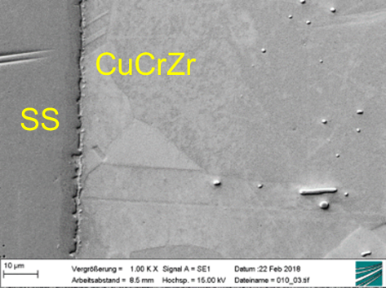
Heat transfer improvements
Antonio Perillo Marcone – 119

Slide 6
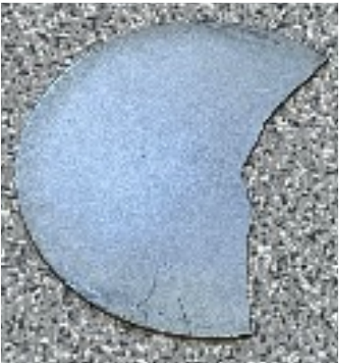
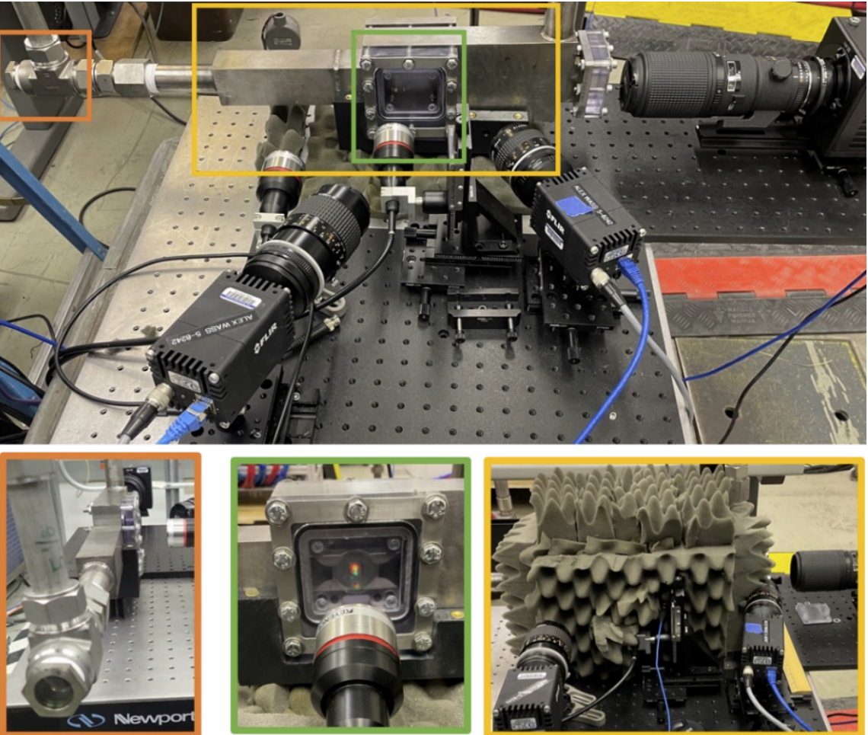
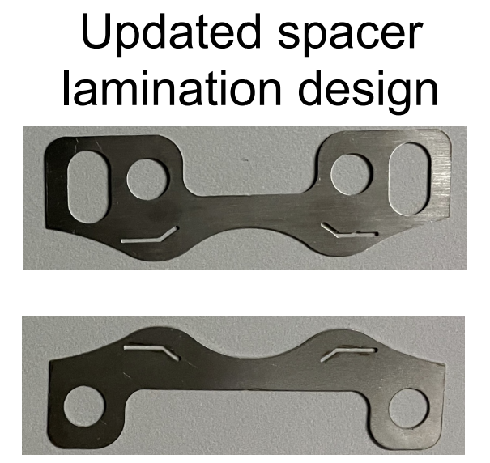
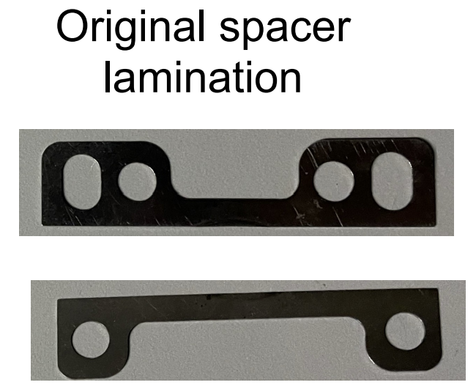
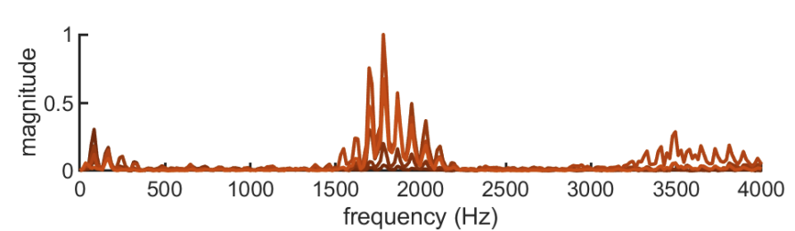
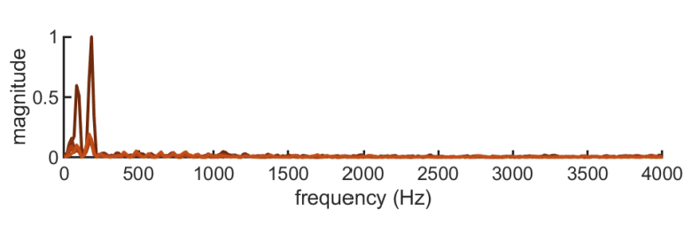
Addressing challenges
R&D
Bhavini Singh – 25
Kieran Kessaci – 103
Notes:
In-beam tests

Slide 7
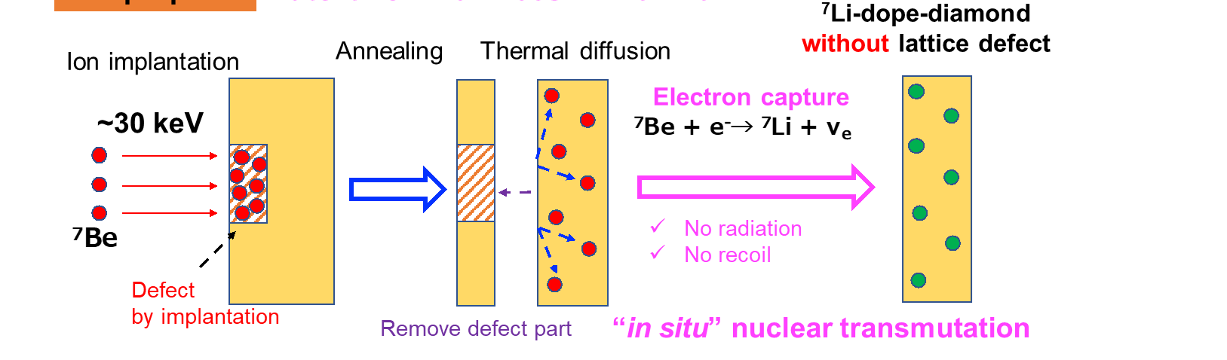
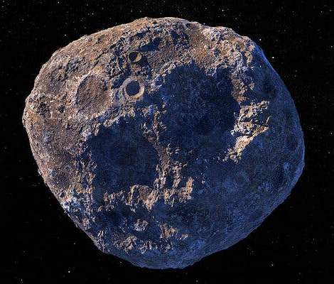
New ideas
Karl-Georg Schlesinger & Melanie Bochmann – 65
Yasuto Miyake – 117

Slide 8
R&D is needed and critical to support projects
Multi-MW target concepts
  Free liquid target
  Granular target
  Upward spiral flow
Heat transfer improvements
  Diffusion bonding
  Heat transfer using 2-phase flow
  Tesla converter
  Heat exchanger for solid methane
Addressing challenges
  Target backing
  Vibration
New ideas
  In-situ conversion for semiconductor doping
  Asteroid bombardment

