Slide 1
Topic 5: Target Facility Challenges
Facility radioprotection, remote handling, lifecycle challenges
P. Hurh (FNAL) & D. Kim (BNL)

Slide 2
11 talks over 3 sessions, 6 posters
Topic 5 overlaps with other topics, such as target facility operations
Overall, very interesting talks with good discussion and some lessons learned
Following slides are just a few highlights

Slide 3
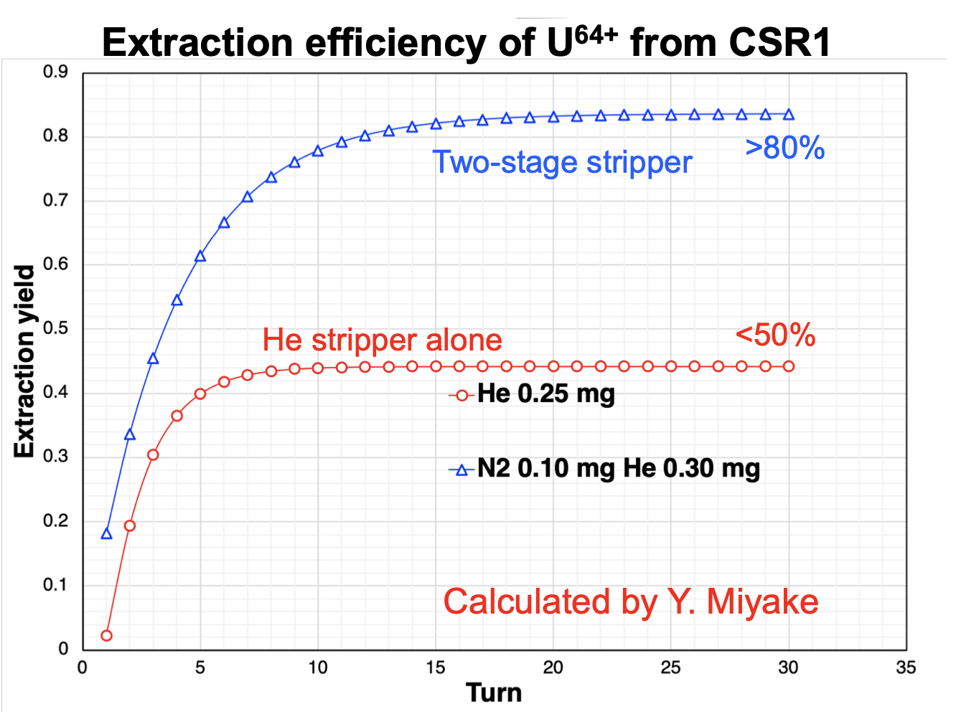
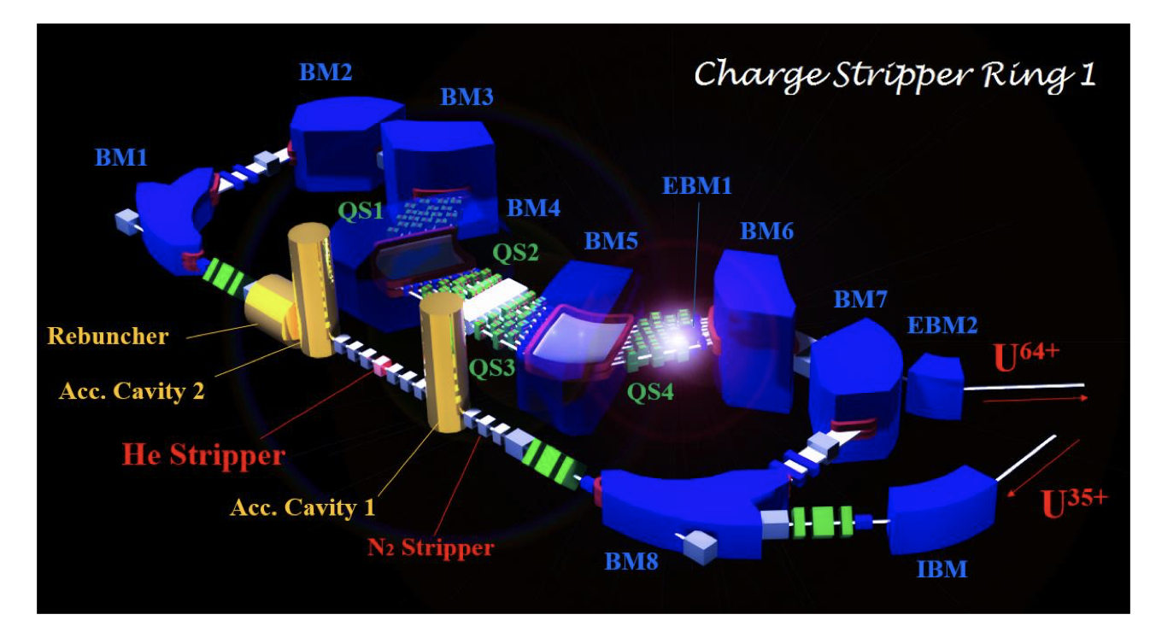
-Dramatically increase stripping yield for heavy ions by using ring with multiple passes through helium stripping section

Slide 4
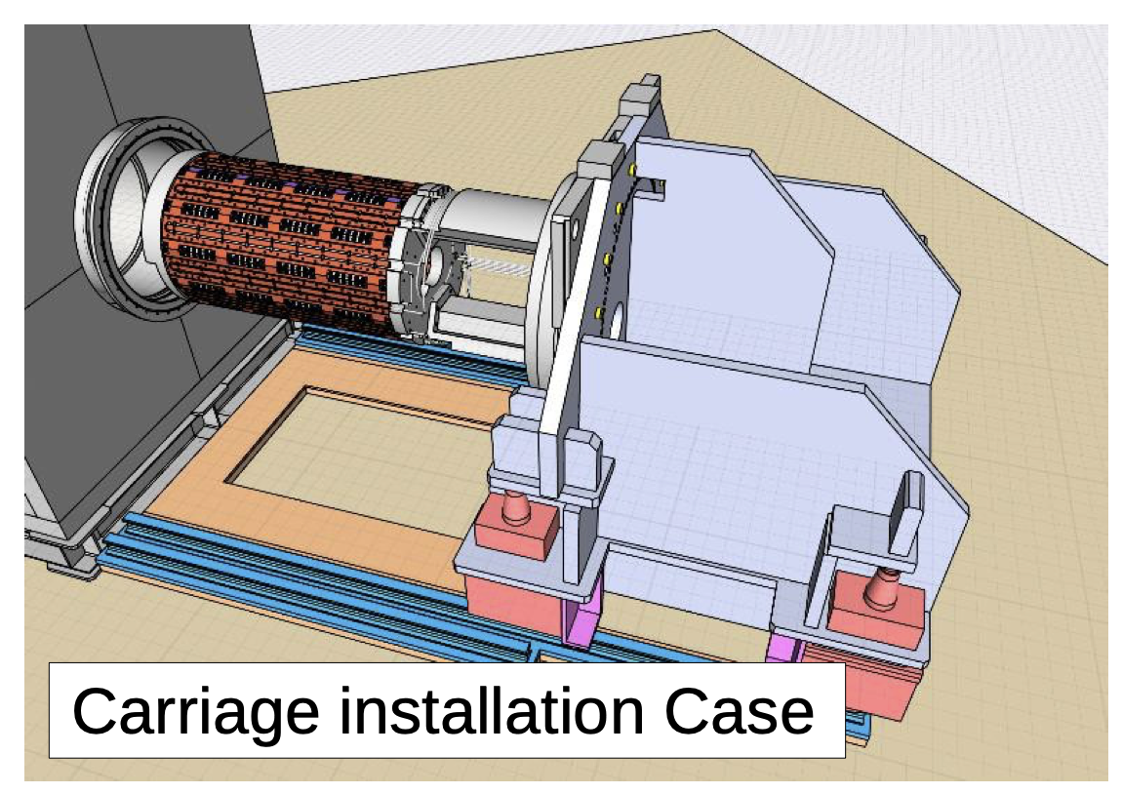
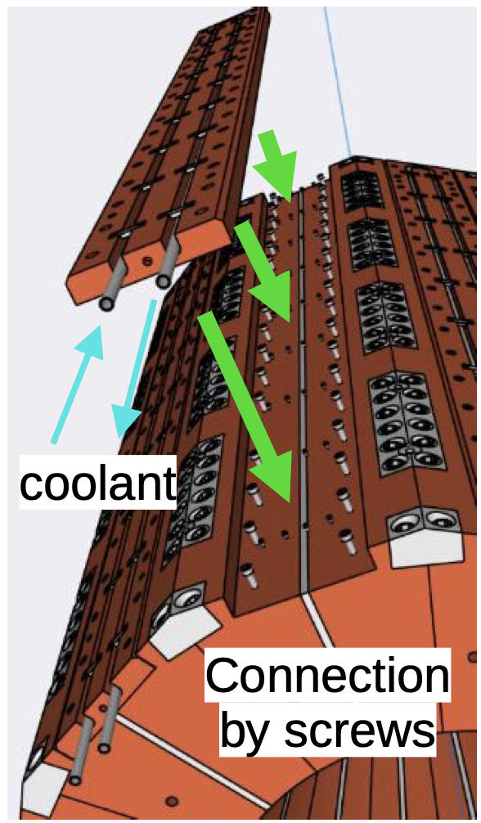
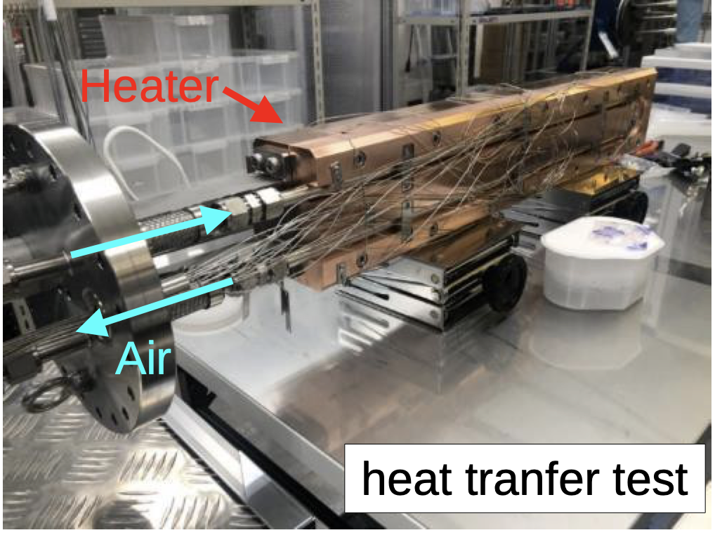
Facility Design of the COMET Experiment at J-PARC - Y. Fukao, S. Makimura, N. Kamei and S. Mihara (KEK IPNS)

Slide 5
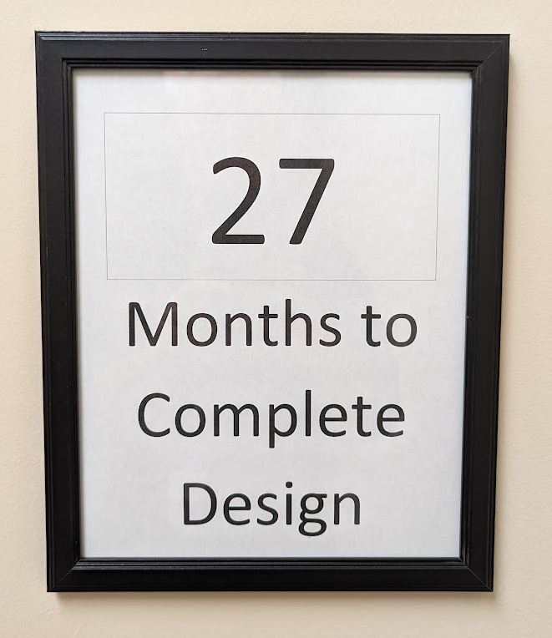
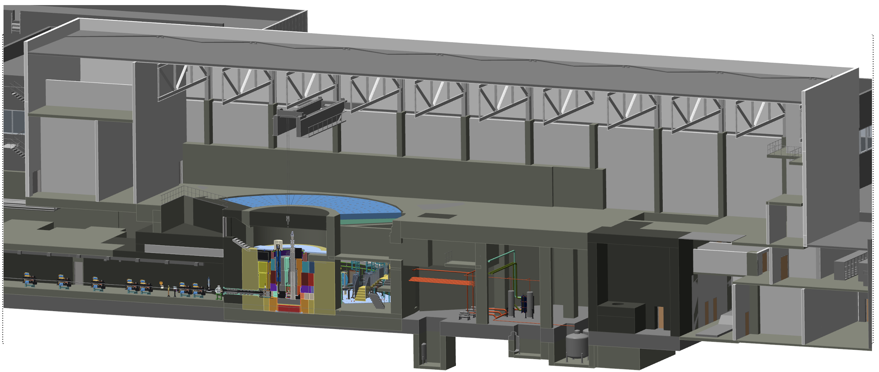
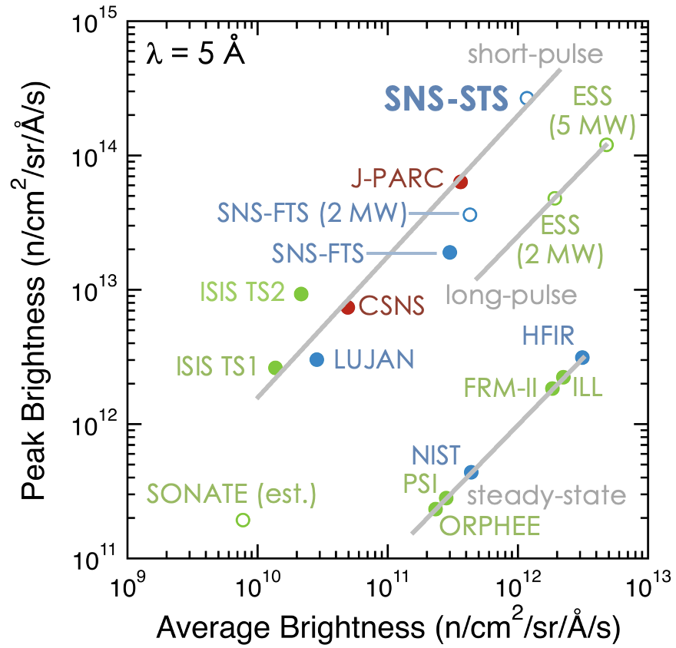
Second Target Station (STS) Preliminary Design Status -Mike Strong

Slide 6
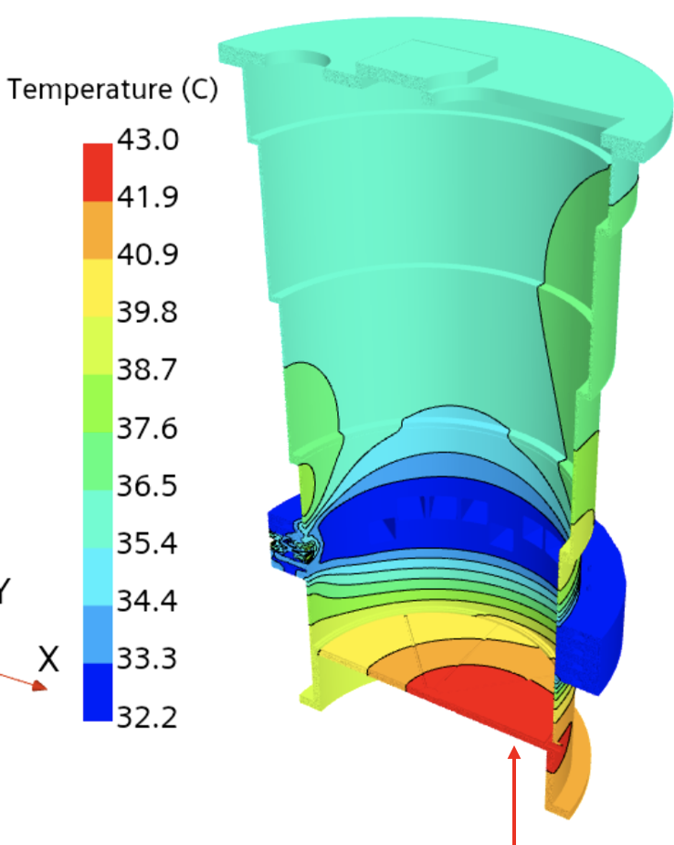
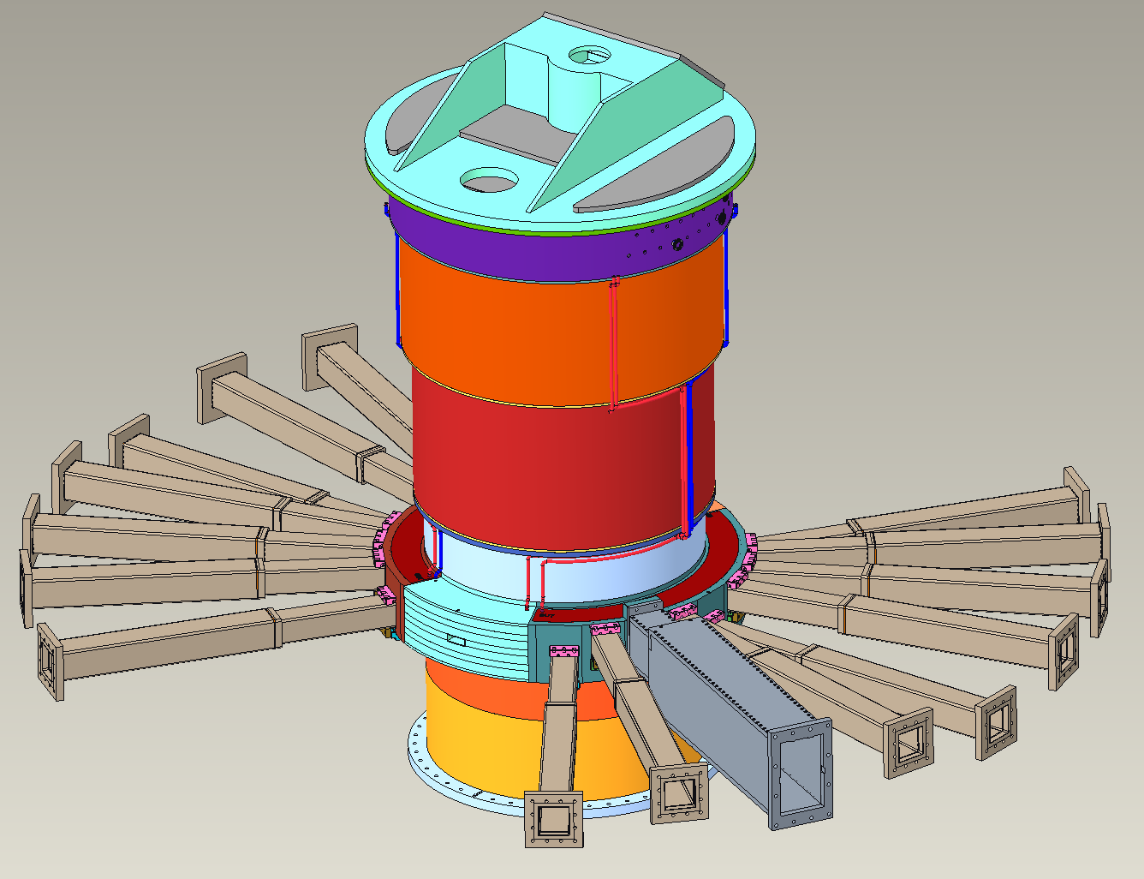
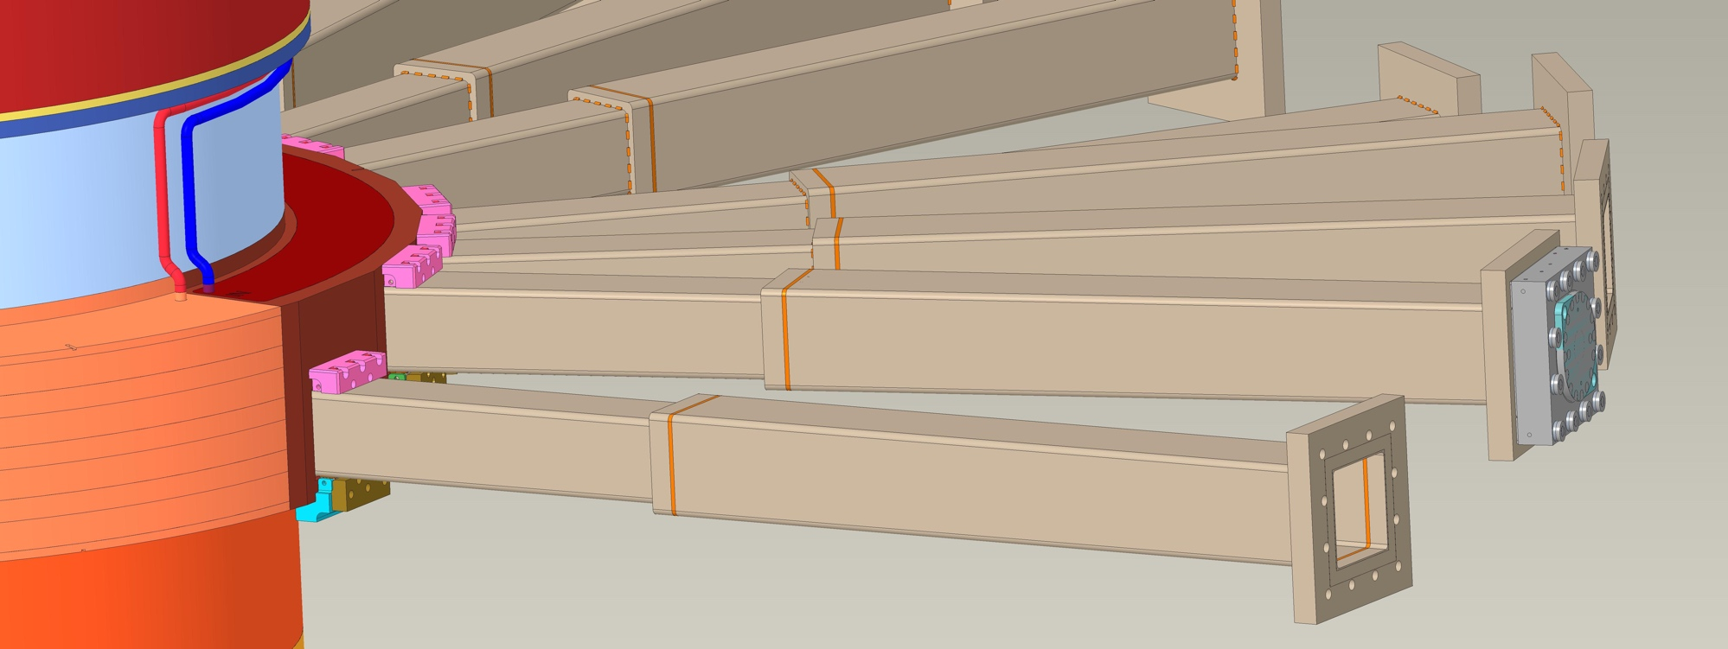
ORNL Second Target Station Vessel Systems Preliminary Design Update – C. Anton et al

Slide 7
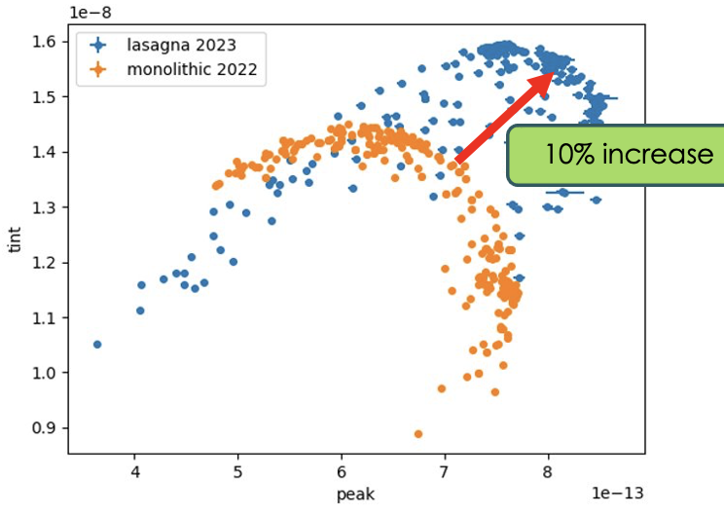
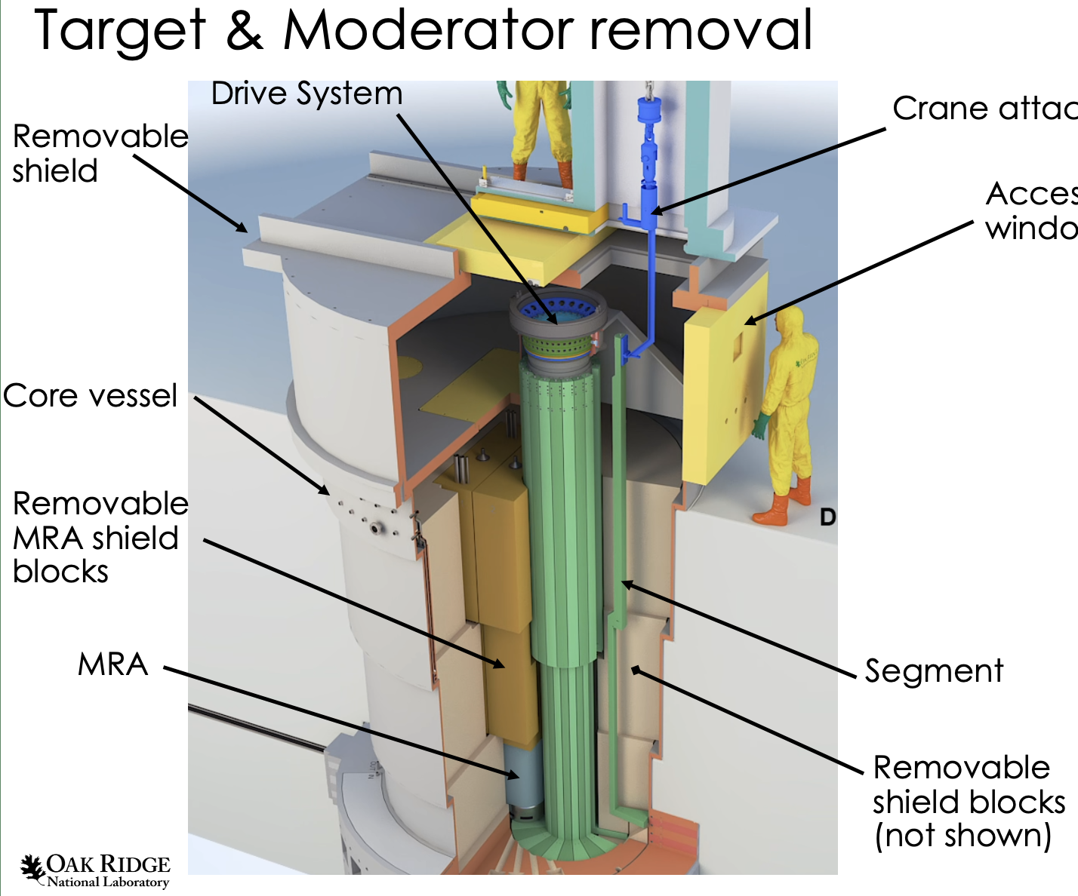
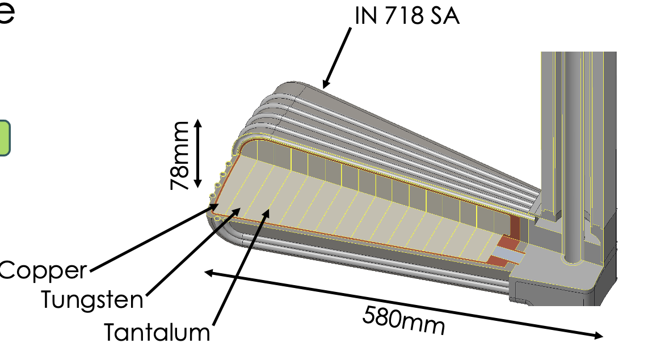
Design of Rotating Tungsten Target with Segmented Modules for Replacement – A. Jacques et al

Slide 8
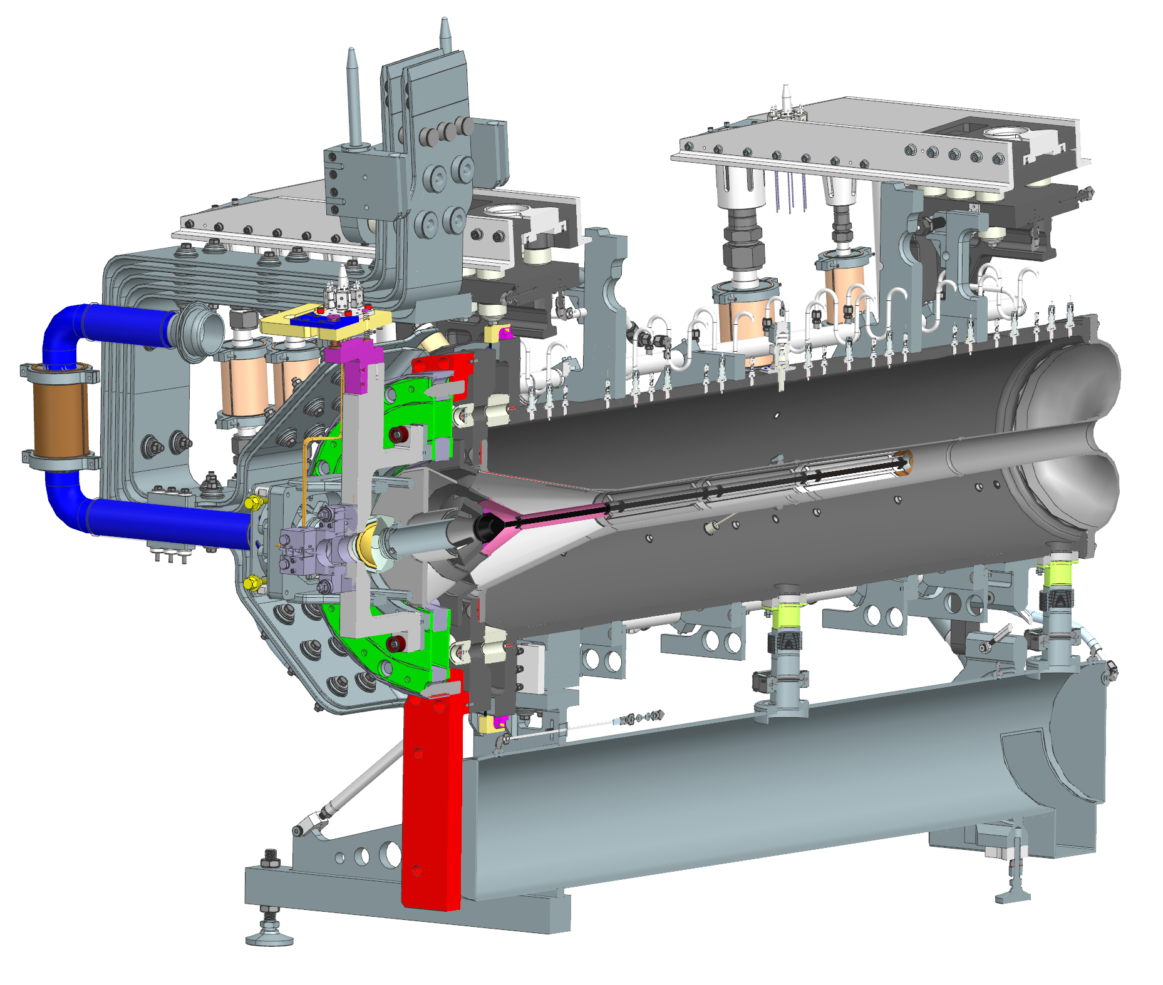
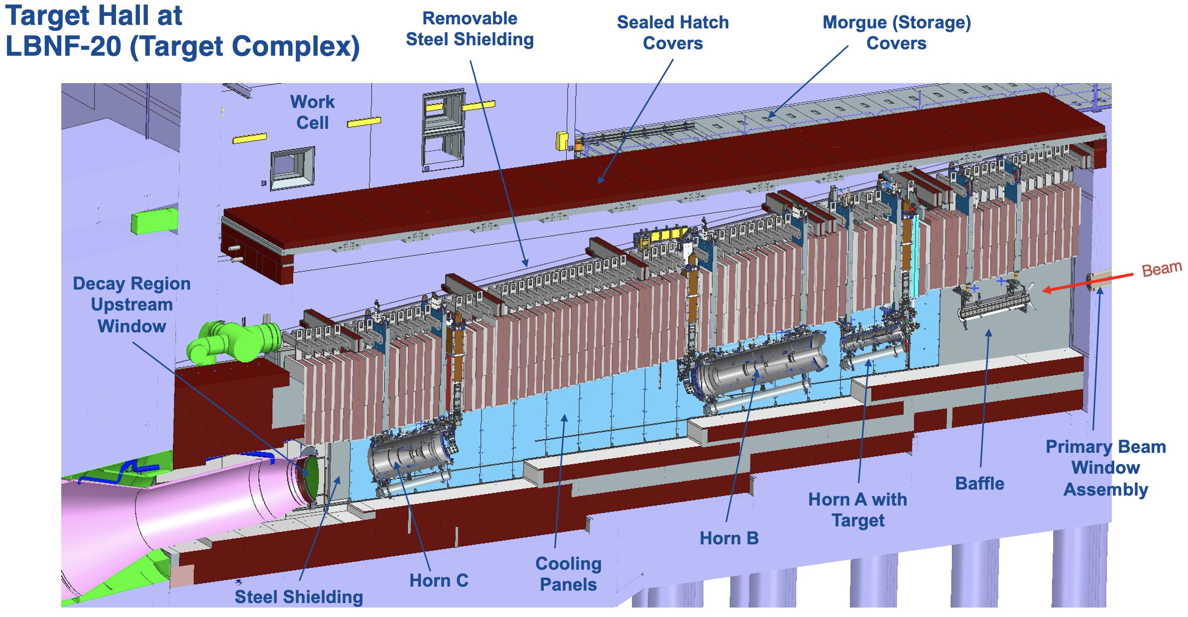
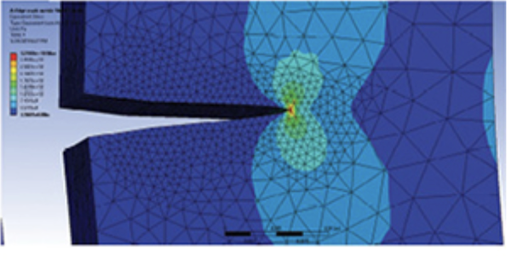
Long Baseline Neutrino Facility (LBNF) Beamline and Targetry Overview – P. Hurh et al
Can we use an ASME Section III approach to show “same level of safety as provided by national consensus standards” for irradiation effects integration?
Future crack propagation test at HiRadMat proposal under development at FNAL
Collaborators welcome!

Slide 9
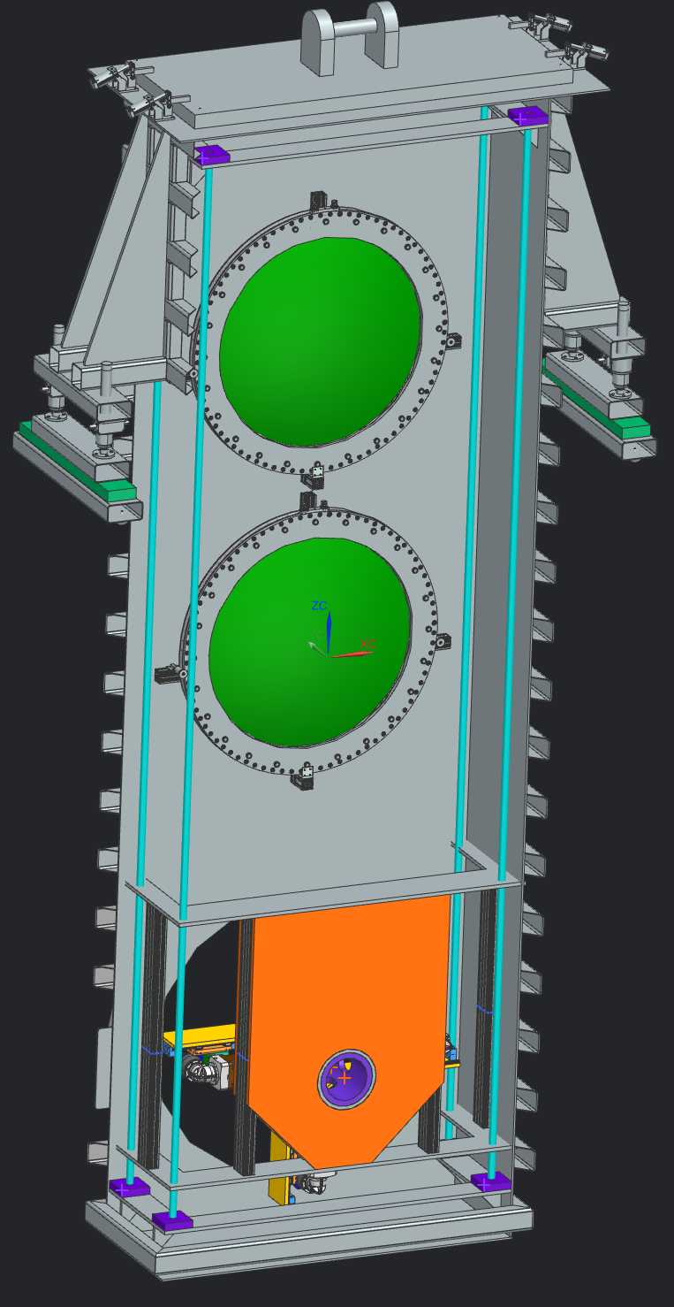
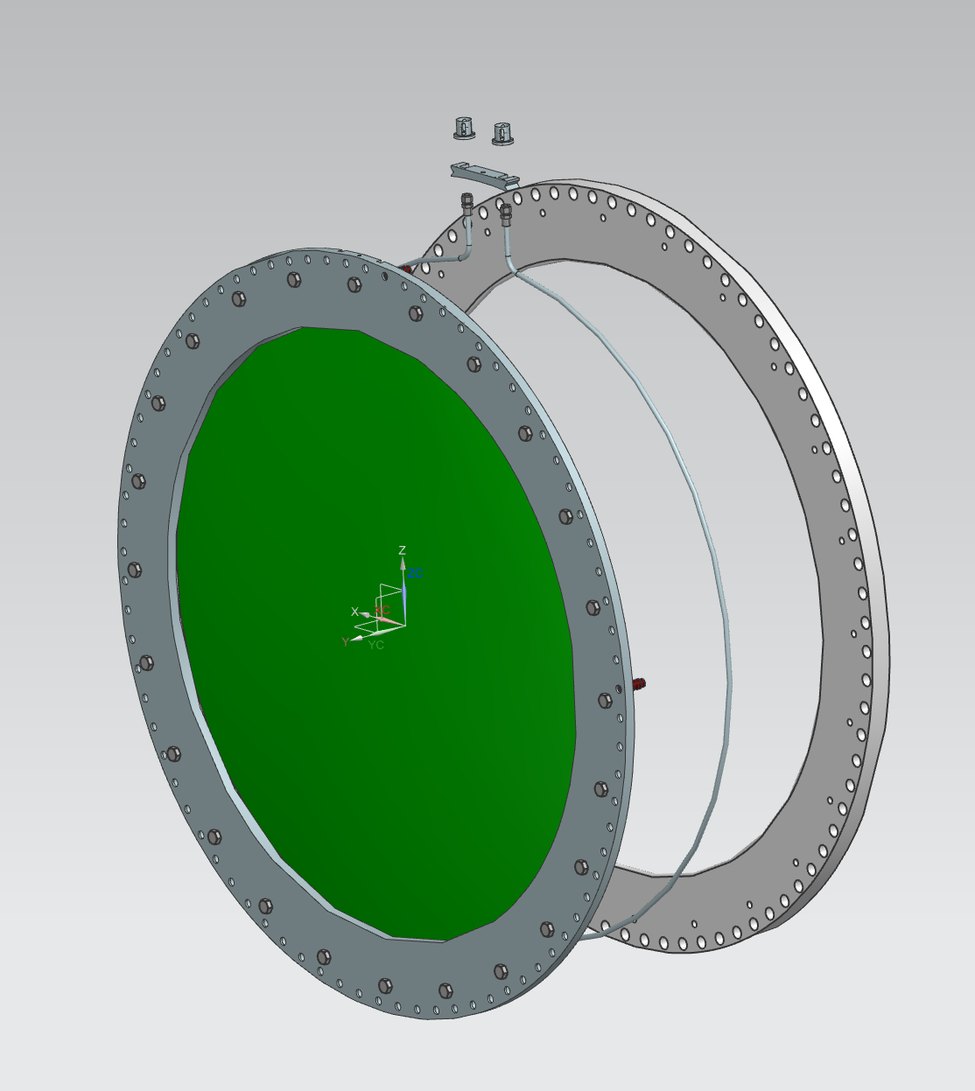
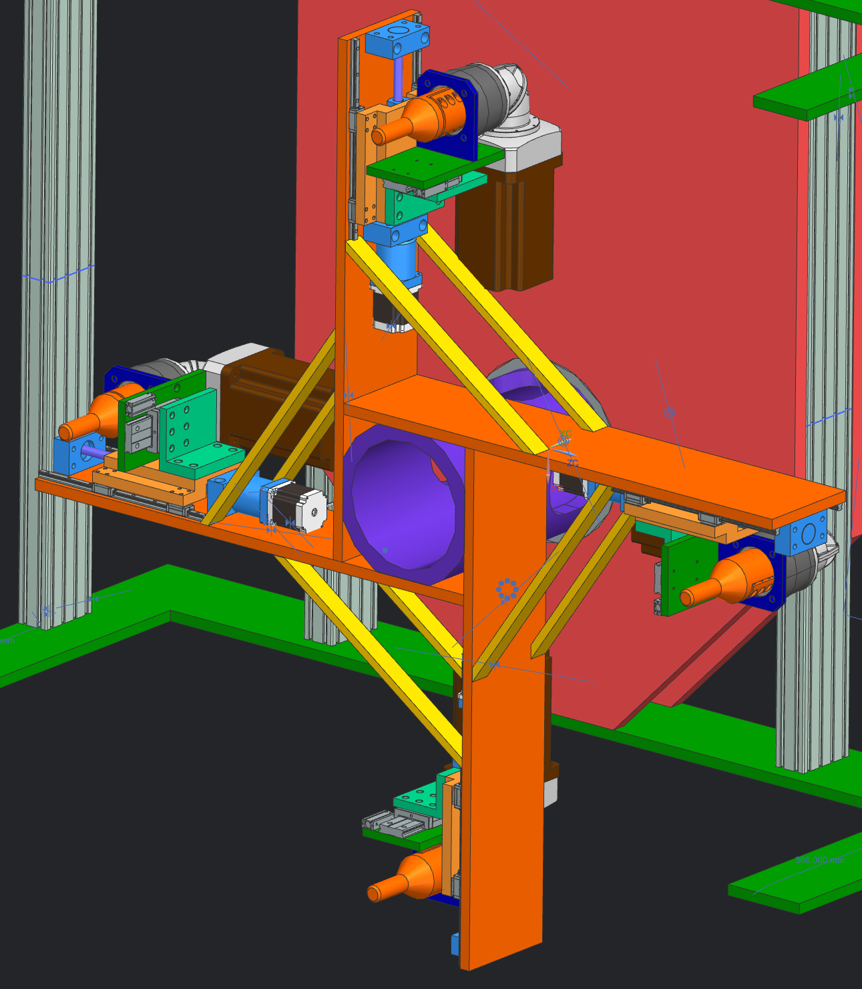
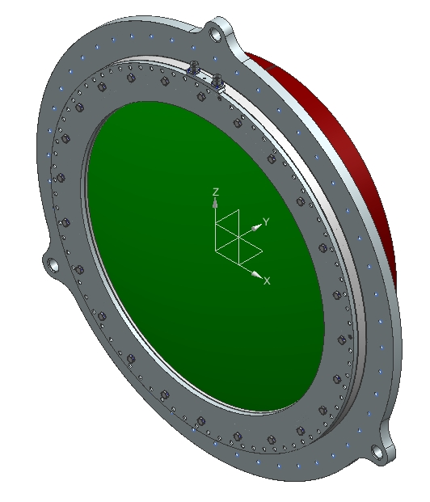
LBNF Beam Windows and Remote Handling R&D Needs – Q. Peterson

Slide 10
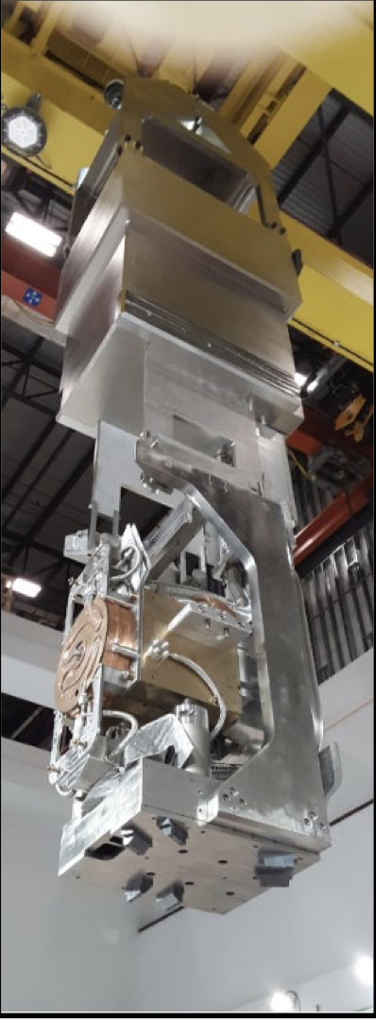
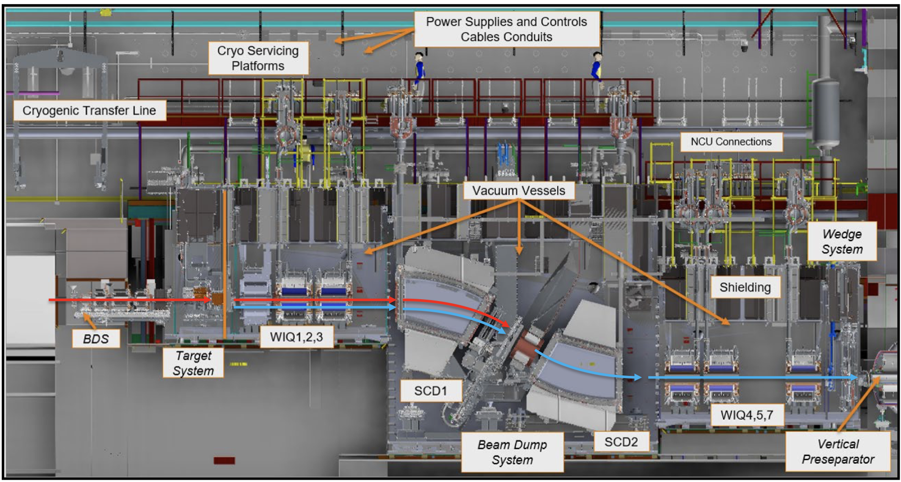
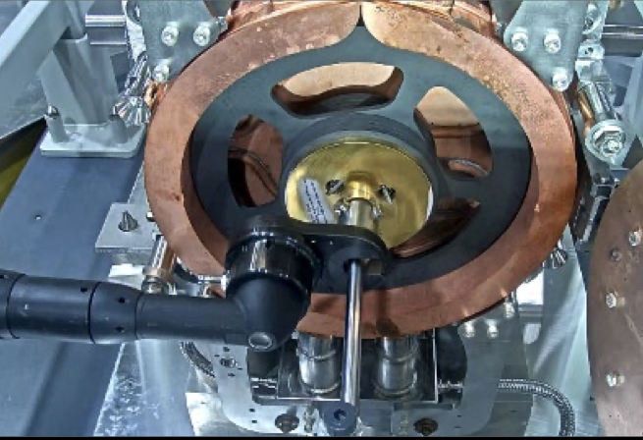
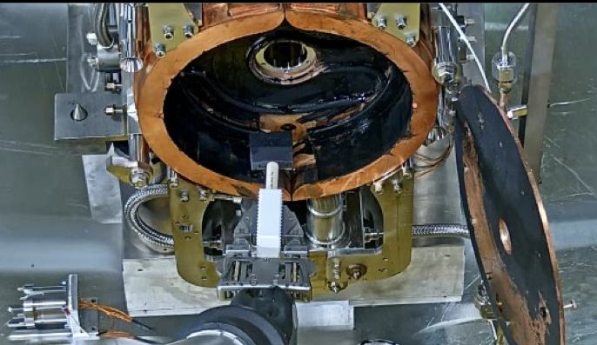
FRIB Remote Handling – Operations Experience and Future Plans - M. Larmann et al

Slide 11
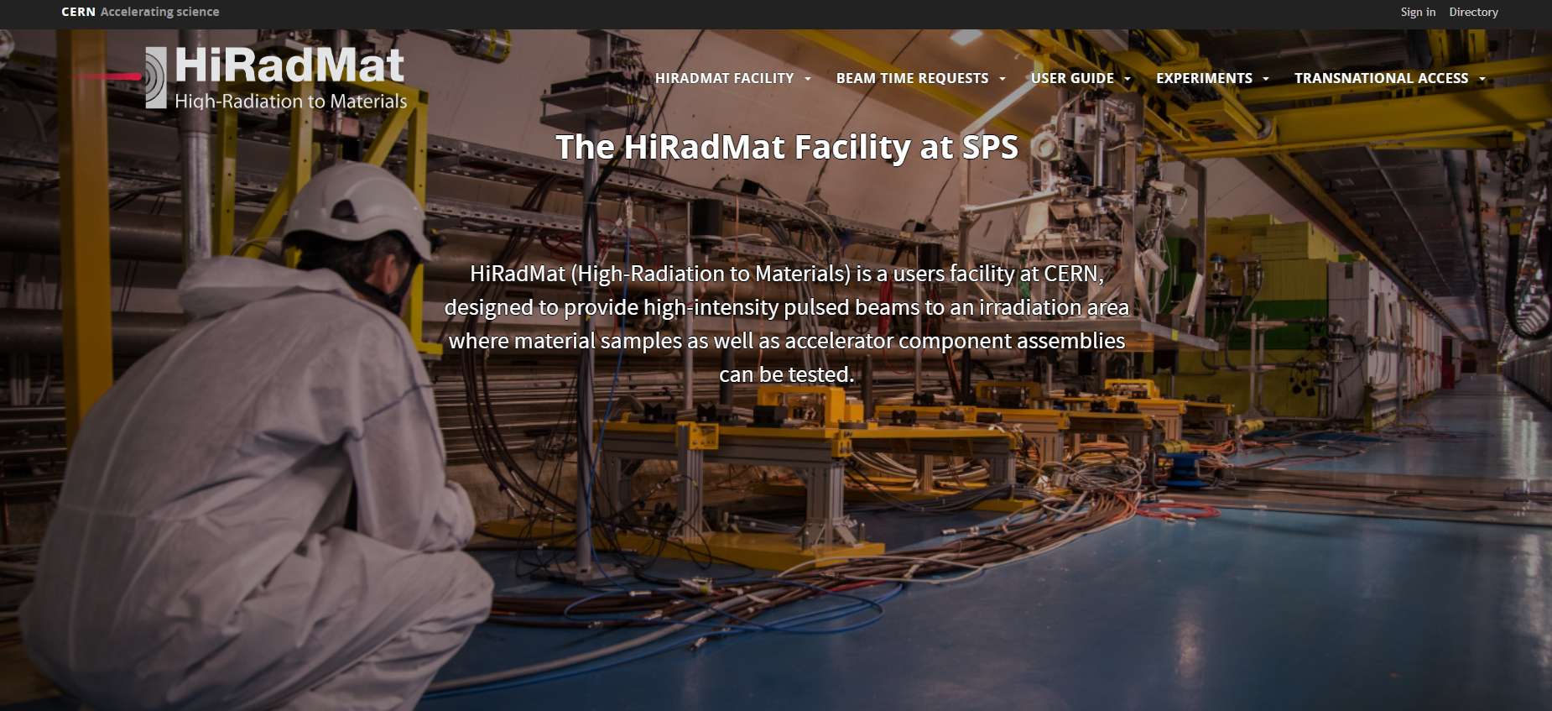
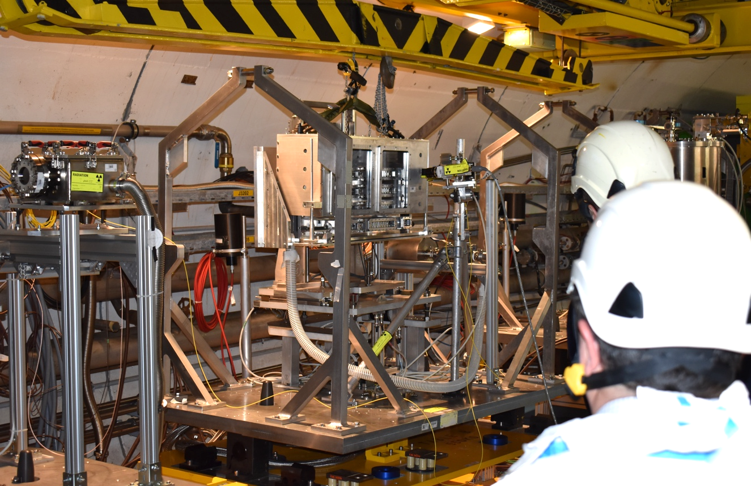
HiRadMat: a high power targetry facility at CERN – A. Goillot
 | Protons
Beam Momentum | 440 GeV/c
Pulse Energy | up to 2.4 MJ
Bunch Intensity | 5·10⁹ – 2.3·10¹¹ protons
Number of Bunches | 1 to 288
Maximum Pulse Intensity | 3.46 · 10¹³ protons
Bunch Length (4 sigma) | 1.5 ns
Bunch Spacing | 25 ns
Beam Size at Target | ~ 1 mm²
TT61 – shielded area
Injection from SPS
TJ7 bunker
TNC – Irradiation area

Slide 12
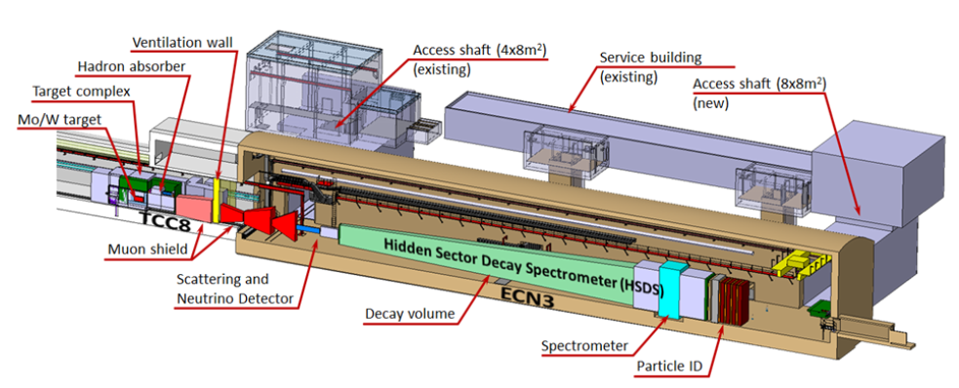
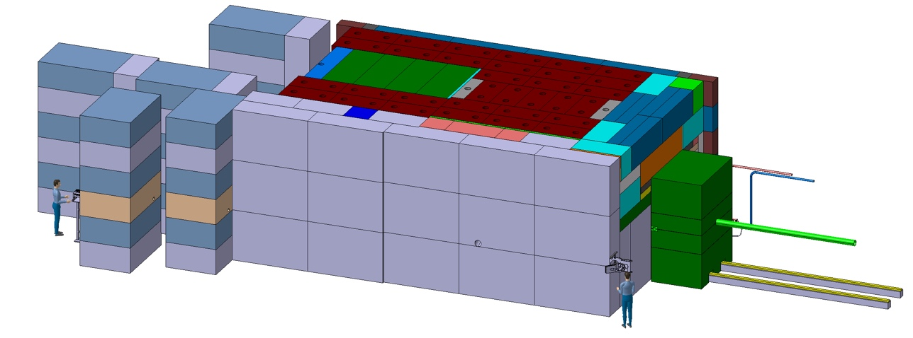
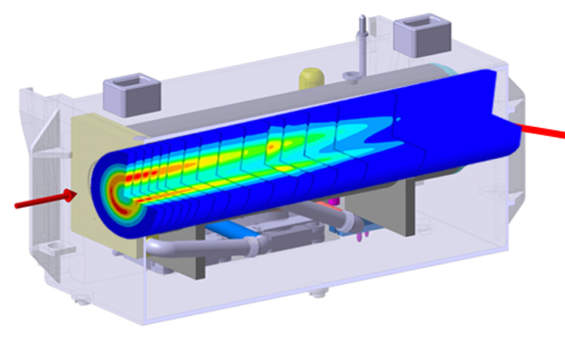
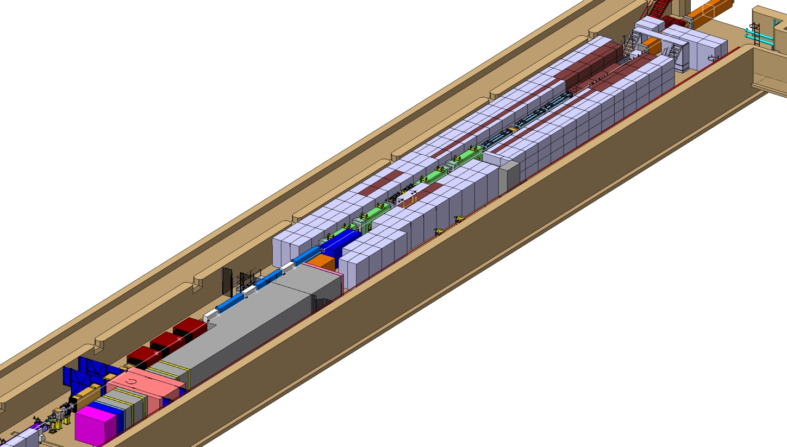
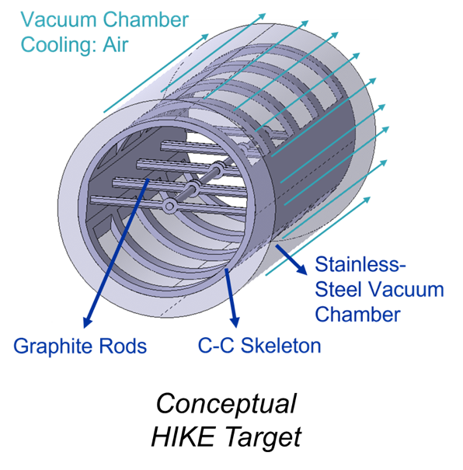
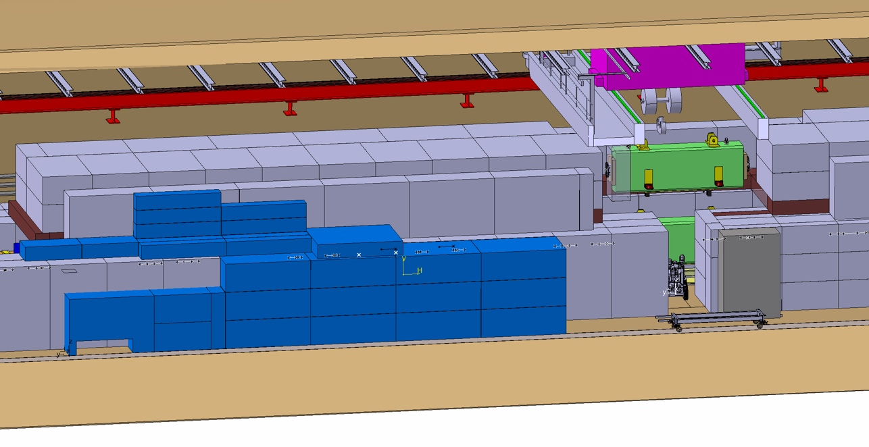
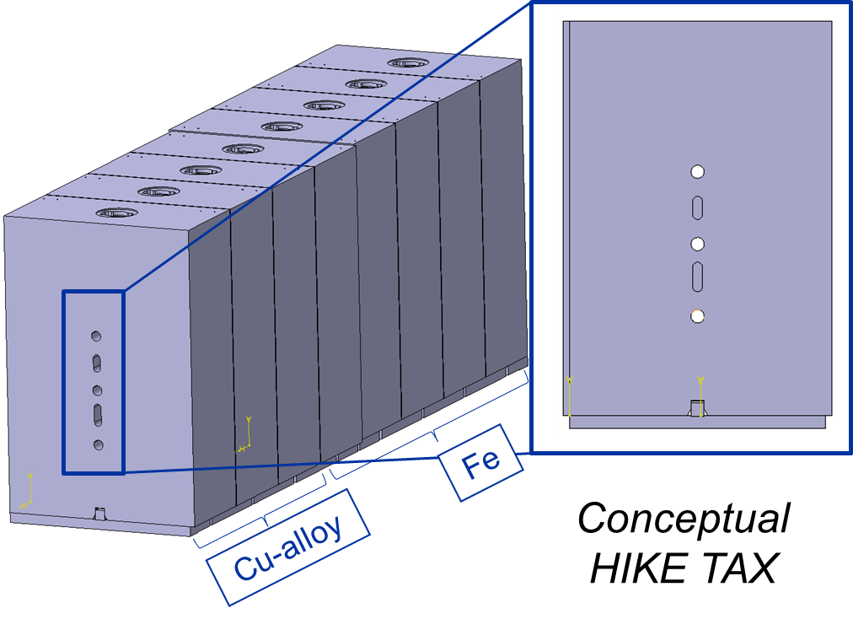
Target Systems Integration for a high intensity facility in the CERN’s North Area – J-L Grenard et al

Slide 13
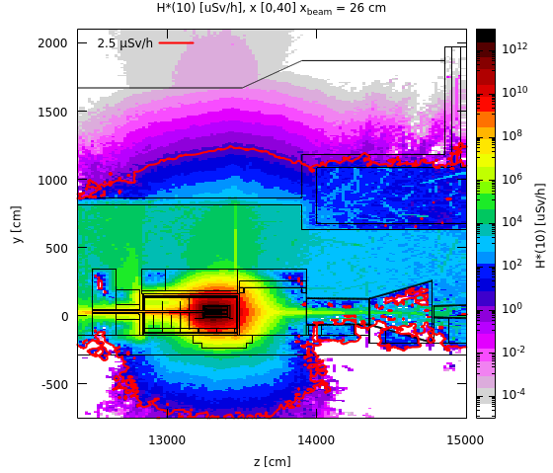
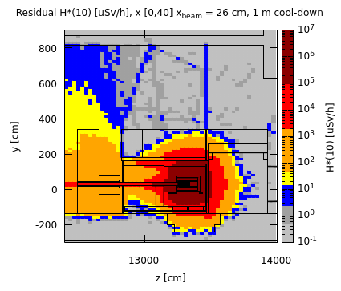
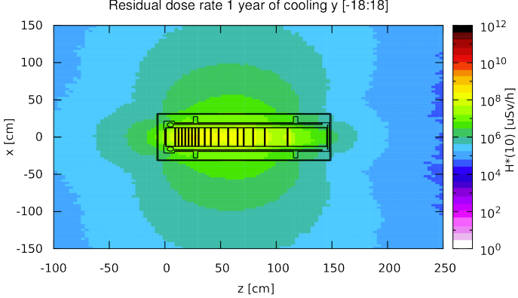
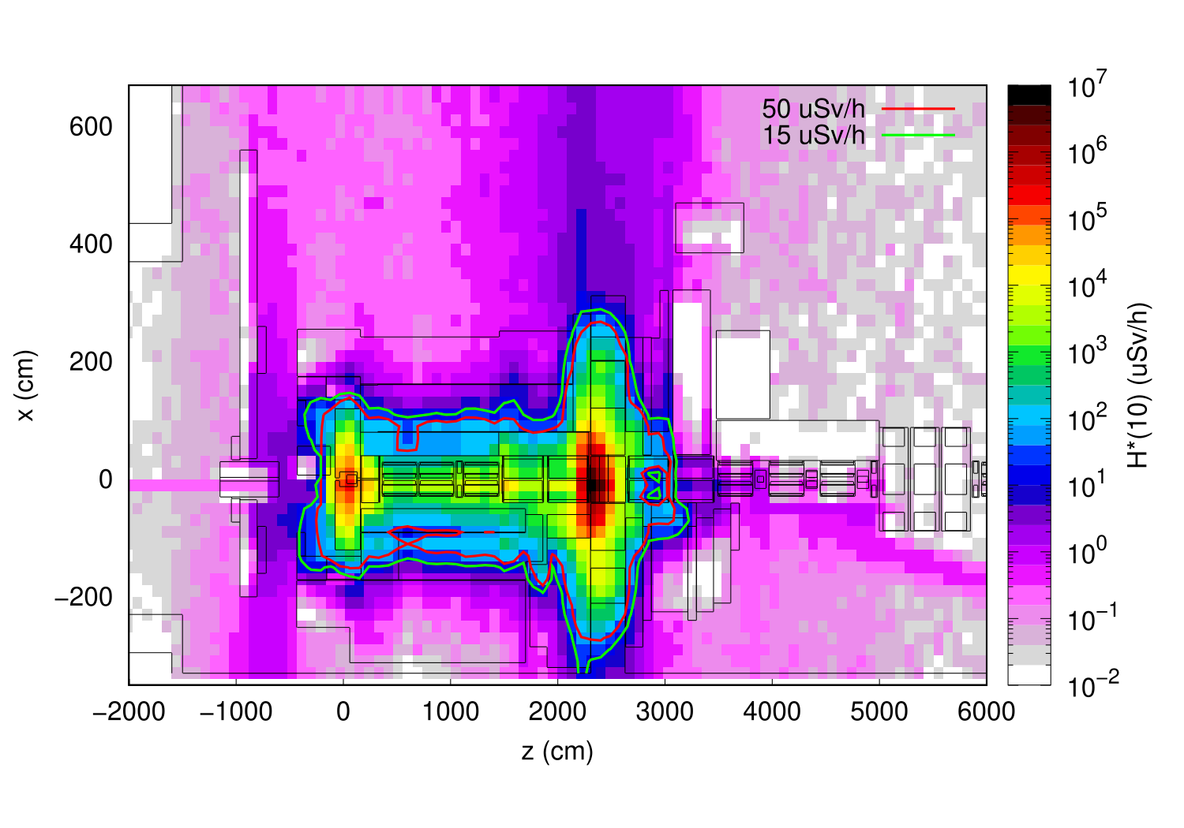
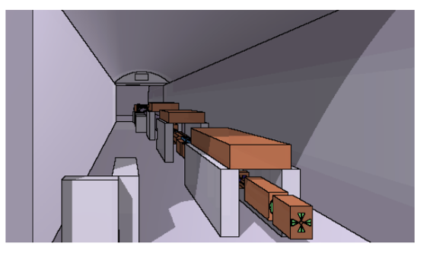
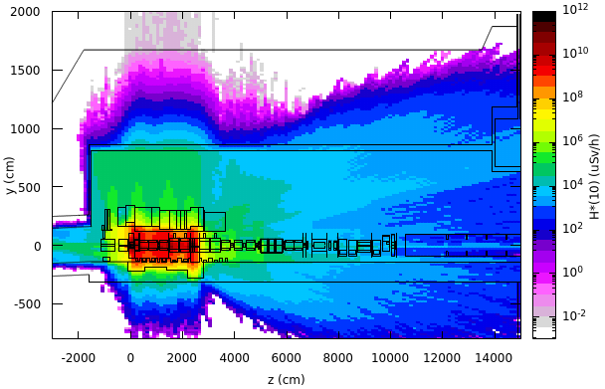
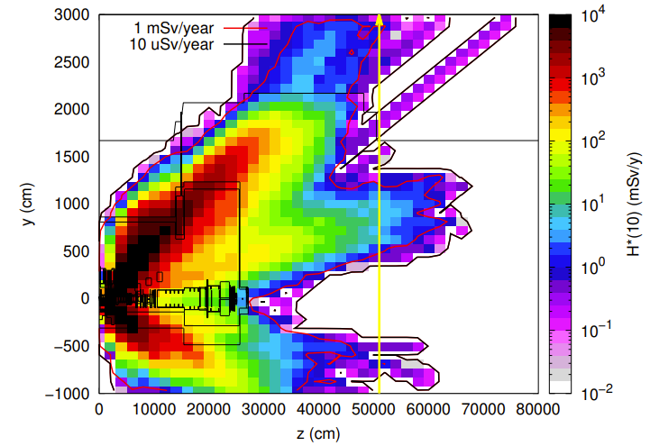
Radiation protection studies for a high intensity facility in the CERN's ECN3 area – C. Ahdida

Slide 14
Topic 5 Posters!
63. ISIS Target Station Two Horn Water Pre-Moderator Failure, Investigation, and Redesign
Mark Telkman (STFC)
91. Target Systems at the Front end of the International Muon Collider
Dr Marco Calviani (CERN)
37. ISOLDE Beam Dumps Exchange: A challenging consolidation, from buried dumps to flexible access
Mrs Ana-Paula Bernardes (CERN)
57. The Shielding Flask System at Super-FRS
Dr Faraz Amjad (GSI Helmholtz Centre for Heavy Ion Research)
80. Impact and Lessons Learned from the Mercury System Filling Incident at the Spallation Neutron Source
Drew Winder (Oak Ridge National Laboratory)
21. Experimental study of nuclide production cross sections via the natPb(p,X) reaction with GeV-energy proton incidence
Dr Kenta SUGIHARA (KEK)
143. Overview of High-Power Targets and Strategies for Remote Handling at TRIUMF - Canada's Particle Accelerator Center
Isaac Earle (TRIUMF)

Slide 15
Blatant Advertisements!
Engineering Position Open at Fermilab: Target Systems Department Projects Staff Engineer
Work on Target Systems projects such as LBNF Beamline, Mu2e, SBND, etc
Interviewing starting next week
Co-Convening Sessions on High Power Accelerator Components and Targets at AccApp
Accelerator Applications 2024

