Slide 1
Summary of Topic 3: PIE
Yong Dai (PSI)

Slide 2
7 presentations distributed into in 2 session on Monday morning and Thursday morning. Including:
- PIE of the beam dump of the CERN Large Hardron Collider (LHC)
- PIE of SNS Hg-target containers
- PIE activities at PSI
- PIE capabilities at Fermilab
PIE of other targets (e.g. ISIS TS2, Triump TS-2), PBW (J-Parc, )… were also reported in other sessions.

Slide 3
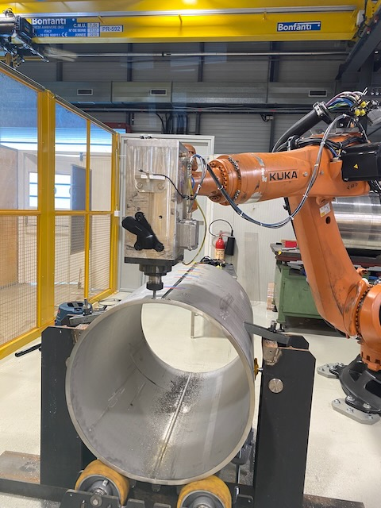
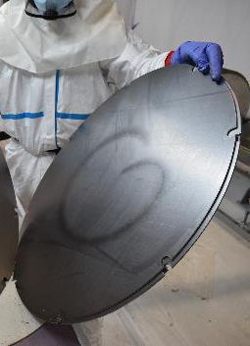
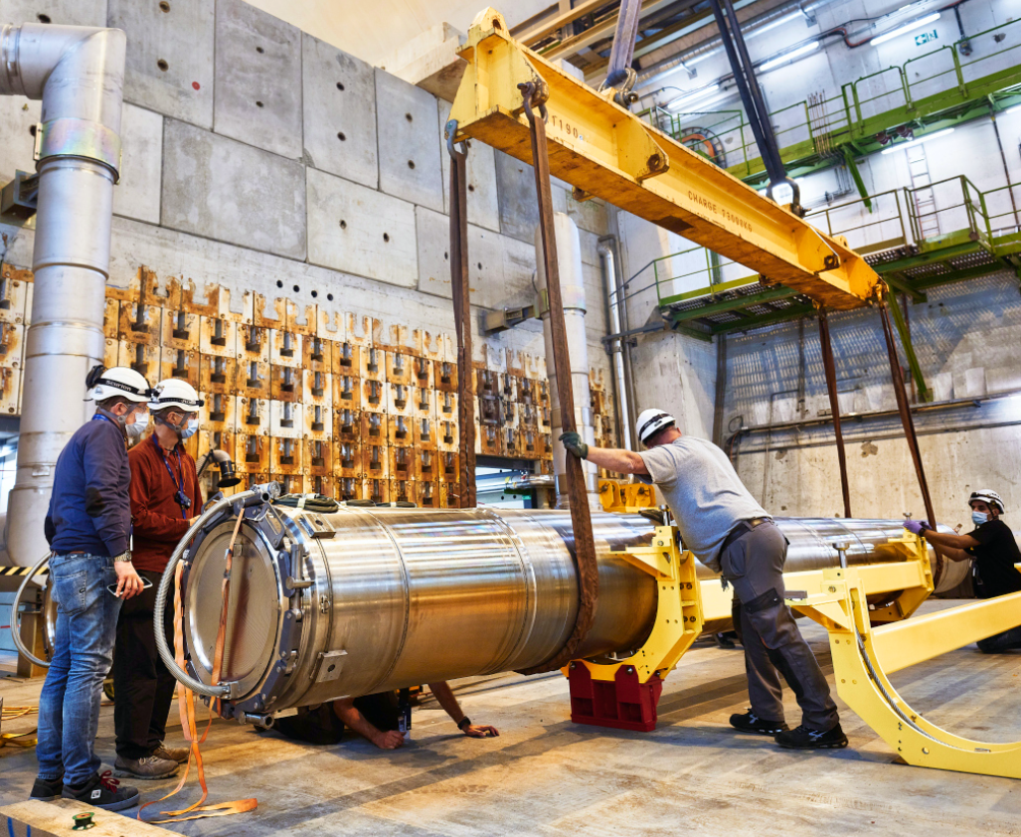
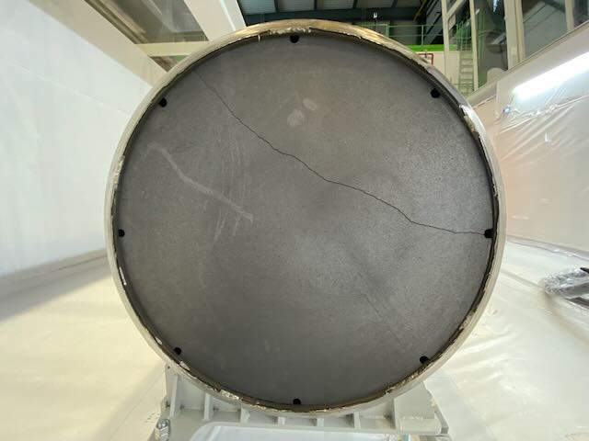
PIE of the beam dump of the CERN Large Hardron Collider (LHC)
''First-of-a-kind autopsy of the Large Hadron Collider external beam dump'' (Ana-Paula Bernardes)
Dump autopsy showed no major issue with core configuration during run 2 (320 MJ, 1.5 kJ/g) despite extruded graphite damaged.
Important lessons learnt for future similar endeavours. Autopsy is a key activity for the future.

Slide 4
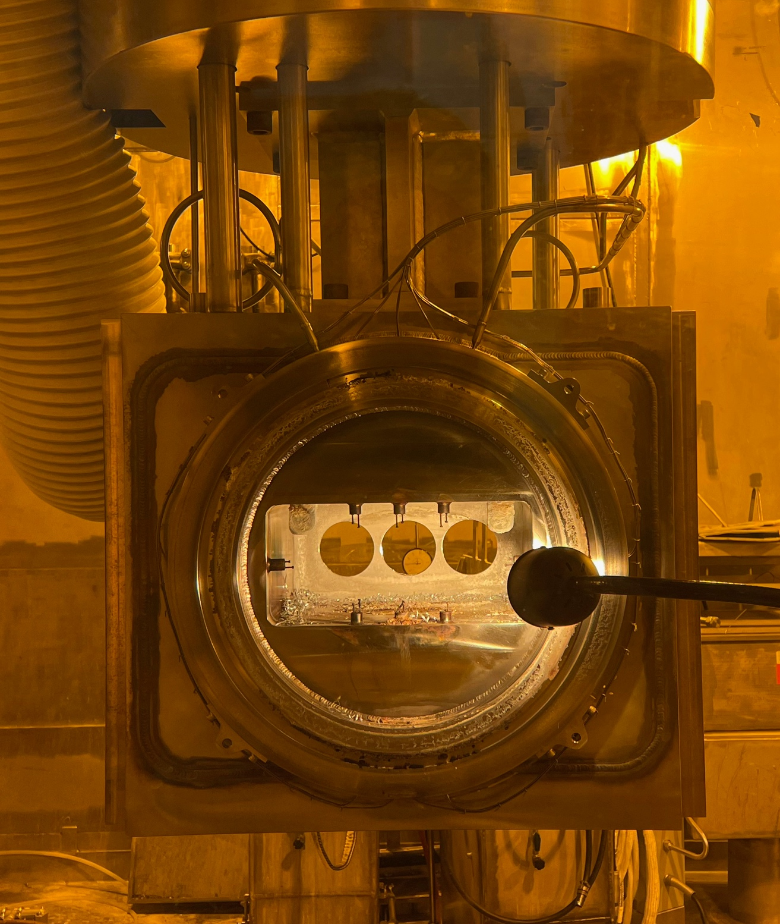
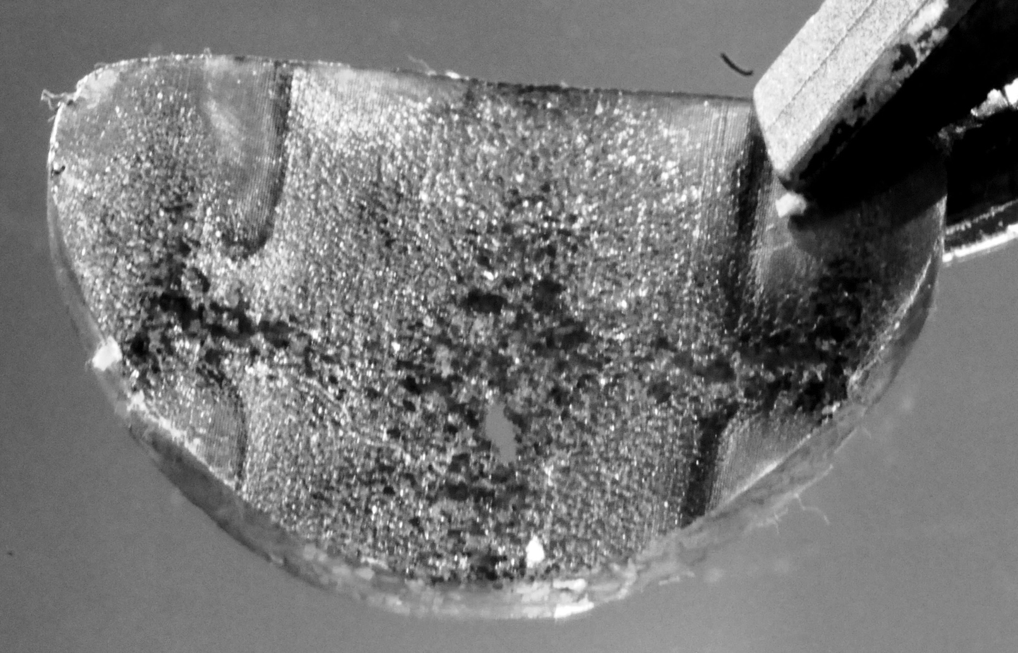
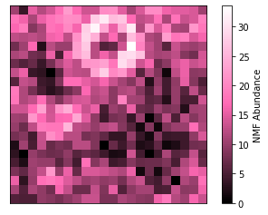
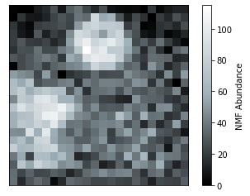
PIE of SNS components
''Materials research and dose limits for highly irradiated components at the SpallationNeutron Source'' (D. McClintock)
Results of SA Inconel 718 PBW
H
He
Ni
Fe
O
PIE results for the PBW 4 Inconel 718 window material were peculiar
- Ultimate and total elongation values increased with increasing dose
- He and H “core and shell” structure was observed after 900°C exposure
Administrative lifetime limits at the SNS are based on dose levels expected to degrade ductility (fracture toughness) “10 % total elongation” is used for most structural components at the SNS

Slide 5
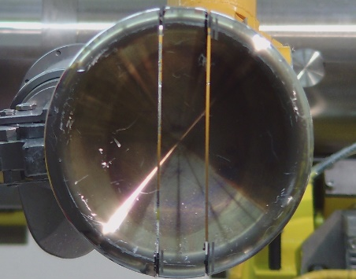
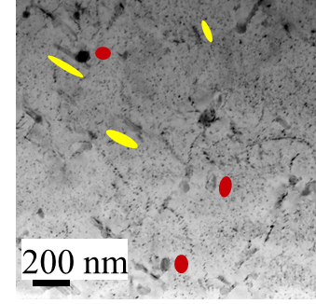
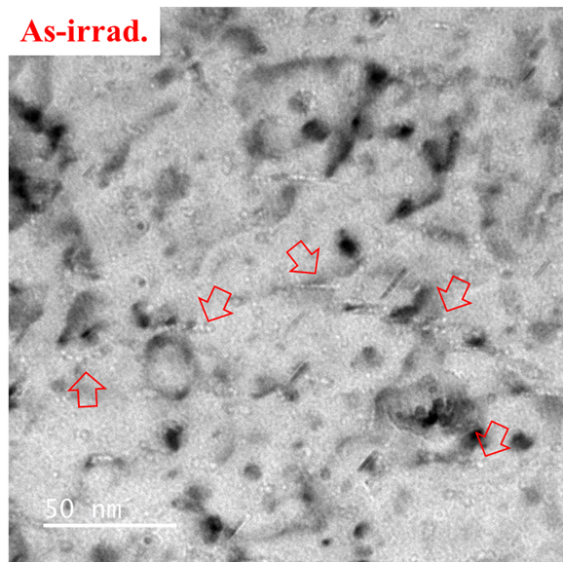
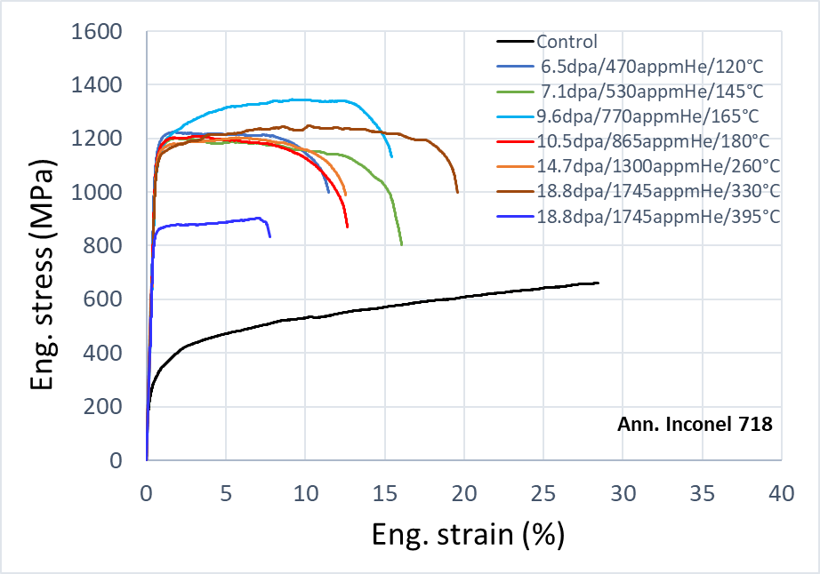
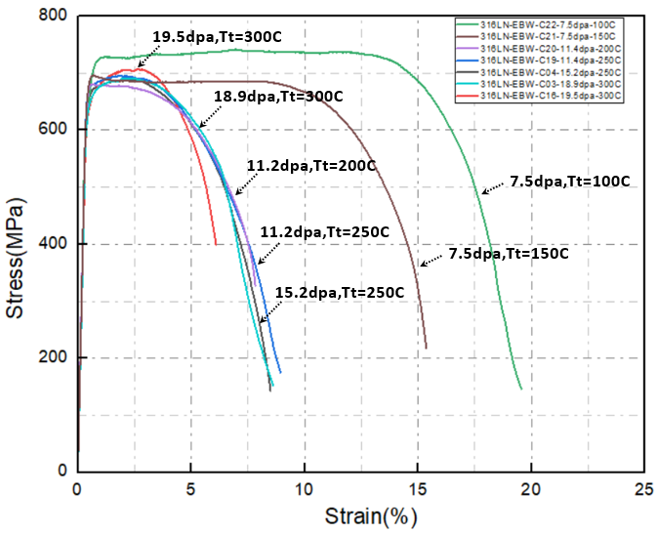
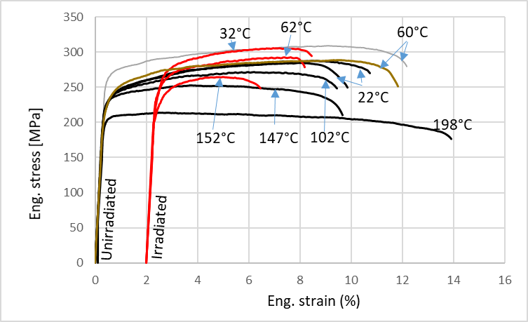
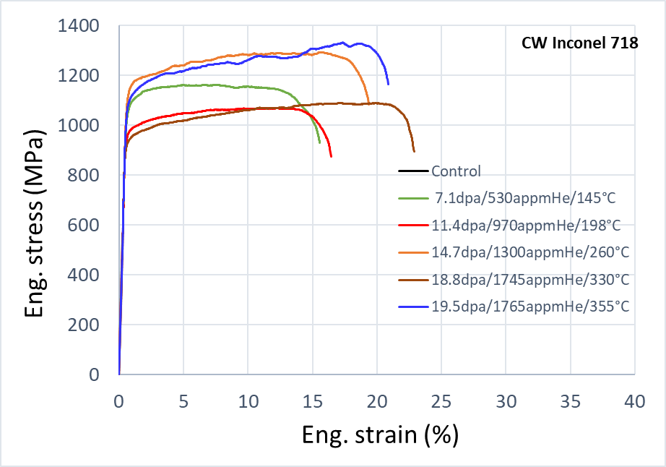
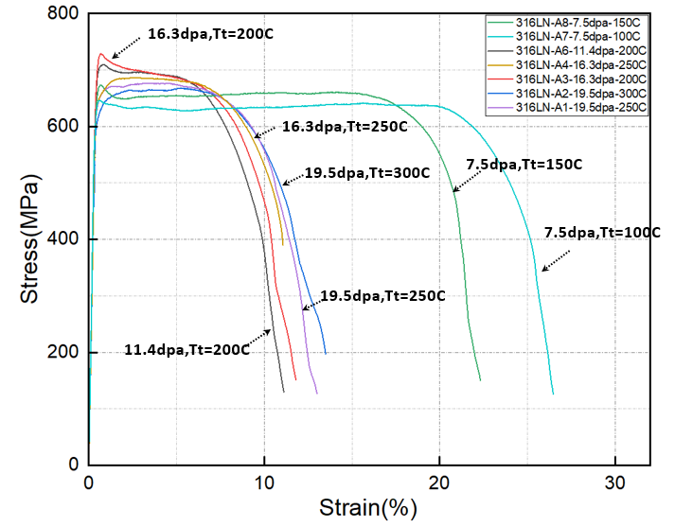
PIE activities at PSI
AlMg3 BW
Al-6061-T6
Inconel 718
SS316 EBW
Control
316L-EBW
SINQ Target-9 (2011-12), 13.13Ah P⁺
10 dpa
SA316L
8.8 dpa / 2400 appm He / 4800 appm H

Slide 6
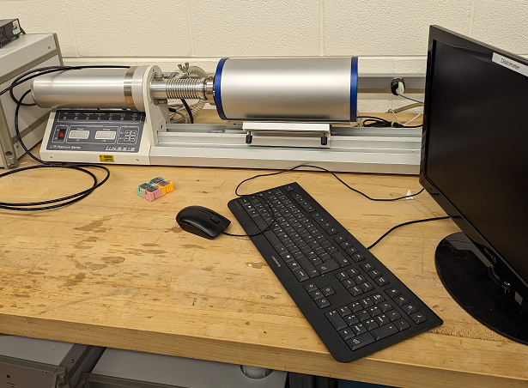
PIE capabilities at Fermilab
''Recent Advancements and in-house capabilities in Thermal and Mechanical Characterization of Conventional and Novel Materials'' (Sujit Bidhar)
Integrating new non-contact techniques (TGS, IC,LDV) to evaluate radiation damaged properties

