Slide 1
Topic 8 (Multipurpose use of targets and beam dumps)
Hiroki Okuno Convenor of TOPIC8
2 invited talks and 2 contributed talks
Only one talk for multipurpose use

Slide 2
Overview of the session 1
Invited talk
The Muon Collider Study: Challenges and perspectives
Roberto LOSITO (CERN)
  Muon target for Muon Collider
Production of astatine-211 for targeted α-particle therapy at RIBF
Hiromitsu HABA (RIKEN)
  Target for mass production of At211

Slide 3
Overview of the session 2
Present status and upgrade plan of RI production target in SCRIT electron scattering facility
Yasushi Abe (RIKEN)
  RI production target for SCRIT
The ISAC facility secondary irradiation and PIE upgrades
Ferran Boix Pamies (TRIUMF)
  Secondary irradiation

Slide 4





Challenges in the Design of Muon Colliders
R. Losito
for the International Muon Collider Collaboration
8th High Power Targetry Workshop, 6-10 November 2023
Co-Funded by the European Union (EU). Views and opinions expressed are however those of the author only and do not necessarily reflect those of the EU or European Research Executive Agency (REA). Neither the EU nor the REA can be held responsible for them.

Slide 5
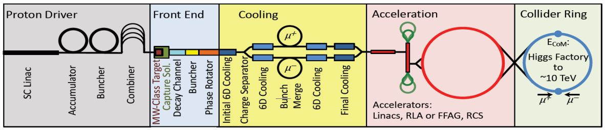

Slide 6
Target System & shielding
Thermal Radiation shield
Non cooled shielding
HTS
water moderator
Neutron absorber (water and boron carbide layer)
Shielding He coolant (RT)
Shielding (Tungsten)
Stainless Steel Shielding vessel
548
590
Stainless Steel wall
Vacuum
Target He coolant (RT)
Titanium Outer Vessel
Cooling Helium
170
171
P+ Beam
Static Helium
150
R15
C-Target
Outside solenoid cryostat
To be optimized with WP4 & WP7
Inside solenoid cryostat
Target Titanium vessel
800
Target p+ beam pipe
6

Slide 7
Production of astatine-211 for targeted α-particle therapy at RIBF
Hiromitsu HABA (RIKEN)

Slide 8
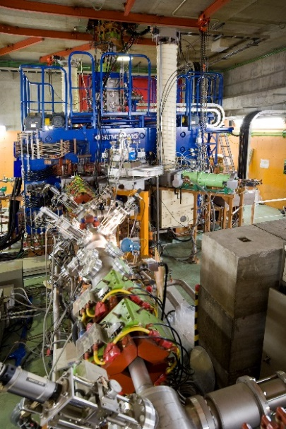
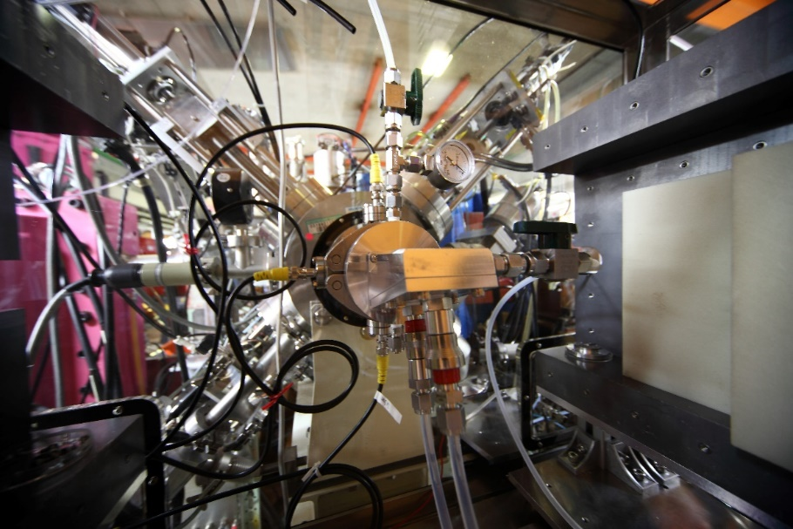
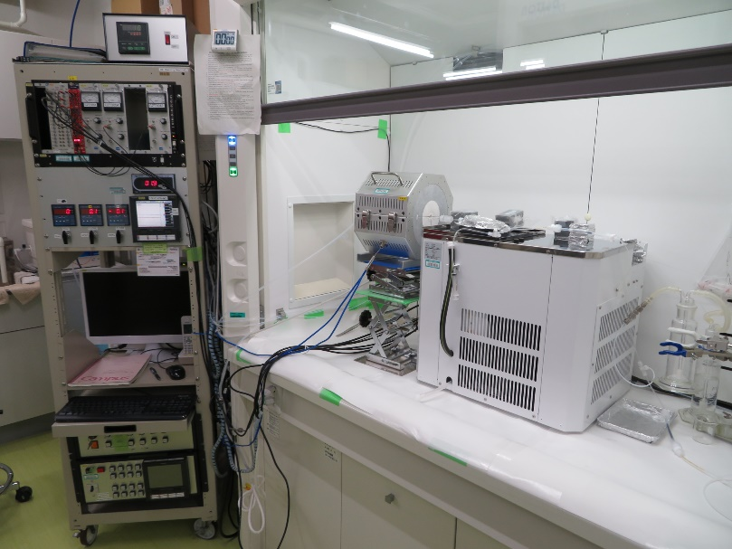
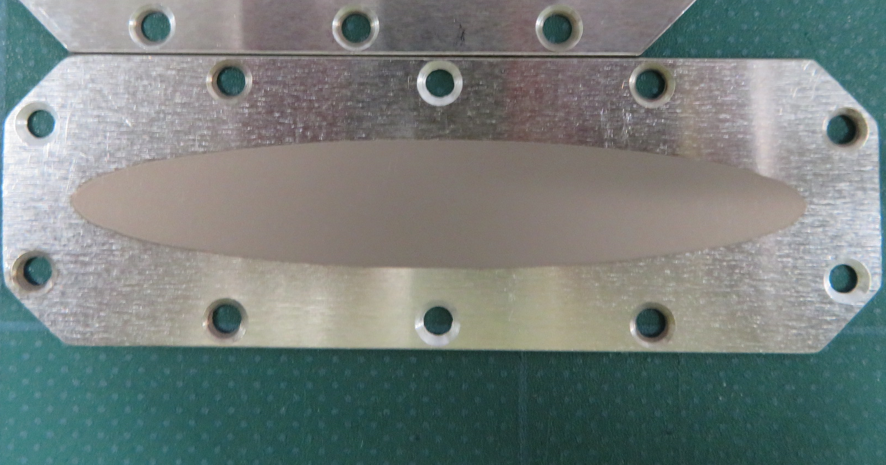
Development of production technology of ²¹¹At at AVF
Purity: 99.999%
Thickness: ~20 mg/cm²
69 mm
12 mm
850ºC
Metallic ²⁰⁹Bi target
29-MeV ⁴He
25 pμA
Oxygen
PFA trap cooled with C₂H₅OH at –100 ºC
200 μL of H₂O, CH₃OH, CHCl₃, …
(Chem. Yield: ~80%)
Water- and helium-cooled target chamber
AVF
Dry distillation of ²¹¹At
25 pμA×1 h → 1.2 GBq of ²¹¹At (EOB)
Metallic Bi
M.P.: 271.5ºC
T.C. (300 K): 7.97 W/m⋅K
²⁰⁹Bi target
(~75 mg/cm²)
Be vacuum window (20 μm)
29-MeV α beam (25 pμA)
10º
Beam wobbler
(2 Hz, φ3 mm)
Beam energy monitor
(TOF detector)
→ 29 (±1%) MeV
0
50 [mm]
Al plate (1 mm)
Cooling water (4 L/min, 5ºC)
N. Sato et al., RIKEN Accel. Prog. Rep. 50, 262 (2017).
S. Yano et al., RIKEN Accel. Prog. Rep. 50, 263 (2017).
Y. Wang et al., RIKEN Accel. Prog. Rep. 53, 192 (2019).
H. Haba, Drug Deliv. Syst. 35, 114 (2020) (in Japanese).
T. Watanabe et al., Proc. of PASJ12, 1198 (2015).
Cooling He (30 L/min)

Slide 9


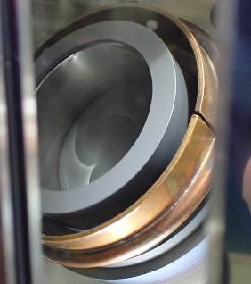

Development of a large-scale ²¹¹At production apparatus
FY2017–
Rotating liquid Bi target
Rotation at 2000 rpm
Heat the vessel to dissolve Bi at 300∼400°C
Spread Bi to the wall of the vessel by centrifugal force

Slide 10
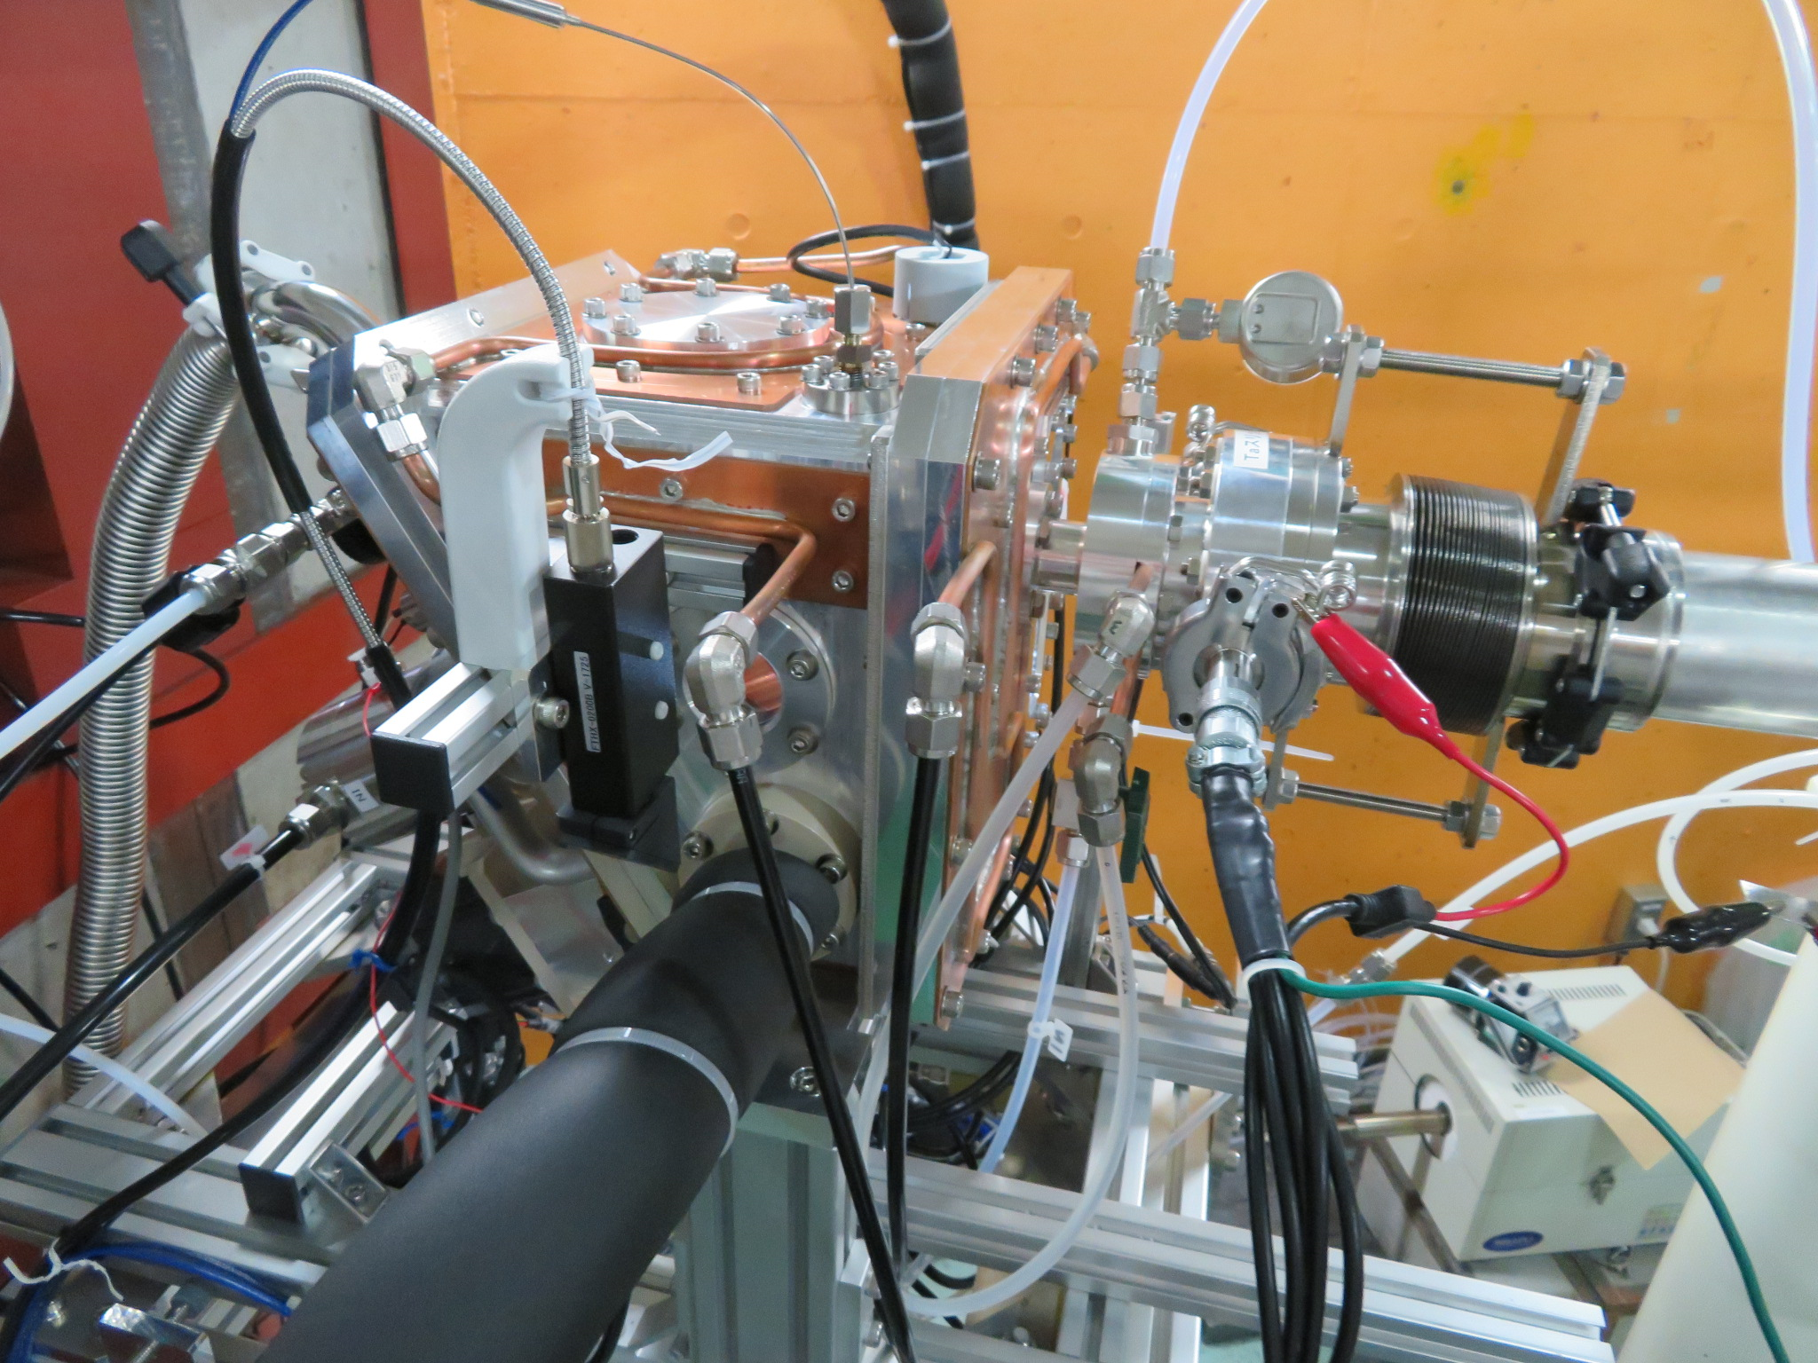
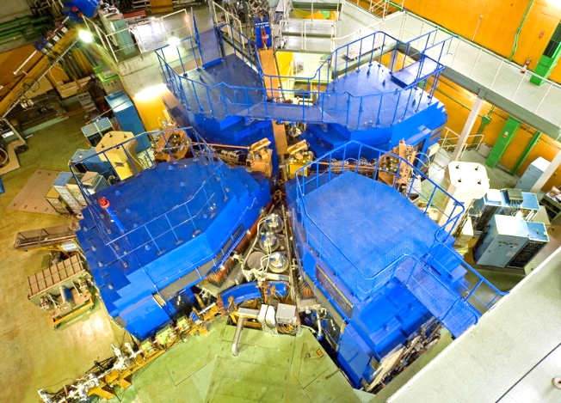
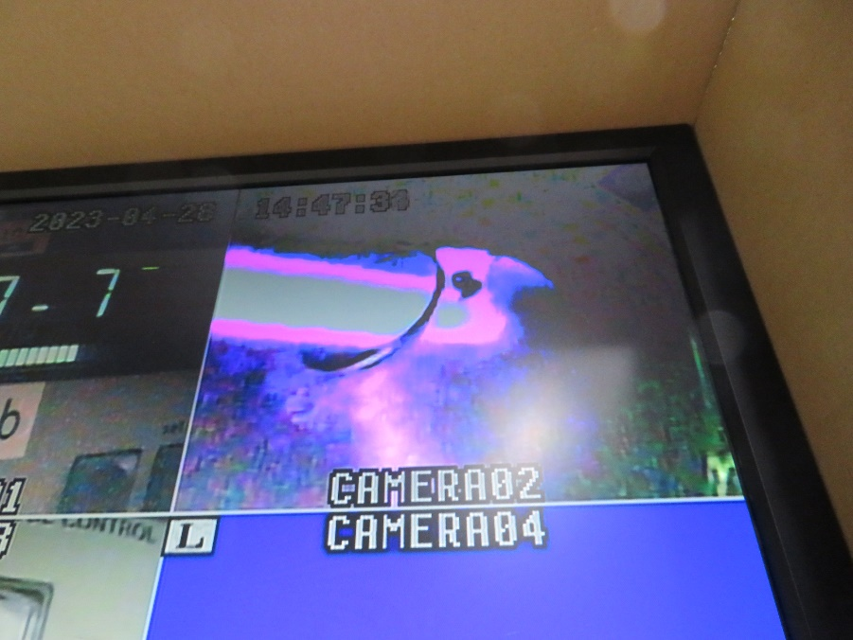
Commissioning of the large-scale ²¹¹At production apparatus
RILAC2
29-MeV
25-pμA ⁴He
29-MeV
25-pμA ⁴He
²¹¹At production chamber
RIKEN Ring Cyclotron
・Irradiation with 28-MeV × 25-pμA ⁴He beam
・High recovery yield (∼80%), comparable to that of conventional apparatus
・Production of ∼200 MBq of purified ²¹¹At required for a typical use after 1.5-h irradiation
⁴He beam

Slide 11
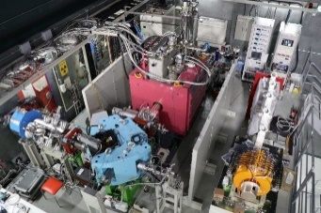
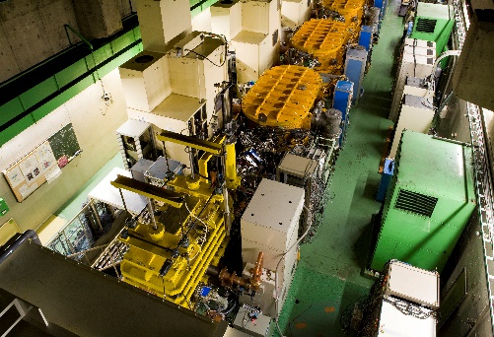
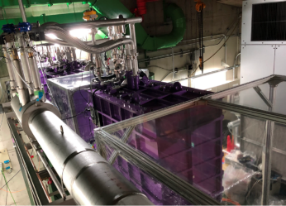
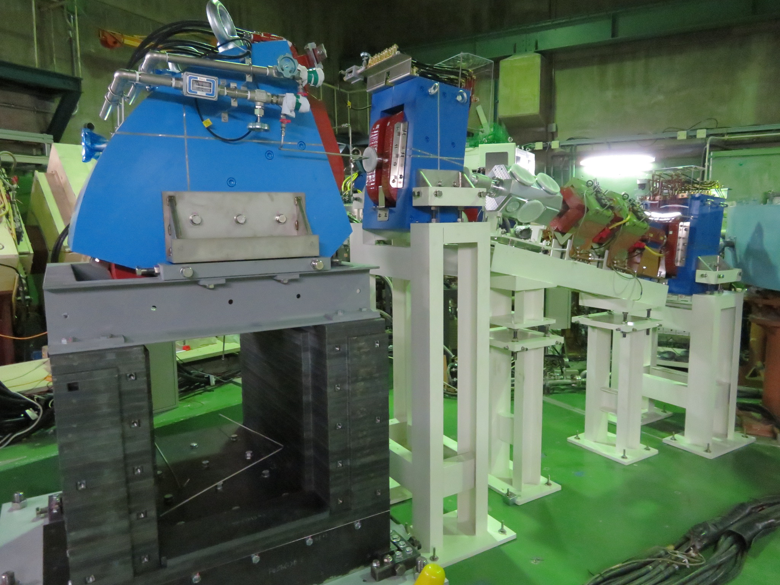
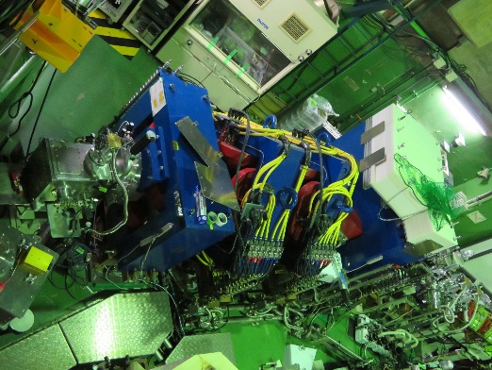
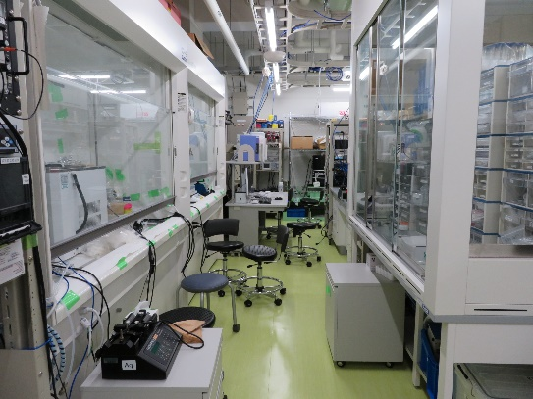
Future plan: large-scale production of ²¹¹At at SRILAC
Development of production technology of ²¹¹At with 100-pμA ⁴He beam
28 GHz ECRIS
SRILAC
SRILAC
(2020.1~)
²¹¹At
²¹¹At
–
SHE RIs
RI production beam line under construction
Large-scale ²¹¹At production apparatus
GARIS III
Nucl. Chem. Lab.

Slide 12
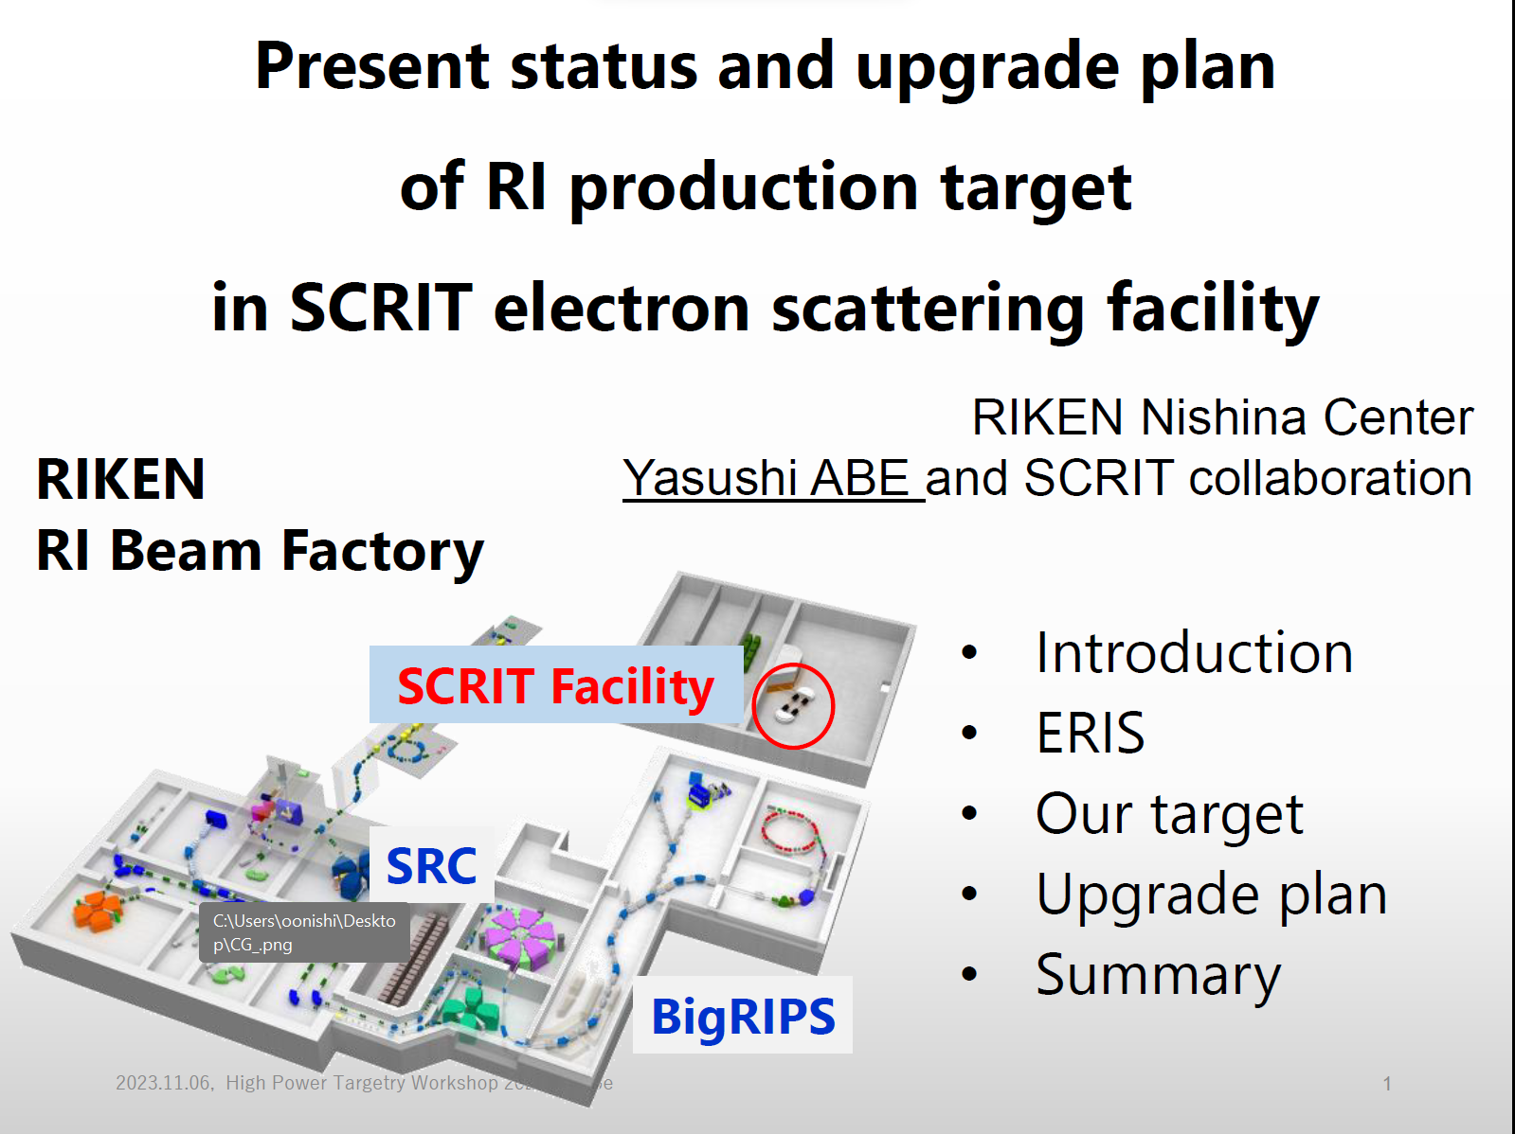

Slide 13
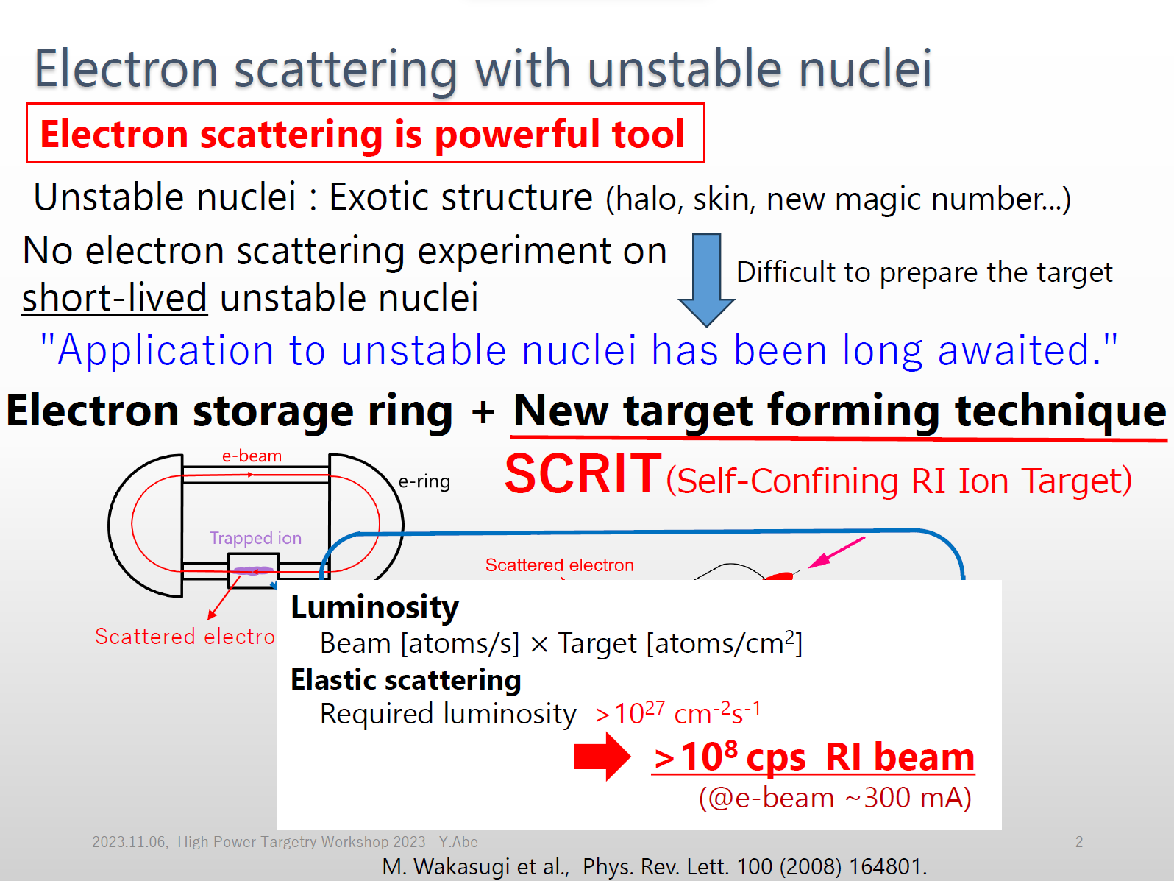

Slide 14
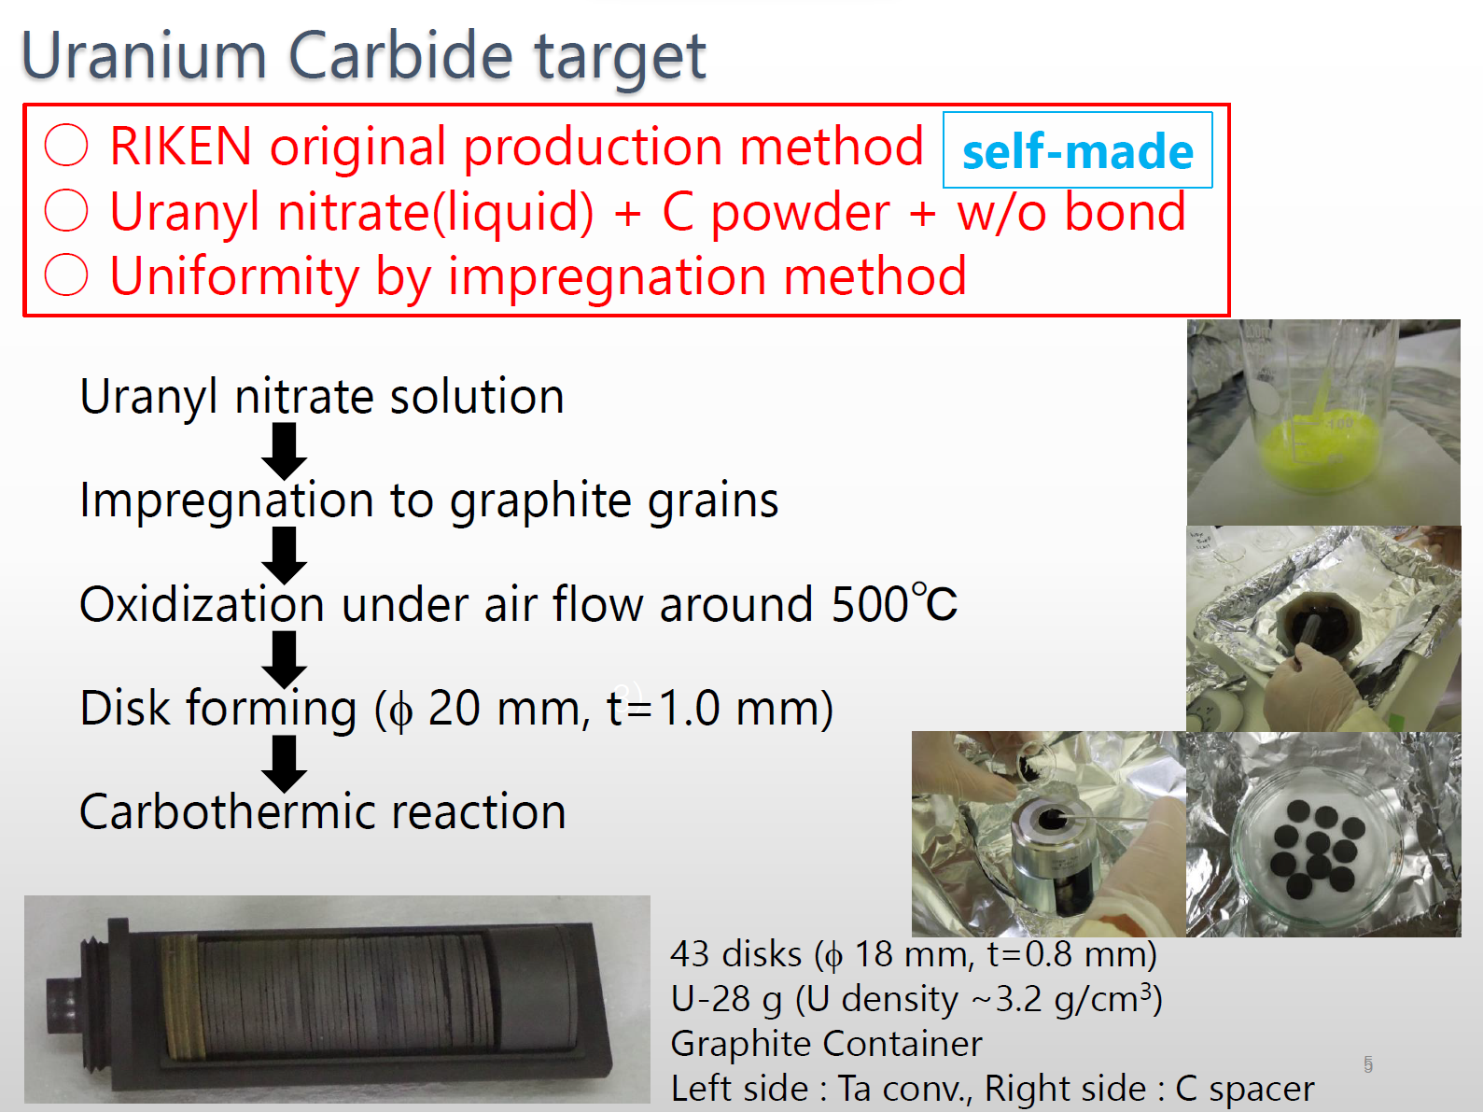

Slide 15
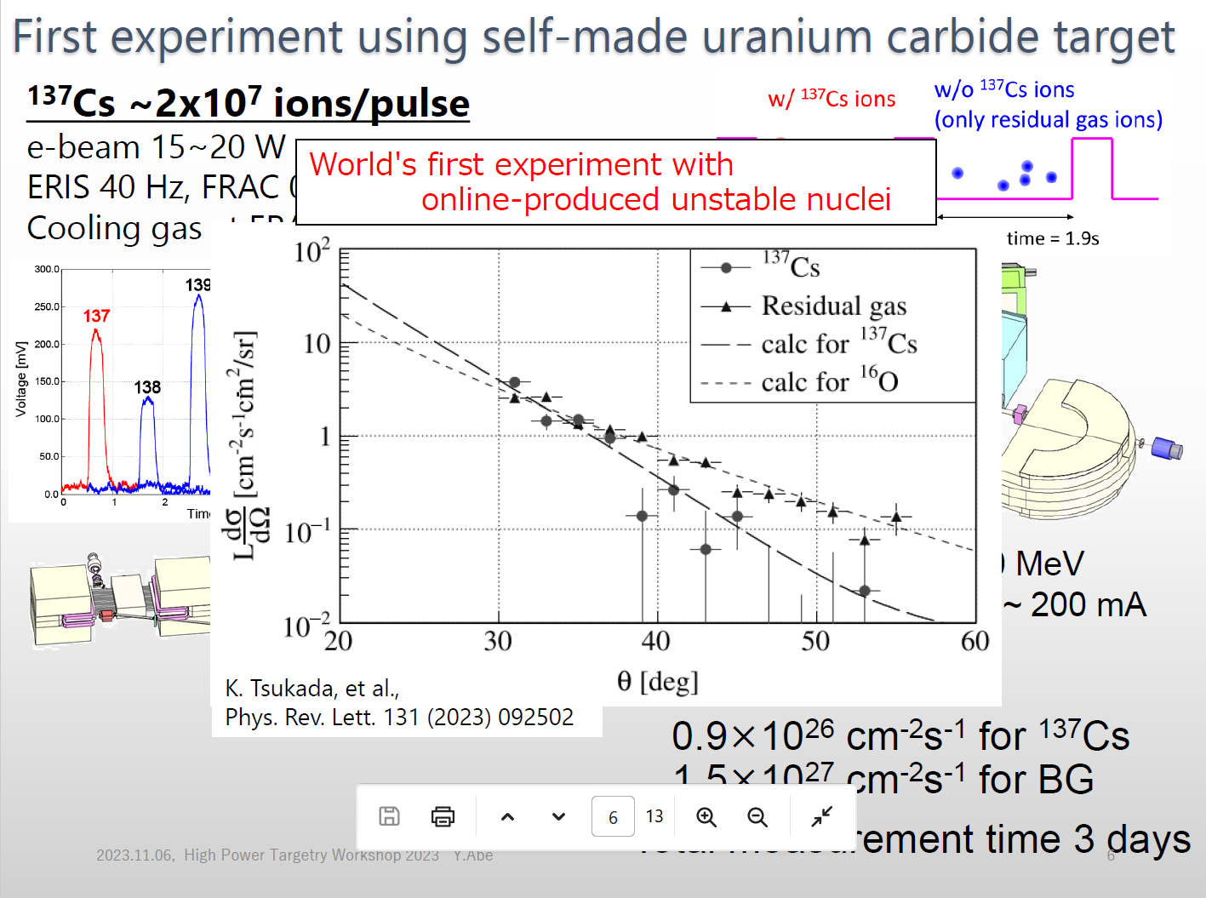

Slide 16
The ISAC facility secondary irradiation and PIE upgrades
HPTW 2023
Ferran Boix Pamies and Alexander Gottberg

Slide 17
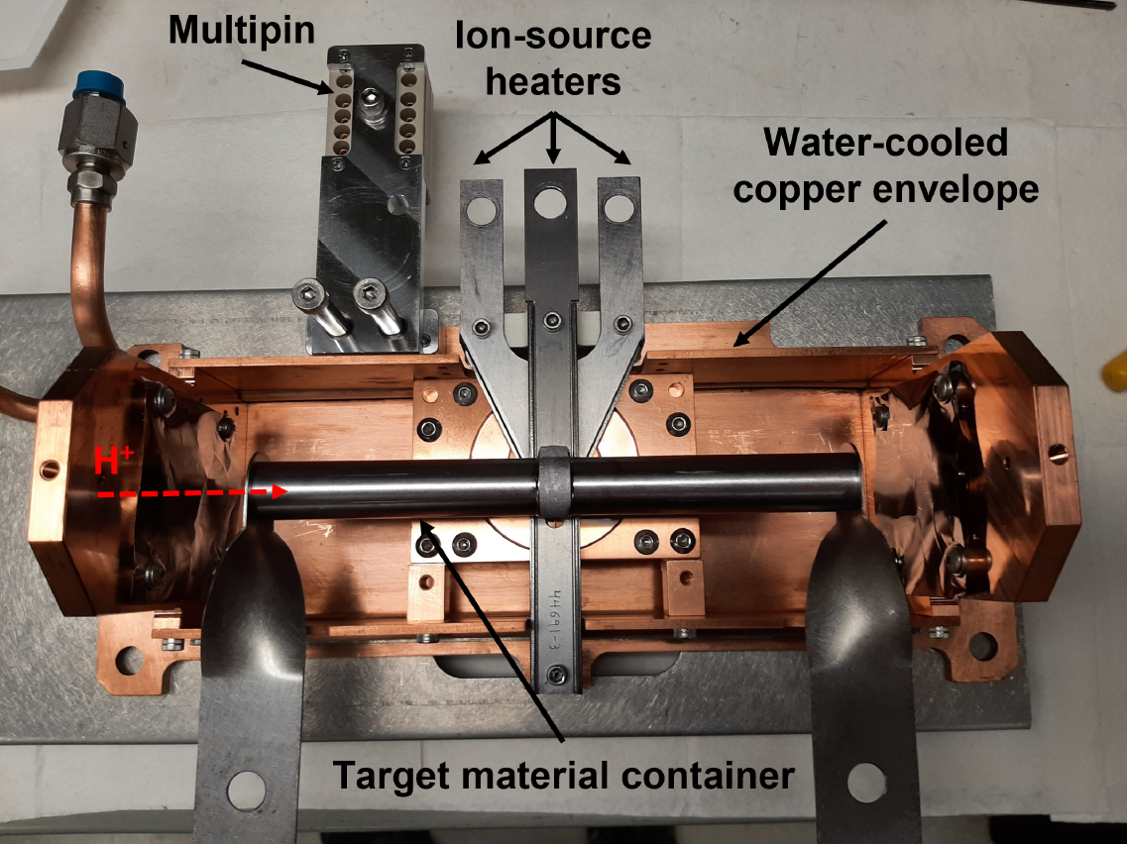
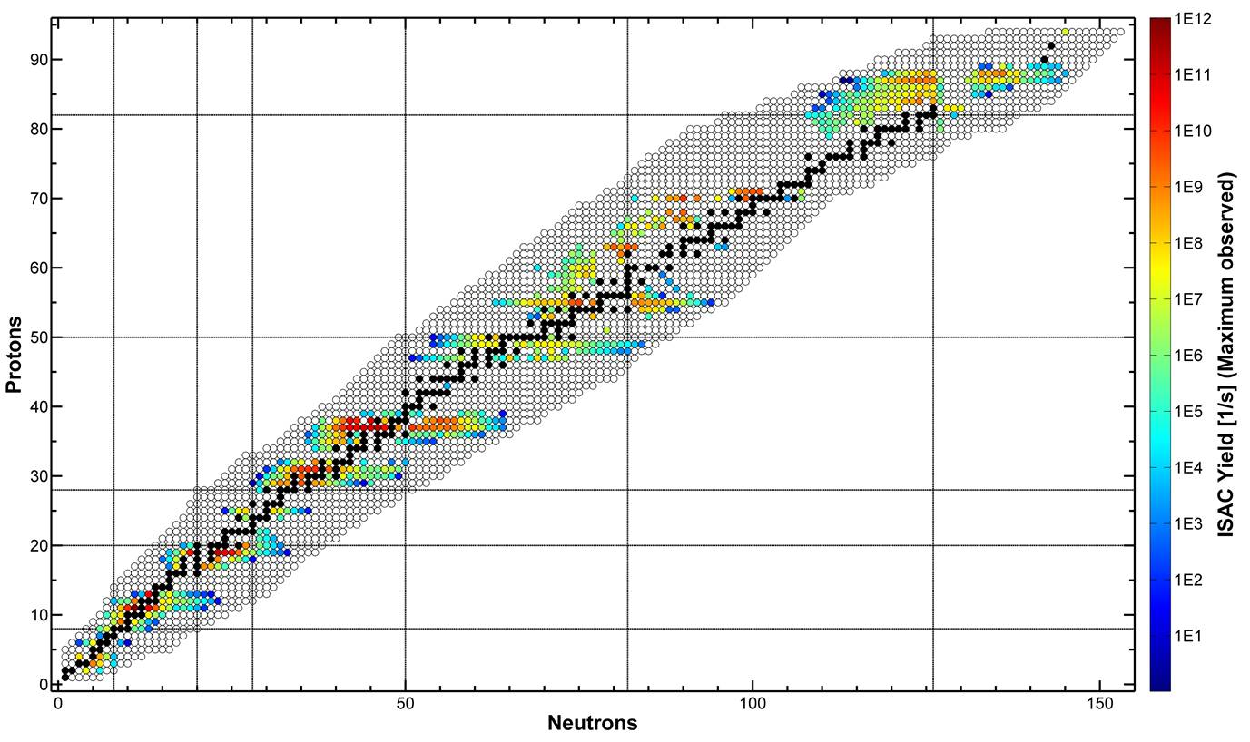
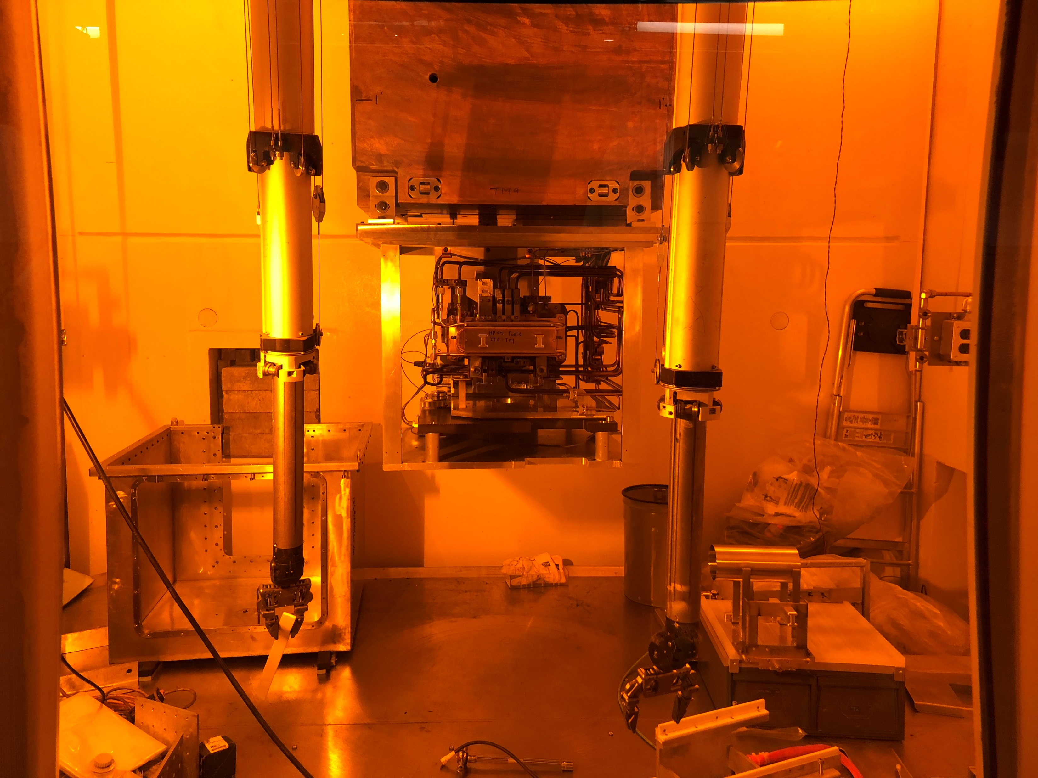
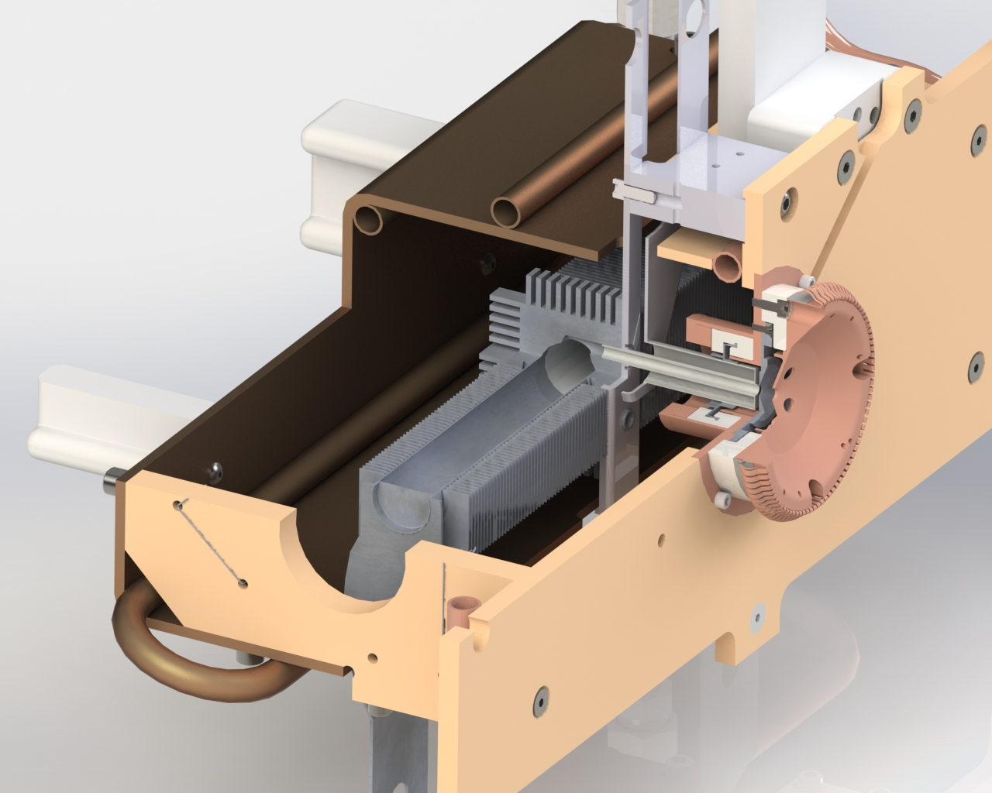
ISAC-TRIUMF
ISAC RIB production target
ISAC target station
RIB
H⁺

Slide 18
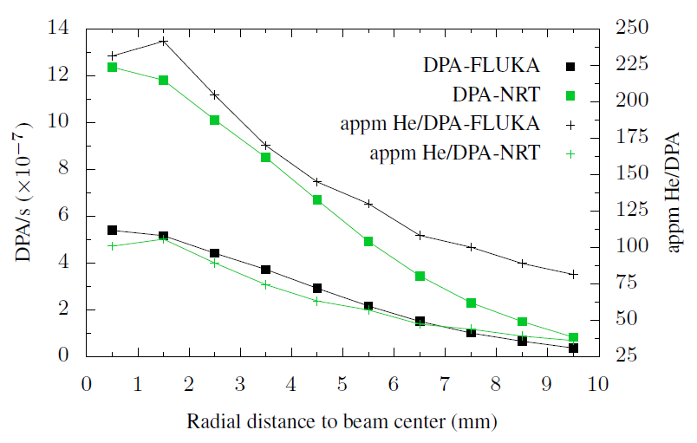
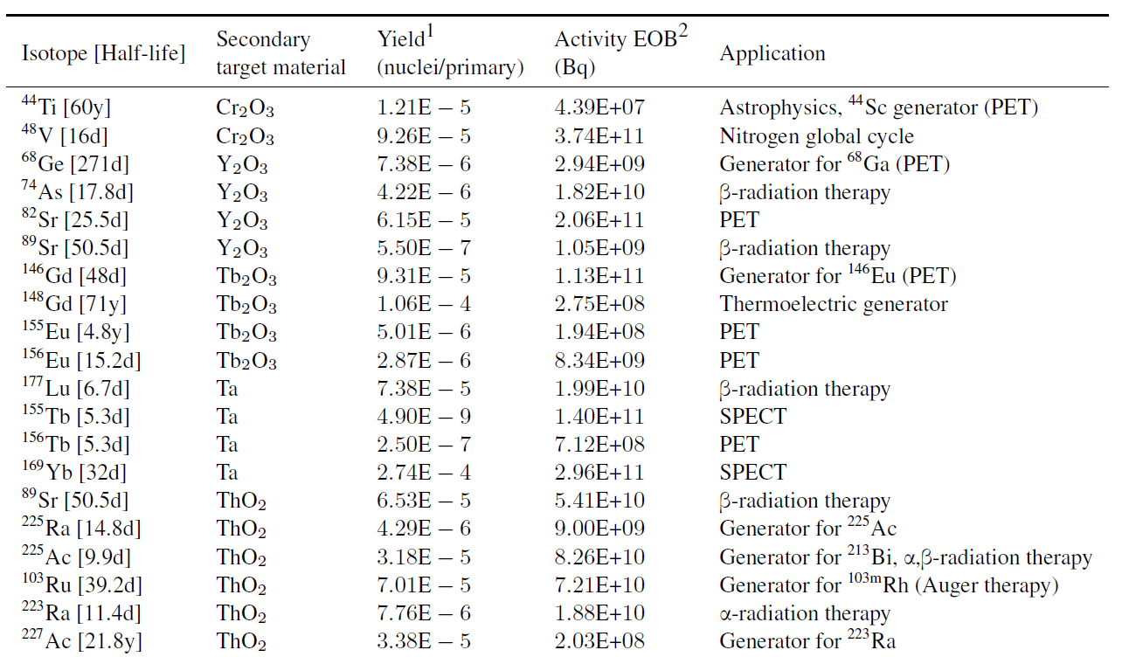
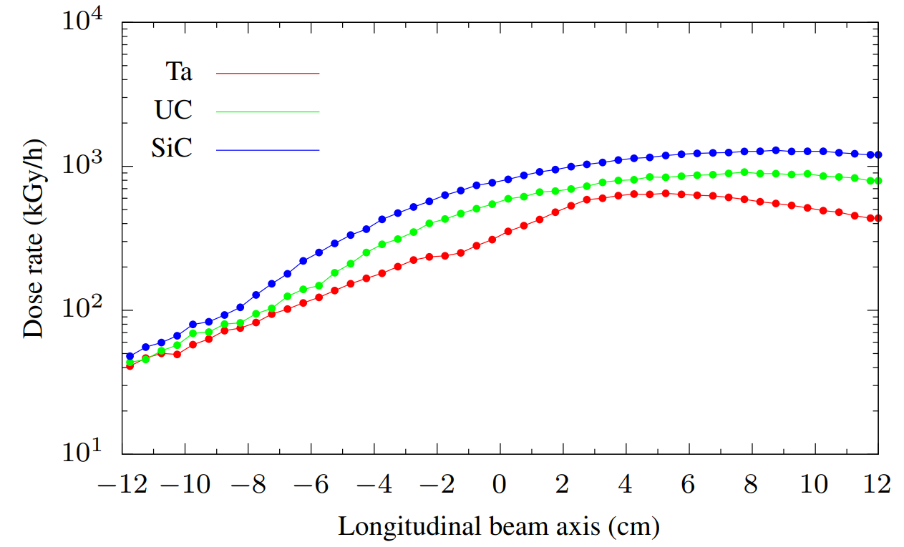
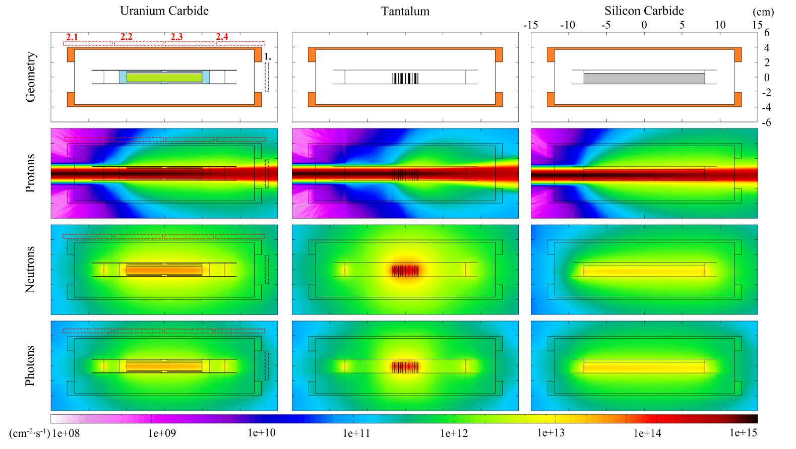
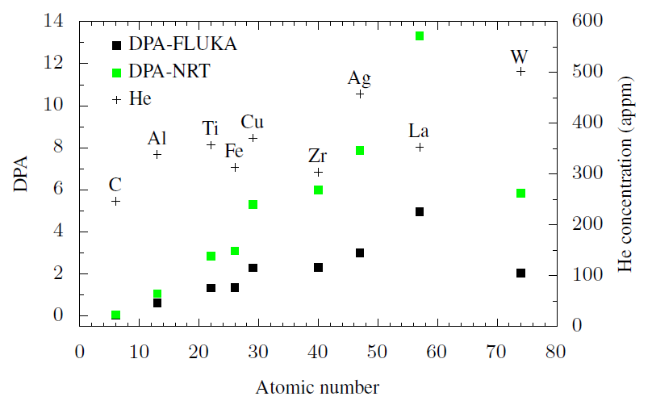
Multipurpose use of ISAC targets
In-beam radiation damage
Long-lived radioisotope production
Off-beam radiation damage
Operational fluxes near ISAC targets
20day, 1kW irradiations of secondary targets are considered readily achievable with existing infrastructure

Slide 19
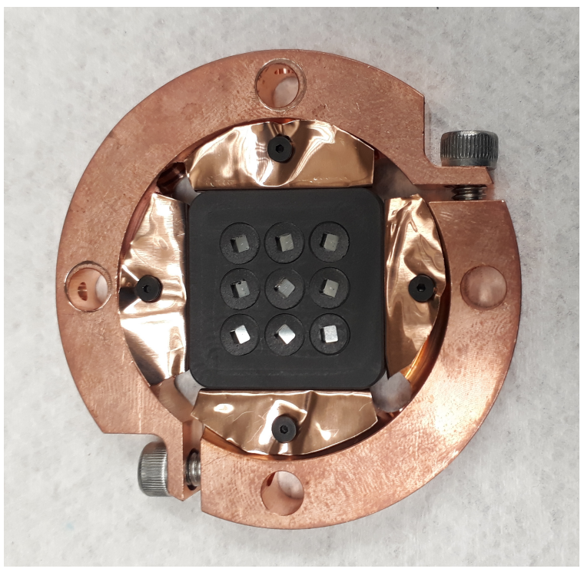
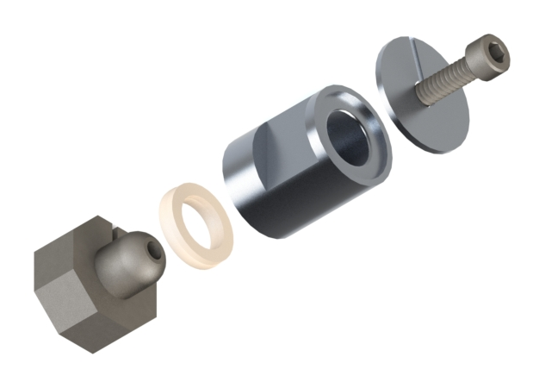

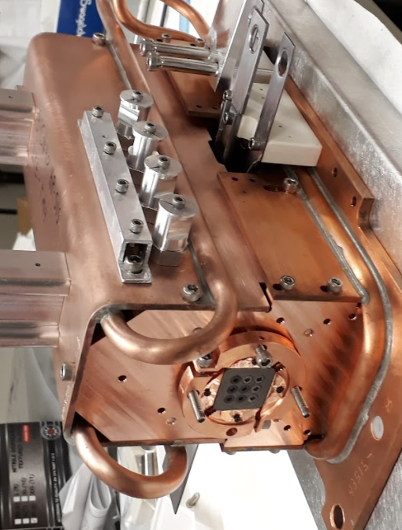
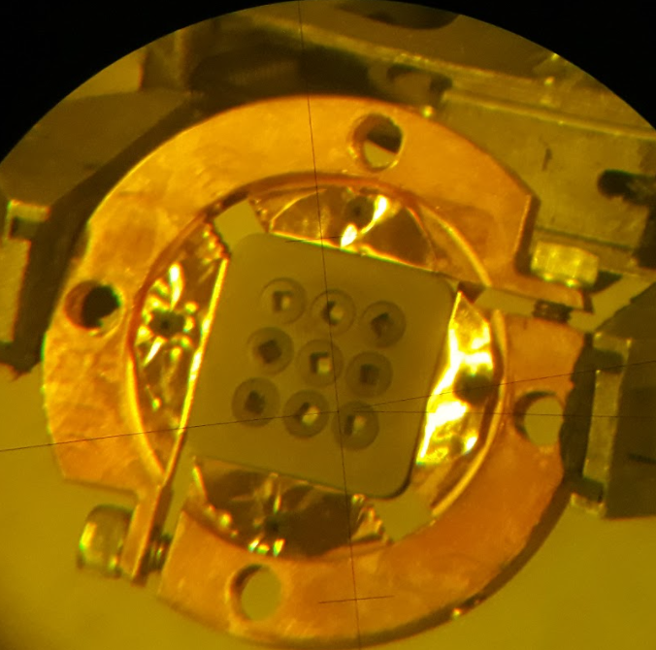
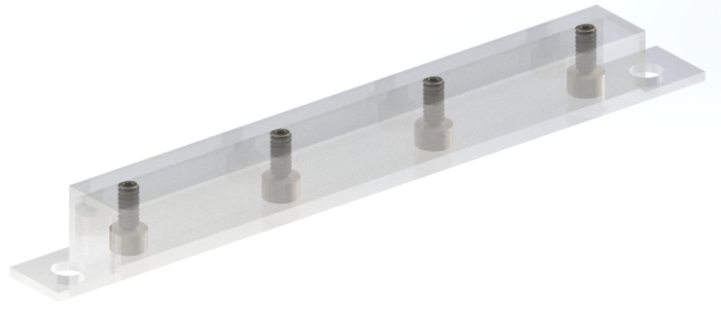
Secondary irradiation development
In-beam secondary target
Off-beam secondary assemblies
Ø=56
THK=7
Future ARIEL targets aim to use coaxial spring-energized PEEK seals
3
The assembly can be leak checked post-irradiation in the hot-cell
(mm)
24
SPT samples
Ø=4
THK<1
In parallel, PEEK SPT samples are irradiated to similar doses

Slide 20
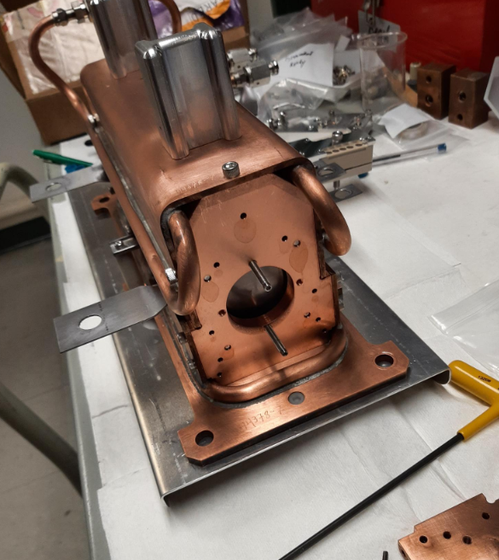
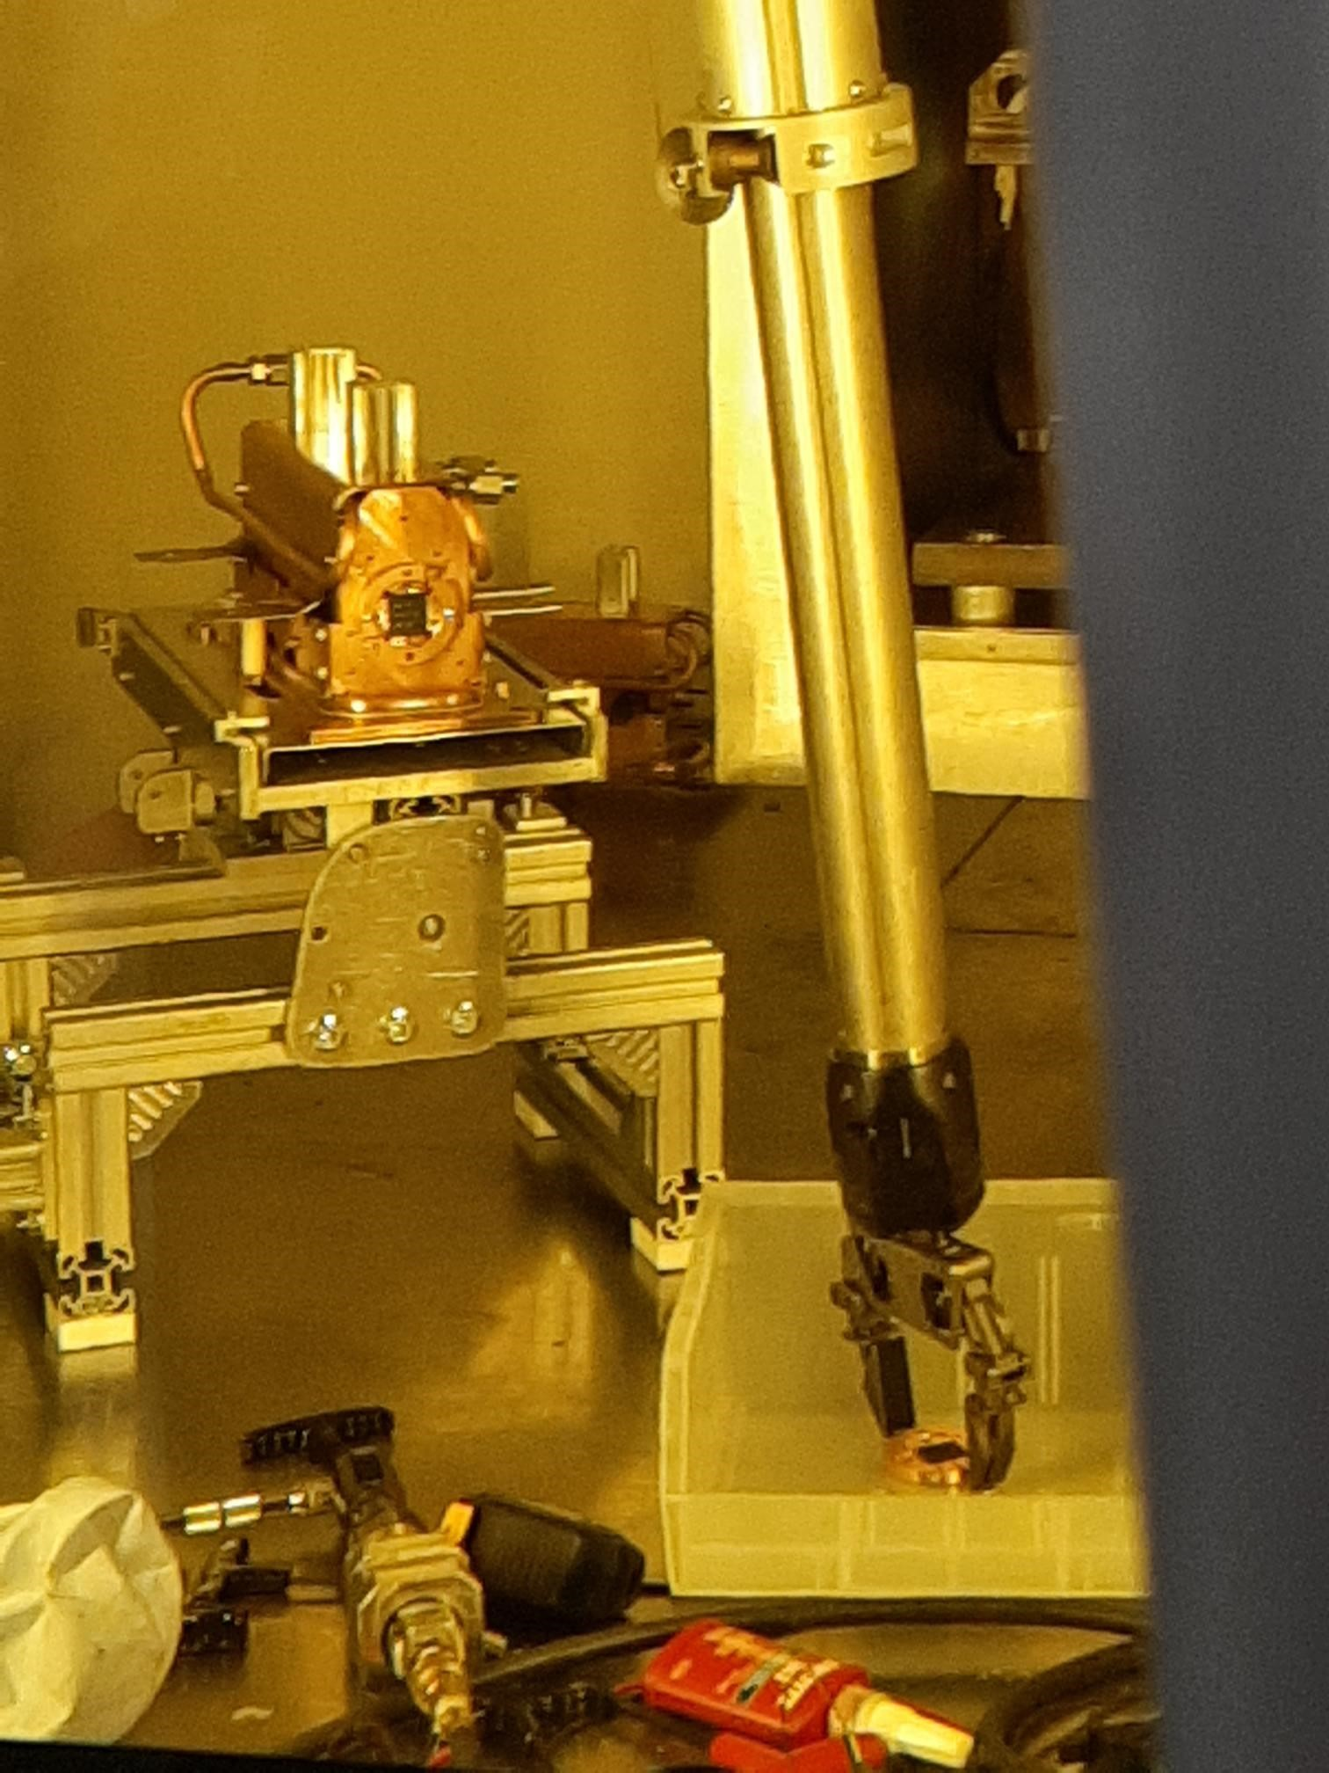
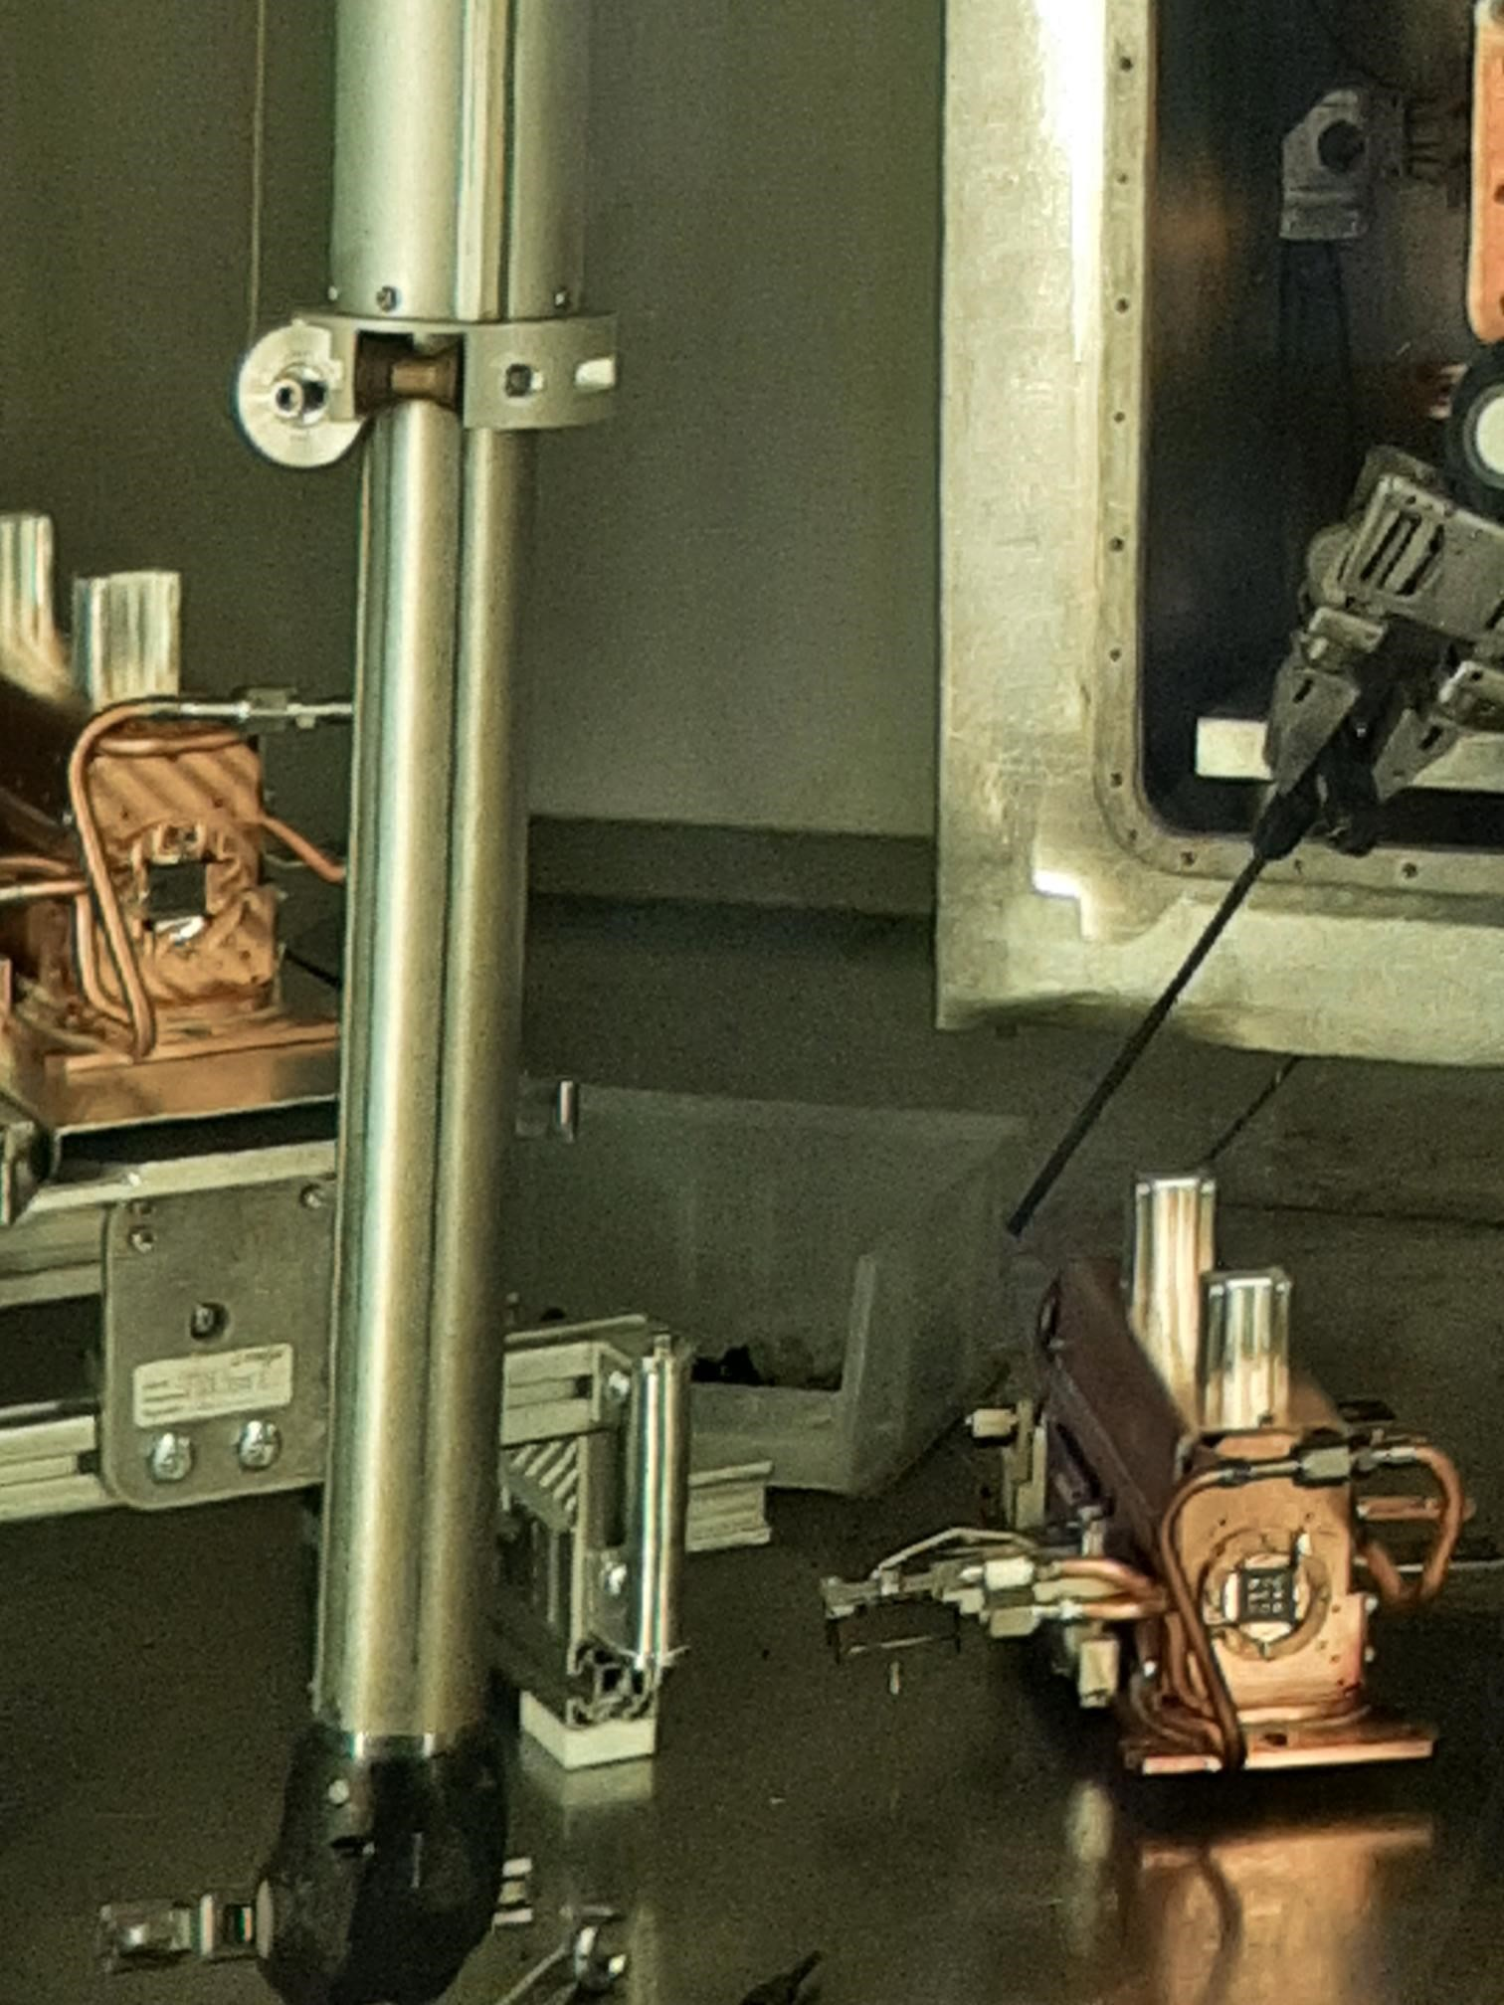
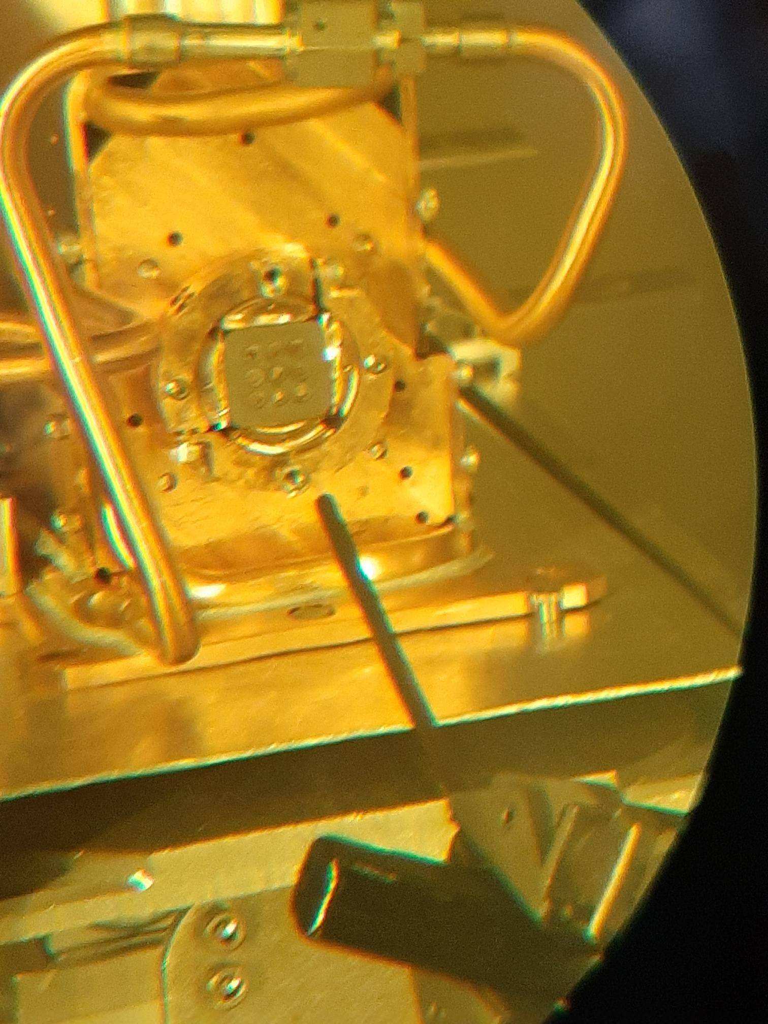
Secondary irradiation campaign
Secondary target # | Material | Total charge (mAh) | DPA-NRT max. | DPA-FLUKA max. | He (appm) max. | H (appm) max.
ST#1 | Al6061, AlSi10Mg (AM) | 2.9 | 0.025 | 0.014 | 8 | 10
ST#2 | Al6061, AlSi10Mg (AM) | 33.3 | 0.48 | 0.28 | 142 | 190
ST#3 | SS316L, CrMnFeCoNi (HEA) | 40.6 | 1.76 | 0.77 | 187 | 530
ST#4 | SS316L, CrMnFeCoNi (HEA) | 11.8 | 0.46 | 0.28 | 44 | 125
ST#5 | CrFeCoNiCu (HEA), CrMnFeNi (HEA) | 13.9 | 0.51 | 0.23 | 42 | 117
ST#6 | CuCrZr | 79.0 | 5.99 | 2.58 | 417 | 1135
ST#7 | SS310, 800H | 22.7 | 0.87 | 0.38 | 86 | 256
ST#8 | Cu (AM) | 22.7 | 1.31 | 0.57 | 90 | 246
ST#9 | Al6061 | 4.2 | 0.05 | 0.03 | 16 | 21
ST#10 | SS316L | 28.8 | 1.88 | 0.81 | 223 | 629
ST#11 | Al6061 | 28.8 | 0.44 | 0.24 | 136 | 182
ST#12 | SS316L | - | - | - | - | -
ST#13 | Ta (AM) | 45.2 | 3.13 | 1.09 | 292 | 373
ST#14 | TRISO, Ni-alloys | 45.2 | 2.7 | 1.19 | 254 | 909
ST#15 | ZrC | 27.0 | 1.34 | 0.54 | 98 | 187
2021
week\month | June | July | August | September | October | November | December
1 |  | UC#33 ST#2 | Ta#62 ST#3 | UC#34 | Shutdown | UC#35 | Ta#63 ST#5
2 |  |  |  |  | Shutdown
3 | UC#32-p2n ST#1 |  |  | SiC#41 ST#4 | C#3 | UC#36
4
2022
week\month | June | July | August | September | October | November | December
1 | UC#37-p2n | Ta#64 ST#7 ST#8 | UC#38 | SiC#44 | Shutdown |  | UC#41
2 |  |  |  |  | Shutdown
3 | SiC#43 ST#6 |  |  | UC#39 ST#9 | C#4 ST#10 ST#11 | UC#40 ST#12
4
2023
week\month | June | July | August | September | October | November | December
1 | TiC#5 |  | UC#42 | Nb#11 ST#15 | Shutdown
2 |  |  |  |  | Shutdown
3 | TiC#6 | TiC#6 |  | Ta#65
4 | SiC#45 ST#13 ST#14 |  |  |  | Ta#66 | UC#43

Slide 21
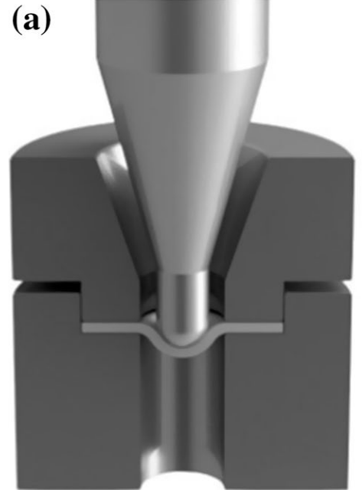
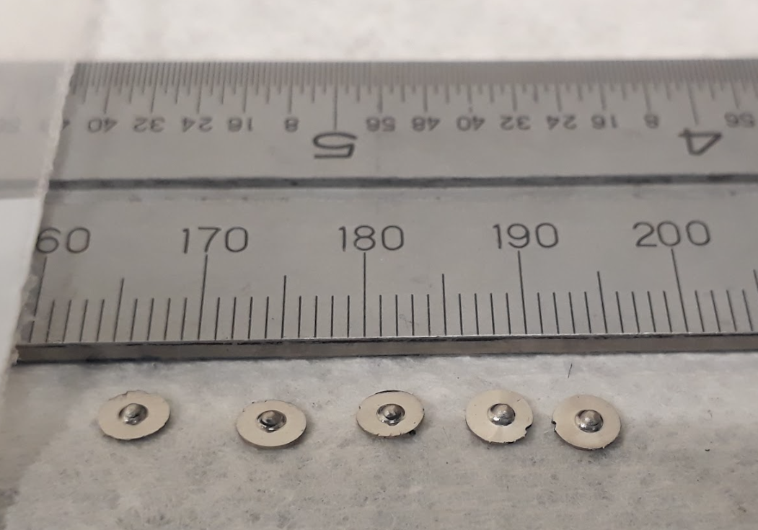
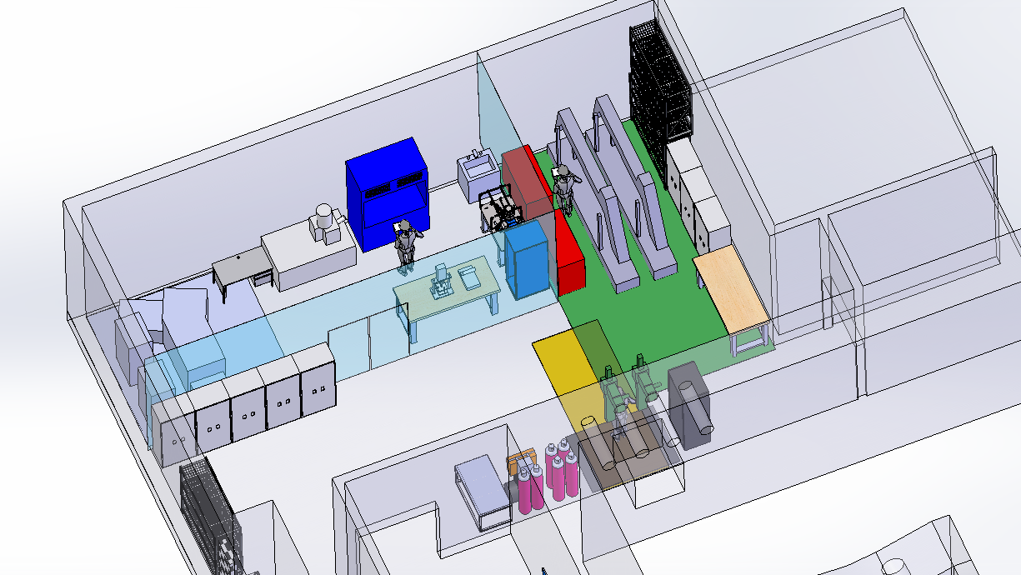
Post-Irradiation Examination
Characterization tools:
Mechanical: Actuator up to 4.5kN, Small punch test stage
Microscopy: TEM (not yet commissioned), SEM
Others: Thermal conductivity, isotope release studies
Access to additional characterization tools and sample preparation with CNL
SPT technique
Punched SS310 samples
Plan for PIE laboratory
Arunkumar, S. Met. Mater. Int. 26, 719–738 (2020).

Slide 22
Outline
Results: FeCrMnCoNi vs SS316L
  Mechanical characterization
  TEM analysis, preliminary

Slide 23
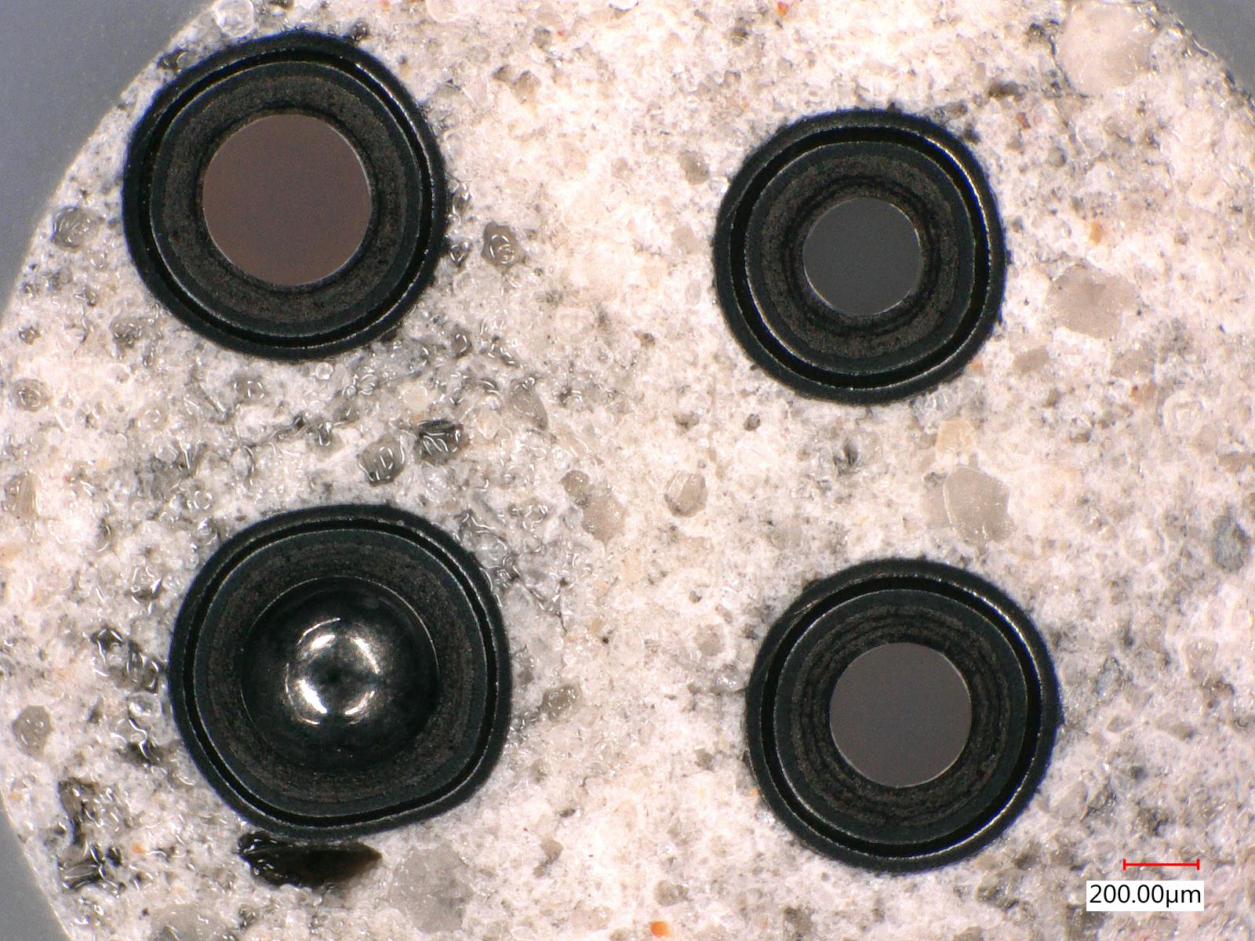
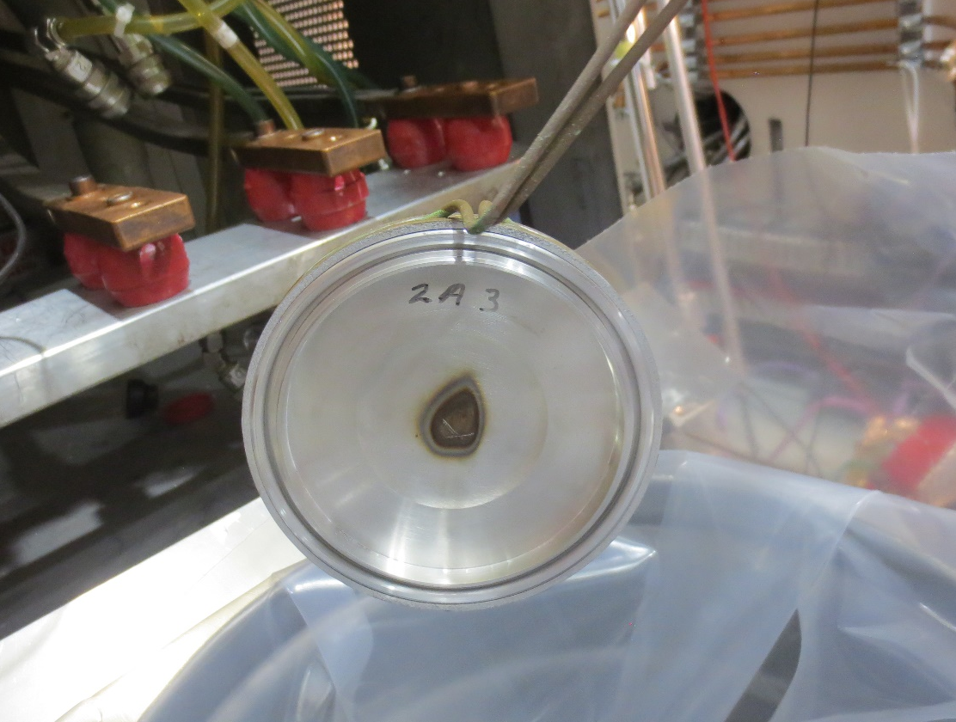
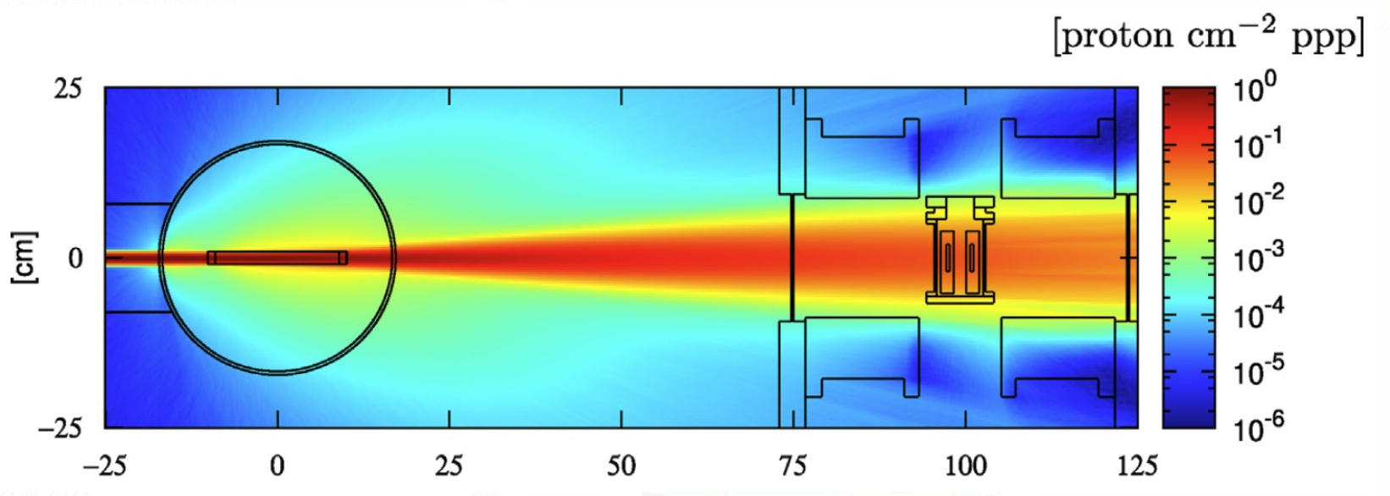
Future work
  Collaboration with Canadian Nuclear Laboratories (CNL)
  Development of a temperature control stage
  High temperature irradiations (~1000degC)
  PIE
  Development of PIE lab
  TEM installation
  ISAC Al6061 beam windows
  Two windows recovered:
  6.5 DPA-NRT, 2050 appm He
  9 DPA-NRT, 2830 appm He
Cement embedded TRISO particles
  ARIEL
  Secondary irradiation positions available
R.S. Augusto et al., Radiation Physics and Chemistry 201 (2022) 110491

