Slide 1
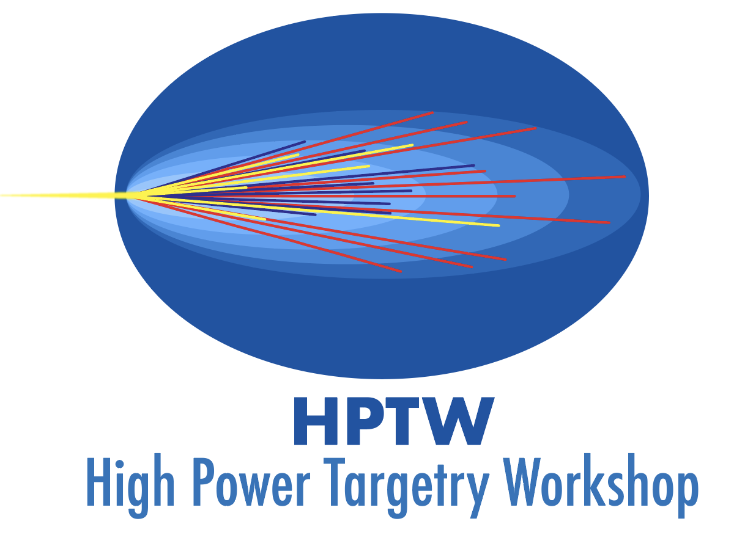
HPTW 2026
Marco Calviani & Thierry Stora (CERN)
6-10 November 2023

Slide 2
CERN has the honour to host the next High Power Targetry Workshop event, in spring 2026

Slide 3
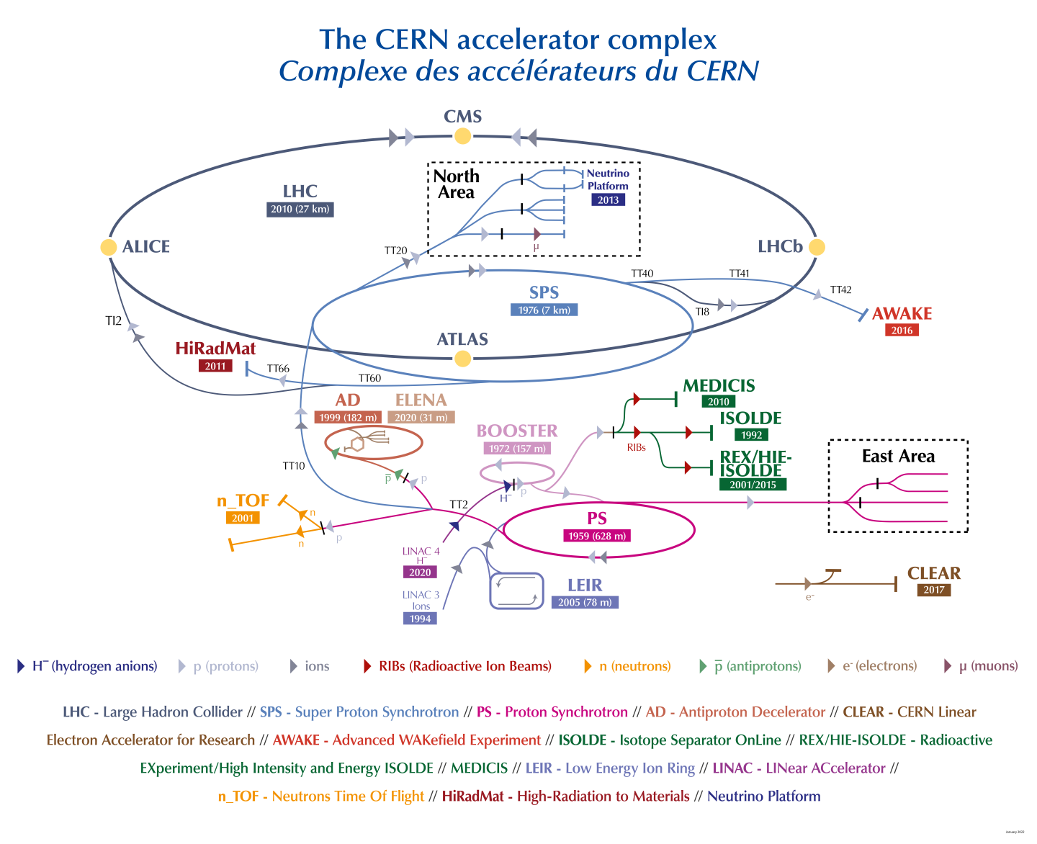
A laboratory for people around the world
Users
6642 from Member States
422 from Associated Member States
2917 from Observers
+ 1194 from non-Member States
http://dx.doi.org/10.17181/cds.2020780

Slide 4
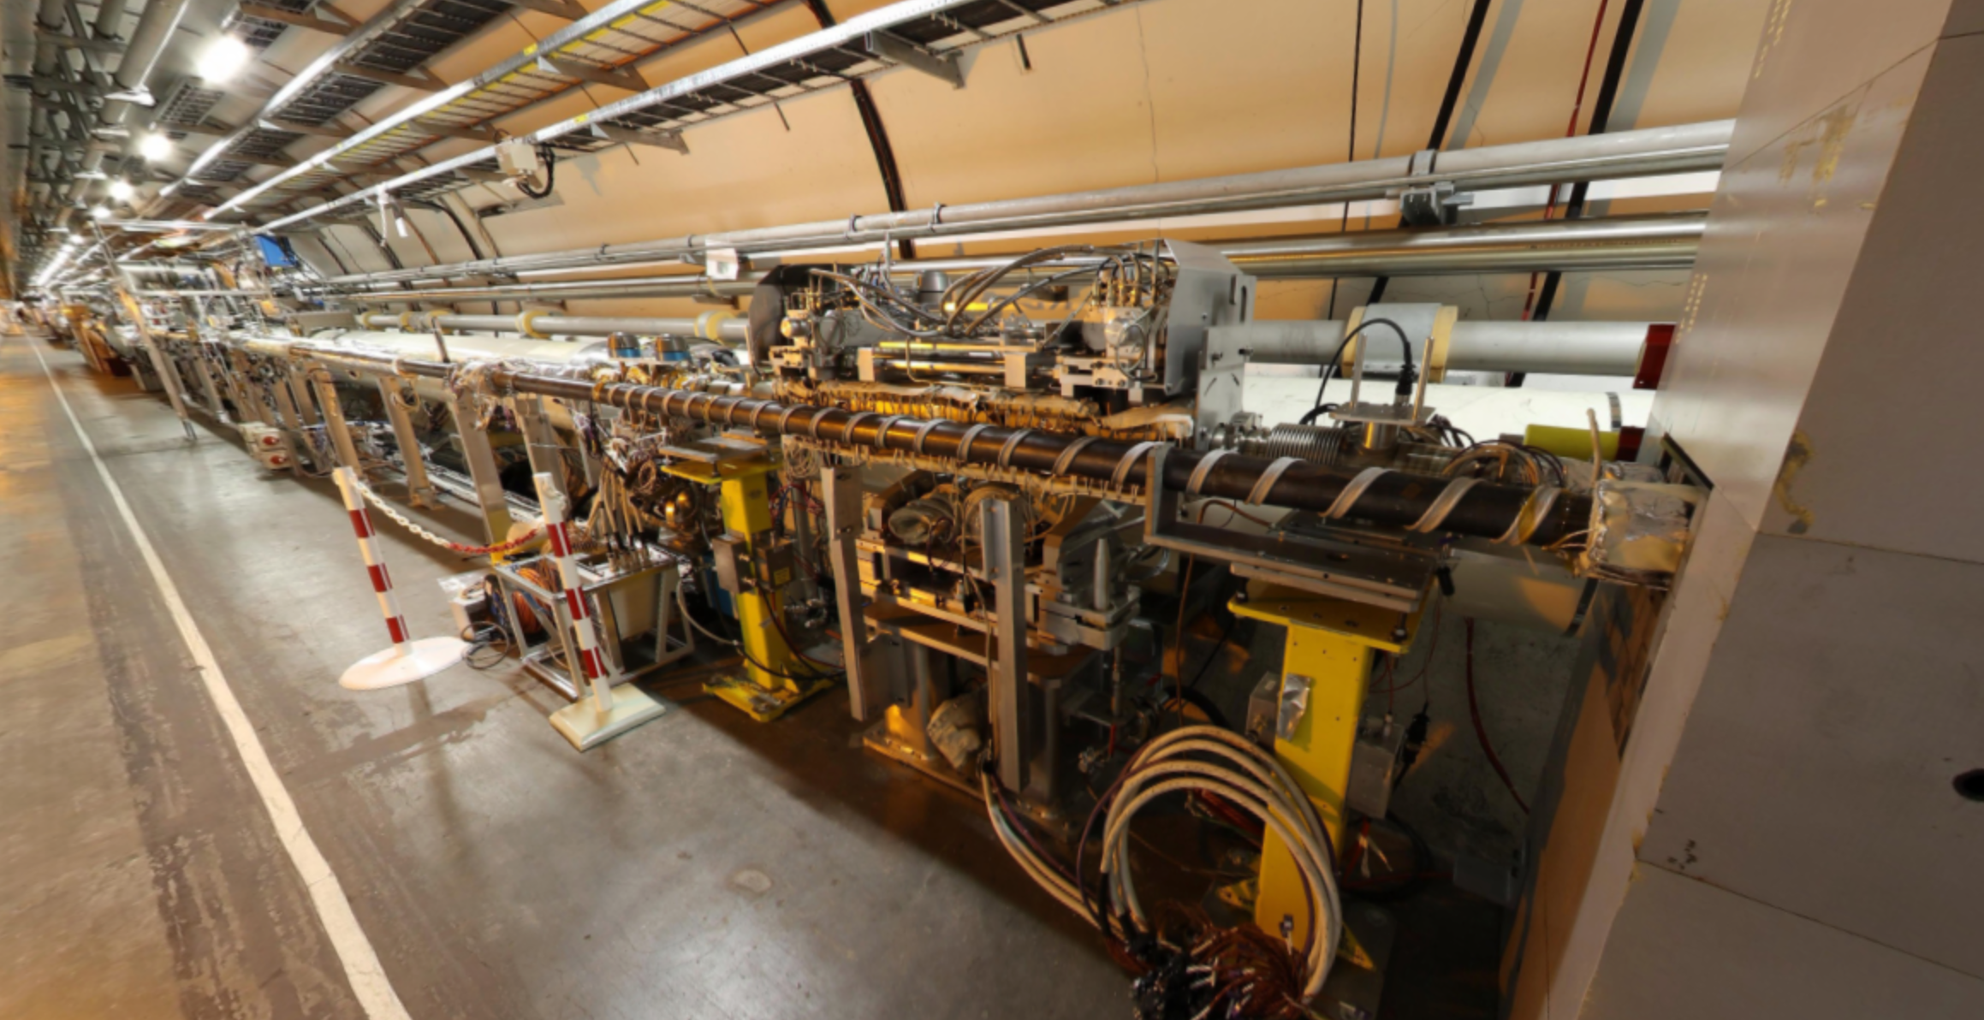
https://panoramas-outreach.cern.ch/index.html

Slide 5
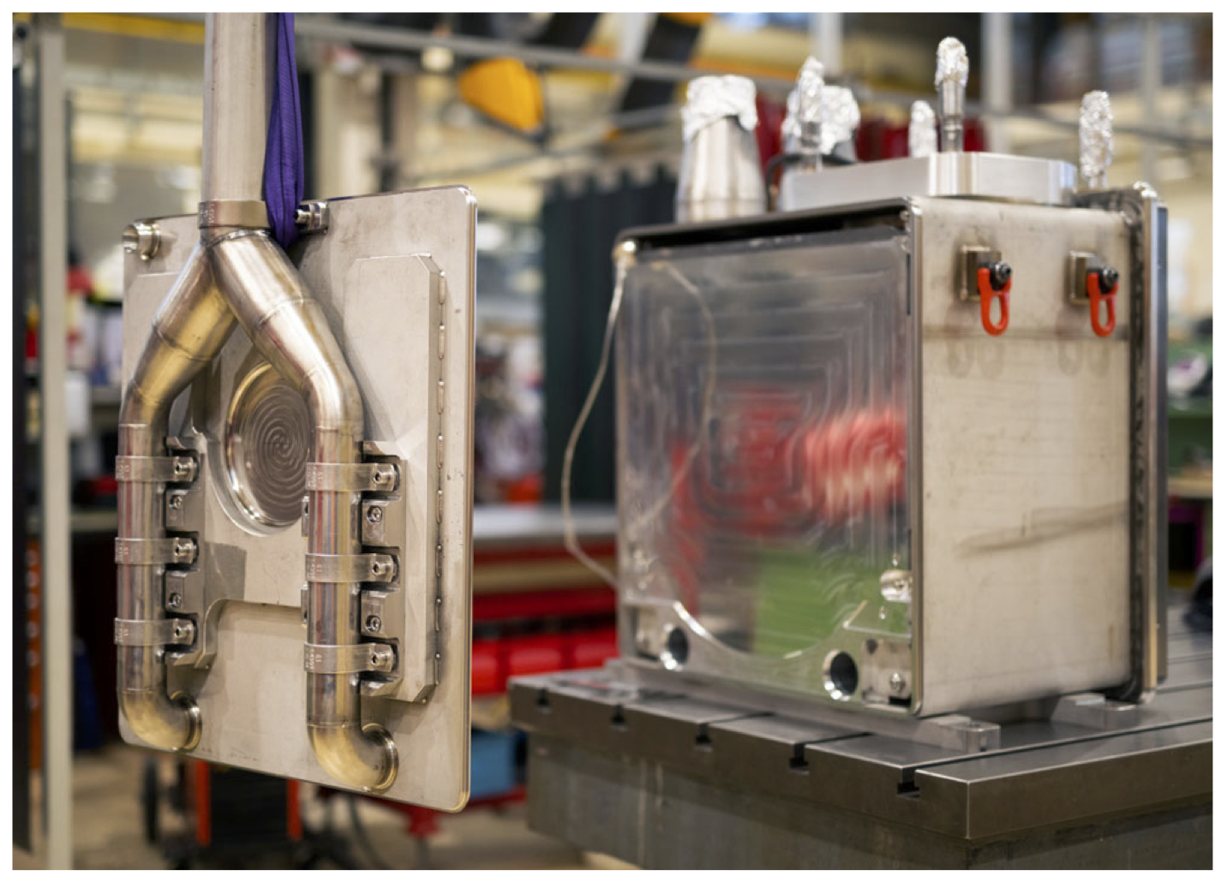
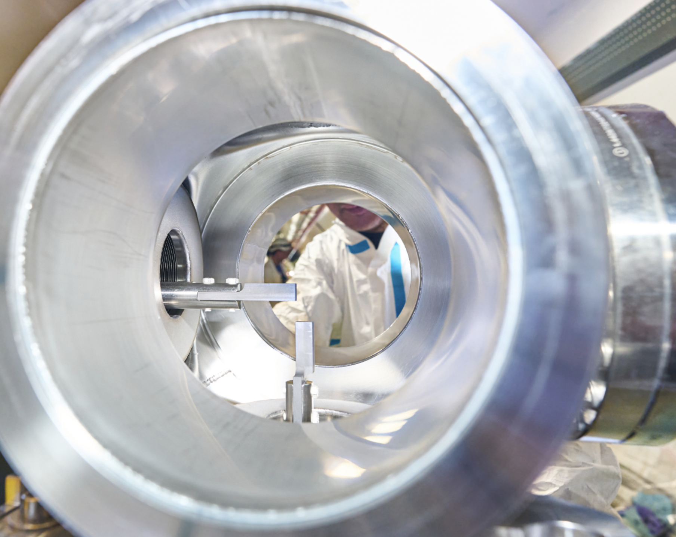
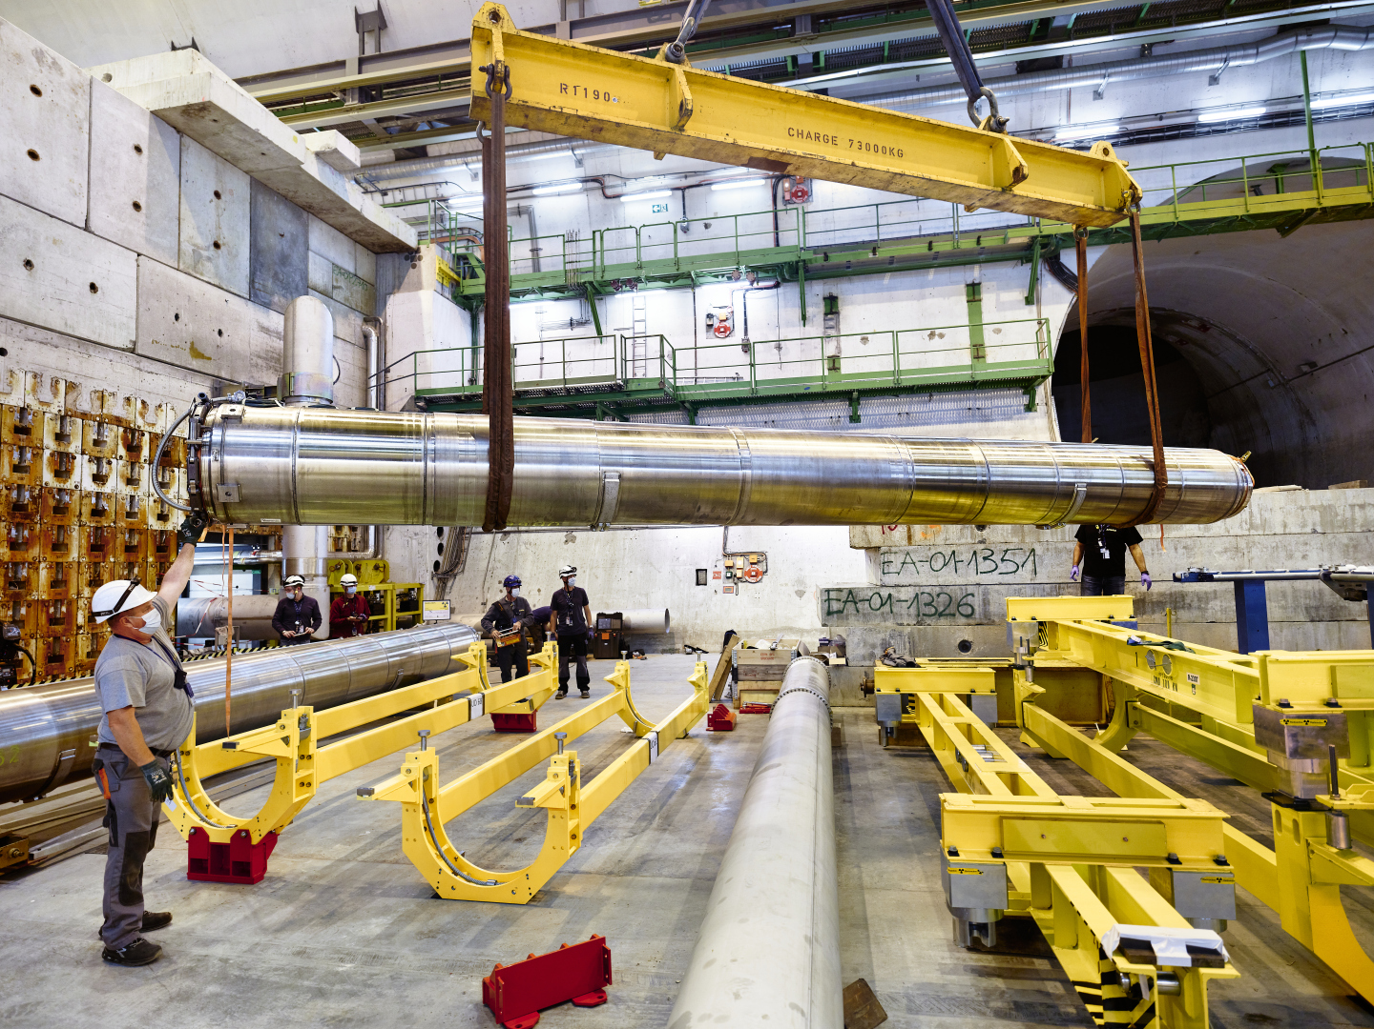
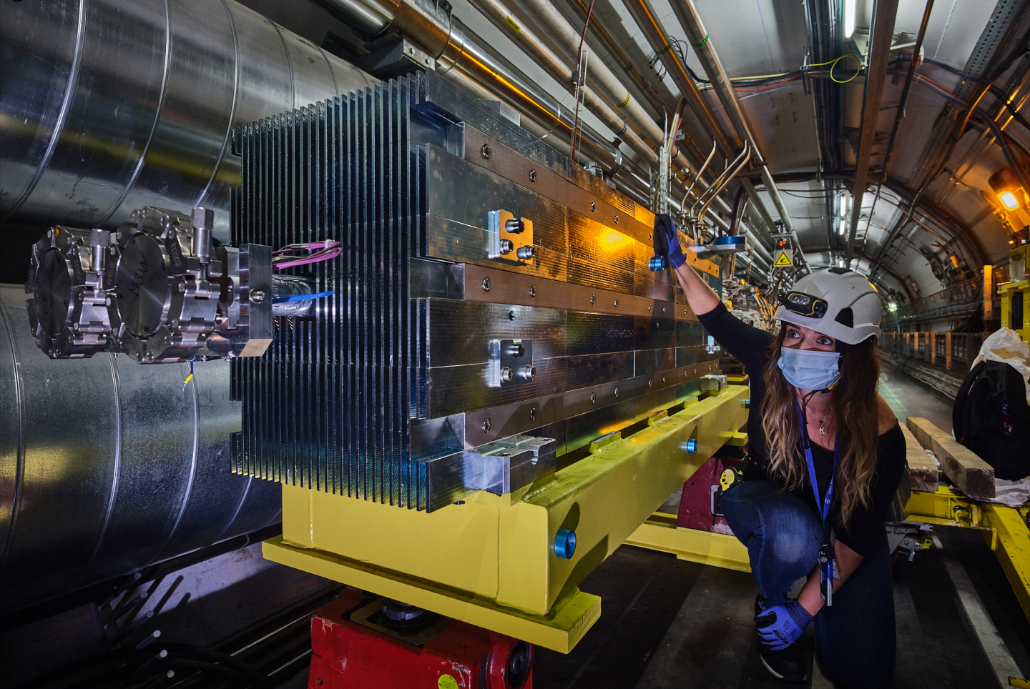
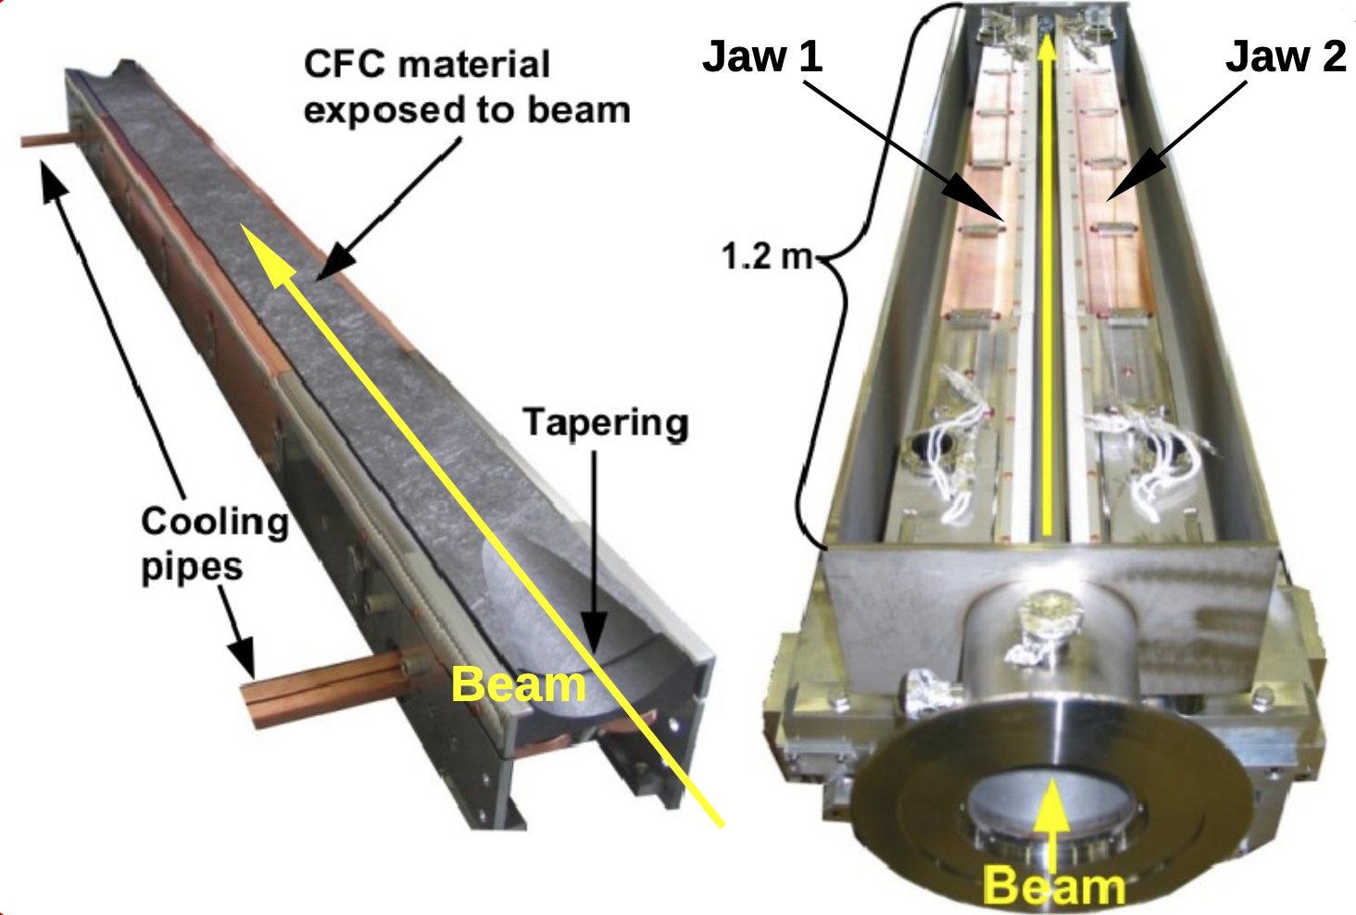
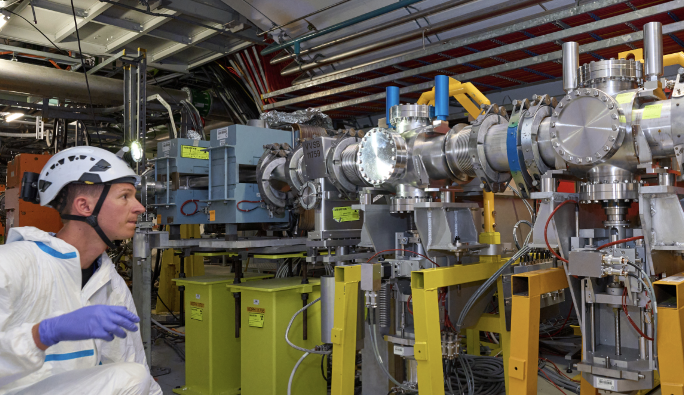
SPS scraper
SPS beam dump
LHC beam dump
Spallation target
LHC shower absorbers
LHC collimators

Slide 6
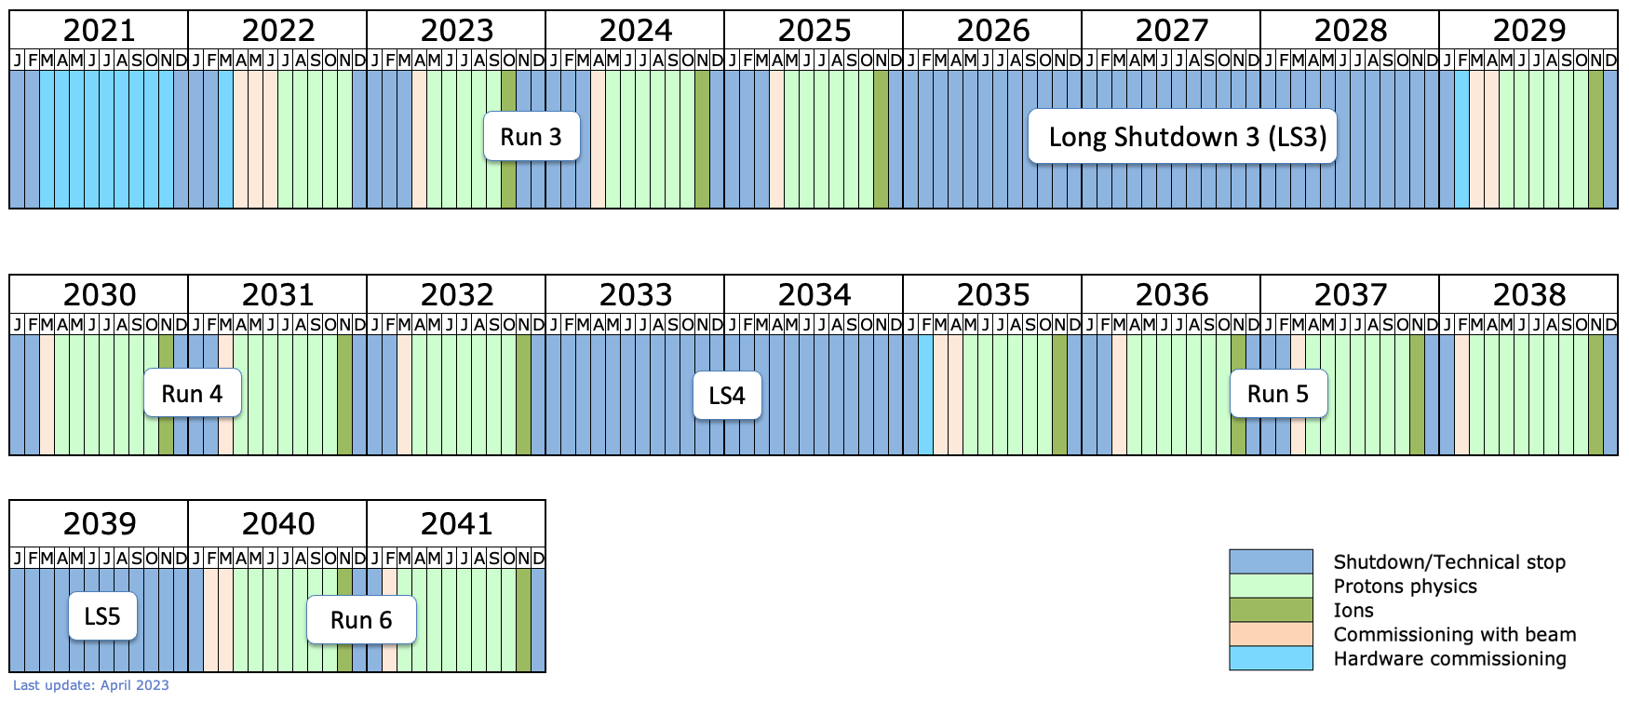
HPTW 2026 during CERN’s Long Shutdown 3
HPTW 2023
HPTW 2026
Would allow technical visits to be organized in underground areas

Slide 7
HL-LHC
The High-Luminosity LHC, operational by 2029, will increase the LHC’s integrated luminosity by a factor of 10
To achieve this major upgrade, scientists and engineers are optimising many of the collider’s parameters. Several new key technologies, some of which are completely innovative, are being developed within the scope of the project

Slide 8
Implementation of High-Luminosity LHC
Notes:
The High Luminosity Large Hadron Collider (HL-LHC) is an upgrade of the LHC which aims to achieve instantaneous luminosities a factor of 5 to 7.5 larger than the LHC nominal value, thereby enabling the experiments to enlarge their data sample by one order of magnitude during the 12 years of HL-LHC operation compared with the LHC baseline programme. Following five years of design studies and R&D, this challenging project requires about ten years of developments, prototyping, testing, series production and implementation; hence operation is expected to start at the end of this decade. The timeline of the project is dictated by the fact that, in the coming years, many critical components of the accelerator will reach the end of their lifetime due to radiation damage and will thus need to be replaced. The upgrade phase is therefore crucial not only for the full exploitation of the LHC physics potential, but also to enable operation of the collider beyond the end of the nominal LHC exploitation in 2025.
The HL-LHC will rely on a number of key innovative technologies, including cutting-edge Nb₃Sn and Nb-Ti superconducting magnets, compact superconducting crab cavities with ultra-precise phase control for beam rotation, new technology for beam collimation such as bent crystals, and high-power, loss-less MgB₂ superconducting links, to name only a few. A detailed description of the project and its technological and operational challenges is provided in the HL-LHC Technical Design Report and the HL-LHC book.

Slide 9
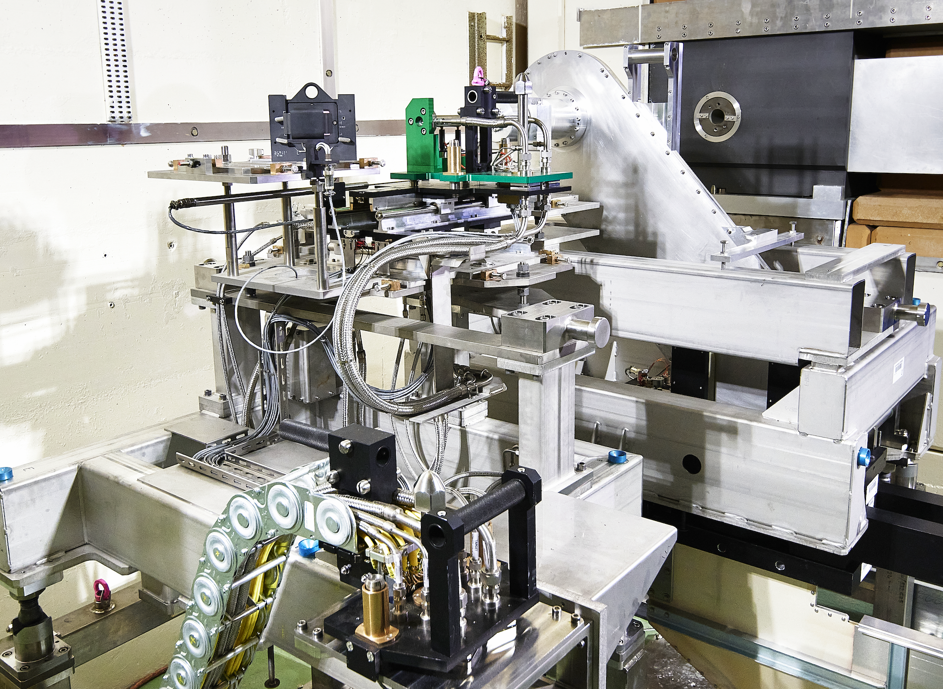
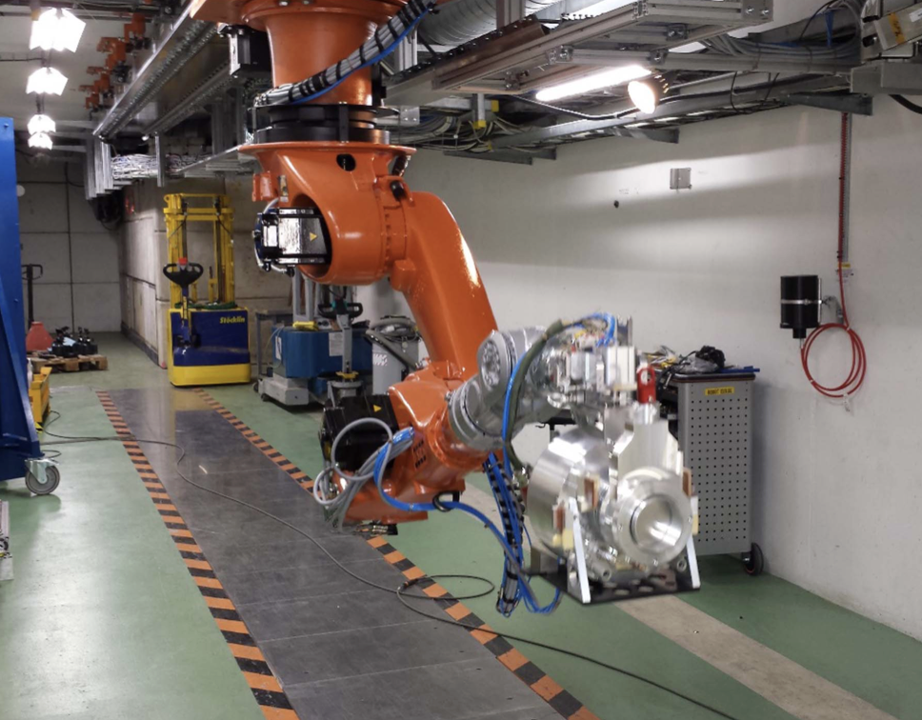
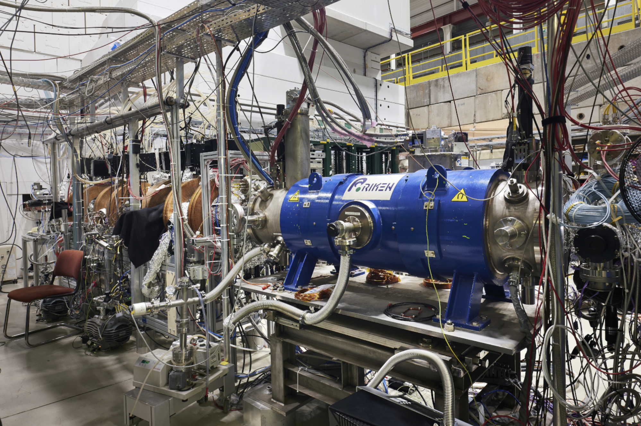
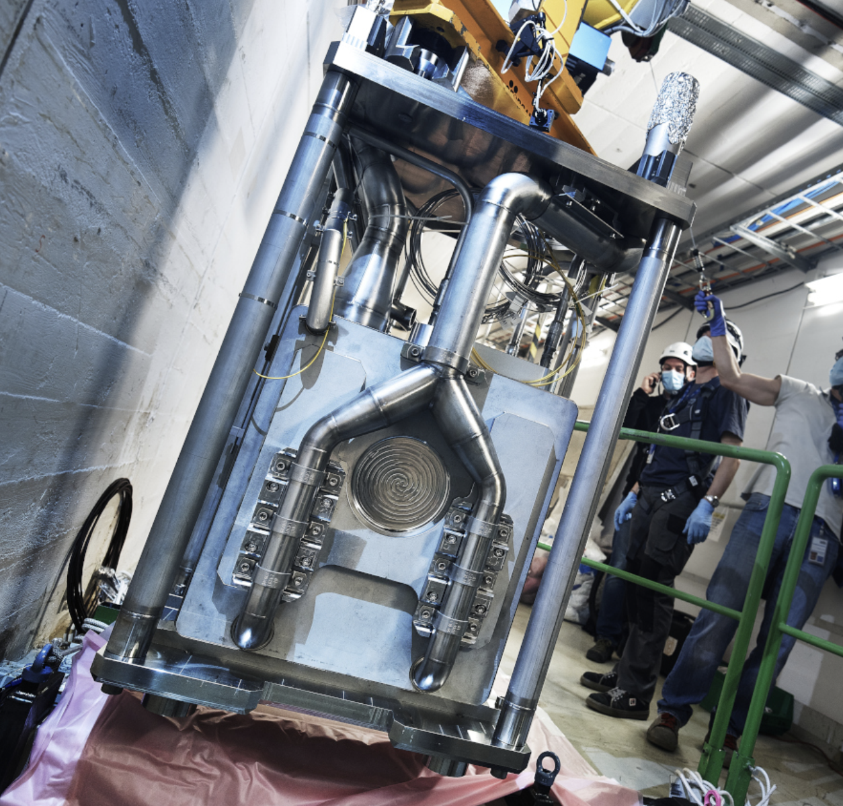
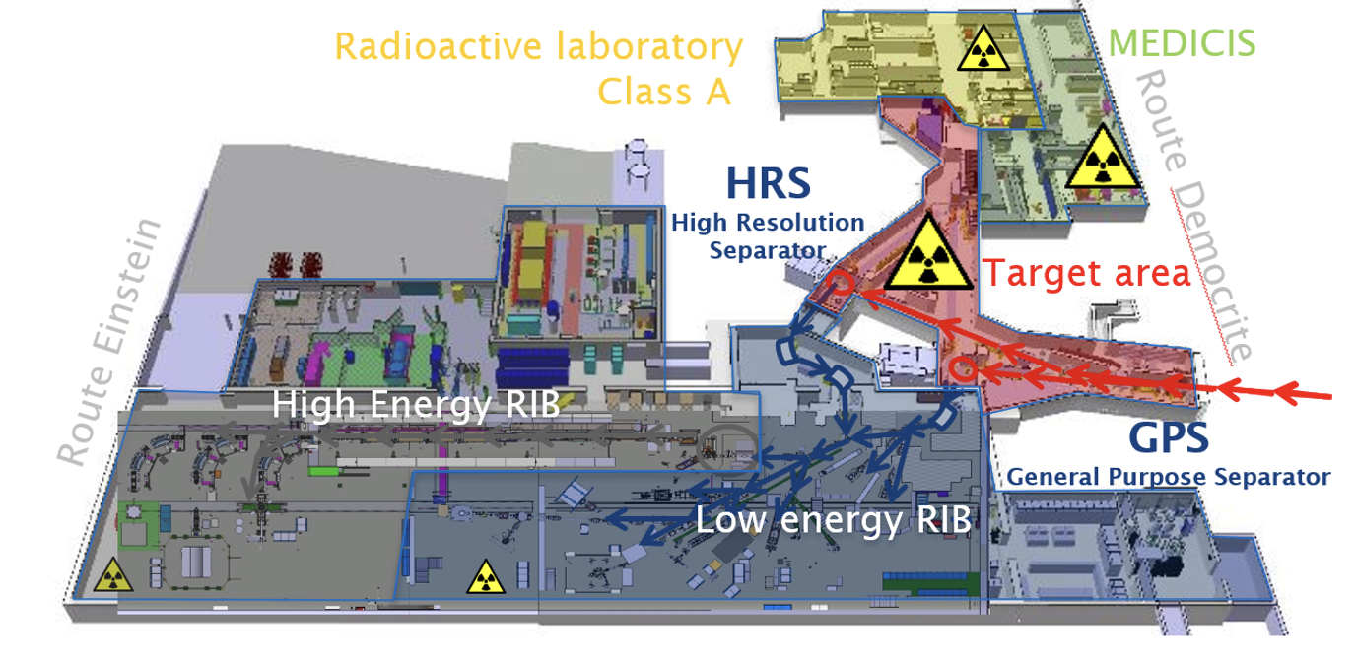
CERN injector fixed-target complex
Antiproton Decelerator
ISOLDE & MEDICIS
Radioactive Ion Beam & Medical Isotope Production
Neutron time-of-flight n_TOF

Slide 11
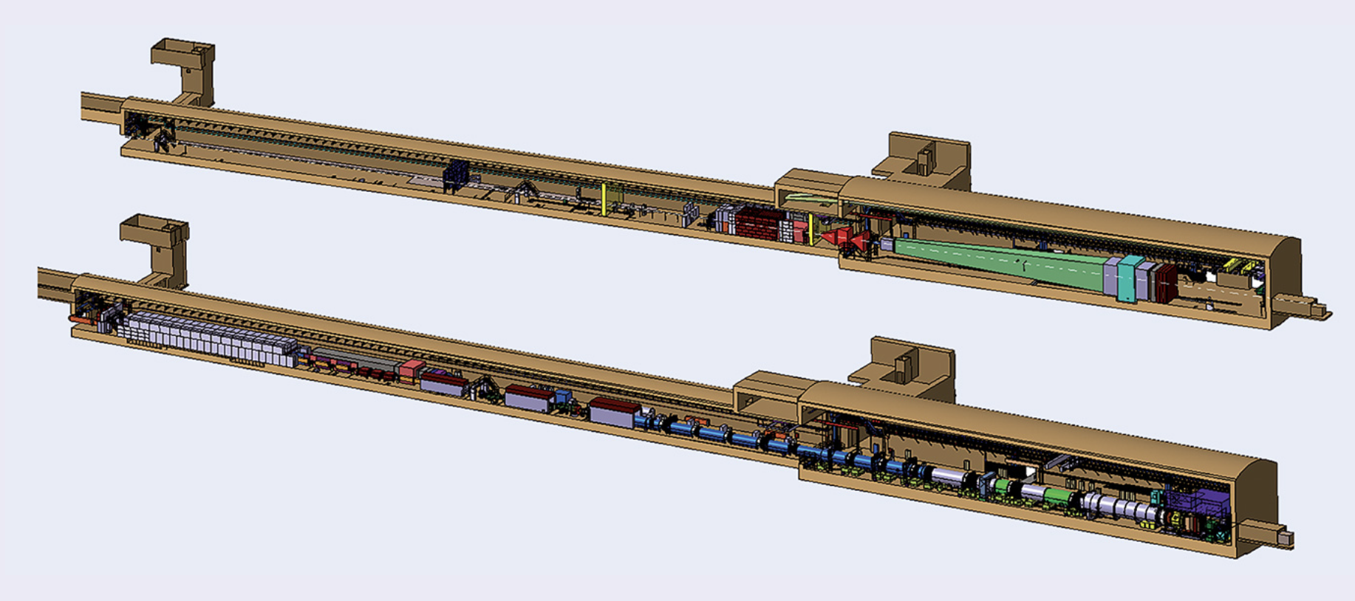
High-intensity fixed target facility
Study approved to deliver a Technical Design Report for a high intensity upgrade of the ECN3 experimental hall
Project approval expected for early 2024, together with the experiment selection – beam on target by 2030
Would require increase average power on target from ~20 kW up to 350 kW slowly extracted beam
260 m

Slide 12
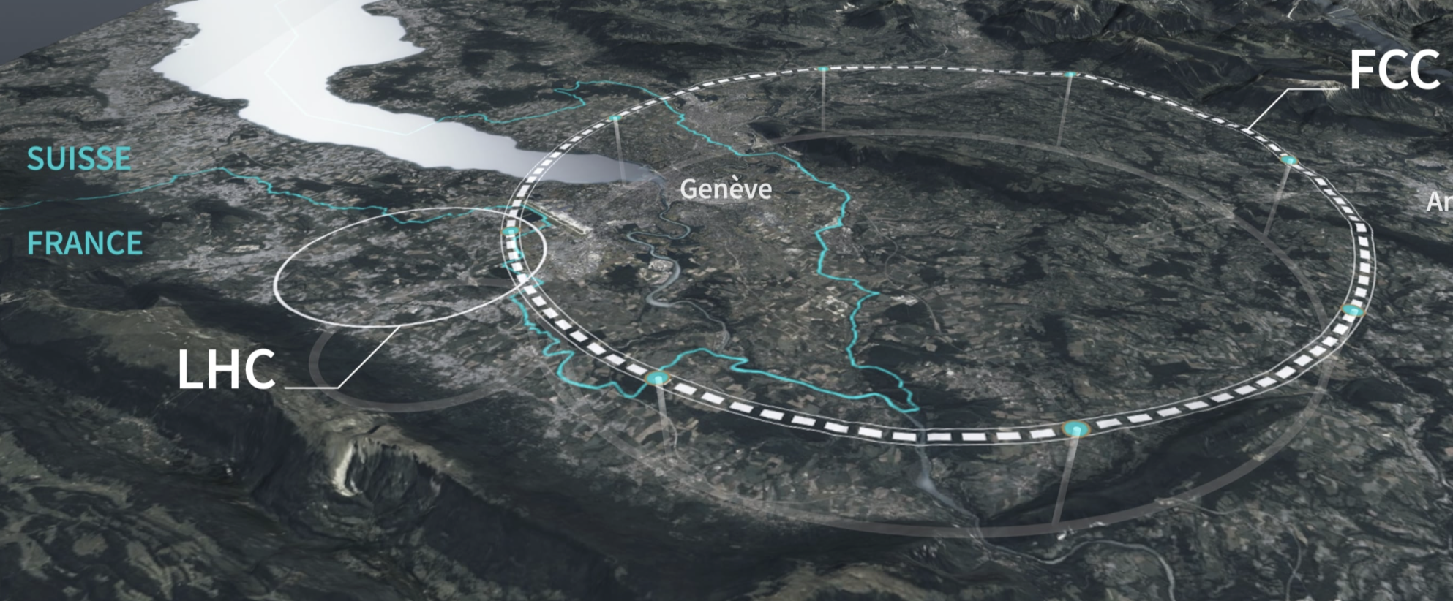
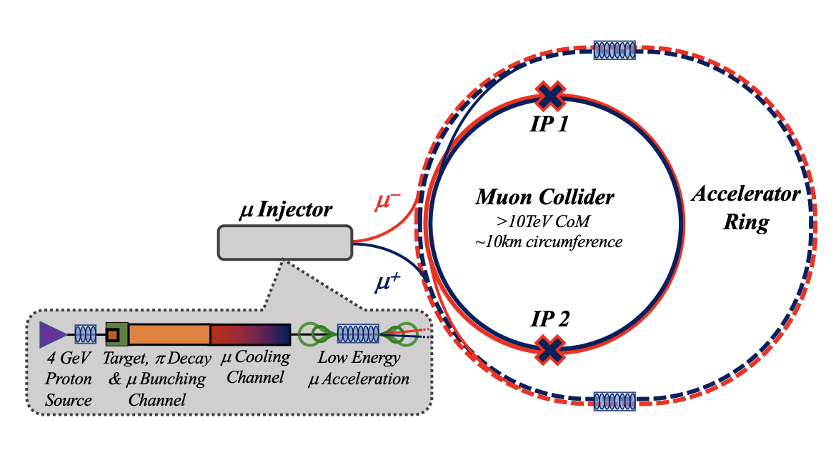
Future endeavour and R&D plans
~90 km
Muon Collider
Future Circular Collider

Slide 13
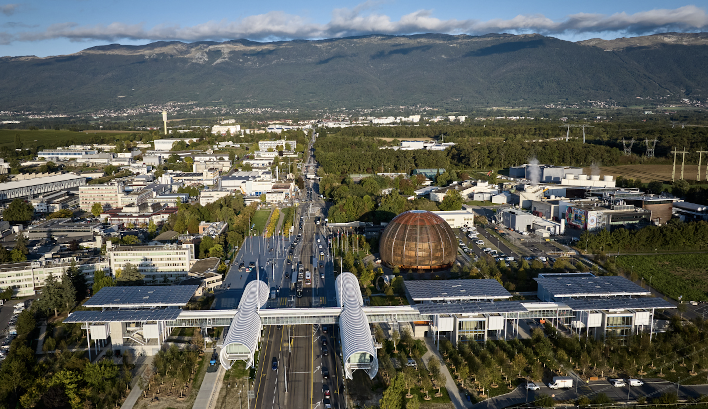
HPTW2026 will take place in spring 2026 in the iconic Science Gateway
CERN Meyrin site
(including hostel)
ATLAS & LHC P1
Auditorium
(HPTW2026)
Public transport to Geneva downtown

Slide 14
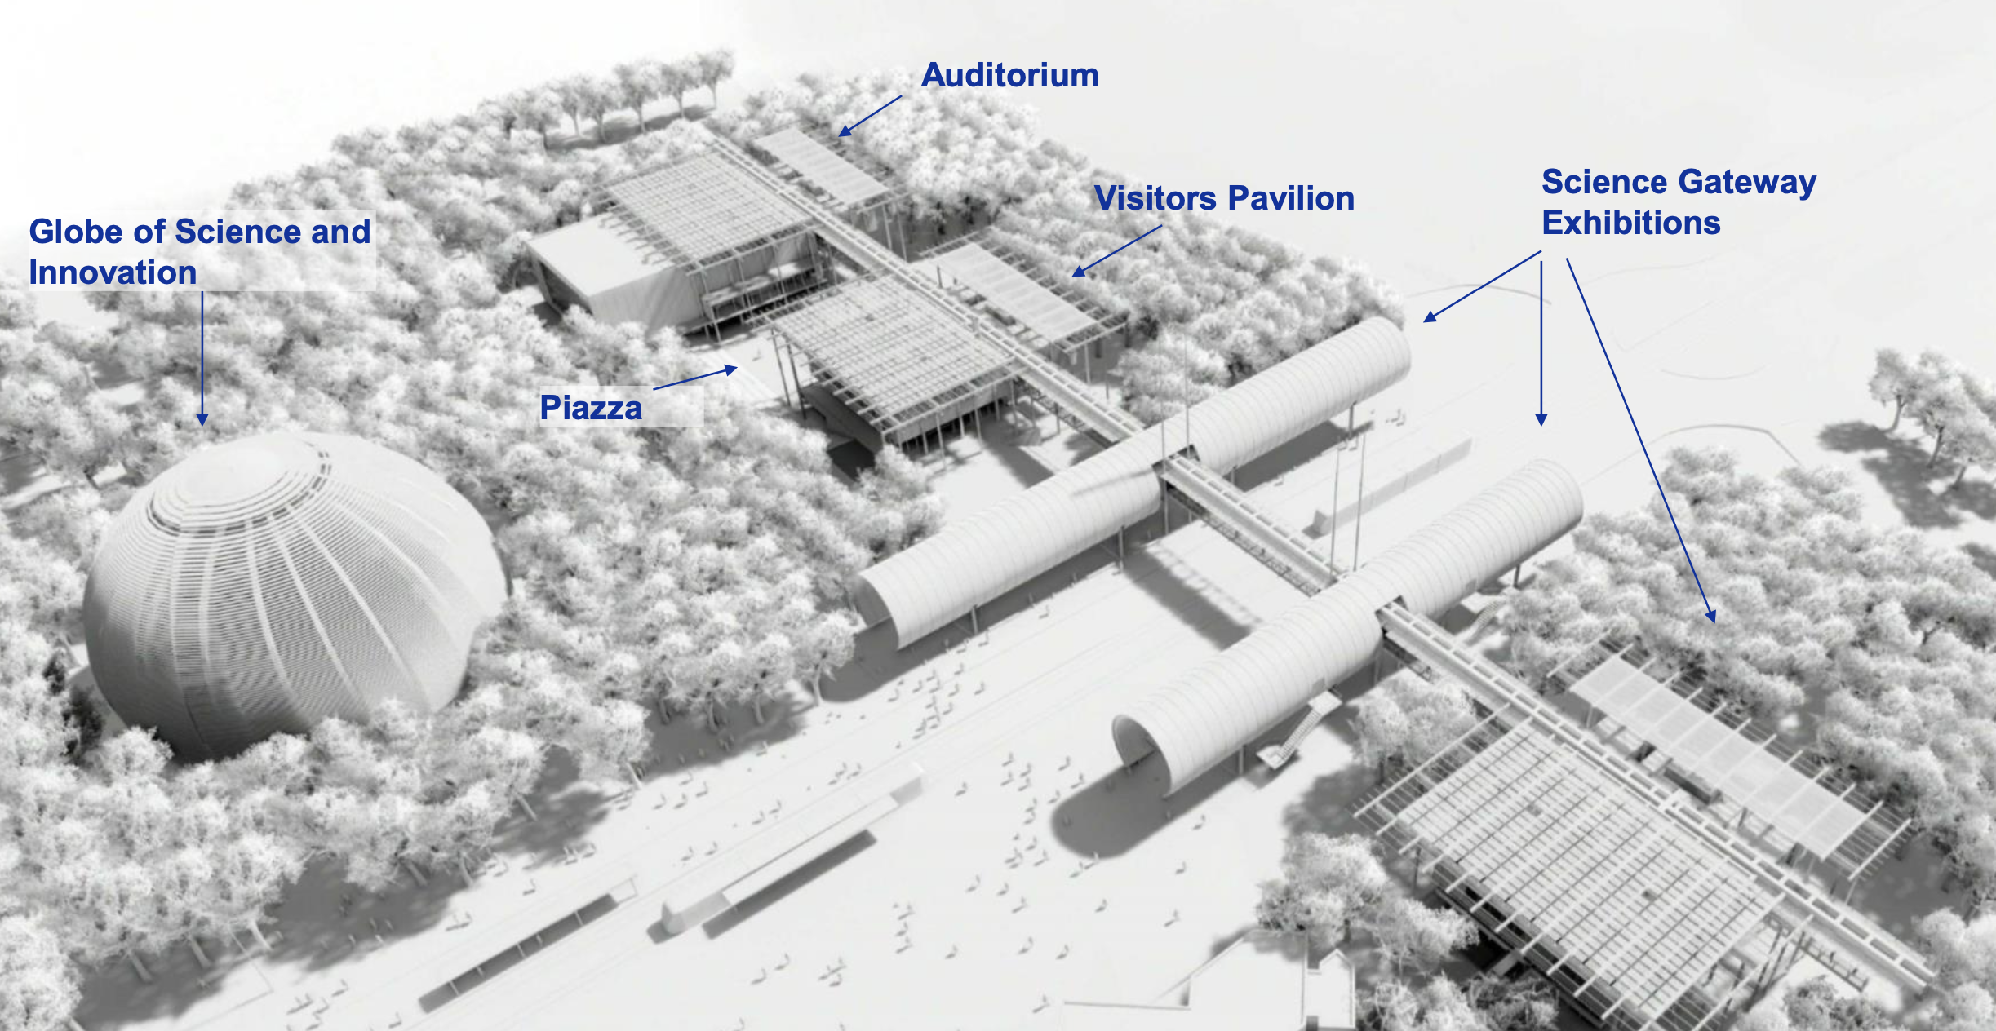

Slide 15
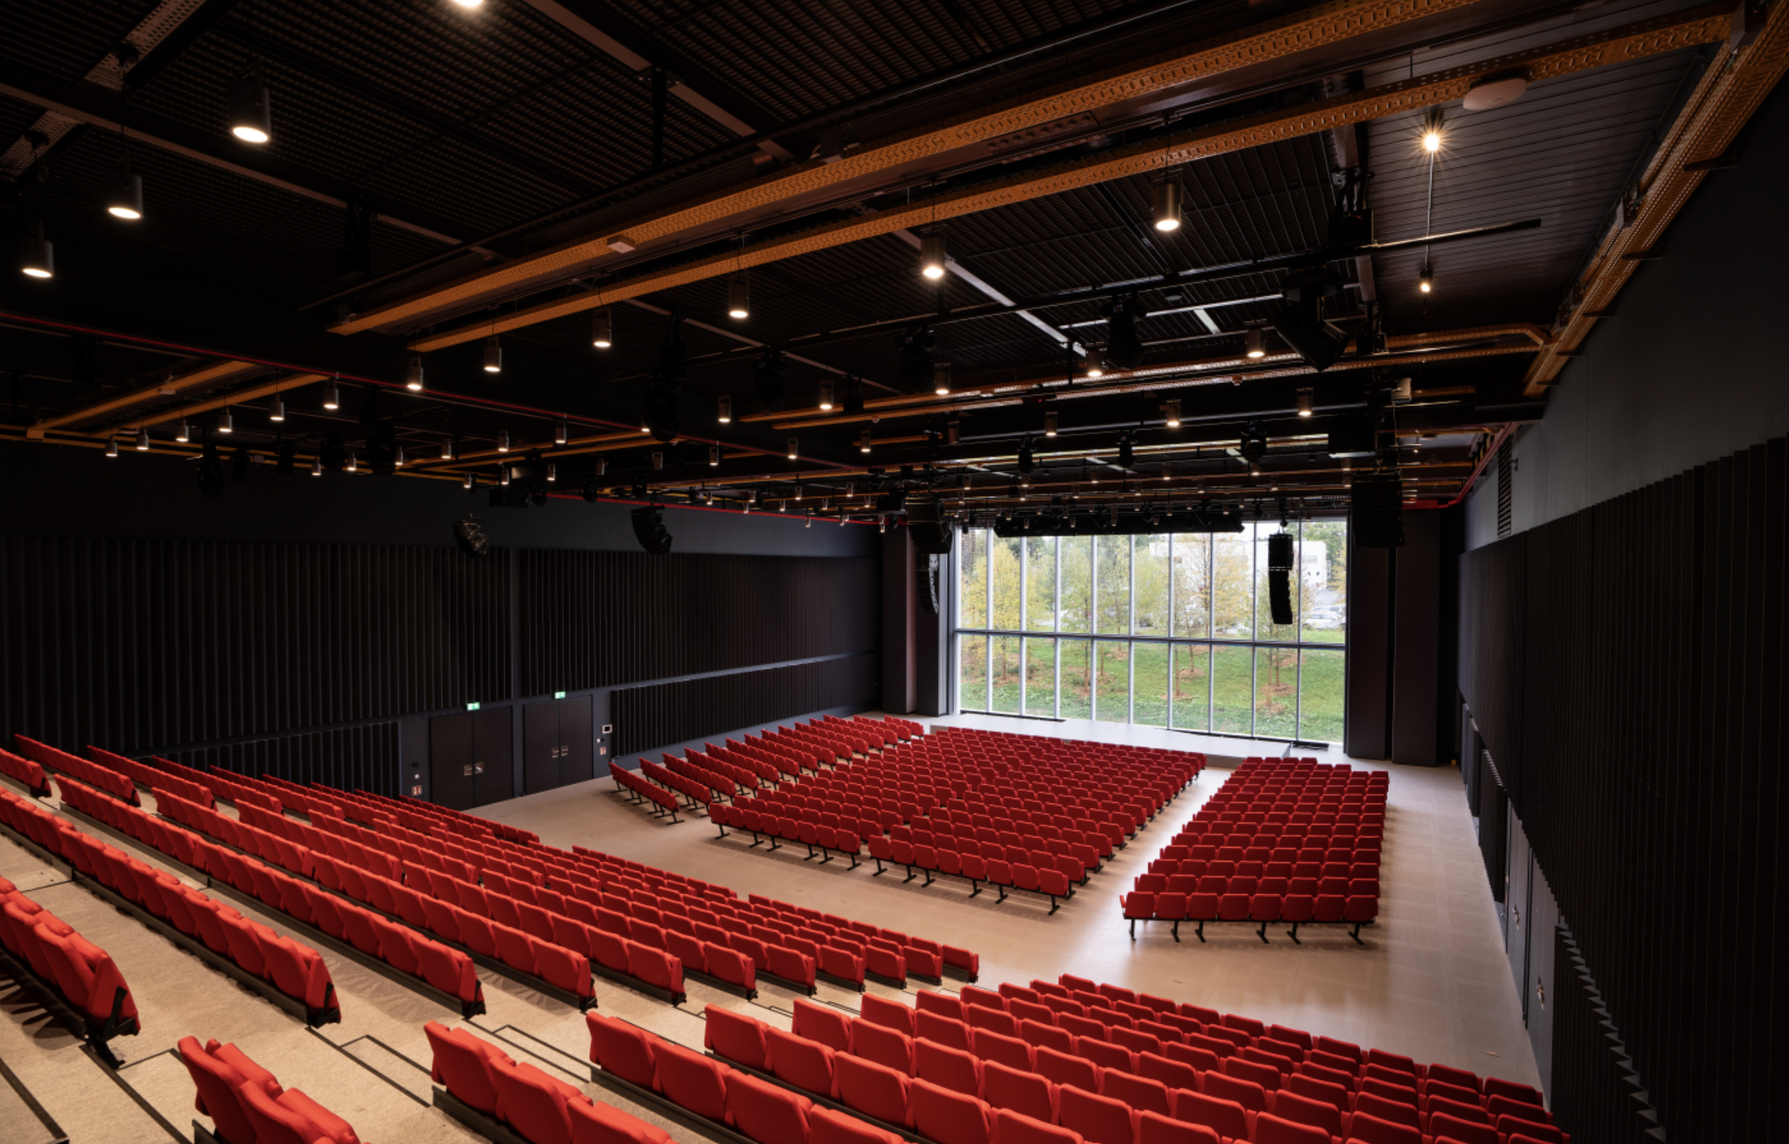
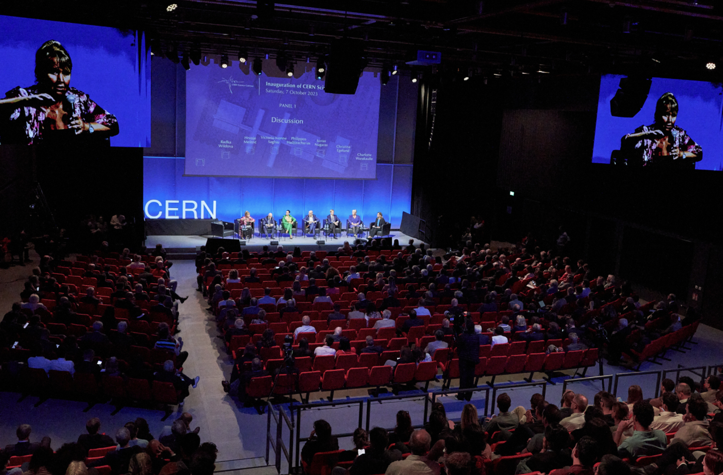
Science Gateway auditorium
Science Gateway inauguration 7th October 2023

Slide 16
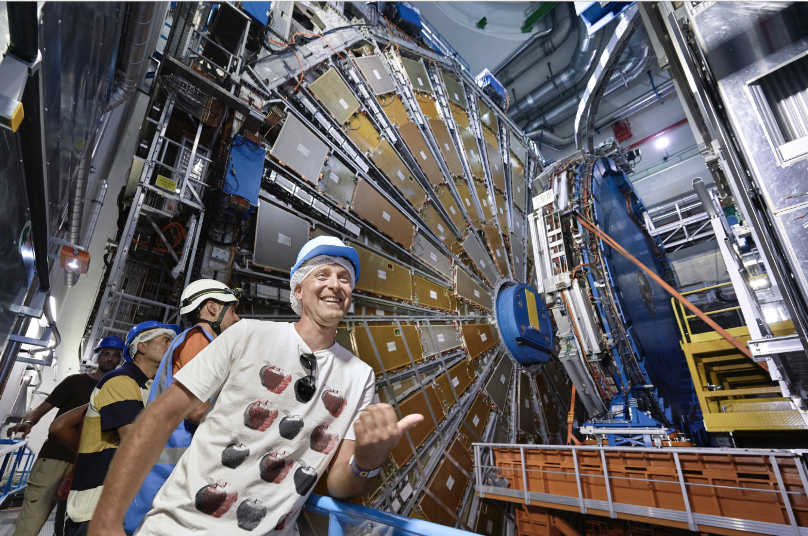
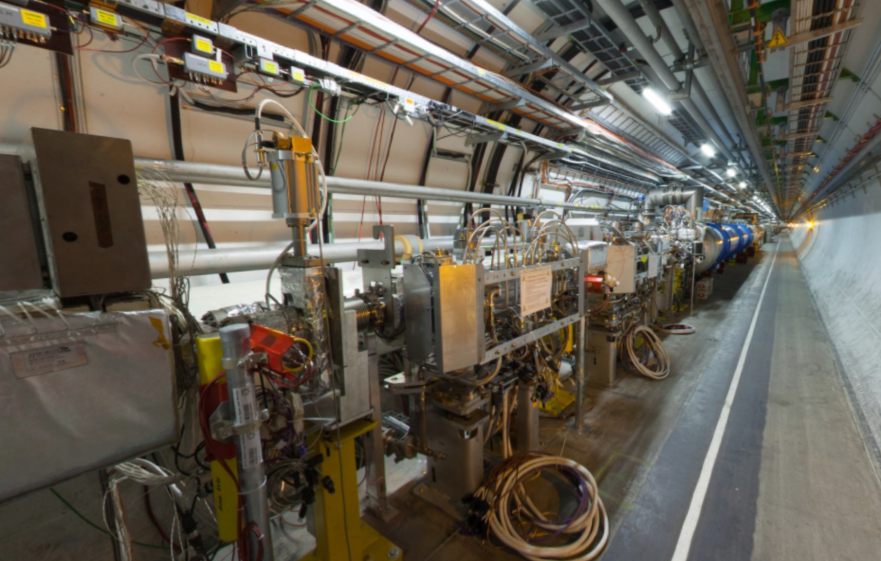
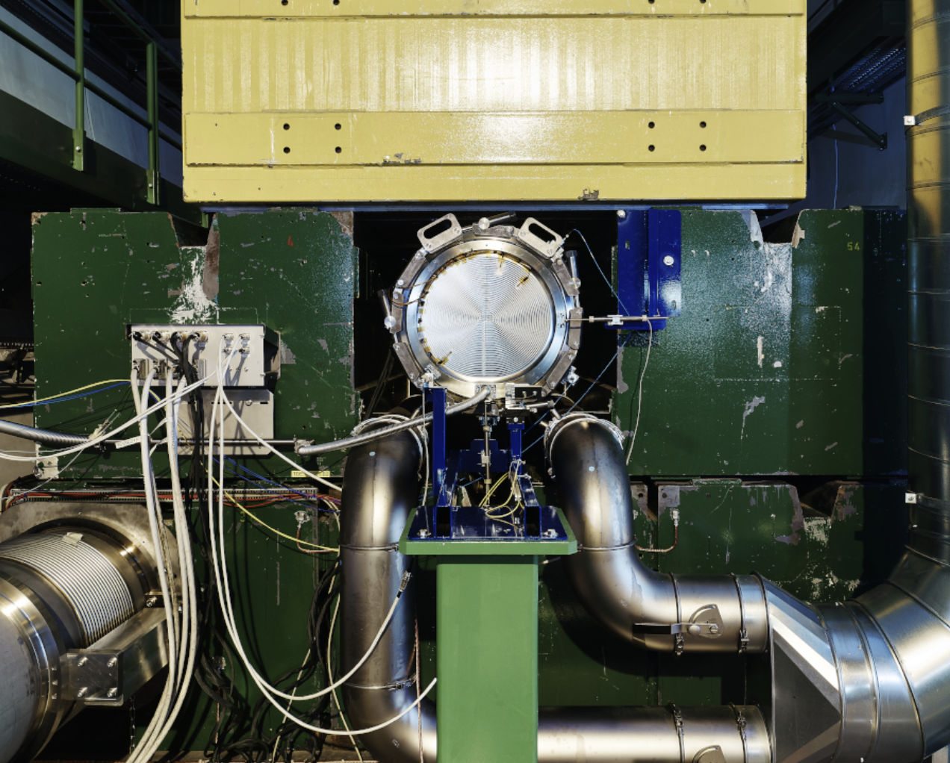
Surface and underground visits
Underground visit to the LHC
ATLAS experimental cavern
LHC inner triplet and absorbers at Point 1
LHC beam dump (Point 6) and beam extraction system
Visit to fixed-target experimental facilities (ISOLDE/MEDICIS, AD, HiRadMat)

Slide 17
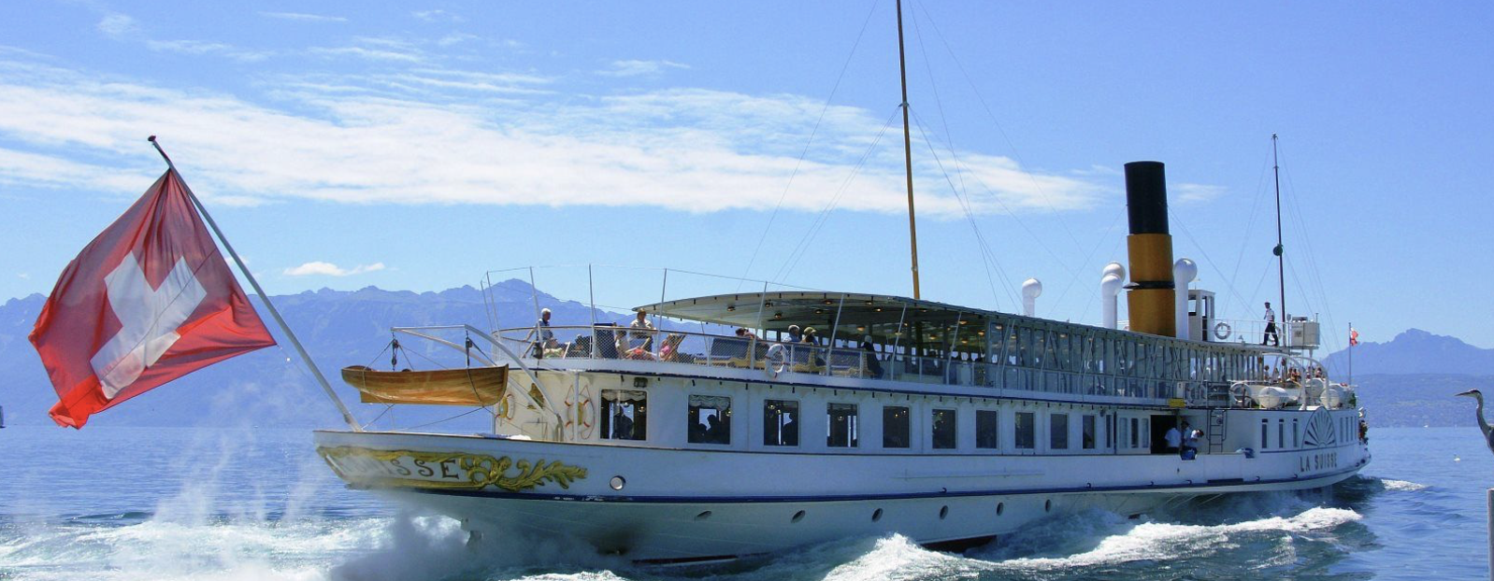
Accommodation, workshop dinner and event
A certain number of rooms will be reserved in the CERN hostel(s), plus suggestions for hotels nearby CERN
Reception & dinner would be ideally located around Lake Geneva (either in a typical restaurant or on a “belle epoque” boat)
Excursion possibilities under consideration
Accompanying people are welcome to enjoy the local area

Slide 18
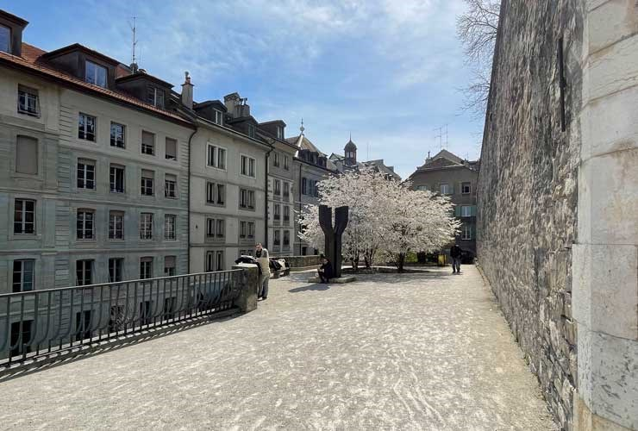
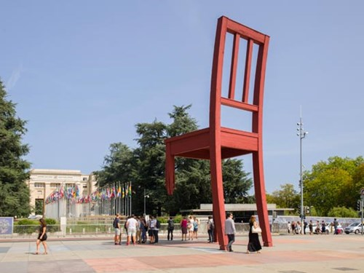
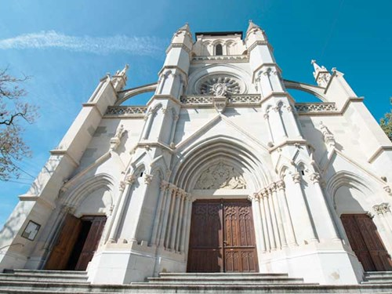
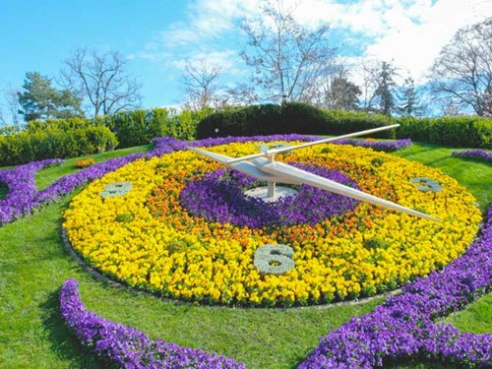
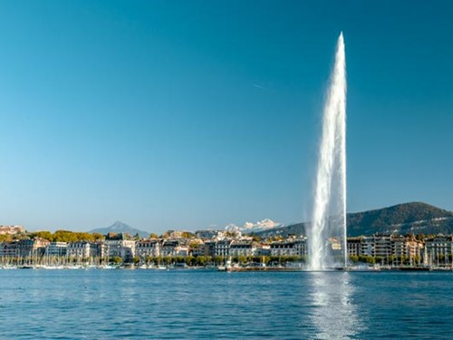
Geneva in spring

Slide 19
Looking forward to seeing you all at CERN in 2026!

