Slide 1
Closing session
Hiroki OKUNO
RIKEN

Slide 2
Next host is
CERN in Geneva, Switzerland!
Marco gives an announcement.

Slide 3
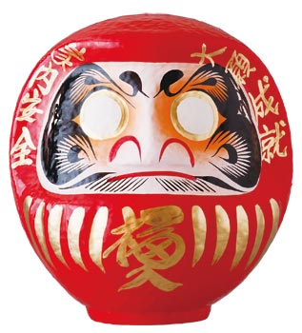
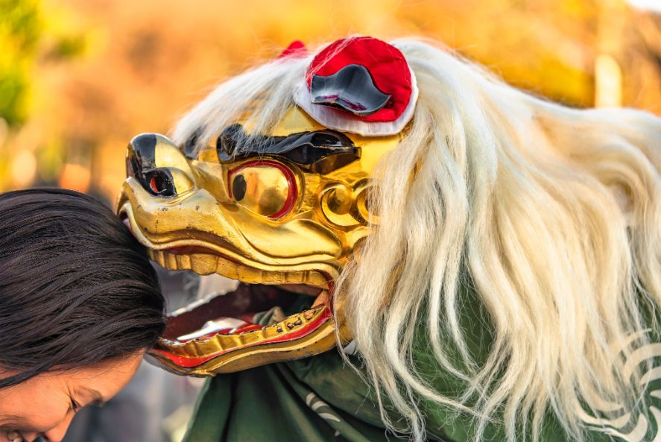
What is “Daruma” doll?
They are a symbol of good fortune and perseverance in Japanese society, and Japanese people find spiritual meanings in these auspicious dolls.
Step1: The dancing lion gave us it.
Step 2: Make a wish and paint either of the eyes. (Successful HPTW2026 at CERN!)
Step 3: Marco brings it to CERN.
Step 4: Final step! Once you have reached your goals, complete the other eye. (Complete the other eye at the end of HPTW2026)

Slide 4
Thank you, LOC members
RIKEN
J-parc/(KEK/JAEA)
H. Okuno SRC, Charge stripper
T. Adachi Beam instrumentation
H. Hasebe C foil stripper
H. Imao He gas stripper
Y. Miyake Stripper (liquid lithium)
T. Nishi ML in accelerator
K. Sakuma Assistant
A. Uchiyama Control system
M. Yamamoto Assistant
K. Yoshida ex. BigRIPS team leader
S. Makimura (Co-chair)
H. Takahashi
N. Kawamura
K. Haga
T. Matsubara
T. Naoe
S. Saito
M. Futakawa

Slide 5
Closing remark
We will upload a lot of photo in the workshop in the indico system.
We wish your safe trip to your home.

Slide 6
See you at HPTW2026 in CERN!

