Slide 1
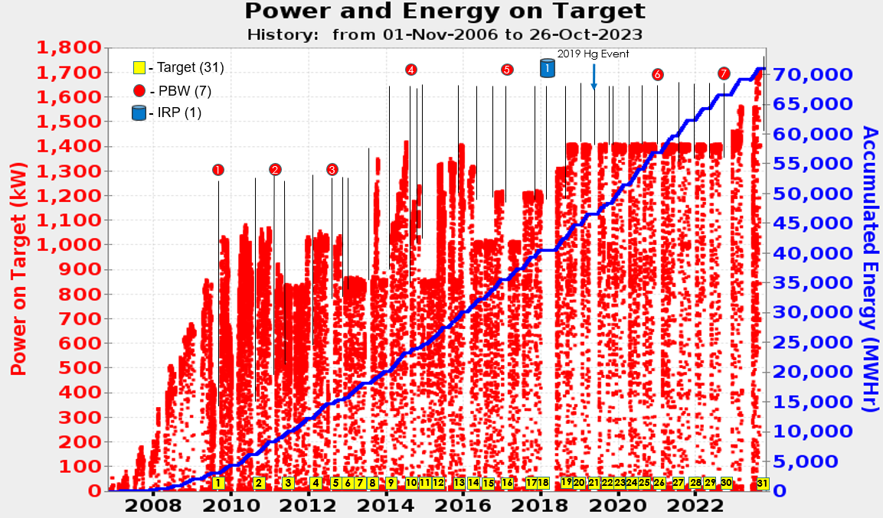
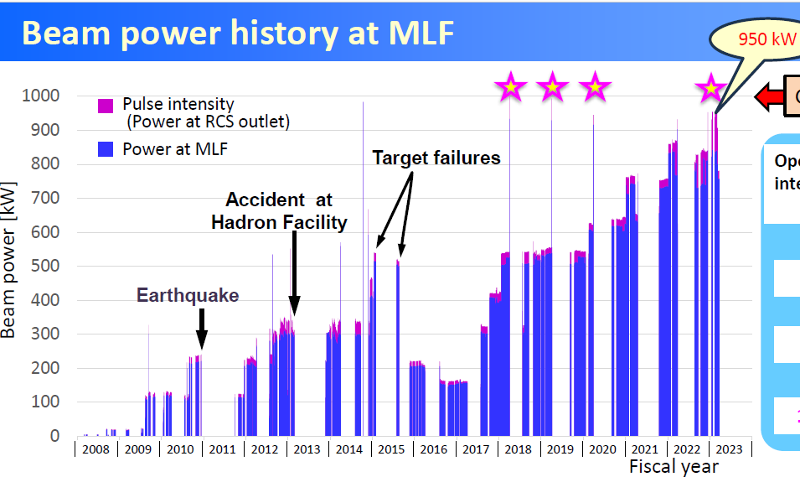
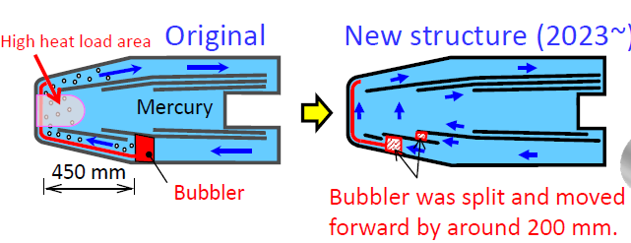
Summary sessions 7-1, 7-2. Operation of Targets and Beam Dumps
reach beam intensity -> 1 MW
Goal: Reliable, efficient Operation, Up-Time
Key: reduce stress on target vessel (pitting damage).
Tritium release is a problem,
waste storage optimisation
gas injection is key to realiability
Large experience at high intensity, statistics on targets
, on the road 1.4 MW -> 2 MW
online diagnostics, rad. hard, reproduce expected pattern

Slide 2
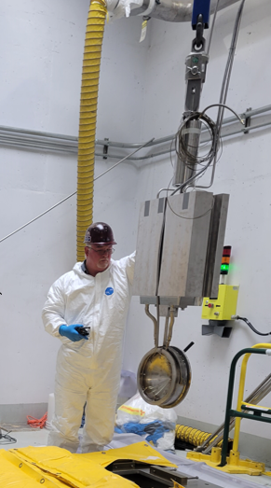
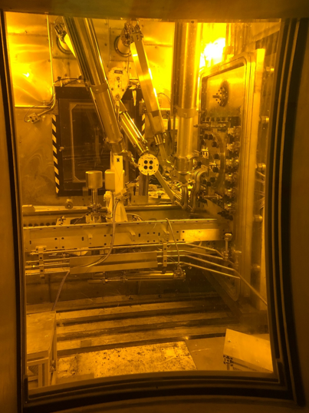
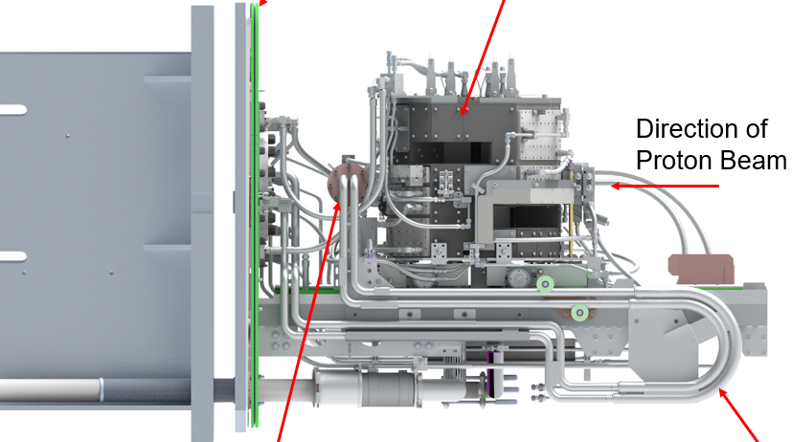
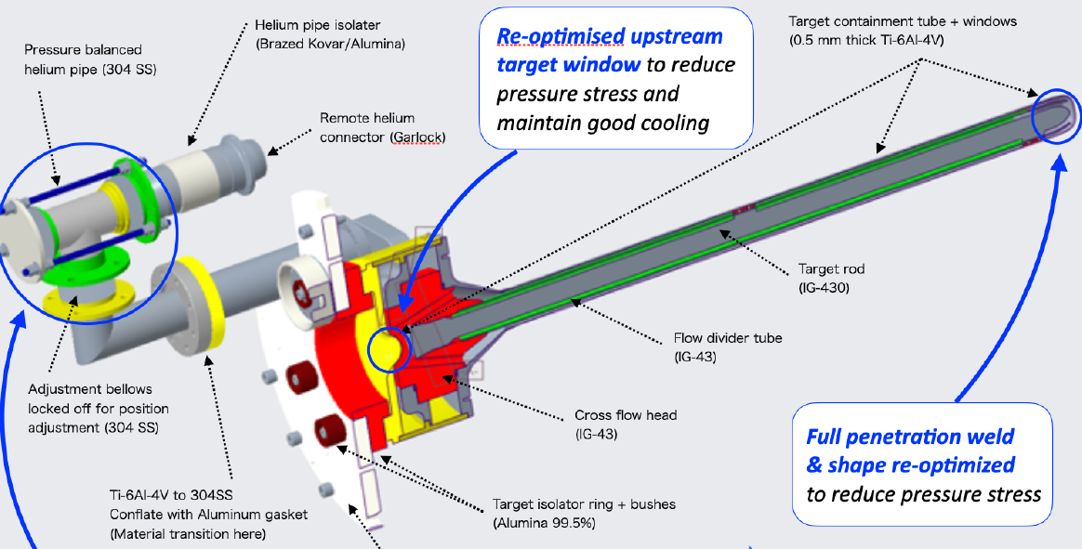
hands-on experience (but only from far above)
dismantle old
cutting after use
to →
target rebuilt
from model
He gas cooled graghite rod, high pressure and flow
enhance capability of existing target

Slide 3
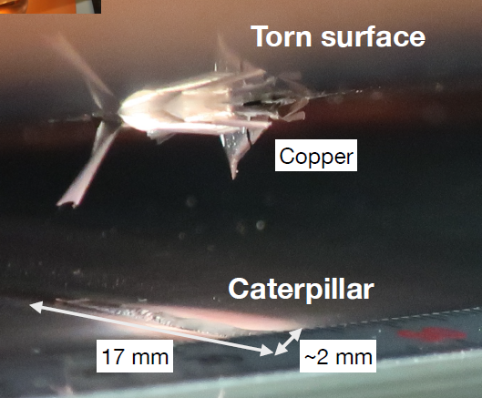
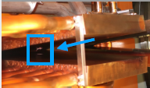
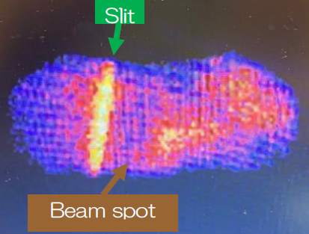
Beam dump inside beamline, small critical spot, melts material easily
high velocity water flow in cooling tubes has worked well over long time.
Erosion in copper tubes at high water flow?
Also for heavy ions, on Li jet stripper, goal even more intense than RIBF
More damage close to Bragg peak
1 kW --> 1e-3 DPA/s on jaws for
intercepting other charge states.
Very fast jet needed (60 m/s) -> moving graphite foil ?
target operation, infrared monitoring
use bolometer camera (not semiconductor sensor)
isotope production, Trend ! (no large installation, but like to push the limits)
Here degrade energy to production reaction energy -> mat. damage
many contributions on this topic at HPTW, reliable operation is key
no access to talk -> no picture ☹

