Slide 1
2. Radiation damage in target material and related simulations
Shunsuke Makimura (J-PARC, KEK)
10th November 2023
High Power Targetry Workshop @ RIKEN

Slide 2

(Invited) ''Overview of Radiation Materials Science and Radiation Damage Modeling'' (David Senor)
(Invited) "Irradiation damage of diamond by ion implantation'' (Masahiko Ogura)
ID90 ''Capabilities of the FLUKA particle transport code for the design and operation of high power targetry systems'' (Francesc Salvat Pujol)
ID22 ''Measurement of displacement cross section for high-energy protons and future plan for material damage using 0.4 GeV protons at J-PARC'' (Shin-ichiro Meigo)
ID70 ''RaDIATE Collaboration Status and Recent Results on Material Studies'' (Frederique Pellemoine)
ID36 ''Novel Materials R&D for Next-Generation Accelerator Target Facilities'' (Kavin Ammigan)
ID47 ''Computational Exploration of High Entropy Alloys as Promising Materials for Future Beam Windows'' (Gaurav Arora)
ID100 ''Evaluation of β-phase based titanium alloys'' (Eiichi Wakai)
The Nick Simos Effect
(Patrick Hurh)

Slide 3
(Invited) ''Overview of Radiation Materials Science and Radiation Damage Modeling'' (David Senor)
Was. 2007. FRMS, Springer
Radiation damage
  Point defects
  Displacement cascade
  Defect annihilation, clustering and mobility
Radiation damage microstructures
  Radiation induced segregation
  Dislocations
  Voids and bubbles
  Phase stability
Macroscopic effects of radiation damage
  Irradiation hardening and embrittlement
  Radiation growth and swelling
  Irradiation creep
  Irradiation assisted stress corrosion cracking
  Transport property degradation
Radiation damage modeling
  Atomic Level Simulations
  Microstructural Modeling
  Machine Learning to Integrate Experiments and Modeling
Atomic scale
Macroscopic
Jenkins and Kirk. 2001. Characterization of Radiation Damage by TEM, IOP
Modeling

Slide 4
(Invited) "Irradiation damage of diamond by ion implantation'' (Masahiko Ogura)
Diamond is expected to be applied to next-generation power electronics and quantum sensor
Ion implantation technology is indispensable for realizing diamond devices
The depth and concentration can be controlled by ion energy and dose, respectively.
Irradiation damage is simultaneously introduced, that degrades electronic properties and device performances.
The accumulation of defects induces graphitization and prevents from returning to crystalline diamond.
As for the doping technique, boron, the most promising p-type dopant, was successfully ion-implanted to show p-type characteristics from an early stage, although sufficient electronic properties for device applications have not yet been achieved.
Clear n-type properties have not been shown by ion implantation. A key issue is how to eliminate the influences of irradiation damage.
Point defects by ion implantation can be effectively utilized. For example, Quantum sensing devices using magnetic resonance related to the vacancy complexes with additive elements such as nitrogen (N-V center) in diamond. Here, it is necessary to control the position so that a vacancy should be located next to an ion-implanted additive element.

Slide 5

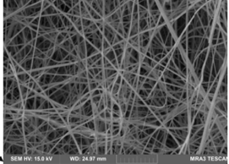
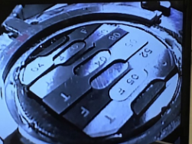
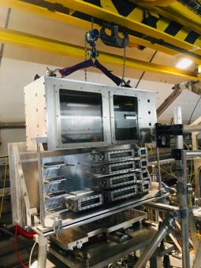
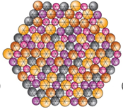
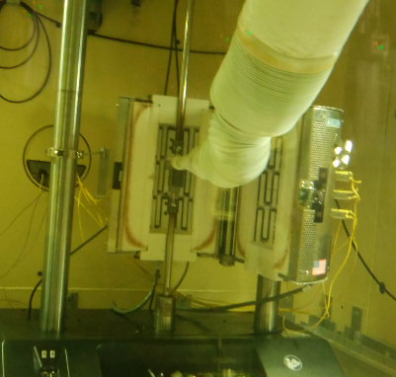
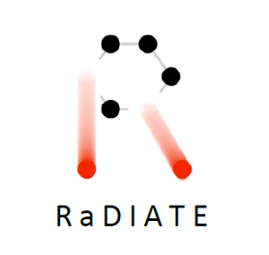
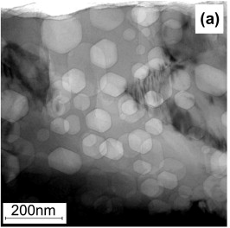
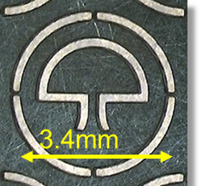
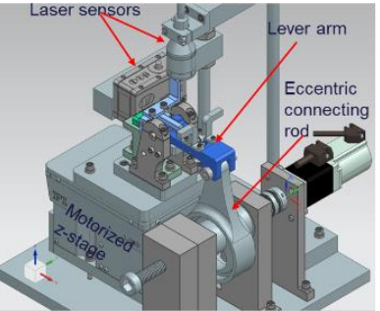
ID70 ''RaDIATE Collaboration Status and Recent Results on Material Studies'' (Frederique Pellemoine)
RaDIATE collaboration created in 2012, with Fermilab as the leading institution. The collaboration has grown up to 20 institutions over the years.
In-Beam Studies
Evaluate in-beam performance of candidate materials
Irradiated Material Studies: high energy proton irradiation at BNL-BLIP
Thermal shock testing: HiRadMat facility at CERN
Novel Target Materials
New materials with enhanced thermal shock and radiation damage resistance
High-Entropy Alloys
Nanofibers
Composite materials
Heat treatment
Alternative Methods
Emulate high energy proton irradiations for accelerated and cost-effective material screening
Low Energy Ion: for assessing radiation damage effects
Electron beam for thermal shock and fatigue testing
Novel Testing Methods (fatigue studies)
Develop Modeling
Prediction of fundamental response of various materials to irradiation and thermal shock
Helium gas bubbles formation and segregation
Radiation damage effects
Heat transfer mechanism in nanofiber media

Slide 6
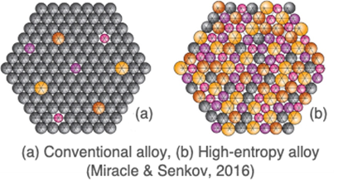
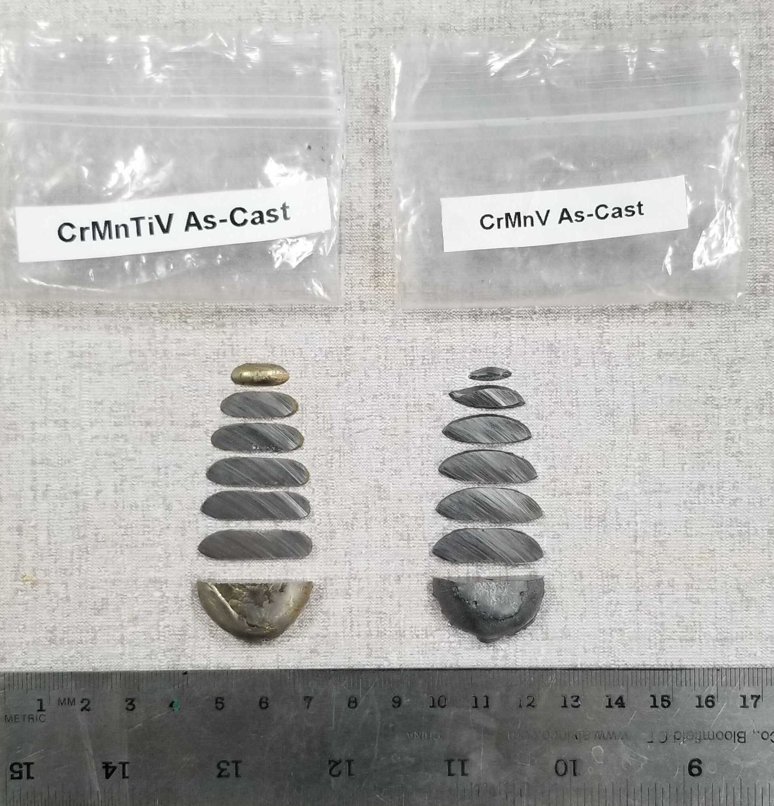
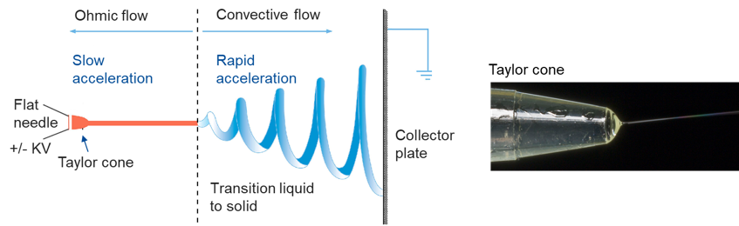
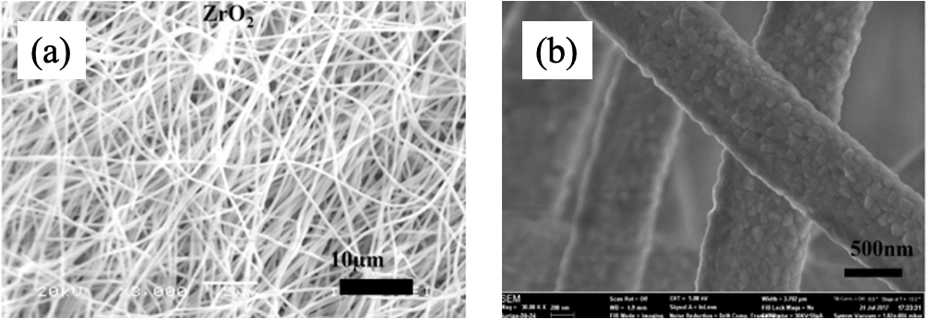
(Materials)
  High-Entropy Alloys (for beam windows)
HEAs are alloys with multiple principal elements:
Large composition space to explore new materials
β-Ti-15Cr-3V-3Al-3Sn alloy (ST and STA)
Ion irradiation 11 dpa, R.T.
Sectioned arc-melted ingots (UW-Madison)
Nano-hardness
TEM observation
TEM diffraction pattern & HREM & Positron Annihilation Measurement
4 HEA compositions
Cr₃₃Mn₃₃V₃₃
Cr₃₁Mn₃₁Ti₇V₃₁
Al₁₅Cr₂₀Mn₂₀Ti₁₀V₃₅
Al₁₅Co₄Cr₂₅Mn₁₅Ti₆V₃₅
No observable cracks at corners of indents
Precursors & Omega-like embryo
  Nanofiber Materials (secondary particle-production targets)
Displacement Damage | Phenomena
0 dpa | High number density Precursor does not act as sink, but as decreasing of diffusion velocity of point defects
3 dpa | High number density: Omega like embryo formation and it can act as sink site
6 dpa | High number density: omega like embryo is developing
9 dpa | Disappearing of omega-like embryos
11 dpa | Disappearing of omega-like embryos and precursors
Electrospinning technique and Taylor cone.
SEM images of Zirconia nanofibers produced at Fermilab, (a) bulk nanofiber mat, (b) single nanofibers revealing polycrystalline grains (S. Bidhar)
Intrinsically tolerant to both thermal shock and radiation damage
ID36 ''Novel Materials R&D for Next-Generation Accelerator Target Facilities'' (Kavin Ammigan)
ID100 ''Evaluation of β-phase based titanium alloys'' (Eiichi Wakai)

Slide 7
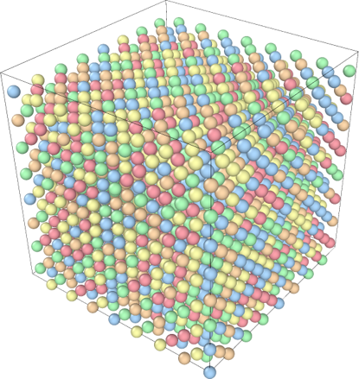
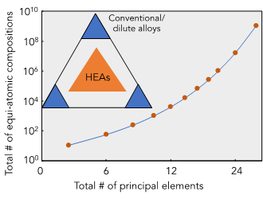
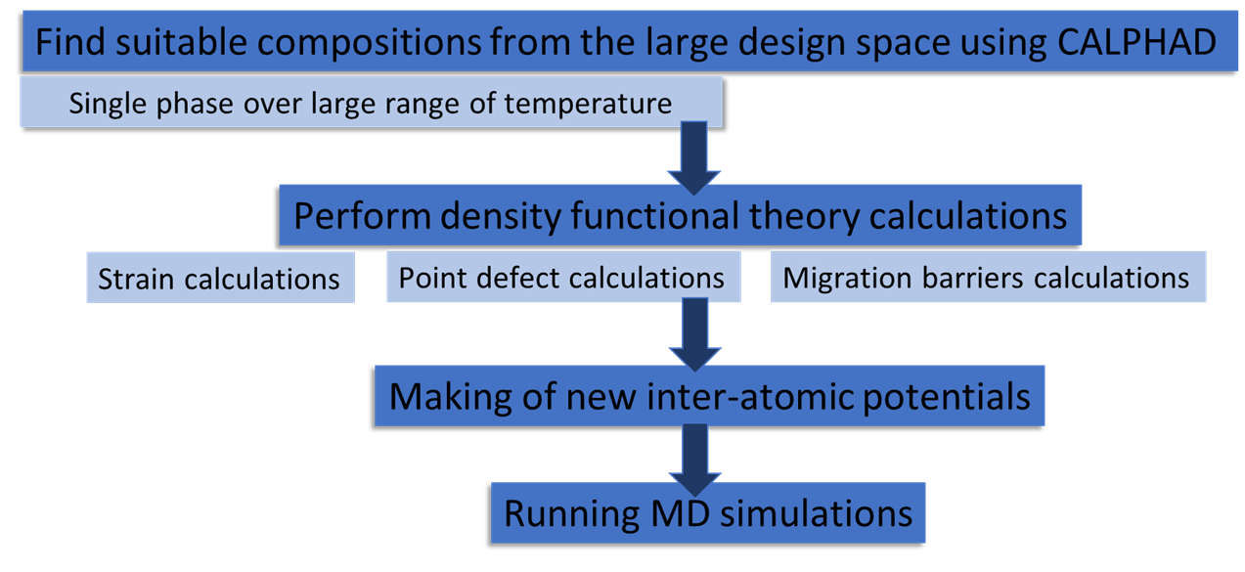
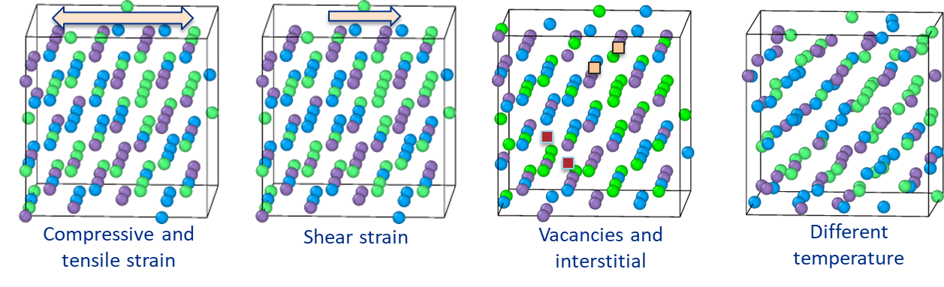
ID47 ''Computational Exploration of High Entropy Alloys as Promising Materials for Future Beam Windows'' (Gaurav Arora)
Density functional theory (DFT)
Work on the principle of quantum physics
Highly accurate
Computationally expensive
Limited to ~300 atoms
Software: VASP, Q-espresso, etc.
Molecular dynamic (MD)
Work on the principle of Newton laws
As accurate as interatomic potentials
Computationally cheap
Million of atoms can be modeled
Software: LAMMPS
Development of accurate interatomic potentials is the key challenge in designing or studying defect properties of materials
High-Entropy Alloys
CALPHAD stands for "Calculation of Phase Diagrams.“
Preliminary results
Model can predict energies accurately
Increasing model complexity decreases the error
Approximately 600 simulations are performed for each composition.
Forces and energies are extracted and fed into making of machine learning potential.

Slide 8
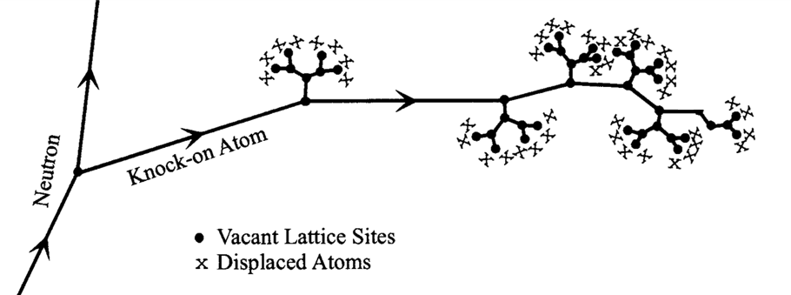
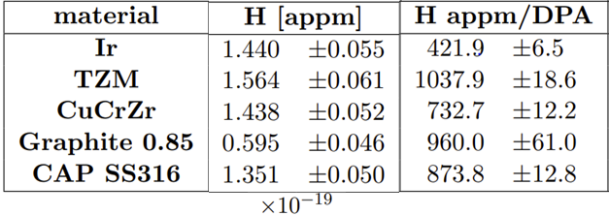
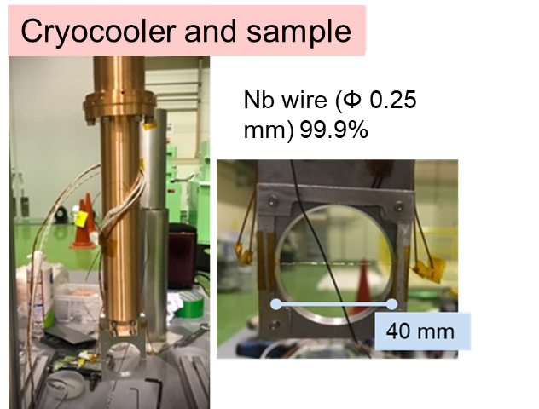
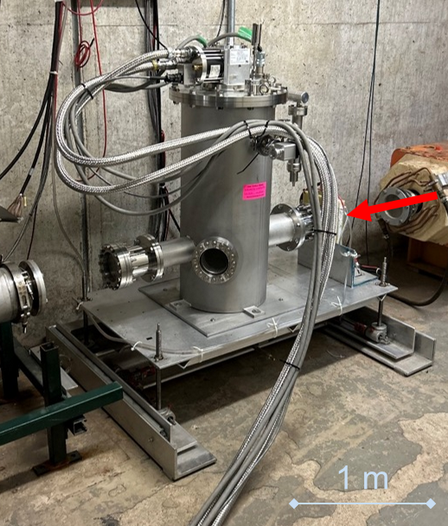
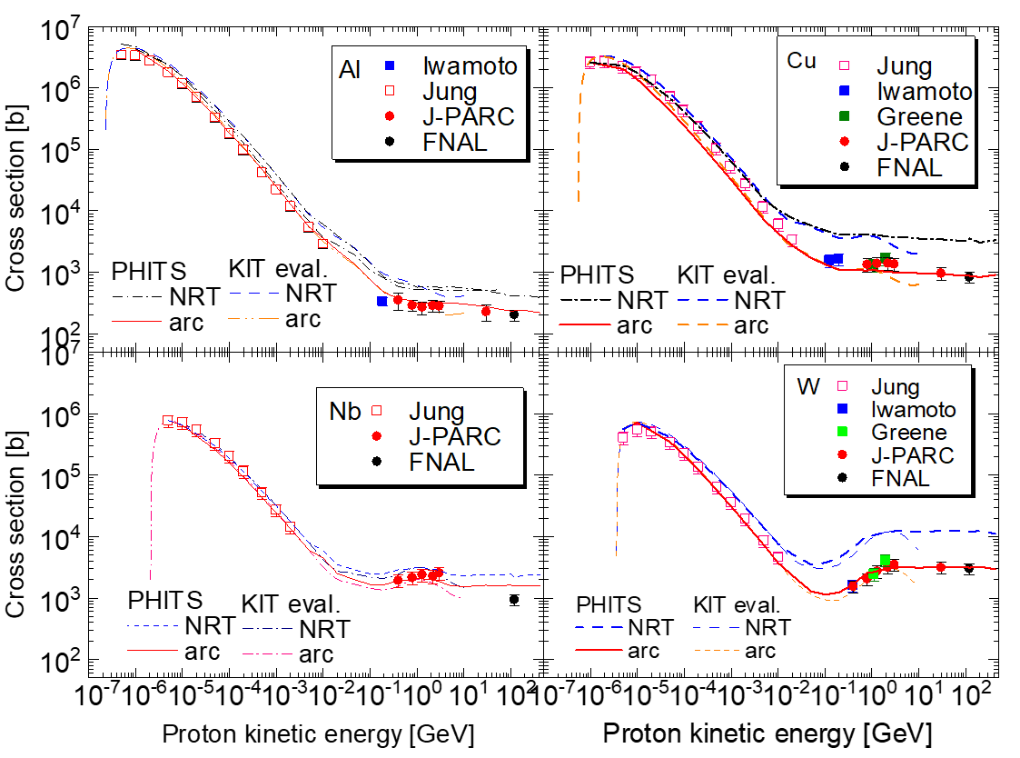
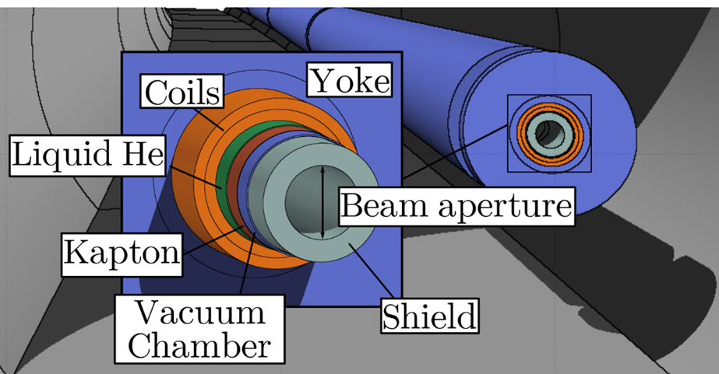
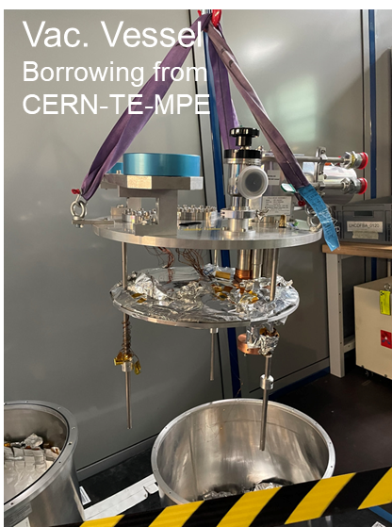
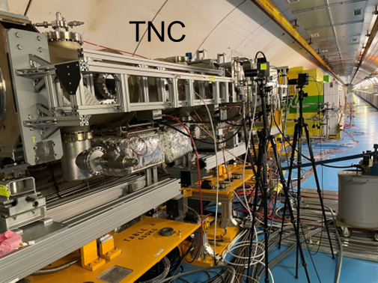
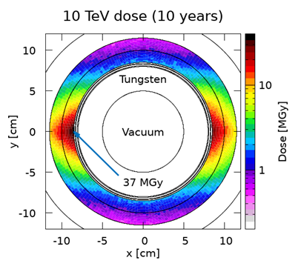
Modeling
dpa (displacement per atom)：
Widely used as damage index for fission
and fusion reactors, and accelerator fac.
dpa = Fluence x displacement X-sec
Lack of data above 20 MeV: Difficult validation of calculation models
⇒ Experiments at J-PARC, FNAL
Energy (dose) deposition
Secondary particle production
Radiation damage estimates
  DPA (DPA-NRT and ARC-DPA)
  H and He production
Radiation to electronics
Prompt radiation and activation
  Prompt and delayed in a single run
  Radionuclide inventories
  Ambient doses
Provides input for finite element analyses (ANSYS)
BLIP gas production
Applicability should be confirmed for further higher energy (i.e., Ep 440 GeV).
Application:
radiation damage in the Muon Collider arc
neutron attenuation benchmark
Experiments at HiRadMat, CERN in 2025
CERN Shielding Benchmark Facility (CSBF)
ID90 ''Capabilities of the FLUKA particle transport code for the design and operation of high power targetry systems'' (Francesc Salvat Pujol)
ID22 ''Measurement of displacement cross section for high-energy protons and future plan for material damage using 0.4 GeV protons at J-PARC'' (Shin-ichiro Meigo)

