Slide 1
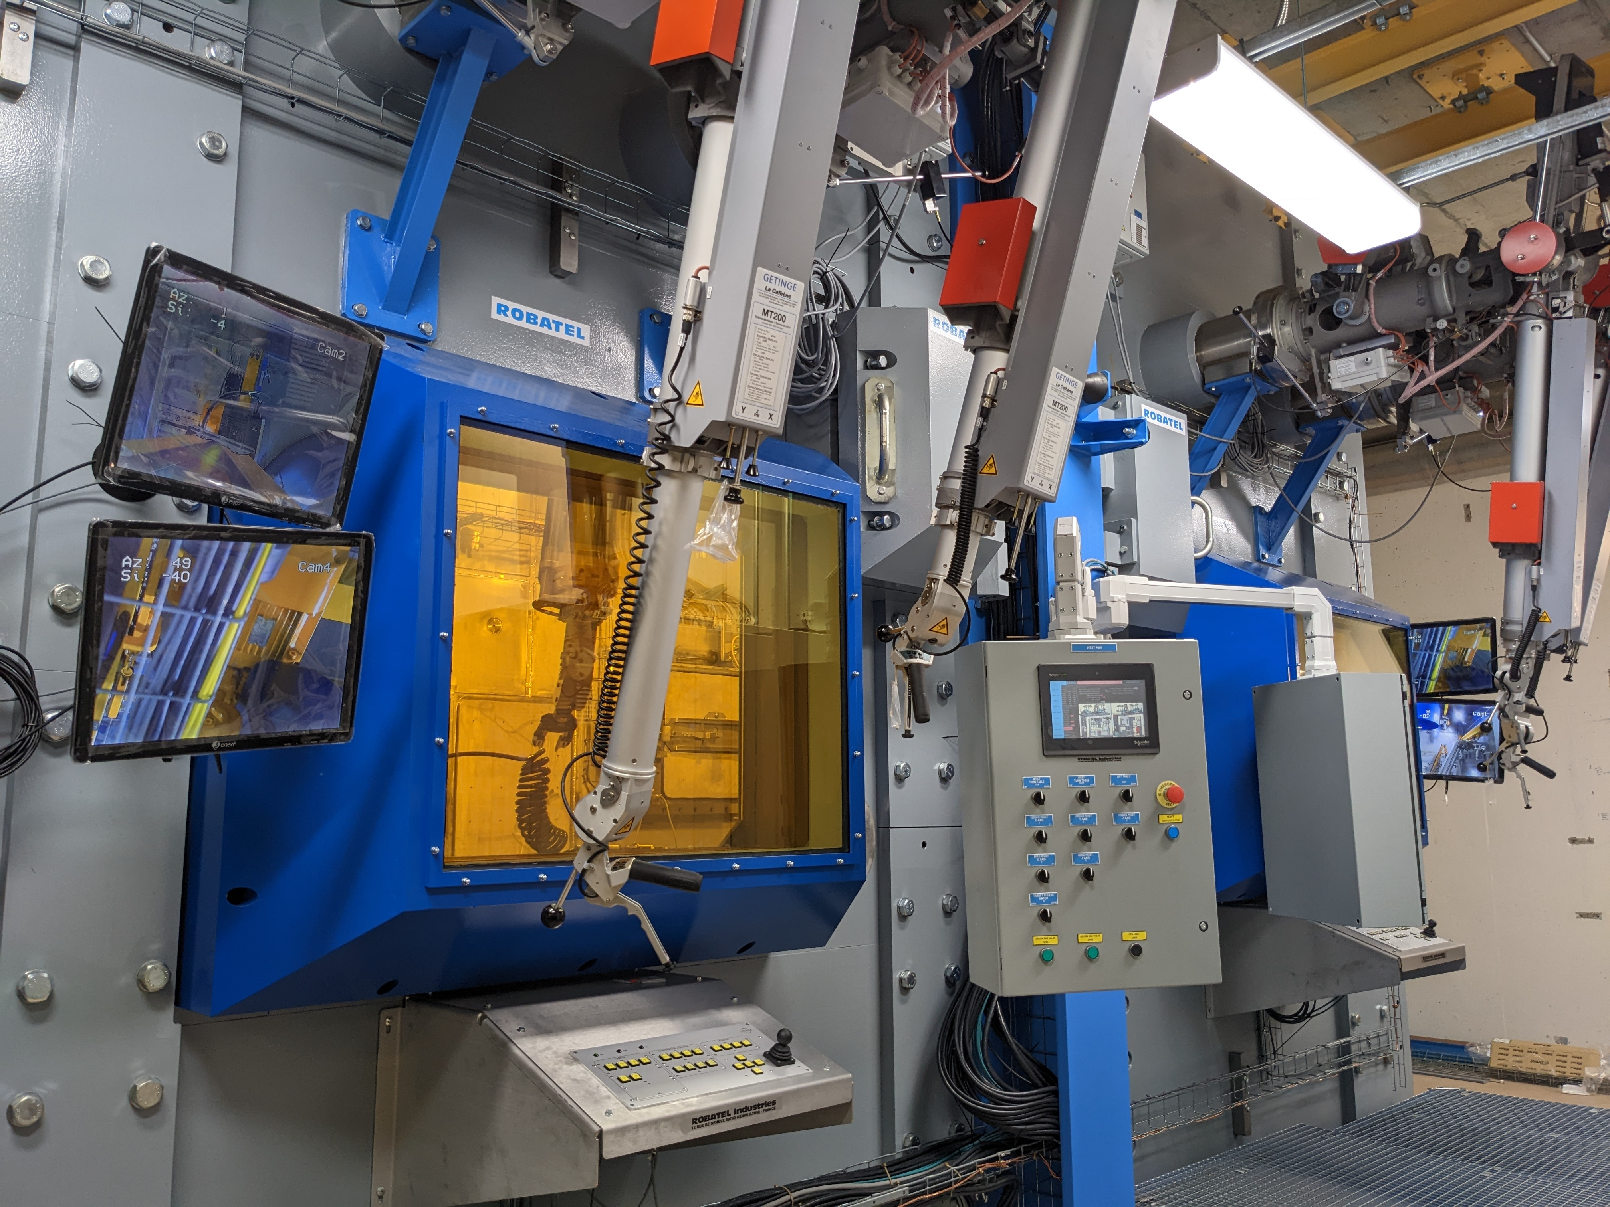
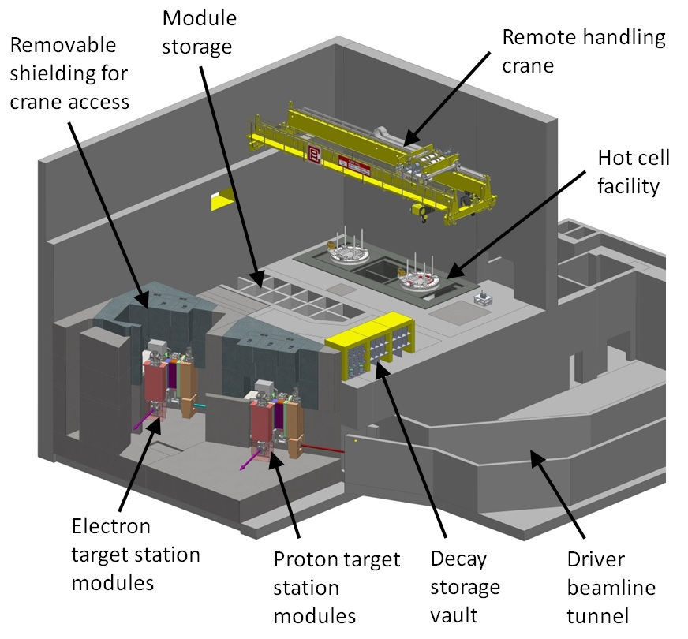
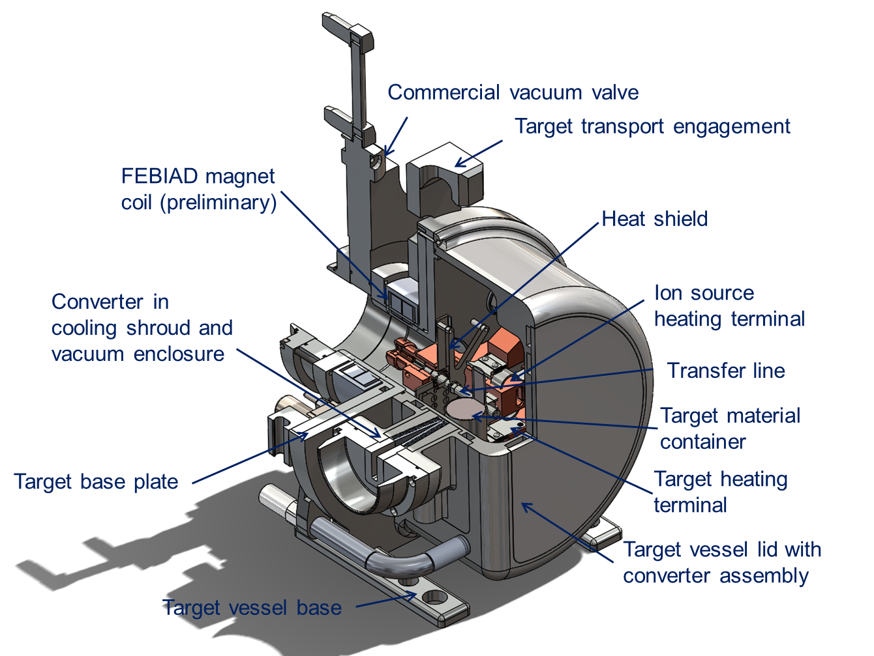
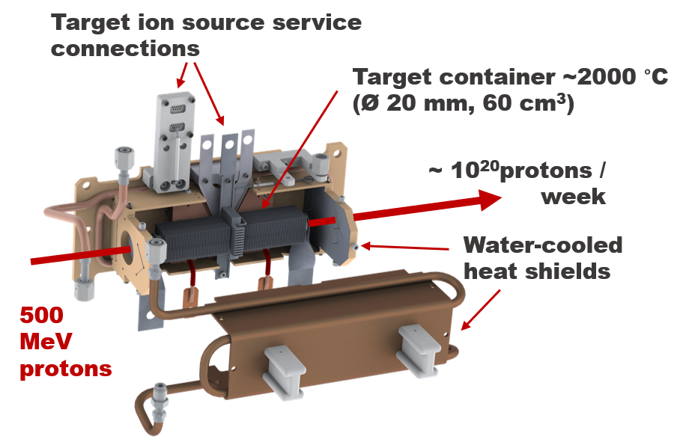
Overview of High-Power Targets and Strategies for Remote Handling at TRIUMF
Isaac Earle, Adam Newsome, Alexander Gottberg
Overview of the key high-power targets and beam dumps at TRIUMF
Details on target irradiation, life cycle, and activation
Remote Handling equipment and strategies used for target exchange, disassembly, packaging and disposal

