Slide 1
ZDC Detector Technology Choice
RIKEN
Itaru Nakagawa

Slide 2
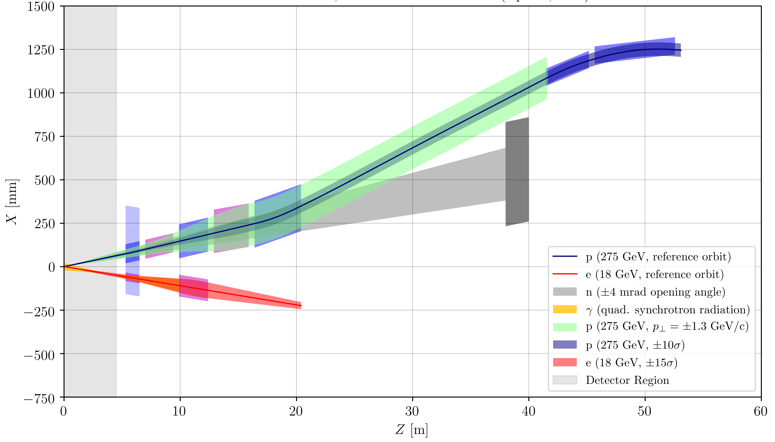
eRHIC Forward Magnet Apertures
Roman Pot Region
B2BPF
B2APF
Closest Large Aperture, High Field Quadrupole
B1PF
ZDC
Spectrometer Dipole
Q2PF
B0PF
C1XPF
Q1PF
Q0EF
Q1EF
Forward Side

Slide 3
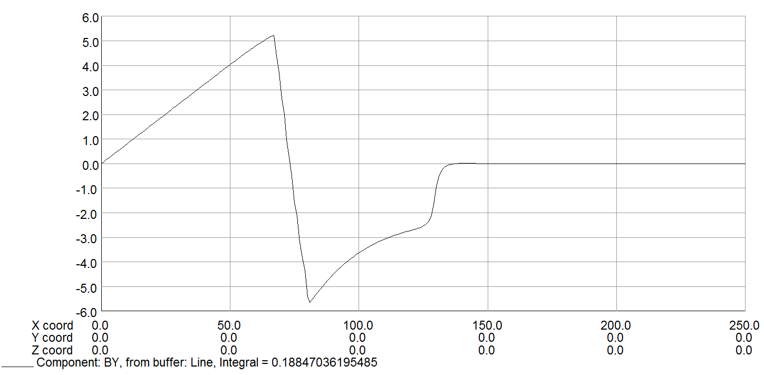
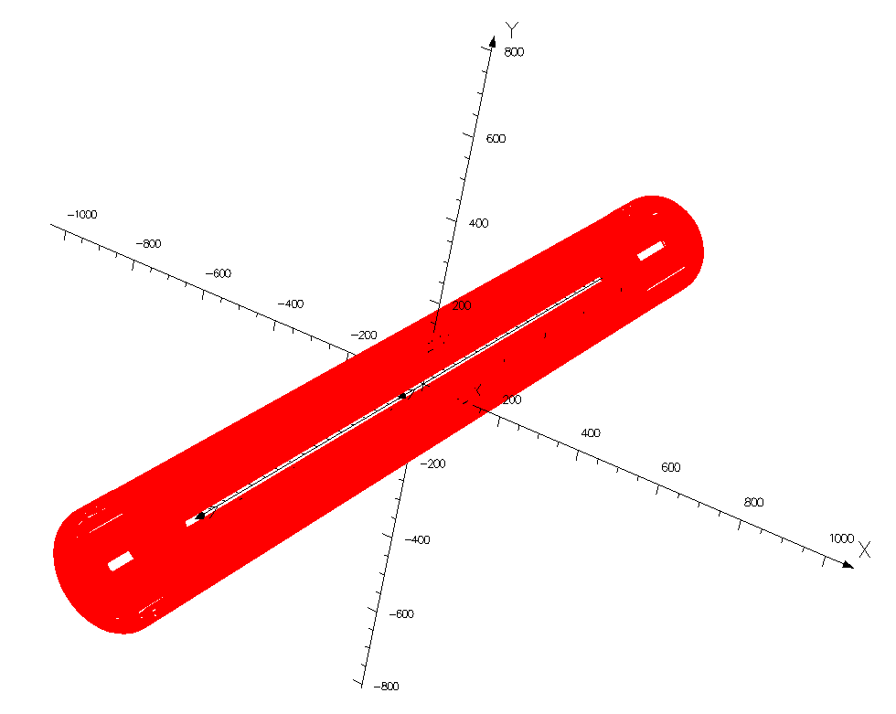
Compact Forward Magnet Example
Direct Wind, NbTi, Actively Shielded eRHIC Q1PF
Q1PF B_{y} Field
Quad Field
Zero Field Region
B_{Y} (T)
“Pole Tip Field” = 4.4 T
Main Coil
Shield Coil
Return Flux
X (mm)
R_{apt} = 55 mm
Efficiency Factor = 90%
G_{net} @ 275 GeV = 80.8 T/m
Forward magnets must have large apertures to accommodate neutrons and forward charged particles.
But combination of large aperture and large gradient mean a large B-field at the coil....
However, the electron beam must be shielded from any large external fields.
Budget for outer structure was set to accommodate the electron beam pipe.

Slide 4
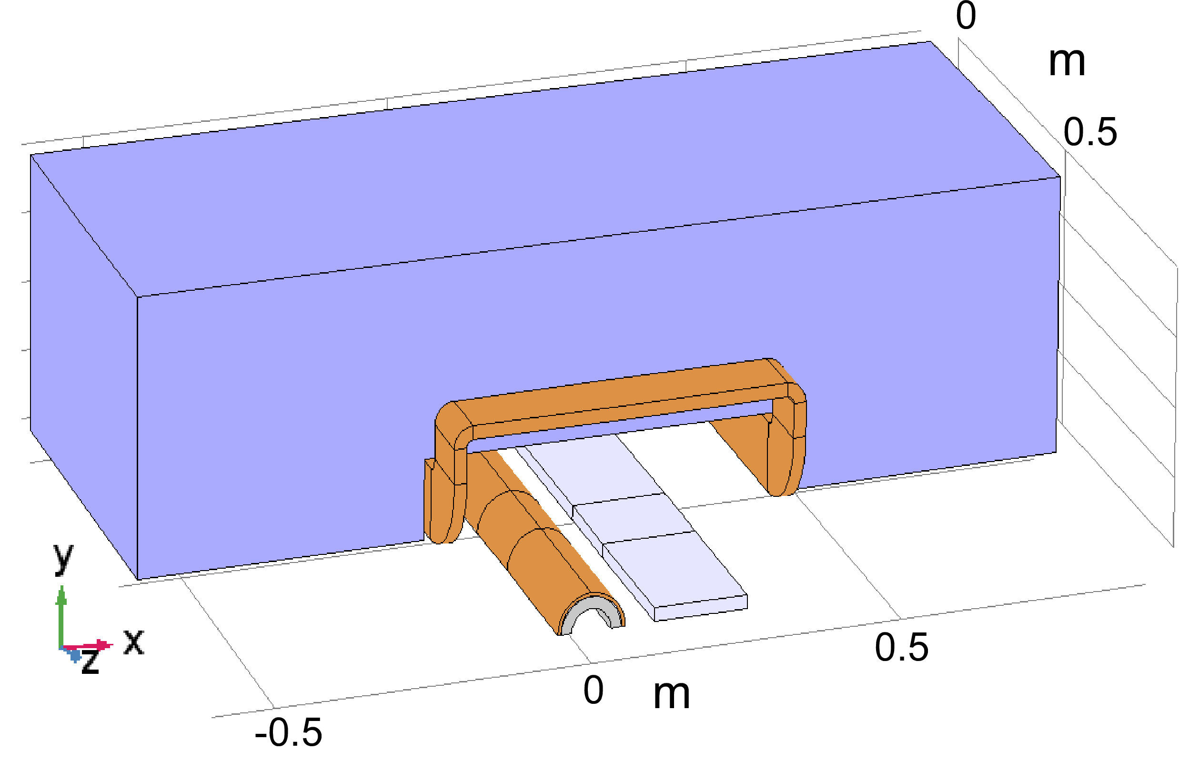
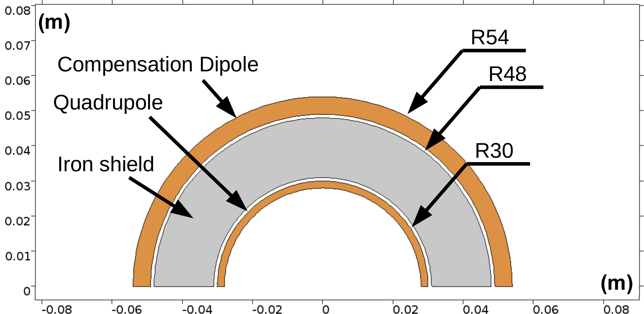
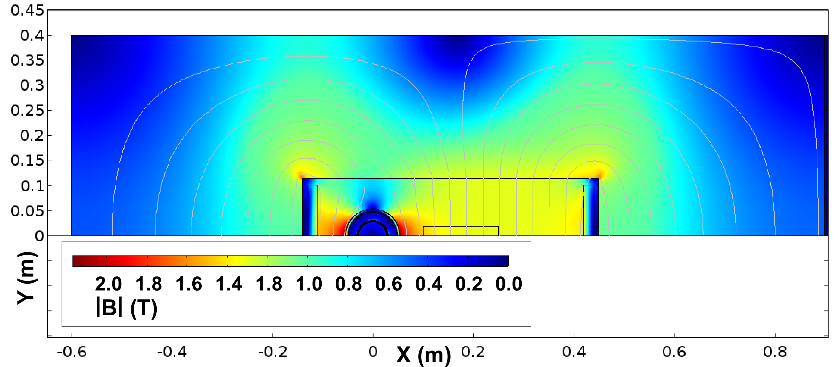
Shielding e-Beam Inside Spectrometer Dipole
B0PF/Q0EF
B0 Magnetic Yoke
1.3 T Cancel Coil Detail
Magnet is aligned with the e-beam, so p-beam enters at 25 mrad angle.
Superconducting Coils
Q0EF
e-Beam
eRHIC IR needs to pass an e-beam through main aperture of first hadron spectrometer dipole (B0PF).
First electron quad (Q0EF) inside B0PF.
With a combination of a bucking dipole and passive shielding, this can be accomplished.
Experimental
Detector Here

Slide 5
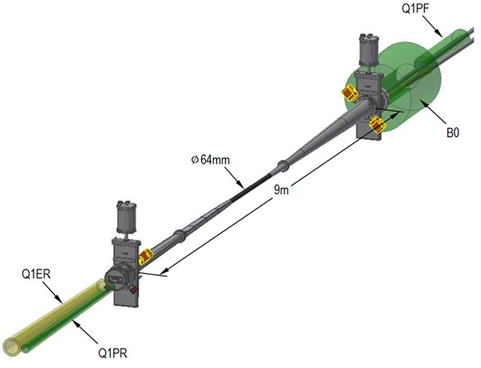
Detector Beam Pipe
Small diameter, thin walled Be in center region.
Smooth tapers and transitions to limit energy deposited by beam in trapped modes (wakes).
Need to provide beam tube cooling and Higher Order Mode (HOM) absorbers.
Need to provide adequate vacuum pumping.
eRHIC / Beast plans include in situ bakeout.
Central beam pipe requires meticulous optimization.

Slide 6
Detector Idea?
Sampling Type EM Section
Hcal Extension
Low Energy Section?
2~3X_{rad}
Shower Max Choices | Radiation Hardness | Cost | Position Resolution | Experiments
Quartz Fiber | good | Inexpensive | Poor | ALICE, JZCaP
Scintillator Fiber | poor | inexpensive | OK | RHICf
Silicon Sensors | OK | Expensive | Best | RHICf, FoCAL, TOPSiDE

Slide 8
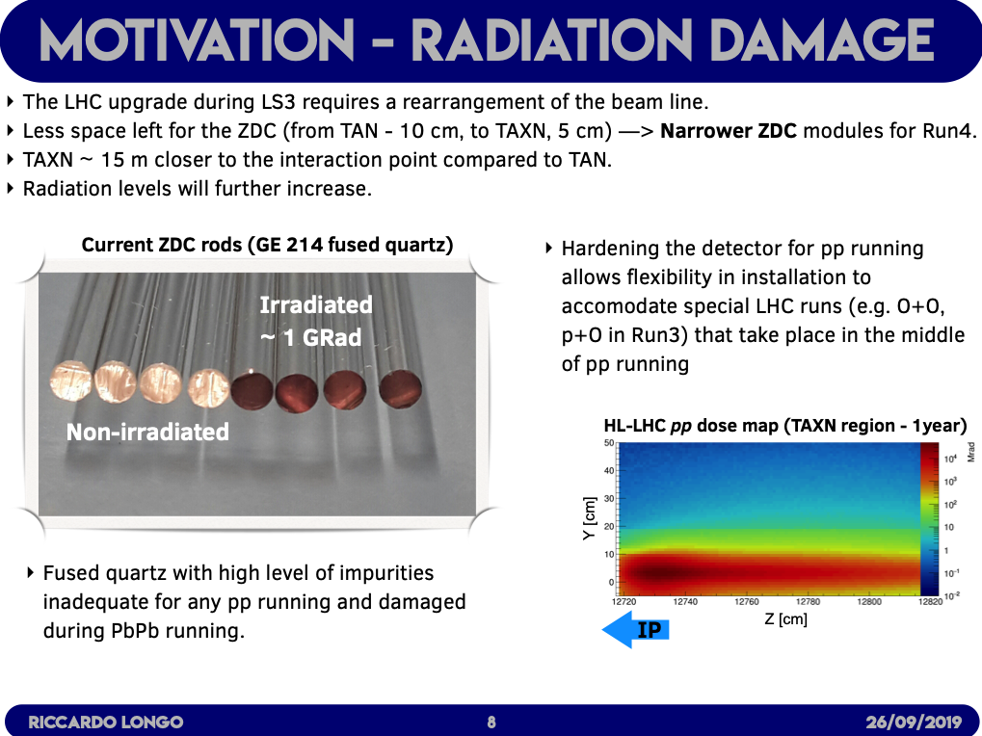

Slide 11
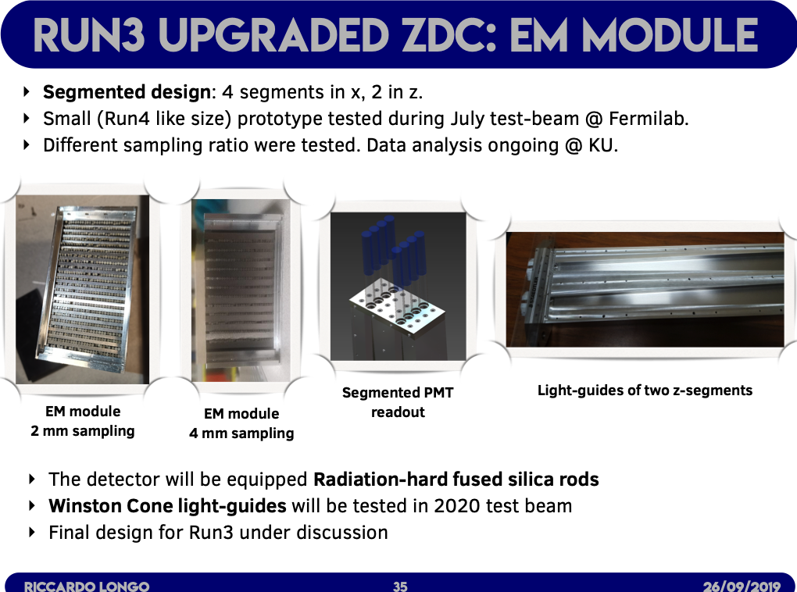

Slide 12
Discussion with Mike Murray
About EM Section of ZDC Upgrade

Slide 13
ALICE ZDC

Slide 14
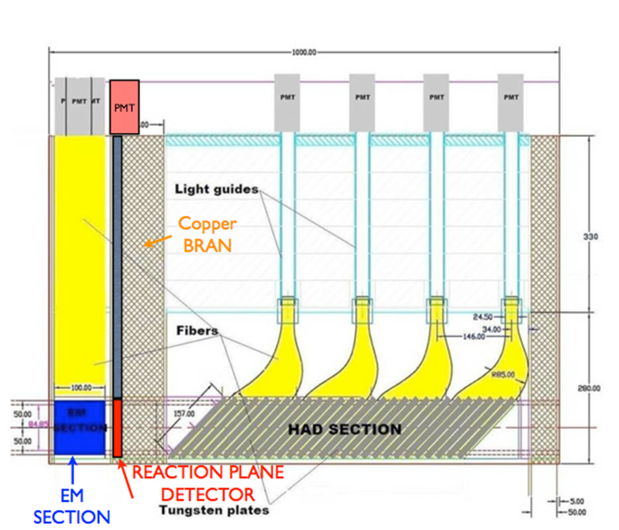
ZDC detector
Electromagnetic section (EM):
  33 vertical tungsten plates
  19 radiation lengths or one nuclear interaction length.
  5 divisions in the x direction
    (Not enough room for read-out of y-segmentation)
Reaction Plane Detector (RPD):
  4x4 quartz block array
Hadron section (HAD):
  24 tungsten plates
  5.6 hadronic interaction lengths
  Plates are tilted by 45◦ → maximizes the light that a ﬁber can pick up.
  Divided into 4 segments in z direction
Notes:
Em 2 mm thick 1.5 cm for had plates 1 cm quartz rpd

Slide 15
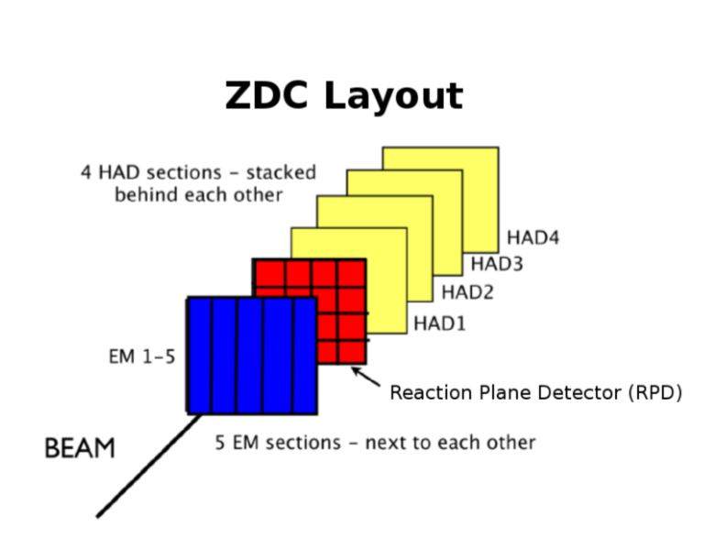
Segmentation of ZDC detector
Segmentation:
  EM: x-axis – 5 channels
  HAD: longitudinally – 4 channels
  RPD: 4 x 4 quartz array – 16 channels
Physics capabilities:
  Centrality in pA, AA
  Tagging UPC events
  Event plane (with RPD)

Slide 16
Quartz Fibers

Slide 17
TOPSiDE

Slide 18


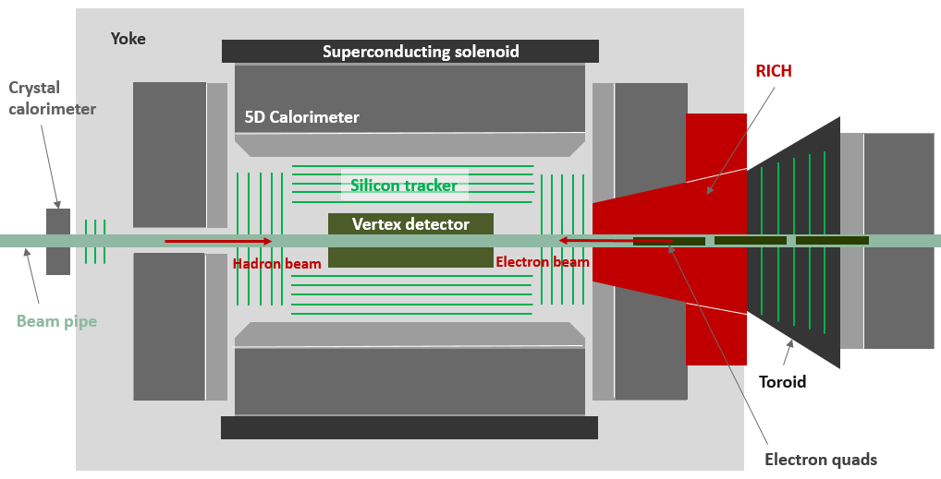
: The 5D Concept
Measure (E,x,y,z,t) for (every) hit in tracker + calorimeter
Silicon pixel vertex + strip tracker
Imaging em calorimeter
Imaging hadron calorimeter
Superconducting solenoid (3T)
Forward gaseous RICH
Forward dipole + cloak or
toroid w/out cloak
Forward silicon disks
Forward calorimetry
Zero degree calorimeter
Backward silicon disks
Backward crystal calorimeter
Particle identification ( pion – kaon – proton separation)
Particle momenta < 10 GeV/c for most of the solid angle f
Utilizes tracker + calorimeter
Requires silicon sensors with time resolution of about 10 ps*
Eliminates
The need for preshower counters, TRDs, TOF or Čerenkov (in front of the calorimeter),
muon chambers (in back of calorimeter)
Particle identifying
imaging
calorimeter
*3 timing layers are sufficient:
early in the ECAL, rear of ECAL,
rear of HCAL:
A resolution of 20 ps is then
adequate. (TBC by simulation)

Slide 19

The Zero-degree Calorimeter
Measure energy and angle of straight going neutrons
Identify (measure) the occasional photon in the calorimeter
Role
Requirements
Dimensions: Laterally ~ 1 x 1 m² (to contain hadronic showers)
Longitudinally at least 5 interaction lengths
Event rate (not exorbitant?)
Timing resolution (not particularly challenging?)
Radiation hardness (not a concern?)
Energy range 100 – 200 GeV (EIC) and 7 TeV (LHeC)
Choice of technology
Electromagnetic Calorimeter ECAL
A) Silicon wafers → Si-W technology
Hadron Calorimeter HCAL
B) Scintillator pads → AHCAL technology
C) Resistive Plate Chambers → DHCAL technology
All explored by

Slide 20
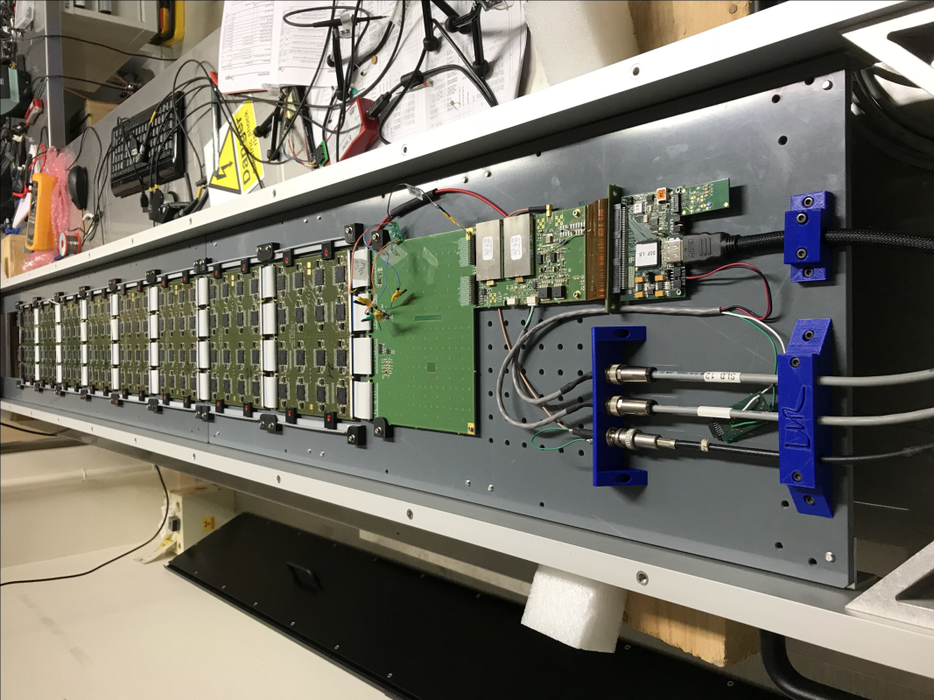
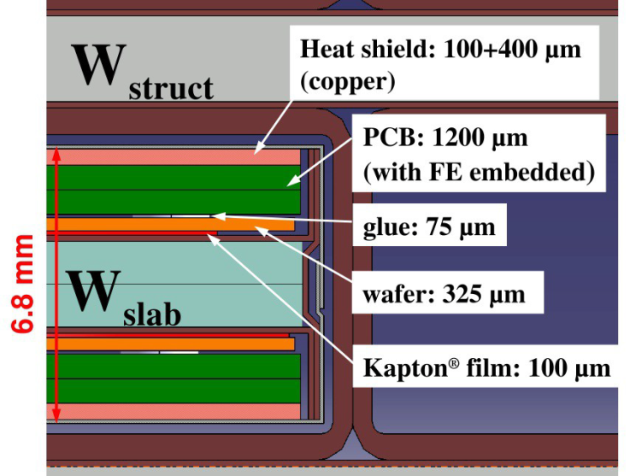

A) The Silicon – Tungsten Electromagnetic Calorimeter – Si-W ECAL
Concept
0.5 x 0.5 cm² Silicon pixels on 325 μm thick wafer
Tungsten absorber plates (< 1 X₀ each)
Readout
Digitization implemented in each layer
64 channel SKIROC ASIC with 12 – bits
Low noise (1/10 of a MIP)
Option to power pulse (25 μW/channel)

Slide 21
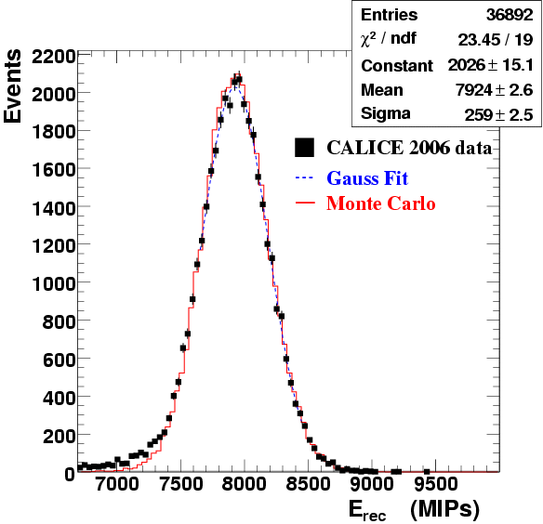
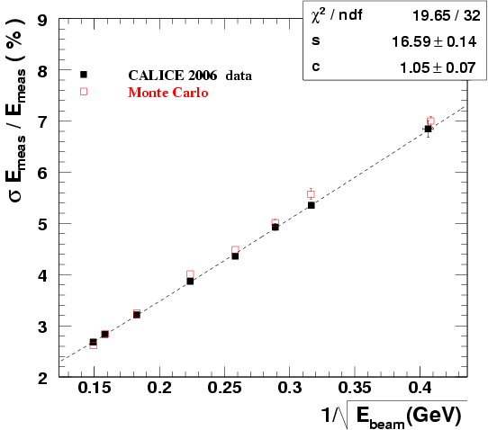
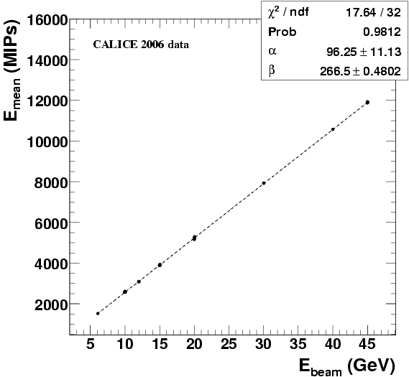

Si-W ECAL Results from Physics Prototype
Linear within ±1% up to 45 GeV
Resolution adequate
-> Negligible contribution to σ(E_{jet})
Excellent agreement with GEANT4 simulation
Both concept and technical implementation validated

Slide 22
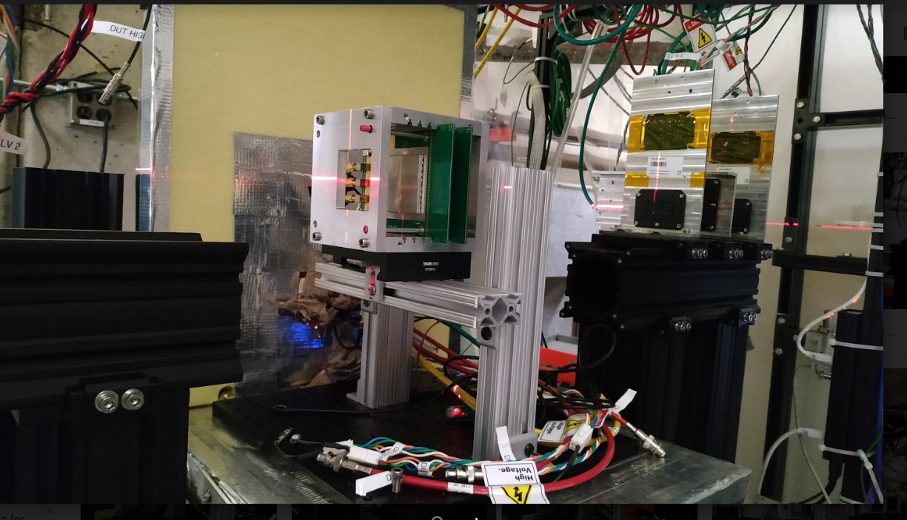
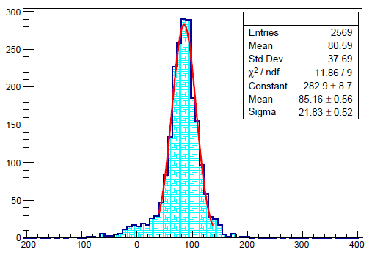
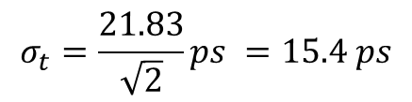
A step further: the 5D concept
Precision timing information
Of order 10 picosecond
In addition to imaging capability
Advantages
Provides particle identification (pion-kaon-proton separation)
Identifies vertex in pile-up events
Suppress noise
Requires
Ultra-fast silicon detectors (UFSDs)
Sensors with 16 ps resolution available
Argonne: implementation of readout electronics onto sensor
→ reduce cost and further improve resolution
$$σ_{t}=\frac{21.83}{\sqrt{2}}ps =15.4 ps$$
Measurement
at room temperature
with DAQ by scope
Time difference from a pair of sensors
[ps]

Slide 23
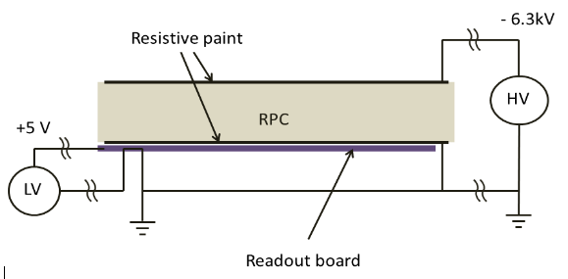
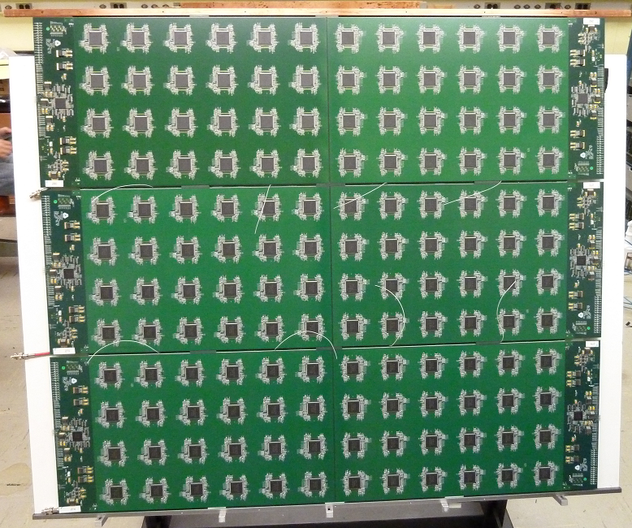
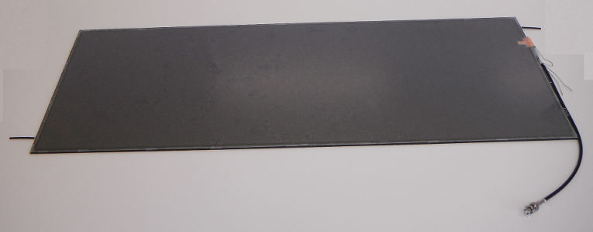
C) The Digital Hadron Calorimeter - DHCAL
Concept
Resistive Plate Chambers (3 layer to obtain 1 m²)
Steel absorber plates (~ 1 X₀ each)
Readout
Digitization implemented in each layer
64 channel DCAL ASIC with 1 – bit (digital!)
Timing to ~ 100 ns

Slide 24
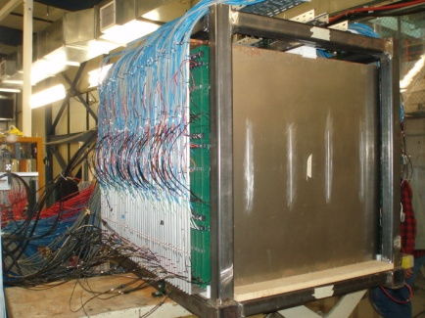
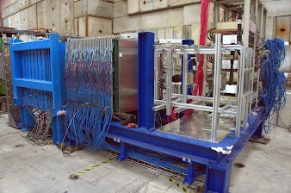
DHCAL Physics/Technological Prototype
38 layers in main stack – 4 interaction lengths deep
14 layers in tail catcher – additional 4 interaction lengths deep
Tests in Fermilab (Steel) and CERN (Tungsten) test beam

Slide 25
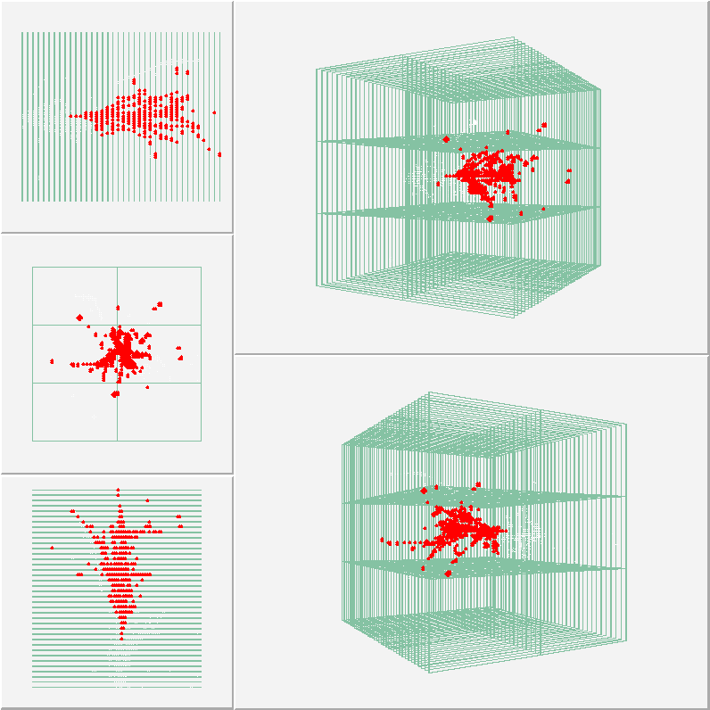
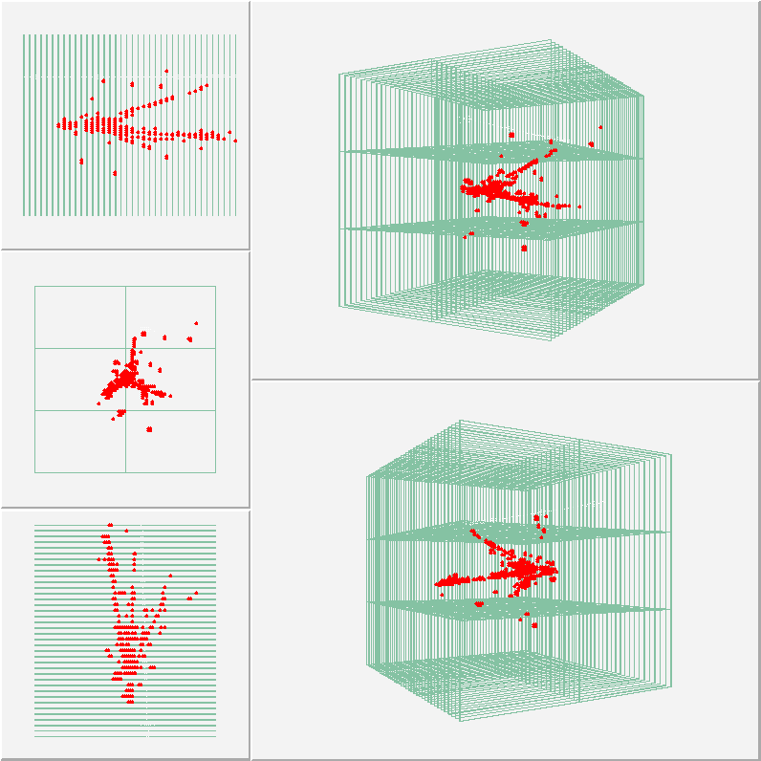
Talking about neutrons…
High energy neutron events
Recorded at Fermilab in self-triggered (streaming) mode
Energy unknown

Slide 26
Summarry of Discussion with Oleg
2019/10/02
Attendee: Oleg, Yuji, Ralf, Itaru

Slide 27
Suggestions from Oleg
For mini-FoCAL position layers, options can be:
  Scintillation fiber
  Silicon sensors : existing detector is MPC-EX@PHENIX
Existing detectors uses scintillation fiber:
  LHCb tracker (TDR should be available) the detector can be already built
  STAR event plane detector (EBD). Can possibly learn how to connect the scintillation fiber to a clear fiber to transfer the photon to the front end electronics. Contact with EBD expert.

Slide 28
Rough Cost Estimate
Diameter 1.0mm x 2m long round fiber = $3.96/piece
Each shower max layer, we need 1.0mm x 1.0mm square x 100mm long x 100 fibers to cover 10cm wide.
For two layers, 100 x 2 layers = 200 fibers.
The square shape is a bit more expensive than the round one, so assume $20/fiber even it is shorter.
200 fibers x $20/fiber = $4k/xy-layer
Oleg’s estimate for ~$5k (SiPM) + ~$5k (pre-amp). So the total is $4k + $5k + $5k = $14k.

Slide 29
Kuraray

Slide 30
Choice of Fibers
 | SCSF-3HF | Blue Fiber
Radiation hardness | good | weak
Light Emission | weaker | stronger
Suitable Use | Shower max | Energy sampling layers
For one year dedicated low luminosity run, the blue fiber may be OK. If we consider about future use, then may be worthy to consider SCSF-3HF.

Slide 31
STAR EPD

Slide 32
LHCb Fiber Tracker

Slide 33
LHCb Fiber Tracker
The modules will have 2.5m long scin- tillating fibres with a diameter of 250 μm. The fibres will be read out by Silicon Photomultipliers (SiPMs) contained in Read-out Boxes at the top and bottom of the detector.

Slide 34
Other Detectors

Slide 35
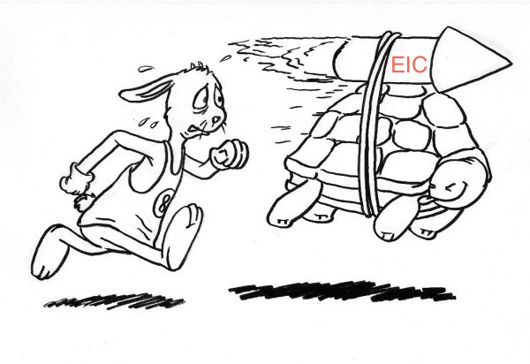



psTOF for the EIC at 0°
Mickey Chiu

Slide 36
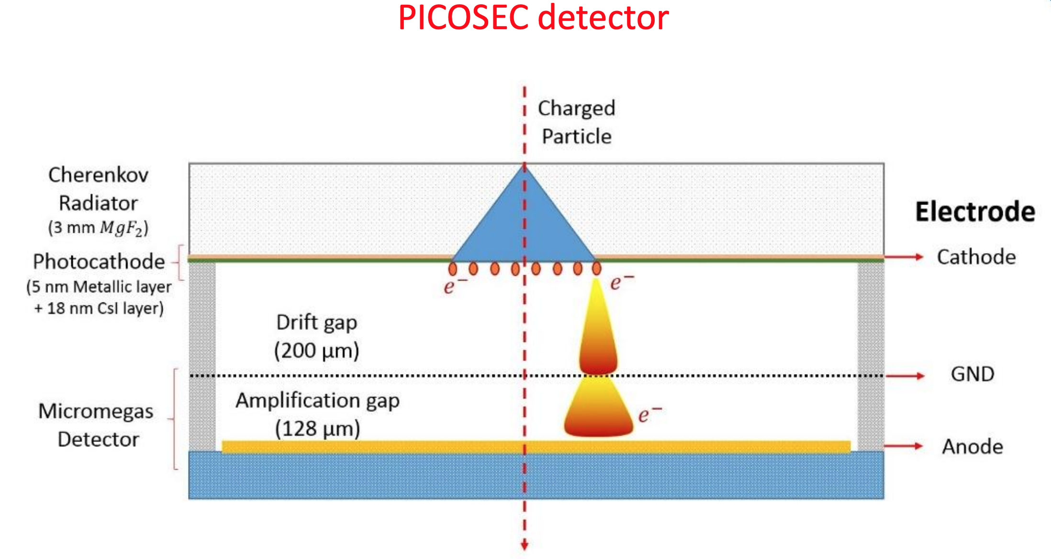
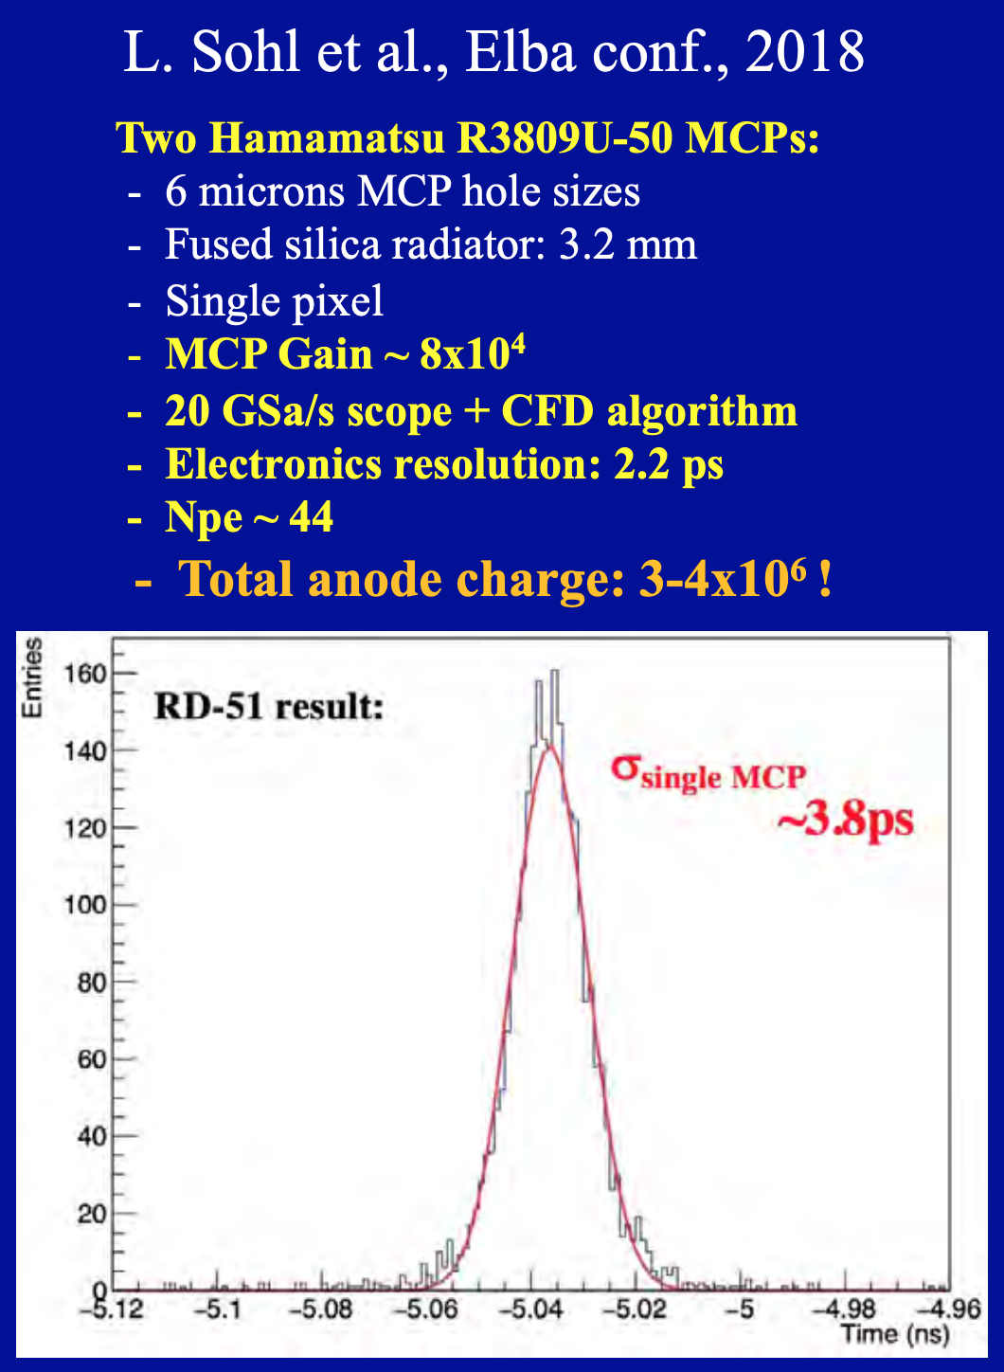
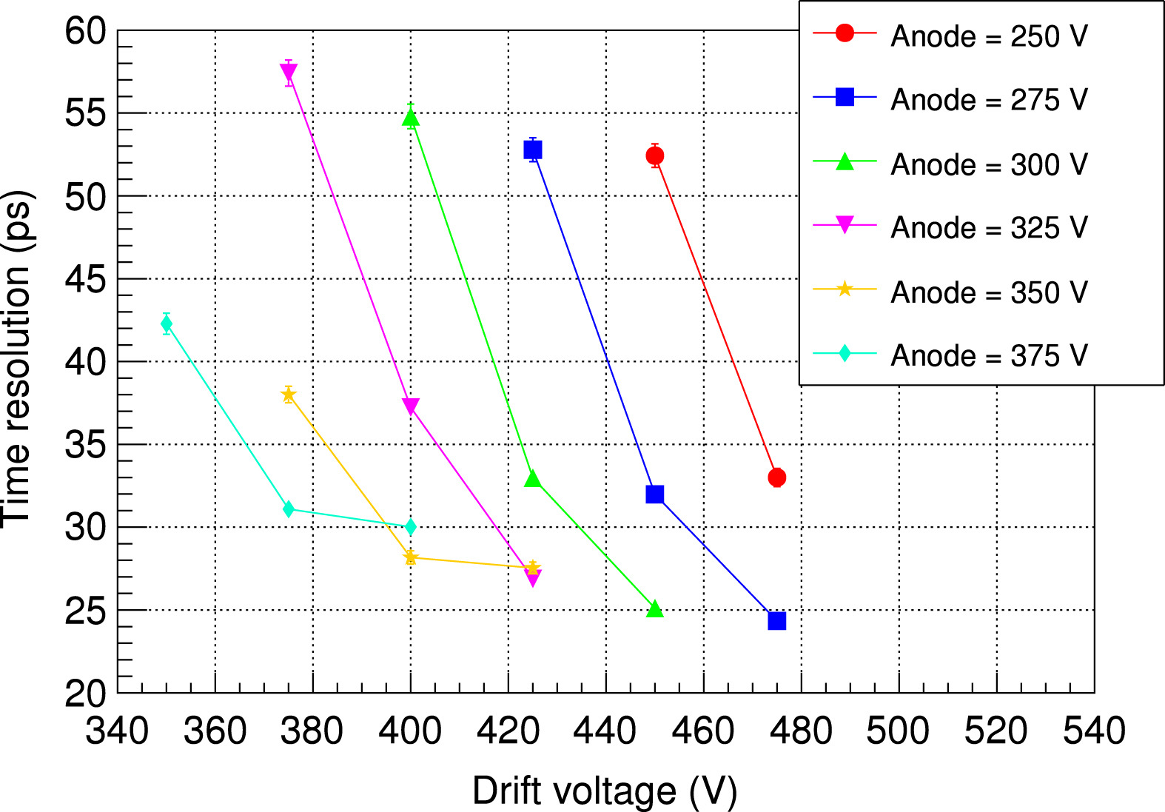
Some Other TOF Technology Today
RD51 supported PICOSEC has achieved ~25 ps
MCP-PMTs have been shown to be capable of ~5 ps since 2006 (K. Inami et al), but for very few channels, and at very high cost
  LAPPDs as a possible solution?

Slide 37
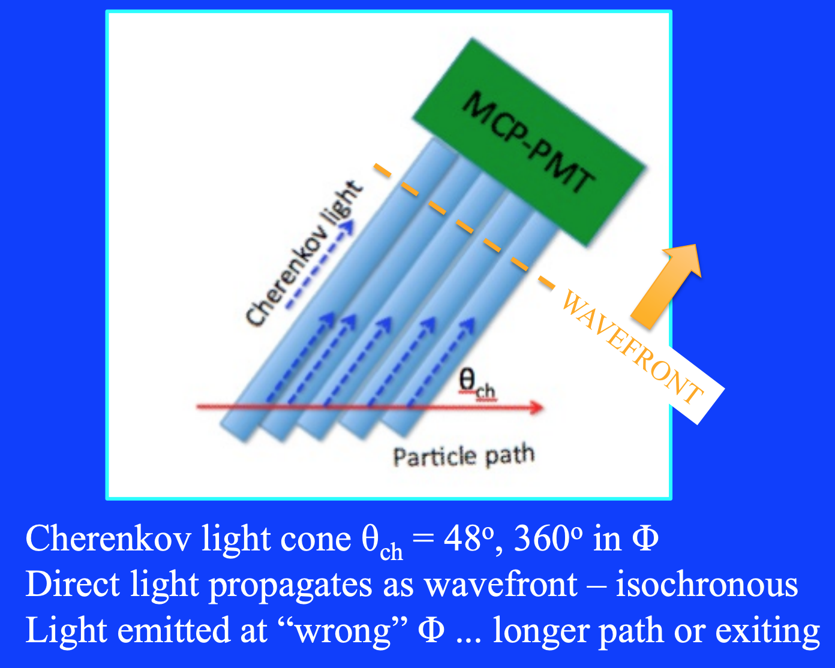
Example Design of a Very Forward psTOF
Similar design to QUARTIC detector proposed for the LHC
Rad-hard, High Rate Design

Slide 38
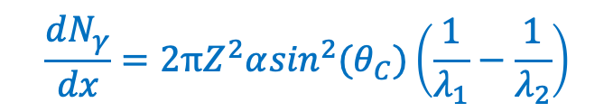
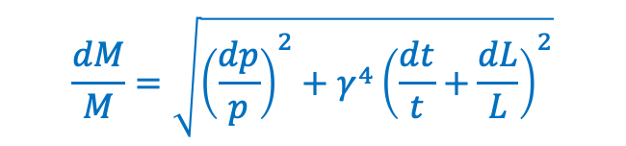
How Well Can psTOF Measure A and Z?
Mass M (A – BE in the case of Ions)
Charge Z
P_{Z}
P_{T}
$$\frac{dM}{M}=\sqrt{{\left(\frac{dp}{p}\right)}^{2}+γ^{4}{\left(\frac{dt}{t}+\frac{dL}{L}\right)}^{2}}$$
t ~ 120 ns, 𝛾 ~ 100 → dt ~ 0.1 ps for dM/M ~ 1%
Num. photoelectrons (1 cm fused silica radiator and LAPPD MCP-PMT Gen1 design):
319K ± 565, Z = 79
311K ± 557, Z = 78
Also means that in principle, the timing resolution one can achieve for the LAPPD (50 ps TTS) is
50 ps/√NPE = 0.1 ps!
$$\frac{dN_{γ}}{dx}=2πZ^{2}α\sin^{2}(θ_{C})\left(\frac{1}{λ_{1}}−\frac{1}{λ_{2}}\right)$$
Measured by magnetic spectrometer

