Slide 1
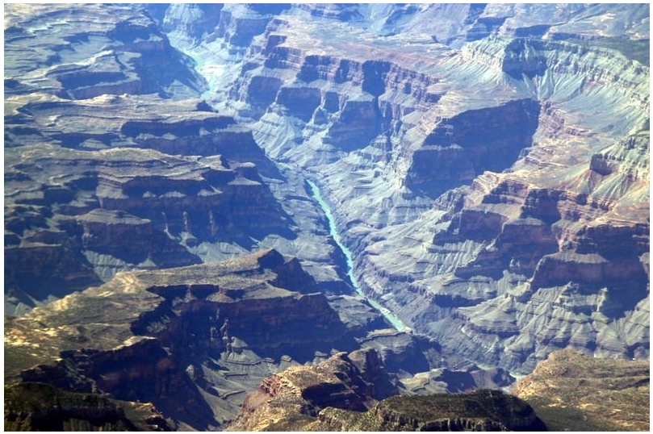
Fission on the Neutron-Rich Side
of the Valley of Stability
Walter F. Henning
SAMURAI Workshop / RIKEN / Nov 22-23, 2010
Outline of the Talk:
Why and What For ?
How ?

Slide 2
Why and What For ?

Slide 3
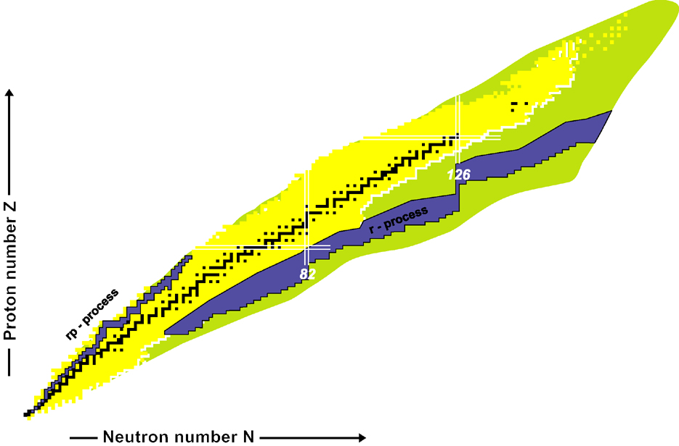
The Far North-East
of the Nuclear Chart
²³⁸U
²⁰⁸Pb
?

Slide 4
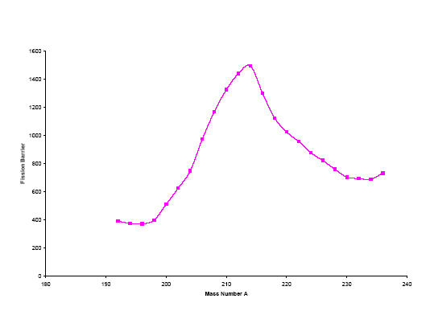
Fissility ~ Z²/A
Fission
A = constant
Peter Möller et al.
Phys. Rev. C79 (2009)
16
12
8
4
Fission Barriers of
Radium Isotopes
Fisson Brrier [MeV]
N=126
190 200 210 220 230 240
Mass Number A

Slide 5
Fissility ~ Z²/A
Fission
A = constant
W. Nazrewicz, private comm.
P. G. Reinhardt, M. Bender,
W. Nazarewicz, and T. Vertse
Phys. Rev. C 73 (2006) 014309
Peter Möller et al.
Phys. Rev. C79 (2009)
16
12
8
4
Surface Symmetry
Energy
Fission Barriers of
Radium Isotopes
Fisson Brrier [MeV]
N=126
190 200 210 220 230 240
Mass Number A

Slide 6
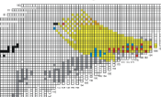
SHE
Cold fusion
Act.+⁴⁸Ca
Hot fusion
Neutron capture
r-process
The Science:
fission barriers of n-rich nuclei and (surface)
symmetry energy; fission dynamics
r-process: fission recycling and r-process
termination; element abundances (²³⁸U/²³²Th)
connection betwee hot-fusion SHE
island and mainland
Unusual GT vs 1st forbidden
Nuclear (shell) structure at the
extremes
U
r-Process production of ²³²Th and ²³⁸U
and fission termination

Slide 7
How ?

Slide 8
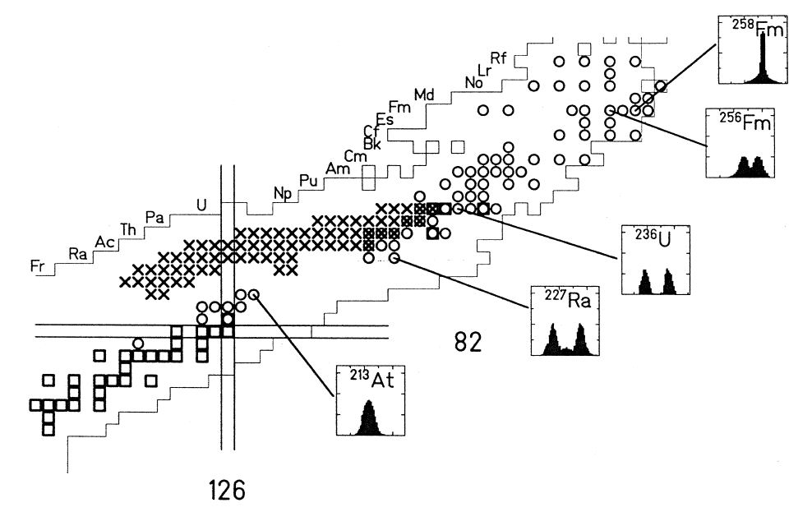
K.-H. Schmidt et al
Nucl. Phys. A 665 (2000) 221
²³⁸U
²⁰⁸Pb

Slide 9
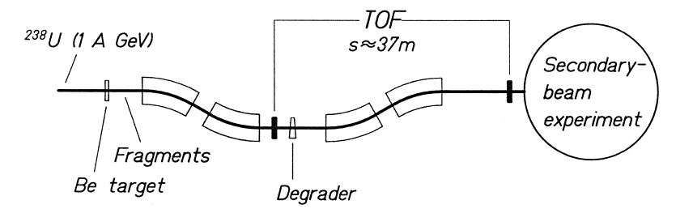
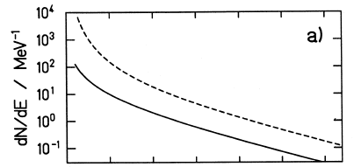
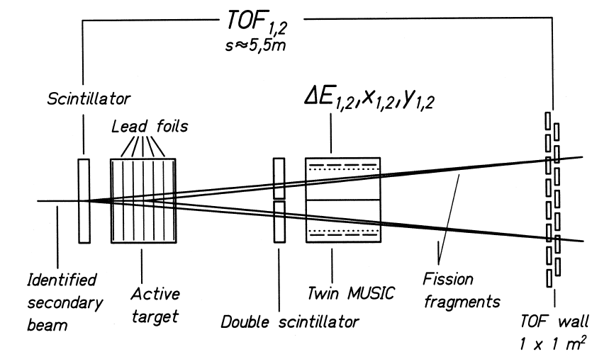
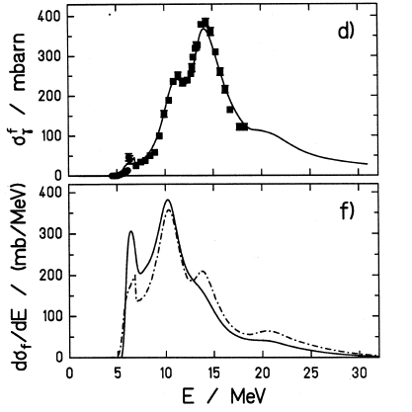
Experimental Set-up
Photo-Fission

Slide 10
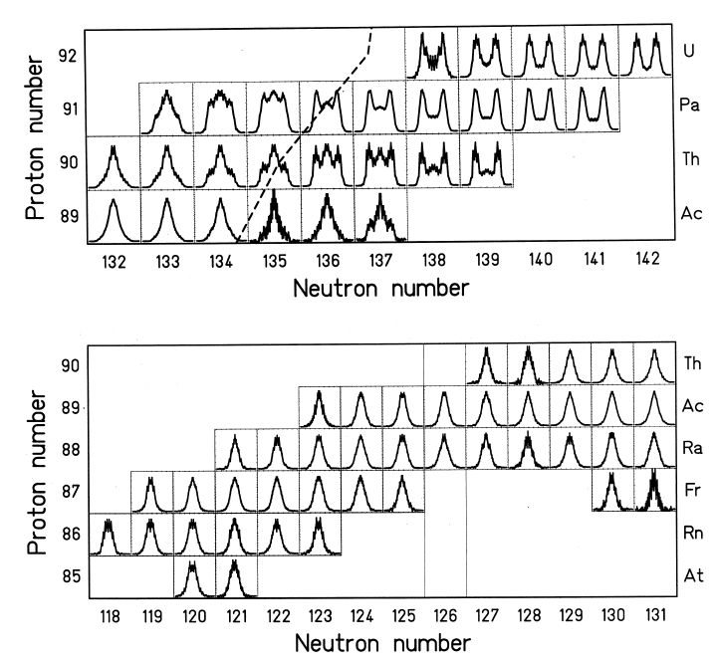
Fission-Fragment Mass Distribution

Slide 11
H. Alvarez-Pol et al
Phys. Rev C 82 (2010) 041602®
Beam: 10⁸ / sec ²³⁸U
100pb sensitivity in 2 days
Factor 5 reduction
per each additional neutron

Slide 12
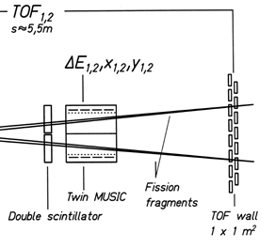
FDC2

Slide 13
Thank you !!!

