Slide 1
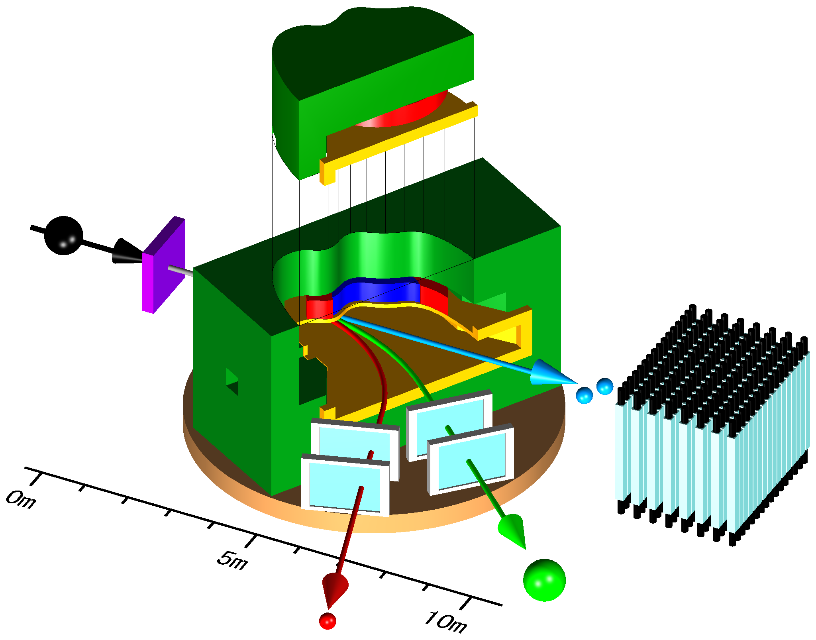
1st SAMURAI Workshop -- Toward first experiments --
T. Motobayashi
On-site construction started in October.
Commissioning experiments are to be performed in early 2012.
SAMURAI collaboration submitted a "construction proposal” to the next PAC.
On construction and physics programs in the early stage.
Workshop:
to summarize the current status of construction,
to discuss about forthcoming detector development and construction,
commissioning and following experiments.
Note: International workshop early next year.
with more extensive discussions => extension of the “collaboration”
SAMURAI collaboration (~50 people, 7 teams)
T. Kobayashi (Tohoku) – spokesperson
T. Motobayashi (Nishina)– co-spokesperson
K. Yoneda (Nishina) – project manager

Slide 2
Current member list of the SAMURAI collaboration
(based on the construction activities at present)
T. Kobayashi (Tohoku) – spokesperson
T. Motobayashi (Nishina)– co-spokesperson
K. Yoneda (Nishina) – project manager
Construction Team Member (*Leader)
Magnet and Infrastructure: H. Sato*, K. Kusaka, J. Ohnishi, H. Okuno, T. Kubo (RIKEN)
Vacuum system and Utilities: H. Otsu*, Y. Shimizu (RIKEN)
Heavy ion detectors: Y. Matsuda, K. Sekiguchi, N. Chiga, graduate students,
T. Kobayashi* (Tohoku), H. Otsu (RIKEN)
Neutron detectors (NEBULA): T. Nakamura*, Y. Kondo, Y. Kawada, T. Sako,
R. Tanaka (Tokyo Tech), Y. Satou (Seoul National Univ.)
Proton detectors: K. Yoneda*, Y. Togano, M. Kurokawa, A. Taketani, H. Murakami,
T. Motobayashi (RIKEN), K. Kurita (Rikkyo), T. Kobayashi (Tohoku),
L. Trache (Texas A&M) and the TWL collaboration
Polarized deuteron induced reaction experiment devices:
K. Sekiguchi*, T. Kobayashi, Y. Matsuda, graduate students (Tohoku)
Time projection chamber: T. Murakami* (Kyoto), T. Isobe, A. Taketani, S. Nishimura, Y. Nakai, H. Sakurai (RIKEN), W.G. Lynch (Michigan State)
and SAMURAI TPC collaboration
In-House Work Force:
Research Instruments Group (T. Kubo - Group Leader)
SAMURAI Team (T. Motobayashi*, H. Sato, Y. Shimizu, K. Yoneda)

