Slide 1
DAQ System for SAMURAI
Hidetada Baba
Research Associate
Computing and Network Team
RIKEN Nishina Center

Slide 2
Contents
Ongoing system
  Common trigger / Time stamp / FPGA
Activities
  Education / Collaboration / Hardware
  Precise timing synchonization
SAMURAI DAQ
Next faster readout system
  QTC + M-TDC / FPGA based CAMAC VME Controller
Summary

Slide 3
Ongoing system - Common trigger
Common trigger + Common dead time
  Full online event building
  CAMAC + VME
BigRIPS + ZDS + DALI
  9 CAMAC FEC+ 3 VME FEC
  Dead time = 150us/event
    It depends on the slowest front-end computer
SHARAQ
  7 VME FEC
  Dead time < 100us/event for beam line
  Dead time ~ 700us/event for focal plane

Slide 4
Ongoing system - Time Stamp
Offline event building
Beta Trigger
Beam Trigger
BigRIPS+ZDS
Beta
Gamma
FEC
FEC
FEC
FEC
FEC
FEC
FEC
FEC
CCEB
CCEB
Gamma Trigger
Time stamp
100 MHz, 48bits
Time stamp based event building

Slide 5
Time stamp based event build
Timing histogram relative to Beam timing
Coincidence window (Offset and Width) is set by human hands
  = Software coincidence
Beam
Gamma
Neutron
0
Offset Width
Time difference
We can change the coincidence configuration after experiments
Notes:
To construct event data based on the time stamp.
We make timing histogram relative to beam timing.
This coincidence window is set by human hands.
5

Slide 6
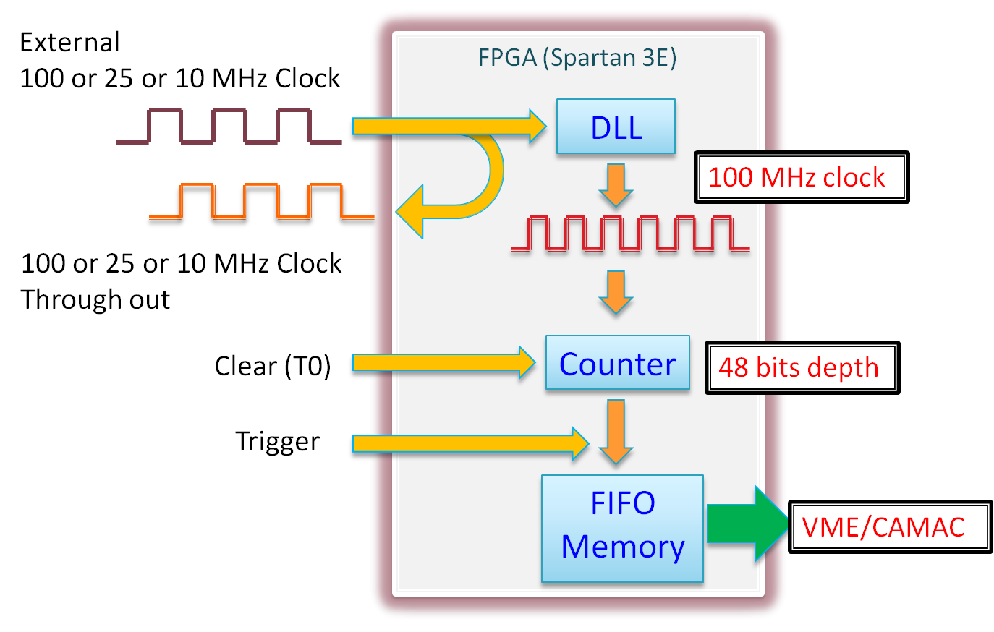
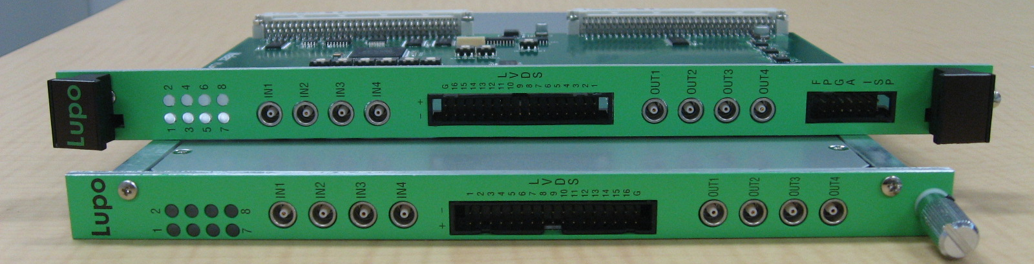
Time stamp module (LUPO)
CAMAC and VME
  Based on FPGA
  Not only for the time stamp
  Output, Interrupt
  Coincidence register
  G.G., Scaler, and so on…

Slide 7
Dead time in Time Stamping System
Common trigger + Common dead-time system
  Faster, efficient
Time stamping system
  Easy to couple different DAQ systems
  Can use individual trigger
Dead time in time stamping system
  20% dead-time for each DAQ 30-40% dead-time after event building
  10% dead-time for each DAQ 15-20% dead-time after event building
  (Very very rough estimation!)

Slide 8
Activities - Education
CNS
DAQ development for SHARAQ
FPGA Training
Rikkyo
DAQ development for Triumf
RIKADAI
DAQ support
Lecture for electronics
RIKEN
(H.B.)
TITECH
DAQ support
Osaka
DAQ support
Saitama U
DAQ support

Slide 9

Activities - Collaboration - MUST2
RIBF
(Beam line)
DAQ
MUST2
GANIL
DAQ
Experiment has been done
May&July 2010
Newly developed
software connector
for RIBF DAQ
by H. Baba, F. Saillant, M. Clotilde
ANAPAW
CAMAC
Decorder
MUST2
Decorder
MUST2
Analyzer
Tree
File
Tree
Maker
Beam line analyzer
by H.Baba, S. Takeuchi, Y. Togano, M. Nishimura,
V. Lapoux, A. Matta (Special thanks S. Ota, T. Isobe)

Slide 10
Activities - Collaboration - TUM
RIBF
(Beam line)
DAQ
The implementation of RIBF Time stamper
(LUPO) into TUM DAQ has been tested
in Jan. 2010.
TU Munchen
DAQ
TUM DAQ is based on MBS (GSI)
VME based
Distribute Clock
= Time Stamp
LUPO
ANAPAW or ROOT
CAMAC
Decorder
TUM
Analyzer
Tree
File
Tree
Maker
Beam line analyzer
Including
A, Z, Position
Time-stamp

Slide 11
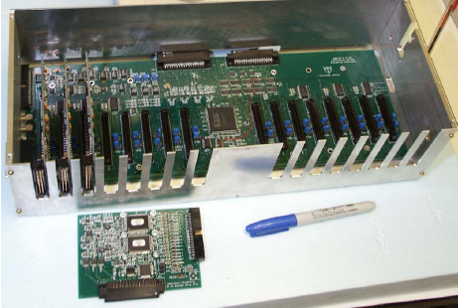
Activities - Collaboration - Samurai Si
RIBF
(Beam line)
DAQ
Washington (St. Louis), SIU, Texas A&M, RIKEN, ...
Samurai-Si (HINP) DAQ system request Time Stamping system
Samurai-Si
HINP
DAQ
Distribute Clock
= Time Stamp
LUPO
Samurai-Si HINP DAQ is based
on NSCL DAQ or RIBF DAQ
VME based

Slide 12
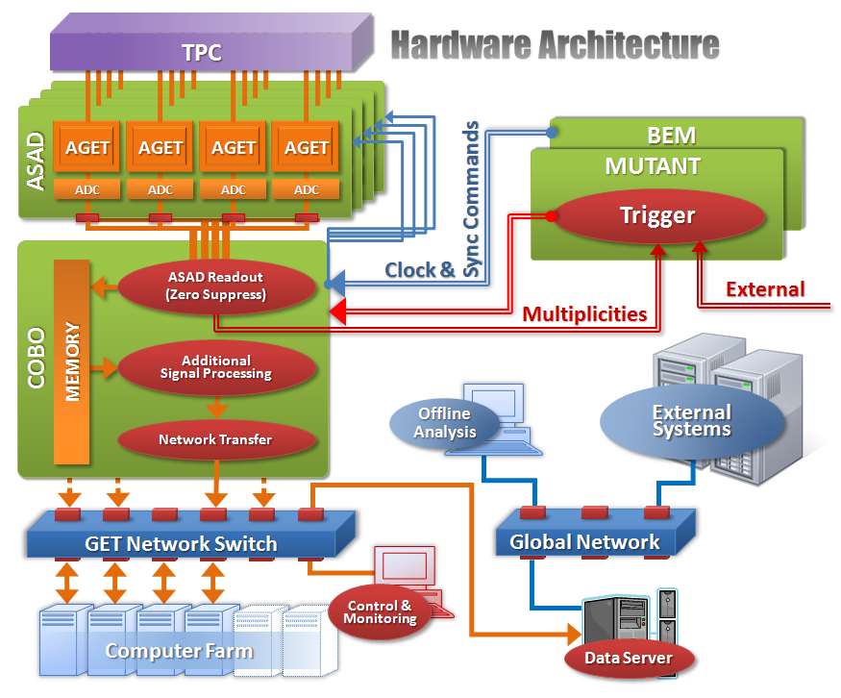
Activities - Collaboration - GET
General electronics for TPC
Self contained
  Front-end
  Data acquisition
  Analysis framework
Connectivity
  Time Stamp
  Distribute common clock
Distribute Clock
= Time Stamp
RIBF
(Beam line)
DAQ
Saclay, CENBG, GANIL, MSU, GSI, RIKEN

Slide 13
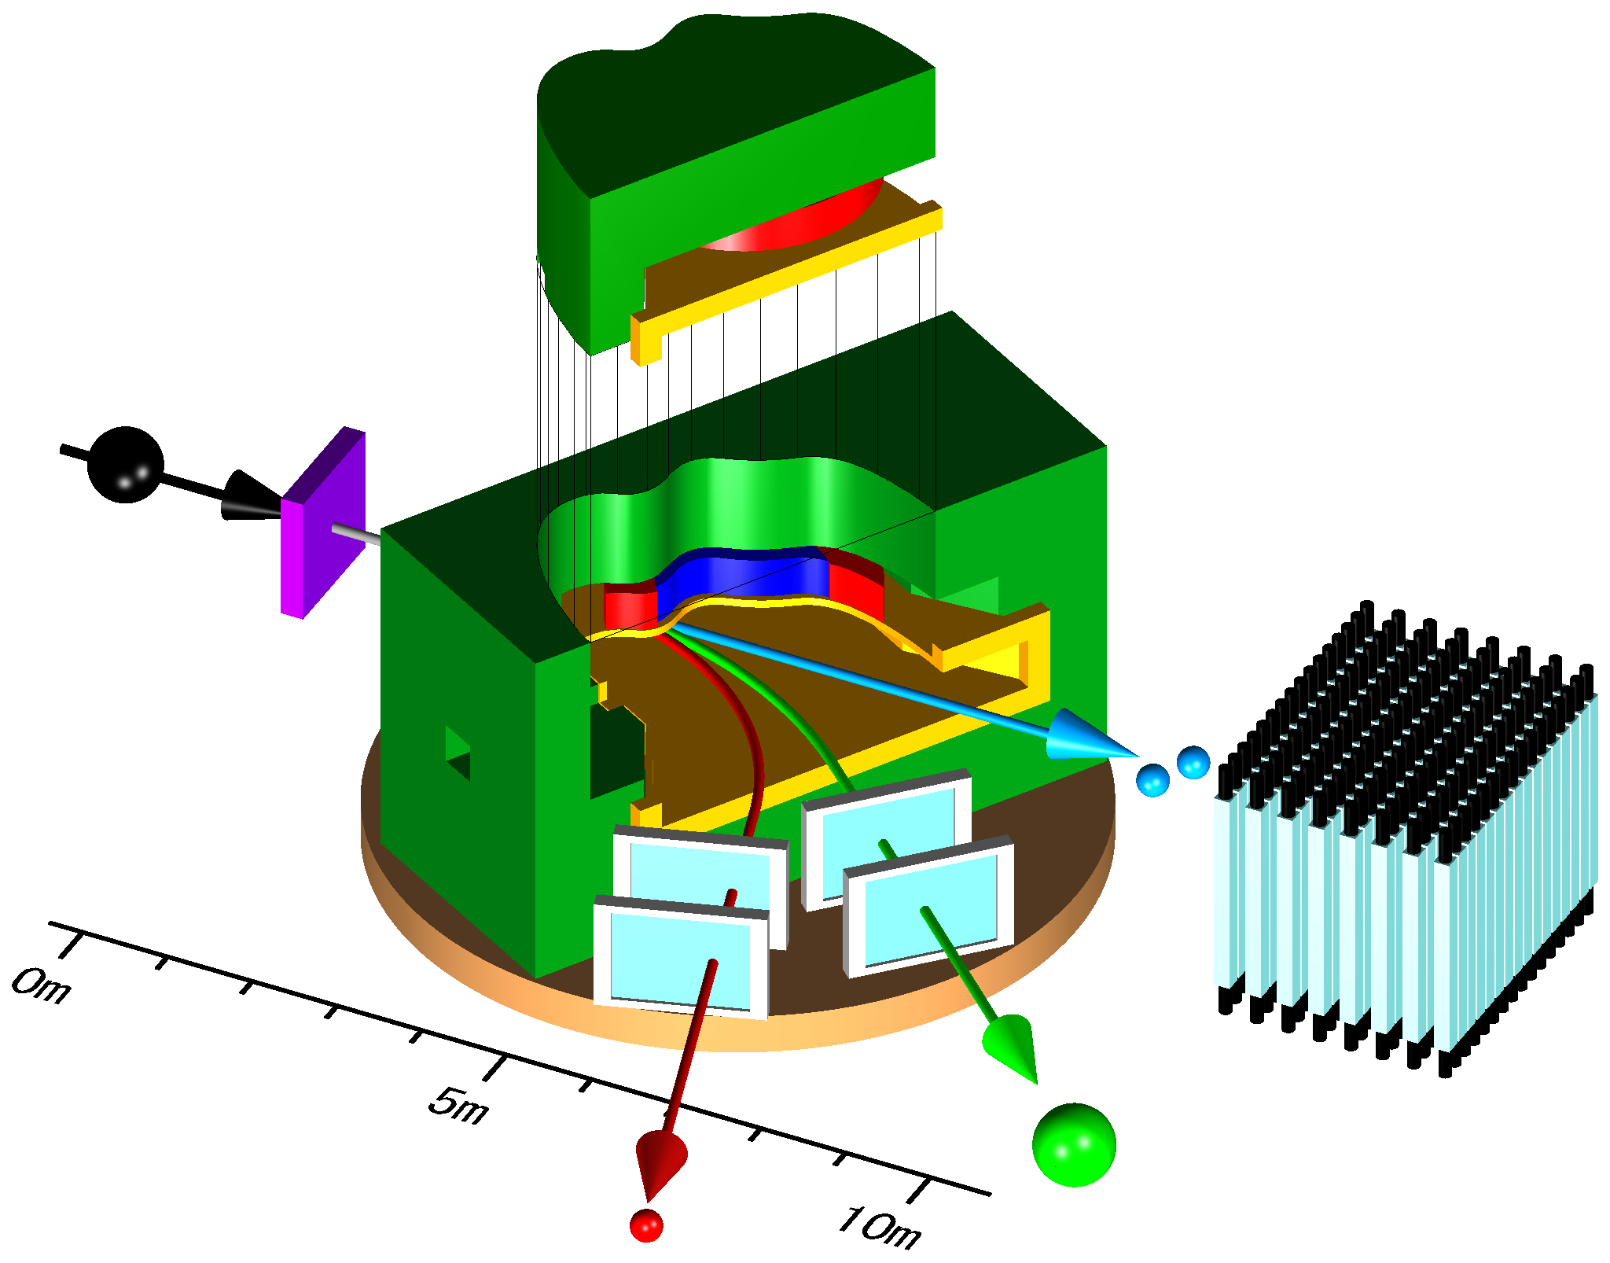
SAMURAI DAQ
Si = HINP system
TPC = GET system
Beam line
= RIBFDAQ
Gamma
= RIBFDAQ
Proton + HI + Neutron
= RIBFDAQ

Slide 14
SAMURAI + Time Stamp
Si
HINP system
Common Trigger
+ Common Deadtime
Beam line
RIBFDAQ
Gamma
RIBFDAQ
TPC
GET system
Proton + HI + Neutron
RIBFDAQ

Slide 15
SAMURAI + Full Time Stamp
If dead time is less than 10%
Gamma
RIBFDAQ
Si
HINP system
HI
RIBFDAQ
Beam line
RIBFDAQ
TPC
GET system
Neutron
RIBFDAQ
Proton
RIBFDAQ

Slide 16
Analysis with Time Stamp
Si
HINP system
TPC
GET system
Beam line
RIBFDAQ
Time Stamp
Energy
Position
Time Stamp
PID
Tracking
Time Stamp
PID
Tracking
Construct event
as you want!

Slide 17
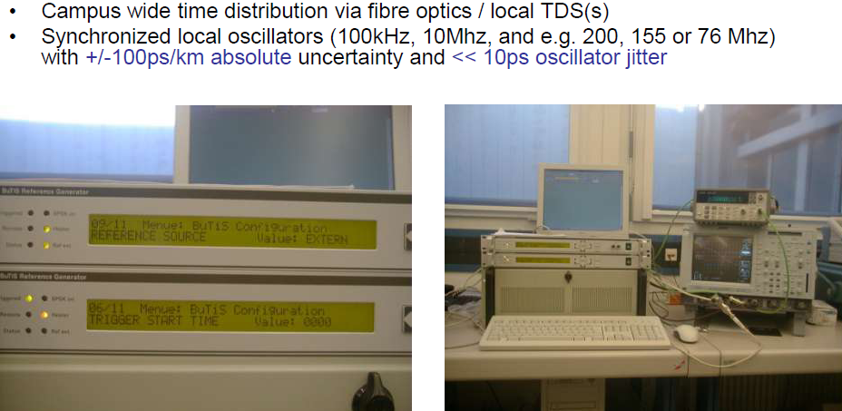
Next step - Precise timing synchronization
BuTiS by GSI
  < 100ps/km uncertainty
  TOF measurement is available based on time stamp
  Ultra long range TDC (1 day with <100ps resolution)

Slide 18
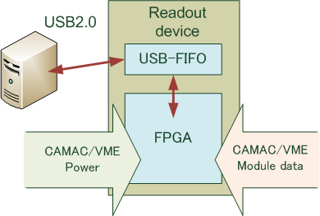
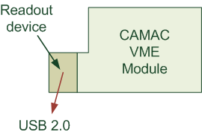
Fast DAQ - Mini Controller
Develop small FPGA based CAMAC/VME controller
Completely parallel readout data from modules
Dead time with existing CAMAC/VME moudles
  CAMAC < 40us/event (including conversion time)
  VME < 20us/event (including conversion time)
  10 - 20kcps trigger is OK (dead-time < 40%)
a part of my Grant-in-Aid

Slide 19
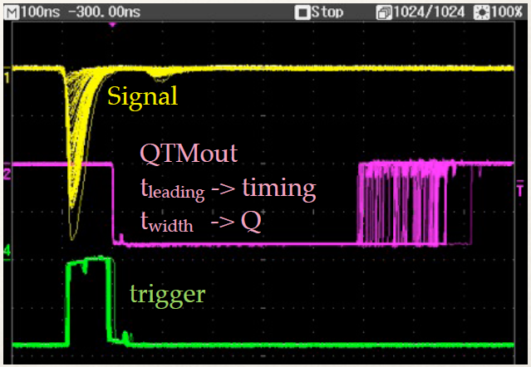

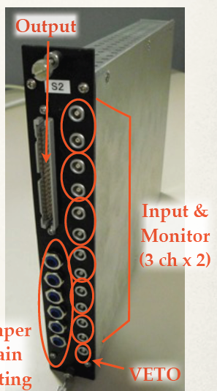
Fast DAQ - QTC + V1190 multihit TDC
Charge-to-Time converter
  500ns dead-time/hit
  Wide dynamic range
    0 - 2500 pC
With V1190 multihit TDC
  100ps LSB
  10ns dead-time/hit
100kcps DAQ is available
  Dead time < 5us/event
  For Plastic, PPAC, NaI, LaBr
+
Already working for SHARAQ experiments

Slide 20
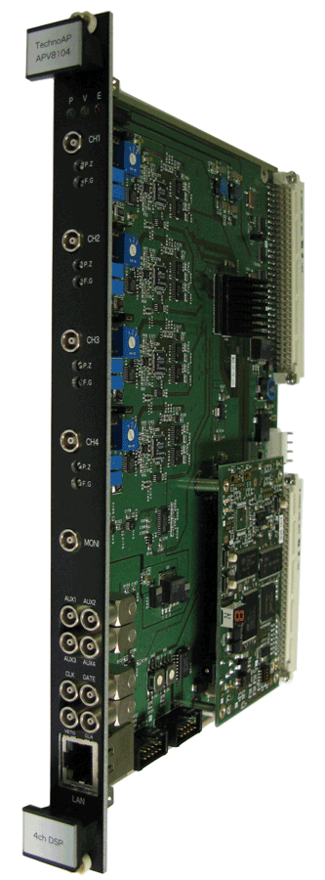
Digital pulse shape with Ge Detector
For beta-gamma experiments
  Nishimura-san, RikaDai Group
Energy and Timing determination by FADC + FPGA
  Small dead time (few us)
Including Time Stamp function
  Synchronized with RIBFDAQ’s time stamp
Already used in 2009 beta-gamma experiment

Slide 21
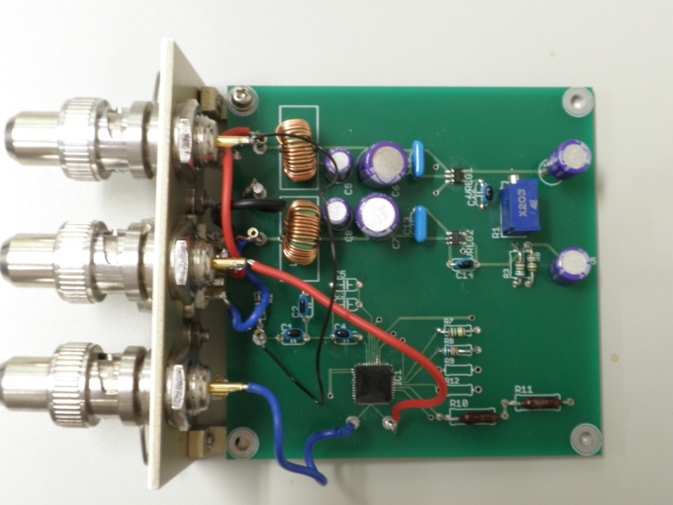
Advertisement - Circuit development
Even in ASIC, now Nishina Center can develop (by M. Kurokawa, detector team)
PCB by M. Kurokawa
Pre-Amplifier ASIC by M. Kurokawa

Slide 22
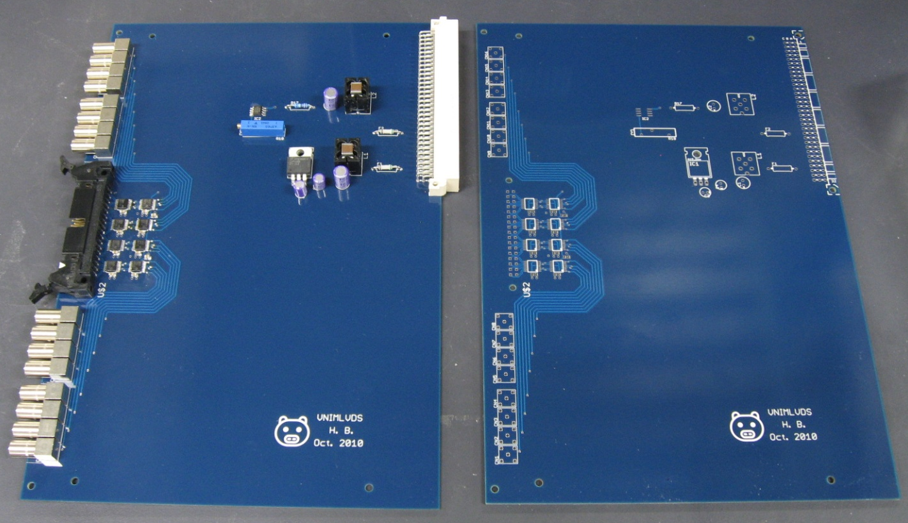
Advertisement - Circuit development
VME NIM-to-LVDS converter
  PDB is designed by H. B.
  Cost is only 25,000 yen/module (including connectors)

Slide 23
Summary
SAMURAI
  Common trigger + Common dead time system
    Beam line, Neutron, Heavy Ion
  Time Stamp
    Si, TPC
Analysis framework
  Let’s discuss
Please keep in mind
  Students who want to develop DAQ soft/hard is welcome
  Precise timing synchronization (100ps resolution with 1 day range)
  Fast readout system for CAMAC and VME (10 - 100 kcps trigger)
  Now, we can design new DAQ hardware by our hands
    Analog part = ASIC by Detector Team
    Digital part = New commercial ICs (LVDS, PLL, FPGA, not ECL)
    The barrier of hardware development has been reduced

Slide 24
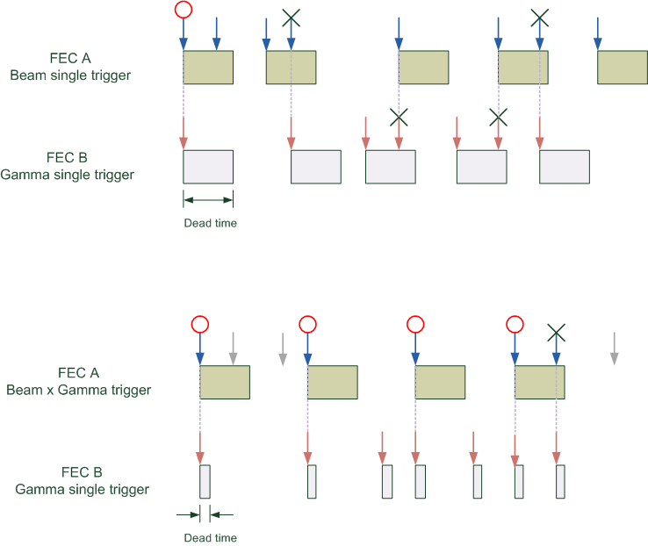
Dead time problem in Time Stamping

Slide 25

Dead time in Time stamping
Dead time of the mixed system is not simple
  Different dead time / trigger rate
  We cannot know the system dead-time by scaler
  Simulation / Dead time monitor by dead-time-free time-stamper
Trigger for DAQ A
Trigger for DAQ B
Dead time free
Time stamper
Trigger for DAQ C
Trigger for DAQ D

Slide 26
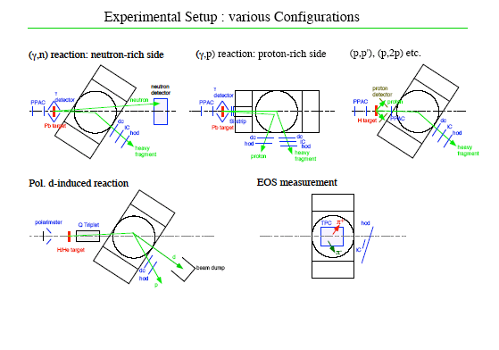
SAMURAI DAQ

Slide 27
SAMURAI DAQ
Common trigger + common dead time is available
BigRIPS + HI + Neutron
Option = Time Stamp
  Beam x Hodo
  Neutron single
  Gamma single

Slide 28
SAMURAI DAQ
Time Stamp
BigRIPS + HI + Proton
Si system (HINP DAQ)
  Can be common trigger but “common dead time” is difficult

Slide 29
SAMURAI DAQ
Common trigger + common dead time is available
BigRIPS + HI + Proton

Slide 30
SAMURAI DAQ
Single crate DAQ

Slide 31
SAMURAI DAQ
Time Stamp
BigRIPS + IC + Hodo
TPC = GET system

Slide 32
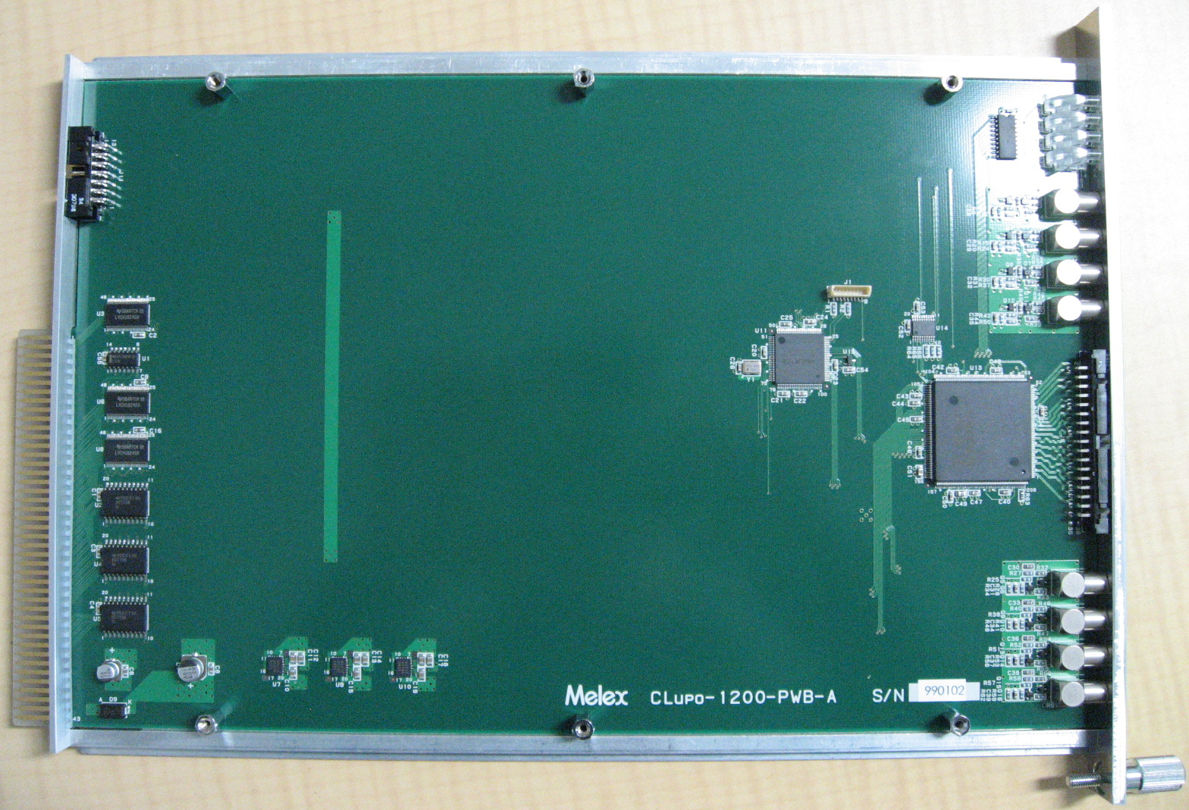
CAMAC Module
8 LED
CAMAC Interface
(CPLD)
4 NIM IN
Internal
Oscillator
(50 MHz)
16 LVDS
32 LVTTL
IN/OUT
CAMAC Bus
User FPGA
(Spartan 3E)
4 NIM OUT

Slide 33
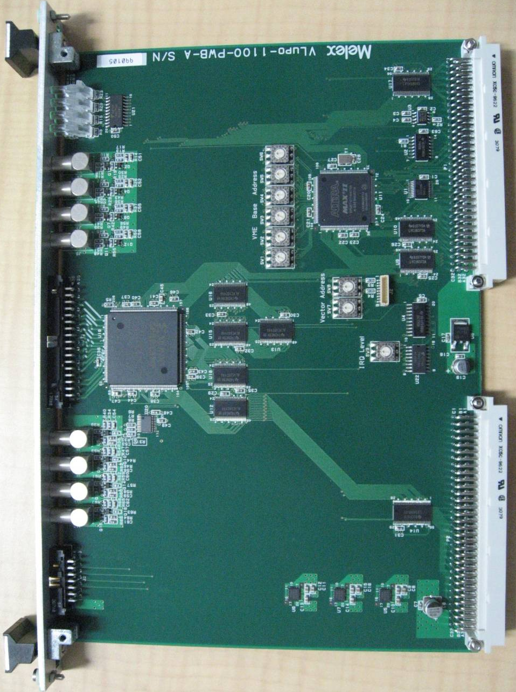
VME Module
VME Interface
(CPLD)
8 LED
4 NIM IN
16 LVDS
32 LVTTL
IN/OUT
User FPGA
(Spartan 3E)
4 NIM OUT

Slide 34
FPGA circuit
External
100 or 25 or 10 MHz Clock
FPGA (Spartan 3E)
DLL
100 MHz clock
100 or 25 or 10 MHz Clock
Through out
Clear (T0)
Counter
48 bits depth
Trigger
FIFO
Memory
VME/CAMAC

Slide 35
Activities - In house
Software
  Device driver
  Event builder
  Web utility
  Analysis software
Hardware
  FPGA
  Handmade module
Management
  Storage
  Computing system
Support
  DAQ for experiments
  User Training

Slide 36
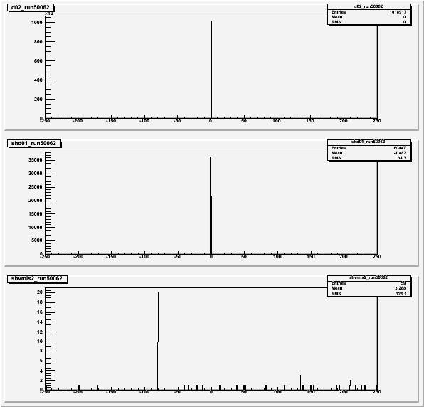
SHARAQ 2009
BigRIPS
SHARAQ BLD
SHARAQ S2
Time stamp

Slide 37
SHARAQ 2009
1000000 / 1000000
BigRIPS
60000 / 85000
SHARAQ BLD
60 / 2000
Coincidence
= Accepted 3%
SHARAQ S2
Time stamp

Slide 38
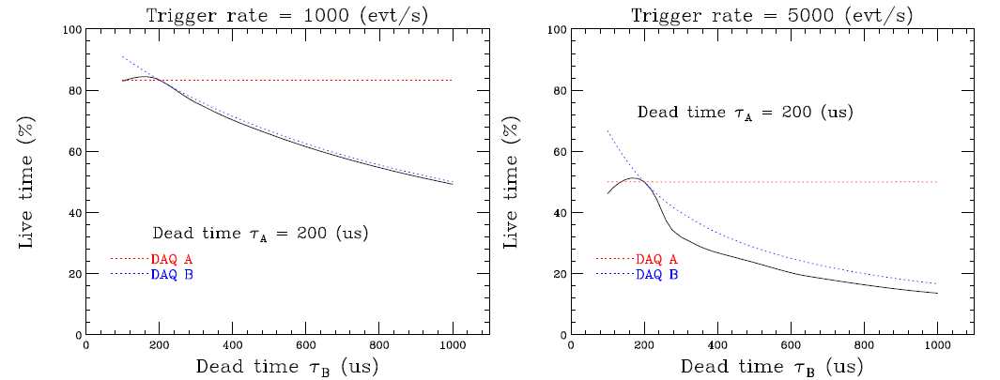
Dead time simulation
2 DAQ system (CAMAC)
Common trigger, non dead-time sharing

Slide 39
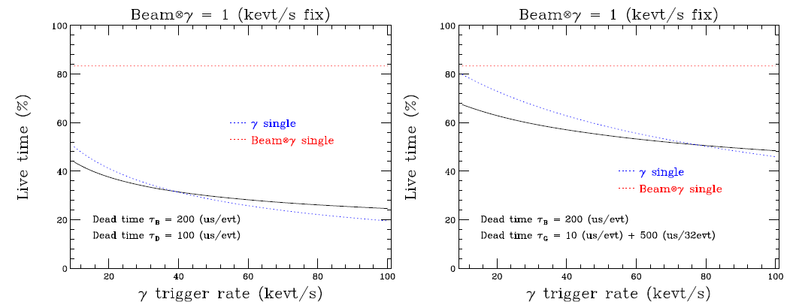
Dead time simulation
2 DAQ system
Beam DAQ = Beam x gamma trigger = 1kcps fix (CAMAC)
Gamma DAQ = Gamma trigger = 0 to 100 kcps
V792 + V775 (Event by event readout vs Multi event buffer)

Slide 40
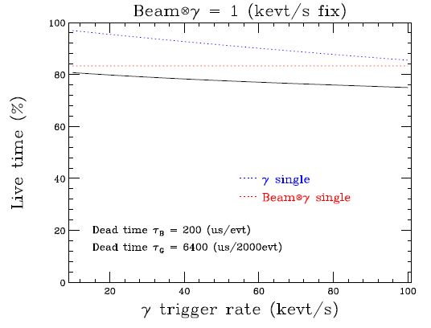
Dead time simulation
2 DAQ system
Beam DAQ = Beam x gamma trigger = 1kcps fix
Gamma DAQ = Gamma trigger = 0 to 100 kcps
QTC + CAEN V1190

