Slide 1
Status of Track/Event Start Counters
23 Jan. 2020
RPC Meeting
H. Sako

Slide 2
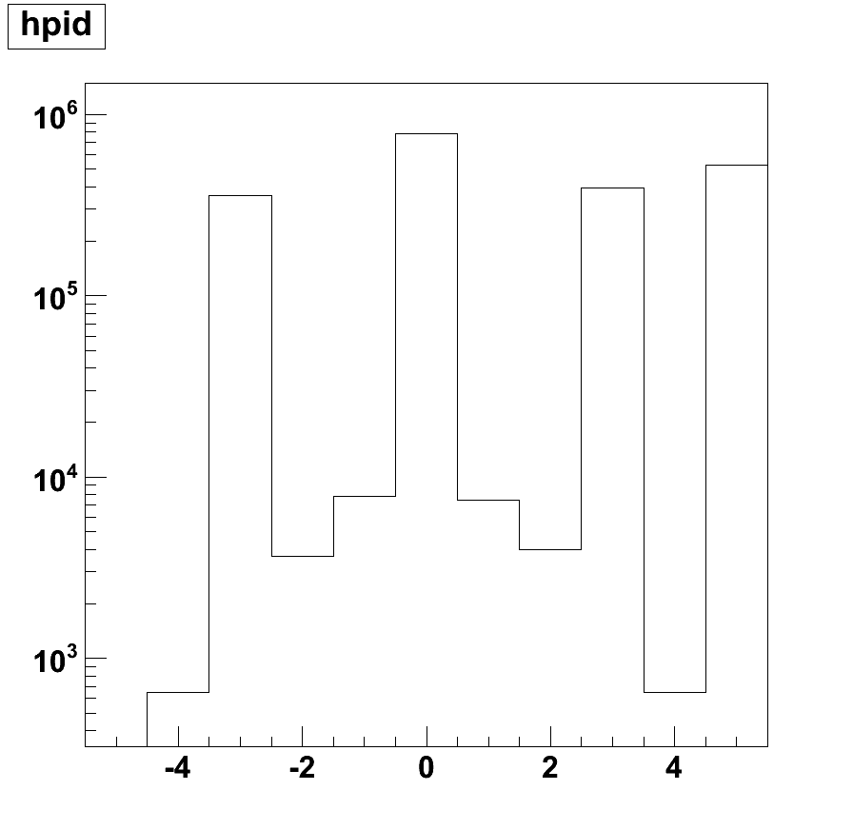
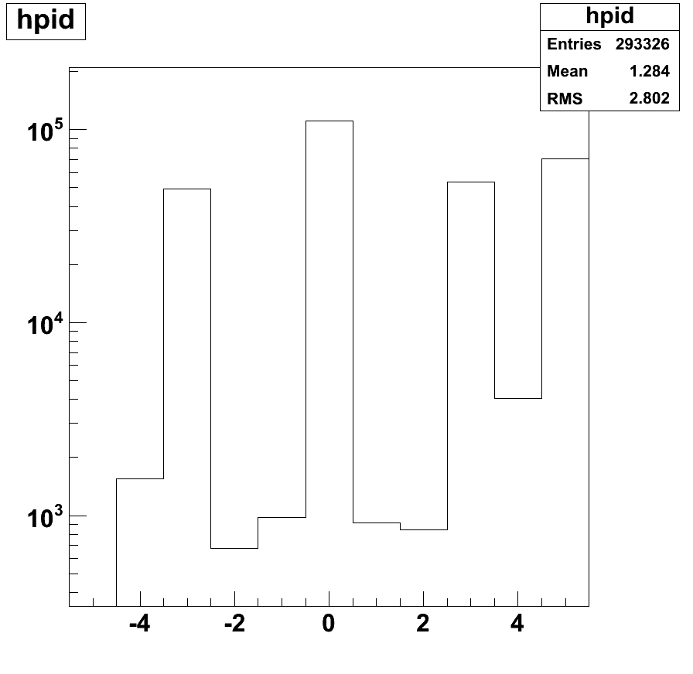
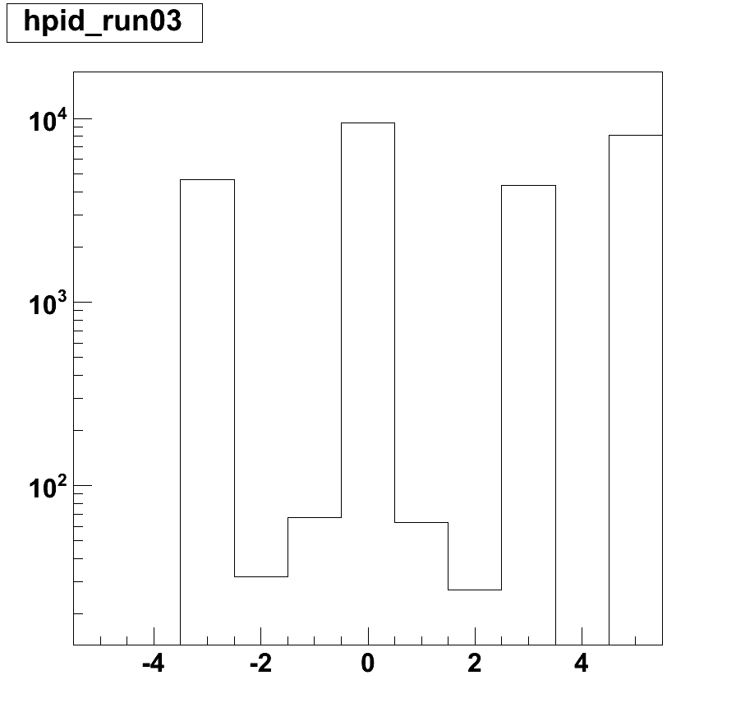
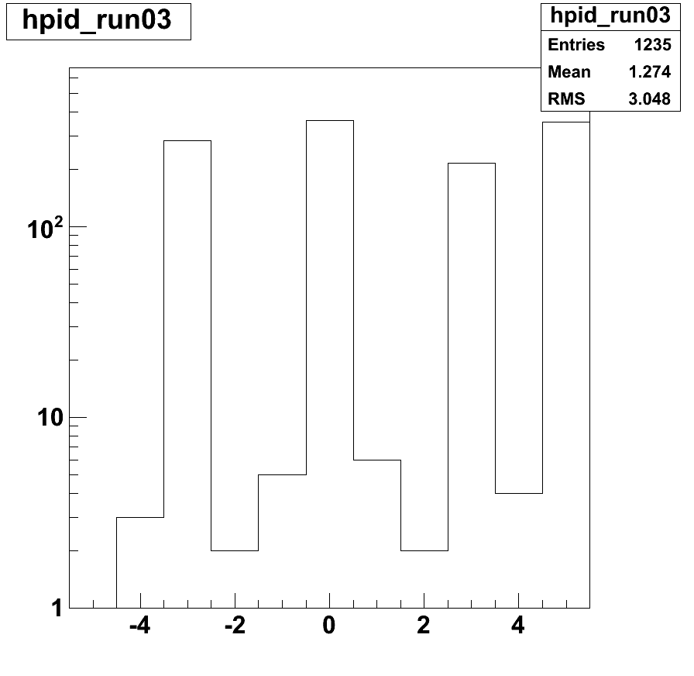
Particle species (Bug found in JAM data → GEANT input data)
Before bug fix
After bug fix
Νπ+~ Νπ-~Np
K/π (4π) ~ 0.03
K/π (φ=120º) ~0.01
others
K+
π-
π+
p
All
e-
e+
μ+
μ−
K-
PID
φ=120^{ο}

Slide 3
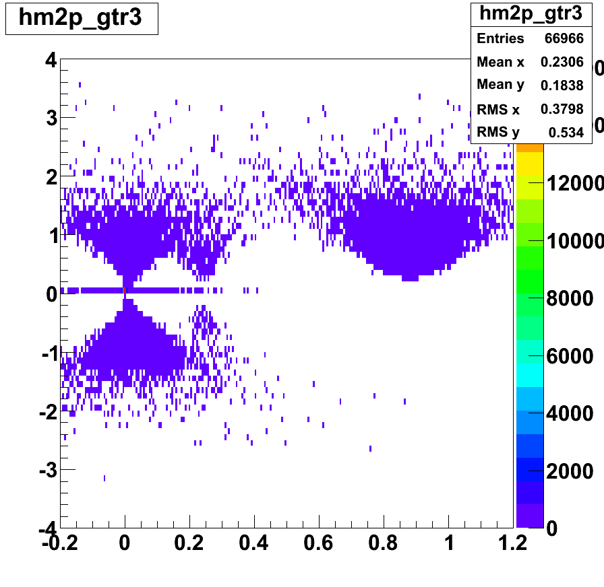
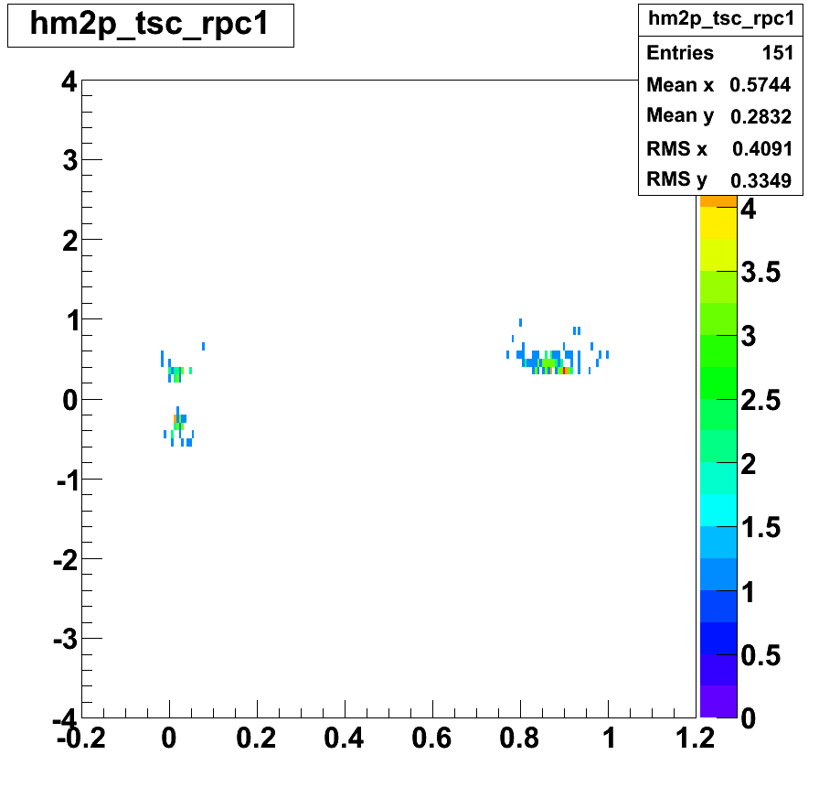
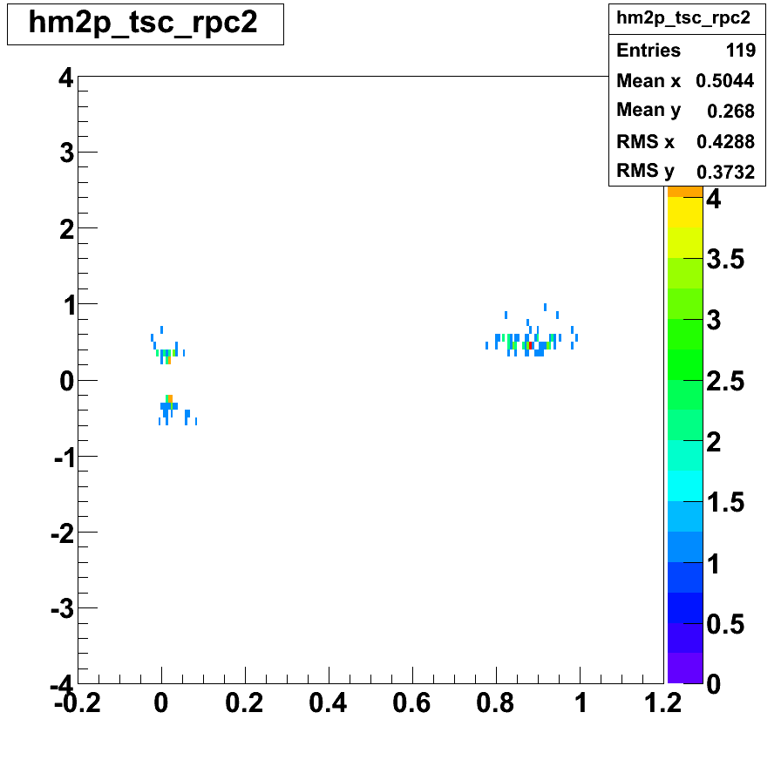
M² vs p/q

Slide 4
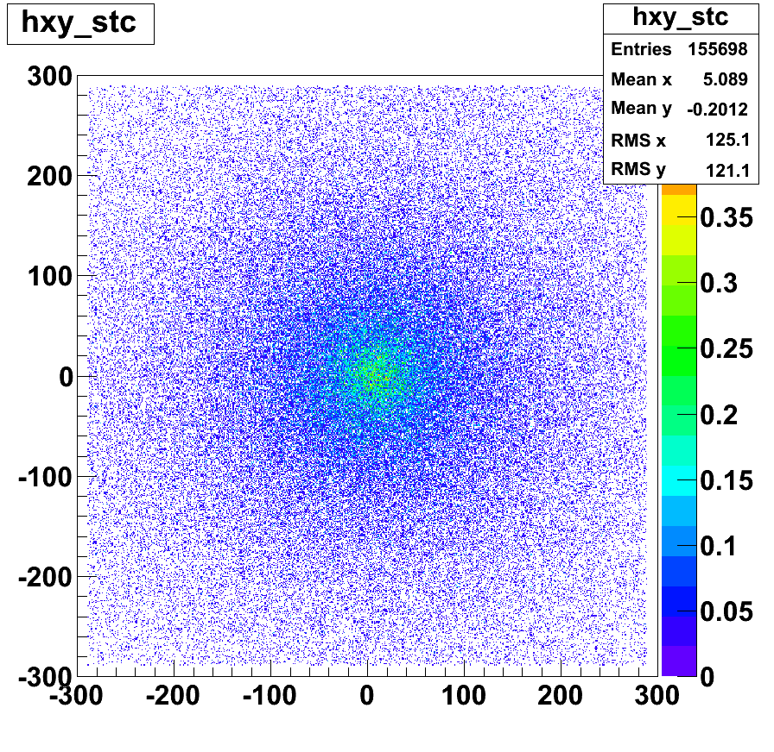
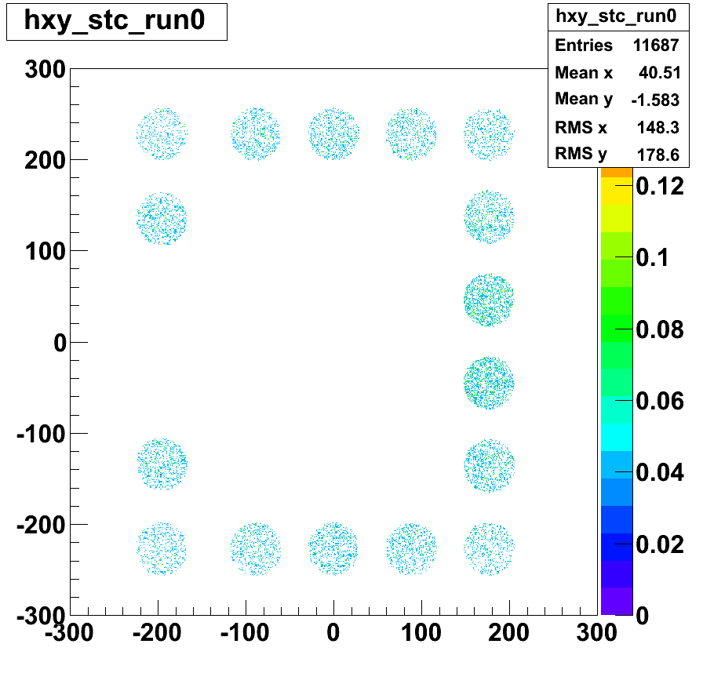
Event Start Counter Simulation

Slide 5
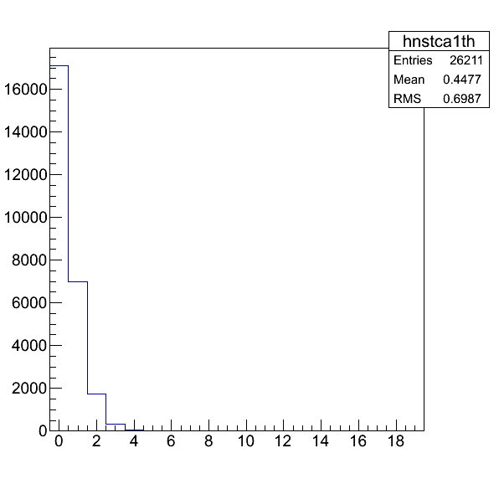
Multiplicity distribution of ESC

Slide 6
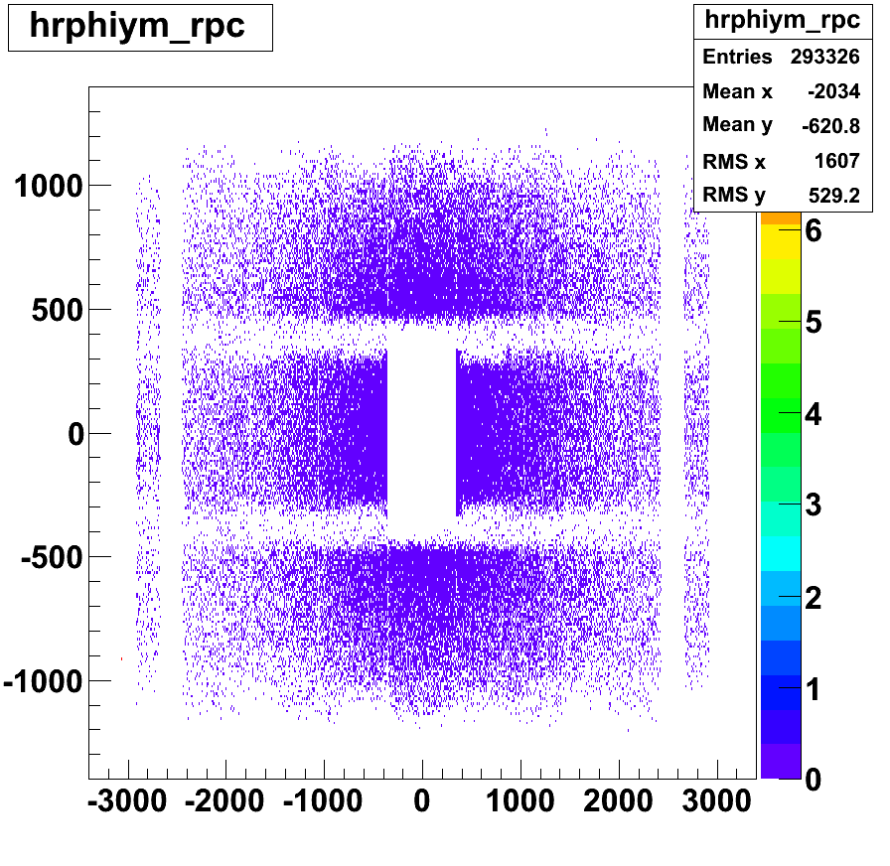
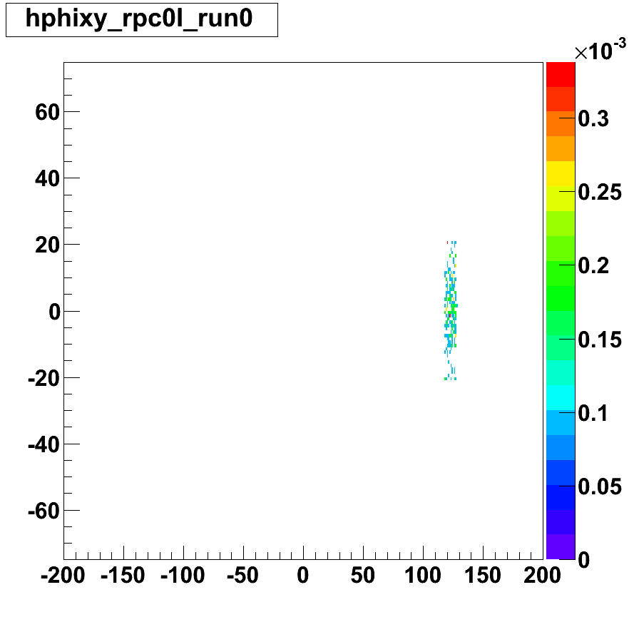
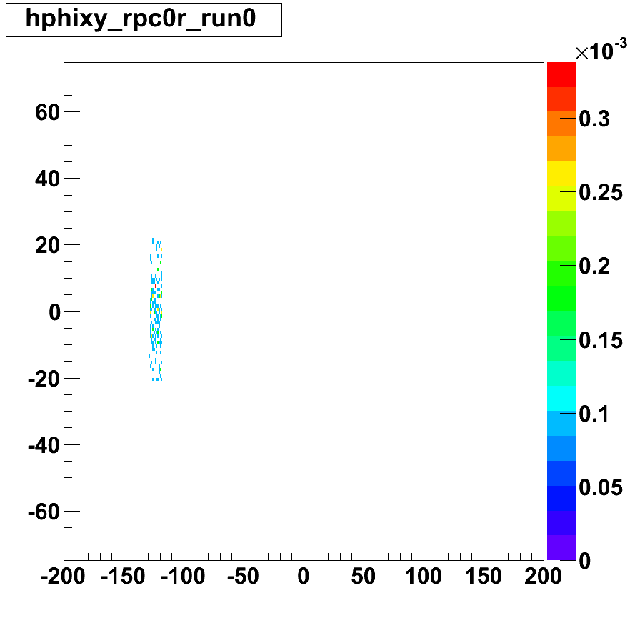
RPC Simulation

Slide 7
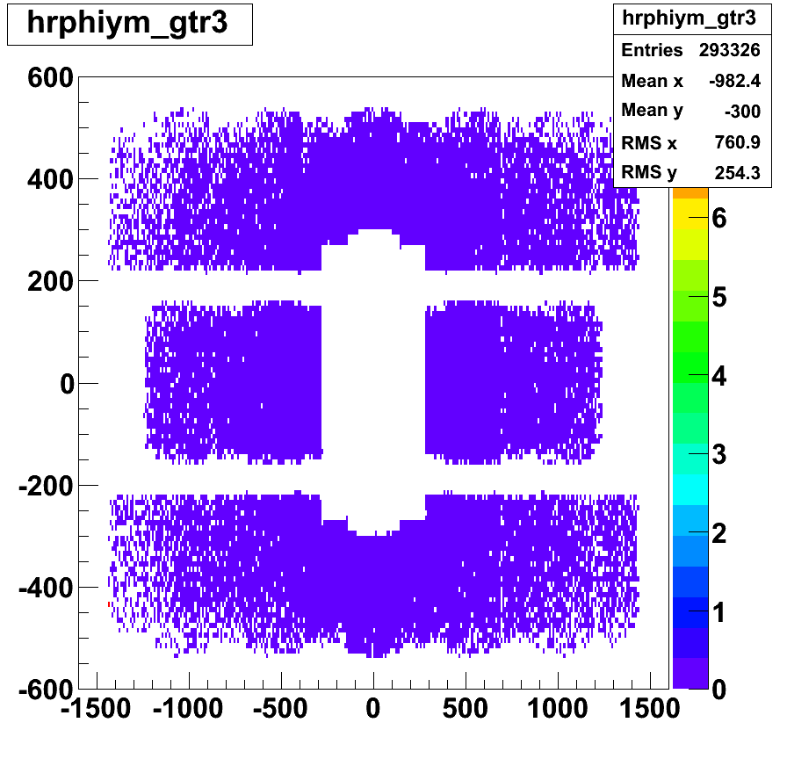
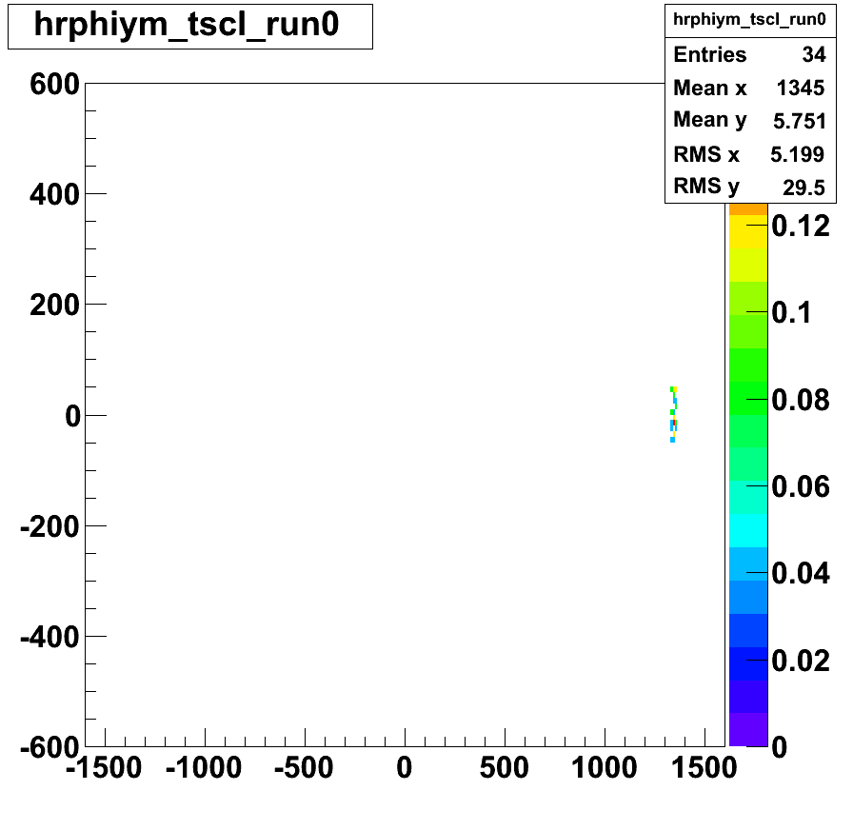
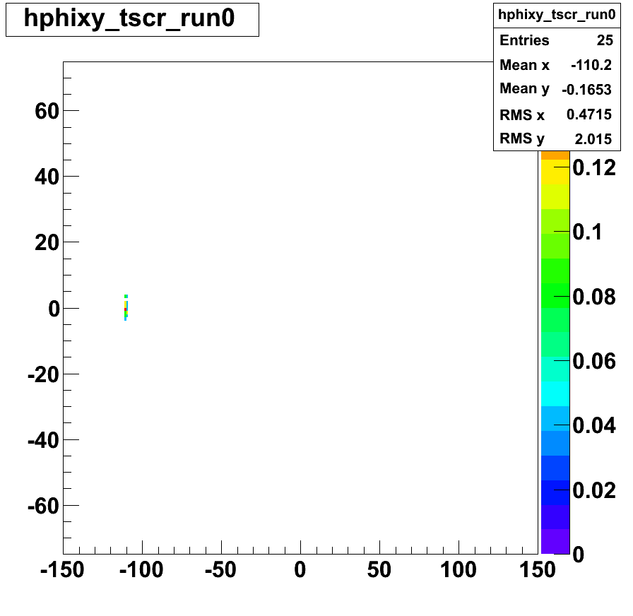
Track Start Counter Simulation

Slide 8
Rate study (p+Cu)
 | Rate / event | Rate at 10MHz interaction
ESC (M>=1) | 0.348+-0.004 | 3.48 MHz
ESC (M>=2) | 0.081+-0.002 | 0.81 MHz
ESC (M>=3) | 0.0152+-0.0008 | 0.152 MHz
ESC (M>=4) | 0.0026+-0.0003 | 0.026 MHz
MRPC (inner, proton side) | 0.0208+-0.0009 | 0.208 MHz
MRPC (inner, pbar side) | 0.0147+-0.0007 | 0.147 MHz
MRPC (outer, proton side) | 0.0177+-0.0008 | 0.177 MHz
MRPC (outer, pbar side) | 0.0137+-0.0007 | 0.137 MHz
TSC (proton side) | 0.0013+-0.0002 | 0.013 MHz
TSC (pbar side) | 0.0010+-0.0002 | 0.010 MHz

Slide 9
Schedule
By Jan 22
Remove caps of PMTs (done)
Assemble EST support (done)
Acryl Radiator delivered
Jan 23-31
Light shielding of the PMT’s, test of PMT’s
Attach PMT’s in the EST support
Test with cosmic ray
Jan 24-31
TSC assembly and test (90Sr source)
Installation of TSC
Test with 90Sr source
Feb 5-6
Installation of ESC

Slide 10
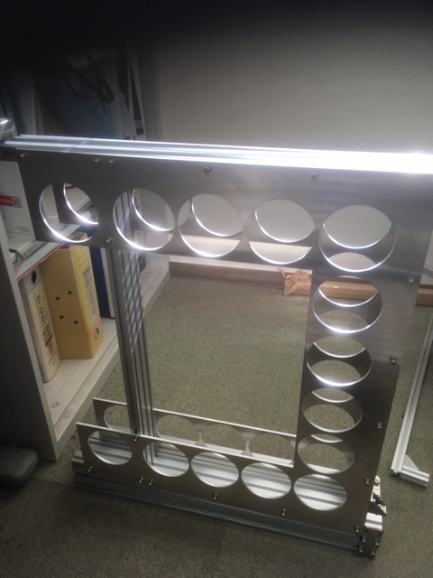
EST frame assembly
We can test the timing among PMT’s and the multiplicity trigger using cosmic ray

Slide 11
Test of TSC
⁹⁰Sr source, or cosmic ray
Collimator

Slide 12
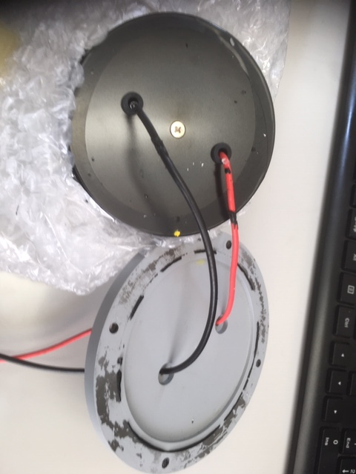
How to remove cap of PMT
It was much easier to cut the cap than to enlarge holes

Slide 13
Test at E16 area before the beam
Measurement with HRTDC’s with a local PC
Test of TSC, 2 MRPC’s and the back counter with cosmic ray
Test of ESC PMT’s with cosmic ray with partial multiplicity trigger
What we can do
Check of signal / noise
Gain and threshold setting
Tuning of timing and for trigger logic

Slide 14
Backup

Slide 15
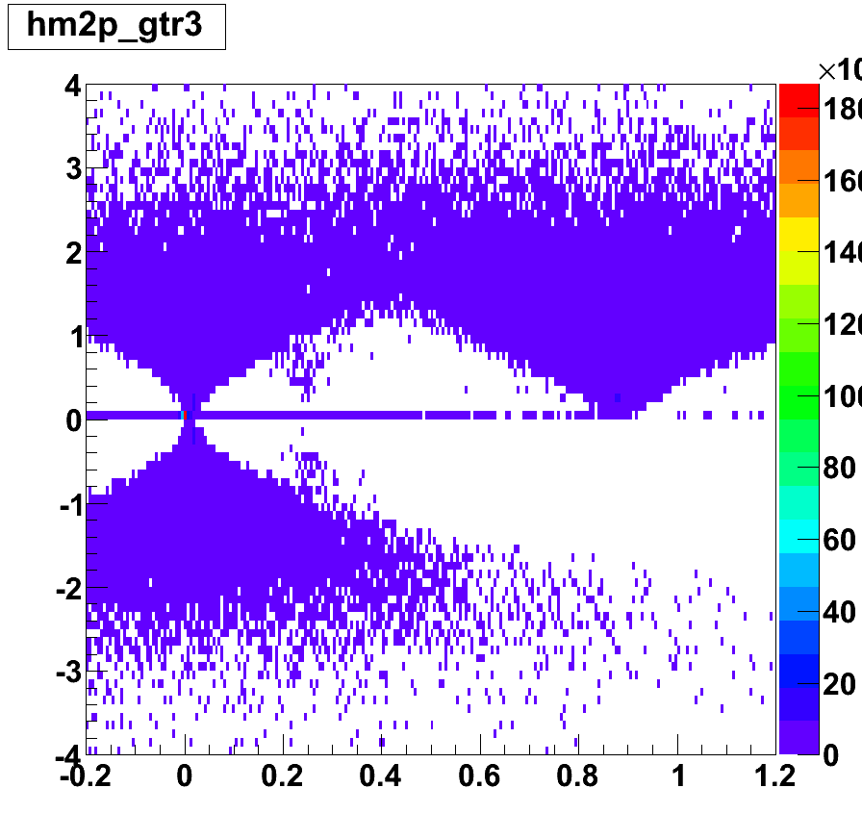
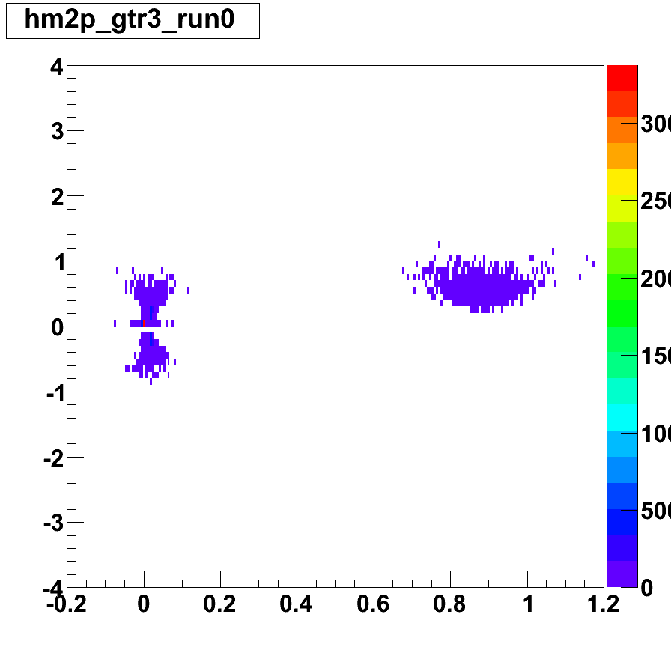
M2 vs p with TSC (R=0.7m) and RPC with resolution 60ps and 70ps
P and pi can be separated
Almost no K
To evaluate resolution should we install a small scintillation counter in the back side of RPC?
φ=120o+-15o
All sections

Slide 16
How to remove cap of PMT
Open large holes around the wires

Slide 17
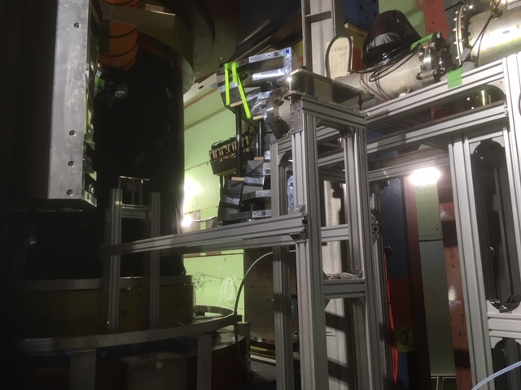
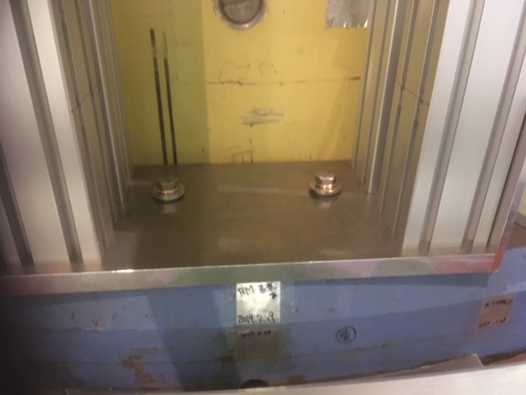
EST support frame on E16

Slide 18
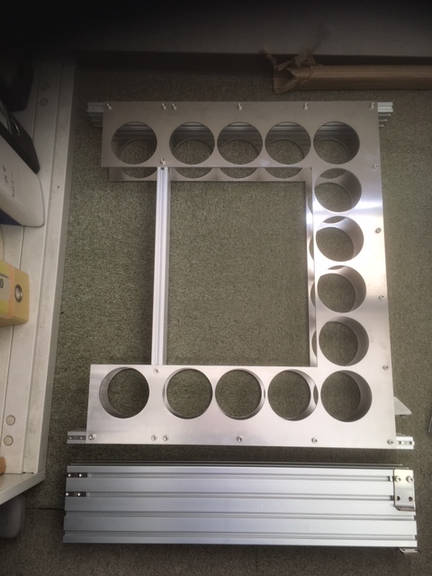
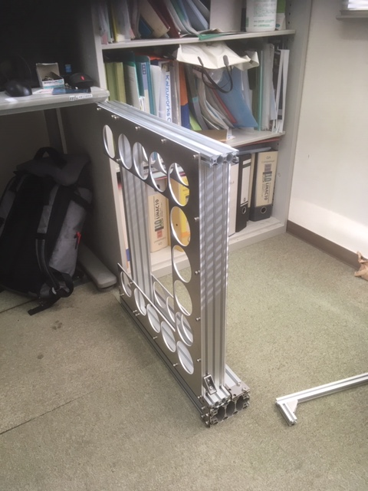
EST frame assembly

Slide 19
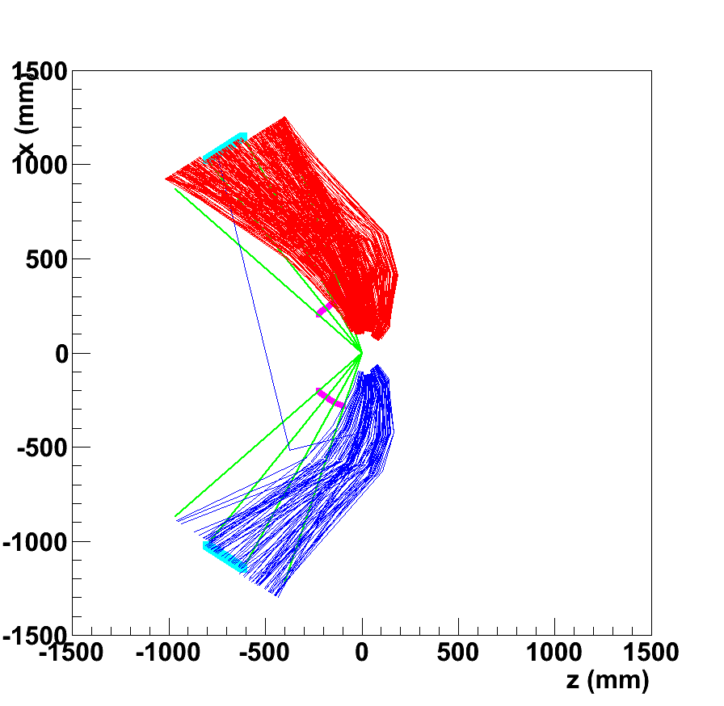
Only tracks with hits on all detectors (SDD,GTR1,2,3,RPC) are shown
RPC
Positive-charged
particles
Findings with simulation
No high-p close-to-straight tracks
Positive or negative particles only
The tracks always pass SSD’s and GTR’s with the next section (90±15 deg)
  We can reconstruct momentum!
At R=300 in our section (120±15 deg), no track passes. We should set the start counter at R>=700 or even outside the MRPC to measure the time-of-flight
Start counter
(R=300mm)
New position
R=700mm
Negative-charged
particles
120±15º
section
RPC (R=1300mm)

Slide 21
Dimensions of the scintillators + 2 circuit boards
Holes for M4 screws
25
50
25
70
~35
65
100
5
47
5
60
~103
60
Scintillator (already delivered)
Circuit (arrive by ~Jan 17)
Assemble by Jan 24

Slide 22
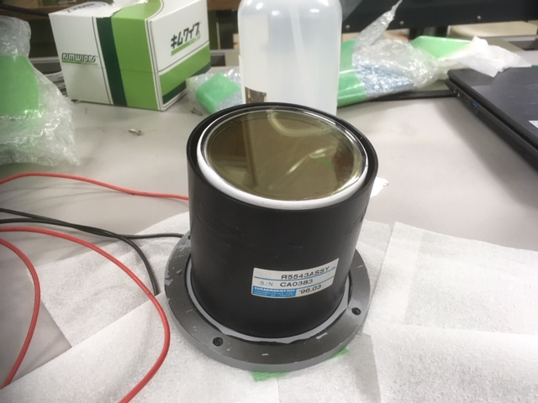
Acryl Cerenkov Detector（変更）
Acryl radiator
86.6→83
83 (PMT)
30
Φ58 (photocathode)
84
71.9
PMT R5543
  Quartz window (UV transparent)
  Fine mesh
  TTS 0.5ns
  Gain 1.7 x 10⁷(B=0), 0.6x10⁷(B=0.5T)
83
83
アクリル外径を小さくし、PMTに合わせることで、蓋を外さずに取り付けフレームに挿入可能となる

Slide 23
PMT Frame
Arrived on Jan 7

Slide 24
Configuration of Event Start Counter
Acryl C
Hole for PMT(φ=84.5 mm)
Position at R=1096
He Bag
PMT+Acryl radiator
Configuration to avoid Forward eID acceptance (12 deg in horizontal)
  14 PMTs
  Additional 2 PMTs if they do not interfere the Forward eID acceptance
Installation
  Slide in the PMT frame with PMTs on the support
104
84
85Φ
5
Al Plate (t=4mm)
Acceptance of
Forward eID
233(12º)
352
124
680
151
Problem in fixing the PMT
Frame to the support
→Order additional parts
5
5
252
124
104
510
Support
550

Slide 25
3. Fix in
the final
position
2. Slide in
Assemble
PMT frame
NFS5-2060
NFS5-2020
Temporary frame
For installation
NFS6-30120
Connect
to He bag
frame
NFS5-6060
320
Installation on Jan 10

Slide 26
Base plate shared with He bag support
NFS6-6060
20

Slide 27
Support of EST
R=1096
Frame for PMTs (R=1096)
Share the base plate with the upstream He bag support
Misumi frames will be delivered on 25 or 26 Dec
Assemble of upstream He bag support should be done with EST frame
Support for ESC
He bag support
(R=956)

Slide 28
Selection of 3-inch PMTs
16 good PMT’s with high gain and 5 PMTs with lower gain (for spares) were selected
Removal of the bottom cap (need to cut HV and signal cables and reconnect) for 16 selected PMT’s
  Removal is not necessary
  Just slide the cap to backside (already done)
PHENIX-BBC (with 3cm thick quartz radiator) was borrowed from BNL and being tested for reference
  Should have ~50ps resolution
  Under test

Slide 29
Cables
Borrowed from KEK on Jan 9
  18 15m SHV-SHV (14m requested)
  18 15m BNC-BNC (14m requested)
  18 6m BNC-BNC (5m requested)
  20 20m BNC-BNC (20m requested)
Found 60/64 BNL-lemo connectors
  Including new 20 connectors to be bought at JAEA and new 10 connectors at Tsukuba

Slide 30
Required circuits and modules
ESC
16 ch of HV (secured)
16 ch PMT amps (secured)
16 ch NIM Discriminators (secured) for trigger
16 ch LEPS Discriminators (secured)
16ch HRTDC (secured)
Multiplicity logic module (borrowed from J-PARC)
  For the trigger
TSC
3 LVPS’s (probably ok)
16 ch PMT amps (secured)
16 ch NIM Discri (secured)
16ch LEPS Discri (secured)
16ch HRTDC (secured)
OR module (secured)
Coincidence (1ch)

Slide 31
Circuit MRPC slowamp
NIM discri (8ch)
OR log (8ch→1ch)
Coincidence (1ch)
LVPS

Slide 32
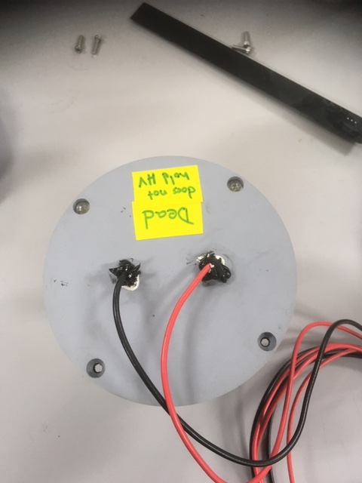
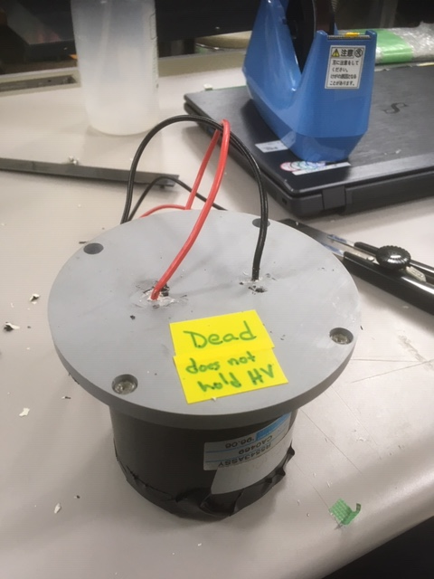
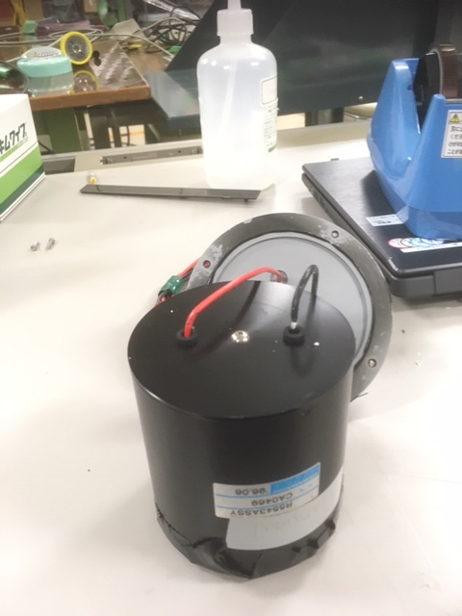
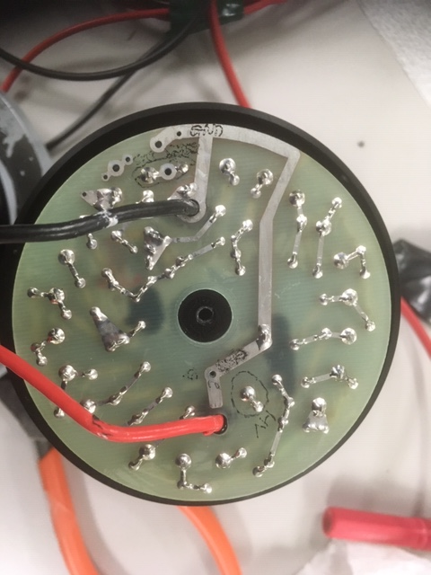
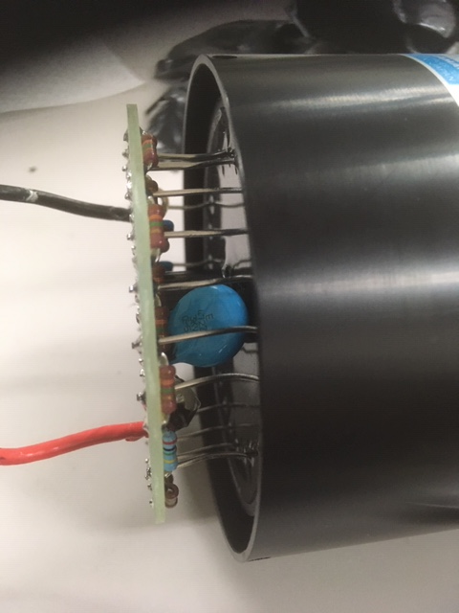
Removing the bottom cap
With the bottom cap, it is difficult to arrange PMTs side by side
Also it is heavy
Bottom cap
Cut HV and signal cables
Remove the bottom cap
Re-solder cables on the back side
of the circuit board
1. Remove gasket
2. Open bottom cap

Slide 33
Weight (with 3inch PMT)
PMT 0.4kg
  Total = 0.4*14
Acryl radiator : ρ=1.19g/cm2
  V=t * π * (R^2)
  = 5 * 3.1416 * (4^2) = 251 (cm3)
  W = 1.19*0.251*14=4.19kg
Misumi frames
  HFS6-30120: 3.01kg/m 0.5m 1.51kg
  NFS6-2060: 1.26kg/m 1.6m 2.02kg
  NFS6-6060: 2.63kg/m 2.4m 6.31kg
  NFS5-2020: 0.5kg/m 0.6m 0.3kg
  Total 10.1kg
Total : 19.9kg

Slide 34
Strategy in Run0
Position TSC just in front of RPCs (R~1200mm) to check operations in E16 environment, and evaluate the hit rate and the timing resolution of 2 RPCs and TSC
  Good interaction events need to be selected
Move TSC to R=700mm position to evaluate PID performance with SSDs and GEM trackers

Slide 35
MPPC circuit for track start counter

Slide 36
Dimensions of the scintillators + 2 circuit boards
Holes for M4 screws
~35
65
100 (scintillator)
5
47
5
~60
~103
60
Scintillator (already delivered)
Circuit (arrive by ~Jan 10)
Assemble by Jan 17
4.2mmφthrough-hole

Slide 37
Circuits
Modules
PMT amp (16ch)
NIM Discriminator (16ch)
LEPS Discriminator (16ch)
OR logic (16ch OR)
HRTDC (16ch)

Slide 38
Status and schedule
8 scintillators delivered
Preamp circuits to be made by Jan 10
Assembly in Jan 13-17

Slide 39
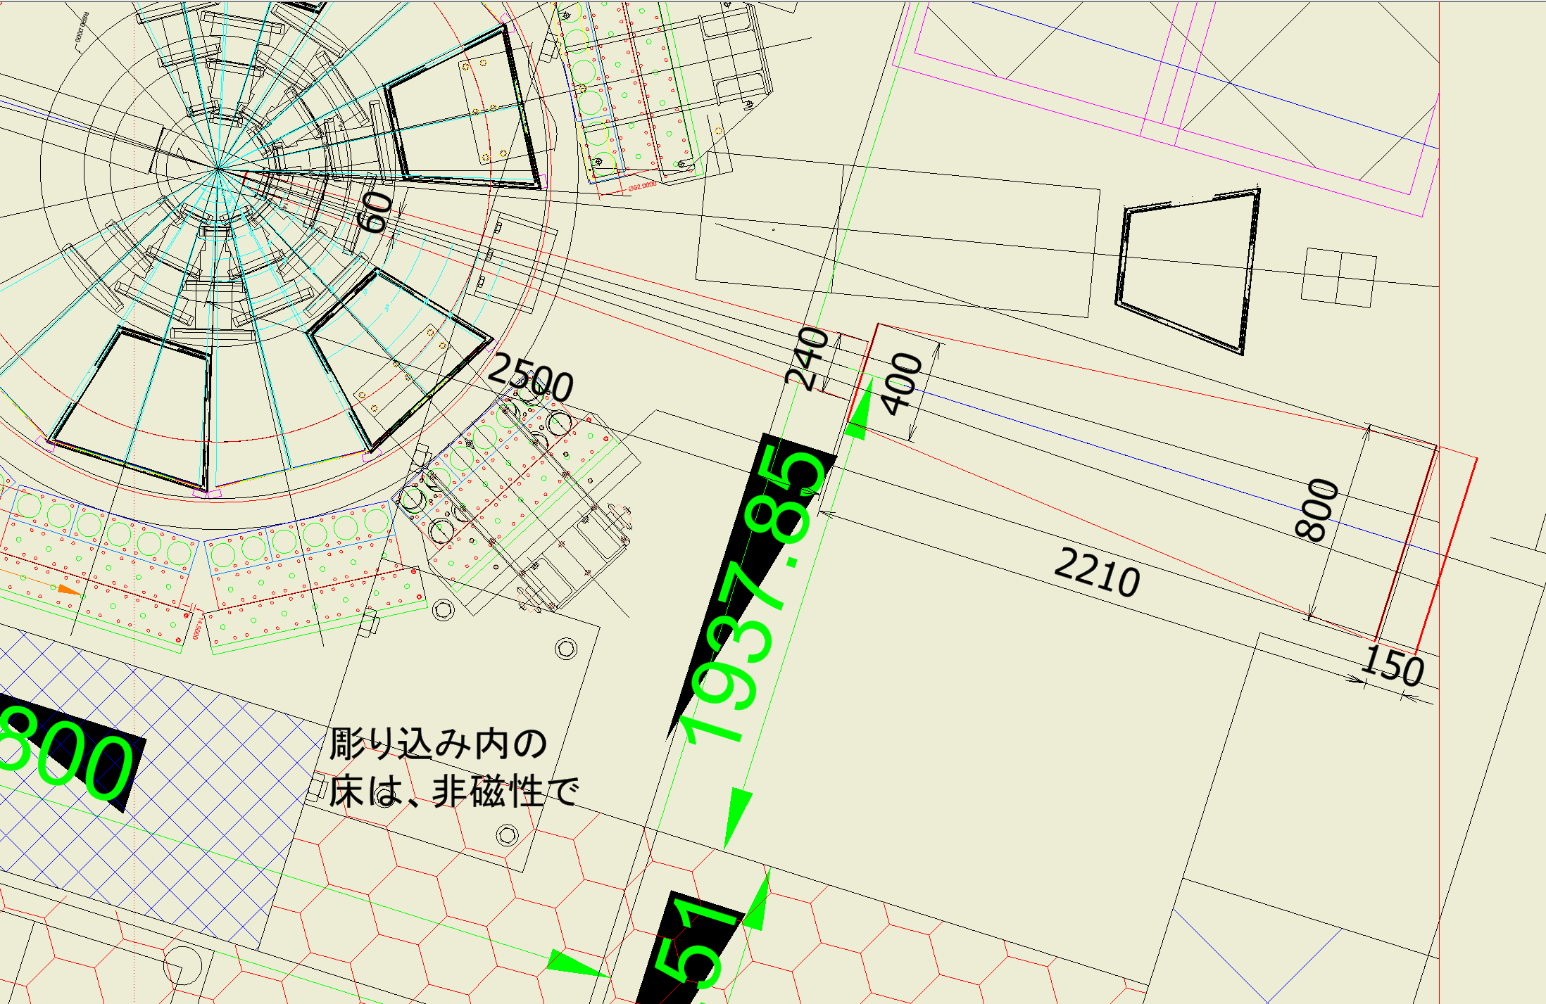
Consideration of setup in E16
Assumed detector position. R=800mm downstream from the target
R=1096mm

Slide 40
Beam duct design (by Morino)
352
252

Slide 41
Window: 100mmφ

