Slide 1
$ηd$ threshold structure from the $γd→π^{0}ηd$ reaction
Hadron in Nucleus 2020 8~10 March 2021, Panasonic hall in Yukawa Institute for Theoretical Physics, Kyoto University
Takatsugu Ishikawa (ishikawa@lns.tohoku.ac.jp)
Research Center for Electron Photon Science (ELPH), Tohoku University, Japan

Slide 2
Introduction
introduction $η$-mesic nucleus S-wave $ηd$ system $γd→π^{0}ηd$ reaction
experiment
event selection
results total cross section differential cross sections angular correlations
summary

Slide 3
Introduction
$η$-mesic nucleus bound by the strong force alone $ηN$ interaction $η$-$η′$ mixing $N\left(1535\right)S_{11}$ in the nuclear medium experimental hints steep increase from the threshold in $pd→{η }^{3}He$ in $γ^{ 3}He→η^{ 3}He$ rather flat angular distribution of $η$ emission no convincing evidence
A. Fix, O. Kolesnikov, PRC97, 044001 (2018).
S.D. Bass, P. Moskal, RMP91, 015003 (2019).
D. Jido et al., NPA811, 158 (2008).
B. Mayer et al., PRC53, 2068 (1996).
J. Smyrski et al., PLB 649, 258 (2007).
T. Mersmann et al., PRL98, 242301 (2007).
B. Krusche, and C. Wilkin, PPNP80, 43 (2014).
J.-J. Xie . Jido et al., NPA811, 158 (2008).

Slide 4
Introduction
S-wave $ηd$ system $𝓓_{ηd}$ with ${I=0, J^{π}=1}^{−}$ the lightest $η$-mesic nucleus if bound
Bag model in a $q^{2}\text{−}q^{4}$ configuration $M=2.41 GeV$ $ηd$ bound state three-body calculation for the $ηNN\text{−}πNN$ coupled channels $M≃M_{η}+M_{d}, Γ=0.01∼0.02 GeV$ $ηNN$ bound state $ηd$ bound state ?
P.J.G. Mulders, A.Th.M. Aerts, and J.J. de Swart, PRL40, 1543 (1978).
T. Ueda, PRL66, 297 (1991).

Slide 5
Introduction
coherent ${γd→π}^{0}ηd$ reaction provide a low relative-momentum condition between $η$ and $d$ produce a possible $ηd$ bound state
similar coherent ${γd→π}^{0}π^{0}d$ reaction dominant is a sequential process: ${γd→𝓓_{IS}→π}^{0}𝓓_{12}→π^{0}π^{0}d$ with a $πd$ resonance $𝓓_{12}$ with $$M=2.14 GeV, Γ=0.09 GeV, I=1, J^{π}=2^{+}$$
sequential processes for ${γd→π}^{0}ηd$ $γd→𝓓_{IV}→π^{0}𝓓_{ηd}→π^{0}ηd$ $γd→𝓓_{IV}→η𝓓_{12}→π^{0}ηd$
T. Ishikawa et al., PLB789, 413 (2019).

Slide 6
Accelerator

Slide 7
EM calorimeter

Slide 8
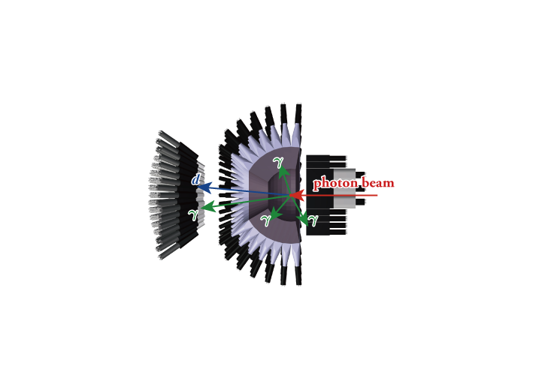
Event selection ($γd→π^{0}ηd$)
4 neutral particles and 1 charged particle
$π^{0}$ and $η$: $γγ$decay time difference is less than $3σ_{t}$ between every 2 neutral clusters out of 4
$d$ is detected with SPIDER (response of SCISSORS III is not required) time delay is larger than 1 ns wrt average $γγγγ$ time energy deposit is higher than $2E_{mip}$
sideband background subtraction to remove accidental coincidence between STB-Tagger II and FOREST

Slide 9
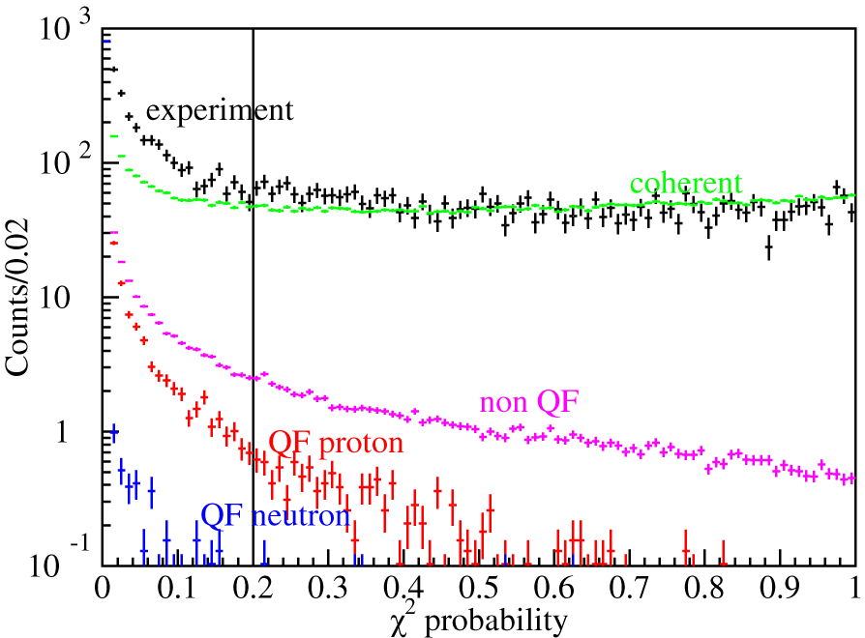
Event selection ($γd→π^{0}ηd$)
Further event selection a kinematic fit (KF) with 6 constraints is applied energy and momentum conservation (4) $γγ$ invariant masses are $m_{π^{0}}$ and $m_{η}$ (2) $χ^{2}$ probability is higher than 0.2 QF $γp^{′}→π^{0}ηp$is rejected using another KF

Slide 10
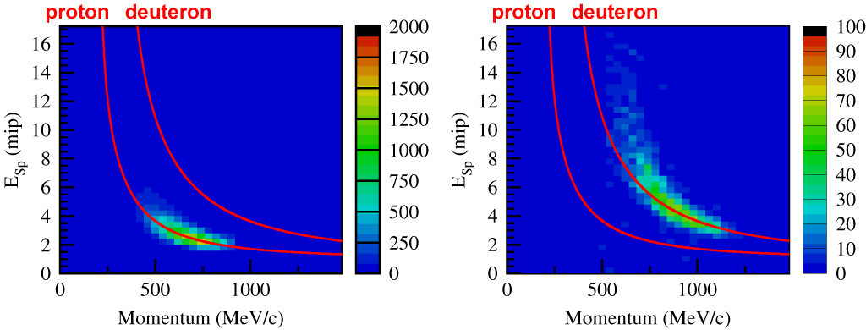
Event selection ($γd→π^{0}ηd$)
Further event selection a kinematic fit (KF) with 6 constraints is applied energy and momentum conservation (4) $γγ$ invariant masses are $m_{π^{0}}$ and $m_{η}$ (2) $χ^{2}$ probability is higher than 0.2 QF $γp^{′}→π^{0}ηp$is rejected using another KF
missing momentum is given for the deuteron in these plots
QF $γp^{′}→π^{0}ηp$
$$γd→π^{0}ηd$$

Slide 11
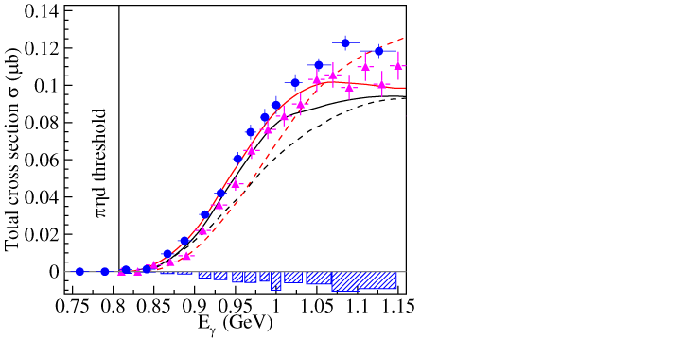
Total cross section
excitation function
dashed curves impulse solid curves including $ηd$ final- state interaction
two models M. Egorov, A. Fix, PRC88, 054611 (2013). M. Egorov, PRC101, 065205 (2020). unified microscopic approach
Both models are based on QF$π^{0}η$ production with deuteron coalescence but different approaches are adopted to incorporate the $ηd$ final-state interaction
A. Käser et al., PLB748, 244(2015).
Mainz
ELPH

Slide 12
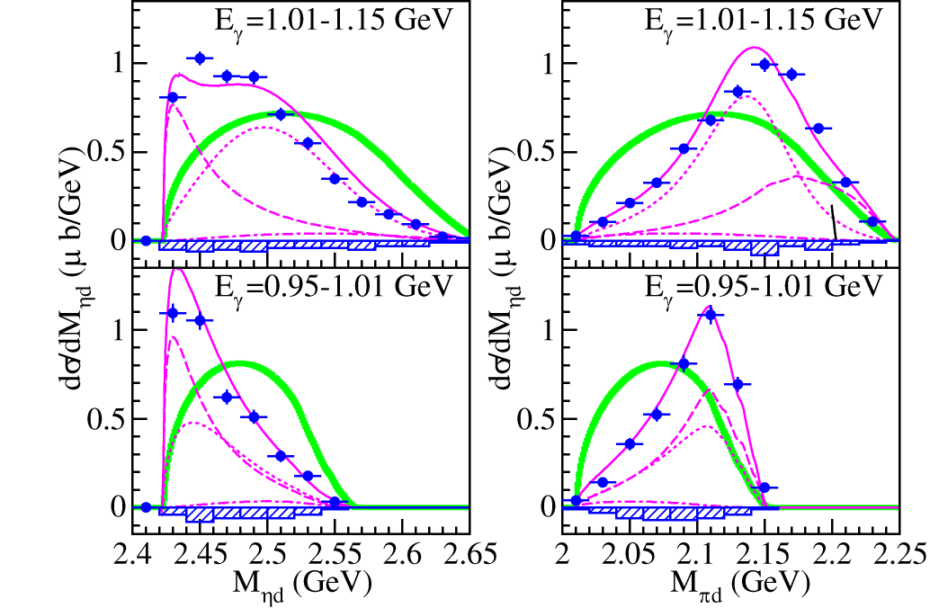
Differential cross sections
mass distributions $dσ/dM_{ηd}$ and $dσ/dM_{πd}$
for the first time
phase space

Slide 13
Observes states
$$γd→π^{0}ηd$$
two sequential processes: $γd→𝓓_{IV}→π^{0}𝓓_{ηd}→π^{0}ηd$ $γd→𝓓_{IV}→η𝓓_{12}→π^{0}ηd$
$𝓓_{ηd}$: S-wave $ηd$ system with $I=0, J^{π}=1^{−}$ mass and width: free parameters
$𝓓_{12}$: well-known $πd$ resonance with $I=1, J^{π}=2^{+}$ mass 2.14 GeV width 0.09 GeV simultaneous fit of four distributions

Slide 14
Observes states
mass distributions $dσ/dM_{ηd}$ and $dσ/dM_{πd}$
phase space
dashed: $𝓓_{ηd}$ ($M∼2.40 GeV, Γ=0.02 GeV$) &
dotted: $𝓓_{12}$

Slide 15
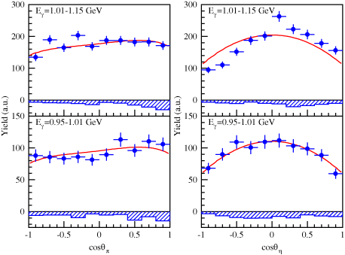
Coherent $γd→π^{0}ηd$
angular distribution & correlation
$$M_{ηd}<2.47 GeV$$
$γ\text{−}π$ in the $γd$-CM frame
$π\text{−}η$ in the $ηd$ rest frame
(opposite sign)

Slide 16
Coherent $γd→π^{0}ηd$
fit of angular distributions
$$M_{ηd}<2.47 GeV$$
$$L=1, 2$$
2/3
$$L=0,1, 2$$
$$L=0$$
2/3
$d\left(1^{+}\right)→𝓓_{IV}\left(0^{−}, 1^{±}, 2^{±}\right)→𝓓_{ηd}\left(1^{−}\right)→d\left(1^{+}\right)$
$d(1^{+})→𝓓_{IV}(2^{+})→𝓓_{12}(2^{+})→d(1^{+})$
$$L=1$$
$$L=1$$
$$L=1$$
1/3

Slide 17
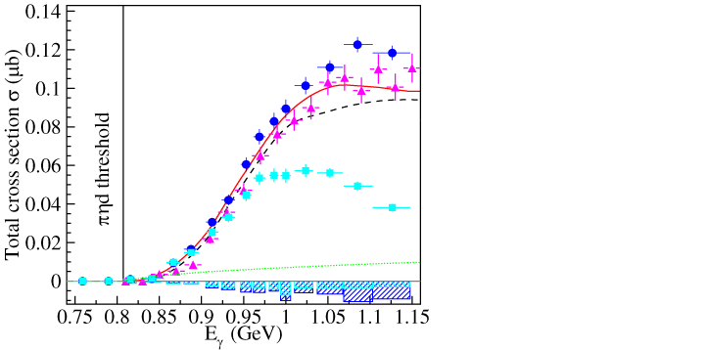
Coherent $γd→π^{0}ηd$
total cross section
two models M. Egorov, A. Fix, PRC88, 054611 (2013). M. Egorov, PRC101, 065205 (2020). unified microscopic approach
The events with $M_{ηd}<2.47 GeV$ form a bump around 1 GeV $NΔ\left(1620\right)S_{31}$, $NN\left(1650\right)S_{11}$, $NN\left(1700\right)D_{13}$ for $𝓓_{01}\left(1^{−}\right)$~$NN\left(1535\right)S_{11}$ $NN\left(1720\right)P_{13}$, $NΔ\left(1600\right)P_{33}$ for $𝓓_{12}\left(2^{+}\right)$~$NΔ\left(1232\right)P_{33}$
A. Käser et al., PLB748, 244(2015).
Mainz
ELPH
$$M_{ηd}<2.47 GeV$$
$$\overline{s}s$$
$$\overline{s}s?1\%\sim 5\% Nη decay$$

Slide 18
Summary
Cross sections are measured at $E_{γ}<1.15 GeV$ for $γd→π^{0}ηd$
excitation function of $σ$ is well-reproduced by the existing theoretical calculations with $ηd$FSI
mass distributions are decomposed to the two sequential processes $γd→𝓓_{IV}→π^{0}𝓓_{ηd}→π^{0}ηd$ $γd→𝓓_{IV}→η𝓓_{12}→π^{0}ηd$ $𝓓_{ηd}$: $I=0, J^{π}=1^{−}, M=2.40±0.01 GeV, Γ<0.03 GeV$ below the $ηd$ threshold $𝓓_{12}$: $I=1, J^{π}=2^{+}, M=2.14 GeV, Γ=0.09 GeV$
doorway states for the first $𝓓_{IV}$ state would be $NN\left(1650\right)S_{11}$ for $π^{0}𝓓_{ηd}$ and $NN\left(1720\right)P_{13}$ for $η𝓓_{12}$

Slide 19
Backup
Backup

Slide 20
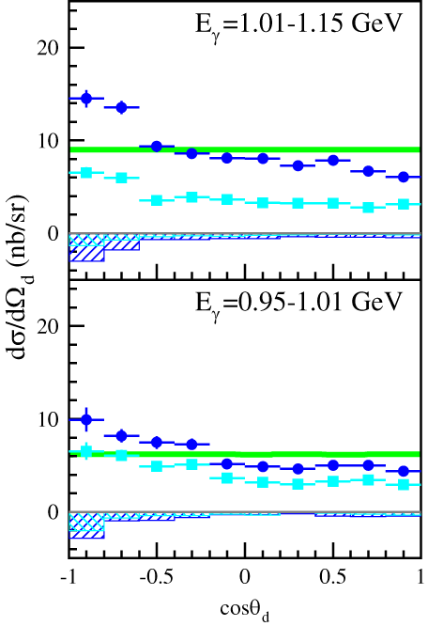
Differential cross sections
angular distributions $dσ/dΩ_{d}$
for the first time
angular distribution of deuteron emission in the $γd$ CM frame
does not show a strongly backward-peaking behavior but shows a rather flat distribution, suggesting a sequential process
phase space
$$− : M_{ηd}<2.47 GeV$$

