Slide 1
Progress report
Kosuke Tsukui

Slide 2
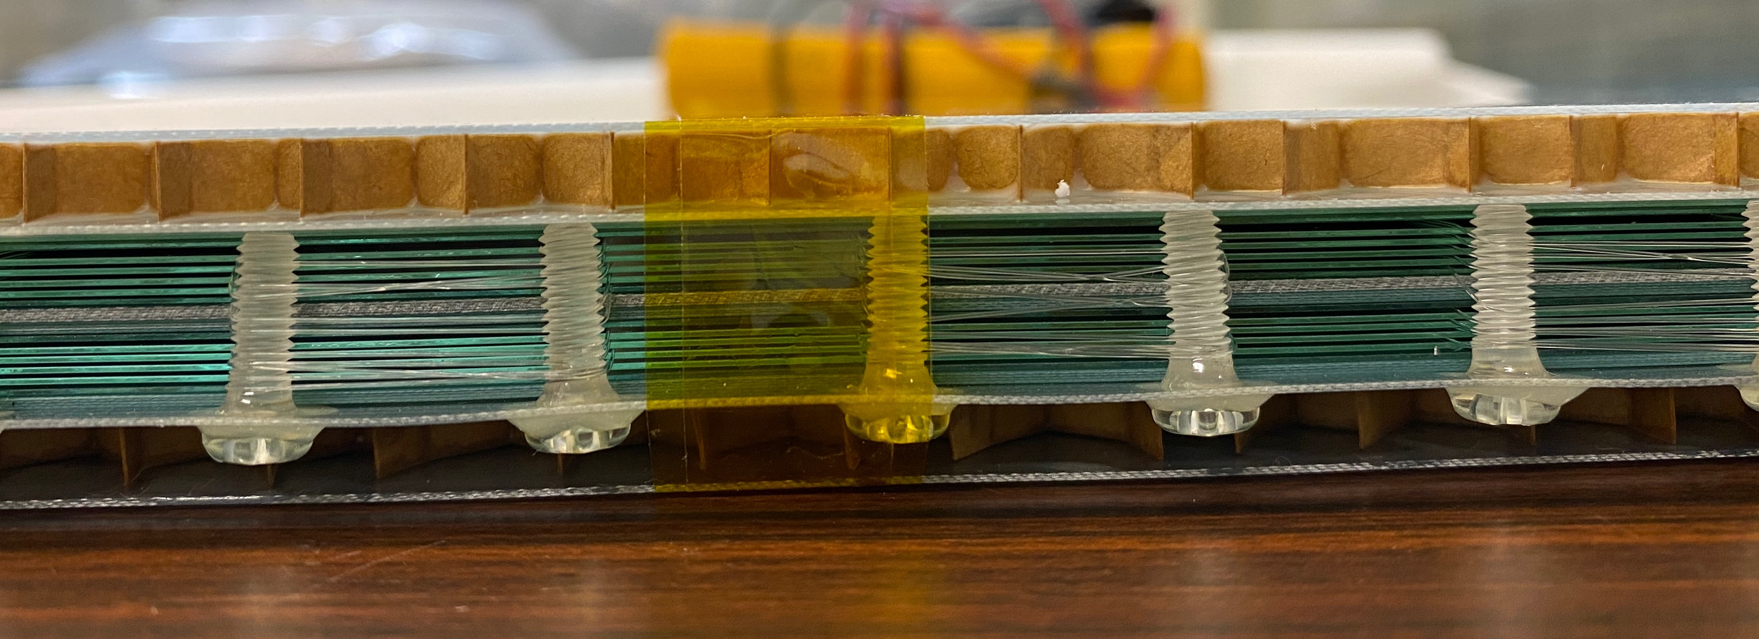
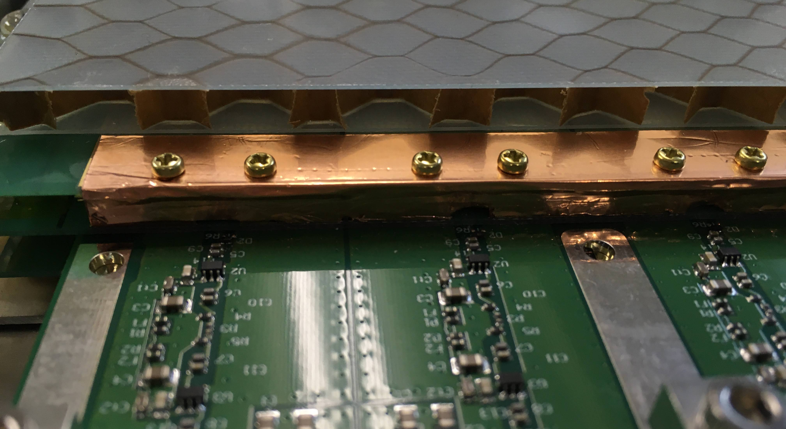
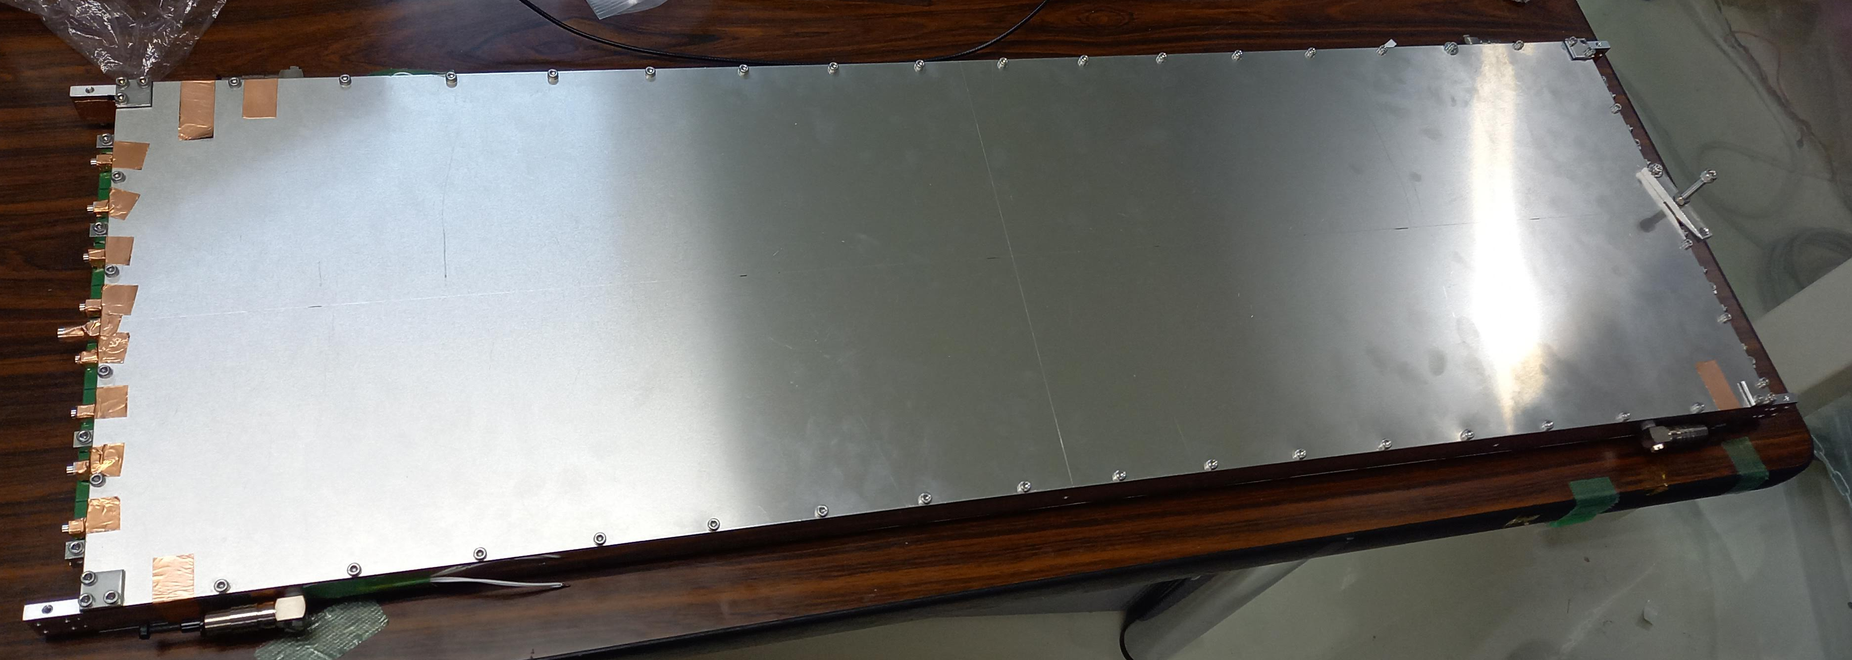
MRPC
260 μm×5 gaps×2 stacks
8 strips / module
Gas : R134a (Freon) 90%, SF6 10% (quench gas)

Slide 3
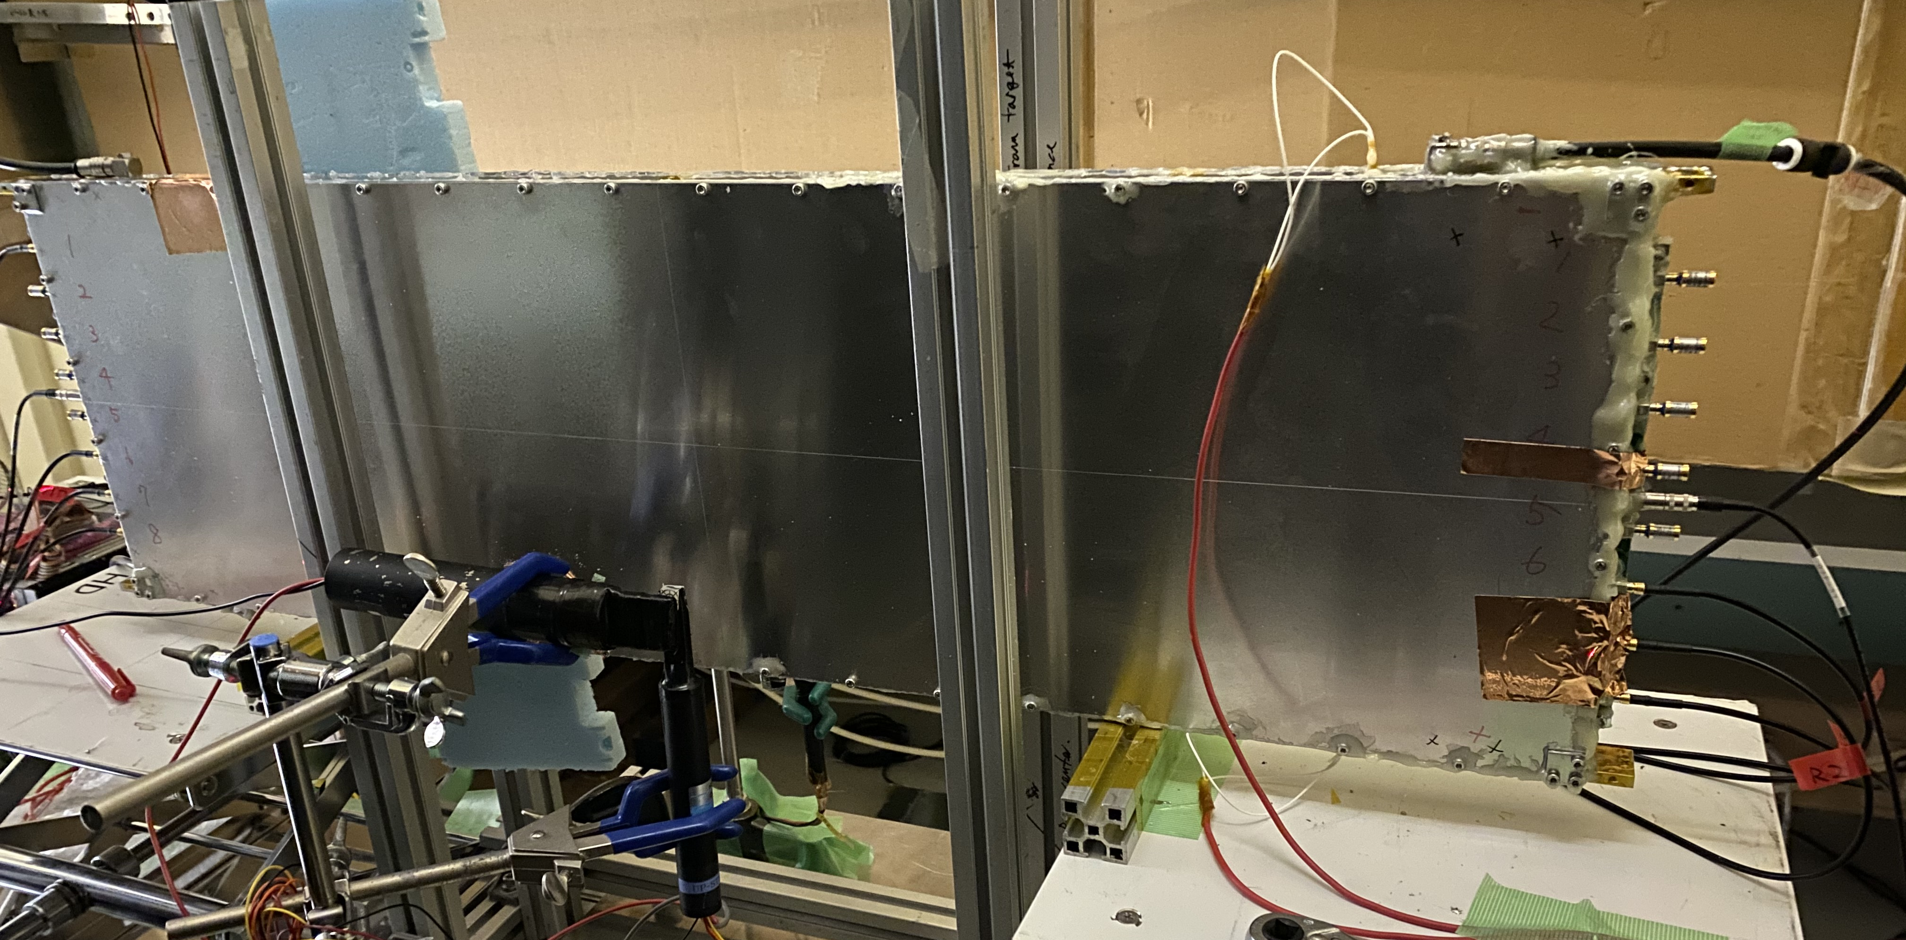



Set up
trigger size : 2 $×$ 1 cm
  trigger scinti : 10 $×$ 1 cm ・ 7 $×$ 2 cm
UPveto
Dipole magnet
$γ$ beam
〜2.4 GeV
30 cm
Scinti.
Electron
Target: Lead
0.55 mm thick
$≈$1GeV
MRPC

Slide 4
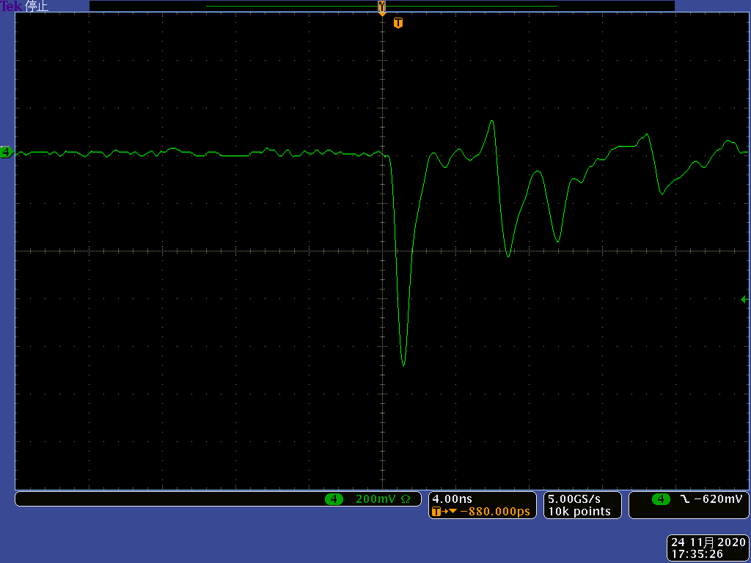
Result
Dark current of RPC
200 mV/div, 4.00 ns/div

Slide 5

Result (RPC1)
RPC1 Strip4
Hit position : center
Time resolution : 72.4 $±$ 0.5 ps
Efficiency : 96.9 $±$ 0.9 %

Slide 6

Result (RPC2)
RPC2 Strip3
Hit position : center
Time resolution : 81.5 $±$ 0.7 ps
Efficiency : 64.2 $±$ 0.7 %

Slide 7
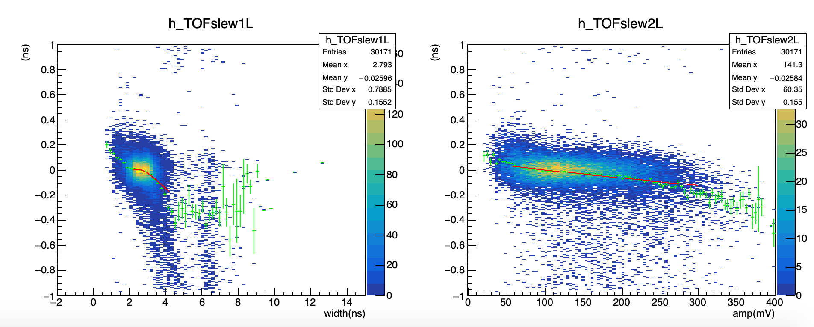
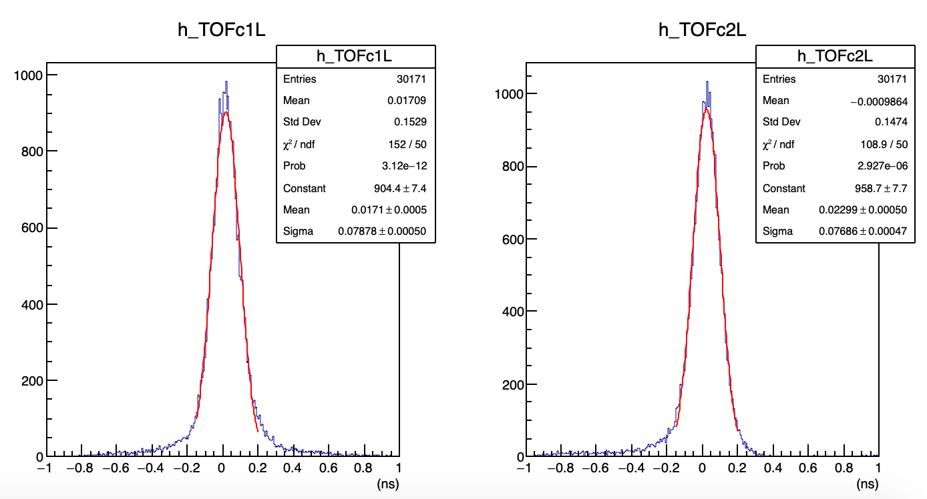
Slewing
Slewing correction

Slide 8
Back up

Slide 9
Time Over Threshold method
Measure pulse width that exceeds the threshold.
Slewing correction using the signal width instead of the signal charge.
threshold
Pulse charge
Pulse width

Slide 10
HR-TDC using FPGA
Delay
Hit
D-FF
Clock
Delay time is 5 – 30 ps
Clock frequency is 520 MHz

Slide 11
HR-TDC using FPGA
Tapped delay line
1111111111111100000000000000
Remapping (192 -> 64 taps)
1111100000
Leading edge finder
0000100000
Binary encoder
5 : Fine count
520 MHz
Clock domain crossing
130 MHz
Calibration table
Event build process

