Slide 1
MRPC meeting
2020/12/1
H. Sako
スケジュール
物理学会の発表申し込み
各自報告
SPring-8報告

Slide 2

スケジュール
12/8 クレーン作業終
12/9 E16天井シールド閉
12/10 HD beam ready
12/14-16 ESC install（佐甲、佐藤）
12/21正午: J-PARC PAC LOI締め切り
12/16 浅水さんの入構、教育手続き
12/17-18 MRPC本体のinstall
12/21-25 MRPC cabling, test（佐甲、佐藤、津久井、喜屋武、浅水）
Run0b
12/17-12/20（ビーム無し）
1/12-2/2

Slide 3
購入すべきもの
電源監視用webカメラ（佐甲）
  有線LANに接続して、Webアクセスで操作が可能
  暗視機能
  カメラの角度を上下・左右に振れる
スケールシール（佐藤）
架台フレーム（喜屋武）
  発注済。今週納品
足りないものがあれば今週中に知らせて下さい

Slide 4
筑波大でのMRPCのテスト(12/1-12/18)
ガスリーク封止の続き
宇宙線測定試験
フレーム組み立て（納期？）

Slide 5
12/21-25 MRPCインストール作業
J-PARC入構手続き
パーソナルキーの講習(浅水、12/21午後？→青木さんに予約）
MRPC等の輸送
SF6の輸送（後で）

Slide 6
E16-MRPC production and beam test at Spring-8
H. Sako, K. Tsukui, S. Kyan, S. Asamizu
2020/12/01

Slide 7
Milestones
2020/11/16
  Start Production of two MRPCs
2020/11/19
  MRPC1 completed
  MRPC1 noise test started
  MRPC2 problem to assemble top glass plates and the top cathode PCB
2020/11/20
  MRPC2 completed
  MRPC1 noise reduction
2020/11/21
  MRPC1 noise reduction
2020/11/22
  MRPC1 noise reduction managed
  MRPC1 gas sealing work started
  MRPC2 noise test started
2020/11/23
  MRPC1 gas sealing managed
  MRPC2 noise reduction completed
  MRPC2 gas sealing managed somehow
2020/11/24
  Setup of beam test
  Start beam test of MRPC1
2020/11/25
  Completed MRPC1 test
  Completed MRPC2 test
2020/11/26
  Completed MRPC2 test with butane

Slide 8
Problems in MRPC production
We didn’t design how to connect between the top honeycomb and the top cathode PCB
  We managed it by using double-sided tapes
It was difficult to place the carbon tape in the right position on G-10 boards or PCBs. We repeated this procedure many times. Discarded much carbon tape.
At MRPC2, we stretched fishing string too strong. As a result, several plastic screws bent inward so that it was very hard to insert glass plates at the top layers. In this procedure, we broke many glass plates. WE SHOULD NOT STRETCH FISHING STRING TOO STRONG.
In particular, we broke the glass on the top cathode PCB. It was impossible to remove glasses from the PCB and we were not able to reuse the PCB. Since we didn’t have a spare cathode PCB, we use the spare anode PCB instead.

Slide 9
MRPC Structure
Cathode PCB
Honeycomb
Glass
Anode PCB
Carbon tape
G-10 spacer
Cathode PCB

Slide 10
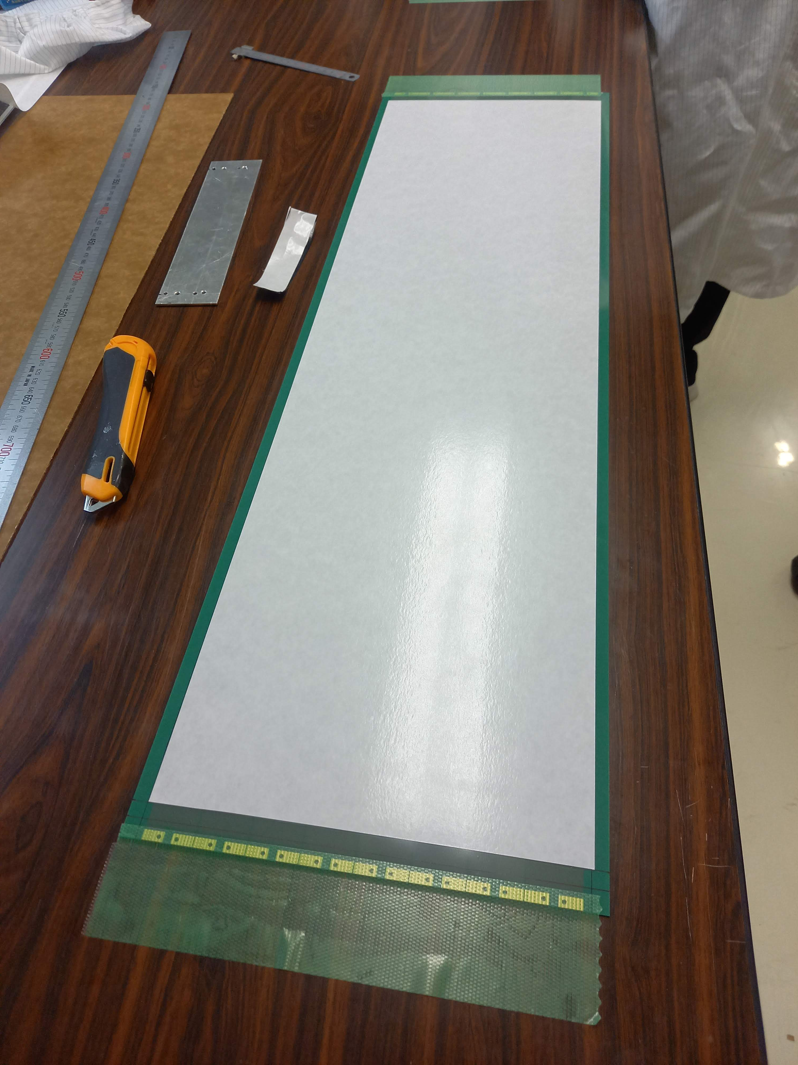
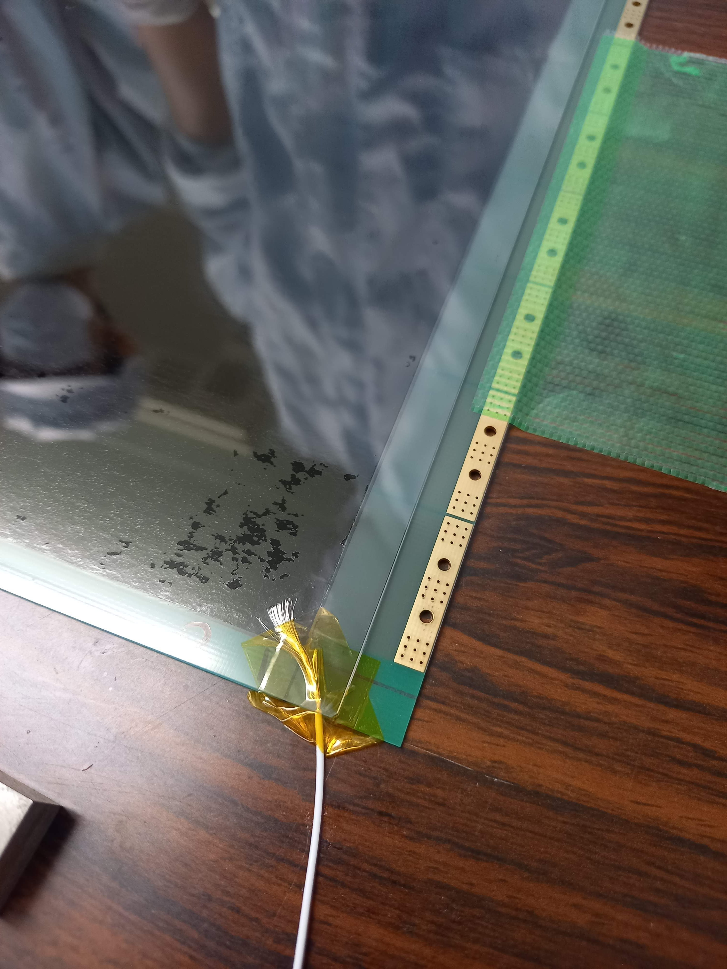
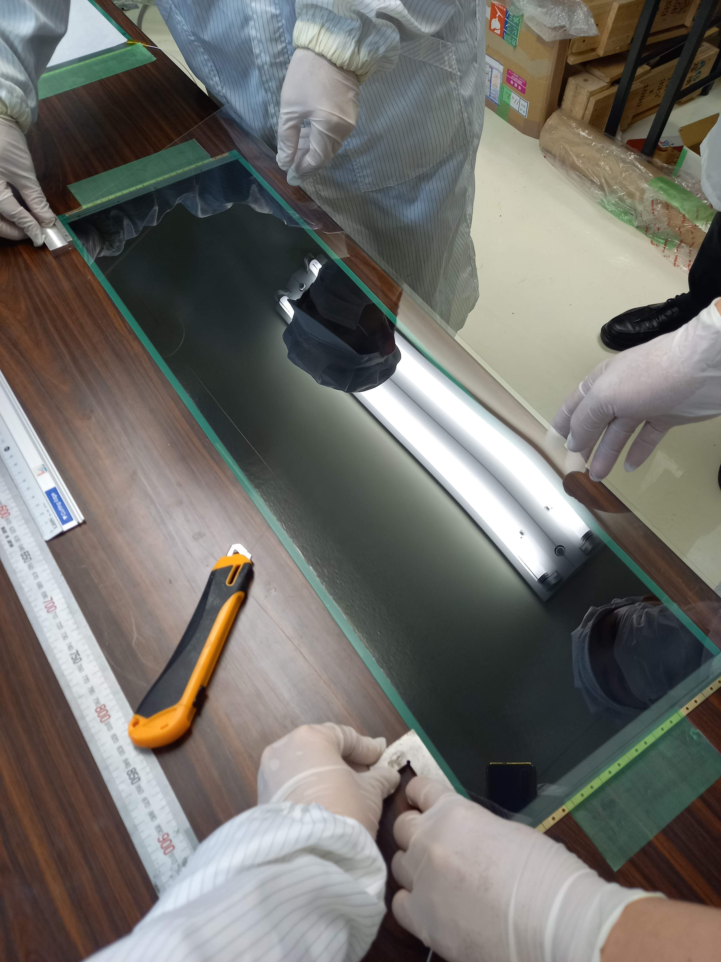
MRPC production procedure
1. Put the carbon tape on bottom cathode PCB
2. Connect HV wire at the edge of the carbon tape
3. Place the glass on the carbon tape

Slide 11
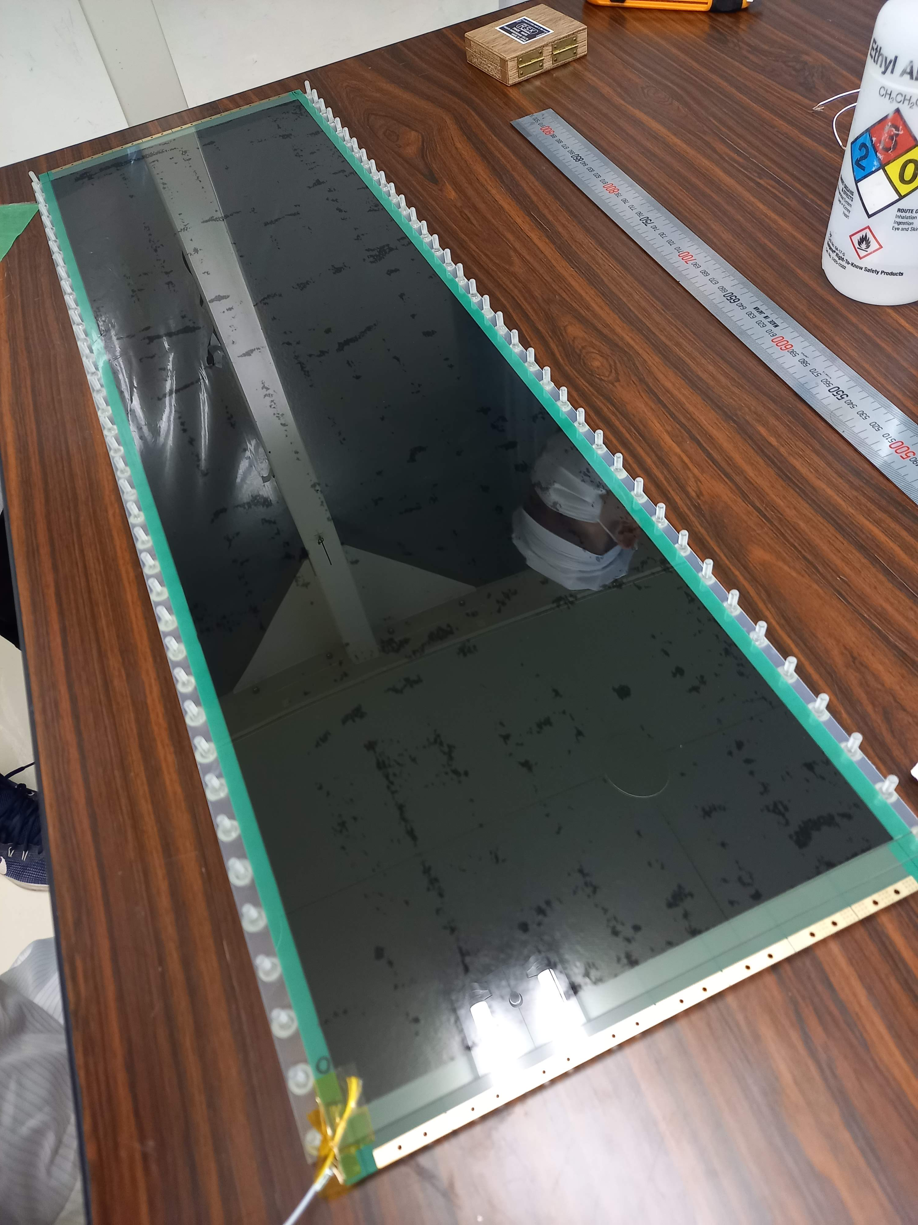
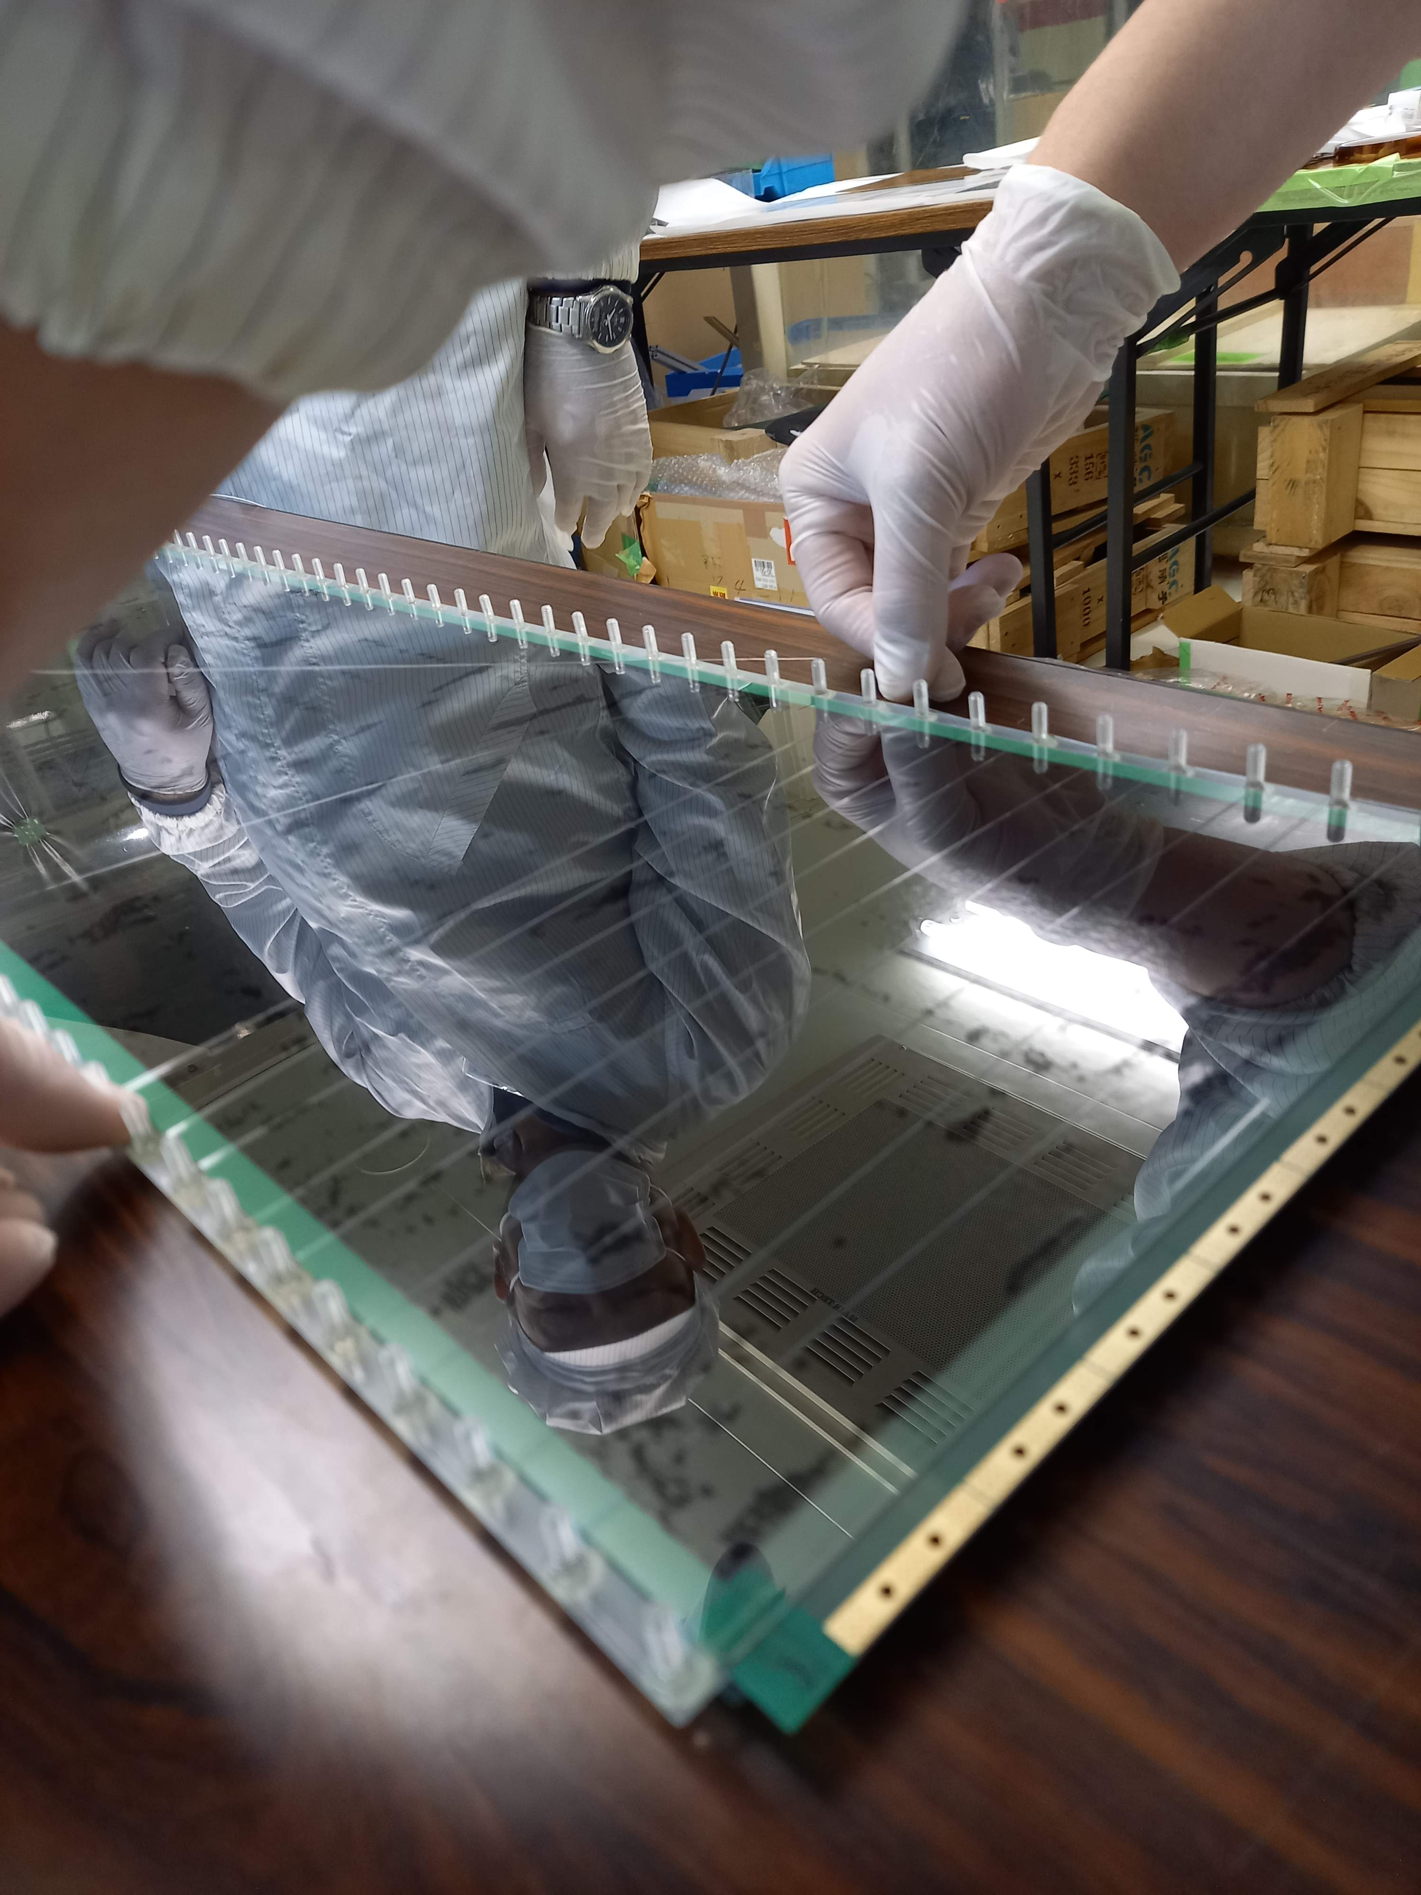
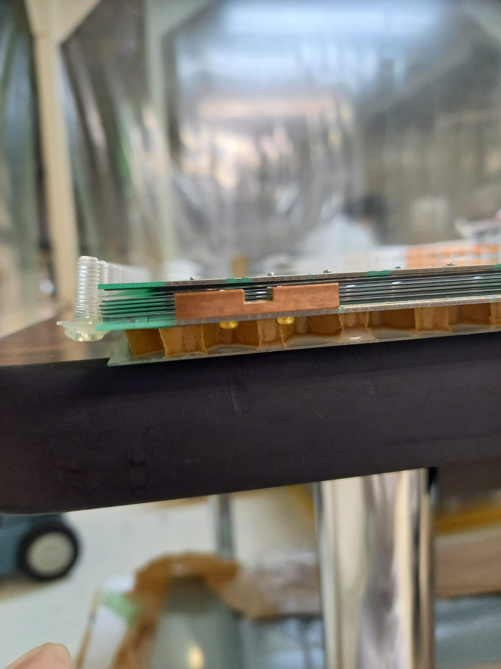
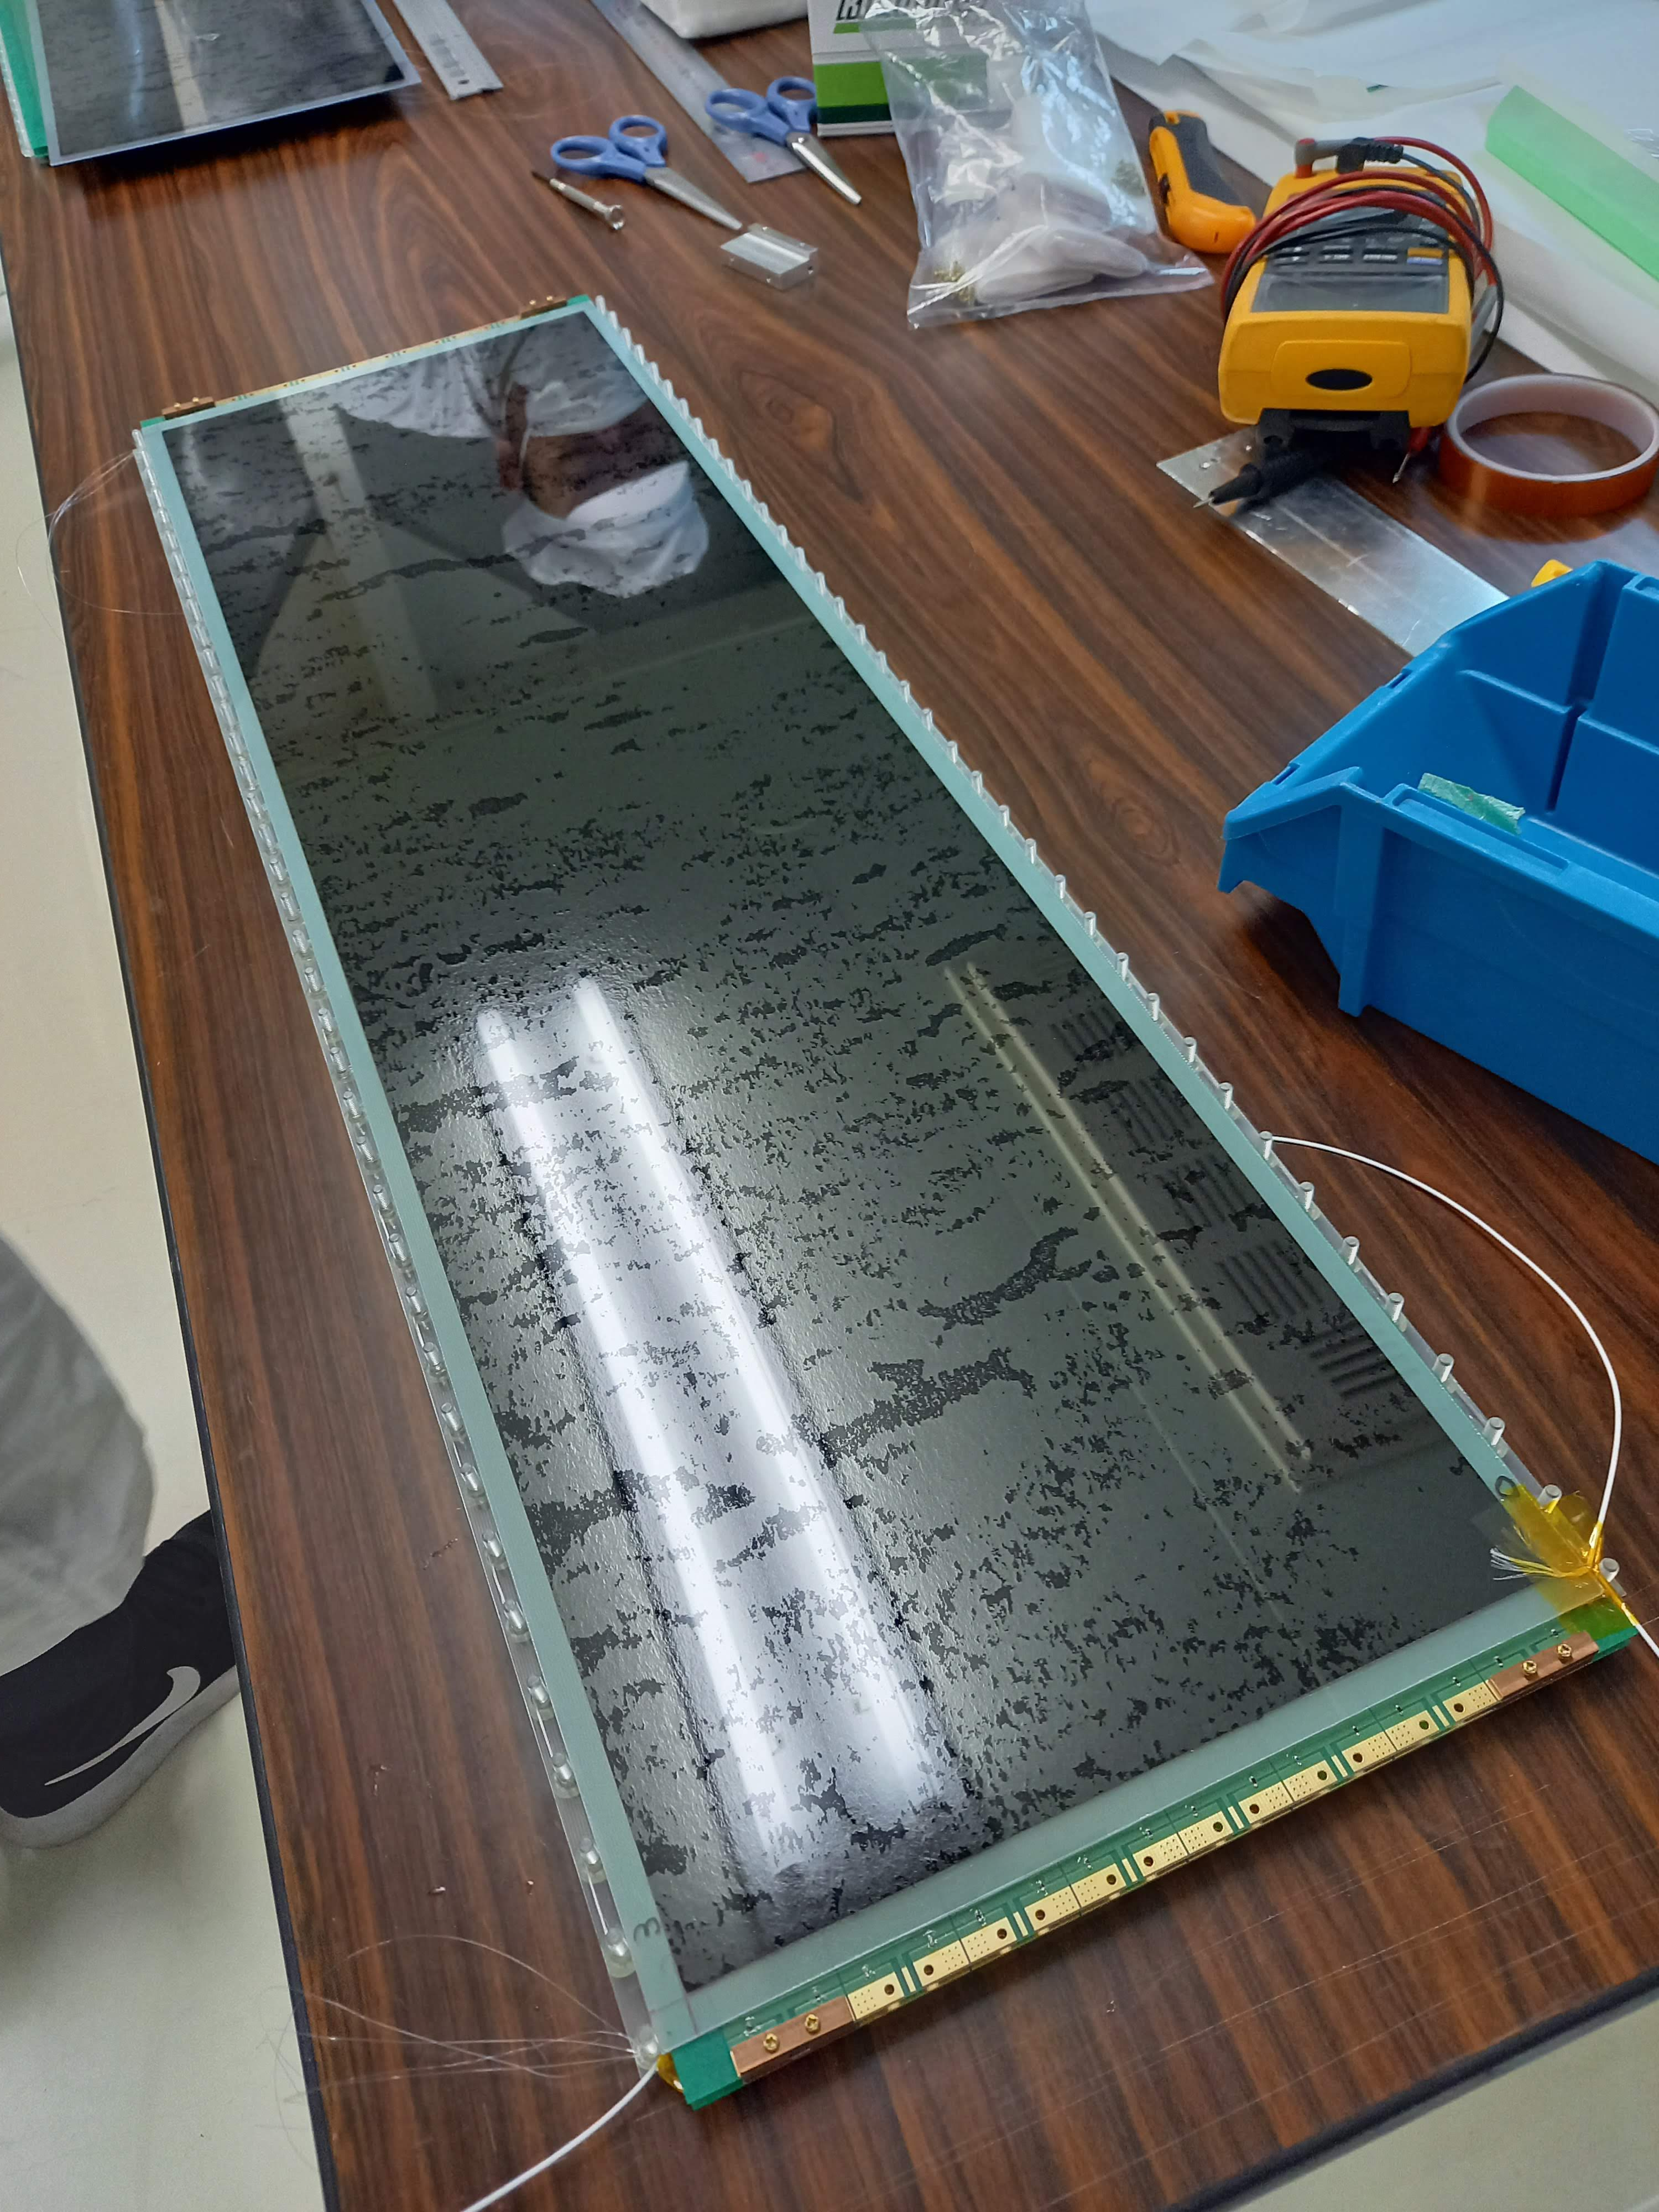
4. Place the cathode PCB+glass on the bottom Honeycomb board
6. Repeat 4 and 5 so that 6 layer of glass was set between the cathode PCB and the anode PCB
5. Stretch fishing string on the glass with plastic screws

Slide 12
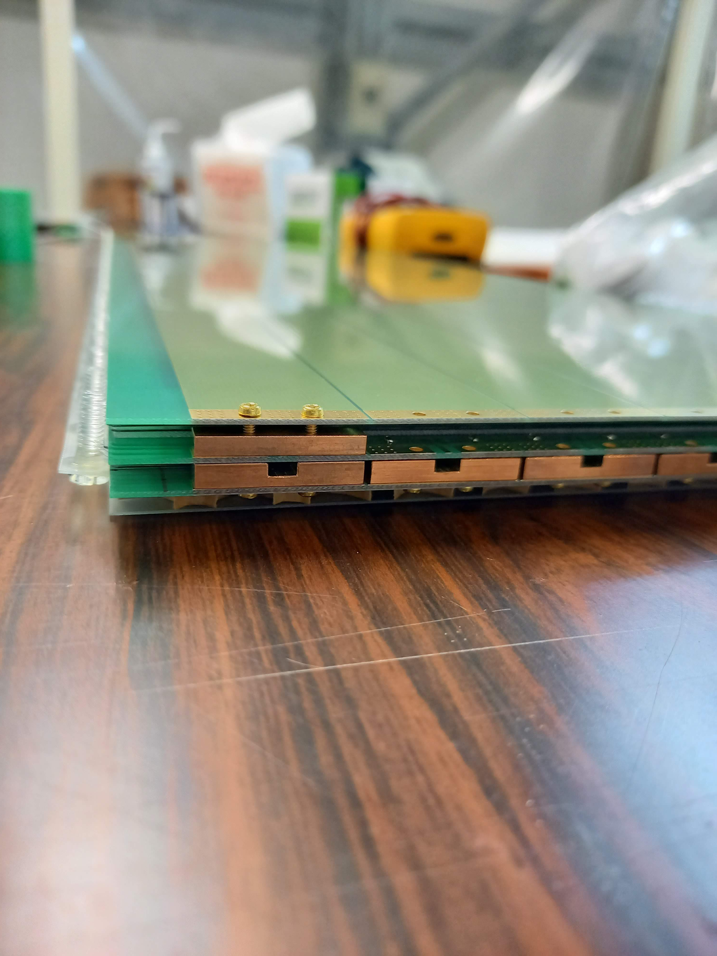
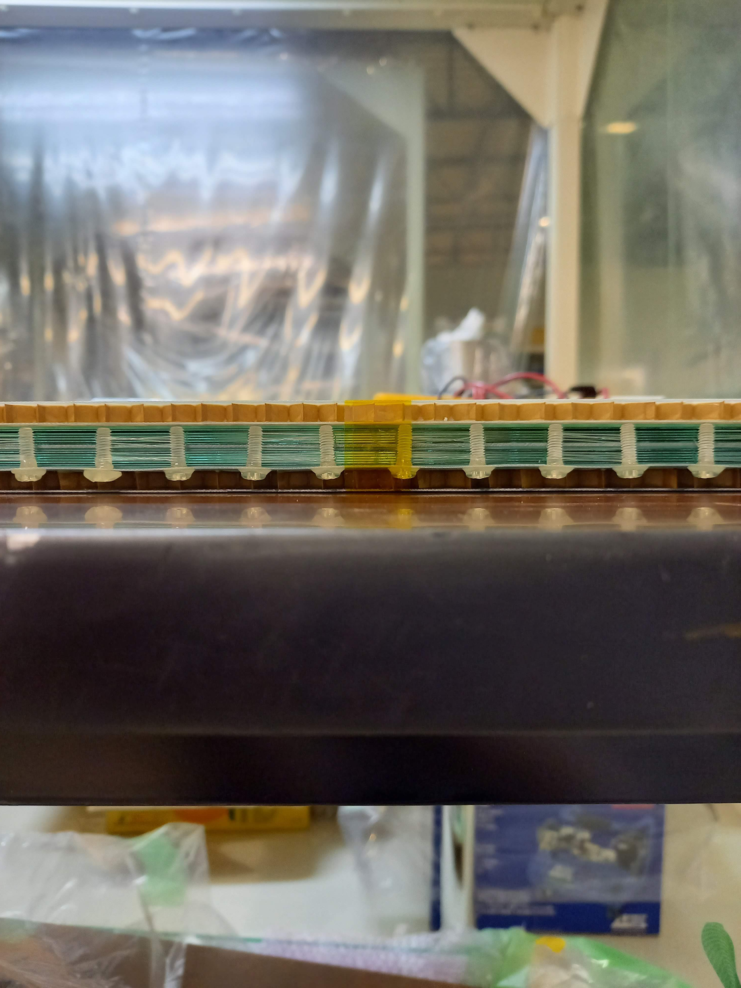
7. Place G-10 spacer+C tape and glass on anode PCB
8. Stack 6 glass sheets between the anode PCB and the cathode PCB (top).
9. Tape Honeycomb board on the cathode PCB (top).

Slide 13
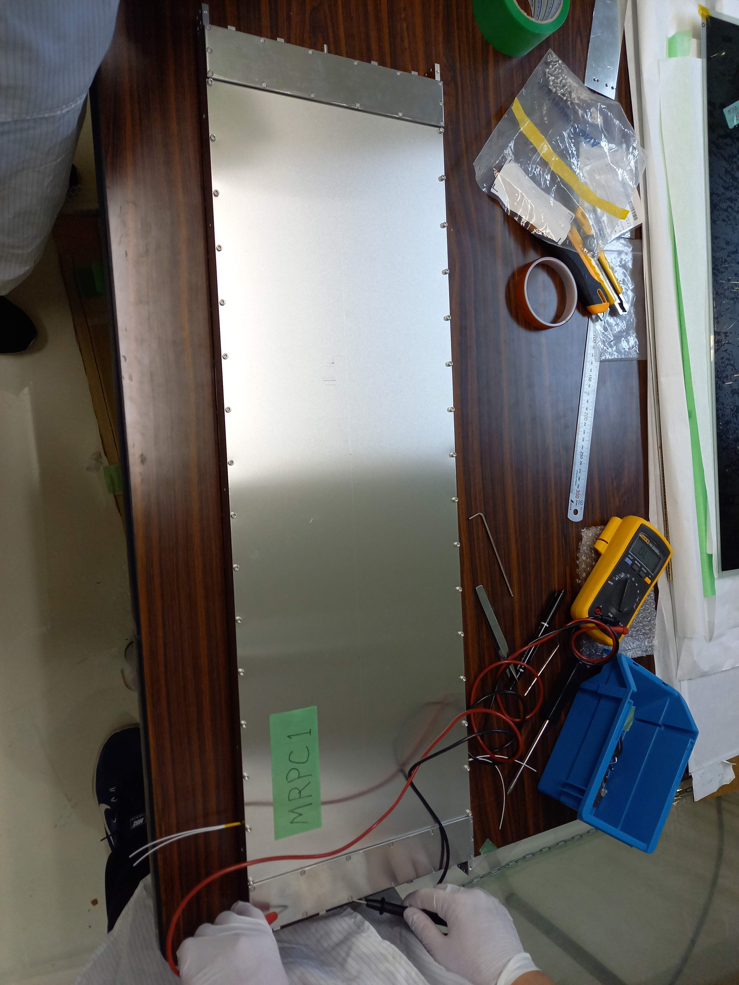
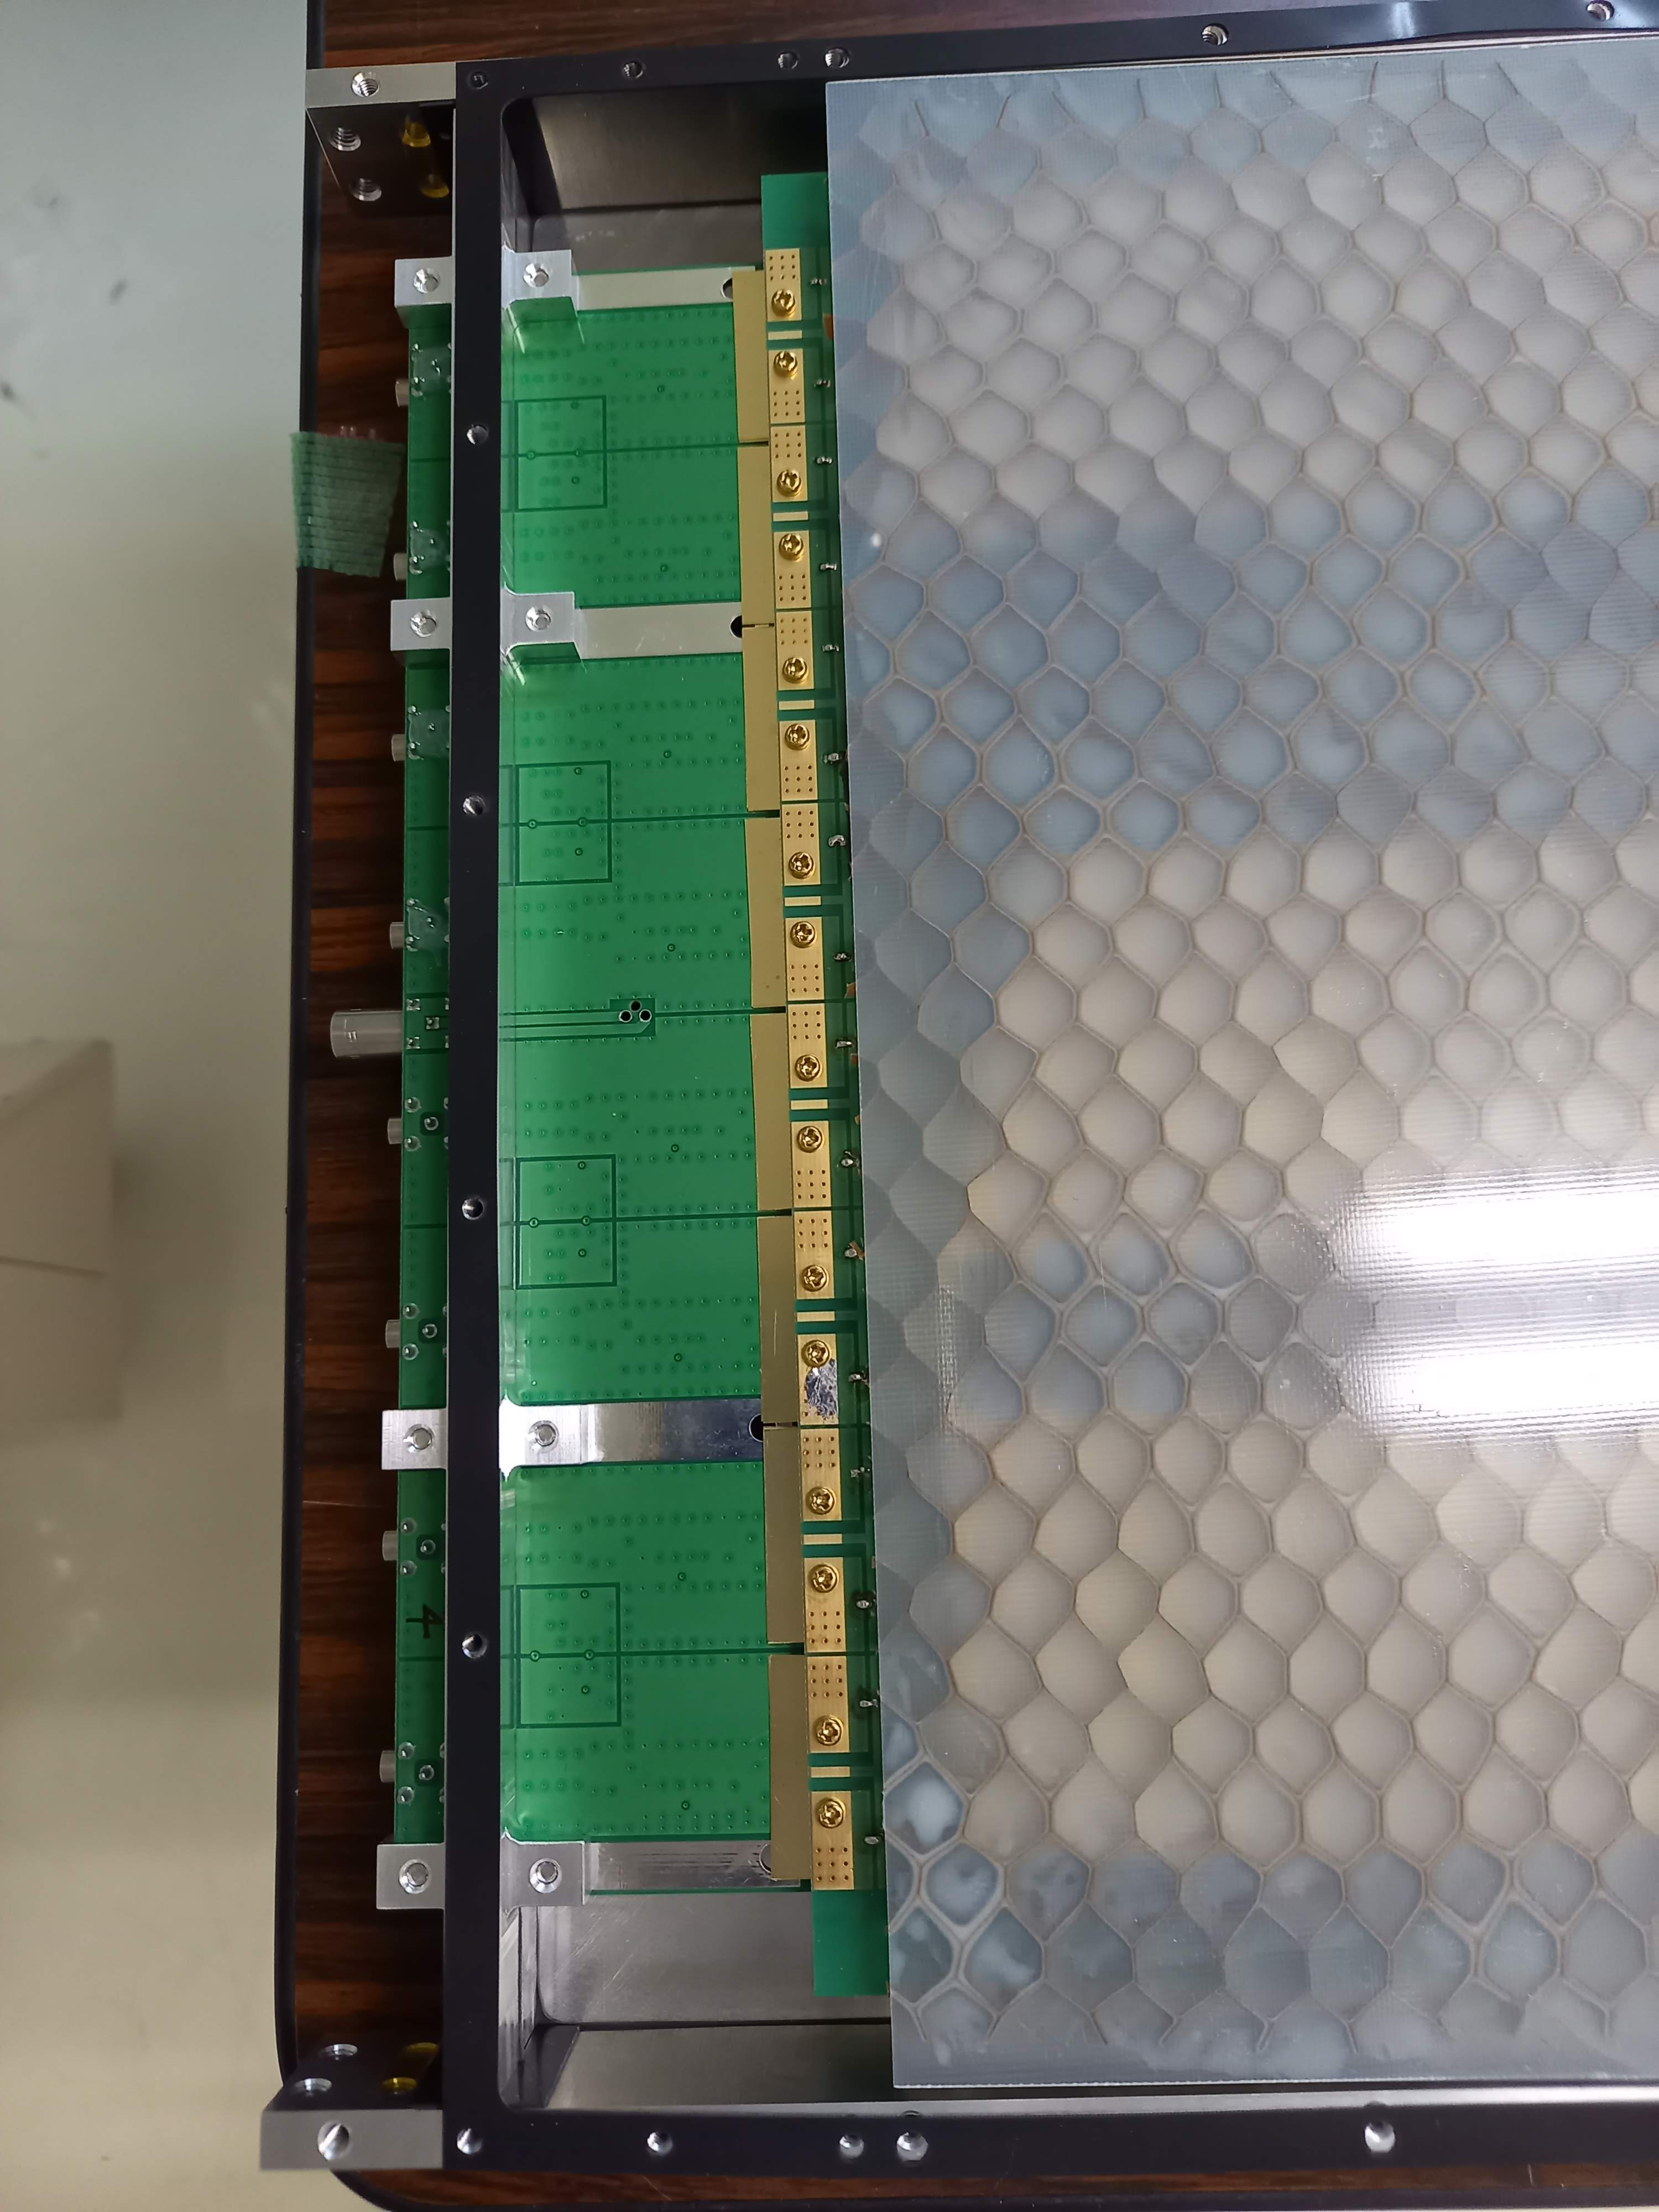
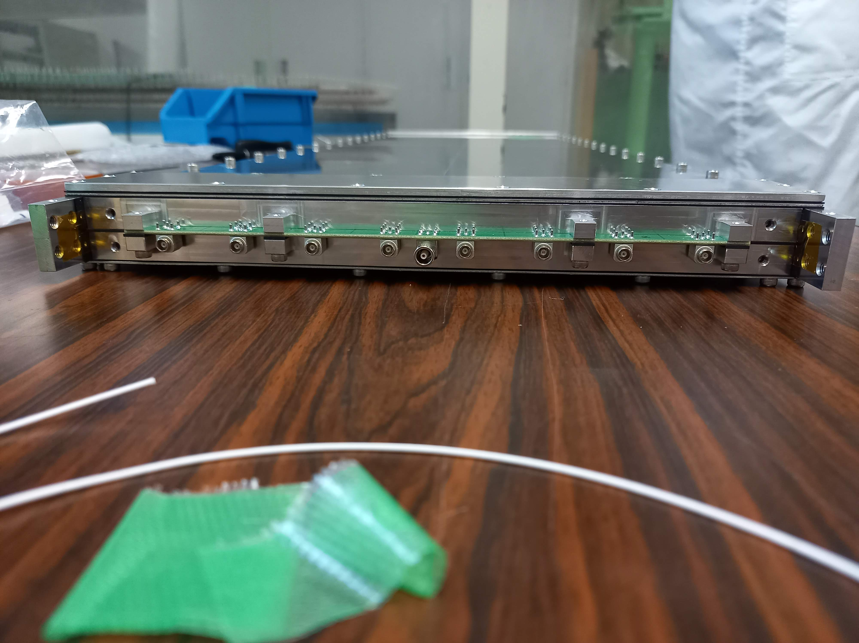
10. Connect amplifier and with its Al bars to anode and cathode plates through Cu blocks
11. Assemble chassis with amplifier
12. Complete

Slide 14
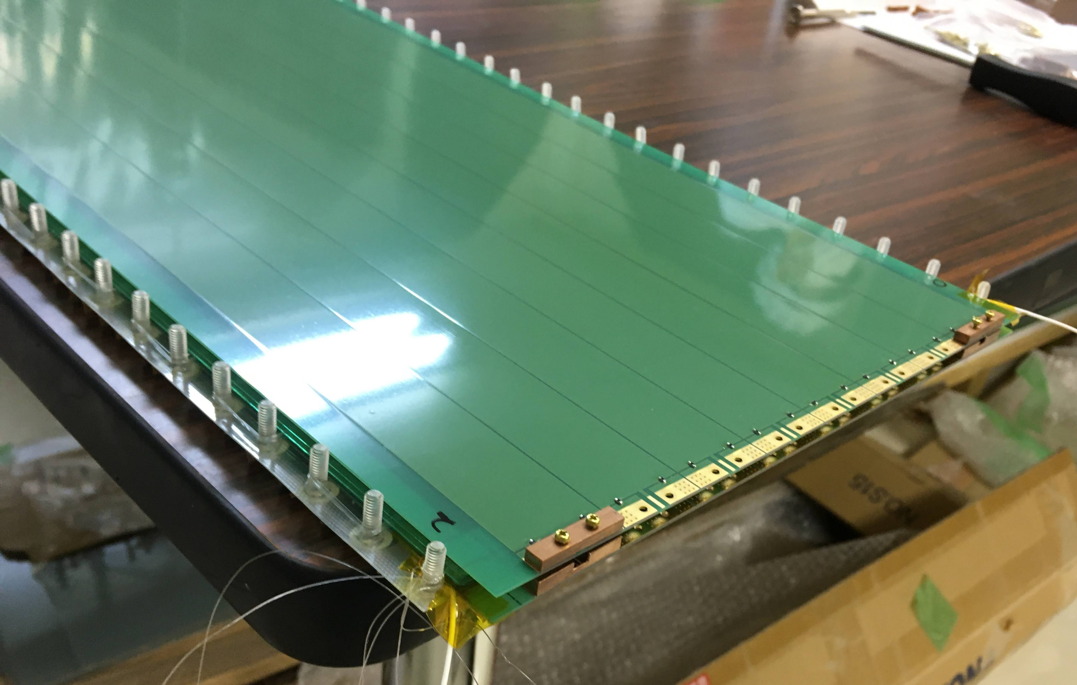
MRPC2 assemble problem
Since we stretch the string with too strong tension, part of plastic screws bent inside too much. Then, they interfere with the glass plate and it was very hard to insert it. We broke many glass plates.
In particular, we broke the topmost glass plate already taped on the top cathode plate. It was impossible to remove the broken glass from the cathode PCB.
Since we didn’t have spare cathode PCB, we decided to use spare anode PCB instead (after soldering between signal and GND patterns).
We cut the end of some screws to make it easier to insert glass plates.
Still we the top glass plate on the cathode PCB was not possible to insert inside the screws completely. The last air gap is larger than others.

Slide 15
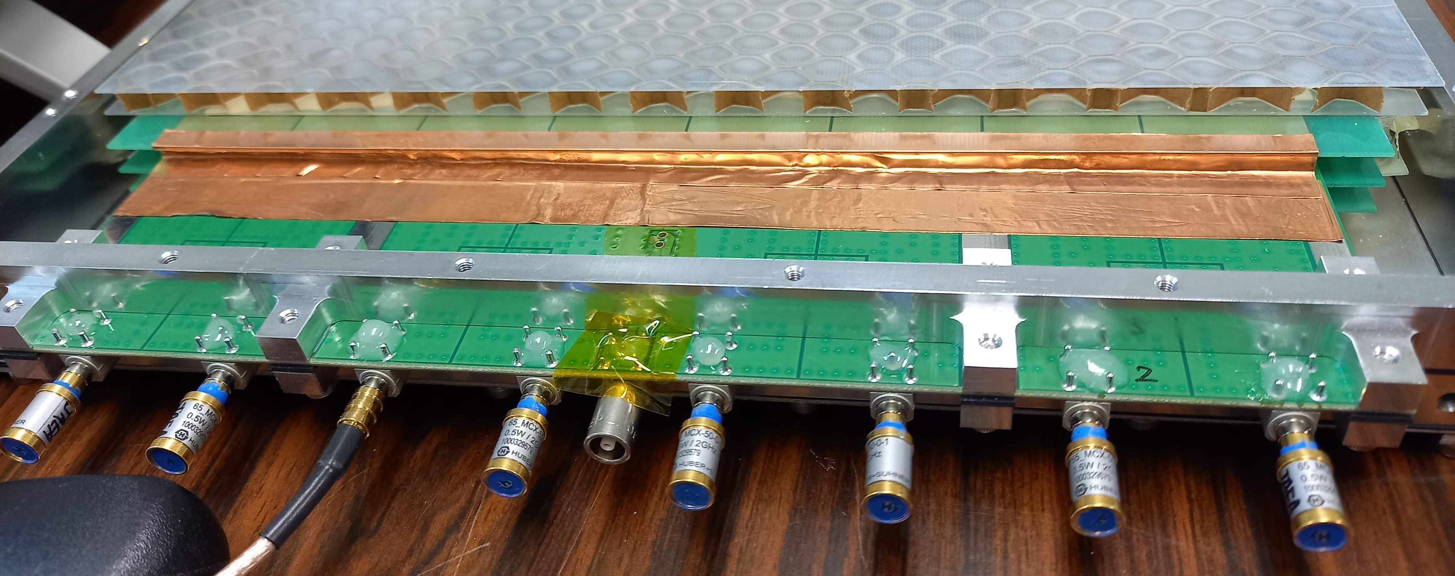
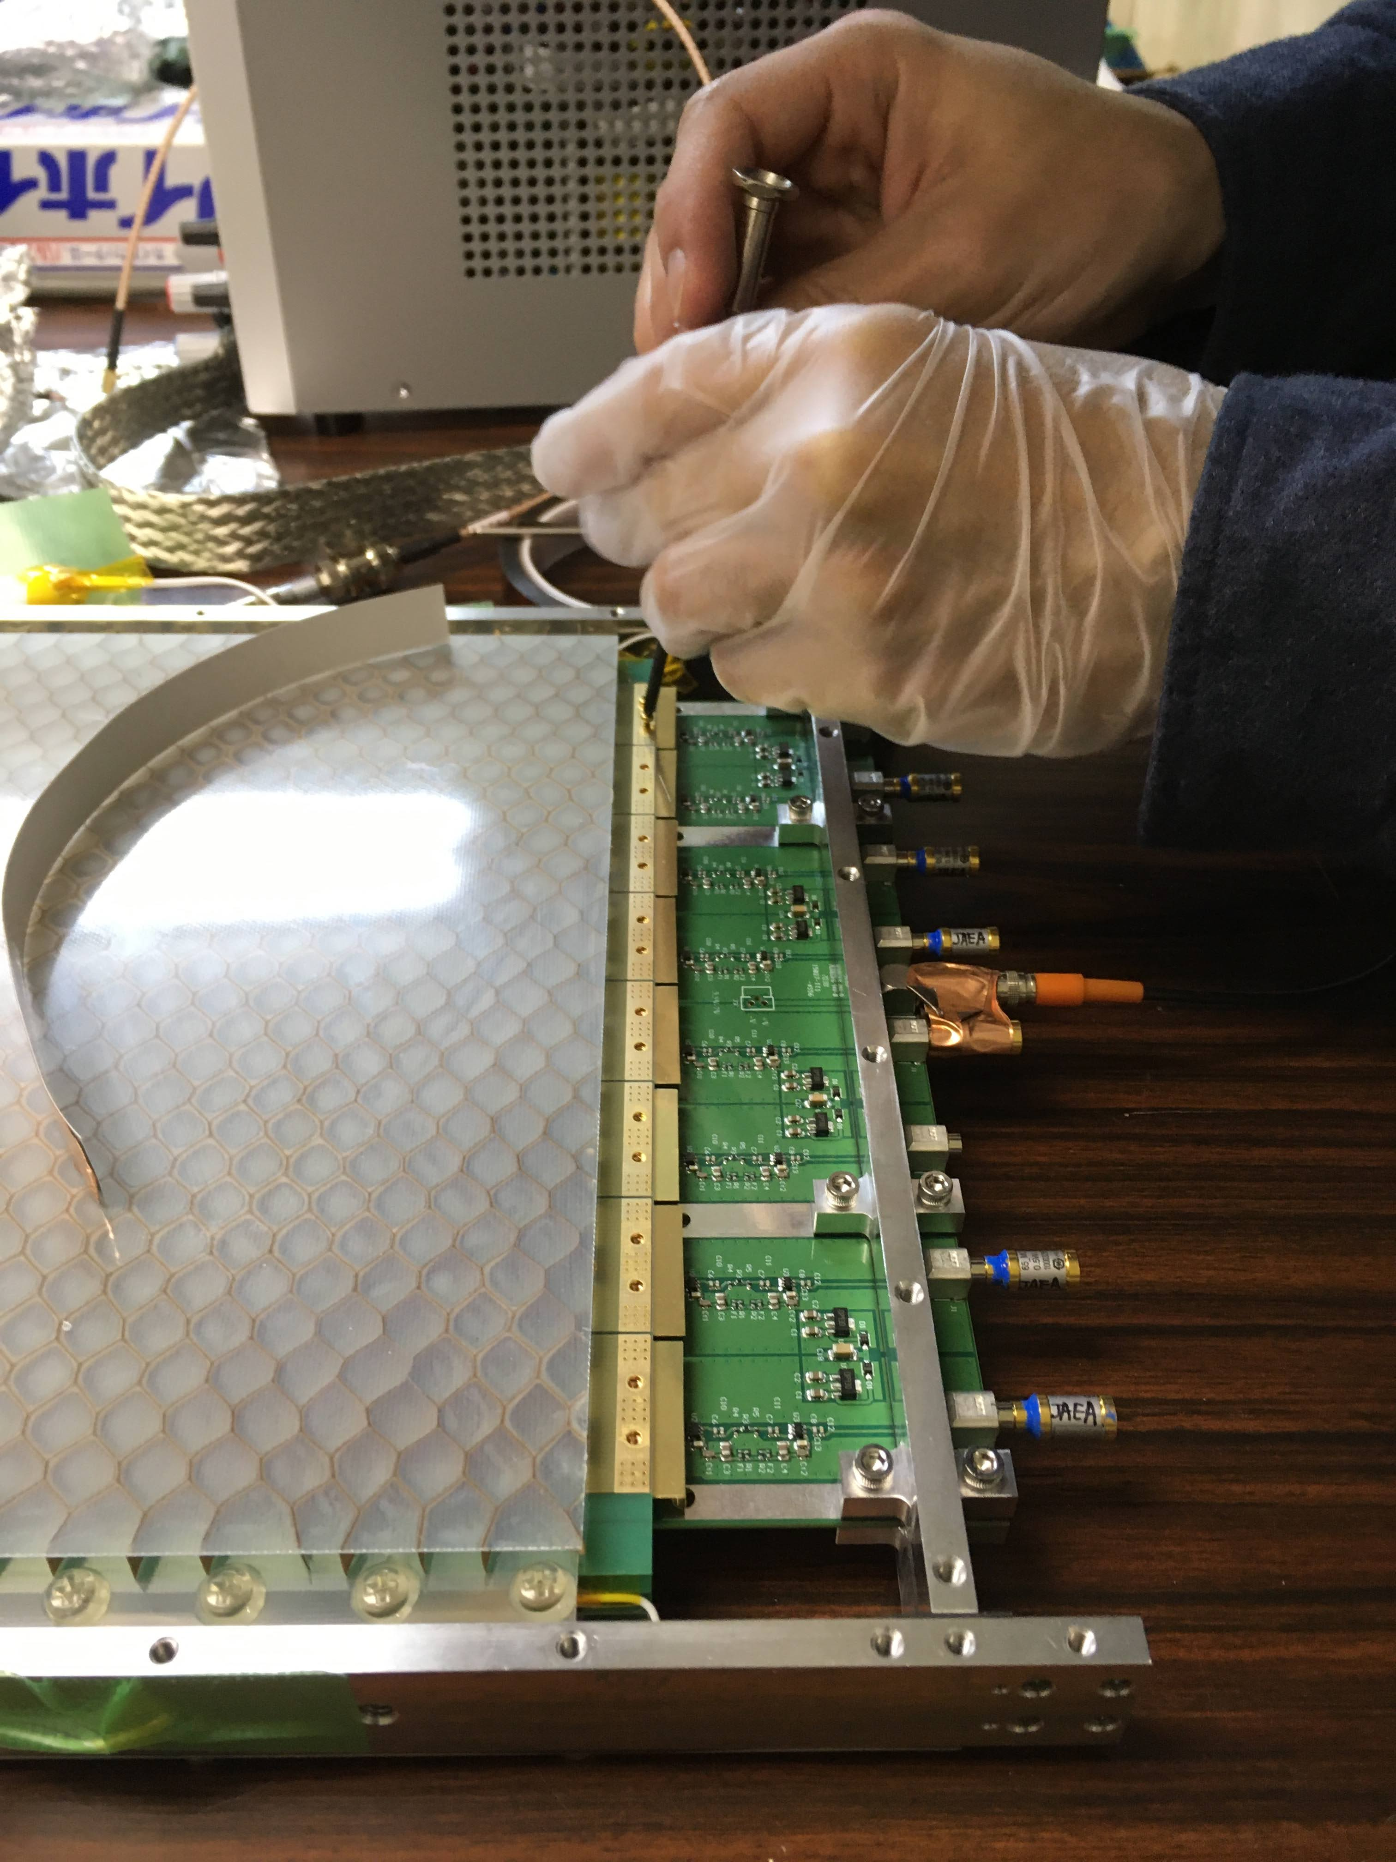
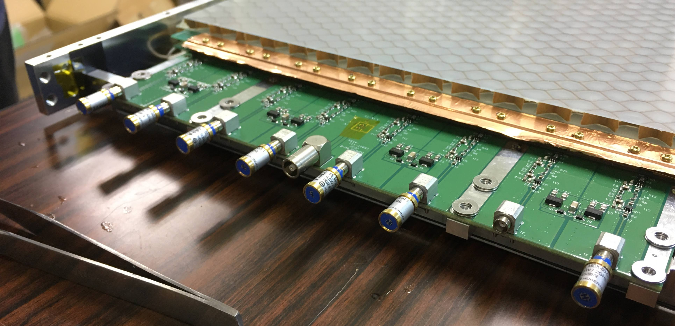
Fighting with noise
2. Cu tape to connect among
Cathode PCB GND, Cu block, and amp GND
Noise level : →700mV (single amp powered)
1. Inserted brass spacer plate for height adjustment
Between cathode PCB and Cu blocks
Contact improved and noise reduced
Noise level : 980mV→860mV (single amp powered)
3. Put Cu tape to cathode PCB and spacer
Noise level : →104mV (single amp)

Slide 16
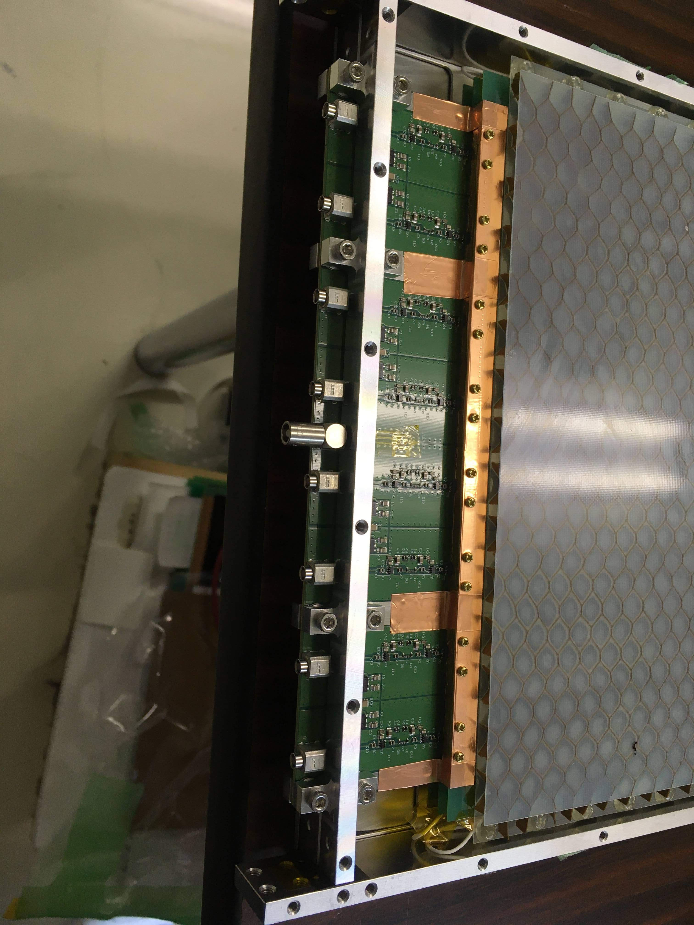
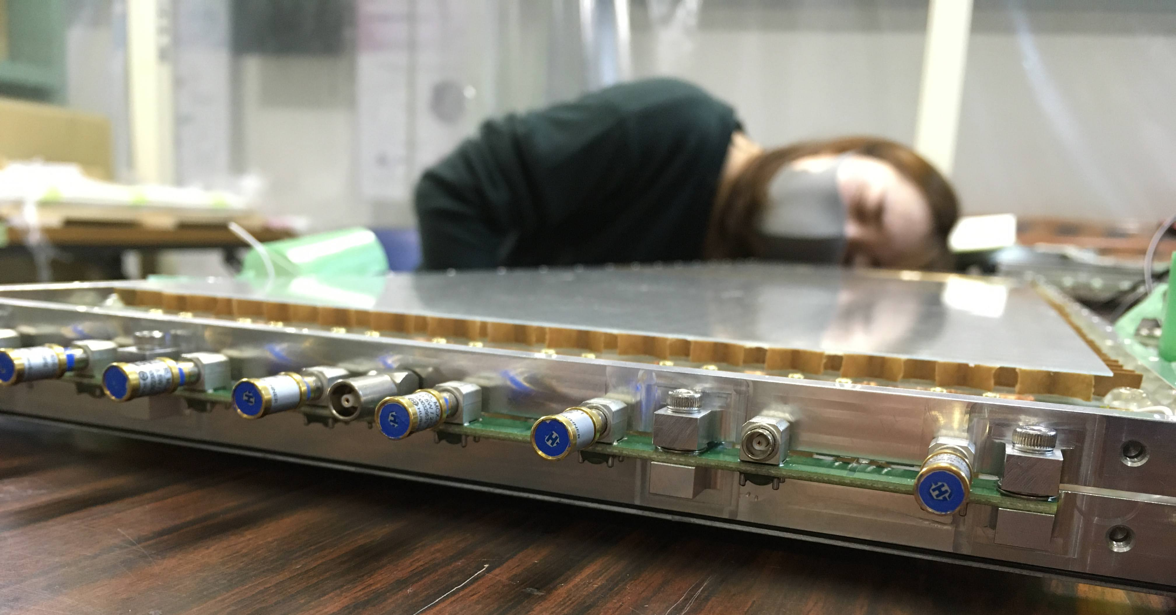
Amp frame plates
4. Removed rubber plate and inserted washer instead
Noise level : →70mV (single amp)
5. Cut spacer and put Cu tape to cathode PCB,
Cu block, and amp GND
Noise level : →21mV (single amp)
90-200mV (double amp)

Slide 17
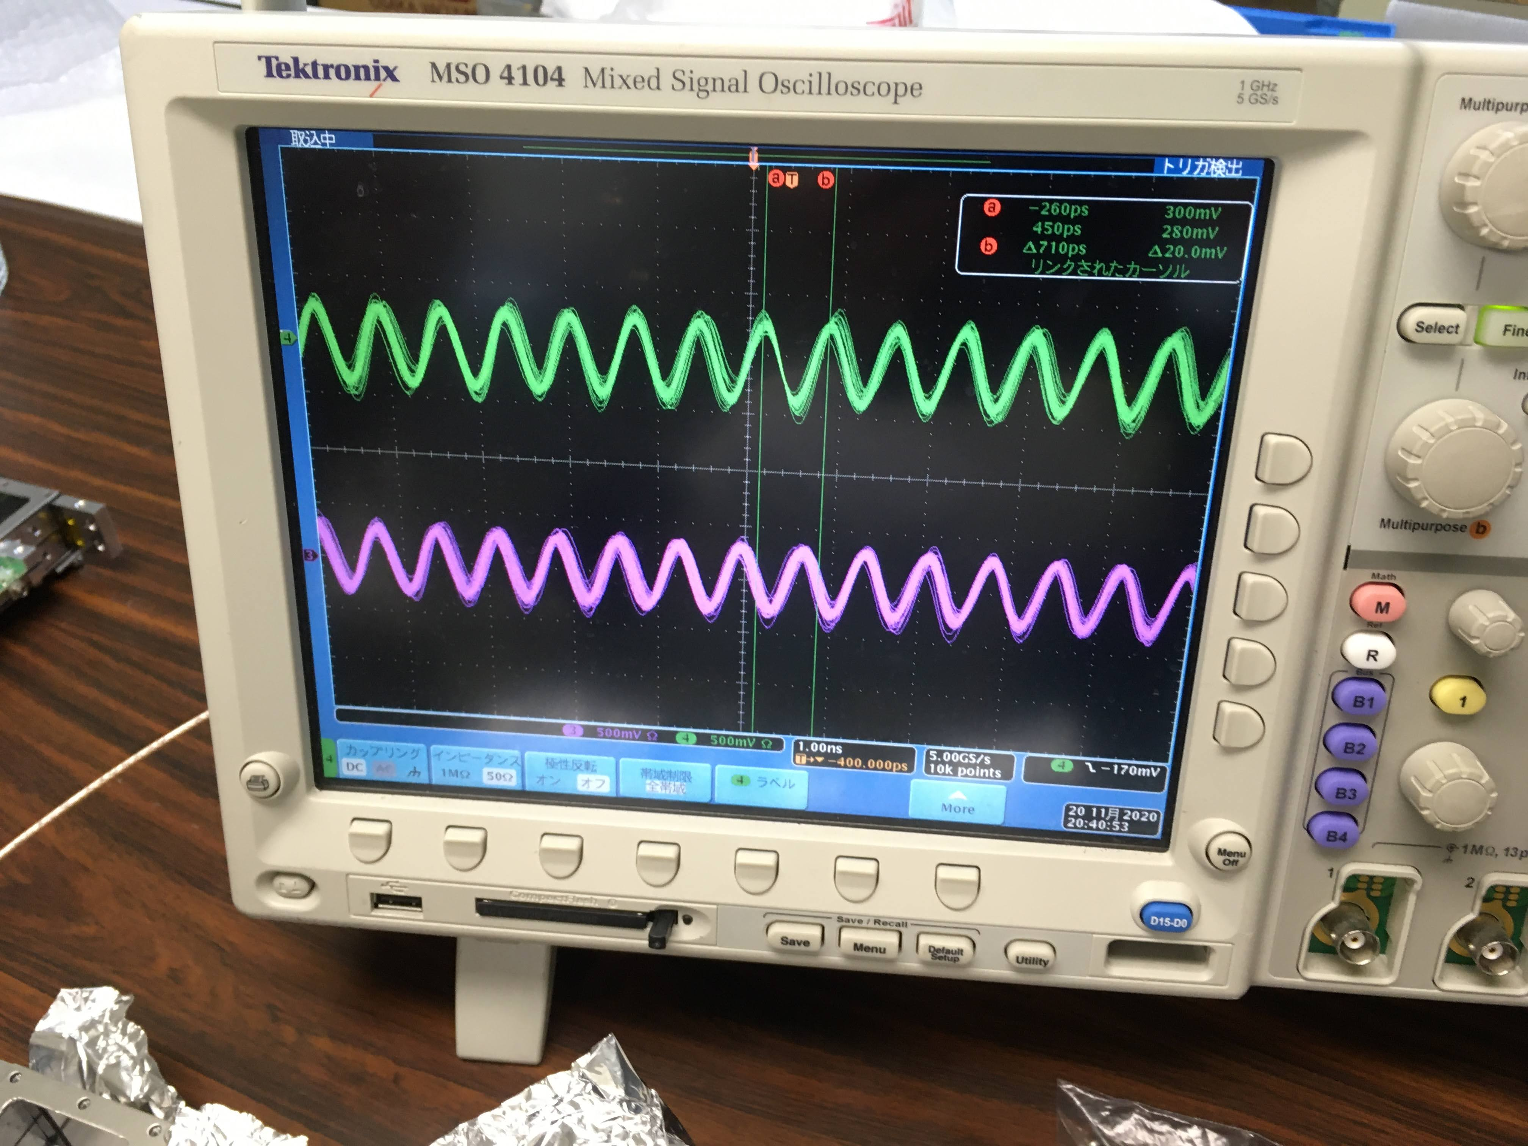
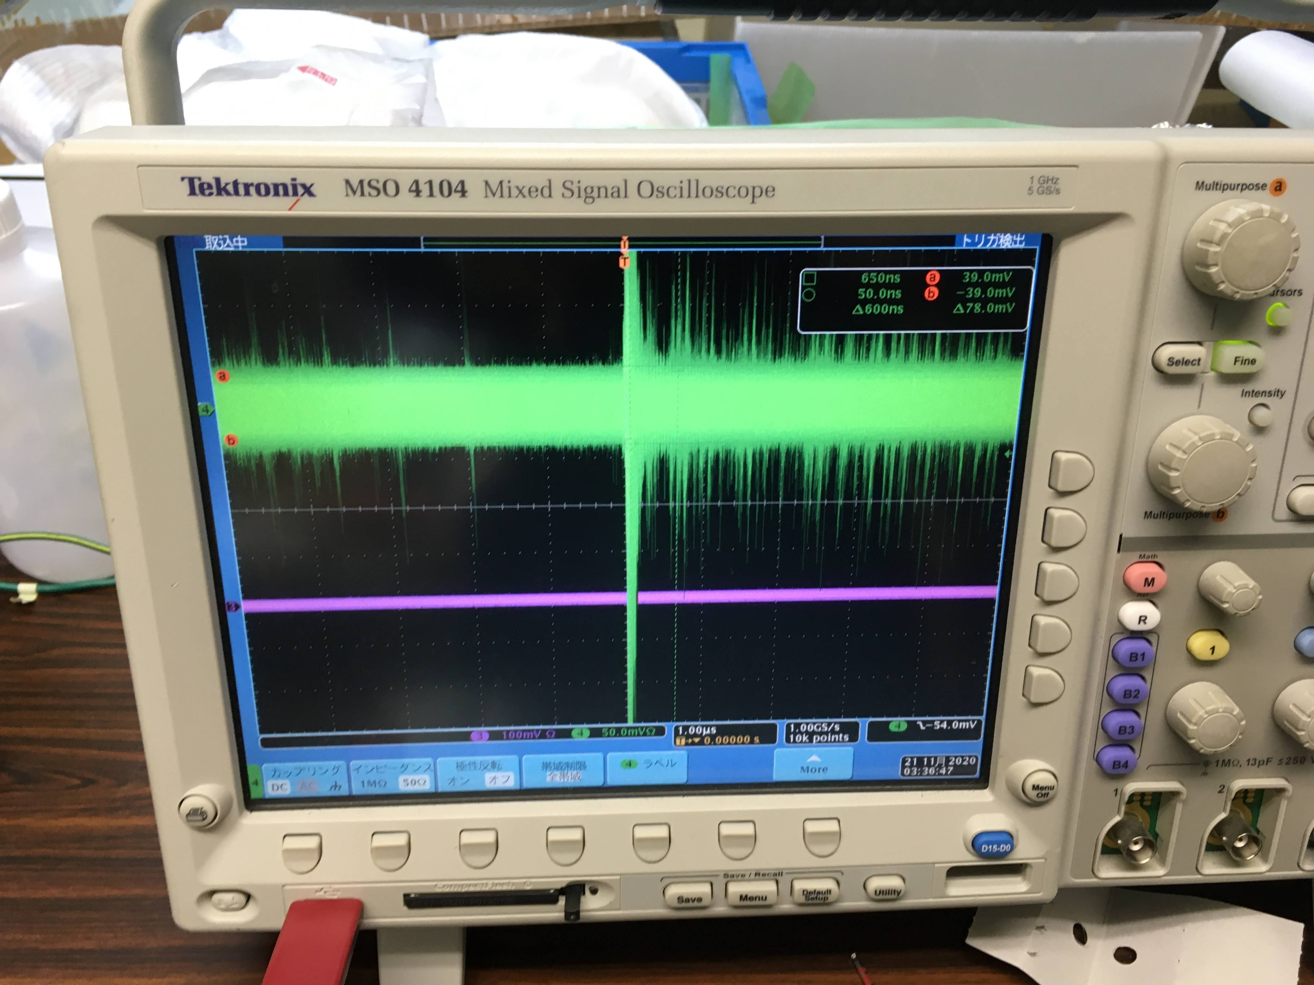
After 4. (inserting washers)
Before 1.

Slide 18
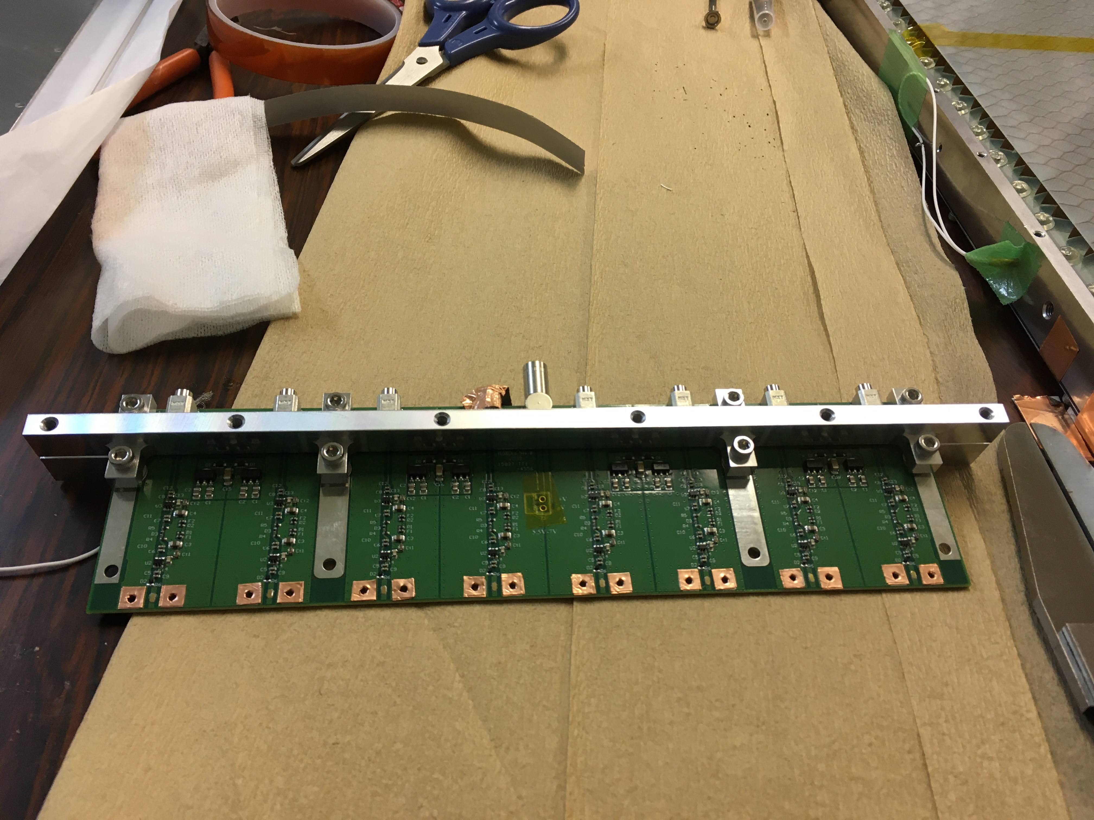
Final fix
6. Put two Cu tapes around the amp GND round
Besides the signal pattern.
Noise level : →23-26mV (single amp)
21-30mV (double amp)
C
Anode PCB
Contact pad+solder
t=0.2
Cu tape 0.1tx2
Amp PCB
Contact of GND was weak
Before inserting Cu tapes

Slide 19
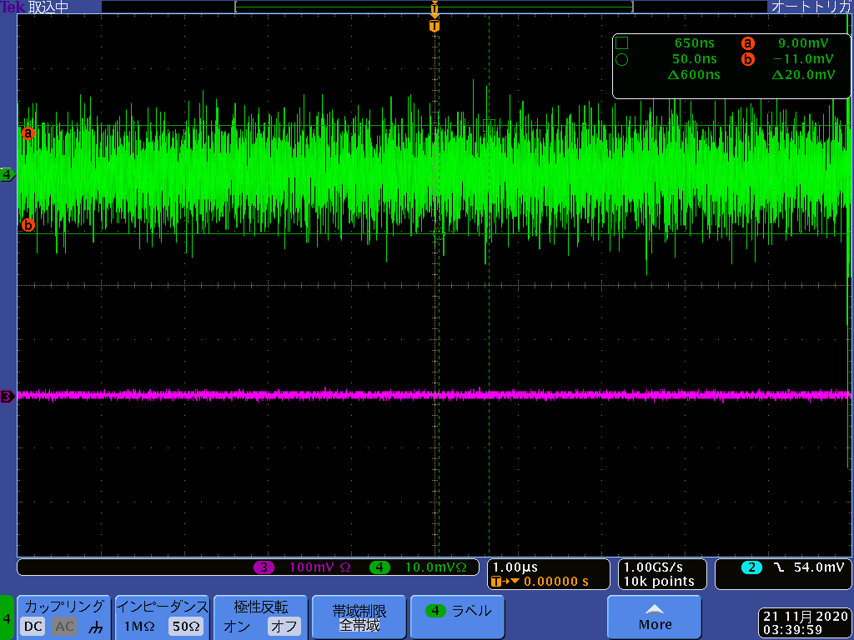
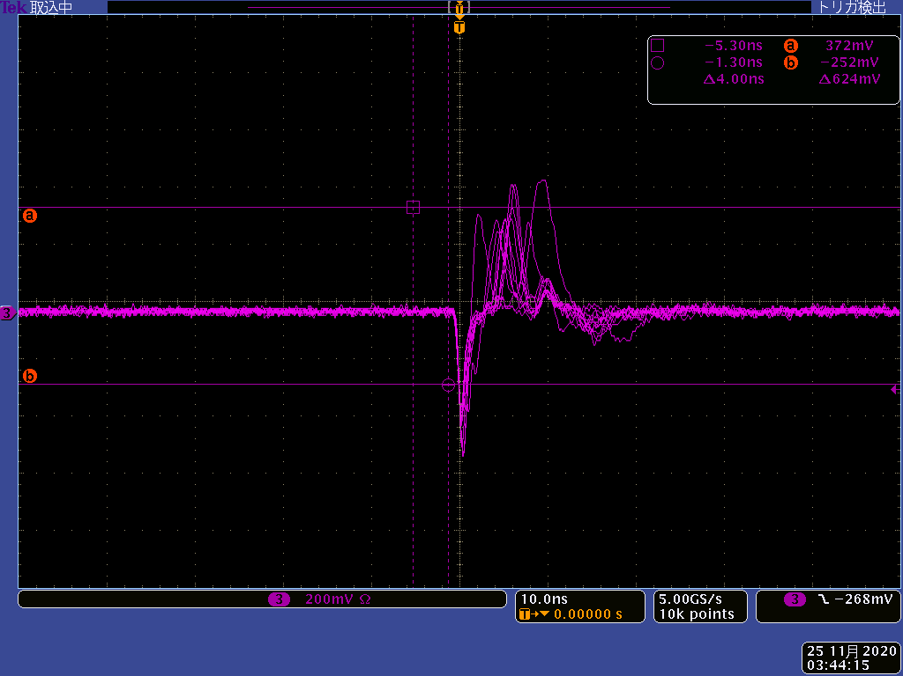
Noise at the experimental area
We found noise increases with LV voltage
  V=5.5V is the best (~20mV peak to peak), the noise level increase by ~ 2 times at 7.0V.
We found by applying HV, the noise level reduces and stable (no oscillation) dramatically.
Signal
Typical noise level at the area

Slide 20
Problems and fix for noise reduction
Noise was huge (order of 1 V) and oscillating, when we assembled a MRPC.
The connection between Cu blocks and PCB boards were weak. We inserted the sim plates made of brass and the noise level reduced slightly (contact improved).
Connection between Al plates which sandwich the amplifier was weak. We inserted washers instead of rubber plate and noise level reduced.
Still ground connections between cathode PCBs and amplifier PCBs were weak. We put Cu tapes to connect from both sides to reduce noise level (~70mV). Also noise level changes with tightness of screws.
We noticed anode PCB ground connection to amplifier PCB were weak. It is because the contact pad height is higher than the ground pattern by 0.3mm. We put two layer of Cut tapes on the ground pattern by 0.2mm thick. Then, the noise level reduced to 30mV level.
CONCLUSIONS: Mechanical contact is difficult. We should improve it by minimum modifications of the current design. It may be better to go back soldering?
Idea of direct contact between anode and amp PCBs are good? The final timing resolution is good.

Slide 21
HV test
No spark up to 13.0kV in MRPC1 and MRPC2.
At 13.5kV there is discharge. (BGOegg RPC can keep 15kV?)
There is some weak point in the structure? Cu blocks to glass ?
But 13kV may be ok for operation (at BGOegg RPC best performance was at ~13kV?)

Slide 22
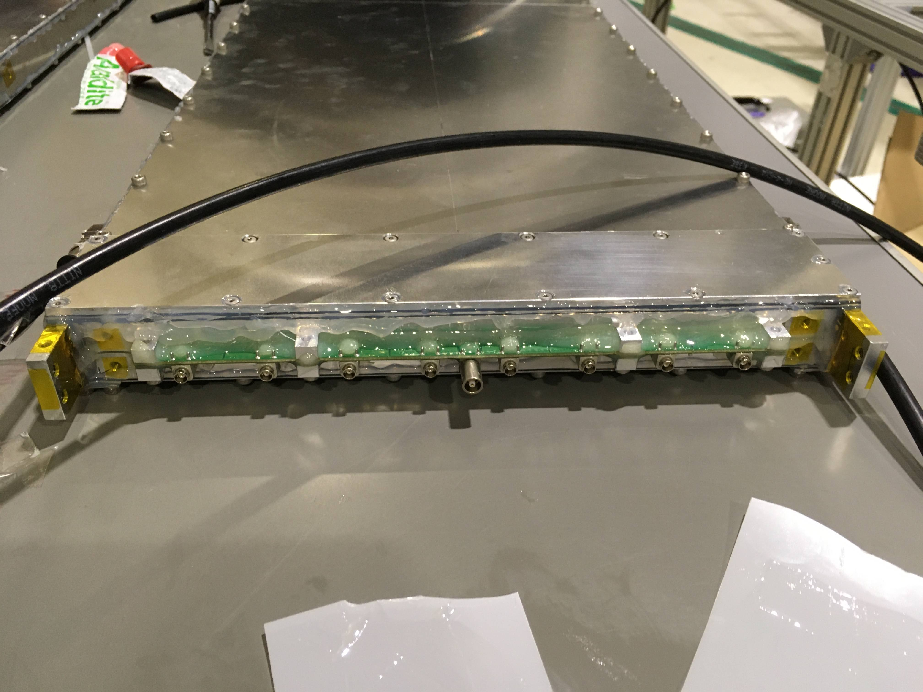
Fighting with gas leak
First we used liquid gasket to seal side part of chassis, between window plate to amp frames, between amp frames
We found large leak points around
  Gas connectors
  Amplifiers
  Amp frame

Slide 23
Problem and fix of gas leak
Large leak around the gas connectors!
  With cover entire connector with Araldite, the gas leak stopped
  We should change the connectors from next production]
Large leak around the amplifier PCBs at both ends.
  We cover most of surface of PCB boards and end Al plates with Araldite. I don’t know how to improve it by design.
Liquid gasket cannot gas leak well. Araldite is much better.
We should remove all rubber plates, and reduce screws. They are only obstacles to stop gas leak. (But still electrical contact among chassis parts needed). And we should use Kapton tapes with small amount of Araldite (As used in LEPS2-RPC).

Slide 24
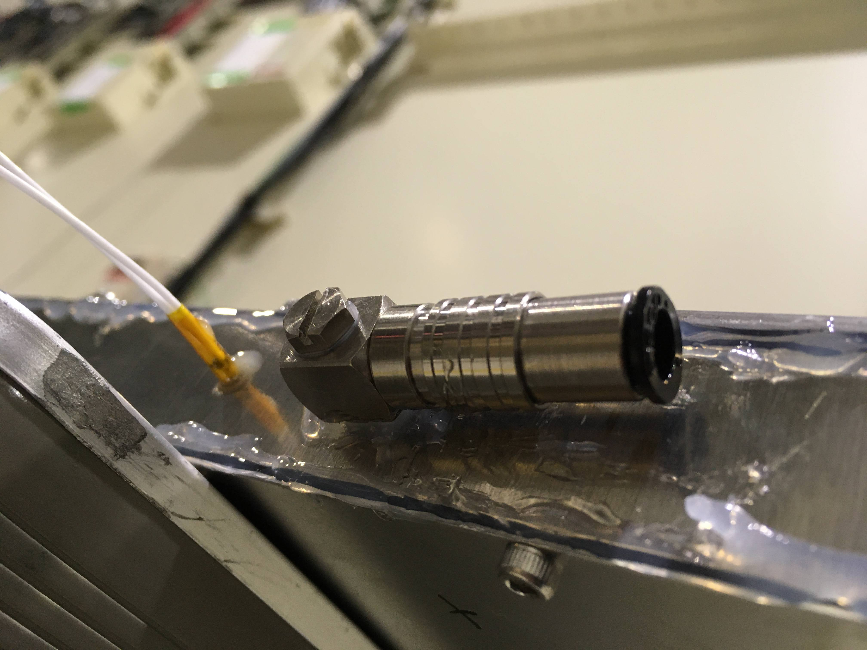
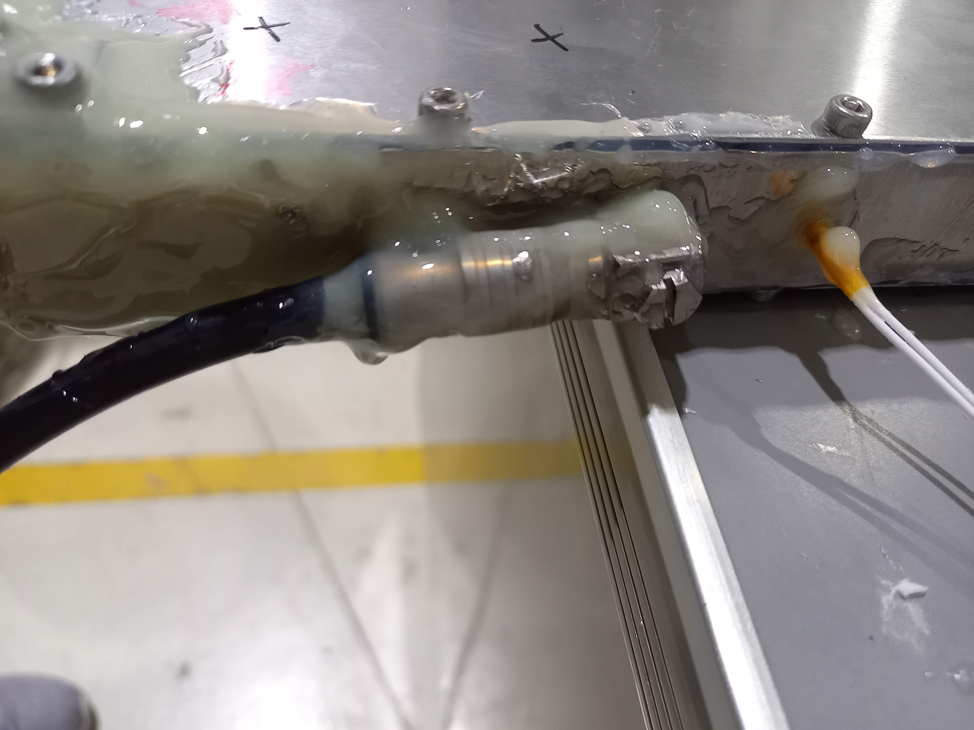
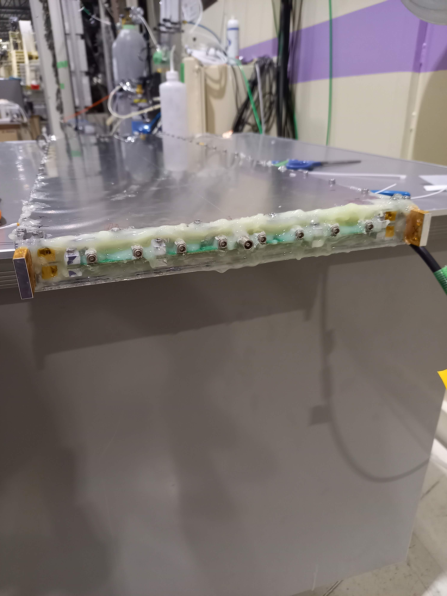
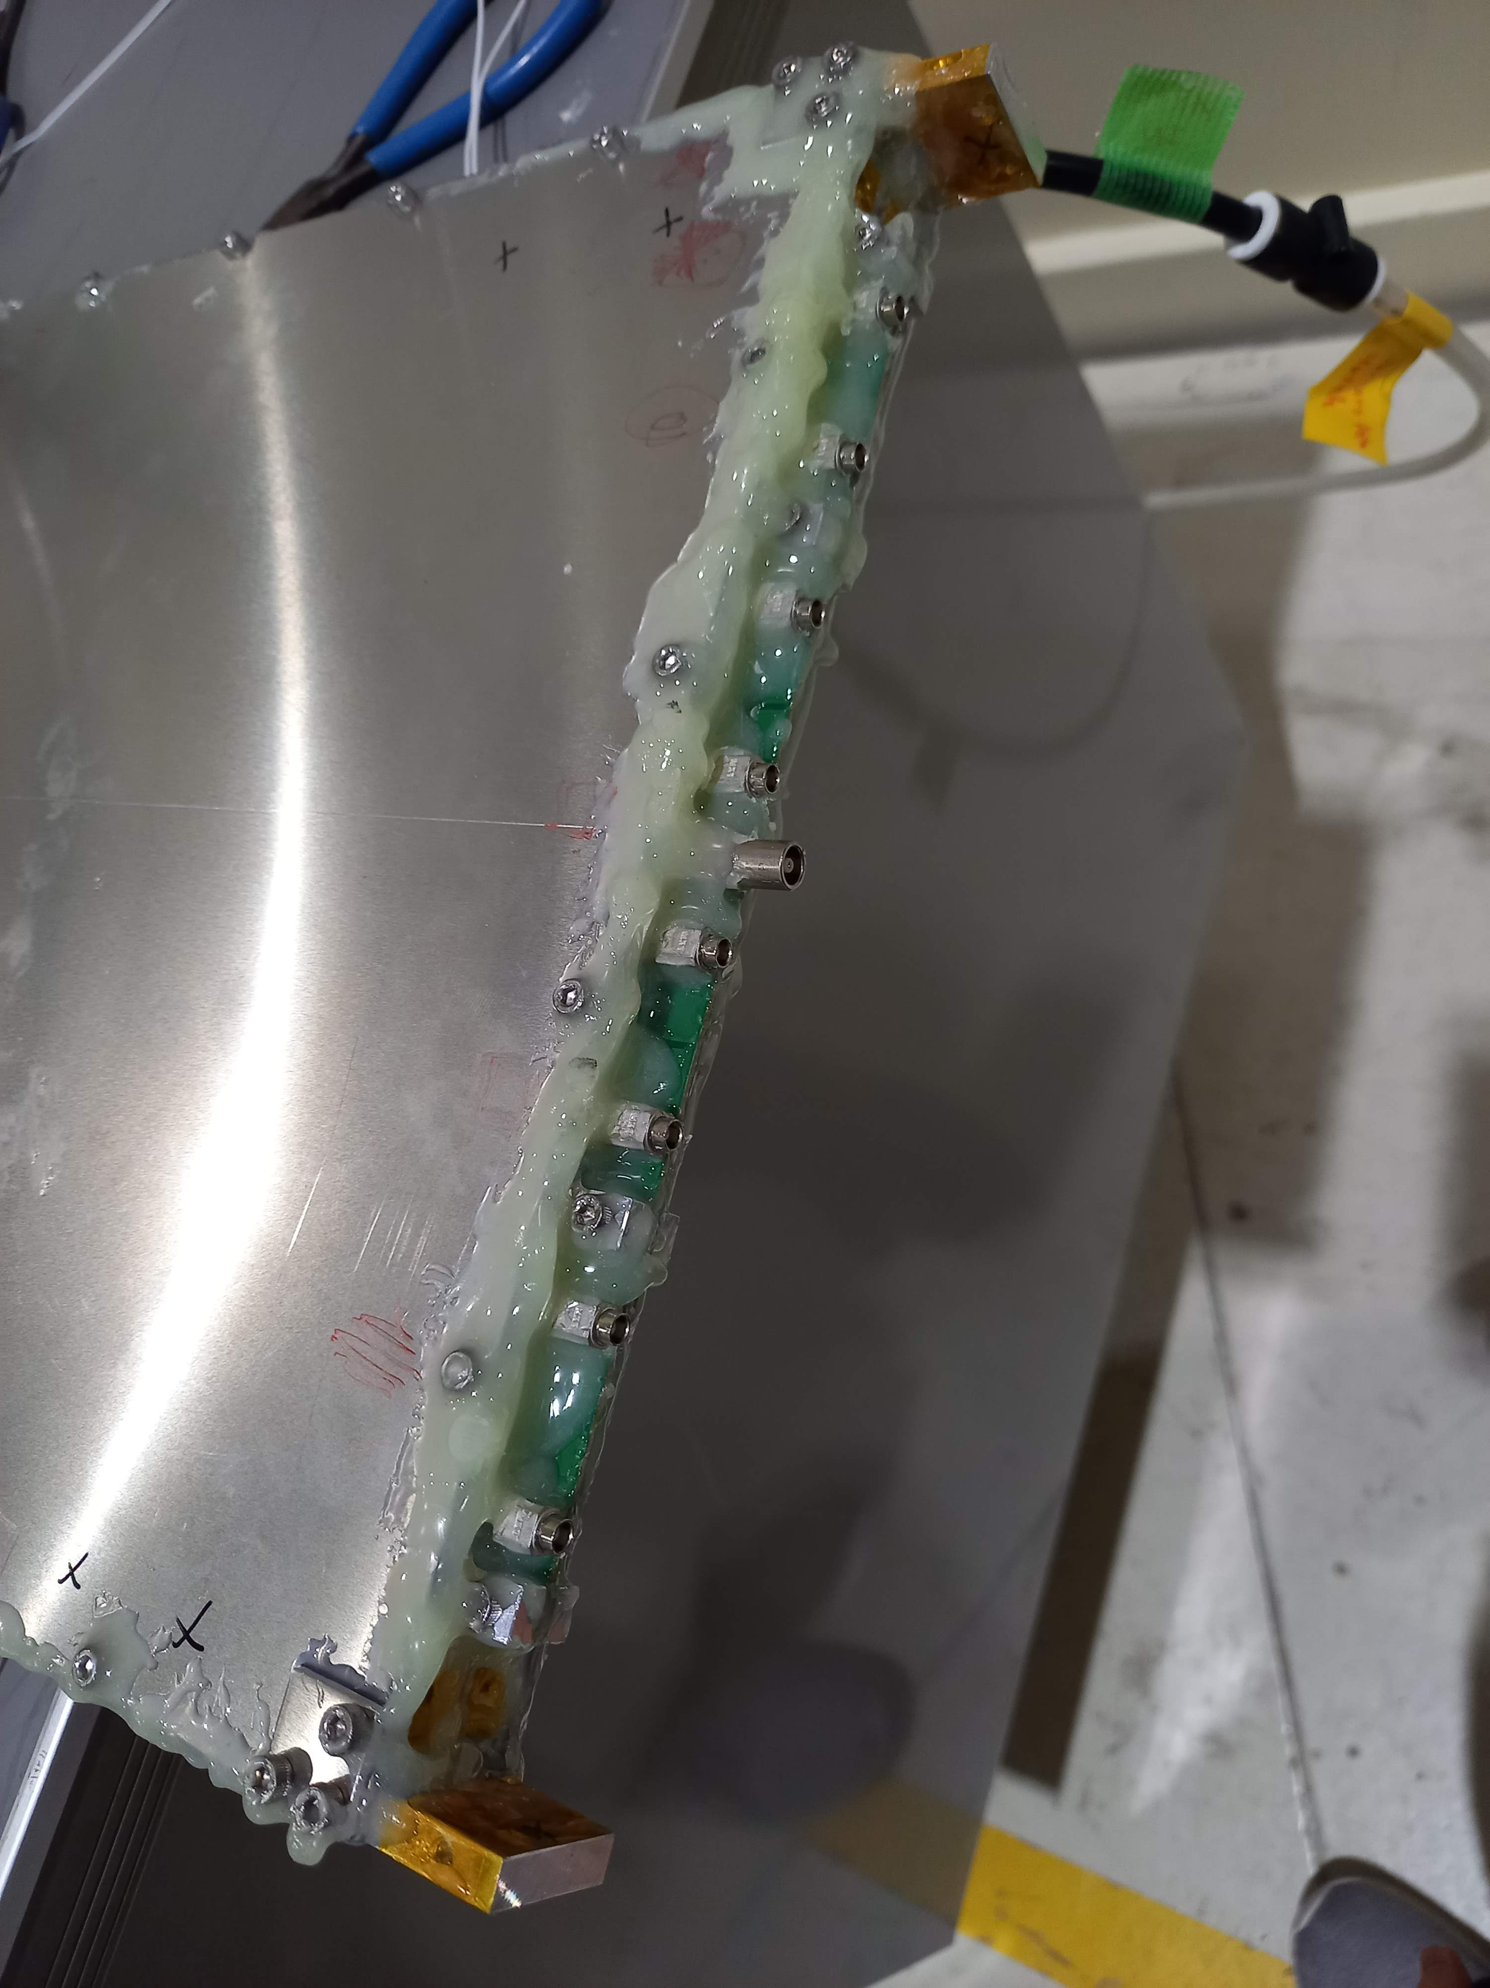
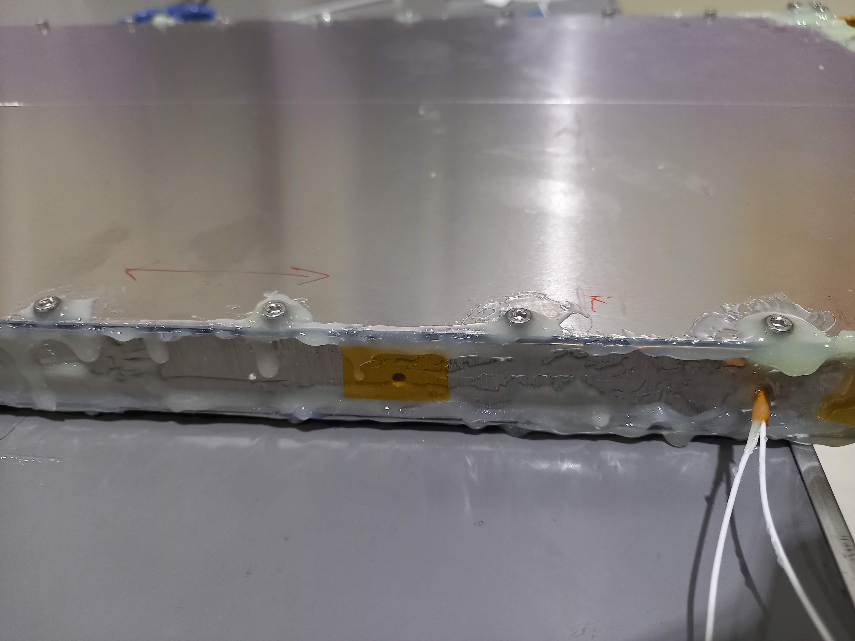

Slide 25

Experimental setup
Trigger=trigU(t) x trigU(b) x trigD(t) x trigU(b) x Upveto
Select Strip 2 hit events with ADC3>ADC1 and ADC3>ADC2
LEPS dipole magnet
Y (vertical)
UPveto
Dipole magnet
e-
$γ$ beam
Z(beam)
30 cm
RPC
Target: Lead
t=0.55 mm
e+
B-field
Scintillation counters
Amp out
Y (vertical)
Amp out
Electron
center
RPC1(R)
→ ADC
RPC (L)
X (horizontal)
RPC2(R)
→TDC, ADC
RPC3(R)
→ADC
→HRTDC and DRS4

Slide 26
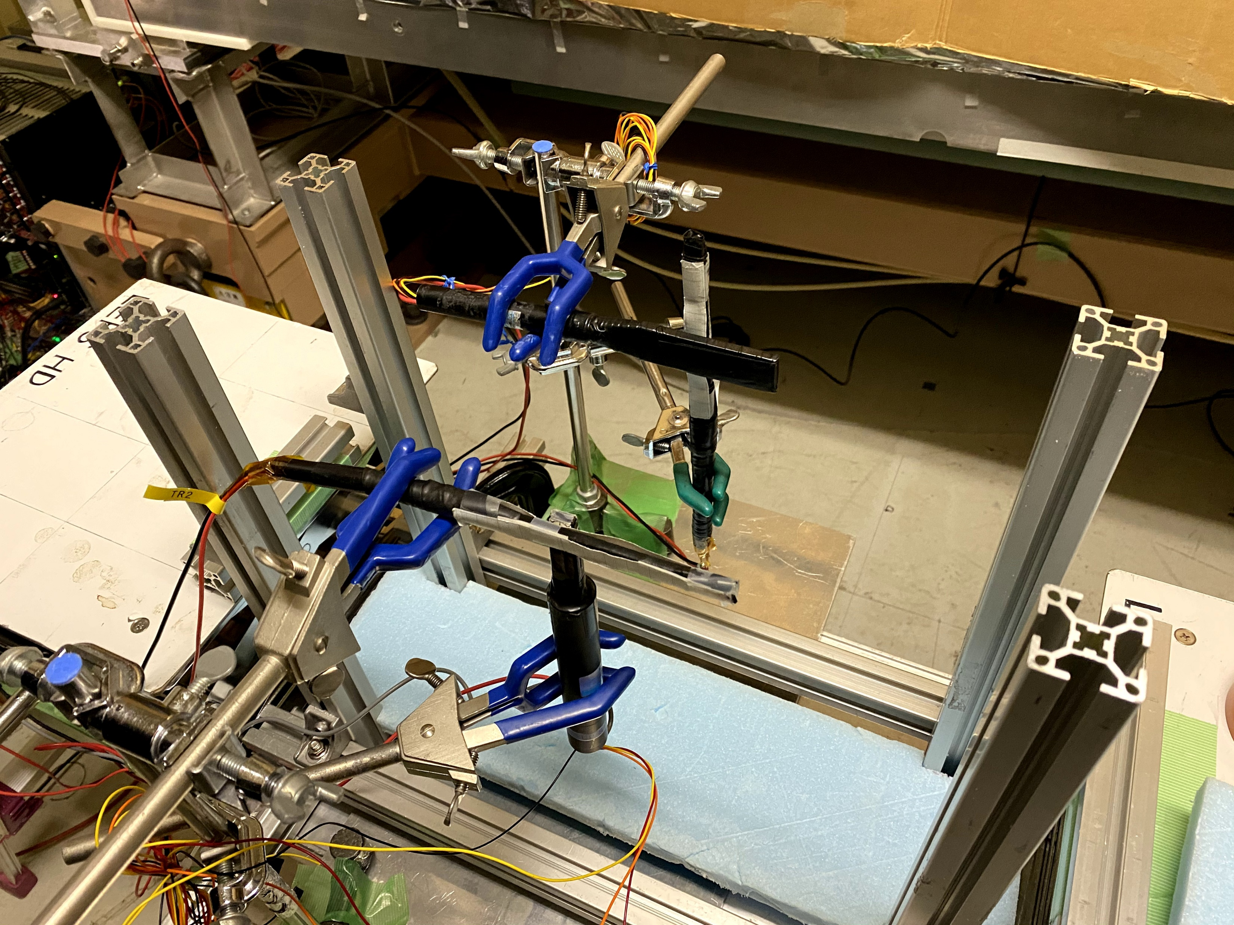
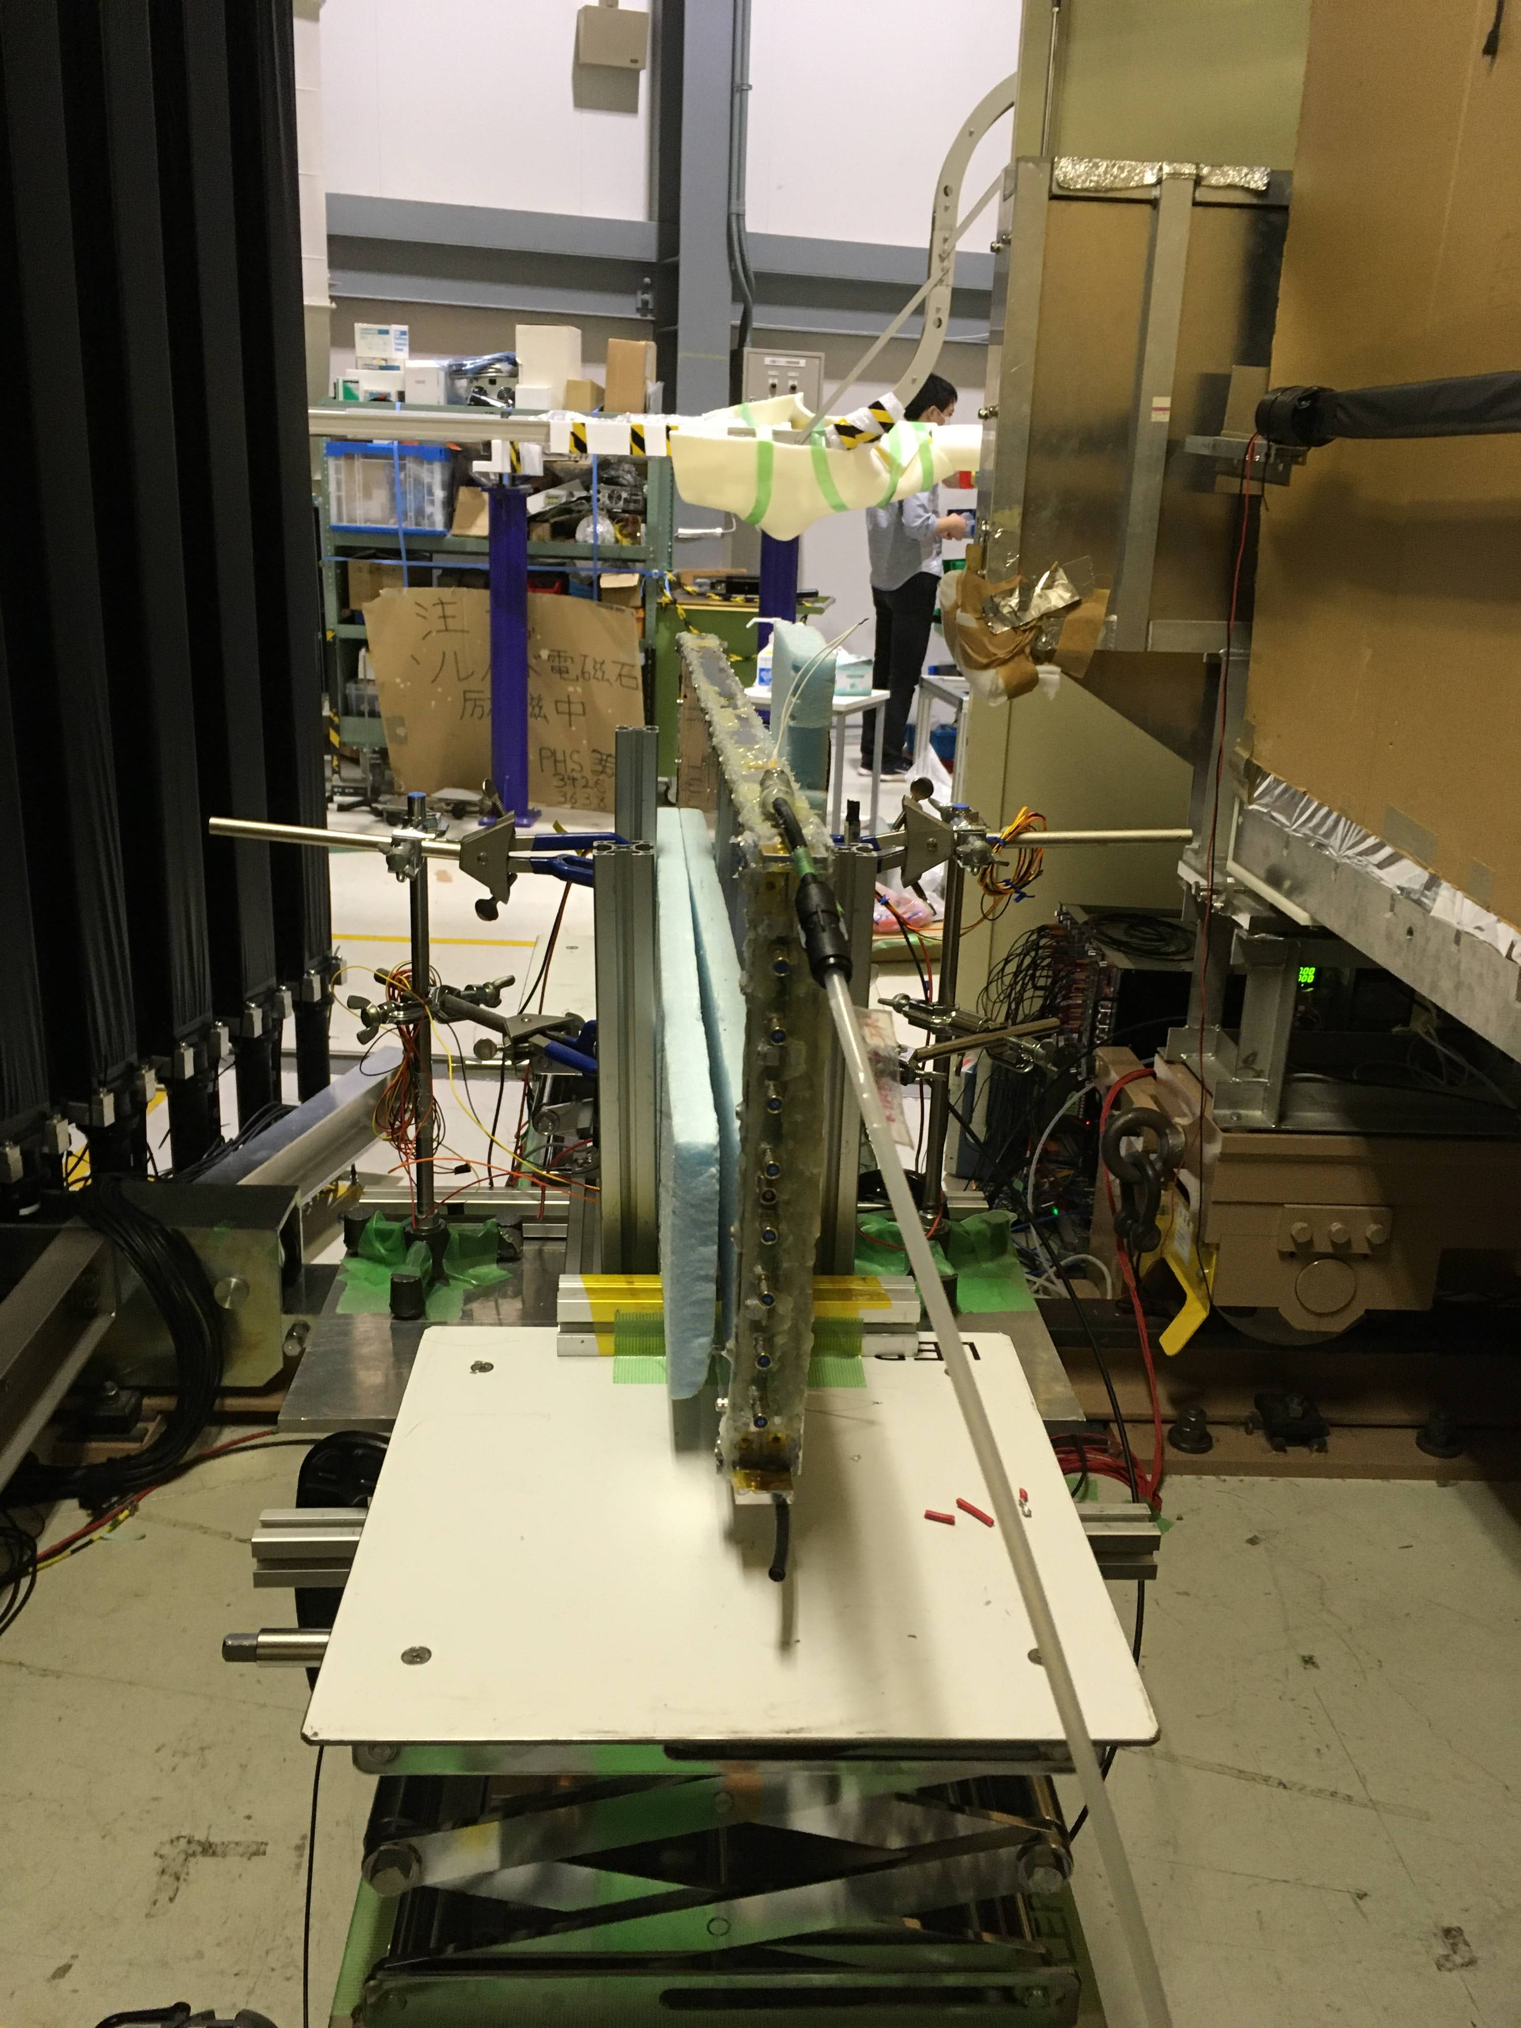
Experimental setup

Slide 27
Conditions
MRPC1, MRPC2
Vth, HV scan
Strip 1-8
Position scan with a strop

Slide 28
Results
MRPC1
  Single end: w/o Slewing correction
  101.4+-0.7ps
MRPC2
  Average of both ends: w/o Slewing correction
  85.5+-1.7ps

