Slide 1
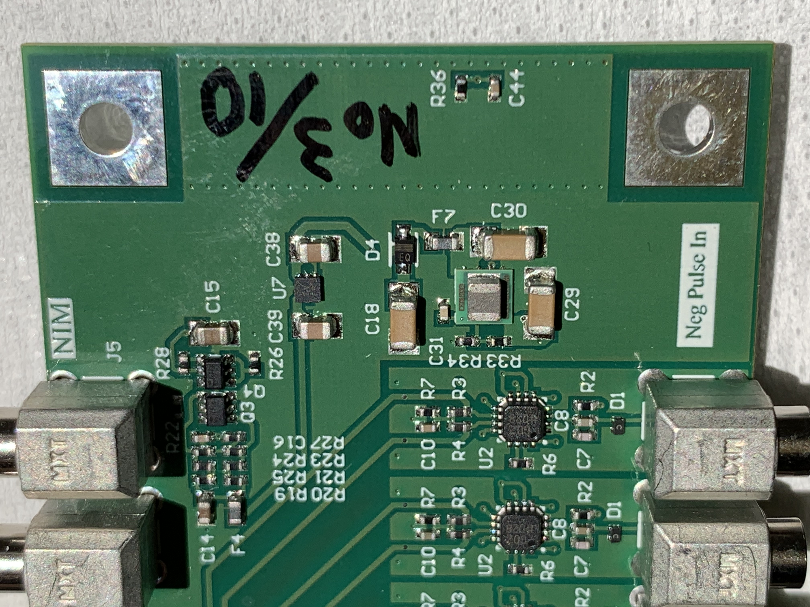
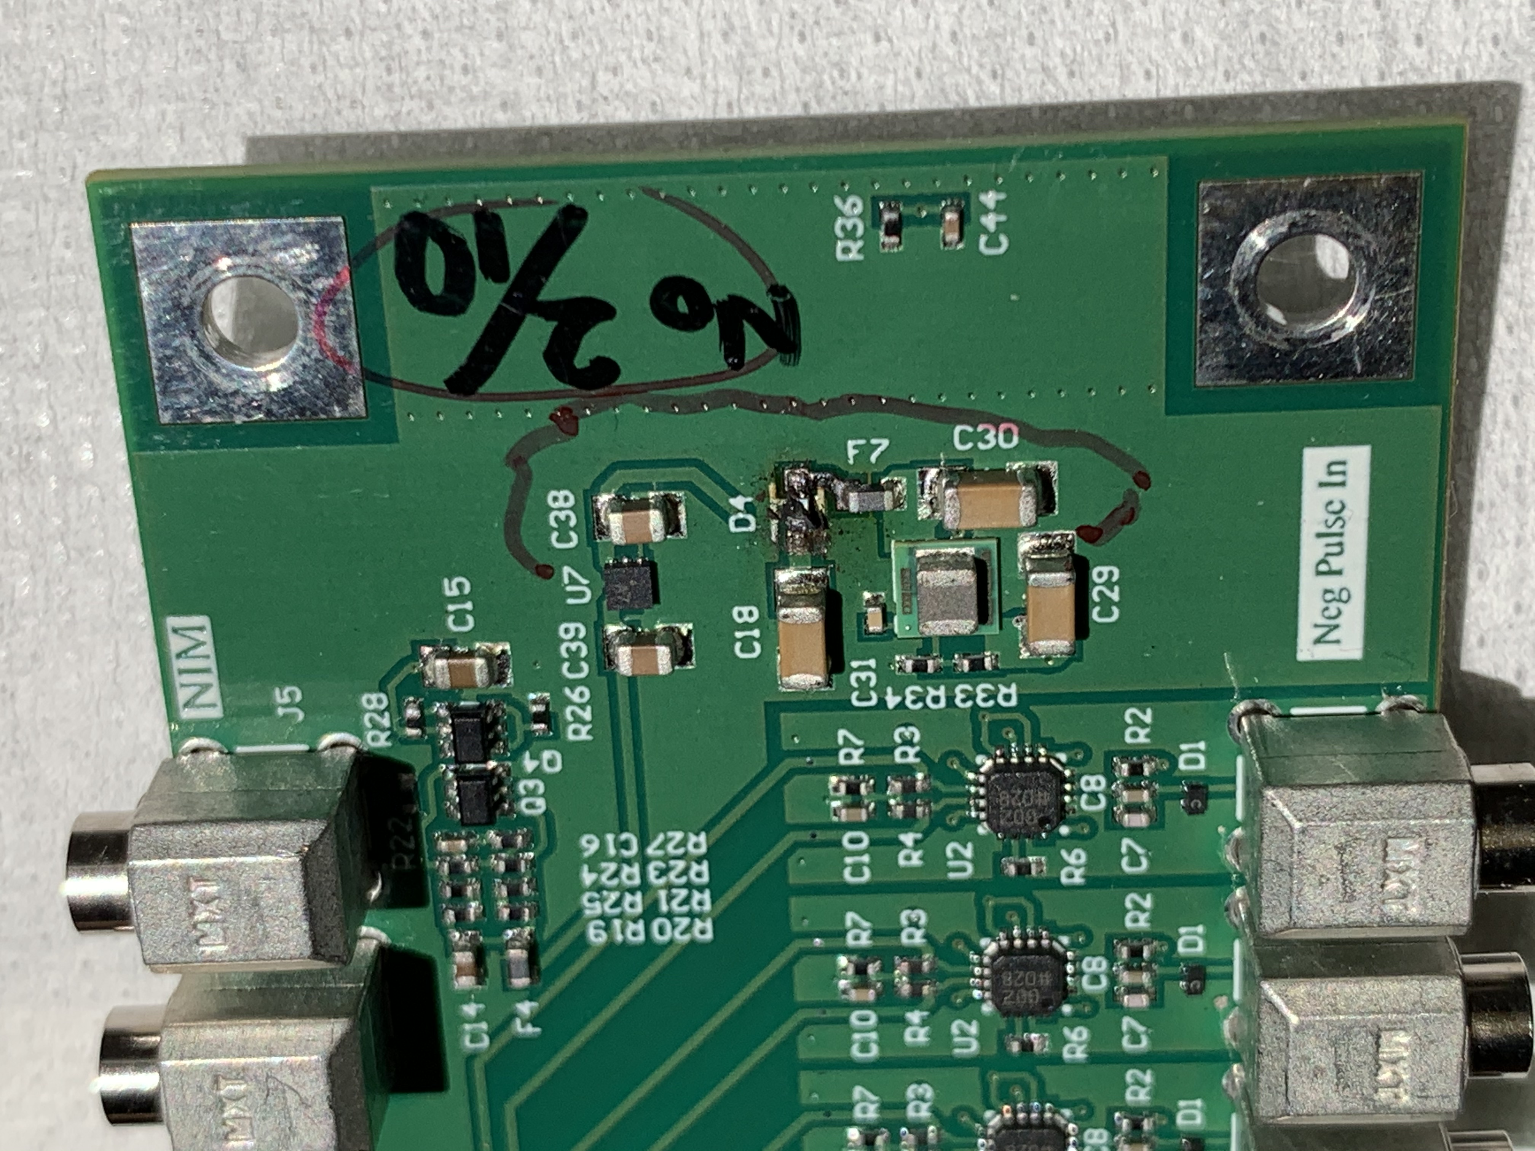
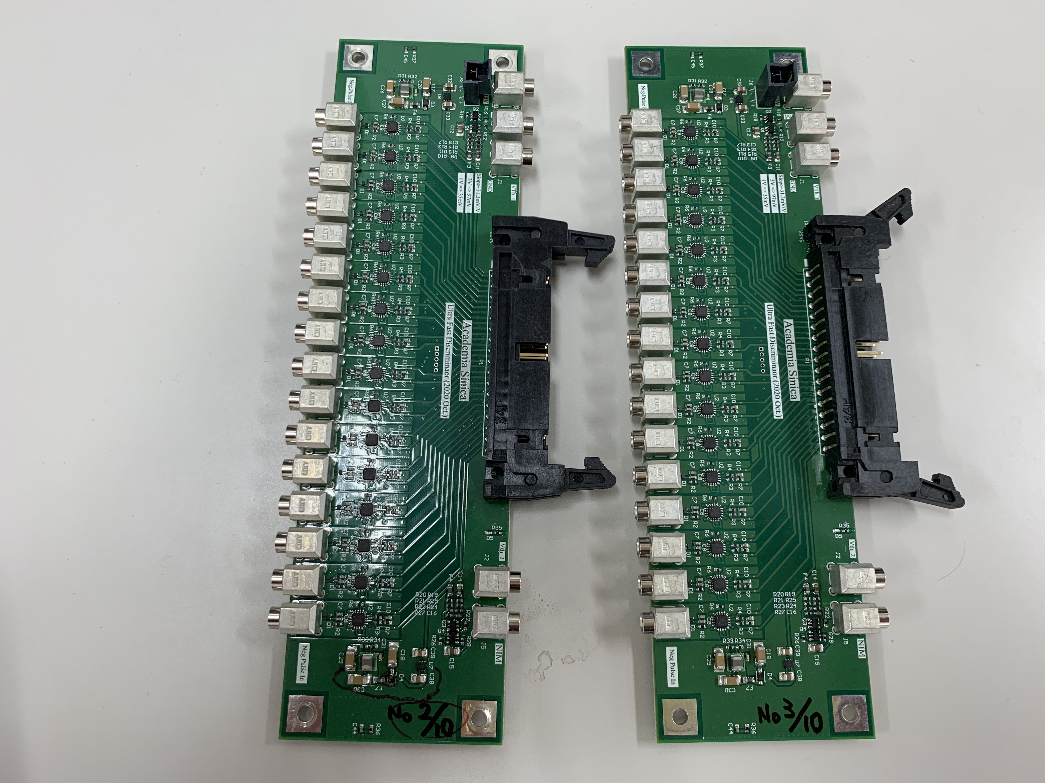
On 2021 Jan 13, we accidentally burned one of the parts called “D4” on the comparator “No.2/10”,
by accidentally make a metal connector touching around the “D4” parts.
Zoomed photo of 2 (good and burned) comparators, out of total 10 comparators
Good
Burned
Zoom-up
Zoom-up
We named 10 comparators as:
“No.1/10”,
“No.2/10”,
“No.3/10”,
… … and so on
“No.10/10”.
And wrote (hand-writing) it
on the board.

Slide 2
Schematical Drawing
On 2021 Jan 13, we accidentally burned one of the parts called “D4” on the comparator “No.2/10”,
by accidentally make a metal connector touching around the “D4” parts.
Zoomed photo of 2 (good and burned) comparators, out of total 10 comparators
By touching
One of “hanging” metal
signal connectors
Resulting in
for burned one (i.e. “No. 2/10”)
R (of D4) ~ 30ohm
[F7 side w.r.t. C18 side]
R (of D4) ~ 100ohm
[C18 side w.r.t. F7 side]
While
for good one (i.e. “No. 3/10”)
R (of D4) ~ infinite ohm.
for both
[F7 side w.r.t. C18 side]
[C18 side w.r.t. F7 side].

