Slide 1
Belle II Aerogel RICH
Koji Hara (Nagoya University)
Belle II Aerogel RICH group

Slide 2
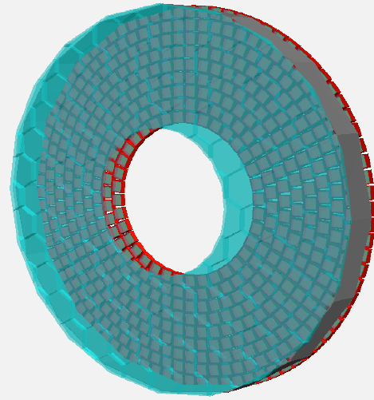
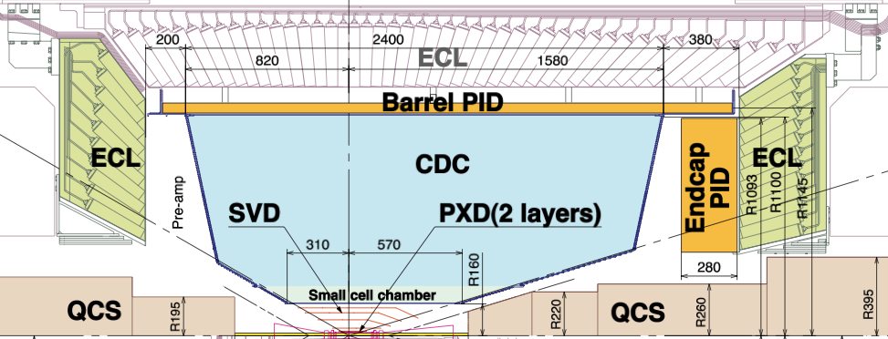
Belle II Aerogel RICH Counter
Upgrade of Belle endcap Particle ID device
Current: threshold type aerogel Cherenkov counter
K/π ID for 0.5 < p < 2GeV/c
Ring Imaging Cherenkov Counter
K/π ID for 0.5 < p < 4GeV/c
Covers full momentum range of two body B decays.
→ study of New Physics (B→ππ, B→ργ etc.),
improved efficiencies full recon. B and charmed particles.
Belle II Detector
B=1.5T
28cm

Slide 3
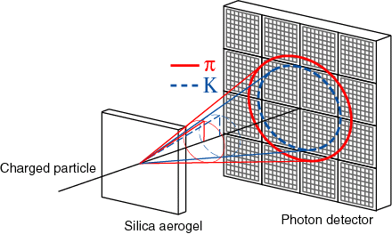
Concept of Belle II Aerogel RICH
Proximity focusing RICH based on silica aerogel radiator
Target: more than 4σ K/π separation at 4 GeV/c
Essential components
Silica Aerogel
Refractive index ~1.05
Highly Transparent
20cm
~60mm
Photodetector : 144ch HAPD
Large sensitive area
High sensitivity to single photon
Position resolution of 5x5 mm²
Large sensitive area
Immunity to high magnetic field (1.5T)
θ_{c}^{π} – θ_{c}^{K}～23mrad (n=1.05)@4GeV/c
angle resolution: σ_{θ}/√N_{p.e.} ＜6mrad
Readout electronics
Readout 10⁵ channels at once

Slide 4
Aerogel Radiator
Cherenkov angle resolution of proximity focusing RICH:
σ_{gel}/√N_{p.e.}∝ √d
→ Limited by radiator thickness.
Increase effective thickness without degrading the angle resolution
→ Focusing scheme
[T. Iijima, et al. NIMA 548,383 (2005)]
Transmittance of larger n (>1.05) is very important.
d
Refractive indices
n₁ < n₂
New aerogels have been produced by a new production technique

Slide 5
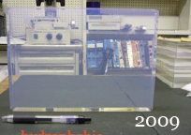
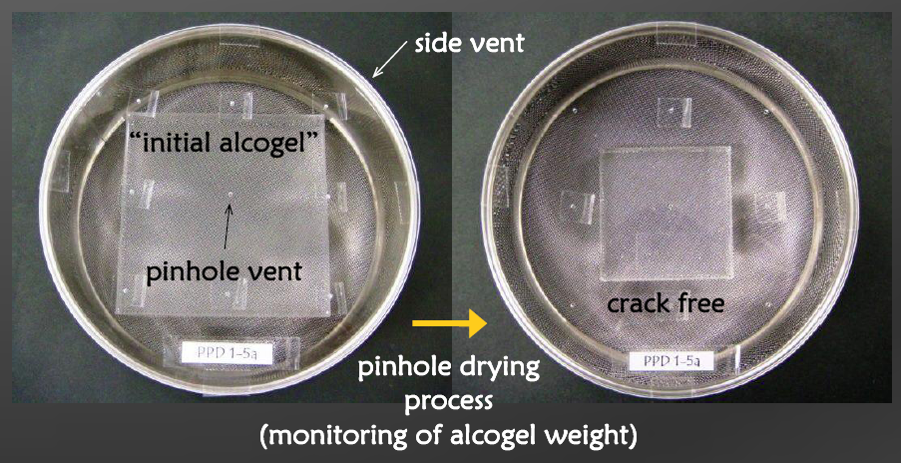
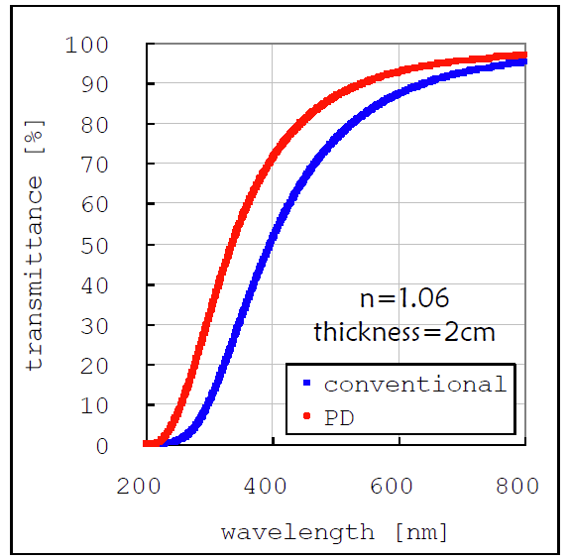
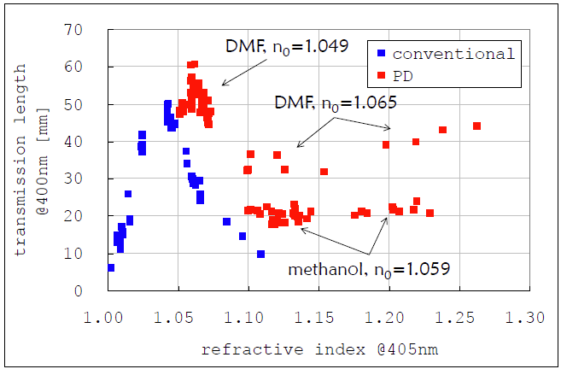
Improved Silica Aerogel Samples
It was difficult to produce transparent silica aerogels with large n.
New silica aerogels are produced by Pin-hole drying method.
[M. Tabata et al. Conf. Rec. IEEE NSS 2005, 816]
n~1.05 → shrink → n ≥ 1.06
x1.4
Big improvement in transmittance

Slide 6
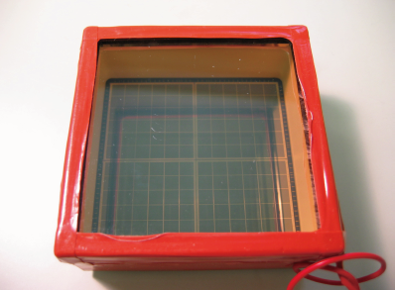
144ch Hybrid Avalanche Photo Detector
We have been developing a new 144ch Hybrid Avalanche Photo Detector (HAPD) with Hamamatsu Photonics since 2002.
quartz
Bialkali
photo cathode
Chip
A
Chip
B
Photon
e⁻
4.9mm
Pixel APD
Vacuum
tube
Chip
D
Chip
C
73mm
6~8kV
300V
photo cathode
voltage
bias voltage
Peak quantum efficiency | 32%
Effective area ratio | 64%
Capacitance | 80pF
Bombarding gain | 1300 ~ 1800
Avalanche gain | ~50
Total gain | 10⁴ ~ 10⁵
Required numbers | 456 HAPDs

Slide 7
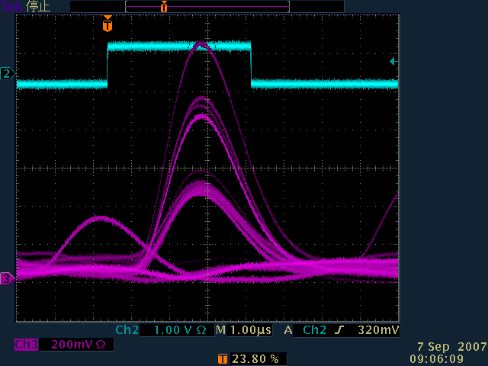
Single photon Response
Pulse height distribution for Single photon irradiation
Preamp.:
Clear Pulse 580K
Shaping amp.:
Clear Pulse
417
3 p.e.
Events
2 p.e.
1 p.e.
1p.e.
2p.e.
1 μs peaking time
10
Gain
Electron[e]
144ch HAPD has excellent single photon detection performance
Notes:
I talk about single photon response. This graph shows pulse height distribution of HAPD. We can confirm good separation between pedestal and 1 photoeletorn signal. Using this formula, S/N ratio is evaluated to be 16.
This is waveform of HAPD. We can confirm multi photoelectron signal clearly. We use 1 micro second peaking time. HAPD has excellent single photon detection performance.

Slide 8
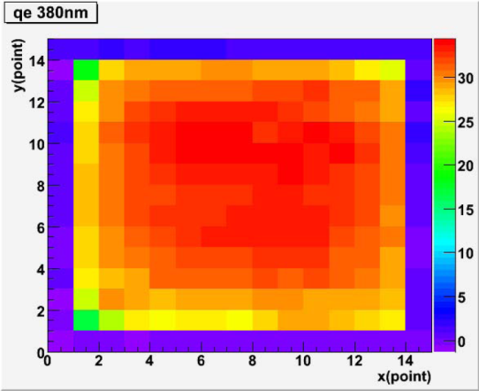
Quantum Efficiency
Wavelength dependence
Uniformity
32% 360nm
25% 360nm
Good uniformity
Peak QE ~32% has been achieved
(bialkali average : 25%)
Notes:
Next I talk about photo cathode development . We are developing the HAPD with super bialkli photo cathode to detect more photons. Previously, We used conventional bialakili photo cathode with peak quantum efficiency about 25%. Super bialkali has more than 30% peak quantum efficiency. We measured wavelength dependence and photo cathode uniformity for super bialkali. We confirm Peak quantum efficiency reaches 32% for the best sample. In addition, super bialakali is better than conventional bialkali at every wave length. This graph shows photo cathode uniformity. Super bialkali has good uniformity, and archive more than 30% on all surface at 380nm.
This is change of quantum efficiency for recent HAPDs. You can see improvement in quantum efficiency for recent samples.

Slide 9
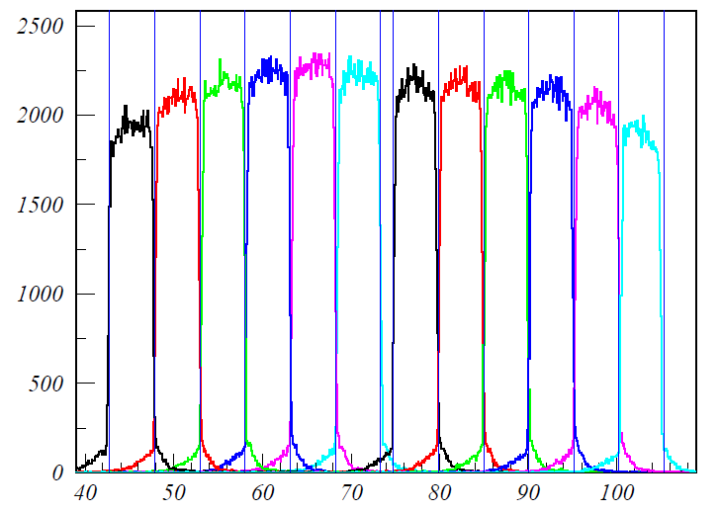
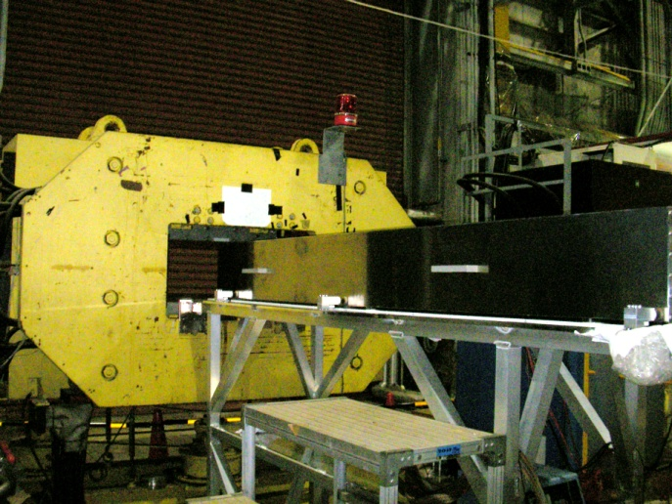
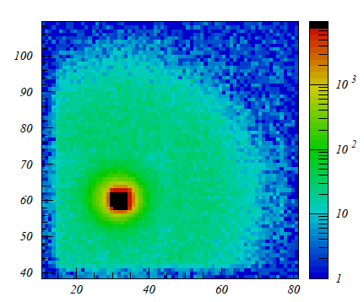
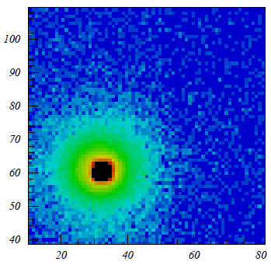
HAPD Performance in B=1.5 T
one row scan
5mm
1.5T
Measured with “Ushiwaka” magnet in KEK
Count
B=1.5T
X
confirmed 5mm resolution
laser incident point (mm)
e
0T
1.5T
15mm
(light reflection)
APD
Reduction of backscattering effect
40mm
We have confirmed HAPD achieves 5mm position resolution and has improved performance in 1.5T.

Slide 10
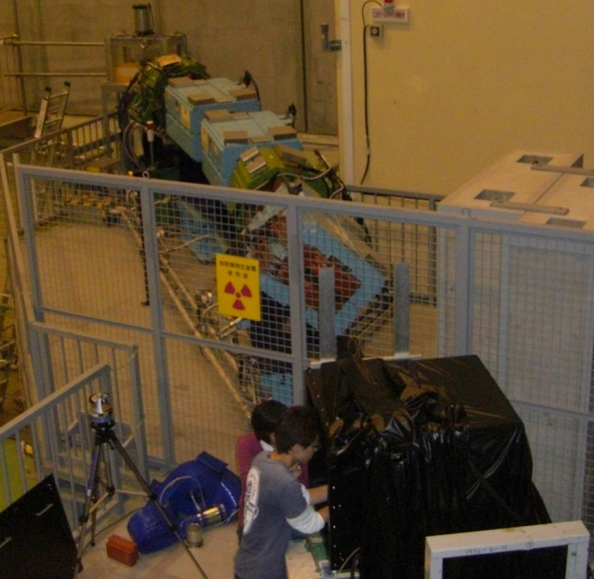
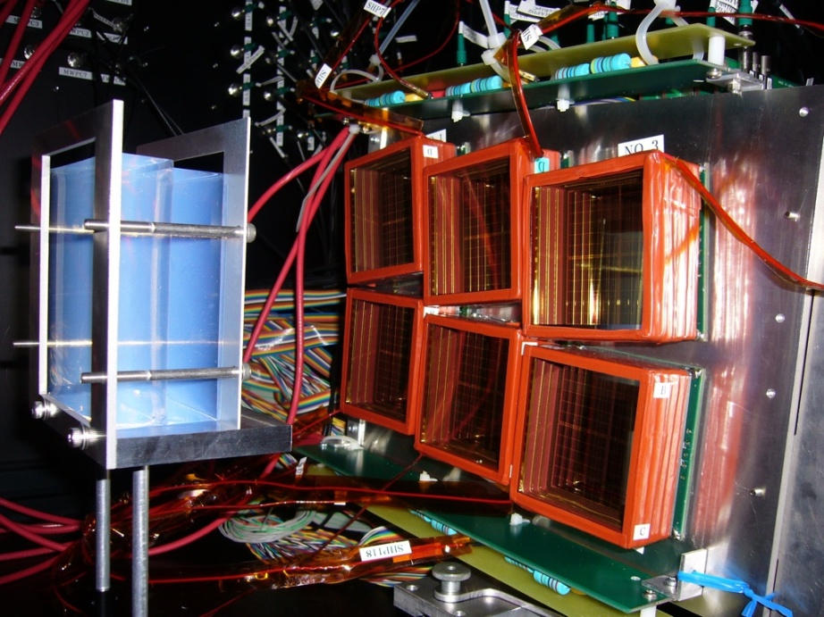
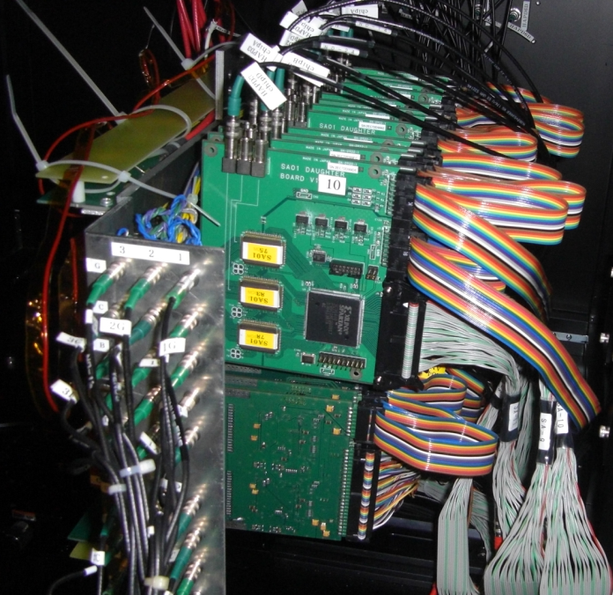
Aerogel RICH Beam Test
KEK Fuji test beam line
2 GeV/c electron
n=1.054
n=1.065
20 mm thick each
Readout by ASICs
Performed at Fuji test beam line in KEK November 2009.
Track parameters are measured by two MWPCs.
6 HAPDs from recent batches (max QE 30%, avg. QE 24% @400nm).
Aerogel with improved transmittance are used.

Slide 11
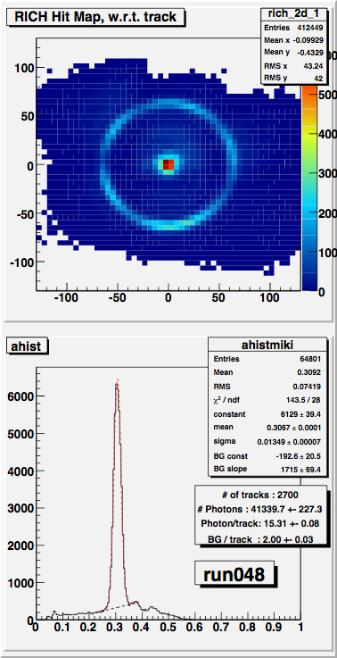
Beam Test Result
Event Display
Clear ring image observed
Cherenkov angle resolution: σ = 13.5 mrad
# of photoelectrons: 15.3
From naive calculation
6.6 σ K/π separation at 4 GeV/c achieved
Cherenkov angle(rad)

Slide 12
Performance of Aerogel RICH
Silica Aerogel by PD method
Highly Transparent
New 144ch HAPD
Large effective area.
High sensitivity to single photon
Position resolution(5×5mm² )
Immunity to 1.5 T magnetic field
Readout ASICs
The prototype RICH achieved enough performance for Belle II.
Remaining concern：
Radiation tolerance of HAPD in Belle II
Notes:
We confirmed these performances of a new 144ch multi-pixel HAPD. HAPD has very good performance for Aerogel RICH. The remaining issue is neutron radiation tolerance.

Slide 13
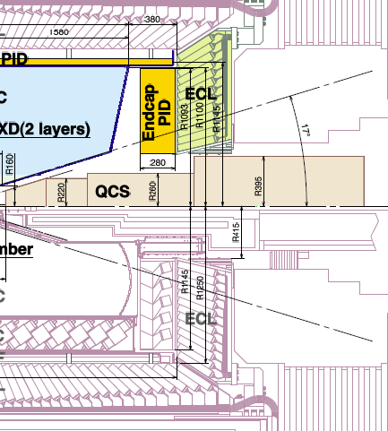
Expected Radiation Dose in Belle II
Extrapolated from the measured radiation dose around Belle ACC
Neutron dose
10¹⁰ n/cm²/1 Belle year at ECL
→ 10¹¹ n/cm² for 1 Belle II year
Ionization dose
1krad/1 Belle year @ SVD repeater dock
→ 10 krad for 1 Belle II year
Belle II
Belle
ACC
Need to work for 10 years in Belle II
neutron 10¹² n/cm²
ionization dose 100krad
Neutron damage to HAPD has been studied in 2009~2010.

Slide 14
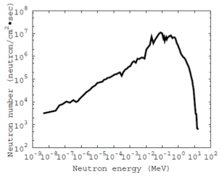
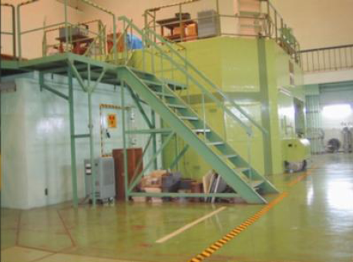
Neutron Irradiation Test of HAPDs
In Belle II 1 year, 10¹¹ n / cm² is expected
→ target: Belle II 10 years, 10¹² n /cm²
Neutron irradiation tests are performed using reactor “Yayoi”.
energy spectrum
Reactor “Yayoi” of Tokyo Univ.
Flux: 2×10⁸ neutrons/cm²/sec at W=500W
Average energy: 370keV

Slide 15
Influence of Neutron Irradiation
Increase of leak current / APD chip
5x10¹¹ neutron/cm²
No degradation in QE
Increase of leakage current in APD

Slide 16
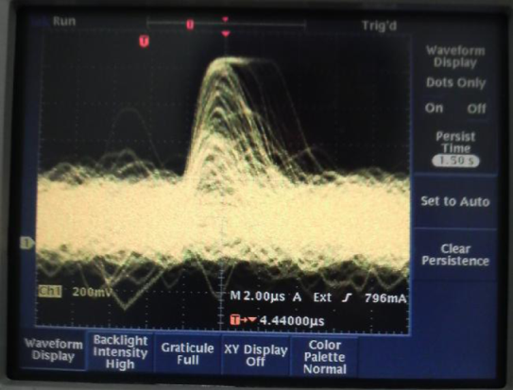
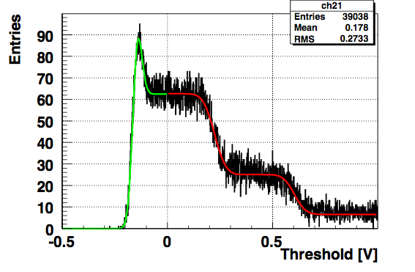
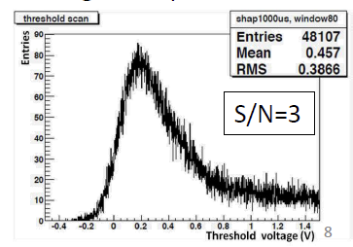
Single Photon Signal after Neutron Irradiation
5x10¹¹ n/cm²
HV: -7kV Peaking time: 1μs
Before irradiation
S/N>10
1p.e
2p.e
Single photon S/N became worse due to the increased noise
→ Need to reduce the noise

Slide 17
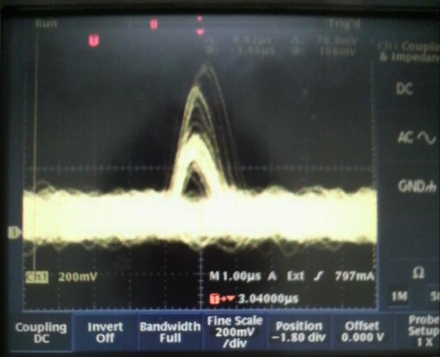
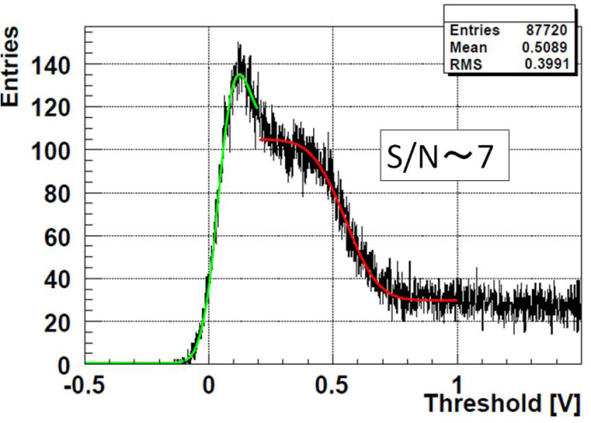
Single Photon Response Improvement
Shot noise by leakage current
Improvement
Shorter peaking time
Increase HV (bombarding gain)
HV=-8.5kV, 250ns
S/N=7
1/4 τ→ 0.5 x noise
Bombarding gain 1300 → 1700,1.3 x signal
Achieved enough S/N=7 after 5x10¹¹ n/cm²(Belle II 5 years)
We achieved S/N = 7 after 5x10¹¹ n/cm².

Slide 18
More Improvement for Belle II 10 years
5x10¹¹ n/cm² S/N=7 has been achieved
1x10¹² n/cm² expect S/N～5 → need more improvement
Shorter peaking time
→ new readout ASIC with τ_{peak}=100ns (current:250ns)
P⁺
Avalanche Amplification region
about
10μm
under development
P
More bombarding gain
→ APD with thinner P⁺ layer
N
Reduction of I_{leak}
Make thinner APD to reduce neutron induced lattice deficits
Contribution of N-layer (hole) is about 1/100 of that of P-layer (e).
→ Thinner P layer
40μm
N⁻
“reverse” type APD
N⁺
：electron
：hole
APD samples with various thickness of P and N layers are irradiated in 2010 Jan and June at Yayoi

Slide 19
APD Neutron Irradiation Test Results
APD Δ leakage current (10¹²n/cm²)
Increase of I_{leak} depends on thickness of P layer
No dependence on N layer
Confirmed I_{leak} reduction by thinner P layer
Thick P
Current, thick N,
thin N
thin P
New HAPD sample with thinner P APD is prepared
and irradiated in 2010 Nov.

Slide 20
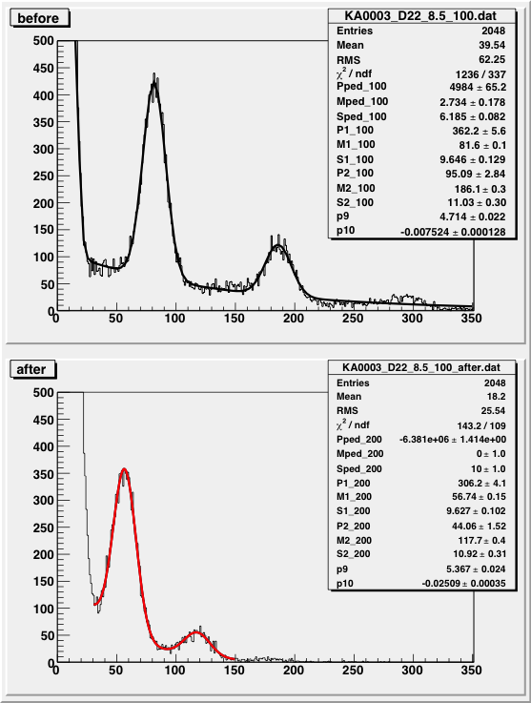
Single photon signals of New HAPD
Before irradiation
Chip B Ch22
Chip D Ch22
S/N=12.2
S/N=10.8
HV 8.5kV
Bias270V
(APD Gain=40)
HV 8.5kV
Bias253V
(APD Gain=32)
After 10¹² n/cm²
S/N=7.1
S/N=6.3
HV 8.5kV
Bias270V
HV 8.5kV
Bias253V
New HAPD sample with thinner P layer keeps S/N 6～7 after 10¹² n/cm²
Detailed studies using ASIC readouts are on going.

Slide 21
Summary and Plan
Aerogel RICH is being developed for Belle II endcap PID upgrade.
Provide improved PID up to 4 GeV/c
Key components that satisfy the required performance have been developed.
→ More than 5σ K/π separation demonstrated from test beam experiment using a prototype.
Remaining concern: Radiation tolerance of HAPD
Neutron damage manageable up to 5×10¹¹ n/cm²
It is confirmed that thinner P APD reduces neutron induced damage.
→ More study using improved readout ASIC will be performed in 2011 to establish clear 1 p.e. detection up to 10¹² n /cm².
Need to check tolerance to ionization damage up to 100krad.
→ Studies using ⁶⁰Co irradiation facility in Nagoya has started.
→ Decide final design of HAPD to start mass production in 2012

Slide 23
backup

Slide 24
I_{leak} of HAPD with thinner P APD
After 10¹² n/cm²
Normal P (thick N)
Thin P

Slide 25
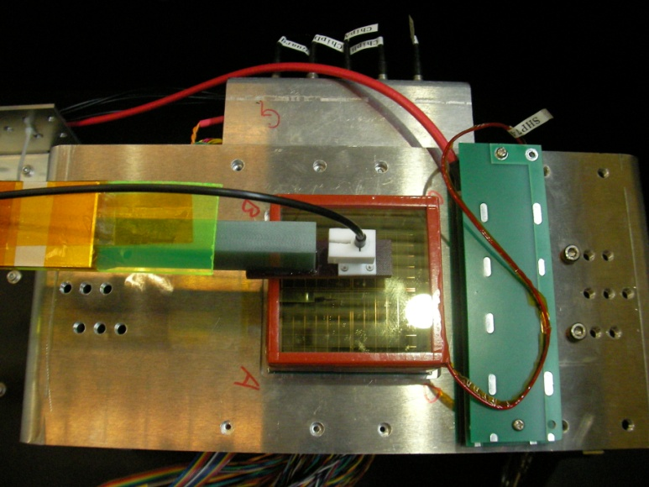
Test in magnetic field
We measured HAPD in the 1.5T magnetic field
using a special equipment to scan the HAPD surface
with pulse laser(controlled by a 2D stage outside the magnet).
Magnet
Ushiwaka magnet (KEK)
Black box
optical fiber
PLP
1.8 m
B
1.5T
G-10 bar
Lens：spot size
～100μm
HAPD
ASIC
2D stage
x
y
Magnet

Slide 26
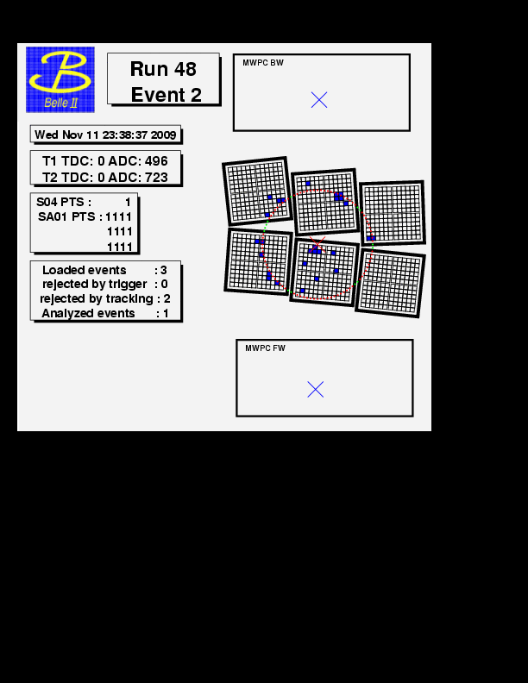
Event Display
注 点線はゲルの屈折率による計算値

Slide 27
K-π Identification image
pion hypothesis
kaon hypothesis

Slide 28
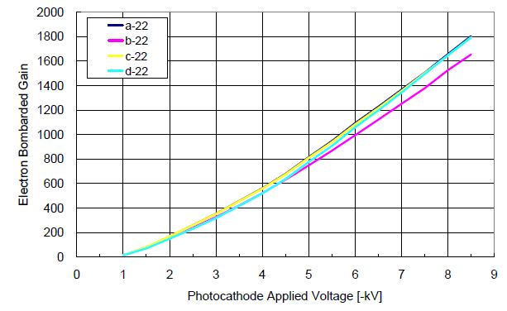
Increase of bombarding gain
Increasing maximum HV → difficult
→ Thinner P⁺ layer
・ Can be applied to thin P APD.
No need to remake APD.
Worry : weaker against surface damage by γ rays?
Photo electron
P⁺
P
Make HV threshold smaller
N

Slide 29
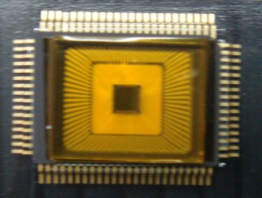
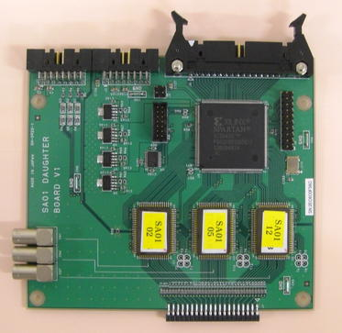
ASIC for readout of 144ch HAPD
We need high density front-end electronics including high-gain and low-noise amplifier for A-RICH.
→ We have been developing ASICs for front-end electronics.
We planed to readout output of ASIC with FPGA.
Circuit configuration
input
DOUT
12ch
or
36ch
hit info.
Shift register
trigger
Preamp
Shaper
Comparator
・・・
to back-end
ASIC
・・・
FPGA
FPGA
4 step variable gain preamplifier.
4 step variable shaping time shaper.
Comparator for the digitization of analog-signals.
(We need only on/off hit information)
We have developed new ASIC SA01 and SA02.
ASIC

Slide 30
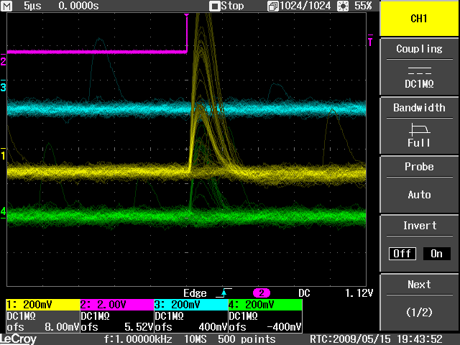
Readout test of HAPD with ASIC
Threshold scan
Distribution of output ASIC for 100 LED light irradiations at each threshold voltage.
Ch5(ASIC)
Ch21
Ch24
HAPD(HV:8kV, Bias:290V)
Total gain : ~32,000
Result
Noise : ~2,000e⁻
Pulse height
1p.e signal : 32,700e⁻
2p.e signal : 66,200e⁻
S/N : ~17
1p.e
2p.e
Clear separation between 1p.e and 2p.e!
Very high S/N ratio (target > 7)!
Good performance of readout system with ASIC + FPGA is confirmed!

Slide 31
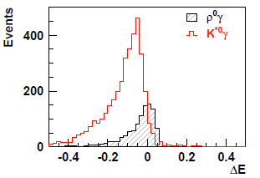
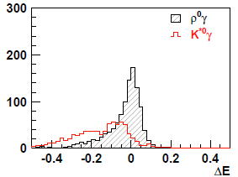
Belle II PIDの威力
B⁰→ρ⁰γ シミュレーション 7.5ab⁻¹相当
現行Belle PID
Belle II PID
S/Nの大幅な向上
ルミノシティーを1.8倍にすることに相当

