Slide 1
Report on NPC Activities
- Introduction of NPC and Physics Subjects
Individual Analysis Status & Takizawa-san’s Comment
Contributions other than Analyses
Norihito Muramatsu
New Hadron Workshop, 28 Feb, 2011 @ RIKEN

Slide 2
NPC = Nuclear Physics Consortium
18 people from hadron physics community have made the consortium with interests to analyze Belle data from Mar 2009.
RCNP, Osaka Univ. : T. Nakano, S. Ajimura, T. Hotta,
Y. Morino, N. Muramatsu
Tokyo Institute of Technology : M. Uchida, T. Shibata, N. Kobayashi
Kyoto Univ. : M. Niiyama, H. Fujioka
Tohoku Univ. : H. Kanda, K. Miwa
Univ. of Miyazaki : T. Matsuda, T. Motoda
Gifu Univ. : K. Nakazawa, M. Sumihama
Yamagata Univ. : Y. Miyachi
Showa Pharmaceutical Univ. : M. Takizawa
Participating from LEPS, JPARC, COMPASS, HERMES, … , and also from a theory side.
Most of persons belong to NPC-II for the Belle-II experiment.
Bold = NPC & NPC-II

Slide 3
What’s NPC ?
Now NPC is one of the groups in the Belle Collaboration.
Actually the members belong to B01, D01, E01, or not.
However, our interests are widely overlapped with A01.
⇒ Closely correlated works :
New hadron meeting by Belle-A01 + NPC
Common interests
- Exotic hadron structure (penta- & tetra-quark, molecule, …)
- Nature of scalar & axial vector mesons (glueball, mixing, …)
- Hadron-hadron correlation (bound-state, confinement, …)
- Hadron fragmentation (color string, gluon exchange, …)
NPC
- Relatively low energy
experiments w/ a fixed target
- Hadrons w/ u,d,s-quarks
Belle
- High energy collider experiment
- B-meson factory + huge production
of charmed meson & charmonium

Slide 4
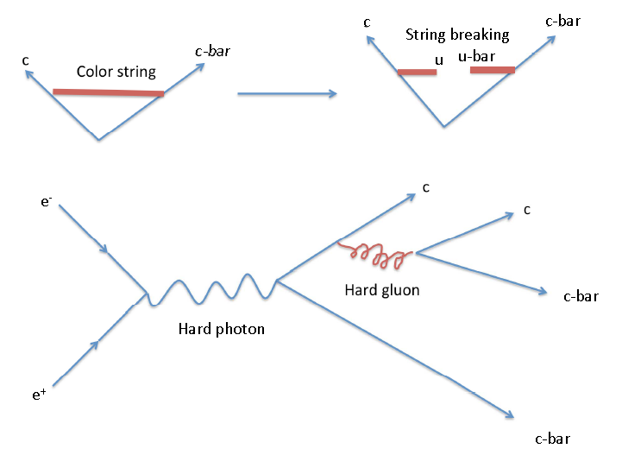
Why Belle data is interesting for us?
High statistics (Exotic & low production rate particles, high precision measurements of hadron properties)
Large acceptance detector w/ excellent momentum resolution and PID ability
High energy
(1) heavy quark hadrons
Produced by ϒ productions,
b→c decays, and
hard gluon exchanges.
Kinetic energy term is small.
(2) Also rich production of light quark hadrons
Produced by heavy hadron decays [ΔM in b→c decays (Matsuda) ]
and color string breaking in hadronization.
Dynamical structure inside hadron becomes more important.
Close to interests of lower energy experiments.
(Takizawa)

Slide 5
Physics Subjects
Understanding hadron structures by investigating
exotic hadrons, controversial hadrons, hadron-hadron
interactions, fragmentations, …
Light quark hadrons
scalar & axial vector mesons : Matsuda, Motoda
statistical treatment of production rates (also
related to exotic hadron production rate) : Uchida
meson-meson interaction : Niiyama
Fragmentation functions for light quark hadrons
Interference FF : Kobayashi
Heavy quark hadrons
X(3872) : Muramatsu
All analyses are under way & individual status is shown from now.

Slide 6
Study of Light quark mesons from B decays
T. Matsuda,T. Motoda (Univ. of Miyazaki) with Prof. J. MacNaughton
Motivation:
Nature of scalar and axial vector mesons are still discussed.
σ, κ, f₀(980), a₀(980), a₁, K₁, ..…
⇒ molecule states, tetraquarks, glueballs or others?
⇒ related to chiral symmetric structures of light quarks?
Strategy and Method:
Construct and carry out Partial Wave Analyses.
Study properties of axial vector, scalar mesons: mass, width, mass line shape, branching ratio, mixing angles, and even existence.
Currently two reactions are being analyzed.
1. B⁰→D^{*+/-} a₁^{-/+}
2. B⁺→J/ψ K₁(1270); K₁(1270)→ωK

Slide 7
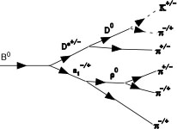
1. B⁰→D^{*+/-} a₁^{-/+}
Mass & width of a₁ are not defined well. (PDG: M=1230±40 MeV, Γ=250∼600 MeV)
S. Leupold, POS (CD09) 051 suggests a possibility of ρ-π molecule state.
Old scattering experiments : Various states are overlapped each other.
⇒ Decay reaction: Initial quantum numbers are well defined.
So far a₁ has been studied by τ decays, but a₁ width cannot be
extracted correctly. (M_{τ}=1.777 GeV/c²)
K^{+/-}
D⁰
Construction of the PWA formalism
B⁰→D^{*+/-}+a₁^{-/+} (0⁻ →1⁻+1⁺)
a₁^{-/+}→ρ⁰+π^{-/+} (1⁺ →1⁻+0⁻)
D^{*+/-}→D⁰+π^{+/-} (1⁻ →0⁻+0⁻)
ρ⁰ →π⁺+π⁻ (1⁻ →0⁻+0⁻)
π^{-/+}
D^{*+/-}
B⁰
π^{+/-}
a₁^{-/+}
ρ⁰
π^{+/-}
π^{-/+}
The skim code of this reaction is almost completed by
Prof. J. MacNaughton. PWA programs are being produced.
π^{-/+}

Slide 8
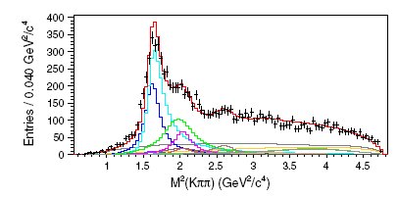
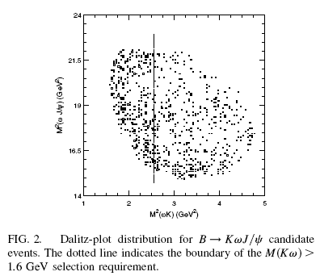
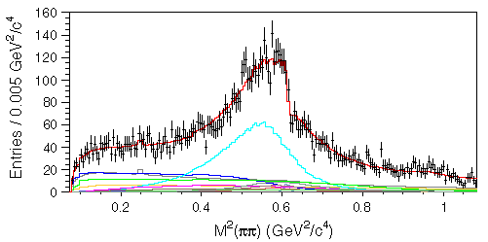
2. B⁺→J/ψ K₁(1270); K₁(1270)→Kω→Kπππ
Recently Belle renewed the mass and width of K₁(1270) in B→J/ψKππ
channel. This must be also checked by Kπππ mode.
BR(K₁→Kω) may be larger than PDG (11%) because of strong ρω interference.
Skim programs for B⁺ → J/ψK⁺ω are under construction,
and very preliminary skim data is being obtained.
K₁(1270) band ?
K₁(1270)
PRD83, 032005(2011).
ω pole
(ω→ππ:1.5%)
PRL94, 182002(2005):
Y(3940) production in B⁺→ J/ψK⁺ω reaction

Slide 9
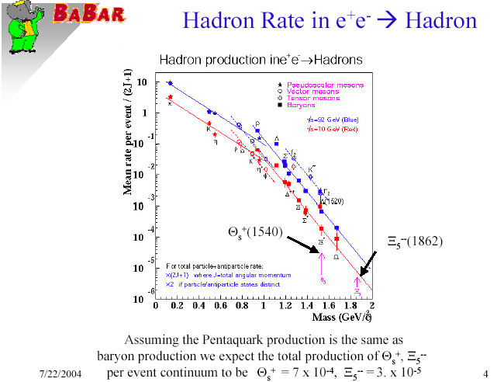

Production Rate of Light Hadrons (M. Uchida)
Production rate of light hadrons
(qq/qqq) tend to be proportional
to their masses. (LEP, BaBar)
Statistical formalism
[Y.-J. Pei, hep-ph/9610329]
Discrepancy from the global
trend indicates the different
production mechanism and/
or internal structure from the
2 or 3 constituent quarks.
⇒ Λ(1405) and some exotic
candidate hadrons will be
examined.
Hadron Production in e⁺e⁻ annihilation
LEP
Pseudoscalar mesons
Vector mesons
Tensor mesons
Baryons
√s=92 GeV (Blue)
√s=10 GeV (Red)
Mean rate per event / (2J+1)
BaBar
Θ_{S}⁺(1540)
Ξ₅⁻⁻(1862)
For total particle+antiparticle rate :
x(2J+1) where J=total angular momentum
x2 if particle/antiparticle states distinct
Mass (GeV/c²)

Slide 10
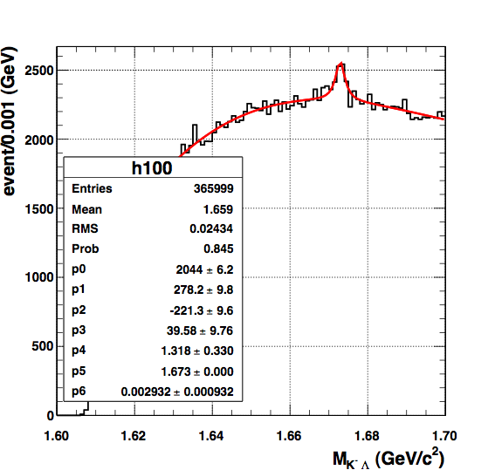
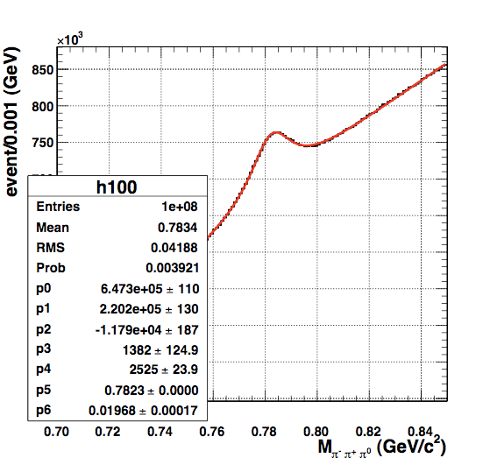
Invariant mass distributions
(36 fb⁻¹ / 1000 fb⁻¹)
Ω⁻ → ΛK⁻ : 3000 events
ω → π⁺π⁻π⁰ : 2.3x10⁶ events
Fitting function : Breit-Wigner + Chevyshev 3rd pol.

Slide 11
List of Hadrons under considerations
Mesons Decay Status
π Cuts optimized
η γγ Cuts optimized
η’ π⁺π⁻η Cuts optimized
K Cuts optimized
K*(892) Kπ Cuts optimized
ρ ππ Cuts optimized
ω π⁺π⁻π⁰ Cuts optimized
φ K⁺K⁻ Cuts optimized
a⁰ π⁰η Future plan
f⁰ ππ Future plan
Baryons Decay Status
P Cuts optimized
Δ Nπ In progress
Λ pπ Cuts optimized
Σ Λγ Cuts optimized
Σ(1385) Λπ In progress
Λ(1405) Σπ In progress
Λ(1520) pK⁻ Cuts optimized
Ξ Λπ Cuts optimized
Ω ΛK⁻ Cuts optimized
N(1535) pη Future plan

Slide 12
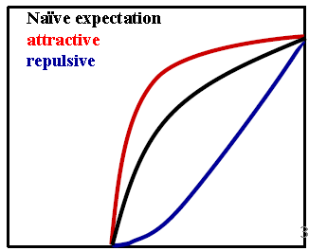
Measurements of Scattering Lengths (M. Niiyama)
Meson-meson scattering length is an important fundamental
variable in hadron physics. While ππ channel has been studied
in detail, KK & Kπ channels are not studied well.
Analysis strategy : Using continuum data, the meson-meson
invariant mass distributions will be compared with phase space
in the kinematical region of relative momentum ∼ 0.
Belle data is suitable for this analysis because of (1) high statistics,
(2) variations of meson pairs, and (3) good momentum resolutions
[no target material, w/ vertex detector].
π
π
π
small invariant mass region
N
π
K
π
π

Slide 13
π⁺π⁻ and K⁺K⁻ invariant mass spectrum
K_{S}⁰
φ
ρ
To do: • Acceptance corrections.
• Understand compositions of invariant mass distributions.
• How to extract scattering lengths is under discussions.
• Systematic study for various meson-meson interactions.

Slide 14
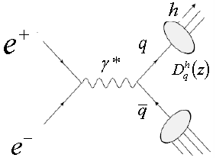
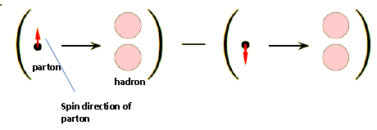
Interference Fragmentation Function (N. Kobayashi)
Fragmentation Function for light quark hadrons
⇒ hard scattering process + non-perturbative hadronization
D_{q}^{h}(z) : Probabilities for a quark (q) to fragment into hadron (h) depending on fractional momentum (z=P_{h}/|P_{q}|).
♣ Momentum conservation : Σ ∫₀dz zD_{q}^{h}(z)=1
IFF H_{q}<(z,M_{h}²) : Fragmentation of a quark (q) with transverse spin into a pair of unpolarized hadrons.
Model predictions by Jaffe et al. [PRL 80] & Radici et al. [PRD 65] for ππ (will be published), KK, & Kπ (will be analyzed by N.K.)
¹
_{h}
⁾
Transverse spins of back-to-back
partons must be correlated.

Slide 15
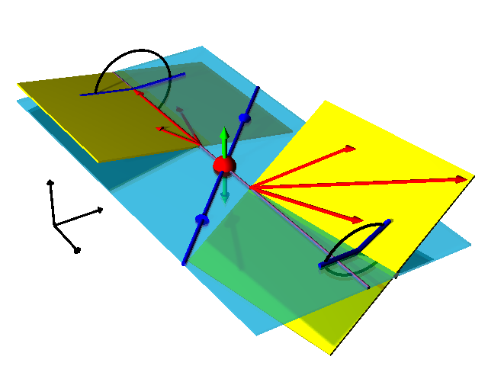
IFF Physics framework
Measure the relative angle
(ϕ_{1R}+ϕ_{2R}) of two planes which
individually include a hadron
pair from either jet.
Obtain an asymmetric distri-
bution in terms of ϕ_{1R}+ϕ_{2R} to
extract modulation amplitude
due to transverse spins of
quark and anti-quark.
e⁺e⁻→ (h₁h₂)_{jet1}(h₃h₄)_{jet2}X
ϕ_{R2}
e⁺
π−ϕ_{R1}
e⁻

Slide 16
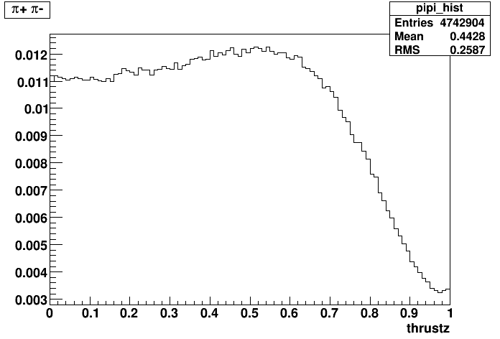

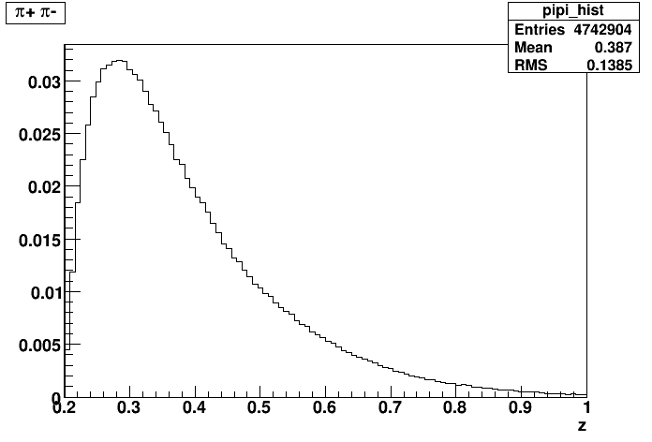
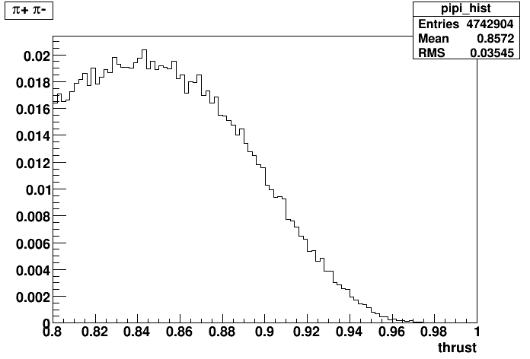
Now checking consistencies of
analysis procedures and results
using ππ mode.
Thrust :
geometrical
acceptance
Fractional energy :
Z-component of Thrust axis
fractional energy
= fractional momentum
(input of IFF)
Select 2-jet events
w/ high thrust value
Fractional energy
Thrust

Slide 17

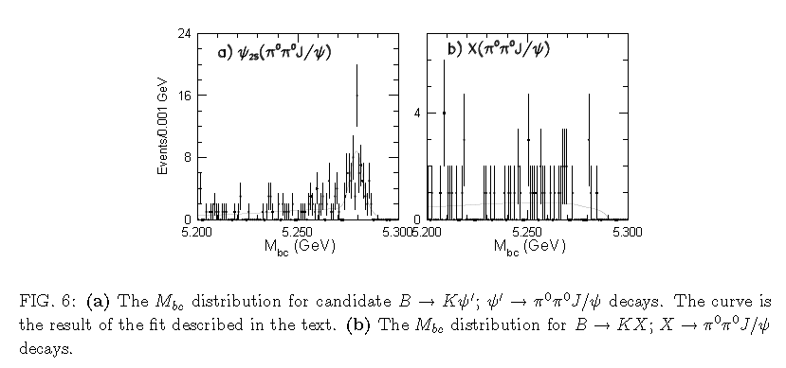
X(3872)→J/ψπ⁰π⁰ in B decays (N. Muramatsu)
Discussion of C-parity
C=+1 : Γ(X(3872)→J/ψπ⁰π⁰)/Γ(X(3872)→J/ψπ⁺π⁺)=0 [I=1 through J/ψρ]
C=−1 : 1/2 [I=0, ex. ψ’]
If X(3872) is 1⁺⁺ DD* molecule, this decay mode cannot be seen.
Υ(4S)→B⁺B⁻ [51.6%] ; B⁺⁻→K⁺⁻X(3872) ; X(3872)→J/ψπ⁰π⁰
Υ(4S)→B⁰B⁰ [48.4%] ; B⁰ →K⁰ X(3872) ; K_{S}→π⁺π⁻ [50% x 69.20%] ; X(3872)→J/ψπ⁰π⁰
Previous measurement at Belle : hep-ex0408116 using 253 fb⁻¹
vs. Currently
increased up
to 711 fb⁻¹

Slide 18
Before a correction for γ radiations
Before examining X(3872),
ψ’→J/ψπ⁰π⁰ [16.84%]
must be checked as
a control sample.
Now optimizing
selection criteria.
Here are some snap shots
of event reconstruction
w/ ψ’-signal MC (only
B⁺→K⁺ψ’) as an example.
J/ψ→e⁺e⁻
J/ψ→μ⁺μ⁻
π⁰→γγ
ψ’→J/ψπ⁰π⁰
Beam
Constrained
Mass
ΔE

Slide 19
Comments from M. Takizawa
Why so many exotic charm hadrons?
Bound state of hadrons : Kinetic energy vs. Potential energy
Heavier Hadron ⇒ Smaller kinetic term
Deuteron (proton, neutron)
Strength of the interaction between hadrons is just making the bound state of the hadrons of 1 GeV and/or above.
Charm quark hadrons : Mass is bigger than 1 GeV
⇒ High possibility of forming the bound states
ex. Many X, Y, Z states have been found.
H_{c} dibaryon : Flavor singlet state w/uuddsc
Repulsive interaction becomes ∼1/2.
T_{cc} : udcc exotic hadron w/ 0⁺ or 1⁺
Bottom quark hadrons ⇒ More probable
♣ Many exotic hadrons with charm and bottom flavors.

Slide 20
Contributions other than analyses
18 shifts in 2009 & 6 shifts in 2010
Efficiency, fake rate & systematic error tables for Belle-PID
with great helps of Nishida-san
(KID: Niiyama, eid/muid : Uchida, Sumihama, Muramatsu)
Internal referees of Belle papers (Muramatsu, Matsuda,
Niiyama, Miyachi, Uchida) ⇒ Having physics discussions &
Learning Belle analysis procedures.
NPC-II service task : CDC-related works (Uchida et al.)
Preparation of computing environment at RCNP (Kanda)

Slide 21
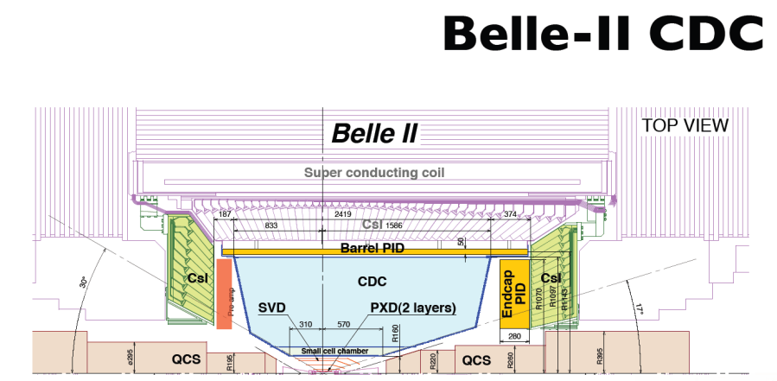
NPC-II Contribution
Removal of Belle-CDC cables on 27 & 28 Dec, 2010 (Uchida,
Sumihama, Matsuda, Motoda, Kobayashi)
Qualification assurance for sense/potential wire (this summer)
Contribution for CDC part of Belle II simulator
(Fine tuning of CDC geometry, response function, etc)
+ Event generation for hadron physics.

Slide 22
Preparations of analysis environment at RCNP computers (Kanda)
☆Motivation : To increase analysis speed and performance of NPC members,
and to dig up analysis man powers inside NPC.
☆Comparisons of computing powers
B computers RCNP computers
CPU & clock Intel Xeon X5460 (3.16 GHz) Intel Xeon X5680 (3.33 GHz)
#CPU 2 x 480 node 2 x 76 node
Throughput/CPU 48 128
Total throughput 2.37 1
Data storage 3.5 PB Tape + 1.5 PB HDD 3.5 PB
#User 600(FY2008) ~10 (current active user)
☆ Working Status
1. Transferring Hadron skim data and generic MC data w/ ∼1.1 TB/day.
22% of the hadron skim data (78.5 TB) has been transferred.
Two more months will be necessary.
2. Construction of BASF (Belle AnalysiS Framework) environment will start soon.

Slide 23
Final Remarks
NPC has interests to understand hadron structures and
interactions from various aspects. Belle data is new and exciting
for us with many benefits. We can explore quark (and gluon)
configurations from dynamical to static ranges.
We have entered an ‘active phase’ in Belle data analysis
with great helps of A01 people. We really thank to Belle-A01
for a good collaboration.
We need helps & feedbacks from theorists. Any comments &
requests are very welcome.
Hopefully we will increase man powers and raise up analysis
activities with the new computing environment. In addition,
we have started to contribute to Belle-II (NPC-II).

