Slide 1
Pionic BEC-BCS crossover at finite isospin chemical potential
Masayuki Matsuzaki
Fukuoka Univ. of Education
Phys. Rev. D 82 016005 (2010)

Slide 2
Finite μI=μu-μd with μB∝μu+μd=0 : artificial but suitable for lattice QCD and expected to give some insight into finite μB , accommodate pion condensation
（Campbell et al., PRD, 1975）

Slide 3
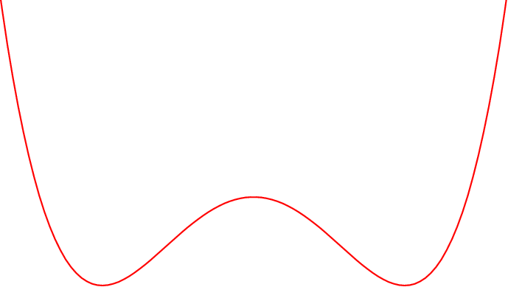
Sigma condensation
Pi condensation

Slide 4
Crossover: Meson condensation at low |μI| → Cooper pair condensation at high |μI| (Son and Stephanov, PRL, 2001)
Spatial extension of the composite ← momentum-dep. interaction
・nuclear superfluidity (relativistic) :
Tanigawa and M.M., PTP, 1999
・color superconductivity : M.M., PRD 2000

Slide 5
Present study:
adopt linear sigma model as a q-q interaction
Effects of μI are well studied
（He, Jin, and Zhuang, PRD, 2005）

Slide 6
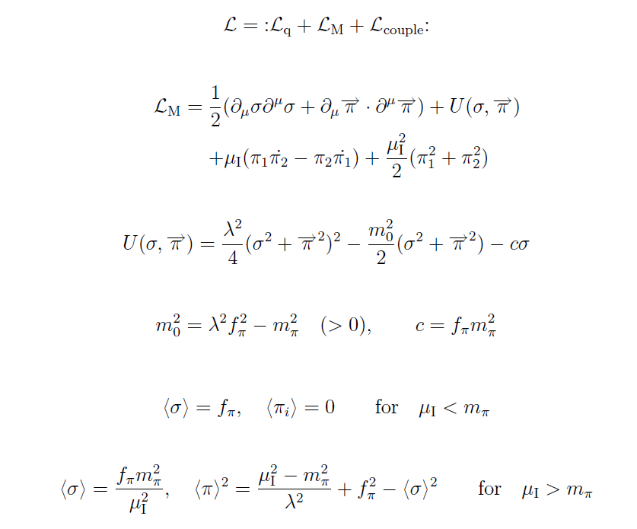
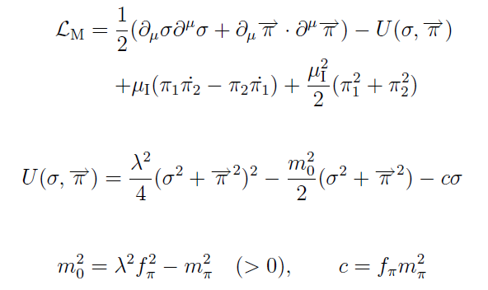
Linear sigma model with μI
Stationary points of the mean field

Slide 7
Decomposition to mean field + fluctuation only for “radial” direction
→ assures current (“angular mom.”) conservation
Solving the K-G equations
--- NG mode
then inserting them into …

Slide 8
the EOM
of the quark propagator
The one-body (Fock) approximation
gives
--- non-local self energy.

Slide 9
Fourier transformation and isospin decomposition lead to
the Gor’kov equation
Expand in terms of the plain waves with
and pick up residues.
Finally we obtain the matrix equation
for the Bogoliubov amplitudes A – D at each k:

Slide 10
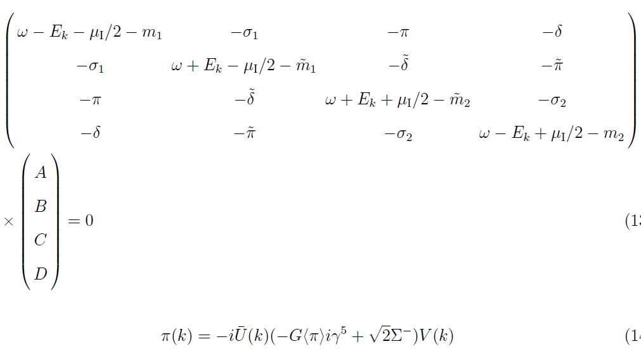
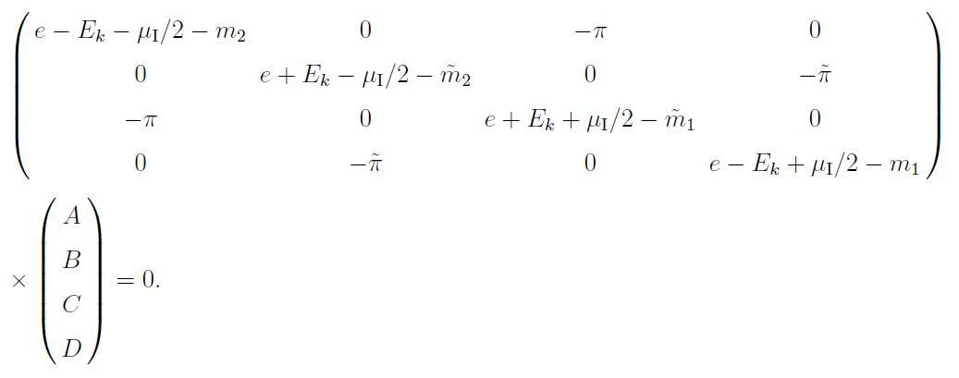
k-indep. meson condensation
k-dep. “gap” for the quark --- function of all A(k’) –D(k’)

Slide 11
Parameters

Slide 12
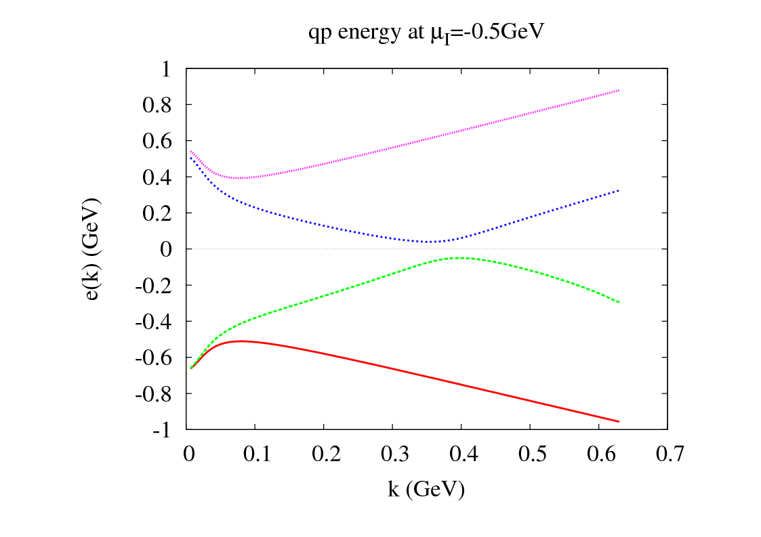

Slide 13
u
d
μI

Slide 14
d
u

Slide 15
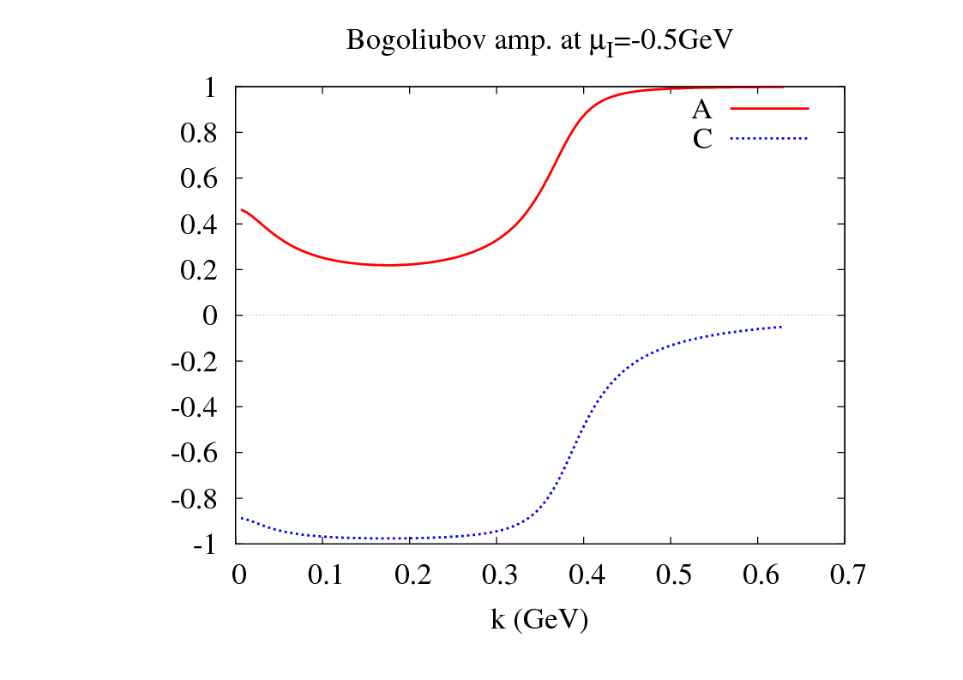
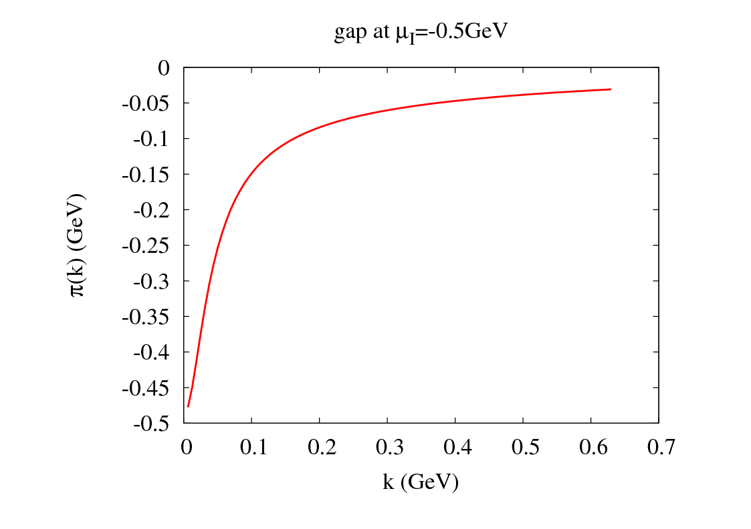
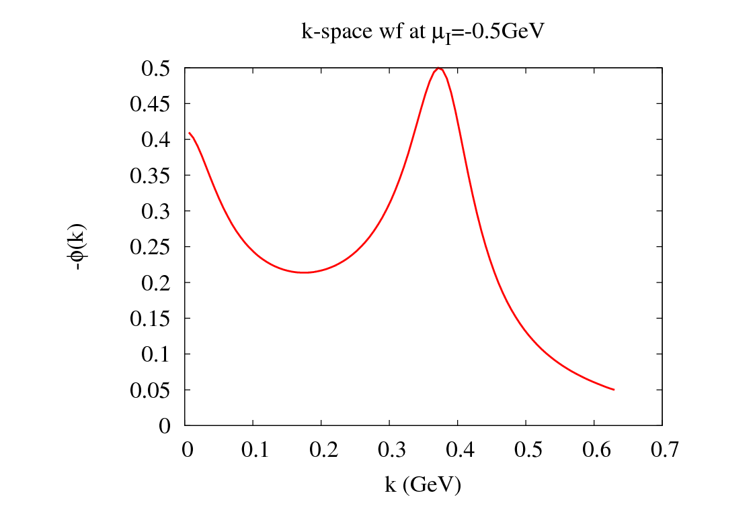

Slide 16
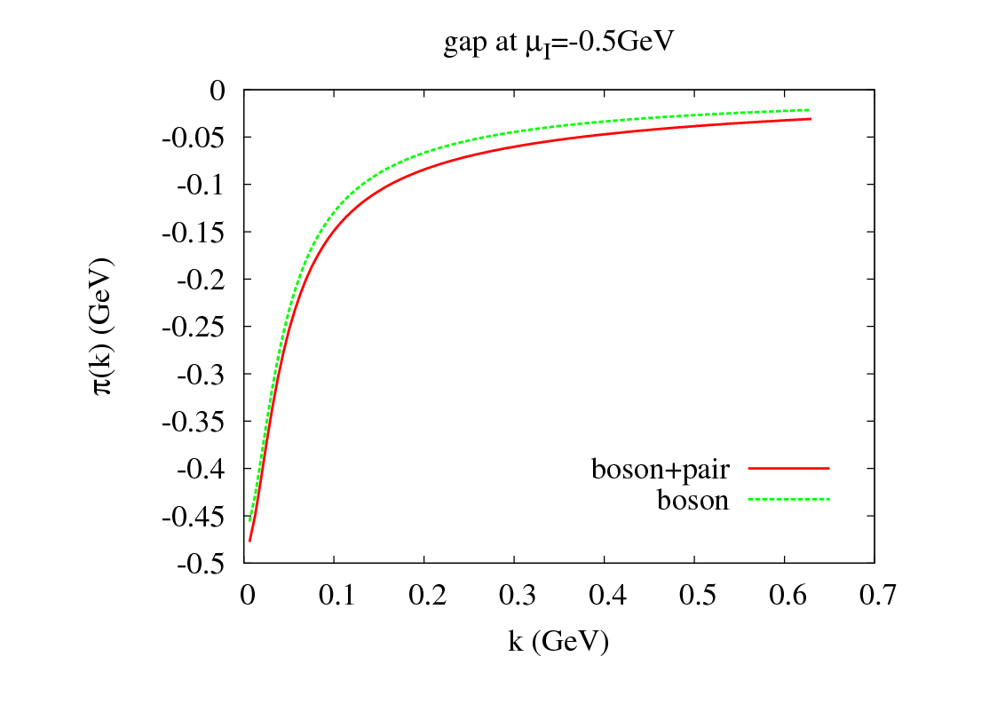
pairing
boson
k-dep. with

Slide 17
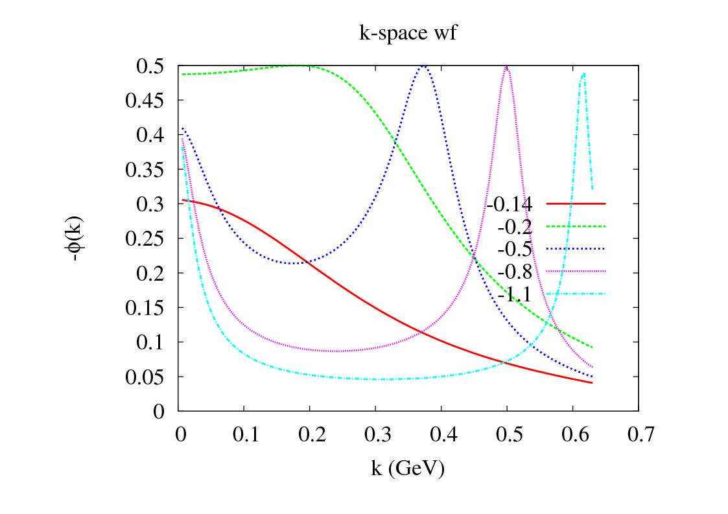
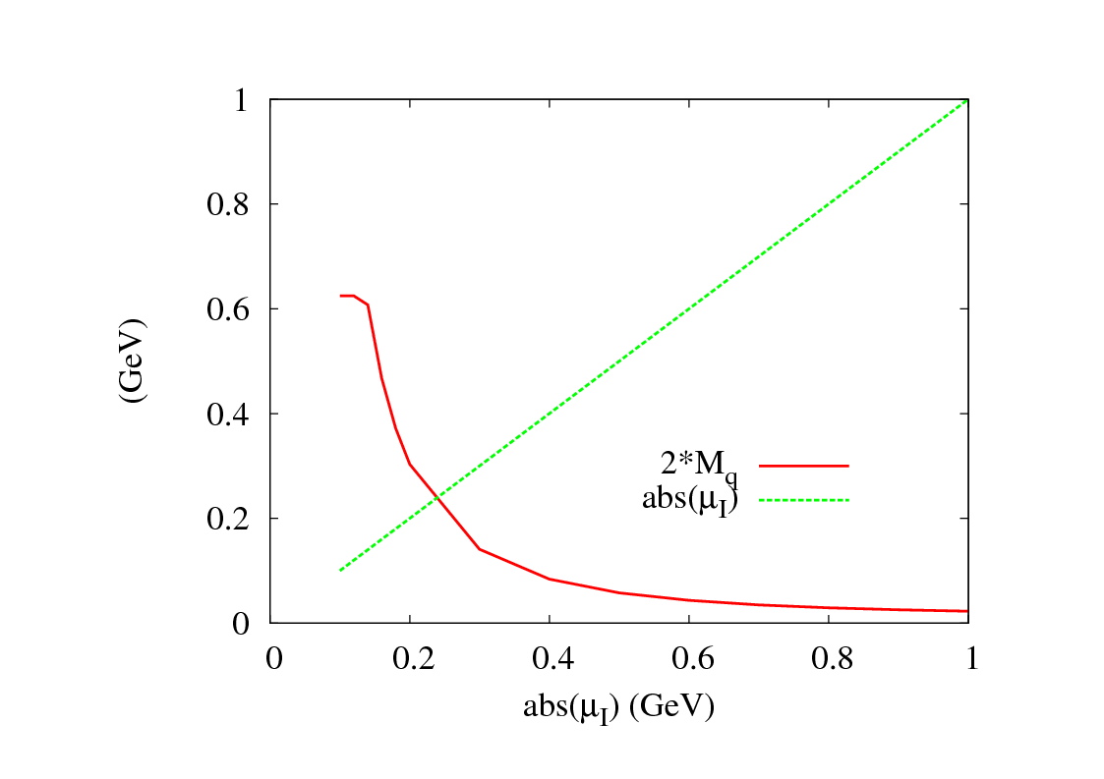
２ peaks：
boson --- k～0 ,
Cooper pair --- k～kF
forms Fermi surface
at|μI|> 0.24 GeV
while q-q bound state
at|μI|< 0.24 GeV

Slide 18
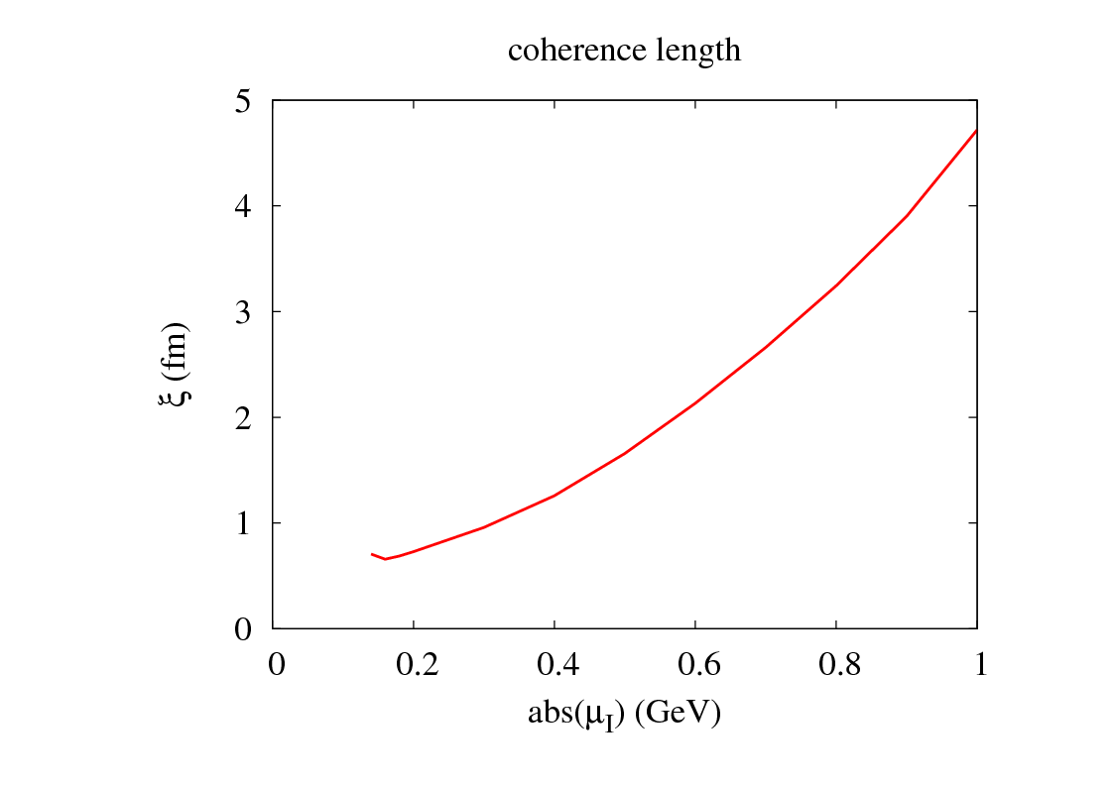
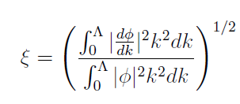
Coherence length --- spatial size of the pair

Slide 19
Summary
Pion condensation at|μI|>mπ (μB=0)
Linear sigma model (in isospin rotating ｆrame) as the q-q interaction
Gor’kov equation for quark propagator
boson at k～0 and Cooper pair at k～kF coexist

Slide 20
Back up

Slide 21
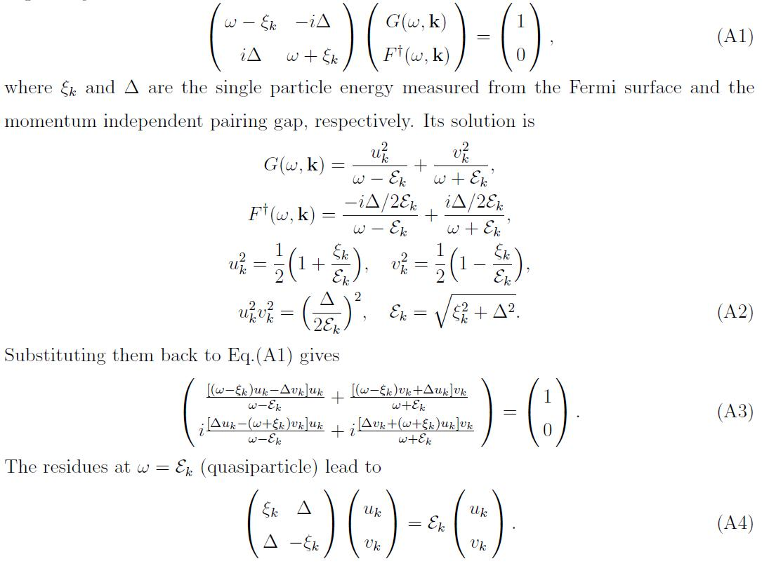

Slide 22
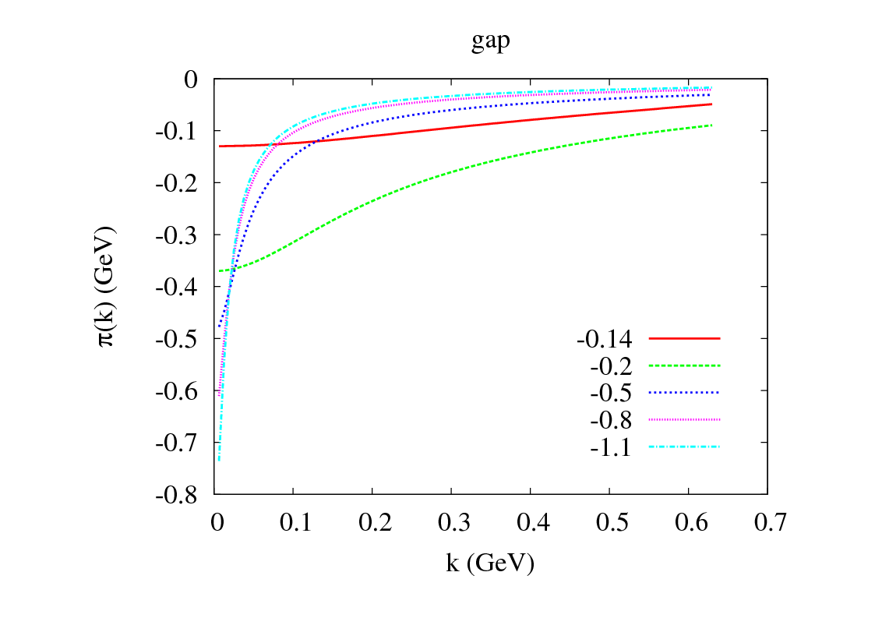
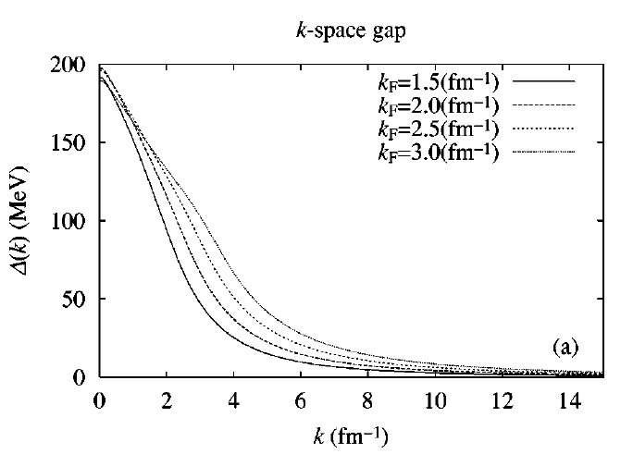
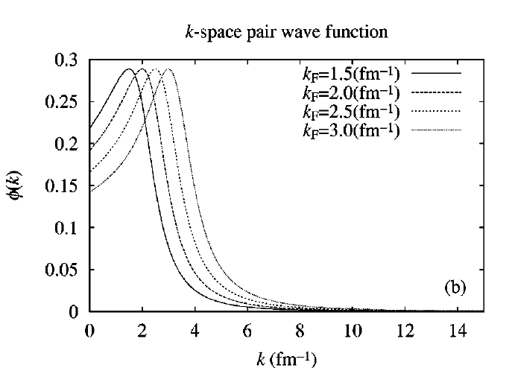
Present
Color superconductor

Slide 23
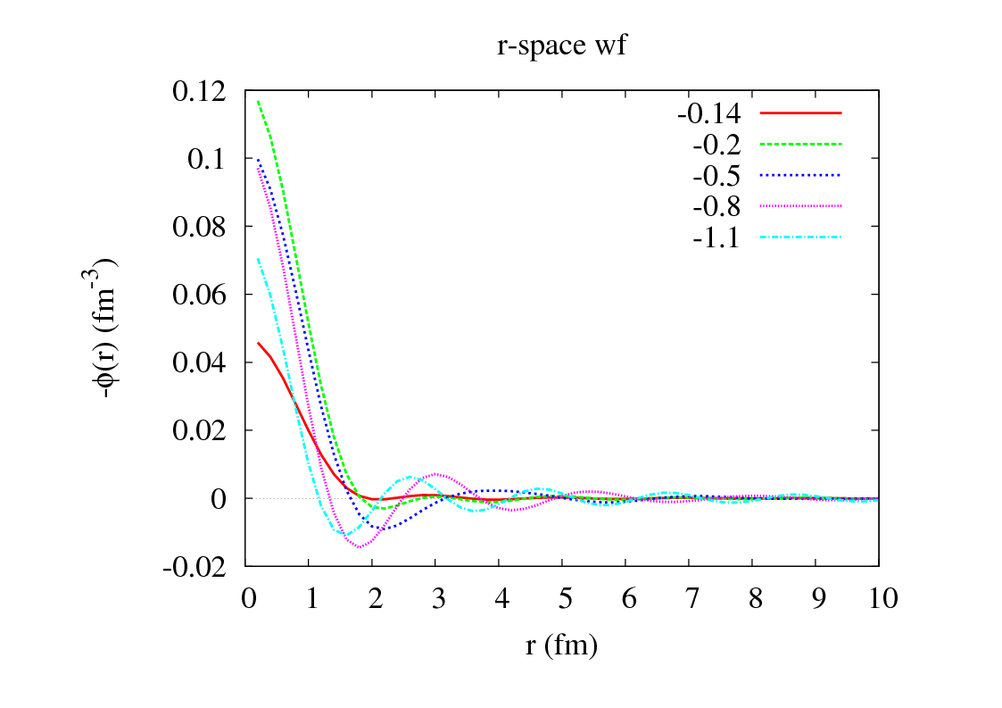
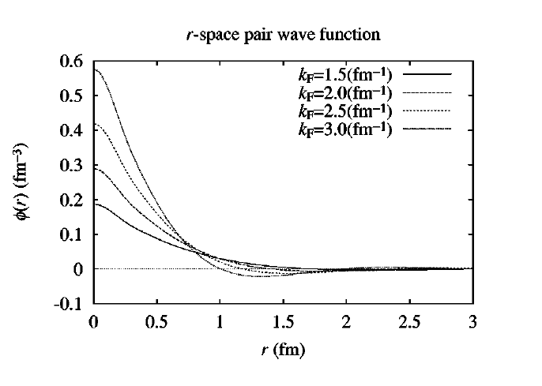

Slide 24
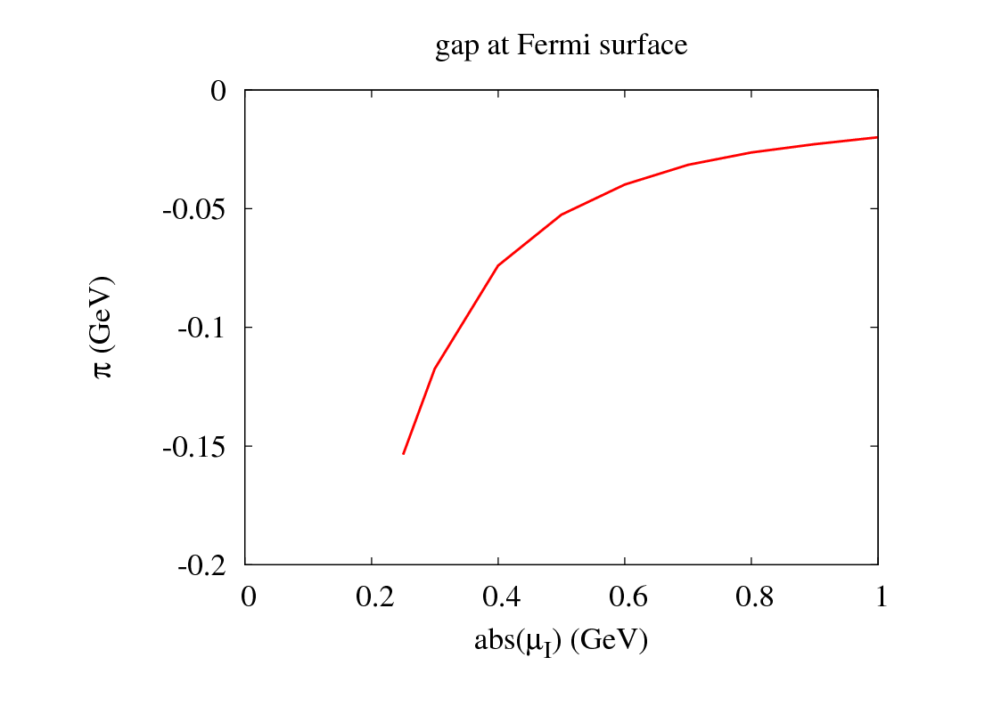
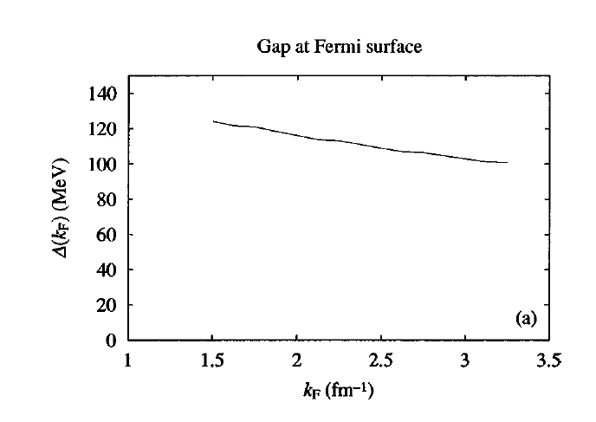
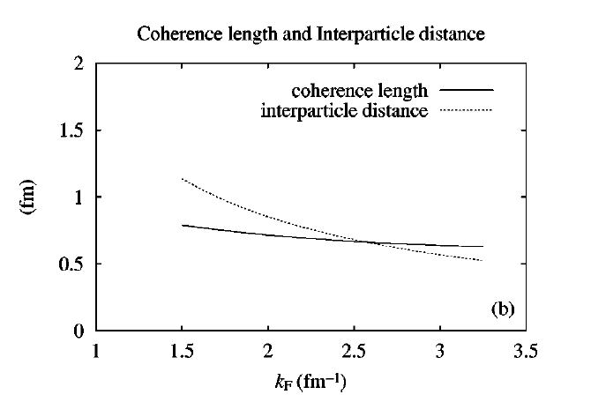

Slide 25
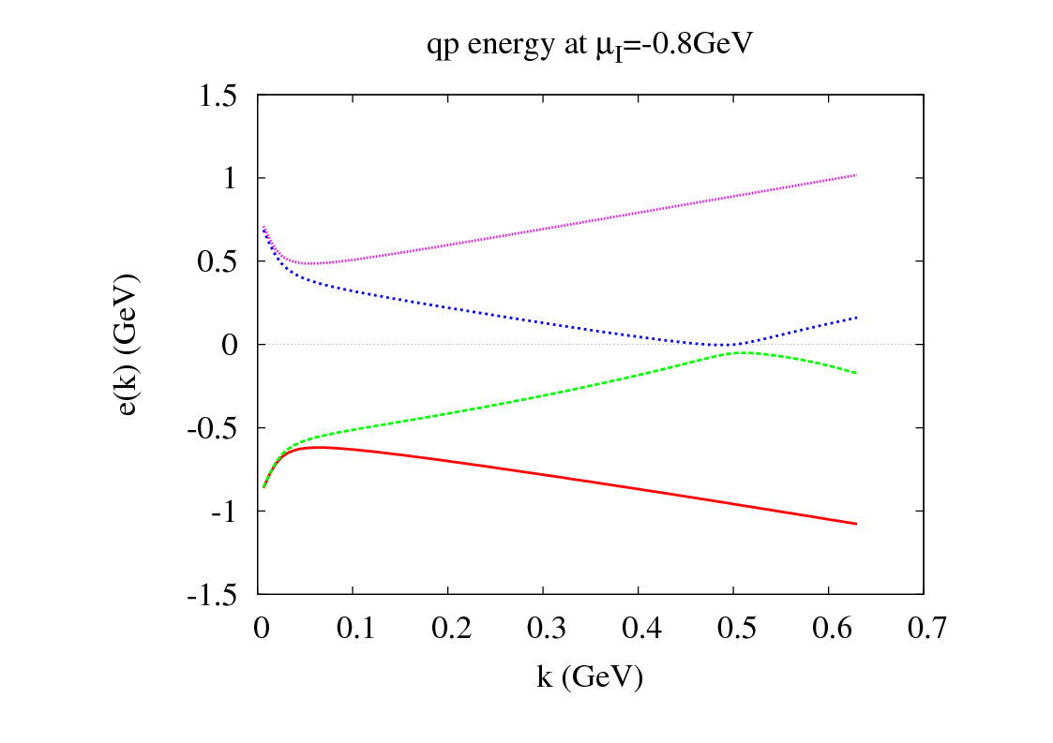
gapless

Slide 26
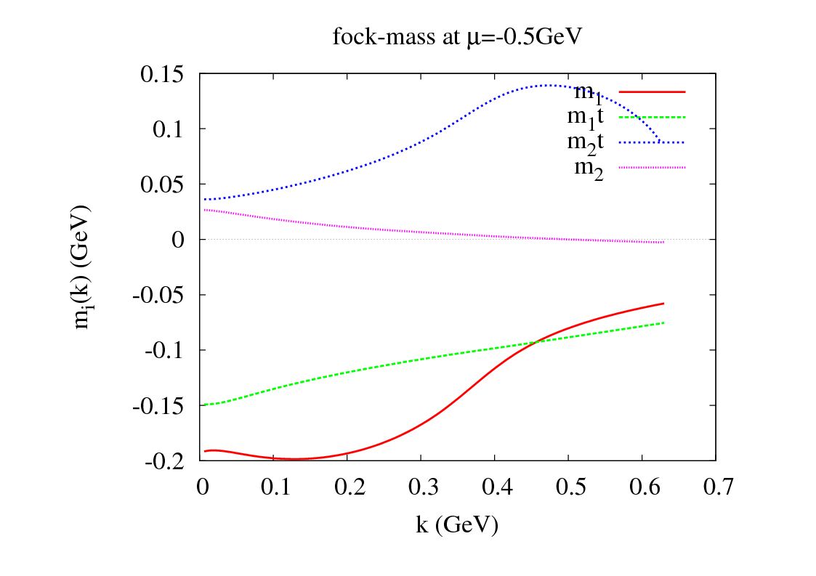
u
d

Slide 27
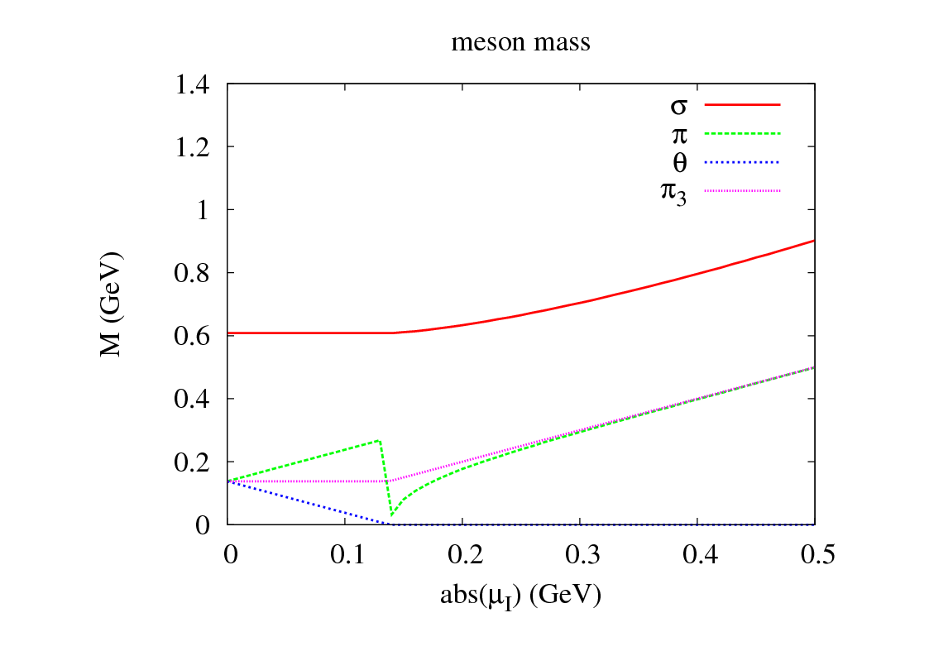
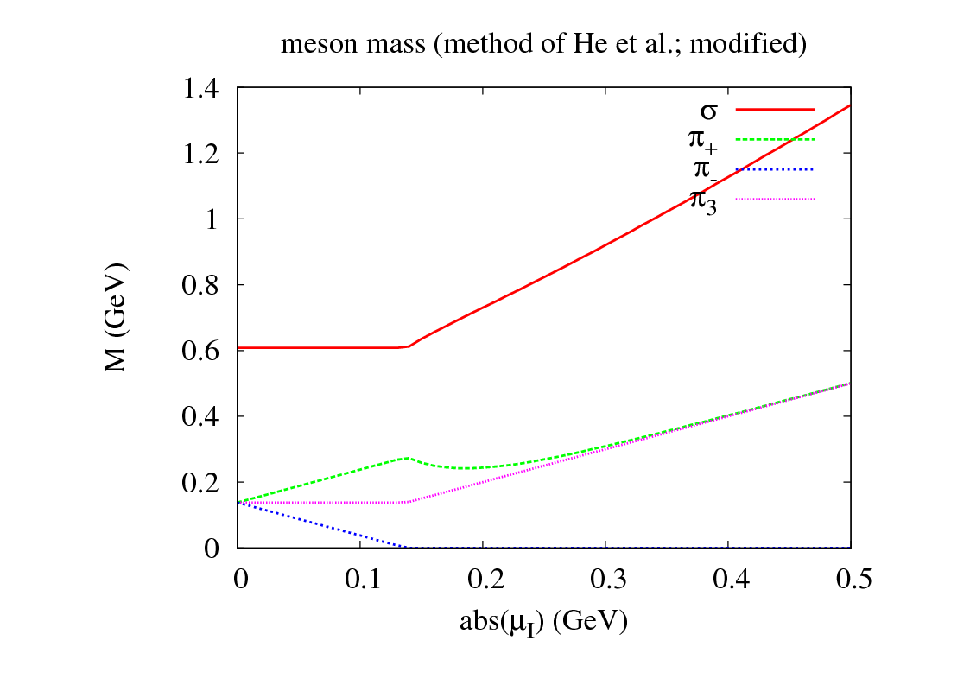
ignore “Coriolis” interaction

Slide 28
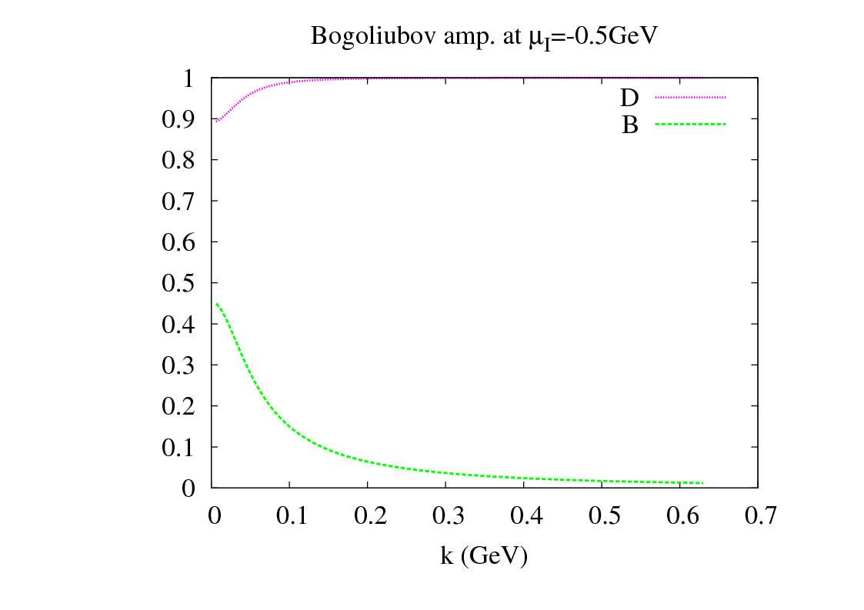
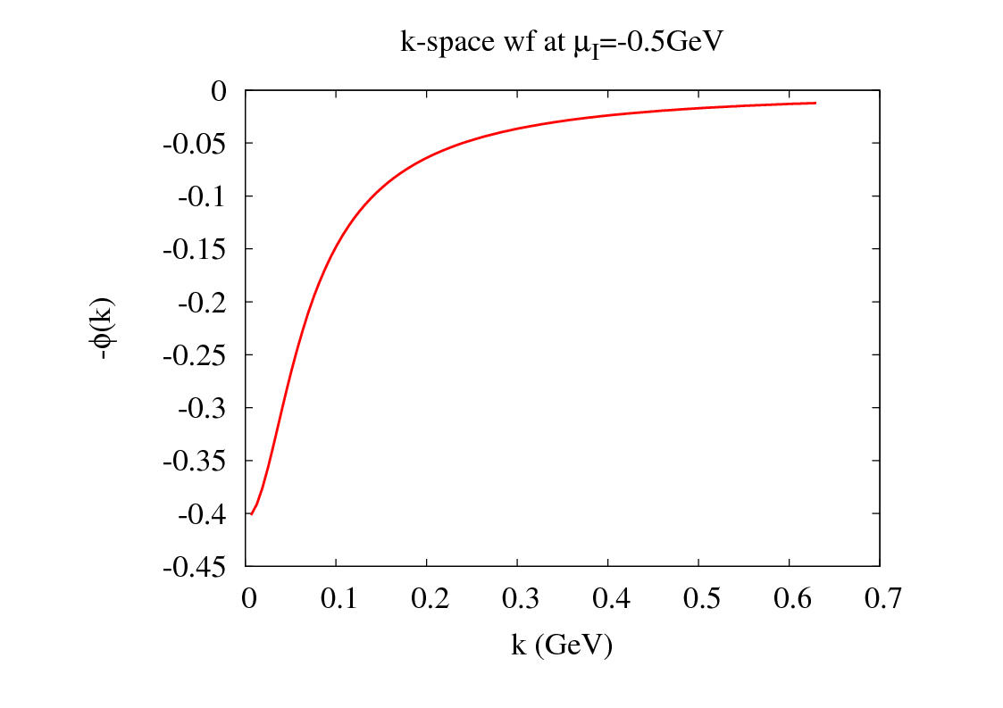
higher solution
pure u quark aside from k～0
bosonic contribution

Slide 29
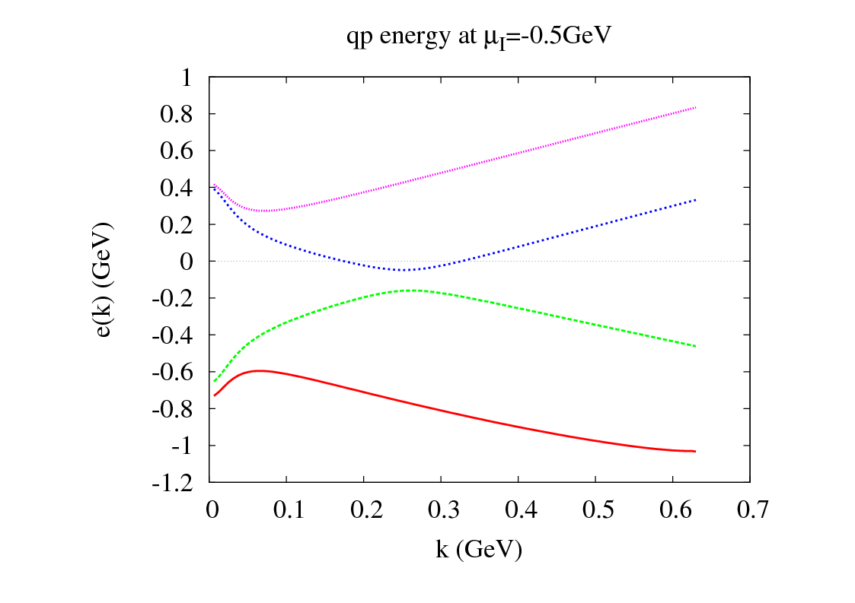
lower solution s.c. cal
higher solution s.c. cal

Slide 30
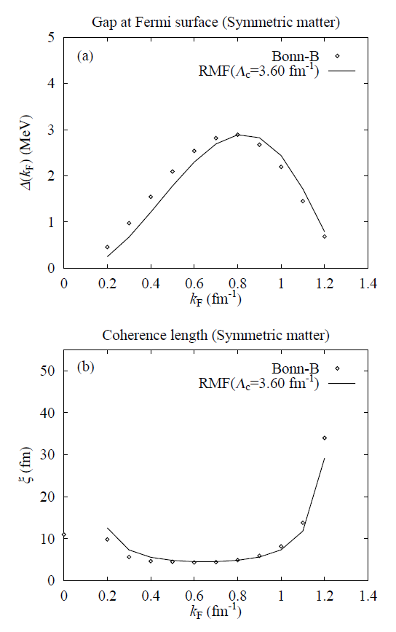
nuclear superfluidity

Slide 31
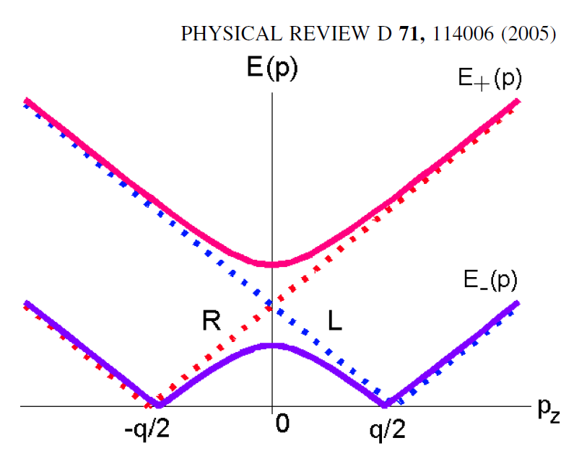
E. Nakano and T. Tatsumi

Slide 32
E. Nakano and T. Tatsumi
q

