Slide 1
X-ray Emissions
from Magnetic Polar Regions
of Neutron Stars
Hajime Inoue
ISAS, JAXA
Theoretical study:
Inoue, 2020, PASJ, 72, 12
Observational study:
Kondo, Dotani & Inoue, 2021, PASJ, 73, 286

Slide 2
Since discoveries of Cen X-3 (Giacconi et al. 1971) with Uhuru, more than 100 X-ray pulsars have been found.
General consensus on situations of X-ray pulsars
・ a close binary of a strongly magnetized neutron star + a normal star
・ an accretion flow from the normal star to the neutron star
・ a magneto-boundary surface at ~ 10⁸ cm where the magnetic pressure of the NS once stops the flow
・ two channeled flows along magnetic funnels to the magnetic poles at the NS surface
・ X-ray emissions from the polar regions at the NS surface
・ an oblique rotation of the magnetic axis, causing X-ray pulsation

Slide 3
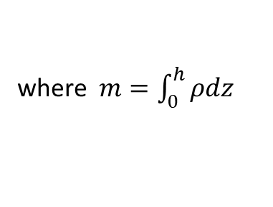



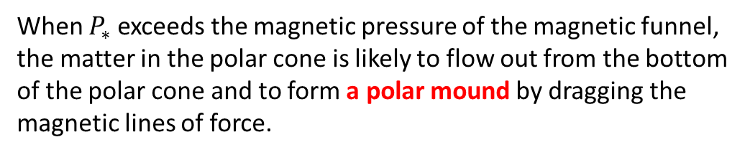





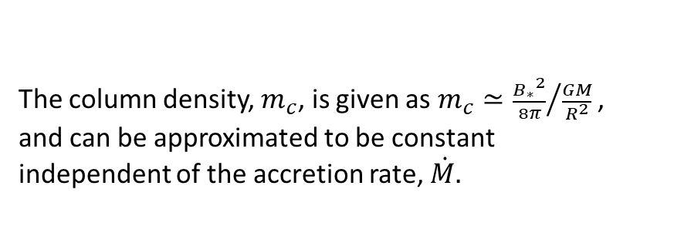
Theoretical study :
Structures of X-ray emitting magnetic polar regions on neutron stars
Basic consideration:
(Inoue, 2020, PASJ, 72, 12)
Accreted matter accumulates in a polar cone on a neutron star.
Hydrostatic equation: $\frac{dP}{dz}=−ρ\frac{GM}{R^{2}}$
, when $h≪R$,
$P, ρ$: pressure & density
$M, R$: mass & radius of N.S.
and we get $P_{∗}=m\frac{GM}{R^{2}}$ ,
where $m=\int_{0}^{h}{ρdz}$
$$z$$
$P_{∗}$: Pressure at the bottom of the polar cone
$m$ : Column density along the z-axis in the polar cone
As the accumulation proceeds, $m$ increases and $P_{∗}$ increases.
When $P_{∗}$ exceeds the magnetic pressure of the magnetic funnel, the matter in the polar cone is likely to flow out from the bottom of the polar cone and to form a polar mound by dragging the magnetic lines of force.
shock
Polar Cone Region
$$h$$
Hence, we can expect $P_{∗}≃\frac{{B_{∗}}^{2}}{8π}$ .
The column density, $m_{c}$, is given as $m_{c}≃{\frac{{B_{∗}}^{2}}{8π}}/{\frac{GM}{R^{2}}}$ , and can be approximated to be constant independent of the accretion rate, $\dot{M.}$
Polar Mound Region
•

Slide 4



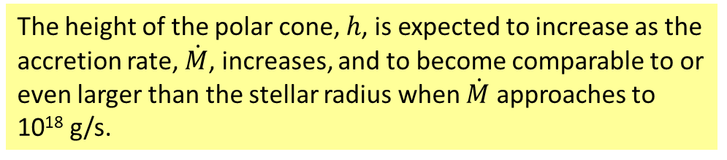
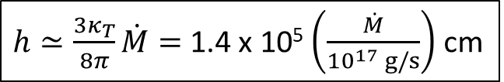






Since the polar cone is optically thick, the radiation energy also accumulates there in the photon diffusion time.
When $h>x_{c}$, the photon diffusion time, $t_{d}$, is approximately given as
$t_{d}≃\frac{3κ_{T}ρ_{c}{x_{c}}^{2}}{4c}$ .
$ρ_{c}$: the average density of the polar cone
$κ_{T}$: the Thomson scattering opacity
$x_{c}$: the average radius of the polar cone
$c$: the velocity of light
On the other hand, the matter accumulation time, $t_{a}$, is written as
$$z$$
$t_{a}≃\frac{m_{c}π{x_{c}}^{2}}{{\dot{M}}/2}=\frac{ρ_{c}h π{x_{c}}^{2}}{{\dot{M}}/2}$ .
($\dot{M}$ is the total accretion rate to the N.S. and the factor 1/2 comes from the assumption that the accretion flow is evenly divided into the two funnel flows to the magnetic N and S poles.)
shock
In the steady state,
$t_{d}=t_{a}$ .
$h≃\frac{3κ_{T}}{8π}\dot{M}=$ 1.4 x 10⁵ $\left(\frac{\dot{M}}{{10}^{17} g/s}\right)$ cm
Polar Cone Region
$$h$$
$$x_{c}$$
The height of the polar cone, $h$, is expected to increase as the accretion rate, $\dot{M}$, increases, and to become comparable to or even larger than the stellar radius when $\dot{M}$ approaches to 10¹⁸ g/s.
Polar Mound Region
•

Slide 5

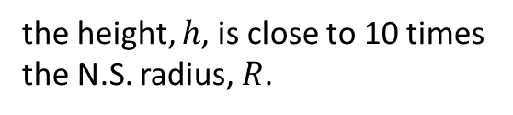
More generalized calculation is done for the structure of the polar cone by Inoue (2020).
The height of the polar cone
When $\dot{M}$ is ∼10¹⁸ g/s,
the height, $h$, is close to 10 times the N.S. radius, $R$.

Slide 6







Expected X-ray emission
3 components
I) 2 components from the Polar Cone:
$\frac{dL}{dr}$ = $\frac{4πc}{3κT}$ ε
$L$ : Luminosity from the surface of the polar cone
$ε$ : Specific energy density at the center of the polar cone
$\dot{M}$
3 x 10¹⁶ g/s
$\dot{M}$
3 x 10¹⁷ g/s
$\dot{M}$
3 x 10¹⁸ g/s
Top region
specific
eregy density
(1)
(3)
Bottom region
$(\frac{ε}{GM/R}$)
(2)
Bottom region
Top region
Mound
Portions of the radiated energy of the 3 components
1
(3)
(1)
(1) X-rays from a region near the top boundary
The release of the kinetic energy before reaching the shock.
(2)
(2) X-rays from a region near the bottom boundary
10⁻¹
The release of the gravitational energy due to the gradual infall of the matter in the polar cone.
II) 1 component from the Polar Mound
(3) X-rays from the Polar Mound
10⁻²
The release of the remaining radiation-energy at the bottom of the polar cone.
10¹⁶
10¹⁷
10¹⁸
10¹⁹
$\dot{M}$ ( g/s )

Slide 7



Two typical cases of accretion rate
Height of the Polar Cone
Portions of 3 emission components
1
100
(PC-Top)
(Mound)
10
(PC-Bottom)
h_{S}/R
10⁻¹
1
0.1
10⁻²
10¹⁶
10¹⁷
10¹⁸
10¹⁹
10¹⁶
10¹⁷
10¹⁸
10¹⁹
$\dot{M}$ ( g/s )
$\dot{M}$ ( g/s )
Case of low accretion rate : $\dot{M}$ ≈ 10¹⁶ g/s
Case of high accretion rate : $\dot{M}$ ≈ 10¹⁸ g/s
Emission from a region behind the shock
Quasi-single
blackbody
emission
Multi-color blackbody emission
Becker & Wolff (2007)

Slide 8






Expected X-ray spectrum
Bright X-ray pulsars
L ≈ 10³⁷∼10³⁸ erg/s
2 component spectrum
$\dot{M}$ ≈ 10¹⁷ ∼ 10¹⁸ g/s
a multi-color blackbody + a blackbody
"NPEX" model well reproduces observed spectra of several X-ray pulsars.
(Mihara 1995;
Makishima et al. 1999)
NPEX model
F_{E}
(A_{n} E^{-α} + A_{p} E²) exp(- $\frac{E}{kT}$)
E^{-α} exp(- $\frac{E}{kT}$) ∼ multi-color blackbody spectrum
$\frac{dLPC}{dr}$ = $\frac{4πc}{3κT}$ ε = 2πrΘ σT_{e}⁴
ε ∝ r^{-ν}
Θ ∝ r^{μ}
α = $\frac{6 −2(ν+μ)}{ν+μ+1}$
E
T_{e} ∝ r^{-(ν+μ+1)/4}
E² exp(- $\frac{E}{kT}$) ∼ single blackbody spectrum
F_{E}
The 2-component spectrum of a multicolor blackbody + a blackbody well reproduces Her X-1 spectra in every pulse phases by changing only normalization factors.
(Kondo, Dotani & Inoue 2021)
E

Slide 9
Observational study :
Studies of emission regions of the X-ray pulsar Hercules X-1 with pulse-phase-resolved spectra observed with Suzaku
Analyzed data
(Kondo, Dotani & Inoue 2021)
Suzaku data of Her X-1 during the main-on phase of the 35 day cycle on 2008 February 21.

Slide 10

Hypothesis of the analysis:
Ratio spectra
A/E
B/E
Observed periodic variations of the continuum spectra:
• Due to changes of the projection areas of the emission regions viewed from the observer
H
L
M
• No associated change of the spectral shape observed from each of the emission region
C/E
D/E
Search for flat portions in the ratio spectra
Three candidate energy-ranges are found.
• Low energy range : 0.3 - 1 keV
• Medium energy range : 2 - 6 keV
• High energy range : 18 - 30 keV
$χ^{2}$ tests of the flatness approve
B/A
• Low energy component
common to all A - E phases
• Medium energy component
common to all A - E phases
• High energy component
common to A - B phases
common to C - E phases

Slide 11

Solving the simultaneous equations for the intrinsic spectral components from a pair of the phase-resolved spectra that show flat portions in the ratio spectrum.
Low energy component $⟷$ a soft blackbody
Medium energy component $⟷$ a cut-off power law
High energy component $⟷$ a hard blackbody
Final simultaneous fit to all the phase-resolved spectra with a composite model of three continuum components together with a cyclotron absorption feature and an iron line.
Acceptable result
Phase A
Phase B
Phase C
Phase D
Phase E

Slide 12
Best fitting parameters of the revised three-continuum component model
The revised three-continuum component model :
the cut-off power law model $→$ the modified multicolor blackbody model
for the medium energy component

Slide 13
Discussions on the fitting results
Hard b-body
• Same flux-peak-phase of the hard b-body component and the multi-color b-body component
M-color b-body
Phase
3 components in the beam pattern discussed by Inoue (2020)
(2)
I) 2 components from the Polar Cone region
(1)
1) a narrow pencil beam : Main peak of the M-Color BB Comp.
(3)
2) a broad fan beam
II) 1 component from the Polar Mound region
3) a broad pencil beam : Main peak of the Hard BB Comp.
X-ray beaming in the direction of the magnetic lines of force (Basko & Sunyaev 1975)
free from electron scattering
X-rays polarized
along the lines of force
X-rays originally polarized along the field lines tends to be beamed in the direction of the lines of force.
X-rays polarized
perpendicular to
the lines of force
free from electron scattering
X-rays originally polarized perpendicular to the lines of force should be emitted without beaming.
central side of the Polar Cone
magnetic lines of force
in the surface layer of
the Polar Cone

Slide 14
• Deferences of the best fit parameter-values in the hard blackbody component between the phases A-B and the phases C-E.
BB temperature
Cyclotron energy
A possible interpretation :
We see different polar mounds at the opposite magnetic poles.
side view
A - B phases
C - E phases
N
Observer
N
Observer
S
S
Hard blackbody component + Cyclotron absorption
Polar mound

Slide 15
Presence of phase-dependent obscuration
complications in reproduction of the pulse profiles
Pulse profile variation of Her X-1 associated with the 35-day cycle
Main on
Mid on
Accretion flow along the magnetic funnels could be optically thick and possible to periodically obscure the central X-ray source.
Candidate place of the soft blackbody component
observer
This funnel pattern could change in association with the 35-day cycle.
(Scott et al. 2000)

Slide 16
Summary
I studied structures and properties of an X-ray emitting magnetic polar region on a neutron star composing of a polar cone region and a polar mound region.
(Inoue 2020, PASJ, 72, 12)
This model can well reproduce the pulse-phase-resolved spectra of Her X-1 observed with Suzaku.
(Kondo, Dotani & Inoue 2021, PASJ, 73, 286)
shock
Polar Cone Region
Multi-color blackbody emission
Polar Mound Region
Quasi-single blackbody emission +
Cyclotron absorption

