Slide 1
硬X線パルスの位相変調から
探るマグネターの物理
Physics of Magnetars Probed through Hard X-ray Pulse-Phase Modulation
牧島一夫 Kazuo Makishima
東京大学Kavli IPMU 上席連携研究員
東京大学 理学系 物理学専攻 名誉教授
理研 玉川高エネルギー宇宙物理研究室 客員
牧島一夫「マグネターの自由歳差運動の観測的研究」天文月報2019/８月
K.M. et al. 2014, Phys. Rev. Lett. 112, id. 171102
K.M. et al. 2016, Publ. Astr. Soc Japan 68S, id. 12
K.M. et al. 2019, Publ. Astr. Soc Japan 71, id. 15
K.M. et al. 2021, MNRAS, 502, 2266-2284
K.M. et al. 2021, ApJ, submitted
K.M. 2021, AIP Conf. Proc. 2319, 040003

Slide 2
1. Basic Views of Magnetars (MGTs)
A. Genuine MGTs (SGRs+AXPs；狭義のマグネター)
Magnetically-driven isolated NSs, not accreting objects.
B. MGT-like Objects (広義のマグネター）
(B-1) Weak-B_{d} magnetars, e.g., CCOs.
(B-2) Strong-B_{d} (＞5e13 G) NSs in binaries.
・The gamma-ray binary LS 5039
Yoneda,H., KM, Enoto,T.+2020, Phys.Rev.Let. 125, id.111103
〜9秒パルス検出、非降着系、回転駆動ではなく星風駆動でもなし。
・Binary X-ray pulsars with Long Periods & Low-Lx
X-Persei (P=840 s), 4U 0114+65 (P=2.6 hr), 4U1954+32
(P=5.4 hr), etc. Yatabe,F., KM + 2018, PASJ 70, id. 89
MAXI長期監視, 降着torque測定==> Huge Alfven radii, B~10¹⁴
(B-3) FRB(?) and others

Slide 3
2. Some Interesting Issues
Some MGTs are found in binaries as well.
A significant fraction of NSs might be born as MGTs (Nakano, KM+15, PASJ 67, id.9)
MGTs could be massive; 2.03±0.17M◎ for X-Persei (Yatabe+18) and 1.23-2.35M◎ for LS 5039 (Yoneda+20).
Converted from the P-Pdot diagram
magnetars
Compiled by
T. Nakano
Accreting
Pulsars
death line
The NS magnetism may be understand as ferromagnetism 強磁性 of e⁻ or neutrons (KM+99; KM16 学士院紀要B 92, 135). Data suggest phase transitions 相転移 from ferromagnetic to paramagnetic state. 8/10 大西先生の講演。

Slide 4
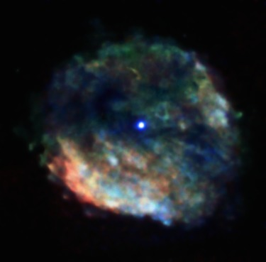
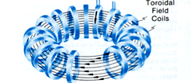
3.Toroidal M.F. of MGTs
A. Evidence for strong toroidal MF B_{t}
Differential rotation in the progenitor’s
core ==> B_{t} amplification.
Dipole-field energy can sustain L_{x} of
typical MGTs for only ~ 1ky.
Some weak-field NSs (e.g., CCOs)
behave like MGTs.
MGTにおいて、B_{t} は基本的に重要。
RCW 103 and its CCO
B. How to directly estimate B_{t}
Obviously, extremely difficult!
B_{t} elongates the NS by 非球対称度
ε≡(I₁-I₃)/I₃ ~10⁻⁴ (B_{t} /10¹⁶G)²
where I is the moment of inertia. Then, how to measure ε?
B
j
トカマクのトロイダルコイルの間には強い引力が働く

Slide 5
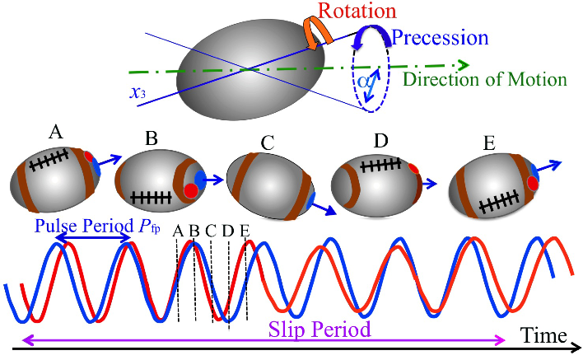
4. Free Precession of an Axisymmetric Rigid Body
An axisymmetric (ε≠0) rigid body(剛体) has two modes of rotation.
Spin around the symmetry axis x₃, with a period P_{spin} = 2πI₃/L (L=angular momentum).
Free precession (自由歳差運動) of
x₃ around L, with another period
P_{fp} = 2πI₁/L =P_{spin} (1+ε),
and a const. wobbling angle α.
コマの首振は強制歳差。自由歳差ではない！
x₃
α
A hotspot right on x₃ ;
periodic pulses at P_{fp}.
If emission breaks symmetry
around x₃ ==> pulses become
phase-modulated at the beat
period between P_{fp} and P_{spin,}
T = P_{fp} /εcosα (slip period)
and L
If T is measured, we can estimate ε∝B_{t}²

Slide 6
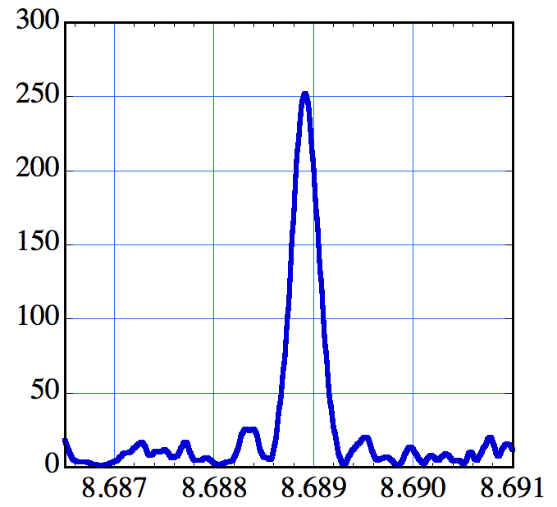
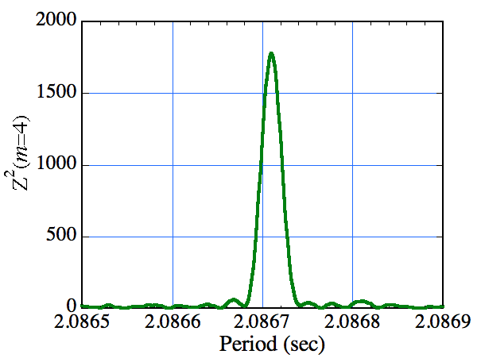
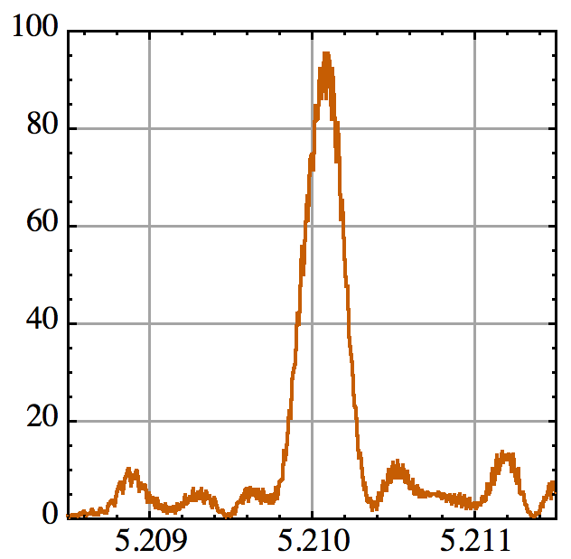
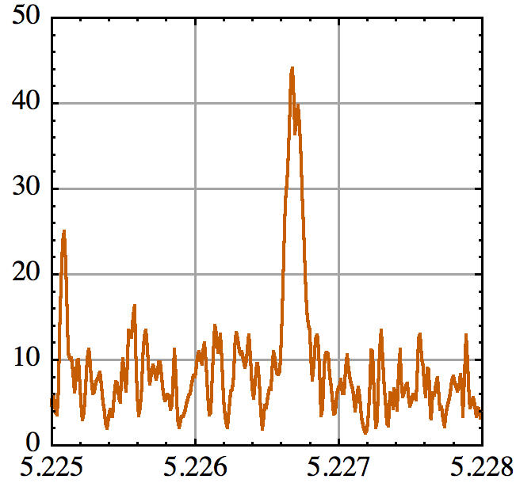
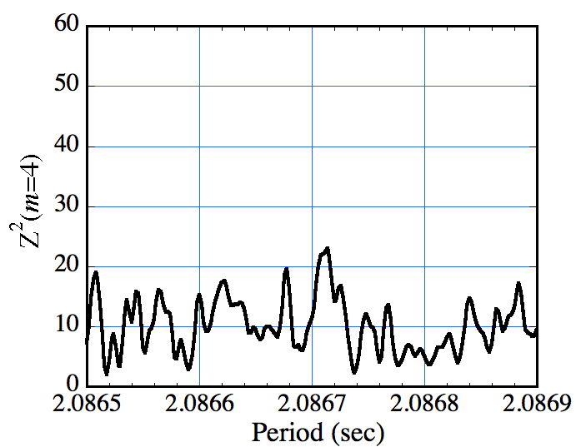
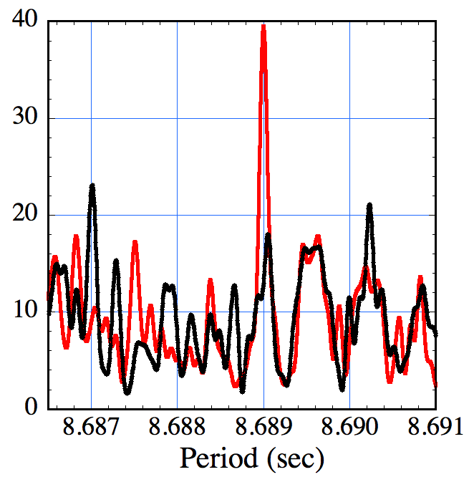
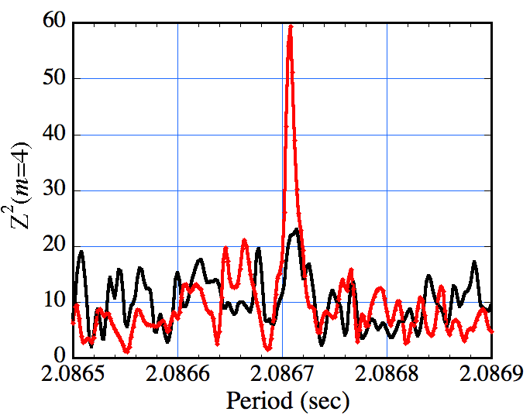
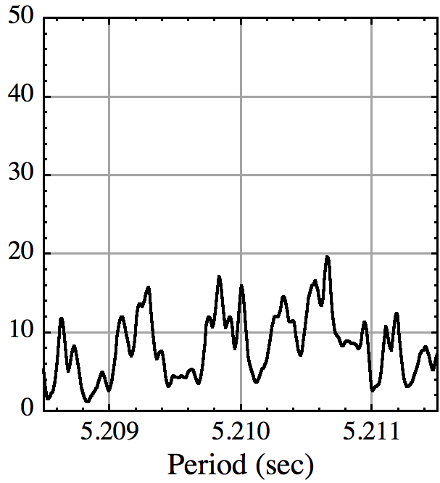
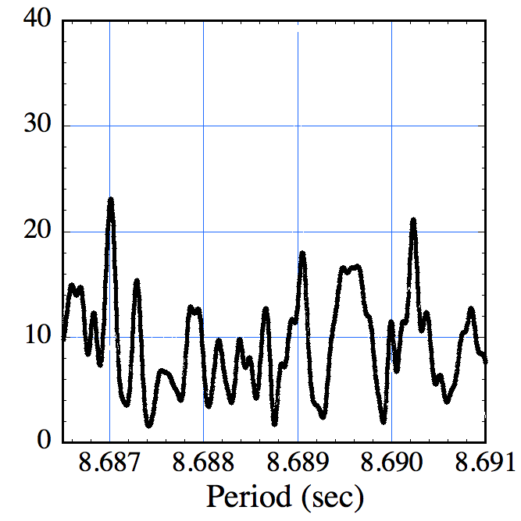
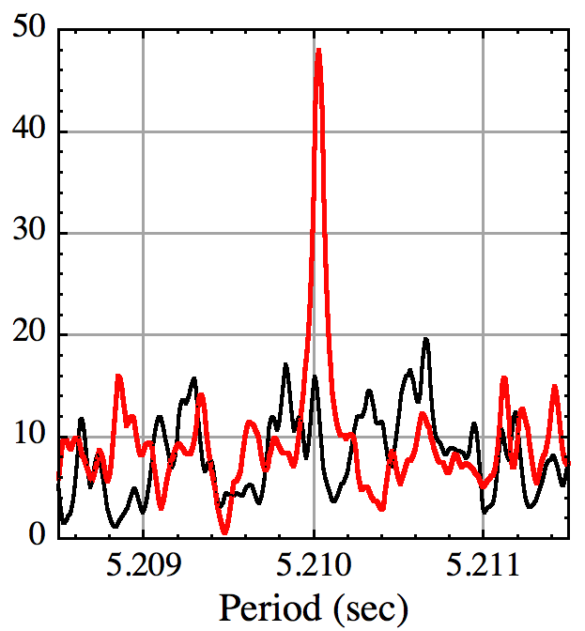
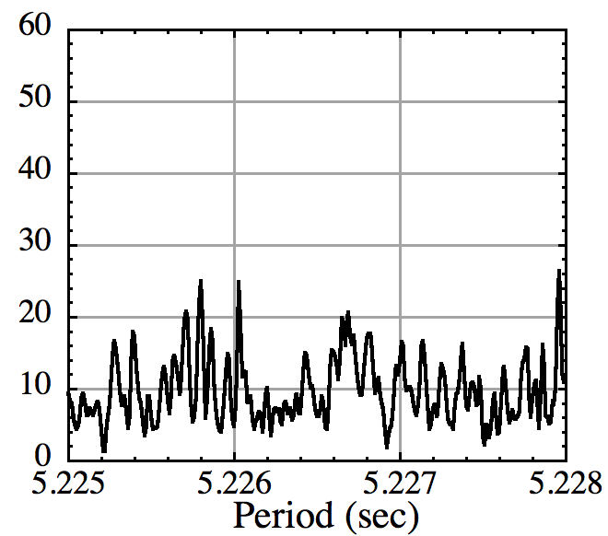
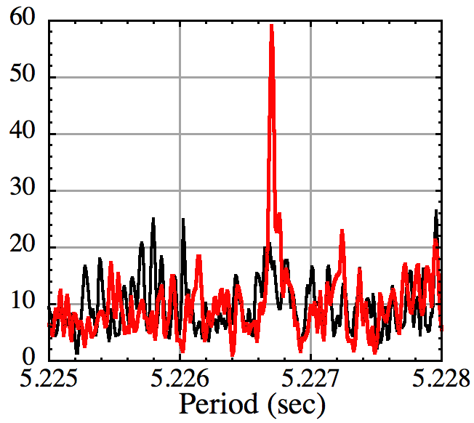
5. Periodograms : Missing Hard X-ray Pulses ?
4U 0142+61
Suzaku, Aug 09
1E1547-5408
NuSTAR, Apr16
SGR 1900+14
Suzaku Apr 09
NuSTAR Oct 16
XIS
1-10
keV
3-10
keV
XIS
1-6
keV
3-6
keV
The SXC (軟X線成分) pulses are detected significantly,
but very often, the HXC (硬X線成分) pulses are missing..?
HXD
15-40
keV
10-70
keV
HXD
12-50 keV
6-70
keV
魔法により HXCパルスが復元!
(KM+14)
(KM+21)
(submitted)
(Tamba+19)

Slide 7
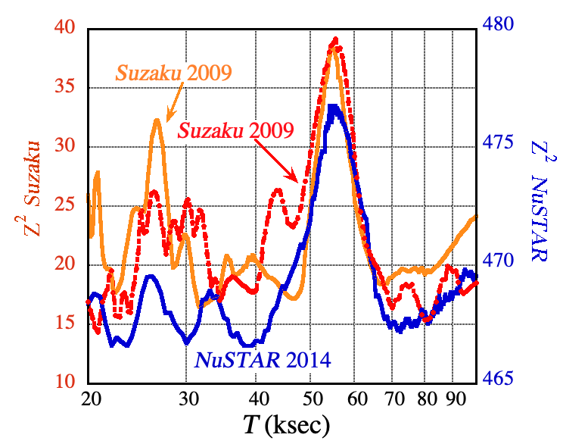
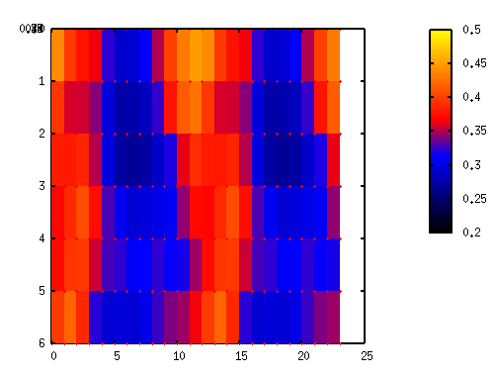
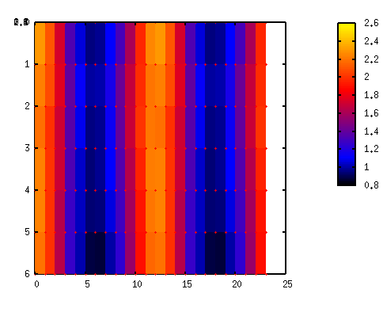
6. Periodic Phase Modulation in the HXC Pulses
HXC pulse phases often fluctuate in phase (認識している人は少い).
Assume the arrival times t of individual pulses are modulated as
δt = A sin(2πt/T – ψ₀) (T= mod. period, A=ampl, ψ₀=init. phase)
Modify the arrival times of photons as t --> t-δt (demodulation).
Find a triplet (T, A,ψ₀) that maximizes the pulse significance
==> The HXC pulses become detectable.
4U 0142+61 Pulse Significance
1E 1547-54, NuSTAR
Suzaku 2013
3-7 keV
8-25 keV
Suzaku
NuSTAR
One cycle in T=36 ks
(KM+21)
Two pulse cycles
(KM+14,19)

Slide 8
7. Possible Geometry
(KM+16, +21)
Identify the symmetry axis x₃ with the dipole MF axis, and assume;
The star has a prolate deformation with ε > 0.
The wobbling angle is not zero, e.g., α~45deg
The SXC emissivity is symmetric around x₃ .
The HXC has a conical beam pattern around x₃ , and its emissivity varies along the cone’s azimuth.
Then, the HXC pulse-phase modulation can be explained.
t=0; HXC pulse peak precedes SXC peak (x₃)
t=T/4; HXC and SXC pulses are in phase.
t=T/2; HXC pulses are delayed from SXC pulses.
x₃
L
x₃
x₃
L
L
slip
slip
slip
precession
precession
precession

Slide 9
8. Summary of the Measurements
Object | Obs. | P (sec) | T (ksec) | P/T~ε
4U 0142+61 KM+14, +19 | Su 2009 | 8.68899 | 55 ±2 | 1.6×10⁻⁴
 | Su 2013 | 8.68914
 | NS 2014 | 8.68917
1E 1547-54 KM+16, +21 | Su 2009 | 2.072135 | 36±3 | 0.6×10⁻⁴
 | NS 2016 | 2.086712
SGR 1900+14 submitted | Su 2009 | 5.21013 | 40.5±0.5 | 1.2×10⁻⁴
 | NS 2016 | 5.22670
1RXS J1708-4009 in prep | Su 2009 | 11.00623 | 47±2 | 2.3×10⁻⁴
 | Su 2010 | 11.00701
AXP
Tran
SGR
AXP
Identify T with the slip period associated with free precession.
Several more examples to come!
Common properties:
The pulse-phase modulation is seen only in HXC, but not in SXC.
T is specific to each object; depends neither on epoch or energy.
In all cases, ε= P/T cosα ~10⁻⁴ ==> B_{t}~10¹⁶ G (cf. ε∝B_{t}² )
In each object, A varies from obs. to obs. over (0.02-0.25) P.

Slide 10
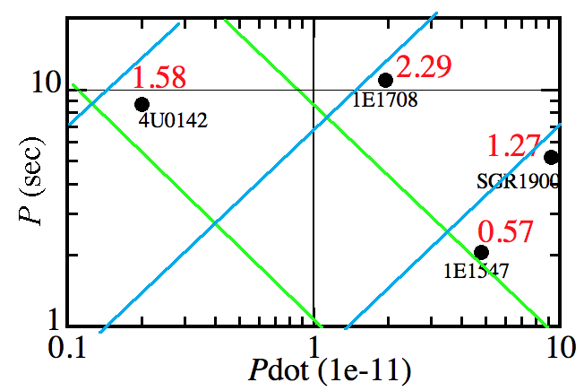
9. Estimating B_{t}
Observables
Newtonian dynamics
p/(T cosα)=ε〜10⁻⁴ (B_{t} /10¹⁶G)²
Data cannot constrain α, so we assume cosα〜１.
Theoretical (e.g. Ioka & Sasaki 04)
☆Values of P/T (in 10⁻⁴) in red
p/T∝B_{t}² ⇔B_{d},τ, spin down energy, L_{x}, etc.
Plot p/T on the (Pdot, P ) diagram.
MGTs with shorter P have lower B_{t} , and close to rot.-powered pulsars?
100
10 ky
3e14
B_{d}=1e14
τ=1 ky

Slide 11
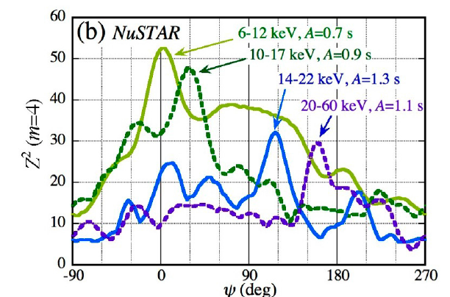
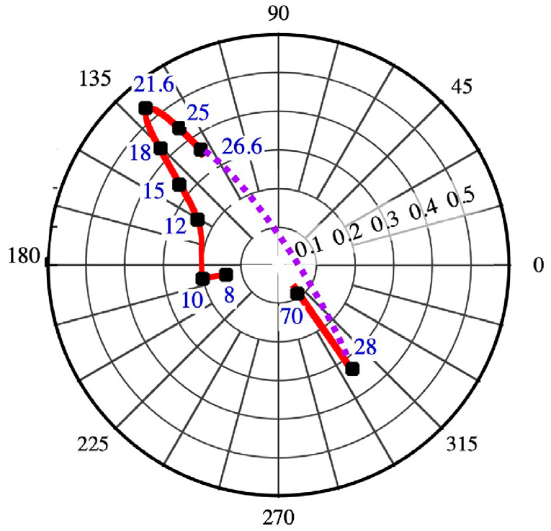
10. Peculiar Energy Dependences
In three sources, we found ψ₀ (and sometimes A too) to depend strongly on energy, in the 10-30 keV range.
1E 1547-5408 (NuSTAR)
At 21.6±6.9 keV, A increased resonantly by a factor ~3.
Over 10-28 keV ψ₀ decreased by 66°, followed by a reversal
(KM+21).
Manifestations of some exotic physics in strong magnetic fields, e.g. photon splitting and proton cyclotron resonance?
SGR 1900+14: With both Suzaku and NuSTAR, ψ₀ was found to increase by ~180° from 13 keV to 16-20 keV
(A, ψ₀) 極座標

Slide 12
11. Conclusion
The HXC pulses of 4 MGTs were found to be phase-modulated with T~10⁴ P and A~(0.02-0.25) P.
The phenomenon is explained by free precession of NSs axially elongated by ε〜 10⁻⁴. The elongation is attributed to B_{t}~10¹⁶ G.
Using archival Suzaku and NuSTAR data, we expect to detect the same effect from several more MGTs, and clarify how their B_{t} is related to other quantities.
Often ψ₀ (and sometimes A too) depends strongly on energy in the 10-30 keV interval. This could be caused by some exotic strong-B physics, e.g., photon splitting and proton cyclotron resonance.

Slide 13
11. Conclusion
The HXC pulses of 4 MGTs were found to be phase-modulated with T~10⁴ P and A~(0.02-0.25) P.
The phenomenon is explained by free precession of NSs axially elongated by ε〜 10⁻⁴. The elongation is attributed to B_{t}~10¹⁶ G.
Using archival Suzaku and NuSTAR data, we expect to detect the same effect from several more MGTs, and clarify how their B_{t} is related to other quantities.
Often ψ₀ (and sometimes A too) depends strongly on energy in the 10-30 keV interval. This could be caused by some exotic strong-B physics, e.g., photon splitting and proton cyclotron resonance.

