Slide 1
場の量子論に基づく強磁場・有限温度・密度中の素過程の解析
～中性子星の観測と理論～
研究活性化ワークショップ 2021
服部恒一
2021年8月10－12日
koichi.hattori@yukawa.kyoto-u.ac.jp

Slide 2
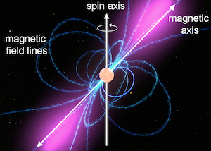
Motivations
Quantum field theory
NS/magnetar physics
Quantum fluctuations
in strong external fields
Strong-field QED/nonlinear QED
Strong B fields from the P-P dot diagram
Stable/homogeneous over macro scales
EM processes in the magnetosphere
→ Important for the pulsation mechanism
E, B
Cascade processes due to
Cyclotron radiation
(Inverse) Compton scattering
Curvature radiation
γ → e⁺ e⁻
Photon splitting
Schwinger mechanism
Vacuum birefringence/dichroism
Photon splitting, etc
Not confirmed or controversial yet
Challenges in several ongoing experiments/observations
・・・
Timokhin & Harding (2019)
c/Ω ≳ Macroscopic scale ≳ km
本研究会
(木坂氏、井上氏、西村氏、米山氏等）
磁気圏で見つかれば
学際的なインパクト
強電磁場中特有の量子過程を検出したい

Slide 3
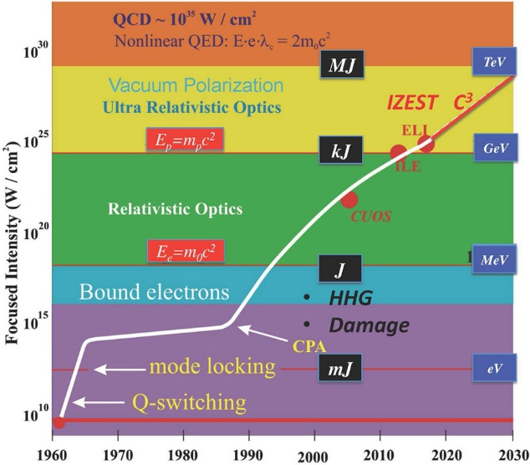
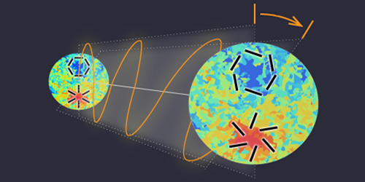
Strong EM fields in nature and laboratory
Magnetospheres of neutron stars/magnetars
High-intensity laser field
2021
Dipole strength estimated from the intervals of the pulsation.
Mourou&Strickland (2018 Nobel laureates)
https://www.nobelprize.org/prizes/physics/2018/mourou/lecture/
Ultraperipheral collisions
Cosmic birefringence (CMB)
Other ingredients expected like axion fields.
B
RHIC, LHC
Z
Z
Z
Z
https://physics.aps.org/articles/v13/s149

Slide 4
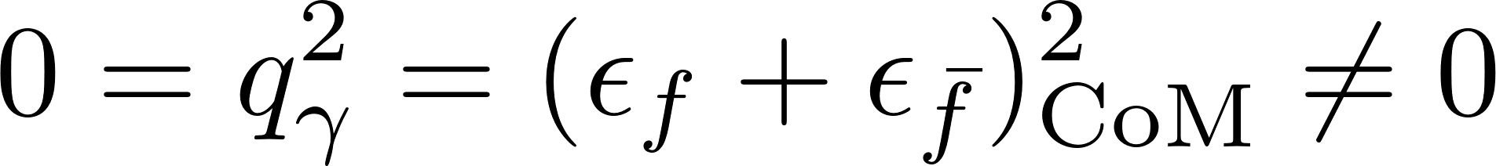

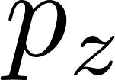
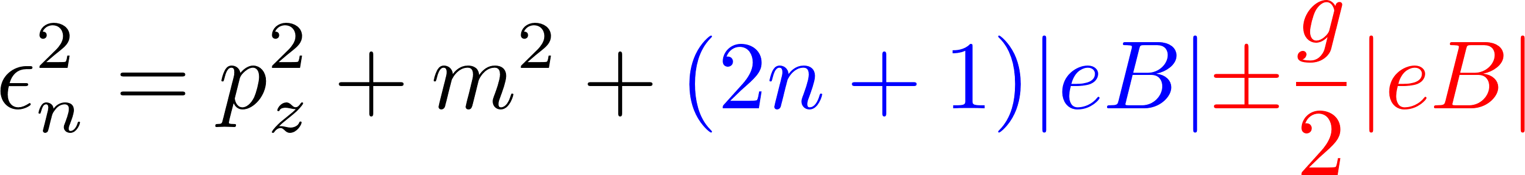
On-shell photon decay in magnetic fields
✘
On-shell photons never decay in vacuum
Not compatible with each other w/o B fields.
e⁻
On-shell photon
e⁺
E-m conservation
Massless on-shell condition
✔
Magnetic fields open finite kinematical window
--- On-shell photons can decay in magnetic fields.
B_{z}
e⁻
On-shell photon
Transverse momentum is NOT a good quantum number.
No transverse momentum conservation (due to momentum supply from external B-fields).
e⁺
KH, Taya, Yoshida, “Di-lepton production from a single photon in strong magnetic fields: vacuum dichroism”, [2010.13492]
Kinematics is satisfied with the Landau levels.

Slide 5



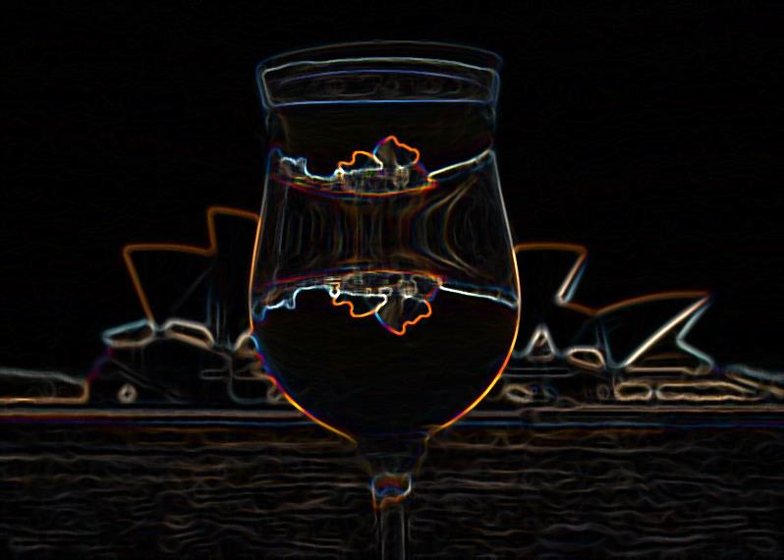

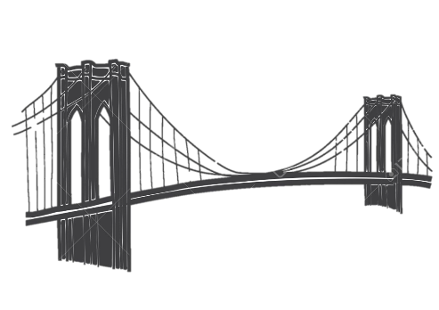
Complex refractive indices
Refraction (real part of the index of refraction)
Decay cross-section
Optical theorem for the imaginary part
=
＋
＋
＋
＋ ・・・
=
Both sides of a coin
Dispersion integral
Photon refraction
Di-fermion production
Lorentz & gauge symmetries → n ≠ 1 in general

Slide 6
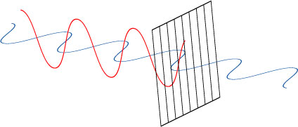

Rotating photon polarizations
Polarizer
Cf. Cotton-Mouton effect, Faraday effect, etc in optics
Inborn polarization
in photon sources
(Possibly unpolarized as well)
Acquired polarization due to the birefringence
Some of photons decay into fermion pairs
More involved cascade processes can occur in the magnetosphere.

Slide 7

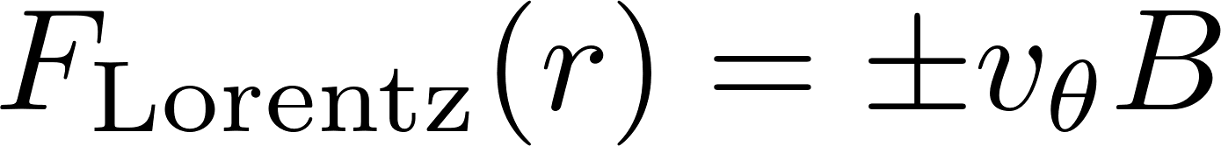
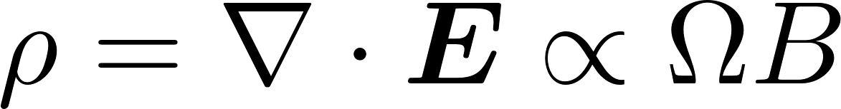
Magnetosphere
Shapiro, Teukolsky
宇宙物理(高原氏)
宇宙物理(KEKシリーズ)
NSs are surrounded by plasma.
Unipolar induction
--- “Rotational Hall effect”
Goldreich-Julian, ApJ (1969)
Ω
B
Hall current in B: Needs charge density
Hall current in Ω: Present in neutral systems
→ Charge separation
+
+
+
-
-
+
+
-
F
v
+
+
-
+
+
-
+
+
-
-
-
F
-
-
-
-
+
+
-
-
+
+
-
+
+
NS
+
+
+
→ Depends on electric charges
Charge separation in a steady state

Slide 8
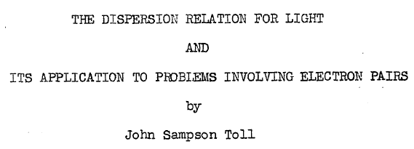
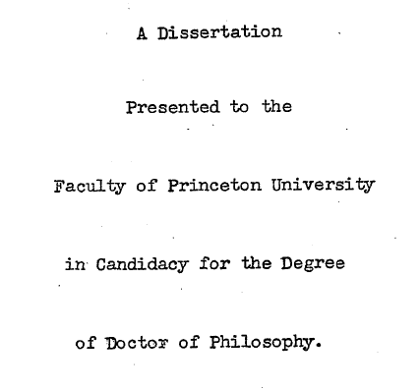
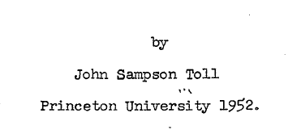
Photons in magnetic fields
“Vacuum” in magnetic fields ( = without medium )
Medium effects at finite temperature and density
Vacuum fluctuations in magnetic fields
Feynman diagrams for the coupling between
photons and vacuum fluctuations
γ
=
＋
＋
＋
＋ ・・・
(γ = photons at any ω in this talk.)
Quantum corrections to the Maxwell eq.
Solutions determine the photon dispersion relations
Complex refractive indices

Slide 9
(1) Refractive index of photon in strong B-fields
- Old but unsolved problem
Coupling constant is small, unlike low-energy QCD
But,
Perturbation breaks down and resummation required
Has not been confirmed in experiments
KH and K.Itakura, “Vacuum birefringence in strong magnetic fields”:
(I) Photon polarization tensor with all the Landau levels,” (2013);
(II) Complex refractive index from the lowest Landau level,” (2013).

Slide 10
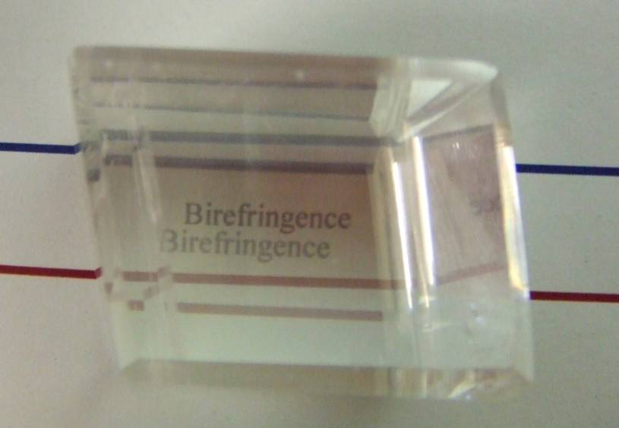
What is birefringence？
Structured ions
→ Anisotropic spring constants
Response of electrons to incident lights
electrons
ions
Birefringence (複屈折)
= Polarization-dependent refractive indices
Polarization 1
Polarization 2
(1+1)-dimensional fluctuations
B
Birefringent substance
“Calcite” (方解石)
Bunch of cyclotron motion
Lesson: Refractive indices are manifestation of the fermion spectrum.

Slide 11
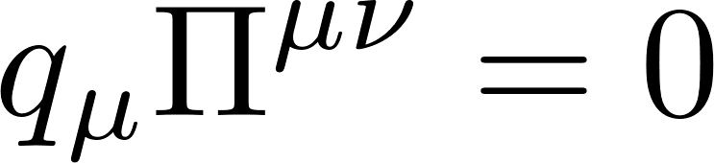

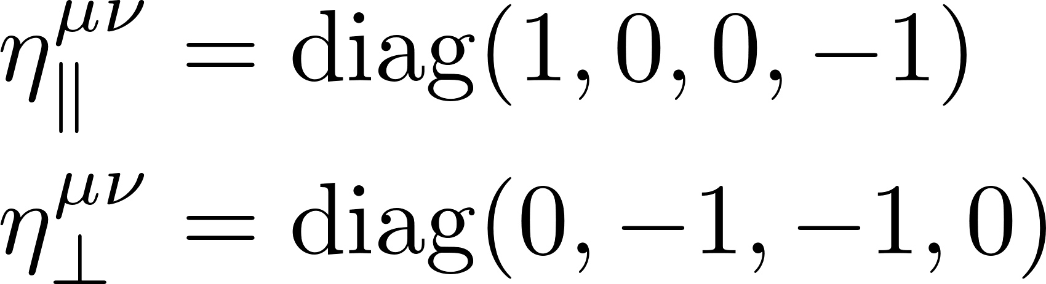
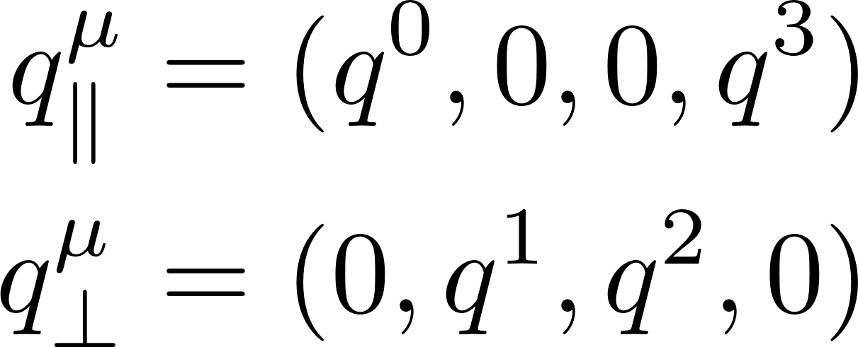
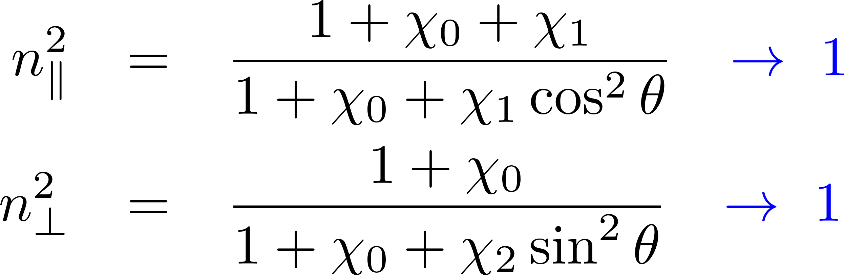
Maxwell eq. w/ quantum corrections:
U(1) gauge symmetry constrains
possible tensor structures
Preferred orientation in B
B-induced structures
(Boost invariance along B)
Refractive indices from the Maxwell eq.
Two (physical) polarization modes in || and ⊥ to B.
Direct consequence of the gauge symmetry and the breaking of one spatial rotational symmetry.
Vanishing B limit:

Slide 12

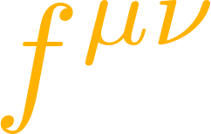
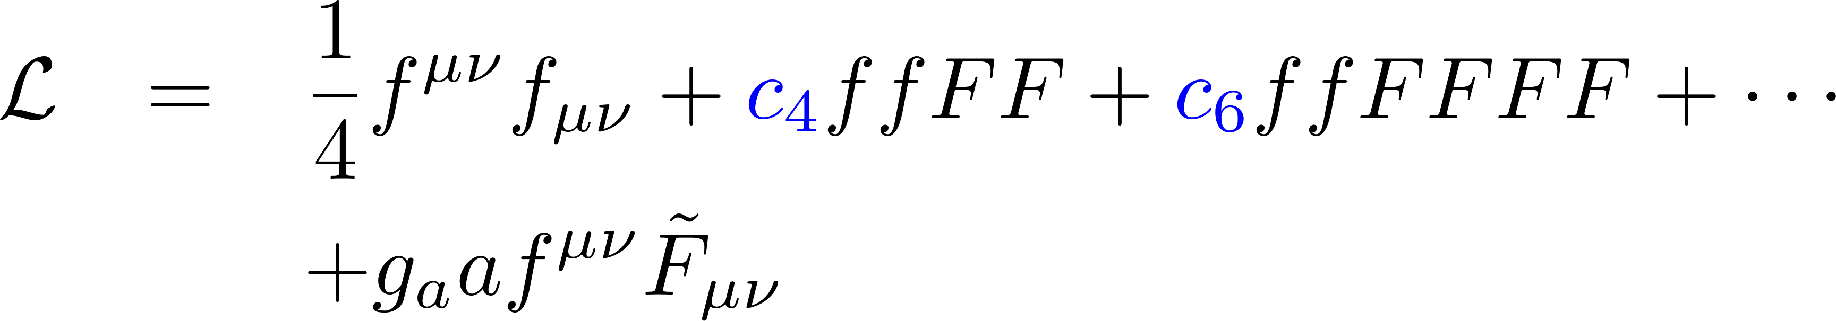
Oriented couplings among EM fields
Preferred orientation along B
QFT provides the coefficients
Fermion loops
axion
Cf. 1305.7224 [hep-ph]
All-order computation by the proper-time method
KH and K.Itakura, “Vacuum birefringence in strong magnetic fields”(2013)
1209.2663 [hep-ph]; 1212.1897 [hep-ph] and refs. therein published since 1952.

Slide 13
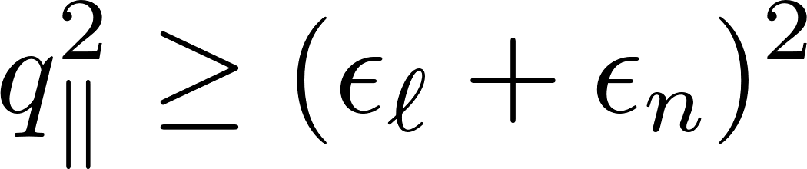
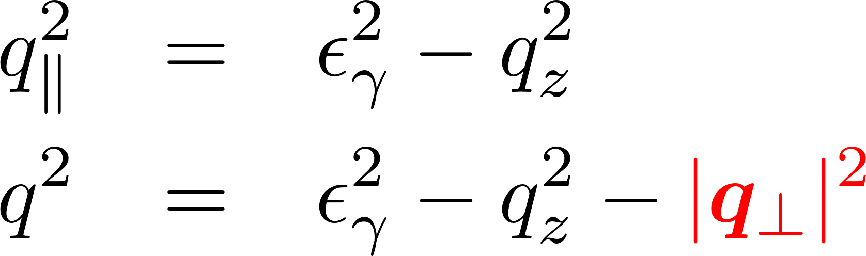
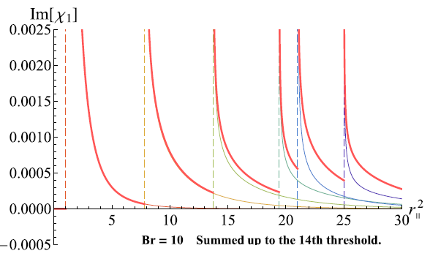
Fermion spectrum in the threshold conditions
Remember the lesson: Photon spectrum depends on the fermion spectrum.
Landau quantization
Threshold conditions
B_{z}
Imaginary part appears when
Classical motion
No effects on the longitudinal motion
Cyclotron motion ～ Harmonic oscillation
Spin polarization (Zeeman effect)
Infinite # of thresholds
Energy spectrum
Photon transverse momentum works
like a “photon mass” in the (1+1)-d kinematics.
Fermion transverse momentum is NOT a good quantum number.
No transverse momentum conservation (due to momentum supply from external B-fields).

Slide 14
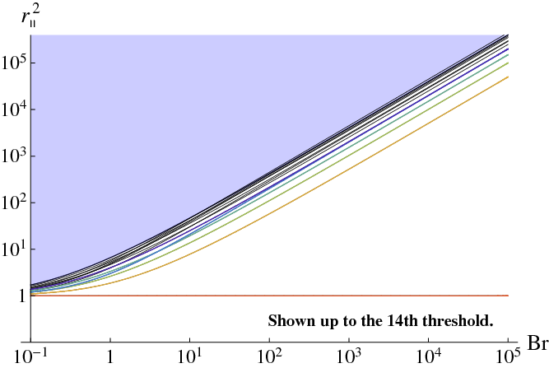
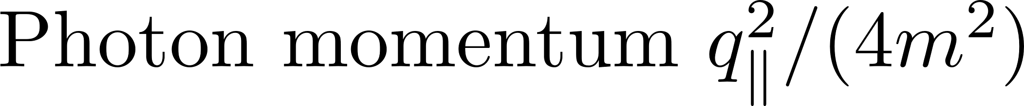
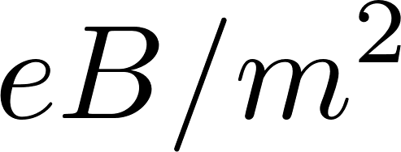
Summary of relevant scales and preceding calculations
Untouched in the literature
KH, Itakura
Narrowly spaced Landau levels
Strong field limit (LLL approx.)
(Tsai&Eber; Shabad; Gusynin, Miransky, Shovkovy; Fukushima; KH&Itakrua, etc.)
Lowest Landau level (2m)²→
No imaginary part→
Soft photon & weak field limit (Adler, etc.)
Numerical computation
below the LLL threshold (Kohri and Yamada)

Slide 15
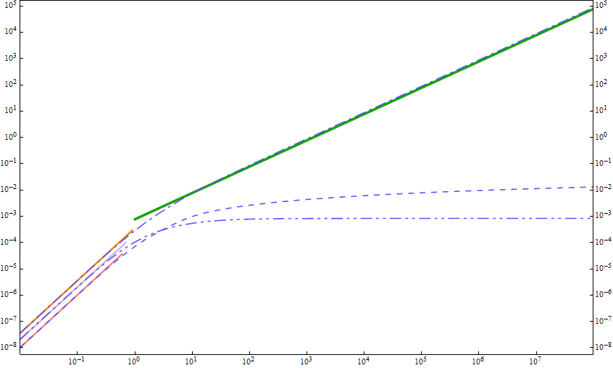
Summary of relevant scales and preceding calculations
Narrowly spaced Landau levels
Strong field limit (LLL approx.)
(Tsai&Eber; Shabad; Gusynin, Miransky, Shovkovy; Fukushima; KH&Itakrua, etc.)
Lowest Landau level →
No imaginary part→
Soft photon & weak field limit (Adler, etc.)
Numerical computation
below the LLL threshold (Kohri and Yamada)
Numerical computation
in the soft photon regime
Strong field limit (LLL approx.)
Soft photon & weak field limit

Slide 16
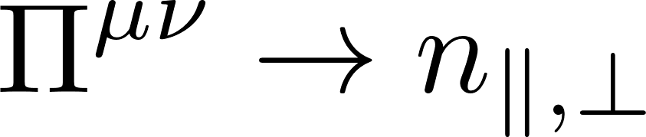
Refractive indices and decay rate

Slide 17
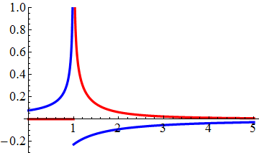
Refractive indices with the LLL fluctuations
Refractive indices at the LLL(ℓ=n=0)
(1+1)-dimensional fluctuations
Polarization excites only along the magnetic field
``Vacuum birefringence’’
B
← No modification in the ⊥ mode

Slide 18
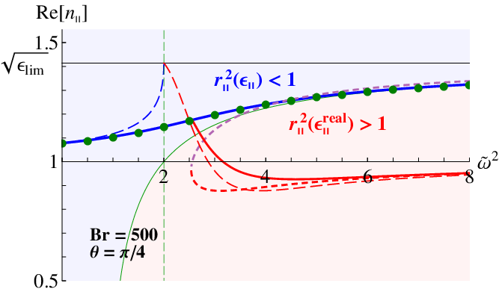
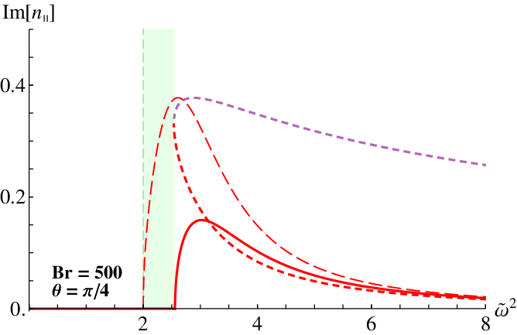



Complex refractive indices
$$ω^{2}/4m^{2}$$
≈ Magnetar << UrHIC
Final results shown by solid lines
$$ω^{2}/4m^{2}$$
cf. air n = 1.0003, water n = 1.3, prism n = 1.5
Refraction
Difermion production

Slide 19
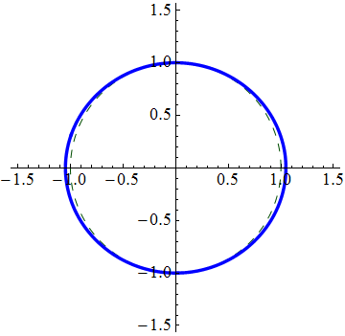
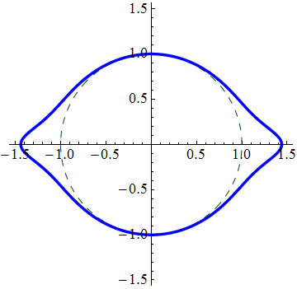
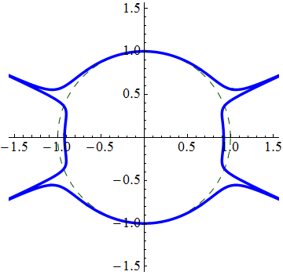
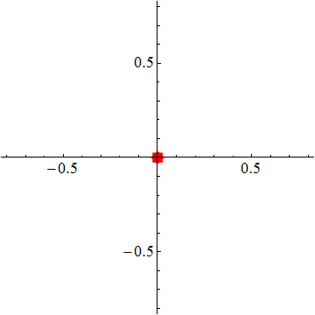
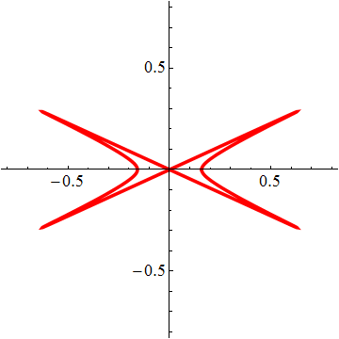
Anisotropy of the refraction index
Angle : Direction of the photon propagation
Radius : Magnitude of the refraction index
Real part
B
Photon energy ω
Threshold
Imaginary part
No imaginary part below the threshold

Slide 20
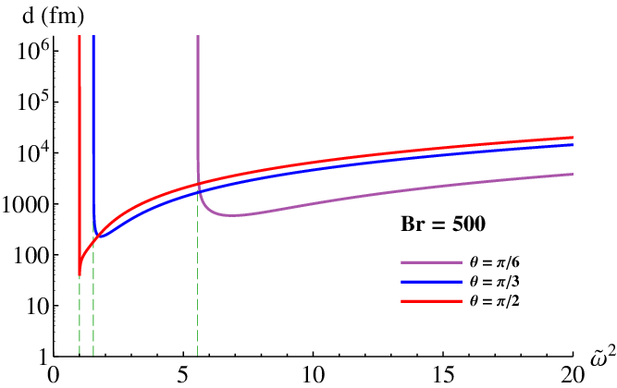
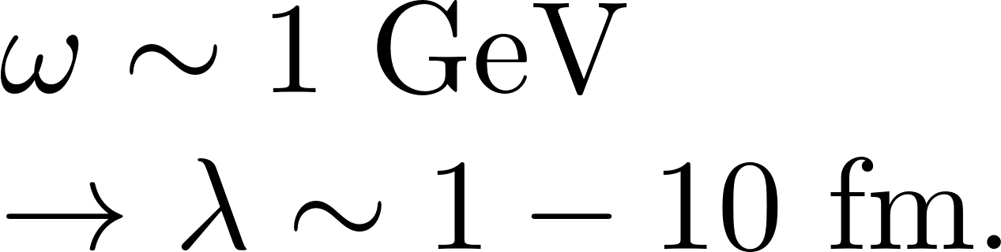
“Mean-free-path” of photons in B-fields
When the refractive index has an imaginary part,
“Photon mean-free-path”
λ (fm)
Even real photons decay
in a microscopic scale!
[Real photons never decay in
ordinary vacuum without B-field.]
Smaller mfp for a larger energy ~ 1/ω

Slide 21
Medium effects at finite temperature and density
in the strong magnetic field limit
Modification of the imaginary part
= Effects on the kinematics of on-shell particles
Dispersion integral
Effects on the real part (off-shell fluctuations)

Slide 22
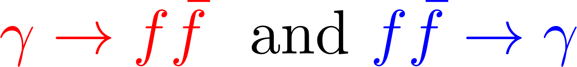

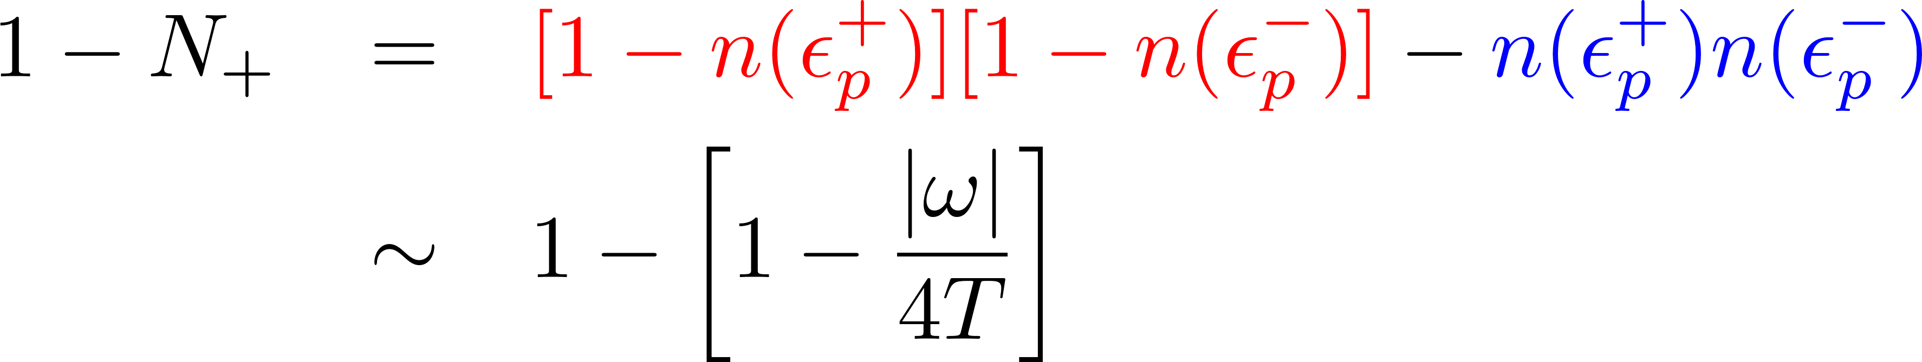
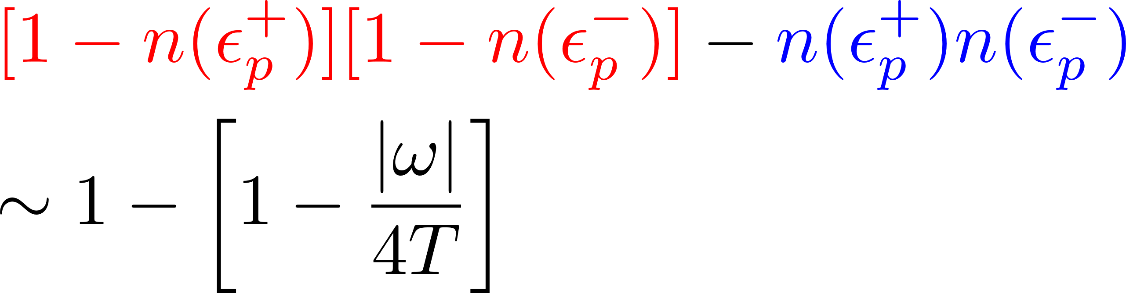
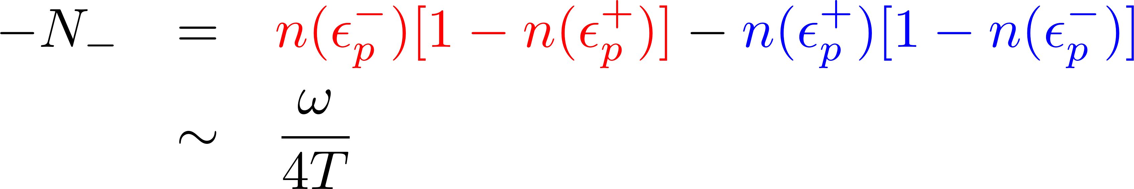
Expected effects: Pauli-blocking effect
Photon decay/creation
Vacuum
Medium
Pauli blocking & detail balance
n(ε): Fermi-Dirac distribution function
Cancellation
→ Highly suppressed in high T limit
Vacuum
Medium
Landau damping
Pauli blocking & detail balance
Suppressed in high T limit

Slide 23
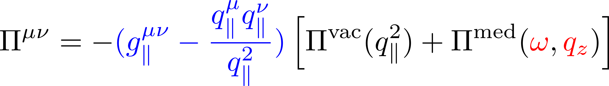
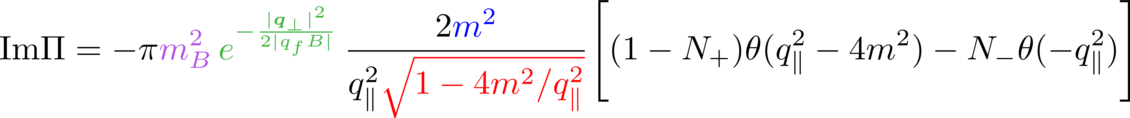
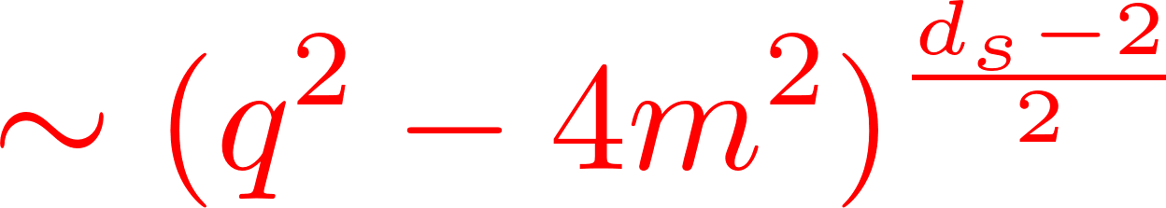
Medium contributions at finite T and μ
One can use either the imag.- or real-time formalism.
No modification in the tensor structure.
Separate dependences on photon energy and momentum.
vac. + med.
Time-like region
Pure medium effect
Space-like region
Wave functions in B-fields
Mass suppression for chiral anomaly
Threshold behavior in (1+1) d

Slide 24
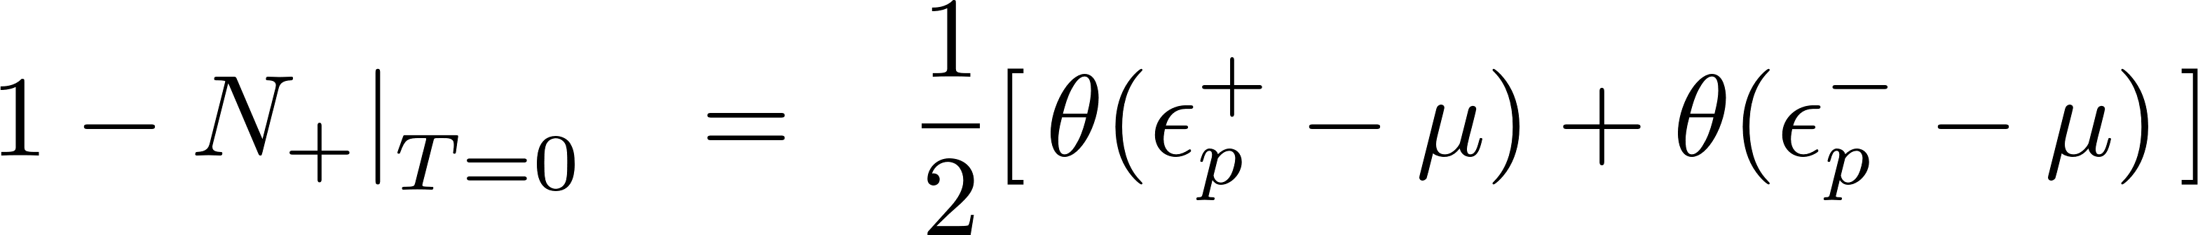
Thresholds at finite density and zero temperature
Pauli blocking on particles
No blocking on antiparticles

Slide 25
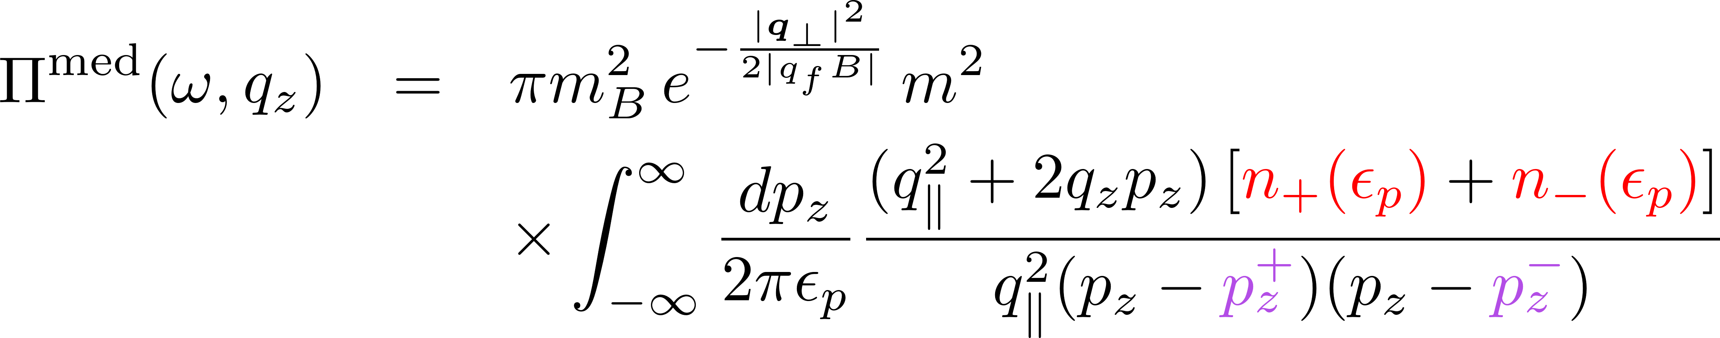
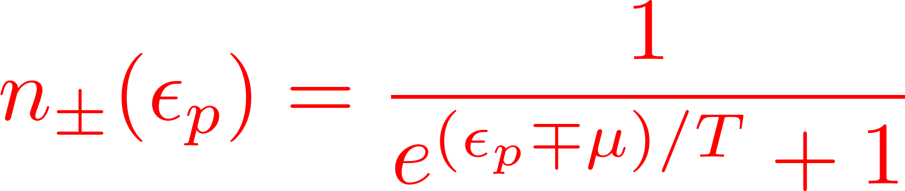
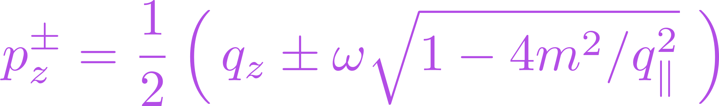


LLL, T, μ
Complete form in the LLL at finite T and μ
One can use either the imag.- or real-time formalism.
Explicit calculation verifies what we discussed in previous slides.
Finite temperature: [T = 2m, μ = 0]
Finite density: [T = 0, μ = 1.2*(2m)]
Suppression of
the pair creation
Suppression of
the pair creation
Shift of the thresholds
Landau damping
Landau damping

Slide 26
Temperature effects
→ Smearing the step singularities at zero temperature
T /μ = 0
T/μ = 0.03
T/μ = 0.1
The threshold goes back to 4m^2 a.s.a. T gets finite.
However, strong suppression near the threshold at low T.

Slide 27


Peak structures at finite temperature
Finite temperature: [T = 2m, μ = 0]
Consistent with the dispersion integral
from the analyticity
The weight has a peak at s = ω.
Peak positions in the real and imag. parts
are correlated with each other.

Slide 28
Peak structures at finite density
Finite density: [T = 0, μ = 1.2*(2m)]

Slide 29
Electric screening mass in the zero energy & mom. limits
E_{ind}
E
The Schwinger mass
(No medium corrections)
Massless fermions
(= vacuum limit due to chiral anomaly)
Heavy fermions

Slide 30


Finding tiny rats in the NS zoo (?)
How can we identify the signals of the quantum fluctuations?
Spectrum, polarizations,
Precession angle, beaming angle, etc.
θ
r
θ*r >> r_{Earth}
Questions from a beginner
パルスの発光過程は未解決と言われますが、実際のところ、ゴールはどこにあるのか？スペクトラムを越えた観測量はどのようなものがありますか？
パルスの発光には磁気圏の荷電粒子が中性子星と共回転している事が必要だと思いますが、磁気圏のプラズマは遅延せず、集団的(剛体的)に高速回転できるのでしょうか？→粘性ηは十分小さいか？一般にη∝σ (GJモデルではσ>>1)。
GJモデルでは、電磁気的な釣り合いしか考慮していない。
理想流体(MHD)からずれる場合、磁場も追従できませんが、捩じれる等の空間配位をとる事はあり得るのでしょうか？
歳差角とビーミング角の関係は？(米山氏、井上氏)
中性子星の個数の推定への影響は？(勝田氏)

Slide 31
Summary
Vacuum birefringence (polarization-dependent refractive indices)
γ→ ee for both on-shell and off-shell photons
Prospects
Novel microscopic processes such as the photon splitting
In progress.
Also, interested in MHD and chiral transports.
“Magnetohydrodynamics with chiral anomaly: phases of collective excitations and instabilities” 1711.08450 [hep-th]

Slide 32
Back-up slides

Slide 33


Strong magnetic fields induced by relativistic heavy-ion collisions
B
Z
Z
Z
Z
Static Coulomb field
Boost → Lienard-Wiechert potential
Free streaming
HIJING
Central coll.
Peripheral coll.
Deng & Huang; KH & Huang [1609.00747]

Slide 34




Resummation for external-field insertions
Resummed propagator
eB
eB
eB
eB
eB
eB
eB
eB
eB
eB
eB
eB
eB
=
＋
＋
＋ ・・・
＋ ・・・
Furry’s theorem: The odd-order diagrams cancel in C-even systems.
Fock (1937), Schwinger (1951)
＋
＝ ０
Charge flows
Resummed polarization tensor
=
＋
＋ ・・・
＋ ・・・

Slide 35
Fermion spectrum in a magnetic field
Remember the lesson: Photon spectrum depends on the fermion spectrum.
Landau quantization
Landau degeneracy
B_{z}
B_{z}
Classical motion
No effects on the longitudinal motion
Cyclotron motion ～ Harmonic oscillation
Spin polarization (Zeeman effect)
Energy spectrum
No energetically favored position.
→ Degeneracy
Fermion transverse momentum is NOT a good quantum number.
No transverse momentum conservation (due to momentum supply from external B-fields).

Slide 36




Fermion pair spectrum in the imaginary part
--- Thresholds at the Landau levels
Fermion transverse momentum is NOT a good quantum number.
No transverse momentum conservation (due to momentum supply from external B-fields).
Only one possible source of the imaginary part:
Polarization tensor acquires an imaginary part when
Threshold condition
Kinematics w/o magnetic fields
The integers are identified with the Landau levels.
Not compatible with each other without B.
E-m conservation
Massless on-shell condition
Photon transverse momentum works
like a “photon mass” in the (1+1)-d kinematics.

Slide 37
Summary of relevant scales and preceding calculations
Narrowly spaced Landau levels
Strong field limit (LLL approx.)
(Tsai&Eber; Shabad; Gusynin, Miransky, Shovkovy; Fukushima; KH&Itakrua, etc.)
Lowest Landau level →
No imaginary part→
Soft photon & weak field limit (Adler, etc.)
Numerical computation
below the LLL threshold (Kohri and Yamada)
Numerical computation
in the soft photon regime
Strong field limit (LLL approx.)
Soft photon & weak field limit

Slide 38






Vacuum polarization tensor in two different series representations
1. Naïve perturbative series when eB is small.
Naïve perturbation breaks down when eB is large!
=
＋
＋
＋ ・・・
＋
Weak-field approximation
Adler, etc.
No modification
2. Landau level representation
Lowest Landau approximation
(ℓ = n = 0) when eB is large.
=
KH&Itakrua [1209.2663, 1212.1897]
Cf. For the Landau level representation of the HE effective action,
see KH, Itakura, Ozaki [2001.06131].

Slide 39
Differential dilepton spectrum
--- Better accessibility than the photon polarization
KH, Hidetoshi Taya, Shinsuke Yoshida, “Di-lepton production from a single photon in strong magnetic fields: vacuum dichroism”, [2010.13492]

Slide 40



Pair production in a magnetic field
LO w/ B-fields
LO w/o B-fields
No kinematical window for
a single on-shell photon when B = 0.
→ Starts only from 2 photons
Nonperturbatively dressed fermions
Both on-shell and off-shell photons can decay in B.
E.g., Breit-Wheeler process

Slide 41




Ritus basis formalism
= Perturbation theory with the fermion wave functions in B-fields.
See a review part in [2010.13492]
Free Dirac eq. → Plane wave solutions
Dirac eq. in B-field → Localized wave functions
Mode expansion with the eigen-basis in B-fields
→ Ritus-basis Feynman rule
Fermion propagator (= Inverse of D) is given in a simple form.
Price: The vertex function is no longer a simple delta function.
Cf. Photon wave function is still a plane wave
→ Convolution of different bases at the vertices.

Slide 42



Pair production rate for general kinematics
Fermion pair in the Landau levels
One-shell/off-shell photon
Differential information includes
Photon polarization (ε^{μ})
Photon momentum (q^{μ}) with a general direction and invariant mass
Landau levels (n, n’) and continuous momentum (p_{z}, p_{z}’) along B
Consistency checks done: Ward identity, etc.
KH, Hidetoshi Taya, Shinsuke Yoshida, “Di-lepton production from a single photon in strong magnetic fields: vacuum dichroism”, [2010.13492]

Slide 43

















Muon-pair excess over electron pairs
KH, Taya, Yoshida [2010.13492]
“Helicity suppression” in pion decay
The LLL (= soft photon)
PDG
Opposite momentum
Opposite spin
along B-field
Opposite spin
Same helicity
Same helicity
Opposite chirality
→ Needs chirality mixing by finite mass.
Opposite chirality
Especially, R neutrino (L antineutrino) does not exist at the QCD scale.
(However, this is not an essential reason for the helicity suppression.)

Slide 44








Kinematics in the massless LLL
Linear dispersion relations in the lowest Landau levels
R handed
L handed (when eB>0)
Perturbative vertex does not mix the R and L.
Kinematics in the massless limit is satisfied only in the “collinear limit.”
⇒ No coupling to the transverse photons.

Slide 45




Resummed polarization tensor
Gauge symmetries lead to a tensor structure,
Integrands with strong oscillations
B
Exponentiated trig-functions generate
strongly oscillating behavior with
arbitrarily high frequency.
Proper time integrals on the two fermion lines
Schwinger, Adler, Shabad, Urrutia,
Tsai and Eber, Dittrich and Gies
Vanishing B limit:

Slide 46
Decomposing exponential factors
Contains arbitrarily higher harmonics
Linear w.r.t. τ in exp.
1st step: “Partial wave decomposition”
Linear w.r.t. τ in exp.
2nd step: Getting Laguerre polynomials
Associated Laguerre polynomial
Linear w.r.t. τ in exp.

Slide 47


All terms fall in one of three elementary integrals.
Integers specify the fermion spectrum encoded in the photon spectrum.
(Remember the lesson in introduction)
eB
eB
eB
Invariant mass:
Fermion-antifermion spectrum
Square of the decay amplitude
(Optical theorem)

Slide 48


Renormalization
=
+
+
+
・・・
Log divergence
Term-by-term subtraction
Finite
Ishikawa, Kimura, Shigaki, Tsuji (2013)
Re
Im
Taken from Ishikawa, et al. (2013)

