Slide 1
EIC Project and Experimental Program status Update
E.C. Aschenauer (BNL)
R. Ent (JLab)
Co-Associate Directors for the Experimental Program
EIC Meeting with Japanese Physics Society
May 12th, 2021

Slide 2
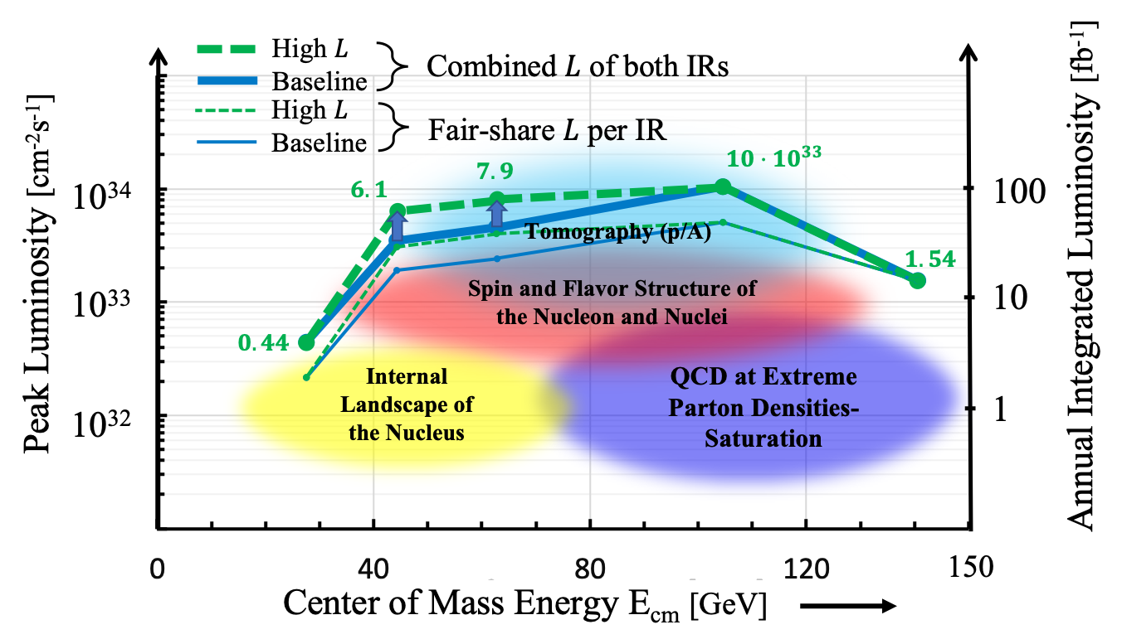

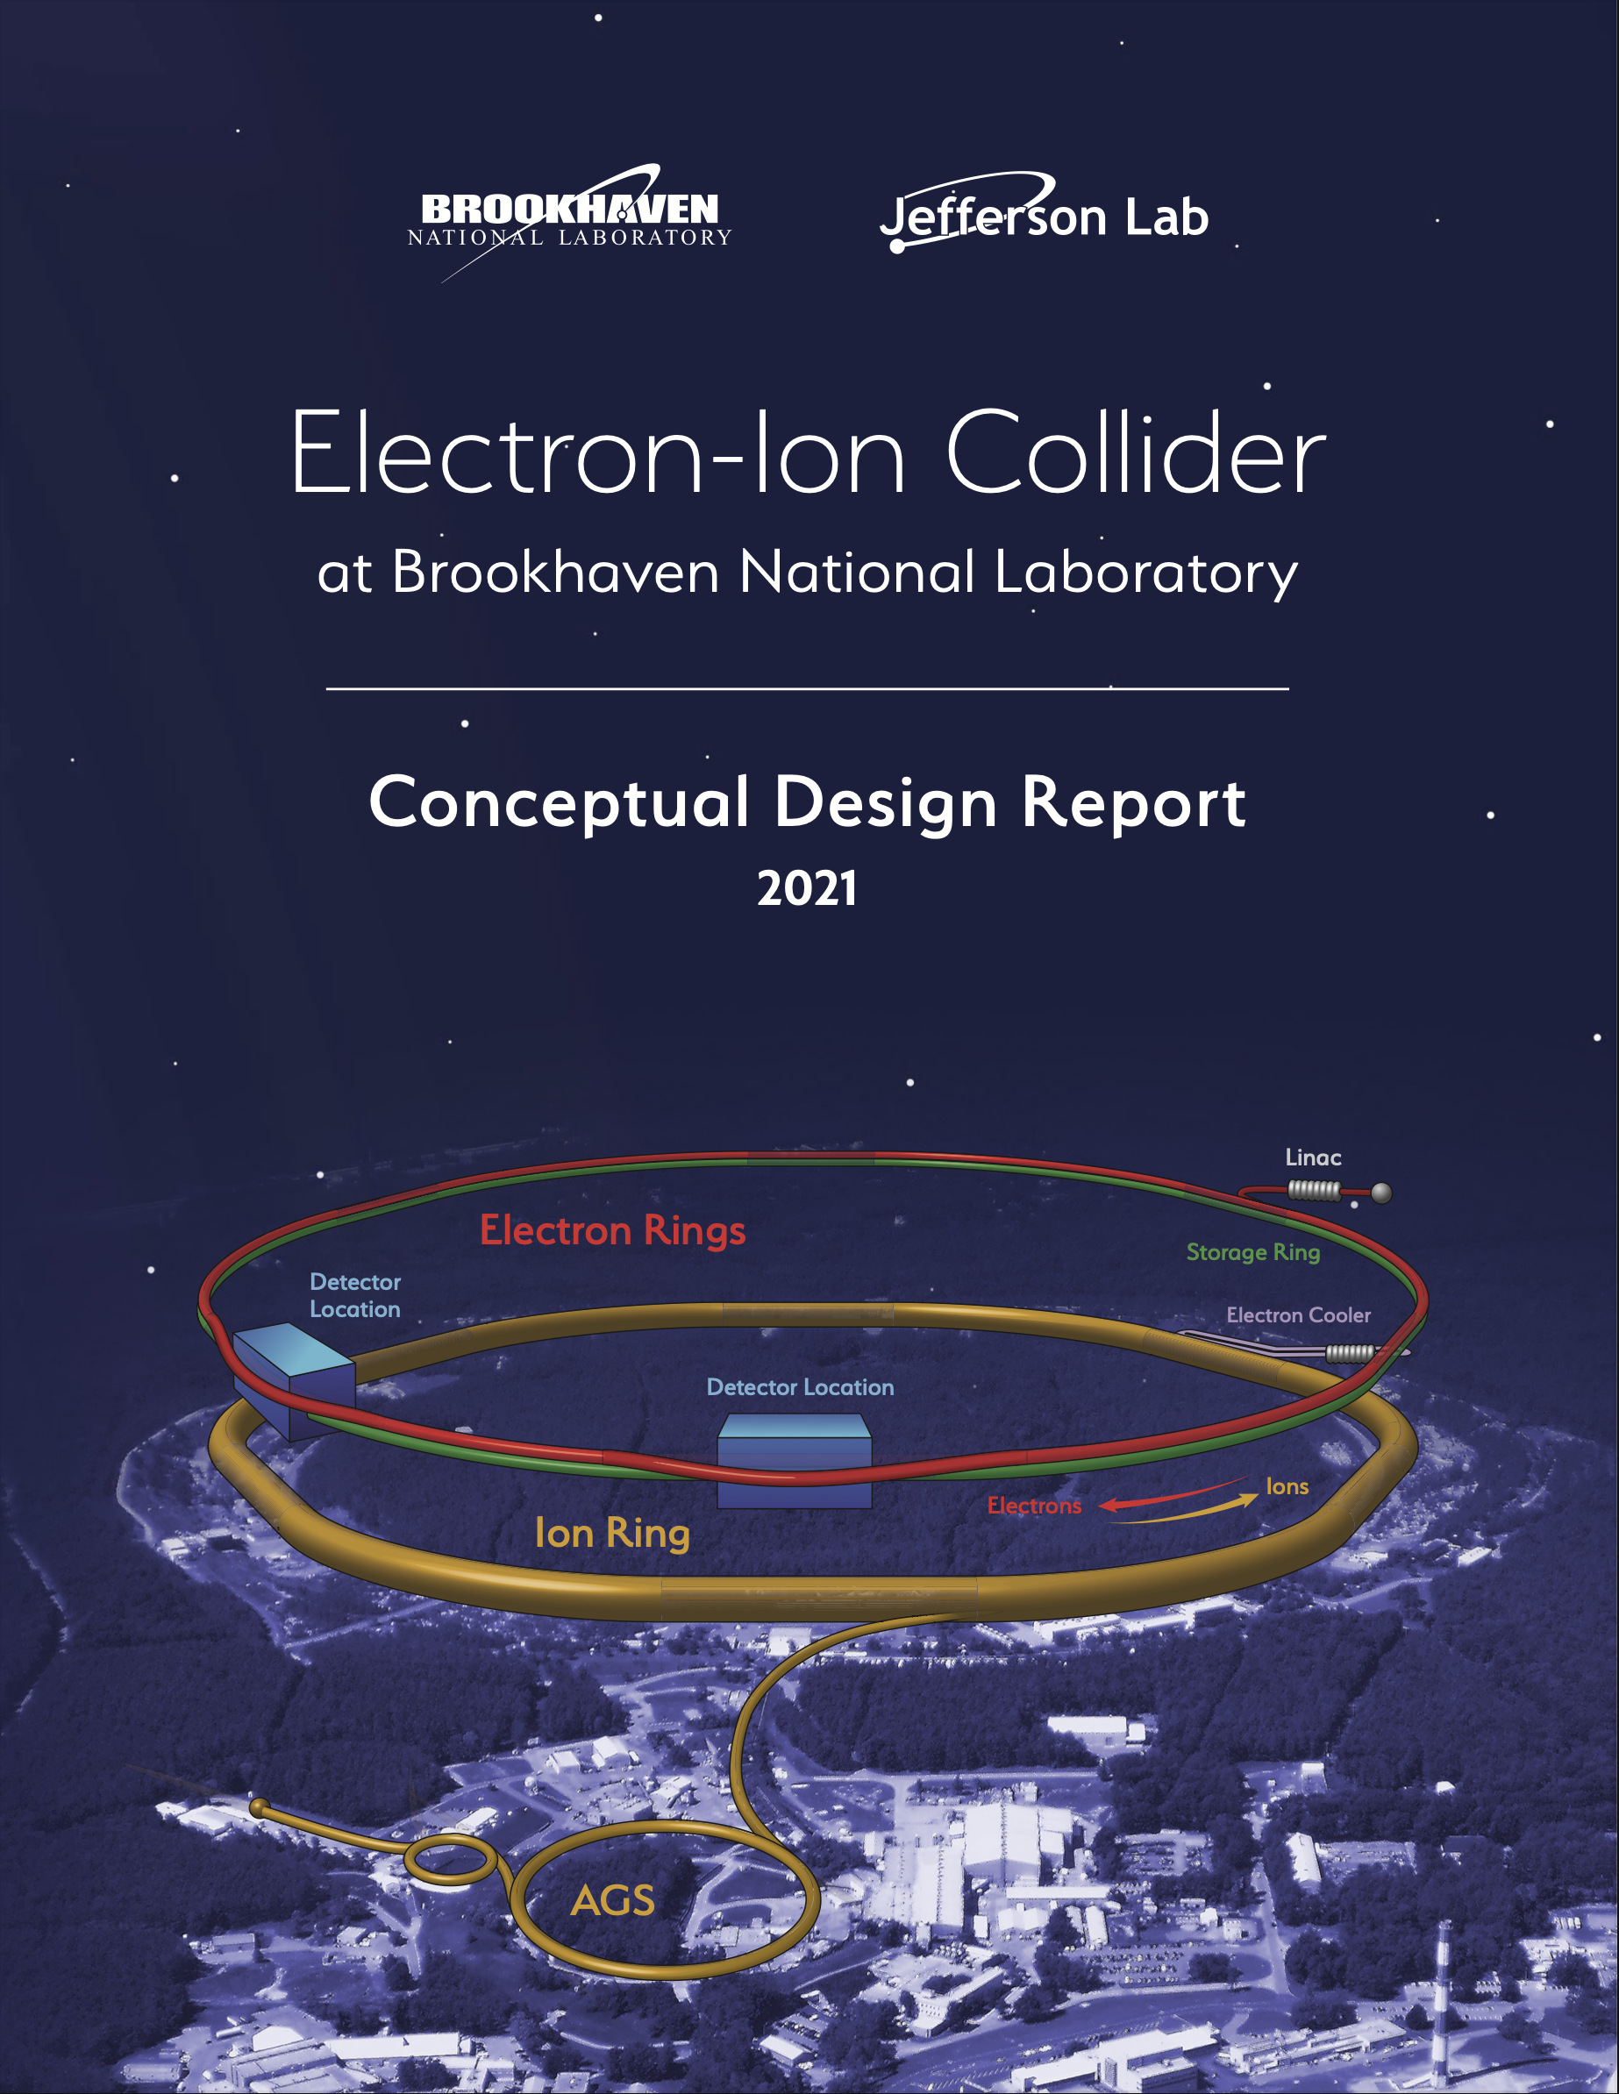
EIC Machine Parameters
CDR: https://www.bnl.gov/ec/files/EIC_CDR_Final.pdf
Double Ring Design Based on Existing RHIC Facilities
Hadron Storage Ring: 40 - 275 GeV | Electron Storage Ring: 5 - 18 GeV
RHIC Ring and Injector Complex: p to Pb | Many Bunches, Large Beam Current - 2.5 A
1160 bunces @ 1A Beam Current 9 ns bunch spacing | 9 MW Synchrotron Radiation
Light ion beams (p, d, ³He) polarized (L,T) | Polarized electron beams
Requires Strong Cooling: new concept → CEC | Electron Rapid Cycling Synchrotron
 | Spin Transparent Due to High Periodicity
High Luminosity Interaction Region(s)
25 mrad Crossing Angle with Crab Cavities

Slide 3
EIC Recent History
Event | Date
DOE Mission Need Statement Approved | January 22, 2019
DOE Independent Cost Review | July 2019
DOE Electron Ion Collider Site Assessment | October 2019
Critical Decision – 0 (CD-0) Approved | December 19, 2019
DOE Site Selection Announced | January 9, 2020
BNL TJNAF Partnership Agreement | May 7, 2020
DOE Office of Science Status Review | September 9-11, 2020
Independent EIC Conceptual Design Review | November 16-18, 2020
DOE Office of Science CD-1 Review | January 26-29, 2021
DOE Independent Cost Review | January - February 2021
CD-1 Approval Target Date | June 2021

Slide 4
Project Organization
BNL/TJNAF Partnership
  BNL and TJNAF partnering agreement signed in May 2020.
  Executive Management Team established that integrates BNL and TJNAF into project leadership roles.
  EIC Council, chaired by BNL Director, established in June 2020. TJNAF Director is a founding member. Major international partners will also join the Council.
Established standing advisory committees with international membership
  Machine Advisory Committee: 08/26/20, TBD Fall
  Project Advisory Committee: 08/27/20, 12/01/20, 04/29-30/21
  Detector Advisory Committee: 09/28-29/20, 12/18/20, 03/24-26/21

Slide 5
CD-1 Reviews
CD-1 Preparation Reviews
  Independent Design Review – November 2020 ✔️
  Director’s Review – December 2020 ✔️
DOE CD-1 Reviews
  DOE Office of Science, Office of Project Assessment
  CD-1 Readiness Review – January 26-29, 2021 ✔️
  DOE Office of Project Management Independent Cost
  Review – Jan/Feb 2021 ✔️
DOE reviews recommend proceeding with CD-1!

Slide 6
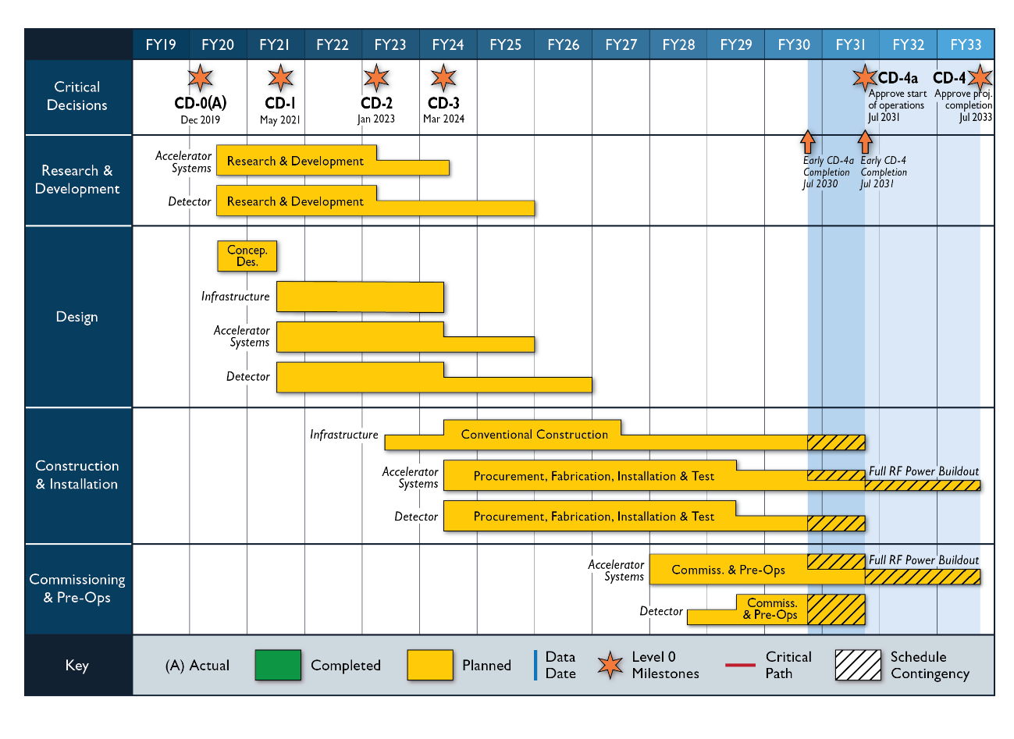

Slide 7
Key Milestones Proposed
DOE Critical Decision (CD) | CD-1 Review (2020) | Change (Months) | Proposed (03/21)
CD-1, Alternative Analysis | April 2021 | +1 | May 2021
CD-2, Performance Baseline | October 2022 | +3 | January 2023
CD-3, Construction Start | July 2023 | +8 | March 2024
 |  | Construction Start to Early Ops = 6 ¼ Years | Construction Start to Early Start of Ops = 6 ¼ Years
Early Start of Operations (CD-4a) | July 2029 | +12 | July 2030
Late Start of Operations (CD-4a) | January 2031 | +6 | July 2031
CD-4 Early Project Completion | July 2031 | = | July 2031
 |  | Schedule Contingency = 2 Years | 2 Years Schedule Float
CD-4 Late Project Completion | January 2033 | +6 | July 2033
Revised funding profile including actual FY2021 ($30M vs $43M planned)
DOE Total Project Cost now includes a 40% contingency budget
Additional year of schedule contingency on project completion – 2 yrs total

Slide 8
Post CD-1 Timeline
Accelerator Technical Reviews | Spring/Summer 2021
Call for Detector Proposals | March 2021
Start Preliminary Design | April 2021
Detector Proposals Submitted | December 2021
Selection of Project Detector | March 2022
Start Earned Value Tracking | Summer 2022
Clarify In-kind Deliverables - Agreements | Summer/Fall 2022
Goal for CD-2 Approval | January 2023
Goal for CD-3 Approval | March 2024

Slide 9
Challenges and Opportunities
Affordability – EIC is very large project for DOE Office of Nuclear Physics (NP) and Office of Science (SC)
  Requires reprioritization of RHIC operations funding to EIC and new funding
  Significant ramp up of project funding is required to maintain timeline for DOE Critical Decisions
  Most cost-effective project follows closely to a technically driven schedule
Partner Engagement – Expectations and Implementation
  International engagement is highly desirable and widely expected
  In-kind contributions to the accelerator and detector are being pursued
  Partners must engage now given the EIC technically driven schedule

Slide 10
Experimental Program Preparation
Call for Collaboration Proposals for Detectors launched after extensively soliciting input from DOE and EIC User community
Jointly developed between EIC Project, JLab and BNL
Appeared in the same week as the community Yellow Report (https://arxiv.org/abs/2103.05419 )!
BNL and TJNAF Jointly Leading Process to Select Project Detector | BNL and TJNAF Jointly Leading Process to Select Project Detector
2020 | Call for Expressions of Interest (EOI) https://www.bnl.gov/eic/EOI.php | May 2020
 | EOI Responses Submitted | November 2020
 | Assessment of EOI Responses | Finalized
2021 | Call for Collaboration Proposals for Detectors https://www.bnl.gov/eic/CFC.php | March 2021
 | BNL/TJNAF Proposal Evaluation Committee | Spring 2021
 | Collaboration Proposals for Detectors Submitted | December 2021
✔️ | Decision on Project Detector | March 2022

Slide 11
Call for Collaboration Proposals for Detectors
Call for proposals for
  Detector 1 is within the scope of the EIC project and should be based on the “reference” detector and must address the EIC White Paper and NAS Report science case.
  Detector 2 should address major parts of the science described in the EIC White Paper and possibly science beyond that and enable some complementarity to Detector 1.
Evaluation Criteria:
  science capabilities
  risk, cost, and schedule of the proposed experiment, specifically for detector technology, design choices
  strength of the collaboration
Who Evaluates:
  scientific-technical committee of renowned and independent subject matter experts in collaboration with members of the Detector Advisory Committee
  Further from the Call: “The EIC Detector Advisory Committee will be asked to provide input on detector technology, design choices, and collaboration strength”

Slide 12
Other Considerations
It is understood that the process of collaboration formation is even more complex during a pandemic preventing face-to-face meetings and community building.
Thus, we use methods to remove uncertainties as much as possible and facilitate the process, e.g.,
First round of FAQ (similar as what was done for the Expressions of Interest)
  Collect further FAQ from user questions to eic-call-det-proposal-l@lists.bnl.gov
In coordination with the EIC User Group (EICUG), schedule some workshops and organizational meetings to facilitate discussions and collaborations, and provide additional information.
  Week-long Summer workshop/UGM co-hosted by VUU & UCR
  Monthly “forums” with EICUG SC and proposal contacts, may lead to new FAQ.
  Share EIC Detector Proposal Advisory Panel charge and review process beyond December 1 submission date in May at remote quarterly EICUG Meeting.
Provide some assistance to the proto-collaborations with cost template, basis-of-estimate information, simulations, layouts, schedules, etc.
Guiding Principles:
achieving a transparent and fair process
Everybody has a place in the EIC experimental program

Slide 13

General Purpose Detector @ EIC
The EIC facility is capable supporting a science program that includes two detectors and two interaction regions
The DOE-NP supported EIC Project includes one detector and one Interaction Region
Two possible locations – IP6 and IP8 – for detectors and Interaction Regions.
IP6 is the planned detector location for the project detector
Backward
Hadron Storage Ring
Electron Storage Ring
Electron Injector Synchrotron
Possible on-energy Hadron
injector ring
Hadron injector complex
p/A beam
electron beam
Forward
13

Slide 14
EICUG: Yellow Report (YR) Initiative
The EIC Users Group: EICUG.ORG
Report: https://arxiv.org/abs/2103.05419
Detector requirements and design driven by EIC Physics program and defined by EIC Community
Physics Topics ➝ Processes ➝ Detector Requirements
Physics Working Group:
  Inclusive Reactions
  Semi-Inclusive Reactions
  Jets, Heavy Quarks
  Exclusive Reactions
  Diffractive Reactions & Tagging
Detector Working Group:
  Tracking + Vertexing
  Particle ID
  Calorimetry
  DAQ/Electronics
  Polarimetry/Ancillary Detectors
  Central Detector: Integration & Magnet
  Far- Forward Detector & IR Integration
  Provides critical input for detector proposals – handoff between Physics & Detector Working Groups in “interactive detector matrix”: Collects physics requirements “real time”, lists all technologies for a given region, and links to studies that established the numbers

Slide 15
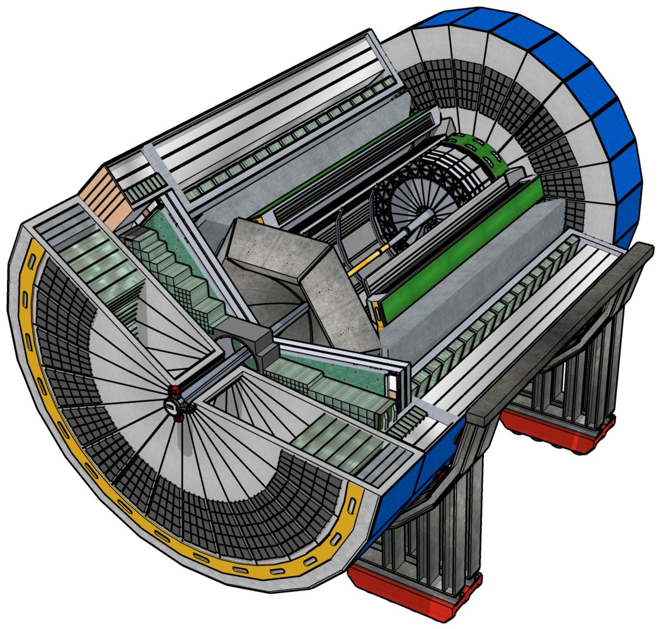
EIC Experimental Equipment
Any general purpose EIC Detector is complex
Overall detector requirements:
Large rapidity (-4 < η < 4) coverage; and far beyond in especially far-forward detector regions
High precision low mass tracking
  small (μ-vertex) and large radius (gaseous-based) tracking
Electromagnetic and Hadronic Calorimetry
  equal coverage of tracking and EM-calorimetry
High performance PID to separate π, K, p on
track level
  also need good e/h separation for scattered electron
Large acceptance for diffraction, tagging, neutrons from nuclear breakup: critical for physics program
  Many ancillary detector integrated in the beam line: low-Q² tagger, Roman Pots, Zero-Degree Calorimeter, ….
High control of systematics
  luminosity monitor, electron & hadron Polarimetry
Integration into the Interaction Region is critical

Slide 16
2nd IR Progress and Status
Position paper for 2nd IR to define commitment of layout and compatibility verification, and trigger point for further work. Scope agreed upon.
Basic concept of a 2nd IR option fulfilling many RHIC boundary conditions (crossing angle can not be too large, < 50 mr, and not too small, > 25 mr) was presented by Vasiliy Morozov at 2nd IR meeting.
    In this lattice more space was required for positioning crab cavities, etc.
Have now integrated this 2nd IR design into the overall EIC layout, with as goal to minimize need for new magnets far away from the IP (J. Scott Berg) - reuse as much as possible of RHIC → this also constrains crab cavities to “existing” locations.
Laid out two configurations
    35 mrad, beam lines converging on forward hadron side
    25 mrad, beam lines diverging on forward hadron side (i.e., extra beam kink)
Ongoing work:
    Fold in secondary focus – think this is doable within available lattice space.
    First acceptance tests showed a “cut”, and that some optimization of magnets and optics was required to obtain good acceptance. First order work has been done and we are rechecking acceptance.
We plan to pass things on to EICUG this month (May) for further discussion and physics simulations - we first need to ensure we have a quasi-stable optics layout and get the right acceptance.

Slide 17
Strategy for Detector 1 and 2nd IR/Detector 2
EIC with two interaction regions and detectors
  Ensures a robust EIC physics program and enhances the science reach.
The DOE-NP supported EIC Project includes one detector and one IR
  The included detector is ~70% scope as carried by the US-DOE EIC Project and ~30% international or in-kind scope.
  The call for Expression of Interest was a crucial step to get guidance on the EIC detector scope.
IR2 and detector concepts needed now
  Informs strategies for achieving IR2 and detector
  Influences project decisions on IR1 and detector
  EIC project schedule is an important planning constraint
  We do have a little more time for a 2nd EIC detector and IR – to be ready by CD-4
Major effort needed to secure resources (~$500M)
  Second detector may be opposite in scope, ~70% international or in-kind and ~30% possibly a DOE Major Item of Equipment (MIE) project
  Significant international engagement is needed for 2nd detector and 2nd IR
  Many bi-lateral meetings with potential partners underway to discuss opportunities in accelerator and experimental areas

Slide 18
EICUG Activities towards Collaboration Formation
EIC user community efforts on detector collaboration formation have started:
The ECCE consortium had its first organizational meeting February 12th. ECCE is investigating a detector based on an existing 1.5T solenoid in both EIC interaction regions, ready for the beginning of EIC accelerator operation: https://www.ecce-eic.org
EIC@IP6 (naming competition ongoing) had its organizational meeting March 12-13. EIC@IP6 is investigating a new EIC experiment at IP6 based on a 3 T magnet and the Yellow Report Reference Detector: https://sites.temple.edu/eicatip6/
CORE had a "Kick-Off" Workshop on March 29-30 for an open collaboration for an EIC Detector proposal based on a new 2-4 T compact magnet at IP8: https://userweb.jlab.org/~hyde/EIC-CORE/
There is in addition a 2nd IR EIC Workshop series with a focus on Detector and IR complementarity (https://indico.bnl.gov/event/10677/timetable/) – First workshop had 400+ attendants, 2nd and 3rd workshop planned. They plan to submit a (draft) White Paper to the Proposal Detector Advisory Panel.

Slide 20
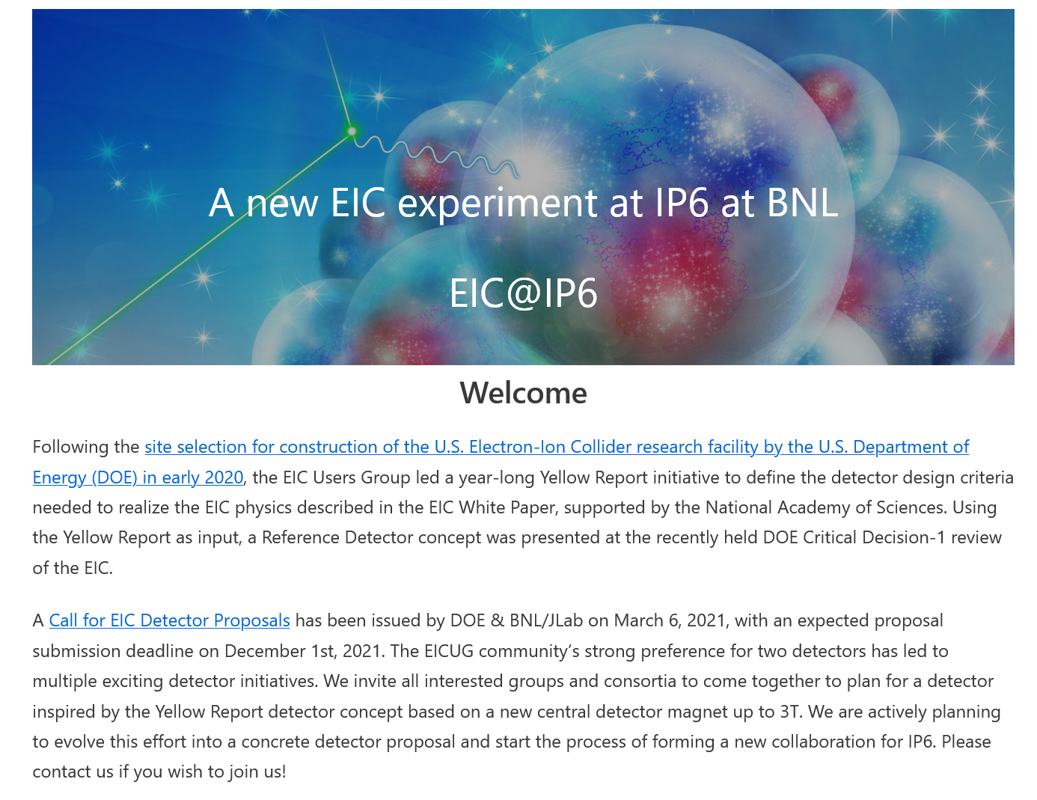

Slide 21
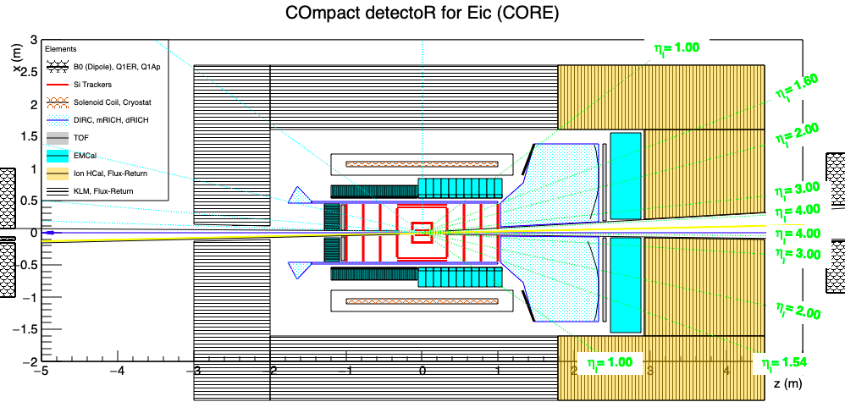
Compact detector for the Eic (CORE)
Details of CORE at https://indico.bnl.gov/event/11053/

Slide 22
Proto-Collaborations at a Snapshot
ECCE
  Contacts: Or Hen (MIT), Tanja Horn (CUA), John Lajoie (Iowa State)
  ~70 collaborating institutions
  Includes institutions from Armenia, Chile, China, Czech, France/IN2P3, Germany, Israel, Japan, Korea, Russia, Taiwan, UK
EIC@IP6
  Coordinating Committee: Abhay Deshpande (BNL/SBU), Silvia Dalla Torre (INFN Trieste), Olga Evdokimov (UIC), Yulia Furletova (JLab), Barbara Jacak (LBL/UCB), Alexander Kiselev (BNL), Franck Sabatie (Saclay), Bernd Surrow (Temple)
  ~96 collaborating institutions
  Includes institutions from Canada, China, Czech, France, Italy, India, Poland, Rumania, UK
CORE
  Contacts: Charles Hyde (ODU) and Pawel Nadel-Turonski (SBU)
  Smaller-scale effort, at present 20 active collaborators

Slide 23
Conclusion
The EIC User Community is strongly engaged in all parts of the EIC experimental program, e.g., the EIC-related detector R&D program, the Yellow Report initiative to define requirements.
The call for Expression of Interest was a crucial step to get guidance on the EIC detector scope.
The Yellow Report was finalized: https://arxiv.org/abs/2103.05419
Next phase: Collaboration Proposals for Detectors: https://www.bnl.gov/eic/CFC.php
  Critical to have excellent detector proposals with science and technology complementarity integrated
Strong community and international engagement efforts – goal is to have DOE ONP, EIC project and EIC User Group to go hand in hand.
  Semi-annual DOE NP International Funding Agencies Meetings (most recent one on March 12, 2021, where we discussed project status, international engagement of accelerator and detector, governance model and user activities)

Slide 24


Slide 25
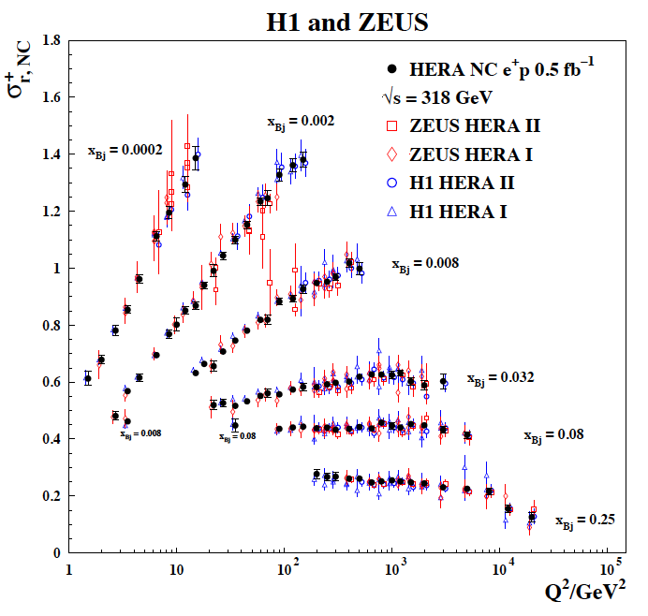
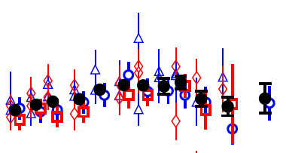
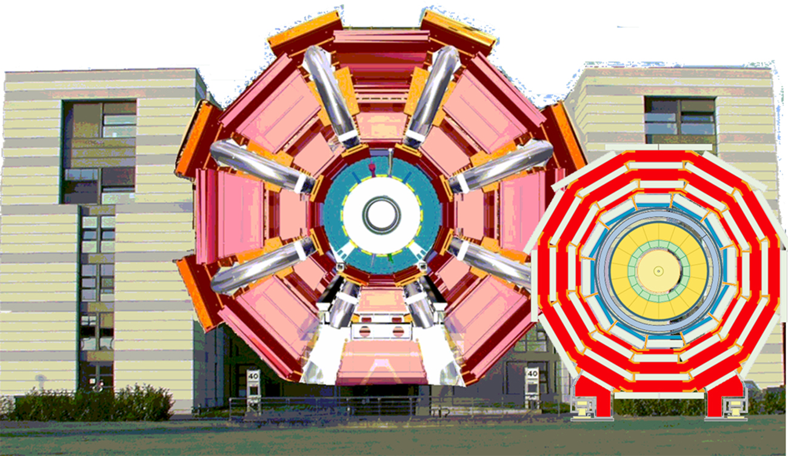
2nd Detector: Complementary is Key
What do we want from “Complementary”
Cross-checking important results (obvious!)
  Many examples of wrong turns in history of nuclear and particle physics.
  Independent cross checks (detector, community, analysis tools) are essential for timely verifications and corrections
Cross Calibration
  Combining data gave well beyond the √2 statistical
  improvement …
  Different dominating H1, ZEUS systematics…
  Effectively use H1 electrons with ZEUS hadrons
  … not all optimal solutions have to be in one detector…
Technology Redundancy
... by applying different detector technologies and philosophies
to similar physics aims
  mitigates technology risk vs. unforeseen backgrounds
  differently optimises precision and systematics
Different primary physics focuses
... EIC has unusually broad physics program
(from exclusive single particle production to high multiplicity
eA or gA with complex nuclear fragmentation)
→ Impossible to optimize for the full program in a single detector.
ATLAS
CMS

Slide 26
Complementarity for 1st-IR & 2nd-IR
Since CD-1 we made significant progress in the preliminary design for the 2nd IR with a focus on complementarity
1st IR (IP-6)
2nd IR (IP-8)
Geometry:
ring inside to outside
ring outside to inside
tunnel and assembly hall
are larger
Tunnel: ⦰ 7m +/- 140m
tunnel and assembly hall are smaller
Tunnel: ⦰ 6.3m to 60m then 5.3m
Crossing Angle:
25 mrad
35 mrad
secondary focus
different blind spots
different forward detectors and acceptances
different acceptance of central detector
Luminosity:
more luminosity at lower E_{CM}
optimize Doublet focusing FDD vs. FDF
→ impact of far forward p_{T} acceptance
Experiment:
1.5 Tesla or 3 Tesla
different subdetector technologies

Slide 27
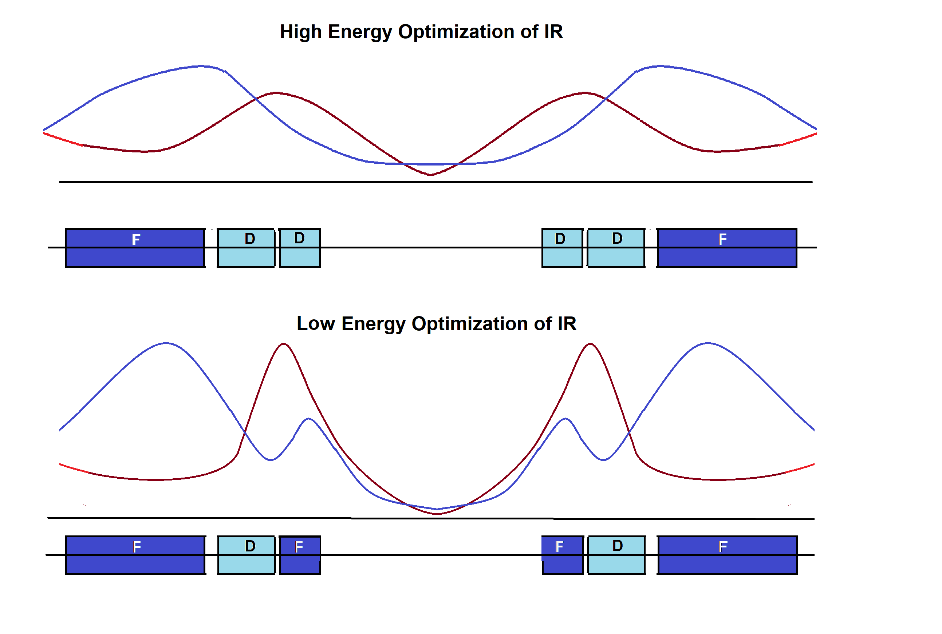
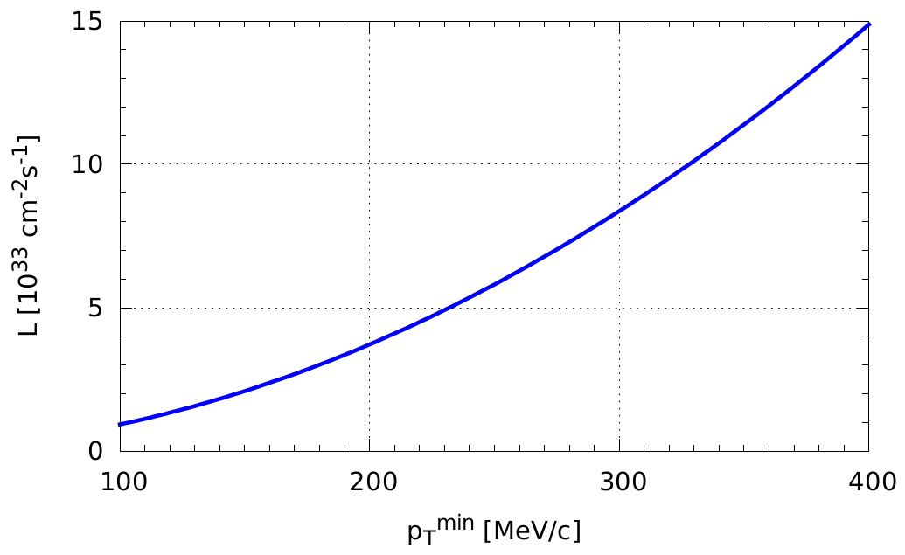

How to get more luminosity at lower E_{cm}?
F. Willeke, V. Morozov
schematics
Doublet focusing
Triplet focusing
But nothing is for free, there is a direct impact on the low p_{T} acceptance, e.g., for 100 GeV protons: p_{T}^{min} = 0.2 → 0.3 GeV
For hadrons, final focus lens is split into two.
Doublet focusing for E_{cm} ~100-140 GeV.
For low hadron beam energy (E_{cm} ~ 60 GeV) can rewire into triplet focusing, reduce β* ➔ Increase L by factor of ~2.
Applicable at both IP6 and IP8
Luminosity E_{cm} ~ 40 – 60 GeV could be increased by factor of almost 2 (work in progress!)
High-divergence
Highest $L$
High-acceptance

