Slide 1
Overview of SAMURAI Project
Yohei SHIMIZU
RIKEN, Nishina center
Notes:
I’d like to talk about “Overview of SAMURAI Project”.

Slide 2
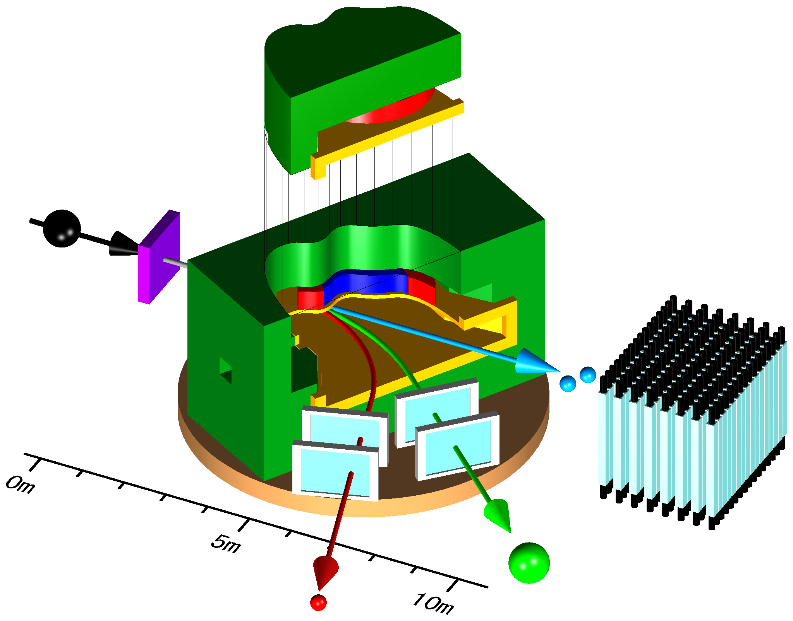
SAMURAI
Superconducting Analyzer for MUlti-particle from RAdio Isotope Beam with 7Tm of bending power
Kinematically complete measurements by detecting multiple particles in coincidence
RI beam
from BigRIPS
pole(2m dia.)
superconducting
coil
Superconducting Magnet
Heavy Ion Detectors
Proton Detectors
Neutron Detectors
Large Vacuum Chamber
Rotational Stage
vacuum chamber
target
Neutron
rotate
Invariant Mass Measurement
Missing Mass Measurement
Proton
Heavy Ion
Notes:
SAMURAI stands for Superconducting Analyzer for Multi-particle from Radio Isotope Beam with 7 Tesla meter of bending power. SAMURAI is designed for kinematically complete measurements by detecting multiple particles in coincidence. SAMURAI spectrometer consists of a superconducting dipole magnet, heavy ion detectors, proton detectors, and neutron detectors with large vacuum chamber on rotating basement. And SAMURAI will be provided to invariant mass measurement as well as missing mass measurement.

Slide 3
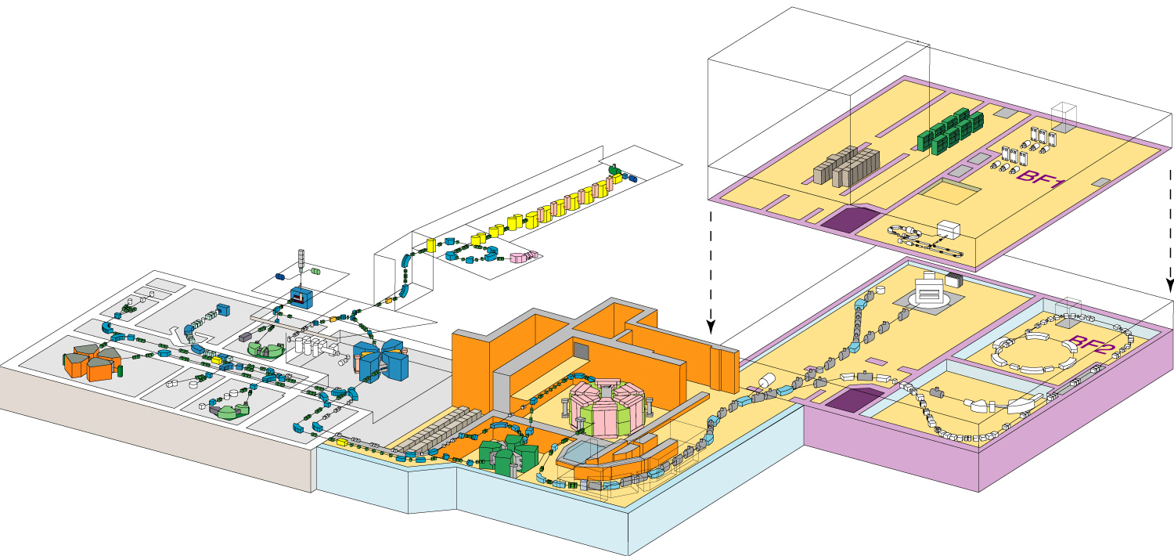
SAMURAI at RIBF
Schematic layout of RIBF
RILAC
SCRIT
AVF
RIPS
ZeroDegree
SAMURAI
GARIS
SLOWRI
SRC
fRC
RRC
RI-ring
SHARAQ
IRC
BigRIPS
SAMURAI will be located on straight beamline downstream of BigRIPS, provided for experiments using secondary / primary beams upto ~ 350 A MeV.
Notes:
This figure shows the overview of the RIBF. We can find several basic instruments. Among them, we can find SAMURAI in the downstream end of straight beam line from BigRIPS. We can use SAMURAI with secondary beam as well as primary beam which pass through the BigRIPS.

Slide 4
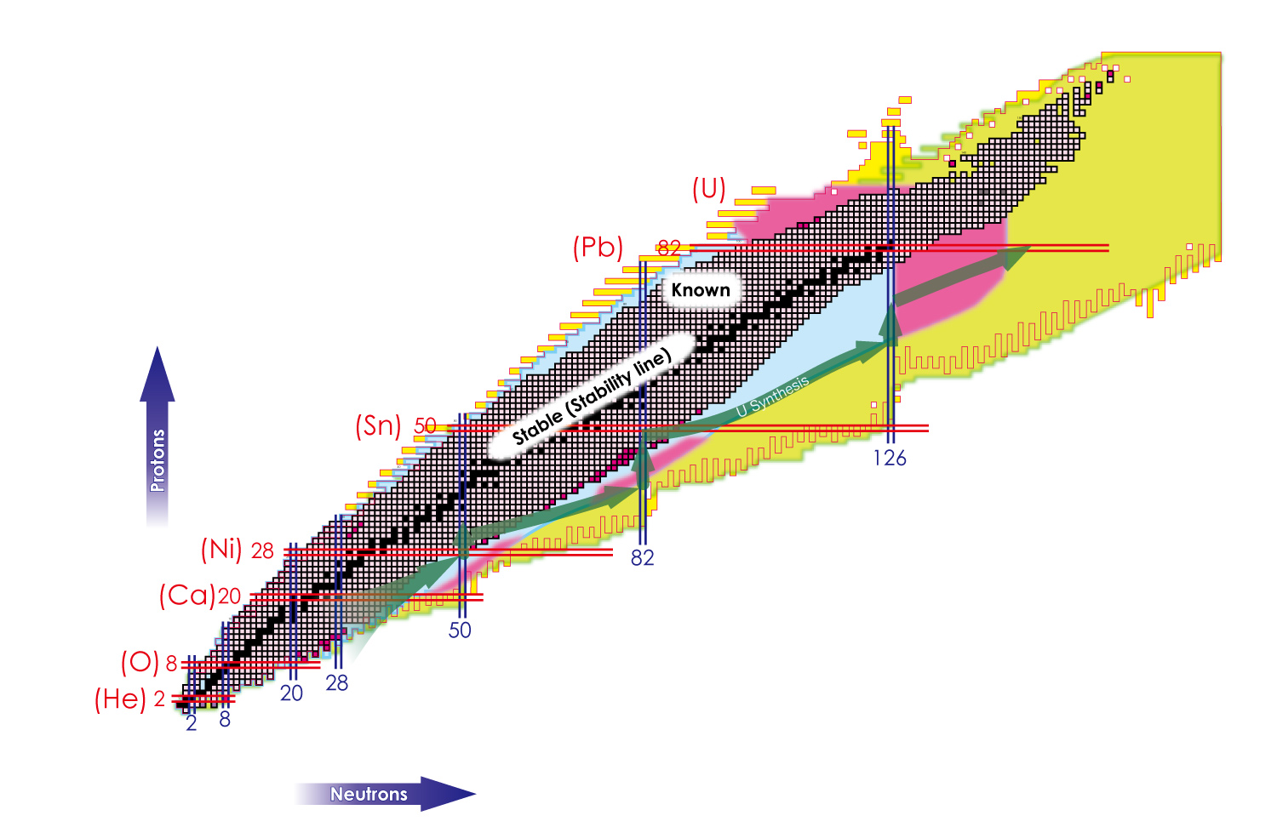
Physics Subjects
Asymmetric Nuclear Matter
Pigmy and giant resonances
Nucleon skin
Nuclear Equation of State
Nuclear Astrophysics
rp-process
Nuclear Astrophysics
r-process
3NF
Drip-Line Physics
Giant Halos 2n, 4n-correlation
New Cluster/Molecular States
Notes:
There expect various interesting physics in exotic properties of neutron drip-line nuclei, such as neutron halo, neutron correlations, unbound states beyond the drip line, and new cluster/molecular states. On the proton-rich side, astrophysical processes involved in explosive the rp process are governed by the properties of proton-rich nuclei in the region just above the proton threshold.
These phenomena should be well suited for measurements with SAMURAI.

Slide 5
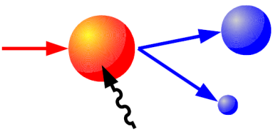
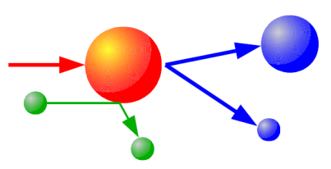
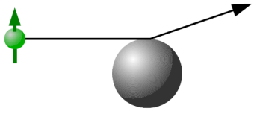
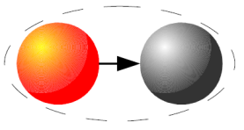
Physics Subjects
Electromagnetic Dissociation (γ, n), (γ, p) | Single-particle orbit Collective motion Nucleosynthesis | Invariant-mass measurement
2) p, d, a induced Reaction in inverse kinematics (p, p), (p, p’), (p, n), (p, 2p), (p, np), … | Density distribution Single-particle orbit Giant resonance | Missing-mass measurement
Polarized d induced Reaction (d, d), (d, p), (d, g) | 3NF, Short range correlation | Spin observables A_{ij}, C_{ij}, K_{ij}^{y}
Multi Fragmentation π⁺, π⁻ yield ratio | Density dependence of the asymmetry term of Equation Of State | 4π measurement
virtual photon (target)
p, d, α target
polarized d beam
N>>Z N<<Z
Notes:
Physics subjects can be categorized as this table. First is the electromagnetic dissociation as (γ, n) or (γ, p) reactions for investigation of single particle orbit, collective motion, and nucleosynthesis. Second is the proton or light ion induced reaction in inverse kinematics for investigation of density distribution, single particle orbit, and giant resonance. Third is the polarized deuteron induced reaction for investigation of three nucleon forces. Last is multi fragmentation for investigation of EOS in large isospin nuclei.

Slide 6
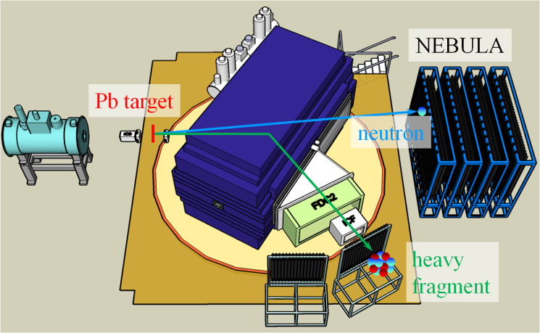
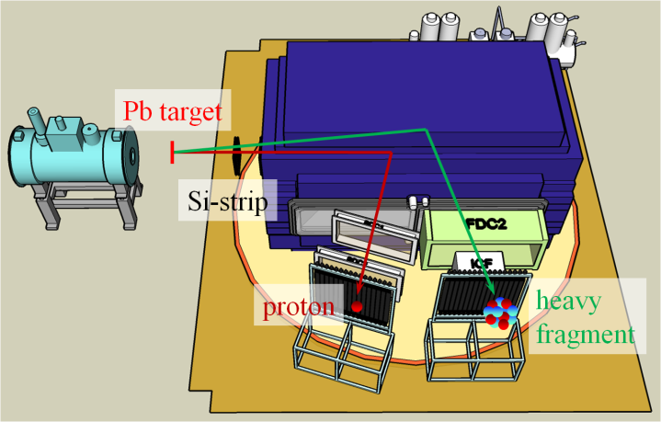
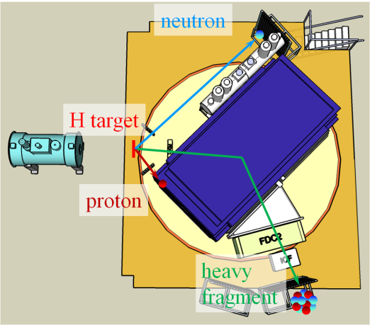
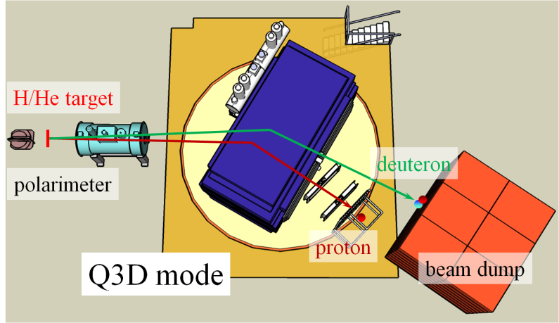
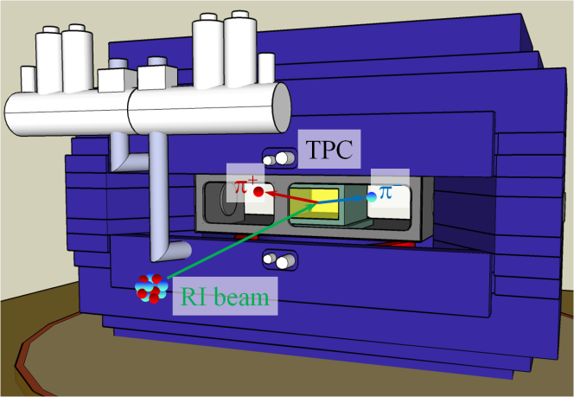
Various Configuration
SAMURAI allows versatile usage
(γ, n) reaction: neutron-rich side
(γ, p) reaction: proton-rich side
(p,p’), (p,2p), (p,pn), …
pol. d-induced reaction
EOS measurement
Flexibility of settings is one of the good properties of SAMURAI.
Notes:
In order to realize these multi purposes, we design SAMURAI very flexible way like these figures. By using the rotating basement, SAMURAI spectrometer can be rotated from 0 degree to 90 degrees. For general usage, SAMURAI spectrometer will be rotated around 30 degrees like this figure. With an effective combination of several detectors, SAMURAI system allows us to perform various experiments. So, flexibility of settings is one of the good properties of SAMURAI.

Slide 7
Requirements of SAMURAI
Target
Neutron
RI Beam
H, α
γ (Rb/U)
Magnetic Field
 | [range] | [accuracy]
angle: | ±10° | ~several mrad
velocity: | 0.62 | σ_{β}/β ~ 0.5
 | ±15%
efficiency: | > 70% (1n)
 | + multiple neutron
PID
Energy
position/direction
time-zero
Light particle
γ-ray
p, d, α, …
250 MeV/A A/Z = 3
Heavy Proj. Fragment
R_{min}/R_{max} ~2-3
Proton
 | [range] | [accuracy]
momentum: | R < 2.2 GeV/c | σ_{R}/R < 1/700
 | ±few% | σ_{p}/p < 1/1000 (d)
angle: | < few° | < few mrad
charge: | < 50 | σ_{z} ~ 0.2
velocity: | 0.62 | σ_{β}/β ~ 10⁻³
 | [range] | [accuracy]
momentum: | 0.7 GeV/c | σ_{p}/p < 1/100
 | ±15%
angle: | ± 5° | ~ few mrad
Mass identification
5 sigma mass separation
Notes:
This figure shows the summary of required measurements. If 5 sigma mass separation is required for A = 100, these accuracies are required for heavy ion measurements.
SAMURAI spectrometer and detectors are designed and developed in order to satisfy these requirements.

Slide 8
Superconducting Dipole Magnet
Requirements
  Large field integral → for high precision momentum analysis
  Large pole gap → for large vertical acceptance for neutrons
  No coil link → for large acceptance in the horizontal direction
  Small fringing field → for detectors around the target region and tracking detectors
  Flexibility → for various experimental conditions
  Large momentum acceptance → for heavy fragments and protons in coincidence
  High momentum resolution → for deuteron-induced reactions
Design
  Field Integral 7 Tm (dR/R ~ 1/700 @ 2.3 GeV/c for A/Z=3)
  → mass separation σ_{A}=0.2 for A=100
  Large Gap (0.8 m → vertical ±5 degrees)
  Large opening (3.4 m → holizontal ±10 degrees)
  Small Fringing Field (< 50 gauss @ 50cm from magnet)
  H-type magnet with cylinder poles (2m in diameter)
  Magnetic field … about 3T at center by ~1.9MAT
  Field clamp
  Build-in vacuum chamber
  Rotatable base (from -5 to 95 deg, 0.1deg/sec)
Notes:
Superconducting dipole magnet is required to have a large field integral for high precision momentum analysis, a large pole gap for large vertical acceptance for neutrons, no coil link for large acceptance in the horizontal direction, small fringing field for detectors around the target region and tracking detectors, flexibility for various experimental conditions, a large momentum acceptance for heavy fragments and protons in coincidence and high momentum resolution for deuteron-induced reactions.
To satisfy these requirements, superconducting dipole magnet is designed to have a field integral of 7 tesla meter, large gap space of horizontally over 3 meter and vertically 0.8 meter, small fringing field of less than 50 gauss at 50 cm from magnet, H-type magnet with cylinder poles, magnet field of 3 tesla at center, field clamp, build-in vacuum chamber, and rotatable base.

Slide 9
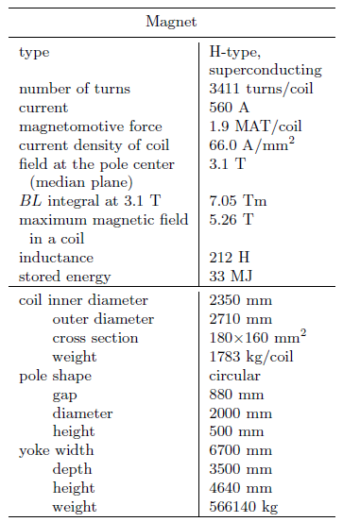
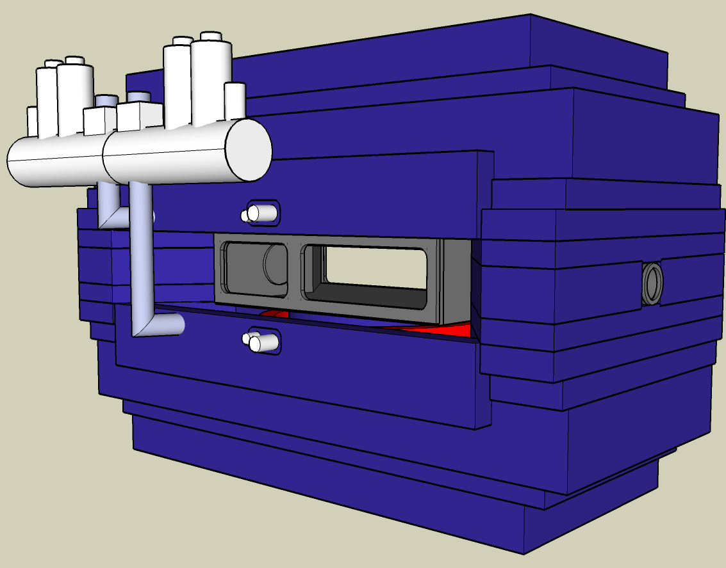
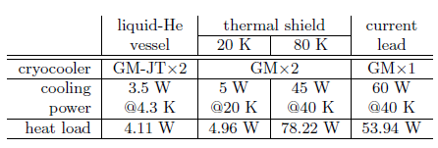
Superconducting Dipole Magnet
4K cryocoolers
LHe vessel
4640 mm
cryocooler for power lead
6700 mm
3500 mm
cryocoolers for thermal shields
vacuum chamber
List of the cryocoolers for one cryostat.
Notes:
These table show the specifications of magnet and cryocoolers. And this figure shows the overview of the superconducting dipole magnet.

Slide 10
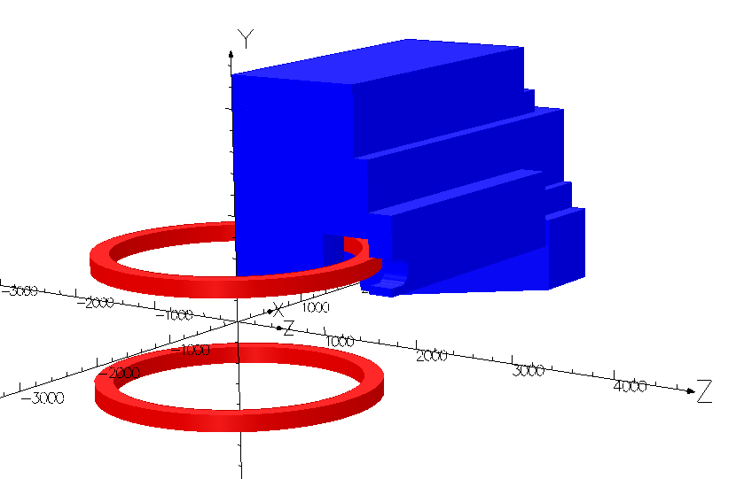
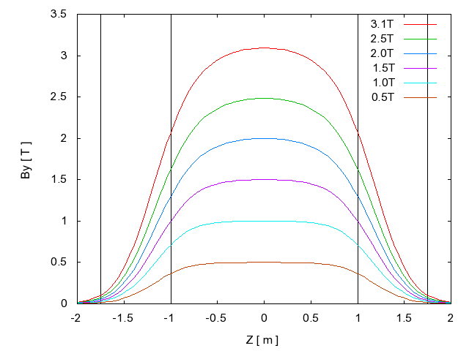
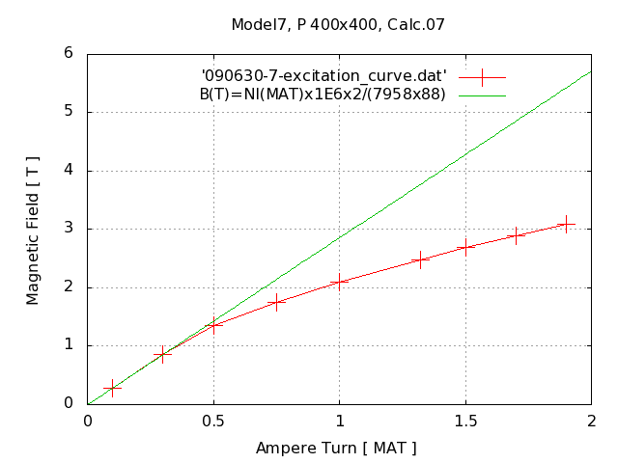
Superconducting Dipole Magnet
Magnetic field is calculated using TOSCA.
Y
1.9 MAT/coil
Fy=625ton
I=560 A (66 A/mm²)
X
Fr=1918ton
Integral BL=7.05 Tm
By(center)=3.1T
-2000
2000
Z
excitation curve @ center
calc. by TOSCA
μ=infinity
3.1T
pole diameter
yoke width
1.9MAT
Notes:
Magnetic field is calculated by using the code TOSCA. This figure shows the excitation curves of dipole magnet. This figure shows the y component of the magnetic fields plotted along z-axis. The integration of By for region from z = -2 to +2 meter is calculated to be 7.05 tesla meter. This value fulfills the requirement of bending power.

Slide 11
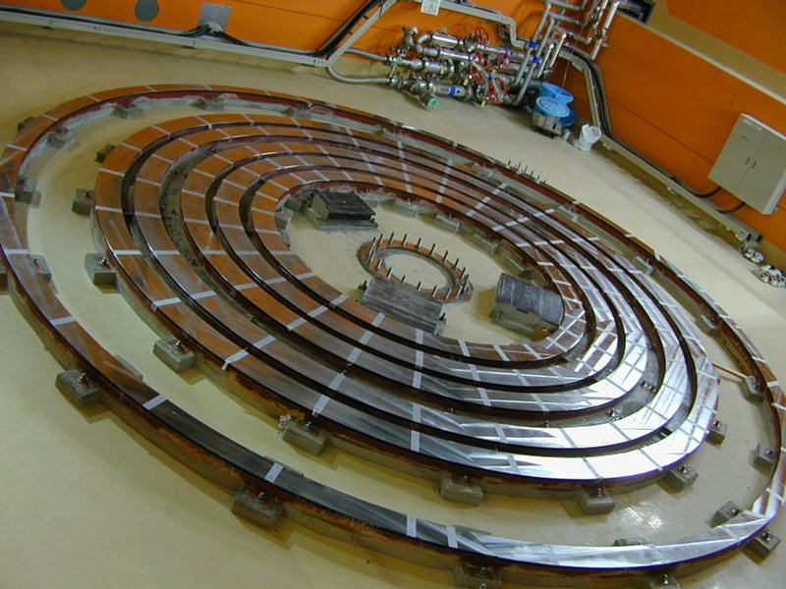
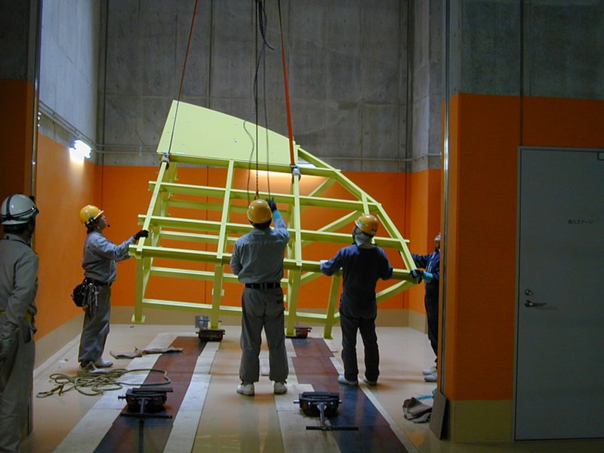
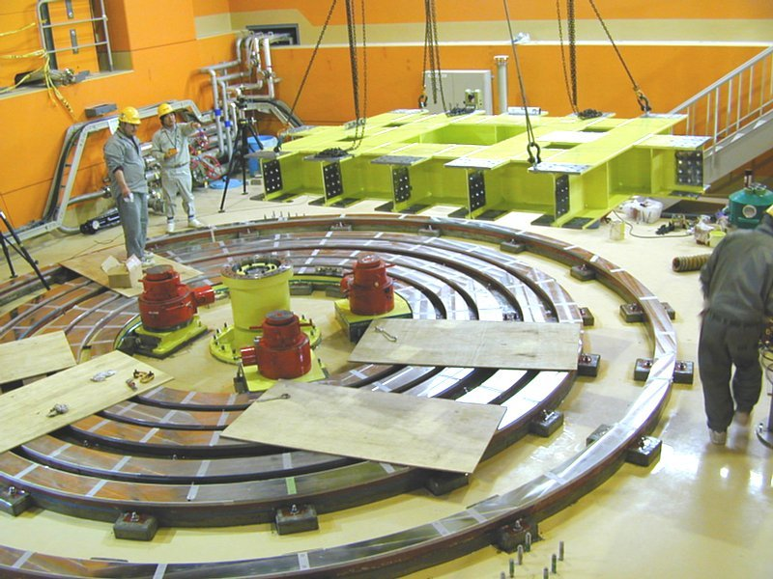
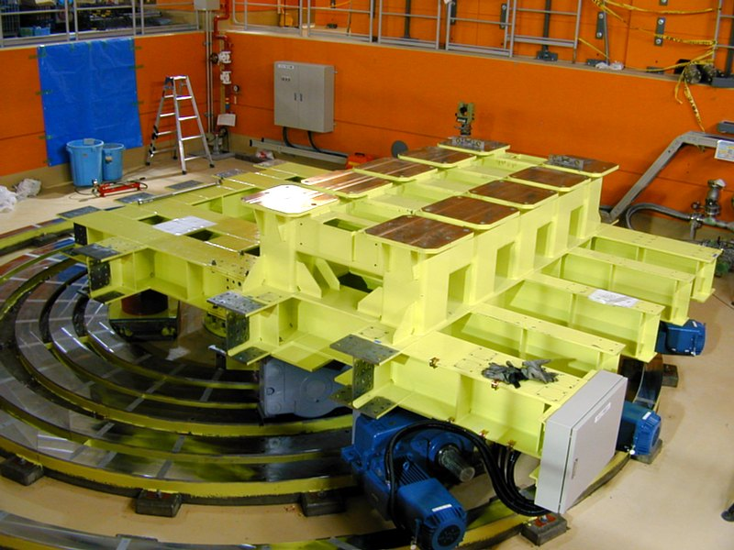
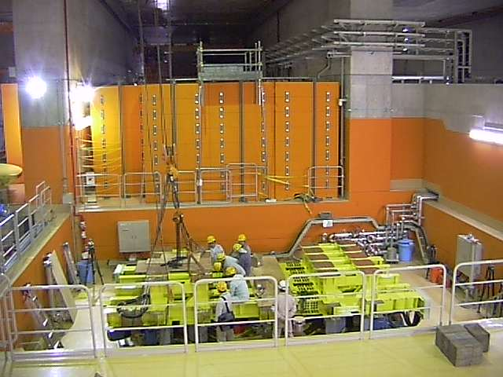
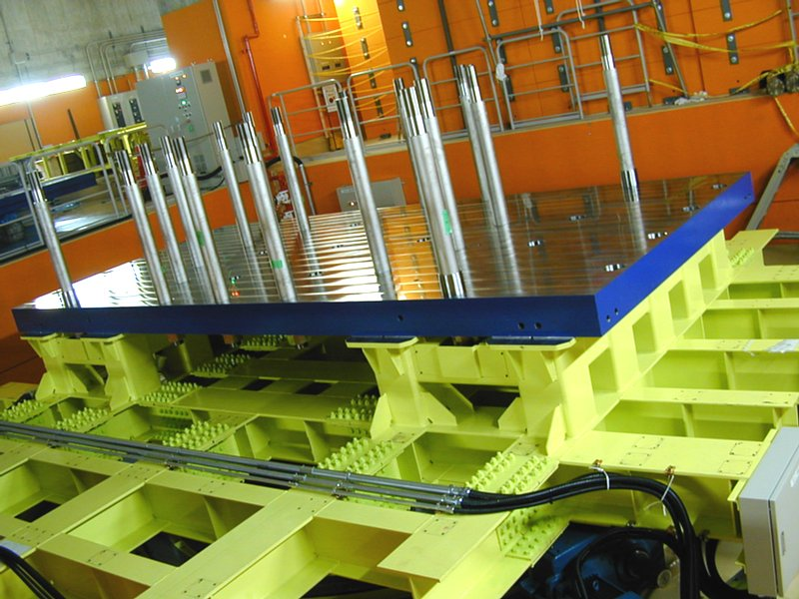
Photos ~Magnet Construction~
Magnet construction has started in RIBF site.
Notes:
Magnet construction has started in RIBF site. These photographs show the magnet construction. The rotatable base has been already completed.

Slide 12
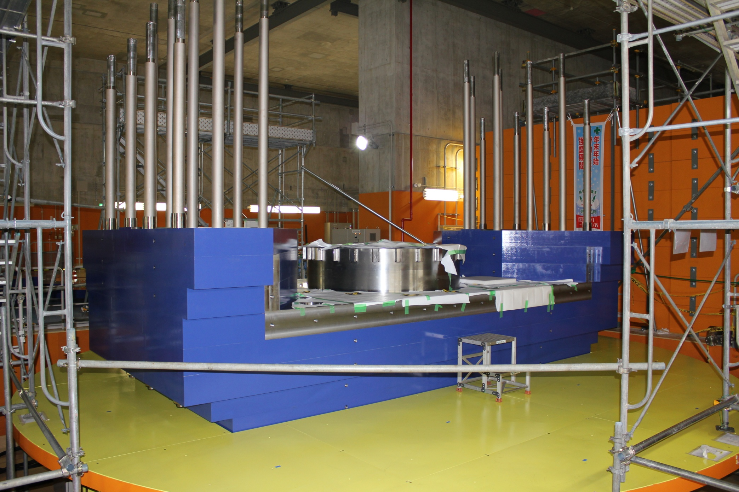
Photos ~Magnet Construction~
SAMURAI spectrometer is under construction now.
A commissioning will start from early 2012.
Notes:
SAMURAI spectrometer is under construction now. The construction will finish in May, 2011. A commissioning will start from early 2012.

Slide 13
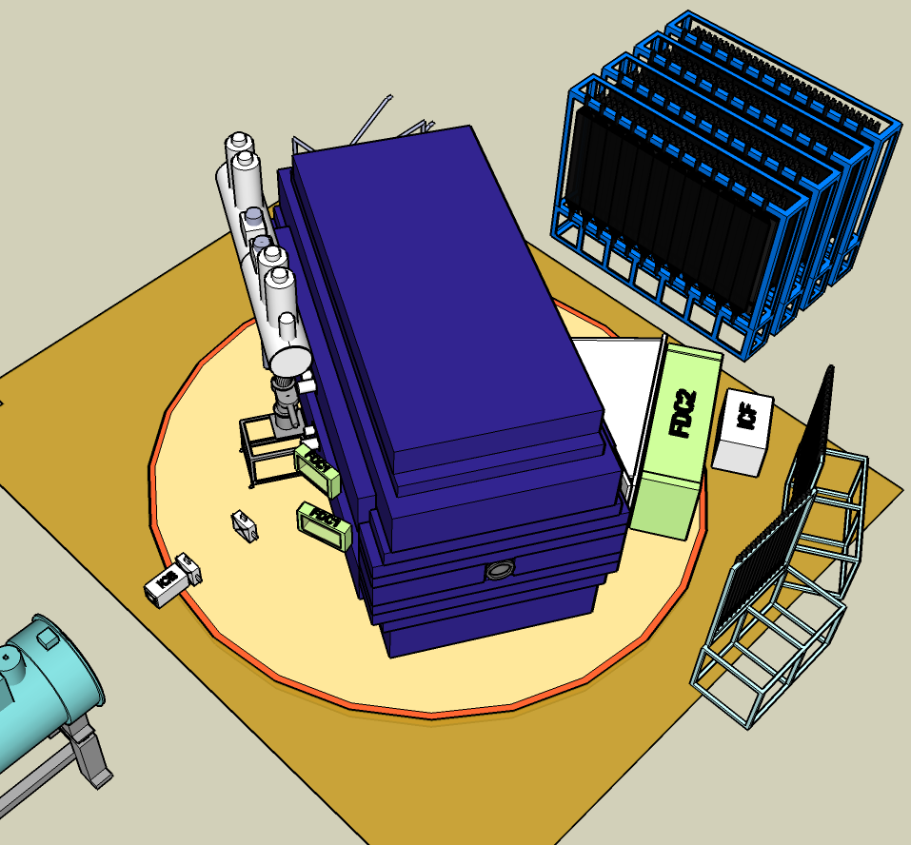
Planned Setup @ spring 2012
(γ, n) reaction: neutron-rich side
Detectors for Heavy Ion
  Position measurement
    Beam Proportional Chamber (BPC)
      momentum tagging at F5
    Beam Drift Chambers 1, 2 (BDC1, 2)
      beam phase space
    Forward Drift Chamber1 (FDC1)
      scattering angle
    Forward Drift Chamber2 (FDC2)
      rigidity analysis for fragments
  Charge measurement
    Ion Chamber for Beam (ICB)
      charge of beam
    Ion Chamber for Fragment (ICF)
      charge of fragment
  TOF (charge) measurement
    Hodoscope for Fragment (HODF)
  Total-Energy measurement
    Total Energy Detector (TED)
      high-precision total-energy meas.
Detectors for Neutron
  NEBULA
    projectile-rapidly neutron
Detectors for Gamma ray
  DALI2
    excited fragments produced
NEBULA
Detectors for Heavy Ion
Pb target
DALI2
Notes:
Planned experimental setup in early 2012 is (γ,n)-type Coulomb breakup experiments in C, O and Ne region. This type setup is shown in this figure. Detectors for heavy ion are listed here. Secondary beams are momentum tagged at F5 by BPCs. Two sets of BDCs are used to measure the phase space of the incident secondary beams on the reaction target. FDC1 and FDC2 are used for rigidity reconstruction. ICB is used to measure the charge for heavier beams. ICF is used to measure the charge of heavier fragments. HODF is used to measure the TOF and charge of the fragment. TED is used to measure the total energy of the fragment. A gamma detector array, DALI2, is used to measure gamma rays emitted from the excited fragments produced in the decay process of Coulomb excitation. Projectile-rapidity neutrons are detected by NEBULA.
I will show the present status of each detector as follows.

Slide 14
Beam Proportional Chamber (BPC)
Eff. area: 240 mm x 150 mm
Config: x1, x2
#Anodes: 128
Gas: iC₄H₁₀
200 torr for p
20 torr for Kr
Status:
built & used in the experiment
Notes:
BPC is used to tag the rigidity of secondary beams at momentum dispersive focal plane F5 by measuring the horizontal position. It is a 4 mm spacing multiwire proportional chamber with 2 anode planes.
BPC was built in FY2009 and tested using beta-rays, proton, He, and Li beams at 250 MeV/A, and Kr beam at 400 MeV/A. It has a stable high voltage plateau with almost 100 % efficiency even for protons at 250 MeV/A. It can be operated above 1MHz without serious problems.

Slide 15
Beam Drift Chamber (BDC1, BDC2)
Drift dist.: ±2.5 mm for high rate
Half gap: 2.5 mm
Eff. area: 80 mm x 80 mm
Config: xx’yy’xx’yy’
#Anodes: 256
Gas: He+60%CH₄ @ 1 atm
iC₄H₁₀ @ 100 torr
Status:
built & used in the experiment
σ ~ 120 μm (p, He, Li)
Outer box being made
Notes:
Two sets of BDCs are used to measure the phase space of the incident secondary beams. It is a Walenta-type drift chamber with 2.5 mm drift distance for high beam rates.
BDCs were built in FY2009. This type has been used for tracking high intensity beams.

Slide 16
Forward Drift Chamber (FDC1)
Drift dist.: ±5 mm
Half gap: 5 mm
Eff. area: φ310 mm (620 x 340)
Config: xx’uu’vv’xx’uu’vv’xx’
#Anodes: 448
Gas: He+60%CH₄ @ 1 atm, iC₄H₁₀ @ <200 torr
Status:
built
HV leakage problem fixed
Notes:
FDC1 is placed between the target and SAMURAI magnet in order to measure the emission angle of the projectile fragments. It also has wide opening in order not to interfere with projectile-rapidity neutrons at zero degree.
FDC1 was built in FY2009 and tested using beta rays with full efficiency. It is being tested using cosmic rays. FDC1 will be used in the detector box for low pressure operation. Detector box will be constructed in FY2010.

Slide 17
Forward Drift Chamber (FDC2)
Drift dist.: ±10 mm, Hexagonal cell
Eff. area: 2.23 m(H) x 0.81 m(V) x 0.79 m(D)
Config: xx’uu’vv’xx’uu’vv’xx’
#Anodes: 1568
Gas: He+60%CH₄ @ 1 atm
Status:
wiring: ~ ¾ finished
detector stand: being designed
FDC2 cell structure
Notes:
FDC2 is placed after SAMURAI magnet for rigidity analysis of projectile fragments. The cell structure is hexagonal with 10 mm drift length.
FDC2 is under construction. FDC2 itself and detector stand will be finished by the end of FY2010. Tests using beta-rays and cosmic rays will be done by the fall of FY2011.

Slide 18
Ion Chamber for Beam (ICB)
Multi-Layer: 10 anodes + 11 cathodes
Effective area: 140 mm(H) x 140 mm(V) x 420 mm(D)
Gas: P10 @ 1 atm
Status:
built
Preamp with 10 usec decay time
Shaping amp. with 0.25 usec time const.
unipolar output with active baseline rest.
tested
For z = 36 @ 300 MeV/A
pulse height resolution ~ 0.9 %
charge resolution: σ_{z} ~ 0.17
Notes:
ICB is multi-layer ion chamber and placed upstream of the target. It is used to measure the charge of incident secondary beams.
ICB was built in FY2008. It was tested using primary and secondary beams from ⁸⁴Kr. Optimum high voltage and shaping time have been studied. Charge resolution was 0.17 at z = 36.

Slide 19
Ion Chamber for Fragment (ICF)
Multi-Layer: 12 anode planes (4-strips/plane) + 13 cathodes, 48 readout channel
Effective area: 750 mm(H) x 400 mm(V) x 480 mm(D)
Gas: P10 @ 1 atm
Status:
* being assemble
Status:
being assembled
Notes:
ICF is a multi layer ion chamber and placed after the FDC2. It is used to measure the charge of projectile fragments. Due to several technical difficulties, effective area of the ICF is much smaller than that of FDC2.
ICF was built in FY2010. It was tested using primary and secondary beams from ⁸⁴Kr. Since the horizontal size of ICF is small compared with that of FDC2, detector stand will have a mechanism to move ICF along FDC2.

Slide 20
Hodoscope for Fragment (HODF)
Slat: 1200 mm(V) x 100 mm(H) x 10 mm(t), 16 slats
Plastic: BC408/EJ200
Eff. area: 1600 mm(H) x 1200 mm(V)
PMT: H7195 with Booster
Status:
30 assemblies and 2 stands were built
to be mounted on the stand
Notes:
HODF is conventional scintillator hodoscope. It is place after FDC2 and ICF to measure TOF and charge of projectile fragments.
Hodoscope slats and detector stands were built.

Slide 21
Total Energy Detector (TED)
Crystal: pure CsI, 100 x 100 x 50
32 elements
PMT: R6233HA(non-UVW)
Eff. area:800 x 400
@ 270 MeV/A (Δp/p=0.1%, absorber: Al 9mm)
combined with the absorber,
>6σ separation possible
Notes:
TED is composed of 32 pure CsI crystals to measure the total energy of projectile fragments.
Prototype tests showed that combination with the energy degrader in front of TED has enough mass resolving power for fragments.
32 detector elements will be assembled in FY2010. Whole assembly is placed in the detector box which serves as a light shield and a magnetic shield. Since pure CsI has relatively large temperature dependence of about 1 %/deg, temperature of the crystals will be monitored. Detector box and stand will be finished by the middle of FY2011.

Slide 22

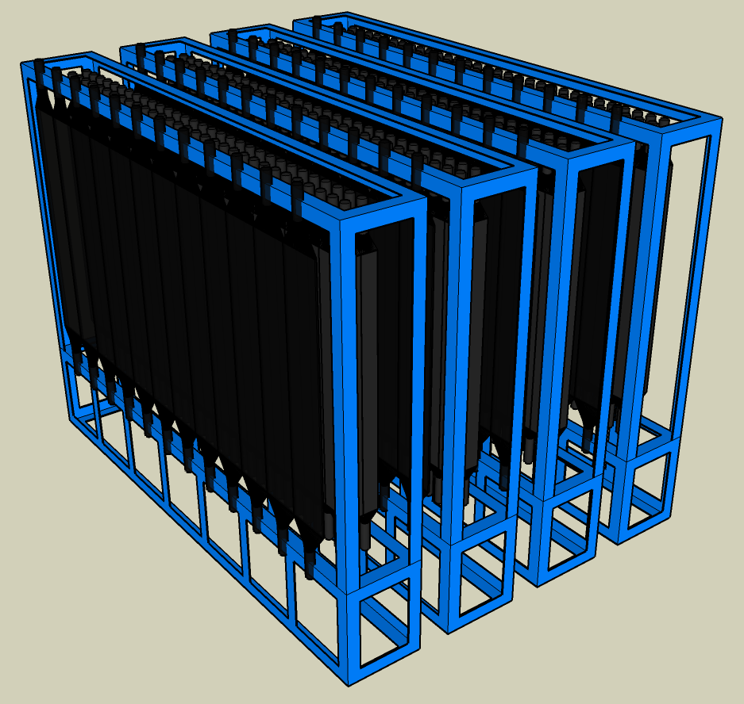
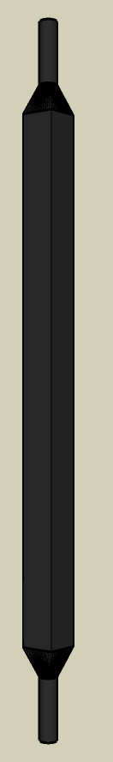
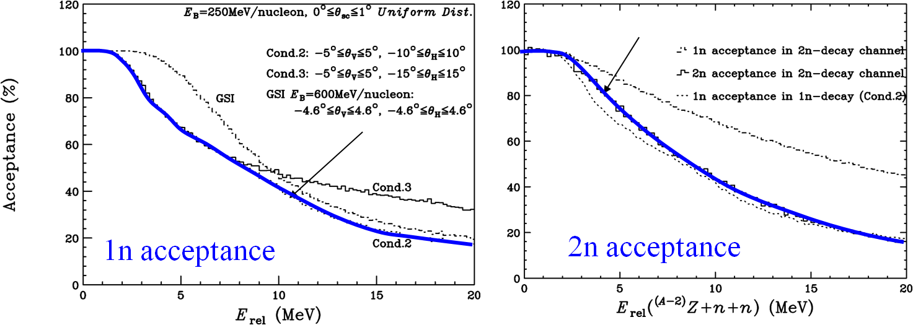
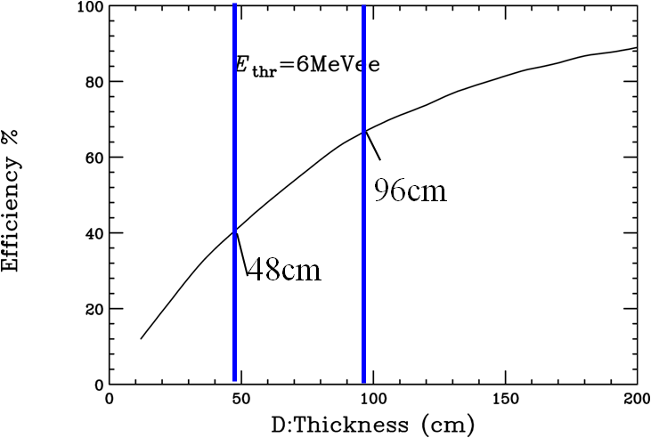
NEBULA
Neutron Detector Module
Plastic Scintillator (BC408)
120mm(H) x 1800mm(V) x 120mm(D)
Coupled to 2 PMT’s (HAMAMATSU R7724ASSY)
Veto Detector Module
Plastic Scintillator (BC408)
320mm(H) x 1900mm(V) x 10mm(D)
Coupled to 2 PMT’s (HAMAMATSU R7724ASSY)
1800 mm
1900 mm
3600 mm
1800 mm
2550 mm
120 mm
320 mm
Neutron
Module
VETO
Module
Basic setup➔H: ±10°, V: ±5°
Intrinsic efficiency for neutron
  100 % coverage @ E_{rel} < 3 MeV
  40 % coverage @ E_{rel} ~ 10 MeV
  Thickness: 96 cm ➔ ~ 66%
  Current (Half volume) ➔ ~ 40%
Notes:
Projectile-rapidity neutrons are detected by NEBULA. NEBULA is composed of 240 modules of plastic scintillators. NEBULA has a large effective area. For single neutrons, NEBULA can cover 100 % for relative energy less than 3 MeV and even at around 10 MeV, it can cover 40 %. The efficiency for single neutrons is estimated to be 66 % and 40 % for full and half volume, respectively.
Half volume have already been mounted and are being tested by measuring cosmic rays.

Slide 23
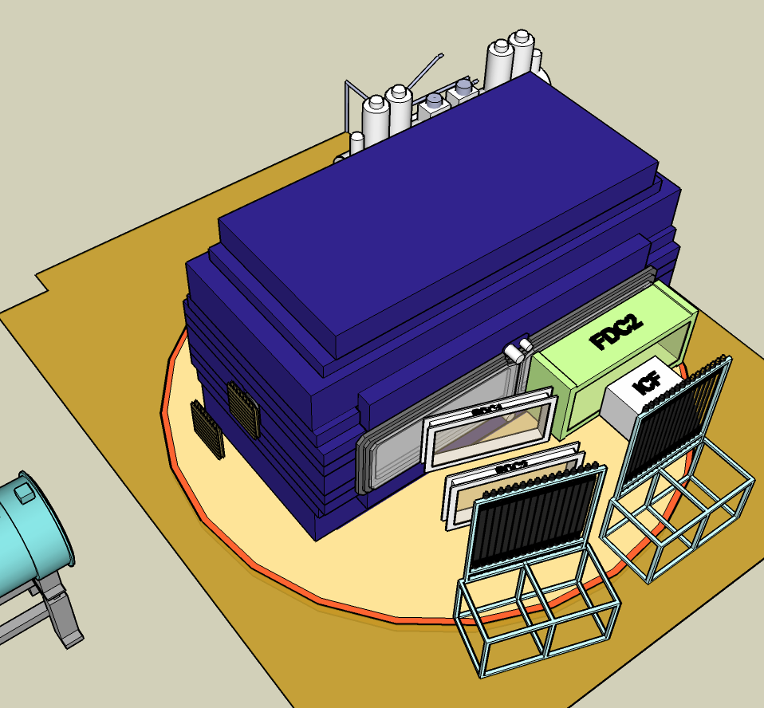

Other Detectors
(γ, p) reaction: proton-rich side
EOS measurement
Detectors for Heavy Ion
Silicon Strip Detector
Pb target
Detectors for Proton
Detectors for proton
  Proton Drift Chamber (PDC1, 2)
  Hodoscope for Fragment (HODF)
Silicon Strip Detector
  Presentation by Kurokawa san
SAMURAI TPC
  Presentation by Isobe san
Notes:
Other detectors are also under development. This figure shows the setting for (γ, p) measurement. In this setting, the detectors for heavy ion and proton are needed. In order to measure the scattering angle of proton, the silicon strip detectors are used. They are required to have the broad dynamic range, because both proton and heavy ion hit the detector. For silicon strip detector, Kurokawa san will present.
This figure shows the setting for EOS measurement. For SAMURAI TPC, Isobe san will present.

Slide 24
Summary
SAMURAI
  Spectrometer for multi purposes by multi-particle detection
Construction budget approved – FY2008-11
Superconducting Dipole Magnet
  7 Tm with 800 mm gap ➔ large acceptance
  Rotatable magnet ➔ versatile usage
SAMURAI spectrometer is under construction
and will be completed in May, 2011.
Detectors are currently under development in parallel.
  for heavy ion, neutron, proton to be ready in 2011.
The first commissioning run is scheduled in early 2012.
Notes:
I will summarize my talk. SAMURAI project is currently underway at RIBF. SAMURAI spectrometer is under construction and will be completed in May 2011. Detectors for heavy ion, neutron, and proton are currently under development in parallel and are ready in 2011. The first commissioning run is scheduled in early 2012.

Slide 25
Construction Members
T. Kobayashi (Tohoku) Spokesperson
T. Motobayashi (RIKEN) Co-spokesperson
K. Yoneda (RIKEN) Project manager
Construction Team Members (* Leader)
In-House Work Force
Magnet and Infrastructure: H. Sato*, K. Kusaka, J. Ohnishi, H. Okuno, T. Kubo (RIKEN)
Vacuum system and Utilities: H. Otsu*, Y. Shimizu (RIKEN)
Heavy Ion Detectors: T. Kobayashi*, Y. Matsuda, K. Sekiguchi,
N. Chiga, graduate students (Tohoku), H. Otsu (RIKEN)
Neutron Detectors (NEBULA): T. Nakamura*, Y. Kondo, Y. Kawada, T. Sako,
R. Tanaka (Tokyo Tech), Y. Satou (Seoul National Univ.)
Proton Detectors: K. Yoneda*, Y. Togano, M. Kurokawa, A. Taketani, H. Murakami,
T. Motobayashi (RIKEN), K. Kurita (Rikkyo), T. Kobayashi (Tohoku),
L. Trache (Texas A&M) and the TWL collaboration
Pol-d induced reaction exp. devices: K. Sekiguchi*, T. Kobayashi, Y. Matsuda, graduate students (Tohoku)
Time Projection Chamber: T. Murakami* (Kyoto), T. Isobe, A. Taketani, S. Nishimura, Y. Nakai,
H. Sakurai (RIKEN), W.G. Lynch (Michigan State)
and SAMURAI TPC collaboration
Research instruments group: T. Kubo (Group leader)
SAMURAI team: T. Motobayashi*, H. Sato, Y. Shimizu, K. Yoneda
Notes:
This shows the construction members. That’s all. Thank you for your attention.

Slide 26
Backup

Slide 27
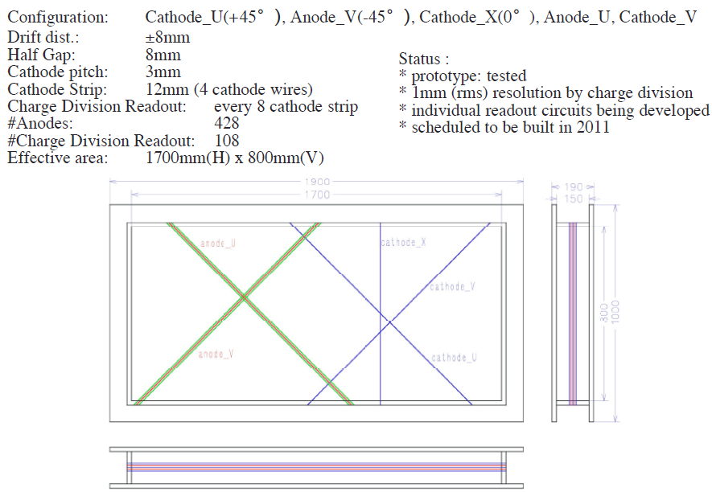
Proton Drift Chamber (PDC1, PDC2)

Slide 28
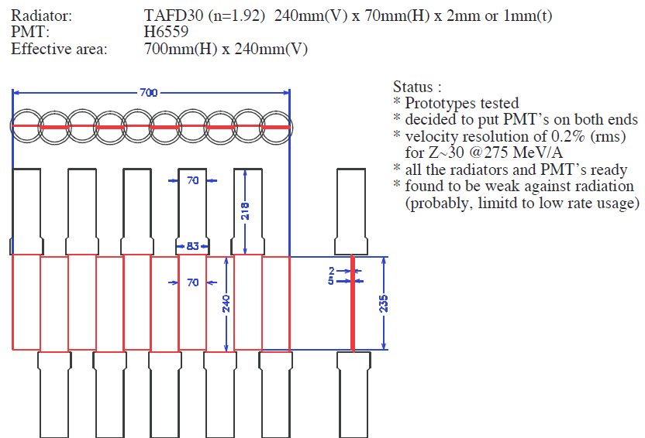
Total Internal Reflection-type Cherenkov Detector (TIRC)

Slide 29
Detector System − (γ, p) measurement mode
Detectors for Proton
  Proton Drift Chamber
  Plastic Hodoscope
Silicon Strip Detector
  Broad dynamic range
  Both proton & heavy ion (Z < 50)
  hit the detector
  Capability of high density
signal processing
Signals of about 2500ch in total
Modify integrated ASD circuit
HINP16C in collaboration with
Texas A&M and Washington Univ.
HINP16C --- 16ch processing in 1 chip
two output for energy and timing
(γ, p) reaction: proton-rich side
All detectors are ready in 2011.
Detectors for Heavy Ion
Silicon Strip Detector
Pb target
Detectors for Proton
Notes:
This figure shows the setting for (γ, p) measurement. In this setting, the detectors for heavy ion and proton are needed. The detectors for heavy ion are the same as shown in (γ, n) measurement. The detectors for proton are listed and are ready in 2011.
In order to measure the scattering angle of proton, the silicon strip detectors are used. They are required to have the broad dynamic range, because both proton and heavy ion hit the detector. They are under development in collaboration with Texas A&M and Washington University.

Slide 30

Detector System − Other modes
Detectors for Gamma
  Without γ detector with high efficiency, invariant mass measurements above medium-mass is impossible.
  DALI-II / GRAPE
  New γ detector
    Liquid Xe ionization/scintillation
Polarized Deuteron Experiments
  MWDC – Hodoscope
  Beam dump
  Polarimeter
SAMURAI TPC
  Presentation by Isobe san
Other Settings
Notes:
Other equipments are shown here. Without γ detector with high efficiency, invariant mass measurements above medium mass is impossible. For gamma ray detection, we plan to use DALI-II or GRAPE. Both of them are under operation in the current RIPS beam line. In the future, we will develop new γ detector such as liquid Xe counter. Unfortunately, several devices for polarized deuteron experiment are scarcely funded. For SAMURAI TPC, Isobe san will present in poster session.

