Slide 1
SAMURAI Si Detector
M. Kurokawa^{a)}, H. Baba^{a)}, T. Gunji^{b)}, H. Hamagaki^{b)},
S. Hayashi^{b)},T. Motobayashi^{a)}, H. Murakami^{a)}, A. Taketani^{a)},
M. Tanaka^{c)}, Y. Togano^{a)}, K. Yoneda^{a)}
a) RIKEN, Nishina Center
b) CNS, the Univ. of Tokyo
c) KEK

Slide 2
Requirements for SAMURAI Si detector system
Coulomb breakup exp.
proton
SAMURAI
heavy particle
(z < 50)
Definition of dynamic range
upper limit / lower limit (= 4σ)
of detection
proton rich particle up to ¹⁰⁰₅₀Sn
Effective area ~ 9 cm × 9cm
Position resolution ~ 1 mm
Dynamic range of the electronics ~ 10^4
coincident measurement from proton (z = 1) to heavy ions (z ~ 50) → 2500
Pileup of beam events

Slide 3
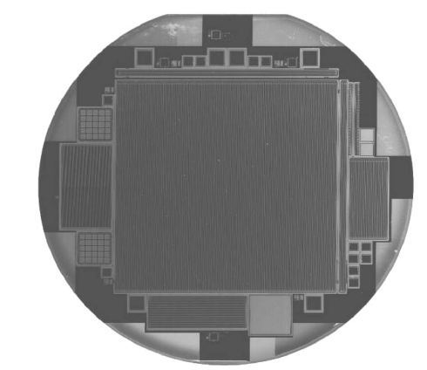
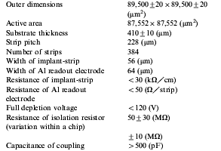
Specification of a Si detector
single-sided strip detector developed for
GLAST satellite is employed
Ref.) T. Ohsugi et al., “Design and properties of the GLAST flight
silicon micro-strip sensors”, Nucl. Instr. and Methods, A541
(2005) 29 - 39.
signals from 3 strips are grouped
together on the PCB
readout pitch = 228 μm × 3 = 684 μm
number of signal channels / detector
= 384 / 3 = 128 ch.
total number of signal channels
= 128 × 5 = 640 ch.
6 in.
--> 325 μm

Slide 4
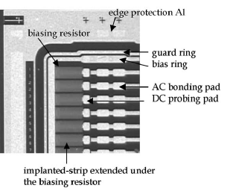
PCB design and bonding pattern for Si detector
Outer dimensions = 130 mm × 130 mm
Connectors made by KEL
(USL0040L) for ultrafine coaxial cable
0.4 mm pitch
Capacitors to suppress cross talk
through rear side < 1 / 10^4 = 0.01%
1
C1
stip1
3
R1
R1
C1
C1
C1
C1
C1
C1
C1
C1
C1
C1
5
Stip2
6
Si
89.5 mm × 89.5mm
Stip3
enlarged view
:
:
:
stip383
stip384
Symmetric layout with upper side
Will be ready in May

Slide 5
Specifications of the electronics
Only conceptional idea exits at the moment
Electronics must have a wide dynamic range ~ 10^4
Electronics must be highly integrated circuit or really tiny discrete circuit
Started development of a CSA (Charge Sensitive Preamplifier)
with a dynamic range of 10^4 in ASIC (Application Specific Integrated Circuit )
less than 2 years ago
For the subsequent stage of the CSA, such as S.A., HINP16C will be used.
Ref.) G. L. Engel et al., “A multi-channel integrate circuit for use in low and
intermediate-energy nuclear physics --- HINP16C”, Nucl. Instr. and Methods,
A573 (2007) 418 - 426.

Slide 6
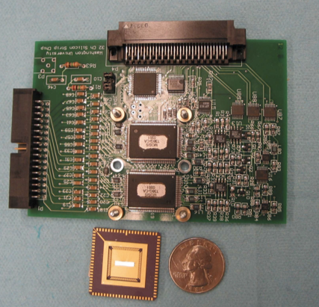
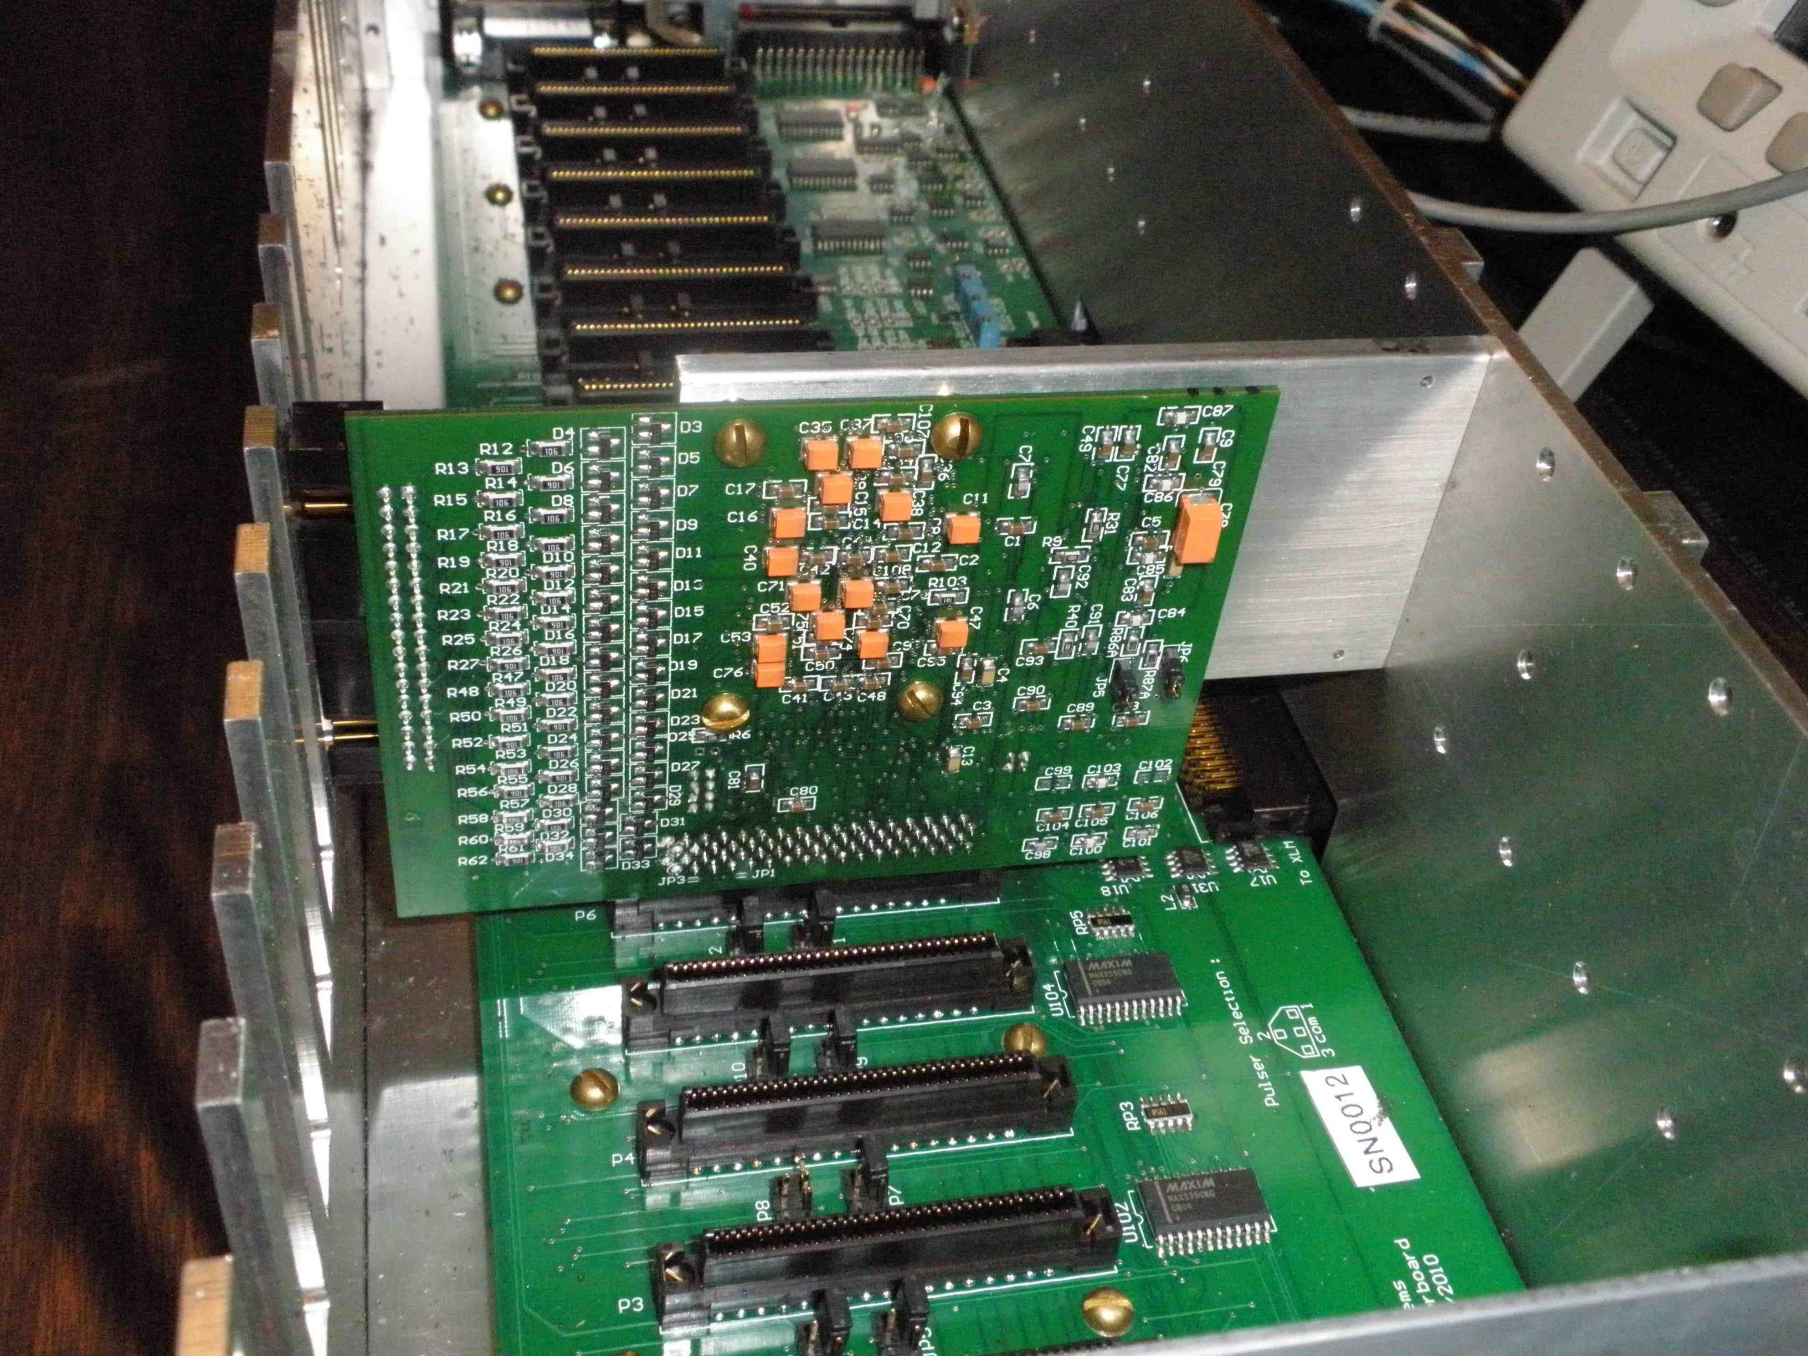
pictures of HINP16C
16 ch/chip × 2 = 32 ch
Mother Board with 16 slots
32 ch × 16 = 512 ch
external preamp. Mode
S.A. → Peak Hold → multiplexer
C.F.D. → hit. pat. & multiplicity
Drs. Yoneda , Baba and I visited
U.S.A. for the negotiation last Nov.
One PCB & one M.B.
will be arrived in Feb. in RIKEN

Slide 7
Cooperative framework for the development of ASIC
RIKEN
specialist of analog circuit: Murakami-san
modification using FIB (focused ion beam)
Collaborative research agreement
was concluded on Aug. 1st, 2010
KEK
CNS, Univ. of Tokyo
development tool
Experiences
stuffs
Need a CSA with a wide dynamic range
for ALICE calorimeter consisting of W + Si
Fund

Slide 8
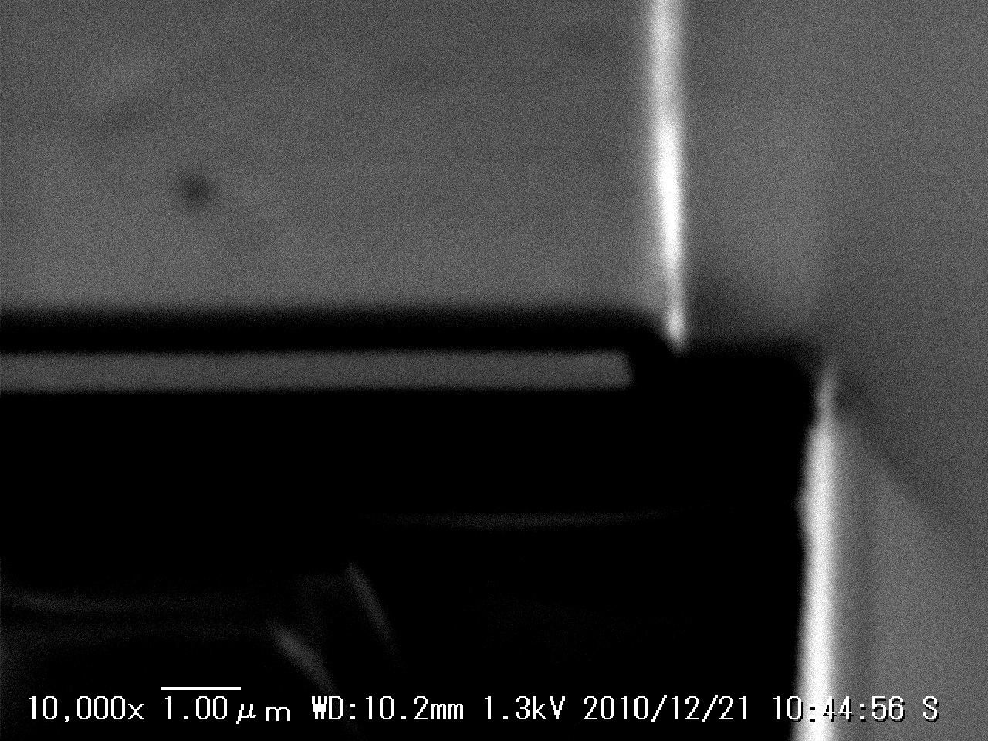
Example of the modification using FIB
Insulation layer
Disconnection of traces
passivating coating
Metal (Al) layer
Limited area was irradiated with
Ga beam
RIKENDGCSP
enlarged and tilted view

Slide 9
Architectures of the present ASIC
Cf = 1.8 pF
Rf = 50 MΩ equivalent: Krummenacher feed back circuit is used ref.) F. Krummenacher, Nucl. Instru. Meth., A305 (1991) 527.
Power consumption 10 mW/ch
Capacitive division
Openloop gain
Saturation suppression

Slide 10
Architecture I: dual channel system
Input charge is divided in proportion to the capacitance ratio between coupling capacitances Ch and Cl (Ch > Cl).
Ref. ) N. Uematsu and S. Nishimura, “Development of silicon strip detector with wide-dynamic-range readout system from
20 keV to 4 GeV”, RIKEN Accel. Prog. Rep. 41, (2008) 151.
Qh = Qin × Ch / (Ch + Cl)
Log Vout
Extended as much as the
capacitance ratio
high-gain
channel
CSA
Qin
Ch
similar response with
single channel system
Cl
low-gain
channel
CSA
H
Ql = Qin × Cl / (Ch + Cl)
L
Log Qin
4 pC
40 pC
Ch = 10 × Cl

Slide 11
Output pulse shapes from the CSAs
CSA
H
This part is implemented in first prototype
Ch
Cl
Chip and its test board TSMC 0.5 μm process chip size ~ 1.6 mm × 1.2 mm
L
CSA

Slide 12
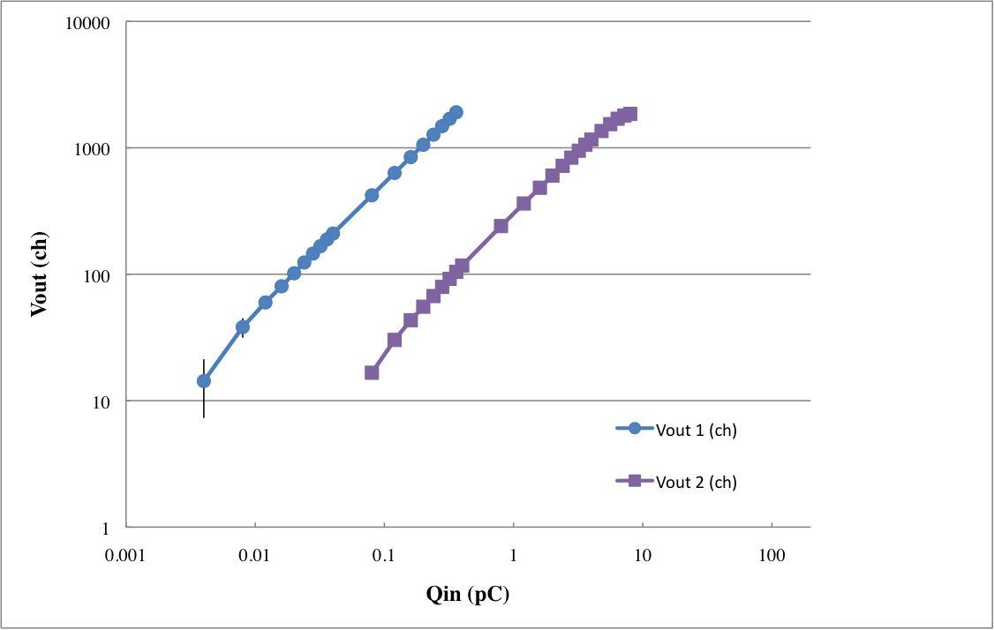
Result I: Dynamic range for a single channel CSA
pulser
10⁴
10³
CSA
SA-HG
ADC-H
SA-LG
ADC-L
10²
10¹
ADC-H
5.2 fc
5.6 pc
ADC-L
10⁰
10⁻³
10⁻²
10⁻¹
10⁰
10¹
10²
Definition of lower limit = 4σ. 4.4 fC corresponds to 100 keV.
Dynamic range ~ 10^3

Slide 13
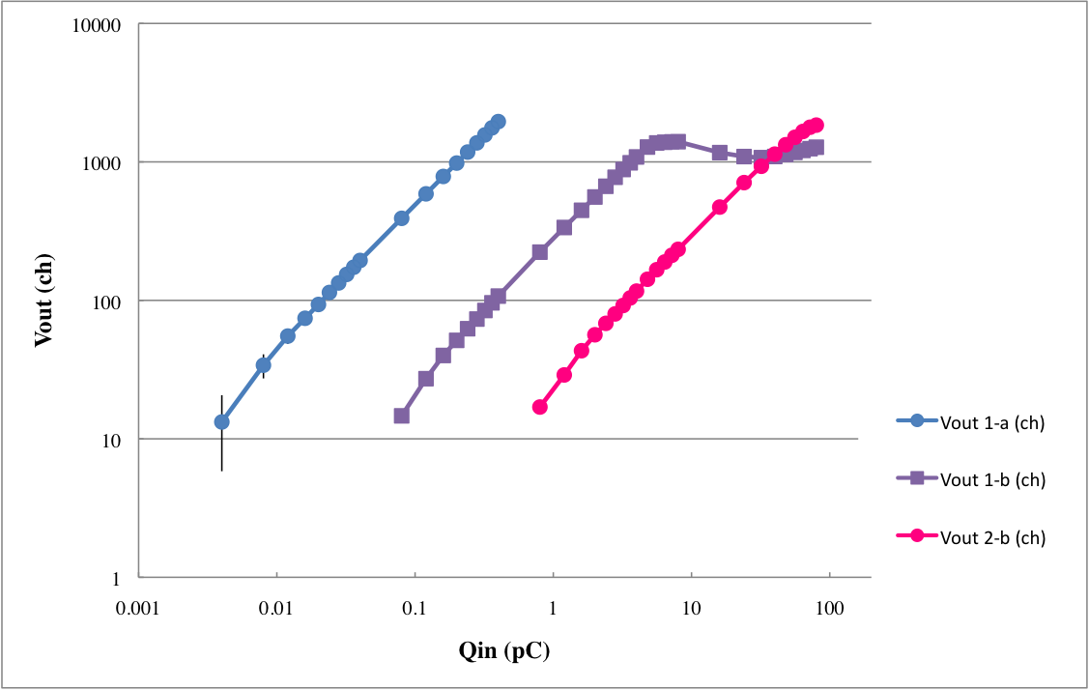
Result II: Dynamic range for dual channel CSAs
pulser
560 pF
SA-HG
ADC-H-H
CSA
SA-LG
ADC-H-L
Dynamic range ~ 10^4
10 times wider than that is obtained
for the single channel usage
CSA
56 pF
SA-LG
ADC-L-L
10⁴
10³
10²
ADC-H-H
10¹
ADC-H-L
5.8 fc
56 pc
ADC-L-L
10⁰
10⁻³
10⁻²
10⁻¹
10⁰
10¹
10²
Definition of lower limit = 4σ

Slide 14
Summary and time schedule
First prototype of RIKENDGCSP (Riken Dual Gain Charge Sensitive Premplifier) is working well. Dynamic range can be extended as much as the gain ratio.
2009
2010
2011
2012
2013
First prototype of
RIKENDGCSP
second prototype of
RIKENDGCSP
Test with HINP16C
& RIKENDGCSP
Good news:
HAMAMATSU has started production of
double sided strip detector.
Selection has increased.
Test including Si
detector
Mass production of
circuit and test
first experiment

