Slide 1
DAQ topics by H.B.
Hidetada Baba
RIKEN Nishina Center

Slide 2
Software
Linux only
Event builder = pure C language
Any distributions are OK
Analysis software
PAW base (C++ , C, Fortran)
ROOT base (C++)
CAMAC / VME front-end computer
Customized distribution (based on Debian/Scientific/ttyLinux)
Kernel 2.2, 2.4 and 2.6 are available ( + RTLinux 2.2 and 2.4 was used)
Modified CAMAC / VME device driver
Web based utilities (Any OS)
Written by PHP and RUBY (+ JavaScript)
Process manager, Scaler monitor, Configurator

Slide 3
Development of Device Driver (from 1998)
Tried to porting CAMAC driver to RTLinux
I studied C language to develop the device driver
Real-time extended Linux
2000, Linux based DAQ in RIPS
no more VAX workstation
without ACC (Auxiliary Crate Controller, J11)
Readout routine has been developed by T. Ichihara with assembly language
Network distributed DAQ
After that
ported many CAMAC / VME drivers to Linux

Slide 4
CAMAC / VME Device Driver
Basic functions for CAMAC / VME Controllers
porting to Linux 2.2,2.4,2.6
CC/NET
ccnet_read16
ccnet_write16
ccnet_dma_block_read16
K2915+K3922
k3922_read16
k3922_write16
k3922_dma_block_read16
CC/7700
cc77_read16
cc77_write16
SBS620
sbs620_vread32
sbs620_vwrite32
VMEMM
vmemm_vread32
vmemm_vwrite32
VMIVME (Universe IIB)
univ_vread32
univ_vwrite32
sbs620_dma_vread32
univ_dma_read
univ_init_window
univ_map_read32
univ_init_dma
univ_dma_read

Slide 5
Example of read out routine
Can use the same routine
for different controllers
PCI-CAMAC
+
PCI-VME
#define k2915_read16 read16
//#define ccnet_read16 read16
void evt(){
...
read16(C, N, A, F);
...
}
void evt(){
...
cc77_read16(C, N, A, F);
sbs620_vread32(Address);
...
}

Slide 6
Event driven driver (Readout routine)
Buffered data to
Evnet Builder
via Ethernet
User mode
Data sender
polling
select()
Readout routine
evt(), startup(),,,
Data
Buffer
Event driven driver,
Linux / RTLinux
Interrupt
from controllers
CC7700
SBS620
Driver for Controllers

Slide 7
DMA transfer but CPU polling
Usual case
Small data case
DMA Start
schedule()
DMA Start
check
check
check
Check the end of DMA
by CPU
(Other tasks are blocked)
check
CPU is free
check
check
check
check
check
check
check
DMA end
interrupt is generated
Readout
Readout
Latency << 1us
Interrupt latency > 20us
For small data (such as
CAMAC / VME modules)
CPU polling type is better
For large data,
this usual method is efficient

Slide 8
Data transfer (Front-end to Event builder)
CAMAC
Event Builder
Event Sender
Receiver
Thread
Information
Manager
Event
Build
Thread
Driver
Receiver
Thread
CAMAC
Event Sender
Receiver
Thread
Online
analysis
Driver
VME
Event Sender
Many threads in the Event Builder
Driver

Slide 9
Data management, linked list
Event Builder
Receiver
Thread
Event data
Event data
Makes many small
data buffer.
Event
Build
Thread
Receiver
Thread
Event data
Event data
Receiver
Thread
Event data
Event data
struct evtmen{
struct evtmem *next;
char *evtdata[256];
int size[256];
unsigned int evtn;
};
struct evtmem *new = NULL;
new = (struct evtmem *)malloc(sizeof(struct evtmem))
new->evtdata[efn] = malloc(size))
Data Receiver and Event builder works independently
(Mutual exclusion is very important)

Slide 10
Comments
Cording with pure C language
bare TCP/IP Socket
handmade memory management
Light, efficient, portability
The extension is not easy
It is tough to understand for other people
Recently
I adopt XML for commands through TCP/IP
We should know the basis of the cording
but it is also important that adopting OO and/or middleware

Slide 11
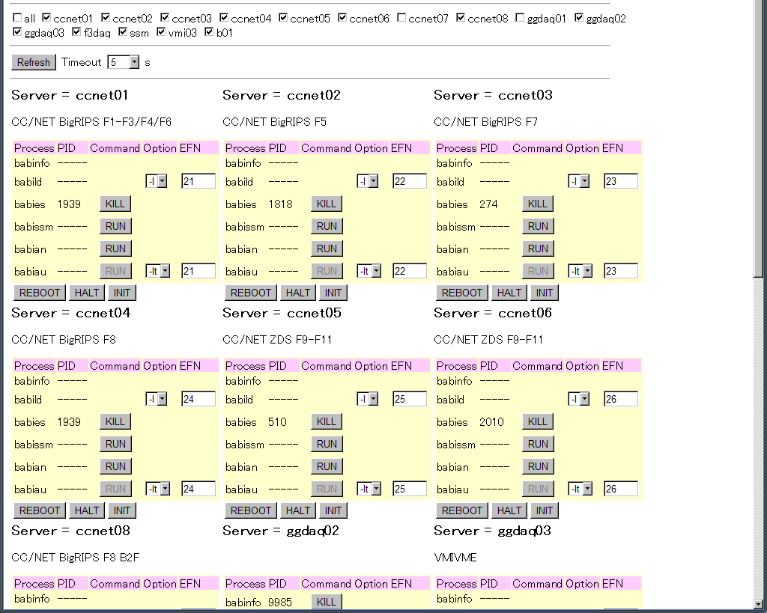
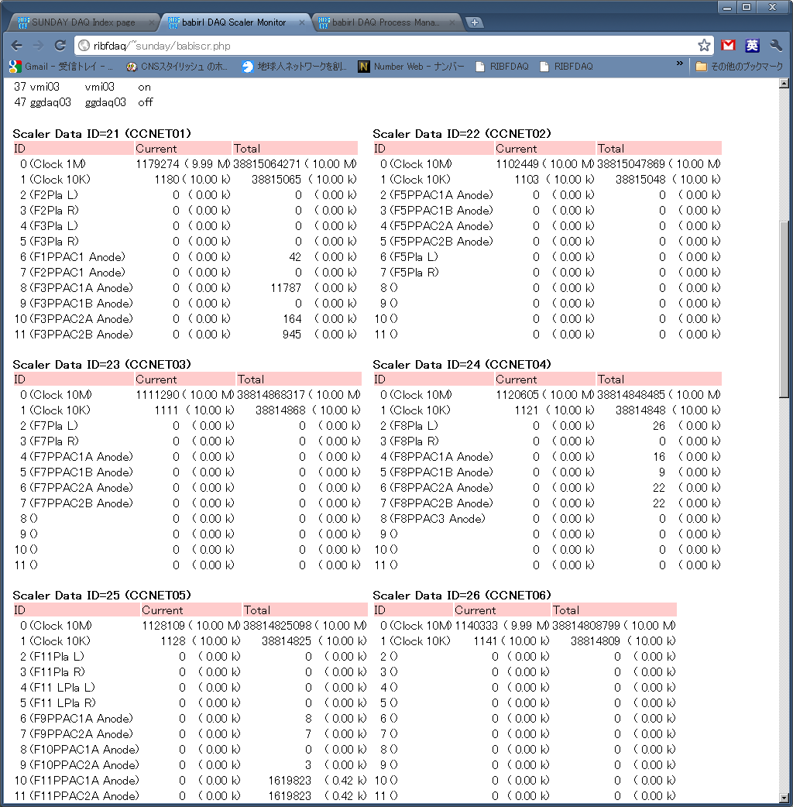
Web Utilities (PHP + JavaScript, RUBY)
Process Manager
Scaler Monitor

Slide 12
RIBF DAQ = Common trigger (usually)
Must2@BigRIPS case
Common trigger , common dead-time mode
Dead time is completely shared
7 CAMAC FEC + 1 VME FEC + 1 VXI FEC
FEC = Front-End Computer (= controller)
MUST2
Beam line
CAMAC
VXI
CAMAC
B2F
CAMAC
CAMAC
B3F
CAMAC
VME
CAMAC
CAMAC

Slide 13
With Time Stamp
Beta decay@BigRIPS case
Beam line = Common trigger
Beta = Si single trigger
Gamma = Ge x Si trigger
Dead time monitor = Dead time free
Common
Trigger
Self
Trigger
Self
Trigger
Self Trig
VME
Self Trig
VME
Beam line
CAMAC
CAMAC
B2F
CAMAC
CAMAC
B3F
CAMAC
VME
CAMAC
CAMAC

Slide 14
Anyway, FPGA
Input
Register
Output
Register
FIFO
Memory
Interrupt
Register
Clock
Generator
Scaler
Selector
AND/OR
Logic
Special
Logic
Time
Stamp
Latch
Gate
and Delay

Slide 15
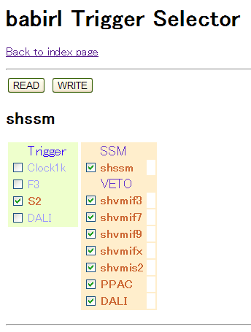
Trigger Select via Web
with
FPGA module
similar to the GANIL GMT

Slide 16
FPGA implementation by VHDL
25 MHz
External Clock
FPGA
Free IP Core
DLL
External
100 MHz Clock
Clear
48 bit
Counter
Trigger
FIFO Memory
48 bit
x
1024 cell
Switch
Latch
Latch
48 bit
Counter
100 MHz Clock
CAMAC/VME
Interface
50 MHz
Oscillator
DLL
Internal

Slide 17
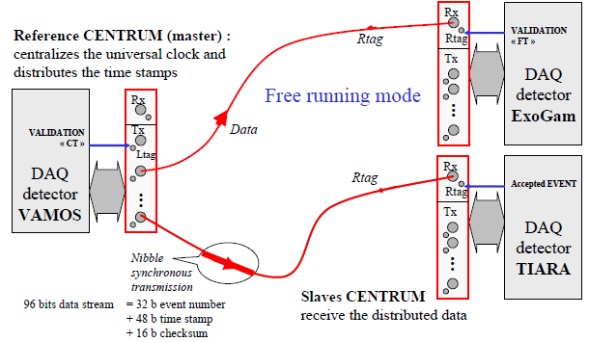
GANIL Time Stamp v.s. RIKEN Time Stamp
GANIL case
100 MHz
48 bits
Master module counts the clock (= time-stamp)
Slave modules ask the time stamp for the Master
Very safe system
Not easy to combine with other system

Slide 18
GANIL Time Stamp v.s. RIKEN Time Stamp
RIKEN case
100 MHz
48 bits
Clock
Clear
Clock
Source
Clock
Clear
Reset
Pulse
Distribute bare clock and the reset pulse
Each module counts the clock (= time-stamp)
A little bit dangerous system (Should have a monitor)
Easy to combine with other system

Slide 19
Dead time with Time stamp
DAQ A
Dead time
DAQ B
DAQ C
Event if the common trigger,
the dead time of the system is not straight forward.

Slide 20
Dead time measurement
Time-stamp based event building
Simulation (MonteCarlo + Poisson process)
We must monitor the trigger rate of each DAQ
Usually, simulation makes systematic error
Dead time monitor by 1 dead-time free system
Trigger for DAQ A
Trigger for DAQ B
Dead time free
Time stamper
Trigger for DAQ C
Trigger for DAQ D
Acquire trigger timings only

Slide 21
Beta decay experiment
Strip Si
Beam line detector
Beam line DAQ
Beam trigger
Si detector
Si DAQ
Si trigger
= Beam OR Beta
Ge detector
Ge DAQ
Si and Ge trigger
= (Beam OR Beta) AND Gamma
Delayed beta
Implanted Beam
Prompt gamma
Isomer gamma
Delayed gamma
Beam line
Prompt
Isomer
Beta
time
Beam event
Beta event

Slide 22
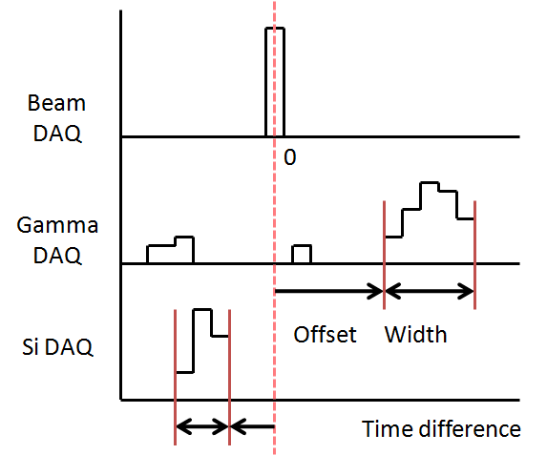
Live time @ Beta decay experiment
Title | Trigger | Rate(cps) | Window | Live Time(%)
Beam line single | Beam | 101 |  | 97.9
Si single | Si | 456 |  | 95.3
Si x Gamma | Si x Gamma | 495 |  | 71.3
Prompt Gamma | Beam x Si x Gamma | 54 | -50 to 50 ns
Isomer Gamma | Beam x Si x Gamma | 21 | 0.1 to 10us
Beta Gamma | not Beam x Si x Gamma | 172 | -50 to 50 ns
Under
analyzing
N of built events by acquired data
Live time =
N of built events based on DT monitor

Slide 23
Fast DAQ, as far as possible
Especially for time-stamp based measurement
Detector
Analog Signal Processing
Digitize
Front-end
ADC
PC
FPGA
Hybrid
IC
ASIC
TDC
Digital Signal Processing
Merger
Scaler
IC
FPGA
PC

Slide 24
Readout data from CAMAC/VME ADC
Software effort
OS, Device Driver < 50us/event is difficult
FPGA based small CAMAC/VME controller
Can reach the intrinsic speed of CAMAC/VME
CAMAC/VME
Module
CAMAC/VME
Bus
Data to PC
Mini
Controller
Data
Power only

Slide 25
Mini Controller (VME case)
5V
3.3V
BUS Transceiver
LDO
VME Bus
Power only
Xilinx
Spartan
3A or 3AN
(50 or 200)
VME Module
Power and Data
JTAG
FDTI
USB-Parallel
FT2232HL
USB
2.0
to PC

Slide 26
Schematics
Small PC
with USB
Ethernet
Even in usual CAMAC / VME modules, << 50us/event dead time is available
If we choose fast VME TDC such as V1190, 100kcps trigger DAQ will be available
Slightly over the crate...

Slide 27
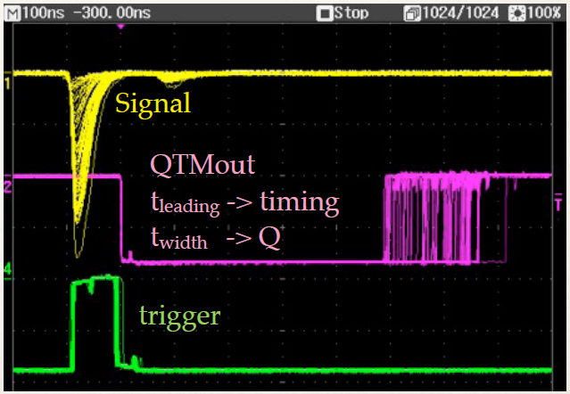
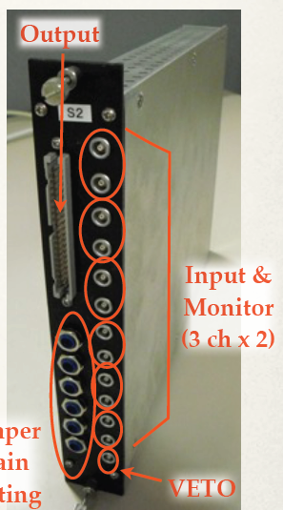
Fast DAQ - QTC + V1190 multihit TDC
Charge-to-Time converter
500ns dead-time/hit
Wide dynamic range
0 - 2500 pC
With V1190 multihit TDC
100ps LSB
10ns dead-time/hit
100kcps DAQ is available
Dead time < 5us/event
For Plastic, PPAC, NaI, LaBr
+
Already working for SHARAQ experiments

Slide 28
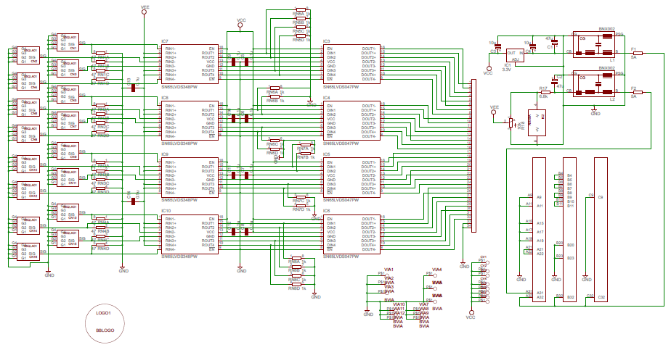
The first step of the module development
To know, how to make PCB, what is the difficulty, how cost is it?
VME NIM-to-LVDS converter

Slide 29
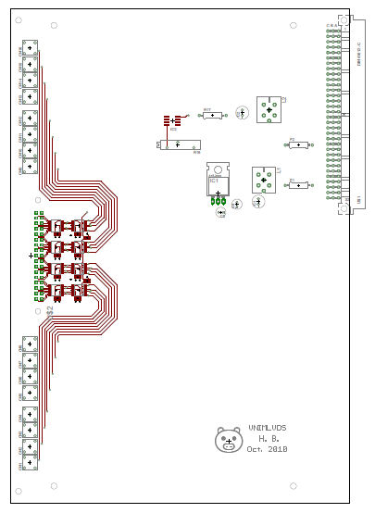
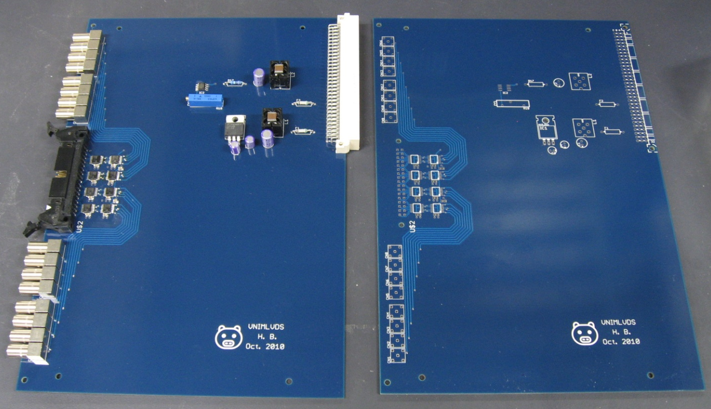
The first step of the module development
VME NIM-to-LVDS converter
The cost is only 25,000 yen/module
(50% = LEMO connectors)

Slide 30
Activities - Education
CNS
DAQ development for SHARAQ
FPGA Training
Rikkyo
DAQ development for Triumf
RIKADAI
DAQ support
Lecture for electronics
RIKEN
(H.B.)
TITECH
DAQ support
Osaka
DAQ support
Saitama U
DAQ support

Slide 31
Activities - Collaboration - MUST2
RIBF
(Beam line)
DAQ
MUST2
GANIL
DAQ
Experiment has been done
May&July 2010
Newly developed
software connector
for RIBF DAQ
by H. Baba, F. Saillant, M. Clotilde
ANAPAW
CAMAC
Decorder
MUST2
Decorder
MUST2
Analyzer
Tree
File
Tree
Maker
Beam line analyzer
by H.Baba, S. Takeuchi, Y. Togano, M. Nishimura, V. Lapoux, A. Matta (Special thanks S. Ota, T. Isobe)

Slide 32
Activities - Collaboration - TUM
RIBF
(Beam line)
DAQ
The implementation of RIBF Time stamper
(LUPO) into TUM DAQ has been tested
in Jan. 2010.
TU Munchen
DAQ
TUM DAQ is based on MBS (GSI)
VME based
Distribute Clock
= Time Stamp
LUPO
ANAPAW or ROOT
CAMAC
Decorder
TUM
Analyzer
Tree
File
Tree
Maker
Beam line analyzer
Including
A, Z, Position
Time-stamp

Slide 33
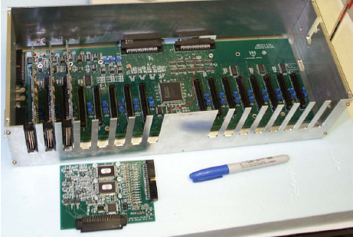
Activities - Collaboration - Samurai Si
RIBF
(Beam line)
DAQ
Washington (St. Louis), SIU, Texas A&M, RIKEN, ...
Samurai-Si (HINP) DAQ system request Time Stamping system
Samurai-Si
HINP
DAQ
Distribute Clock
= Time Stamp
LUPO
Samurai-Si HINP DAQ is based
on NSCL DAQ or RIBF DAQ
VME based

Slide 34
Activities - Collaboration - GET
General electronics for TPC
Self contained
Front-end
Data acquisition
Analysis framework
Connectivity
Time Stamp
Distribute common clock
Distribute Clock
= Time Stamp
RIBF
(Beam line)
DAQ
Saclay, CENBG, GANIL, MSU, GSI, RIKEN...

Slide 35
Conclusion ?
Software development
pure C is OK for alone development
For big system is no good, it is the common sense
GUI development is tough, however web-based GUI is relatively easy and stable
Speed up effort
by software is limited, even with RTOS
going to hardware (FPGA)
Hardware development
FPGA firmware development
Just started to learn “How to make module” and “What is the cost”

