Slide 1
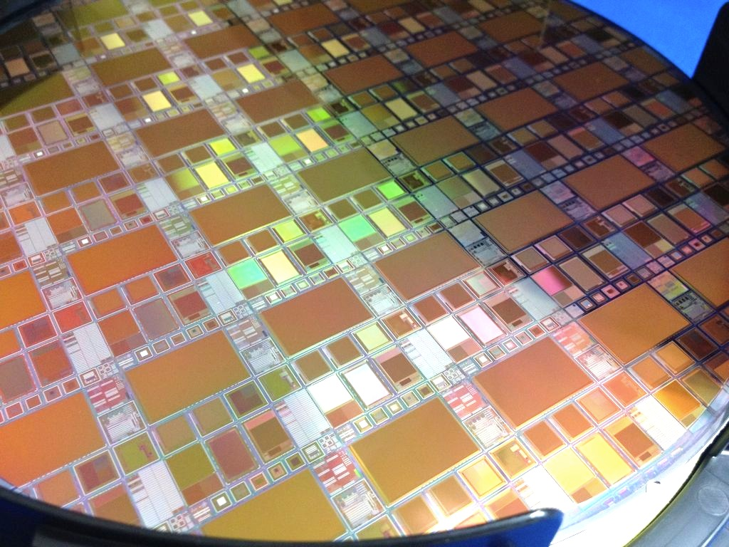
Introduction of the SOI Pixel Detector and application to the EIC vertex detector
T. Tsuboyama
For the SOI collaboration
16 July 2021

Slide 2
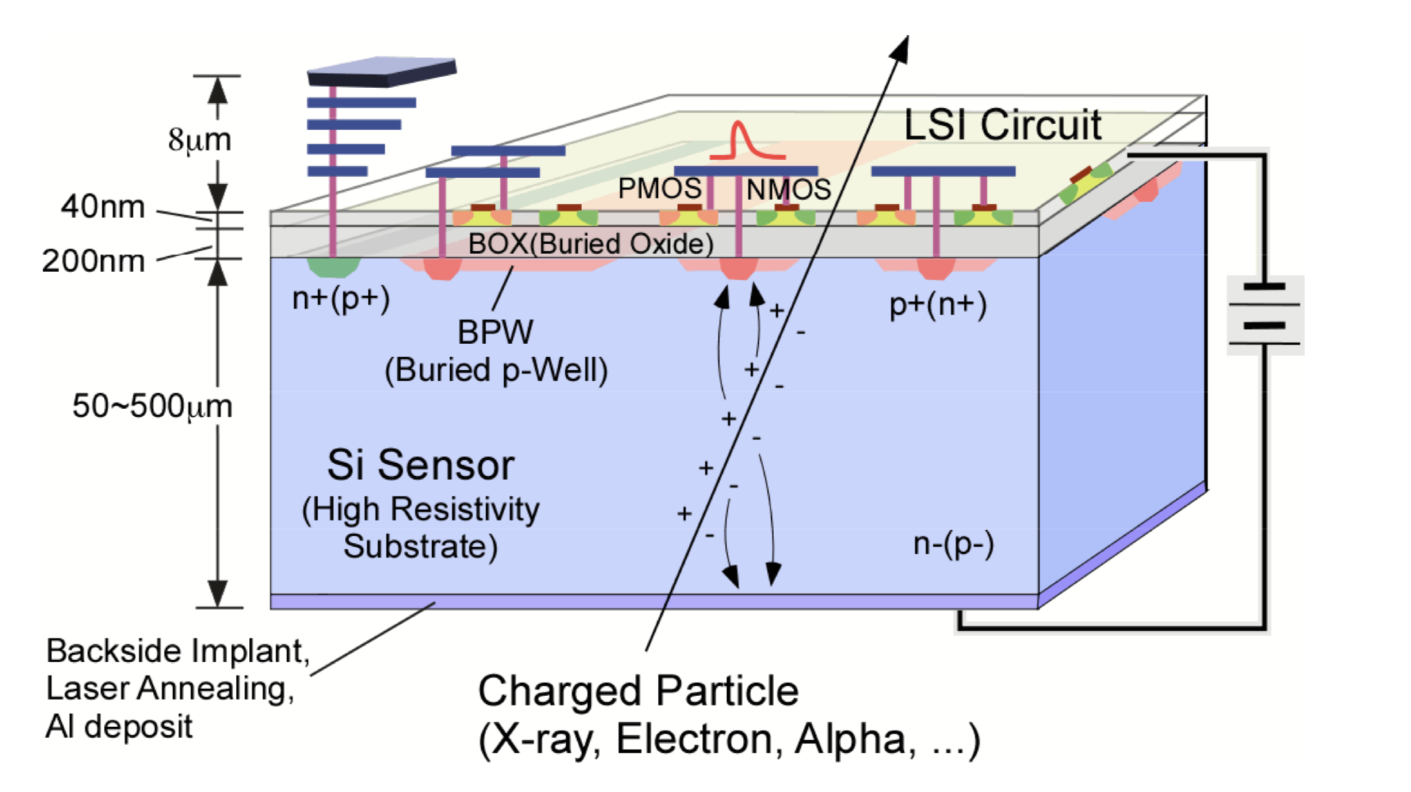
WHAT is
Silicon-On-Insulator Pixel (SOIPIX)?
Transistors are isolated from each other and from the Si bulk
→ High performance CMOS circuit can be obtained
SOI is an advanced CMOS LSI technology:
CMOS circuit is produced on silicon wafer separated by an oxide layer
CMOS radiation sensor
The charge induced in the Si wafer is processed by the CMOS circuit above
Various wafer (sensor) and implantation features can be chosen depending on the radiation (MIP/X ray/Gamma/Neutron…)

Slide 3
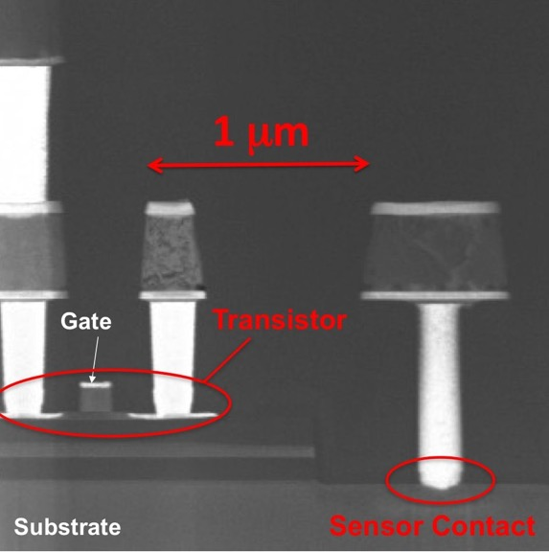
Close up of the SOI structure
Cross Section of SOIPIX
Aluminum metal layer
Tungsten Plugs
Transistor (40 nm thick Silicon)
SiO₂ layer (140-200 nm)
Substrate (Sensor Silicon)

Slide 4
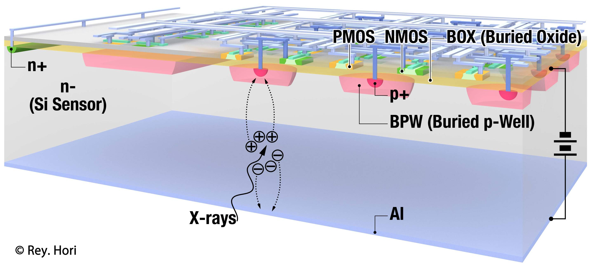
Working with LAPIS semiconductor, Japan.
The production is done in the industry semiconductor factory → Reliability, Quality control…
Standard CMOS technology → Complex circuit can be implemented in the pixel die with the standard CAD tools.
Sensor thickness from 500 μm to 50 μm (thinning)
The sensor characteristics can be controlled by impurity implantation design.

Slide 5
Activities of the SOI pixel sensor group
2005 SOI activity started in KEK

Slide 6
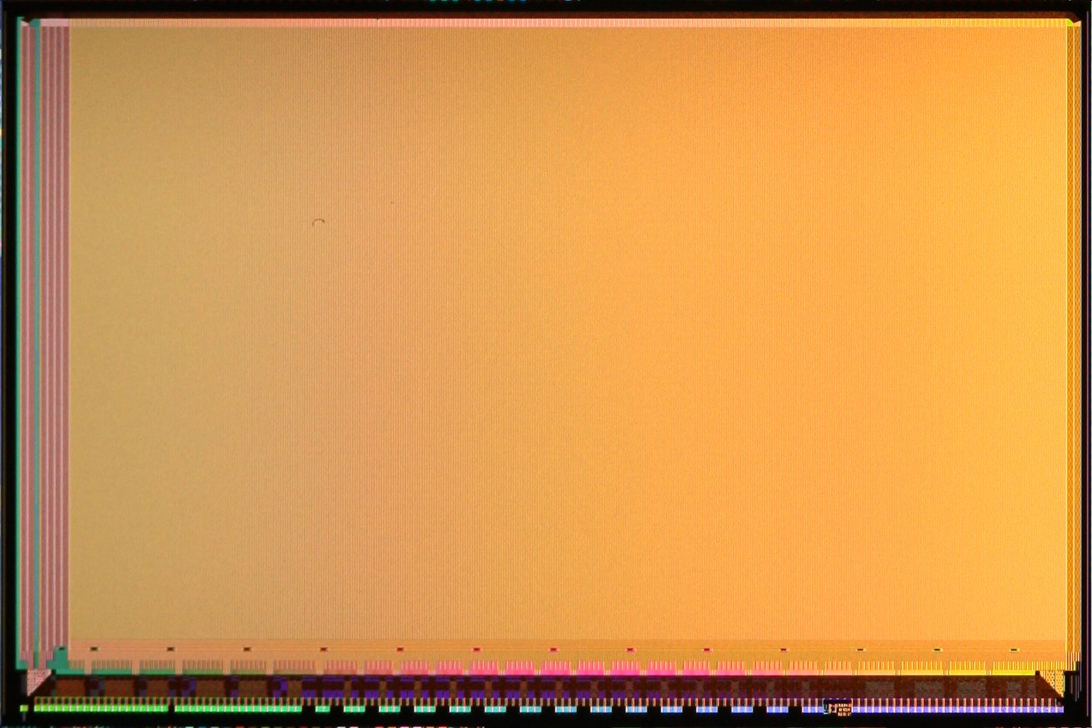
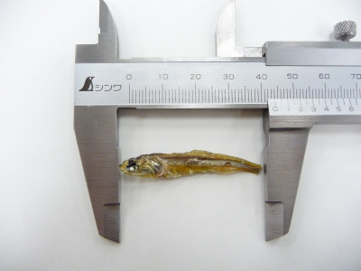
First X ray image of a small fish (2010.12)
INTPIX4
Pixel Size : 17 um x 17 um
No. of Pixel : 512 x 832 (= 425,984)
Chip Size : 10.3 mm x 15.5 mm
Vsensor=200V, 250us Int. x 500
X-ray Tube : Mo, 20kV, 5mA
5mm
X-ray Image of a small dried sardine taken by a INTPIX4 sensor (3 images are combined).
(A. Takeda)

Slide 7
Double SOI (2012-)
Another SOI structure is added to a SOI sensor.
The new SOI layer works as shield between the CMOS circuit and the sensor.
Improve the performance of the SOI pixel sensor.
Effect of back bias voltage
Digital-Analog interferences
Radiation hardness
High R-Si
High R-Si

Slide 8
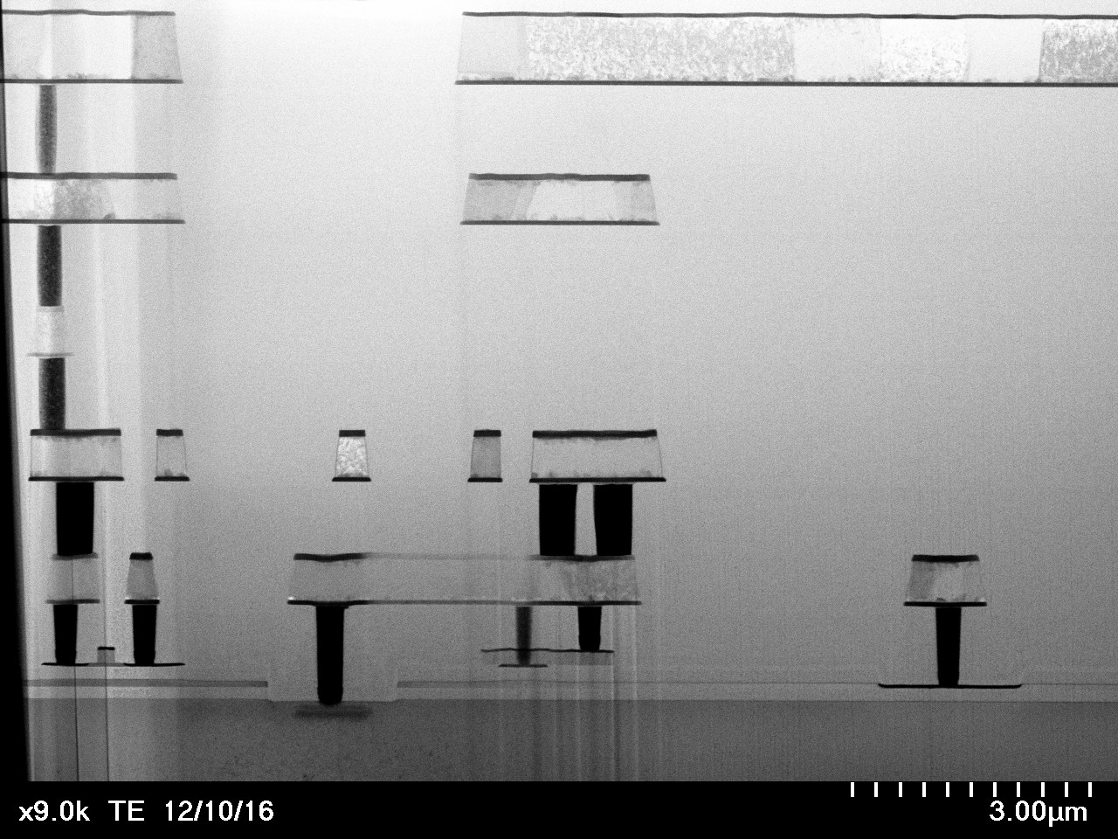
Metal 5
Cross section of a double SOI pixel sensor
Middle Si
Middle Si
Contact
Metal 1
Transistor
Sensor
Contact

Slide 9
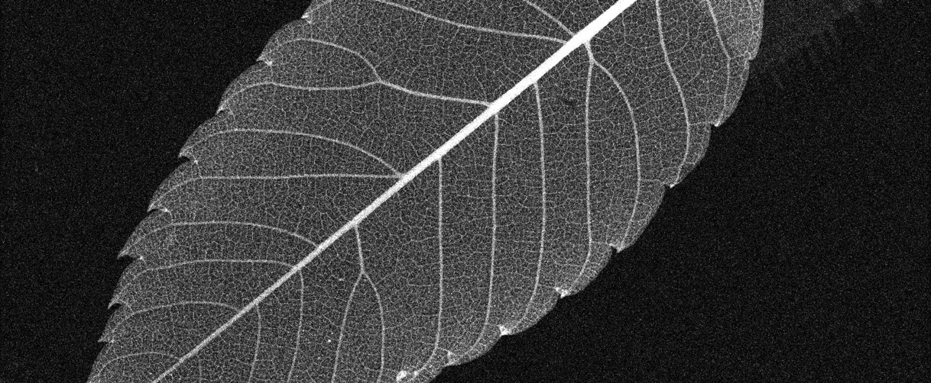
SOPHIAS for the Free Electron Laser Imaging device
64.8mm (2160 pix)
26.7mm (891pix)
Large size by stitching of 3 reticule size sensor to one.
Large dynamic range by combining different gain circuit.

Slide 10
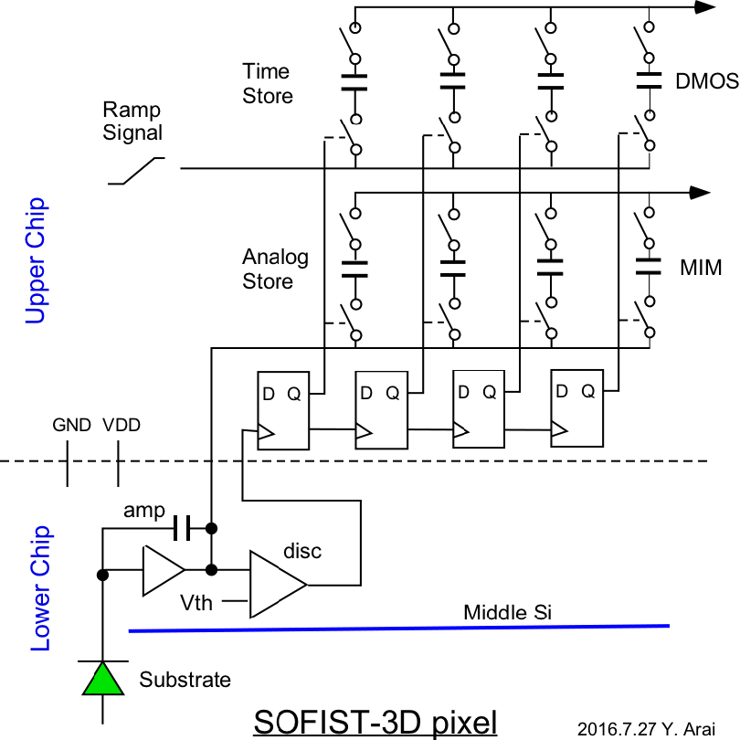
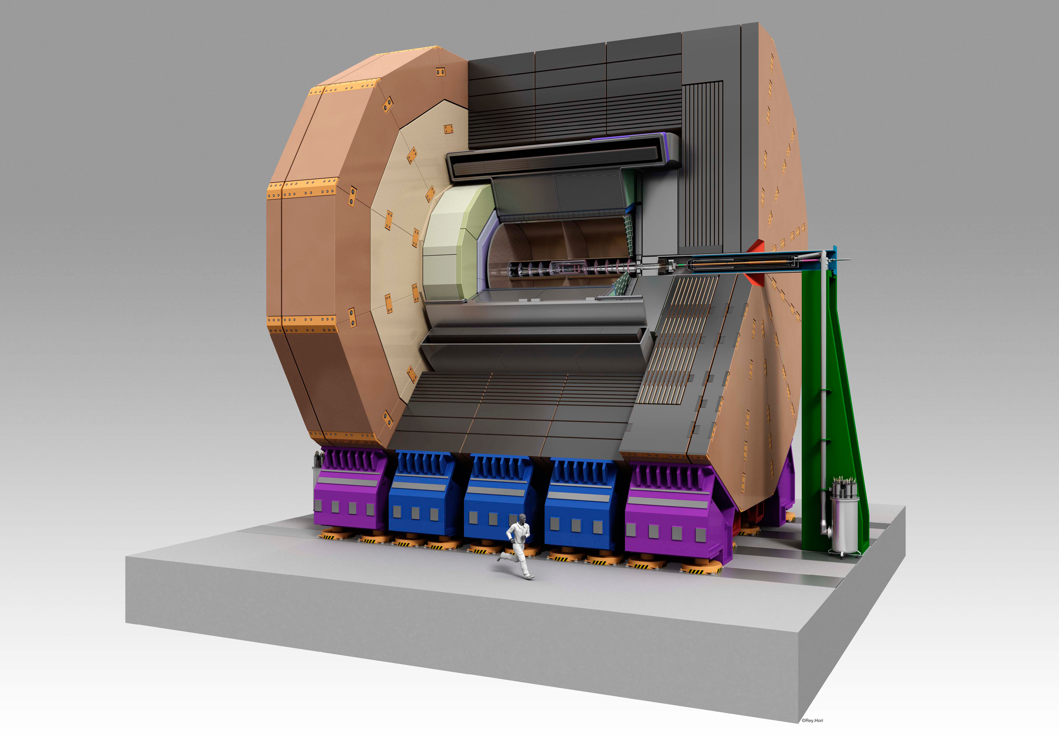
SOFIST (2016-) for the ILC pixel detector
Beam collision occurs in every 554 ns for 1 msec.
Hit information should be stored in each pixel and read out in the 200 ms collision interval.
Pixel size: 20 μm x 20 μm from physics requirement.
1 msec
1 msec

Slide 11
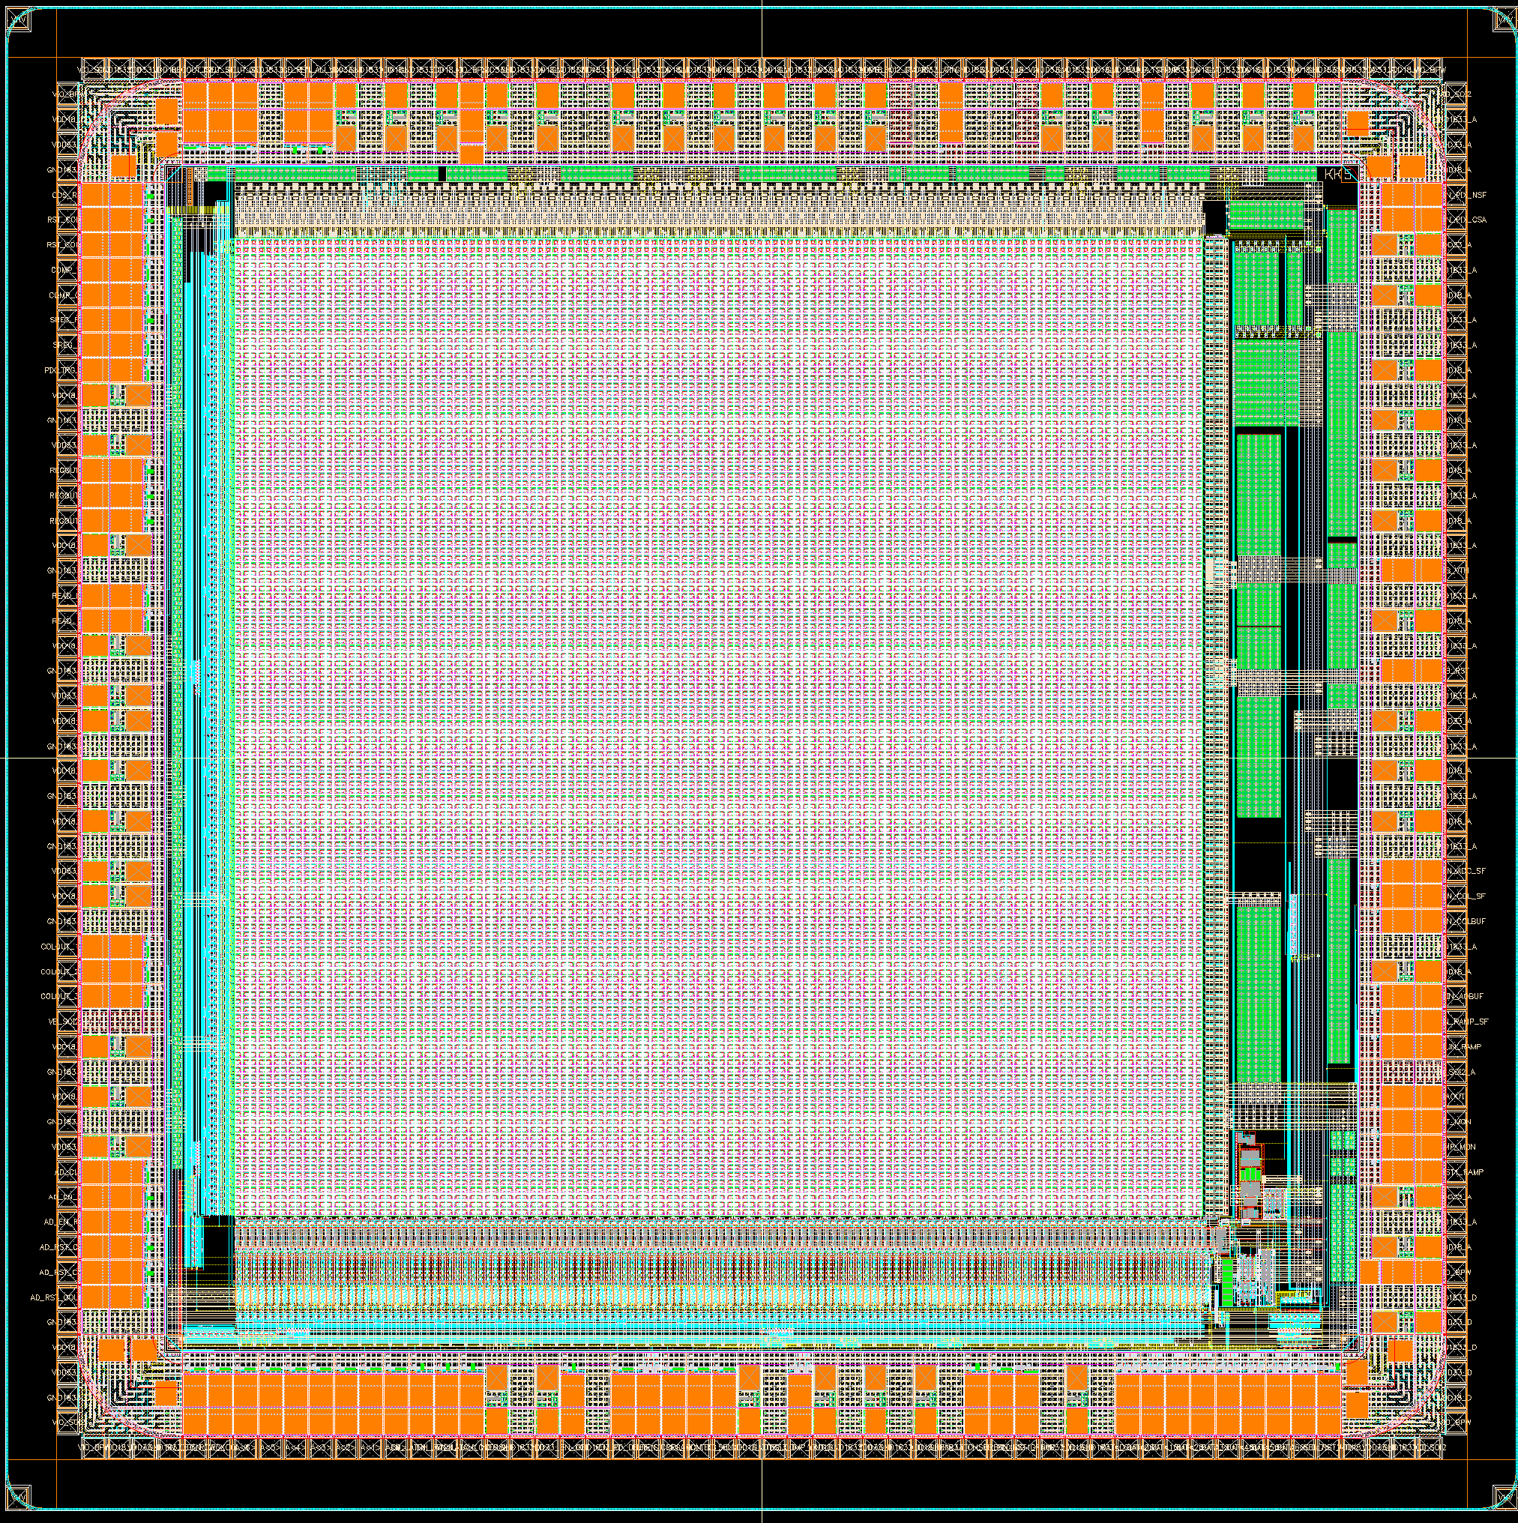
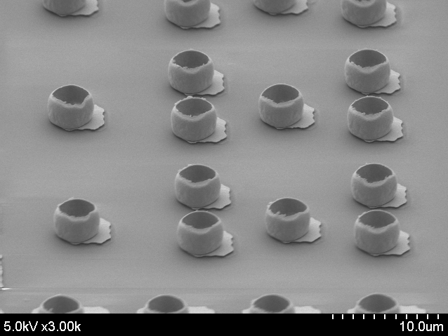
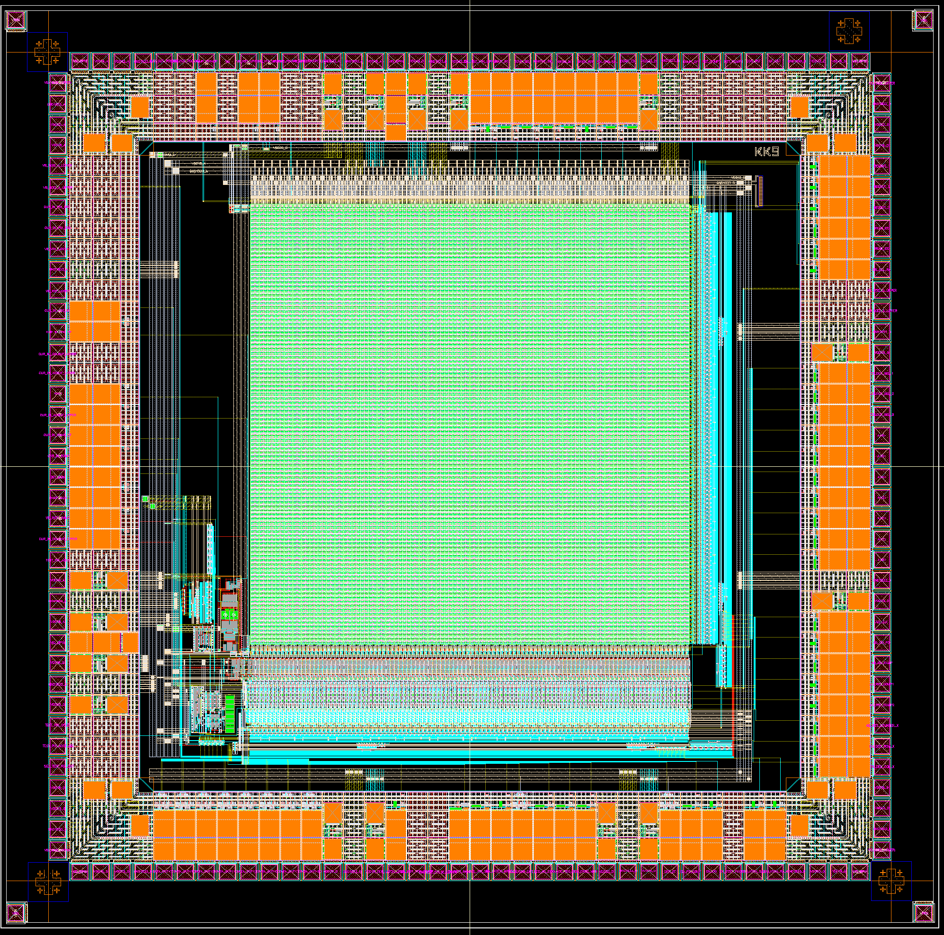
3D integration (2019-) Stacking of CMOS circuit to achieve more complex function
To integrate such complex functions to a given pixel size (20 μｍ x 20 μｍ), we had to add a CMOS circuit onto a pixel sensor.
Upper chip
(additional circuit)
Thinned to 6 μm thick
Micro bump for 3D integration
Pixel size (20 μｍ x 20 μｍ
Lower chip
(SOI pixel sensor)
Micro bumps (3.5 μm)

Slide 12
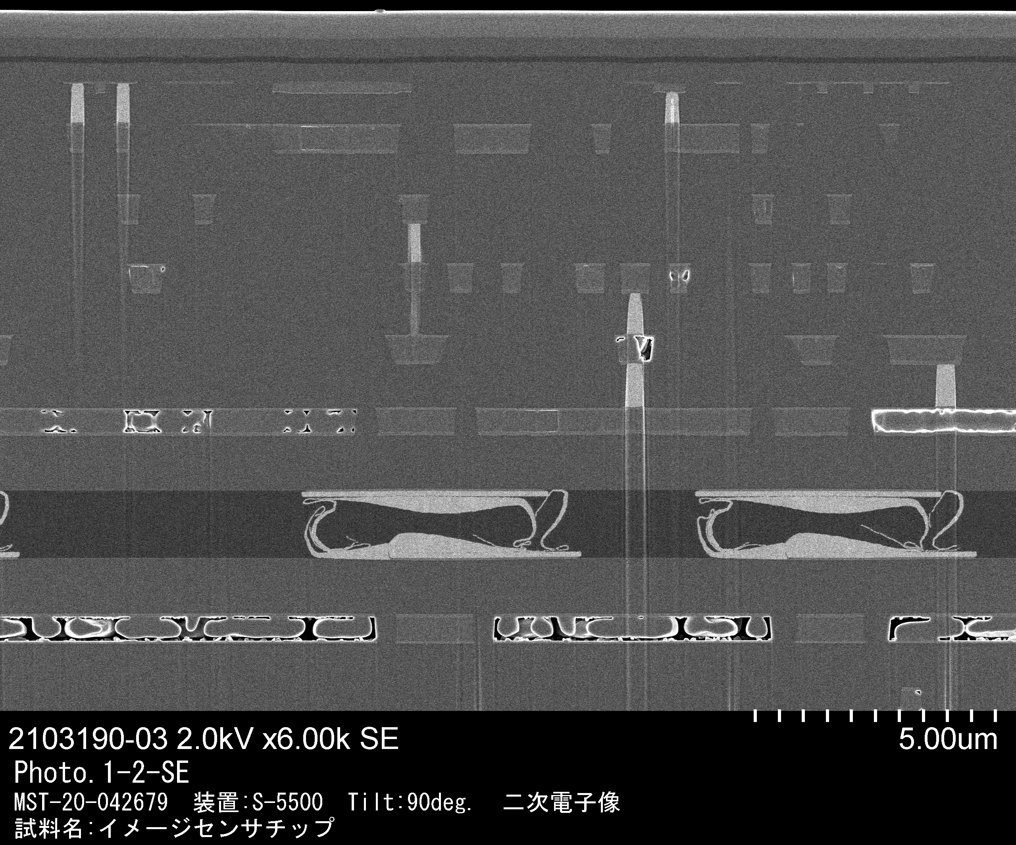
3D integration (2019-) Stacking of CMOS circuit to achieve more complex function
To integrate such complex functions to a given pixel size (25 μｍ x 25 μｍ), we integrated a CMOS circuit to a pixel sensor.
Four connection per pixel: Connection yield is found to be > 99.9 %
Upper chip
(additional circuit)
Thinned to 6 μm thick
0.2 μｍ transistors
Micro bumps (3.5 μm)
Lower chip
(SOI pixel sensor)

Slide 13
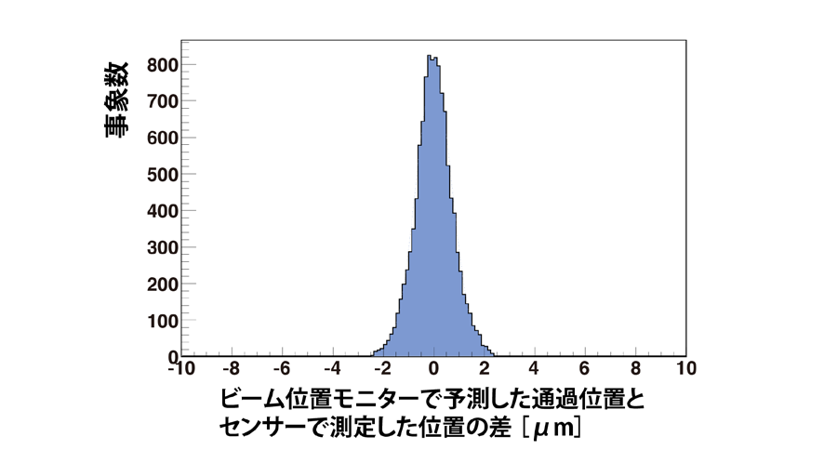
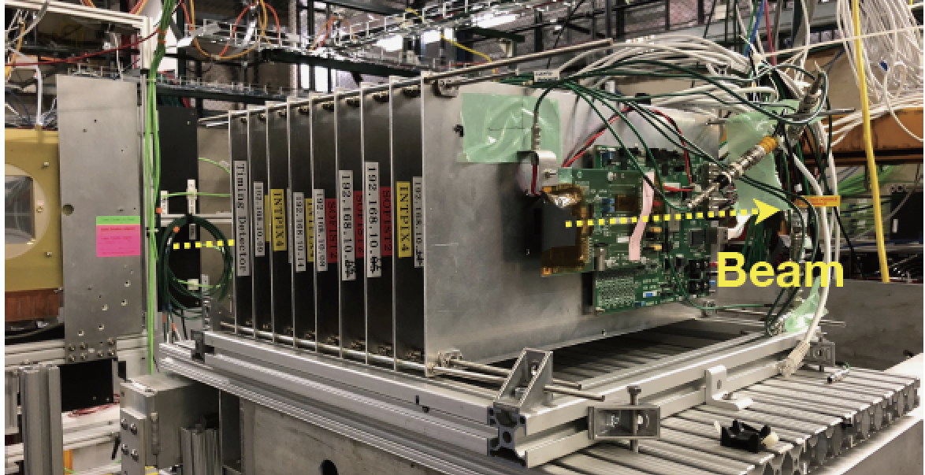
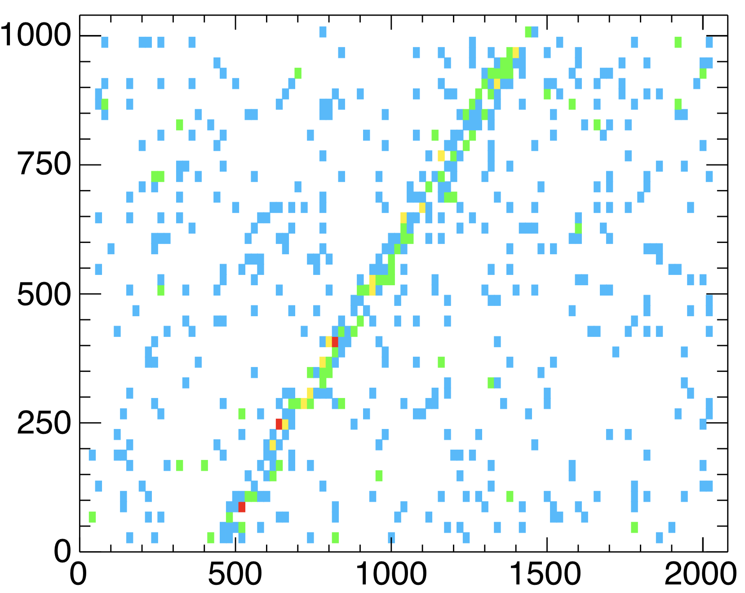
Beam tests at Fermilab 120 GeV proton beam
2017 with a 8 μｍ x 8 μｍ SOIPIX sensor, FPIX, better than 1 μm position resolution has been confirmed.
2020 with the SOFIST sensor (with 3D integration) the MIP particle was observed successfully.
Residual: Tracker- DUT (μｍ)
Position (Tracker) (μm)
Position (SOFIST-3D) (μm)

Slide 14
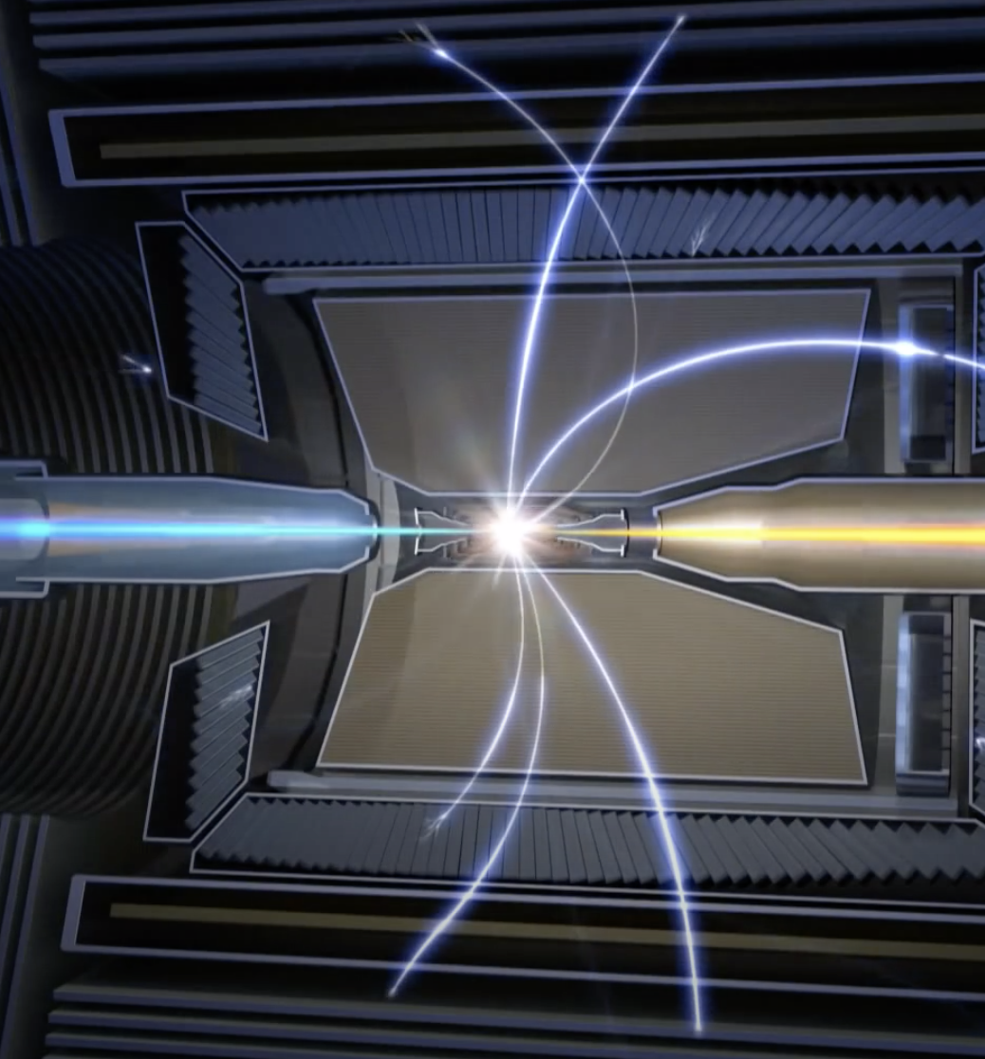
DuTiP (2020-) for the Belle II upgrade pixel
Belle2 detector
Pixel sensor will be placed 15 mm from Beam
Beam back ground hits 133 MHz/cm².
Trigger rate 30 kHz
Trigger decision 5-10 μs
Pixel size 40-45 μｍ
Low power consumption
2 m
15 mm

Slide 15
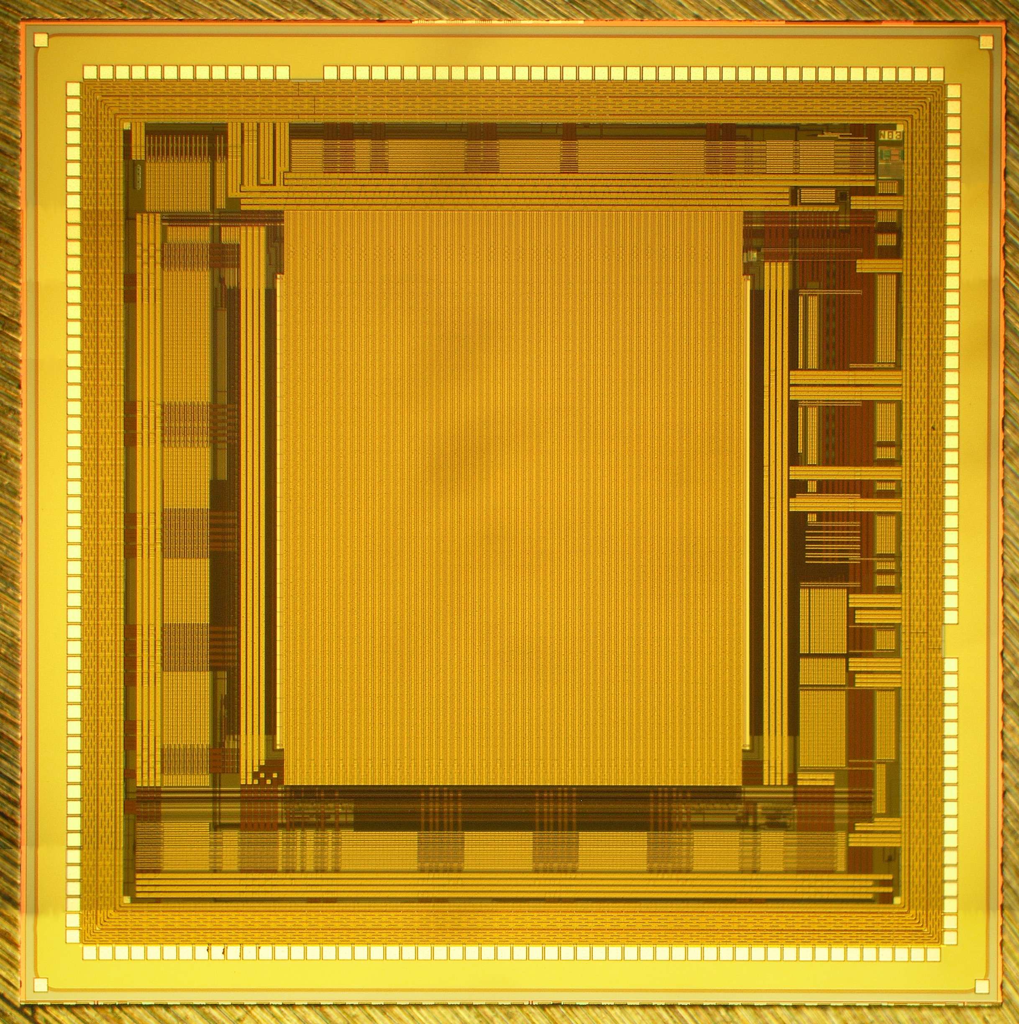
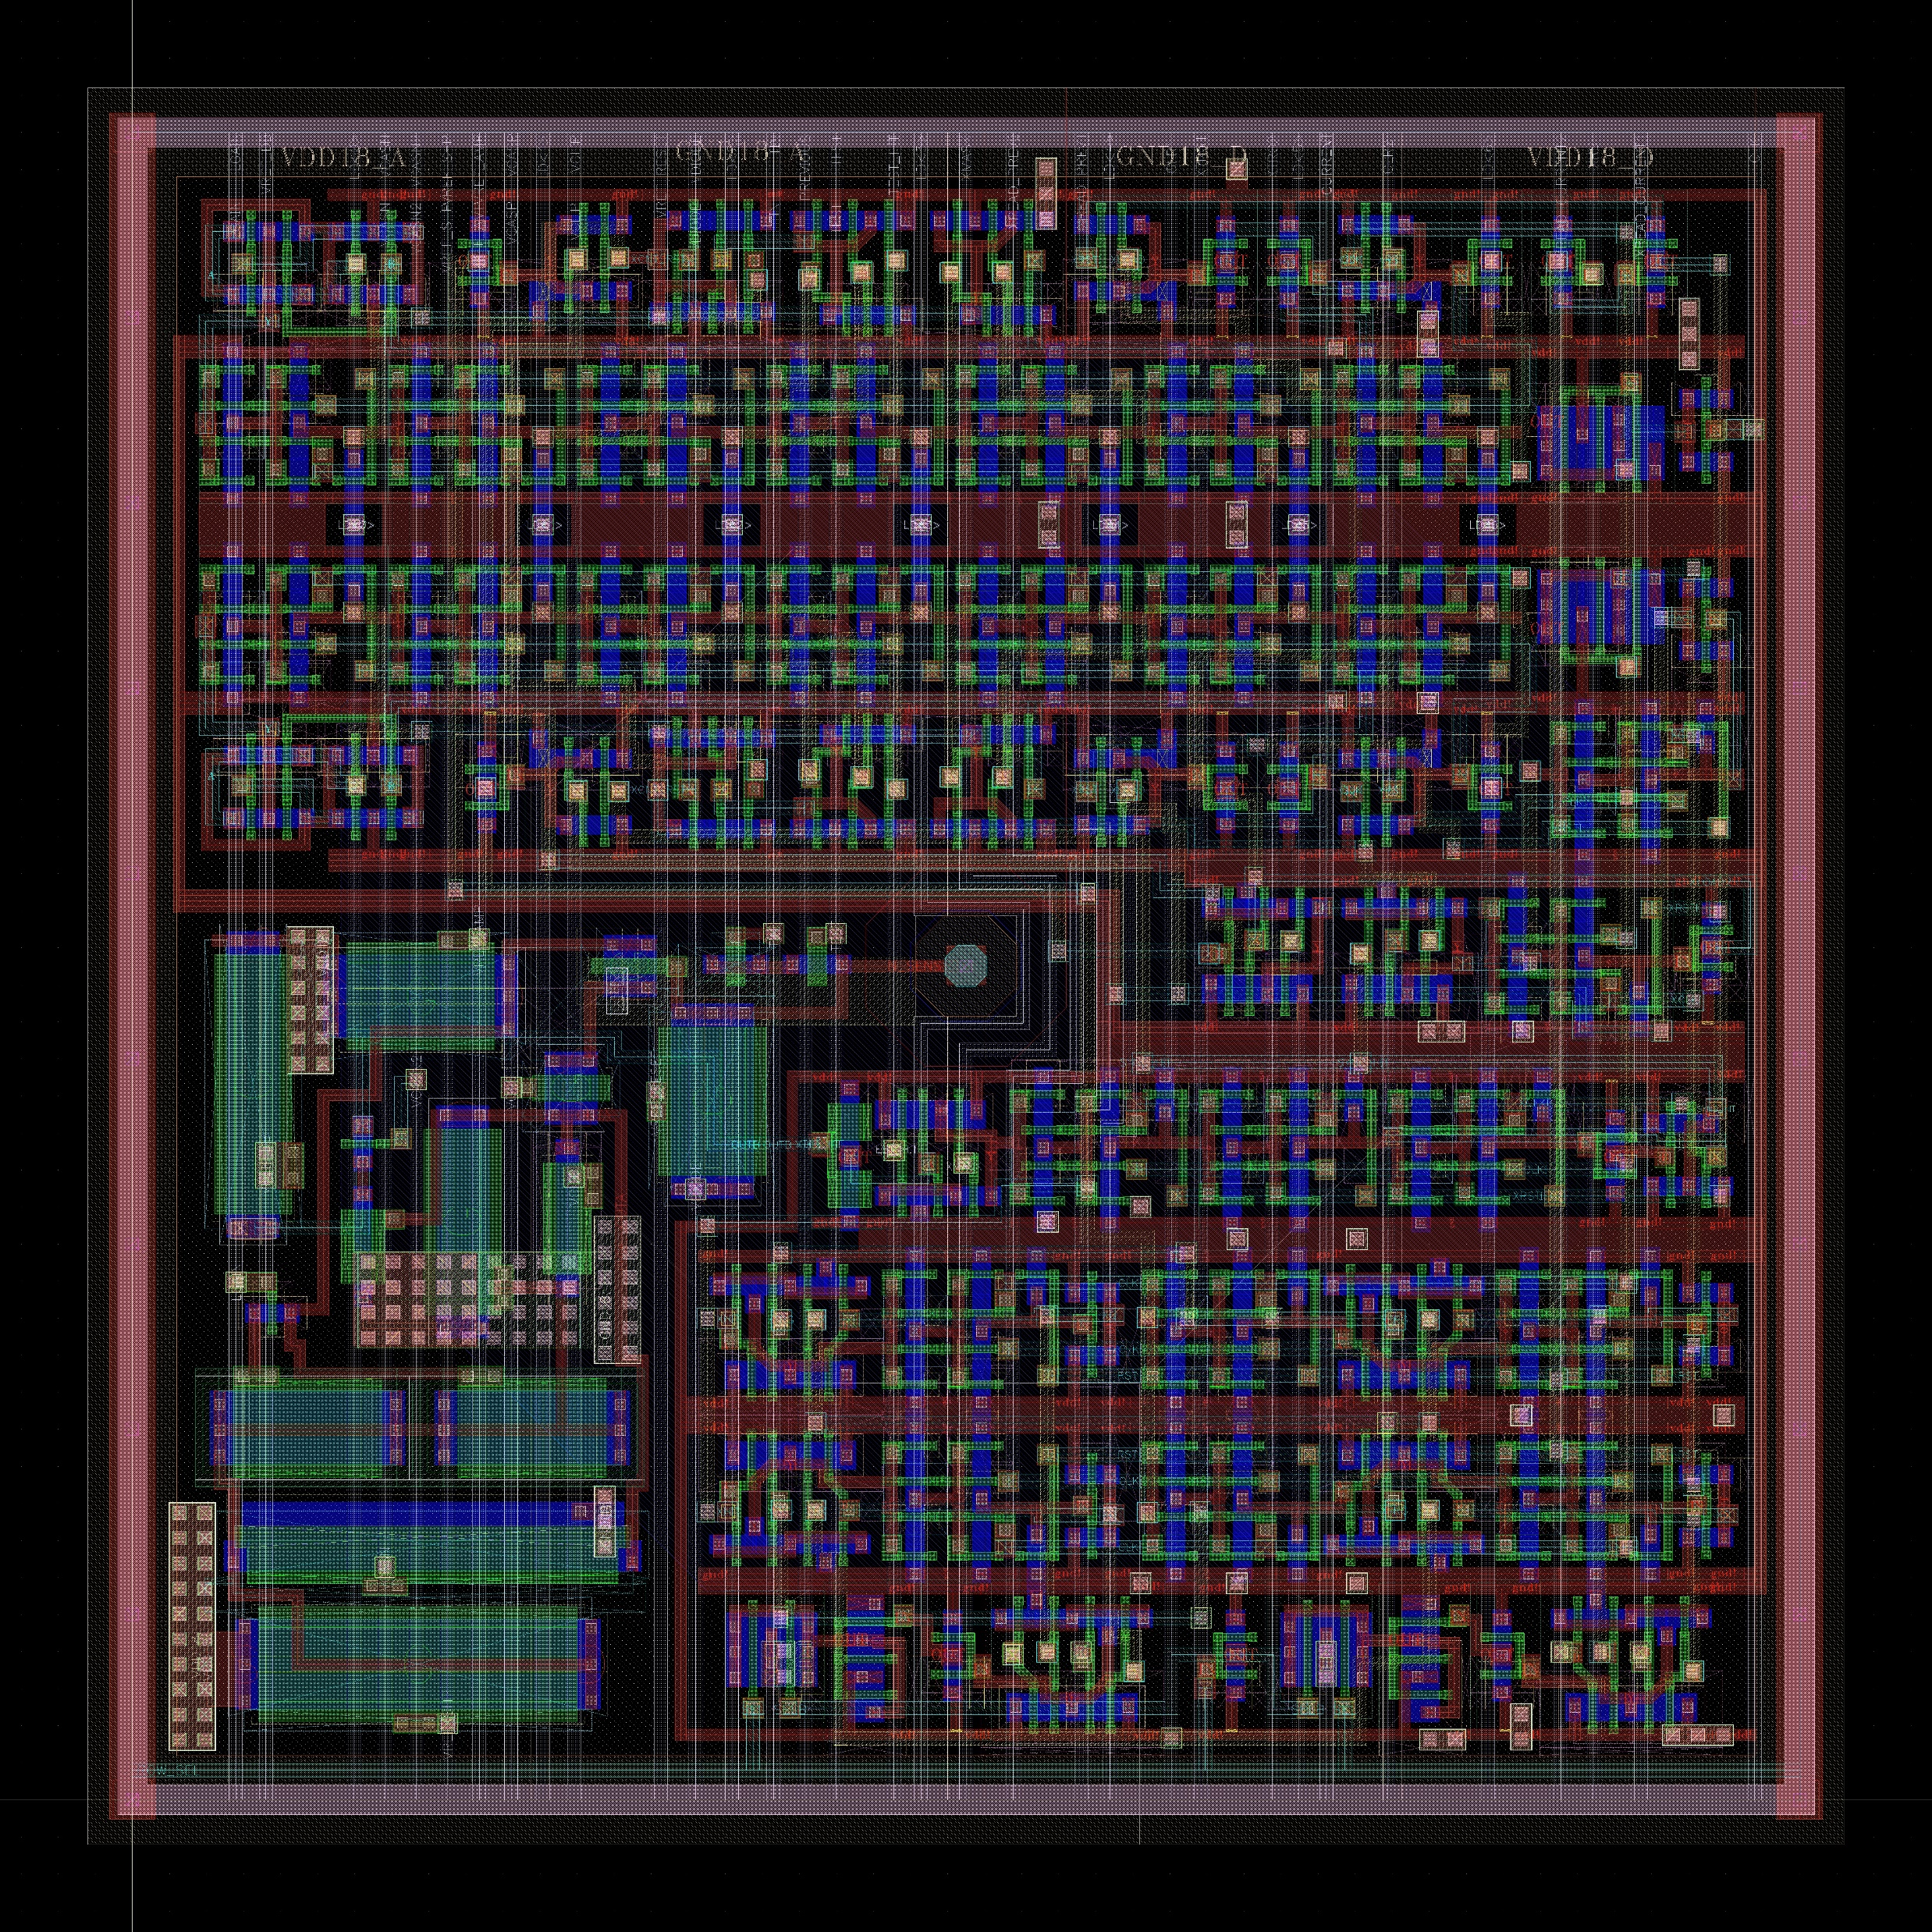
DuTiP (2020-) for the Belle II upgrade pixel detector
Hit reduction by taking coincidence hit with trigger in each pixel.
Hit information should be kept for the decision time in each pixel.
Most complex SOIPIX so far designed.
45μm
6mm
Belle event trigger
(5-10 µs for decision)
0.1 µs signal window
Back ground rate
< 0.001 hits/trigger/pixel
Efficient for physics signal.
100 MHz/cm² background
+ signal
Delay (5-10 µs for decision)
ALPIDE
amplifier

Slide 16
What Can We Provide for the EIC ?
Input parameters for pixel sensor design
Necessary spatial resolution → Sensor thickness and pixel size.
Distance from the collision point → Chip size
The following parameters are necessary to determine the circuit and readout scheme of the pixel sensor.
Beam collision frequency or interval
Trigger rate / Trigger latency /Data acquisition scheme.
Back ground rate.
Signal hits /event.

Slide 17
Summary
SOIPIX is a monolithic pixel sensor with the standard CMOS circuit and (almost) arbitrary structure of the radiation sensor.
We have developed various sensors for Xray.
It also fits particle physics experiments.
We have designed and produced the prototype sensors for the ILC and Belle pixel detector.
Even small pixel size, we can integrate necessary circuits by using the 3D stacking.
We need some more information to start chip design.

