Slide 1
Nucleon structure experiments using proton beam
- present and future -
RIKEN/RBRC
Itaru Nakagawa

Slide 2
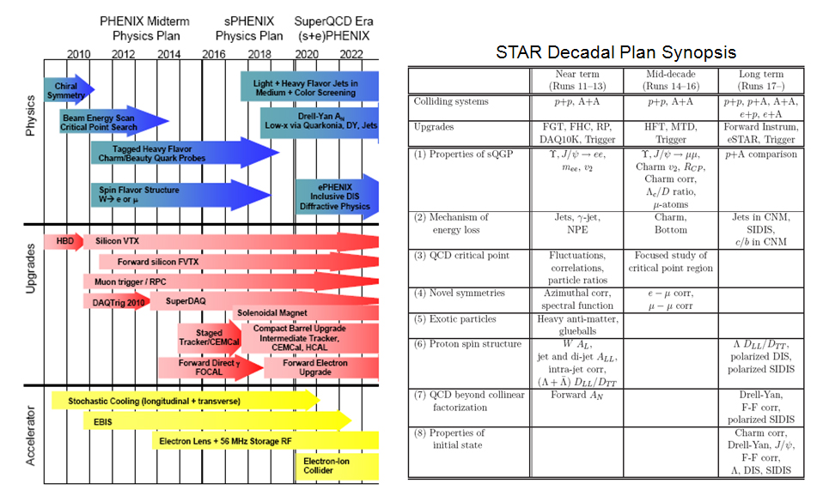
RHIC Future Plan

Slide 3
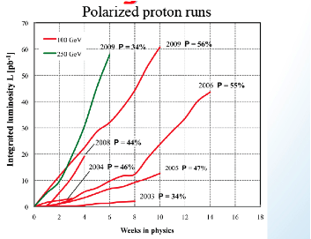
RHIC Performance Upgrades
Not only detectors, but also RHIC accelerator performance also be developed
  9MHz cavity
  Electron lenze
  Spin flippers
  …

Slide 4
Next 5 years

Slide 5
PHENIX and STAR Upgrades and Spin Physics
PHENIX Upgrade
STAR Upgrade

Slide 6
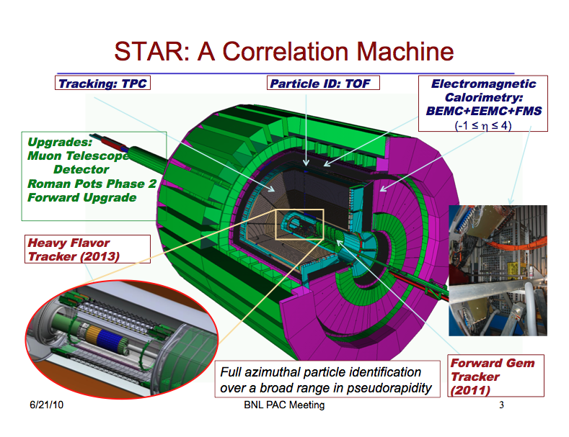
Slide from STAR Decadal Plan Status James Dunlop 6/21/10 1 BNL PAC Meeting

Slide 7
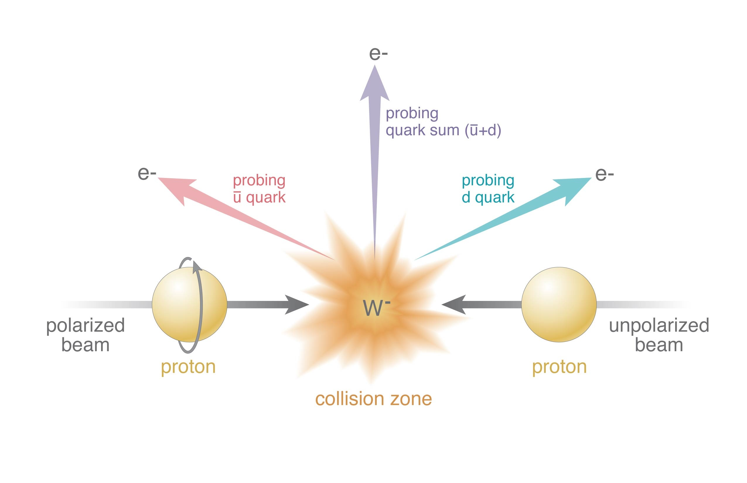
Sea Quark Polarization Measurement via W-boson Production

Slide 8
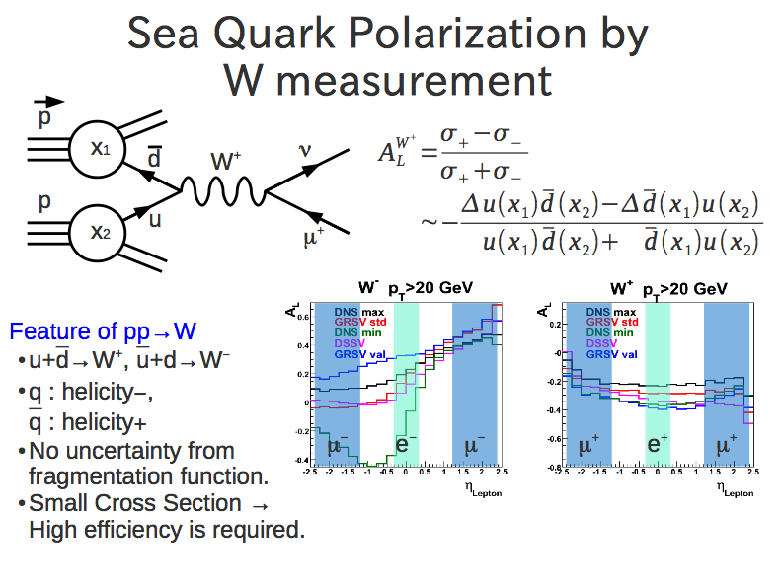

Slide 9
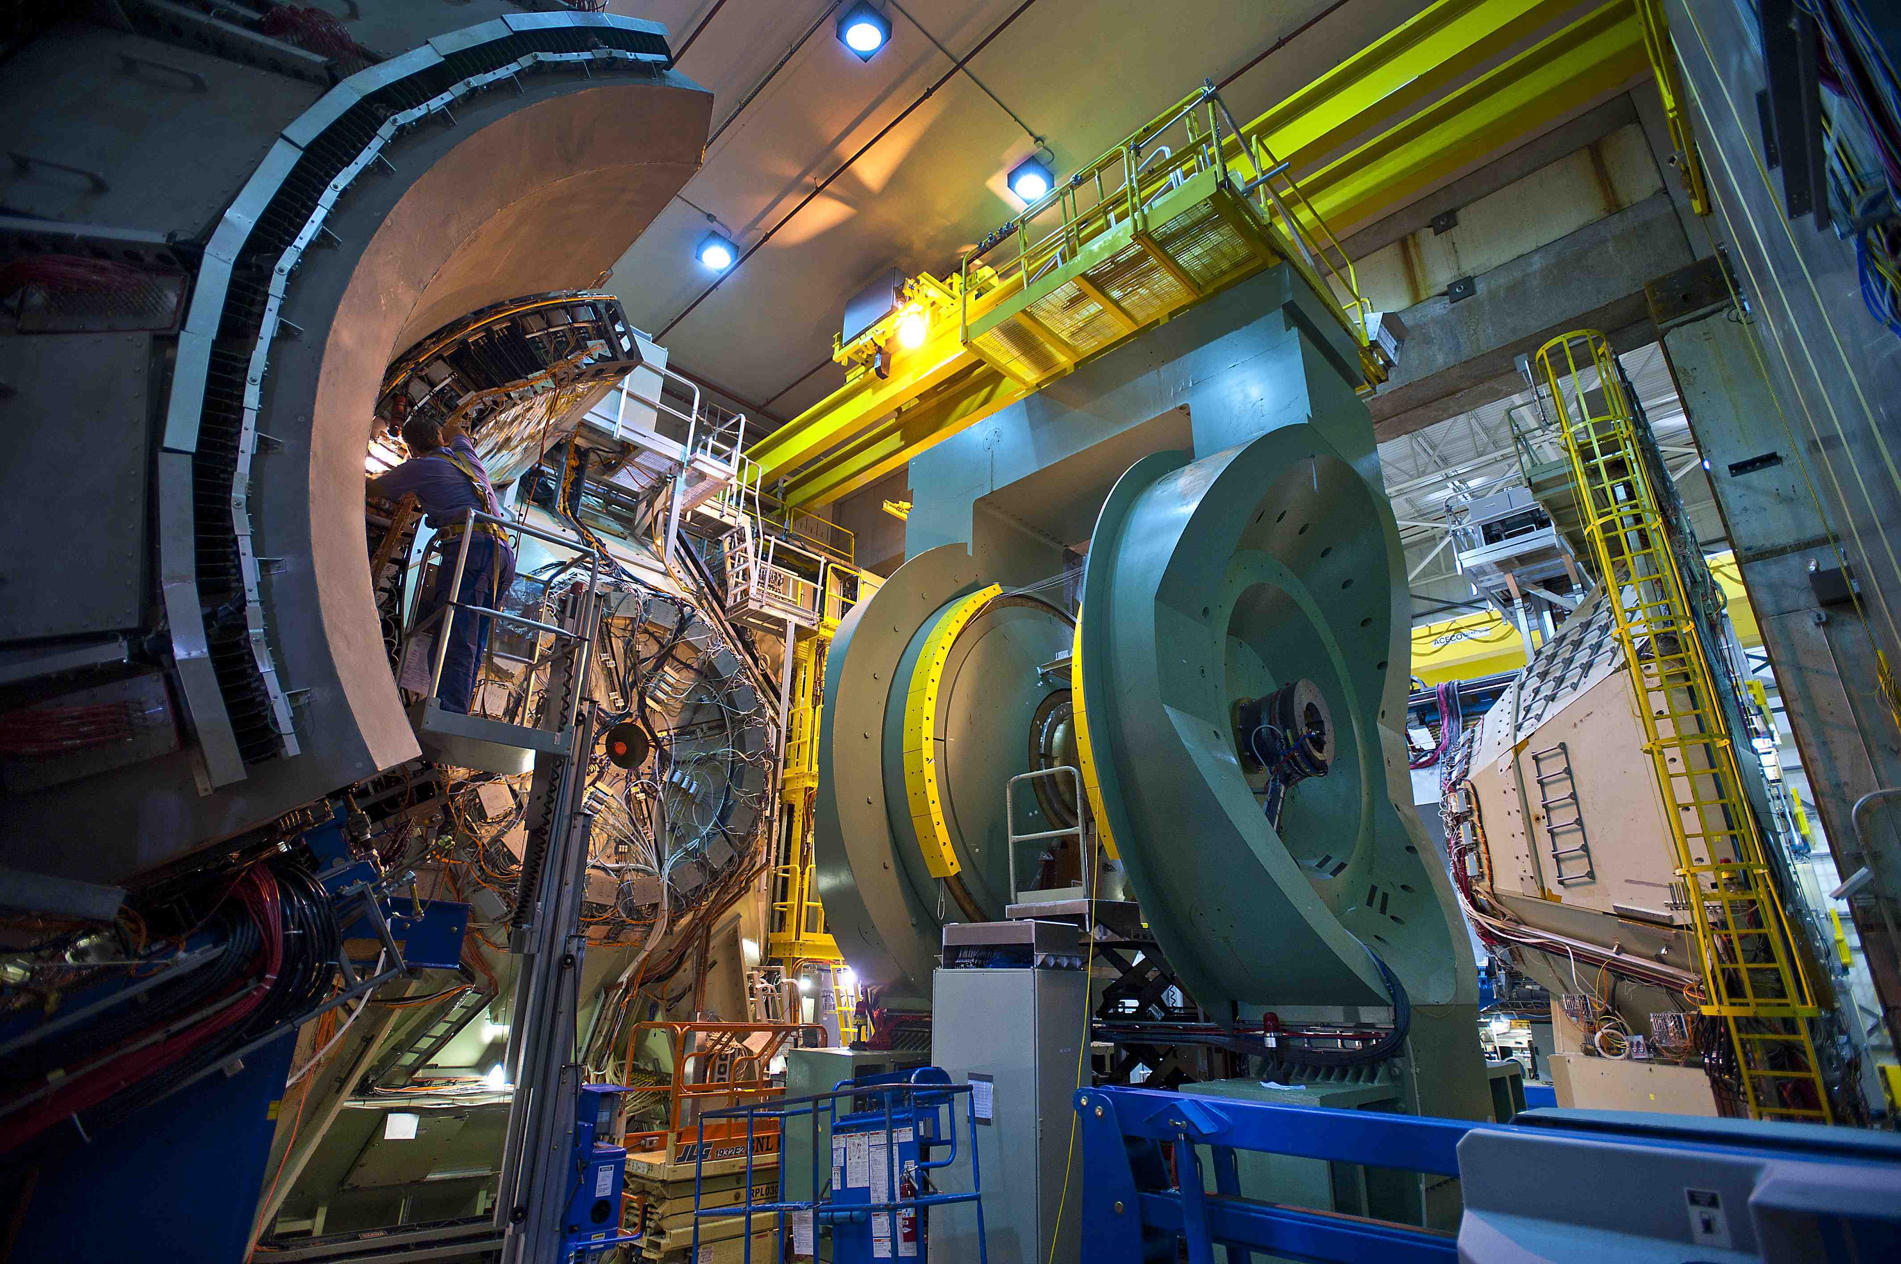
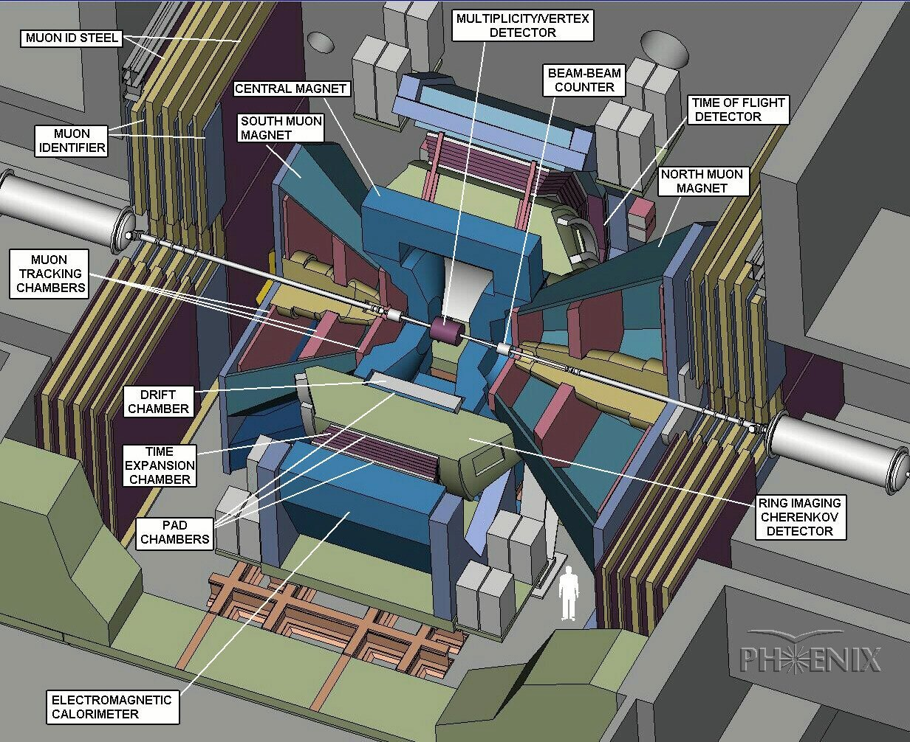
Forward (North&South) Muon Arms

Slide 10
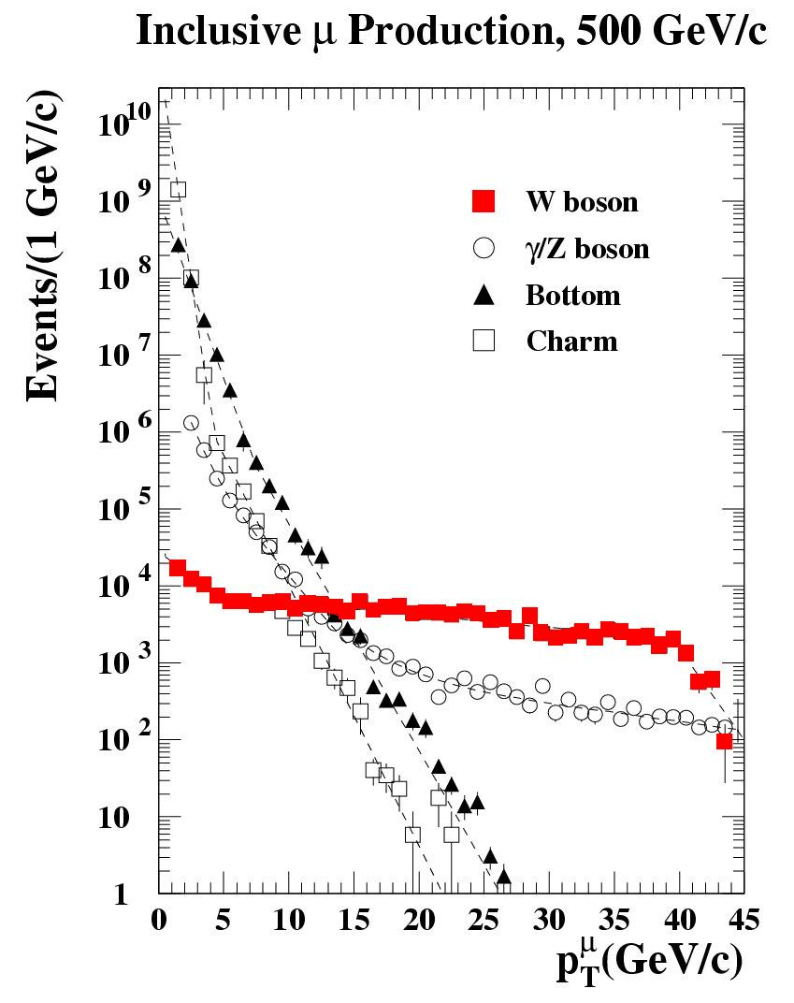
High Momentum Muon Trigger
Run11 500 GeV Projection
σ_{tot}=60mb
L=1.5x10³²cm⁻²s⁻¹
Rate
9 MHz
BBC×MuID Rejection Power
RP~100
New Trigger
Upgrade
90 kHz
Trigger Upgrade
RP ~ 45
W
RP_{tot} ~ 4500
2 kHz
PHENIX Band Width for Muon
Required Rejection Power
High Rejection Power
High Efficiency
MuID
Trigger

Slide 11
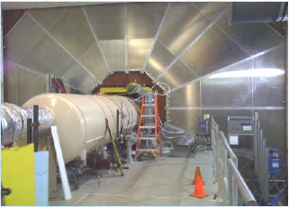
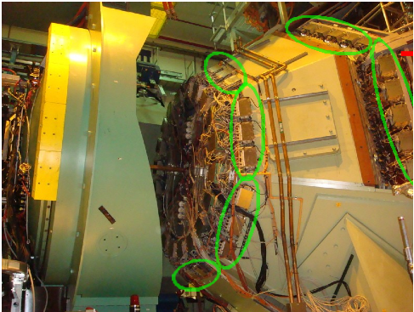
PHENIX Muon Trigger Upgrade
Run11 under commissioning
RPC3
2 dedicated trigger Resistive Plate Chambers (RPC) stations (CMS design):
~ 1 degree pitch in ϕ
RPC1
NSF (Funded)
r=3.40m
MuTr front end electronics
(MuTr-FEE Trigger)
MuTr
JSPS (Funded)
Run11 Production Trigger

Slide 12
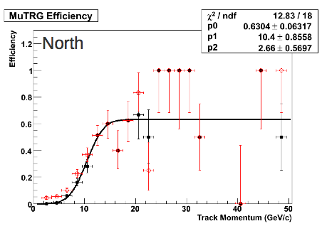
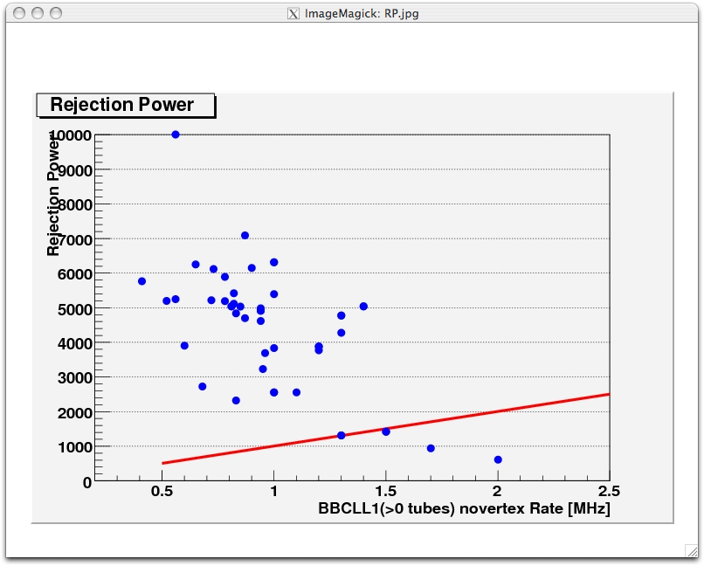
Muon Trigger FEE Performance
Goal :
High Efficiency > 90%
High Rejection Power > 3000
PHENIX DAQ band width limit
New MuTrig-FEE operation is on its way to be optimized.

Slide 13
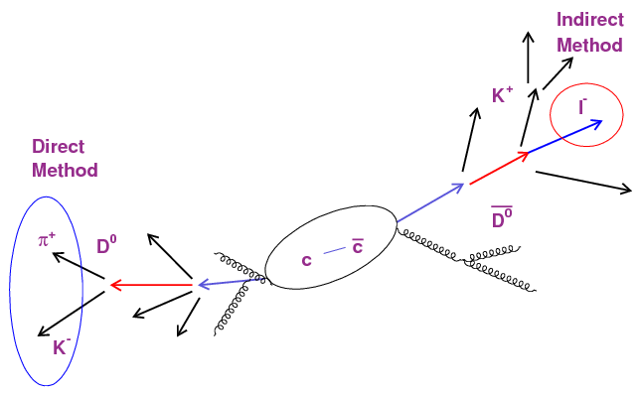
Heavy Quark Measurement
Direct Method
Reconstruct the parent meson from their
daughter particles.
Hard to reconstruct in high multiplicity
Indirect Method
Measure leptons(electrons) from semi-leptonic decays of D/B.
Standard method in PHENIX
VTX can improve both Indirect and Direct method
by DCA measurement.

Slide 14
Distance of Closest Approach (DCA)
Collision happens
D meson is emitted from the event vertex
This D meson will decays in flight. Decay products are scattered at secondary vertex.
Electron is measured by VTX. The track is reconstructed.
DCA = Distance of Closest Approach of a reconstructed track to the event vertex
e
ν
K
Secondary
Vertex
D
DCA
beam
beam
Event
Vertex

Slide 15
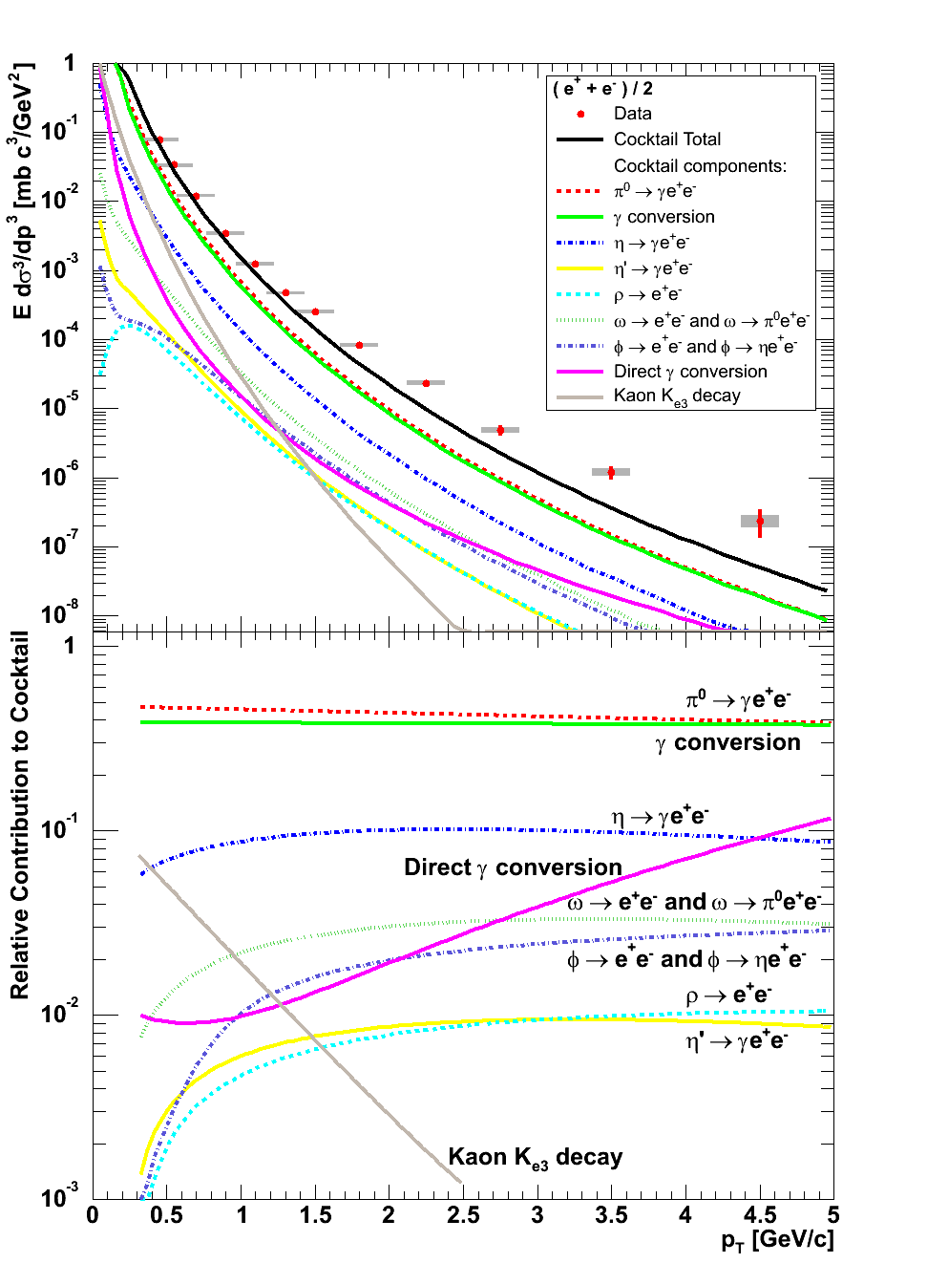
DCA : Flight path length of Signal and Background
Back Ground
π0 cτ = 25.1 nm
η for Γ = 1.30 ± 0.07 keV
ω for Γ = 8.49 ± 0.08 MeV
ρ for Γ = 149.1 ± 0.8 MeV
φ for Γ = 4.26 ± 0.04 MeV
j/ψ for Γ = 28.6 ± 2.2 MeV
K+/-e3 cτ = 3.712 m
K0S cτ = 2.6842 cm
K0L cτ = 15.34 m
γ conv @ material
Signal
D0 cτ = 122.9 μm
D+ cτ = 311.8 μm
B0 cτ = 457.2 μm
B+ cτ = 491.1 μm
Emitted from Zvtx
Far from Zvtx
With 50um resolution, VTX separate D and B and reject BG contribution

Slide 16
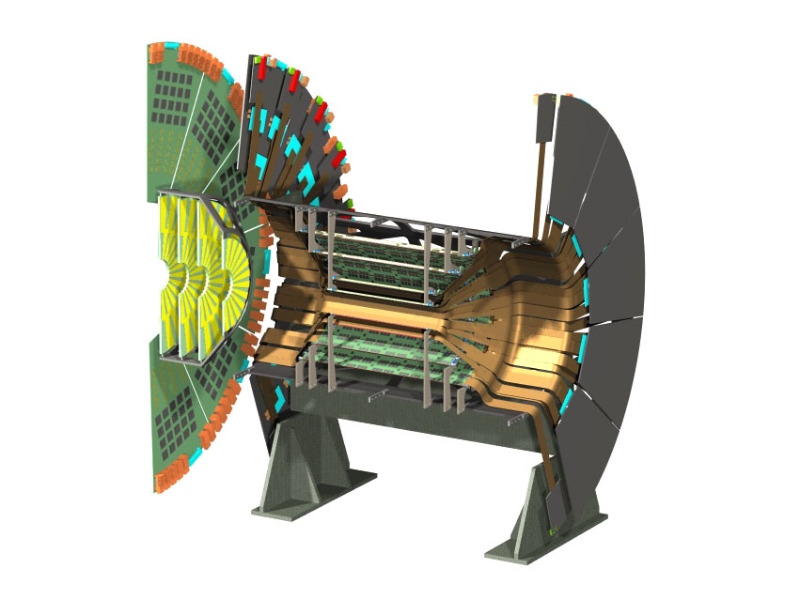
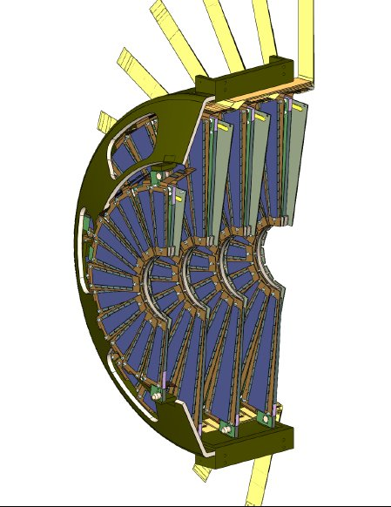
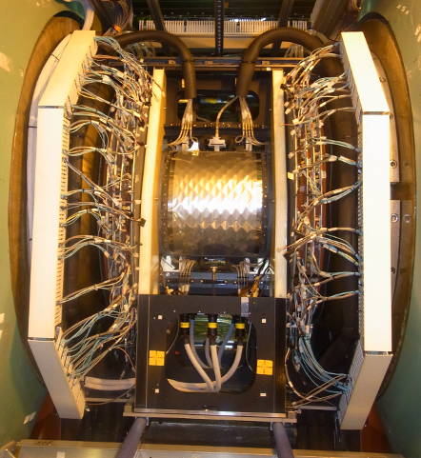
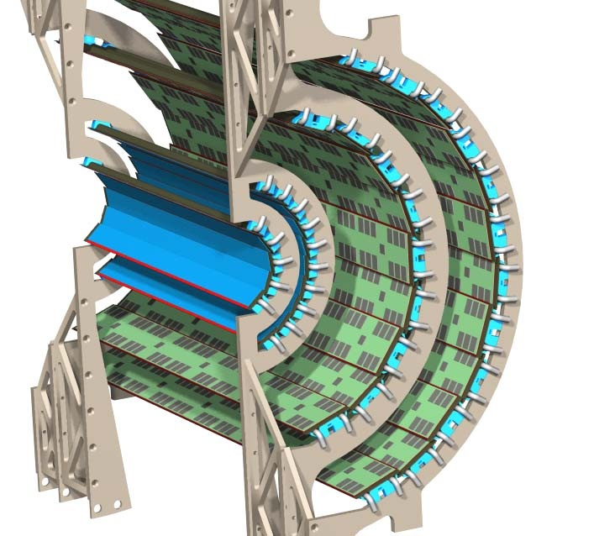
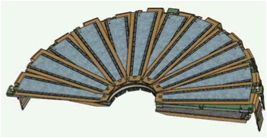
PHENIX Silicon Vertex Trackers (VTX & FVTX)
  Side view
To be installed in 2011!
Installation Completed!
2 Pixel layers
2 Stripixel layers
  Beam view

Slide 17
Physics Motivation
Measurement in p + p, d + Au and Au + Au Collisions
  Single Muons measurements:
    Precision heavy flavor and hadron measurements.
    Separation of c and b in semi-leptonic decays via decay kinematics.
    Improve W background rejection.
  Dimuons measurements:
    Separation of ψ’ from J/ψ at forward rapidity.
    B→J/ψ, golden channel to measure B cross section.
    First Drell-Yan measurement at RHIC.
Physics FVTX Can Access:
  Energy loss mechanism in hot dense medium (Heavy flavor R_{AA,} v₂)
  Cold nuclear effects ( Heavy flavor R_{dAu})
  Gluon polarization ΔG/G (Heavy flavor A_{LL})
  Sivers function, higher twist (Heavy flavor A_{N})
  Crucial test of QCD universality (Drell-Yan A_{N})
Notes:
Then, go to details of physics goals with FVTX, what we are going to achieve in pp dAu and AuAu collisions? In single muon …

Slide 18
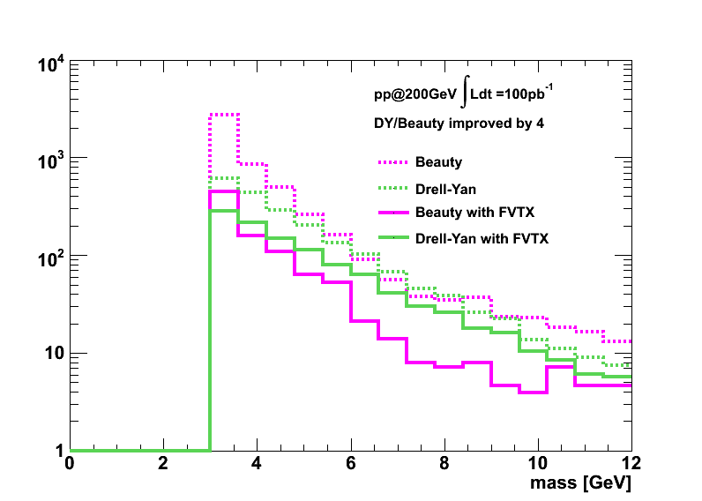
Drell-Yan measurement
Heavy flavor background
b-bbar background rejection with FVTX
In Drell-Yan process
Drell Yan
ϒ-states
J/Ψ
charm
beauty
4 GeV < M < 10 GeV
Background (bottom,Charm) rejection using FVTX
Improve Signal / Background Ratio by factor ~4
FVTX + new muon trigger will open up wide variety of physics opportunities from forward arm!
Notes:
Drell-Yan is an important and direct way to understand QCD. In the dimuon mass range from 4 to 10 GeV, the main source of background is ccbar and bbbar pairs. FVTX will help to reject the heavy flavor background and the improvement factor is around 4.

Slide 19
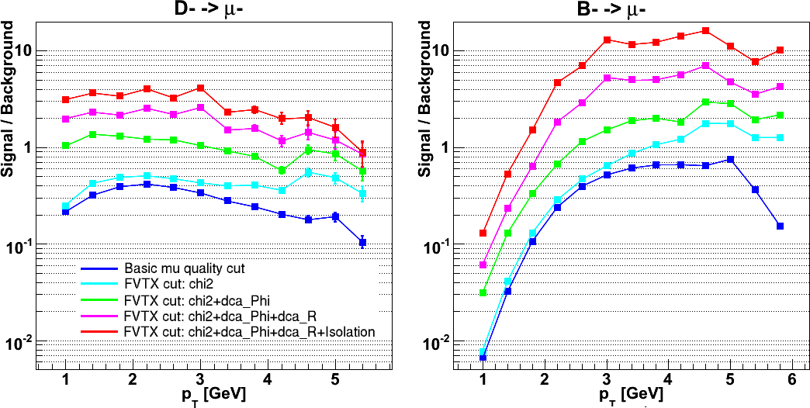
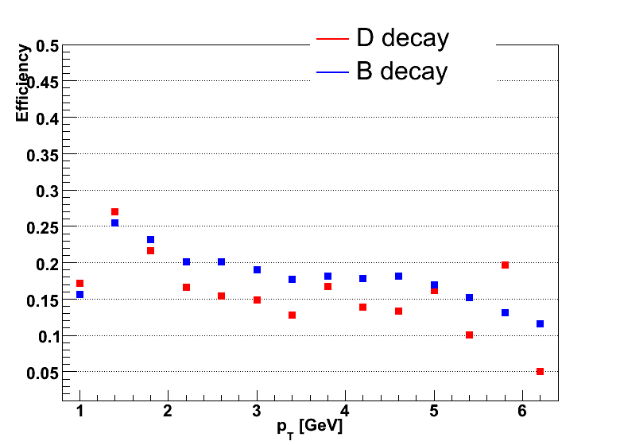
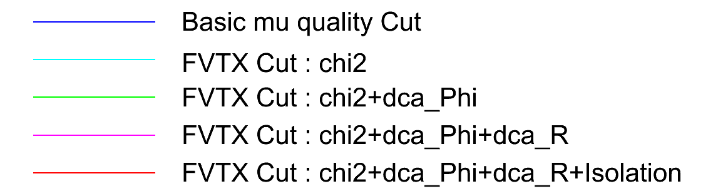
Signal / Background improvements
S/B improvement with FVTX cuts
x 10 improvement
Efficiency
Cut :
FVTX improve S/B ~10 ;
Efficiency 15% ~ 20% ;
Notes:
With various FVTX related cuts, chi2, dca_R, dca_phi and isolation, we expect to improve S/B ratio by a factor of 10 at most, with an efficiency from 15% to 20%. The trade off between signal improvement and efficiency can be adjusted to find the balance point.

Slide 20
10 years

Slide 21
Some thoughts on future detectors
Multipurpose, flexible—ready to address new questions as they arise!
Uniform, compact
Two multipurpose detectors? One optimized for hadronic/nuclear collisions with secondary capabilities in e+A, e+p; other vice versa? (Challenging to optimize for both!)
Staged implementations?
Renewed collaborations!
  Major new program should attract new collaborators!

Slide 22
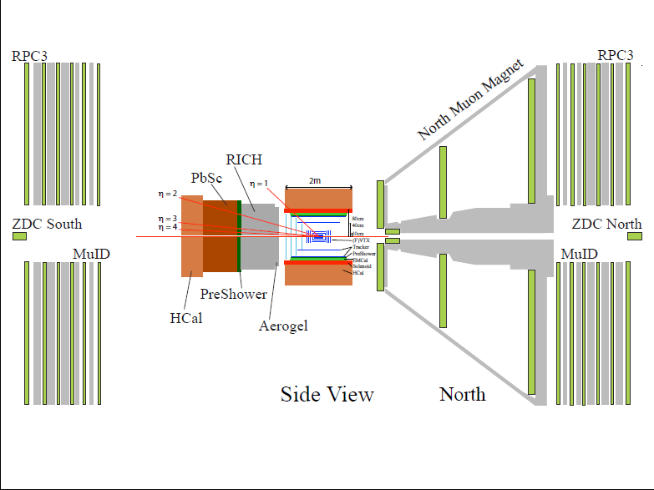
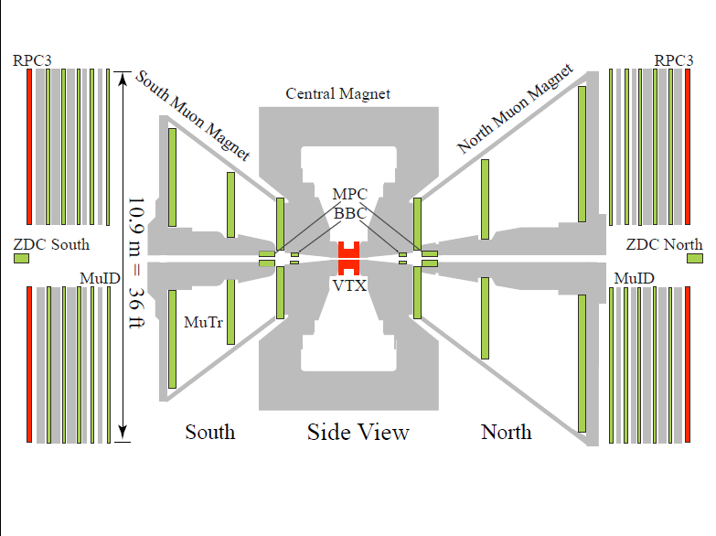
Conceptual Design sPHENIX

Slide 23
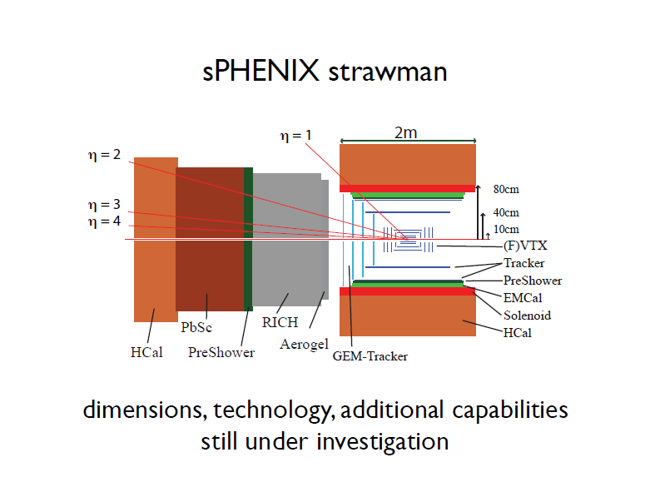

Slide 24
Target Physics
Dynamical Origin of Spin Dependent Interactions -> DY vs. SIDIS
New probes of Longitudinal Spin Effects -> Direct g
Measurements with polarized 3He (different valence quark components) and higher energy (sqrt(s)=650 GeV by upgrading DX magnets)

Slide 25
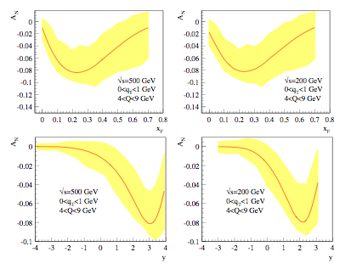
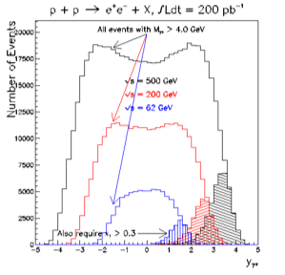
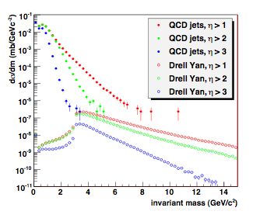
DY

Slide 26
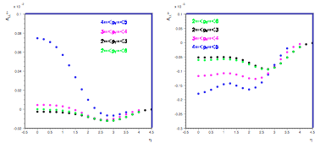
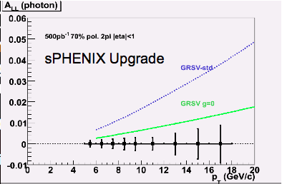
Longitudinal
π⁺
π⁻

Slide 27
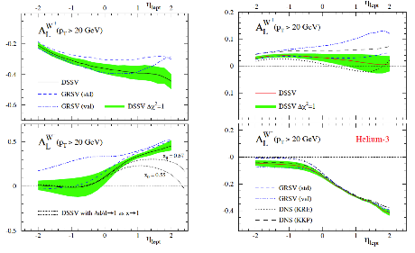
p-³He collision

