Slide 1

NOPTREX project ( overview )
Masataka Iinuma ( NOPTREX collaboration )
Hiroshima University
2022.9.2(Fri) 19th QCD Workshop, Yamagata, Japan

Slide 2
Outline
Motivation
- Search of T-violating effects in a low-energy region -
Enhancement of PNC and T-violation in compound state
Plan of NOPTREX project
Summary

Slide 3
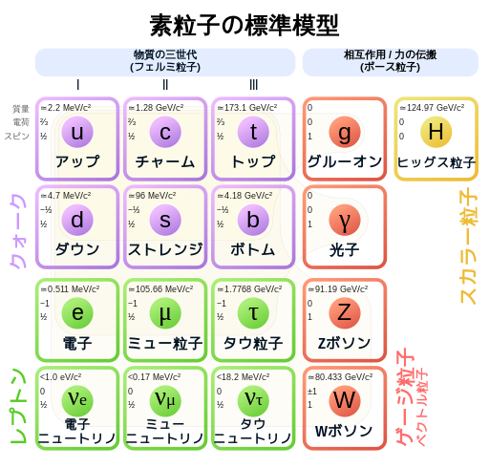
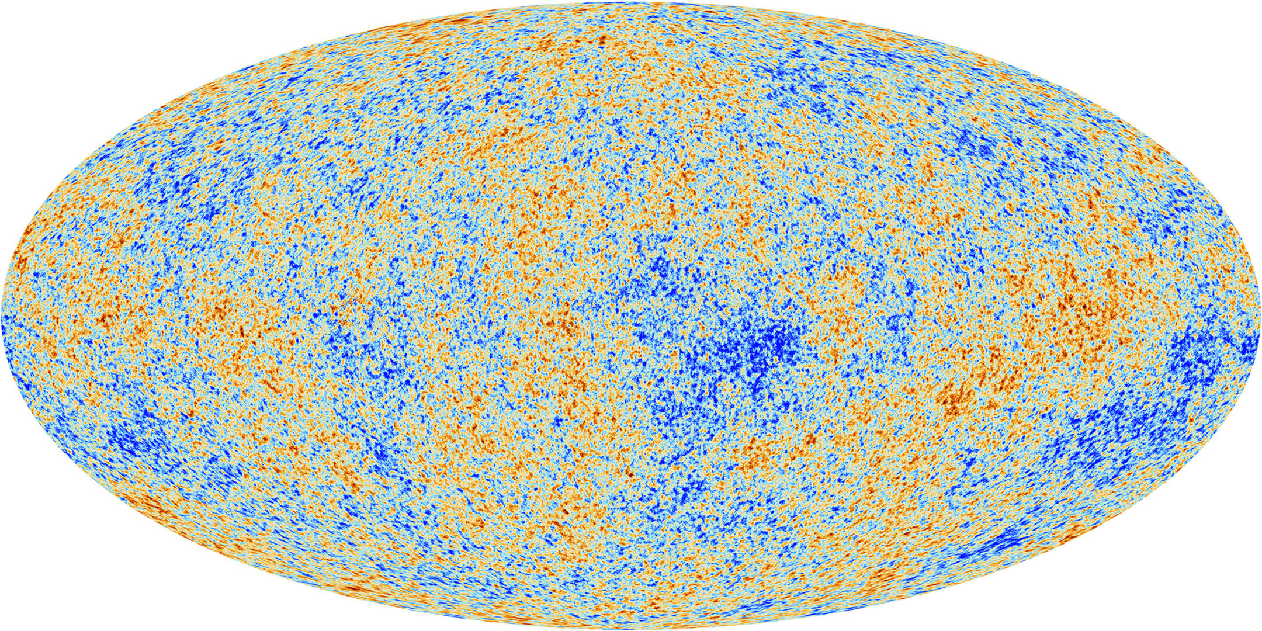



Search of unknown CP violation
$$η≡\frac{N_{baryon}}{N_{photon}}$$
Matter-Antimatter Asymmetry in universe
Observation
the Standard Model
CMB
Unexplained !!
$$η=\left(6.05±0.07\right)×{10}^{−10}$$
Planck13
$$η\sim {10}^{−18}$$
(CP violation in the Standard Model)
E. O. Zavarygin and A. V. Ivanchik, J. Phs.: Con. Ser. 661, 012016, (2015)
W. Bernreuther, in CP violation in Particle, Nuclear and Astrophysics, Springer, 2022
Existence of unknown CP violation ?
T-violation
・Possible in low energy region ( unnecessity of anti-particles )
・Investigation of connection between low and high energy phenomena
European Space Agency - https://www.esa.int/ESA_Multimedia/Images/2013/03/Planck_CMB, CC 表示-継承 4.0, https://commons.wikimedia.org/w/index.php?curid=108189337による

Slide 4

T-violation in low energy region
Two methods only without final state interaction (fake effects)
unrealistic
Electric Dipole Moment (EDM)
Neutron transmission
Normal scattering
Static state
Initial state = final state
Initial state $≠$ final state
Spin
Compound state
EDM
Distinguishable in steam of time
time
time
time
Spin
EDM
Compound state
time
time
time
Difference of transmission

Slide 5
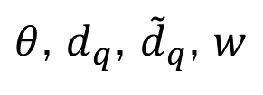
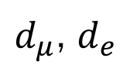



Connection to high energy region
Fundamental CP-odd phase
TeV
Gluon self-coupling
QCD
$d_{μ}$, $d_{e}$
$C_{qe}$, $C_{qq}$
$θ$, $d_{q}$, ${\tilde{d}}_{q}$, $w$
Muon EDM
pion exchange
Neutron EDM
nuclear
$$C_{S,P,T}$$
${\overline{g}}_{πNN}$
eN coupling
Compound state
EDM of nuclei and ions( deuteron )
EDM of paramagnetic atoms(Tl, Cs)
and molecules(YbF, PbO )
atomic
EDM of diamagnetic atoms
( Hg, Xe, Ra, Rn )
M. Pospelov and A. Ritz, Ann. Phys. 318, 119 (2005)

Slide 6
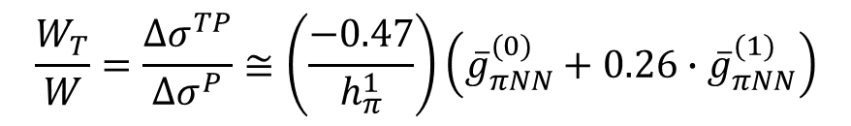




Search region
$${\overline{g}}_{πNN}^{\left(1\right)}$$
n-EDM
J. Eagal, et al., Prog. Part. Nucl. Phys. 71, 21 (2013)
$$d_{n}=−\left(1.5×{10}^{−14}\right)∙\left({\overline{g}}_{πNN}^{\left(0\right)}−0.93×{10}^{−2}∙{\overline{g}}_{πNN}^{(1)}\right)$$
n-EDM
Compound state
Sensitive
Compound state
Y.-H. Song, et al., Phys. Rev. C 83, 065503 (2011)
$${\overline{g}}_{πNN}^{\left(0\right)}$$
$$\frac{W_{T}}{W}=\frac{Δσ^{TP}}{Δσ^{P}}≅\left(\frac{−0.47}{h_{π}^{1}}\right)\left({\overline{g}}_{πNN}^{(0)}+0.26∙{\overline{g}}_{πNN}^{(1)}\right)$$
Both sensitive
Reference:
$$n+p →d+ γ$$
Complimentary to n-EDM
$$h_{π}^{1}=\left(3.04±1.23\right)×{10}^{−7}$$

Slide 7
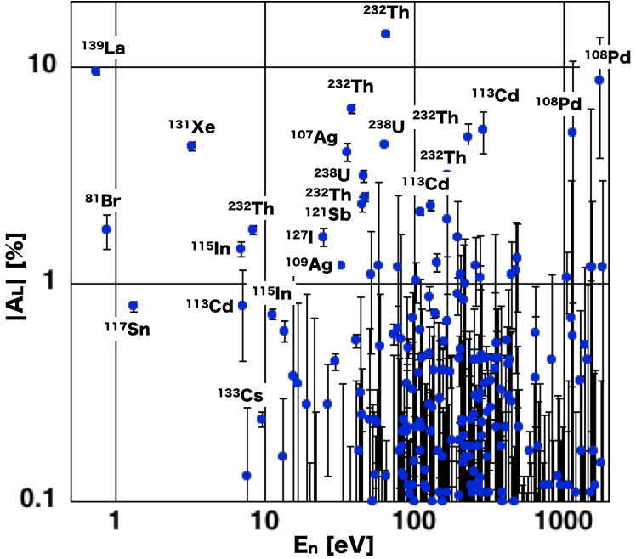

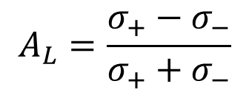



Enhancement of Parity violation in Compound state
Helicity Asymmetry
neutron
Nucleus
$$A_{L}=\frac{σ_{+}−σ_{−}}{σ_{+}+σ_{−}}$$
Ex) ¹³⁹La : $E_{P}=0.734$ eV
$$A_{L}=0.097±0.003$$
Proton-proton scattering
10⁶ enhancement
proton
proton
$$A_{L}=−\left(1.7±0.3\right)×{10}^{−7}$$
$E=15$ MeV

Slide 8



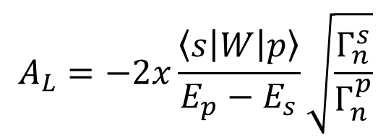
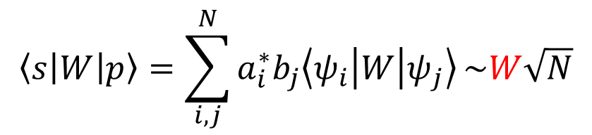
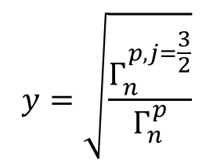
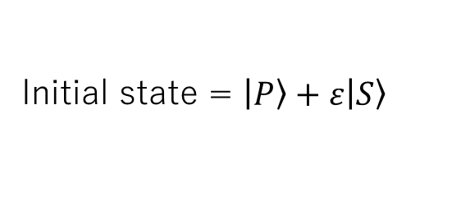
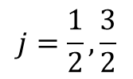
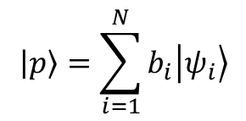

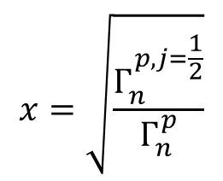
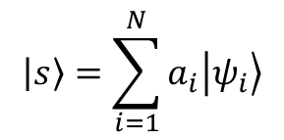


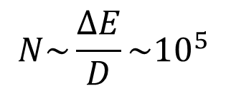
S-P mixing model
Generation of compound state
neutron
nucleus
$$Γ_{n}^{s}$$
$$L$$
$$S$$
$$Γ_{n}^{p}$$
Initial state = $\left.\left|P\right.\right\rangle +ε\left.\left|S\right.\right\rangle$
$$j=\frac{1}{2}, \frac{3}{2}$$
$$J=L+S$$
$$A_{L}=−2x\frac{\left\langle s | W | p\right\rangle }{E_{p}−E_{s}}\sqrt{\frac{Γ_{n}^{s}}{Γ_{n}^{p}}}$$
$$x=\sqrt{\frac{Γ_{n}^{p,j=\frac{1}{2}}}{Γ_{n}^{p}}}$$
$$y=\sqrt{\frac{Γ_{n}^{p,j=\frac{3}{2}}}{Γ_{n}^{p}}}$$
Unknown parameters
$$x^{2}+y^{2}=1$$
$$\left\langle s | W | p\right\rangle =\sum_{i, j}^{N}{a_{i}^{∗}b_{j}\left\langle ψ_{i} | W | ψ_{j}\right\rangle }\sim W\sqrt{N}$$
10⁶ eV
$$\left.\left|p\right.\right\rangle =\sum_{i=1}^{N}{b_{i}\left.\left|ψ_{i}\right.\right\rangle }$$
$$\left.\left|s\right.\right\rangle =\sum_{i=1}^{N}{a_{i}\left.\left|ψ_{i}\right.\right\rangle }$$
$$N\sim \frac{ΔE}{D}\sim {10}^{5}$$
P-violating
Weak matrix element
10 eV

Slide 9
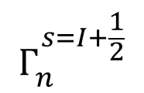
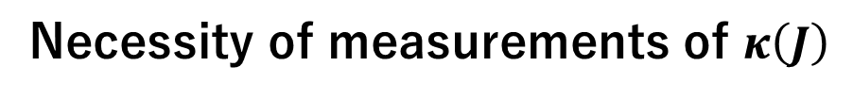

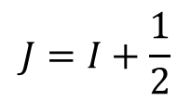

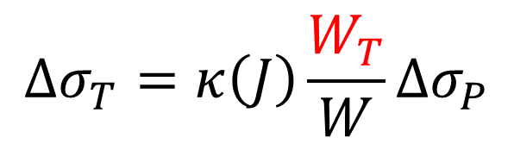
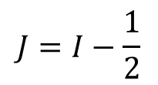
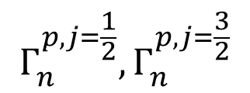
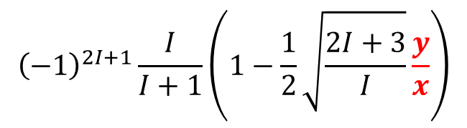

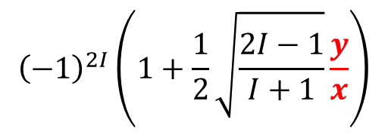
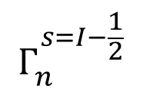
T-violation in Compound state
T-violating matrix element
T-violation
$$Δσ_{T}=κ\left(J\right)\frac{W_{T}}{W}Δσ_{P}$$
Gudkov, Phys Rep 212, 77 (1992)
T-violation
P-violation
Interference between different channel spins
$$Γ_{n}^{s=I+\frac{1}{2}}$$
$$Γ_{n}^{s=I−\frac{1}{2}}$$
P-violating matrix element
P-violation
Angular momentum factor
Interference between s and p waves
$${\left(−1\right)}^{2I}\left(1+\frac{1}{2}\sqrt{\frac{2I−1}{I+1}}\frac{y}{x}\right)$$
$$Γ_{n}^{p,j=\frac{1}{2}}, Γ_{n}^{p,j=\frac{3}{2}}$$
$$J=I−\frac{1}{2}$$
$$Γ_{n}^{s}$$
$$κ\left(J\right)=$$
$${\left(−1\right)}^{2I+1}\frac{I}{I+1}\left(1−\frac{1}{2}\sqrt{\frac{2I+3}{I}}\frac{y}{x}\right)$$
$$J=I+\frac{1}{2}$$
Depending on $x$ and $y$
Necessity of measurements of $κ\left(J\right)$

Slide 10

Candidates of target nuclei
¹³⁹La
⁸¹Br
¹¹⁷Sn
¹³¹Xe
◎
〇
◎
◎
Large PNC effect
Small resonance energy
◎
◎
〇
〇
Small nuclear spin
△
7/2
〇
3/2
◎
1/2
〇
3/2
Large natural abundance
◎
〇
×
△
Large $\left|κ\left(J\right)\right|$
~1
T. Okudaira, et al.,
Phys. Rev. C97,
034622, (2018)
Nuclear polarization
~50%
DNP
－
－
~7%
SEOP
P. Hautle and M. Iinuma,
NIM A440, 638, (2000)
Molway et al., arXiv: 2105.03076 (2021)
US NOPTREX

Slide 11


Configurations
Pseudomagnetic effects
Forward scattering amplitude
$$f=A+B\left(σ∙I\right)+C\left(σ∙k\right)+Dσ∙\left(k×I\right)$$
P-odd T-even
T-odd P-odd

Slide 12

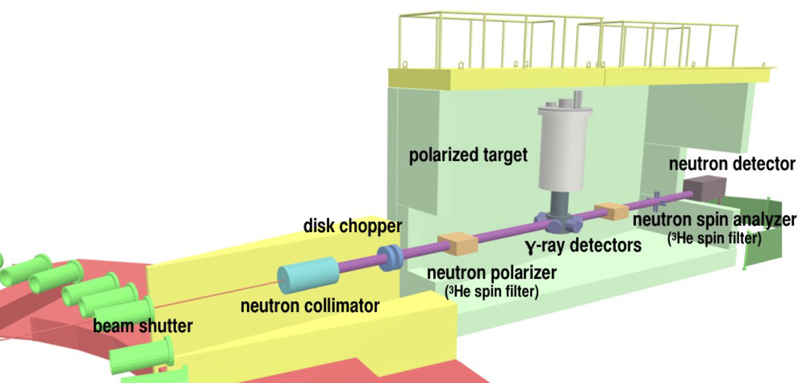
T-violation experiment at J-PARC
J-PARC P76
KEK 2018S12
RCNP国際共共プロジェクト
RCNP, Hiroshima Univ., Nagoya Univ., KEK
NOPTREX Collaboration
Neutron Optical Parity and Time Reversal EXperiment
Indiana Univ,. Kentucky Univ., RCNP, Nagoya Univ.
KEK, JAEA
Given by Prof. Kitaguchi

Slide 13


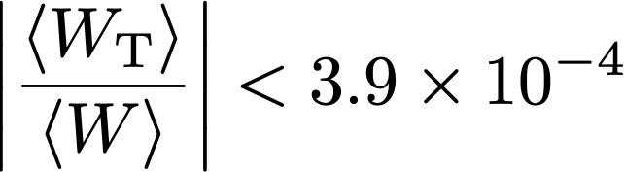
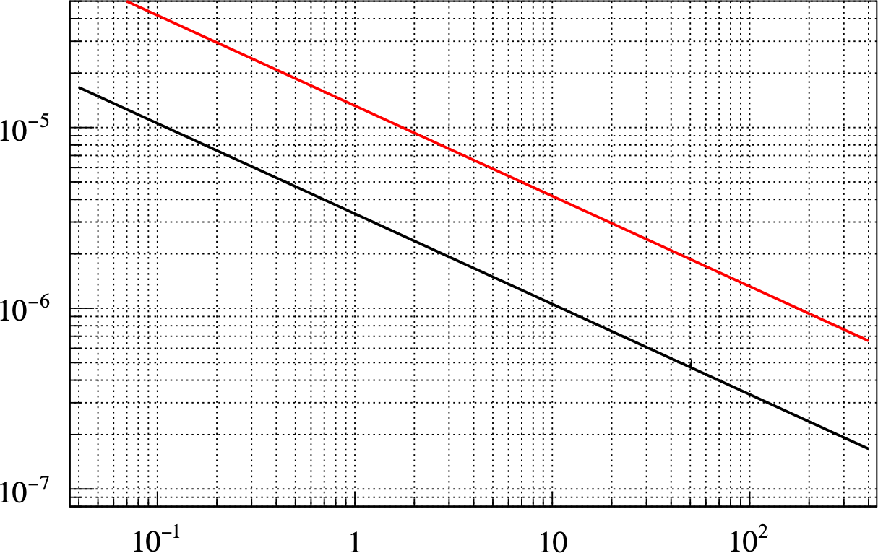

P(¹³⁹La)≥0.4, V≥4cm×4cm×2.8cm B0≤0.1T
P(
3
P(
He)=70%, P(
3
He)=100%, P(
139
La)=40%
139
discovery potential corresponding to
dn =3.0×10⁻²⁶ e cm
discovery potential corresponding to
dn =3.0×10⁻²⁷ e cm
Measurement Time [day]
La)=100%
(Existing Technology)
(Ultimate Technology)
Given by Prof. Kitaguchi

Slide 14
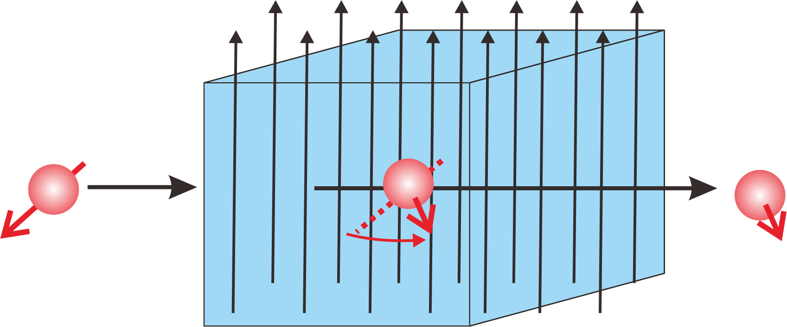

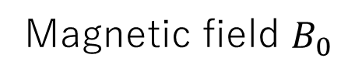

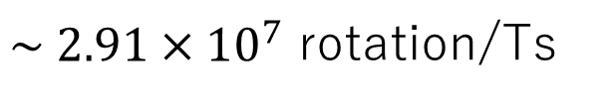


Major systematic effects
D term
$$Dσ∙\left(k×I\right)$$
Three vectors : orthogonal
Neutron spin rotation in a magnetic field
Reduction of the sensitivity because of averaging
Magnetic field $B_{0}$
Neutron spin rotation per 1[T] and 1[s]
$\sim 2.91×{10}^{7}$ rotation/Ts
At 2.3 [T] ( La DNP exp )
and thickness of 4cm
$$σ$$
$$σ$$
Rotation angle : $8.1°$

Slide 15
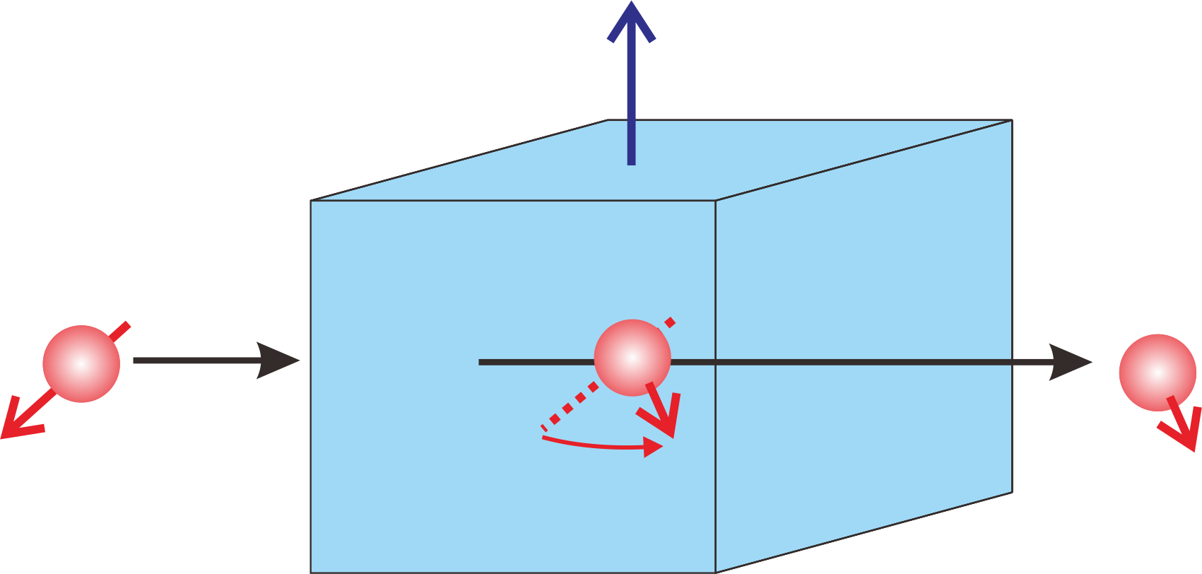
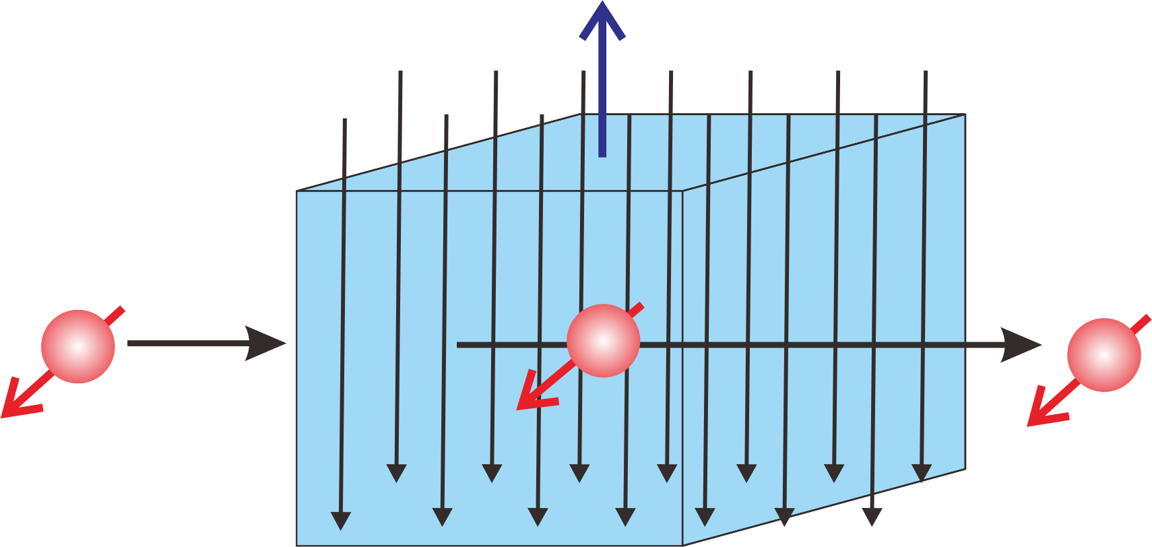


Use of pseudomagnetic effect
B term
$$B\left(σ∙I\right)$$
Pseudomagnetic field for neutron spins
Pseudomagnetic rotation
Cancellation of the spin rotation
Nuclear polarization( 50% )
Nuclear polarization( 50% )
Opposite direction
Magnetic field ( 0.1[T] )
Interaction between a target spin and a neutron spin
LaAlO₃： $H^{′}=0.1$ [T] for 50% polarization
V. Gudkov and H. M. Shimizu, Phys. Rev. C 95 045501, 2017
External field for the 50% polarized La target ~ 0.1 [T]
Necessity of measurements of B terms in advance

Slide 16
Setup for measurements of Im B term
Given by Prof. Okudaira

Slide 17
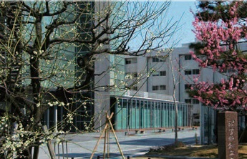
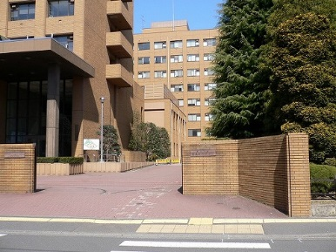
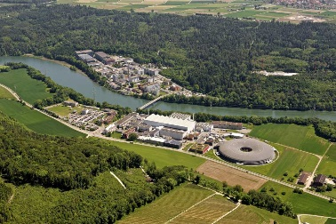
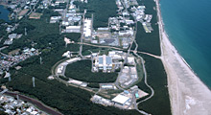
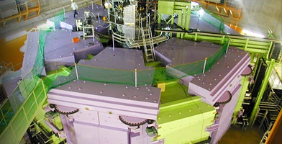
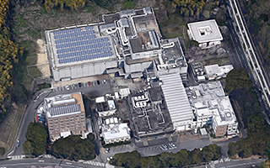
Research organization (polarized target)
Collaboration of 7 research institutes and 6 universities
Nagoya University
IMR(Tohoku University)
Hiroshima University
Kyoto University
Yamagata University
Ashikaga University
Japan Weman’s University
PSI
KEK IPNS, KEK CSC
KEK IMSS
RIKEN Nishina
RIKEN CEMS
RCNP(Osaka University)

Slide 18
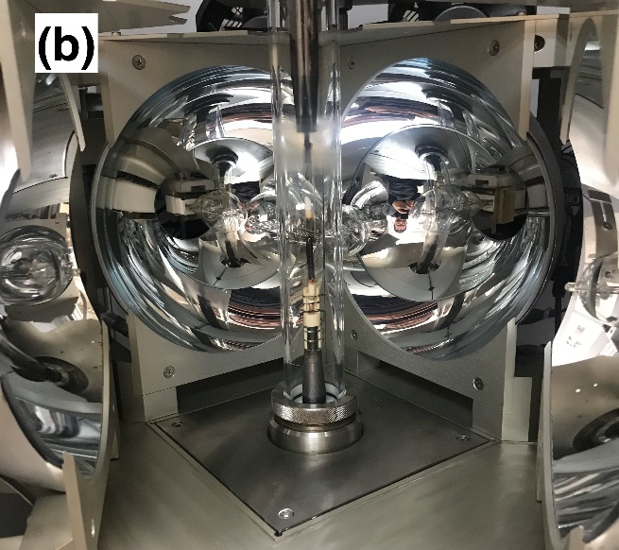
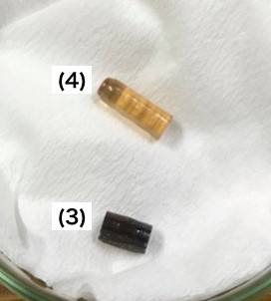
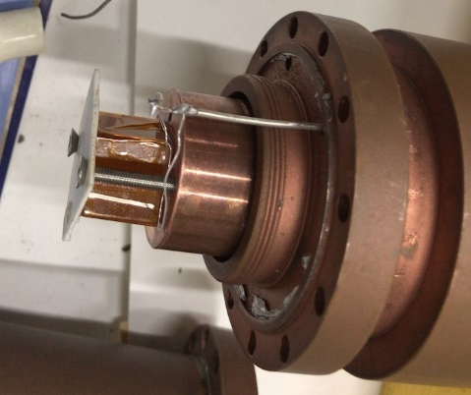
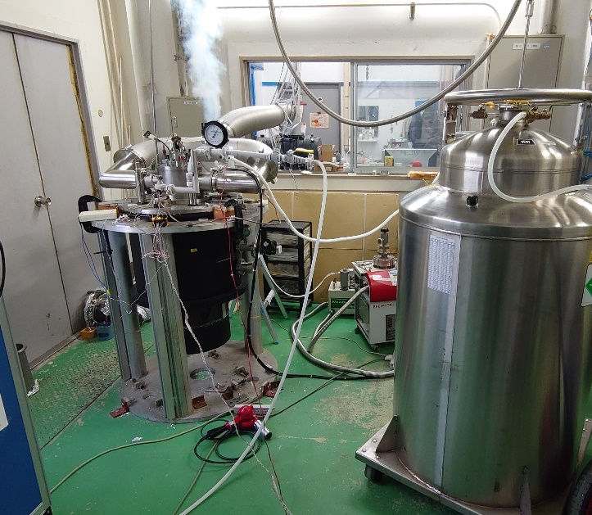
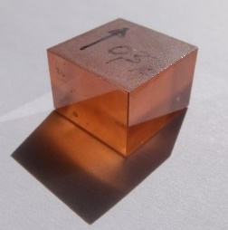
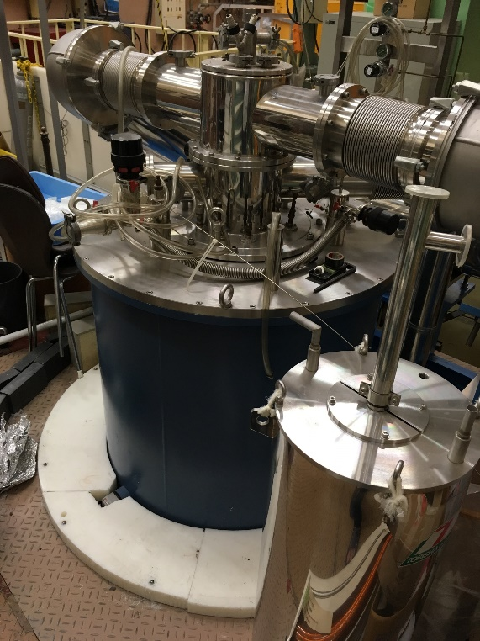
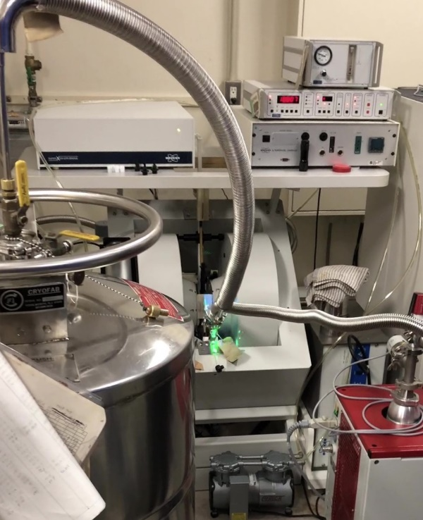
Crystal growth
Tohoku Univ., IMR
DNP & BF
Osaka Univ., RCNP
Tohoku Univ.
Nagoya Univ.
Hiroshima Univ.
RCNP、Nagoya Univ.
Hiroshima Univ., RIKEN
Yamagata Univ., PSI
Polarized target
Cryogenics
Active control
of relaxation
Nagoya Univ.,
Riken, JWU,
Ashikaga Univ.,
Hiroshima Univ,
KEK, KEK CSC, RCNP
LaAlO₃ crystal
Nd doped ( DNP )
pure ( BF )
Hiroshima Univ., N-BARD
Hiroshima Univ.
Nagoya Univ.
Development of
Cryogenic system
Control of nuclear relaxation with aromatic molecules

Slide 19

Summary - activity toward T-violation -
Selection of target nuclei
Verification of S-P mixing model
Measurements of $κ\left(J\right)$
¹³⁹La, ¹³¹Xe, ⁸¹Br, ¹¹⁷Sn, …
Measurements of angular correlations in $\left(n,γ\right)$
T. Okudaira, et al., Phys. Rev. C97, 034622, (2018)
J. Koga, et al., Phys. Rev. C105, 054615, (2022)
T. Yamamoto, et al., Phys. Rev. C101, 064624, (2020)
T. Okudaira, et al., Phys. Rev. C104, 014601, (2021)
Neutron polarizer
Neutron detector
³He spin filer
D. Schaper, et al., NIM A969, 163961 (2020)
T. Okudaira, et al., NIM A977, 164301 (2020)
U.S. NOPTREX
RCNP
Polarized target
Investigation of pseudomagnetic effects
La polarization by the DNP and BF
K. Ishizaki, et al., NIM A1020, 165845 (2021)
Imaginary B term of ¹³⁹La
First attempt of using polarized ¹³⁹La target
RCNP, Nagoya, Yamagata, Tohoku IMR,
Hiroshima, KEK CSC, etc.

Slide 20
NOPTREX collaboration
(Neutron Optical Party & Time Reversal Experiment)
Nagoya Univ.
Indiana Univ.
H. M. Shimizu, M. Kitaguchi, K. Hirota, T. Okudaira, T. Yamamoto, K. Ishizaki, Y. Niinomi, I. Ide, H. Tada, H. Hotta, T. Hasegawa, Y. Ito, R. Nakabe, Y. Kiyanagi, N. Wada, T. Matsushita
W. M. Snow, C. Auton, J. Carini, J. Curole, K. Dickerson, J. Doskow,
H. Lu, G. Otero, J. Vanderwerp, G. Visser
Univ. of South Carolina
Kyushu Univ.
V. Gudkov
T. Yoshioka, J. Koga,
Oak Ridge National Lab.
JAEA
J. D. Bowman, S. Penttila, P. Jiang
S. Endoh, A. Kimura, H. Harada, K. Sakai, T. Oku
Univ. Kentucky
Osaka Univ.
C. Crawford, B. Plaster, H. Dhahri
T. Shima, H. Yoshikawa, K. Ogata, H. Kohri, M. Yosoi
Los Alamos National Lab.
NIST
Tokyo Inst. Tech.
Ashikaga Univ.
D. Schaper
C. C. Haddock
H. Fujioka, Y. Tani, K. Kameda
D. Takahashi
Southern Illinois Univ.
Hiroshima Univ.
Japan Women’s Univ.
B. M. Goodson
M. Iinuma, M. Abe, S. Wada
R. Ishiguro
Ohio Univ.
Middle Tennessee State Univ.
Yamagata Univ.
Univ. British Columbia
P. King
R. Mahurin
T. Iwata, Y. Miyachi, Y. Takanashi
T. Momose
Eastern Kentucky Univ.
Western Kentucky Univ.
Tohoku Univ.
IHEP-CSNS
J. Fry
I. Novikov
M. Fujita, Y. Ikeda, T. Taniguchi, S. Takada
J. Tang, X. Tong
UNAM
KEK
L. Barron-Palos, A. Perez-Martin
T. Ino, S. Ishimoto, K. Taketani, K. Mishima, G. Ichikawa
RIKEN
Berea College
Paul Scherrer Institut
Y. Yamagata, H. Ikegami, T. Uesaka, K. Tateishi, D. Miura
M. Veillette
P. Hautle
Kyungpook Univ.
Kyoto Univ.
Juelich
Nottingham
Depauw
G. N. Kim, S. W. Lee, H. J. Kim
K Hagino, Y. I. Takahashi, M. Hino
E. Babcock
M. Barlow
A. Komives

Slide 21
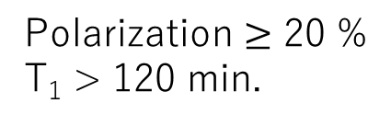
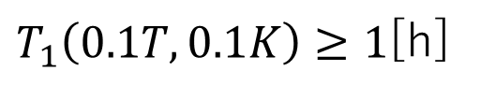

Current states of R & D
Estimation of spin-lattice relaxation time (T₁) at 0.1 K and in 0.1 T ( RCNP )
( K. Ishizaki ,et al., NIM A V1020, 165845, 2021 )
Extrapolation with the measurement results of T₁ at various conditions
Assumption of electronic spin-spin reservoir (SSR)
$T_{1}\left(0.1T, 0.1K\right)≥1$[h]
Necessity of optimization of Nd concentration
Observation of enhancements with the crystals grown by ourselves ( Yamagata Univ. )
Nd condition：0.01mol%
DNP condition：2.3T, 1.3K
Polarization $≥$ 20 %
T₁ > 120 min.
Establishment of our basic method for the crystal growth
Long T₁
Precise control of Nd concentration ( Tohoku Univ. IMR )
Establishment of precise control of 0.001 mol% level
Nd optimization : feasible
Interesting region : $≤$ 0.01 mol%

Slide 22
Current status of Nd optimization
We have achieved the technological level for studying the Nd optimization.
Crystal growth
Evaluation through the DNP
provided
Simple tests at 1.3 K in 2.3 T
Control of Nd concentration
Tohoku Univ. IMR
Yamagata Univ.
feedback
Current summary in various Nd concentration ( blue color : our crystals )
Nd concentration | condition | La enhancement | Al enhancement | Relaxation time
0.05 mol% | 2.3T, 1.3K | 2.7 | 2.7 | ~ 15 min
0.03 mol% [1] | 2.3T, 1.5K | ~ 100 | > 50 | ~ 80 min
0.01 mol% | 2.3T, 1.3K | > 100 | > 50 | > 120 min
0.003 mol% [2] | 2.3T, 1.5K | 1 | 1
[1] : T. Maekawa, et al., NIM A V366, 115 (1995)
[2] : T. Maekawa, Kyoto Univ. Master thesis (1995) unpublished
Best results

Slide 23




Image of S-P mixing for P-violation
Initial state : $\left.\left|P\right.\right\rangle$
exit
entrance
$$\left\langle S | W | P\right\rangle$$
S
W
P
P-violating matrix element
Superposition of two states
Initial state : $\left.\left|S\right.\right\rangle$
exit
entrance
$$\left\langle S | U | S\right\rangle$$
S
W
S
matrix element

Slide 24




Enhancement of PNC
compound state
entrance channel
p j=3/2
p-wave
p j=1/2
exit channel
P
s j=1/2
s-wave
~ P-violation in NN interaction
10⁶ eV
randomness of expansion coefficients
10 eV

Slide 25
Enhancement of T-violation
entrance channel
compound state
p 3/2
p-wave
p 1/2
exit channel
T
s-wave

Slide 26

Preparation of solid polarized target
Dynamic Nuclear polarization (DNP)
Operation for spin frozen
Electron polarization
Nuclear spins
Cooling down to very low temperature( < 0.1 K ) and reducing the field
Polarization transfer
Nuclear
spin
beam
Long relaxation time
in a low field
Switch
Electron spin
Low temperature ( ~ 0.5 K )
High magnetic field ( > 2.5 T )
Very low temperature ( < 0.1 K )
Low magnetic field ( < 1 T )
Too high for a typical beam experiment
Practical polarized target : only proton and deuteron

Slide 27



Relaxation process
Two major processes in a solid polarized target with high quadrupole moment
Dipole-dipole interaction
Quadrupole interaction
electron
Nuclear spin
thermal fluctuation
local charge distribution
ー
ー
ー
$$D_{ij}$$
+
+
+
Magnetic field
+
+
+
thermal fluctuation
ー
ー
Principle axis of
quadrupole interaction
ー
$D_{ij}$ : Dipole-dipole interaction
Electric field gradient
Controllable by changing the number of electron spins
Mixing of Zeeman sublevels
Keeping the high polarization is not easy in a low magnetic field

Slide 28


Development of polarized La target
Metal La
Z = 57 A=139
Nuclear spin ：$I=7/2$
Magnetic moment
$μ=2.783μ_{B}$ （proton：$μ=2.793μ_{B}$）
Quadrupole moment
$Q=0.20$ [barn]（deuteron：$Q=0.00286$ [barn]）
Two order higher compared to deuteron
middle in whole nuclear species
First step for opening realization of new polarized target
Key device for the T-violation search with a slow neutron

Slide 29




Use of Nd³⁺:LaAlO₃ crystals
LaAlO₃ crystal
Perovskite structure
Al
+c/4
Paramagnetic ions for the DNP
La
Nd³⁺: LaAlO₃ crystal
+c/6
Perovskite crystal
Partially replacement of La with Nd
+c/12
$$N_{La} : N_{Nd} \sim 10000 :1$$
$$a$$
0
g-factor of Nd³⁺ : $g_{//}=2.12$ $g_{⊥}=2.68$
-c/4
Twining domain structure
-c/6
Cubic ($Pm\overline{3}m$)
Pseudo-cubic
$$a=5.365Å$$
Phase transition at 813 [K]
$$c=13.11Å$$
-c/4

Slide 30






Advantage of crystal symmetry
Y. Takahashi, et. al., NIM A 336, 583 (1993)
Narrow ESR linewidth
Magnetically equivalence
Diagonalization on C₃ axis
Electric field gradient $V_{xx}=V_{yy}$
Principle axis = $C_{3}$ axis
La
Nd
$$H_{total}=H_{Zeeman}+H_{quad}$$
$\sim 6$G
La
Superhyperfine
of Al
Equilateral triangle
$$\frac{eQV_{zz}}{4I(2I−1)}\left[\left(3I_{z}^{2}−I^{2}\right)+\frac{V_{xx}−V_{yy}}{V_{zz}}\left(I_{x}^{2}−I_{y}^{2}\right)\right]$$
C₃ symmetry
No mixing of Zeeman sublevels
High efficiency of DNP
Equivalent efficiency for all sites
Possibility of maintaining the polarization in a low magnetic field

Slide 31

DNP of La with LaAlO₃ at PSI
Spin transfer by SSR（Spin-Spin reservoir）( thermal mixing )
P.Hautle and M. Iinuma, NIM A 440, 638 (2000) Results of reanalysis
 | Spin temperature | Polarization
Al ( positive ) | + 2.00 [mK] | + 61.9 %
Al ( negative ) | - 1.58 [mK] | - 71.0 %
La ( negative ) | - 1.72 [mK] | - 49.8 %
Sample:
  Size : 15x15x4 [mm]
  Concentration of Nd : 0.03 mol%
Condition : B=2.35 T, T< 0.3 K
Possibility of realizing a practical polarized target
Necessity of studies on the relaxation in a low field( ~ 0.1 [T] )

Slide 32

Measurements of relaxation time at RCNP
( K. Ishizaki ,et al., NIM A V1020, 165845, 2021 )
  Project research in RCNP ( 2018/4 – 2022/3 )
  COREnet proposal in RCNP ( 2020/4 – 2022/3 )
Purpose
Refrigerator (17T、10mK)（DRS2500)
Measurements at various conditions
Estimation at 0.1 T, 0.1 K based on the results
Measured crystal
1.5cmX1.5cmX1.5cm
Nd concentration：0.03mol%
Direction of magnetic field：parallel to C₃ axis
Measurement conditions
Use of thermal NMR signals without the DNP
 | La | Al
Oct. – Dec. / 2019 | 0.5K (5.0 T) | 0.5K ( 0.5, 1.0, 2.5 T )
Mar. – Apr. / 2020 | 0.5K (0.5, 1.0, 2.5 T) 0.1K (0.75 T) | 1.5K (1.0, 2.0 T)

Slide 33










Thermal NMR spectra of La
Condition : 5 [T], 0.5[K]
Tuned frequency : 28.04 [MHz]
Zeeman system
$$I_{z}=−7/2$$
$$I_{z}=−5/2$$
Peak 1
$$I_{z}=−3/2$$
Peak 2
$$I_{z}=−1/2$$
Peak 3
$$I_{z}=+1/2$$
Peak 4
$$I_{z}=+3/2$$
Peak 5
$$I_{z}=+5/2$$
$$I_{z}=+7/2$$

Slide 34







Thermal NMR spectra of Al
Condition : 2.5 [T], 0.5[K]
Tuned frequency : 28.2 [MHz]
$$I_{z}=−5/2$$
Peak 1
$$I_{z}=−3/2$$
Peak 2
$$I_{z}=−1/2$$
Peak 5
5 peaks
$$I_{z}=+1/2$$
Peak 8
$$I_{z}=+3/2$$
Peak 9
$$I_{z}=+5/2$$
Peak 3, Peak 4, Peak 6, Peak 7 : from the other domain

Slide 35




Methods
Buildup
Al （1.5K, 2.0T)
Condition
$0.97±0.06$ [h]
Decay
La （0.5K, 0.5T)
Condition
$1.21±0.17$ [h]

Slide 36







Estimation of relaxation time in a low field
Assumption of relaxation process via Electric Spin-Spin reservoir (SSR)
$$\frac{1}{T_{1n}}∝C^{2}\frac{1}{H_{0}^{2}}\left(\frac{1}{T_{1SS}}\right)\left(1−P_{0}^{2}\right)$$
La relaxation time $≅$ Al relaxation time
Nd concentration
Extrapolation of ratio of $T_{1SS}$
Extrapolation of $r$
（Al data）
$$r\left(B_{0}, T\right)≡{\left(\frac{1}{T_{1SS}\left(B_{0}, T\right)}\right)}/{\left(\frac{1}{T_{1SS}\left(1.0T, 0.5K\right)}\right)}$$
0.1 [K]
Estimation at 0.1T 0.1K
0.5 [K]
$T_{1}\left(0.1T, 0.1K\right)≥1$[h]
Necessity of the optimization of Nd concentration

Slide 37
Current issues toward the development
1. Establishment of research environment for Nd optimization
Provided
Preparation of crystals
various Nd concentration
Simple DNP tests at 1.3 K
feedback
Necessity of growing crystals by ourselves
Observation of the enhancement with our grown crystals
2. Fundamental studies on a polarized target at low temperature
Preparation of a test bench at RCNP
3. Development of cryogenic system toward the T-violation search
Studies on basic characteristics of LaAlO₃ at low temperature,
thermal conductivity, Kapitza resistance, etc..

Slide 38

Crystal growth in IMR, Tohoku Univ.
IMR cooperative program,
No. 18G0034, 19K0081, 19G0037, 202012-CNKXX-0001, 202012-CRKEQ-0015
Floating-Zone(FZ) method
Mixed sample : powder of La(OH)₃ + Al₂O₃
Melting : 2100℃
rotation
Moving up
Floating zone
Filament of
Halogen lamps

Slide 39



Typical grown crystals
First crystal Nd : 0.05mol%
Dimension : Diameter 5 mm Length 40 mm
ESR measurements
Narrower
Crystalline part 40 mm
4.38G (< 6G)
Direction of crystal axis

Slide 40

Simple DNP test at Yamagata Univ.
Condition：2.336 T, 1.33 K
Microwave generator
Apparatus : Glass dewar
Vacuum pump
Wave guide
Microwave: 69-71GHz, 200mW
NMR detection :
Al 25.915 MHz La 14.505 MHz
Glass dewar

Slide 41







First results with our grown crystal
First observation of the enhancement with the crystal grown by ourselves.
0.05mol% crystal
La spectrum
Al spectrum
Condition: 2.3 T, 1.3 K
$$2.45±0.03$$
$$−1/2↔+1/2$$
Enhancement $=2.68±0.20$
Enhancement $=2.45±0.03$
$$P_{vector}=0.202±0.011$$

Slide 42




Buildup & relaxation
La NMR signal $−1/2↔+1/2$transition
Condition: 2.3 T, 1.3 K
Buildup time $≅$ Relaxation time
Short relaxation time
caused by the relaxation

Slide 43


Second attempt
Condition: 2.3 T, 1.3 K
0.01 mol% crystal
Expectation of longer relaxation time
Enhancement > 14
Al spectrum
80 min
Not saturated !!

Slide 44





Target materials (DNP)
Chemically-doped Glassy materials
Paramagnetic ions : Cr(V) complex
Ethylene glycol
Butanol
Propanol
Irradiated materials
Paramagnetic ions: Radicals produced by irradiation
Li-H
Ammonia
Lithium hydride
Lithium deuteride
Flexible target size, high rate of contents
Practical target : only proton and deuteron typical P(p)>90%、p(d)>50%

Slide 45






















DNP mechanism
La Zeeman system
Al Zeeman system
Electronic Spin-Spin reservoir
$$I_{z}=−7/2$$
$$I_{z}=−5/2$$
$$I_{z}=−5/2$$
SSR
$$I_{z}=−3/2$$
NMR signals
NMR signals
$$β_{SS}$$
$$I_{z}=−1/2$$
$$I_{z}=−3/2$$
$$β_{La}=β_{SS}$$
$$β_{Al}=β_{SS}$$
$$β_{Al}$$
$$I_{z}=+1/2$$
$$I_{z}=−1/2$$
Microwave irradiation
$$β_{La}$$
$$I_{z}=+3/2$$
$$I_{z}=+1/2$$
$${β_{SS}=β}_{Ze}$$
$$I_{z}=+3/2$$
Electron Zeeman system
$$I_{z}=+5/2$$
$$β_{Ze}$$
$$I_{z}=+5/2$$
$$I_{z}=+7/2$$
Spin temperature：$β=1/{kT}$

Slide 46


Evidence of SSR
T=1.8K B=0.8T Microwave : 24GHz, 200mW
Spontaneous Recovery of NMR signals
La transition
$I_{z}=−5/2↔I_{z}=−3/2$
Al transition
$I_{z}=−1/2↔I_{z}=+1/2$
Enhancement (Al)
Microwave ON
Saturation with RF
Enhancement (La)

Slide 47





Use of Nd:LaAlO₃ crystals
Symmetry of Perovskite structure
Paramagnetic ions : neodymium
Advantage (Y. Takahashi, et. al., NIM A 336, 583 (1993) )
Narrow ESR linewidth : ~ 6G
Magnetically equivalence of all La(or Nd) sites
Diagonalization of quadrupole interaction in C₃ axis
g-factor of Nd³⁺ : $g_{//}=2.12$ $g_{⊥}=2.68$
Spin Hamiltonian
$$H=−ℏγ_{N}\vec{I}∙\vec{H}+ℏD_{zz}\left(I_{z}^{2}−{I\left(I+1\right)}/3\right)$$
$γ_{N}$ : gyromagnetic ratio ( ${γ_{N}}/{2π}=0.6$ kHz/G)
$I$ : La nuclear spin ( $I=7/2$ )
$D_{zz}$: quadrupole coupling constant ( ${D_{zz}}/{2π=0.36}$ MHz )

