Slide 1
Flip and Swap – Forward Jet Proxy
Josh Perry
Iowa State University

Slide 2
Goal
Measure Collins decoupled from Sivers
fragmenting parton
parton spin
φ
fragmentation hadron

Slide 3
Collins
What we want
Transversely polarized fragmenting quark
Fragmenting quark’s momentum direction
Fragmentation hadron’s momentum direction
Fragmenting quark’s (transverse) spin direction
What we have
Transversely polarized protons
Forward pi0 reconstruction
Central Jet reconstruction

Slide 4
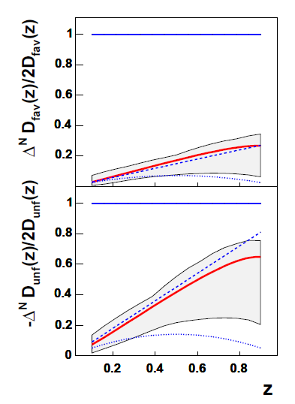
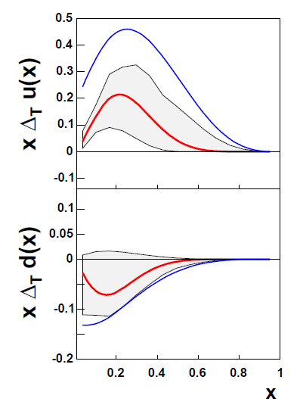
Anselmino Parameterization
Collins Favored and Unfavored
Transversity

Slide 5
Previous results
High x, forward
Large transversity
MPC
Variable z (and x)
Reconstructed pi0s
Single clusters (merged photon pi0s)
MPC Cluster A_N = ~0.06 (J. Koster)
What we want for Collins
Parton axis forward ( ~jet axis)
Hadrons about that parton axis
What can we have
Central arm – jet reconstruction
MPC – forward hadrons

Slide 6
Hard Scattering
2 -> 2 scattering
Conservation of momentum
Outgoing partons back-to-back in CM frame
ignoring initial state k_T, gluon radiation, etc.
G

Slide 7
Kinematic Selection
Central Arm
G
fragmented hadron
MPC

Slide 8
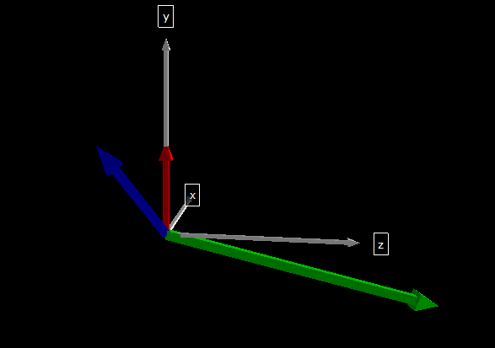
Flip and Swap
Green = forward hadron
Blue = central reconstructed jet
Red = proton spin (could be up or down [+/- y-direction])

Slide 9
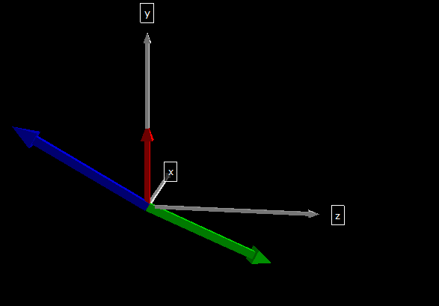
Flip and Swap
Boost along z until the p_z of the forward hadron and central jet are equal and opposite
Note: actual procedure will correct for the central jet’s <z> and the hadron’s <z>.

Slide 10
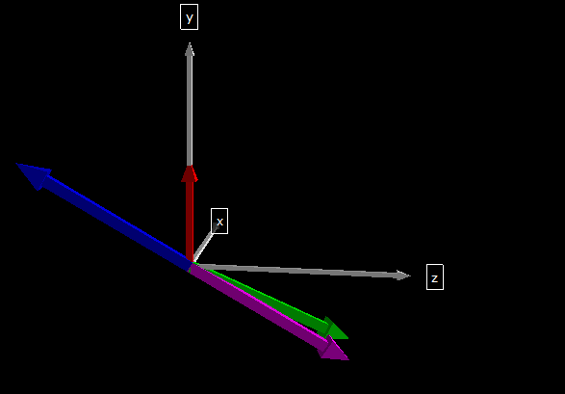
Flip and Swap
Magenta = jet proxy
Flip direction of central jet: this is now our ‘jet proxy’ for the forward hadron jet
Once completed, boost back into the lab frame; everything shown is in the lab frame

Slide 11
Jet Proxy
Note: parton spin = transversity coupled with proton spin (through polarization)
jet proxy
parton spin
φ
forward hadron

Slide 12
ToyMC Monte Carlo
Pythia performs parton scattering
Pythia fragmentation turned off
Utilize DSS, KKP, or AKK FF
Author’s code and interpolations tables are used
Collins fragmentation only implimented for DSS currently
Transversity and Sivers also included
Anselmino parameterizations
Not strictly applicable
Sea quark pol = 0
TMD factorization assumed
etc...
Effective Sivers
Applied using final state event weighting

Slide 13
MC Acceptance and Triggering
Acceptance
MPC eta range
Central arm eta range (2pi azimuth for statistics)
Checked with central arm phi range as well
Triggering
pi0 into MPC
Change to single cluster
EMC energy in central arm

Slide 14
Central clustering
Clustering of central hadrons
seeded cone algorithm from ppg093
cluster formed with EMC clusters and charged hadrons (DC+PC1)
pT > 0.4 (pT<5.0 for charged hadrons)
n > 2
What I have now
Forward pi0 (or cluster)
Central jet
Need them back to back in CM frame

Slide 15
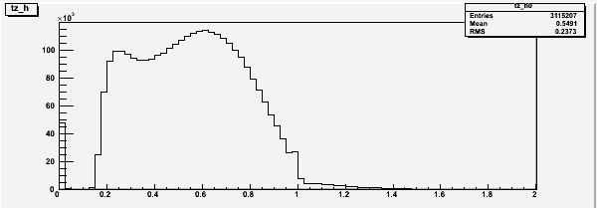
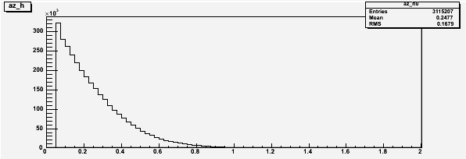
z
z of central jet and forward hadron
z = P_object.Dot(P_parton)/P_parton^2

Slide 16
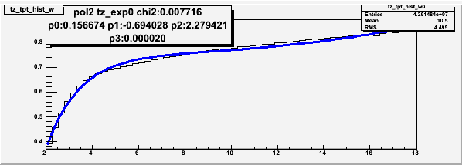
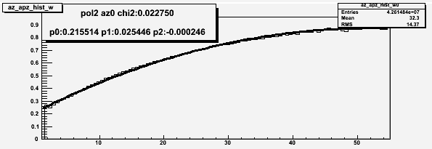
Momentum correction
<z> = average z as a function of central jet or forward hadron momentum
determined from MC
(central cluster)/<z> , (forward hadron)/<z>

Slide 17
z correction
Use <z> vs. p correction curves on last slide
z for central and forward

Slide 18
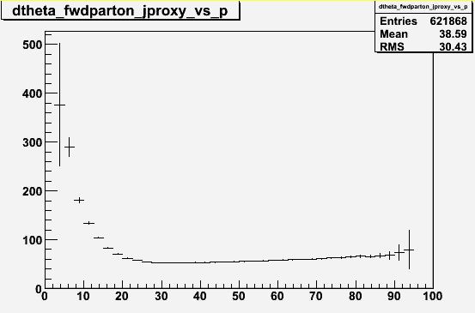
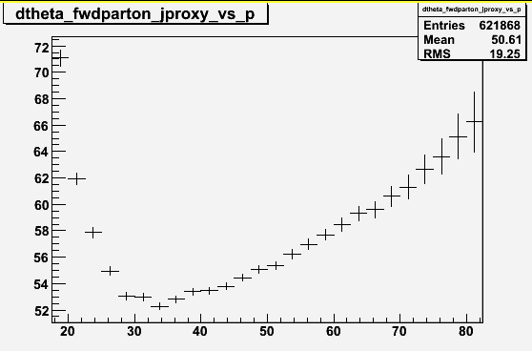
Resolution
Opening angle between JetProxy and forward parton
y axis is mrad, x axis is forward parton momentum

Slide 19
Flip and Swap results
Now have central parton and forward parton approximations
Perform boost, flip, and swap
Repeat millions of times
Collins effect seen?

Slide 20
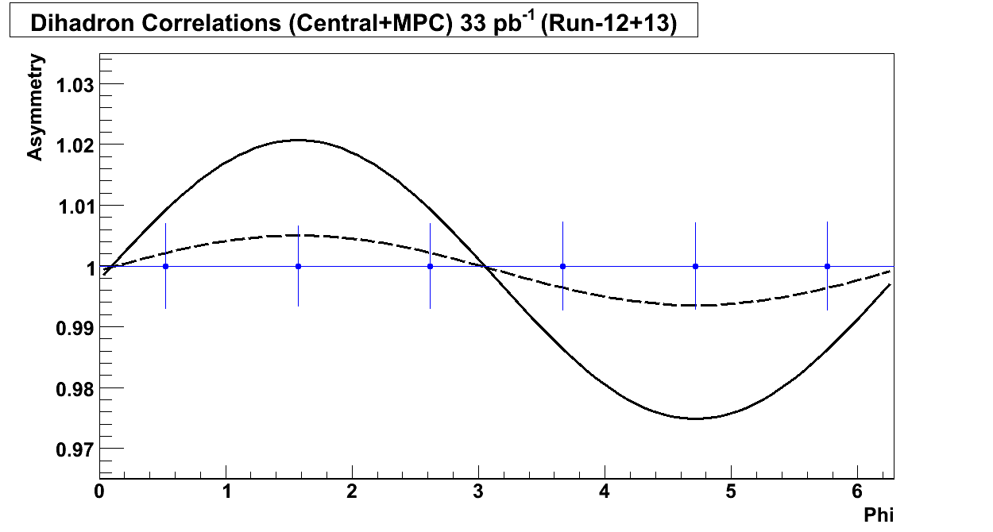
BUP
A_N = 0.06 forward, 60% pol assumed

Slide 21
Parameter scan
What we can change
Collins distribution
Transversity distribution
Sivers distribution
Why not only use Anselmino global fit central values?
Uses data from SIDIS (ep) and ee->q q-bar, unknown in pp
Applying Anselmino parameterization to pp yields small single spin asymmetry (~0.4%, Collins+Sivers)
We see large single spin asymmetry in pp (~4-15%)

Slide 22
Scanning parameters
Conditions | Asym with Sivers Off Asym with Sivers On
Transversity at Soffer Bound | 0.4%
 | 0.7%
Transversity at Soffer Bound Quark Sivers at Positivity Bound | 1.4%
 | 8%
Transversity at Soffer Bound Quark Sivers at Positivity Bound Unfavored Collins Frag at Positivity Bound | 2.5%
 | 9.6%
Transversity at Soffer Bound Quark Sivers at Positivity Bound Unfavored Collins Frag at Positivity Bound Favored Collins Frag at Positivity Bound | 14%
 | 20%

Slide 23
Real data
Run8 transverse
MPC4x4c && ERT4x4c||a
Mixed trigger data set
CNT_DST, PWG_DST, MPC_DST
What’s been done so far
MPC
Clusters
Pi0 cluster pairs
Central
Tracks
DC+PC1 charged tracks
EMC clusters

Slide 24
What’s next
Interface Kenichi Nakano’s ppg093 central arm jet reconstruction (clustering) code
Pipe previous output into my Flip and Swap code
EMC Warnmap
Study MPC and EMC cuts used
ecore, etc.
Understand low z shoulder on central arm z distribution
Checked dependence on number of clusters in jet
Jet composition?
1 EMC cluster + 2 charged vs. 2 EMC cluster + 1 charged, etc
Suggestions?

Slide 25
BACKUP
End

Slide 26
process vs. x

Slide 27
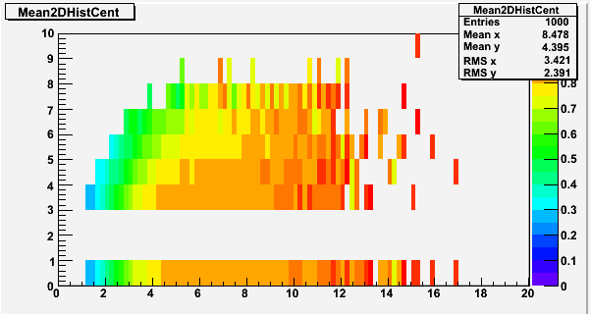
Mean z values for the central object
pretty strong nclust dependence, run in to statistics limits

Slide 28
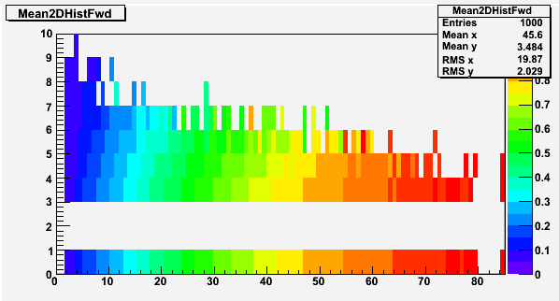
Here’s the forward object’s nclust separated ‘z vs p’ 2D histogram, weak dependence seen

Slide 29
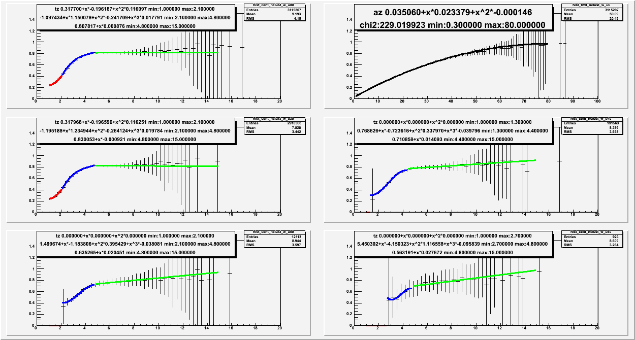
non sequitur: piecewise ‘z vs p’ fitting this produced weird results... will look at again later, maybe

Slide 30
Questions / concerns
Use Pythia fragmentation for central arm and compare to our DSS fragmentation
Does our frag generate neutrons, Klong, Kshort, protons? It definitely should.
Compare central parton to central reco jet, what resolution?
Gaussian filter jet reco comparison

