Slide 1
CCJ introduction
RIKEN Nishina Center
Kohei Shoji

Slide 2
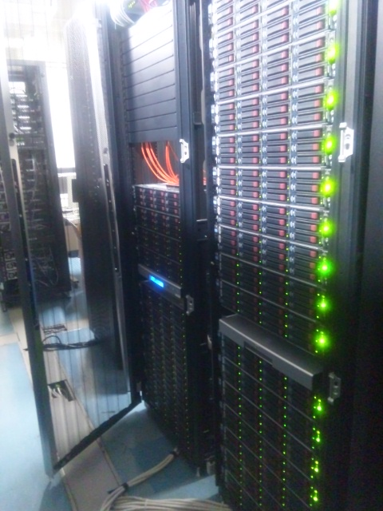
RIKEN CCJ – PHENIX Computing Center in Japan
RIKEN CCJ is constructed as a principal site of computing for PHENIX simulation and data analysis
http://ccjsun.riken.go.jp/ccj/index.html
At room 258 in Main research building
Linux CPU Farm
2.6GHz x 264CPUs
500GB memory in total
380TB disk
Data storage
40TB on HDD
1400TB on HPSS
Data transfer between RCF
200MB/sec with Grid-FTP

Slide 3
Overview
Internet
Gateway
ccjsun.riken.jp
ccjgw.riken.jp
login
login
RO
Interactive node
linux1/2/3/4/5
NIS
NFS /ccj/u/username
RO
LSF
batch job
NFS /ccj/w/r0x/username
RO
Linux CPU Farm
RCF
daily
mirroring
NFS afs
NFS DB
NFS data storage

Slide 4
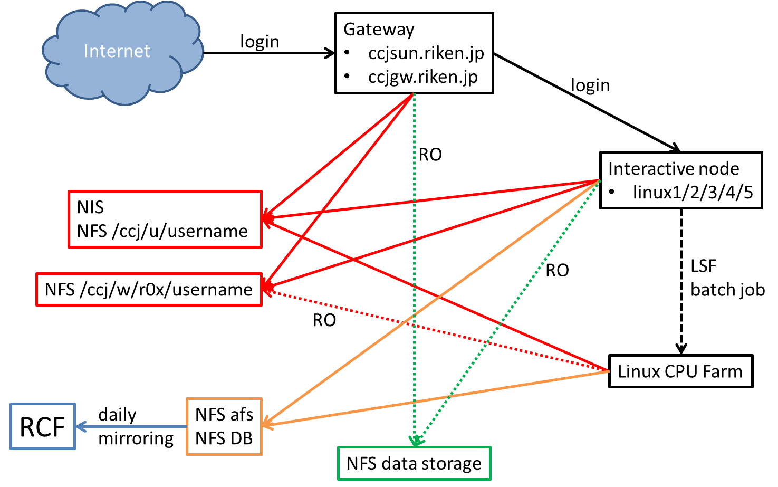
Gateway & interactive node
Login to ccjsun.riken.jp / ccjgw.riken.jp
Login to interactive node
most users use linux4 / linux5 which have 64bit-CPU with SL5.3
other interactive nodes have 32bit-CPU with older SL version
Common directories served by NFS
/ccj/u/username
home directory
quota 4GB/5GB
daily backup
/ccj/w/r0x/username
work directory
quota 40GB/50GB
NO daily backup
Tips
confirm your quota by /usr/bin/rsh ccjnfs20 vxquota -v

Slide 5
Interactive node & Linux CPU Farm
Setup
source /opt/phenix/bin/phenix_setup.csh -a
setenv ODBCINI /opt/ccj/etc/odbc.ini.ccj.analysis
setenv PGHOST ccjams002.riken.go.jp
setenv PGPORT 5432 or 5440
Use “-a” option because phenix_setup.csh remove PATH and LD_LIBRARY_PATH needed for LSF batch job system if “-a” is not specified
“setenv”s are for database access at CCJ
CCJ provides /afs/rhic.bnl.bnl.gov and database which you are familiar at RCF
But they are just daily-mirror of that at RCF
Actually you can commit to CVS but it would be lost next day
The changes at RCF are reflected next day

Slide 6
Linux CPU Farm
LSF batch job system is used at CCJ (cf. Condor at RCF)
http://ccjsun.riken.go.jp/ccj/doc/LSF/lsf-wrapper.html
Commands
bsub –q short –o stdout.txt –e stderr.txt –s “script arguments”
select queue with your job length : short 2.5 hours / long 24 hours
get log for stdout and stderr
the output should be under /ccj/u/username
could NOT specify under /ccj/w/r0x/username because the directory is mounted with read-only mode at batch node
write script you want to run with double quotation
bqueues
check queue status
bjobs
check job status

Slide 7
Linux CPU Farm – local disk
NFS /ccj/u/username
NFS /ccj/w/r0x/username
batch node
batch node
batch node
batch node
batch node
batch node
local disk
local disk
local disk
local disk
local disk
local disk
If submitted jobs make multiple/massive access to NFS, everything gets slow
people on interactive node needs a few or more minutes to get “ls”
Do not read from/write to /ccj/u or /ccj/w/r0x in your job
To avoid this, in your job script
copy input files to local disk at batch node
do computing / run analysis and write output to local disk
copy output files from local disk to your directory
Use dedicated command “rcpx” for file copy, not use “cp”

Slide 8
Linux CPU Farm – rcpx
Local disk directory you can use at batch node is given by environmental variable $CCJ_JOBTMP
/ccj/u and /ccj/w/r0x are served by NFS server ccjnfs20
Example of job script
#!/bin/csh
# copy input files
rcpx ccjnfs20:/ccj/w/r0x/username/run.csh $CCJ_JOBTMP/run.csh
rcpx ccjnfs20:/ccj/w/r0x/username/input.root $CCJ_JOBTMP/input.root
set input_name = $CCJ_JOBTMP/input.root
set output_name = $CCJ_JOBTMP/output.root
# run analysis
$CCJ_JOBTMP/run.csh $input_name $output_name
# copy output files
rcpx $CCJ_JOBTMP/output.root ccjnfs20:/ccj/w/r0x/username/output.root
exit

Slide 9
Linux CPU Farm – rcpx
rcpx command controls the number of accesses to the NFS server to avoid the panic
Tips
Do not forget to put “ccjnfs20:” or the rcpx fails
It would be better to use wild card to reduce overhead
Directory you submitted job is the initial directory of the batch job
You don’t need to take care about libraries and database though they are served by NFS
Directory you used ($CCJ_JOBTMP) is automatically cleaned by LSF

Slide 10
Linux CPU Farm – nDST
Several types of nDSTs have been put at local disks
http://ccjsun.riken.go.jp/ccj/doc/phenix-data/localdisk/index.html
User can access these nDSTs by using “-r” option of bsub
Command
bsub –q short –o stdout.txt –e stderr.txt –r 123456 –s “script arguments”
The location of nDSTs is given by variable $CCJ_DATADIR
Available files can be obtained by /opt/ccj/bin/filename
this command lists available nDST file name
Example to get file list in job script
set files = `/opt/ccj/bin/filename 123456 | grep CNT`
foreach file ( $files )
/bin/ls $CCJ_DATADIR/$file >> filelist.txt
end

Slide 11
Data storage & File transfer
http://ccjsun.riken.go.jp/ccj/doc/usersguide/ccjusersguide.html
HPSS
tape drive to archive files
NFS
If you need a space to put some amount of files, please submit the application to get the space on which files can be accessed with rcpx from batch node
http://ccjsun.riken.go.jp/ccj/forms/
scp & bbftp – transfer files from/to outside
scp to transfer files up to 100MB
bbftp to transfer files up to 50GB
Grid-FTP
CCJ achieved transfer speed of 200MB/sec between RCF and CCJ
If you want to transfer new DSTs from RCF, please contact to CCJ guys

Slide 12
Summary
CCJ provides analysis/computing environment similar to RCF
libraries, CVS, database, etc.
LSF batch job system is available at CCJ
User should take care not to hang up the system by reading/writing NFS directly
Several types of nDSTs are available on batch job
HPSS, NFS file storage are useful to progress the analysis and simulation smoothly
User can use scp/bbftp to transfer files from/to outside
Grid-FTP makes it possible to transfer a large amount of files between CCJ and RCF
Please contact to phenix-ccj-admin at ribf.riken.jp

