Slide 1
Spinfest: Vernier Analysis and Quality Assurance
Mike Beaumier
University of California Riverside
Brookhaven National Laboratory

Slide 2
Outline and Motivations
Vernier Analysis
Working with Kensuke, Oleg, et al
Determine Absolute Luminosity
Define measured variables
Define experimental apparatuses
Results
Quality Assurance
Working with Richard
Determine errors in crucial kinematic data
Semi-distant, hopeful plans:
W-analysis (Can anyone suggest some reading?)

Slide 3
Vernier Analysis
Primary motivation: determine absolute luminosity
Also, good starting point to learn framework
Intuitive Absolute luminosity: not $\left[\frac{W}{m^{2}}\right],$ but reasonable analog in particle physics: $L= \dot{\frac{N}{σ}} →\left[\dot{\frac{N}{σ}}\right] ≡ \left[\frac{Event Rate}{Unit Area}\right] ≡ \left[\frac{1}{{cm}^{2}s}\right]$
Luminosity can also be thought of as a proportionality constant between event-rate and cross-section:
$$\dot{N}=Lσ$$
$$E\frac{d^{3}σ}{dp^{3}}≈\frac{N}{L}\frac{1}{2πp_{T}}\frac{1}{∆p_{T}∆y}\frac{1}{η_{trig}}\frac{1}{η_{recon}}$$
Example cross – section
Most calculations require “L”

Slide 4
Derivation
Parameters: ${\dot{N,}N}_{y}, N_{b}, k_{b}, f_{rev}, A, and σ$.
Probability of single particle in blue beam interacting head-on with particle in yellow beam:
P ${≡N}_{y}×\frac{σ}{A}$
Consider $N_{b}$ particles in the blue beam:
Total collisions = $N_{b}∗P=N_{b}\left[N_{y}×\frac{σ}{A}\right]$
Rate at which bunches cross:
Crossing Rate = $k_{b}×f_{rev}$
It follows: $\dot{N}=N_{b}\left[N_{y}×\frac{σ}{A}\right]×k_{b}×f_{rev}$
Rearranging Terms:
$$\dot{N}=\left[k_{b}×f_{rev}×\frac{N_{y}×N_{b}}{A}\right]×σ \\ L= k_{b}×f_{rev}×\frac{N_{y}×N_{b}}{A}$$

Slide 5
Math to Measurement
In the limit of small bunch-lengths with non-uniform Gaussian charge distributions in transverse direction (x,y)
$$L=k_{b}×f_{rev}×\iint_{−∞}^{+∞}{ρ_{b}\left(x,y\right)ρ_{y}\left(x,y\right)dxdy}$$
$$dN_{b}→ρ_{b}\left(x,y\right)dxdy, dN_{y}→ρ_{b}(x,y)$$
$$dA→dxdy$$
Example Beam
$$x$$
$$y$$
$$L≈k_{b}×f_{rev}×\sum_{i=1}^{k_{b}}{\frac{N_{b}^{i}×N_{y}^{i}}{2π\sqrt{{(σ}_{bx}^{i2}+σ_{yx}^{i2})+(σ_{by}^{i2}+σ_{yy}^{i2})}}}$$
$$z$$
Carry out integration – we arrive at Luminosity
in terms of measurable parameters

Slide 6
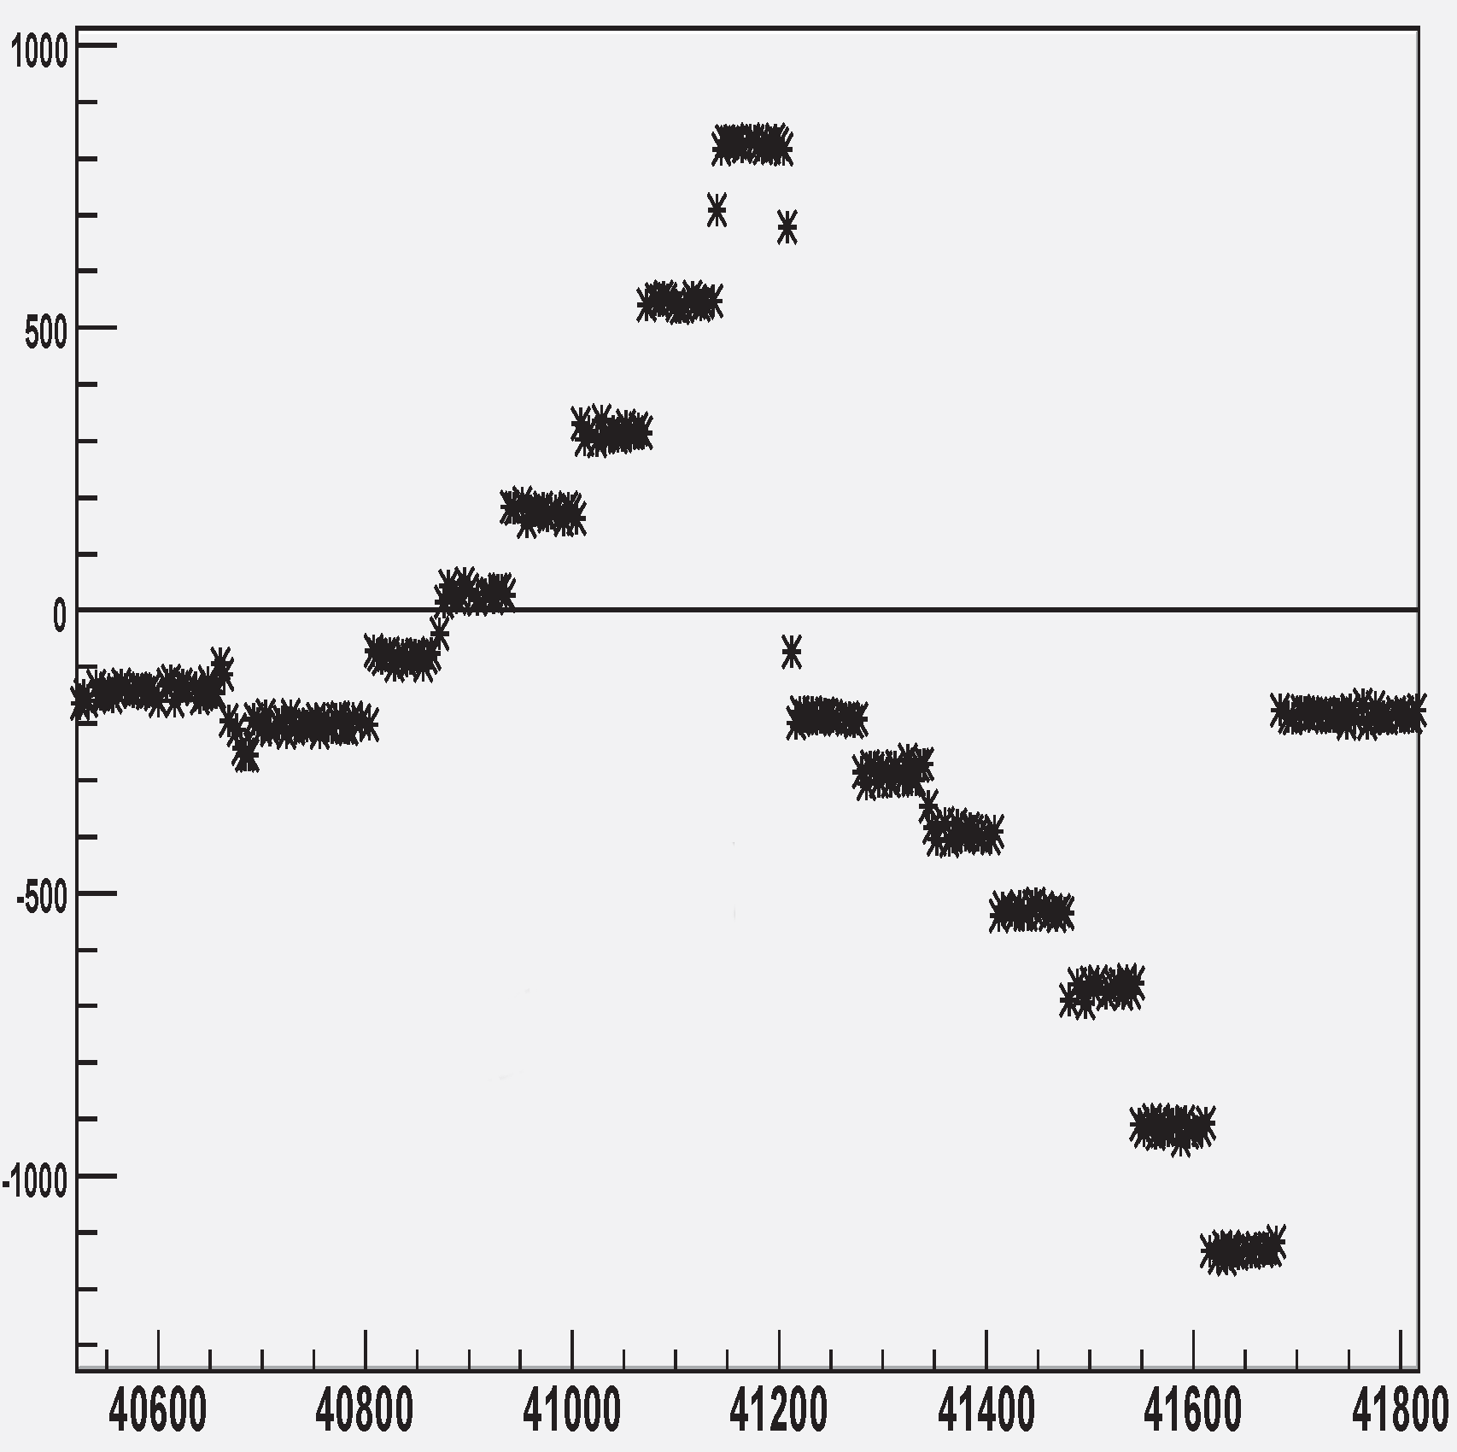
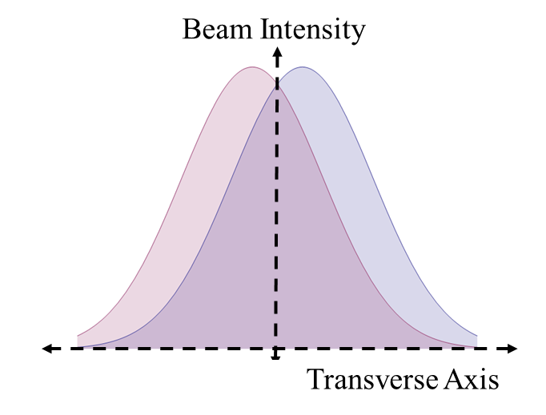
Measuring $σ_{x}$ and $σ_{y}$
Vernier Scan determines Absolute Luminosity by measuring $σ_{x}$ and $σ_{y}$
Moving a Beam - BPM
Position (microns)
h = offset
h
Overlap Region
time (seconds)
Figure modified from AN888
$$L≈k_{b}×f_{rev}×\sum_{i=1}^{k_{b}}{\frac{N_{b}^{i}×N_{y}^{i}}{2π\sqrt{{(σ}_{bx}^{i2}+σ_{yx}^{i2})+(σ_{by}^{i2}+σ_{yy}^{i2})}}}$$

Slide 7
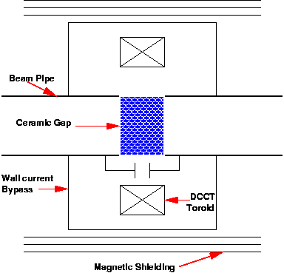
Measuring $N_{b}^{i}$ and $N_{y}^{i}$
DCCT
Apparatus 1: Direct Current Transformer (DCCT)
Advantages:
Excellent count of total number of ions in beam – 0.2% accuracy (small systematic uncertainty)
Calibration of Wall Current Monitor (WCM) with DCCT
Cost of Advantages:
Insensitive to beam debunching
Sampling time bins are large
$$L≈k_{b}×f_{rev}×\sum_{i=1}^{k_{b}}{\frac{N_{b}^{i}×N_{y}^{i}}{2π\sqrt{{(σ}_{bx}^{i2}+σ_{yx}^{i2})+(σ_{by}^{i2}+σ_{yy}^{i2})}}}$$

Slide 8
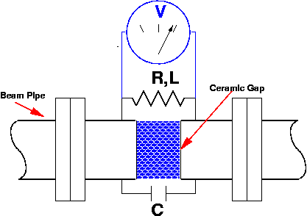
Measuring $N_{b}^{i}$ and $N_{y}^{i}$
Apparatus: Wall Current Monitor (WCM)
Advantages:
RLC circuit gives good sensitivity to bunched beam
$ω_{low}≈\frac{R}{L}$
$ω_{high}≈ \frac{1}{RC}$
Measures bunch profile in z-direction
Cost of Advantages:
Very small time sampling bins (~25 ns)
Less accurate for total beam ion count
Larger systematic uncertainty (~2%)
WCM
$$L≈k_{b}×f_{rev}×\sum_{i=1}^{k_{b}}{\frac{N_{b}^{i}×N_{y}^{i}}{2π\sqrt{{(σ}_{bx}^{i2}+σ_{yx}^{i2})+(σ_{by}^{i2}+σ_{yy}^{i2})}}}$$

Slide 9
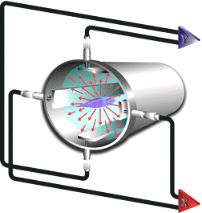
Measurement: Beam Offset
Apparatus: Beam Position Monitors
Measure transverse beam location – 10 $μ$m accuracy
Compare induced voltages in side-strips
Comparator circuit determines center in x and y direction
i.e. : $X_{center}≈ \frac{X2−X1}{X2+X1}$
Disadvantages
Many possible offsets: electrical center ≠ mechanical center ≠ orbit center
Beam Position Monitor
Y1
X1
X2
Y2
Image Credit: SLAC Graphic
$$L≈k_{b}×f_{rev}×\sum_{i=1}^{k_{b}}{\frac{N_{b}^{i}×N_{y}^{i}}{2π\sqrt{{(σ}_{bx}^{i2}+σ_{yx}^{i2})+(σ_{by}^{i2}+σ_{yy}^{i2})}}}$$

Slide 10
Measurement: Beam Offset
Steering Magnets Vs BPM Step
Apparatus: Magnets
Dipole magnets used to steer beam
Magnet step linearly proportional to measured step by BPM
Cross check for beam position monitor
Magnets step beam – BPMs measure step size.
BPM Step (microns)
Magnet Step (microns)
$$L≈k_{b}×f_{rev}×\sum_{i=1}^{k_{b}}{\frac{N_{b}^{i}×N_{y}^{i}}{2π\sqrt{{(σ}_{bx}^{i2}+σ_{yx}^{i2})+(σ_{by}^{i2}+σ_{yy}^{i2})}}}$$

Slide 11
Vernier Analysis Goals
Determine Acceptance of BBC trigger (integral of BBC (aka trigger efficiency)
Pitfalls:
BBC Narrow and Wide have different acceptances defined over run – check trigger configuration at: https://www.phenix.bnl.gov/WWW/run/daq/runcontrol/
Determine correction to Acceptance
Need to use ZDC Narrow and Wide
Determine Efficiency of BBC
Once BBC efficiency is known, we may proceed with calculation of luminosity and correct for “hourglass” artifact.

Slide 12
BBC Trigger Acceptance Run 340329
Vertex Cut – 30 cm
Vertex Cut – 15 cm
Counts At Given Vertex
Ratio vs Vtx position: Without Statistical Error
Ratio vs Vtx Position: With Statistical Error
BBC Wide / BBC Narrow
Vertex Postion – (cm)
Vertex Postion – (cm)

Slide 13
To Do
Integrate over Ratio figure to obtain acceptance
Acceptance subject to correction since BBC triggers become less efficient at large vertex displacement
Need to plot BBC event rate as a function of beam step
Problem: there is no watch – we need to use the clock gl1p and the time-step data to calculate where the beam was at a given time
Need to fully understand the ‘hourglass correction’
Recall parameters – still need to extract:
${\dot{N}\left(h\right),N}_{y}, N_{b}, k_{b}, f_{rev}, (A→σ_{BBC}) and σ$
Calculate L

Slide 14
Quality Assurance
Goals:
Establish reasonable criteria for cutting out garbage from physics runs
Retain as much data as possible
Currently studying global event characterization for di-muon data (runs 331691 – 340515)
Other analyses that must be done:
Muon system reconstruction
Muon Tracker health
RPC Health (check for dead channels)
MuID Health

Slide 15
QA – Work So Far
Di-Muon vertex spread
Why we need QA:
BBC vertex spread as function of Run number.
Clearly, we need to make some cuts to keep only good data!
Arbitrary Acceptable Range

Slide 16
QA - Goals
Create and maintain log files with bad runs flagged
Flag data outside acceptable ranges, and display in a useful way
Overarching goal: get used to navigating trees, what variables are stored in these trees, and how each variable must be dealt with.

