Slide 1
Summary of INTT ROC Test
2022/11/29
Kazuma Fujiki

Slide 2
Object
Prepare 16 ROCs with no defects for sPHENIX
16 of 25 ROCs …
▪ are taken over from PHENIX
▪ have malfunctions in many location
▪ need to repair

Slide 3
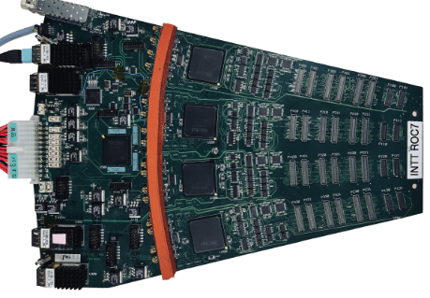
ROC Class Definition
Class | Number of the GOOD ports
1 | 12 Ports
2 | 10 or 11 ports
3 | 8 or 9 ports
4 | Less than 7 ports
D3
C3
B3
A3
D2
C2
B2
A2
C1
B1
12 input ports
D1
A1
Not in use for INTT

Slide 4
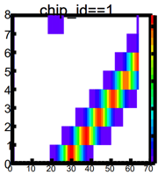
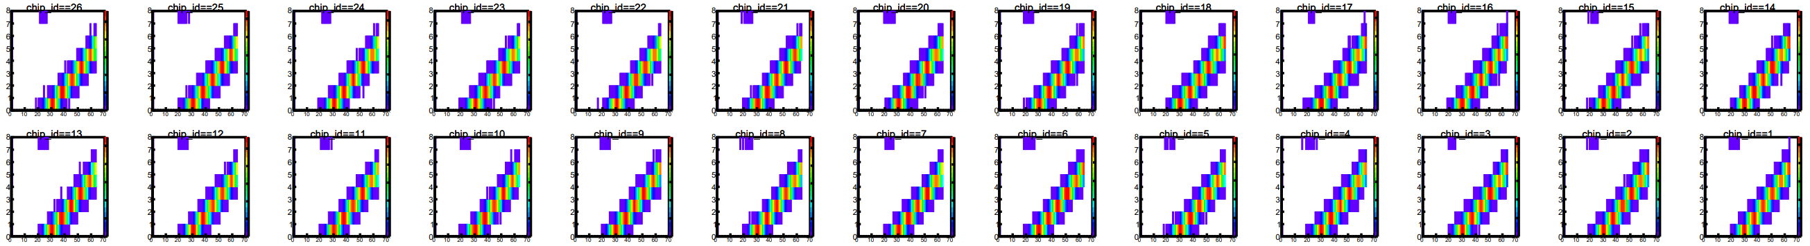
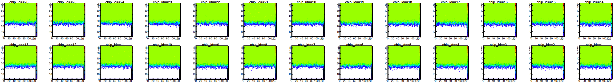
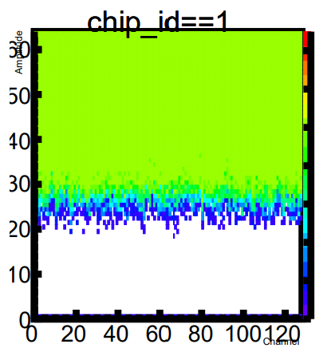
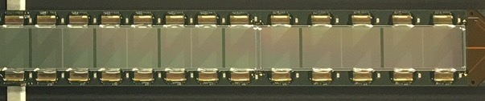
Calibration Data From Good Ports
Output ADC
Input pulse height
Input pulse height
Strip channel
Silicon Sensor

Slide 5
Calibration Data From Bad Ports
The problems can be categorized into 4
Problem in …
Calibration Pulse
Symptom : Abnormal calibration data is acquired from all ports or single port
Data Fiber Sync
Symptoms : Some of the LEDs on the FEM do not light up / No data for the corresponding ports.
Power Supply
Symptoms : Abnormal calibration data is acquired / LED behind ROC lights up
Cause : Calibration generation circuit / Multiplexer
Cause : Regulator / Circuit that supplies power to the elements
Cause : Serializer TLK2711 has radiation damage
Data Missing
Symptoms : Some data is missing
Cause : Under investigation
Any unhealthy calibration result indicates the problem of the port.

Slide 6
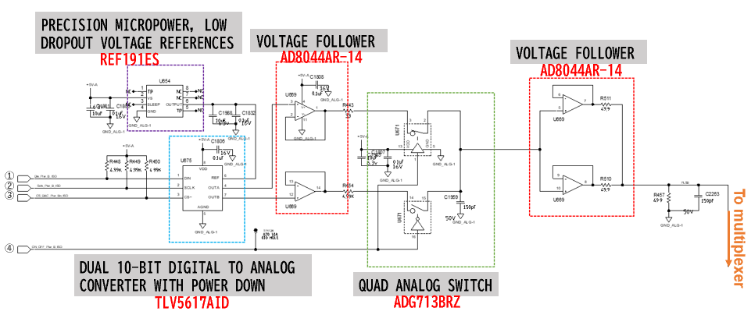
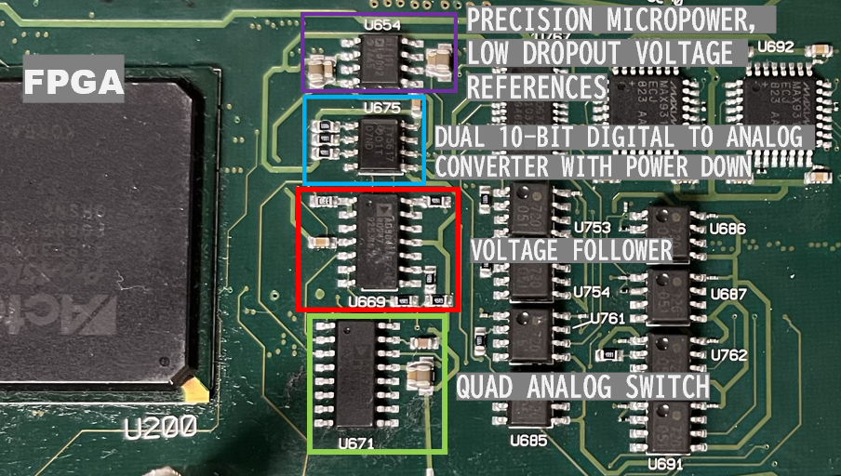
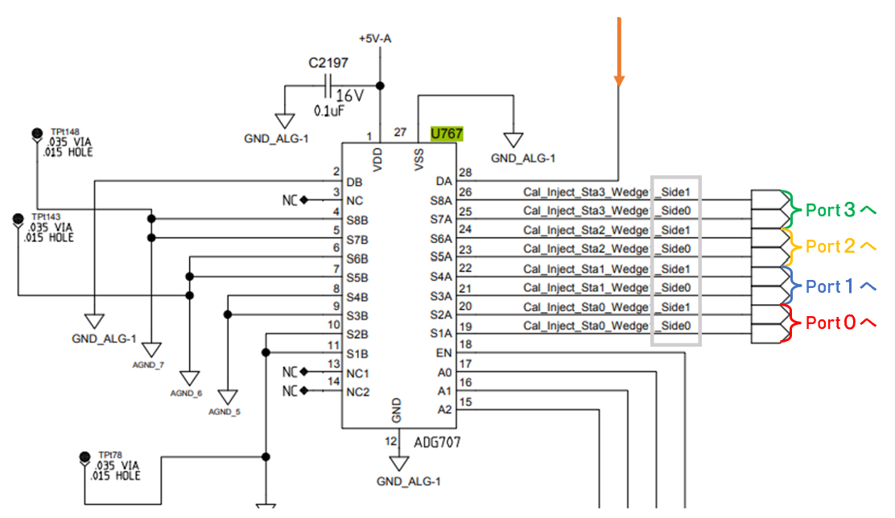
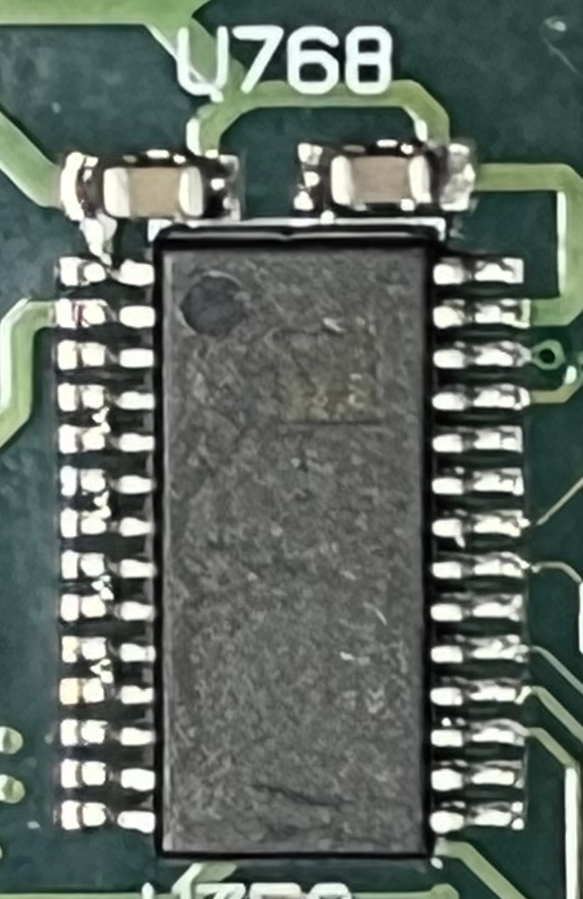
Calibration Pulse
Symptom : Abnormal calibration data is acquired from all ports or single port
Cause : Calibration generation circuit / Multiplexer
Calibration pulse generation circuit
If abnormal data is acquired throughout the column, there is a problem with the calibration generation circuit.
If abnormal data is acquired on a port alone, there is a problem with the multiplexer.
Multiplexer

Slide 7
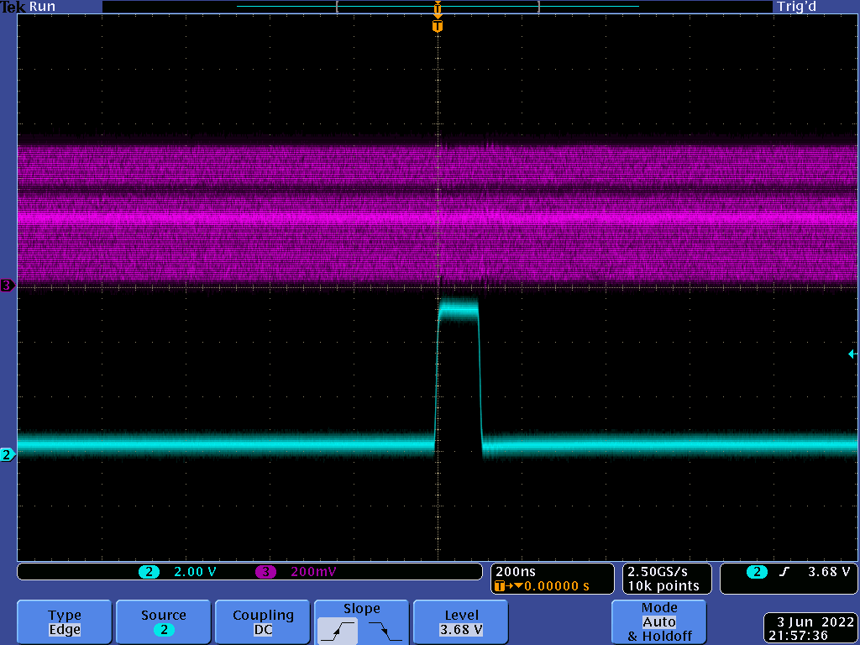

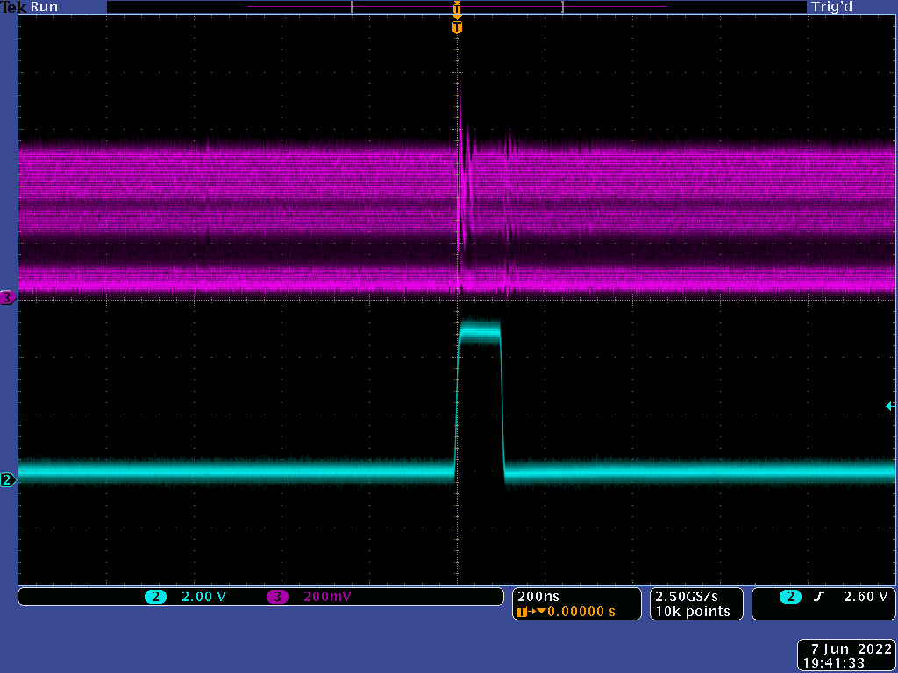

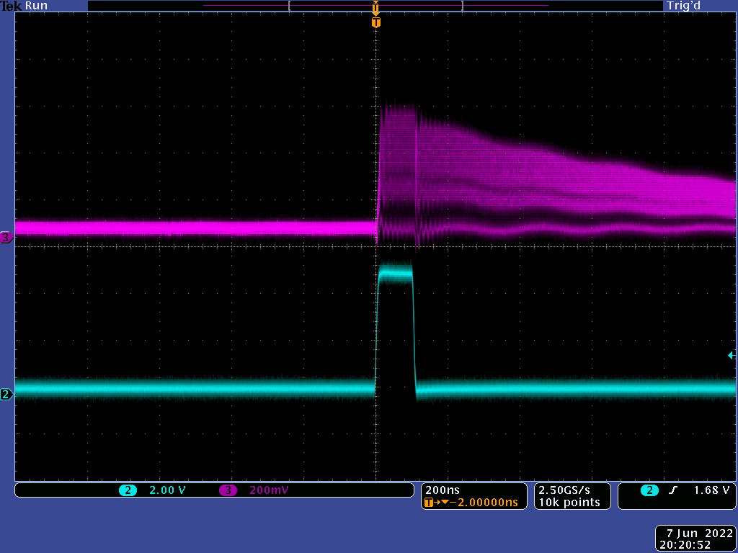
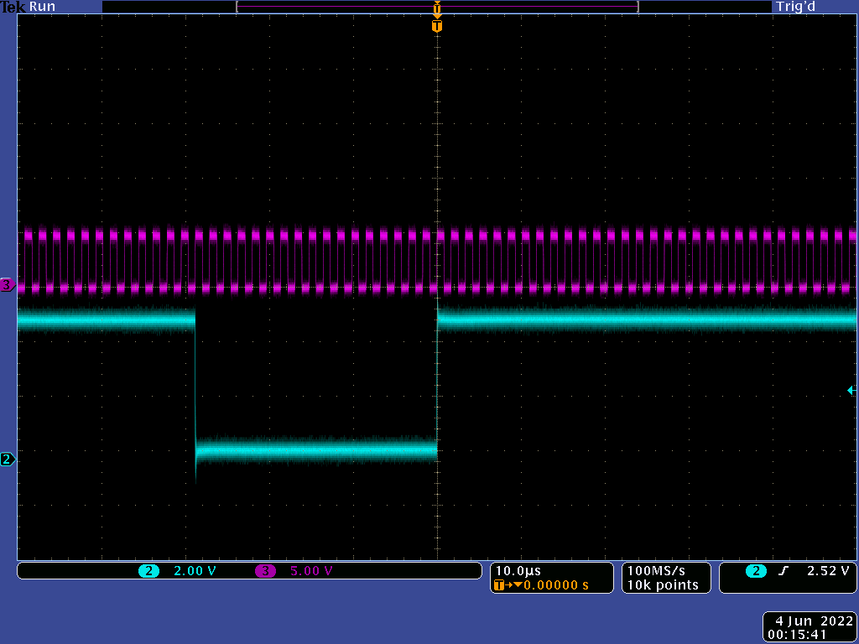
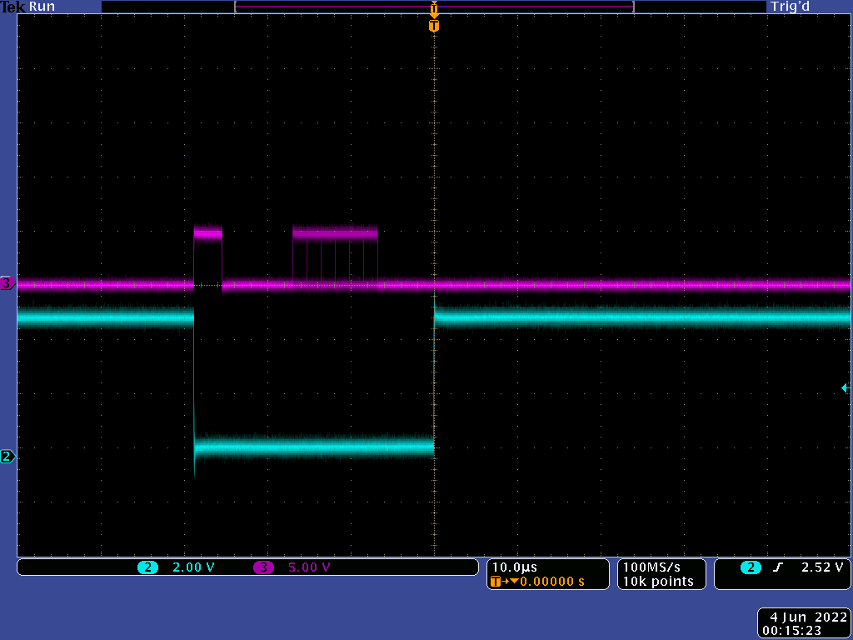
Calibration Pulse
Symptom : Abnormal calibration data is acquired from all ports or single port
Cause : Calibration generation circuit / Multiplexer
Normal waveform
*Trigger signal displayed in cyan

Slide 8
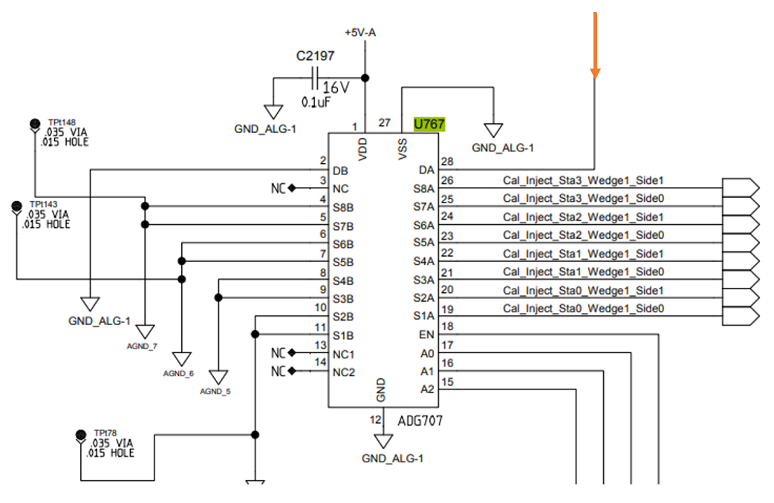
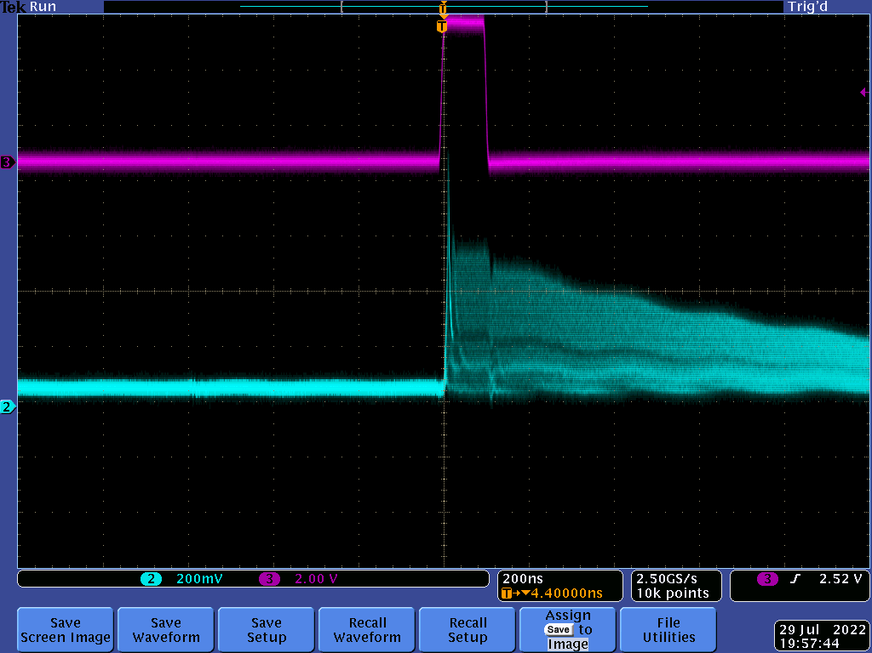
Calibration Pulse
Symptom : Abnormal calibration data is acquired from all ports or single port
Cause : Calibration generation circuit / Multiplexer
Normal waveform
Trigger Signal

Slide 9
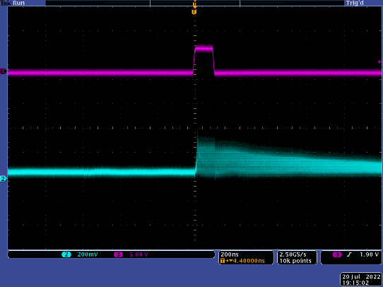
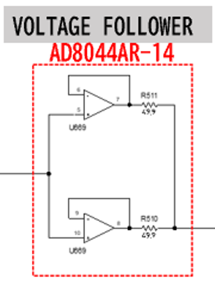
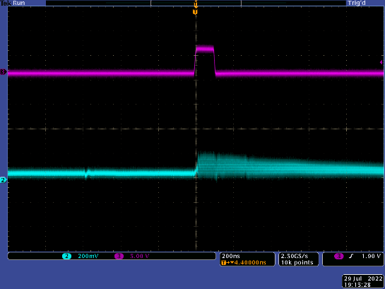
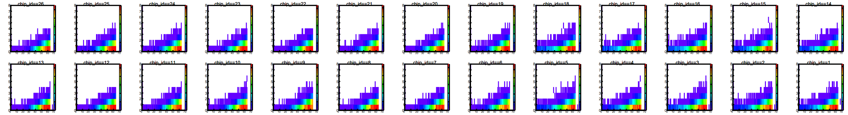
Calibration Pulse
Symptom : Abnormal calibration data is acquired from all ports or single port
Cause : Calibration generation circuit / Multiplexer
400mV
Small amplitude of calibration pulses
200mV
VOLTAGE FOLLOWER U669 has a low output value

Slide 10
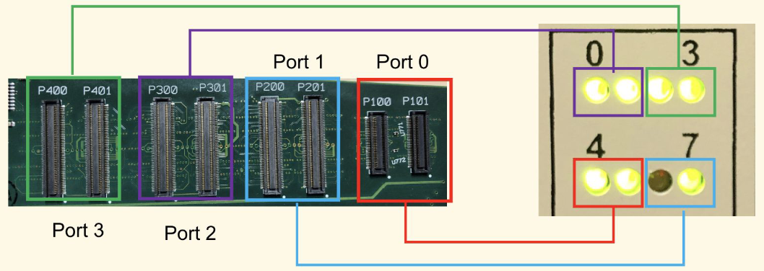
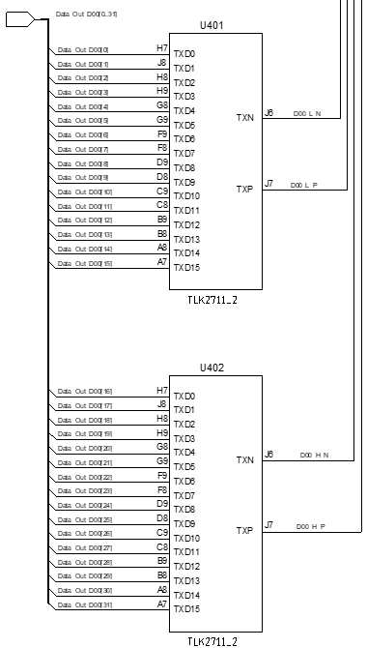
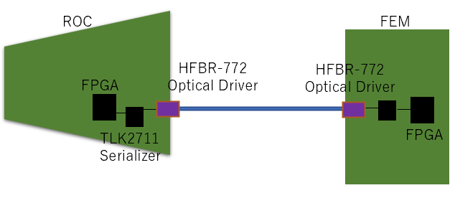
Data Fiber Sync
Symptoms : Some of the LEDs on the FEM do not light up / No data for the corresponding ports.
Cause : Serializer TLK2711 has radiation damage
Replacing serializer repaired Fiber Sync in NE5.
The serializer is likely radiation damaged.
25 serializers per ROC
(2 per 12 ports + 1 for FPGA)
Fiber Sync may increase once the experiment starts, especially if the FPGA serializer is damaged, the entire ROC is at risk
Currently approx. 2.7% (8ports/300ports)
Correspondence between LEDs on FEM and ports
2 serializers per port

Slide 11
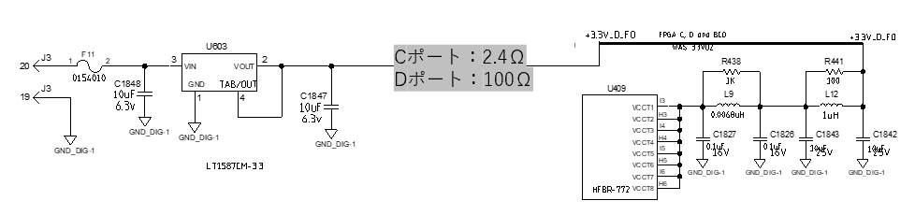
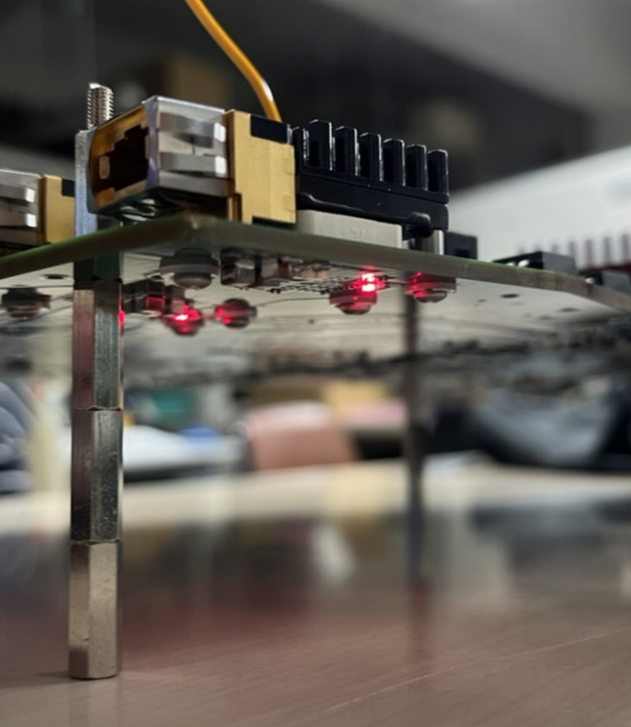
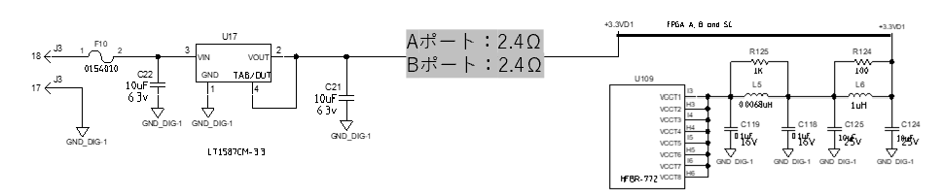
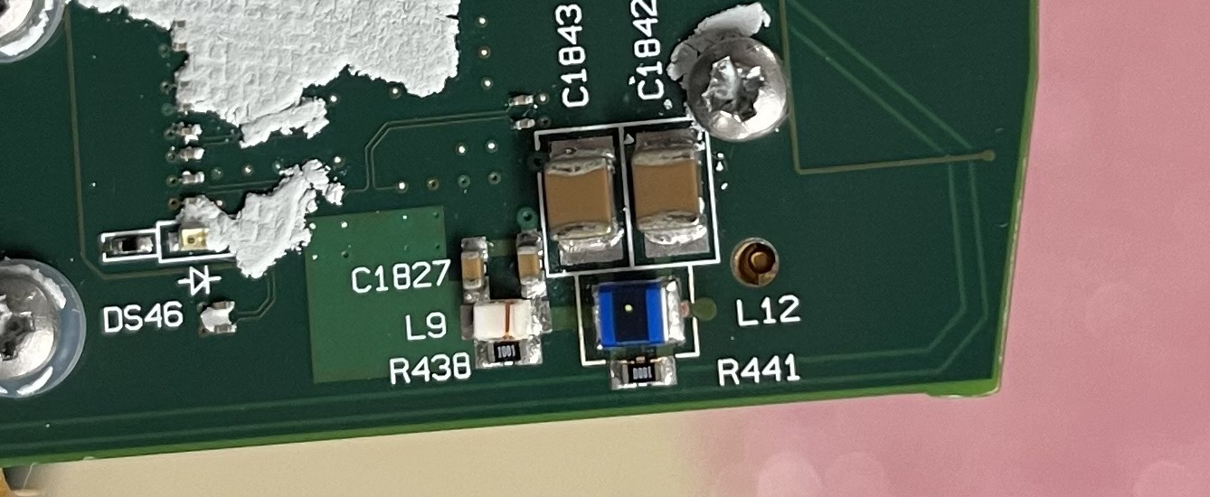
Power Supply
  Symptoms : Abnormal calibration data is acquired / LED behind ROC lights up
  Cause : Regulator / Circuit that supplies power to the elements
Calibration data not acquired in column D of NE1
High resistance of column D circuit.
This symptom is explained by the lack of L12, and we have confirmed that it is indeed missing.
  LED behind ROC lights up

Slide 12
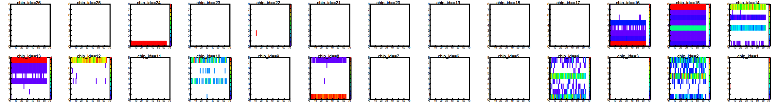
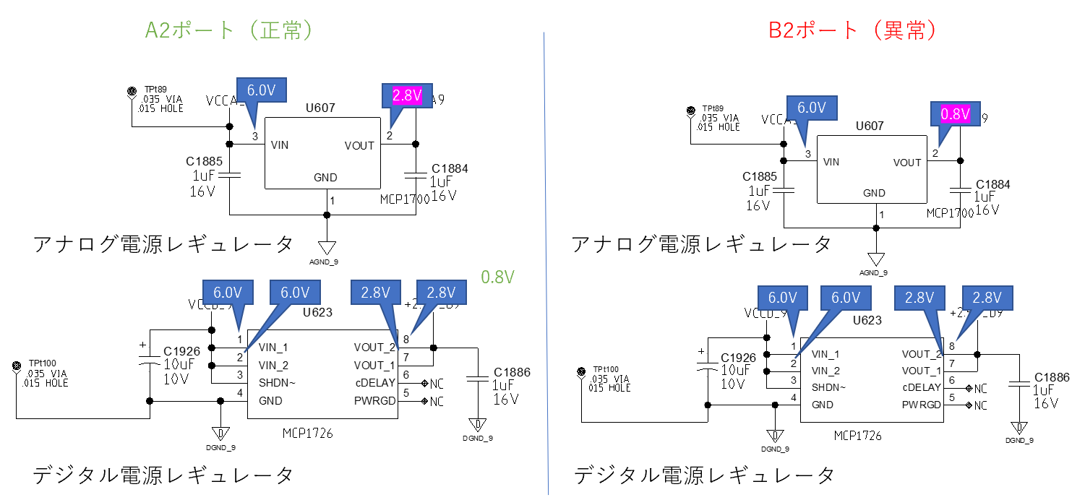
Power Supply
  Symptoms : Abnormal calibration data is acquired / LED behind ROC lights up
  Cause : Regulator / Circuit that supplies power to the elements
Abnormal calibration data acquired at B2 port of NE1
At this time, the current value of FPHX is 0.16 A (normally 0.5 A)
A2 (Normal)
B2 (Abnormal)
Output voltage of analog power regulator for B2 is 2.0V lower than normal port
Analog power regulator
Analog power regulator
Digital power regulator
Digital power regulator

Slide 13
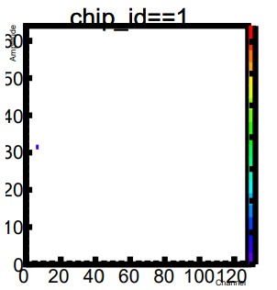
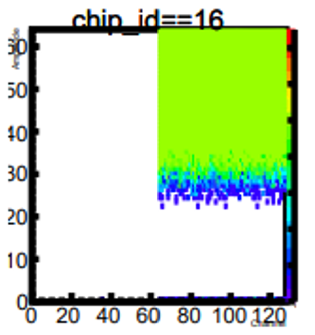
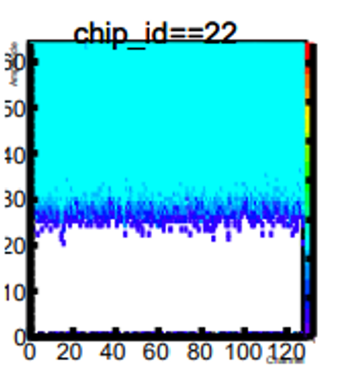
Data Missing
  Symptoms : Some data is missing
  Cause : Under investigation
Problem in missing data are categorized into three types
Good Data
Whole Chip Data Missing
Likely poor contact between ROC and conversion cable.
Partial Missing Channels
Occurs at side 1 of D3 port with micro coaxial cable.
Worse when wearing the BEX.
Half Entry
Only half the overall number of data comes in on some chips.
Poor contact of pins of DF18 connector / Other

Slide 14
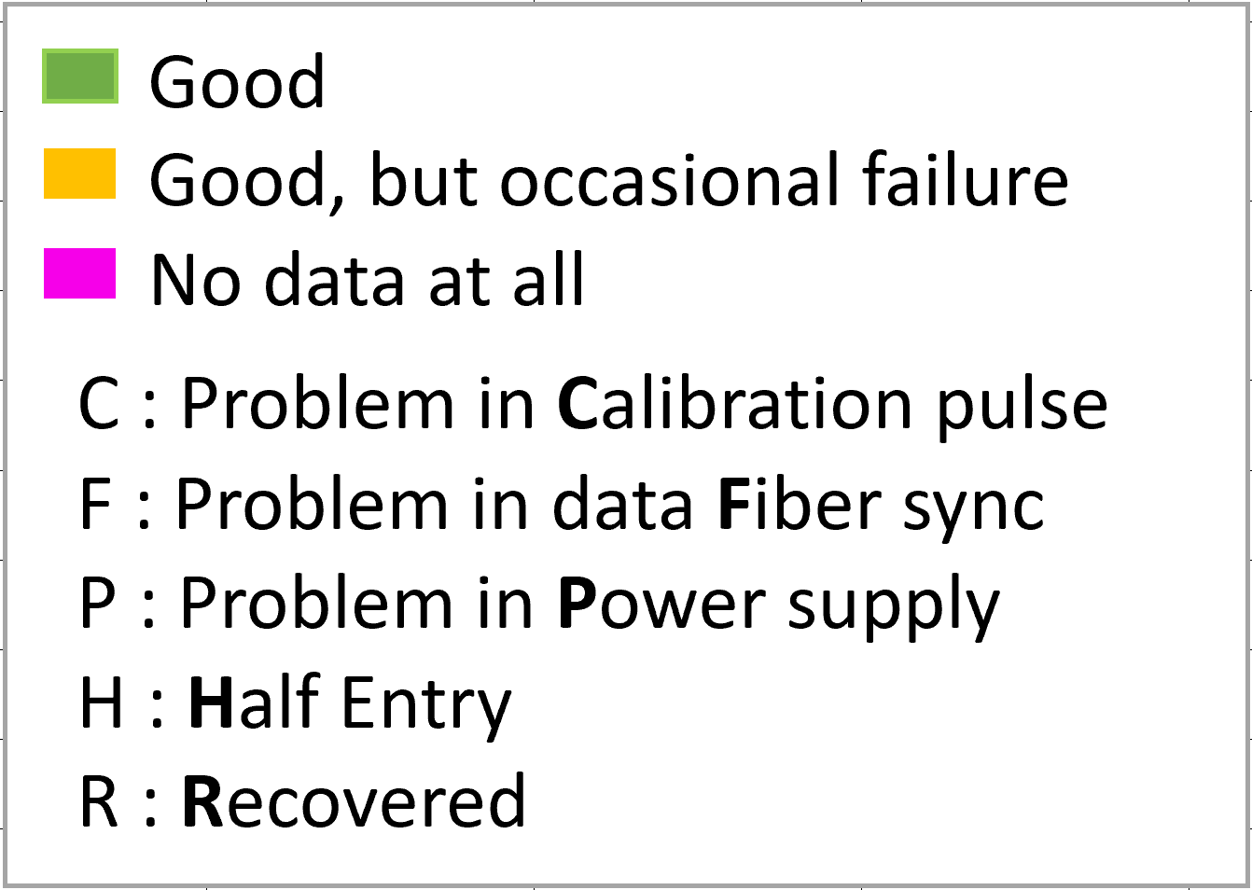
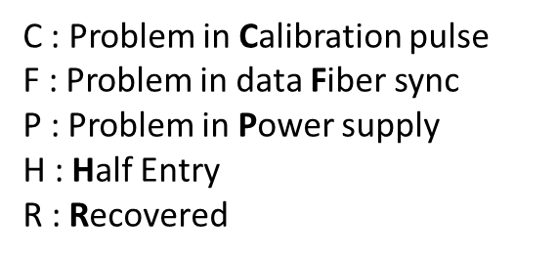
ROC Test Status at a Glance
15 of 16 Class 1ROCs required
6 ROCs were repaired to Class 1.
One more Class 1 ROC is needed.
2022/11/29

Slide 15
Status Summary
Class | Quantity
1 | 15
2 | 6
3 | 4
4 | 0
Code | ROC | Port | Error
C | 1 | 3 | Problem in calibration pulse generating system
F | 6 | 8 | Data fiber doesn’t latch
H | 3 | 5 | Half Entry
P | 0 | 0 | Inadequate power supply to components
D | 3 | 8 | Data collapsed
Total 25 ROCs

Slide 16
Summary
All 25 ROCs were inspected and tested. 34 ports were fixed by repair work.
15 of the 16 Class-1 ROCs needed were ready. One more Class-1 ROC is needed.
Issues associated with partial missing channels or half entry are yet established solution. Keep investigation.
We will continue working on deeper investigation of bad ROC ports and try to fix remaining none class-2 ROCs.
ROC's chart is being prepared with Hikaru.

