Slide 1
Commissioning of a hadron blind detector for dielectron measurement in pA reactions at J-PARC
Koki KANNO for the J-PARC E16 Collaboration
RIKEN

Slide 2
Outline
J-PARC E16 experiment
hadron blind detector (HBD)
HBD commissioning
results
conclusions and outlook

Slide 3
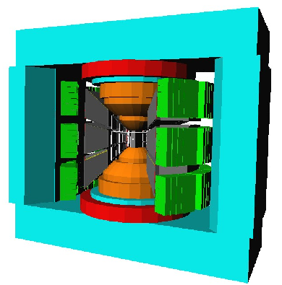
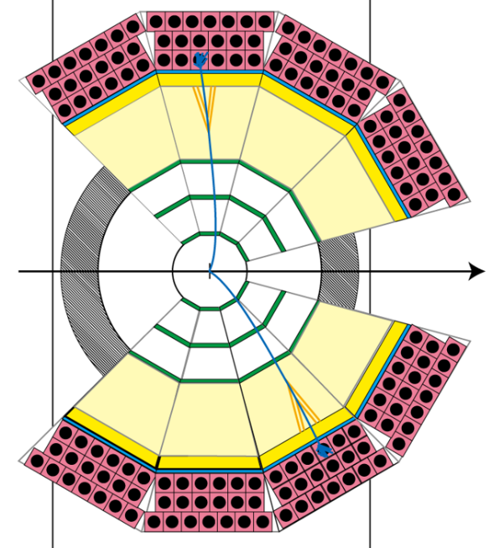
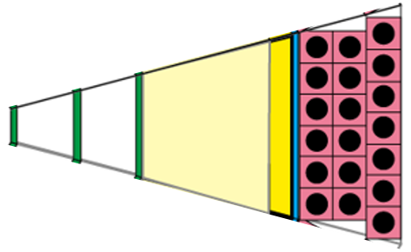
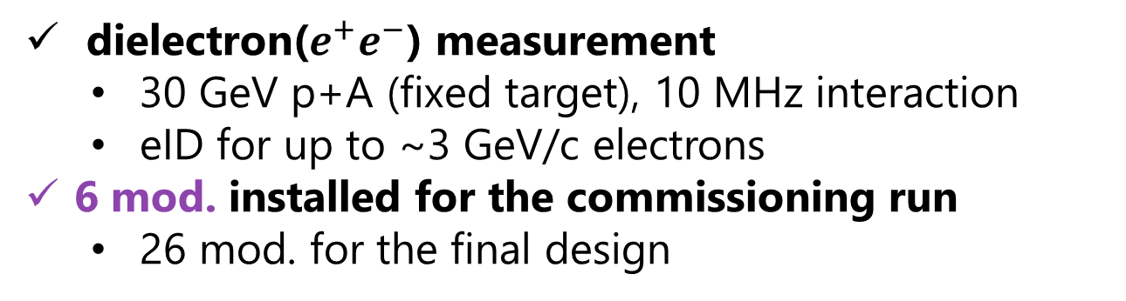
J-PARC E16 experiment
beam
beam
dielectron($e^{+}e^{−}$) measurement
  30 GeV p+A (fixed target), 10 MHz interaction
  eID for up to ~3 GeV/c electrons
6 mod. installed for the commissioning run
  26 mod. for the final design
Tracking detectors
Hadron blind detector
Lead-glass calorimeter

Slide 4
Hadron blind detector (overview)
windowless and mirrorless proximity focus Cherenkov detector
  originally developed by the PHENIX experiment
  utilized for eID
  Triple GEM stack + CsI photocathode
  ionized electrons swept into mesh
  pad readout+APV25 hybrid card of SRS
  ASD connected to the bottom GEM
  for a trigger signal
Incident electron
CF4 radiator
mesh
CsI photocathode
Triple GEM
Readout pad

Slide 5
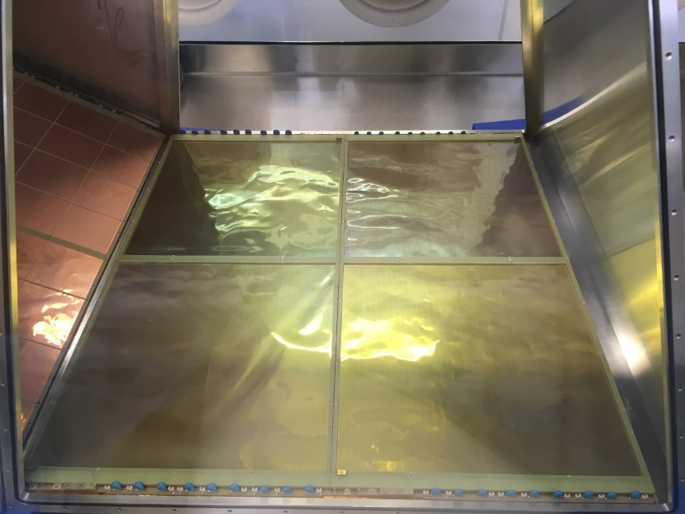
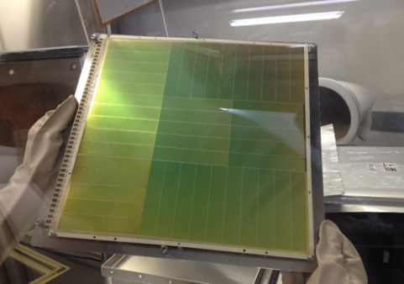
Hadron blind detector (GEM)
30x30 cm2 GEM foils are used for the HBD
  made by Japanese company
  3 foils per stack, 4 stacks per module
  6 modules = 72 foils installed for the commissioning
CsI is evaporated on the top surface of the top GEM
  evaporated by Hamamatsu
Incident electron
CF4 radiator
mesh
CsI photocathode
Triple GEM
Readout pad
CsI evaporated GEM

Slide 6
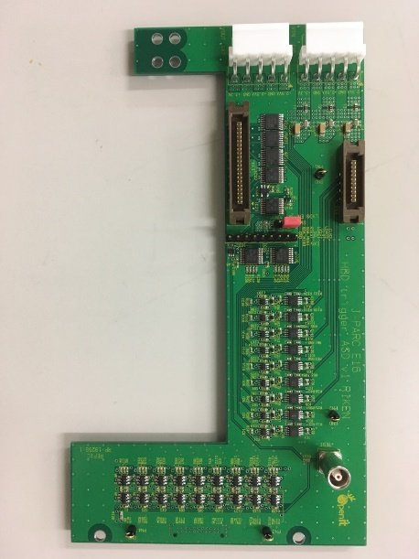
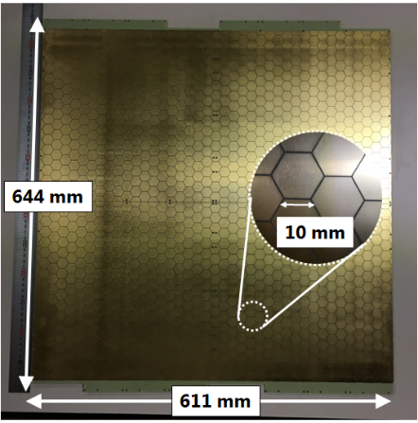
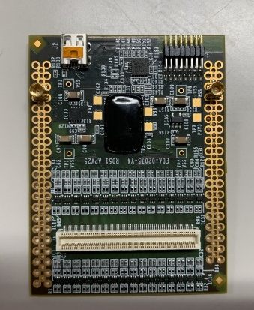
Hadron blind detector (front-end)
two types of readouts are used for the HBD
  pad readout with APV25 hybrid cards of SRS (1400 ch/module)
  the bottom surface of the bottom GEM with ASD
  for the trigger signal (36 ch/module)
Incident electron
CF4 radiator
mesh
CsI photocathode
Triple GEM
trigger ASD
Readout pad
pad readout board
APV25 hybrid card

Slide 7
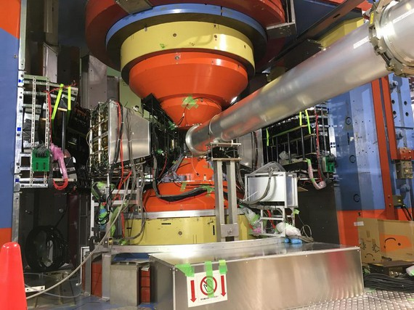
Spectrometer commissioning
30 GeV proton beam
HBD
GEM tracker+SSD
Lead-glass calorimeter

Slide 8
Analysis (waveform)
signals are samples with 41.67 MHz (24 ns/cycle)
  with APV25 hybrid card of SRS
fitting w/ a function based on apv25 circuit constants
  a waveform template obtained with a test pulse does not reproduce well
ADC
events
time [ns]
chi2/ndf

Slide 9
Analysis (clustering)
the side length of a hexagonal pad is 10 mm and it is smaller than the circular image of the Cherenkov photons
  circular image is φ34 mm when incident angle is 0 degree under the zero magnetic field
the neighboring fired pads are defined to belong to the same cluster
  a fired pad is defined to have a greater signal than 4σ of electric noise
cluster charge:
sum of charge of fired pads in a given cluster
cluster size:
the number of fired pads in a given cluster
10 mm

Slide 10
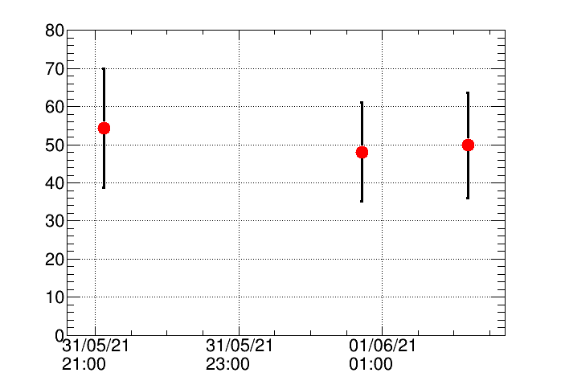

Gain calibration
gas gain of a triple GEM stack is measured with scintillation photons induced by incident charged tracks
  radiator and working gas of CF4 is a good scintillator
exponential curve at low amplitudes attributed to scintillation photons
  gas gain distribution follows the Polya distribution
events
rel. gain
$$S$$
ave. gain fluctuation < 10%
pos. dependent gain fluctuation σ~30%
ADC
time

Slide 11
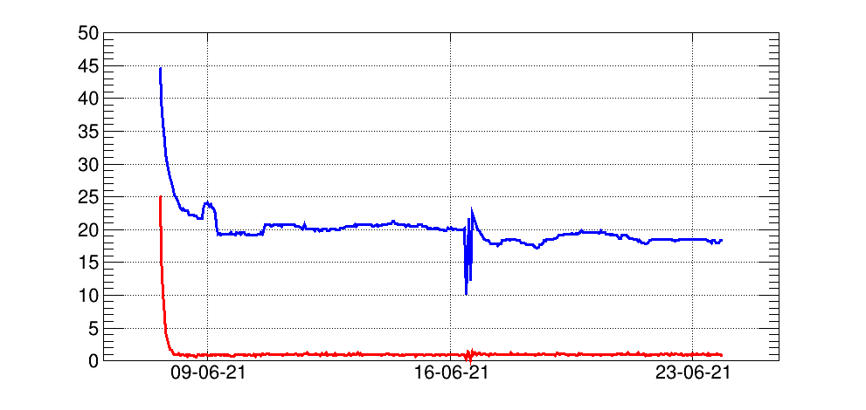
Gas system
a recirculating gas system is implemented to reduce gas consumption and running costs
photon wavelength of interest ranges VUV region (100—200 nm)
kept H2O and O2 reasonably low over 2 weeks
  less than 5% loss of photoelectron
H2O/O2
analyzer
vent
~0.4 L/min
HBD1
280 L
ppm
H2O/O2
analyzer
H2O
O2
fresh gas
~0.4 L/min
HBD2
280 L
purifier
H2O/O2
analyzer
HBD3
280 L
purified gas
~7 L/min
time
2 weeks

Slide 12
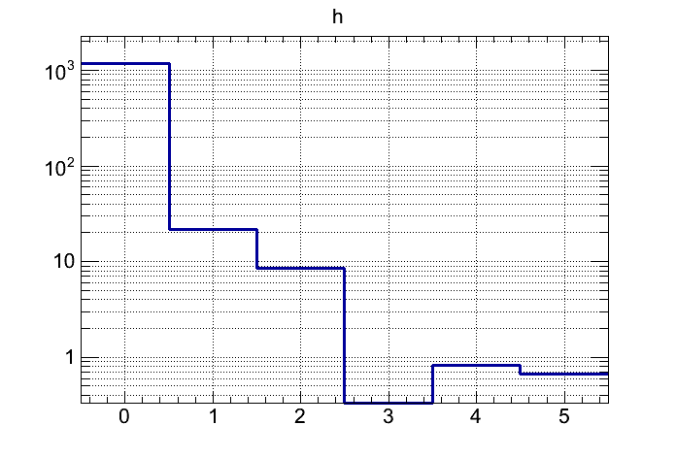

HBD response to pion
search for a HBD signal around the projected position of a track
  tracking with SSD and GEM trackers in front of the HBD
  pion ID with lead-glass calorimeter behind the HBD
ave. charge and cluster size are both consistent with the expected result
hit threshold
counts
counts
$$\left\langle charge\right\rangle =2.9 pe$$
photoelectron
cluster size

Slide 13
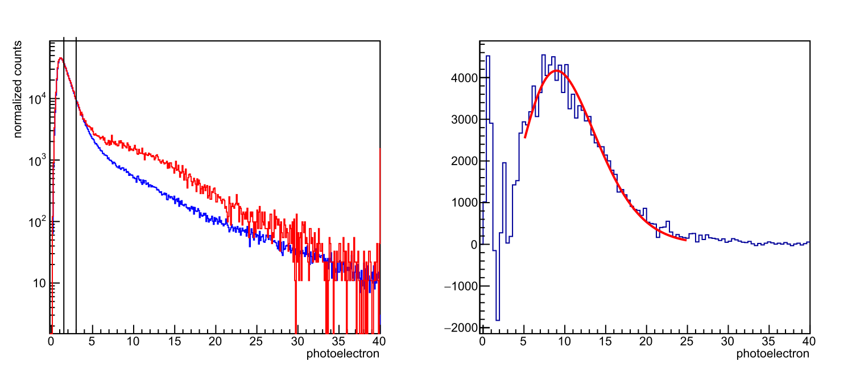
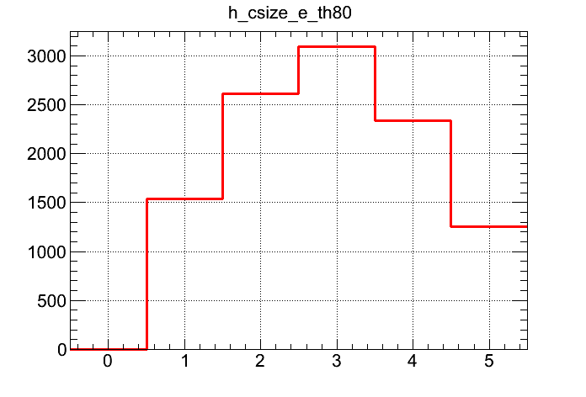
HBD response to electron
Lead-glass calorimeter is used for eID and position matching
we observed 11±1 p.e.
expected performance is 11＋1 p.e. and consistent with the observed result
an electron candidate leaves a multiple-pads hit
pion w/ LG
electron w/ LG
counts
counts
Poisson mean
λ: 11±1 p.e.
counts
cluster size
photoelectron
photoelectron

Slide 14
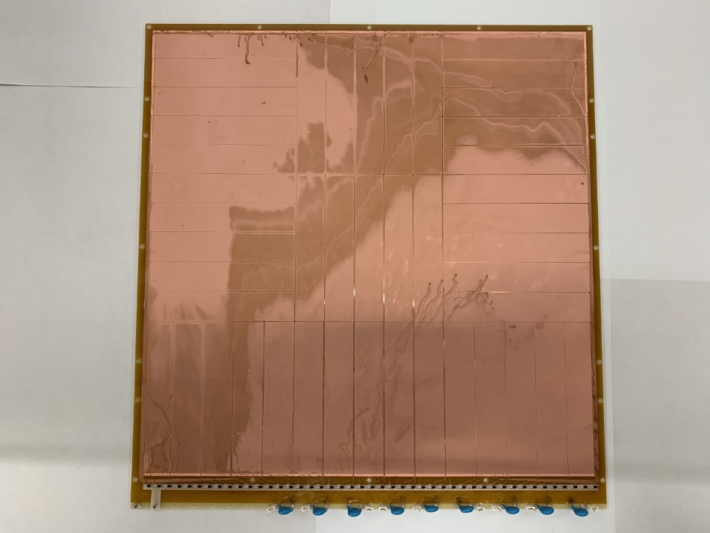
Trigger efficiency
HBD issues a trigger signal via ASD connected to the bottom surface of the bottom GEM
  30x30 cm2 GEM foil segmented into 9 trigger-tiles
due to noise, a very shallow curve around the threshold is observed
  detector capacitance of each segment is ~5 nF
ASD threshold
trig. eff.
9 ch
photoelectron

Slide 15
Electron detection efficiency and pion rejection power
electron detection efficiency and pion rejection power at both the trigger level and the offline level are evaluated
  At the trigger level, only a charge threshold is applied in an ASD board
  At the offline level, a threshold for charge cluster size is applied as well as trigger level condition
pion rejection power at the trigger level is worse than we had expected due to noise of ASD
  noise control
  DAQ upgrade
 | eID efficiency observed/expected | pion rejection power observed/expected
trigger level | 0.63±0.03/0.68 | 0.043±0.005/0.02
offline level | 0.61±0.04/0.63 | 0.009±0.002/0.006

Slide 16
Conclusions and outlook
we performed commissioning runs for the J-PARC E16 spectrometer which was design to measure dielectron spectrum
Hadron blind detector is utilized for eID and works
  expected response to electrons and pions
  recirculating gas system
ASD board for a trigger signal is so noisy that pion contamination increases
noise control by grounding and DAQ upgrade are on-going for the next beam time

