Slide 1
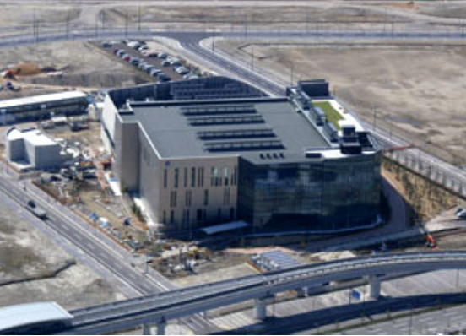
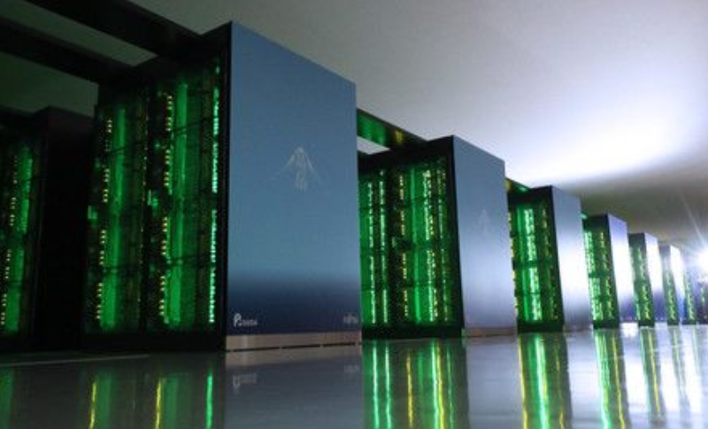
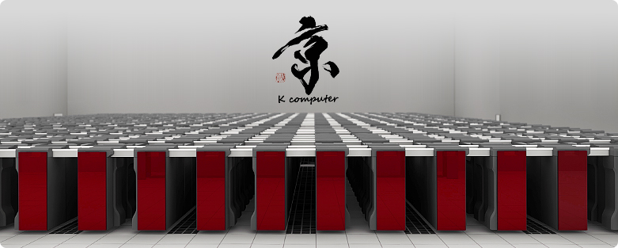
HPC simulation of quantum Computer
Challenges and opportunities in Lattice QCD simulations and related fields
(Feb. 15th, 2023, Kobe)
Nobuyasu Ito and Naoki Yoshioka
RIKEN Center for Computational Science
braket: A open-source quantum computer simulator for parallel computer
C++
https://github.com/naoki-yoshioka/braket
RIKEN R-CCS
and supercomputers
Fugaku 442PFLOPS, 2020-
K 10PFLOPS, 2011-2019
Fugaku NEXT
～2030?
➡
➡
with quantum-hybrid
architecture?

Slide 2
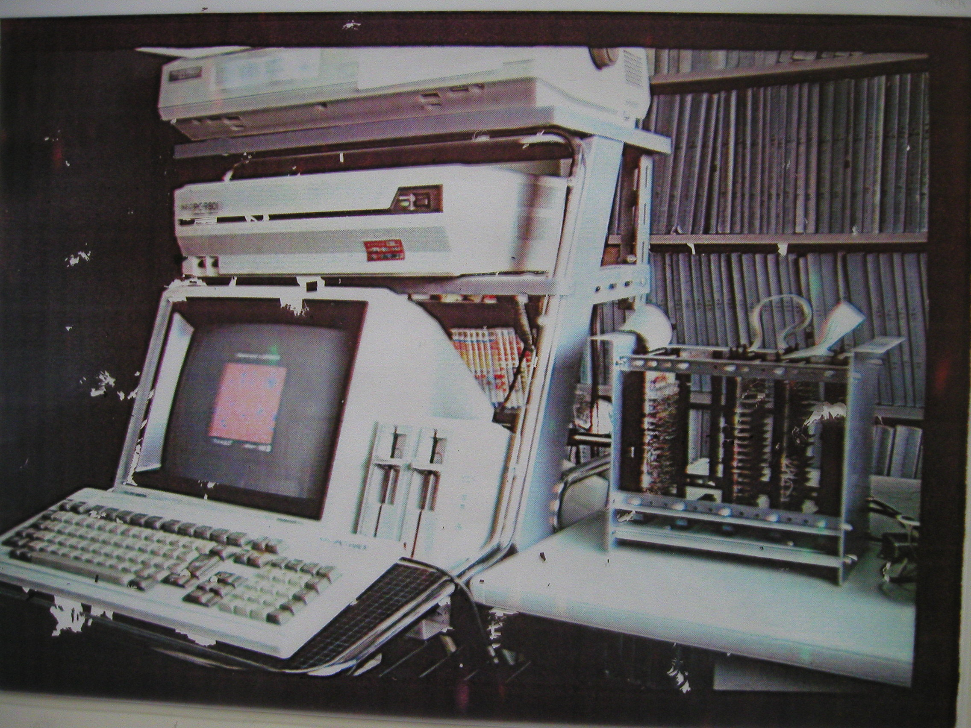
ISING MACHINE m-TIS
- first Ising annealer in Japan, second after A. T. Ogielski in 1985 at Bell Lab.
N. Ito, M. Taiji, M. Suzuki, R. Ishibashi, K. Kobayashi, K. Mitsubo and S. Katsura,
in "Computer Simulation Studies in Condensed Matter Physics III",
edited by D. P. Landau, K. K. Mon and H.-B. Schuettler (Springer--Verlag, 1991) (1991) p.201-203.
M. Taiji, N. Ito and M. Suzuki, Rev. Sci. Intrum. 59 (1988) p.2483
N. Ito, M. Taiji and M. Suzuki, in "Computational Approaches in Condensed Matter Physics",
edited by S. Miyashita, M. Imada and H. Takayama (Springer-Verlag, 1992) (1992) p.297-298.

Slide 3
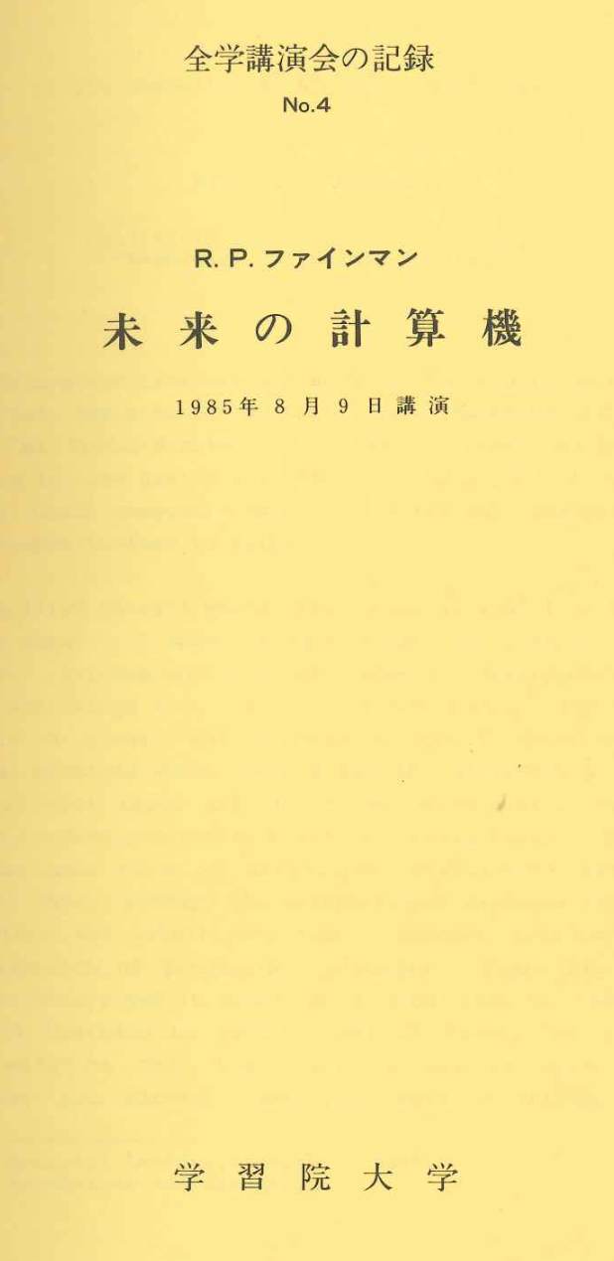
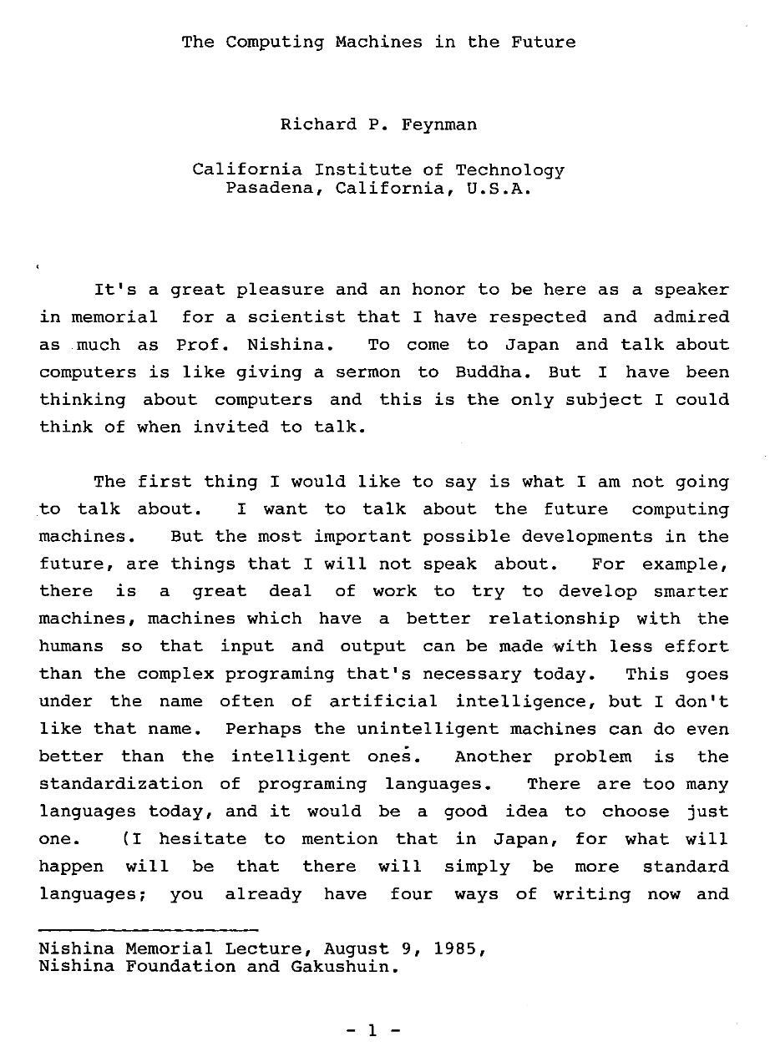

Slide 4
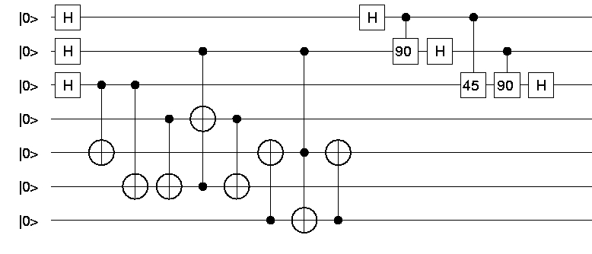
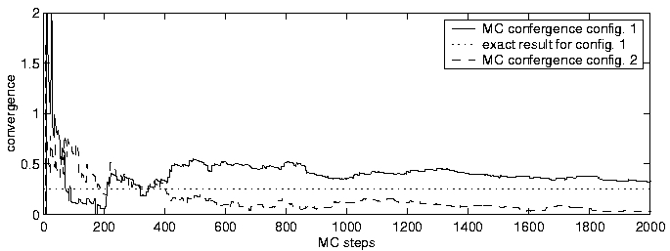
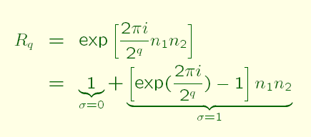
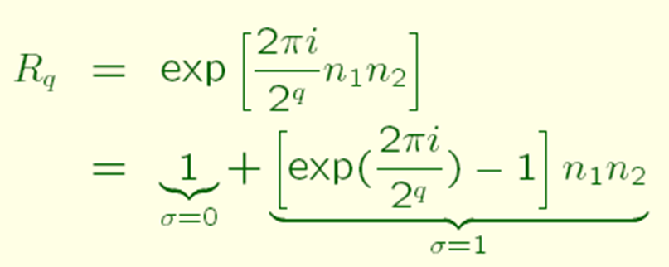
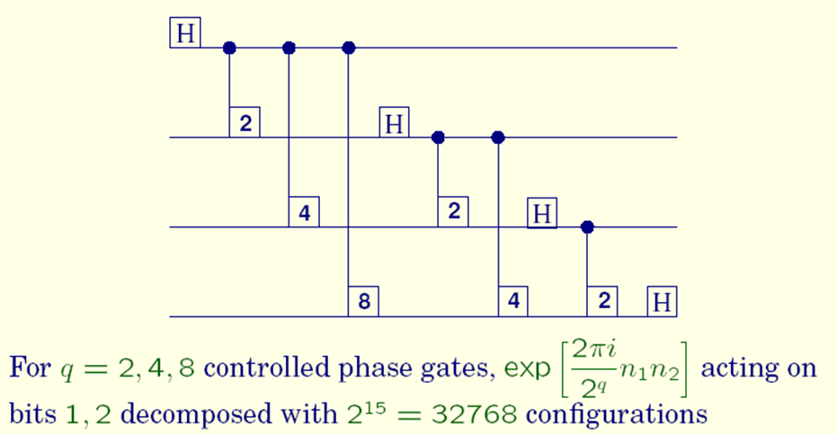
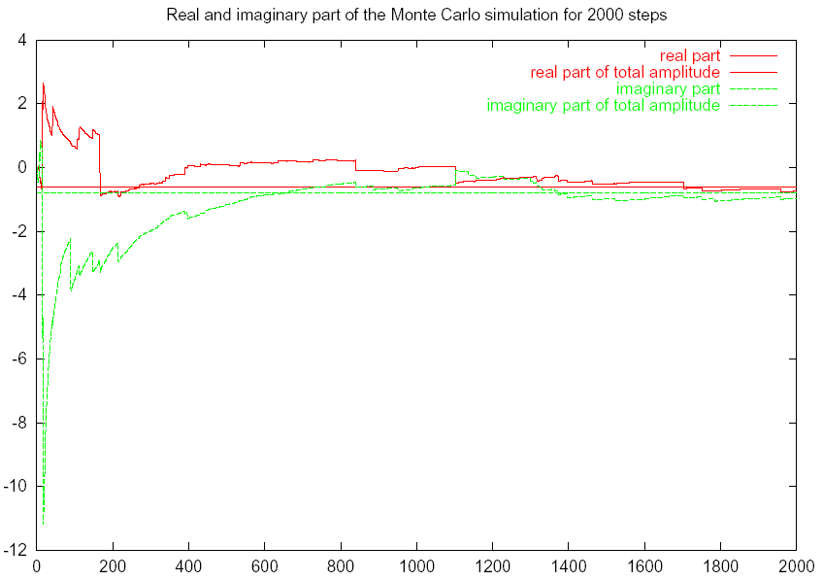
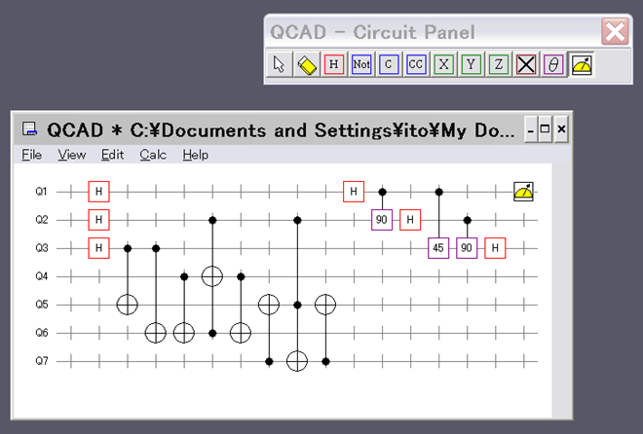
preliminary challenges
◎Application of quantum Monte Carlo simulation
Hubbard-Stratnovich transformation and multicanonical sampling
H.G. Matuttis et al, Intern. J. Modern Phys. C vol. 13 No. 7 (2002) p.917—929.
K. Fischer et al, Intern. J. Modern Phys. C vol. 13 No. 7 (2002) p.931—945.
Quantum Circuit from L.M.K. Vandersypen et. al., Nature 414, p.883 (2001): Shor-like circuit with 4 qubits
Fourier transformation
8bits FT
◎state-vector simulator with GUI: QCAD

Slide 5
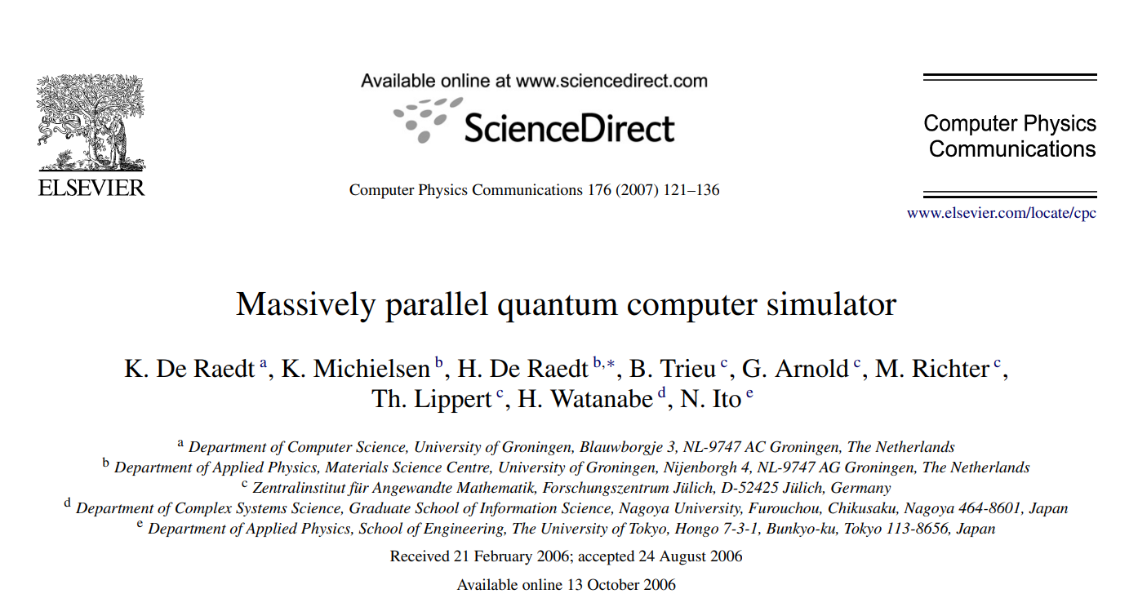
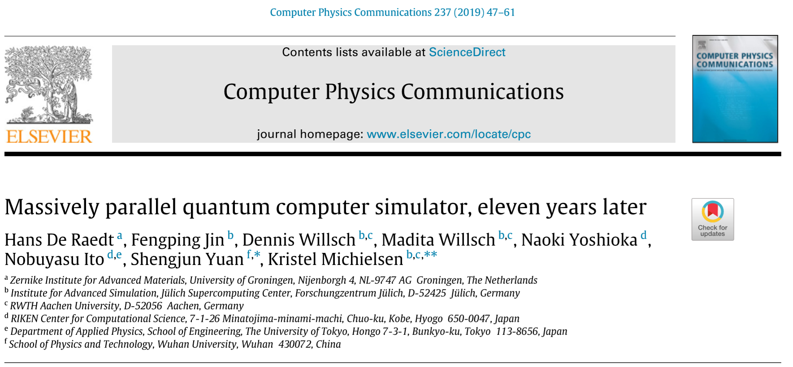
up to 36 qbits
Code https://github.com/naoki-yoshioka/braket
up to 48 qbits
RIKEN Code: https://github.com/naoki-yoshioka/braket
Collaboration with
Naoki Yoshioka(R-CCS), Hans De Raedt(U. Groningen), Fengpin Jin(F. Juelich) ,
Kristel Michielsen, Dennis Wilsch, Madita Nocon (Aachen U. and F. Juelich)
Shengjun Yuan(Wuhan U. )

Slide 6
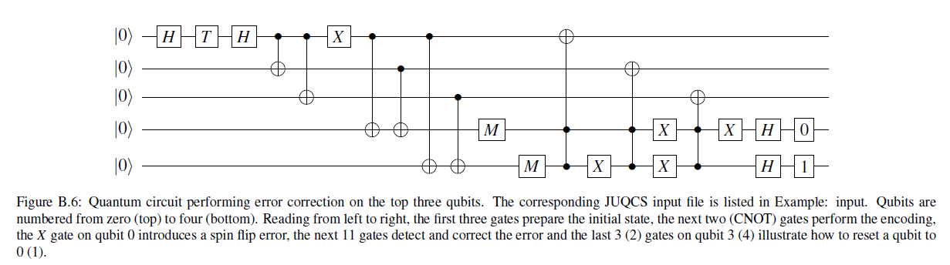
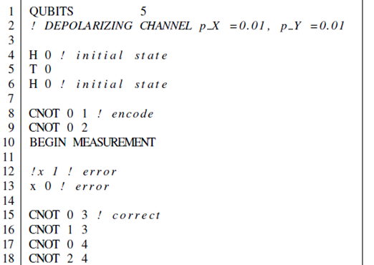
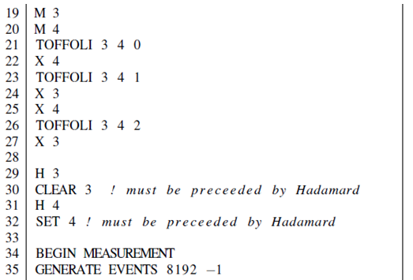
An example
Program: Quantum assembler – input to simulators

Slide 7
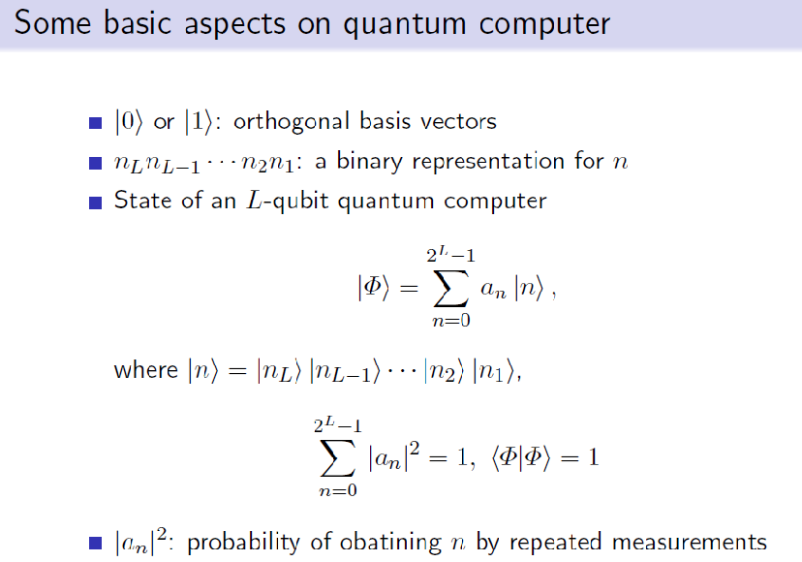

Slide 8
Requirements for QC simulation
Memory limits number of qbits.
N 2^{N} double precision single precision half precision byte precision
～10¹⁶ op. ～10⁸ op. ～10⁴ op. ～10² op.
(over-spec) (practical use) (simple test)
1K 16KB 8KB 4KB 2KB
1M 16MB 8MB 4MB 2MB
1G 16GB 8GB 4GB 2GB
36 16G 1TB 512GB 256GB 128GB
1T 16TB 8TB 4TB 2TB
45 32T 512TB 256TB 128TB 64TB
64T 1PB 512TB 256TB 128TB
128T 2PB 1PB 512TB 256TB
256T 4PB 2PB 1PB 512TB
512T 8PB 4PB 2PB 1PB
50 1P 16PB 8PB 4PB 2PB
51 2P 32PB 16PB 8PB 4PB
52 4P 64PB 32PB 16PB 8PB
…
← 2007 on Blue Gene/L and Regatta p690+
← 2019 on K and Taihu Light
← on Fugaku with two-to-N allocation
← on Fugaku with packed allocation
→ Memory transfer rate limits number of qbits.
per node full system
in-node inter-node in-node inter-node
K: 64GB/s 40GB/s 5.4PB/s 3.4PB/s
Fugaku: 1TB/s 40.8GB/s 155.3PB/s 6.2PB/s

Slide 9
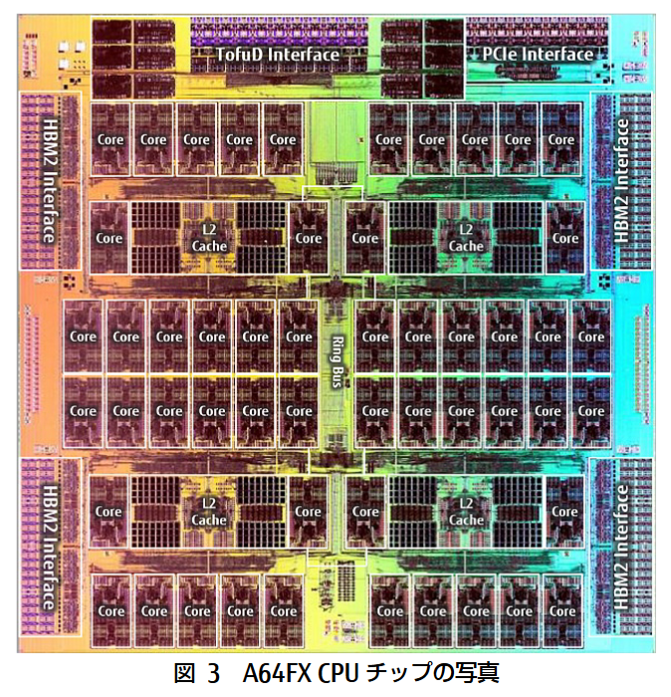
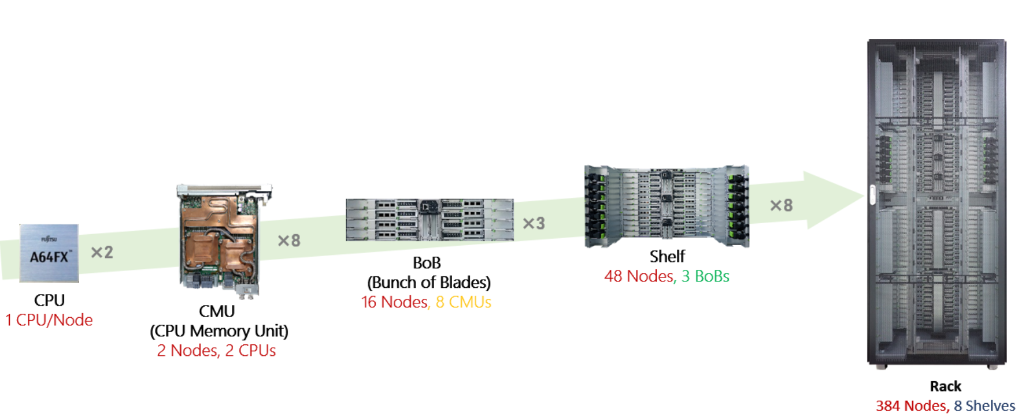
CPU A64FX 7nm FinFET
Architecture Armv8.2-A SVE(512bit SIMD)
48 cores for compute and 4 for OS activities
Normal 2.0GHz (DP:3.072TF, SP: 6.144TF, HP:12.288TF)
Boost 2.2GHz(DP:3.3792TF, SP: 6.7584TF, HP:13.5168TF)
Cache L1: 64KB 4way >230GB/s(load) >115GB/s(store)
L2: 8MB 16way >115GB/s(load) >57GB/s(store)
Memory HBM2 8GB X 4=32GiB 1024GB/s
I/O PICe Gen3 x 16 lane
Performance: Stream triad 830GB/s, Dgemm 2.5TF
Fugaku: 158,976nodes in 432 rack
totally 4.85Peta byte memory
with bandwidth 163 PB/s

Slide 10
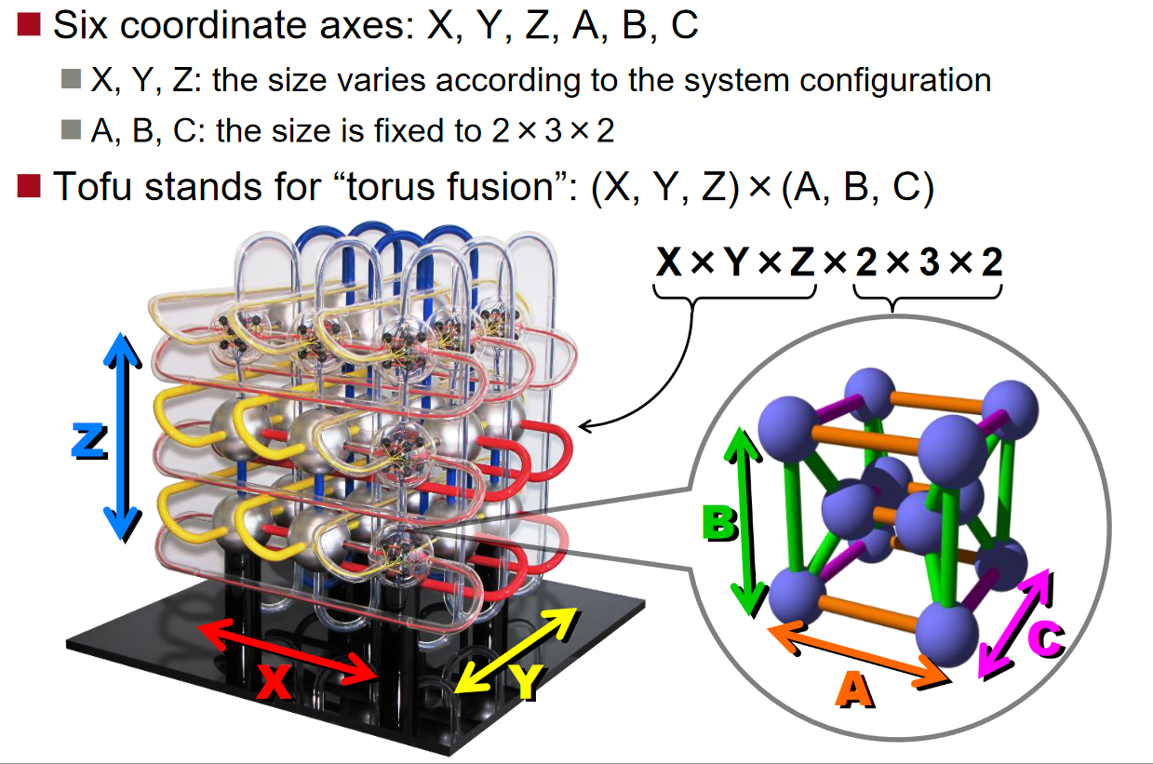
TofuD interconnect
Max performance
each node
40.8 GB/s
2 lanes x 10 ports
full system
6.19 PB hop/s

Slide 11
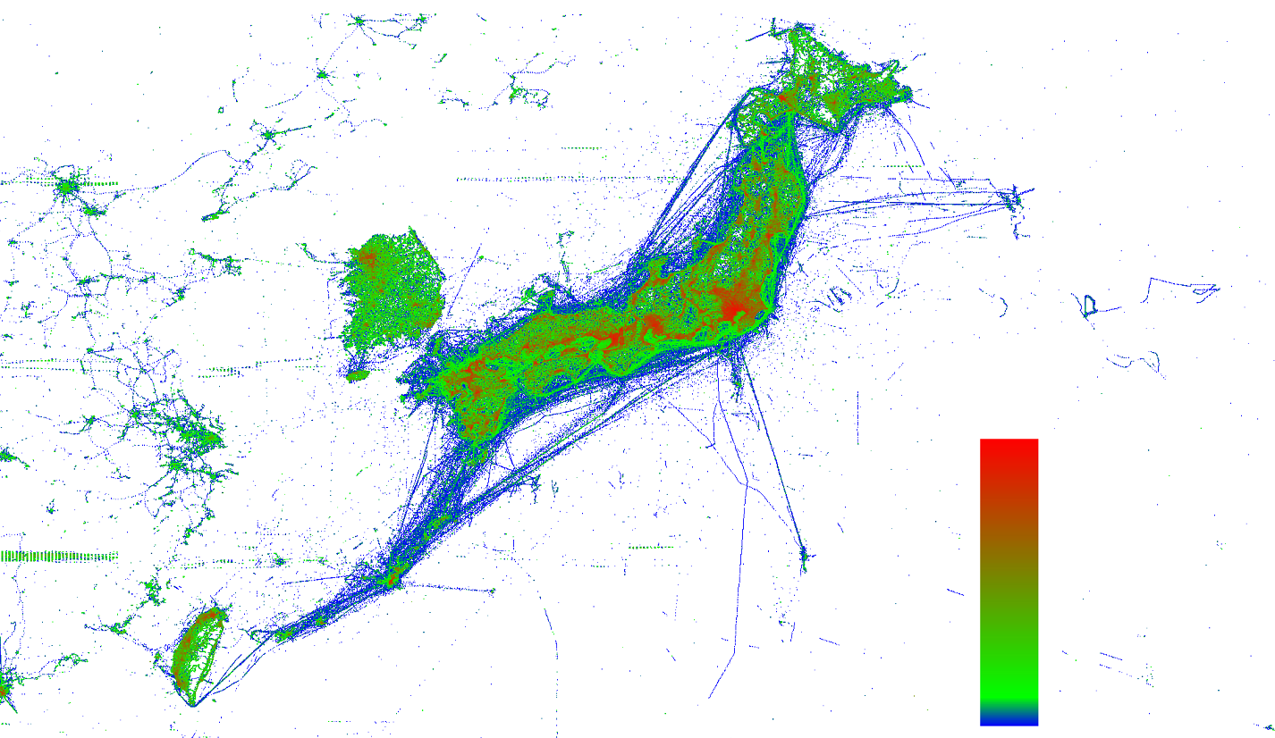

Slide 12
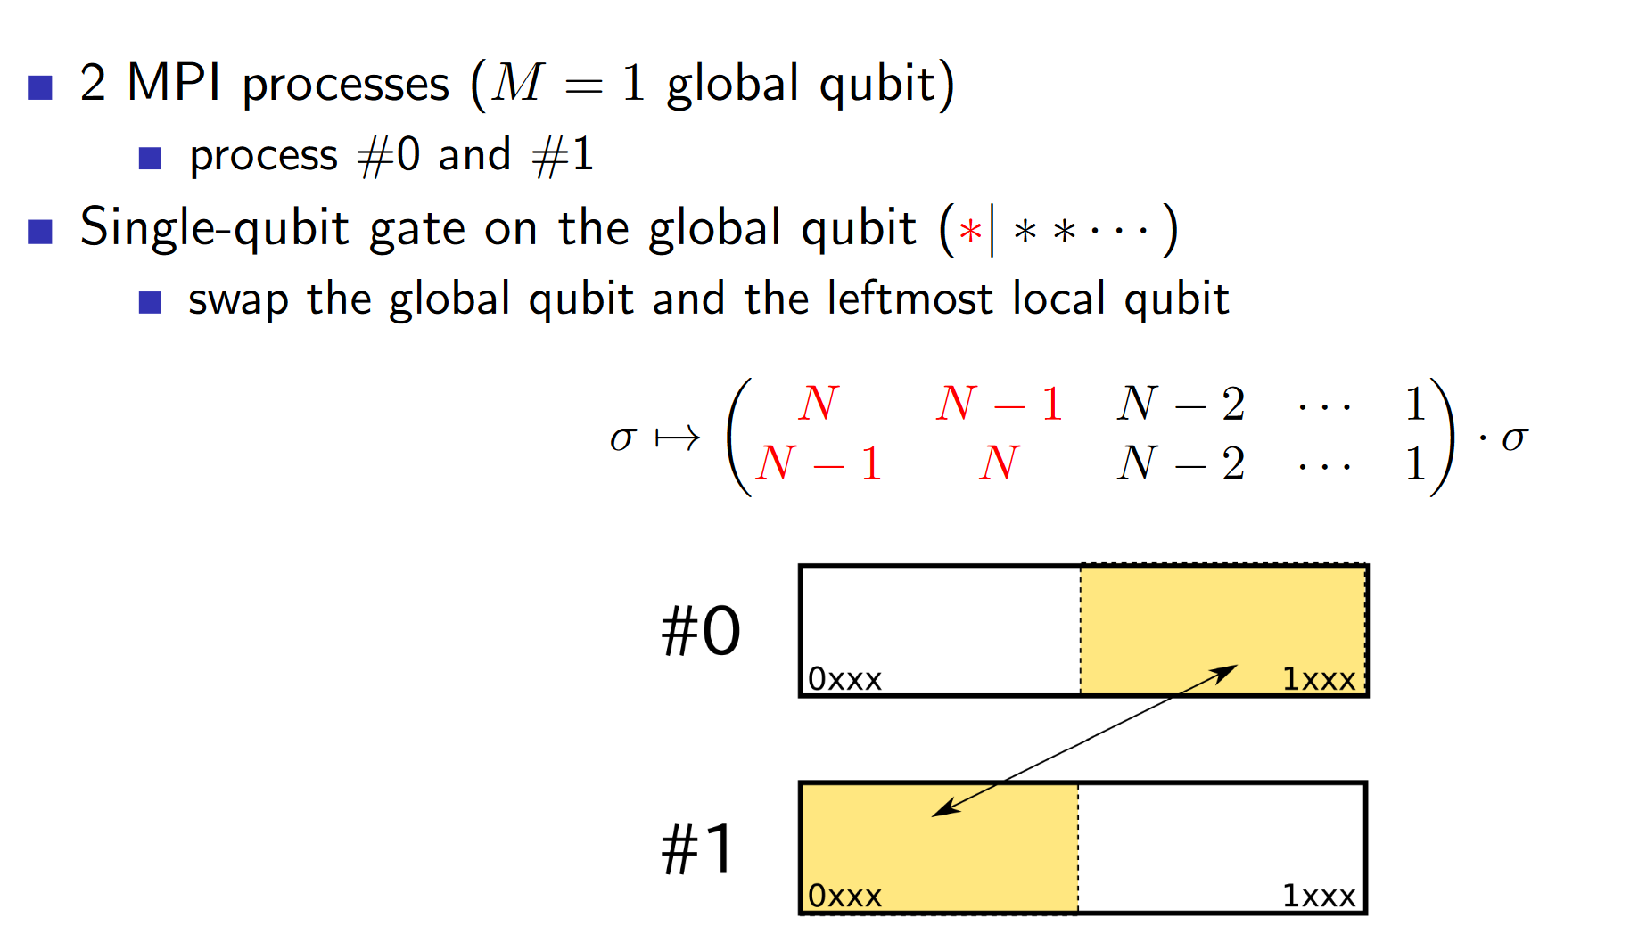

Slide 13
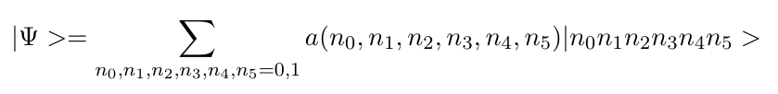
How to allocate coefficients to node? → qubit swap algorithm
Case of N=6 qbits on M=4( using 2⁴⁻²=4 nodes) :
node00
node01
node10
node11
0000 | a(0,0,0,0,0,0)
0001 | a(0,0,0,0,0,1)
0010 | a(0,0,0,0,1,0)
0011 | a(0,0,0,0,1,1)
0000 | a(0,1,0,0,0,0)
0001 | a(0,1,0,0,0,1)
0010 | a(0,1,0,0,1,0)
0011 | a(0,1,0,0,1,1)
0000 | a(1,0,0,0,0,0)
0001 | a(1,0,0,0,0,1)
0010 | a(1,0,0,0,1,0)
0011 | a(1,0,0,0,1,1)
0000 | a(1,1,0,0,0,0)
0001 | a(1,1,0,0,0,1)
0010 | a(1,1,0,0,1,0)
0011 | a(1,1,0,0,1,1)
0100 | a(0,0,0,1,0,0)
0101 | a(0,0,0,1,0,1)
0110 | a(0,0,0,1,1,0)
0111 | a(0,0,0,1,1,1)
0100 | a(0,1,0,1,0,0)
0101 | a(0,1,0,1,0,1)
0110 | a(0,1,0,1,1,0)
0111 | a(0,1,0,1,1,1)
0100 | a(1,0,0,1,0,0)
0101 | a(1,0,0,1,0,1)
0110 | a(1,0,0,1,1,0)
0111 | a(1,0,0,1,1,1)
0100 | a(1,1,0,1,0,0)
0101 | a(1,1,0,1,0,1)
0110 | a(1,1,0,1,1,0)
0111 | a(1,1,0,1,1,1)
1000 | a(0,0,1,0,0,0)
1001 | a(0,0,1,0,0,1)
1010 | a(0,0,1,0,1,0)
1011 | a(0,0,1,0,1,1)
1000 | a(0,1,1,0,0,0)
1001 | a(0,1,1,0,0,1)
1010 | a(0,1,1,0,1,0)
1011 | a(0,1,1,0,1,1)
1000 | a(1,0,1,0,0,0)
1001 | a(1,0,1,0,0,1)
1010 | a(1,0,1,0,1,0)
1011 | a(1,0,1,0,1,1)
1000 | a(1,1,1,0,0,0)
1001 | a(1,1,1,0,0,1)
1010 | a(1,1,1,0,1,0)
1011 | a(1,1,1,0,1,1)
1100 | a(0,0,1,1,0,0)
1101 | a(0,0,1,1,0,1)
1110 | a(0,0,1,1,1,0)
1111 | a(0,0,1,1,1,1)
1100 | a(0,1,1,1,0,0)
1101 | a(0,1,1,1,0,1)
1110 | a(0,1,1,1,1,0)
1111 | a(0,1,1,1,1,1)
1100 | a(1,0,1,1,0,0)
1101 | a(1,0,1,1,0,1)
1110 | a(1,0,1,1,1,0)
1111 | a(1,0,1,1,1,1)
1100 | a(1,1,1,1,0,0)
1101 | a(1,1,1,1,0,1)
1110 | a(1,1,1,1,1,0)
1111 | a(1,1,1,1,1,1)
Global qubits: allocated to node-number bits
Local qubits: allocated to memory-address bits

Slide 14

Apply H 5
node00
node01
node10
node11
0000 | a(0,0,0,0,0,0)
0001 | a(0,0,0,0,0,1)
0010 | a(0,0,0,0,1,0)
0011 | a(0,0,0,0,1,1)
0000 | a(0,1,0,0,0,0)
0001 | a(0,1,0,0,0,1)
0010 | a(0,1,0,0,1,0)
0011 | a(0,1,0,0,1,1)
0000 | a(1,0,0,0,0,0)
0001 | a(1,0,0,0,0,1)
0010 | a(1,0,0,0,1,0)
0011 | a(1,0,0,0,1,1)
0000 | a(1,1,0,0,0,0)
0001 | a(1,1,0,0,0,1)
0010 | a(1,1,0,0,1,0)
0011 | a(1,1,0,0,1,1)
0100 | a(0,0,0,1,0,0)
0101 | a(0,0,0,1,0,1)
0110 | a(0,0,0,1,1,0)
0111 | a(0,0,0,1,1,1)
0100 | a(0,1,0,1,0,0)
0101 | a(0,1,0,1,0,1)
0110 | a(0,1,0,1,1,0)
0111 | a(0,1,0,1,1,1)
0100 | a(1,0,0,1,0,0)
0101 | a(1,0,0,1,0,1)
0110 | a(1,0,0,1,1,0)
0111 | a(1,0,0,1,1,1)
0100 | a(1,1,0,1,0,0)
0101 | a(1,1,0,1,0,1)
0110 | a(1,1,0,1,1,0)
0111 | a(1,1,0,1,1,1)
1000 | a(0,0,1,0,0,0)
1001 | a(0,0,1,0,0,1)
1010 | a(0,0,1,0,1,0)
1011 | a(0,0,1,0,1,1)
1000 | a(0,1,1,0,0,0)
1001 | a(0,1,1,0,0,1)
1010 | a(0,1,1,0,1,0)
1011 | a(0,1,1,0,1,1)
1000 | a(1,0,1,0,0,0)
1001 | a(1,0,1,0,0,1)
1010 | a(1,0,1,0,1,0)
1011 | a(1,0,1,0,1,1)
1000 | a(1,1,1,0,0,0)
1001 | a(1,1,1,0,0,1)
1010 | a(1,1,1,0,1,0)
1011 | a(1,1,1,0,1,1)
1100 | a(0,0,1,1,0,0)
1101 | a(0,0,1,1,0,1)
1110 | a(0,0,1,1,1,0)
1111 | a(0,0,1,1,1,1)
1100 | a(0,1,1,1,0,0)
1101 | a(0,1,1,1,0,1)
1110 | a(0,1,1,1,1,0)
1111 | a(0,1,1,1,1,1)
1100 | a(1,0,1,1,0,0)
1101 | a(1,0,1,1,0,1)
1110 | a(1,0,1,1,1,0)
1111 | a(1,0,1,1,1,1)
1100 | a(1,1,1,1,0,0)
1101 | a(1,1,1,1,0,1)
1110 | a(1,1,1,1,1,0)
1111 | a(1,1,1,1,1,1)

Slide 15
Apply H 1: exchange blocks
Swap data in memory blocks …
node00
node01
node10
node11
0000 | a(0,0,0,0,0,0)
0001 | a(0,0,0,0,0,1)
0010 | a(0,0,0,0,1,0)
0011 | a(0,0,0,0,1,1)
0000 | a(0,1,0,0,0,0)
0001 | a(0,1,0,0,0,1)
0010 | a(0,1,0,0,1,0)
0011 | a(0,1,0,0,1,1)
0000 | a(1,0,0,0,0,0)
0001 | a(1,0,0,0,0,1)
0010 | a(1,0,0,0,1,0)
0011 | a(1,0,0,0,1,1)
0000 | a(1,1,0,0,0,0)
0001 | a(1,1,0,0,0,1)
0010 | a(1,1,0,0,1,0)
0011 | a(1,1,0,0,1,1)
0100 | a(0,0,0,1,0,0)
0101 | a(0,0,0,1,0,1)
0110 | a(0,0,0,1,1,0)
0111 | a(0,0,0,1,1,1)
0100 | a(0,1,0,1,0,0)
0101 | a(0,1,0,1,0,1)
0110 | a(0,1,0,1,1,0)
0111 | a(0,1,0,1,1,1)
0100 | a(1,0,0,1,0,0)
0101 | a(1,0,0,1,0,1)
0110 | a(1,0,0,1,1,0)
0111 | a(1,0,0,1,1,1)
0100 | a(1,1,0,1,0,0)
0101 | a(1,1,0,1,0,1)
0110 | a(1,1,0,1,1,0)
0111 | a(1,1,0,1,1,1)
1000 | a(0,0,1,0,0,0)
1001 | a(0,0,1,0,0,1)
1010 | a(0,0,1,0,1,0)
1011 | a(0,0,1,0,1,1)
1000 | a(0,1,1,0,0,0)
1001 | a(0,1,1,0,0,1)
1010 | a(0,1,1,0,1,0)
1011 | a(0,1,1,0,1,1)
1000 | a(1,0,1,0,0,0)
1001 | a(1,0,1,0,0,1)
1010 | a(1,0,1,0,1,0)
1011 | a(1,0,1,0,1,1)
1000 | a(1,1,1,0,0,0)
1001 | a(1,1,1,0,0,1)
1010 | a(1,1,1,0,1,0)
1011 | a(1,1,1,0,1,1)
1100 | a(0,0,1,1,0,0)
1101 | a(0,0,1,1,0,1)
1110 | a(0,0,1,1,1,0)
1111 | a(0,0,1,1,1,1)
1100 | a(0,1,1,1,0,0)
1101 | a(0,1,1,1,0,1)
1110 | a(0,1,1,1,1,0)
1111 | a(0,1,1,1,1,1)
1100 | a(1,0,1,1,0,0)
1101 | a(1,0,1,1,0,1)
1110 | a(1,0,1,1,1,0)
1111 | a(1,0,1,1,1,1)
1100 | a(1,1,1,1,0,0)
1101 | a(1,1,1,1,0,1)
1110 | a(1,1,1,1,1,0)
1111 | a(1,1,1,1,1,1)

Slide 16
Bit-swap algorithm for inter-node
node n₀n₁n₂…
a(0,0,0,*)
a(0,0,1,*)
1 bit swap: swap of 1/2
2 bit swap: swap of 3/4
3 bit swap: swap of 7/8
…
a(0,1,0,*)
a(0,1,1,*)
a(1,0,0,*)
a(1,0,1,*)
a(1,1,0,*)
a(1,1,1,*)
| 0 0 n₂₆ n₂₅ n₂₄ … n₁ n₀ > 2GB

Slide 17
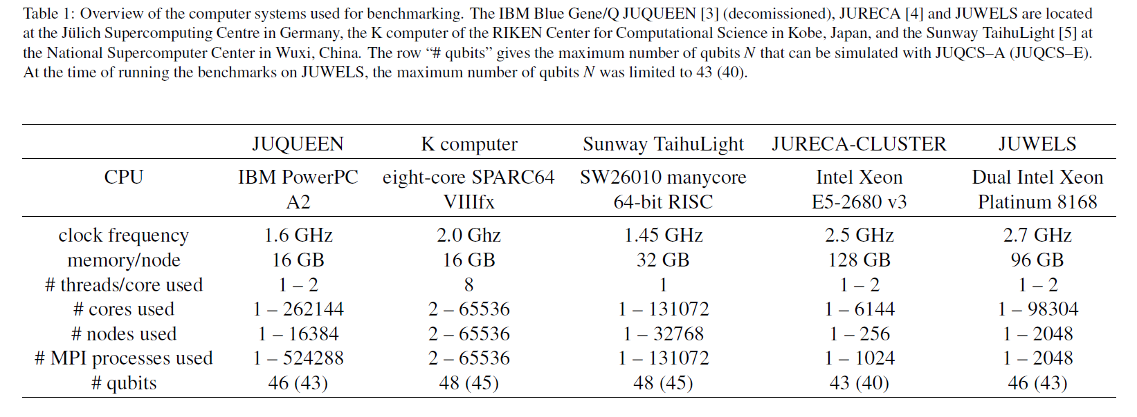
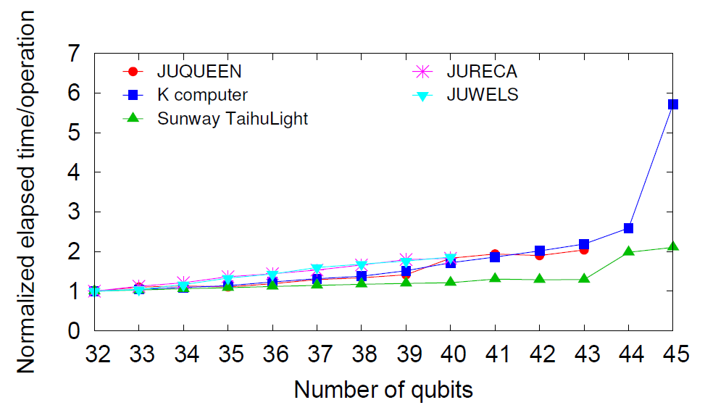
No.1 in 2011
10PFLOPS
No.5 in 2013
5PFLOPS
No.1 in 2016
93PFLOPS
Double precision
Normalied elapsed time by
elapsed time of 32 qbits case
Normalization factors:
・JUQUEEN 1.2sec
・K 1.0sec
・Sunway TaihuLight 7.7sec
・JURECA 1.9sec
・JUWELS 1.3sec
H. De Raedt, F. Jin, D. Wilsch, M. Nocon, N. Yoshioka, N. Ito, S. Yuan and K. Michielsen,
Comp. Phys. Comm. Vol.237 (2019) p.47-61

Slide 18
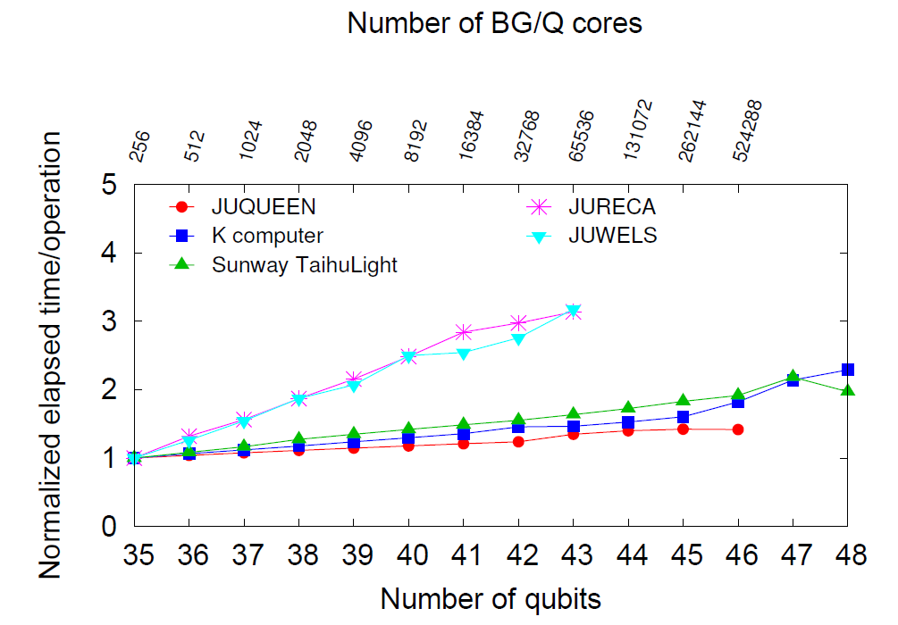
Performance: one Hadamard operation for all qbits
more qbits with reduced precision using one-byte coding
Normalied elapsed time by
elapsed time of 35 qbits case
Normalization factors:
・JUQUEEN 2.7sec
・K 3.8sec
・Sunway TaihuLight 19.9sec
・JURECA 2.4sec
・JUWELS 2.2sec
H. De Raedt, F. Jin, D. Wilsch, M. Nocon, N. Yoshioka, N. Ito, S. Yuan and K. Michielsen,
Comp. Phys. Comm. Vol.237 (2019) p.47-61

Slide 19
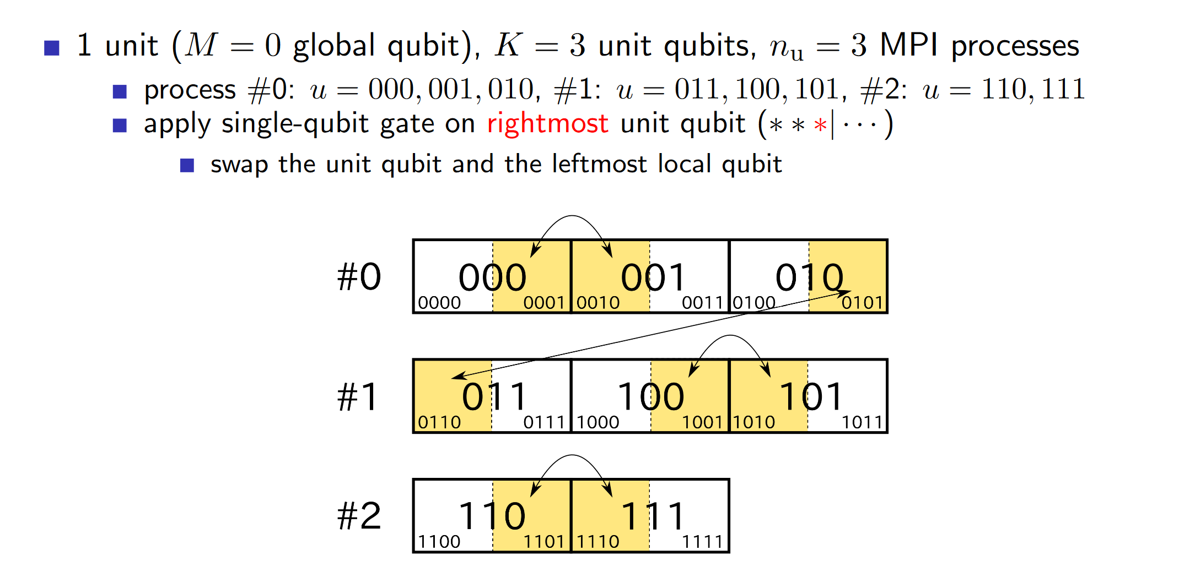

Slide 20
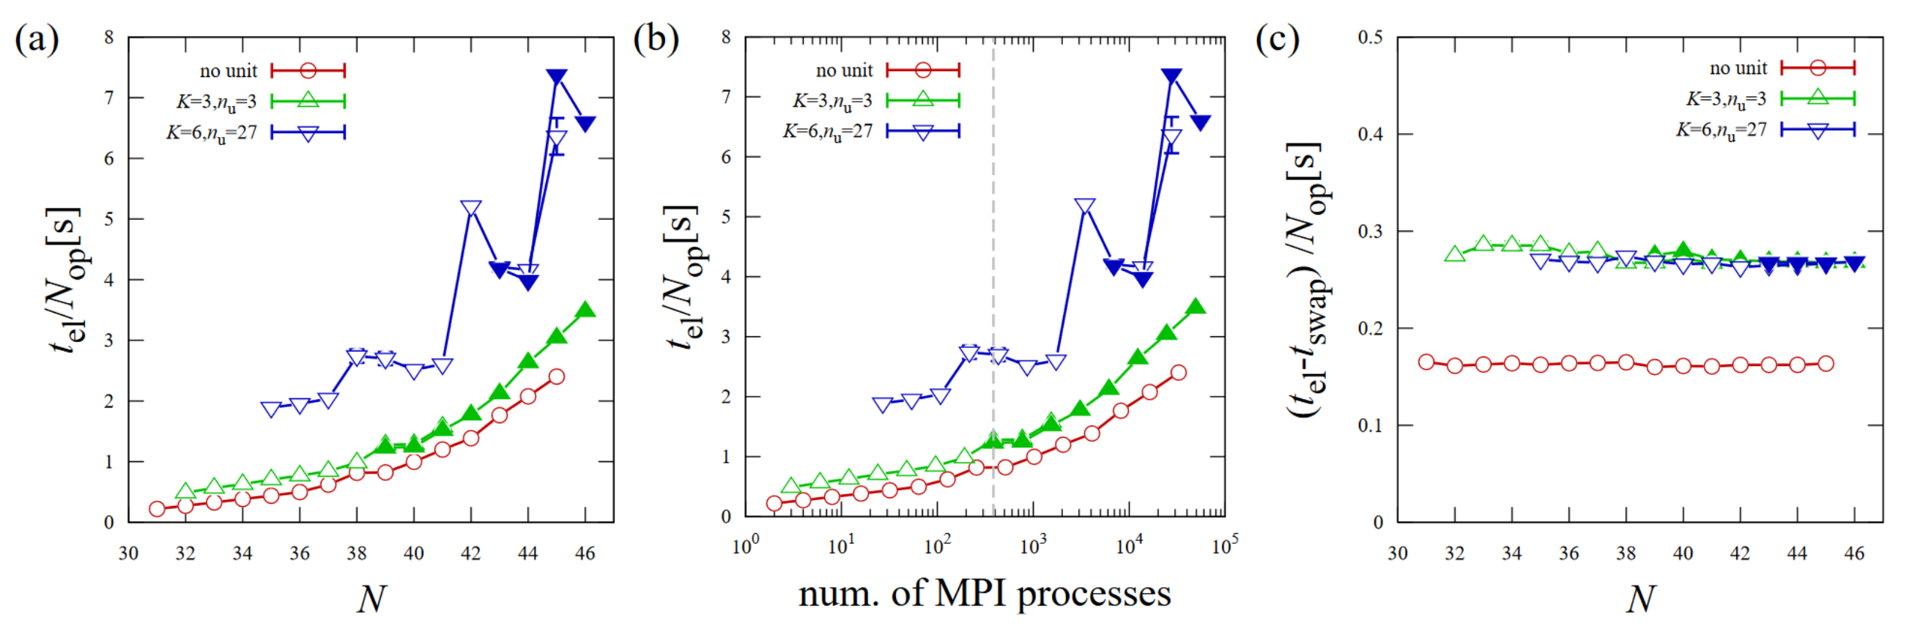
Performance of Hadamard benchmark(once) on the “Fugaku”
55,296 nodes
27,648 nodes
49,152 nodes
24,576 nodes
32,768 nodes
cf on K, 35 qubits: 1.2 sec
40 qubits: 2.0 sec
no unit：basic parallelization using 2^{𝑀} processes
others：non 2^{𝑀} parallelization

Slide 21
Limitations of the qubit-swap implementations
Remove these limitations by allocating more qubits
Number of coefficients on each node is 2^{n}.
memory per node available memory
K 16GB 8 GB
Fugaku 32GB 16 GB
Number of used nodes is 2^{m}.
number of nodes available nodes
K 88,128 65,536 = 2¹⁶
Fugaku 158,976 131,072 = 2¹⁷
Pack more coefficients to each node:
Local set: use smaller number of local qubits 0.5GB
allocate many local sets to each node 53 local sets using 26.5GB
→ 4PB using 158,276 nodes of 158,976 nodes of Fugaku
48 qubits(double), 49(single), 50(half) and 51(byte)
Or “unit” qubits between local and global qubits
Coefficients of (unit+local) qubits are in some nodes or processes.
➡
Limitations of memory band-width
Remove these limitations by optimal allocation
to increase circuit depth
0.5GB(26 qubits in single)/node → 0.5GBx2/1TB = 1 msec
internode 0.25GBx2/40.8GB = 12 msec
10 ms per operation → ～10⁶ operations in 10 hours
In node: 1TB/s(Fugaku) ~100GB(x86 Workstation)
Internode: 40.8GB/s(Fugaku)
one load and one store per operatio
16GB(30 qubits in double)/node → 16GBx2/1TB = 31 msec
one bit-swap per operation
8GB transfer → 8TBx2/40.8GB = 392 msec
sub-second per operation → ～10⁵ operations in 10 hours
➡

Slide 22
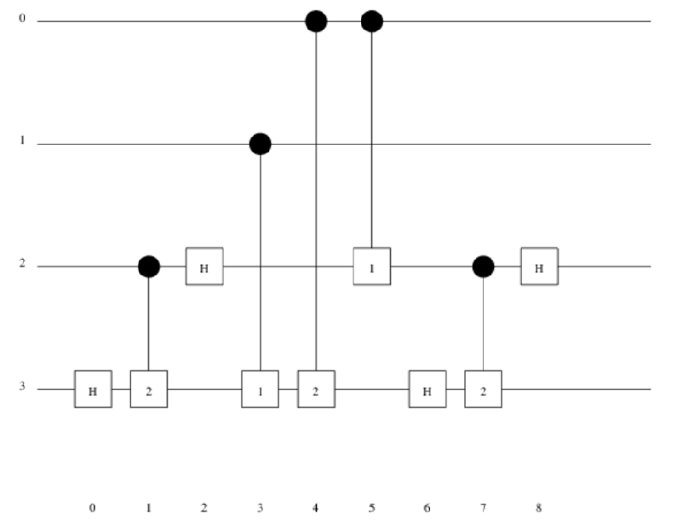
2
1
0
1
3
3
3
1
2
2
0
1
3
1
3
1
1
1
0
1
0
3
1
0
transfer cost:
0
2
2
0
2
2
0
2
Totally 10
example: 2+2, 4qbit, 9 lines, local 2bit Blue figures show bit-position of address
0 and 1: local, 2 and 3: global

Slide 23
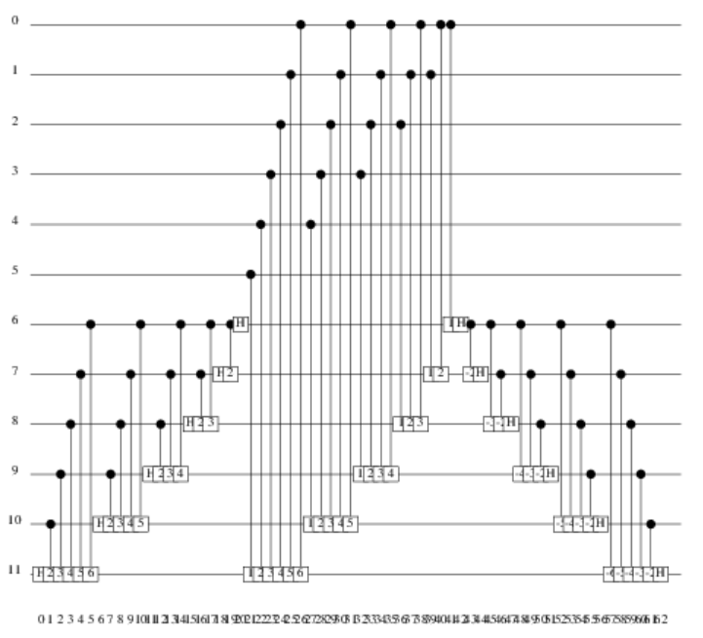
best
42
worst
104
6+6, 12qbit, 63 lines, local 6bit
average 73.22
standard deviation 12.94
0
6
7
8
9
10
11
1
2
3
4
5
4
5
0
1
2
3
6
7
8
9
10
11
Totally
34560
0.0072%
Totally
933120
0.19%

Slide 24
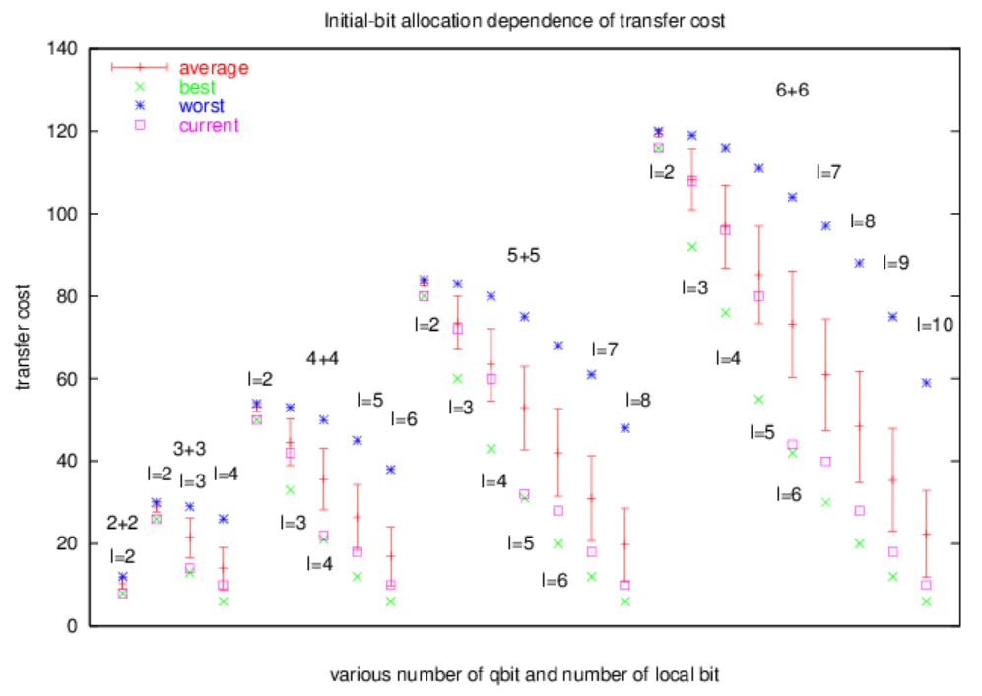
170201
l= N - M
The cost unit is sending and receiving one page, i.e. 2^(l-2) amplitudes, for each nodes.

Slide 25
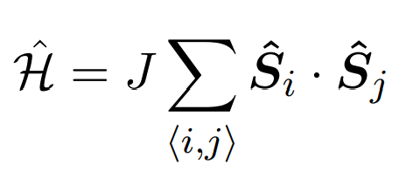
VQE simulation
Heisenberg chain
up to 41,984 nodes
40 qubits×41 parameters
= 1640 qubits
energy calculation
update parameters

Slide 26
Summary
・Algorithm and program for massively parallel supercomputers are showns.
・On Fugaku, state-vector simulation can reach
48 qubits in double precision and 51 qubits in byte precision.
Perspectives
・Further tuning, mainly for data transfer, will improve performance.
・Applications to development of quantum computer and to test quantum algorithms
have been started jointly with RIKEN quantum computer center(RQC).
・Optimization of execution speed.
braket: A open-source quantum computer simulator for parallel computer
C++, two-to-N implementation, no unit qubit
https://github.com/naoki-yoshioka/braket

Slide 27
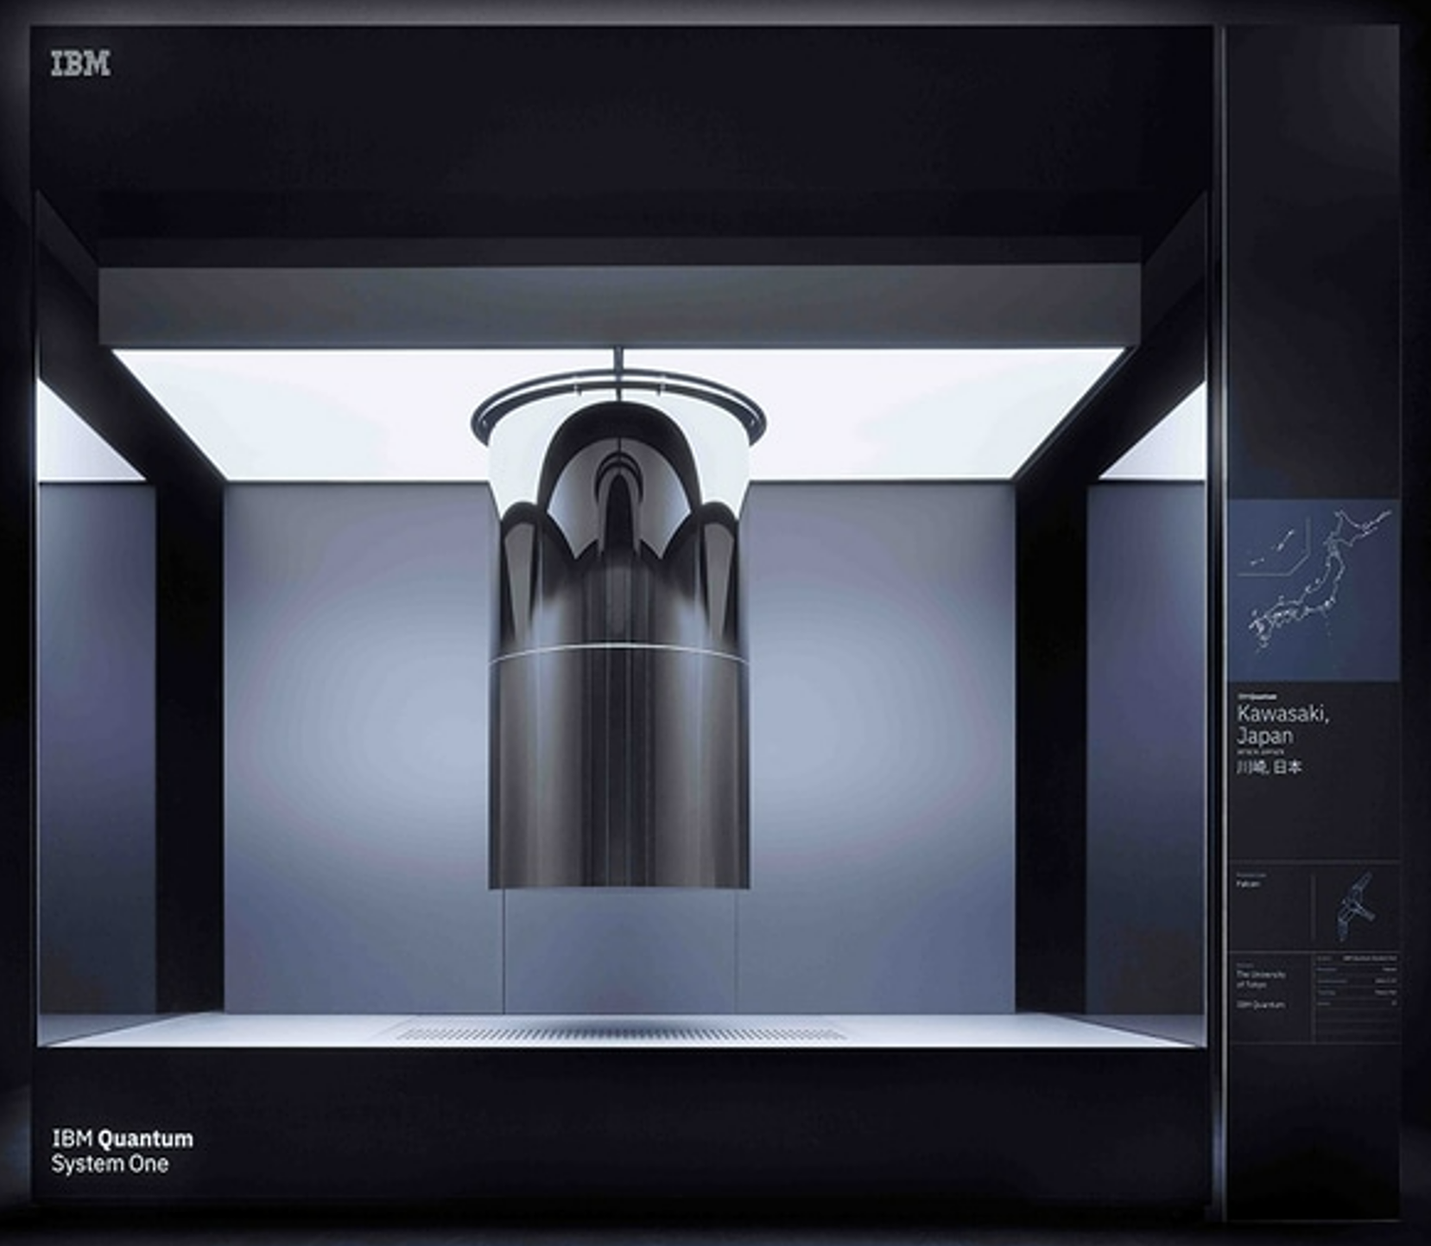
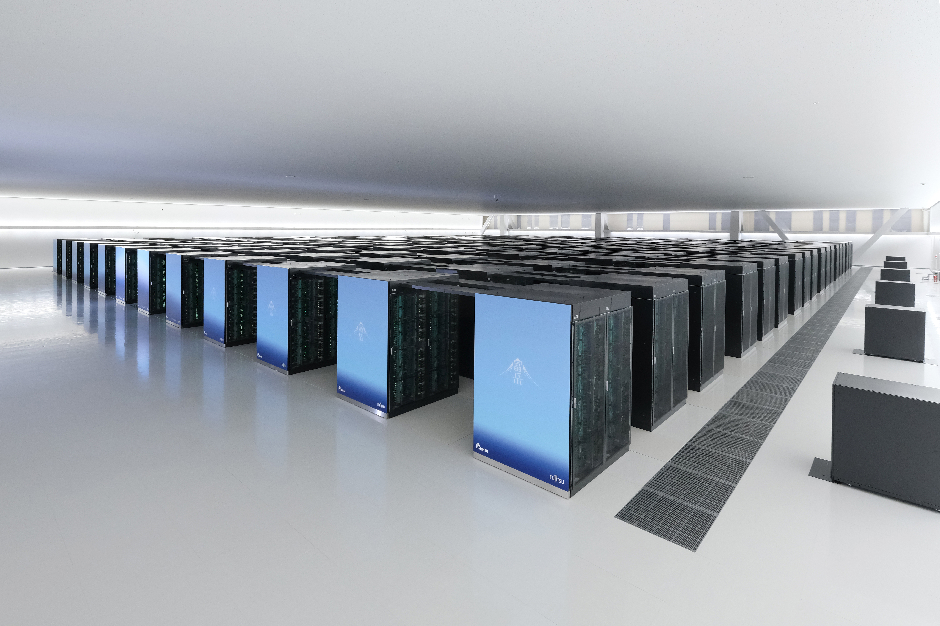
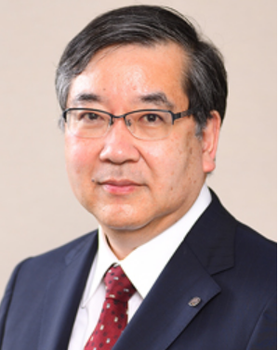


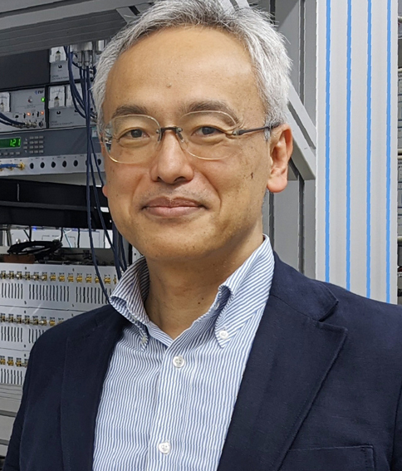
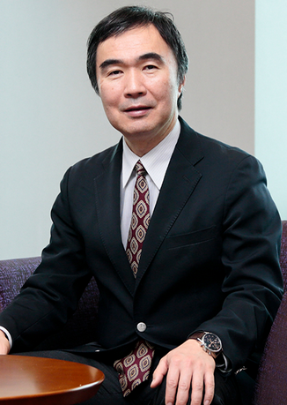
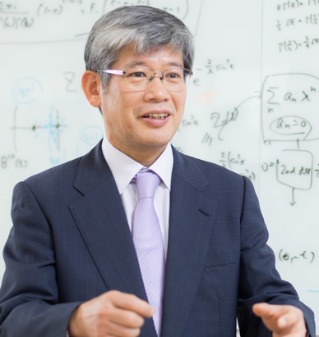
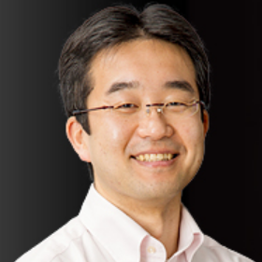



Fugaku
QC and/or
QC Simulator
RIKEN Quantumcomputer Initiative
RQC
Y. Nakamura
R-CCS
S. Matsuoka
iTHEMS
T. Hatsuda
AIP
M. Sugiyama
President
M. Gonokami

Slide 28
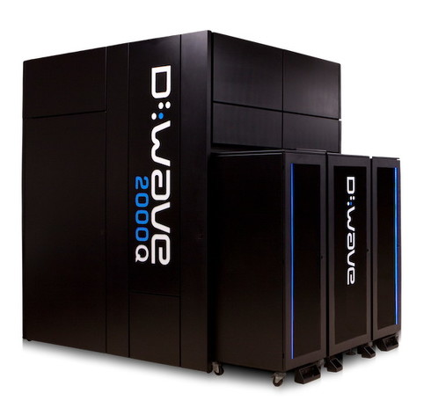
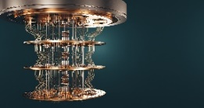
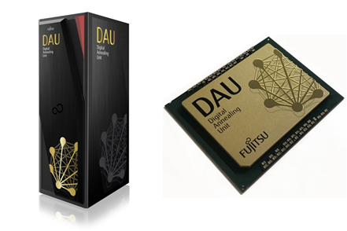
Software environment for classical-quantum hybrid computation
Fugaku/Fugaku NEXT
Software layders necessary to test and evaluation quantum applications
Algorithms
API and work-flow scheduler
Hybrid
cloud/network
Quantum
Quantum applications
NISQ
Near-QC system（GPU & CPU)
API and near-QC programming model
Various tools and environments
Quantum BLAS： basic linear algebra subprogram
Qiskit：framework by IBM
Cirq：development tools by Google
TensorFlow Quantum：framework for quantum machine learning
Q#:language by Microsoft
Qulacs, QunaSys: simulator and language by Osaka University
Covalent: development workflow for quantum HPC environment by Agnostiq
PyQubo：library for quantu annealing
cuQuantum and QODA: simulator and programing language for GPU by NVIDIA
TKET: development kit by Quantinuum
Interface with low latency and high bandwidth
Quantum programming language with unified intermediate representation
QPU
QPU simulator on Fugaku

Slide 29
