Slide 1
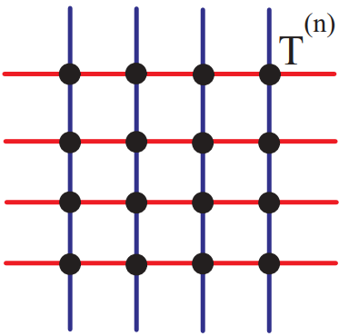
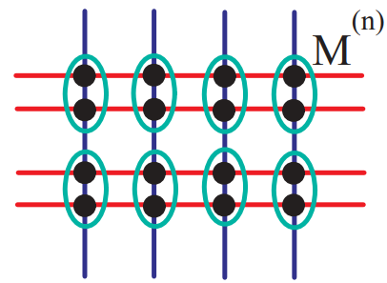
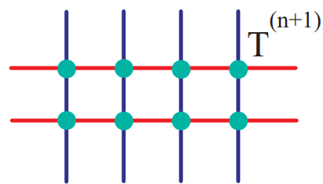
Tensor renormalization group approach to (1+1)-dimensional SU(2) principal chiral model at finite density
XIAO LUO, Graduate School of Pure and Applied Sciences, University of Tsukuba
YOSHINOBU KURAMASHI, Center for Computational Sciences, University of Tsukuba
Introduction: Tensor Renormalization Group
Advantages of tensor renormalization group:
No sign problem
Easy to achieve a large scale simulation
Numerical results
β dependence of internal energy at µ=0 on a lattice with V=1024² , with D_{cut}=50, K=26
µ dependence of ⟨n⟩ at β=0.125 and 1.0 on a lattice with V = 1024² , with D_{cut}=32, K=26
µ₁ dependence of ⟨n₁⟩ at β=0.125 and 1.0 on a lattice with V = 1024² , with D_{cut}=32, K=26
µ₂ dependence of ⟨n₂⟩ at β=0.125 and 1.0 on a lattice with V = 1024² , with D_{cut}=32, K=26
(1+1)-dimensional O(3) non-linear sigma model The O(3) results consist with Phys.Rev.D94,114503
Field on the lattice
SVD, EVD, or character expansion…
Tensor
Tensor on the lattice
Contraction
New tensor
D_{cut} dependence of internal energy at µ=0 with K=26 on a lattice with V=1024²
K dependence of internal energy at µ=0 with D_{cut}=62 on a lattice with V = 1024²
Z. Y. Xie et al. PRB86(2012)045139
Tensor renormalization group is a strategy for evaluating partition function
How to construct the tensor representation of (1+1)-dimensional SU(2) principal chiral model
SU(2) principal chiral model on the lattice
Rewrite the action with O(4) representation
Partition function
Discretize the partition function with Gauss Legendre quadrature
Perform the singular value decomposition (SVD) on M
Tensor network representation of the SU(2) principal chiral model on the (1+1)-dimensional lattice
β dependence of internal energy at µ=0 on a lattice with V=1024² , with D_{cut}=48, K=100
µ dependence of ⟨n⟩ at β=1.0, 1.2, 1.4 on a lattice with V = 1024² , with D_{cut}=48, K=100

