Slide 1
EIC Detector and Integration
E.C. Aschenauer (BNL)
Co-Associate Directors for the Experimental Program
EIC Asia Workshop
March 16th, 2023

Slide 2


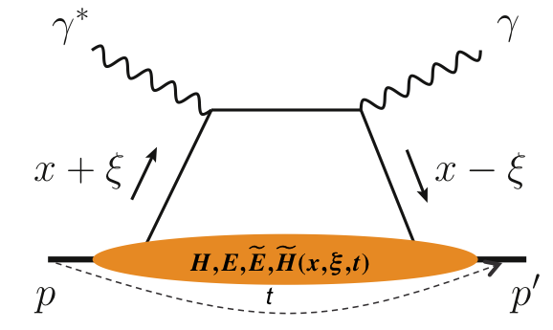
What is needed experimentally?
experimental measurements categories to address EIC physics:
Parton Distributions in nucleons and nuclei
QCD at Extreme Parton Densities - Saturation
Spin and
Flavor structure of nucleons and nuclei
Tomography Transverse Momentum Dist.
QCD at Extreme Parton Densities - Saturation
Tomography
Spatial Imaging
inclusive DIS
semi-inclusive DIS
exclusive processes
measure scattered lepton
→ event kinematics
e-ID: e/h separation
reach to lowest x, Q² impacts
Interaction Region design
measure scattered lepton
and hadrons in coincidence
multi-dimensional binning:
x, Q², z, p_{T}, Θ
particle identification over entire kinematic region is critical
Jets: excellent E_{T}, jet-energy scale
measure all particles in event
multi-dimensional binning:
x, Q², t, Θ
proton p_{t}: 0.2 - 1.3 GeV
  cannot be detected in main detector
  strong impact on Interaction Region design
∫Ldt:
1 fb⁻¹
10 fb⁻¹
10 - 100 fb⁻¹
machine & detector requirements

Slide 3
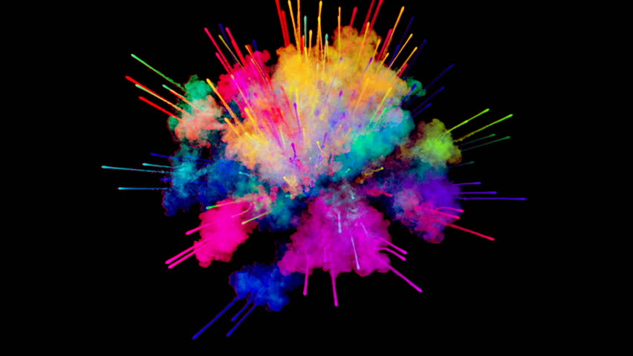
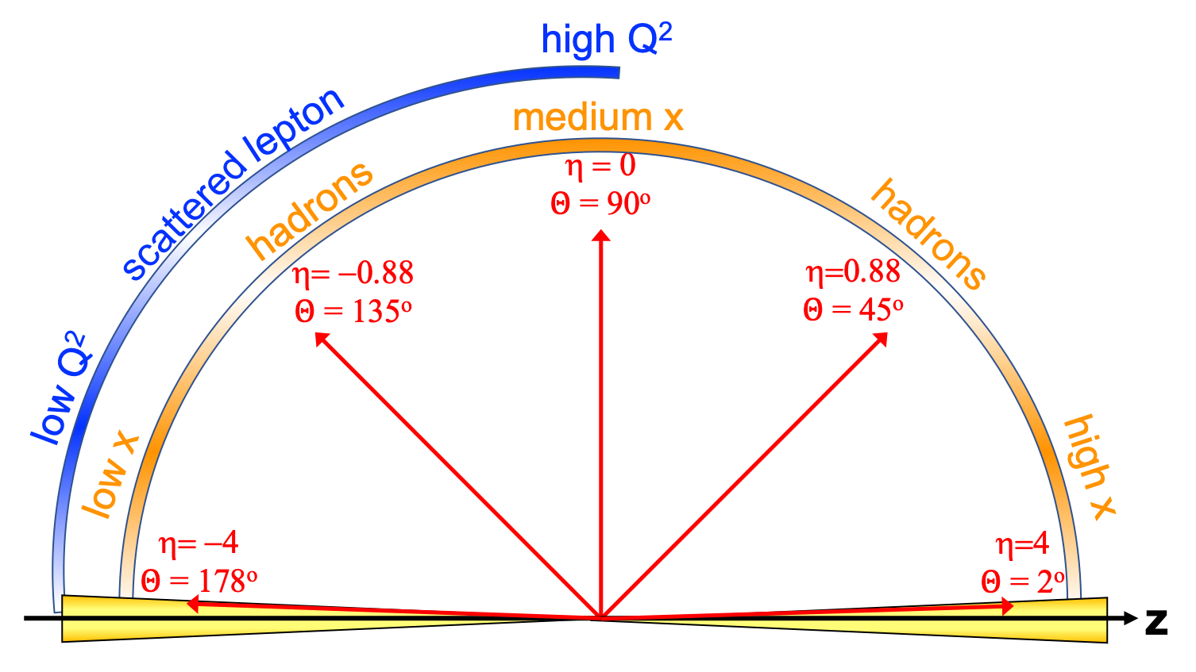
EIC General Purpose Detector: Concept
p/A beam
electron beam
inclusive DIS:
semi-inclusive DIS
Backward-η
Forward-η
Central
Detector
HCAL
Lepton
Endcap
Magnet
Hadron
Endcap
HCAL
ECAL
HCAL
ECAL
ECAL
Tracking
PID
PID
PID
Tracking
very low Q²
scattered lepton
Bethe-Heitler photons
for luminosity
Tracking
particles from nuclear
breakup and
from diffractive reactions
exclusive DIS
ZDC
Luminosity Detector
Forward Tracking
Low Q²-Tagger

Slide 4
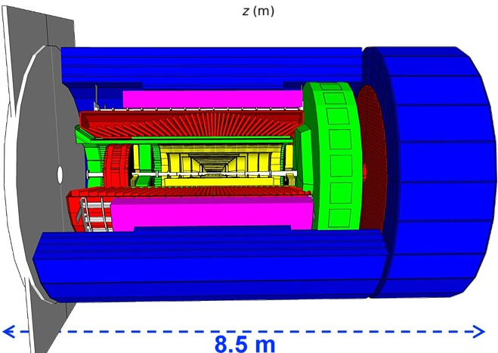
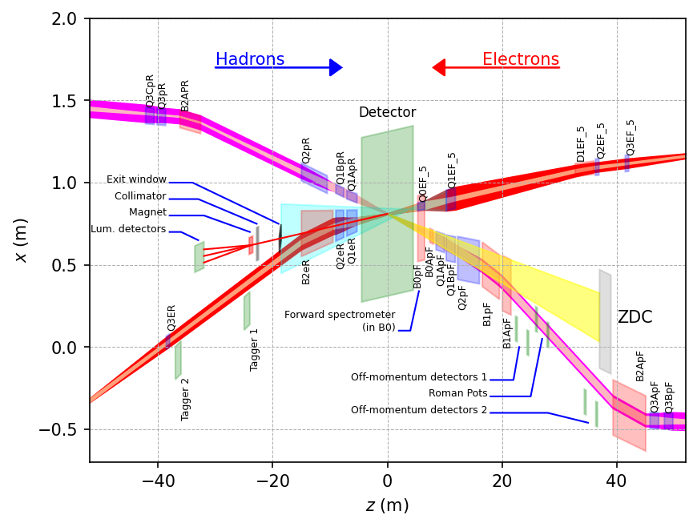
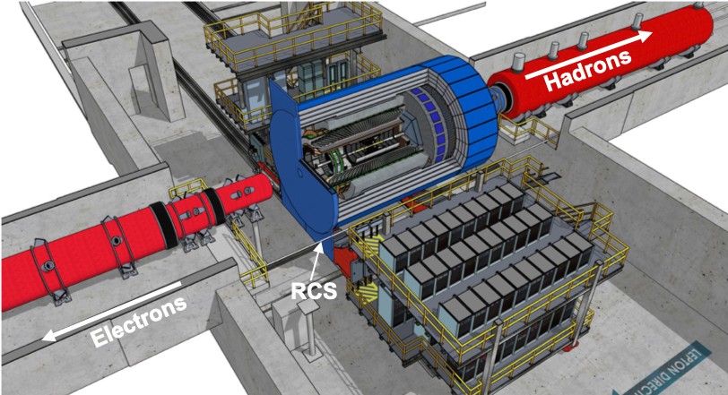
EIC General Purpose Detector: ePIC
hadronic calorimeters
solenoid coils
ToF, DIRC,
RICH detectors
e/m calorimeters
MPG & MAPS trackers
Overall detector requirements:
Large rapidity (-4 < η < 4) coverage; and far beyond in especially far-forward detector regions
large acceptance 1.7 T( up-to 2 T) Solenoid
High precision low mass tracking
  small (μ-vertex) and large radius (gaseous-based) tracking
Electromagnetic and Hadronic Calorimetry
  equal coverage of tracking and EM-calorimetry
High performance PID to separate π, K, p on
track level
  also need good e/h separation for scattered electron
Large acceptance for diffraction, tagging, neutrons from nuclear breakup: critical for physics program
  Many ancillary detector integrated in the beam line: low-Q² tagger, Roman Pots, Zero-Degree Calorimeter, ….
High control of systematics
  luminosity monitor, electron & hadron Polarimetry
→ Integration into wider IR (+/- 40 m) critical

Slide 5
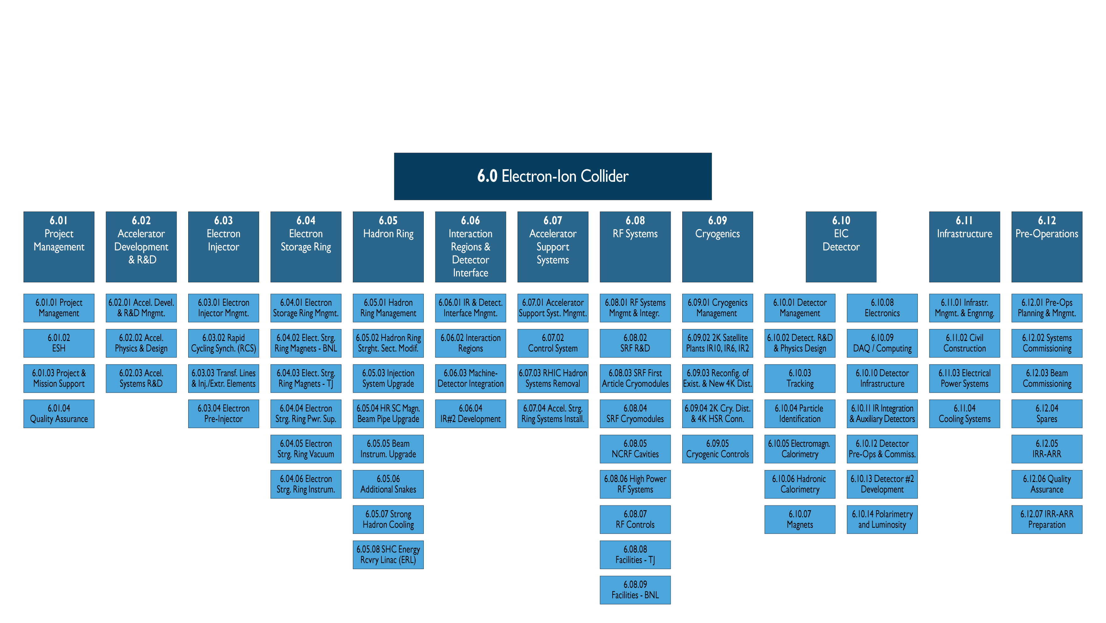
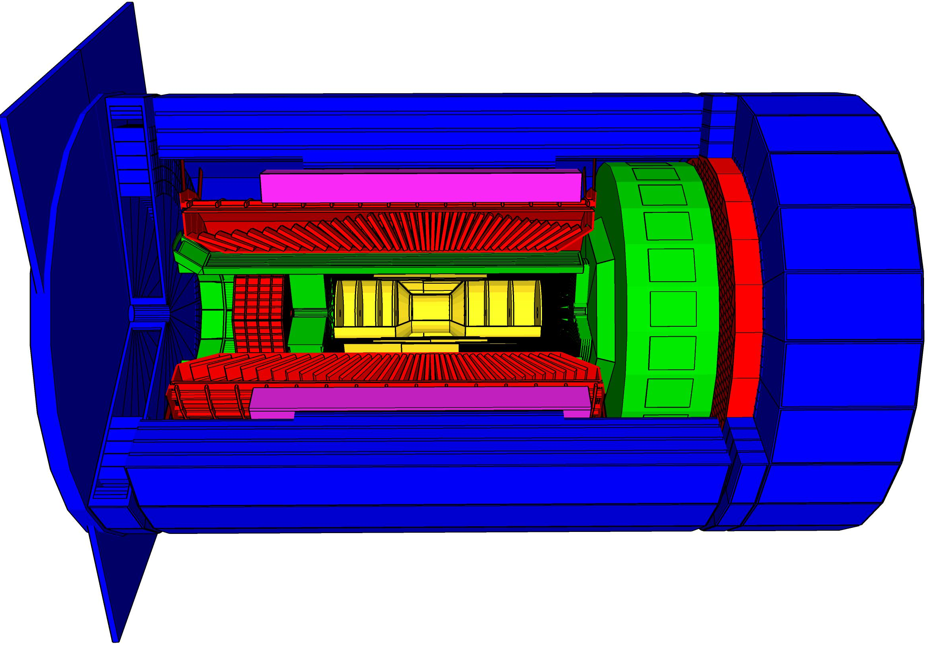
Scope Experimental Equipment
hadronic calorimeters
Solenoidal Magnet
e/m calorimeters
ToF, DIRC,
RICH detectors
MPG trackers
9.5m
MAPS tracker
25 Subdetectors
incl. Polarimeters
provides coordination that
2nd detector remains possible
New 2T Solenoid magnet with the same geometry as the BaBAR magnet

Slide 6
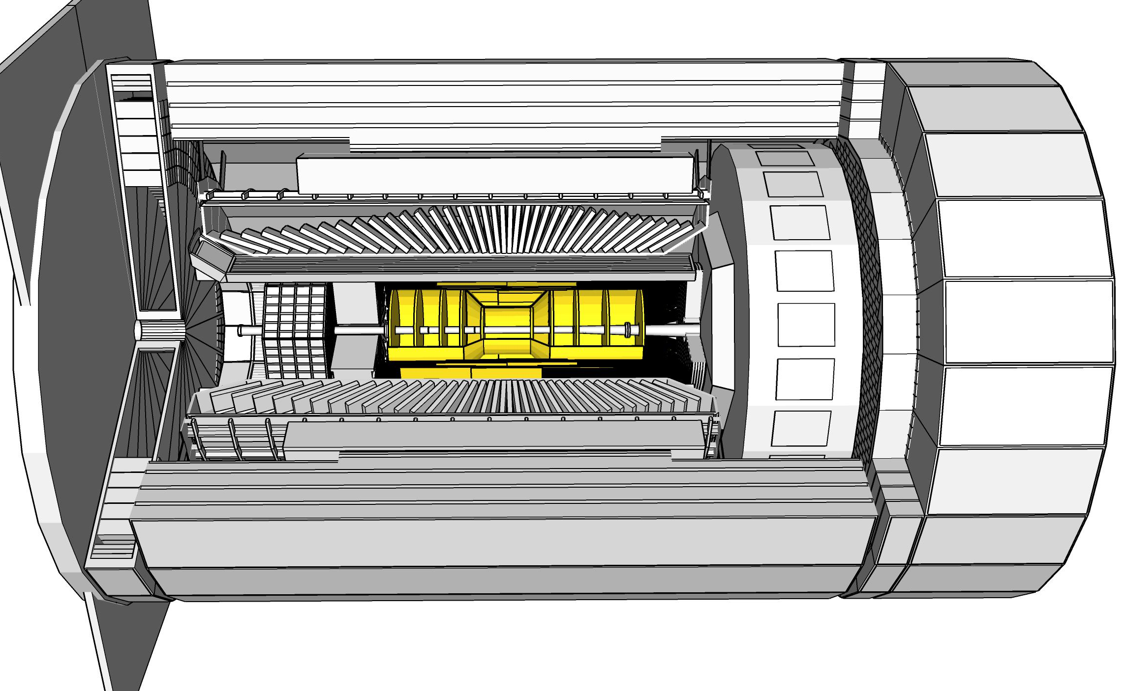
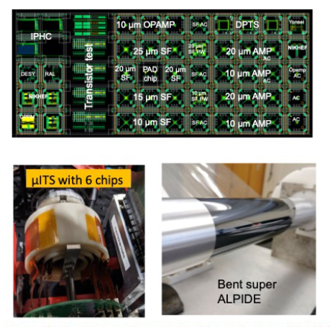
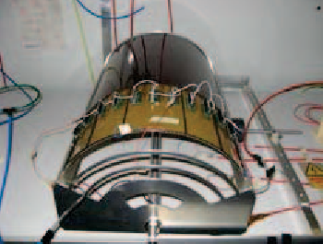
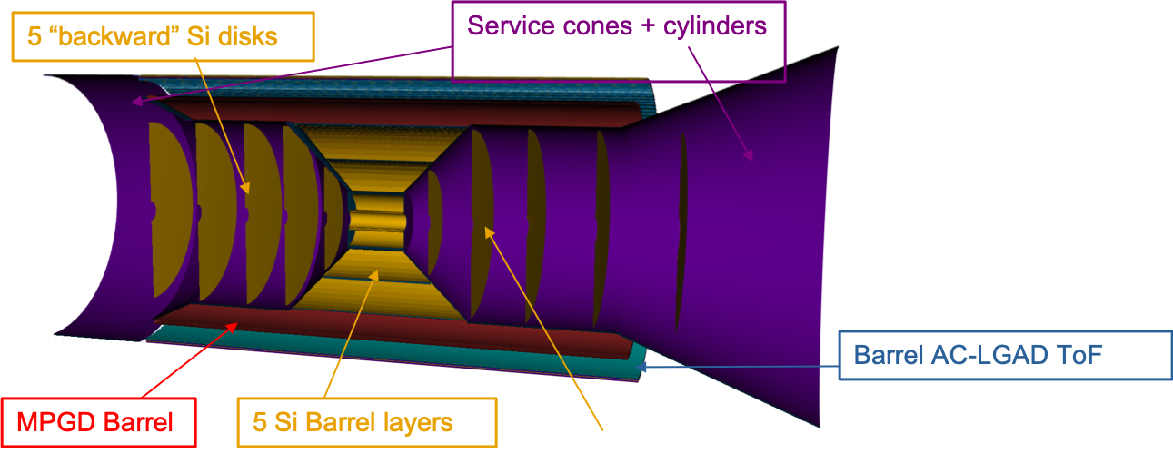
ePIC Tracking Detectors
Monolithic Active Pixel Silicon Tracker:
1 single technology: 65-nm MAPS
  O(10 μm) pitch, <20 mW/cm²
  Developed for ALICE ITS3
Silicon VERTEX (3 layers)
  First layer @ R ~ 4 cm
  Material: 0.05% X/X₀ / layer
Silicon BARREL (2 layers)
  Material: 0.55% X/X₀ / layer
F & B Silicon DISKs
(5 in Front and Back)
  Material: 0.24% X/X₀ / layer
Multi Pattern Gas Detectors:
Cylindrical microMEGAS
→ Additional space point for
pattern recognition / redundancy
→ Ongoing geometry
optimization
μRWELL planar layer behind hpDIRC
→ Impact point and direction for the
ring seeding of hpDIRC
→ Additional space point for pattern
recognition / redundancy
→ Not be required if imaging
calorimeter is used

Slide 7
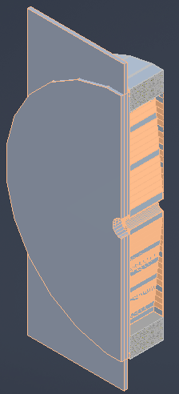
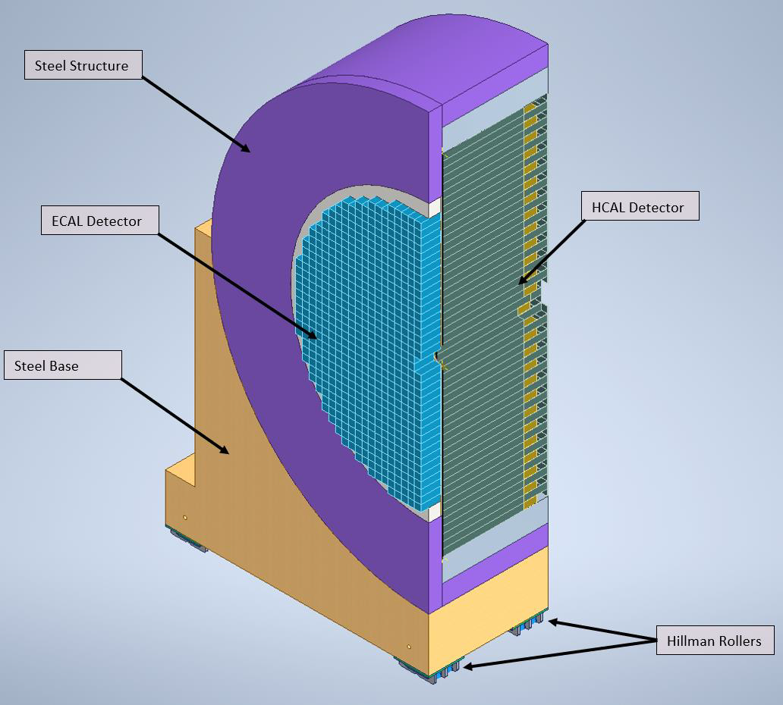
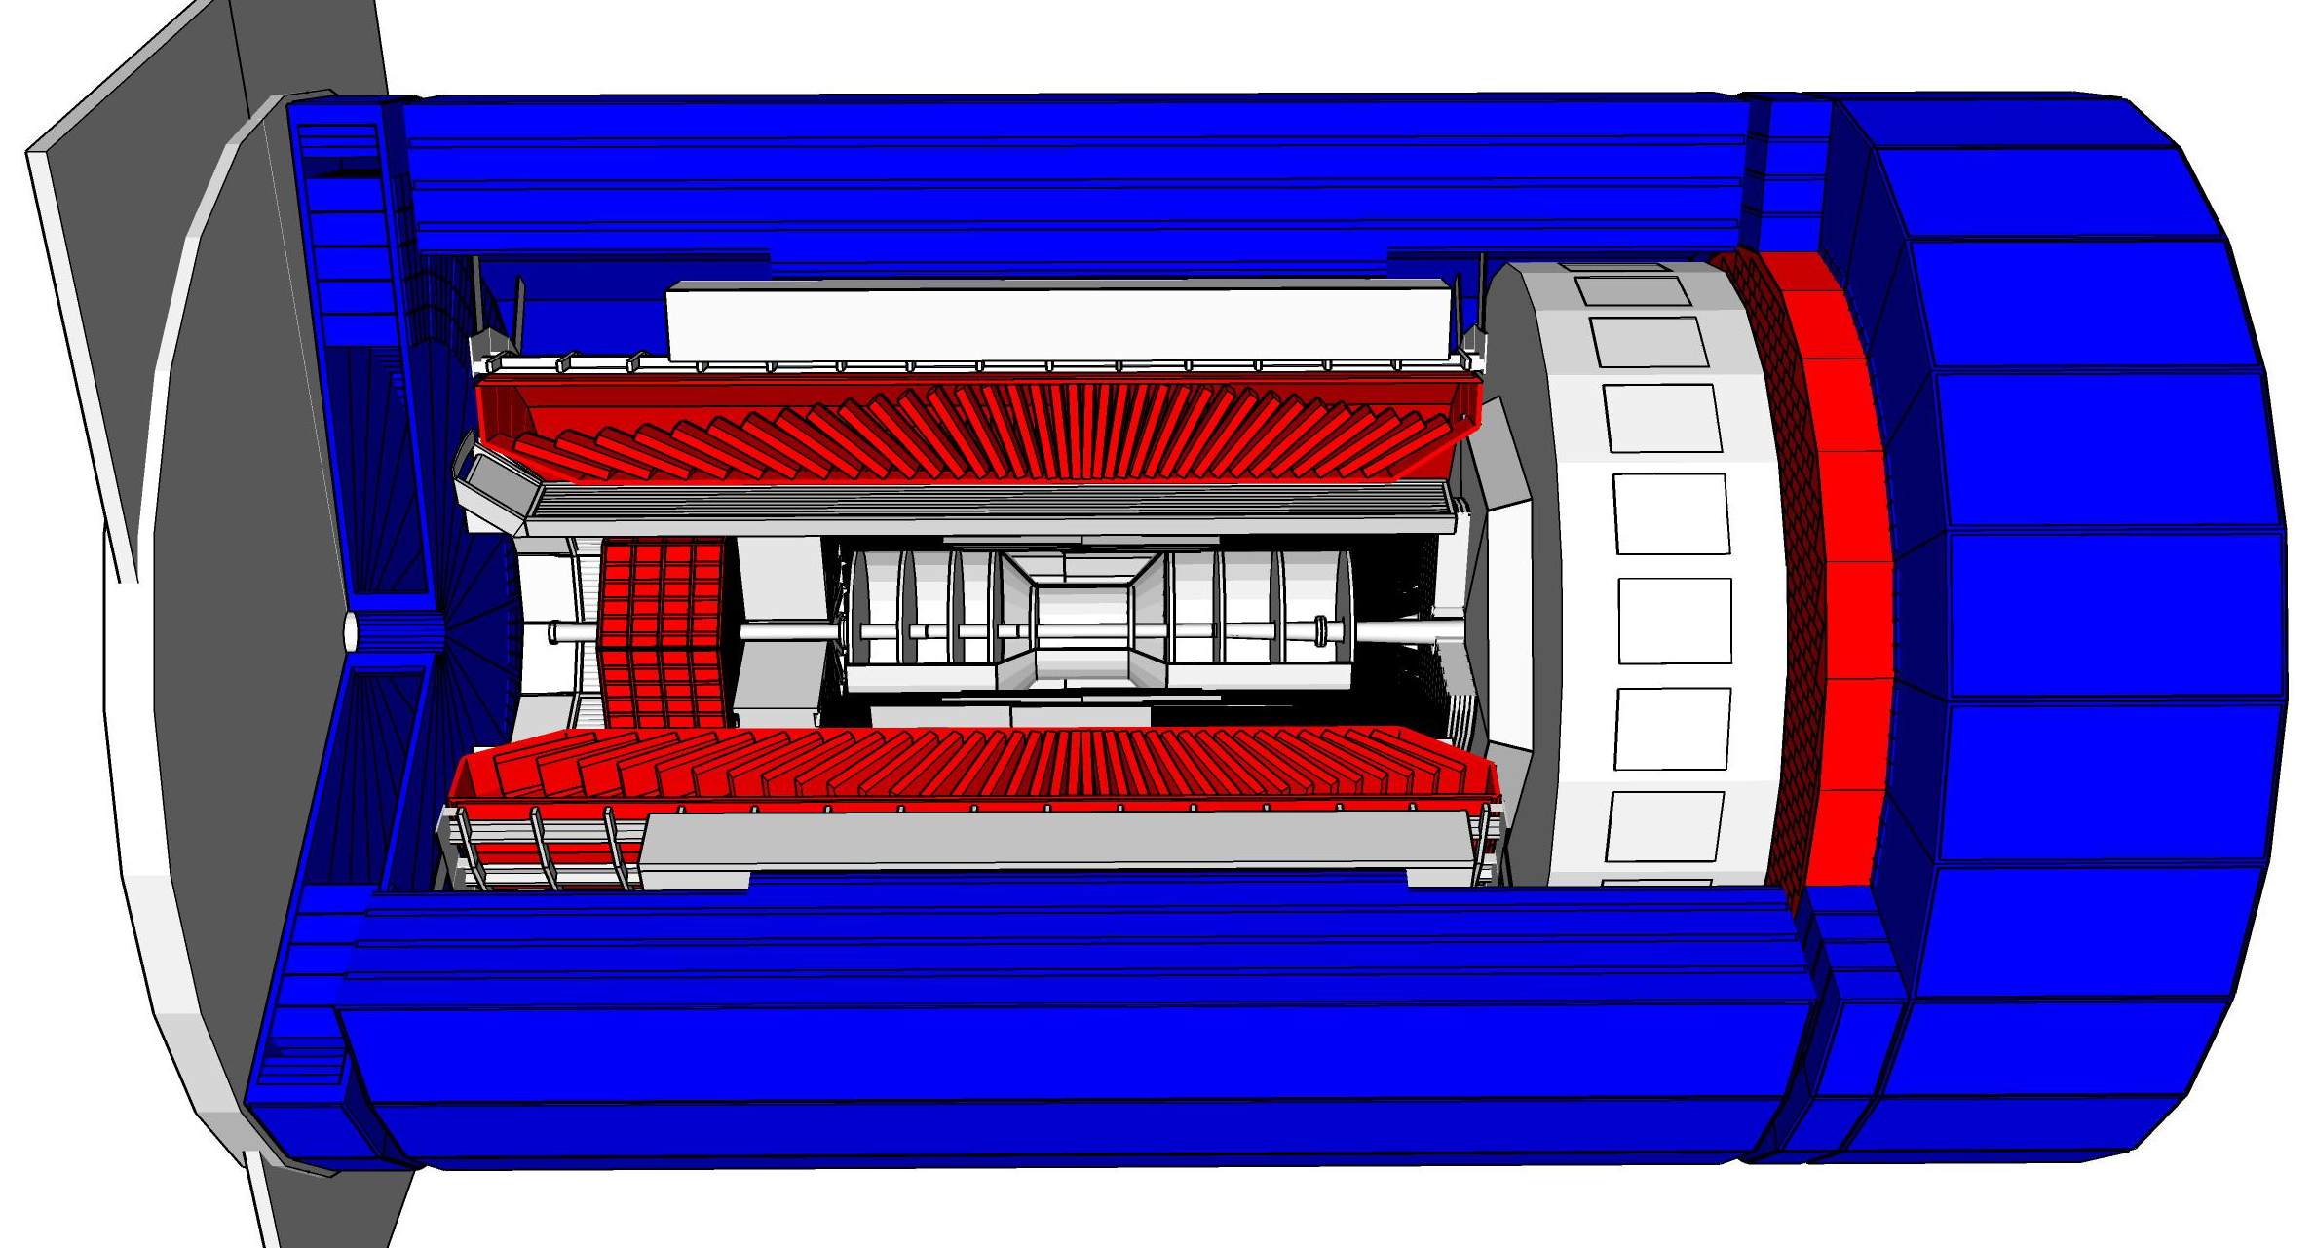
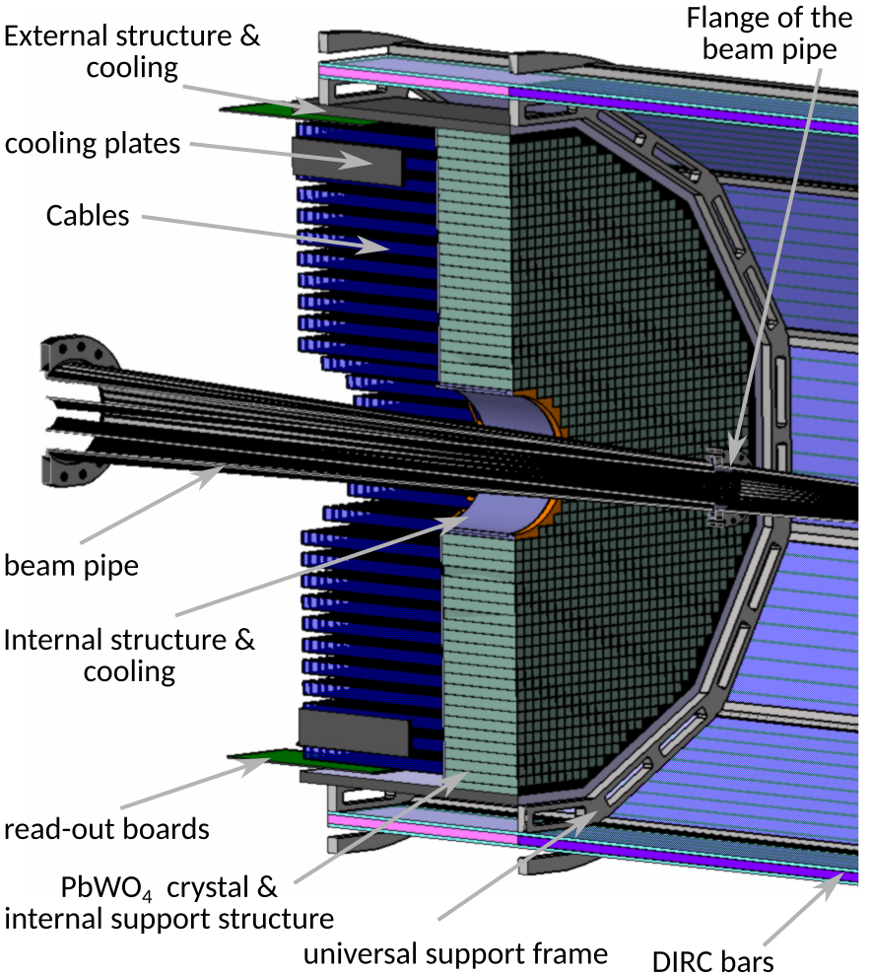
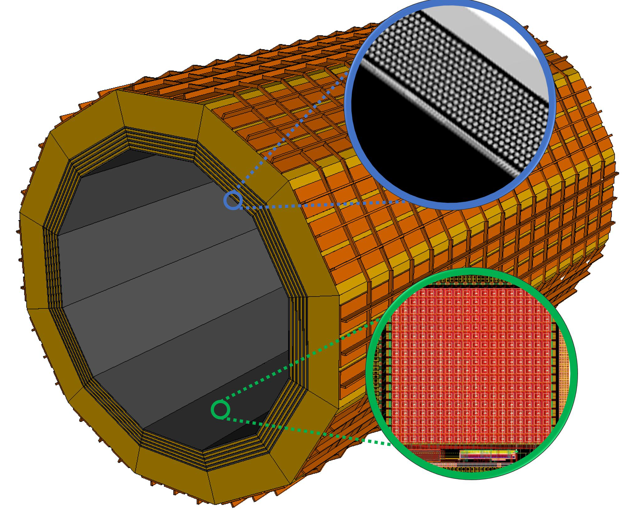
ePIC Calorimetry
Charge Question #4
Backwards HCal
Steel/Sc Sandwich
tail catcher
Barrel HCAL
(sPHENIX re-use)
Backwards EMCal
PbW04 crystals → LLP
High granularity
W/SciFi EMCal
Longitudinally separated HCAL with high-η insert
Steel/Sc & W/Sc sandwich
→ Steel, WSF & SC LLP
Complementary options for BECAL:
SciGlass or
Imaging Calorimeter
2 options for the barrel calorimetry
Imaging Layer
SiPMs of all Calorimeters LLP

Slide 8
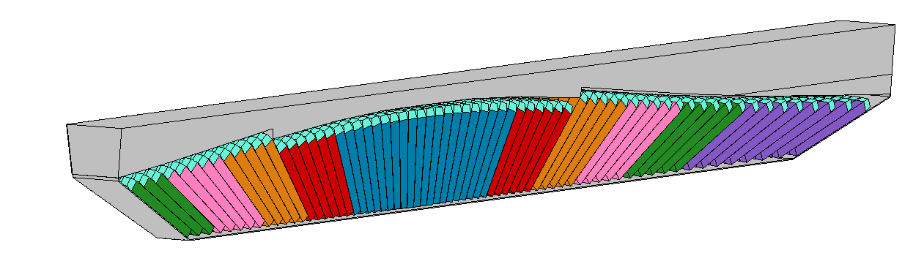
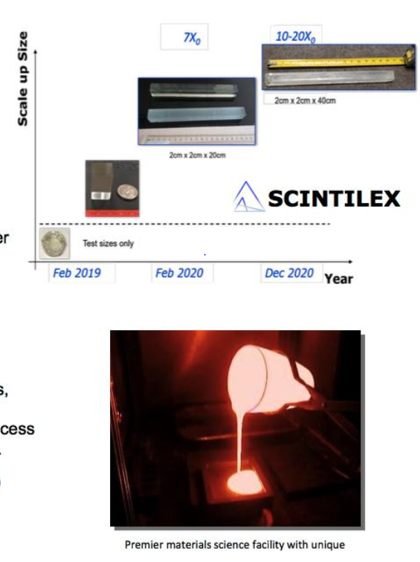
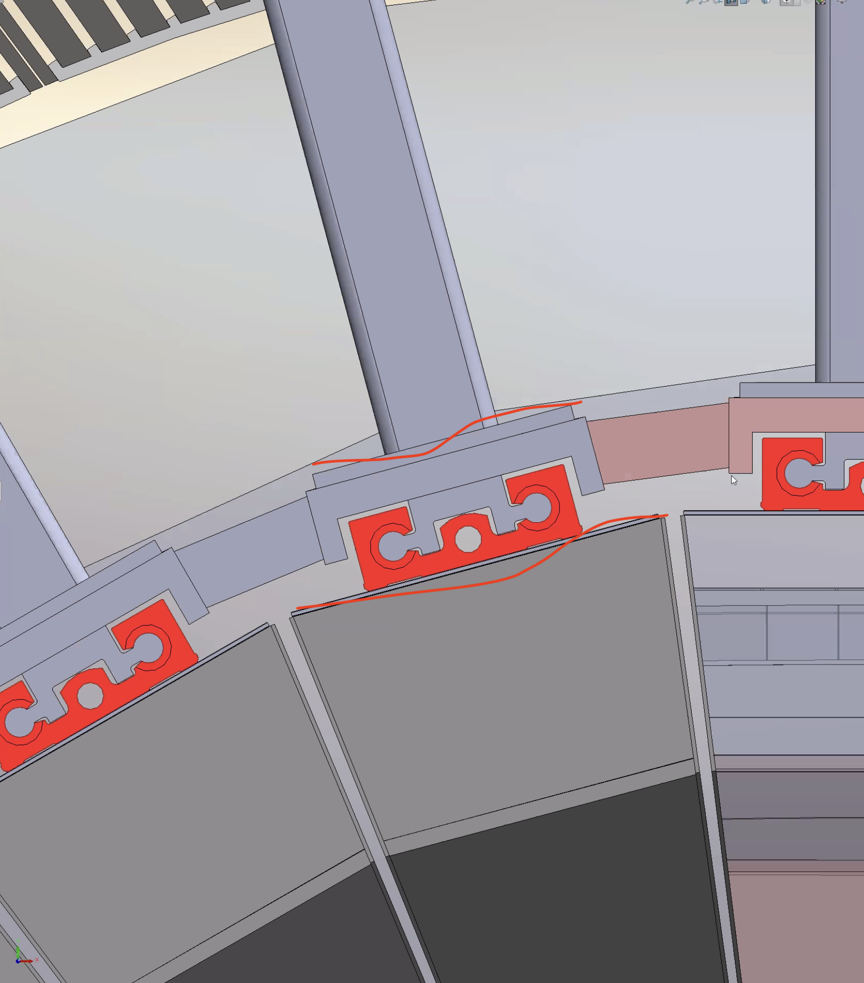
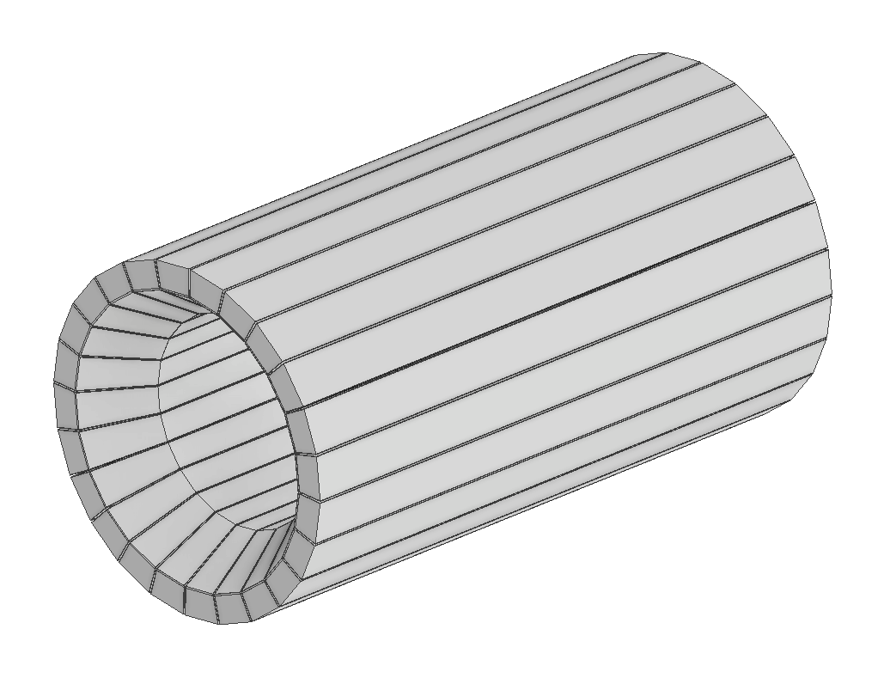
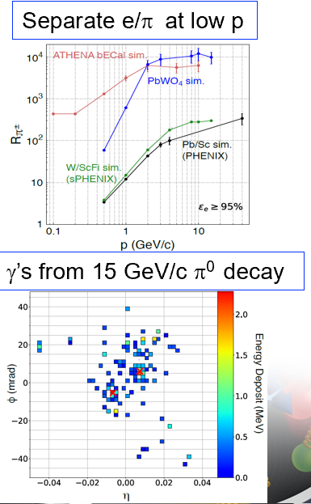
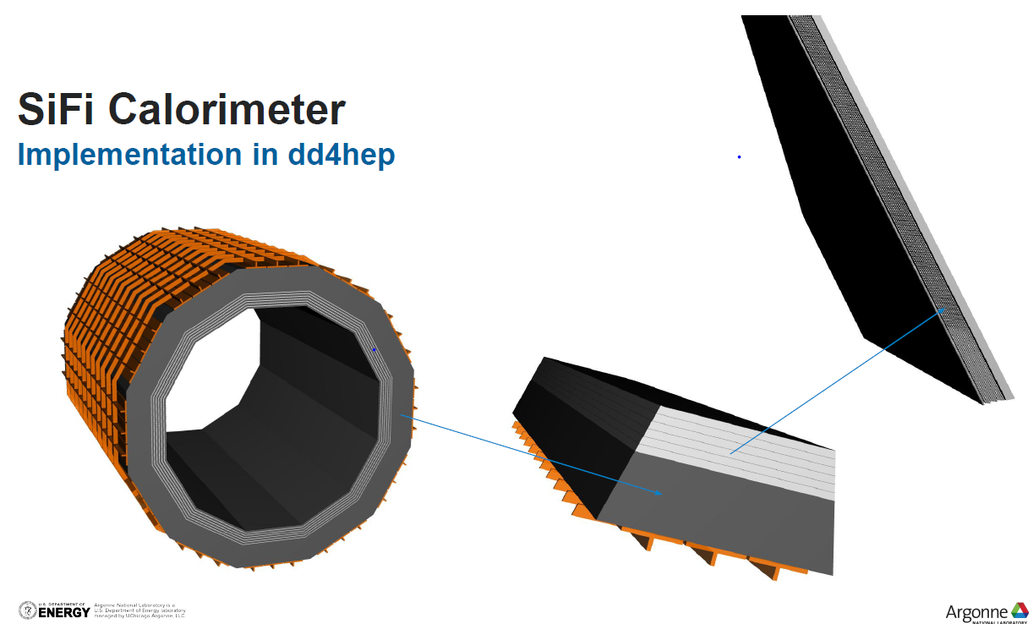
ePIC BARREL ECAL
Charge Question #4
Barrel ECal with SciGlass blocks with projective geometry
EEEmCAL consortium
Alternate: Barrel ECal with a hybrid
imaging calorimeter
5 imaging layers
preceded by a
time-layer
Pb/SciFi
ANL, Regina, Manitoba, UCSC

Slide 9
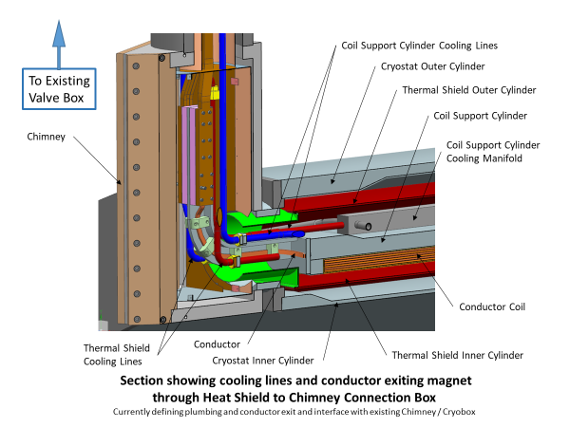
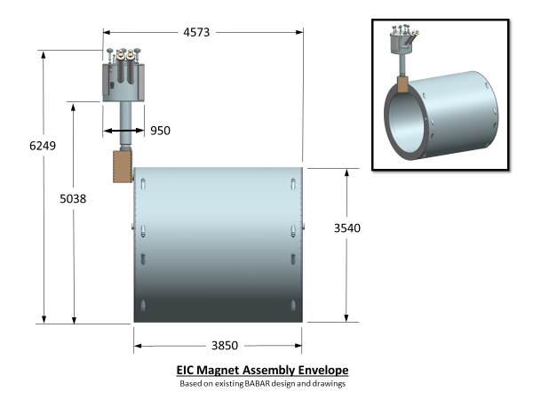
Solenoidal Magnet - MARCO
Large-scale superconducting detector magnets have a limited worldwide vendor supply and carry known technical, cost and schedule risk during the construction phase.
→ A “known” LLP candidate
Magnet status:
  CD-1 Approval June 2021
  3T Detector solenoid preliminary design report December 2021
  Incremental (30%) Design and Safety Review February 2022
  DPAP closeout report – led to reduced field (< 3 T) March 2022
  Contract for 60% Design Review April 2022
  60% design team formation and kick off meeting May 3, 2022
  Mid-Project Progress meeting (@BNL, hybrid meeting) June 28, 2022
  Point design adjusted to stretch goal of 2 T (operation at 1.7 T) August 10, 2022
  60% Design and safety Review October 18, 2022
  90% Design contract in place December 2022
  Found qualified vendor willing to make conductor January 2023
Magnet planning:
  RFI on the street February 2023
  90% Design completion and review September 2023
  (90% design completion is 100% - final design - for “Vendor Design-Build” procurement).
  P6: Milestone FDR date 21 November 2023
→ Magnet is on track to be ready for procurement at CD-3A date

Slide 10
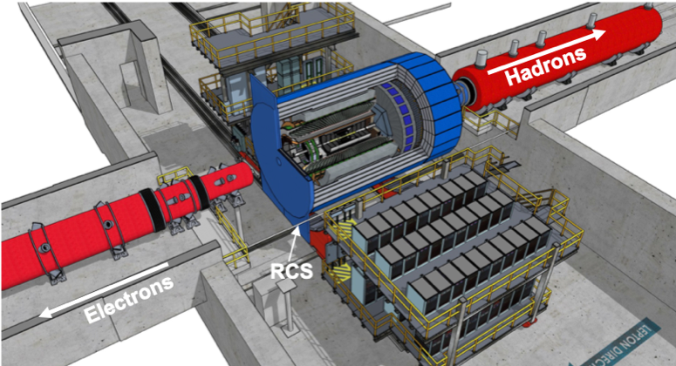
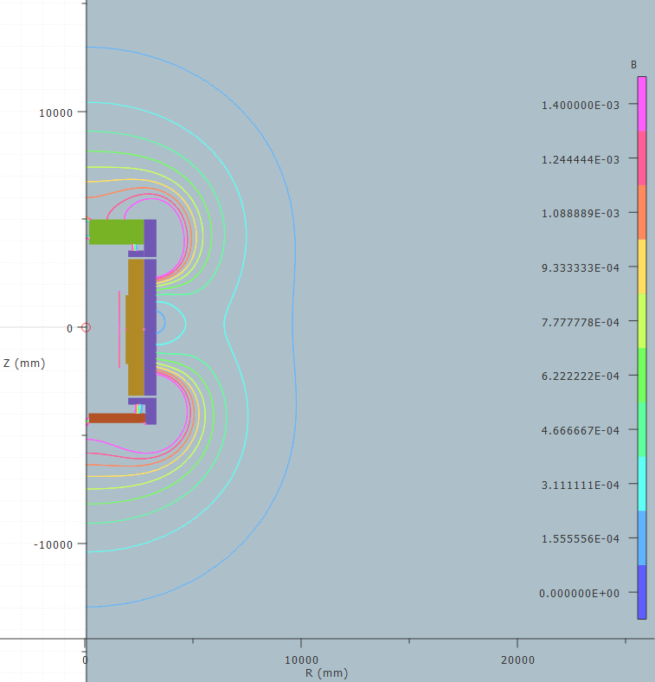
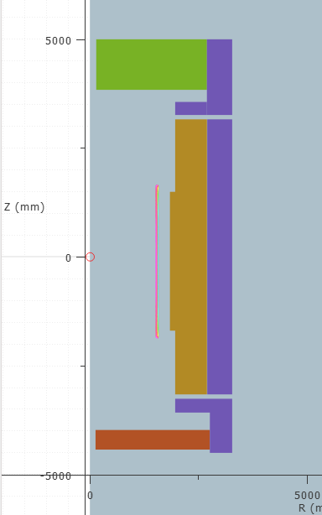
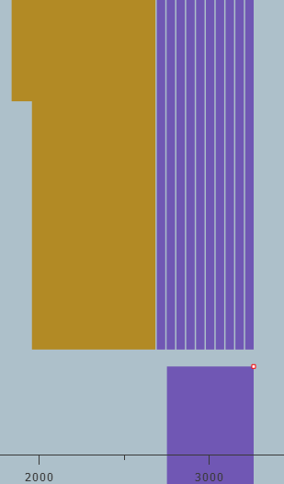
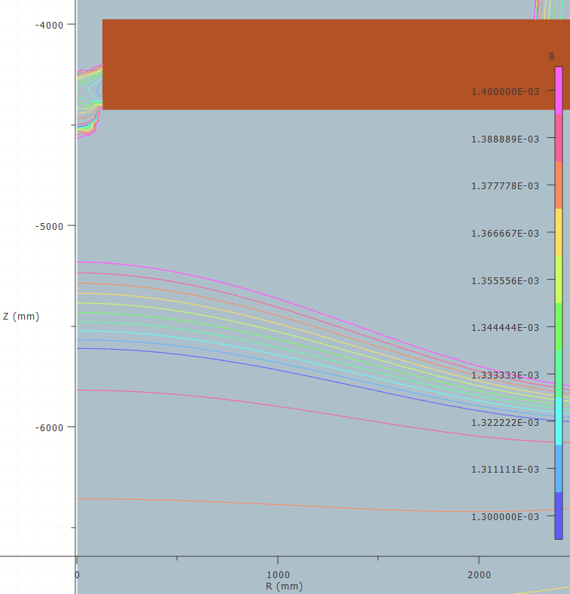
Flux Return layout
Requirement for fringe field: <10 Gauss at forward and backward side
and at RCS location
Challenges detector design not symmetric
→ critical that forces get balanced
Consequences on design:
backward HCal moved as far back as possible
add both sPHENIX flux return doors behind bHCal
forward HCal need to have first tungsten/Sc
and then Steel/Sc
add additional steel around barrel HCal
layered barrel extra flux return
6 layers 50 mm steel 40 mm air
Reach 14 gauss and lower

Slide 11
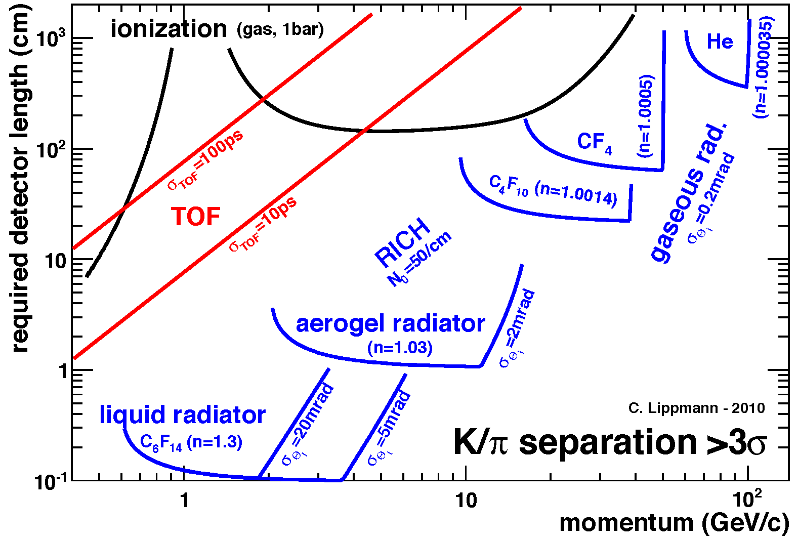
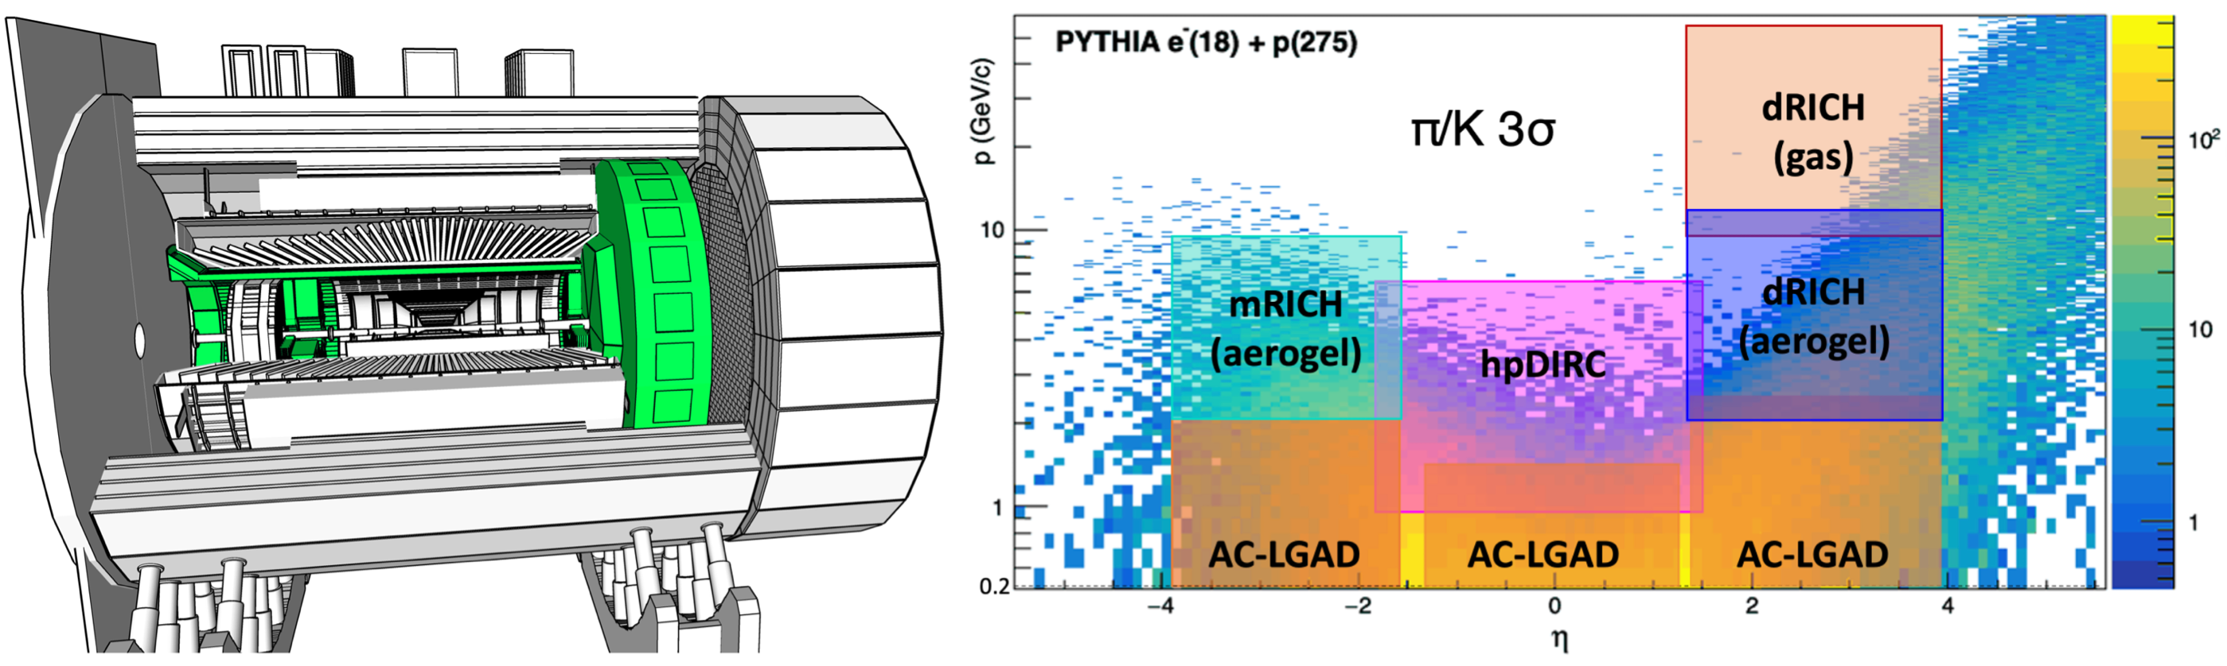
Particle ID
In general, need to separate:
Electrons from photons → 4π coverage in tracking
Electrons from charged hadrons → mostly provided by calorimetry
Charged pions, kaons and protons from each other → Cherenkov detectors
  Cherenkov detectors, complemented by other technologies at lower momenta
  Time-of-flight or dE/dx
Physics requirements:
Need more than one technology to cover the entire momentum ranges at different rapidities
Rapidity | π/K/p and π0/γ | e/h | Min pT (E)
-3.5 − -1.0 | 7 GeV/c | 18 GeV/c | 100 MeV/c
-1.0 − 1.0 | 8-10 GeV/c | 8 GeV/c | 100 MeV/c
1.0 − 3.5 | 50 GeV/c | 20 GeV/c | 100 MeV/c

Slide 12


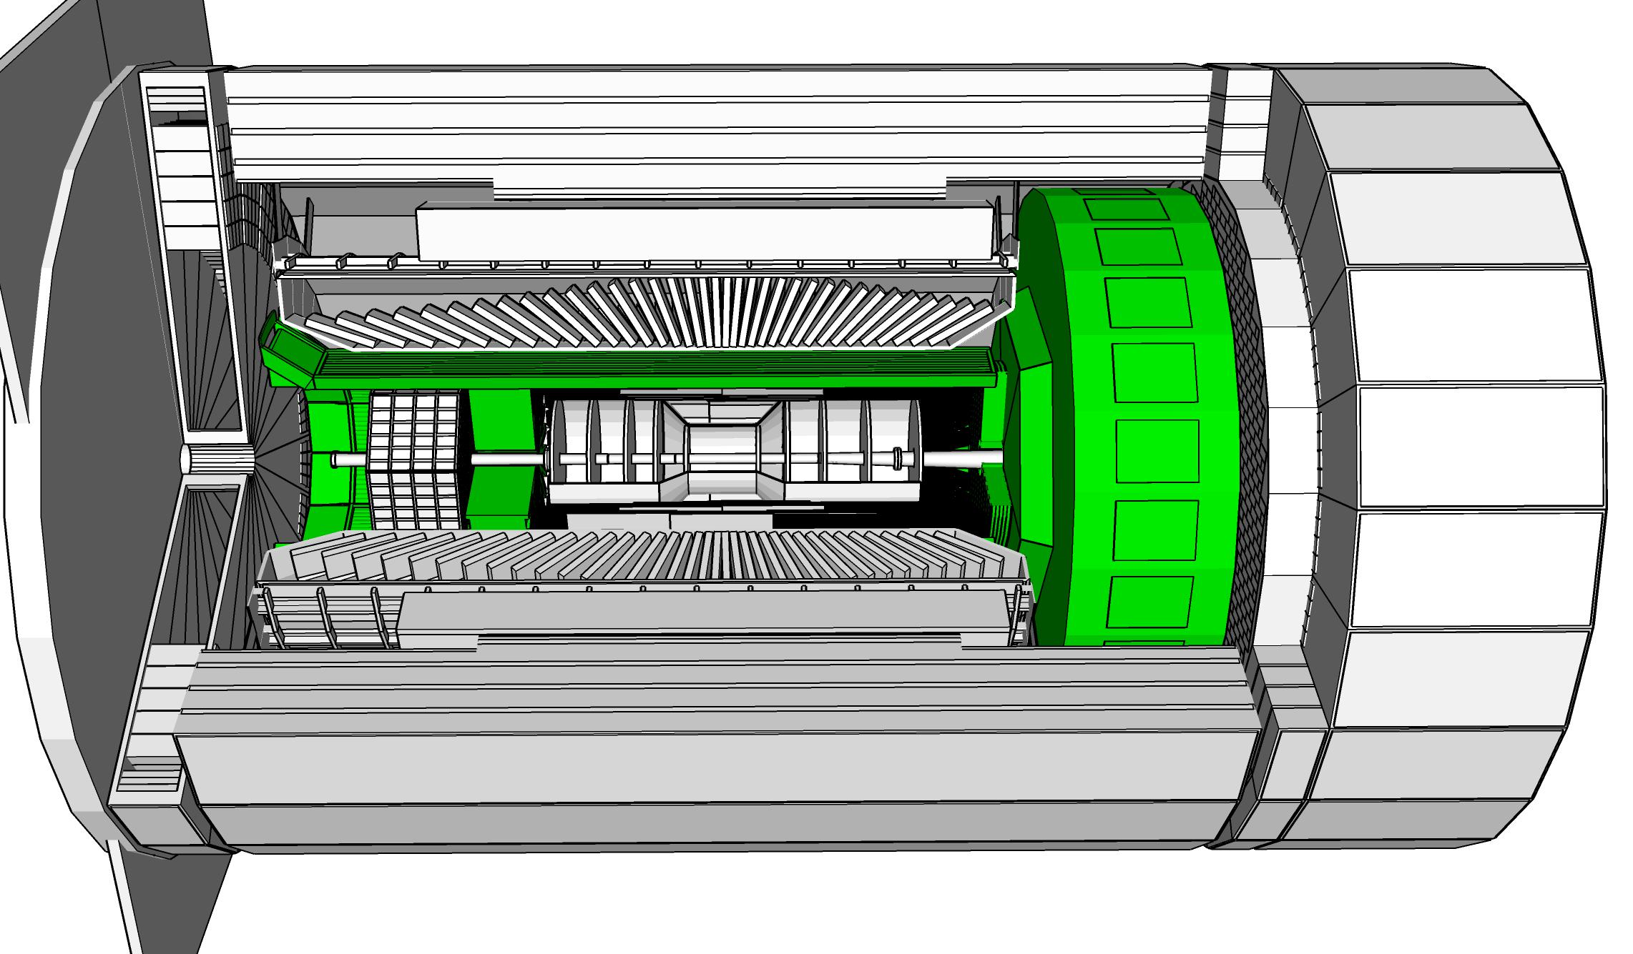

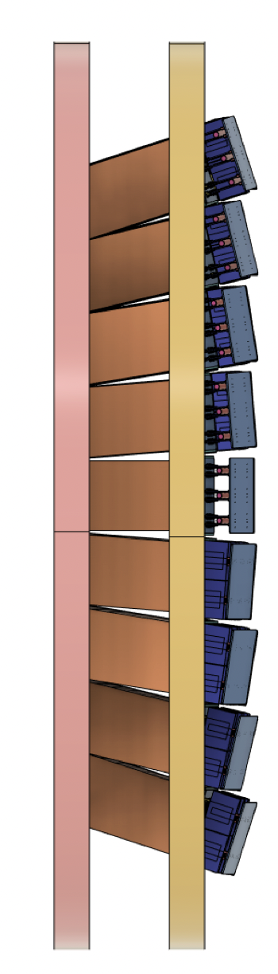
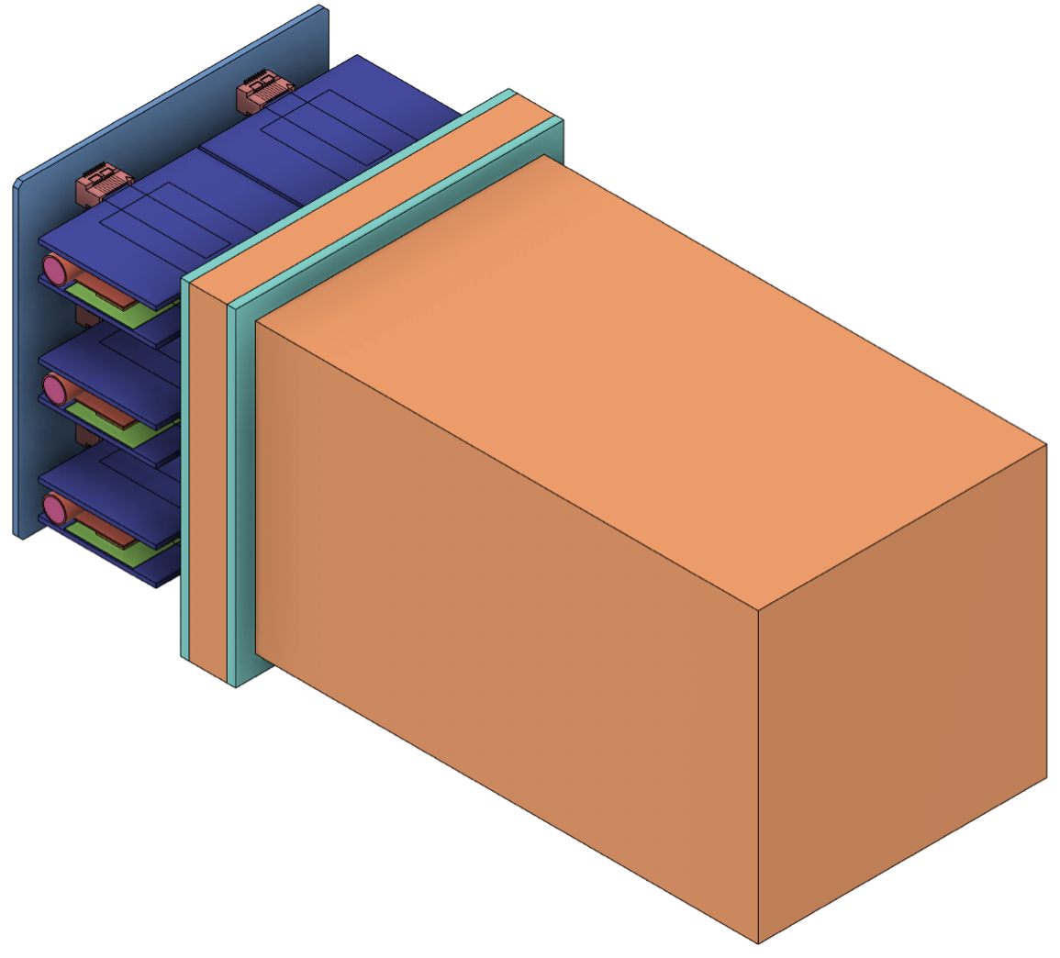
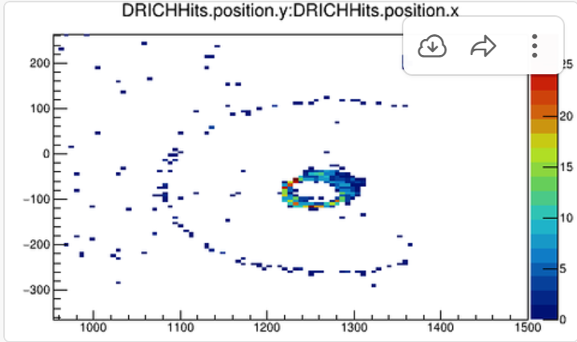
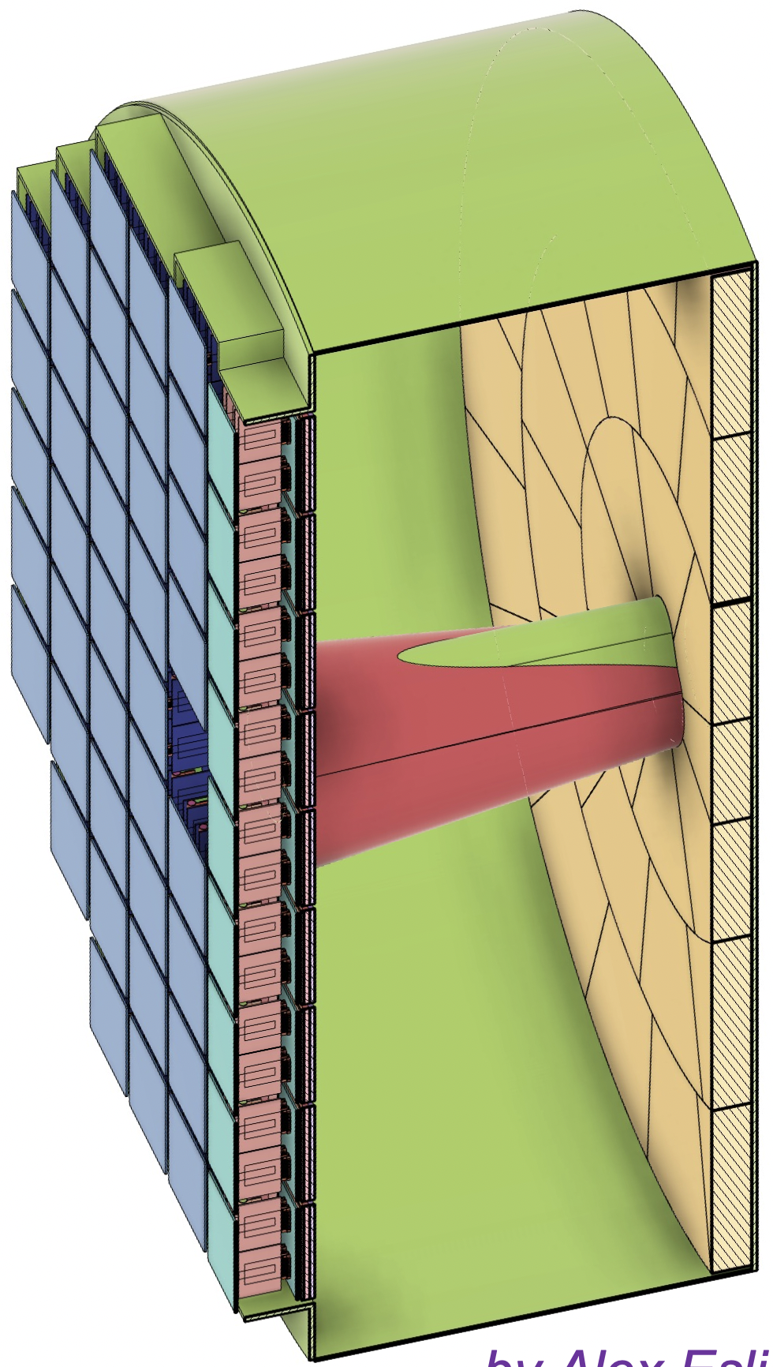
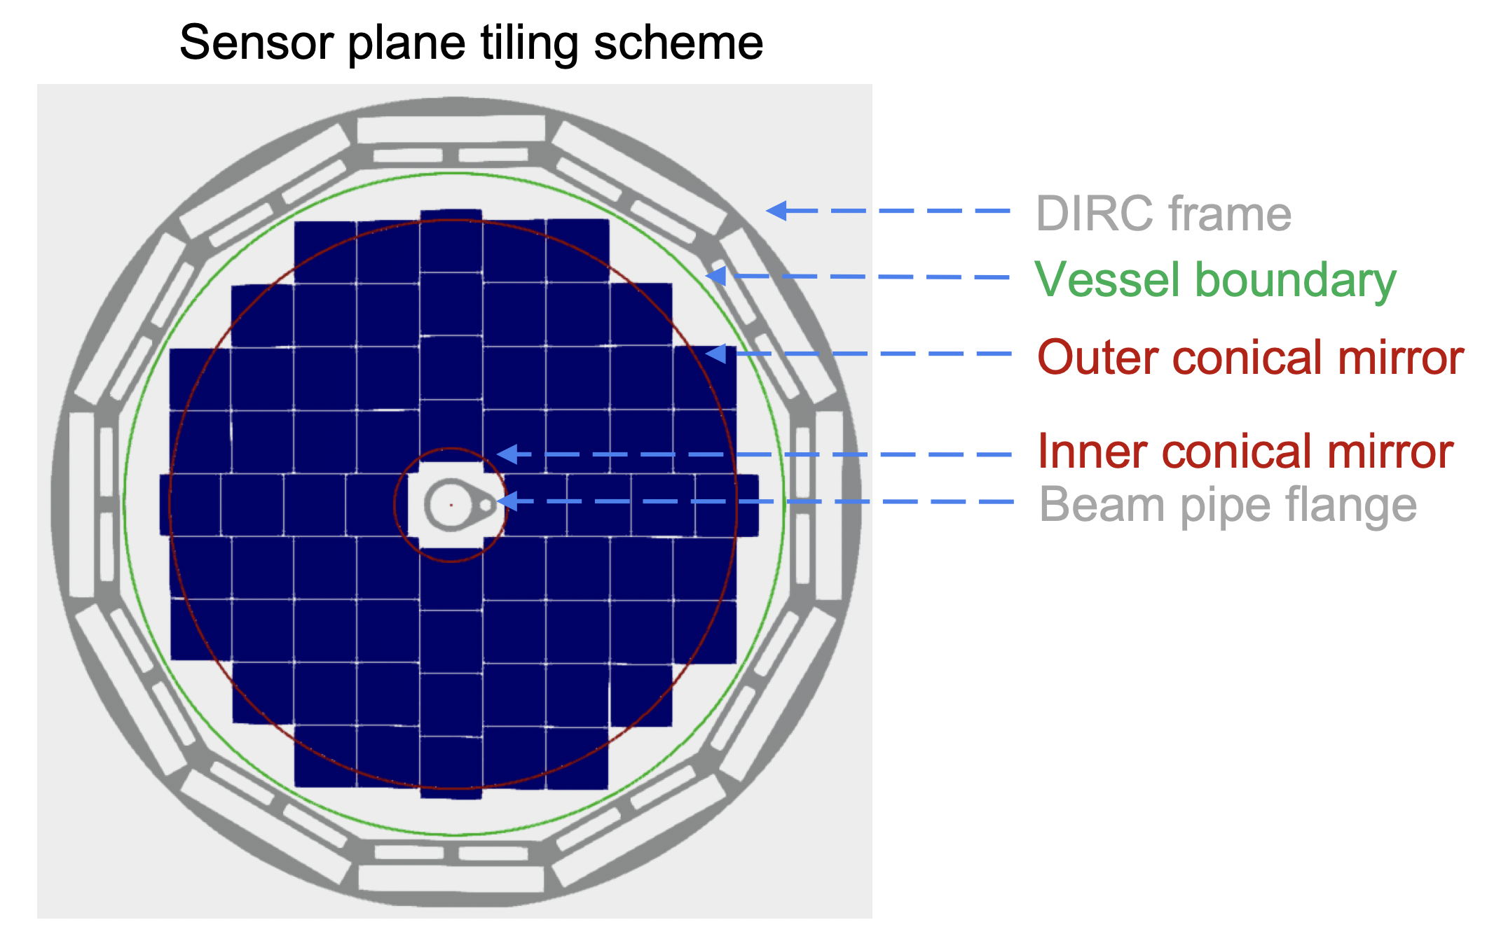
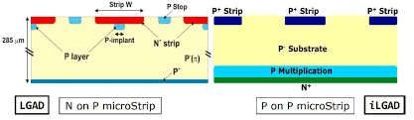
ePIC Particle Identification Detectors
hpDIRC (High Performance DIRC)
Quartz bar radiator → Reuse of BaBAR DIRC bars
light detection with MCP-PMTs
Fully focused
p/K 3σ sep. at 6 GeV/c
dual Radiator RICH
Aerogel
z: 4cm
radius: 110 cm
air gap
0.3 mm acrylic filter
Option-1:
mRICH (Modular RICH)
Aerogel Cherenkov Det.
Focused by Fresnel lens
e, π, K, p
Sensor: LAPPDs to includeTOF
π/K 3σ sep. at 10 GeV/c
Spherical Mirrors
6 Azimuthal Sectors
C₂F₆ Gas Volume
120 cm length
radius: 185 cm
Tapered bore radius
Al vessel
Sensors tiled on spheres
S13361-3050NE-08 SiPMs
8x8 pixels
→ SiPMs LLP
Option-2:
Single volume proximity focusing aerogel RICH with long proximity gap (~30 cm)
Sensor: LAPPDs → includeTOF
π/K 3σ sep. at 10 GeV/c
p/K 3σ sep. at 50 GeV/c
AC-LGAD (Low Gain Avalanche Detector)
20-35 psec
Accurate space point for tracking
forward disk and central barrel
R&D and PED by International consortium HEP & NP

Slide 13
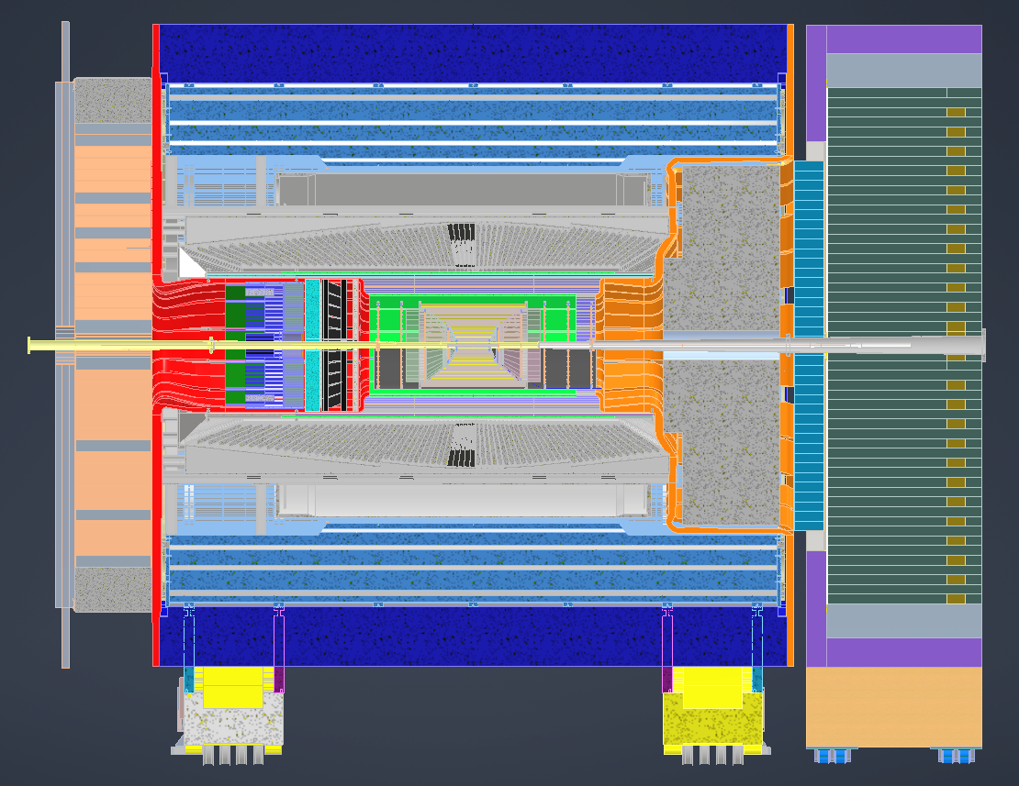
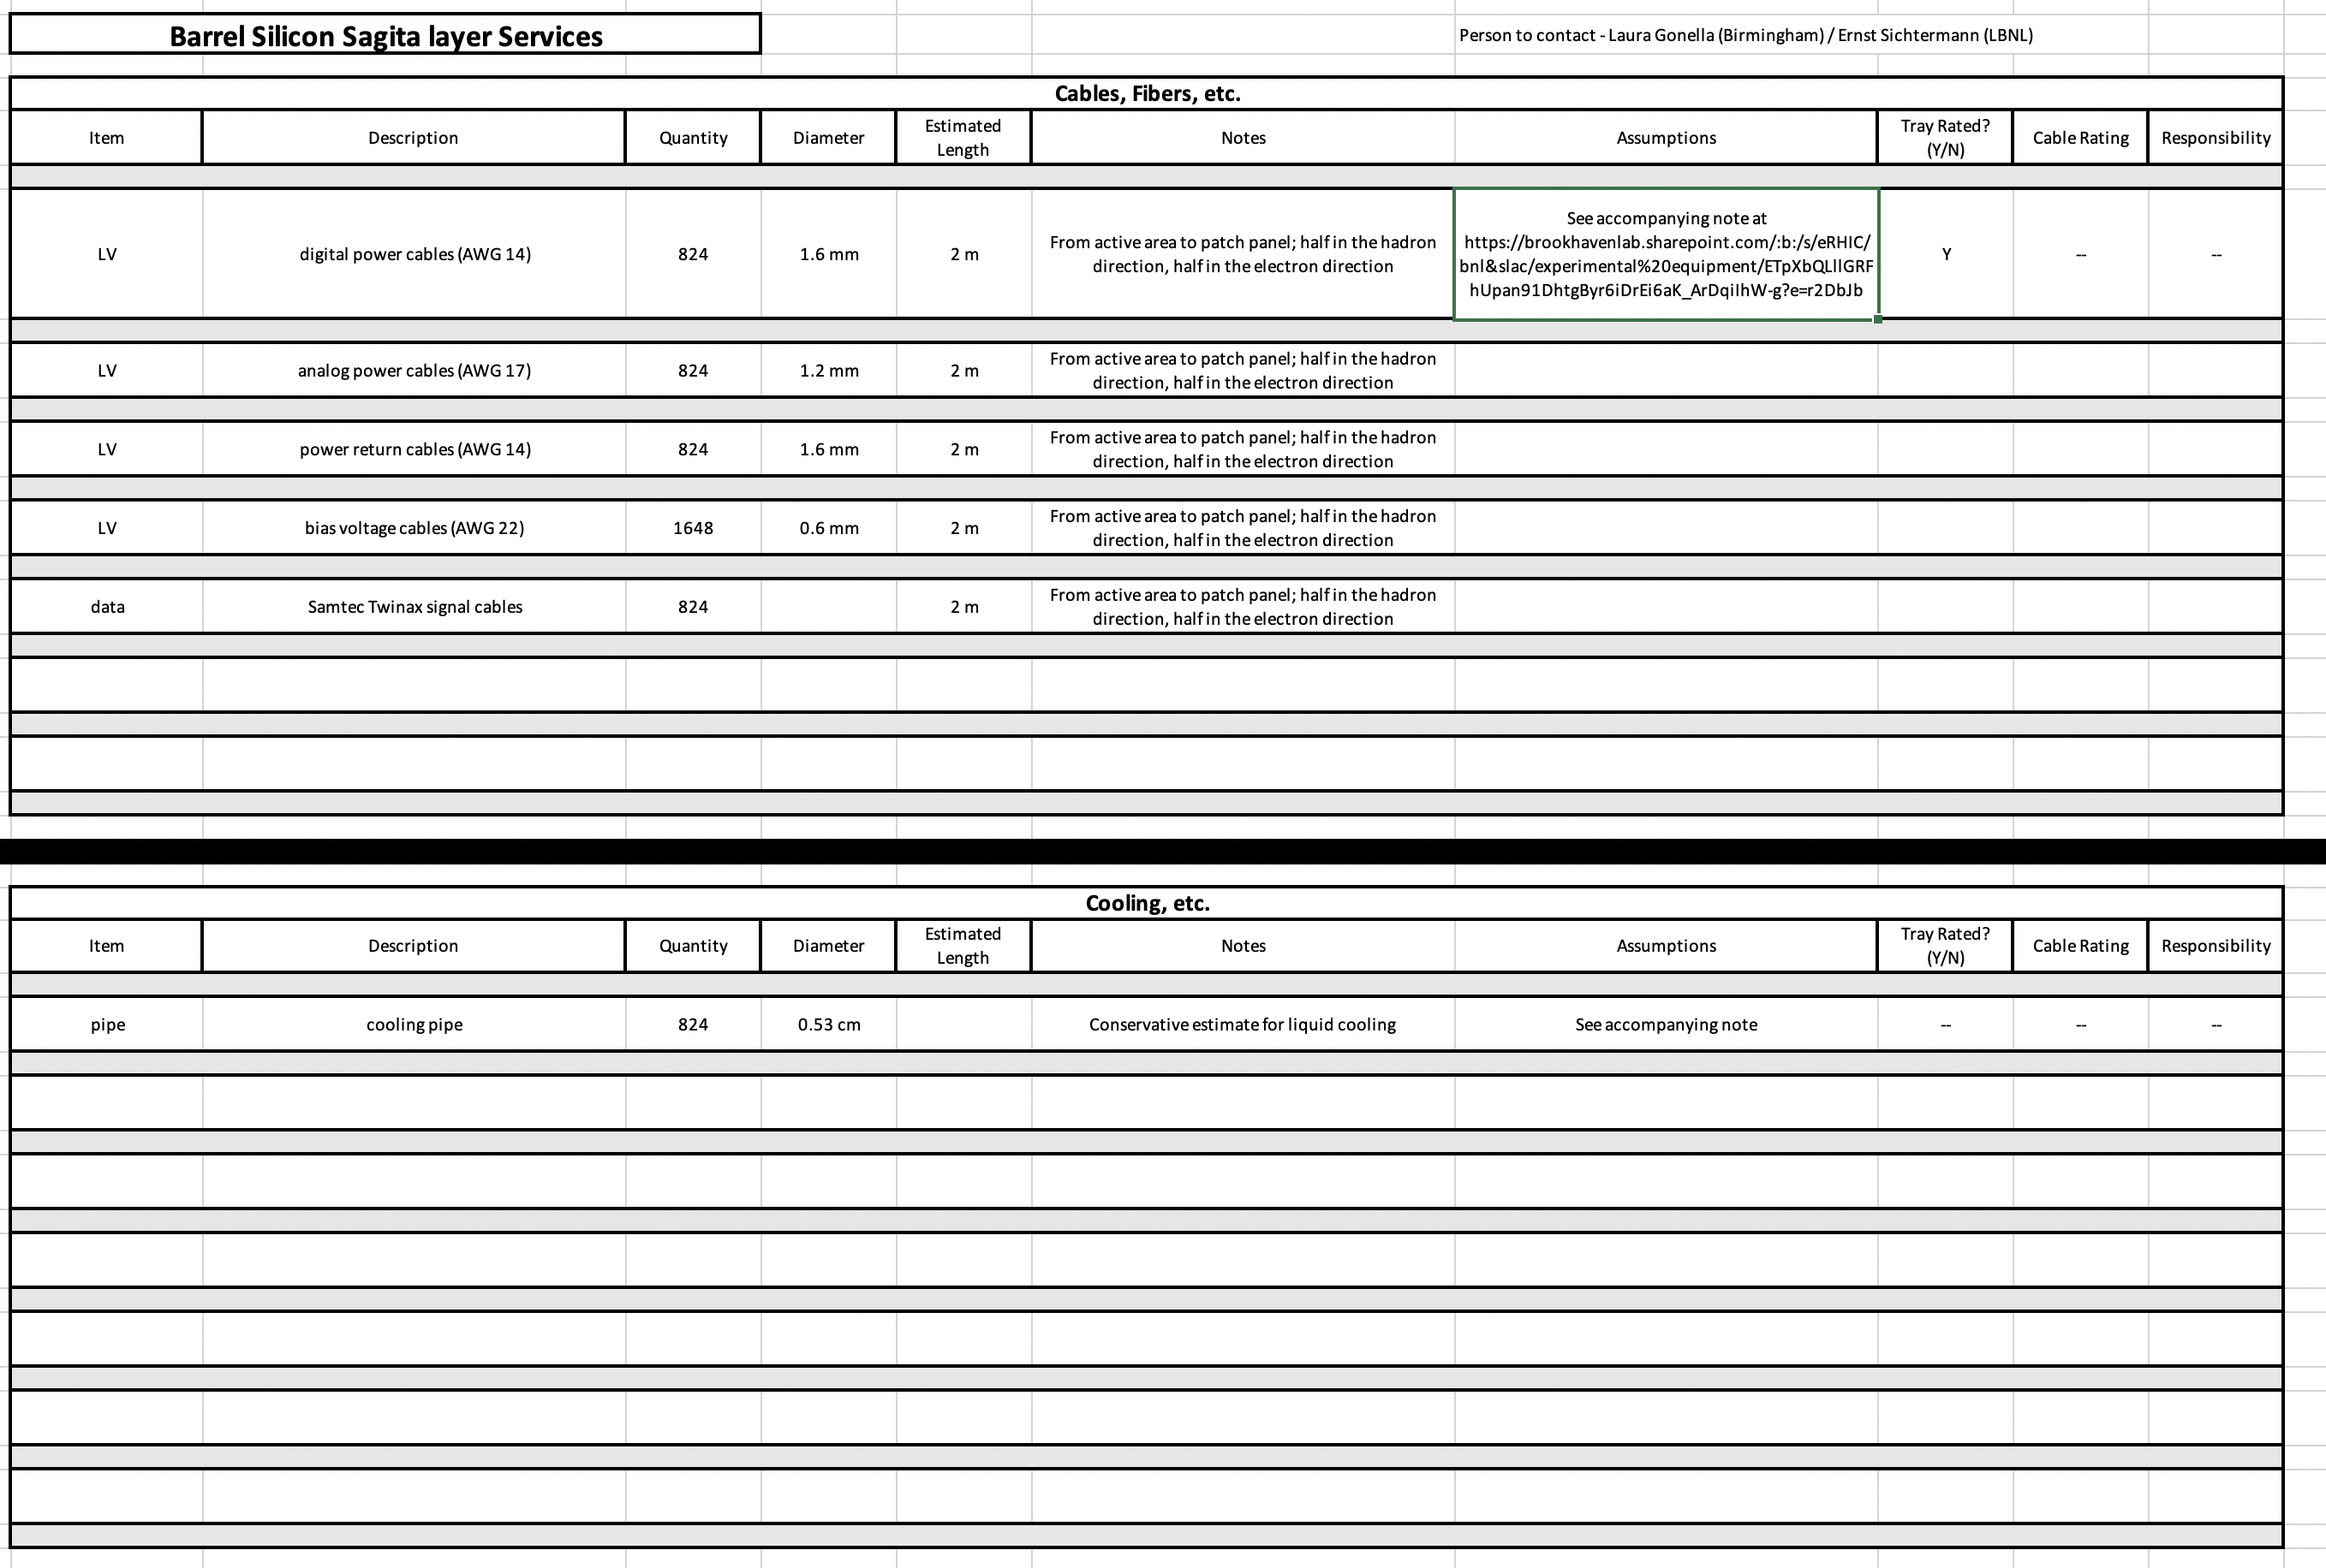
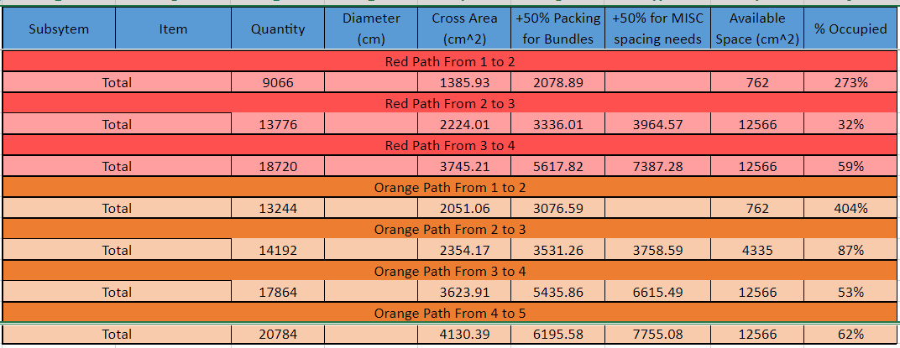
Integration: Define Services
Collect service needs of each subdetector
Fill excel-sheet at https://wiki.bnl.gov/EPIC/index.php?title=Project_Information
Information integrated in CAD model
route cables to both sides → identify bottlenecks
separate services, signal cables, HV&LV, cooling
calculate current through HV and LV cables → cooling?
Currently exceed space allocation
→ will need to iterate with all subdetectors
→ might need to integrate DC-DC
converters and other means to
split the HV & LV inside the detector
→ material budget
4
5
4
3
2
3
1
1
2

Slide 14
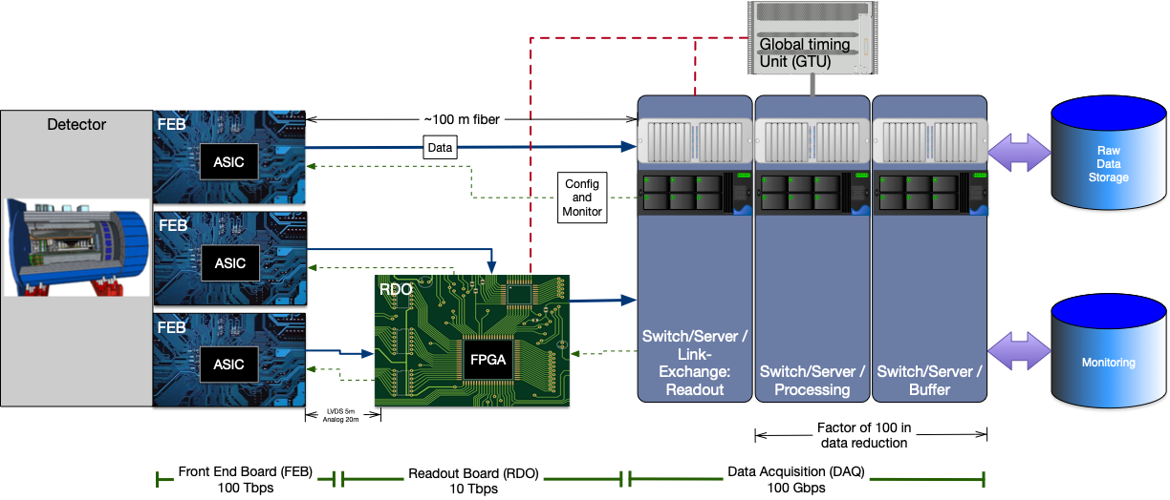
Streaming Readout Architecture
Triggerless streaming architecture gives much more flexibility to do physics
Rates quoted are at output of each stage
Integrate AI/ML as close as possible to subdetectors → cognizant Detector

Slide 15
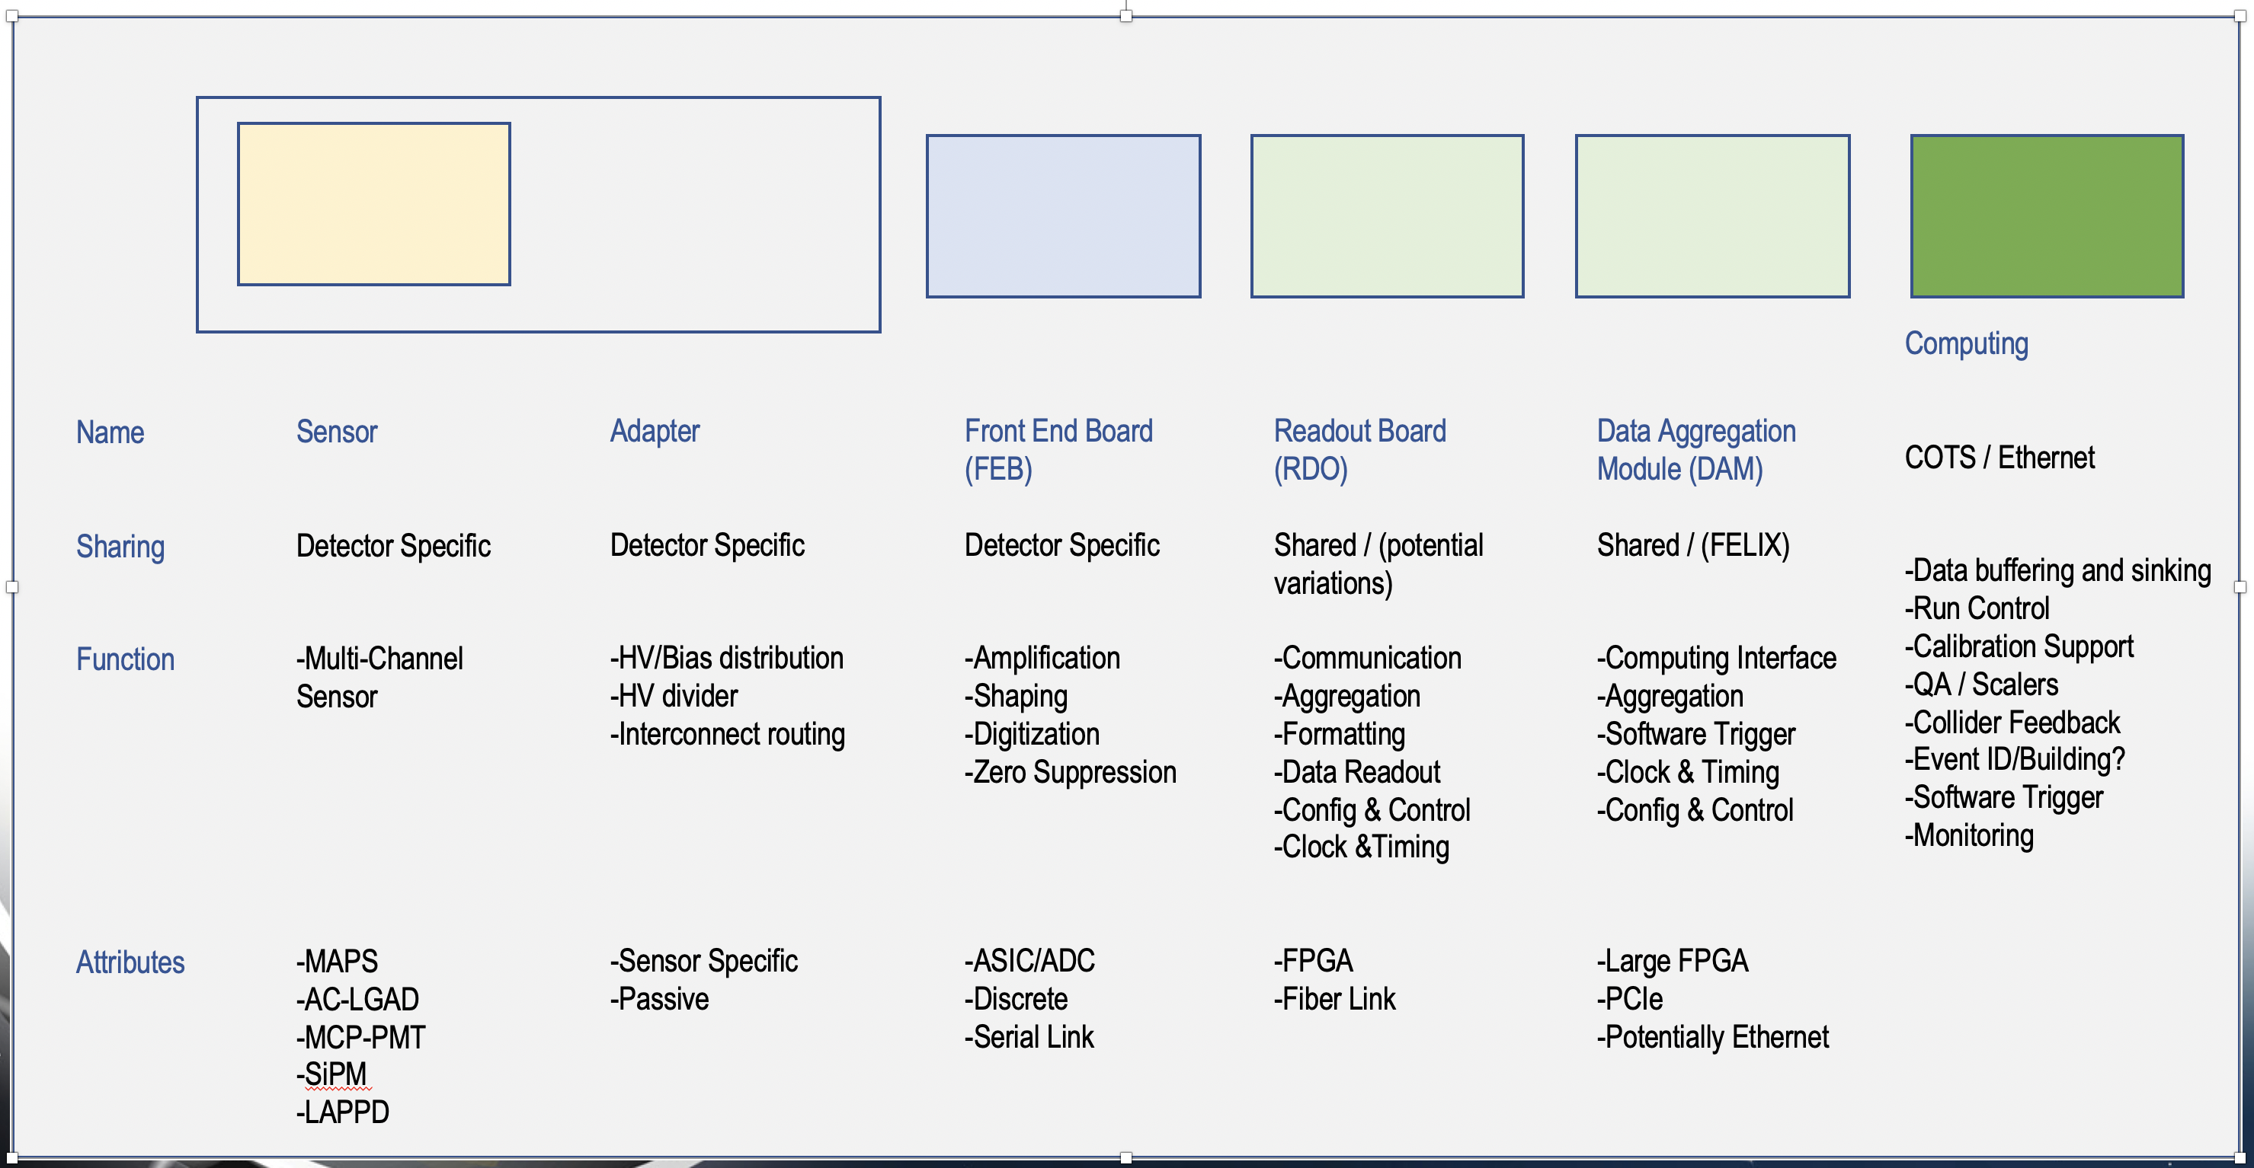
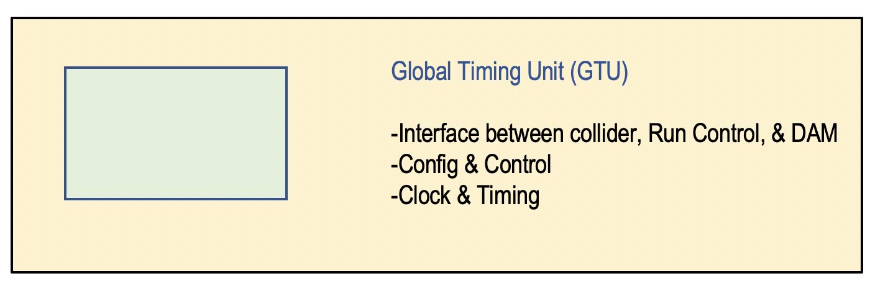
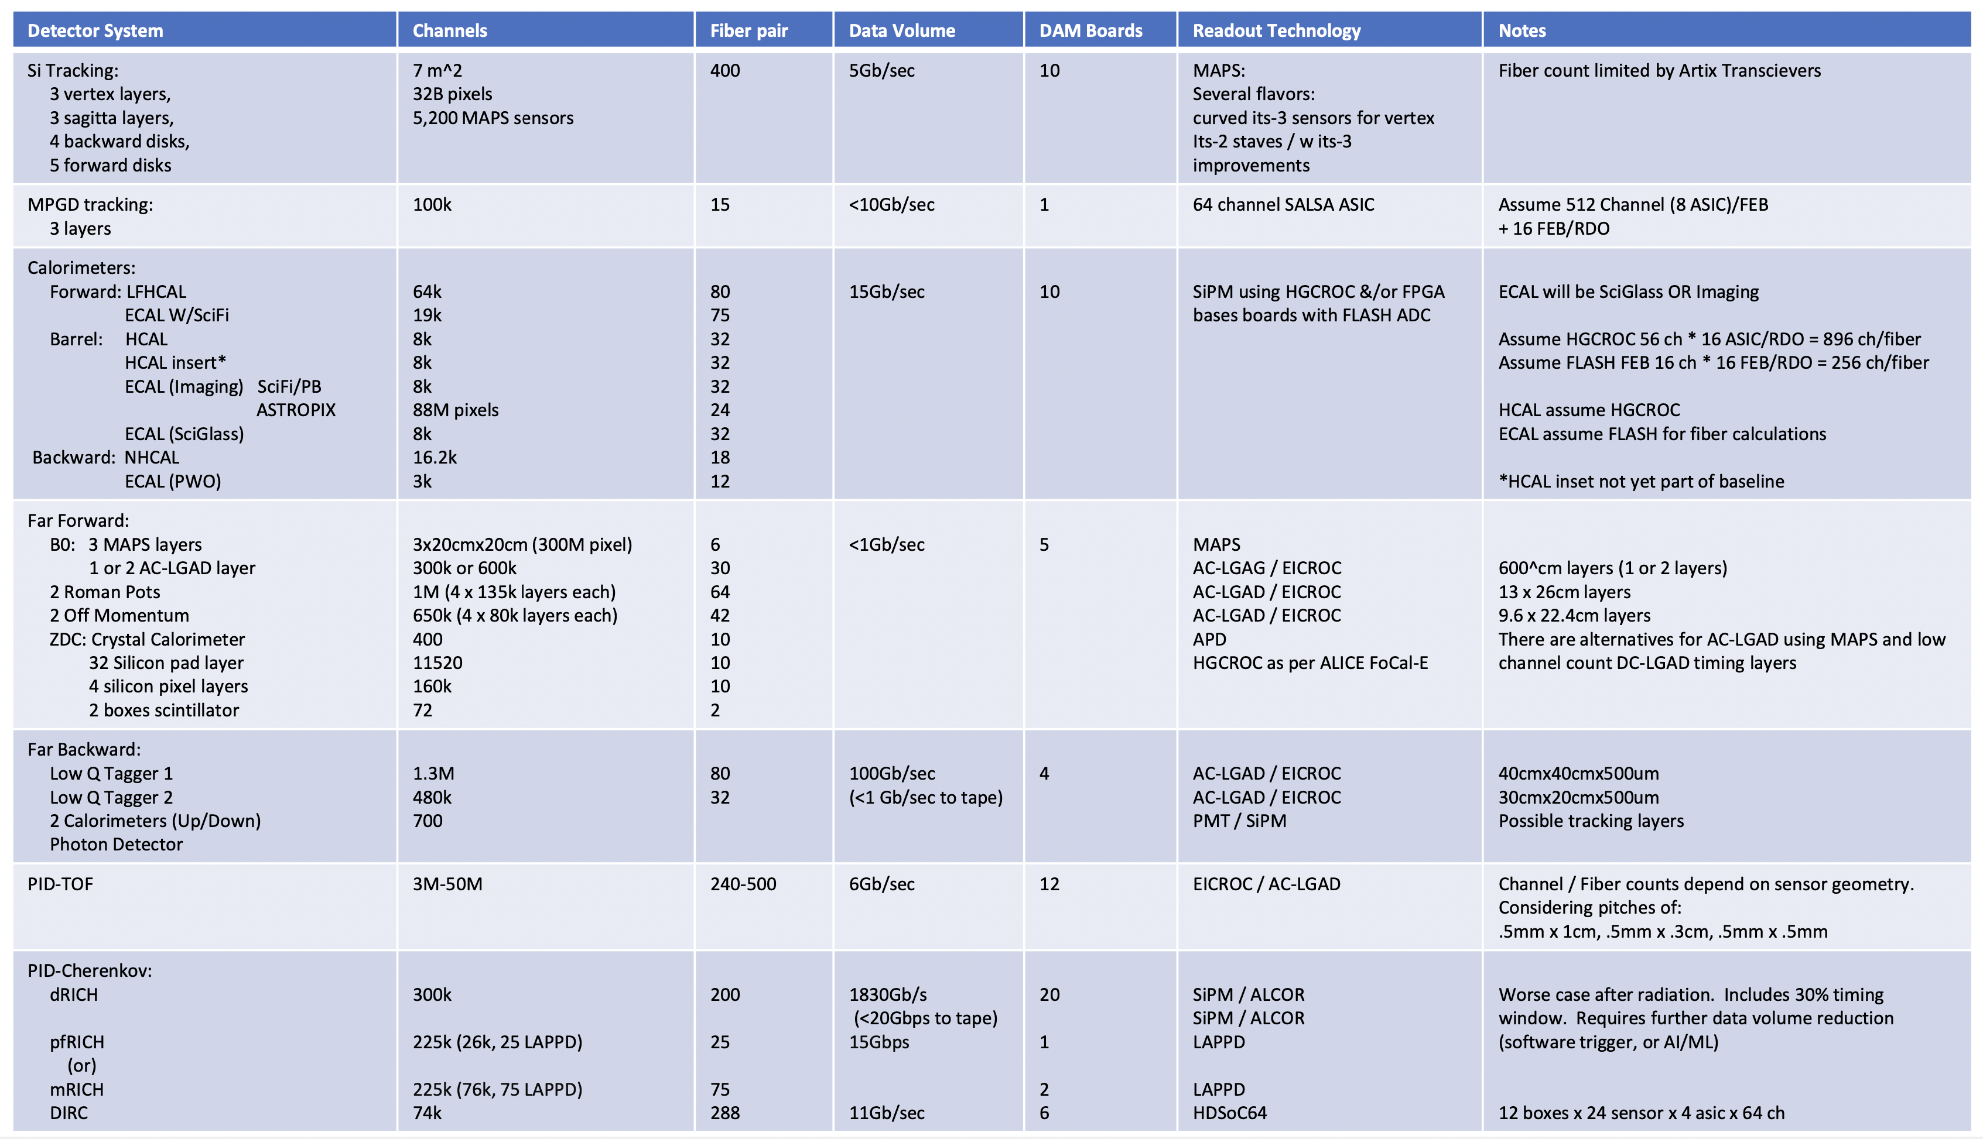
ePIC DAQ and Electronics
Goal: define readout chain for each subdetector
determine synergies between different subdetectors
  synchronize different subdetectors as much as possible on FEB level
ensure full compatibility with streaming readout
Current activities:
Hardware acquisition and development
Evaluate Timing Synchronization Feasibility
Need to define RDO locations
Determine collision data volume using reasonable data
models based upon ASIC functionality
→ including beam backgrounds and noise

Slide 16
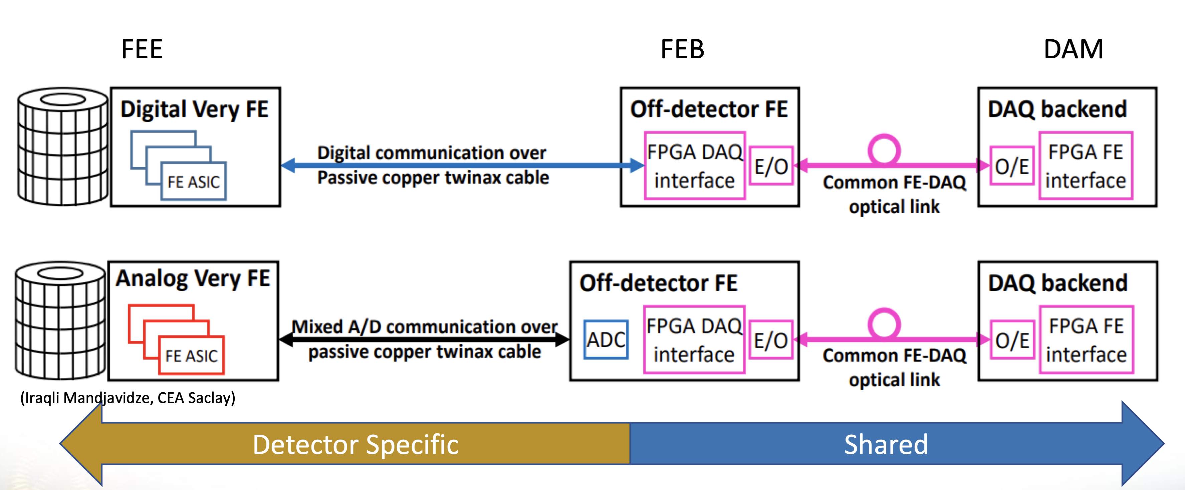
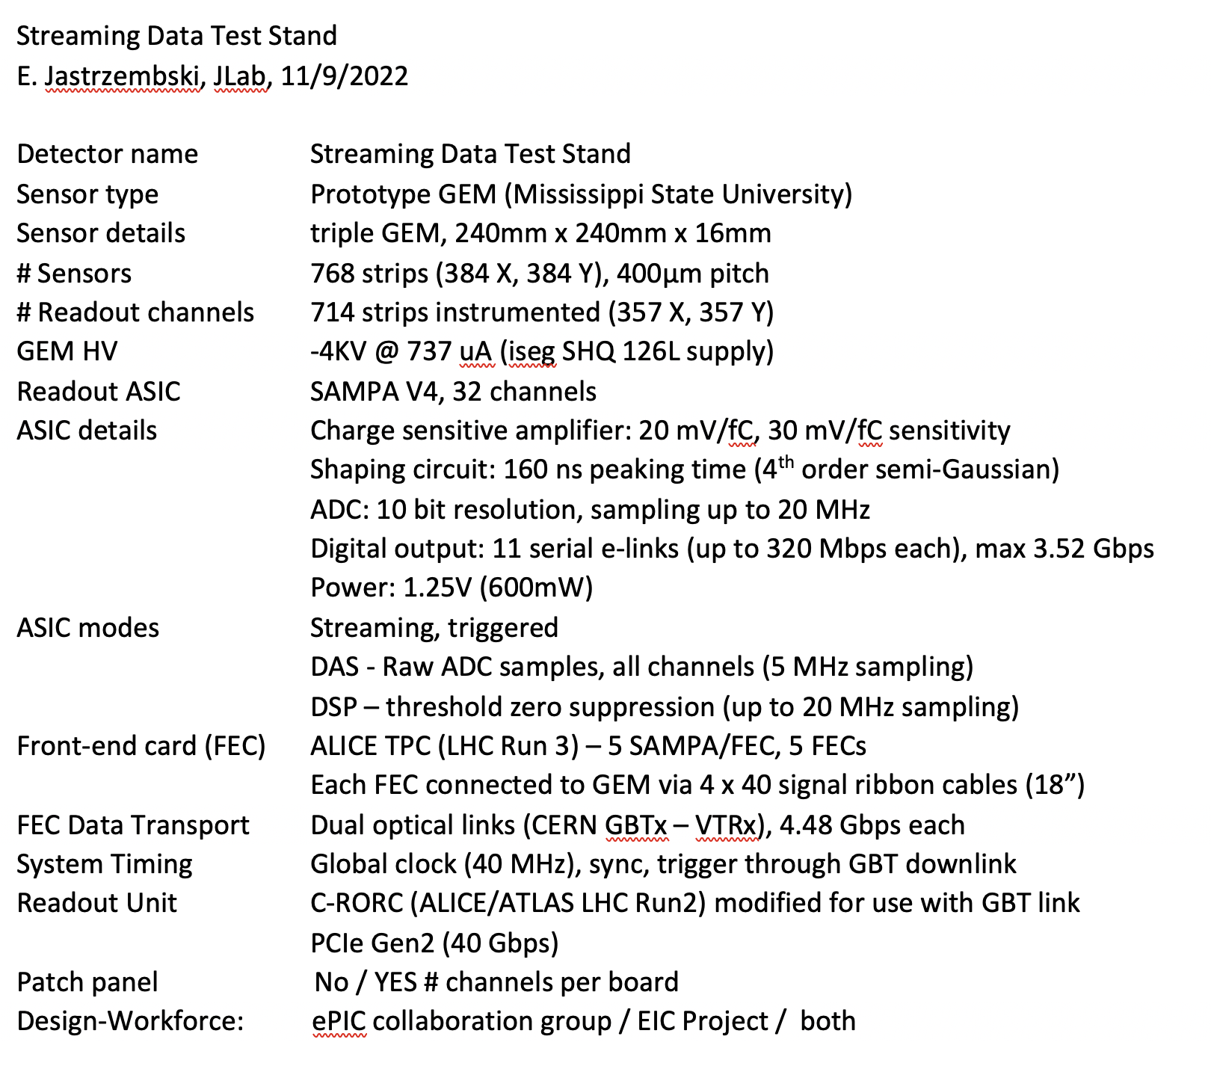
ePIC: Subdetector Readout Chains
Read-out chain questionnaire for all subdetectors following this example to be filled by experts in the service excel-sheet
→ one document
https://wiki.bnl.gov/EPIC/index.php?title=Project_Information#Documents%3A
FEB
RDO
Sensor
detector specific
FEB:
detector specific
RDO:
hopefully one board
common to many
subdetectors

Slide 17
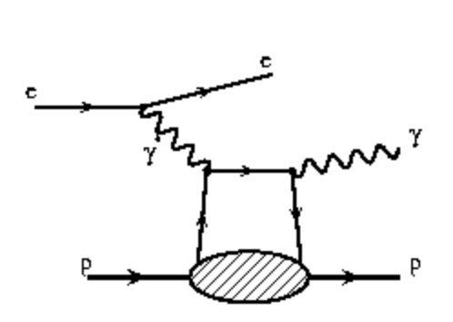
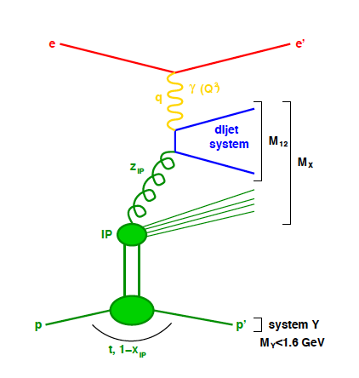





Far-forward physics at EIC
e+p DVCS events with proton tagging.
e+d incoherent J/Psi events with proton or neutron tagging
Diffraction
Rapidity
gap
Saturation (coherent/incoherent
J/$ψ$production)
Meson structure:
with neutron tagging (ep$→\left(π\right)→$e’ n X)
Lambda decays ($Λ→$p$π−$ and $Λ→nπ0$)
e+He3 with spectator proton tagging.
Tagging of coherent light ions (d, He3, He4) from coherent scattering.
e+Au events with neutron tagging to veto breakup and photon acceptance.
….

Slide 18


Interaction Region Layout
Forward Side
SC Magnet Cryostat
ESR Forward side
Central Detector
Rear Side
SC Magnet Cryostat
HSR Injection Line
HSR Forward Side
HSR Rear Side
ESR Rear side
RCS
With Detector Bypass

Slide 19


IR-Integration and Interfaces
Space Constrains:
-4.5 m – IP – +5m not negotiable
50 cm space to 1st IR-magnet occupied by vacuum pumps, valves, …..
IP moved 81 cm towards ring inside compared to RHIC; y: 432 cm above floor
limited installation possible in Collider Hall
  endcap hadron calorimeters need to be split transverse to beam pipe
  RCS vacuum needs to be broken
Electrons
Hadrons
RCS
9.5 long detector does not fit through the door
  Door-Size: 823 cm x 823 cm
  endcap hadron calorimeters need to stay in collider hall, if detector rolls in assembly hall
RCS to IP: radial distance 335.2 cm at a height of 372 cm from floor
  Maximum outer radius ~ 3.2 m

Slide 20






Far-Forward Ancillary Detector Integration
Roman Pots
Off-momentum
detectors
IP magnets & ancillary detectors fully simulated in GEANT including all beam effects
Technologies defined
Silicon: AC-LGAD & MAPS
ZDC:
  ECAL (PbWO4)
  HCAL (PbSi + PbScint)
Detector | Angular accept. [mrad] | p_{T} coverage
ZDC @ ~30m | $θ$<5.5 ( $η>6)$ | p_{T}<1.3 GeV
Roman Pots | 0*<$θ$<5.0 ( $η>6)$ | *Low p_{T}(t) cutoff (beam optics)
Off-Momentum Detectors | 0.< $θ$ < 5.0 ( $η>6)$ | Low-rigidity particles from nuclear breakups
B0 forward spectrometer | $$5.5<θ<20.0$$ (4.6< $η<5.9)$ | High p_{T}(t)
ECAL
PbW0₄
PbSi PbSc

Slide 21



Far-Backward Detectors
Luminosity Detector and Low Q² Tagger
Concept:
Use Bremsstrahlung ep → epγ as reference cross section
Goals for Luminosity Measurement:
Integrated luminosity with precision δL/L< 1%
Measurement of relative luminosity:
physics-asymmetry/10 → ~10⁻⁴ – 10⁻⁵
IP magnets, Lumi & low-Q² detectors fully simulated in GEANT including all beam effects
pair spectrometer
low rate
High precision measurement for physics analysis
The calorimeters are outside of the primary synchrotron radiation fan
needs a lot of attention to design
because of the large SR load
zero degree photon calorimeter
high rate
Fast feedback for machine tuning
measured energy proportional to # photons
subject to synchrotron radiation
Taggers:
Electromagnetic Calorimeters
recently looking into a solution
with Si-detectors inside the vacuum
ala the off-momentum detectors

Slide 22




Ancillary Detector Integration
Everything is super tight – good communication with accelerator team is critical
Off-momentum + RPs + ZDC
Far-Backward:
low-Q²-tagger + Lumi
local pC-polarimeter

Slide 23


Electron and Hadron Polarimetry
Electron Polarimeter:
Method: Compton Backscattering
longitudinal polarization → Energy Asymmetry
transverse polarization → Energy dependent position asymmetry
Requirement:
Need to measure both polarization components
beam is only at IP fully longitudinal polarized
Beamline integration
Backscattered photon cone clearance through quads
Electron detector will need to be ~5 mm from electron beam
  Investigating a Si in vacuum ala off-momentum
  detectors can be used?
In close contact with Accelerator group for SR simulations
and beam backgrounds
Hadron Polarimeter:
Method: RHIC H-Jet and pC Polarimeters
measure polarization through left-right asymmetries in CNI region
Requirement:
Need to measure
absolute polarization → H-jet (slow)
need to measure polarization lifetime, profile and fast feedback to collider
Beamline integration
new location at IP-4
H-Jet and pC fully integrated in lattice, including taggers for He-3 polarimetry
Challenge
make RHIC polarimeters work for the different EIC beam conditions

Slide 24
Requirements: Beam Background at IR
electron beam:
Synchrotron radiation
  Backscattering
  Photo desorption
  → degradation of vacuum
Beam gas interactions
  Off momentum electrons
Higher order mode losses
  Local heating at injection and ramp (short bunches)
  degradation of vacuum
background due to de-excitation of beam if bunches are replaced
proton beam:
Low beam lifetime during
injection and ramping
Beam gas interactions, large
hadronic cross section
  Secondary interactions with
  aperture limitations, i.e. with
  magnets, beam pipe, masks
Requirement:
Keep beam backgrounds as low as possible
→ Careful design of interaction region, beam-pipe masks and photon beam dump
→ Excellent vacuum system
Important to note:
low multiplicity per event: < 10 tracks
No pileup from collisions 500 kHz @10³⁴ cm⁻²s⁻¹ → DIS event every 200 bunches
radiation environment much less harsh than LHC → factor 100 less

Slide 25


Background/Radiation
Primary collisions contribute a substantial fraction of the ionizing radiation and low energy neutron fluence in the experimental hall
→forward EmCal: up to ~5*10⁹ n/cm² per fb⁻¹ (inside the towers); perhaps ~5 less at the SiPM location
→ backward EmCal: ~250 rad/year
(at “nominal” luminosity ~10³³ cm⁻² s⁻¹)
Beam-gas interactions are one of the main sources of neutrons that thermalize within the detector hall and cause the damage.
The current FLUKA simulations show that the EIC detector will obtain annual dose of 6*10¹⁰ n/cm² (1 MeV equivalent)
→ Impact on SiPMs and Silicon Vertex Tracker → suggested tolerance of 10¹⁴ n/cm²

Slide 26

EIC Project Detector R&D Program & In-Kind
in-kind contributions from Italy/INFN, France/IRFU, France/IN2P3, UK/STFC, etc.
https://wiki.bnl.gov/conferences/index.php/ProjectRandDFY23
INFN-Ferrara, Glasgow
INFN-Roma1, INFN-Ferrara
GSI
IJCLab-Orsay, INFN-Genova, AANL/Armenia
Valparaiso
IJCLab-Orsay, CEA Saclay, INFN-Torino
IJCLAB/Omega/
Saclay
Birmingham, Brunel, RAL, INFN-Bari, INFN-Trieste, IMP, CCNU
Nurnberg, GSI, INFN-Bologna, Cosenza, Ferrara, Genova, Trieste
Birmingham, Brunel, RAL, INFN-Bari, INFN-Trieste, IMP, CCNU
Chinese EMCal
Consortium
CEA Saclay
Strong synergies with CERN
CERN – EIC R&D Day November 2021 https://indico.cern.ch/event/1063927/
MAPS: ALICE-3 – ITS-3 development
PID: LHC-b and ALICE-3
Photon-sensors: LAPPDs with LHC-b
MPGD: long-term CERN R&D program RD51
DAQ: strong developments on streaming DAQs for all LHC experiments
AI/ML and high-performance distributed computing

Slide 27
EIC Project Detector R&D
Photon-Sensors:
WBS 6.10.04 & 05 & 06
Assess current state of LAPPD performance. Improve design through iterations to fulfill EIC specifications
  Spatial resolution for Cherenkov imaging applications
  Timing resolution in a single photon mode
  Timing resolution for Time-of-Flight purposes
  Performance in a strong (inhomogeneous) magnetic field
  QE & PDE spectrum optimization
  Geometric form factor optimization
MAPS-Tracker:
Development of a full tracking detector solution composed of 65 nm MAPS sensors Modules from stitched sensors, barrel & discs, mechanics, integration & cooling
reduce the services material load
→ Improved powering and readout system
Development of the EIC sensor: design & characterization
MPGDs:
Development of prototypes of cylindrical MPGDs & planar thin gap MPGDs
AC-LGAD:
Develop system including sensors, ASIC & services for auxiliary detectors and ToF
Electronics & DAQ/Computing
Development of readout solutions for
calorimeters with SiPMs, ASIC based & ADC based
dRICH with SIPMs based on ALCOR
AC-LGAD readout chain with EICROC & FCFD
MPGD readout based on SALSA-ASIC
PID-Detectors:
DIRC: focus on Cosmic ray telescope (CRT), validation of BaBar bars reuse option, and completion of cost optimized hpDIRC design
mRICH: optimize photonsensors + electronics; testbeam of improved prototype
dRICH: Characterize mirror & aerogel; Assessment of dRICH prototype performance with the EIC detection plane
HCals:
Prototype SC-tile production using machining & injection molding & detailed characterization
Sensor board development
first prototype of one full segment
ECals:
bECAL: Full characterization of full SciGlass block designed for EIC by beam test
fECAL: construct 64 channel prototype to optimize light uniformity, light guides, verify performance by test beam
Hadron Polarimetry:
R&D through Accelerator
validate concepts to veto breakup of He-3
new targets for pC-polarimeters

Slide 28

Let’s get to work
and built the EIC
Please join us
Engineers, Designers, Technicians, Administrators, Experimentalists, Theorists, Accelerator Physicists, ……
Jobs:
BNL: https://jobs.bnl.gov/search-jobs/eic?orgIds=3437&kt=1
JLab: https://www.jlab.org/recruiting
Science: https://www.bnl.gov/eic/

Slide 29


Slide 30


Slide 31
Progress Since CD-1
BNL and TJNAF Jointly Leading Efforts Towards Experimental Program | BNL and TJNAF Jointly Leading Process to Select Project Detector
2021 | EIC Yellow Report (https://arxiv.org/abs/2103.05419) | February 2021
 | Call for Collaboration Proposals for Detectors https://www.bnl.gov/eic/CFC.php | March 2021
 | Collaboration Proposals for Detectors Submitted | December 2021
2022 | Decision on Project Detector – “ECCE” | March 2022
 | Process to consolidate ECCE & ATHENA to the EIC Project Detector ePIC | Spring 2022
 | EPIC Collaboration* Formed – 160 institutions | July 2022
2023 | All subdetector technologies defined | April/2023
EIC Project detector fully defined by 04/2023

Slide 32
Organization / WBS
Charge Question #2 & #3
6.10.04 Particle
Identification
Level-3
Rolf & Elke
Level-2
6.10.04.01 Backward RICH
Level-4
6.10.04.02 Barrel DIRC
Level-4
6.10.04.03 Forward RICH
Level-4
6.10.04.04 Time-of-Flight
Level-4
6.10.04.01.01 DIRC-Photon-sensors
Level-5
6.10.04.01.02 DIRC-Quartz-bars
Level-5
Integrating Collaborators:
Fold in users/collaborators as
L3/L4 technical point of contacts
Work Package owners
Example for EM Calorimetry:
(L4) backward EMCal
  (L5) will e.g. be Crystals, Sensors, Mechanics.
(L4) Barrel EmCal
(L4) forward EMCal
WBS levels will go down to levels it is meaningful to accumulate cost and schedule variance. Each WBS level can have many Work Packages below.

Slide 33
Integration of ePIC Collaboration and Project Example II: Si Detectors
6.10.03 Tracking
Level-3
Rolf & Elke
Level-2
6.10.03.01 Silicon Vertex Tracker
Level-4
6.10.03.02 MPGD Tracking
Level-4
Integrating Collaborators:
6.10.03 L3-Manager: Brian Eng
6.10.03.01 L4-Manager: Brian Eng
L4 Technical Point-Of-Contact: Si consortium, one of the consortium leadership
    Laura Gonella (U Birmingham)
    Ernst Sichtermann (LBNL)
    Giacomo Contin (INFN Trieste)
Work Package Owners: TBD
Timeline:
Silicon is not a long-lead procurement so a draft in-kind agreement should be in place at the CD-2 review.
We will need a control account manager (CAM) at each WBS level. WBS levels go down to where it is meaningful to accumulate cost and schedule variance. There can be many Work Packages below.

Slide 34




The EIC General Purpose Detector
Charge Question #4
Vertex detector → Identify primary and secondary vertices,
  Low material budget: 0.05% X/X₀ per layer;
  High spatial resolution: 10 μm pitch CMOS Monolithic Active Pixel Sensor
Central tracker → Measure charged track momenta
  MAPS – tracking layers in combination with micro pattern gas detectors
  MPGD: μ-RWell or MicroMegas
electron and hadron endcap tracker → Measure charged track momenta
  MAPS – disks in combination with micro pattern gas detectors
Particle Identification → pion, kaon, proton separation on track level
  RICH detectors (modular and dual radiator RICH, DIRC) & Time-of-Flight
  high resolution timing detectors (LAPPS, LGAD) 10 – 30 ps
  novel photon sensors: MCP-PMT / LAPPD
Electromagnetic calorimeter → Measure photons (E, angle), identify electrons
  PbWO₄ Crystals (backward), W/SciFi Spacal (forward)
  Barrel: Pb/SciFi+imaging part or new Scintillating glass
Hadron calorimeter → Measure charged hadrons, neutrons and K_{L}⁰
  challenge achieve ~50%/√E + 10% for low E hadrons (<E> ~ 20 GeV)
  Fe/Sc sandwich with longitudinal segmentation
  integrate flux return
Solenoid: Based on a 2T magnet with the same geometry as the BaBAR magnet
DAQ & Readout Electronics: trigger-less / streaming DAQ
  Integrate AI into DAQ → cognizant Detector
Very forward and backward detectors → scattered particles under very small angles
  Silicon tracking layers in hadron beam vacuum
  Zero – degree high resolution electromagnetic and hadronic calorimeter
  Lumi & Low Q²-tagger: High resolution ECals + Si-Tracking
Polarimetry
  Lepton: integrated transverse and longitudinal Compton polarimeter
  Hadron: absolute and relative hadron polarimetry in the CNI region
Radius/Distance from IP

Slide 35
Technical Change Control Process - Detector
Charge Question #2
Copy process as has been used for the accelerator as it works well.
will have more people with detector expertise in the TCCB for such change requests. We need to involve the detector collaboration to initiate documentation for change requests and use their technical board or equivalent to ensure the change request is consistent with the NAS science requirements, and then use the "detector TCCB" to ensure the project part.
As final step it goes to the EMT for the formal approval.
Proposed detector TCCB:
  Qiong Wu (chair)
  Person with detector experience to take notes and help Qiong
  Elke Aschenauer
  Rolf Ent
  detector lead mechanical engineer (Rahul Sharma, 6.10.10 CAM)
  detector lead electronics engineer (Fernando Barbosa, 6.10.08 CAM)
  two members of the ePIC collaboration (for example the lead of the detector/technical board, perhaps a technical coordinator if there is one)
  three accelerator L2 leads or alternate: HSR, ESR and IR to ensure overlap
  relevant L3 CAM of the WBS the change is requested for
  add subject matter experts as needed (for example Charlie Folz for infrastructure).
Always included in TCCB process: Ferdinand Willeke and Todd Satogata
Note: After the TCCB advise, the formal baseline change control is done through the EMT but in obeyance of the various thresholds in the Project Execution Plan.

Slide 36
Recent Technical Accomplishments
Charge Question #4
Defined and documented system requirements down to L4
Completed an update of WBS 6.10 subdetector costs & schedule in P6 after DPAP
Detailed milestones for reviews, LLPs
Work defining electronics needs & standards, i.e. ASICs
Work fo complete readout specifications
DAC review progress & new R&D proposals
2nd round of R&D contracts
Define Streaming readout needs and standards
Support timing and streaming DAQ test stands
test stand to calibrate ANSYS simulations with measurements to verify technical solution to bake-out beam pipe with μ-vertex in-situ
develop beam pipe support
Working on many fronts on the infrastructure layout, reuse and modification of platforms and so on
synchronize aerogel requirements and contacts with producers
working on preliminary mechanical design of mRICH, dRICH and pfRICH
Focusing on design of all far-forward & backward detectors and impedance calculations and screening of in-vacuum detectors
progress on mechanical design and integration for all ECals
Provided input for far-forward & backward simulations
progress on mechanical design and integration for all HCals
BaBAR Solenoid cannot be used B_{max}~1.1 T in ePIC detector layout
60% design finalized barring punchlist
Eased design, use Cu-stabilized conductor – working on conductor test contract
Contract with Saclay to continue final design for a 1.7 - 2 T Solenoid established
ePol: Compton polarimeter is integrated in IR; layout & technical definition are further refined
HPol: worked with accelerator to find new location at IP-4, integration finalized for p and He-3 polarimeter

