Slide 1

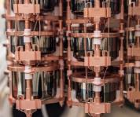
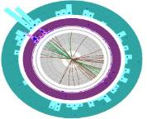
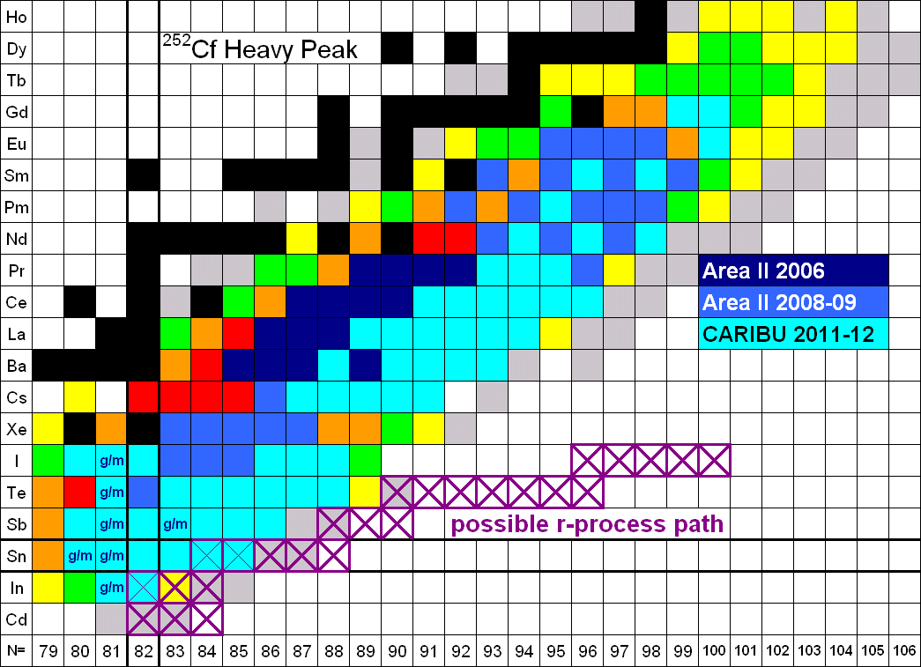
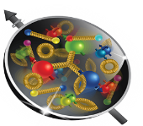
DOE Perspectives on the Electron-Ion Collider
Asia EIC Meeting
March 15, 2023
Dr. T. J. Hallman
Associate Director of the Office of Science
for Nuclear Physics

Slide 2

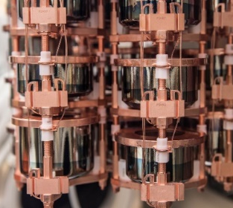
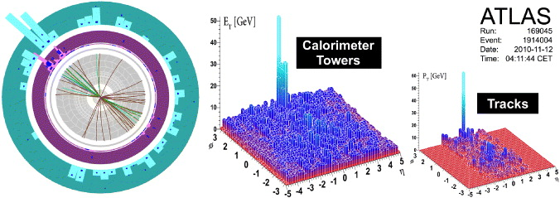
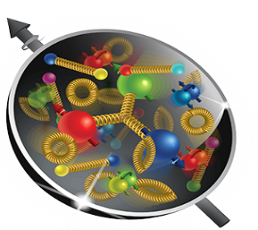
Nuclear Physics
Discovering, exploring, and understanding all forms of nuclear matter
      Understanding why matter takes on the specific forms observed in nature and how that knowledge can benefit energy, commerce, medicine, and security, by:
  Mapping the quantum cosmos inside the proton using the future Electron-Ion Collider
  Discovering the properties of the novel quark-gluon plasma RHIC, LHC
  Exploring the mechanism underlying the confinement of quarks and gluons via CEBAF and RHIC
  Searching for new exotic particles and violations of nature’s symmetries at CEBAF, FRIB, ATLAS
  Determining the limits of nuclear existence and how are heavy elements made via FRIB and ATLAS
  Discovering if the neutrino its own anti-particle or if the neutron’s precise properties point to new physics via Neutrino-less Double Beta Decay and Neutron Electric dipole Moment
  Exploring the strong force in many-body systems via SciDAC, Core Research, QIS/QC, AI/ML
  Advancing Nuclear Data for Space, Energy, and Research through Nuclear Data and AI/ML

Slide 3

The High-Level NP Work Plan
Operate and get science out from the Relativistic Heavy Ion Collider (RHIC),the Continuous Electron Beam Accelerator Facility (CEBAF), the Argonne Tandem Linac Accelerator System (ATLAS) and the Facility for Rare Isotope Beams (FRIB)
Make progress on a U.S.-led ton-scale neutrino-less double beta decay experiment.
Start construction of a high-energy high-luminosity polarized electron-ion collider (EIC)
Implement smaller scale instrumentation to take advantage of facility capabilities
The work plan centers on NP’s mission to understand all forms of nuclear matter to benefit energy, commerce, medicine, and national security. A new Long Range Plan is in development by NSAC.

Slide 4
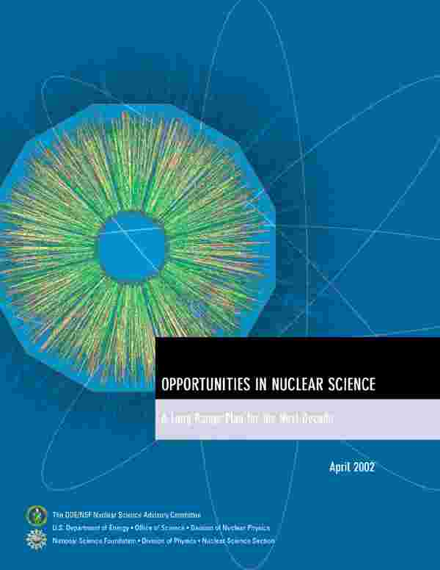
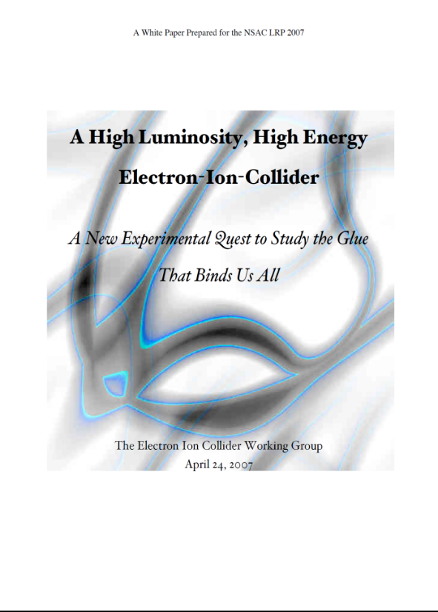


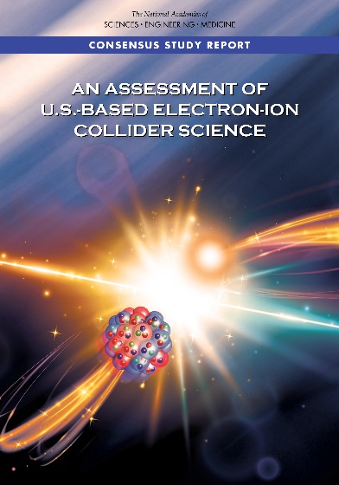
Developing the EIC Science Case
2002
A strong community emphasis on the urgent need for a machine to illuminate the dynamical basis of hadron structure in terms of the fundamental quark and gluon fields has been a persistent message for almost two decades
2007
2009
2010
Gluons and the Quark Sea at High Energies
2012
“a high-energy high-luminosity polarized EIC [is] the highest priority for new facility construction following the completion of FRIB.”
2013
Major Nuclear Physics Facilities for the Next Decade
2015
NSAC
“…essential accelerator and detector R&D [for EIC] should be given very high priority
in the short term.”
“We recommend the allocation of resources …to lay the foundation for a polarized Electron-Ion Collider…”
March 14, 2013
2018
“..a new dedicated facility will be essential for answering some of the most central questions.”
“The quantitative study of matter in this new regime [where abundant gluons dominate] requires a new experimental facility: an Electron Ion Collider.”
Electron-Ion Collider absolutely central to the nuclear science program of the next decade.

Slide 5
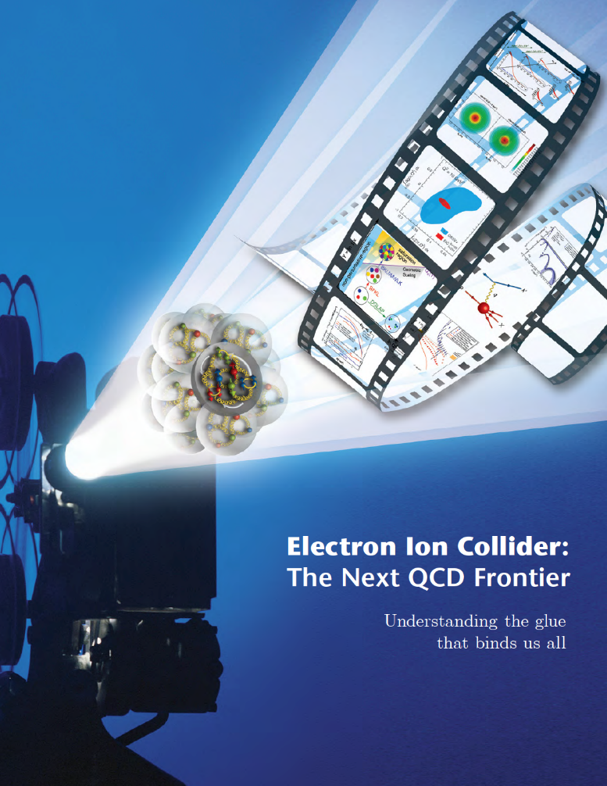
NSAC 2015 LRP Performance Parameters
NSAC Performance Parameters:
A - Polarized e, p, light nuclei
B - Ion beam from deuterons to the heaviest table nuclei
C - Center of Mass energy 20-100 GeV
D - Capable of future Center of Mass upgrade to 140 GeV
E - High collision luminosity ~10³³-10³⁴ cm⁻² S⁻¹
F - More than one Interaction Region
stable nuclei
Community and NSAC defined the parameters of machine needed to address the science.

Slide 6
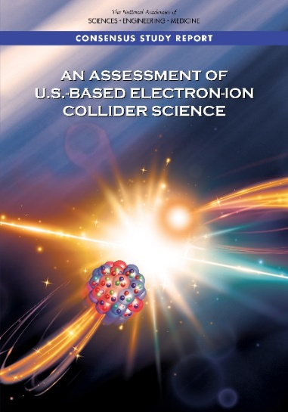
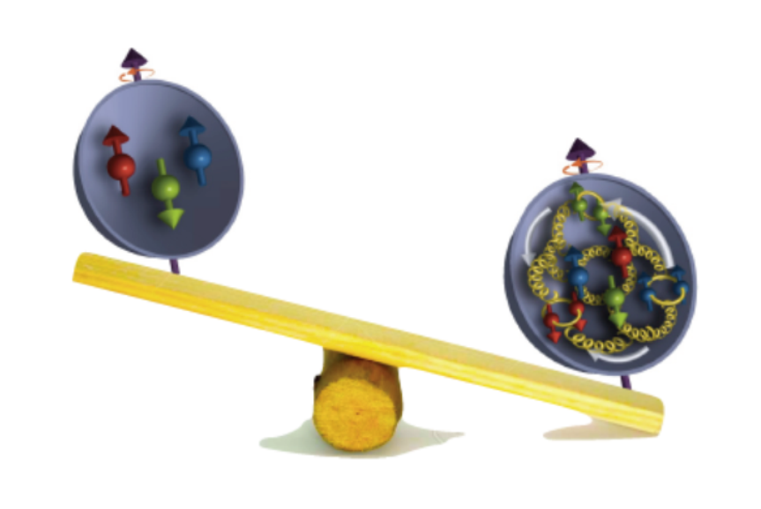
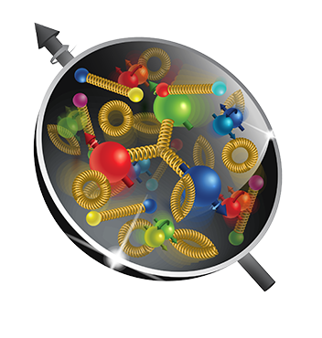
The Next Super High Power, Polarized High Energy Microscope:
The Electron-Ion Collider
U.S. National Academy of Science Report: AN ASSESSMENT OF U.S.-BASED ELECTRON-ION COLLIDER SCIENCE
“An EIC can uniquely address three profound questions
About nucleons—neutrons and protons—and how they
are assembled to form the nuclei of atoms:
• How does the mass of the nucleon arise?
• How does the spin of the nucleon arise?
• What are the emergent properties of dense systems of gluons?”
The EIC would be a unique facility & maintain leadership in nuclear science
The EIC would continue to advance innovation in the science and technology of colliders

Slide 7
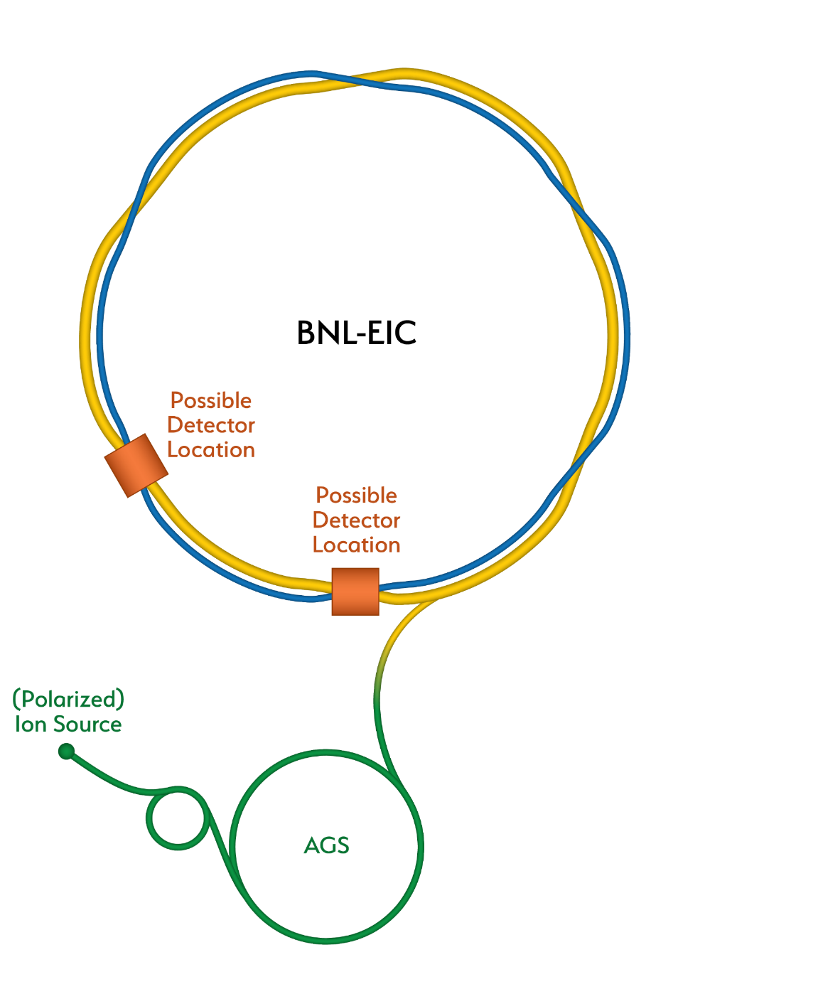
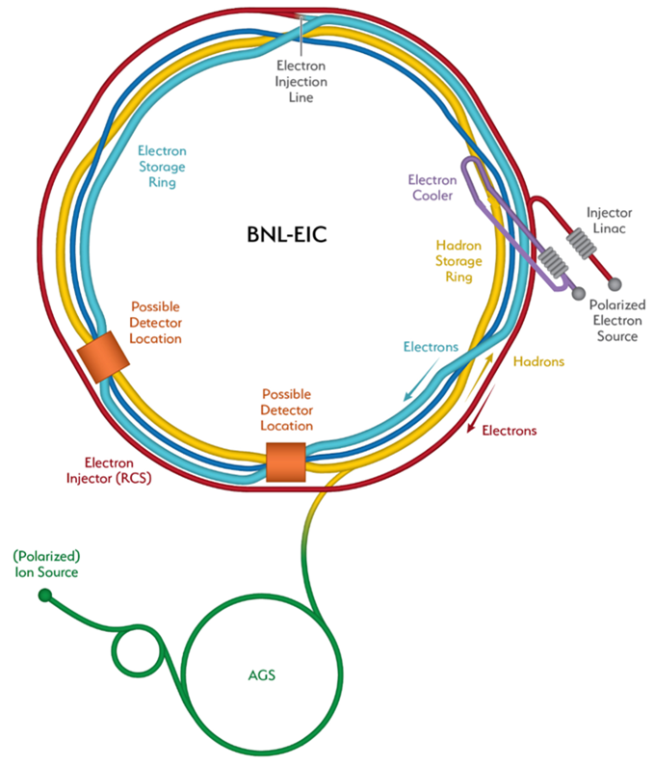
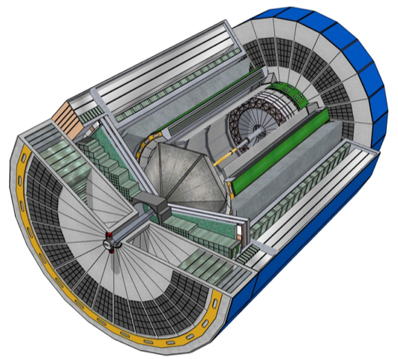
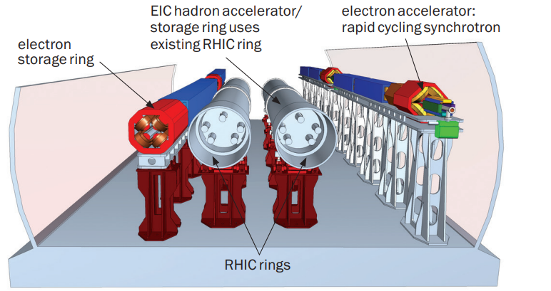
Preliminary Scope Overview
Current plan has the RHIC facility shutting down in 2025 and being modified for the EIC.
RHIC
New systems include:
Polarized electron source,
Injector linac,
Electron cooler complex,
Rapid Cycling Synchrotron(RCS)
Electron storage ring (ESR),
Interaction region (IR) with 1 detector,
Capability for implementing 2 IRs
Infrastructure improvements.
(ESR)
EIC
(HSR)
Detector

Slide 8
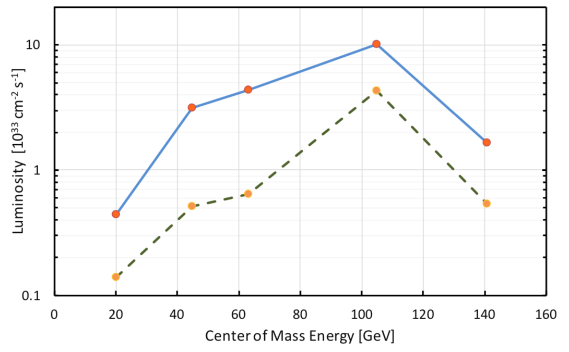
Selection of Alternatives
The range of alternatives that were considered:
Alternative #1 - Design for the Best Luminosity without Strong Hadron Cooling
Alternative #2 – Strong Hadron Cooling (SHC)
Alternative #3 - Frequent On-Energy Injection (FOEI)
Alternative #4 - Combination of SHC and FOEI
Strong Hadron Cooling:
Mix beams of cold electrons into Hadron beams
and transfer energy from “hot” hadrons to electrons.
As beam cools the luminosity increases. Higher
Collisions produce the interesting science results.
with SHC
without SHC

Slide 9
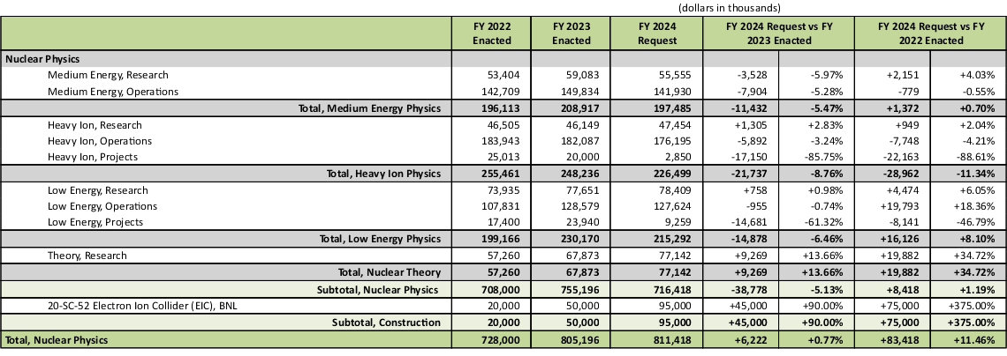
NP - FY 2024 President's Request
The TEC funding appropriated for EIC in FY 2023 is $70M. In addition, the EIC received $138M in Inflation Reduction Act Funding

Slide 10
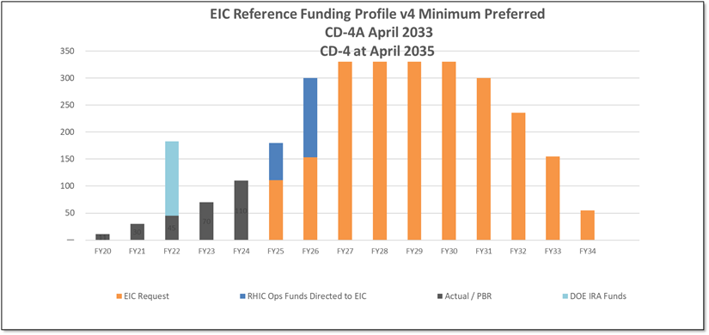
DOE FY2024 Budget TBD
President’s Budget Request for FY2024includes $95M for EIC. Evaluating different scenarios, including ”Minimum” preferred as shown in the bar chart above.
RHIC will shut down in June 2025 and significant RHIC Operations funding is redirected to EIC construction.

Slide 11
EIC History and Plans
Event | Date
CD-0, Mission Need Approved | December 2019
DOE Site Selection Announced | January 2020
BNL - TJNAF Partnership Agreement Established | May 2020
CD-1, Alternative Selection and Cost Range Approved | June 2021
CD-3A, Long Lead Procurement | January 2024
CD-2/3, Performance Baseline/Construction Start | April 2025
RHIC Shut Down | June 2025

Slide 12
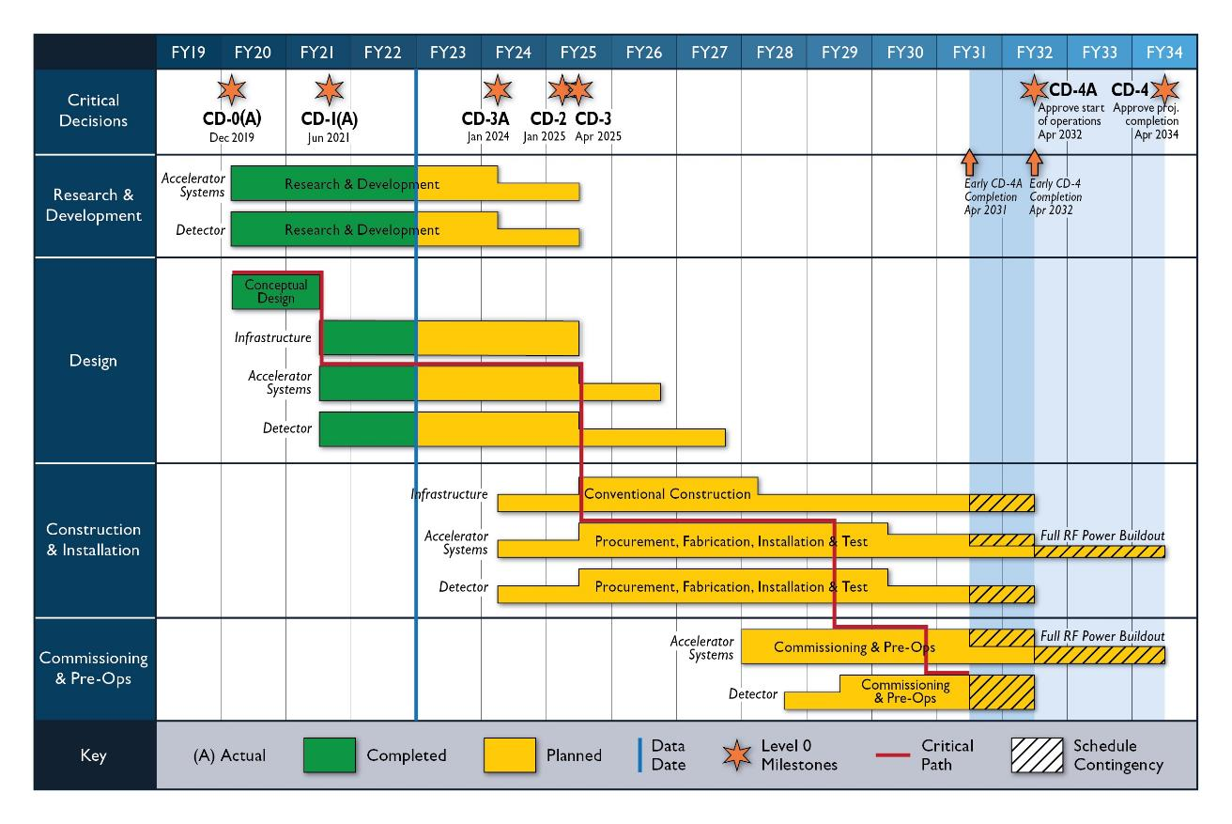
EIC Schedule
Conclusion of RHIC Operations

Slide 13
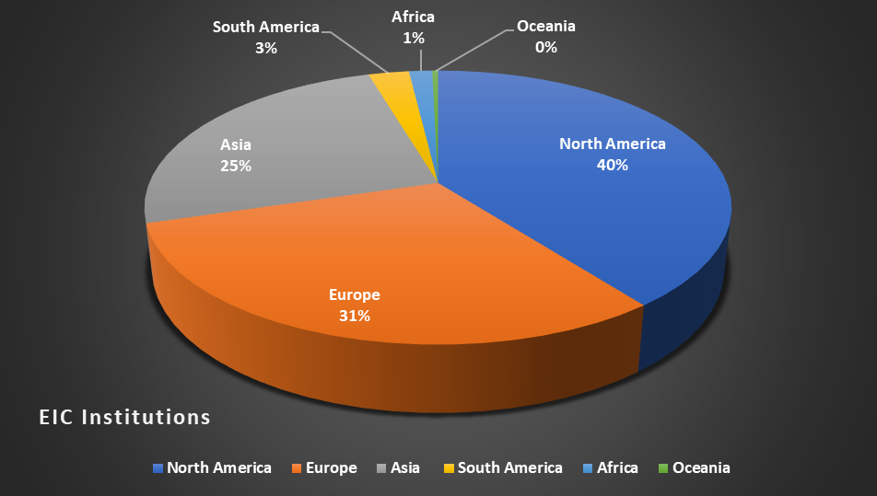
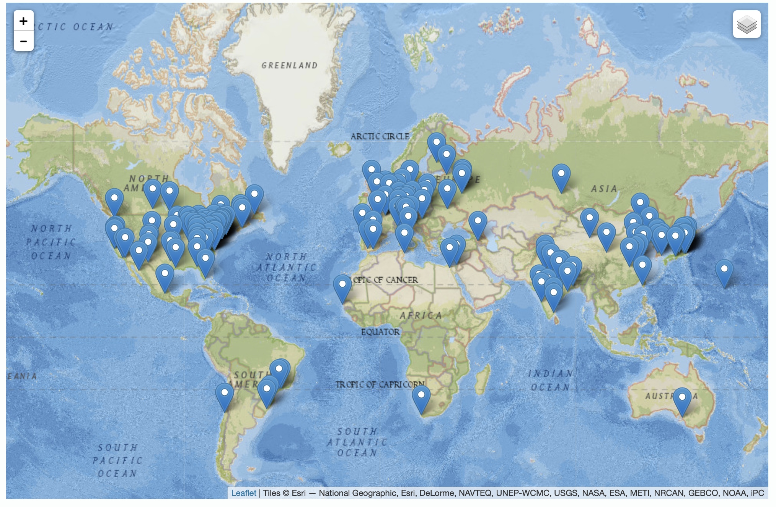
13
The EIC is International At Its Core
EIC Users Group Formed in 2016
EICUG.ORG
Status January 2023:
Collaborators 1379
Institutions 269
Countries 36

Slide 14
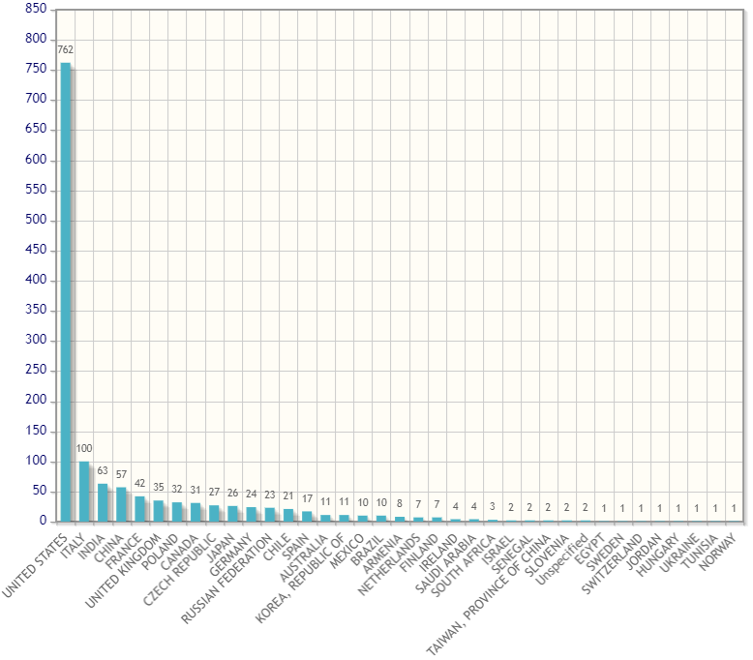
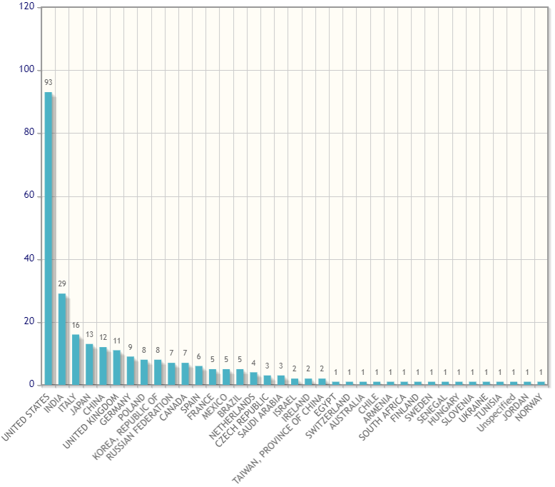
The EIC User Group
There are now >1370 EIC Highly Active Users from 269 Institutions in 36 countries
EIC Users by Country
EIC Institutions by Country
Japan
China
ROK

Slide 15
And the Governance is Being Envisioned Accordingly
The EIC Advisory Board
Name | Affiliation
Stuart Henderson, Chair | TJNAF, USA
Diego Bettoni | INFN, Italy
Paul Kearns | ANL, USA
Mike Lamont | CERN, Switzerland
Reynald Pain | IN2P3/CNRS, France
Franck Sabatié | CEA, France
Nigel Smith | TRIUMF, Canada
Mark Thomson | STFC, United Kingdom
Mike Witherell | LBNL, USA
Laboratory and National Program Leaders from Around the World

Slide 16
International Contributions to the Electron-Ion Collider
The EIC Project is also envisioning international contributions to the EIC detector of approximately $100M, and contributions to the accelerator of approximately $50M
  About half of these contributions have already been notionally identified by international collaborators
The body being established to coordinate such contributions in analogy with the way this is handled at CERN is a Resource Review Board (RRB), the first meeting of which will occur next month (April 2023)

Slide 17
First EIC Resource Review Board To Discuss International Contributions
Name | Affiliation | Country | Funding Agency/PI
Hayotsyan, Sargis | State Science Committee of Armenia | Armenia | Funding Agency
Samson, Claire | Canada Foundation for Innovation (CFI) | Canada | Funding Agency
Vyšinka ,Marek | Ministry of Education, Youth and Sports | Czech Republic | Funding Agency
Sabatie, Franck | Institut de Recherche sur les Lois Fondamentales de l’Univers (Irfu-SPhN), CEA-Saclay | France | Funding Agency
Grasso, Marcella | IN2P3/CNRS | France | Funding Agency
Lucotte, Arnaud | IN2P3/CNRS | France | Funding Agency
Bettoni, Diego | Instituto Nazionale de Fisica Nucleare (INFN) | Italy | Funding Agency
Nania, Rosario | Instituto Nazionale de Fisica Nucleare (INFN) | Italy | Funding Agency
Moon, Young Kun | Research Promotion Division at the Ministry of Science and ICT | Korea | Funding Agency
Gaczyński, Mateusz | Department of Innovation and Development, Ministry of Science and Higher Education | Poland | Funding Agency
Ka, Oumar | Cheikh Anta Diop University | Senegal | N/A
Nxomani, Clifford | National Research Foundation | South Africa | Funding Agency
Blaire, Grahme | UK Science and Technology Facilities Council (STFC) | United Kingdom | Funding Agency
Hiscock, Jenny | UK Science and Technology Facilities Council (STFC) | United Kingdom | Funding Agency
Hallman, Timothy | DOE Office of Nuclear Physics | United States | Funding Agency

Slide 18
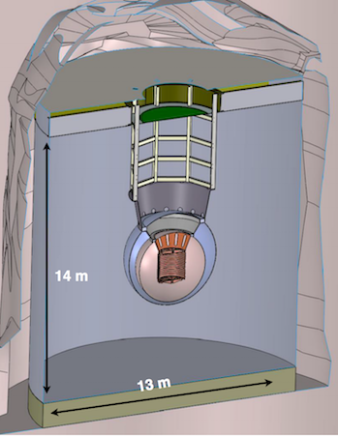
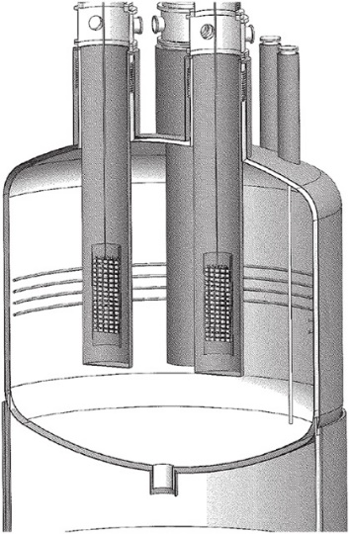
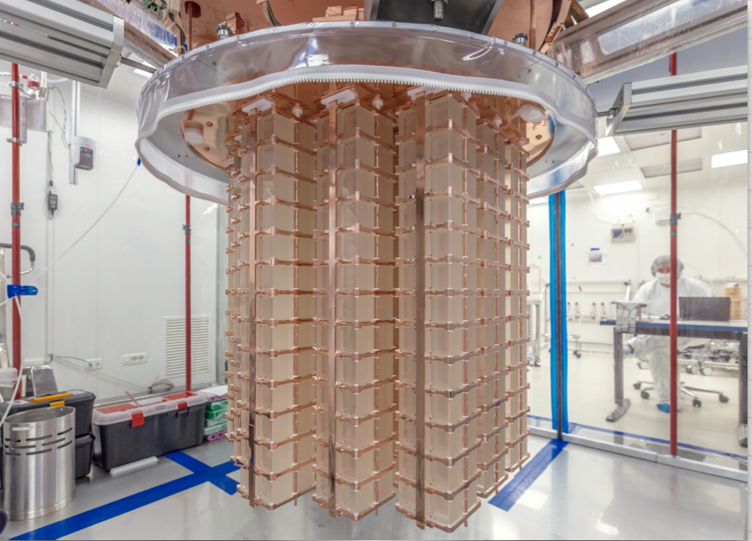
Status of The Other Priority of the 2015 Long Range Plan for Nuclear Science: Neutrinoless Double Beta Decay
Between IRA funding and NP Program Funding, approximately $12.8 M allocated to the three technologies being explored LEGEND 1000, nEXO, and CUPID since FY 2020.
Additional resources provided by international partners
Inability to procure isotopes from Russia is having a severe, existential impact
The next DBD international summit is April 27, 2023 at SNOLab in Canada.
NP is thinking about options to demonstrate a proof-of-principle isotope procurement test
Three Proposed Technologies
  Scintillating bolometry (CUPID, ¹⁰⁰Mo enriched Li₂Mo₄ crystals)
  Enriched ⁷⁶Ge crystals (LEGEND-1000, drifted charge, point contact detectors)
  Liquid Xenon TPC (nEXO, light via SiPM, drifted ionization)
TeO₂ Crystals from CUORE
Potential Partners:
Italy, Canada, and Germany

Slide 19
Snapshot of the Status of NP Projects
Project | Location | Status | Cost | CPI | SPI | CD-4 | Operation cost plan
Construction Projects
Facility for Rare Isotope Beams (FRIB) * | MSU | CD-4 | $730M | 1.00 | 1.00 | 6/2022 | Included in NP budget formulation
Electron-Ion Collider (EIC) | BNL | CD-1 | $1.7B to $2.8B |  |  | Q4 FY33 | RHIC operations funds redirected to EIC project recovered for EIC operations
Major Items of Equipment
Gamma Ray Energy Tracking Array (GRETA) ^{FF} | LBNL | CD-2/3 | $58.3M | 1.00 | 1.01 | 4/2028 | Mostly covered by host laboratory operations experimental support
Super Pioneering High Energy Nuclear Interaction Experiment (sPHENIX) * | BNL | PD-4 | $26.5M | 1.00 | 1.00 | 12/2022 | Covered by RHIC operations experimental support
Measurement of Lepton-Lepton Electroweak Reactions (MOLLER) ^{FF} | TJNAF | CD-1 | $45.8M to $56.6M |  |  | Q4 FY27 | Covered by TJNAF operations experimental support
High Rigidity Spectrometer (HRS) | MSU | CD-1 | $85.0M to $111.4M |  |  | Q2 FY29 | Covered by FRIB operations experimental support
Ton Scale Neutrinoless Double Beta Decay (TS-NLDBD) | TBD | CD-0 | $215M to $250M |  |  | TBD | TBD
Blue (*) indicates “Completed”, green (^{FF}) “Fully Funded”, and purple italic “Substantially Funded”
Smaller NP Projects are being “cleared off the books”

Slide 20
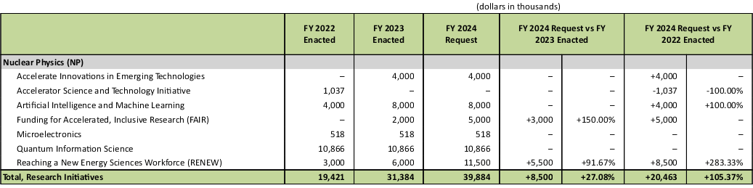
NP - Research Initiatives

Slide 21
DOE NP Outlook On The EIC
The EIC Project is making steady progress, towards CD3a (Long Lead Procurement), and the next DOE gateway CD-2 (Approve Performance Baseline).
The EIC is intended to be fully international in character. For those countries interested in collaborating, now is a good time to become involved and express your interest. All are welcome at any time, but the pace of the project will require clear understanding of “who will do what” in time to baseline the project in FY 2025.
Although not yet baselined, increased support from annual appropriations will continue to be important to enable timely progress and a smooth transition of workforce from the Relativistic Heavy Ion Collider in FY 2025.

