Slide 1
TOMOYA KAto
RIKKYO UNI

Slide 2
Radiation Hardness of micro-coaxial cable

Slide 3
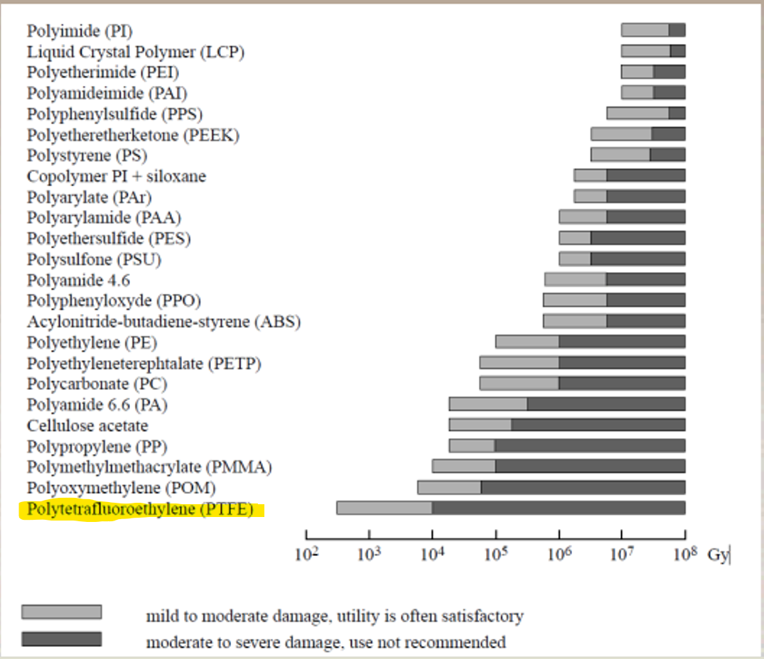
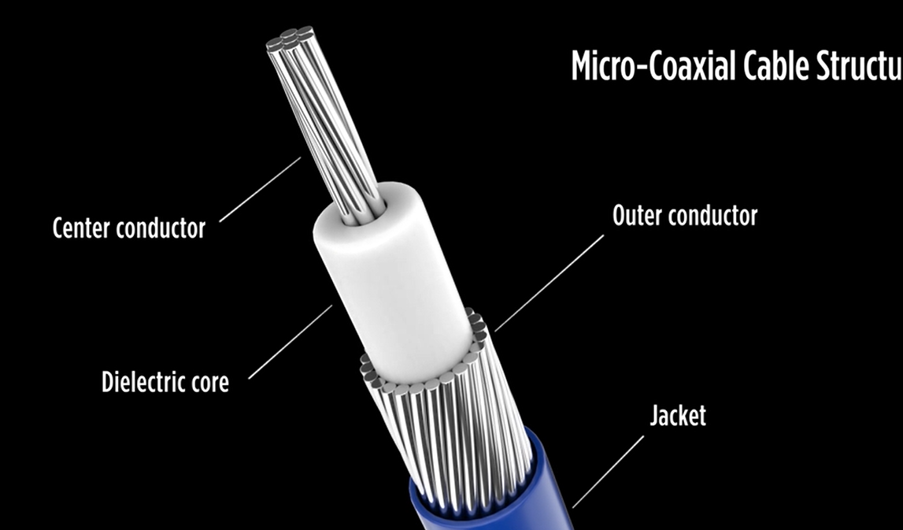
Structure of μ-Coax
直径0.24mm
https://www.osti.gov/servlets/purl/1467983
Teflon
Teflon
Weak against Radiation
テフロン
https://www.i-pex.com/ja-jp/library/video/micro-coaxial-capabilities
引用:https://www.i-pex.com/ja-jp/library/video/micro-coaxial-capabilities

Slide 4
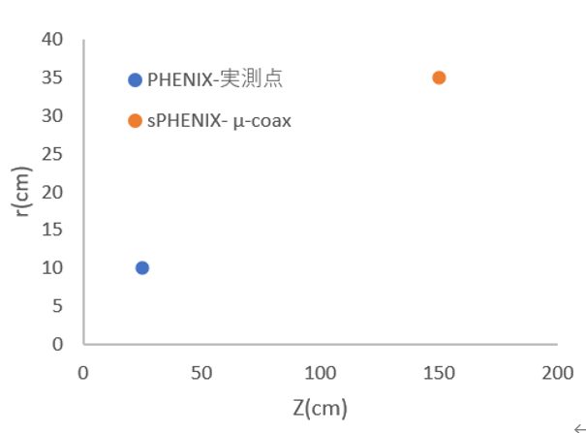
Relative Locations
How much radiation does sPHENIX expose you to in 3 years of operation?
Try to estimate radiation dose at INTT μ-coax positions by scaling from Asai’s paper.
3 years of sPHENIX operation
1.5×10¹¹
/cm²
PHENIX Asai’s paper
10¹⁰
/cm²
Run6 p+p
Collision Point
Beam Line
Radiation Damage Study for PHENIX Sillicon Stripixel Sensor ([18] J. Asai, et al., arXiv:0710.2676)

Slide 5
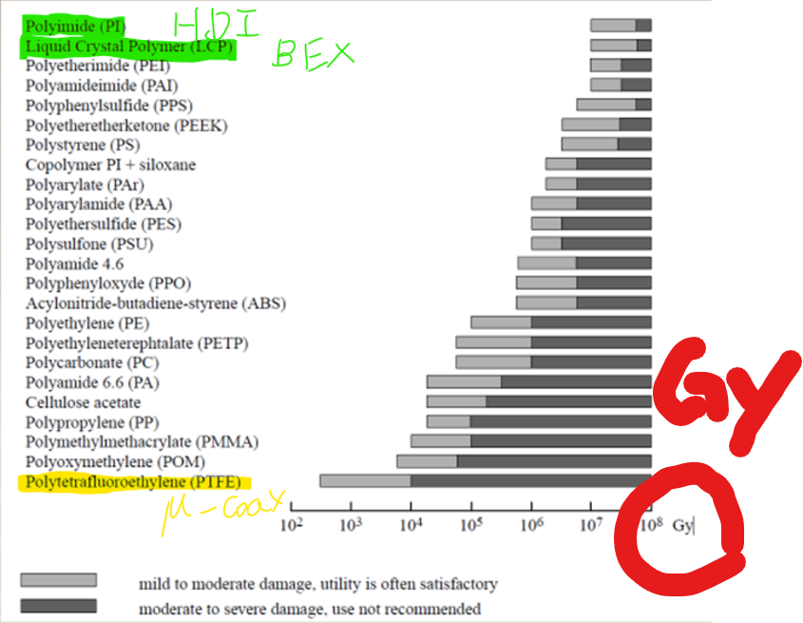
Unit conversion to compare with existing radiation hardness data
1.5×10¹¹/cm² (1 MeV Neutron Equivalent) into Gy
PFA is a derivative of PTFE

Slide 6
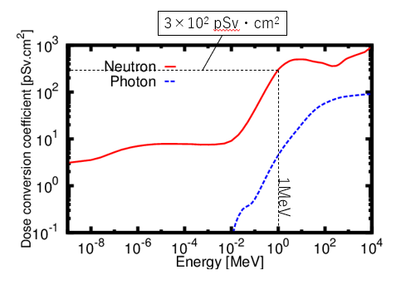
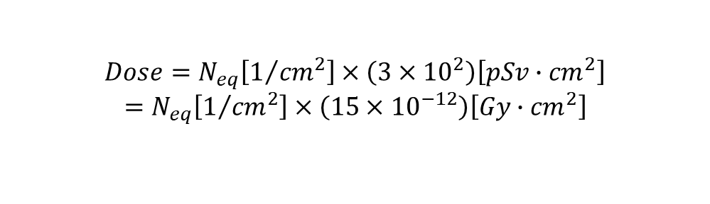
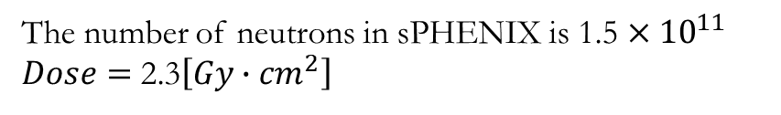
Unit conversion from Neq to Gy via Sv
Equivalent dose (Sv) = radiation weighting factor (20) × absorbed dose (Gy)
$$Dose=N_{eq}\left[1/{{cm}^{2}}\right]×\left(3×{10}^{2}\right)\left[pSv∙{cm}^{2}\right]$$
$=$ $N_{eq}\left[1/{{cm}^{2}}\right]×\left(15×{10}^{−12}\right)\left[Gy∙{cm}^{2}\right]$
The number of neutrons in sPHENIX is 1.5 $×{10}^{11}$
$Dose=$ 2.3$\left[Gy∙{cm}^{2}\right]$
https://www.icrp.org/docs/P116_Japanese.pdf
https://www.osti.gov/servlets/purl/1467983

Slide 7
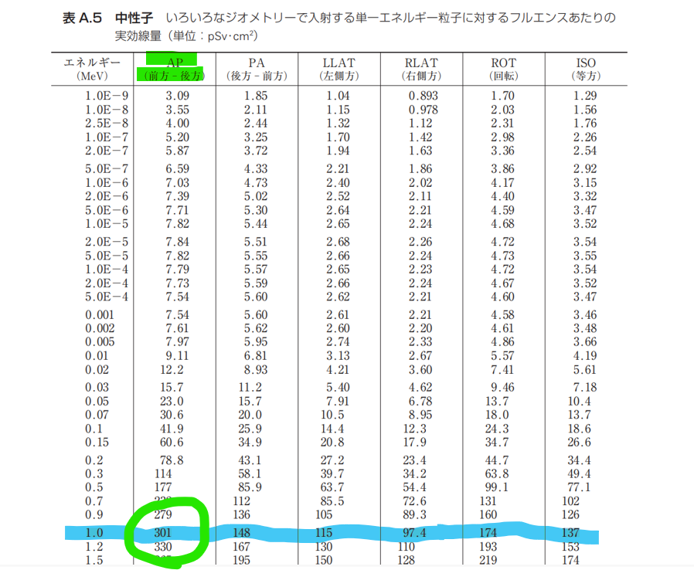
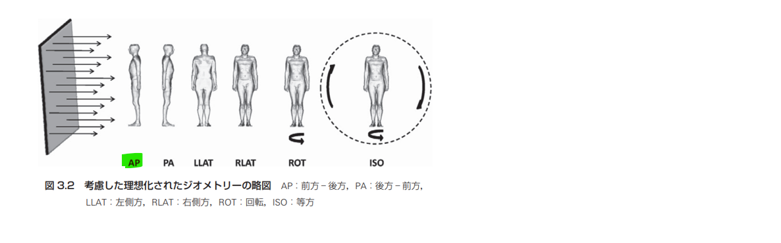
https://www.icrp.org/docs/P116_Japanese.pdf

Slide 8
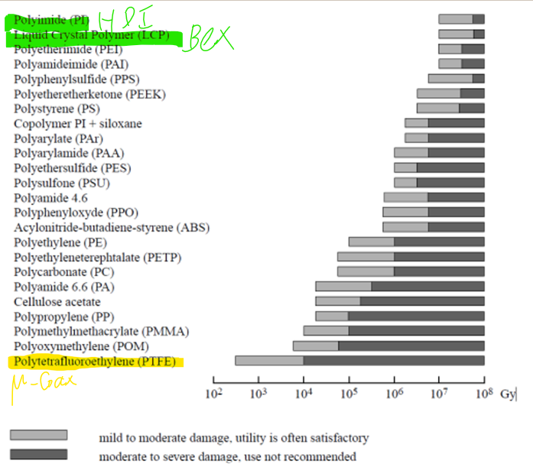
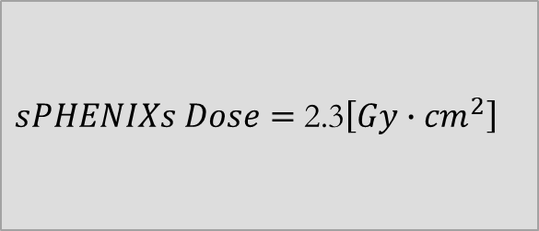
$sPHENIXs Dose=$ 2.3$\left[Gy∙{cm}^{2}\right]$

Slide 9
Does neutron irradiation change PFA?

Slide 10
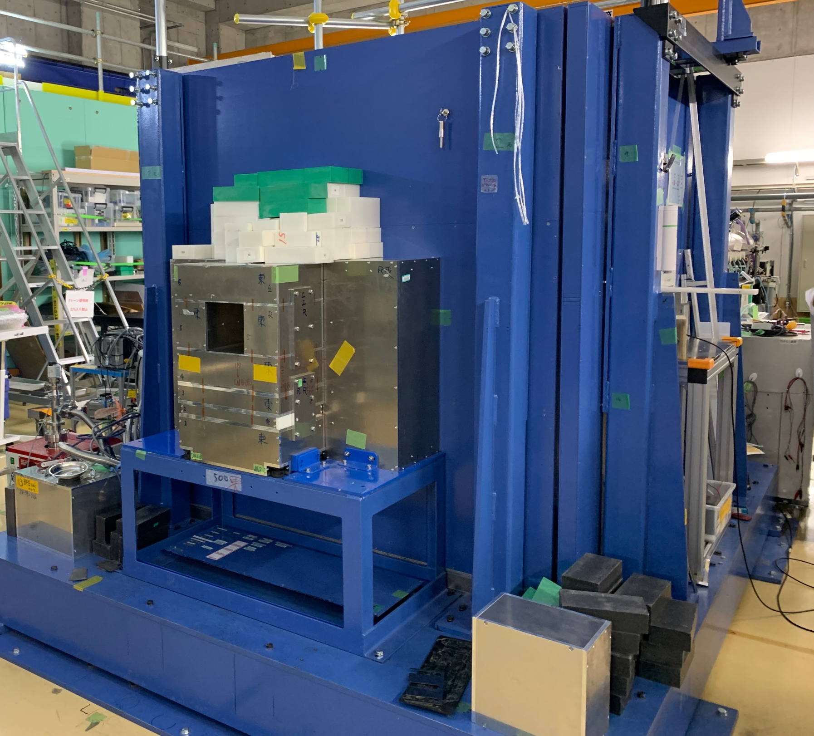
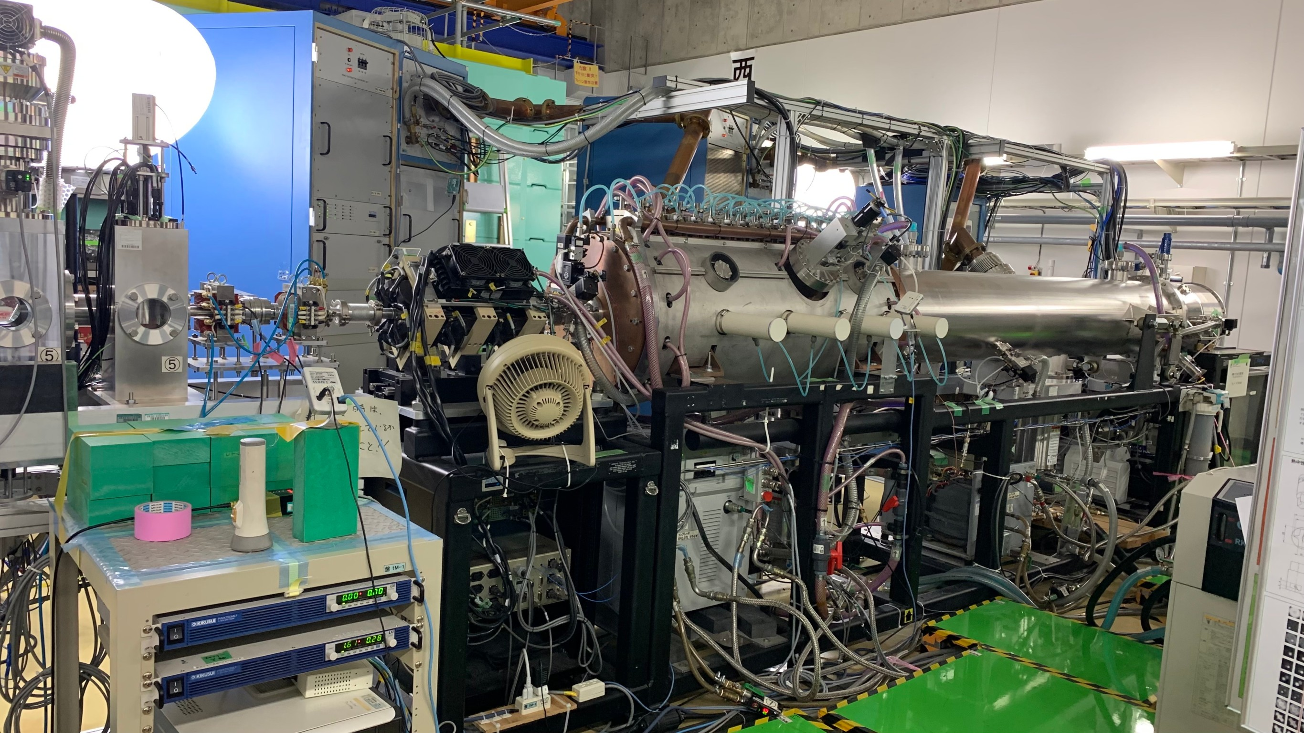
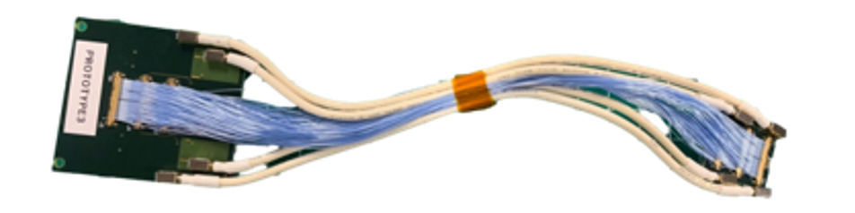
What is RANS?
RANS is Neutron irradiation system in Riken.
BerylliumBe
IonSourceH+
Proton
Neutron

Slide 11
Irradiation Attempts @ RANS
Run-I (March, 2022)
  Pilot run with prototype cable and PFA samples
  Mechanical test of PFA
Run-II (November, 2022)
  Real run with production cable
  Electrical property test

Slide 12


The number of neutrons irradiated
sPHENIX
1.5×10¹¹/cm²
2.3$\left[Gy∙{cm}^{2}\right]$
neutrons irradiated in RANS
4.9×10¹¹/cm²
7.4$\left[Gy∙{cm}^{2}\right]$
<
RUN1

Slide 13
Radiation Damage
Before
After
No obvious damage in PFA samples

Slide 14


We irradiated more neutrons than sPHENIX, but no obvious change in PFA material!
No electrical effects?
Let's measure the signal transmission performance!

Slide 15
signal transmission performances
non-irradiated μ-coax
neutron- irradiated μ-coax
Compare the signal transmission performances with/without irradiation
TDR
(Time Domain Reflectometry)
S-parameters
①transmission loss
②return loss
Eye Pattern

Slide 16
Neutron irradiation in RANS

Slide 17
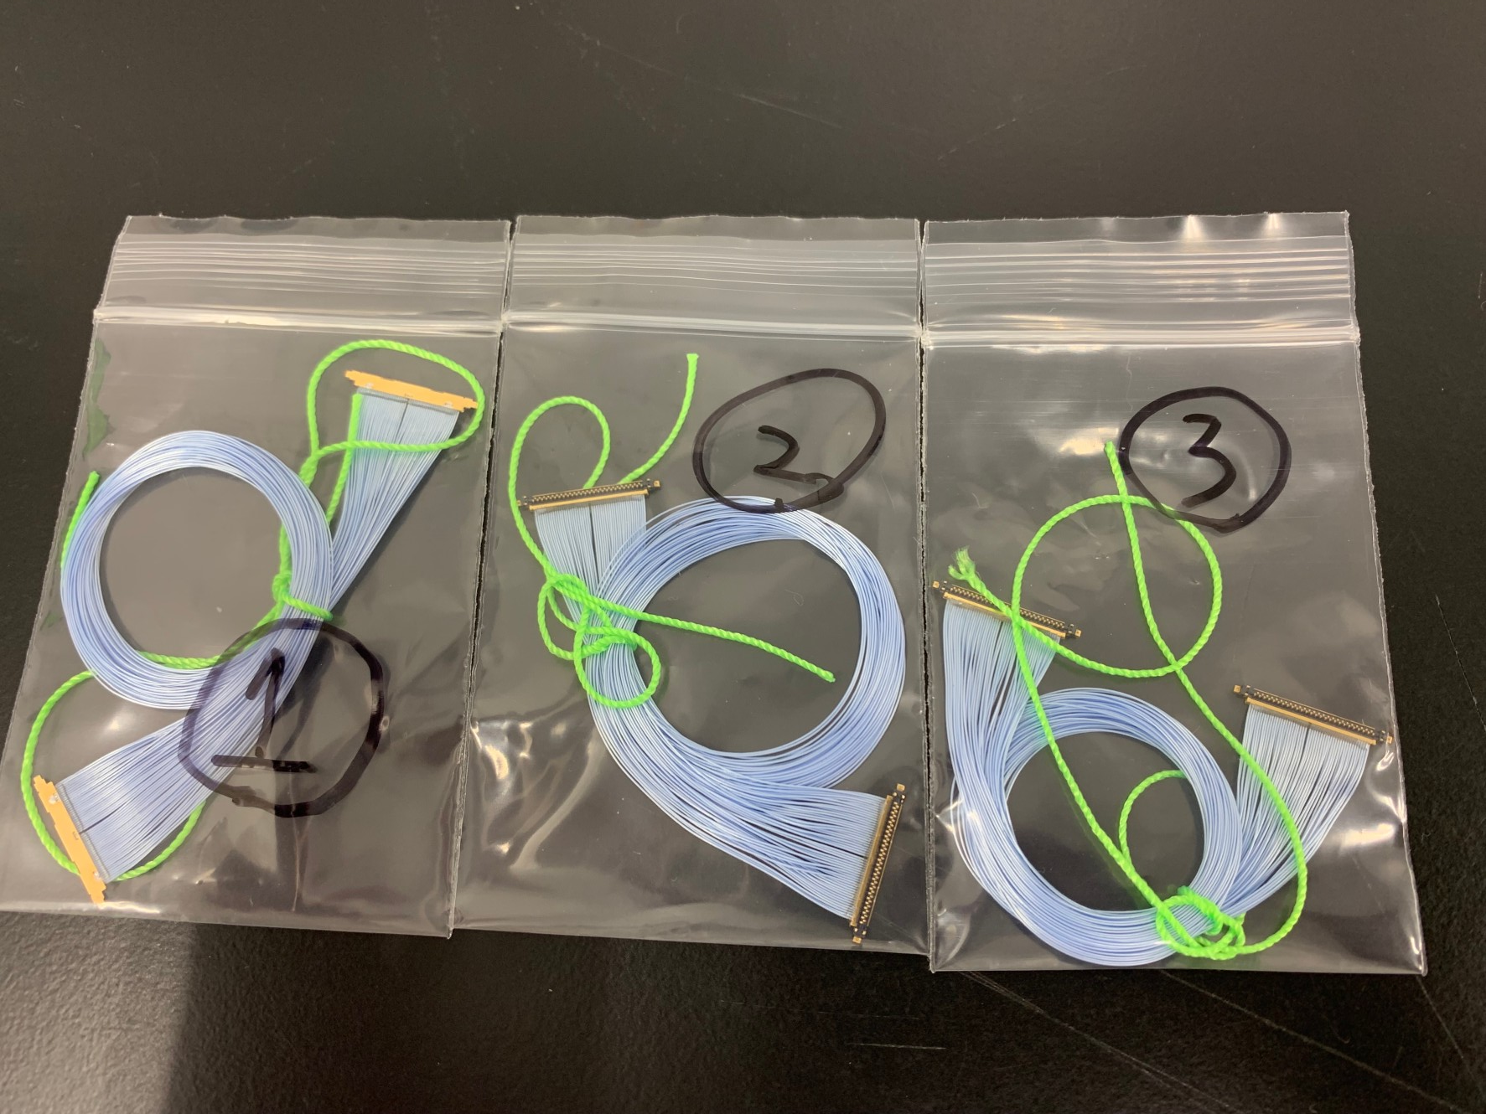
Prepare three types of micro coaxial cables For 1-hour, 2-hour, and 3-hour exposure

Slide 18
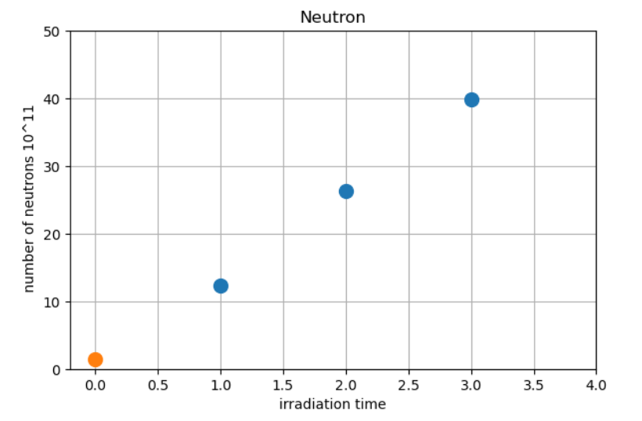
Result
irradiated the number of neutrons
> sPHENIX's the number of neutrons
78years in terms of sPHENIX
RUN2
39.9E+11
51years
26.3E+11
Amount of neutrons irradiated using RANS
24years
12.4E+11
sPHENIX 3years
the amount of radiation μ-coax will be exposed to
at sPHENIX at around the conversion cables are installed.
1.5E+11

Slide 19
transmission performance measurement results

Slide 20
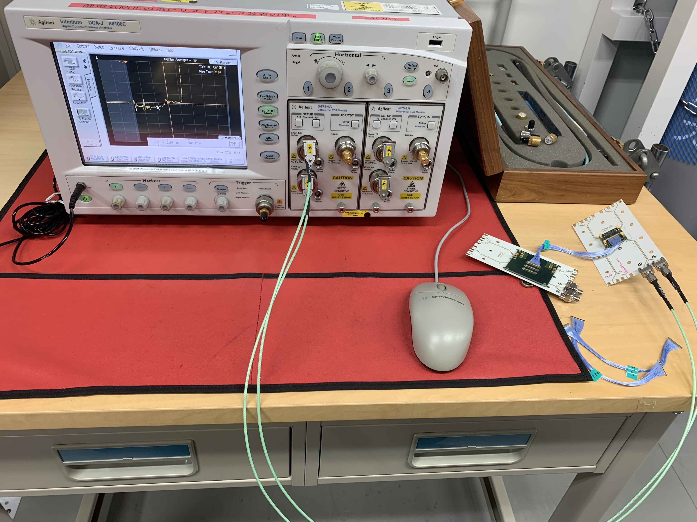
TDR (Time Domain Reflectometry)
Purpose : to measure the impedance characteristics of a transmission line
①send a short electrical pulse(800ps) down the transmission line
②Change in impedance
①800ps
③
②the reflection that is created when the pulse encounters a change in impedance
③observe the reflection

Slide 21

②Change in impedance
①800ps
③
③observe the reflection and time delay
the time delay between the transmitted and reflected signals is used to determine the distance to the impedance change.
ZL: impedance of the sample
Z0: known impedance
ｐ=reflected voltage/input voltage
$$Z_{L}=Z_{0}\frac{1+p}{1−p}$$

Slide 22
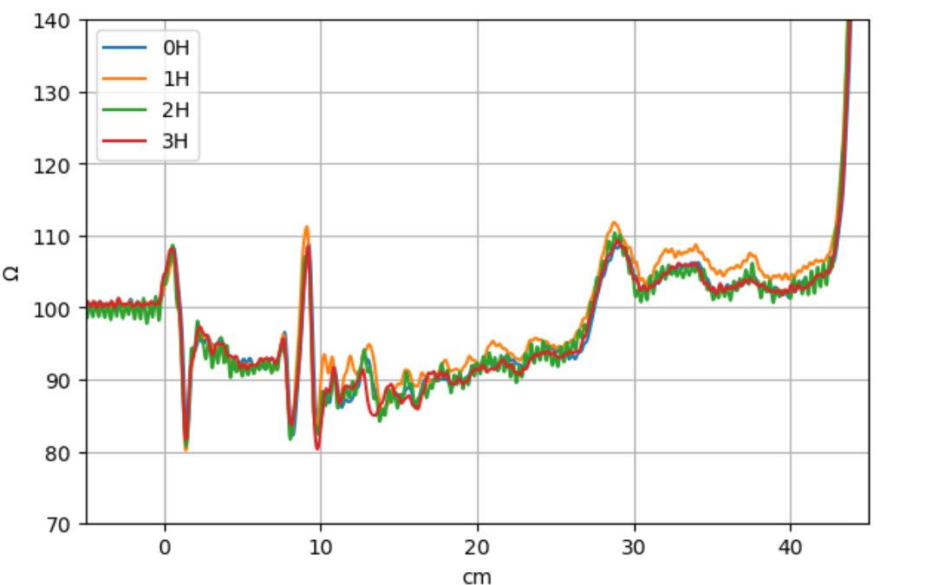
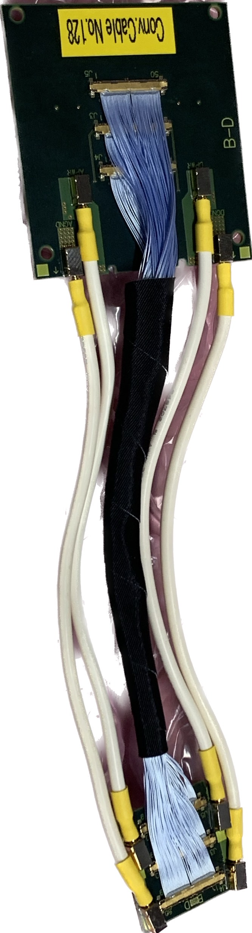
Result of TDR
Results are consistent within 5%. May be induced by individual difference of the harnesses.

Slide 23

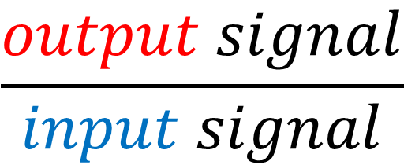

s parameter
$$\frac{output signal}{input signal}$$
s para＝
＝ transmission loss
Apply the input signal
Signal source
$$input$$
measure
$$output$$

Slide 24
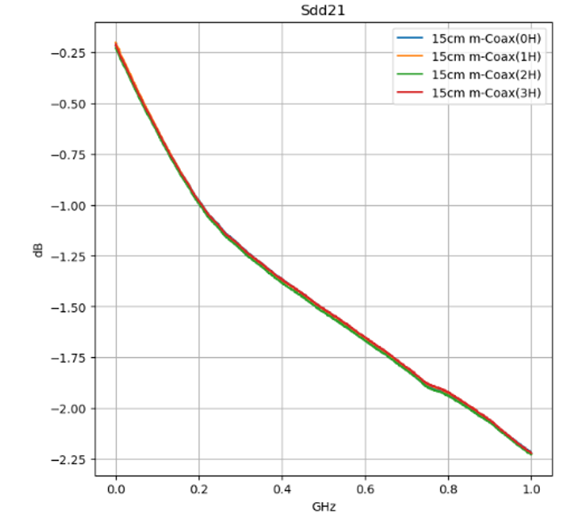
Result of transmission loss
Good
Vertical axis: dB = 20LOG10(S) / Horizontal axis: Frequency of input signal
Micro coaxial cable has S = -0.99±0.02dB at 0.2GHzThat is, signal attenuation is (89±2)% of the original
Results are consistent within 2%.
May be induced by individual difference of the harnesses.
Bad
In actual use

Slide 25
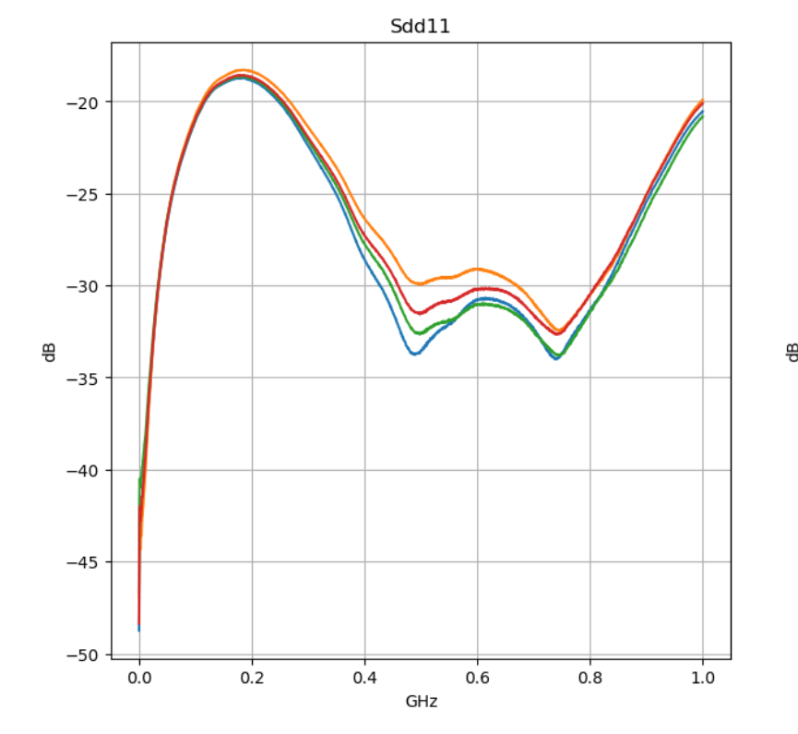
Result of Return loss
0hour
1hour
2hour
3hour
Bad
Results are consistent within 4%.
May be induced by individual difference of the harnesses.
Good

Slide 26
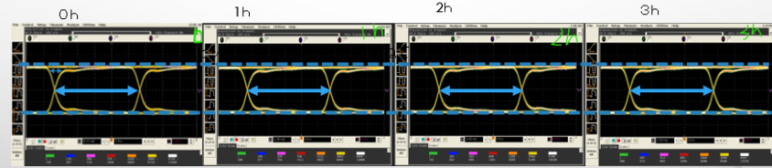
Result of Eye Pattern
Eye pattern is created by cutting various transmission signals bit by bit and overlapping them
800mV
5ns
→No abnormality (change) in waveform

Slide 27
Calibration test results

Slide 28
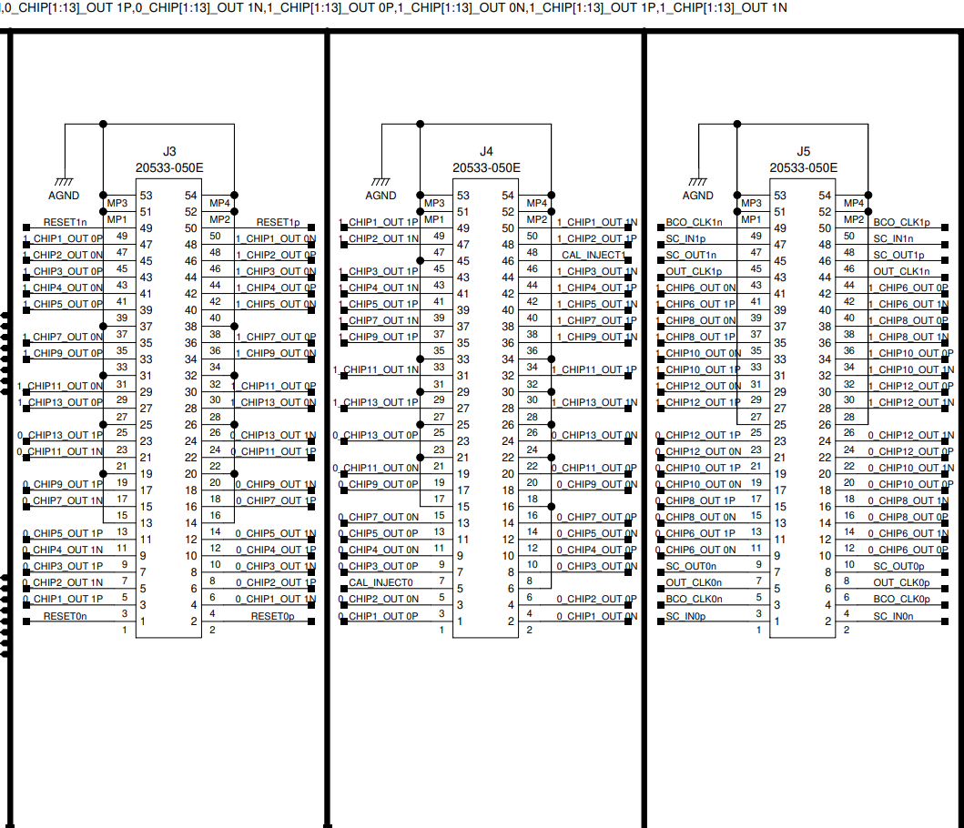
Calibration pulse test was performed using μ-coax irradiated with neutrons.
μ-coax has three harnesses (J3, J4, J5).
Features.
J3 is a RESET signal and data line
J4 is data line only
J5 is BCO, SC, CLK and data lines

Slide 29
measurement item
Four types of measurements were made
J3:0H
J4:3H neutron- irradiated
J5:0H
J3:0H
J4:0H
J5:3H neutron- irradiated
J3:3H neutron- irradiated
J4:0H non-irradiated
J5:0H non-irradiated
J3:2H neutron- irradiated
J4:1H neutron- irradiated
J5:3H neutron- irradiated

Slide 30

Result
No abnormality in all
Four types of measurements were made
J3:0H
J4:3H neutron- irradiated
J5:0H
J3:0H
J4:0H
J5:3H neutron- irradiated
J3:3H neutron- irradiated
J4:0H non-irradiated
J5:0H non-irradiated
J3:2H neutron- irradiated
J4:1H neutron- irradiated
J5:3H neutron- irradiated

Slide 31
Conclusion
PFA material No effect of irradiation
TDR ,s parameter, Eye pattern No effect of irradiation
Calibration pulse test No effect of irradiation
Based on above results, we conclude the radiation hardness of m-coax is sufficient for 3 years of operation in sPHENIX

Slide 32
SUB

Slide 33
How much radiation does sPHENIX expose you to in 3 years of operation?
Radiation levels have been measured in the PHENIX experiment (previous experiment)
PHENIX
Actual measured value
sPHENIX
μ-coax
10¹⁰
/cm²
1.5×10¹¹
/cm²
Compare experimental conditions
(1 MeV Neutron Equivalent)
参考文献:Radiation Damage Study for PHENIX Sillicon Stripixel Sensor ([18] J. Asai, et al., arXiv:0710.2676)

Slide 34
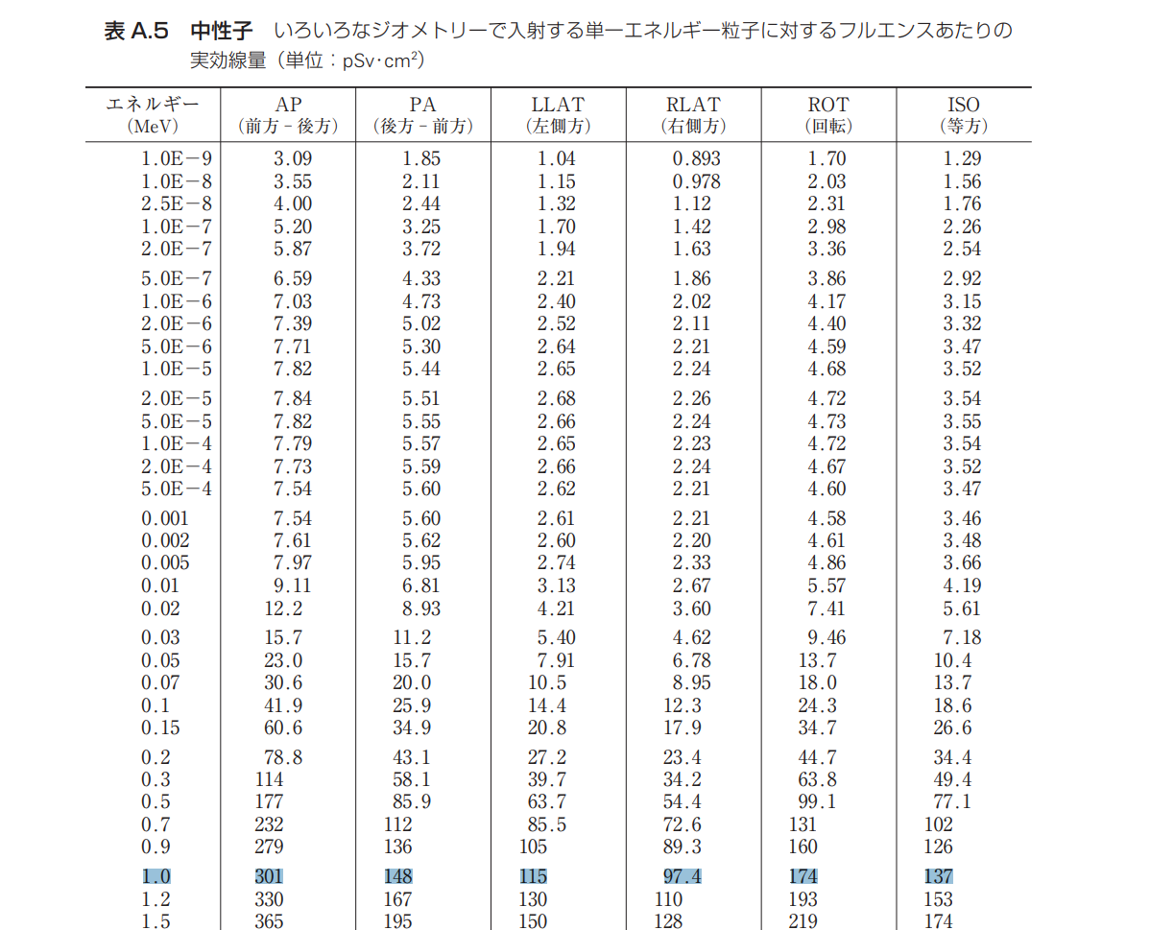
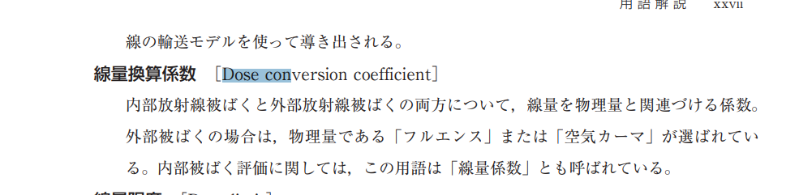
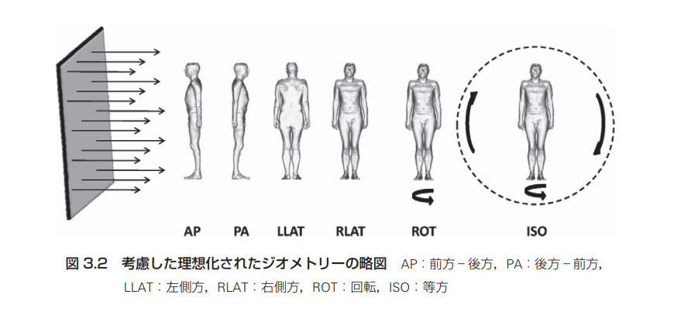
https://www.icrp.org/docs/P116_Japanese.pdf

Slide 35
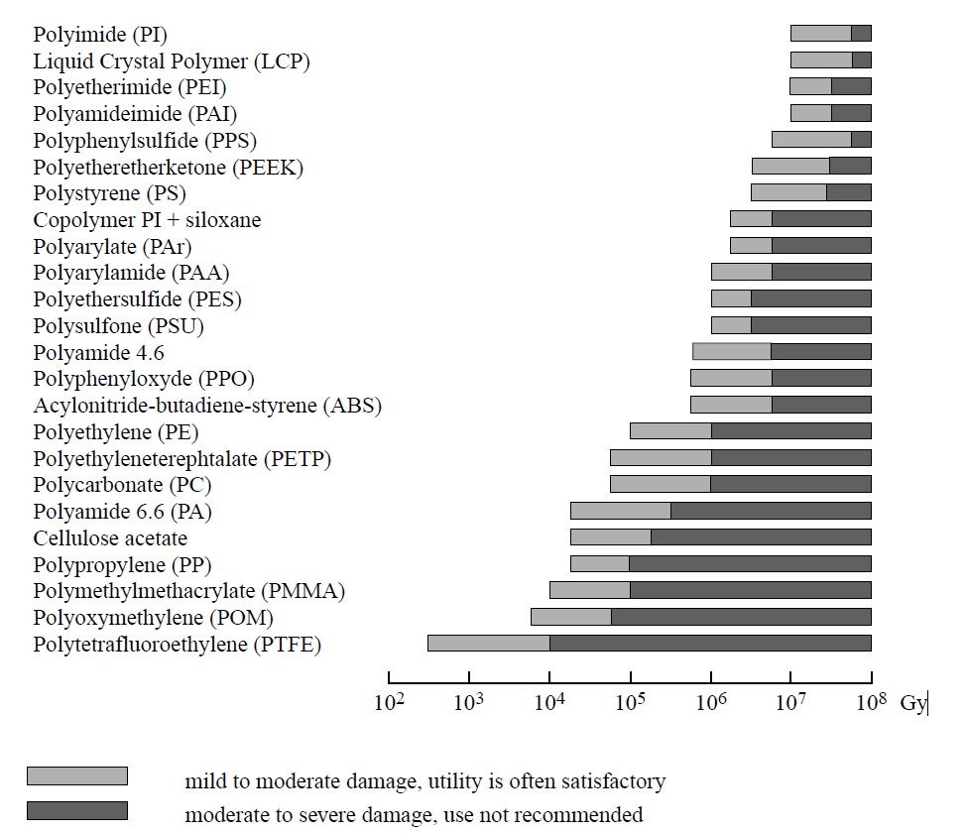
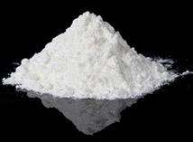
Radiation Hardness of Fluoropolymer
https://www.osti.gov/servlets/purl/1467983
Dielectric material
hard
HDI
BEX
Torn into pieces?
?
sPHENIX3年
5kGy
μ-Coax
In general, fluoropolymer is known to to be weak against the radiation

Slide 36
Method : How to examine the radiation hardness
non-irradiated μ-coax
neutron- irradiated μ-coax
Compare
・the signal transmission performances with/without irradiation

Slide 37
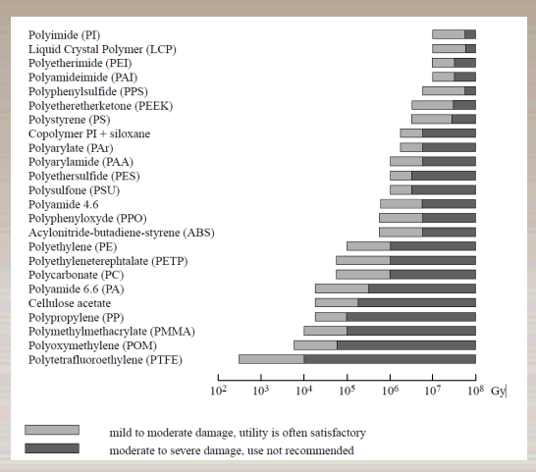
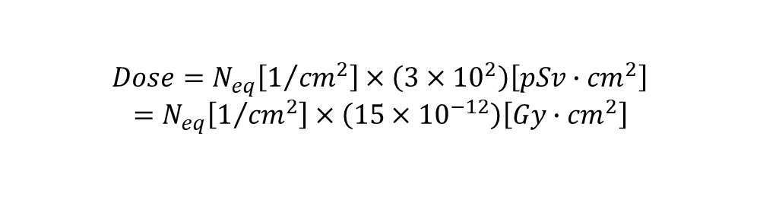
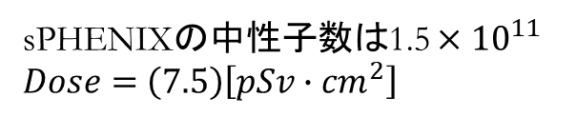
どれぐらいの放射線量ですか？
等価線量(Sv)=放射線加重係数(20)×吸収線量(Gy)
$$Dose=N_{eq}\left[1/{{cm}^{2}}\right]×\left(3×{10}^{2}\right)\left[pSv∙{cm}^{2}\right]$$
$=$ $N_{eq}\left[1/{{cm}^{2}}\right]×\left(15×{10}^{−12}\right)\left[Gy∙{cm}^{2}\right]$
sPHENIXの中性子数は1.5 $×{10}^{11}$
$Dose=$ $\left(\text{7.5}\right)\left[pSv∙{cm}^{2}\right]$
https://www.icrp.org/docs/P116_Japanese.pdf
https://www.osti.gov/servlets/purl/1467983

Slide 38
Estimate the number of neutron

Slide 39
How to examined radiation hardness of the μ-coax-cables
① Measure high speed signal transmission performance of the micro-coax cable.
②Calculate the amount of radiation μ-coax will be exposed to at sPHENIX
③ Irradiate neutrons to the micro-coax cable at RANS facility.
④ Redo the measurement of 1 and see if there is any degradation in the performance

Slide 40
The number of protons in μ-coax
 | protons | neutrons
Existing | 3.59E+17 | 5.47E+11
M-Coax 1hour | 8.39E+17 | 12.4E+11
2hours | 17.2E+17 | 26.3E+11
3hours | 26.1E+17 | 39.9E+11
ratio
ratio
Expected sPHENIX-neutrons =1.5E+11

Slide 41
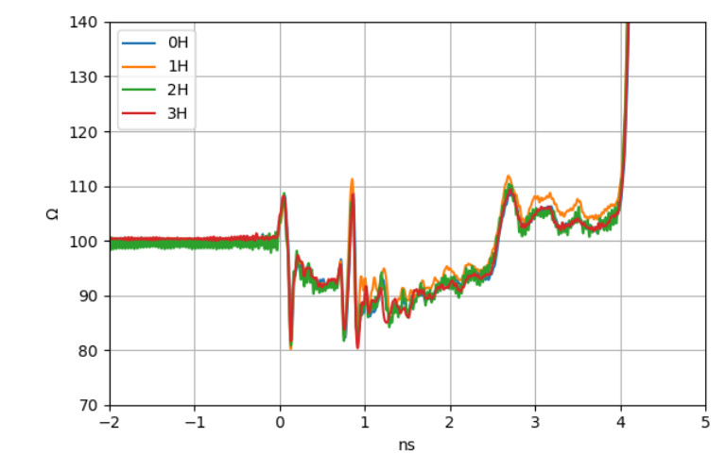

Result of TDR
time delay (ns)
Distance (cm)
$$Distance=time×3/2×{10}^{10}cm÷\sqrt{2.1}$$

Slide 42
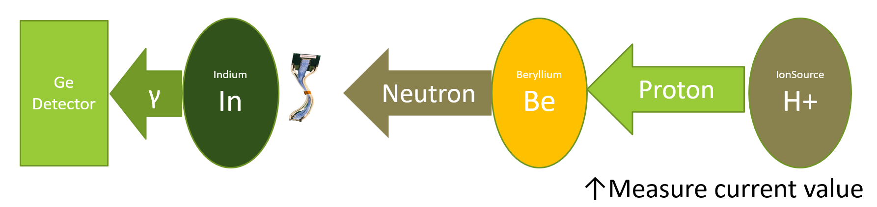
how it works
Neutron flux is not the direct observable
↑Measure γ count

Slide 43
how it works
Neutron flux is not the direct observable
estimate Neutron indirectly from the total charge of proton beam.
↑Measure γ count

Slide 44
how it works
The neutron flux can be calculated by
1.cross calibrating proton charge
2.gamma ray emission from an indium foil
Neutron flux is not the direct observable
estimate Neutron indirectly from the total charge of proton beam.
↑Measure γ count

Slide 45
 | Number of protons | Number of γ rays | number of neutrons(Neq)
Existing Measurement | Known | known | Calculate 5.4E+11
INTT | Measured |  | Goal
ratio
ratio
Number of protons is known from charge of proton beam
Number of protons = time ×(average I) /e
e =1.62E-19
Number of γ rays that measured by Ge detector
Existing Measurement : Courtesy of Ms. Hatsuda,
Juntendo University
Neq is the equivalent flux of 1meV neutrons

Slide 46
sPHENIXの３年間の稼働でどれぐらい放射線を浴びるの？
PHENIX実験（前実験）では放射線量が実測されている
sPHENIX実験のマイクロ同軸ケーブル
PHENIX実験の
実測値
10¹⁰
個/cm²
1.5×10¹¹
個/cm²
実験条件
を比較
中性子線量当量
(1 MeV Neutron Equivalent)
参考文献:Radiation Damage Study for PHENIX Sillicon Stripixel Sensor ([18] J. Asai, et al., arXiv:0710.2676)

Slide 47
Relative Locations
3 years of sPHENIX operation
How much radiation does sPHENIX expose you to in 3 years of operation?
1.5×10¹¹
/cm²
10¹⁰
/cm²
r
Run6 p+p
INTT
μ-coax
Asai et.al.
10,
Beam Line
Collision Point
z
Try to estimate radiation dose at INTT μ-coax positions by scaling from Asai’s paper.

Slide 48
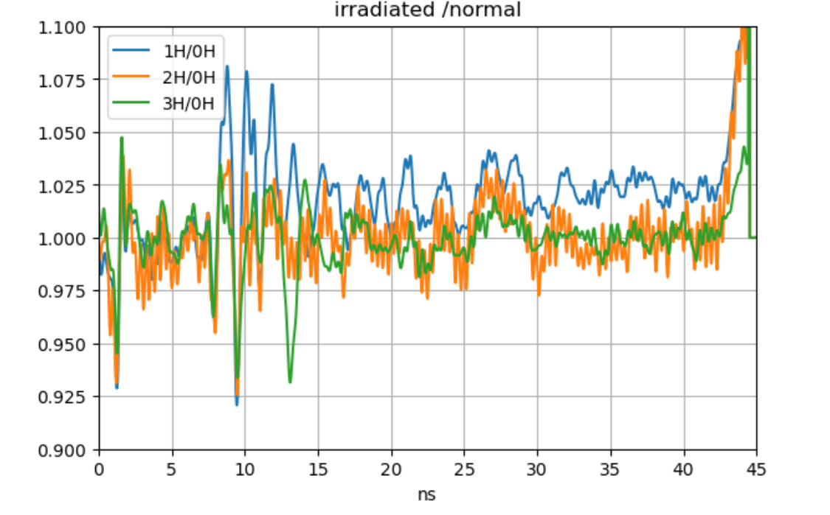

Slide 49
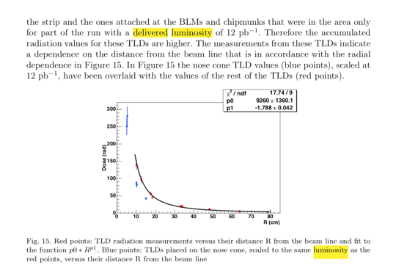
[18] J. Asai, et al., arXiv:0710.2676.
R=10 cm
Reflection from nose cone
9260*R^{-1.788}
Run6 p+p
Delivered Luminosity: 12/pb (50days)
Number of Equivalent Neutrons: 10¹⁰/cm²
(1 MeV Neutron Equivalent)
Location: R=10cm, z=25cm, η=1.65
Z=41cm, 42/pb

