Slide 1
Constraints from the SπRIT experiment and their implications on nuclear matter equation of state
Chun Yuen Tsang, Rohit Kumar, Betty Tsang, Bill Lynch, C.J. Horowitz and the SπRIT collaboration

Slide 2
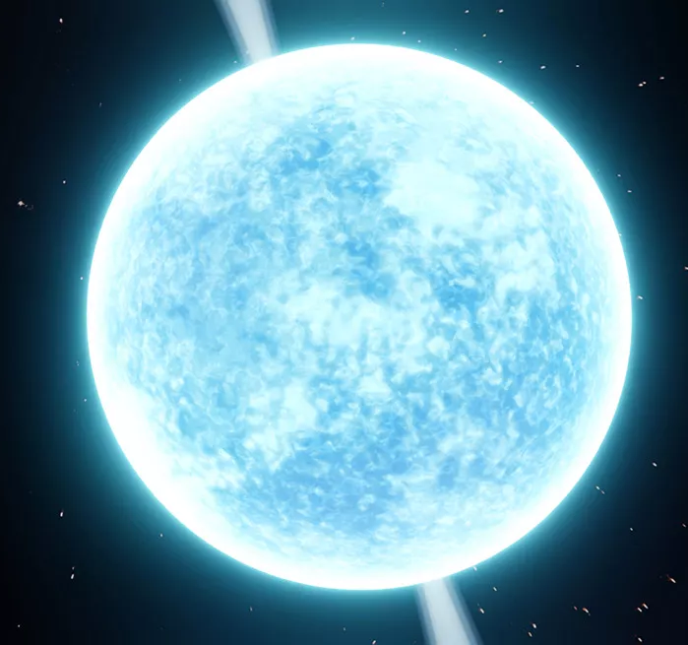
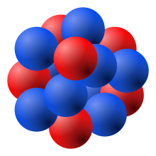
Nuclear and neutron star Equation of State (EoS)
Described by similar (!) equation of state
Observations from both the nucleus and neutron stars can be used to constrain nuclear matter EoS.

Slide 3
Goals
Goal 1: Constraint high density part of symmetry energy term with SπRIT experiment.
Goal 2: Combine multi-messenger constraints for a comprehensive understanding on nuclear matter equation of state (EoS).

Slide 4
Part 1: SπRIT experiment.

Slide 5
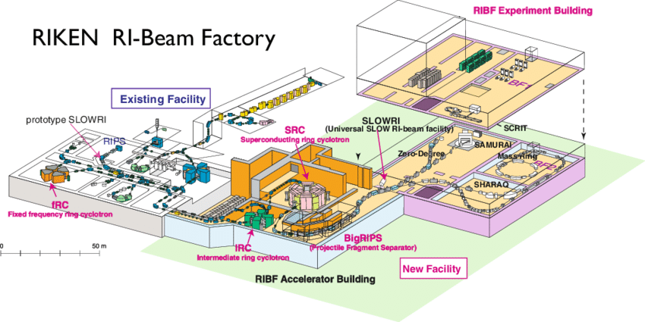
SπRIT experiment
The experiment ran in 2016 in RIKEN, Japan.
Rare isotope beam is provided by RIKEN in Japan, set to collide with stationary target.
Collision fragments are detected with SπRIT Time Projection Chamber (TPC).
δ_{sys} =(N-P)/(N+P) is called the asymmetry
SπRIT TPC
Beam | Target | E_{beam}/A | δ_{sys} | Purpose
¹³²Sn | ¹²⁴Sn | 270 | 0.22 | Max δ_{sys}
¹²⁴Sn | ¹¹²Sn | 270 | 0.15 | Mirror system
¹⁰⁸Sn | ¹¹²Sn | 270 | 0.09 | Min δ_{sys}
¹¹²Sn | ¹²⁴Sn | 270 | 0.15 | Mirror system
Accelerators
M. Wada: DOI: 10.1007/s10751-007-9552-1

Slide 6
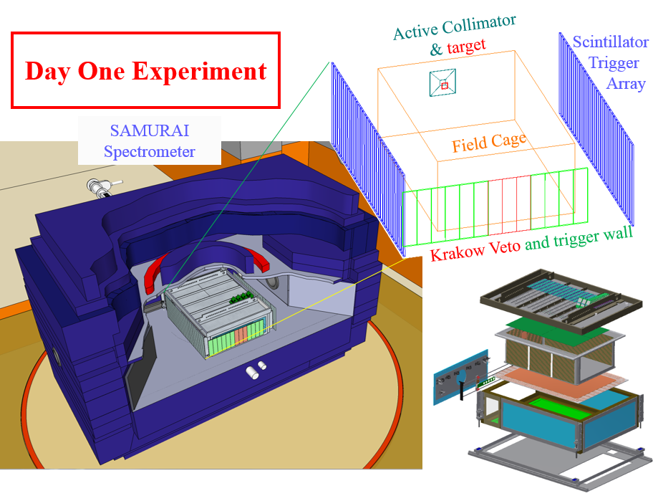
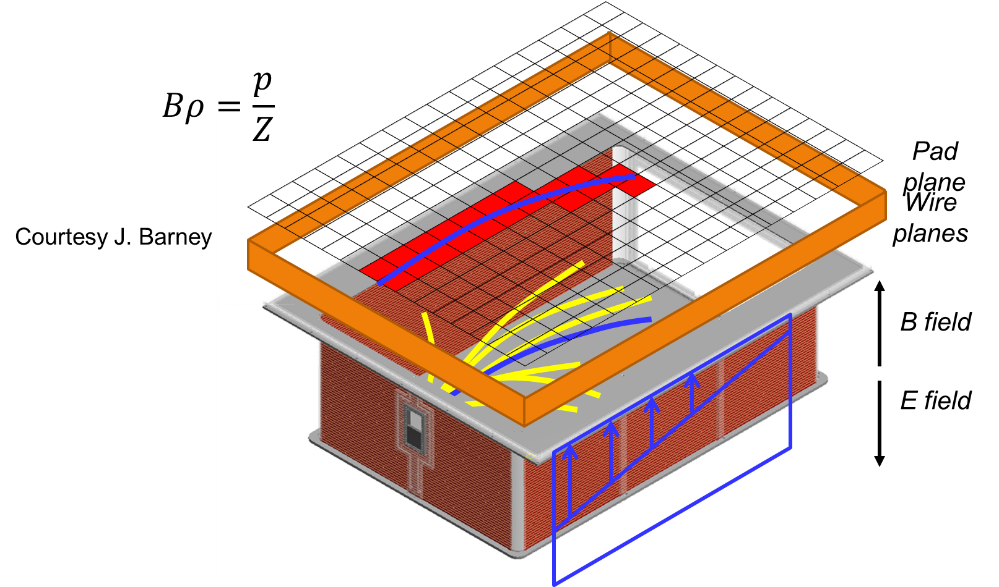
SπRIT experiment
Measures momentum, charge and identify isotopic type of reaction fragments.
Rare Isotope beam
Rare Isotope beam
Target
URL: https://groups.nscl.msu.edu/hira/sepweb/pages/slideshow/samurai.html

Slide 7
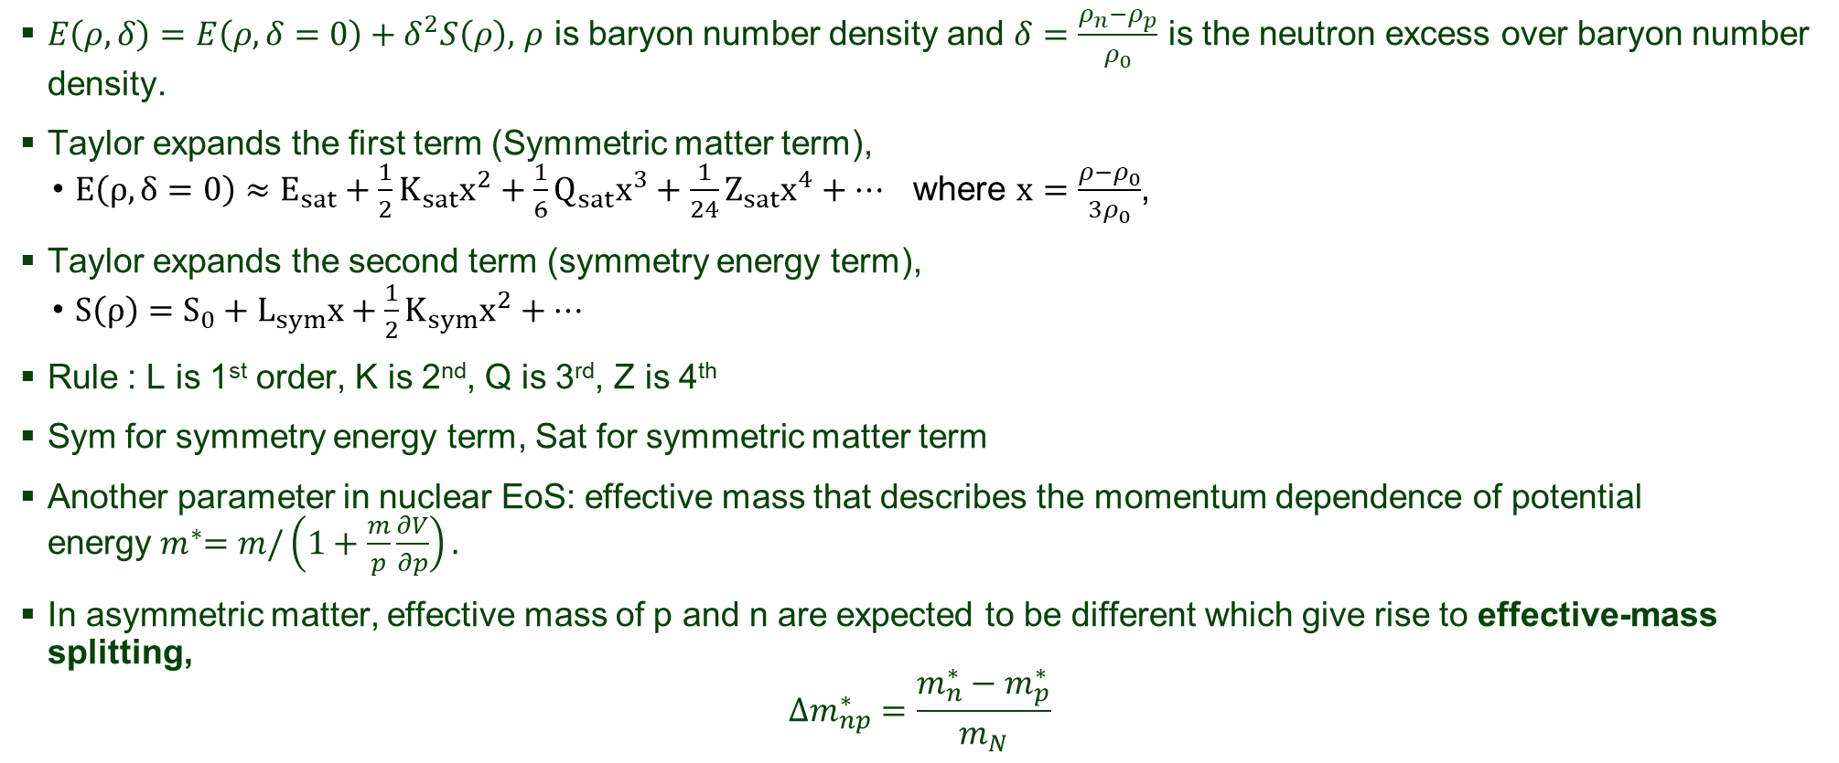
Common EoS parameters
$E\left(ρ, δ\right)=E\left(ρ,δ=0\right)+δ^{2}S\left(ρ\right),$ $ρ$ is baryon number density and $δ=\frac{ρ_{n}−ρ_{p}}{ρ_{0}}$ is the neutron excess over baryon number density.
Taylor expands the first term (Symmetric matter term),
  $E\left(ρ,δ=0\right)≈E_{sat}+\frac{1}{2}K_{sat}x^{2}+\frac{1}{6}Q_{sat}x^{3}+\frac{1}{24}Z_{sat}x^{4}+…$ where $x=\frac{ρ−ρ_{0}}{3ρ_{0}}$,
Taylor expands the second term (symmetry energy term),
  $S\left(ρ\right)=S_{0}+L_{sym}x+\frac{1}{2}K_{sym}x^{2}+…$
Rule : L is 1st order, K is 2nd, Q is 3rd, Z is 4th
Sym for symmetry energy term, Sat for symmetric matter term
Another parameter in nuclear EoS: effective mass that describes the momentum dependence of potential energy${ m}^{∗}=m/\left(1+\frac{m}{p}\frac{∂V}{∂p}\right).$
In asymmetric matter, effective mass of p and n are expected to be different which give rise to effective-mass splitting,
$$Δm_{np}^{∗}=\frac{m_{n}^{∗}−m_{p}^{∗}}{m_{N}}$$

Slide 8
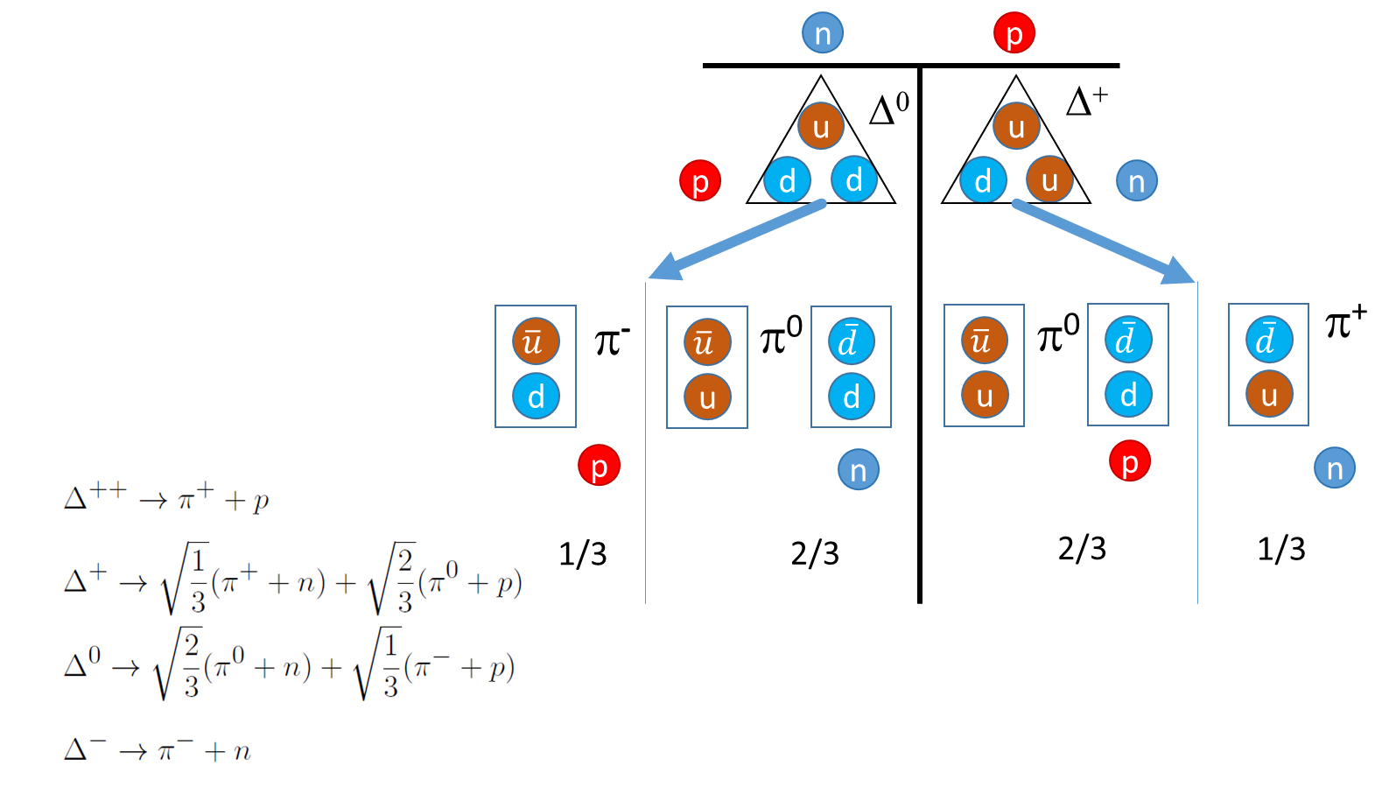
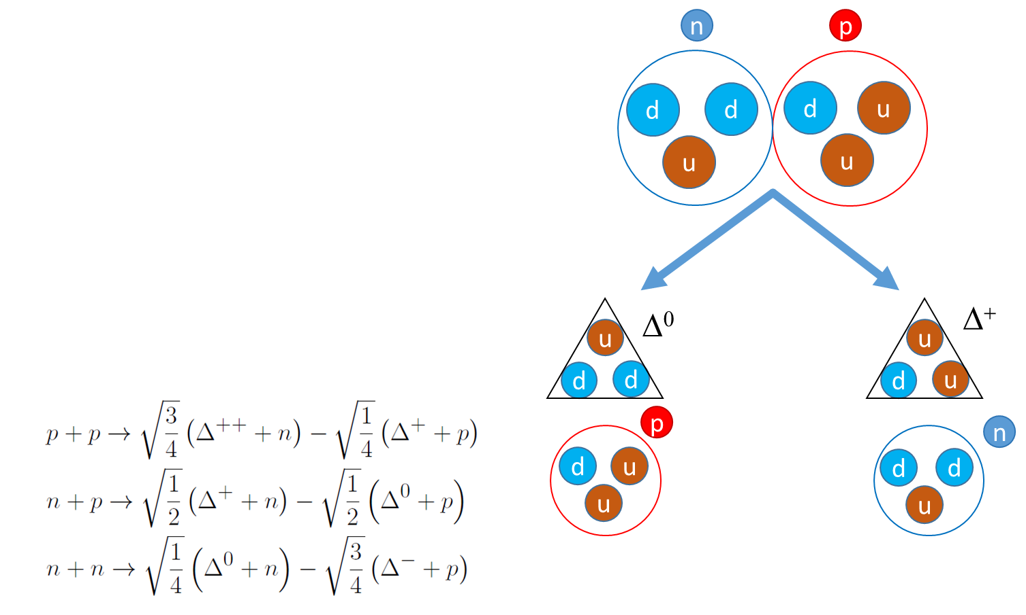
Observable: Pion ratio
Pion ratio Y(pi⁻)/Y(pi⁺) from SπRIT experiment.
¹³²Sn + ¹²⁴Sn and ¹⁰⁸Sn + ¹¹²Sn @ 270 AMeV
Sensitive to high density part.
Courtesy Jon Barney
  Effects that acts similarly on different pions are cancelled out to eliminate sensitivity on effects that are not being considered here.
  Symmetry energy effects are magnified due to symmetry forces acting on π⁻ and π⁺ with opposite sign.
  Systematic uncertainties due to detector errors (if any) are cancelled out in the division.

Slide 9
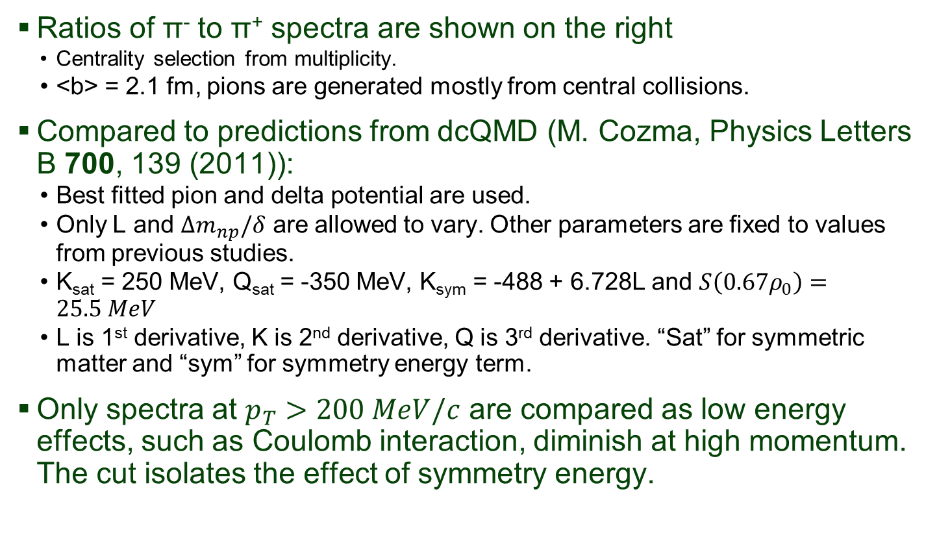
Pion spectra ratio
J. Estee, et al., Phys. Rev. Lett. 126, 162701 (2021).
Ratios of π⁻ to π⁺ spectra are shown on the right
  Centrality selection from multiplicity.
  <b> = 2.1 fm, pions are generated mostly from central collisions.
Compared to predictions from dcQMD (M. Cozma, Physics Letters B 700, 139 (2011)):
  Best fitted pion and delta potential are used.
  Only L and $Δm_{np}/δ$ are allowed to vary. Other parameters are fixed to values from previous studies.
  K_{sat} = 250 MeV, Q_{sat} = -350 MeV, K_{sym} = -488 + 6.728L and $S\left(0.67ρ_{0}\right)=25.5 MeV$
  L is 1st derivative, K is 2nd derivative, Q is 3rd derivative. “Sat” for symmetric matter and “sym” for symmetry energy term.
Only spectra at $p_{T}>200 MeV/c$ are compared as low energy effects, such as Coulomb interaction, diminish at high momentum. The cut isolates the effect of symmetry energy.

Slide 10
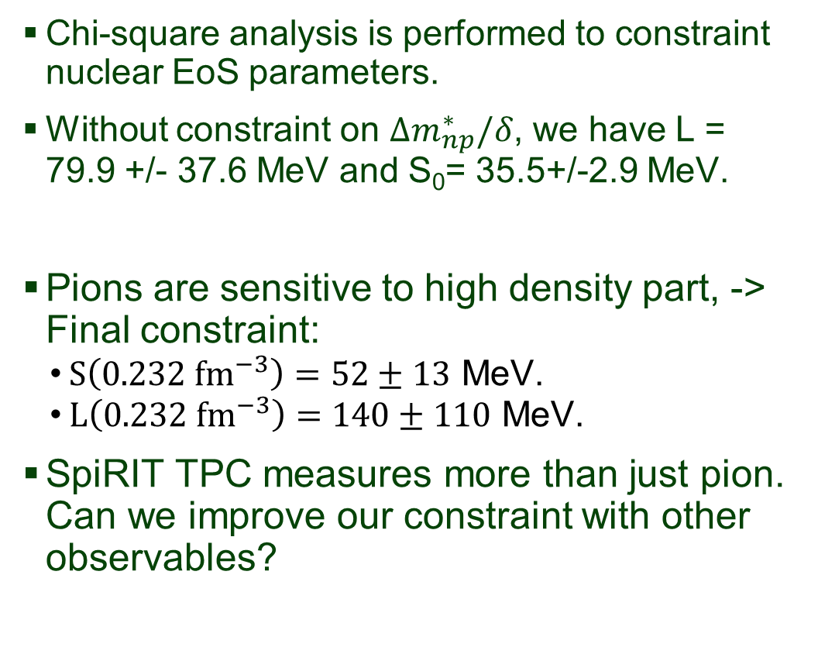
Results
Chi-square analysis is performed to constraint nuclear EoS parameters.
Without constraint on $Δm_{np}^{∗}/δ$, we have L = 79.9 +/- 37.6 MeV and S₀= 35.5+/-2.9 MeV.
Pions are sensitive to high density part, -> Final constraint:
  $S\left(0.232 {fm}^{−3}\right)=52±13$ MeV.
  $L\left(0.232 {fm}^{−3}\right)=140±110$ MeV.
SpiRIT TPC measures more than just pion. Can we improve our constraint with other observables?
J. Estee, et al., Phys. Rev. Lett. 126, 162701 (2021).

Slide 11
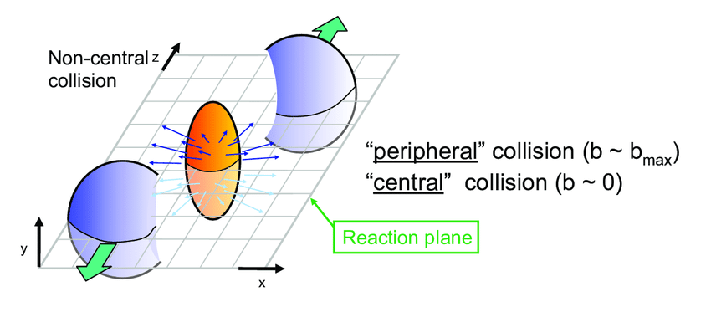
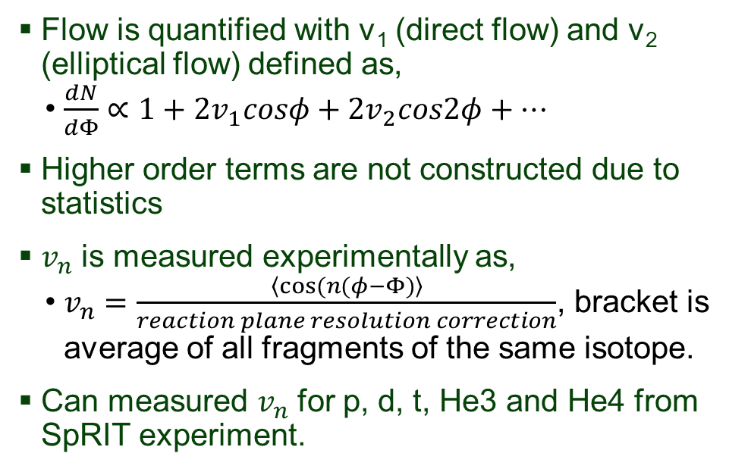
Collective flow
Collisions are rarely head-on, so spectator nucleons often blocks the emission of participant nucleons along reaction plane.
If mean field is very repulsive, particles are promptly ejected. Spectators don’t have time to clear the path of emission, resulting in strong asymmetry, vice versa.
Flow is quantified with v₁ (direct flow) and v₂ (elliptical flow) defined as,
  $\frac{dN}{dΦ}∝1+2v_{1}cosφ+2v_{2}cos2φ+…$
Higher order terms are not constructed due to statistics
$v_{n}$ is measured experimentally as,
  $v_{n}=\frac{\left\langle cos⁡(n(φ−Φ)\right\rangle }{reaction plane resolution correction}$, bracket is average of all fragments of the same isotope.
Can measured $v_{n}$ for p, d, t, He3 and He4 from SpRIT experiment.
Spectator
Participant

Slide 12
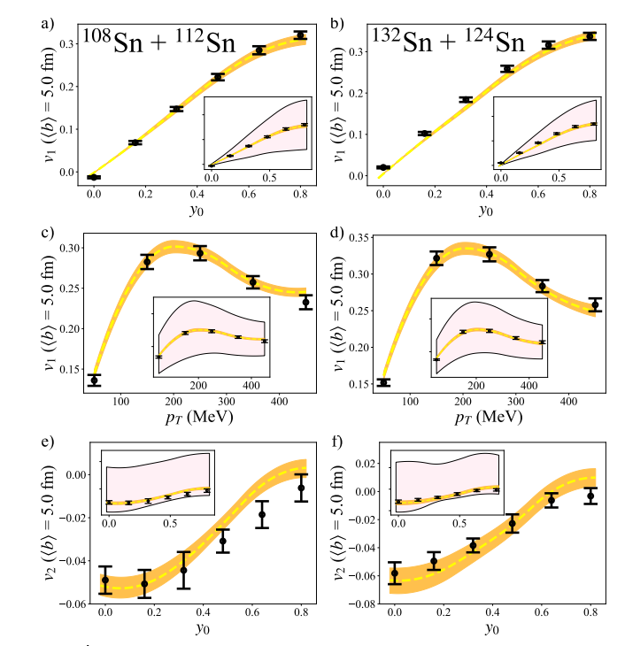
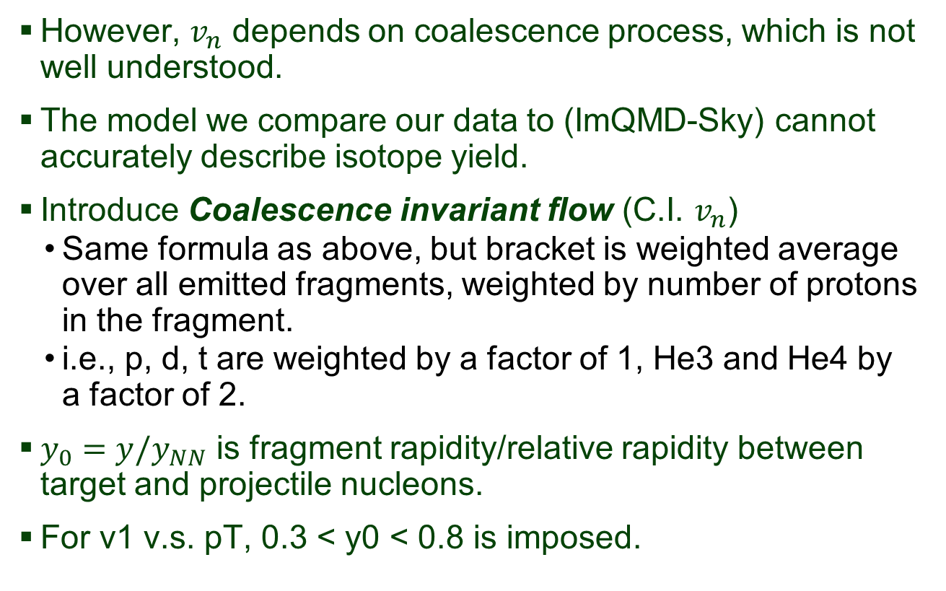
Coalescence invariance flow
Markers are data. Ignore everything else for a moment
However, $v_{n}$ depends on coalescence process, which is not well understood.
The model we compare our data to (ImQMD-Sky) cannot accurately describe isotope yield.
Introduce Coalescence invariant flow (C.I. $v_{n}$)
  Same formula as above, but bracket is weighted average over all emitted fragments, weighted by number of protons in the fragment.
  i.e., p, d, t are weighted by a factor of 1, He3 and He4 by a factor of 2.
$y_{0}=y/y_{NN}$ is fragment rapidity/relative rapidity between target and projectile nucleons.
For v1 v.s. pT, 0.3 < y0 < 0.8 is imposed.
Submitted to PLB

Slide 13
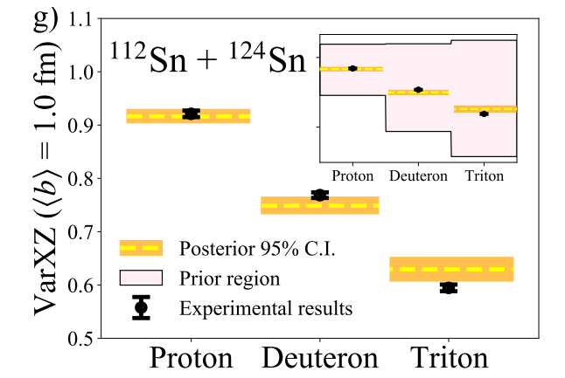
VarXZ to constraint in-medium cross-section
Flow results could be influenced by in-medium cross-section.
The observable VarXZ is also included to constraint in-medium cross-section simultaneously.
VarXZ = VarX/VarZ, where VarX/VarZ are variance of rapidity distribution in x and z-axis respectively.
  Z-axis is the beam axis
  X-axis is a random axis perpendicular to z-axis, NOT defined with respect to reaction plane.
Ratio cancels the systematic effect from coalescence.
VarXZ for p, d, t are measured.
Markers are data. Ignore everything else for a moment
Submitted to PLB

Slide 14
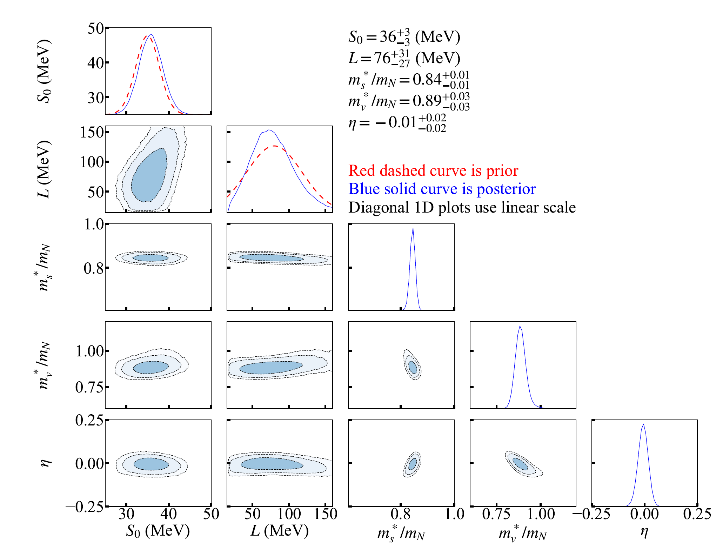
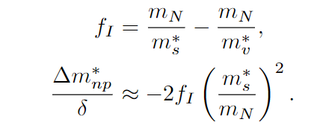

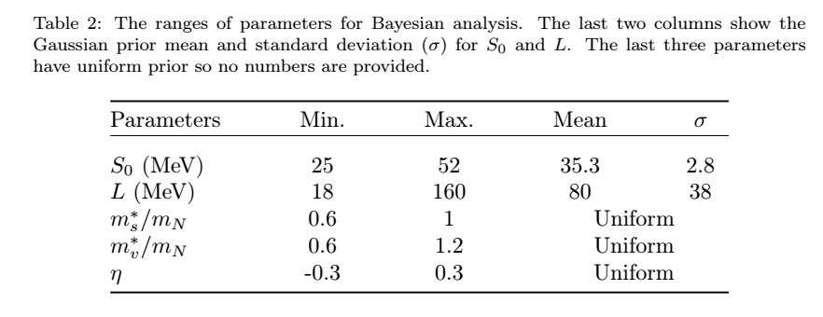
Fit ImQMD-Sky to data with Bayesian analysis
Compare C.I. flows and VarXZ simultaneously with predictions from ImQMD-Sky.
Parameters to vary: S₀, L, m_{s}/m_{N}, m_{v}/m_{N}, η
Prior from pion ratio analysis.
Submitted to PLB

Slide 15

Conclusion on flow and VarXZ analysis with ImQMD
Conclusion 1: Not very sensitive to S₀ and L, but tight constraint on m_{s}/m_{N}, m_{v}/m_{N}, η
Conclusion 2: Can be converted to $\frac{Δm_{np}^{∗}}{δ}=−0.08±0.07$.
Model dependence not well understood, but with future endeavor, this value of effective mass splitting can be imposed on constraint from pion ratios to improve constraint on L
General idea. Not valid now since pion analysis uses dcQMD instead of ImQMD-Sky.
???
J. Estee, et al., Phys. Rev. Lett. 126, 162701 (2021).

Slide 16
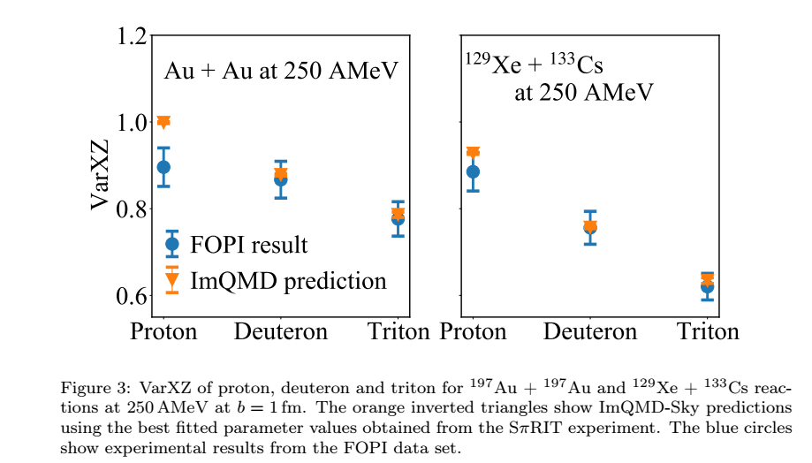
“Prediction” on Au+Au and Xe + Cs
Calculate VarXZ with ImQMD-Sky on Au + Au and Xe + Cs at 250 AMeV with the best fitted EoS parameters.
  S₀= 36 MeV
  L = 76 MeV
  m_{s}/m_{N}= 0.84
  m_{v}/m_{N}= 0.89
  η = -0.01
Good agreement with results from FOPI experiment.

Slide 17
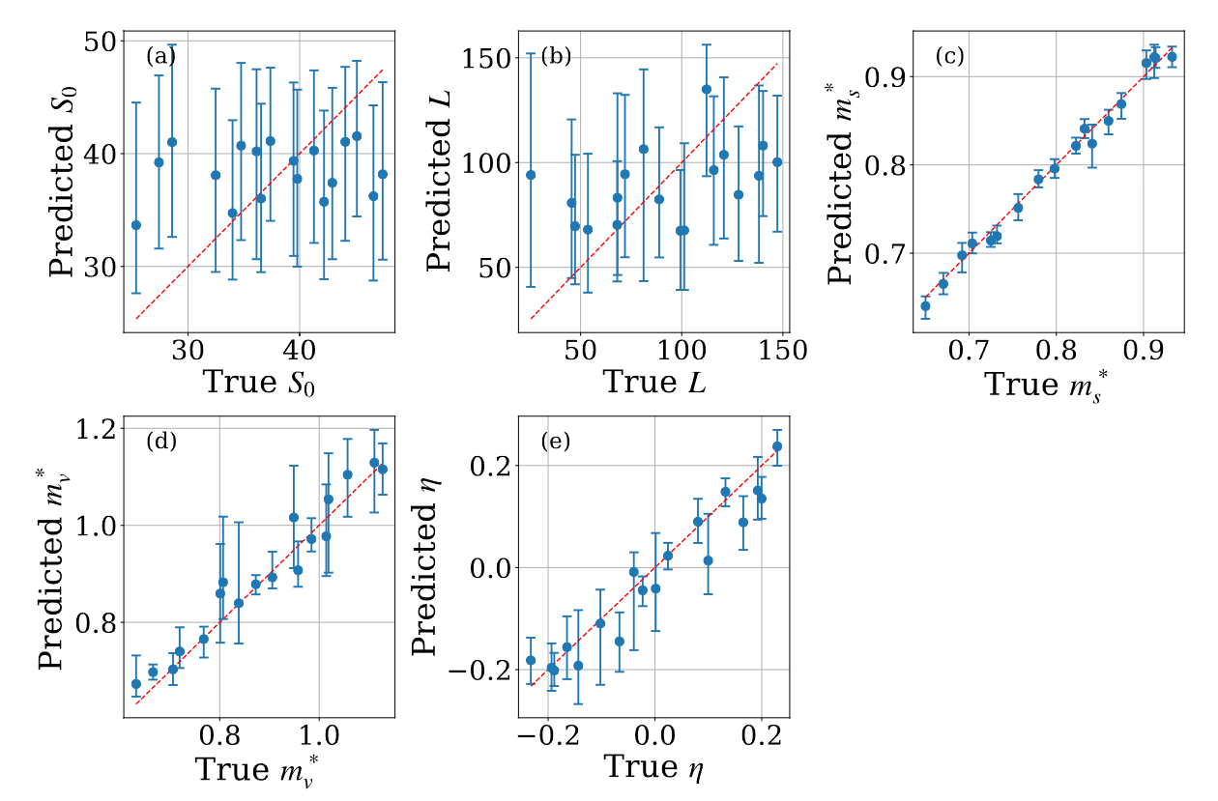
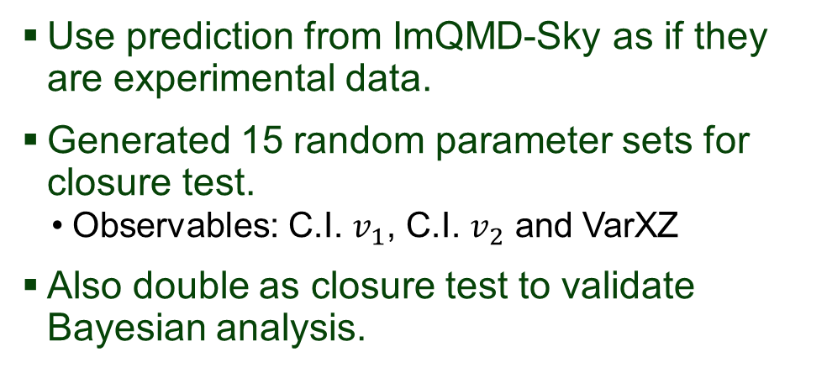
Work in progress: Sensitivity study
Use prediction from ImQMD-Sky as if they are experimental data.
Generated 15 random parameter sets for closure test.
  Observables: C.I. $v_{1}$, C.I. $v_{2}$ and VarXZ
Also double as closure test to validate Bayesian analysis.

Slide 18
Part 2: Multi-messenger constraints on nuclear matter EoS.
Will use n and ρ interchangeably to denote baryon number density

Slide 19
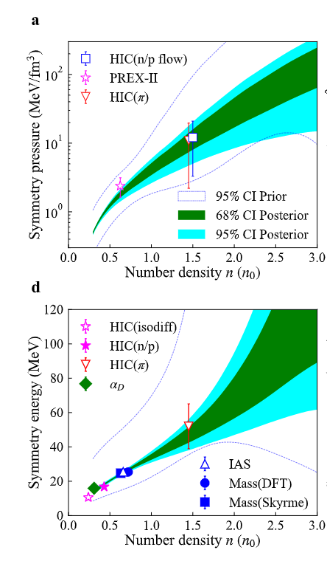
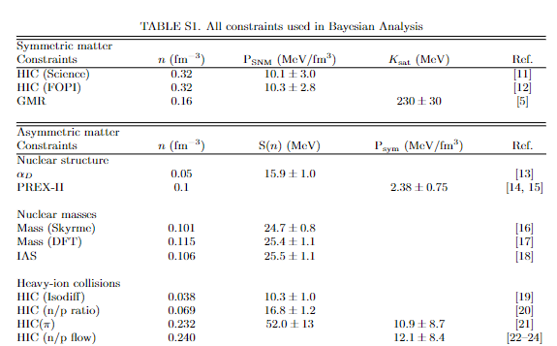
All terrestrial experiment constraints
Choice of measurements will be elaborated on Rohit’s talk.
W.G. Lynch, Physics Letters B 137098 (2022).

Slide 20
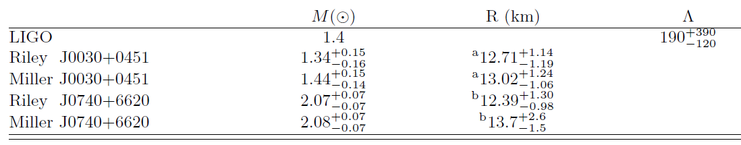
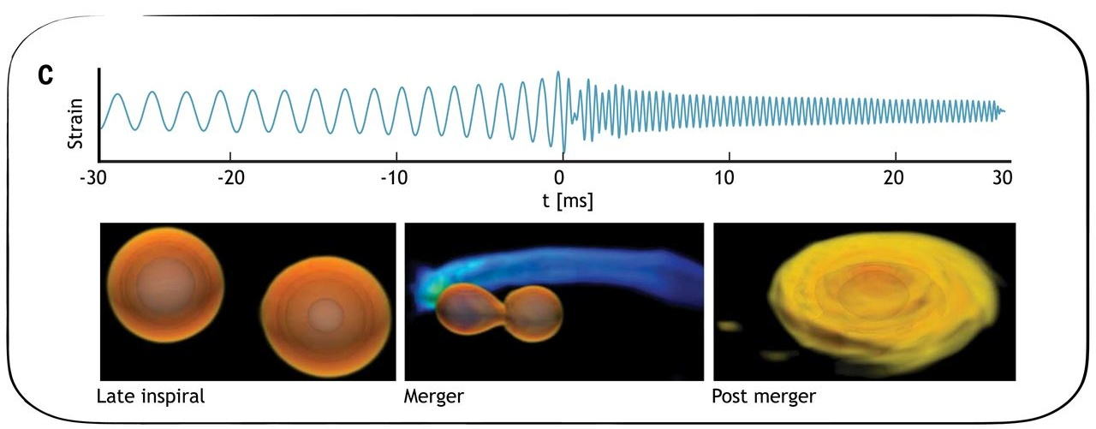
Astronomical observation of NS properties
Deformability from gravitation wave observation of NS merger

Slide 21
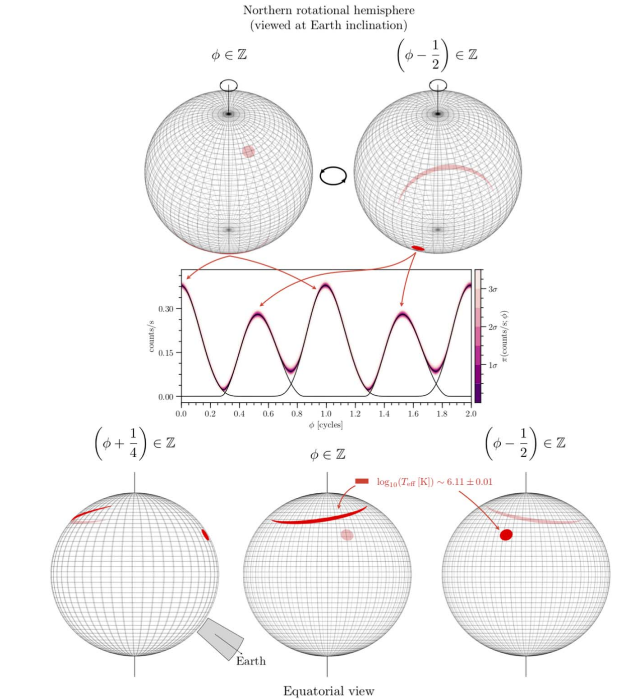
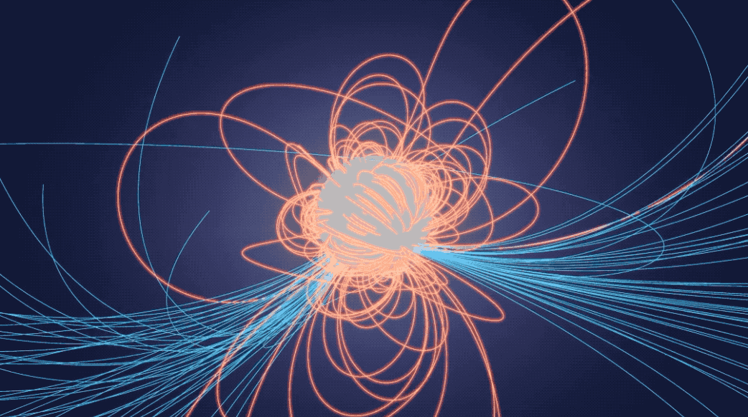
Astronomical observation of NS properties
The Astrophysical Journal Letters, 887:L21 (60pp), 2019 December 10

Slide 22
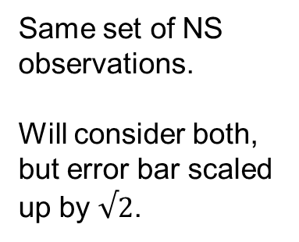
Astronomical observation of NS properties
Same set of NS observations.
Will consider both, but error bar scaled up by $√2$.
The Astrophysical Journal Letters, 887:L21 (60pp), 2019 December 10

Slide 23
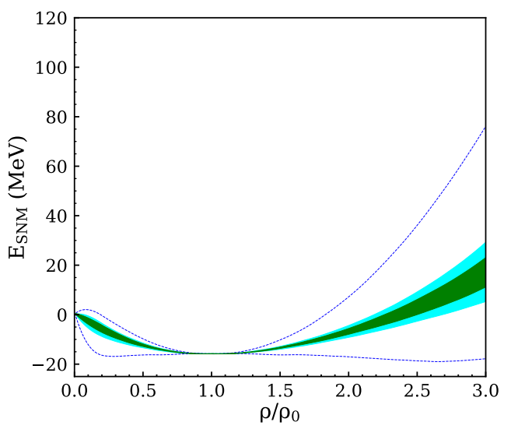
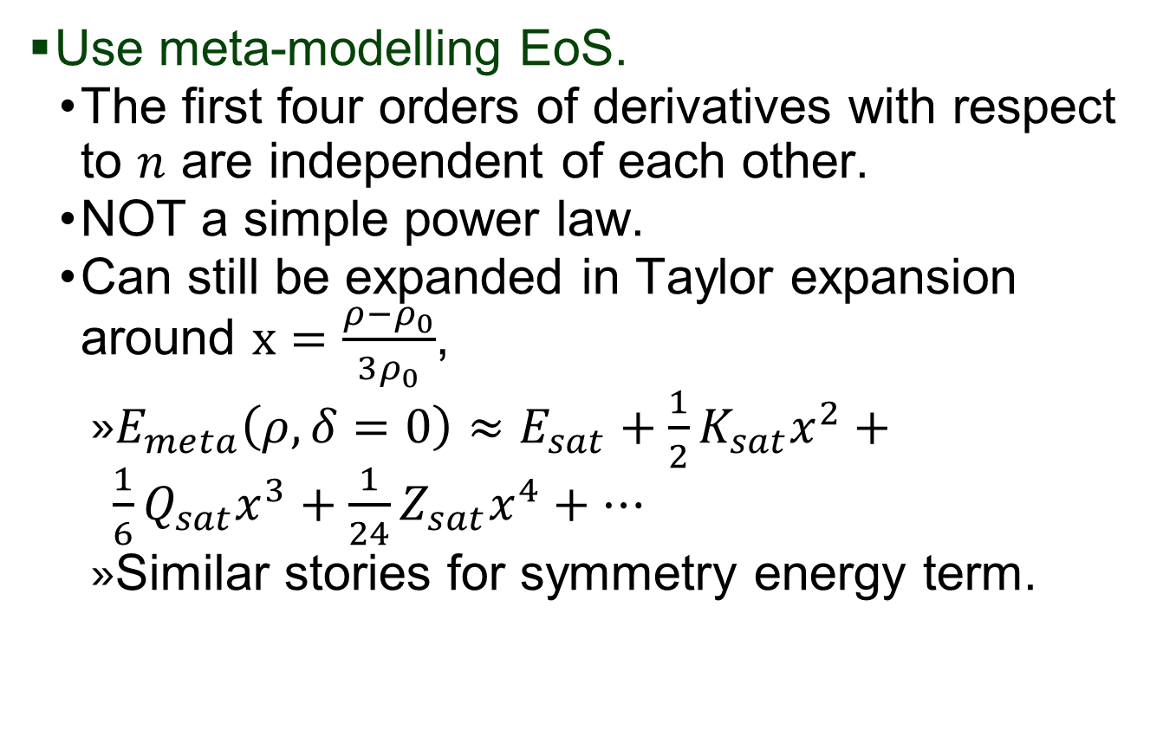
EoS in this analysis
Use meta-modelling EoS.
  The first four orders of derivatives with respect to $n$ are independent of each other.
  NOT a simple power law.
  Can still be expanded in Taylor expansion around $x=\frac{ρ−ρ_{0}}{3ρ_{0}}$,
    $E_{meta}\left(ρ,δ=0\right)≈E_{sat}+\frac{1}{2}K_{sat}x^{2}+\frac{1}{6}Q_{sat}x^{3}+\frac{1}{24}Z_{sat}x^{4}+…$
    Similar stories for symmetry energy term.
Symmetric Nuclear Matter

Slide 24

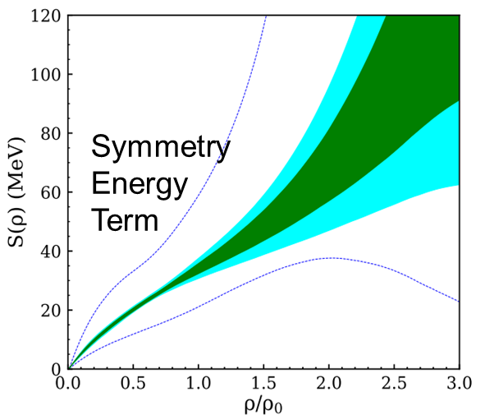
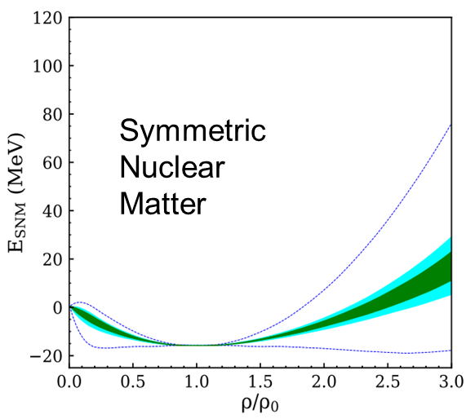
Calculate astronomical predictions from nuclear EoS
Tolman-Oppenheimer-Volkoff (TOV) equation
Convert EoS to NS properties
TOV equation

Slide 25
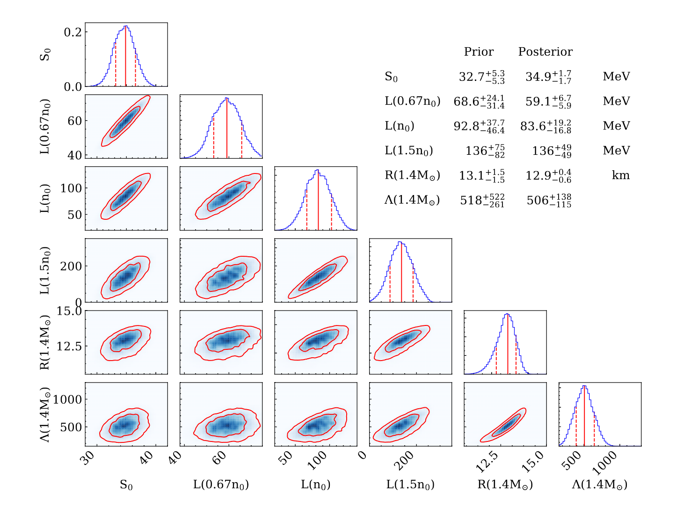
Bayesian analysis – Posterior of selected parameters

Slide 26
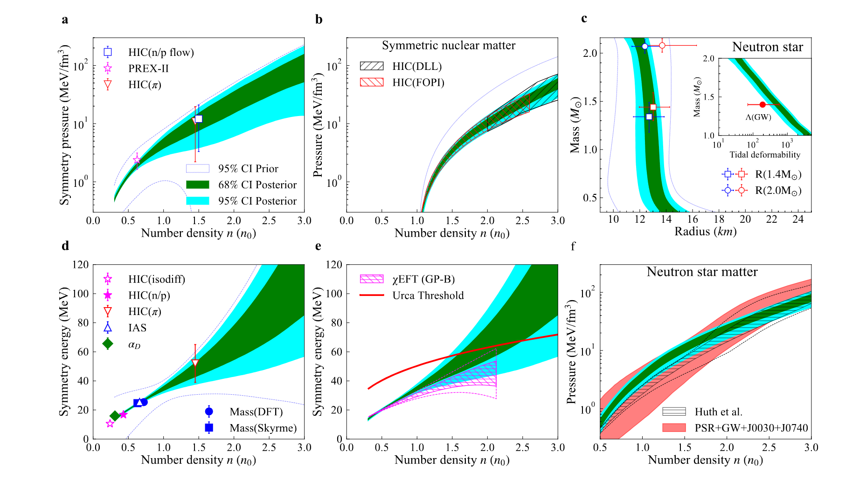
Constrained EoS

Slide 27
Summary and outlook
Compiled a list of astronomical and terrestrial constraints.
Provided a systematic way to select EoS from constraints with Bayesian analysis.
More work are underway to study symmetry energy term at above 1.5ρ₀.
More NS will be measured by LIGO and NICER in the future.

Slide 28


































Jon Barney
Justin Estee
Suwat Tangwangchoen
Masanori Kaneko
JungWoo Lee
Genie Jhang
Yan Zhang
Pawel Lasko
RenSheng Wang
Tommy Tsang
https://groups.nscl.msu.edu/hira/cosmic/SpiritTPC.html

Slide 29
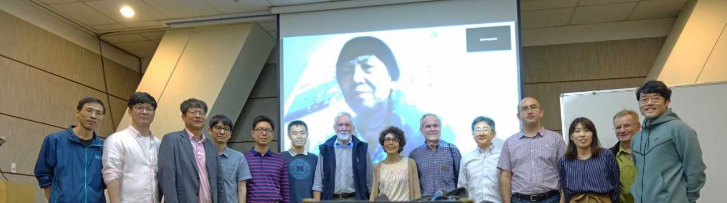

Nusym2018
Busan, Korea
Transport Models Evaluation Project
Maria Colonna
Dan Cozma
Pawel Danielewicz
Natsumi Ikeno
CheMing Ko
Bill Lynch
Akira Ono
Jun Su
Betty Tsang
Hermann Wolter
Jun Xu
YingXun Zhang
Zhen Zhang
Weekly Zoom meeting (Wed @8 AM)
Xu et al., Phys. Rev.C 93,044609 (2016).
Y.Zhang et al., Phys. Rev.C 97, 034625 (2018).
A.Ono et al., Phys. Rev. C 100, 044617 (2019).
M. Colonna et al., PRC, 104, 024603 (2021).
G. Jhang et al., PLB 813, 136016 (2021).
Wolter et al., Code Description paper (in preparation).

Slide 30
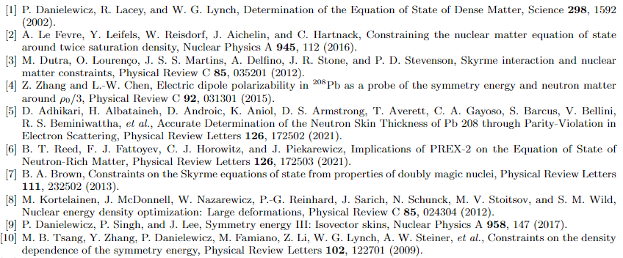
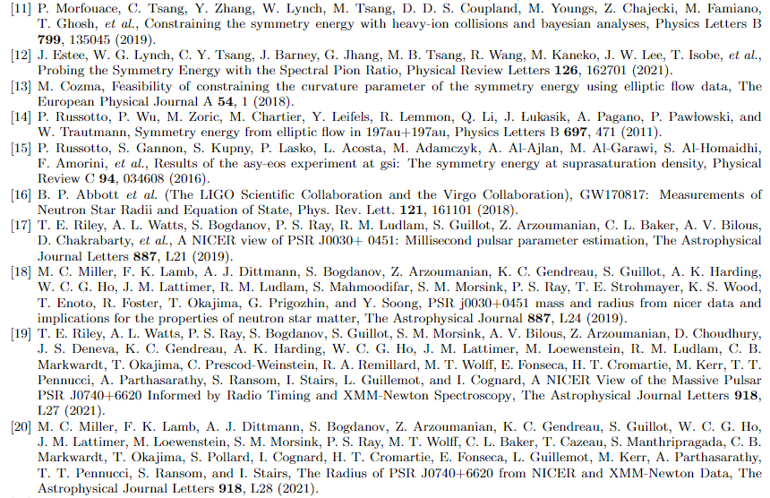
References

Slide 31
Back-up slides

Slide 32
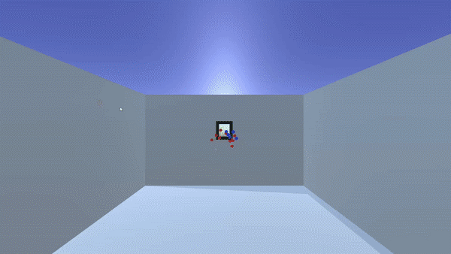
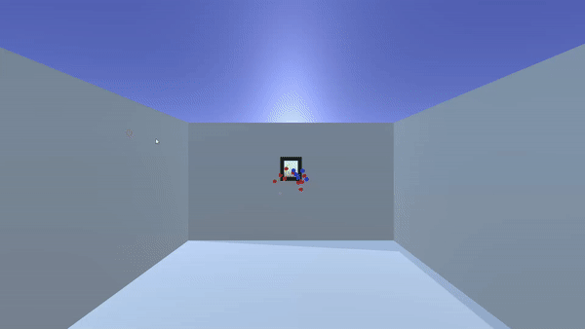
SπRIT experiment
Rare Isotope beam
Target
Credit: Jacob Cosby
Beam comes out of the screen.

Slide 33
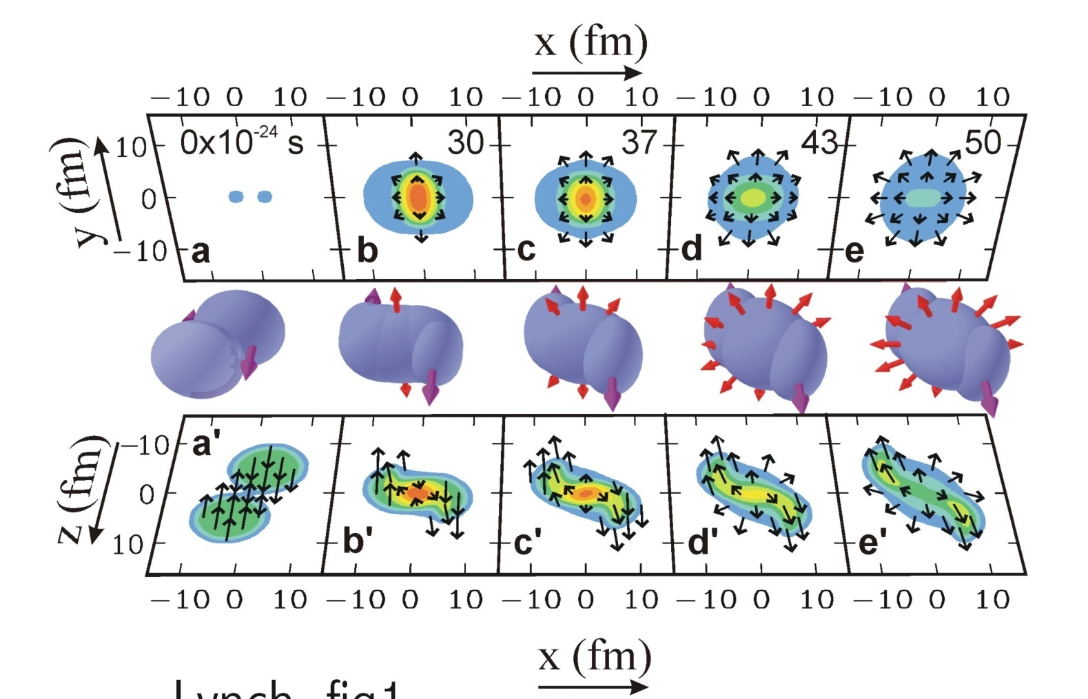
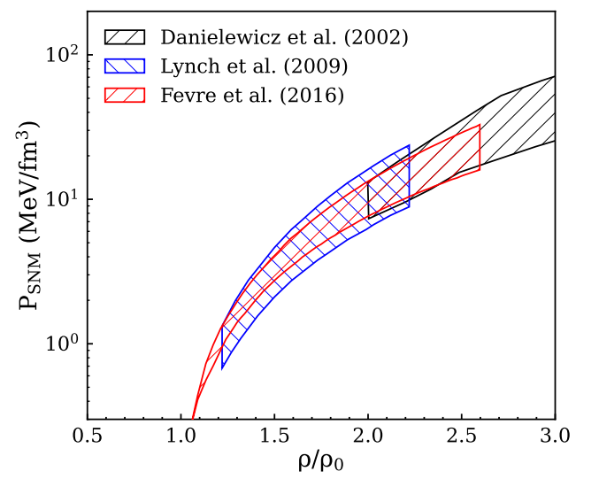
Symmetric matter constraint from the observed nuclear flow
Elliptical flow from Au + Au @ 0.4 - 10 AGeV
Danielewicz, Lacey, Lynch, Science 298, 1592 (2002)
(Le Fevre et. al, NPA 945, 112 (2016))
pressure contours
density contours

Slide 34
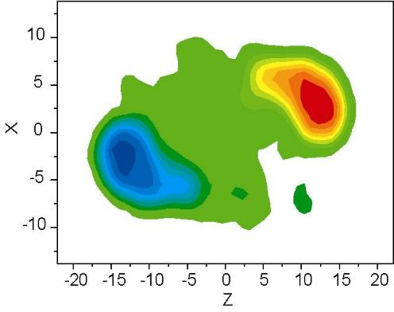


Symmetry energy term constraint from Isospin diffusion and n/p ratio
¹¹²Sn + ¹¹²Sn and ¹²⁴Sn + ¹²⁴Sn
50 AMeV for isospin diffusion, 120 AMeV for n/p ratio
Isospin Diffusion; low ρ
Projectile
¹²⁴Sn
Y(n)/Y(p) ratios
V1(n)/v1(p) flows
Tsang et al., PRL 92, 062701 (2004)
Target
¹¹²Sn
$S\left(0.038 {fm}^{−3}\right)=10.3±1.0$ MeV [10]
$S\left(0.069 {fm}^{−3}\right)=16.8±1.2$ MeV [11]

Slide 35
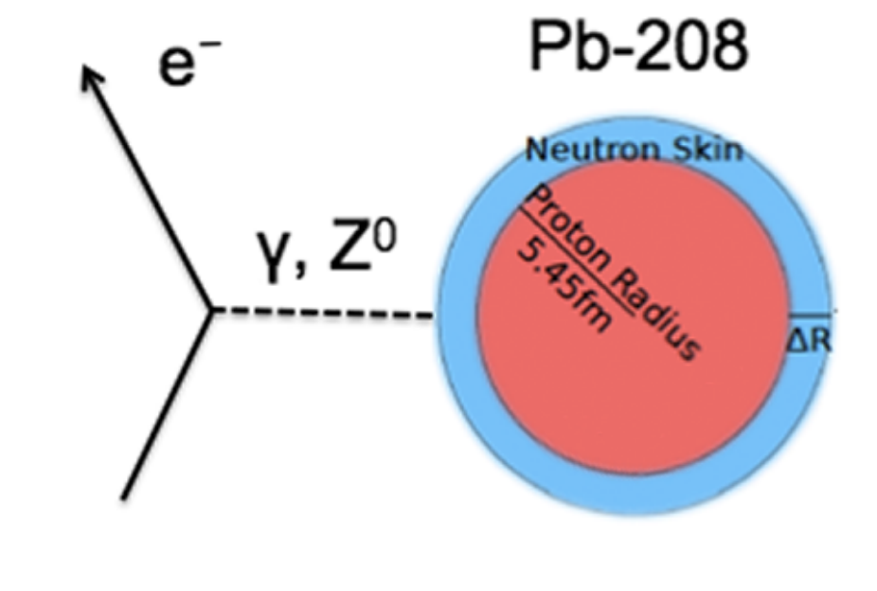
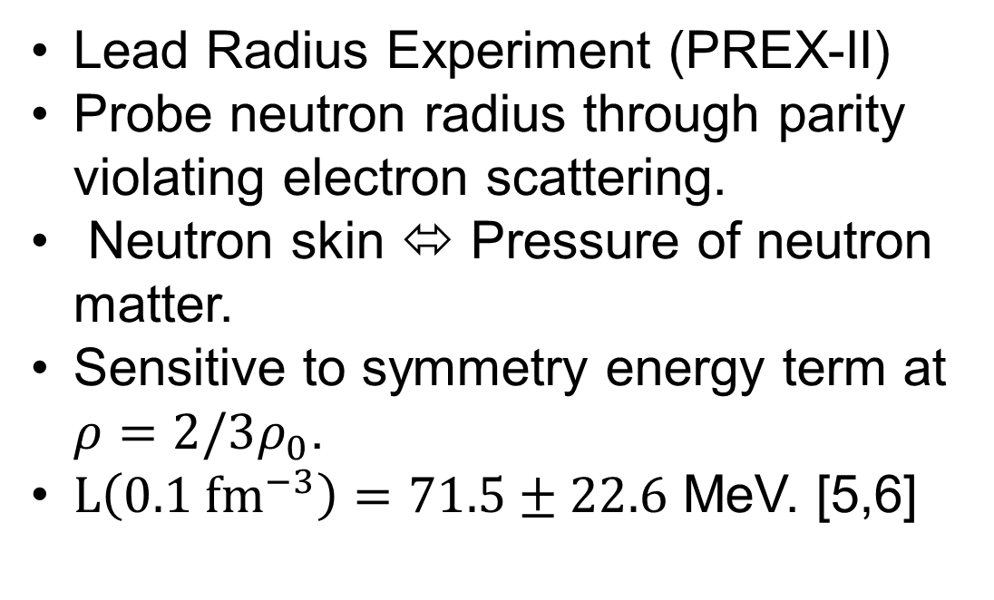
Symmetry energy term constraint from PREX-II
Lead Radius Experiment (PREX-II)
Probe neutron radius through parity violating electron scattering.
Neutron skin ⬄ Pressure of neutron matter.
Sensitive to symmetry energy term at $ρ=2/3ρ_{0}$.
$L\left(0.1 {fm}^{−3}\right)=71.5±22.6$ MeV. [5,6]
Source: https://www.physics.umass.edu/news/2012-01-29-neutron-skin-lead-measured-prex

Slide 36
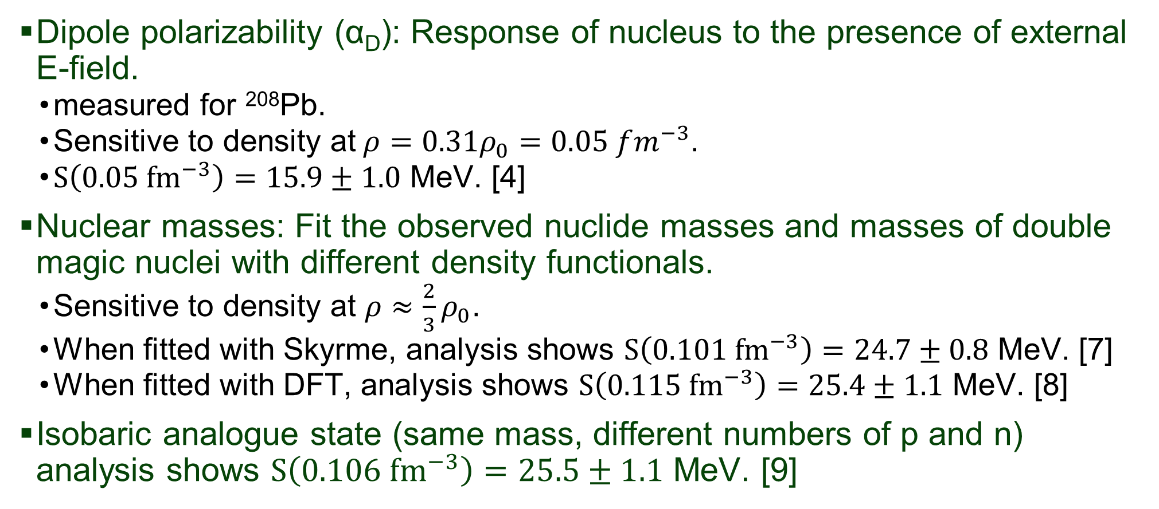
Symmetry energy term constraints from dipole polarizability and nuclear masses
Dipole polarizability (α_{D}): Response of nucleus to the presence of external E-field.
  measured for ²⁰⁸Pb.
  Sensitive to density at$ρ=0.31ρ_{0}=0.05 fm^{−3}$.
  $S\left(0.05 {fm}^{−3}\right)=15.9±1.0$ MeV. [4]
Nuclear masses: Fit the observed nuclide masses and masses of double magic nuclei with different density functionals.
  Sensitive to density at $ρ≈\frac{2}{3}ρ_{0}$.
  When fitted with Skyrme, analysis shows $S\left(0.101 {fm}^{−3}\right)=24.7±0.8$ MeV. [7]
  When fitted with DFT, analysis shows $S\left(0.115 {fm}^{−3}\right)=25.4±1.1$ MeV. [8]
Isobaric analogue state (same mass, different numbers of p and n) analysis shows $S\left(0.106 {fm}^{−3}\right)=25.5±1.1$ MeV. [9]

Slide 37
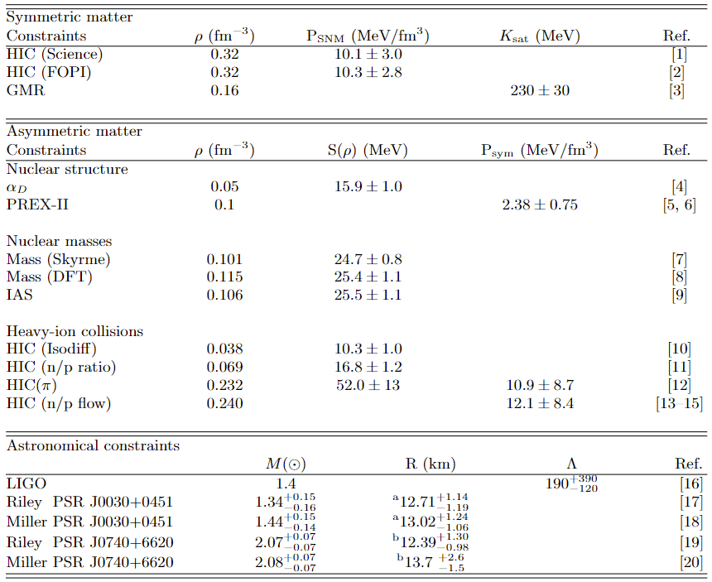
Short summary on all constraints

Slide 38
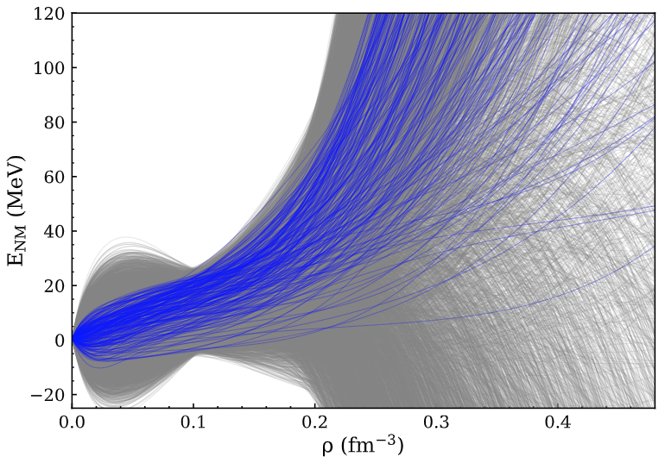
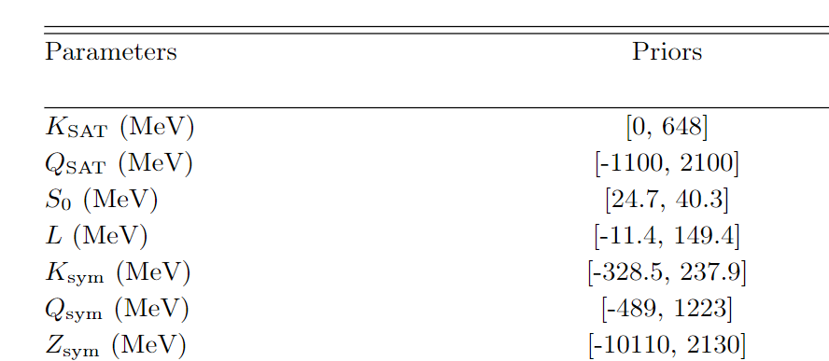
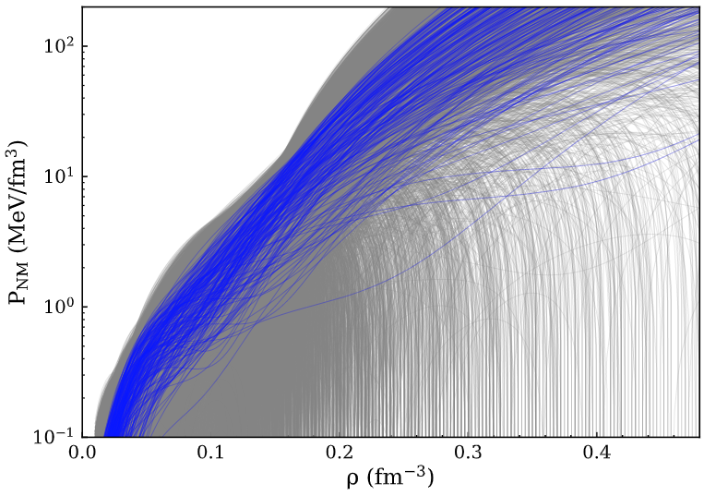

Bayesian analysis – Inclusive Prior and TOV Prior
Inclusive Prior (as wide as possible):
TOV prior:
  Inclusive prior that satisfies thermodynamic stability condition.
  Maximum NS mass > 2.17 solar mass.
TOV- priors
Inclusive priors
[0, 300]

Slide 39


Formulation of our EoS

Slide 40
Conversion to NS properties
To convert each nuclear EoS to neutron star EoS,
  Calculate the ratios of proton, neutron, electrons and muon by minimizing total energy at different pressures.
  At low density, connect it to crustal EoS.
  At high density, if speed of sound exceeds speed of light, meta-modeling EoS will be replaced with EoS of constant speed of sound = c.
The converted EoS is put inside Tolman-Oppenheimer-Volkoff (TOV) equation to predict the radius of 1.4 solar mass NS,
TOV equation predicts the structure of a static spherical object under general relativity.
Details are given in C. Y. Tsang , et al. (2020) Phys. Rev. C 102, 045808
Can be extended to give Λ, the tidal deformability of NS.

