Slide 1


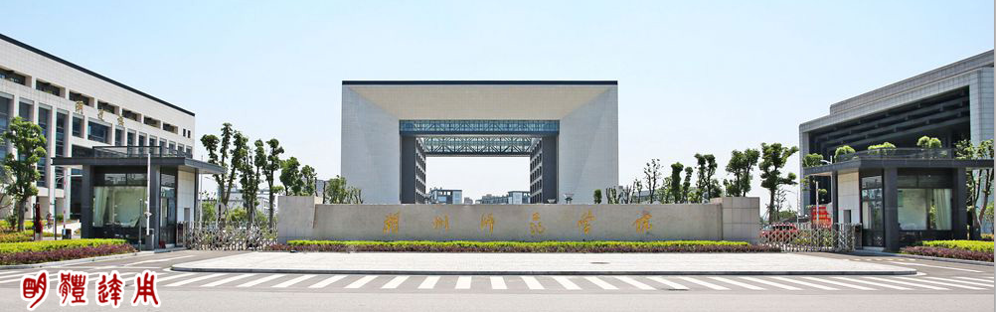
Elliptic flow in heavy-ion collisions at intermediate energy: the role of impact parameter, mean-field potential and collision term
Yongjia Wang (王永佳)
Huzhou University (湖州师范学院)
Equation of State of Dense Nuclear Matter at RIBF and FRIB, Japan, 23-24th May, 2023

Slide 2
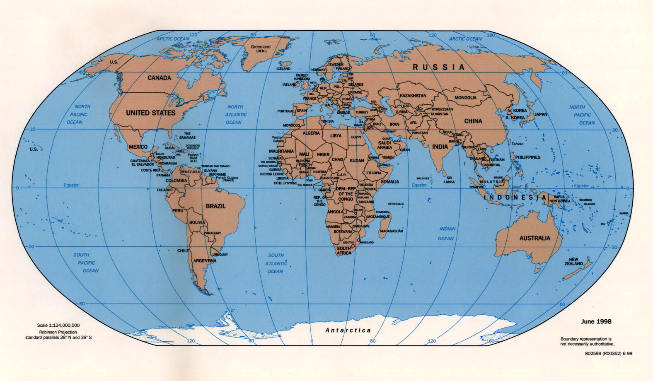


Huzhou city
East longitude
120°
North latitude
30°
A city of Tradition and Modernity
Birthplace of silk.
World-famous
old town: Nanxun
Twin towers
288 m tall
100 m tall

Slide 3
Outline
Introduction
Transport model
Ultrarelativistic Quantum Molecular Dynamics (UrQMD) Model
Time evolution of elliptic flow
The most relevant density probed by elliptic flow
Summary

Slide 4
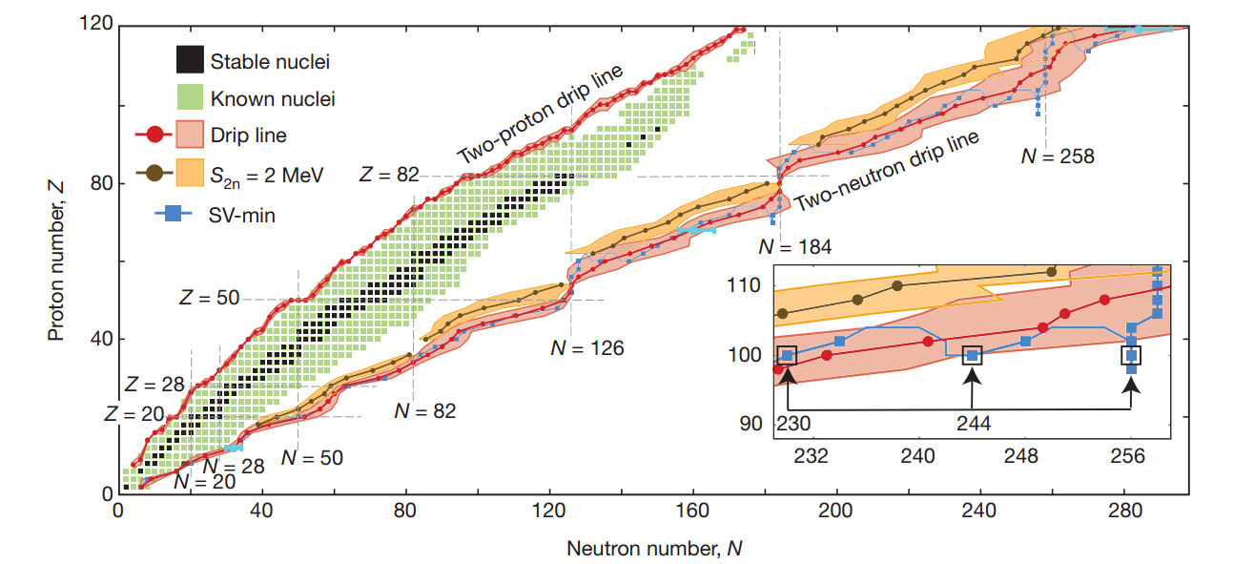
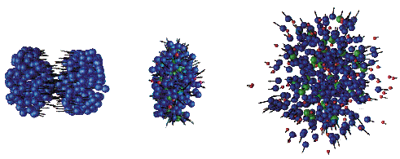
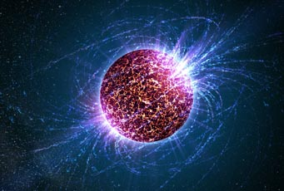
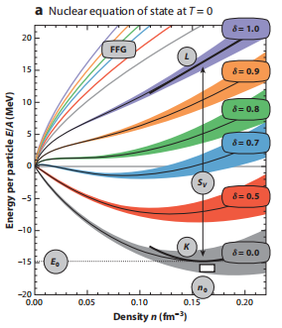
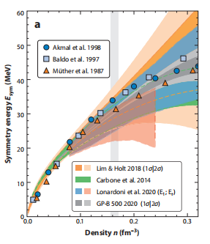
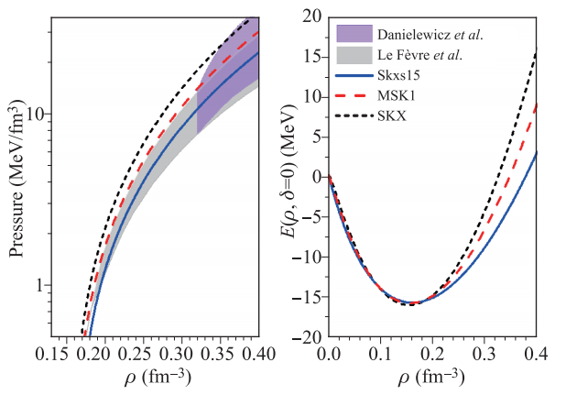
Nuclear equation of state (EOS)
The thermodynamic relationship between the binding energy E (or pressure P) and density ρ, as well as the isospin asymmetry δ.
Nuclear landscape
Heavy ion collision
Neutron star

Slide 5
Nuclear equation of state (EOS)
The thermodynamic relationship between the binding energy E (or pressure P) and density ρ, as well as the isospin asymmetry δ.
Nuclear landscape
Heavy ion collision
Neutron star
K₀ and L determine the EOS in the vicinity of the saturation density.

Slide 6
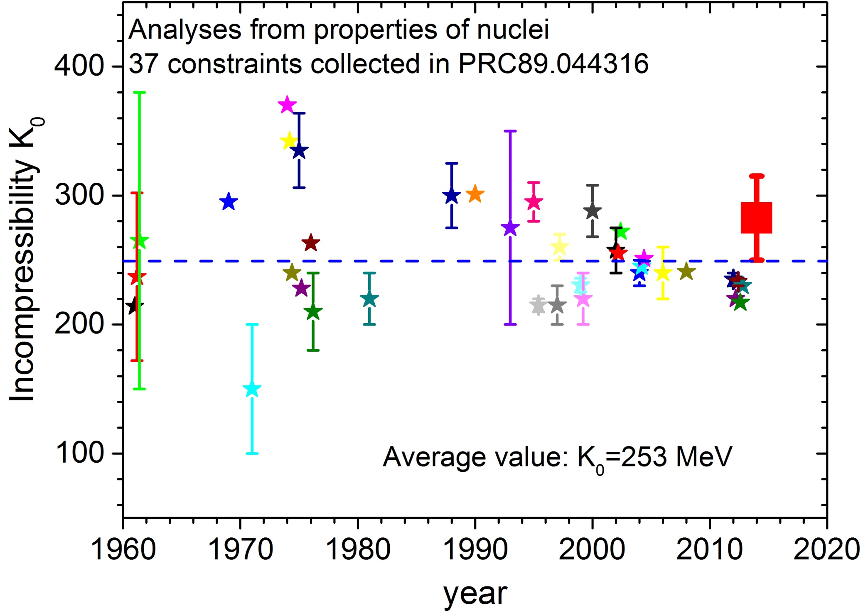
The incompressibility K₀ from properties of nuclei
isoscalar giant monopole resonances (GMR), nuclear masses...
250<K₀<315 MeV, based on the most precise and up-to-date data on GMR energies.
J. R. Stone, et al. PRC89(2014)

Slide 7
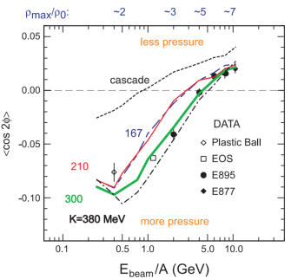
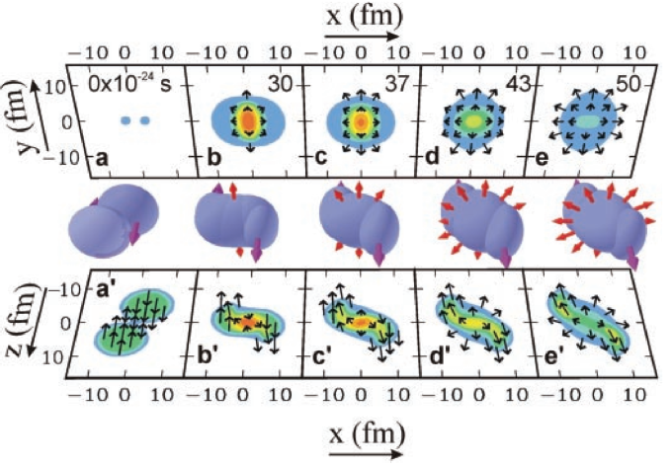
HIC offers a unique way to create nuclear matter with high
density and isospin asymmetry in laboratory.
Danielewicz, et al. Science 298, 1592 (2002).
EOS can be deduced from the comparision bewteen experimental observabels and transport model calculations.

Slide 8
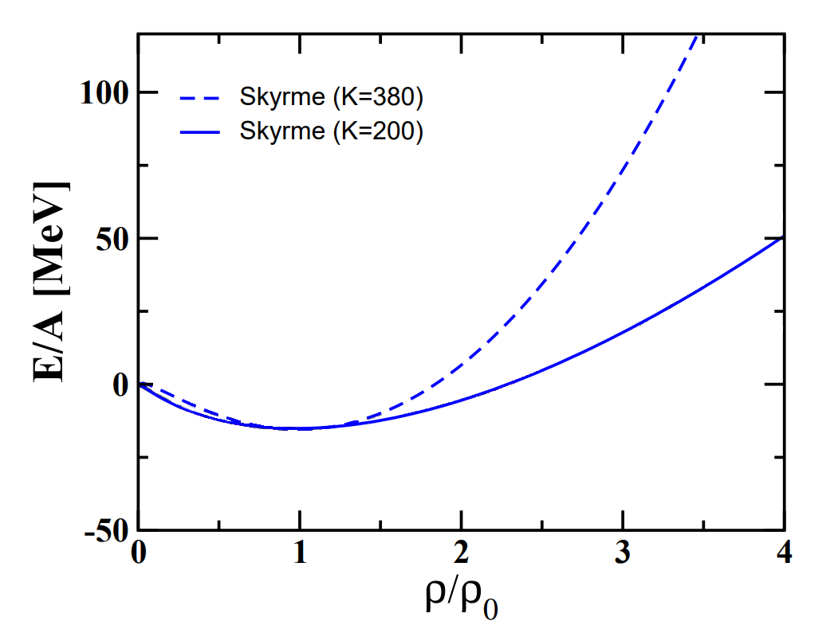
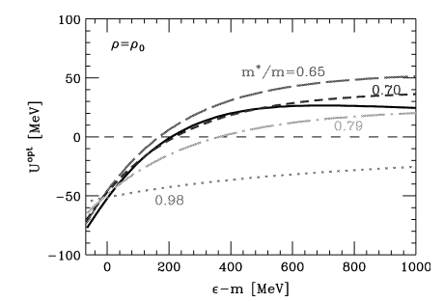
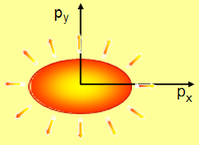
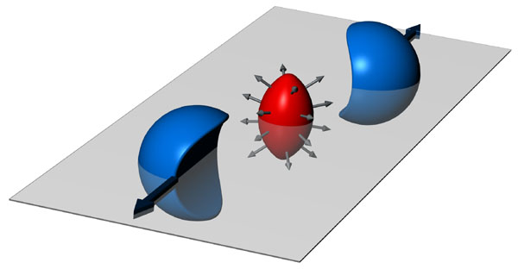
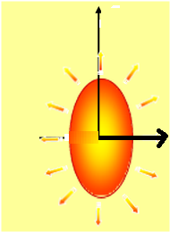
Elliptic flow (v₂)
Momentum-space anisotropy
Coordinate-space anisotropy
z
In-plane
v₂>0
x
p_{y}
Out-of-plane
Squeeze out
v₂<0
v₂ has been widely used to probe the nuclear EOS, the nucleon effective mass,...
p_{x}

Slide 9
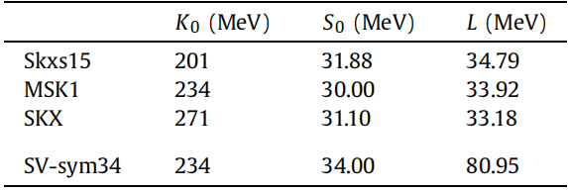
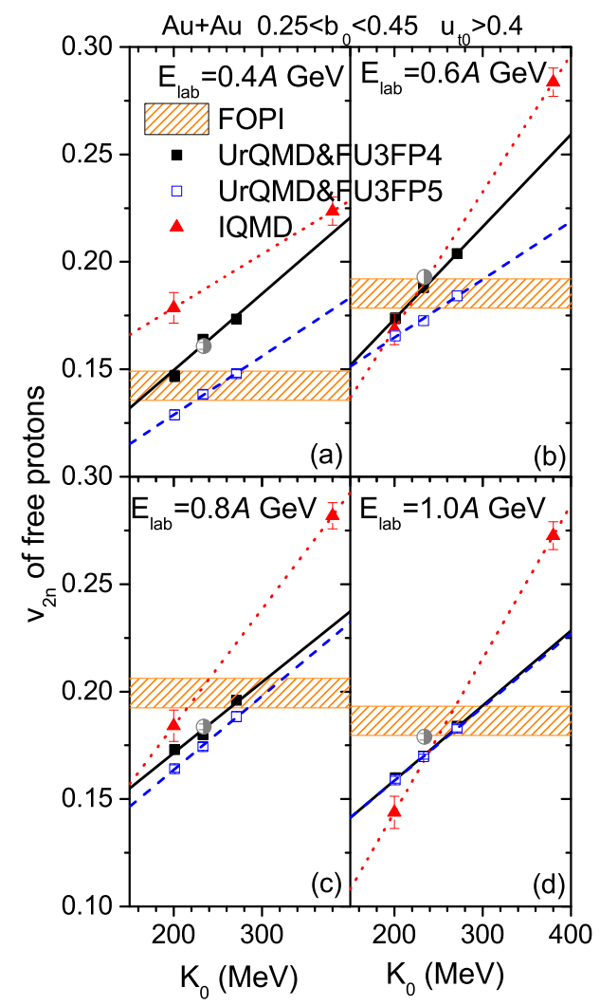
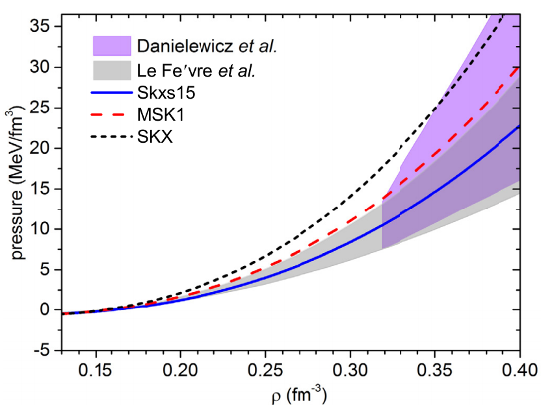
Elliptic flow is a gold min
Determination of the nuclear incompressibility from the
rapidity-dependent elliptic flow in heavy-ion collisions at beam
energies 0.4A–1.0A GeV
Yongjia Wang, et al., Physics Letters B 778 (2018) 207–212.

Slide 10
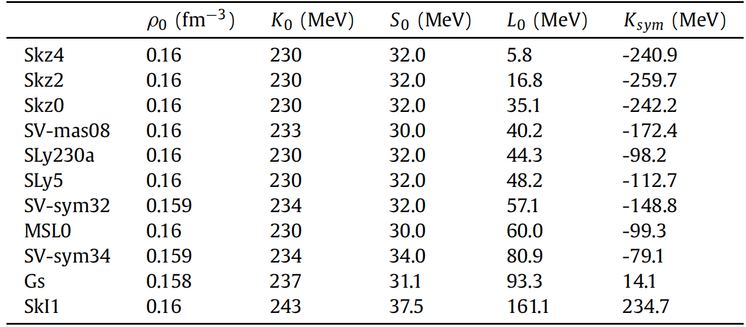
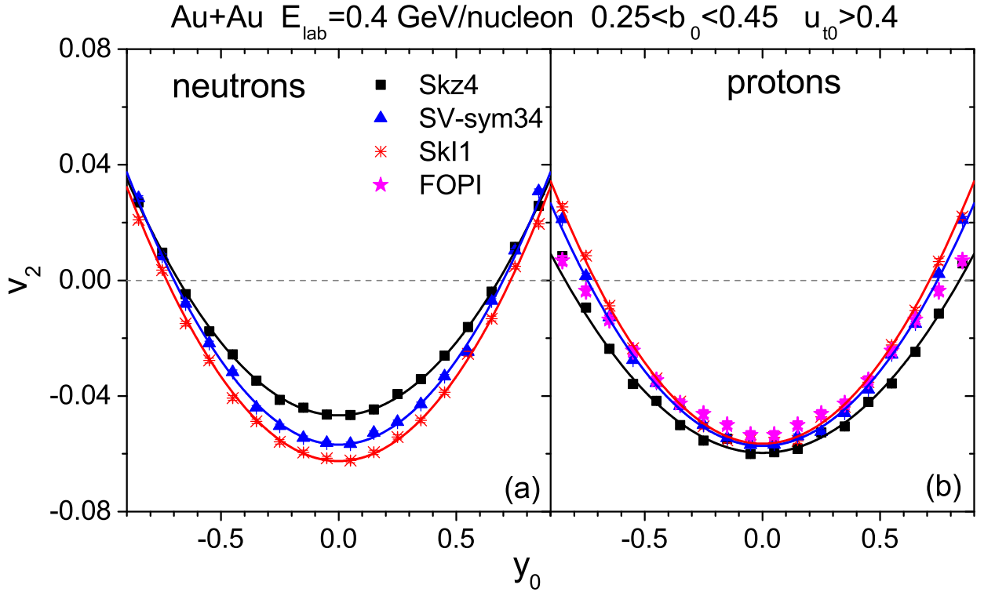
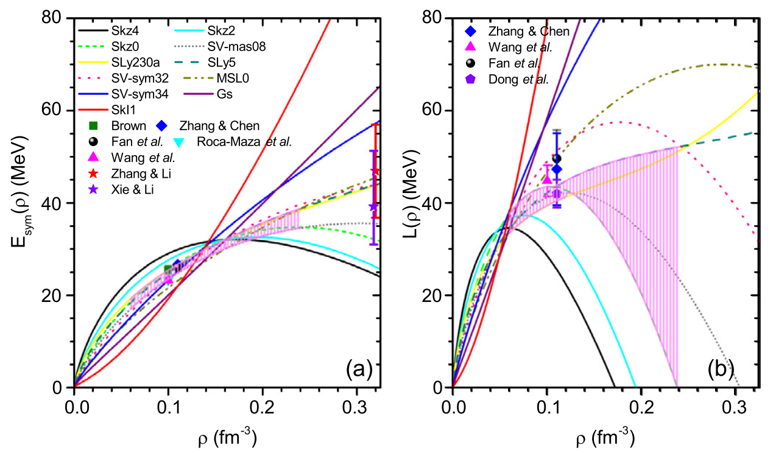
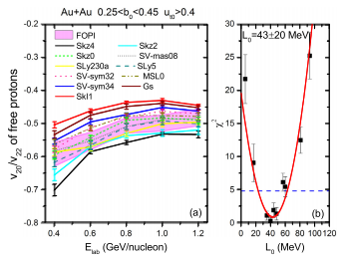
Elliptic flow is a gold min
Yongjia Wang, et al., Physics Letters B 802 (2020) 135249.

Slide 11
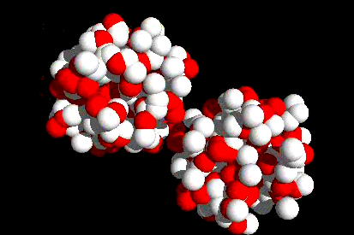

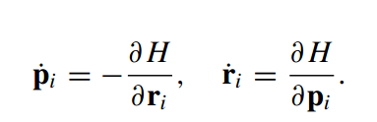
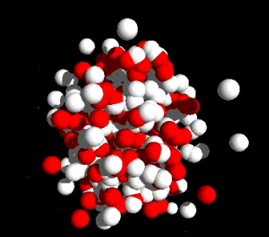
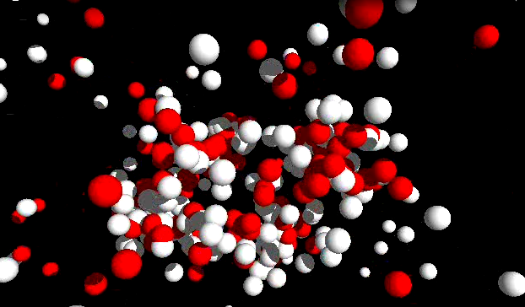
Ultrarelativistic Quantum Molecular Dynamics Model (UrQMD)
1).Initialization
Get the coordinate r
and the momentum p
Input Skyrme forces
EOS, Symmetry energy
2).Propagation
Nucleon moves in the mean-field. Density, momentum, isospin-dependent.
3).Collision term
Medium modified cross section. Density, momentum, isospin-dependent. Pauli blocking.
Input：fσ_{pp}=fσ_{nn} , and fσ_{np}
4). Cluster recognition
an isospin-dependent Minimum Spanning Tree
Then, compare the simulated results with experimental data, one can get the information of EoS and in-medium NN cross section.
PRC 83.044617; 89.034606;

Slide 12
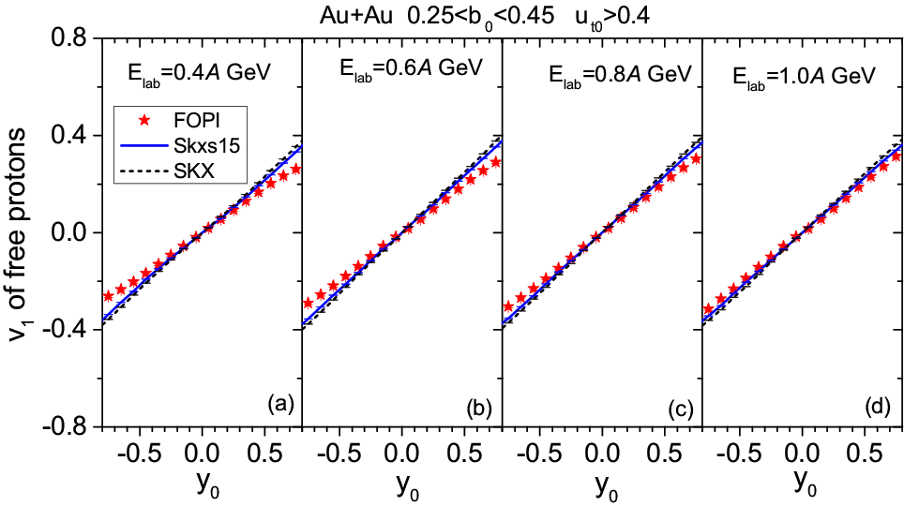
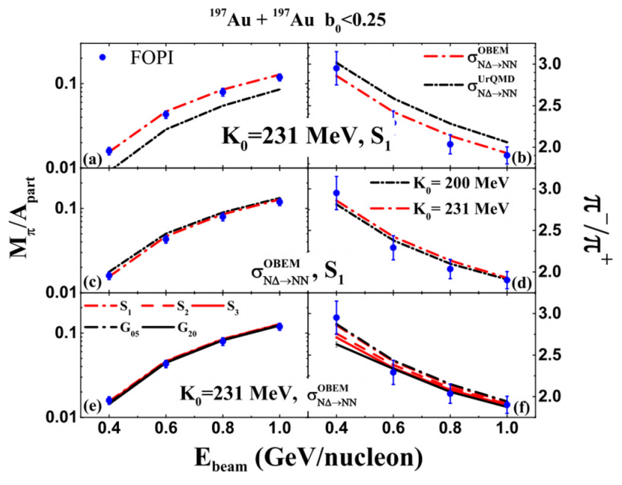
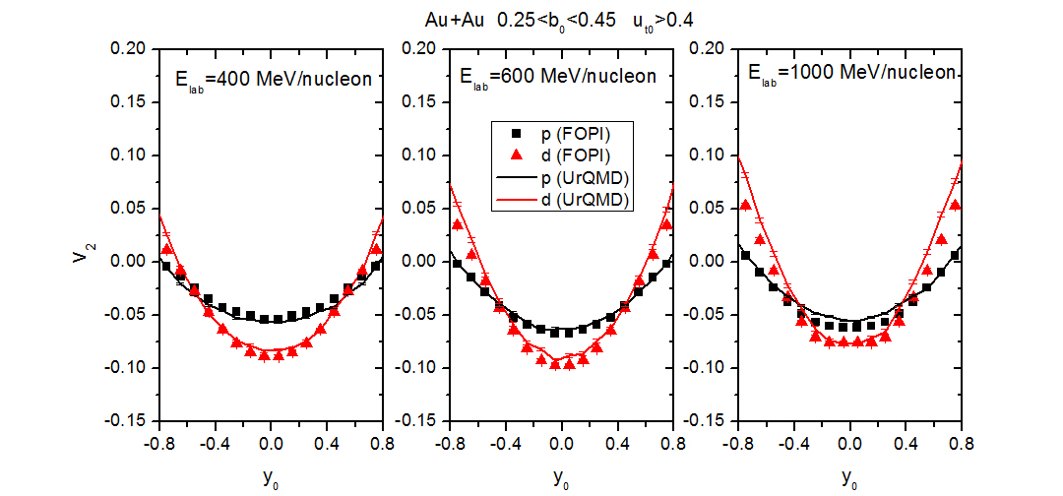
Ultrarelativistic Quantum Molecular Dynamics Model (UrQMD)
PRC83, 044617; PRC89, 034606; PRC97, 044620; PRC97, 034602; Frontiers of Physics, 15(4), 44302 (2020); PLB828, 137019;
PRC103, 014616......

Slide 13
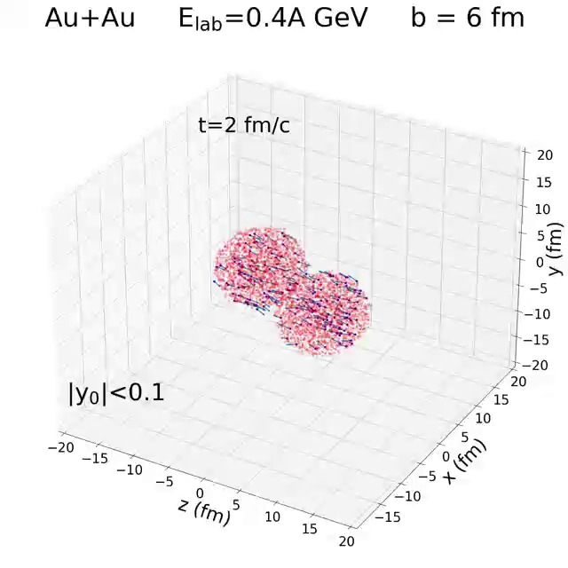
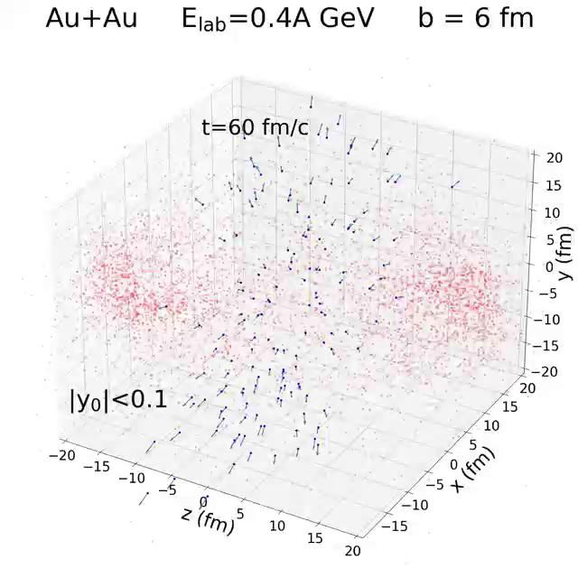



In the framework of transport model, the momentum of each nucleon can be changed either by the force caused by the nuclear mean field (MF) potential or by nucleon-nucleon (NN) scattering.
Reversely tracing nucleons that are finally emitted at mid-rapidity (-0.1<y₀<0.1).
Recording the momentum changes casued by MF and NN collisions.

Slide 14
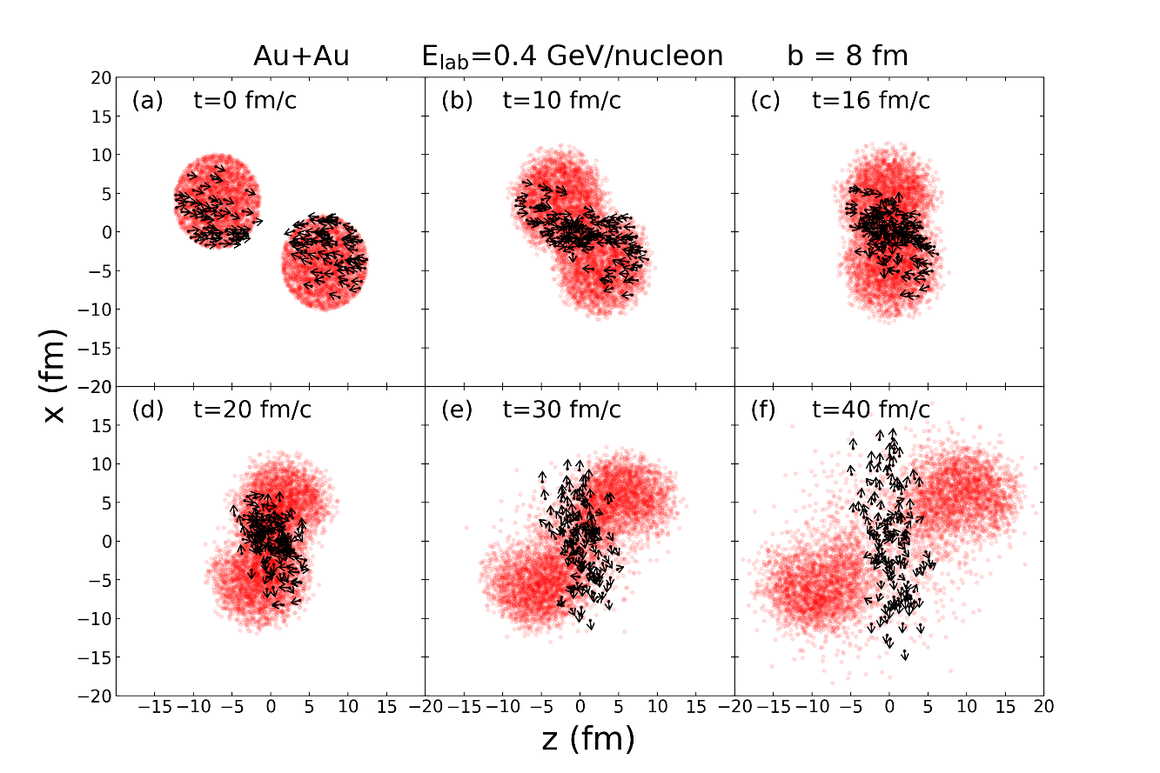
Solid dots with arrows represent the traced nucleons (those will be appeared at mid-rapidity at the final stage), while circles denote other nucleons.
Gao B, Wang Y, Gao Z, et al. Phys. Lett. B, 838 (2023) 137685.

Slide 15
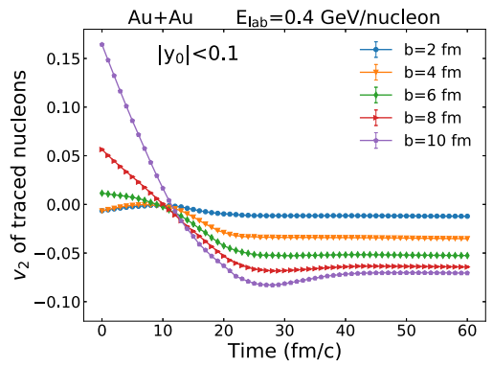
Time evolution of v₂ of the traced nucleons finally emitted at mid-rapidity (|y₀| < 0.1) with different impact parameters.
1. At final stage, elliptic flow increases will increasing b.
2. At the initial time, v₂ is non-zero, indicating that those nucleons are not randomly “selected” out of the uniform distribution in the initial state. This is especially so for large b where v₂(t=0 fm/c) is positive because nucleons with larger |px| and smaller |py| tend to have higher probability to experience NN scattering and finally emerge at midrapidity.
Gao B, Wang Y, Gao Z, et al. Phys. Lett. B, 838 (2023) 137685.

Slide 16
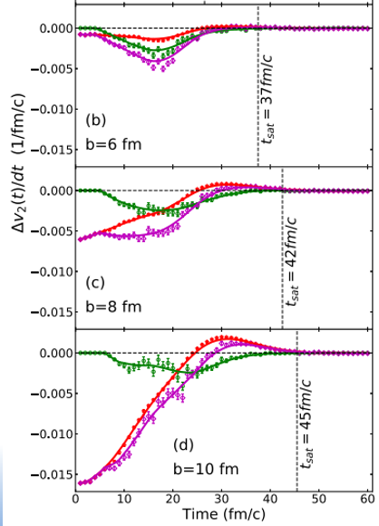
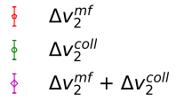
Quantitative attribution of MF and NN effects to v₂ evolution
1. At the initial time, Δv₂^{coll}(t) is zero because it takes approximately 5 fm/c for target and projectile nucleons to encounter each other.
2.Δv₂^{coll}(t) is always negative which indicates NN collision enhances the signal of out-of-plane elliptic flow (decreases the value of v2). This is because the outgoing nucleons along the reaction plane will be blocked.
3.The value of Δv₂^{mf}(t) can be either negative or positive, depending on the impact parameter and time.

Slide 17

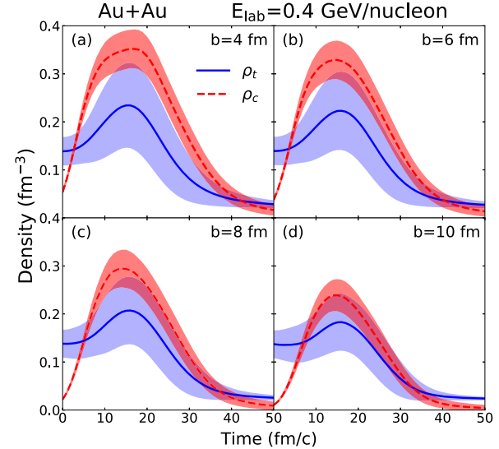
The most relevant density probed by v₂
ρ_{c} denotes the density at the central region.
ρ_{t} denotes the density experienced by the traced nucleons.
The curves and shaded bands denote the mean and the standard deviation.
The most relevant density probed by v₂ of nucleons at mid-rapidity lies in (0.9-1.3)ρ₀ and dependent of the impact parameter. Their values are found to be 60% of the maximum density reached during the collisions.

Slide 18
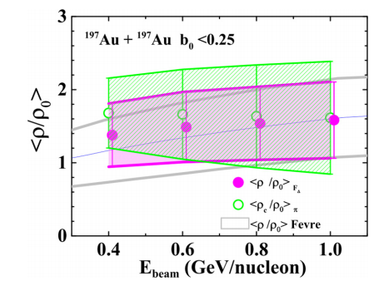


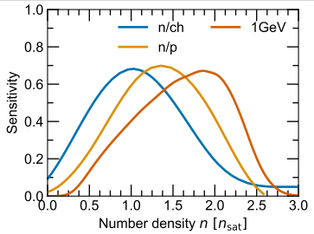

The most relevant density probed by v₂
Liu YY, et al. PRC103, 014616 (2021)
ASY-EOS, PRC 94, 034608 (2016)

Slide 19
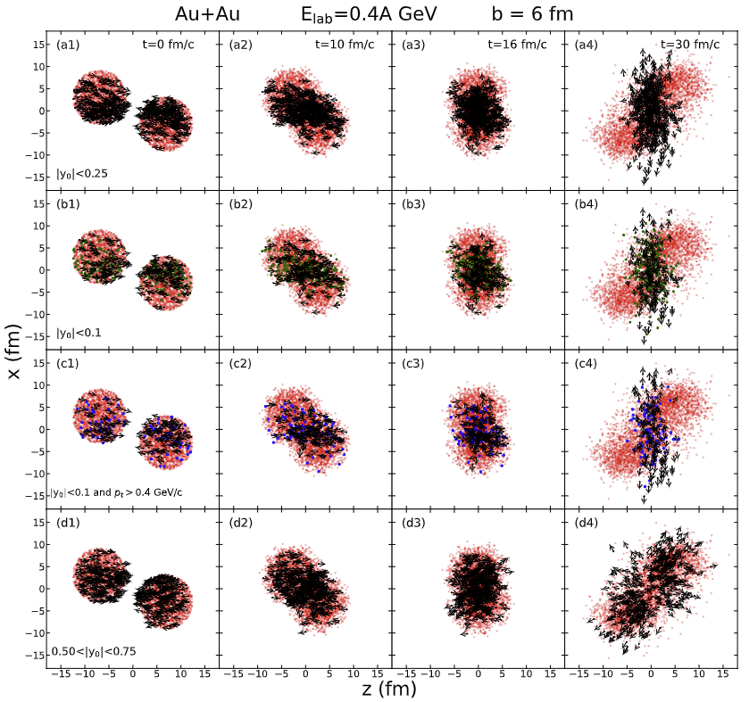
The effects of rapidity and transverse momentum cuts on v₂

Slide 20
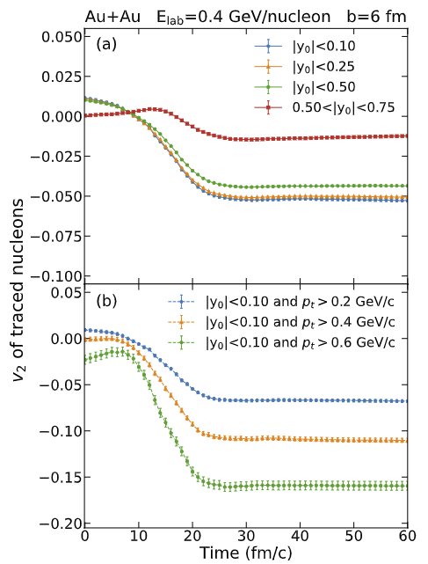
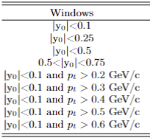

The effects of rapidity and transverse momentum cuts on v₂

Slide 21
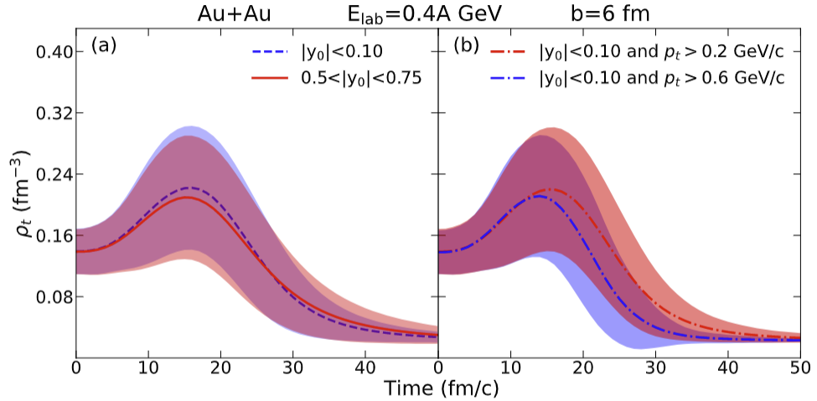
The effects of rapidity and transverse momentum cuts on v₂

Slide 22
Elliptic flow in ¹³²Sn+¹²⁴Sn at beam energy of 270 MeV
-0.25<y₀<0.25

Slide 23
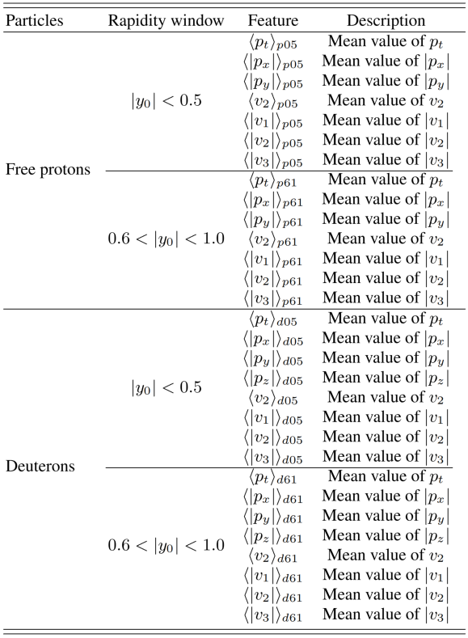
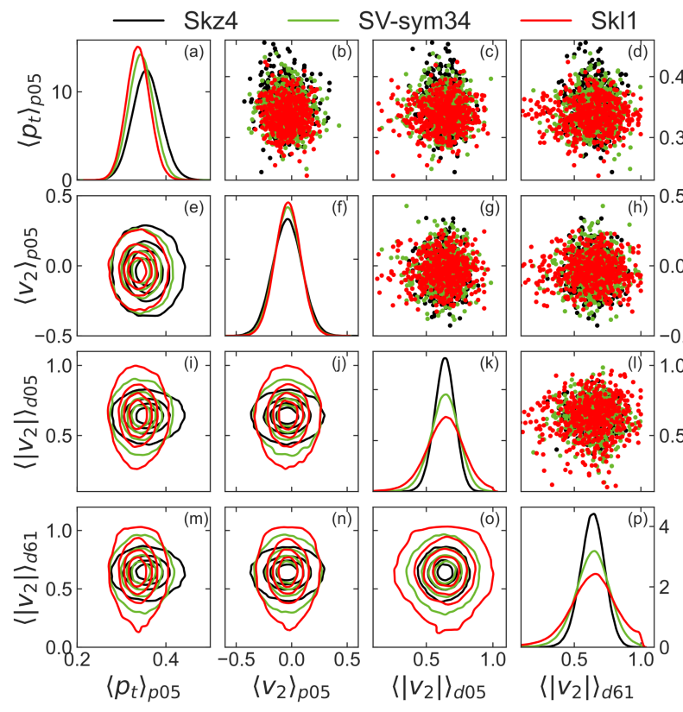
Results from machine learning
Yongjia Wang, et al., Physics Letters B 822 (2021) 136669;
Yongjia Wang, et al., Physics Letters B 835 (2022) 137508.

Slide 24
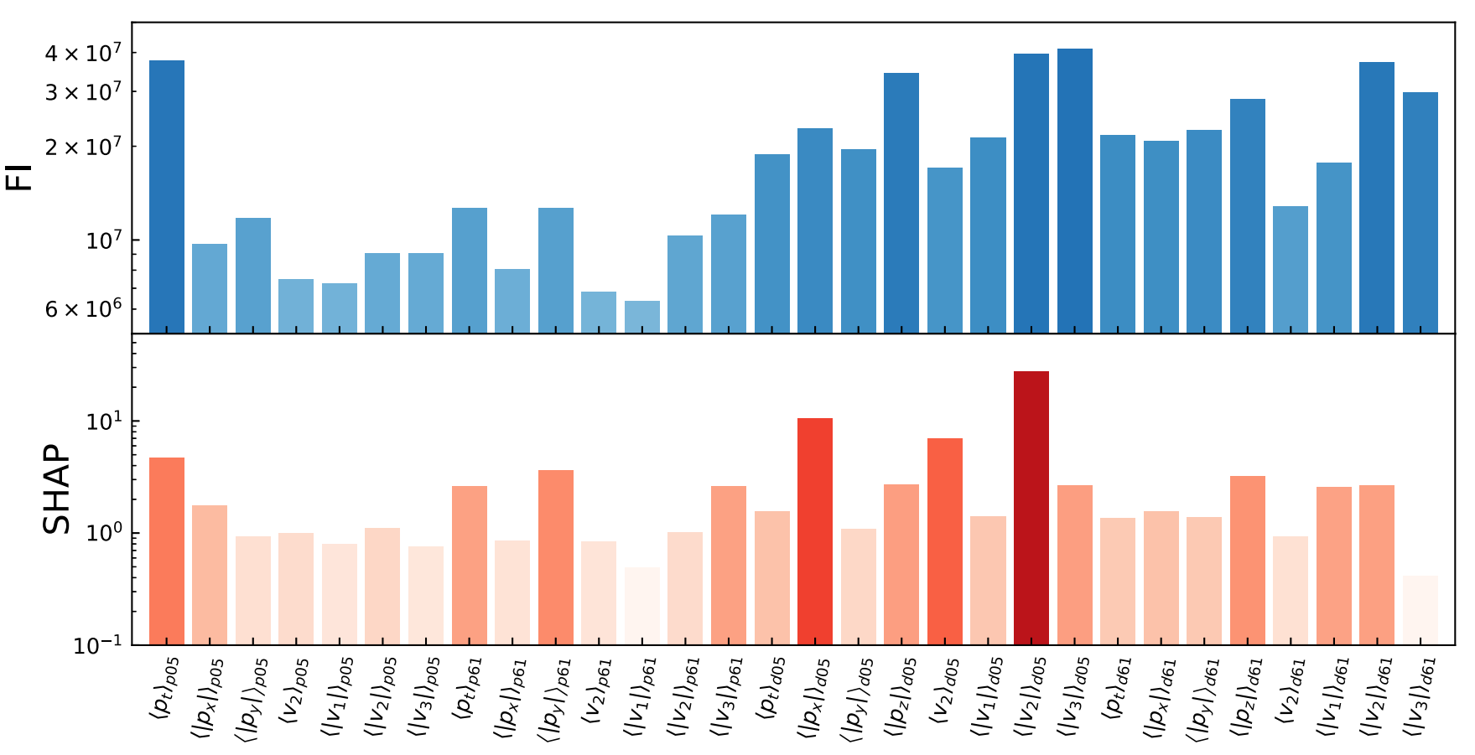
Results from machine learning
The Feature_importance (FI) technology of LightGBM and Shapley additive explanations (SHAP) are two opular feature attribution methods to identify the most important features that drive predictions.
Yongjia Wang, et al., Physics Letters B 822 (2021) 136669;
Yongjia Wang, et al., Physics Letters B 835 (2022) 137508.

Slide 25
Summary
By reversely tracing nucleons finally emitted at mid-rapidity in the entire reaction process, the contributions of MF and NN collisions to the elliptic flow evolution can be studied.
The most relevant density probed by v₂ of nucleons at mid-rapidity lies in (0.9-1.3)ρ₀ and dependent of the impact parameter, in Au+Au collisions at E_{lab}=400 MeV/nucleon.
Thanks for your attention.

