Slide 1

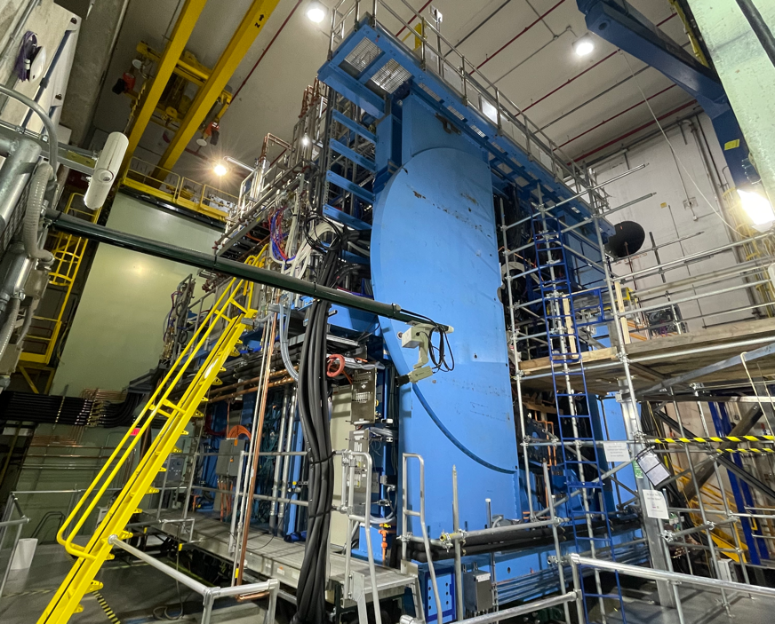



Readiness for physics data taking of sPHENIX experiment at RHIC
RIKEN/RBRC
Itaru Nakagawa

Slide 2

Conclusion
No Physics Yet

Slide 3
Conclusion
sPHENIX is new Jet and heavy flavor Detector at RHIC for QGP and cold-QCD.
Commissioning ongoing.
Some detectors are ready to take physics, while some needs are not yet.

Slide 4
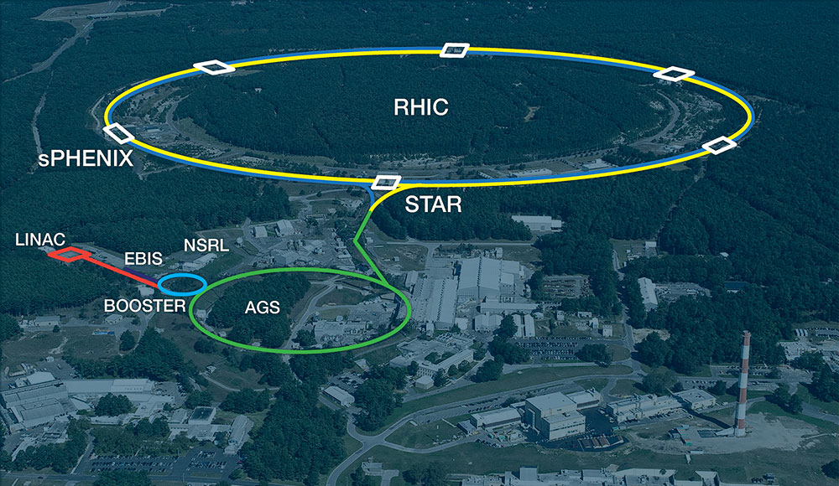
Outline
sPHENIX Physics goals
Detector overview
Installation and commissioning
Commissioning Status

Slide 5
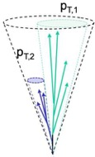
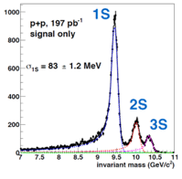
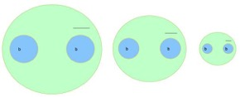
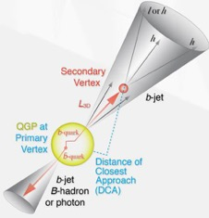



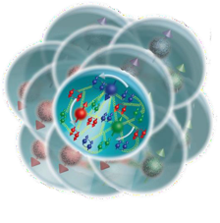
sPHENIX Physics Program
Zhaozhong Shi’s
talk on Thursday 08/24
Υ(1s) 0.28fm
_{Y(3s) 0.78fm} Υ(2s) 0.56fm
vary size of probe
Quarkonium spectroscopy
vary momentum &
angular scale of probe
Jet physics
Parton energy loss
vary mass & momentum of probe
u,d,s
Cold QCD
vary temperature of
QCD matter
study proton spin, transverse-momentum, and cold nuclear effects
c
photon
gluon
b

Slide 6
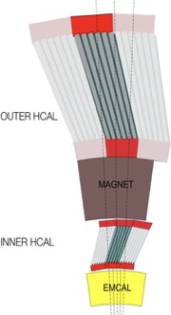
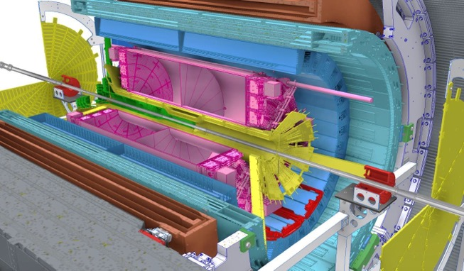




















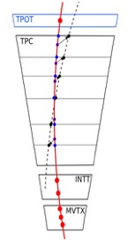






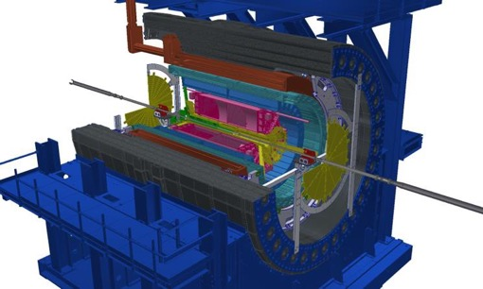




sPHENIX Detector
Calorimeter system
◙ 1.4T Solenoid from BaBar
◙ Hermetic coverage:
|η|<1.1, 2π in φ
◙ Large-acceptance EM+H calorimeters: brings first full jet reconstruction & b-jet tagging at RHIC!!
◙ High data rates: 15 kHz for
all subdetectors
◙ Precise tracking with tracking system in stream readout
sEPD
TPC
iHCal
oHCal
EMCal
MVTX
MBD
iHCal
MAGNET
INTT
oHCal
oHCal
TPOT
2023 : Commissioning Au+Au
2024 : p+p
2025 : Au+Au
Tracking
system
$\sqrt{s}=$200GeV
2023 Jan
May
Aug
Oct
Install
Beam Commissioning
Physics

Slide 7

sPHENIX Detector
Calorimeter system
◙ 1.4T Solenoid from BaBar
◙ Hermetic coverage:
|η|<1.1, 2π in φ
◙ Large-acceptance EM+H calorimeters: brings first full jet reconstruction & b-jet tagging at RHIC!!
◙ High data rates: 15 kHz for
all subdetectors
◙ Precise tracking with tracking system in stream readout
sEPD
TPC
iHCal
oHCal
EMCal
MVTX
MBD
iHCal
MAGNET
INTT
oHCal
oHCal
TPOT
2023 : Commissioning Au+Au
2024 : p+p
2025 : Au+Au
Tracking
system
$\sqrt{s}=$200GeV
2023 Jan
May
Aug
Oct
Install
Beam Commissioning
Physics

Slide 8
sPHENIX Detector
Calorimeter system
◙ 1.4T Solenoid from BaBar
◙ Hermetic coverage:
|η|<1.1, 2π in φ
◙ Large-acceptance EM+H calorimeters: brings first full jet reconstruction & b-jet tagging at RHIC!!
◙ High data rates: 15 kHz for
all subdetectors
◙ Precise tracking with tracking system in stream readout
sEPD
TPC
iHCal
oHCal
EMCal
MVTX
MBD
iHCal
MAGNET
INTT
oHCal
oHCal
TPOT
2023 : Commissioning Au+Au
2024 : p+p
2025 : Au+Au
Tracking
system
$\sqrt{s}=$200GeV
2023 Jan
May
Aug
Oct
Install
Cosmic
Beam Commissioning
Physics

Slide 9
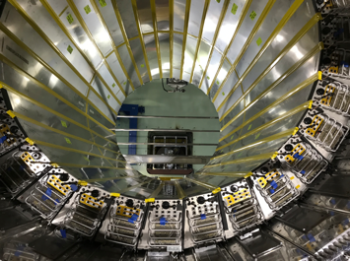
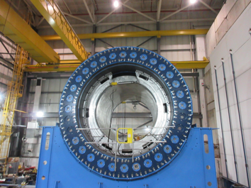
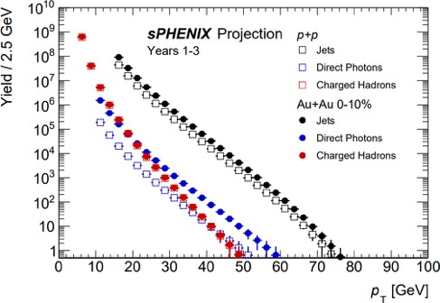
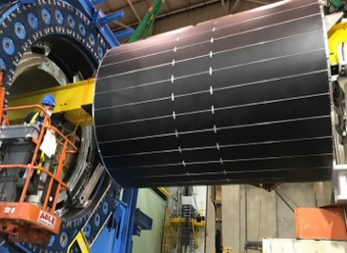
Hadron and EM Calorimeters
EMCal in position
Outer Hcal & Magnet
Outer HCal Installation
sPHENIX Simulation
Inner HCal Installation
sPHENIX will have kinematic reach out to ∼ 70 GeV for jets, kinematic overlap with the LHC.

Slide 10
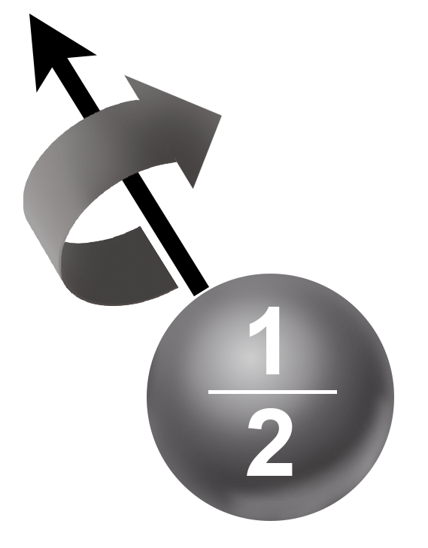
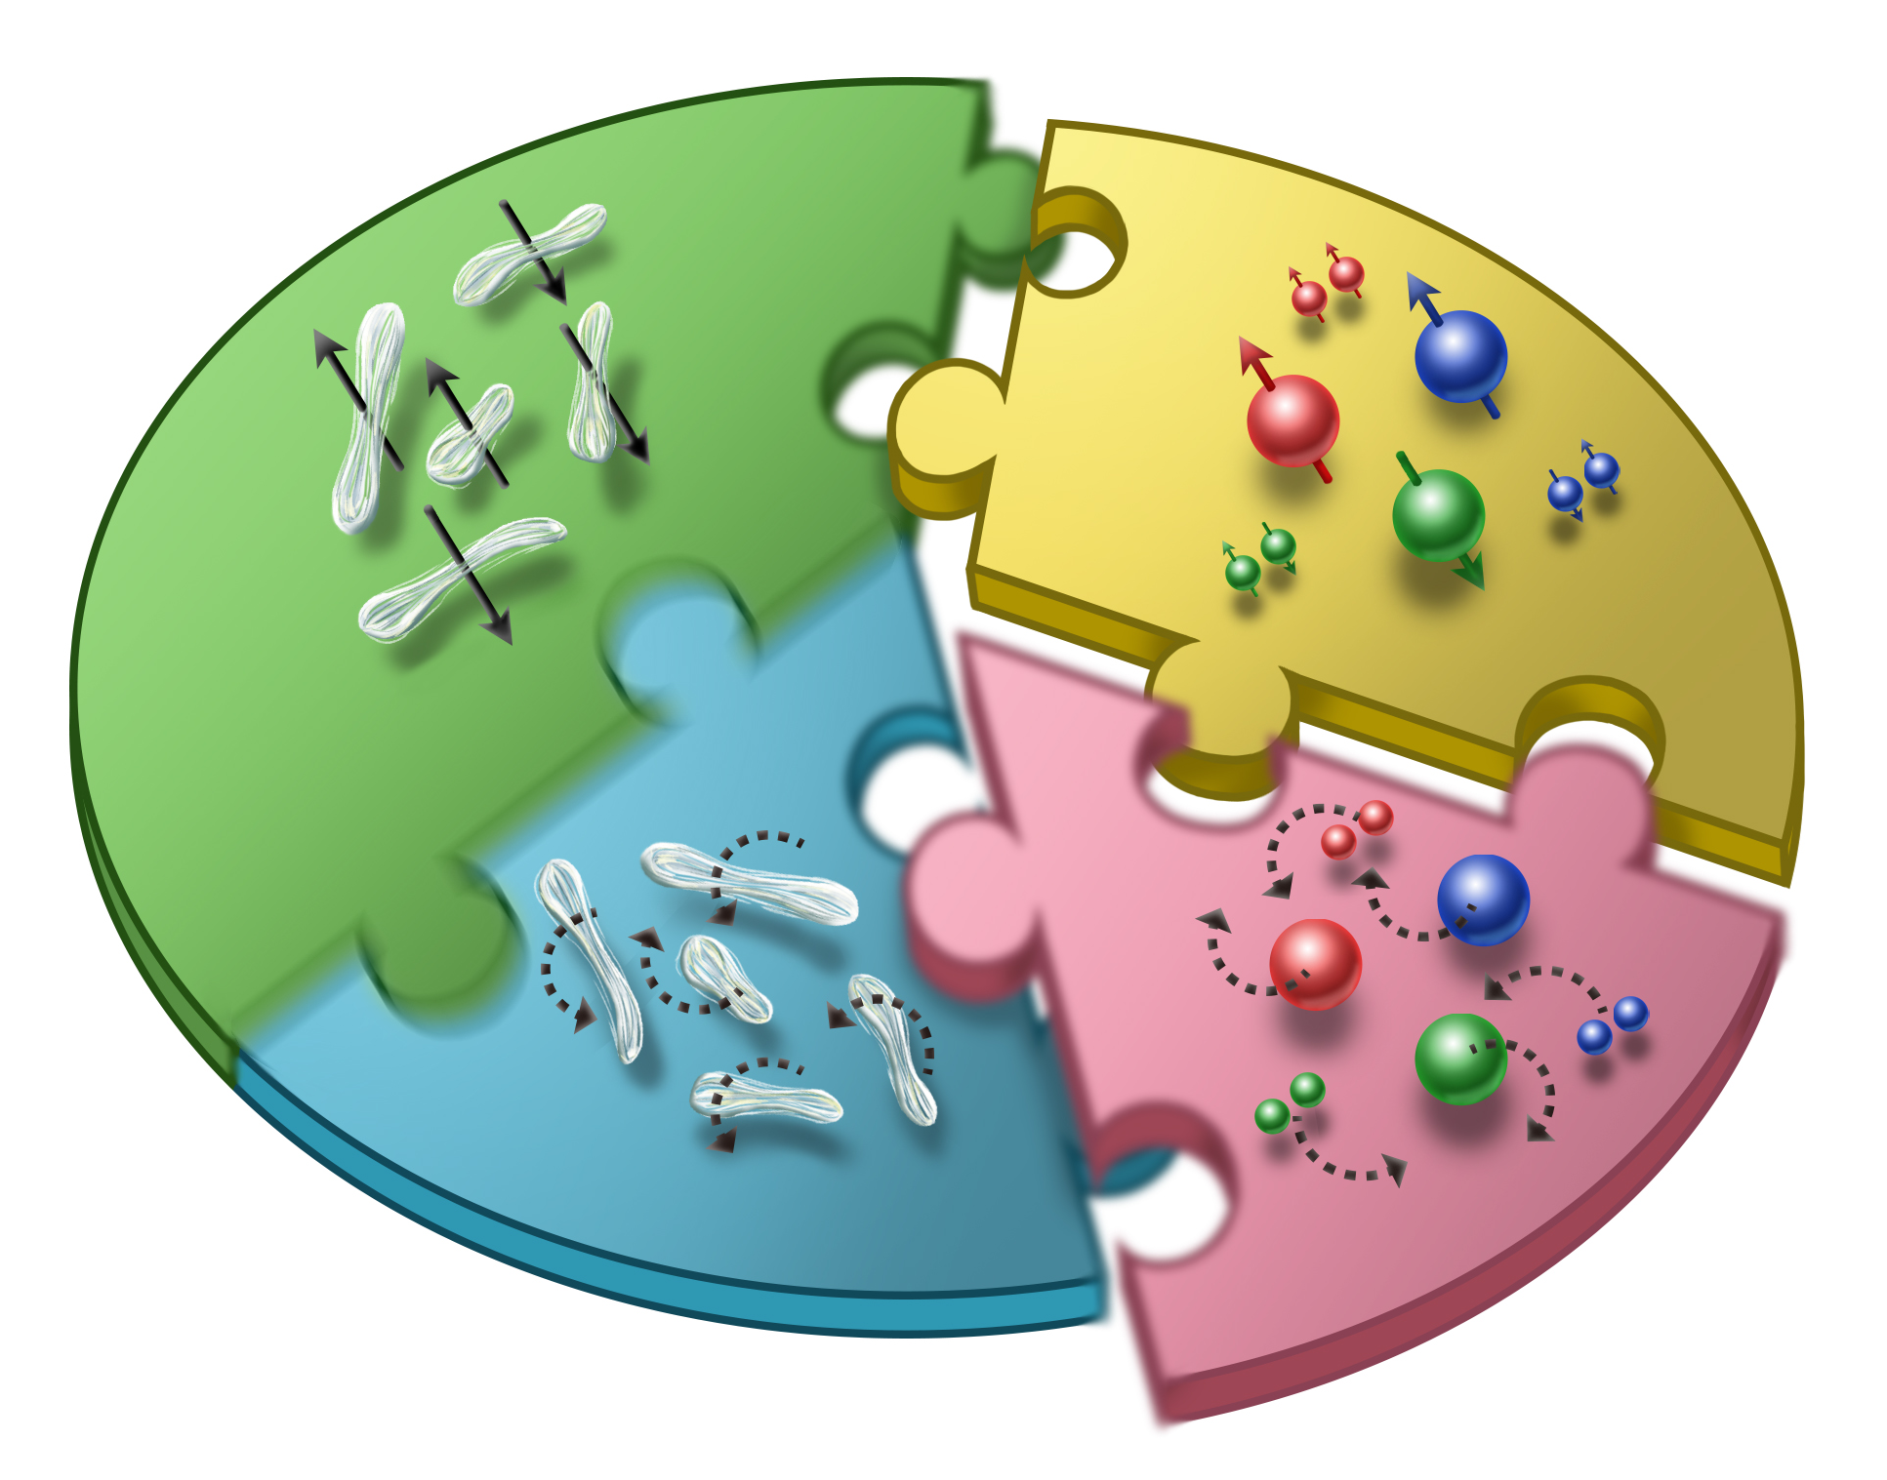




Cold-QCD: Proton Spin Decomposition
Quark
$$ΔΣ :Quark Spin$$
$$Orbital Angular Momentum$$
~25%
~40%
??
Gluon
$$ΔG:Gluon Spin$$
1980’s
2000~2018

Slide 11
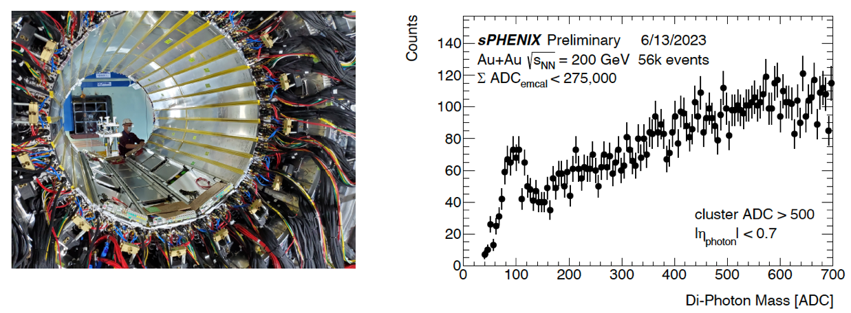
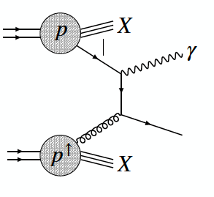

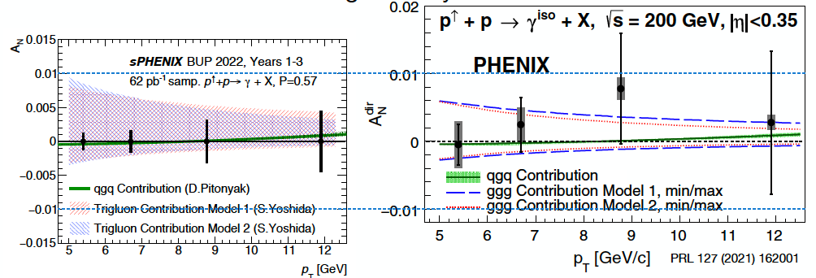
Gluon TMD by Direct-γ
TMD: Transverse Momentum Dependence
Much improved direct photon TSSA -> gluon TMD

Slide 12
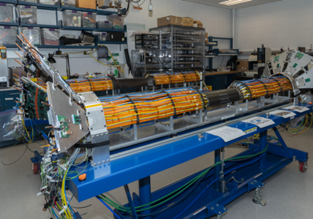
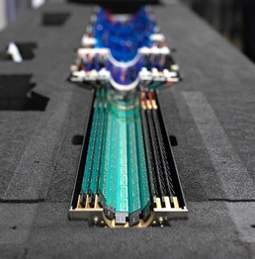
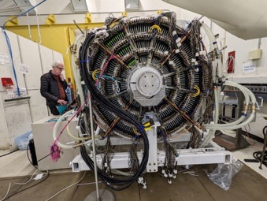
Tracking Detectors
MVTX
INTT
TPC
TPOT
All Trackers installed in Position (March 30th, 2023)

Slide 13
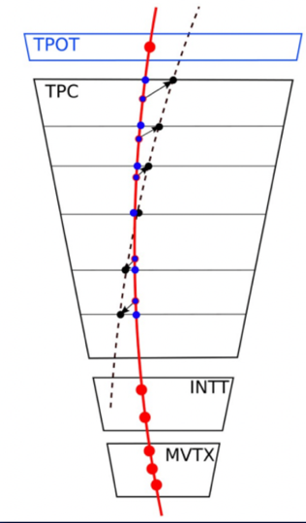
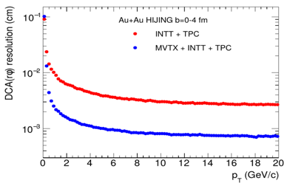
Tracking System
Cosmic Ray Track Reconstruction
Silicon pixel detector (MVTX)
  29 um x 27 um, pixels
  2.5 cm < R < 4.5cm
  20 BLCK integration time
Silicon strip detector (INTT)
  78um, strip sensors
  7cm < R < 11cm
  1 BCLK timing resolution
Time projection Chamber (TPC)
  20cm < R < 78cm
  Spatial resolution, ~100um
  Long drift time, ~13us
TPC Outer Tracker (TPOT)
  Calibrate TPC
MVTX
INTT
TPOT
MVTX
INTT
TPOT
10um

Slide 14
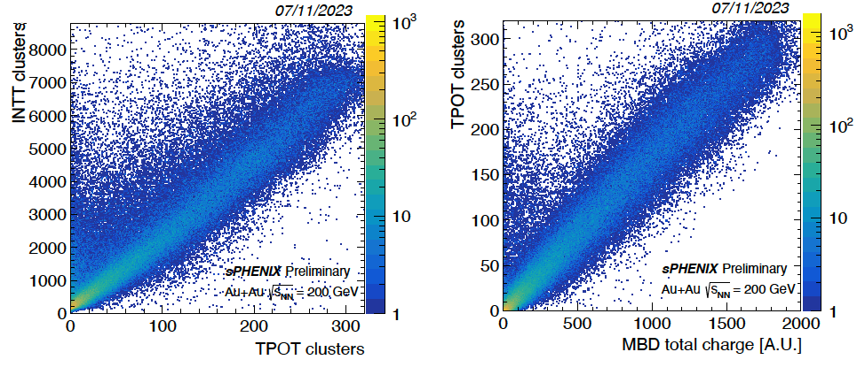
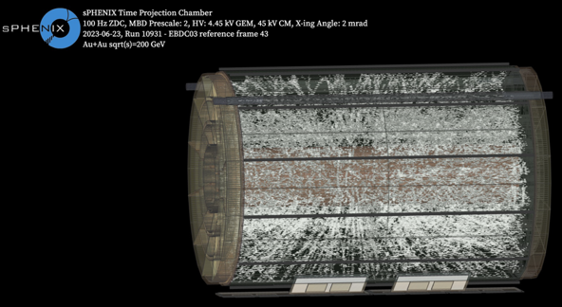
Tracking Detector Commissioning
sPHENIX Simulation
TPC Event Display in Au+Au @ 200GeV
Multiplicity correlations between MBD-INTT-TPOT
MVTX correlation between different layers
More correlation hits in Zhaozhong Shi’s talk on Thursday 08/24
Clear separation between 2S and 3S states

Slide 15
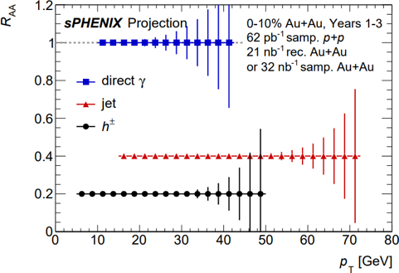
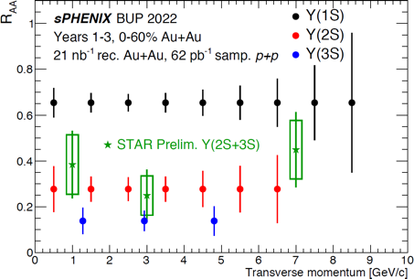
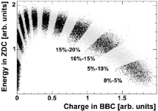
Vertex Reconstruction & Centrality
sPHENIX Simulation
INTT-MBD Z-vertex Reconstruction
MBD-ZDC Centrality
preliminary
Phys. Rev. C 71, 034908 (2005)
Published Centrality plot in PHENIX
Confirmed fairly consistent z-vertex reconstruction between two independent detectors

Slide 16
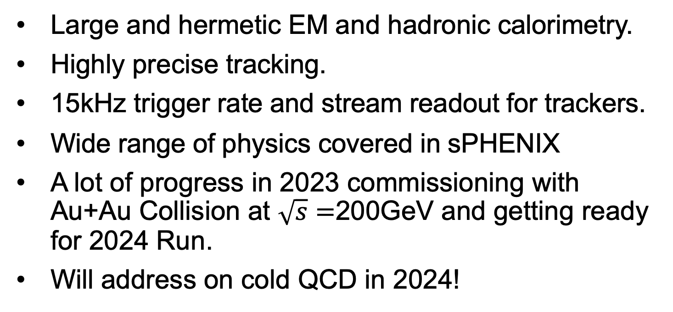
sPHENIX Summary
Quarkonium spectroscopy
Jet Physics
Large and hermetic EM and hadronic calorimetry.
Highly precise tracking.
15kHz trigger rate and stream readout for trackers.
Wide range of physics covered in sPHENIX
A lot of progress in 2023 commissioning with Au+Au Collision at $\sqrt{s}=$200GeV and getting ready for 2024 Run.
Will address on cold QCD in 2024!
Heavy Flavor
Cold QCD

Slide 17
Backup Slides

Slide 18
Jet Physics
High-p_{T} Probes
Probing the QGP with precise jet, direct photon, and hadron measurements
High data rates & hermetic EMCal+HCal offer wide p_{T} range for jet reconstruction.
sPHENIX can precisely measure the low p_{T} region, which is challenging at the LHC.
sPHENIX will have kinematic reach out to ∼ 70 GeV for jets, kinematic overlap with the LHC.

Slide 19
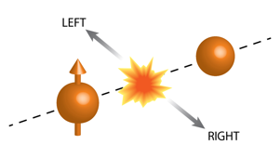
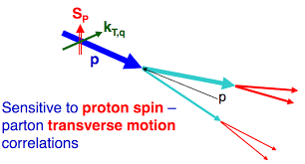
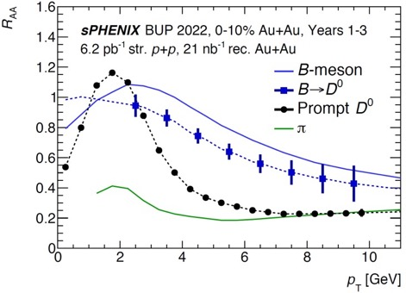

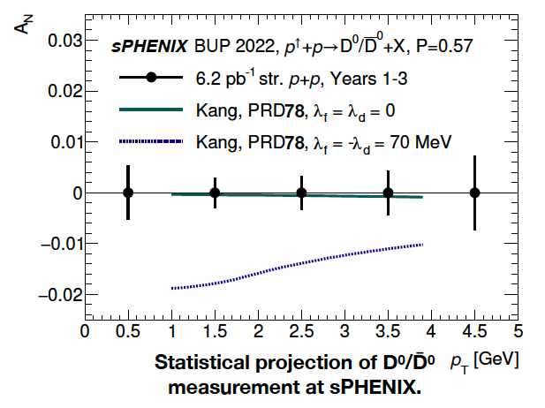
Heavy Flavor
Polarized single spin asymmetry
Cleanly separate open bottom via DCA.
Study mass dependence of energy loss and collectivity.
Bottom quarks and light quarks are expected to be different for RAA and v2 for pT ≲ 15 GeV.
Explores gluon spin contribution to proton spin

Slide 20
Cold QCD : Gluon TMD with Direct photons
Much improved direct photon TSSA -> gluon TMD

Slide 21
First Data from Commissioning: EMCal
Clear pi0 peak seen in the di-photon invariant mass spectrum

Slide 22
Heavy Flavor
Polarized single spin asymmetry
Cleanly separate open bottom via DCA.
Study mass dependence of energy loss and collectivity.
Bottom quarks and light quarks are expected to be different for RAA and v2 for pT ≲ 15 GeV.
Explores gluon spin contribution to proton spin

Slide 23
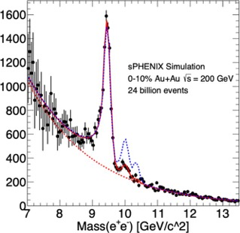
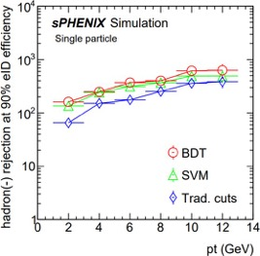
Quarkonium spectroscopy
Upsilon R_{AA}
Mass reconstruction
Suppression with clear distinction of three Upsilon states. Color
dipoles probing the QGP at three length scales.
The centrality dependence and particularly the p_{T} dependence are critical measurements for comparison between RHIC and the LHC.
Signal enhancement with ML tools (BDT) is expected.

