Slide 1
An advanced Si pixel sensor for the electron end cap tracker of the ePIC experiment
Y. Kwon, T. Y. Park, T. J. Kim, J. H. Kim, Y. H. HAN, G. H. Hong
(Yonsei University)
S. H. Lim, J. S. Bok
(Pusan National University)
EIC-Asia Meeting, May. 2023

Slide 2
Contents
Electron-Ion Collider(EIC) & Opportunities
High luminosity, polarized $e^{′}s$ on polarized $p^{′}s$ and ions,
High collision energy, gluons in the nucleon and nuclei
ECCE, a studies of the multi-purpose detector designs
ITS3, ALICE@CERN
Endcap tracker, electron-going side
Key features
Improved performances
Summary
EIC-Asia Meeting, May. 2023

Slide 3
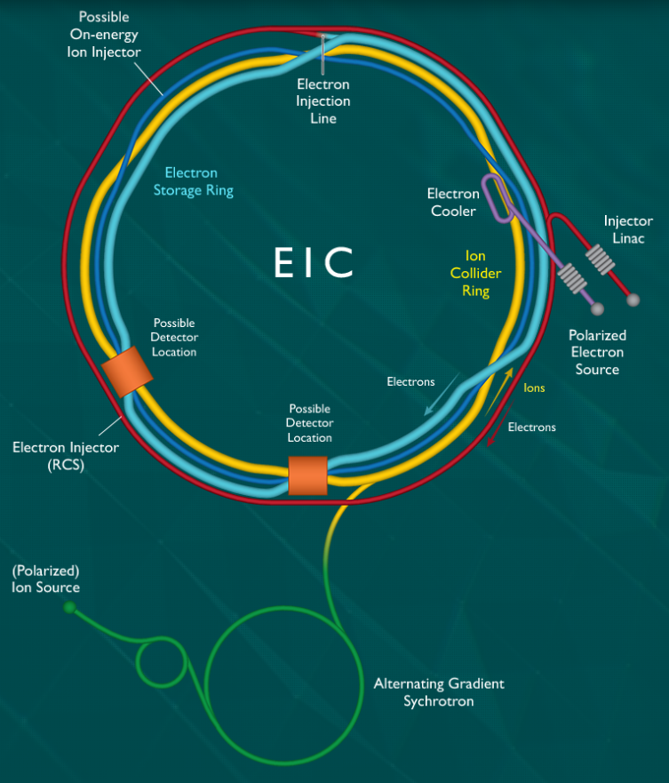
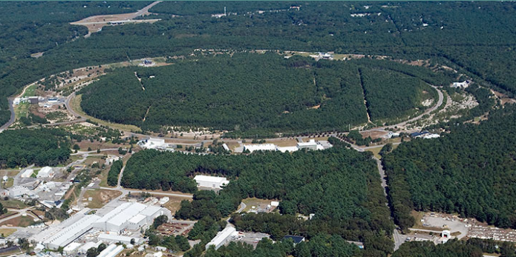
Electron-Ion Collider(EIC) & Opportunities
A collider to be built at BNL, U.S.A., https://www.bnl.gov/eic/machine.php

Slide 4
High luminosity, Polarized $e^{′}s$ on polarized $p^{′}s$ and ions
EIC vs. HERA
Somewhat smaller center-of-mass energy
Much higher luminosity
e/p/ion polarization
Heavy targets
Advanced detectors?
EIC-Asia Meeting, May. 2023
4

Slide 5
High collision energy, gluons in the nucleon and nuclei
$$e\left(k\right)+p\left(P\right)→e\left(k′\right)+p\left(P′\right)+J/Ψ\left(v\right)$$
Gluons with $x\sim {10}^{−3}$ → Probe to control spin, nuclear binding force & structure
EIC-Asia Meeting, May. 2023
5

Slide 6
High collision energy, gluons in the nucleon and nuclei
$k^{μ}=\left(\begin{matrix}E_{e} & 0 & 0 & {−E}_{e}\end{matrix}\right)$
${k^{′}}^{μ}=$ $\left(\begin{matrix}E_{e}′ & E_{e}′\sin{θ} & 0 & −E_{e}′\end{matrix}\cos{θ}\right)$
$q^{μ}=\left(\begin{matrix}E_{e}−E_{e}′ & −E_{e}′\sin{θ} & 0 & −E_{e}+E_{e}′\end{matrix}\cos{θ}\right)$
$P_{p}^{μ}=γ_{p}M_{p}\left(1,0,0,β_{p}\right)$
$Q^{2}=−{\left(k−k^{′}\right)}^{2}=2k⋅k^{′}=4E_{e}E_{e}^{′}\sin^{2}{\frac{θ}{2}}$
$x=\frac{Q^{2}}{2P⋅q}≈\left(\frac{E_{e}}{γ_{p}M_{p}}\right)⋅\left(\frac{E_{e}′}{E_{e}}\right)⋅\frac{\sin^{2}{\frac{θ}{2}}}{\left(1−\frac{E_{e}′}{E_{e}}\cos^{2}{\frac{θ}{2}}\right)}$
$t={\left(P−P^{′}\right)}^{2}={\left(v−q\right)}^{2}$
$W^{2}={\left(q+P\right)}^{2}$
$$e\left(k\right)+p\left(P\right)→e\left(k′\right)+p\left(P′\right)+J/Ψ\left(v\right)$$
Missing mass: $P^{′}=P+k−k^{′}−v$
EIC-Asia Meeting, May. 2023
6

Slide 7
ECCE, a studies of the multi-purpose detector designs
arXiv:2209.02580v1 [physics.ins-det] 6 Sep 2022
EIC-Asia Meeting, May. 2023
7

Slide 8
ECCE, a studies of the multi-purpose detector designs
Gap in $\frac{δp}{p}$ when compared to physics requirement! (EIC Yellow Report)
EIC-Asia Meeting, May. 2023
8

Slide 9
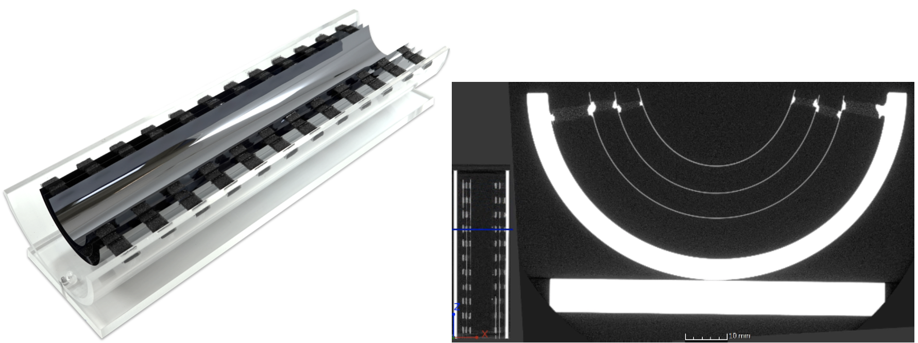
ITS3, ALICE@CERN
An advanced Si pixel sensor, signal processing & digitization within pixel,
fabricated by ‘stitching’, a special CMOS process technology.
ALICE ITS3 ER1: a prototype with arial dimension $260 \left(mm\right) ×14 \left(mm\right)×6$,
pixel resolution(pitch): 5.2(18) $μm$, sensor: thinned down to 30 $μm$.
EIC-Asia Meeting, May. 2023
9

Slide 10
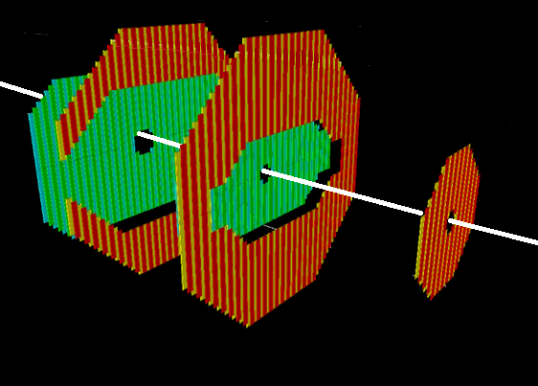
Endcap tracker, Electron-going side
The Considered Korean Detector Concept
EIC-Asia Meeting, May. 2023

Slide 11
Key features
$p_{T}\left[GeV\right]=0.3B\left[T\right]ρ\left[m\right] → s≈\frac{0.3}{8}\frac{L^{2}B}{p_{T}}$
$B,L$ nearly fixed.
Babar
MARCO (~30% stronger)
Measurements of $s$ depend on
position resolution
and multiple scattering
3 layers of advanced Si pixel sensor?... Not enough!
EIC-Asia Meeting, May. 2023
11

Slide 12
Key features
Measurements of $s$ depend on
Position resolution
and Multiple scattering
Advanced Si pixel sensor?... Not enough!
Multiple scattering
30($μ$)-thick Si: $0.032\% X_{0}$
1(m)-thick air: $0.33\% X_{0}$
EIC-Asia Meeting, May. 2023
12

Slide 13
Key features
Measurements of $s$ depend on
Position resolution
and Multiple scattering
Advanced Si pixel sensor?... Not enough!
Multiple scattering
30($μ$)-thick Si: $0.032\% X_{0}$
He-bag for the advanced Si sensor
1(m)-thick He: $0.018\% X_{0}$
50($μ$)-thick Mylar: $0.013\% X_{0}$
EIC-Asia Meeting, May. 2023
13

Slide 14
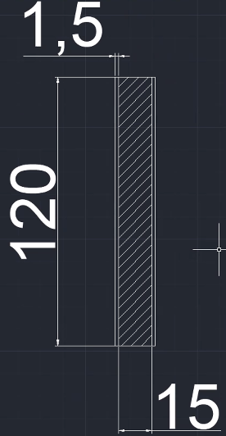
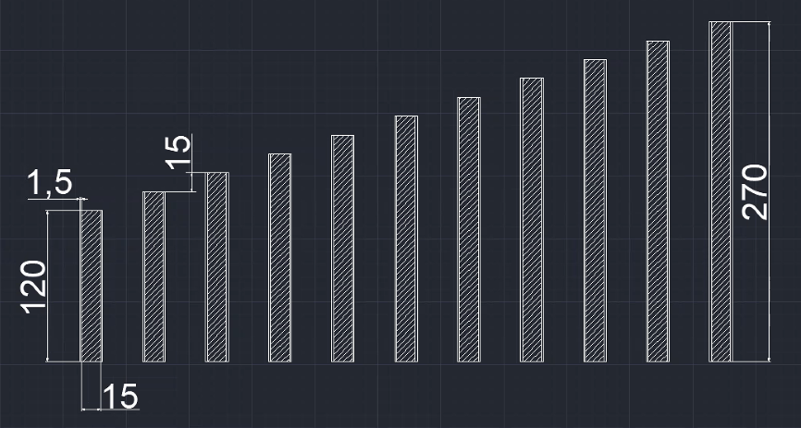
Key features
Varying length strips with width $18 (mm)$ to approximate any shape, motivated by the ALICE ITS3 ER1.
$18 (mm)$ to minimize stitching and maximize yield.
units in mm
EIC-Asia Meeting, May. 2023
14

Slide 15
Key features
Layer 0
Layer 1
Sensors are arranged to cover the acceptance
with minimum overlaps and signal cable routing in the active region.
EIC-Asia Meeting, May. 2023
15

Slide 16
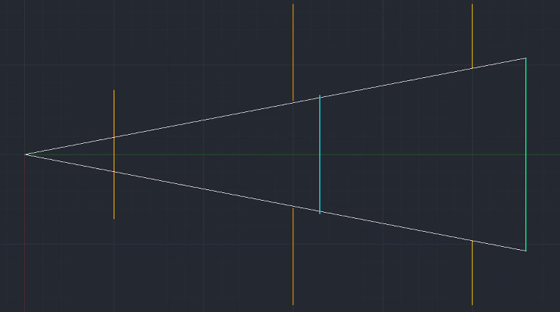
Key features
Longer lever arm for the inner sensors to maximize effective $B,$ and $L.$
EIC-Asia Meeting, May. 2023
16

Slide 17
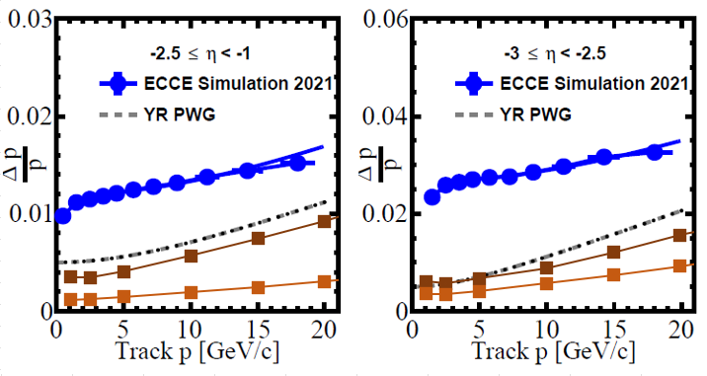
Improved performances
EIC-Asia Meeting, May. 2023
17

Slide 18
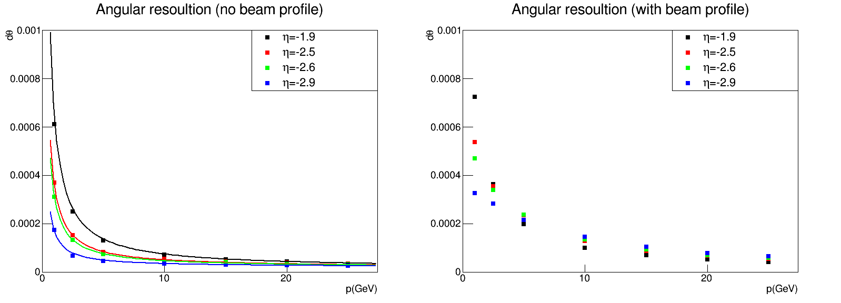
Improved performances
Precise collision location $\left(σ_{x}=50μ,σ_{y}=50μ, σ_{z}=100μ\right)$
Still large uncertainties in the angle, but it’s smaller than ${10}^{−3}!$
EIC-Asia Meeting, May. 2023
18

Slide 19
Improved performances
Resolution
for all charged tracks
$$\frac{σ\left(p\right)}{p}=\sqrt{0.5\%+0.05\%p^{2}}$$
$$σ\left(θ\right)=0.001$$
$$σ\left(φ\right)=0.001$$
eSTARlight, 5 (GeV) e + 100 (GeV) p
19
EIC-Asia Meeting, May. 2023

Slide 20
Improved performances
Resolution
for all charged tracks
$$\frac{σ\left(p\right)}{p}=\sqrt{0.5\%+0.05\%p^{2}}$$
$$σ\left(θ\right)=0.01$$
$$σ\left(φ\right)=0.01$$
eSTARlight, 5 (GeV) e + 100 (GeV) p
EIC-Asia Meeting, May. 2023
20

Slide 21
Improved performances
Resolution
for all charged tracks
$$\frac{σ\left(p\right)}{p}=\sqrt{1.0\%+0.1\%p^{2}}$$
$$σ\left(θ\right)=0.001$$
$$σ\left(φ\right)=0.001$$
eSTARlight, 5 (GeV) e + 100 (GeV) p
EIC-Asia Meeting, May. 2023
21

Slide 22
Improved performances
Resolution
for all charged tracks
$$\frac{σ\left(p\right)}{p}=\sqrt{2.0\%+0.2\%p^{2}}$$
$$σ\left(θ\right)=0.001$$
$$σ\left(φ\right)=0.001$$
eSTARlight, 5 (GeV) e + 100 (GeV) p
EIC-Asia Meeting, May. 2023
22

Slide 23
Kinematic distribution, μ from $J/ψ$
5 (GeV) e + 100 (GeV) p
EIC-Asia Meeting, May. 2023

Slide 24
Summary
We explored a detector concept for ePIC which will overcome the shortcoming, specifically the momentum resolution in the backward region, reported by the previous study ECCE.
From this preliminary study, we believe sensors in the R&D effort, ITS3, ALICE@CERN, will achieve the goal with a few considered optimizations.
Improved momentum resolution will play an important role when we reconstruct so called missing mass to measure the exclusive $J/ψ$ electroproduction off the nuclei.
We will initiate the process to prove the introduced concept to a larger audience, the ePIC collaboration.
EIC-Asia Meeting, May. 2023

