Slide 1
The 2nd irradiation test in 2023
29th of June, 2023.
Motoi INABA
for the ALICE collaboration
Tsukuba University of Technology, Faculty of Industrial Technology.
National University Corporation for the hearing impaired and visually impaired in Japan.

Slide 2
Overview
P.2 of 5
Date
6th and 7th of July, 2023.
Place
Riken RANS
Sensors
P-type monitor PD,
P-type 1x1 baby,
P-type 2x2 baby,
P-type main sensor.
No n-type sensor,
No LDO this time.
Member (from Tsukuba)
犬飼 泰地 (Taichi Inukai), 奥井 渓太 (Keita Okui),
伊東 昴 (Subaru Ito), 依田 浩志郎 (Kohsirou Yoda),
Jonghan Park, 中條 達也 (Tatsuya Chujo), 稲葉 基 (Motoi Inaba)

Slide 3
Schedule (1)
P.3 of 5
Open the box
6th of July, 2023.
8 AM
12 PM
5 PM
8 PM
Preparation of the measurement system (1h)
Preparation of the indium foils (1h)
Pre-measurement (1h)
1st run with 10% intensity (1h)
1st measurement (1h)
2nd run with 100% intensity (1h)
2nd measurement (1h)
3rd, 4th and 5th runs (3h)
The indium foils will be removed.
Measurement of the indium foils (? h)
Measurement (3h)

Slide 4
Schedule (2)
P.4 of 5
6th of July, 2023.
7th of July, 2023.
8 PM
12 AM
7 AM
Automatic measurement of the fixed sensor (11h)

Slide 5
Schedule (3)
P.5 of 5
7th of July, 2023.
7 AM
12 PM
5 PM
8 PM
Measurement (3h)
Preparation of the indium foils (1h)
The indium foils will be removed.
5th -to- 10th runs (6h in total)
Measurement (3h)
Moving to another place in the control area
Measurement of the indium foils (? h)

Slide 6
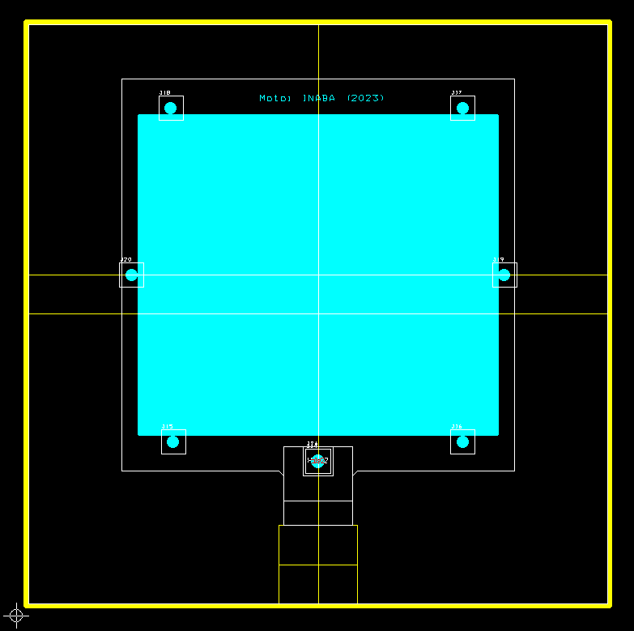
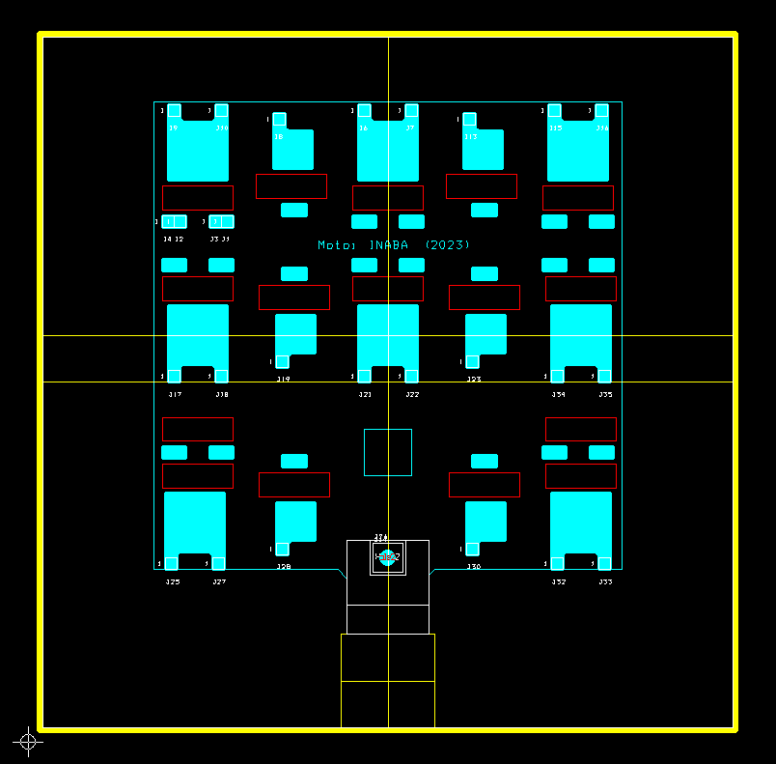
PCB
P.6 of 5
PCB for the main chip
PCB for the baby chips

