Slide 1
OPALユーザーオフ会@理研
Tohoku University CYRIC
M2 Yonekura Shohei

Slide 2
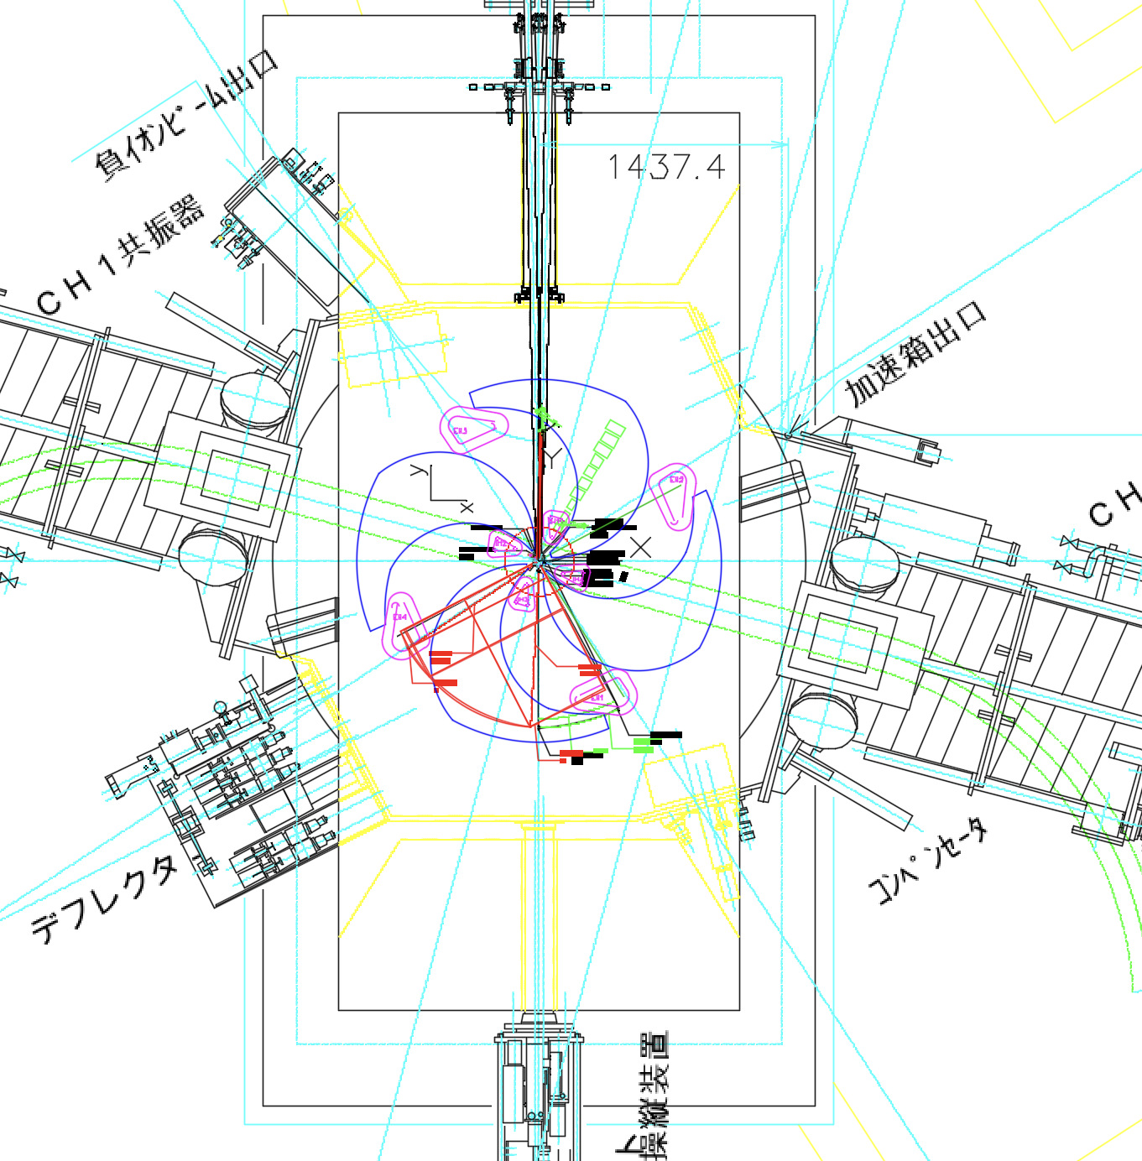
OPAL @ CYRIC
At CYRIC, OPAL is being used for simulations of negative ion acceleration.
( Deuteron - )
OPAL-cycl
Using Stripper
Stripper

Slide 3
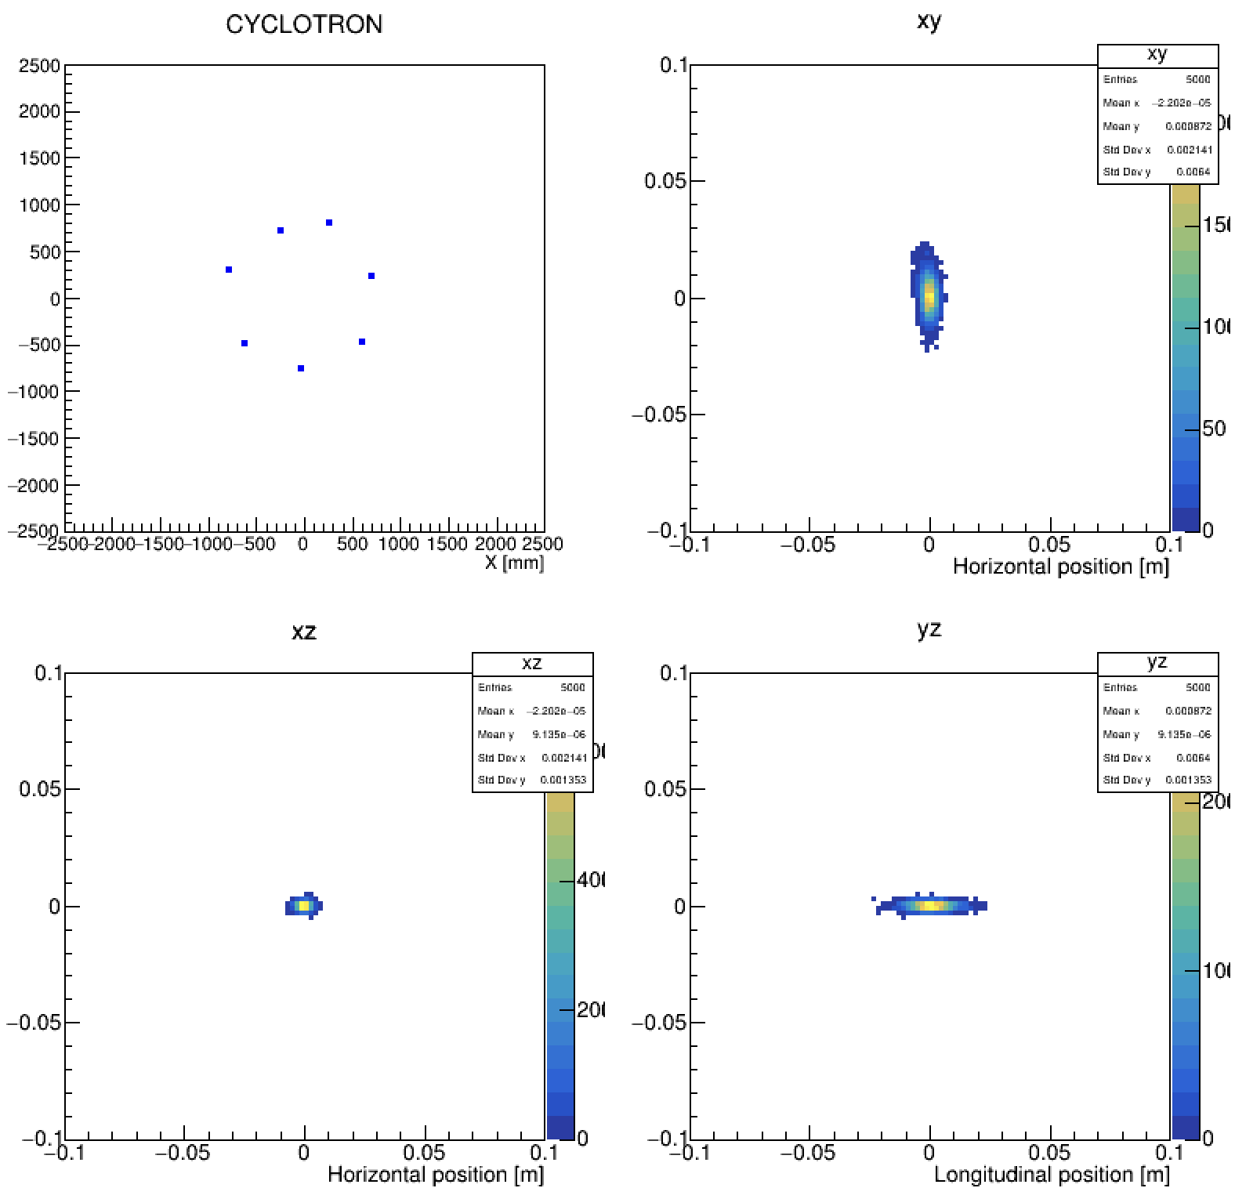
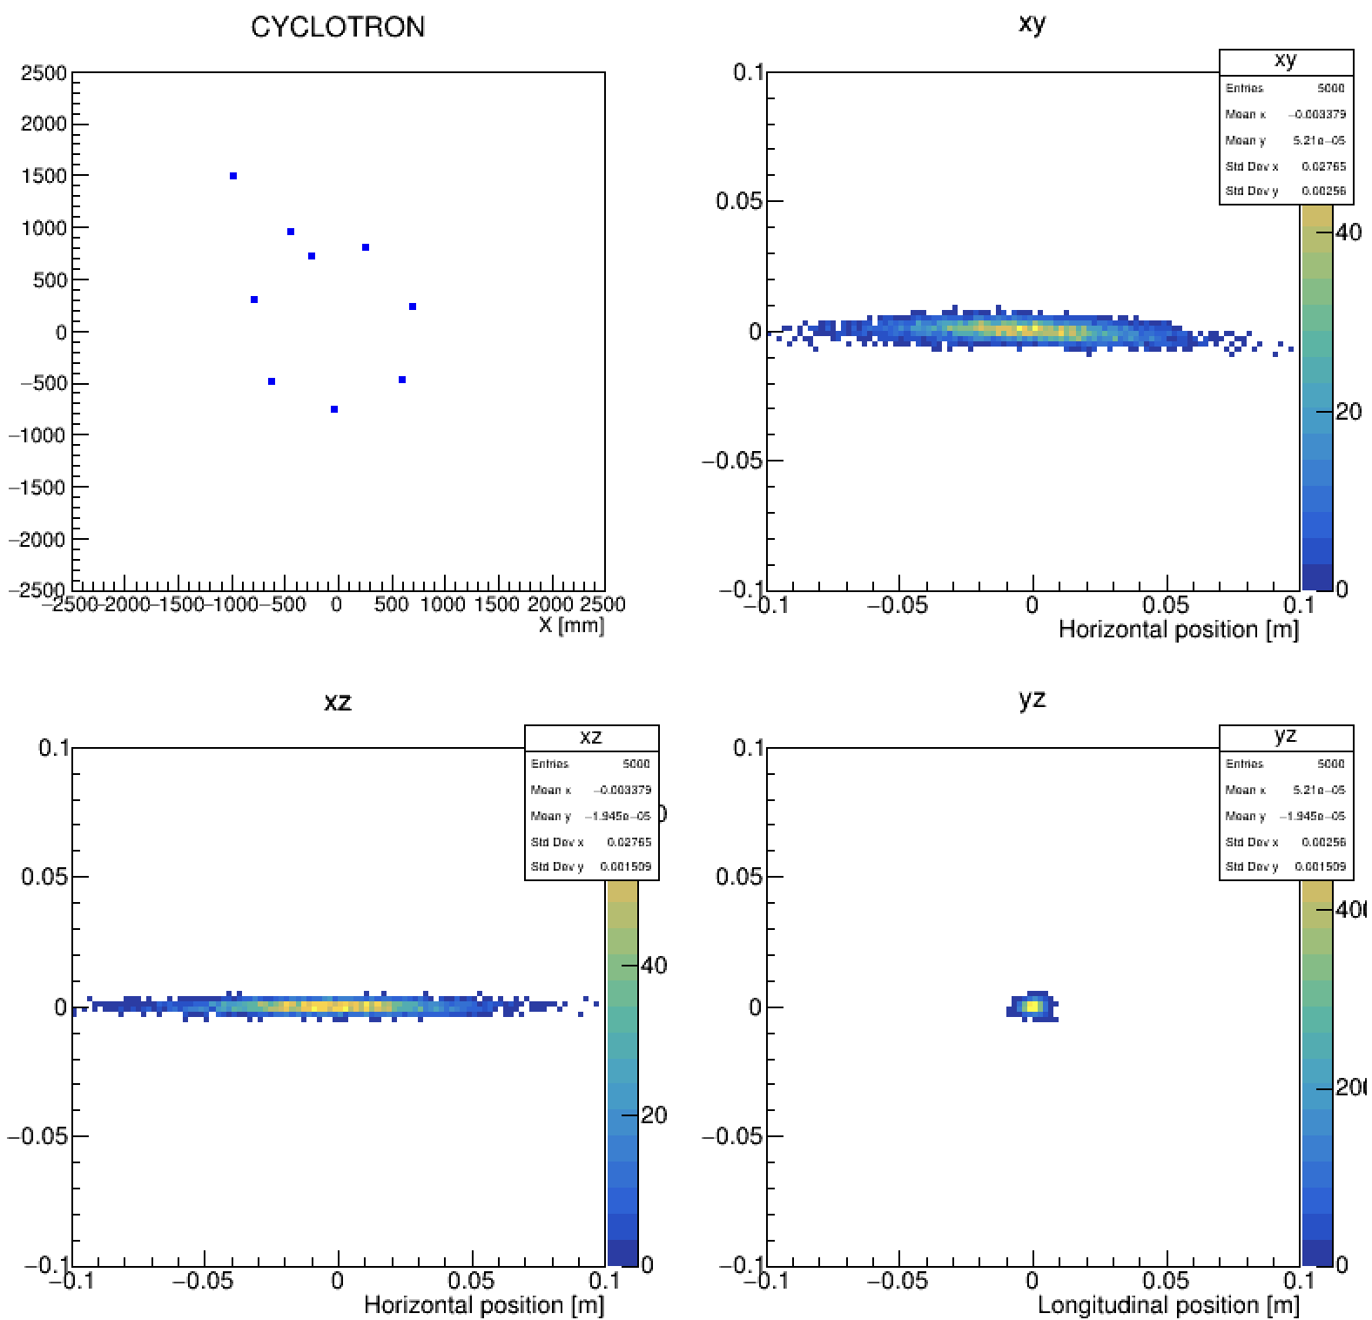
Particle distribution after stripping
Particle distribution after passing through the stripper expands horizontally
Before stripping
After stripping
Y [mm]
Longitudinal position [m]
Y [mm]
Longitudinal position [m]
Stripper
Stripper
Vertical position [m]
Vertical position [m]
Vertical position [m]
Vertical position [m]

Slide 4
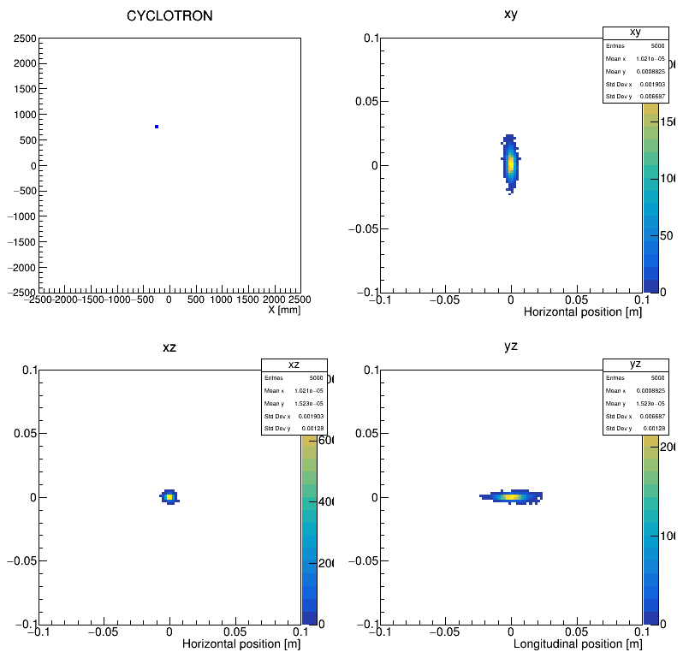
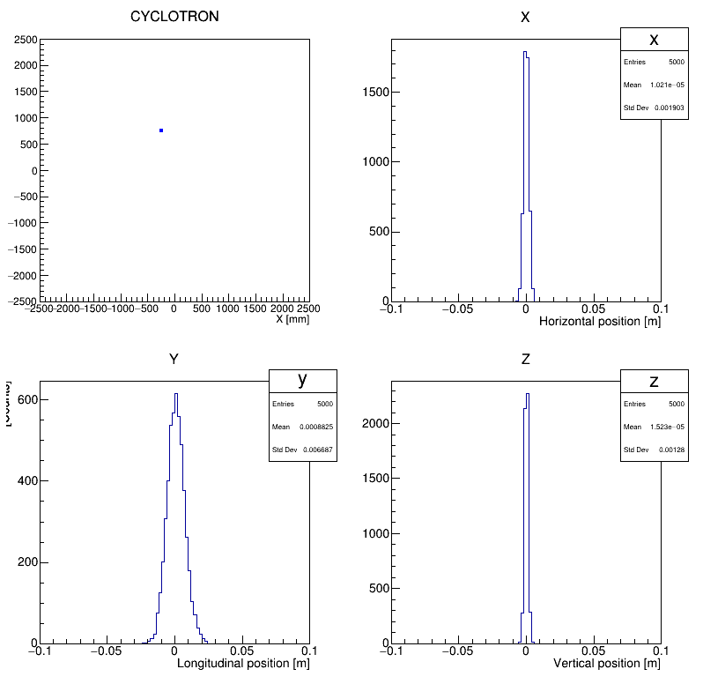
Particle distribution after stripping
Initial distribution (GAUSS)
1.8 mm 180 keV/c (rms emittance 4.4π mm mrad)
10 uA
Y [mm]
Longitudinal position [m]
Y [mm]
Stripper
Stripper
Vertical position [m]
Vertical position [m]

Slide 5
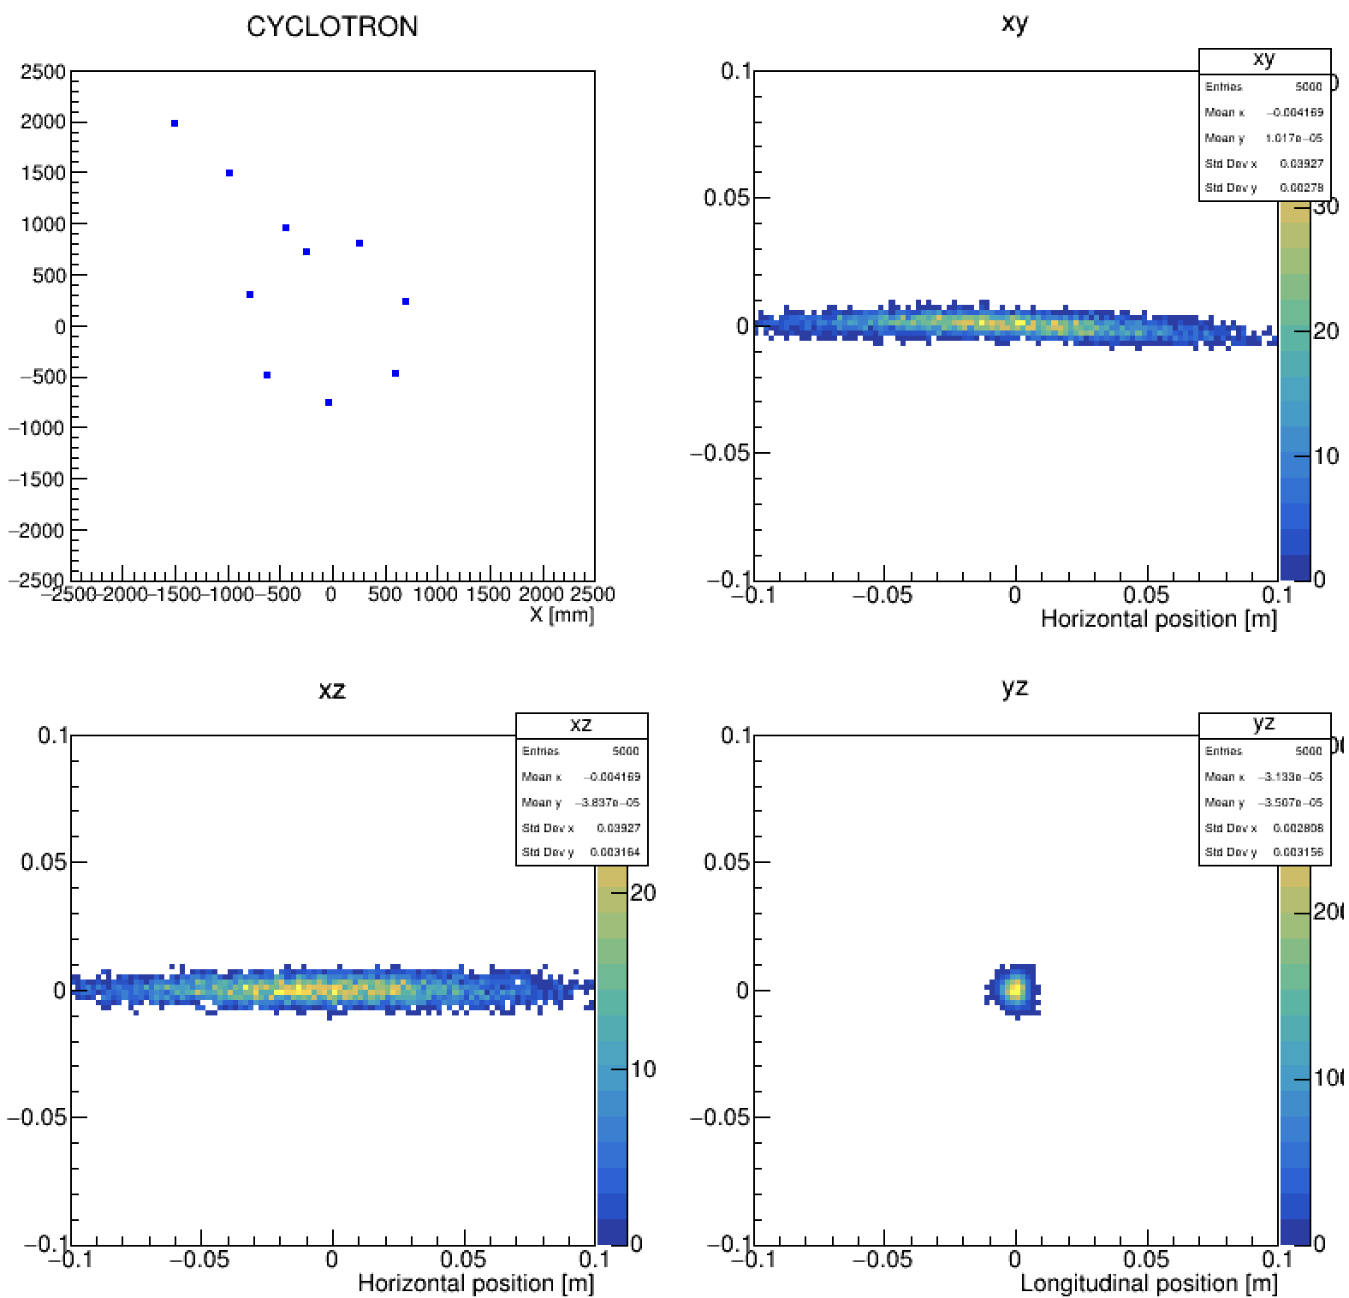
Particle distribution after stripping
OPAL output
Beam current distribution after stripping
(measured with beam stopper and slit)
Similar distribution from 100nA – 10uA
Longitudinal position [m]
Vertical position [m]
Vertical position [m]

Slide 6
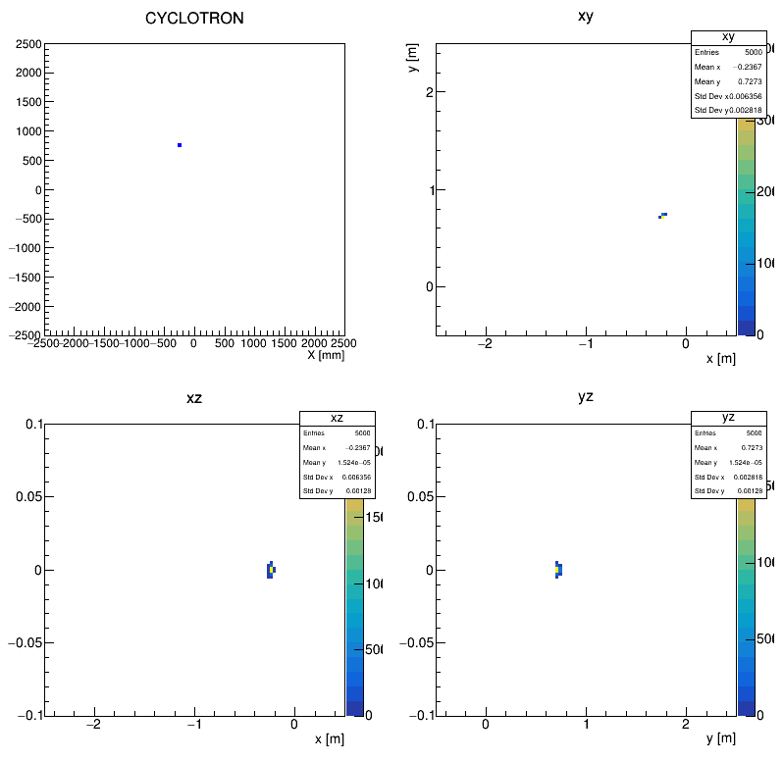
Particle distribution after stripping
Global Cartesianで
プラー出口から

Slide 7
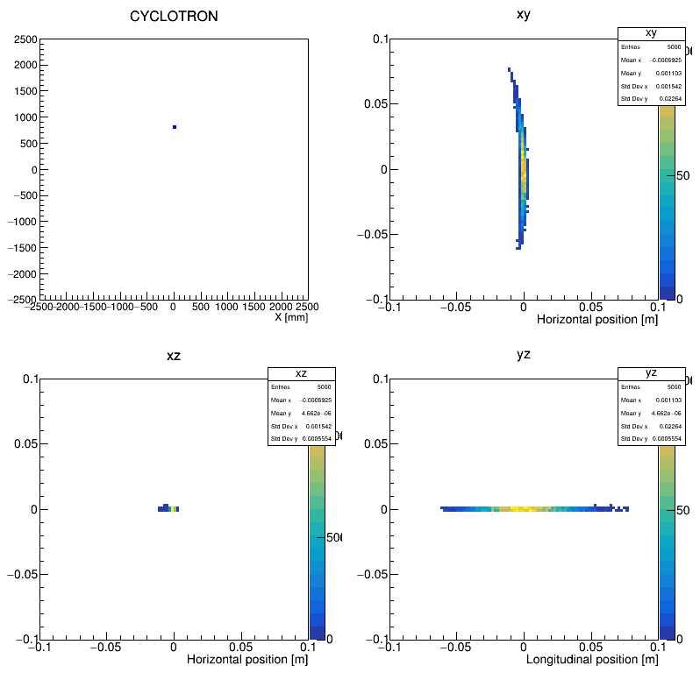
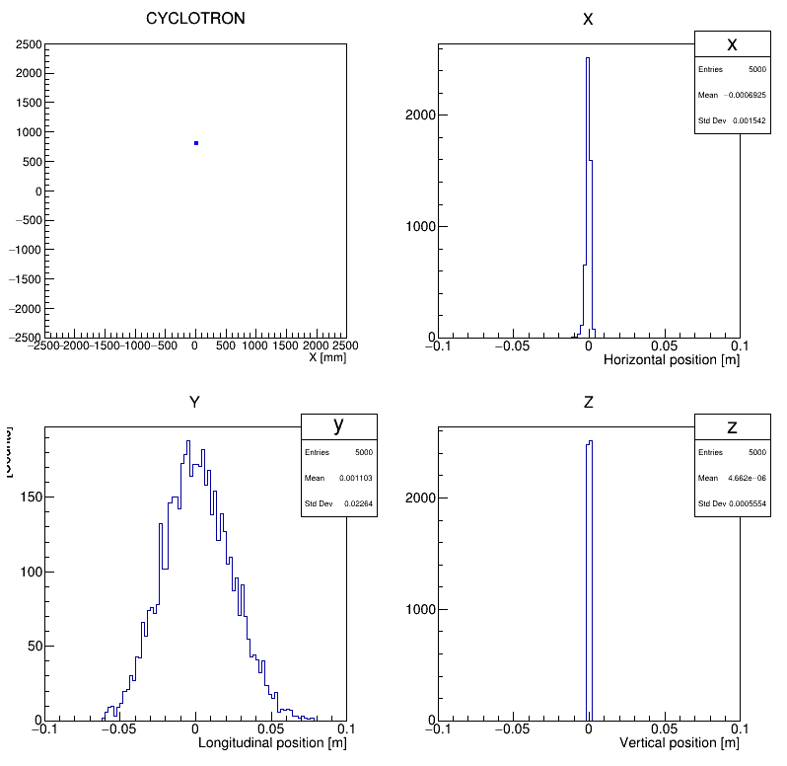
Particle distribution after stripping
インフレクターから

Slide 8
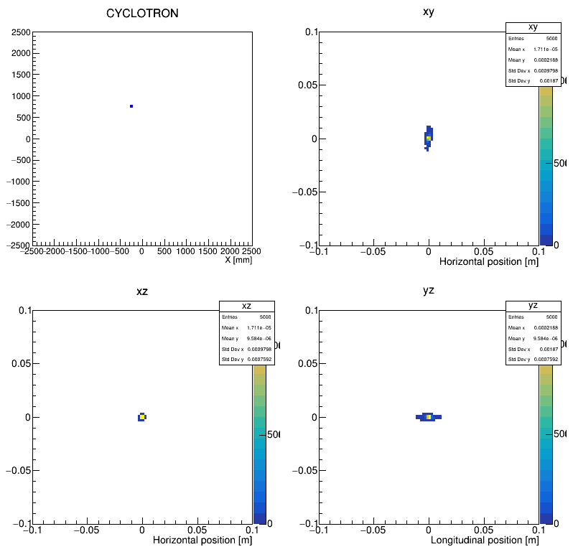
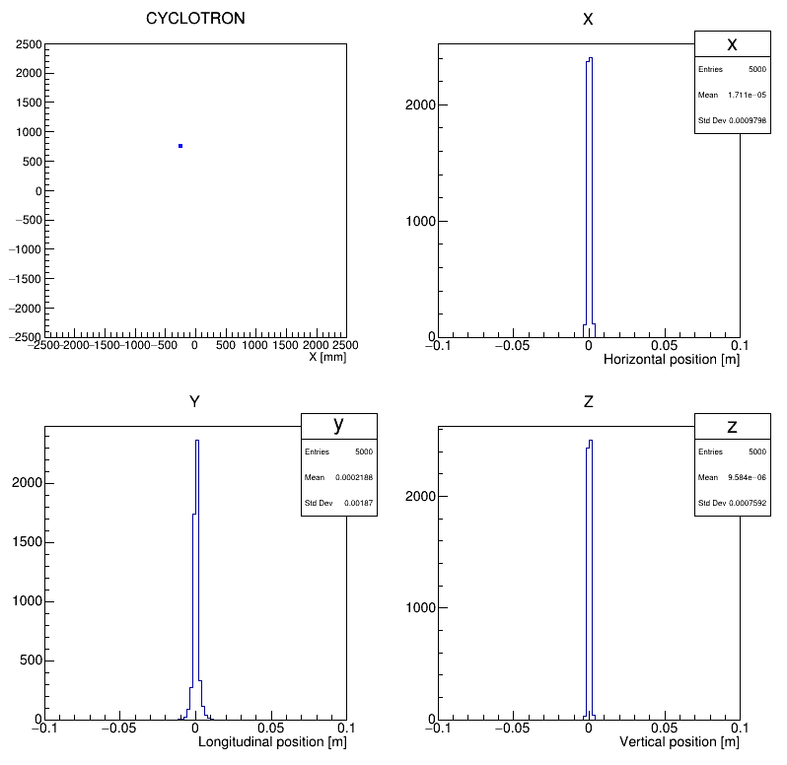
Particle distribution after stripping
プラーから
初期分布0.9mm 90keV/c (1.1π mm mrad)

Slide 9
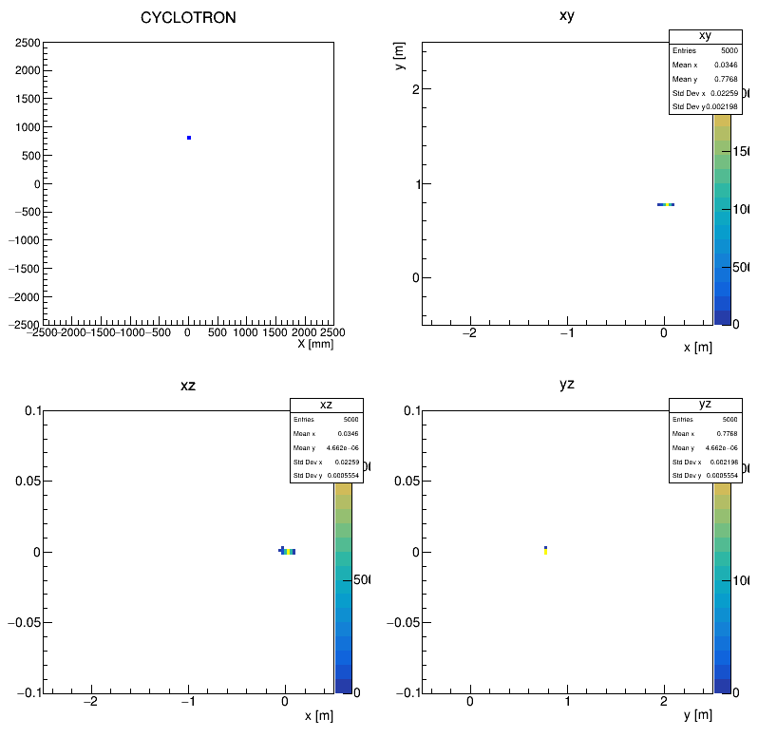
Particle distribution after stripping
Global Cartesianで
インフレクターから

