Slide 1
SIMULATION of CYCLOTRON AUTO-RESONACE ACCELERATION by OPAL-t
Takafumi HARA
RCNP, OSAKA University

Slide 2
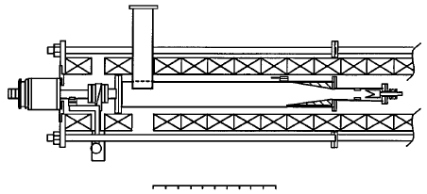
Cyclotron Auto-Resonance Acceleration(CARA)
It consists of solenoid magnetic field and rotating electric field.
It can continuously accelerate DC beam .
It succeeded in accelerating 20 A electron beam with an RF to beam power efficiency of up to 96 % at Yale University.
Electron gun
(100 kV, 30A)
Huge potential
0
50 (cm)
Schematic of CARA for electron (Phys. Rev. Lett. 76 (1996) 2718)
Compact high intensity accelerator
High power efficiency

Slide 3
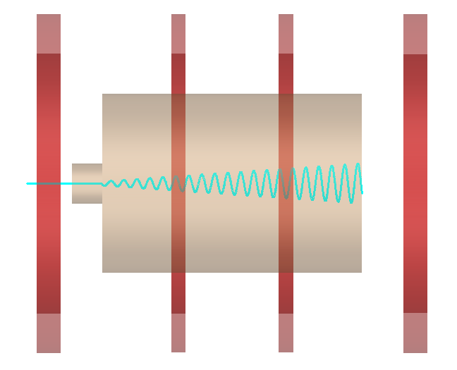
Physical design of proton CARA
changes from electron acceleration
proton beam
several tens keV

Slide 4
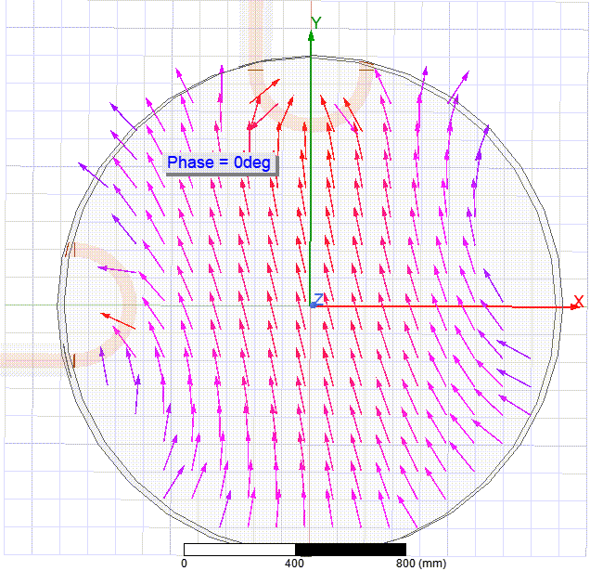
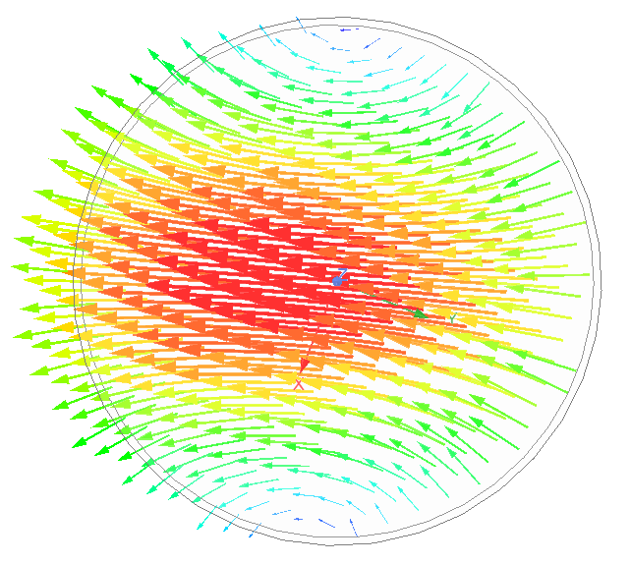
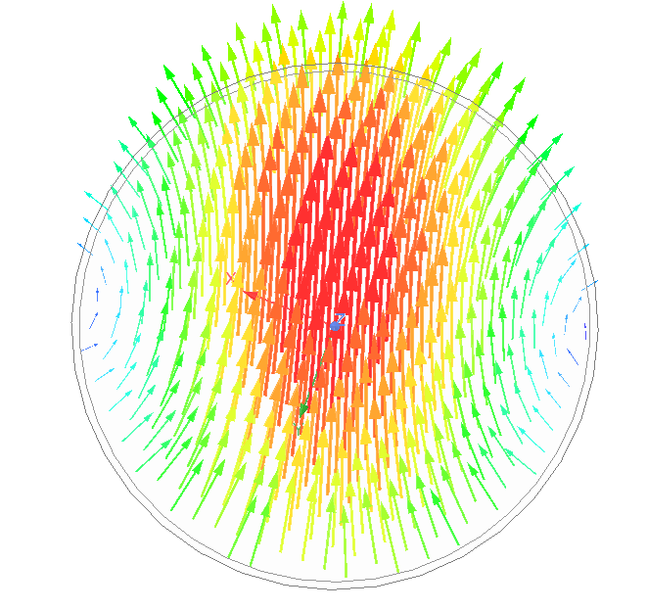
How to Generate Rotating Electromagnetic Field
TE₁₁₁ mode
y polarization
x polarization
$\frac{π}{2}$ phase difference each other

Slide 5
OPAL Simulation
CARA is simulated by OPAL-t (ver. 1. 6. 0) to verify potential of proton acceleration.
RF (simulated by HFSS)
x polarized TE111 mode field map
*Ideal TE111 mode Ez is 0
so input very small Ez value on z-axis.
y polarized TE111 mode field map
OPAL-t
Magnetic Field
(simulated by OPERA 3D/TOSCA)

Slide 6
Beam Line of CARA in OPAL-t
OPAL simulation of CARA needs Beam line has region magnetic field map and RF field maps overlap.
Type of field map files
2DMagnetoStatic
3DDynamic
x polarized TE111 mode field map
+
y polarized TE111 mode field map
magnetic field
Simulation area

Slide 7
Parameters
One of the example of proton CARA parameters in OPAL simulation
RF frequency: 230 MHz
Magnetic Field : 15 T
RF cavity size : 130 cm Length and 90 cm diameter
Initial energy : 25 keV
Beam length : 2 cm
(virtual DC beam :cutoff z is 0.3
Distance the beam travels in one cycle of RF frequency )
Emittance : 100mm mrad
Beam current :1mA
Phase matching : Free
Space charge : on

Slide 8
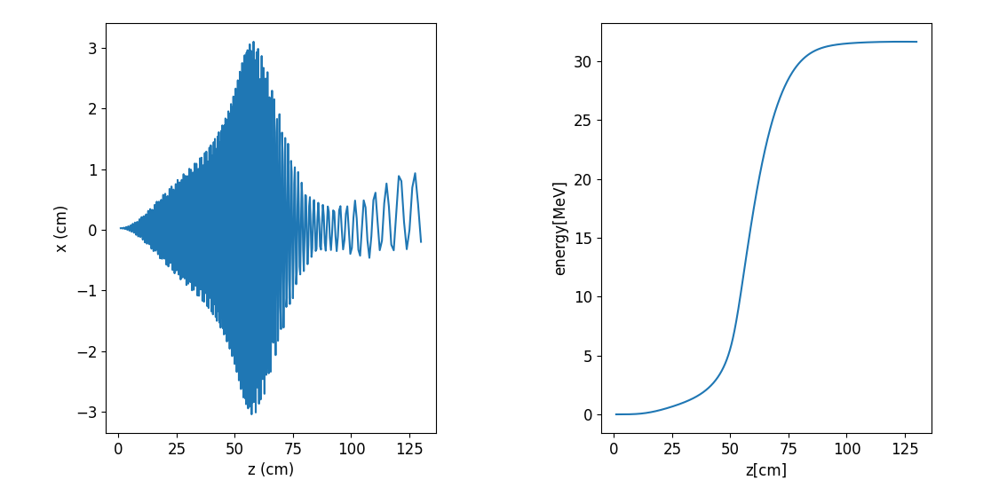
A Result of Simulation
Simulations shows CARA can accelerate 1 mA proton beam.
X vs Z
ENERGY vs Z

Slide 9
About Version of OPAL-t
Now I use ver.1.6.0 rc .
Ver.2.0.0 or later ….
At the region magnetic field map and RF field map overlap, the value of magnetic field in the simulation output file are different from input file ones.

Slide 10
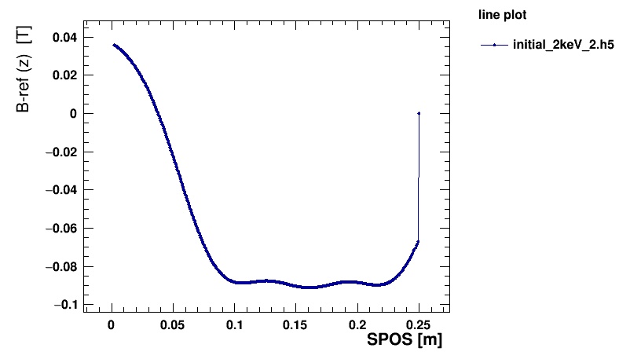
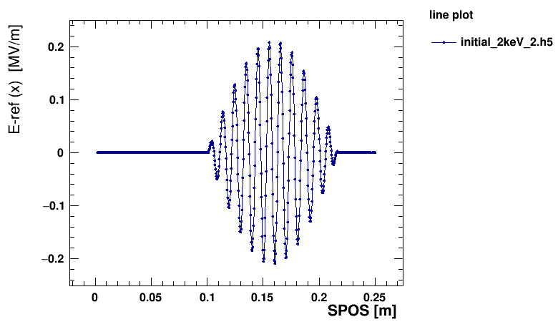
Version 1.6.0
Output field maps values are same to the Value of input file.

Slide 11
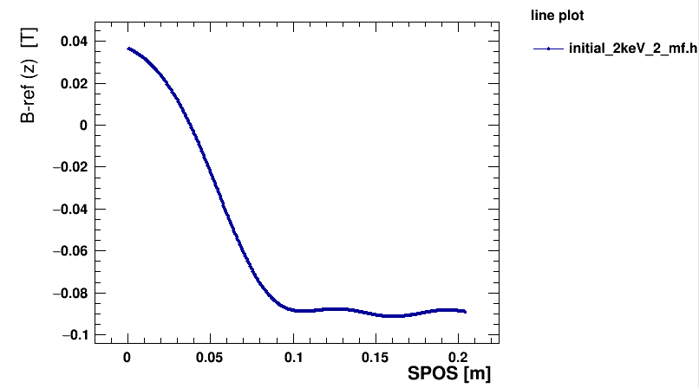
Magnetic field only (ver.2022)
Using same field map files which is adapted to ver. 2022 form.

Slide 12
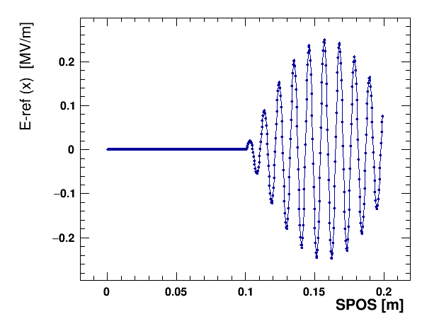
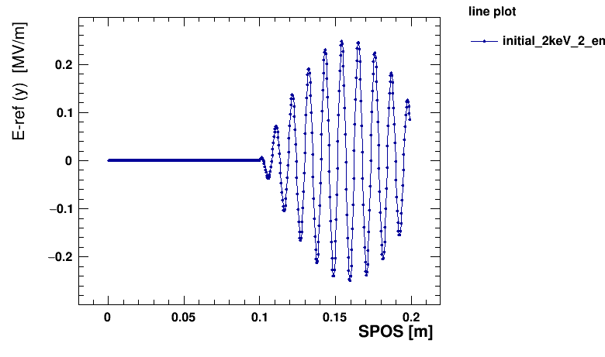
EM fields only (ver.2022)
The case of two maps overlap at the same region, the output field values is same value of input ones.
Ex
Ey

Slide 13
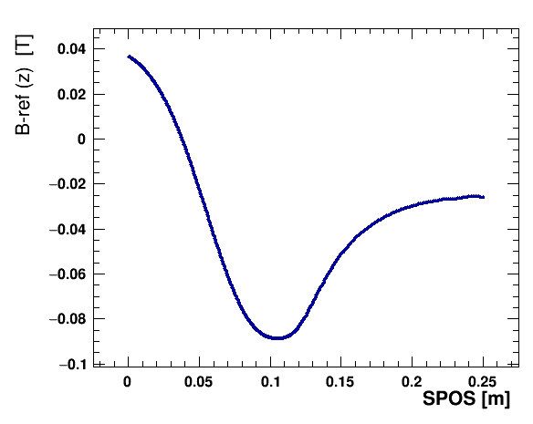
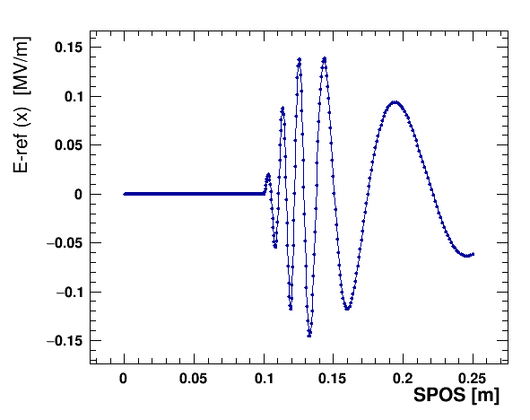
RF field and magnetic field overlap (ver. 2022)
The value of the magnetic field is different from the value of the magnetic field in the input file.

Slide 14
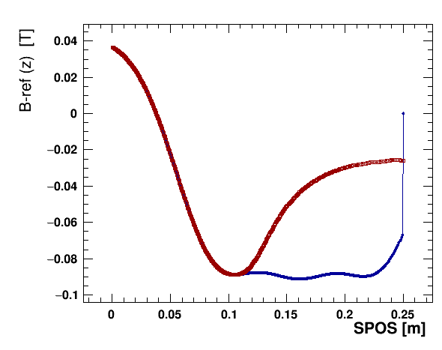
Comparison of ver.1.6.0 and ver. 2022

Slide 15
Summary
We try to development of the proton accelerator which adapt to CARA for proton acceleration.
We simulate proton CARA with OPAL-t to design and verify proton acceleration to proton CARA.
We success to simulate proton CARA by OPAL-t ver.1.6.0.

