Slide 1
CONCEPTUAL DESIGN OF THE HIGH TEMPERATURE SUPERCONDUCTING SELF-SHIELDING TYPE SKELETON CYCLOTRON
Shotaro Matsui, Mitsuhiro Fukuda, Tetsuhiko Yorita, Hiroki Kanda , Kichiji Hatanaka,
Takane Saito, Hitoshi Tamura, Yusuke Yasuda, Shigeo Nagaya, Yasuyuki Morita,
Keijiro Takeda, Takafumi Hara, Tsun Him Chong, Hang Zhao, Masaki Kittaka,
Atsushi Ishiyama, So Noguchi, Hiroshi Ueda, Satoshi Fukui, Yuji Matsuibara,
Yukio Mikami, Jun Yoshida, Takshi Hirayama, Tomonori Watanabe
08/28/2023 ~OPAL PARTY in RIKEN ~

Slide 2
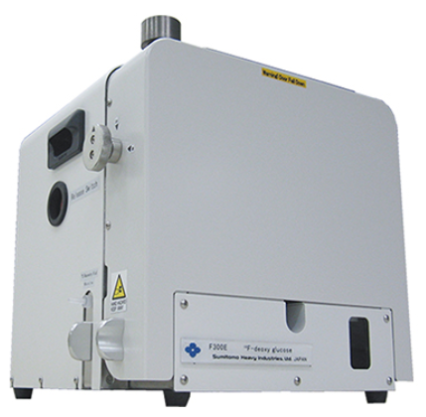
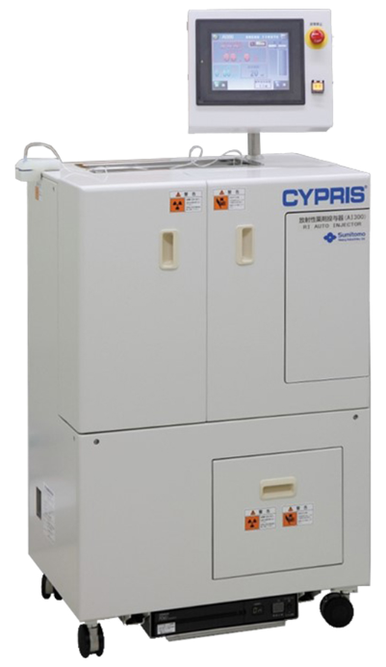
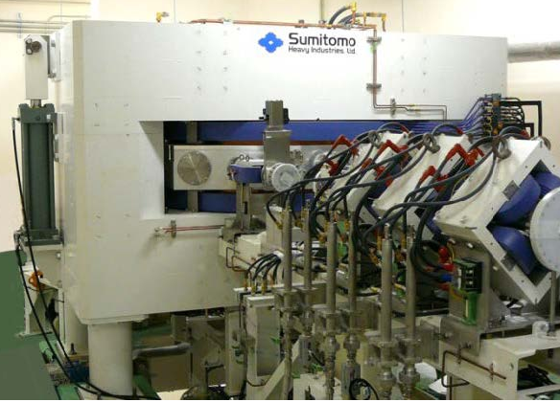
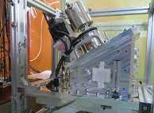
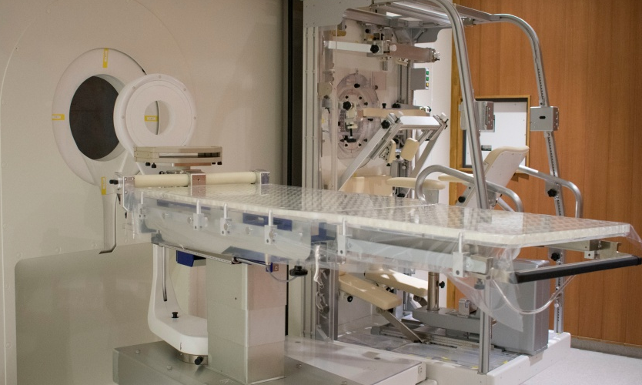
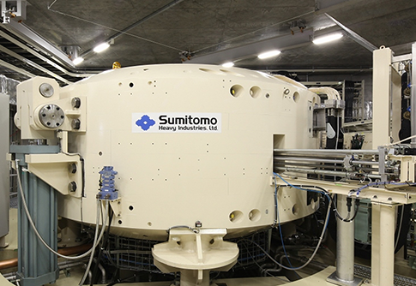
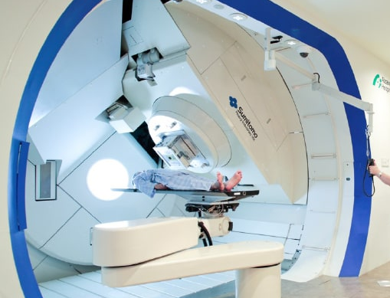
Medical Cyclotrons and Applications
SHI made
RI generarion
For
PET and SPECT
$H^{+}$ ～20 MeV
HM-12S
Tomography
RI generation
For
Targeted Alpha Therapy
${He}^{2+}$ 30 MeV
High Intensity proton beam
For
BNCT
MP-30
230 MeV-Cyclotron
$D^{+}$ 40 MeV
High-Energy proton beams
For
Proton Therapy
$H^{+}$ 200～ MeV
Cyclotron
Therapy
Energy required
～Different cyclotrons are required for different applications～
08/28/2023 ~OPAL PARTY in RIKEN ~

Slide 3
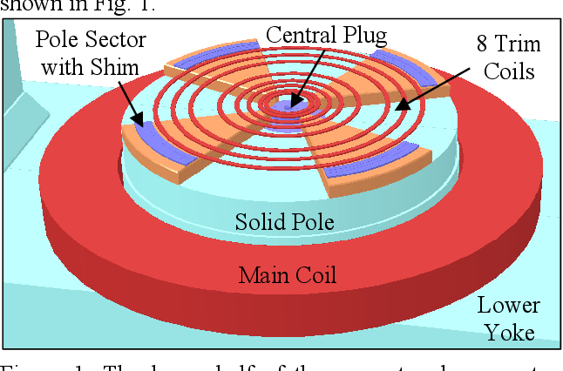
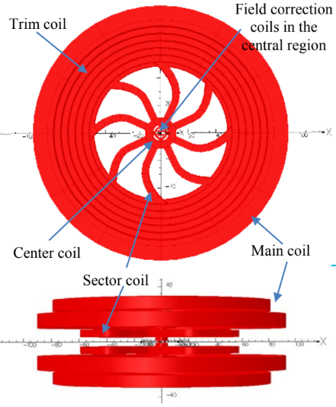
Difference between skeleton cyclotron and AVF cyclotron
Conventional AVF cyclotron
skeleton cyclotron
Main Coil + Trim Coils
Main Coils + Sector Coils + Trim Coils
Room-temperature coils
high-temperature superconductivity
Using room-temperature coils
results in higher power consumption.
High-magnetic field: ～3T
High efficiency: Conducting cooling
High resistant to external field
Using Iron Core
Air-core structure Coil
It is difficult to change the magnetic field
because of the iron core.
Hysteresis requires advanced operators
No Hysteresis
The magnetic field is determined
only by the current in the coil.
Feasibility exists.*
～Self-Shielding Type Aims to Promote High-Intensity Multifunctional Accelerators～
**H.W. Koay, M. Fukuda, H. Kanda, T. Yorita. (2021),
Beam dynamics and characterization of a new high-intensity Compact
air-core high temperature superconducting skeleton cyclotron(HTS-SC).
Results in Physics 33(2022)105090
08/28/2023 ~OPAL PARTY in RIKEN ~

Slide 4
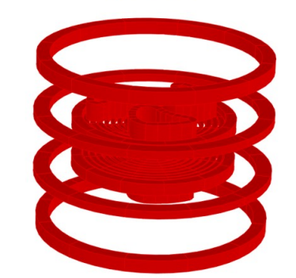
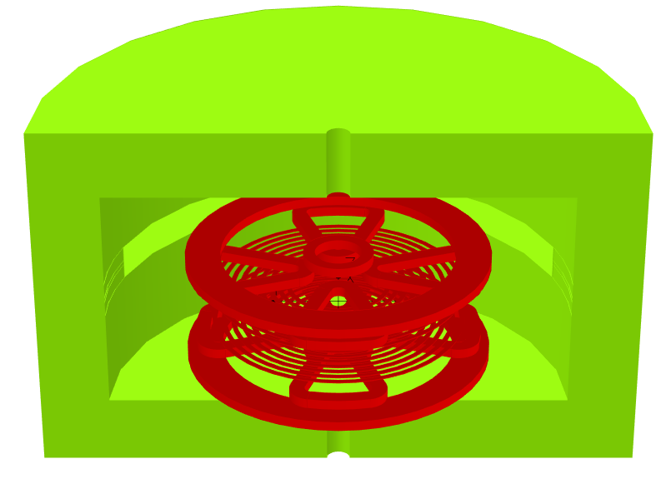
Self Shield
Cover Iron Yoke
More practical
Self-Shielding Type
HTSC-K80-R40-AC
HTSC-K80-R50-SS
No Special room is created, and the existing space is also used.
08/28/2023 ~OPAL PARTY in RIKEN ~

Slide 5
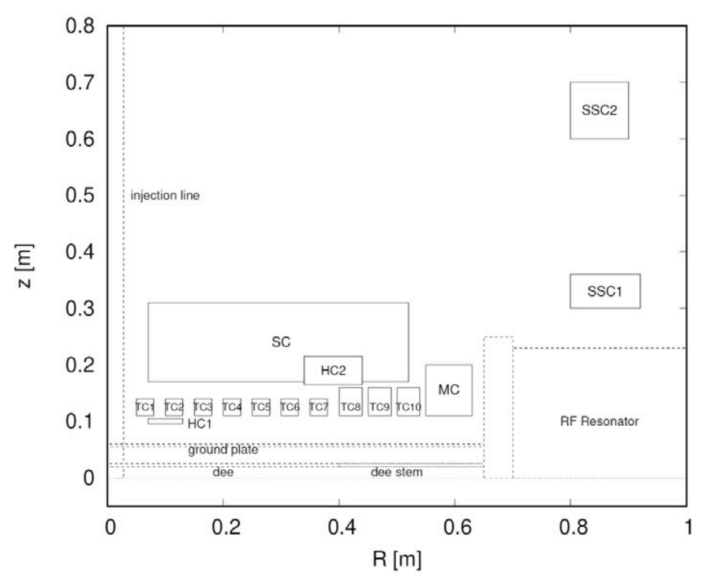
Previous Research of HTS-SC
Using HTS-Trim Coils

Slide 6
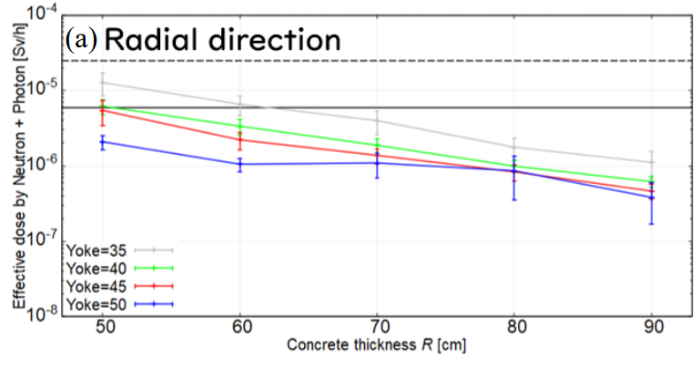
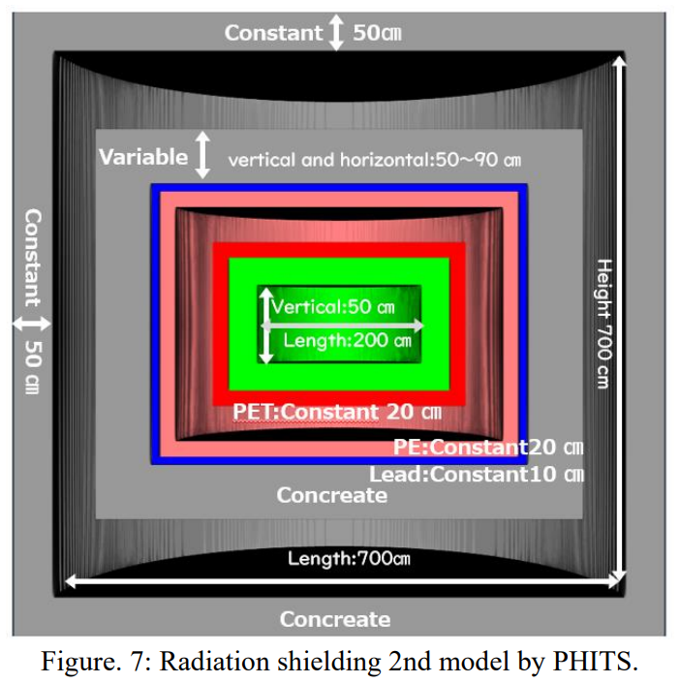
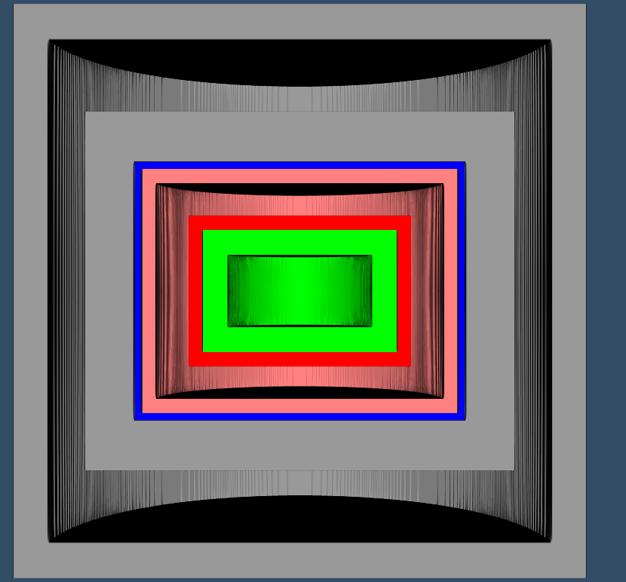
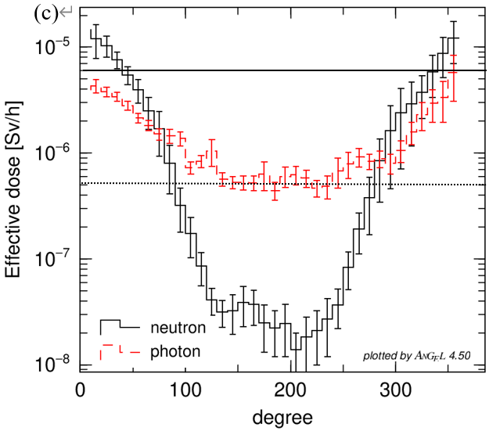
Radiation Shield
200㎝
Measurement
measurement
30㎝
Absolutely
Evaluated by the average dose in the cylindrical part.
Target
500㎝
Measure
ment
Flux →
Effective Dose Rate
Neutron ICRP60
Gamma ICRP103
500㎝
160㎝
30㎝
固定
50㎝
可変
縦横:50～90 ㎝
Target
縦 ７００ cm
固定
縦:50 ㎝
Ideal
50 ㎝
横:200 ㎝
PET:固定20 ㎝
PE:固定20 ㎝
コンクリート
鉛:固定10 ㎝
横:700㎝
コンクリート
08/28/2023 ~OPAL PARTY in RIKEN ~
Notes:
２枚
計算方法
計算結果

Slide 7
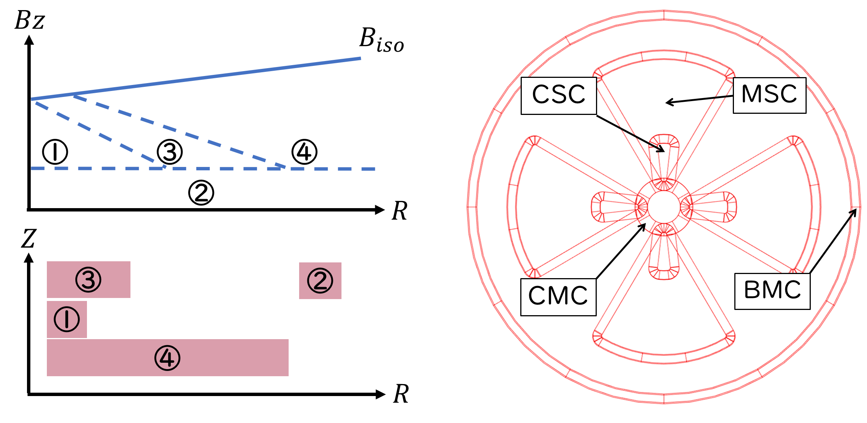
$B_{iso}$ splitting of HTS-SC
③
④
①
②
08/28/2023 ~OPAL PARTY in RIKEN ~
Notes:
等時性磁場を4つに分割しました。
I divided the isochronous magnetic field into four.
1:central bunp field and week focusing
2:Basement coil
3:sub central bunmp and strong focus
4:Main strong focusing
それぞれのコイルを作れば等時性磁場を作ることができます。
If you make each coil, you can make an isochronous magnetic field.

Slide 8
$B_{iso}$ splitting of HTS-SC
This Configuration,
We want ③+④and② to be parallel.
08/28/2023 ~OPAL PARTY in RIKEN ~

Slide 9
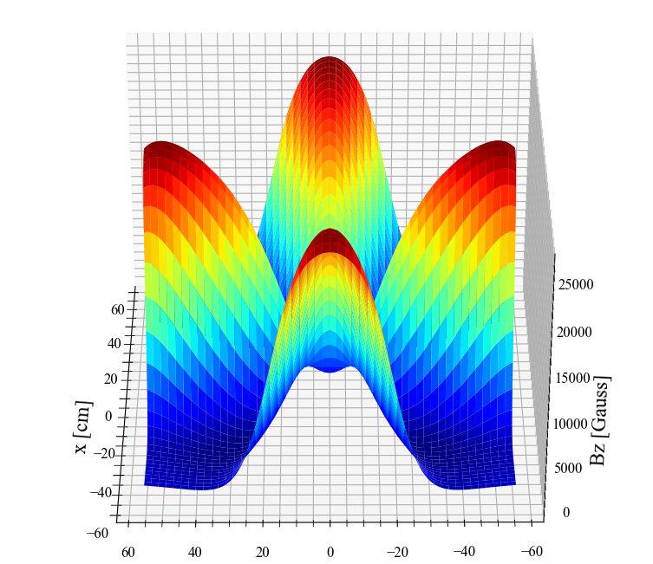
Design Sector
$$Bz$$
MSC
Non-circular air-core coils is Difficult to design
08/28/2023 ~OPAL PARTY in RIKEN ~

Slide 10
Add Gordon’s Method for HTS-SC
Origina Gordon’s Method is $B_{G}\left(r\right)=B_{iso}(r)−B_{SEO}(r)$
$$B_{G}′\left(r\right)=p\left[1+\frac{δ^{2}}{p^{2}}\right]\frac{A}{Q}\left(\frac{m_{1}c}{er}\right)−G_{0}\left(r\right)$$
$$G_{0}\left(r\right)=B_{Sector}\left(R,θ\right)−Σ_{n>1}\left[G_{n}\left(r\right)\sin\left(nθ\right)+H_{n}\left(r\right)\cos\left(nθ\right)\right]$$
$${ B}_{G}′\left(r\right)−Σ_{n}\left[B_{MC_{n}}\left(r,I\right)\right]=0 ∙∙∙\left(1\right)$$
Solving Eq(1) gives Biso
08/28/2023 ~OPAL PARTY in RIKEN ~

Slide 11
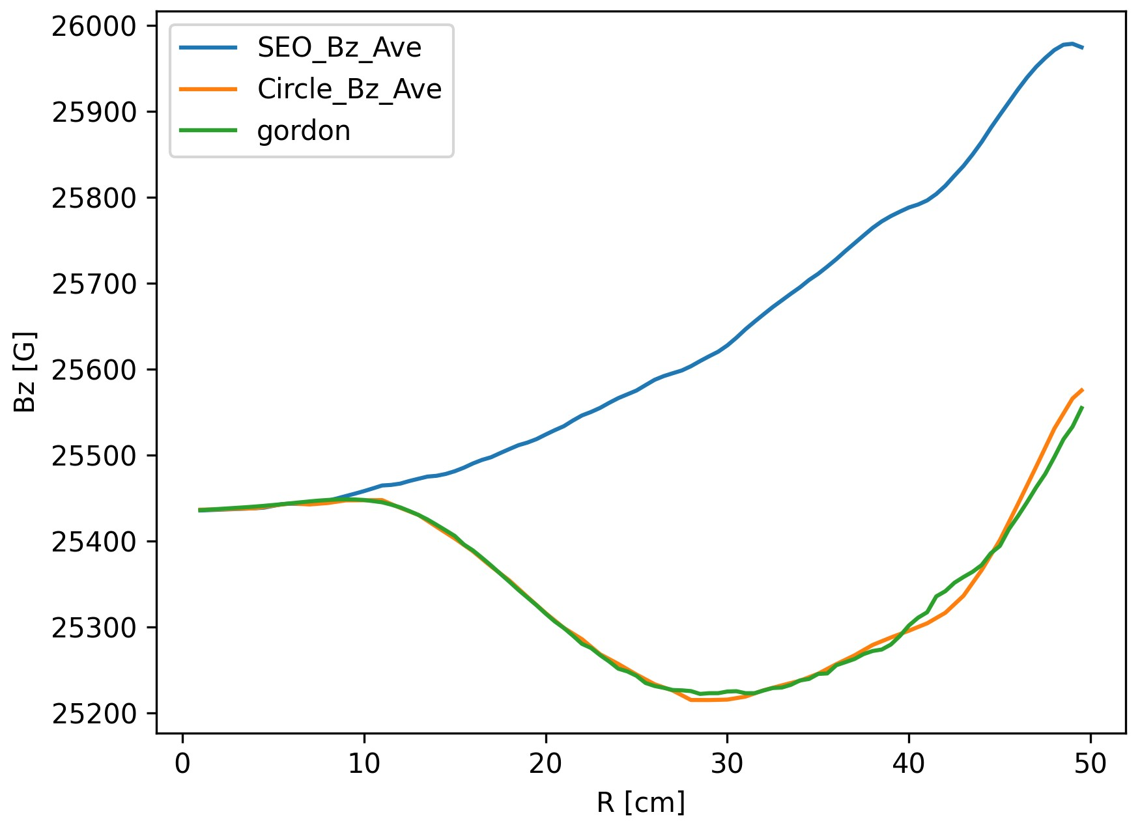
Gordon’s Method Example data
$$B_{iso}(r)≅B_{SEO}(R,θ)$$
$$B_{G}(r)≅B_{SEO}(R)$$
08/28/2023 ~OPAL PARTY in RIKEN ~

Slide 12
Design Sector
$${B′}_{Gordon}$$
$$Bz$$
MSC
MSC
Non-circular air-core coils is Difficult to design
08/28/2023 ~OPAL PARTY in RIKEN ~

Slide 13
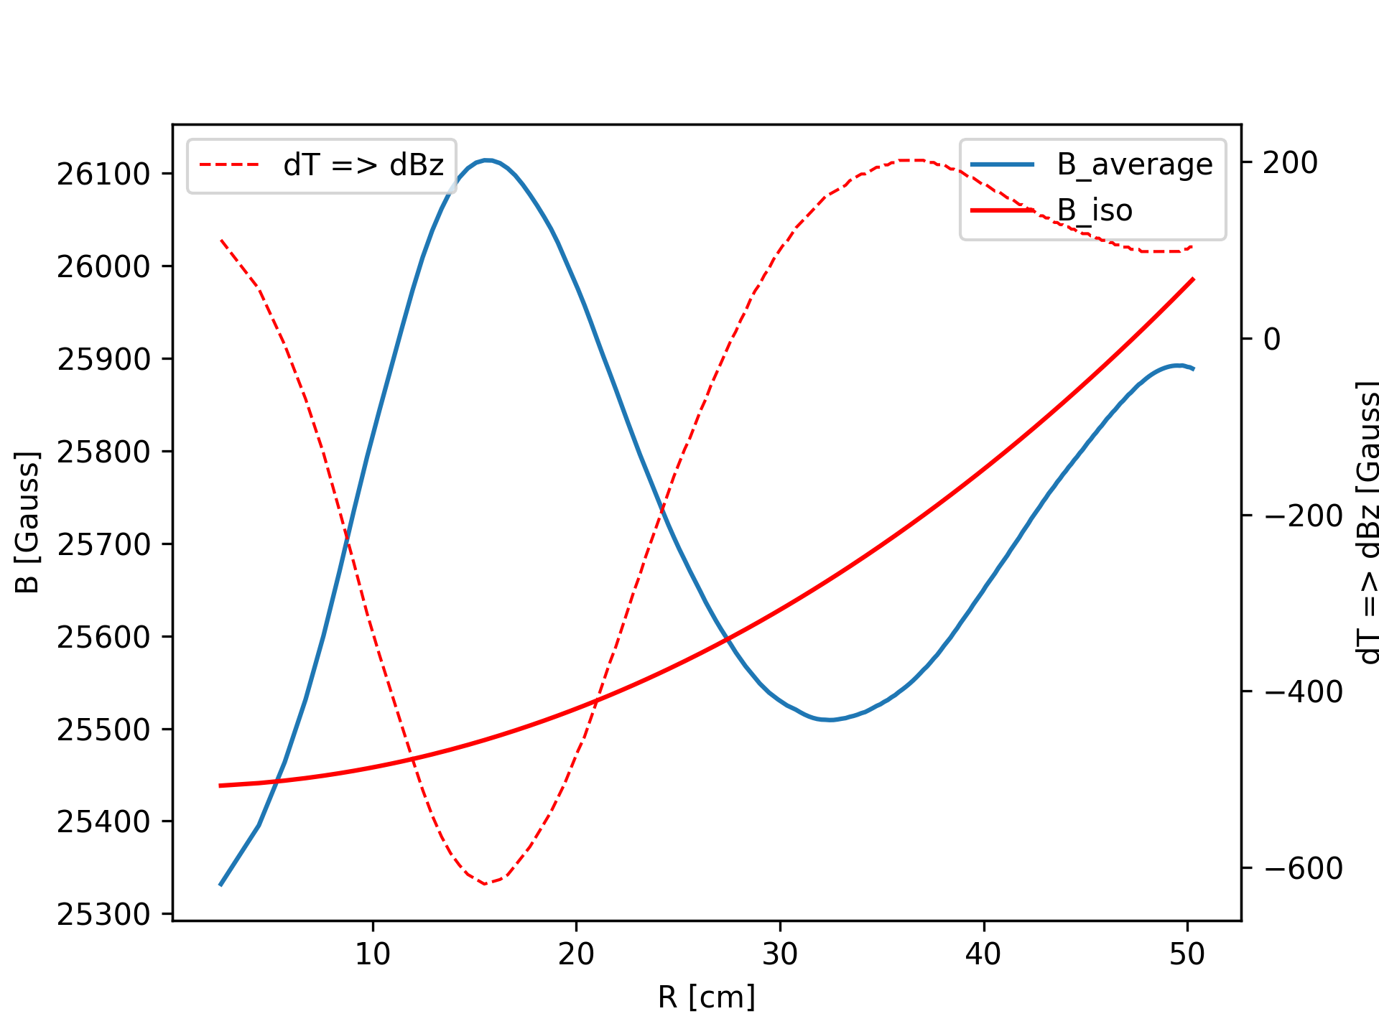
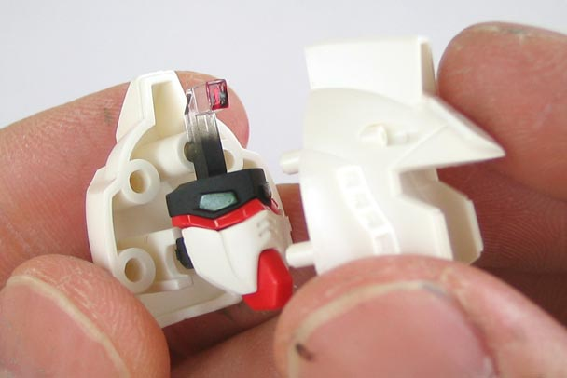
Without CSC
Error 3.2 %
Weak Foucusing is difficult!
Difficult to combine perfectly without CSC

Slide 14
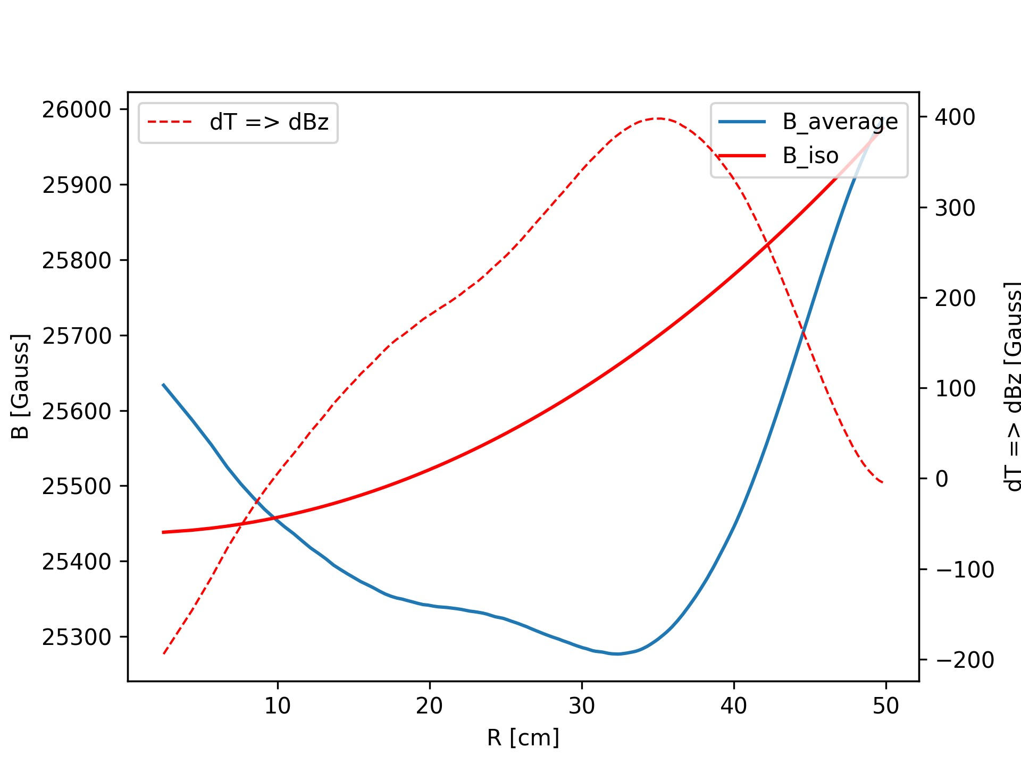
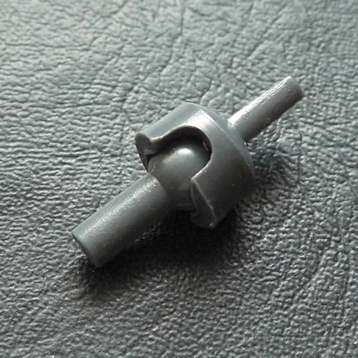
Add CSC
Error 2.2 %
Weak Focusing is Easy
CSC makes $B_{iso}$ flexible and good WF

Slide 15
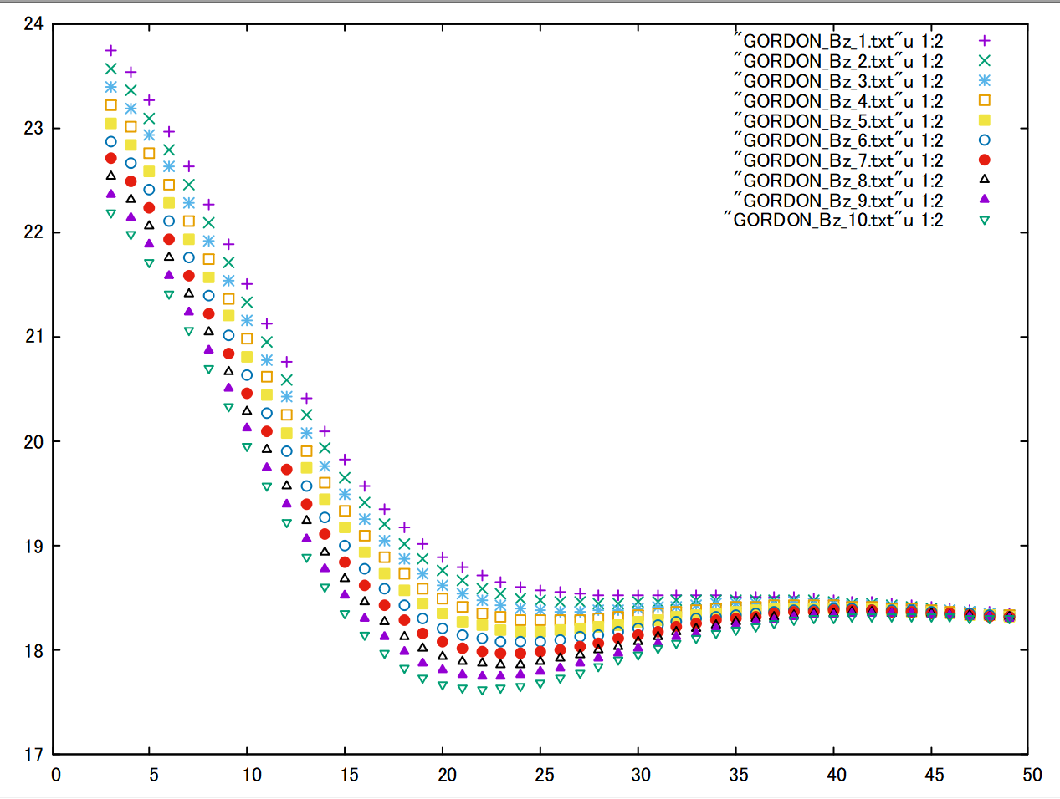
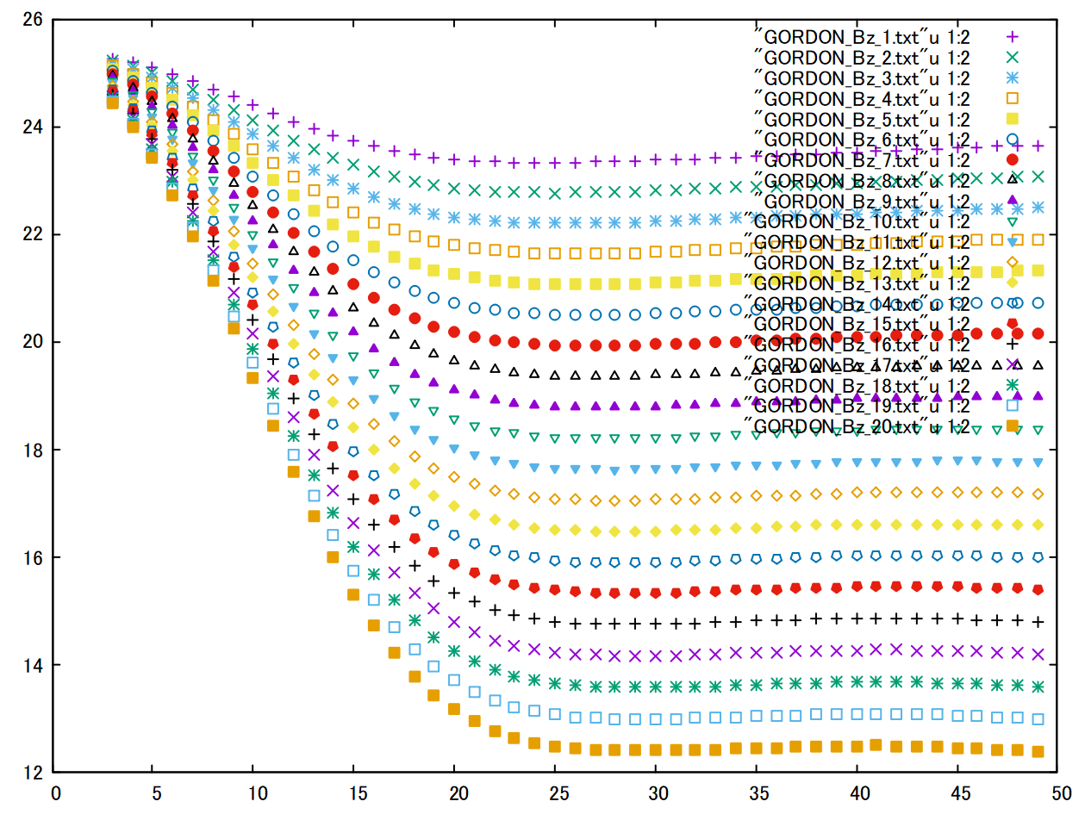
MSCの電流を変えると
可変フラッター
MSCの電流を変えると
可変フラッター
になると予想できるが、
パチっとセンターメインを合わせる必要がある。

Slide 16
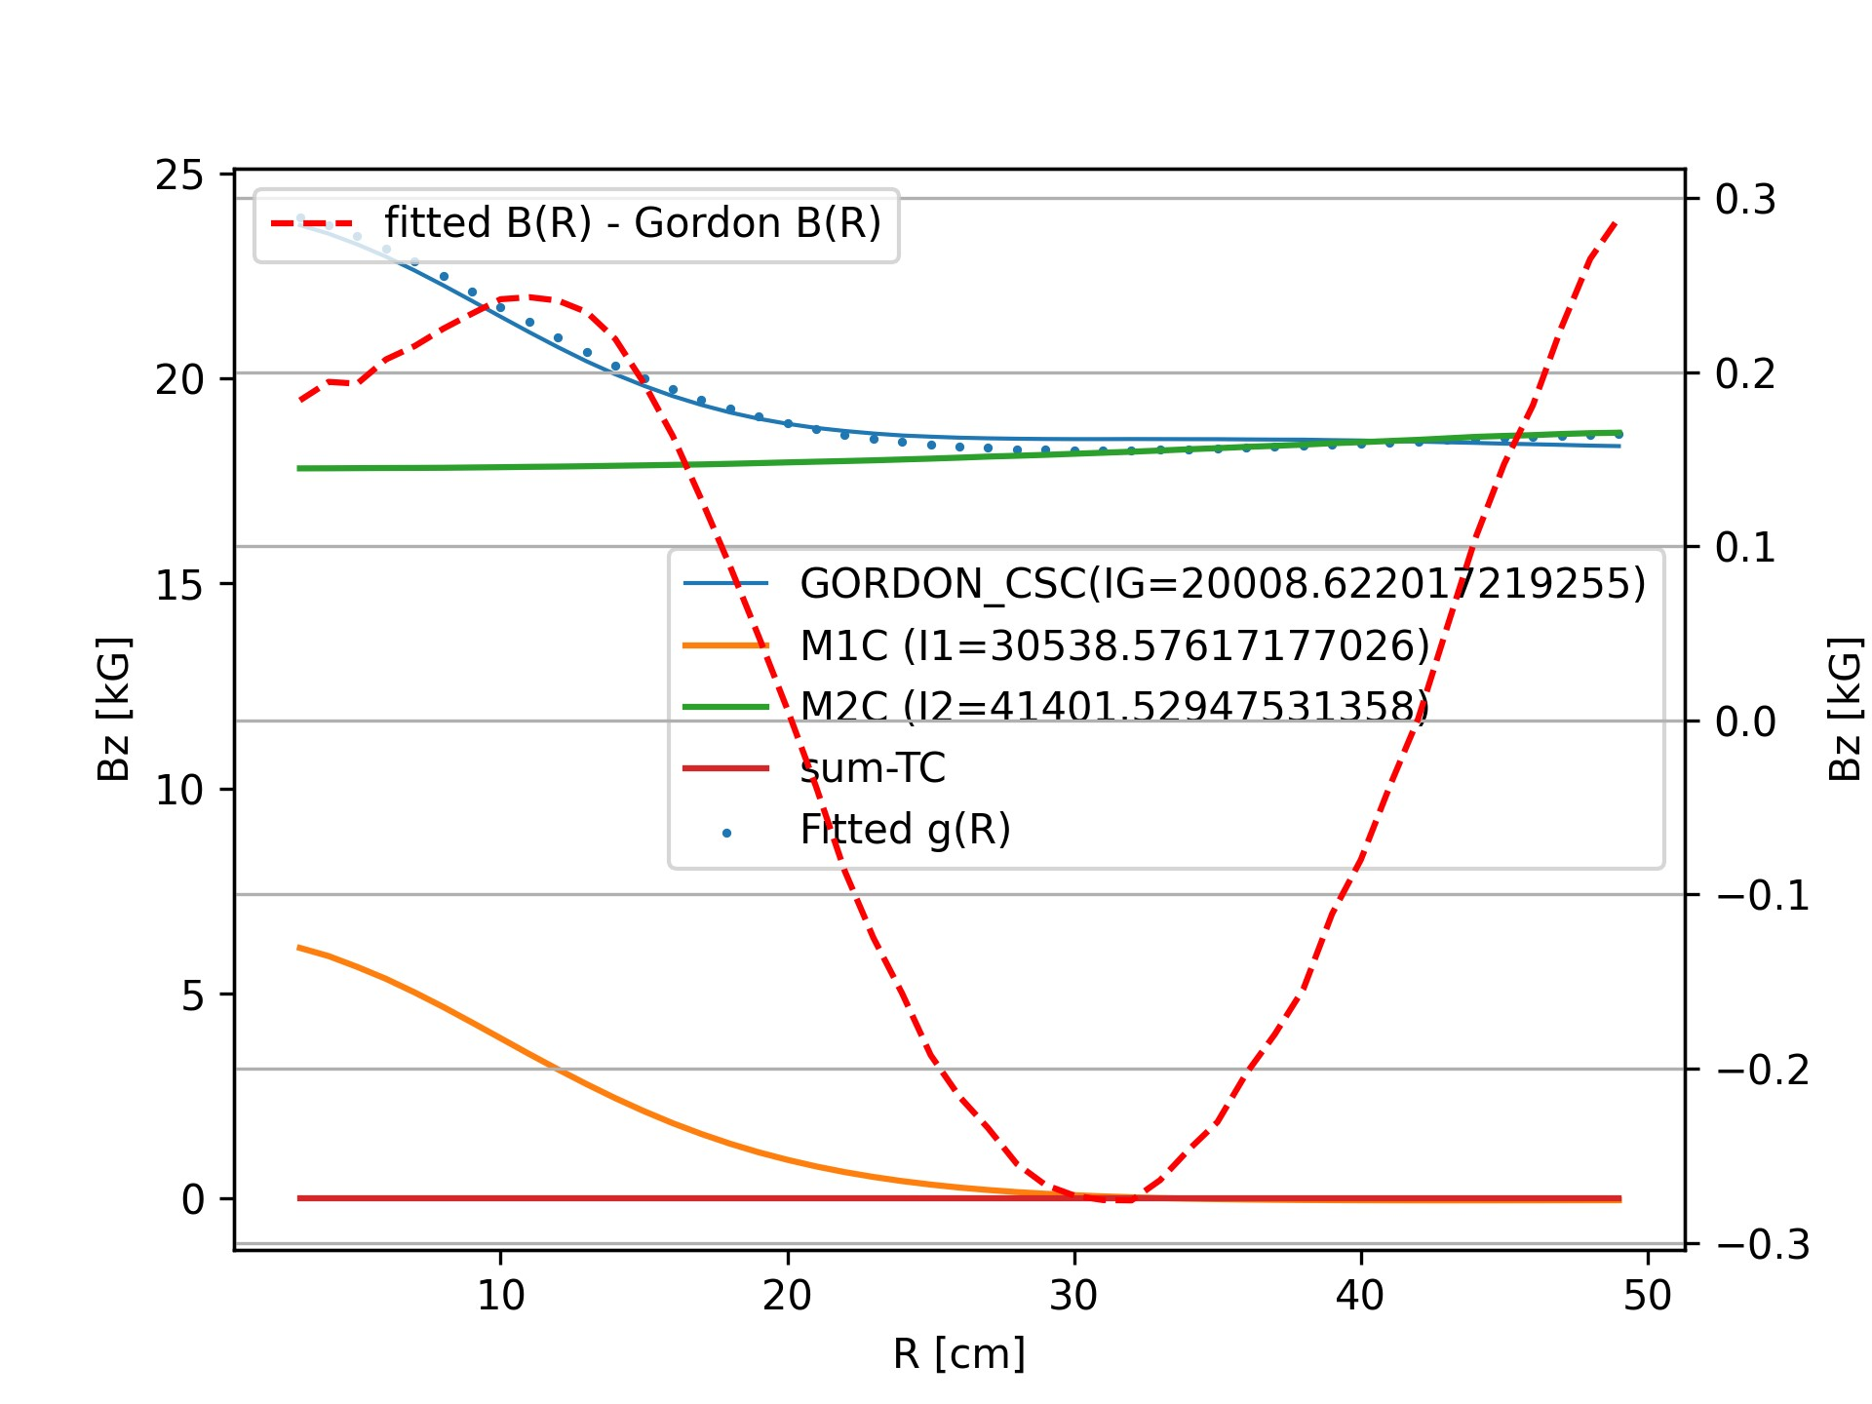
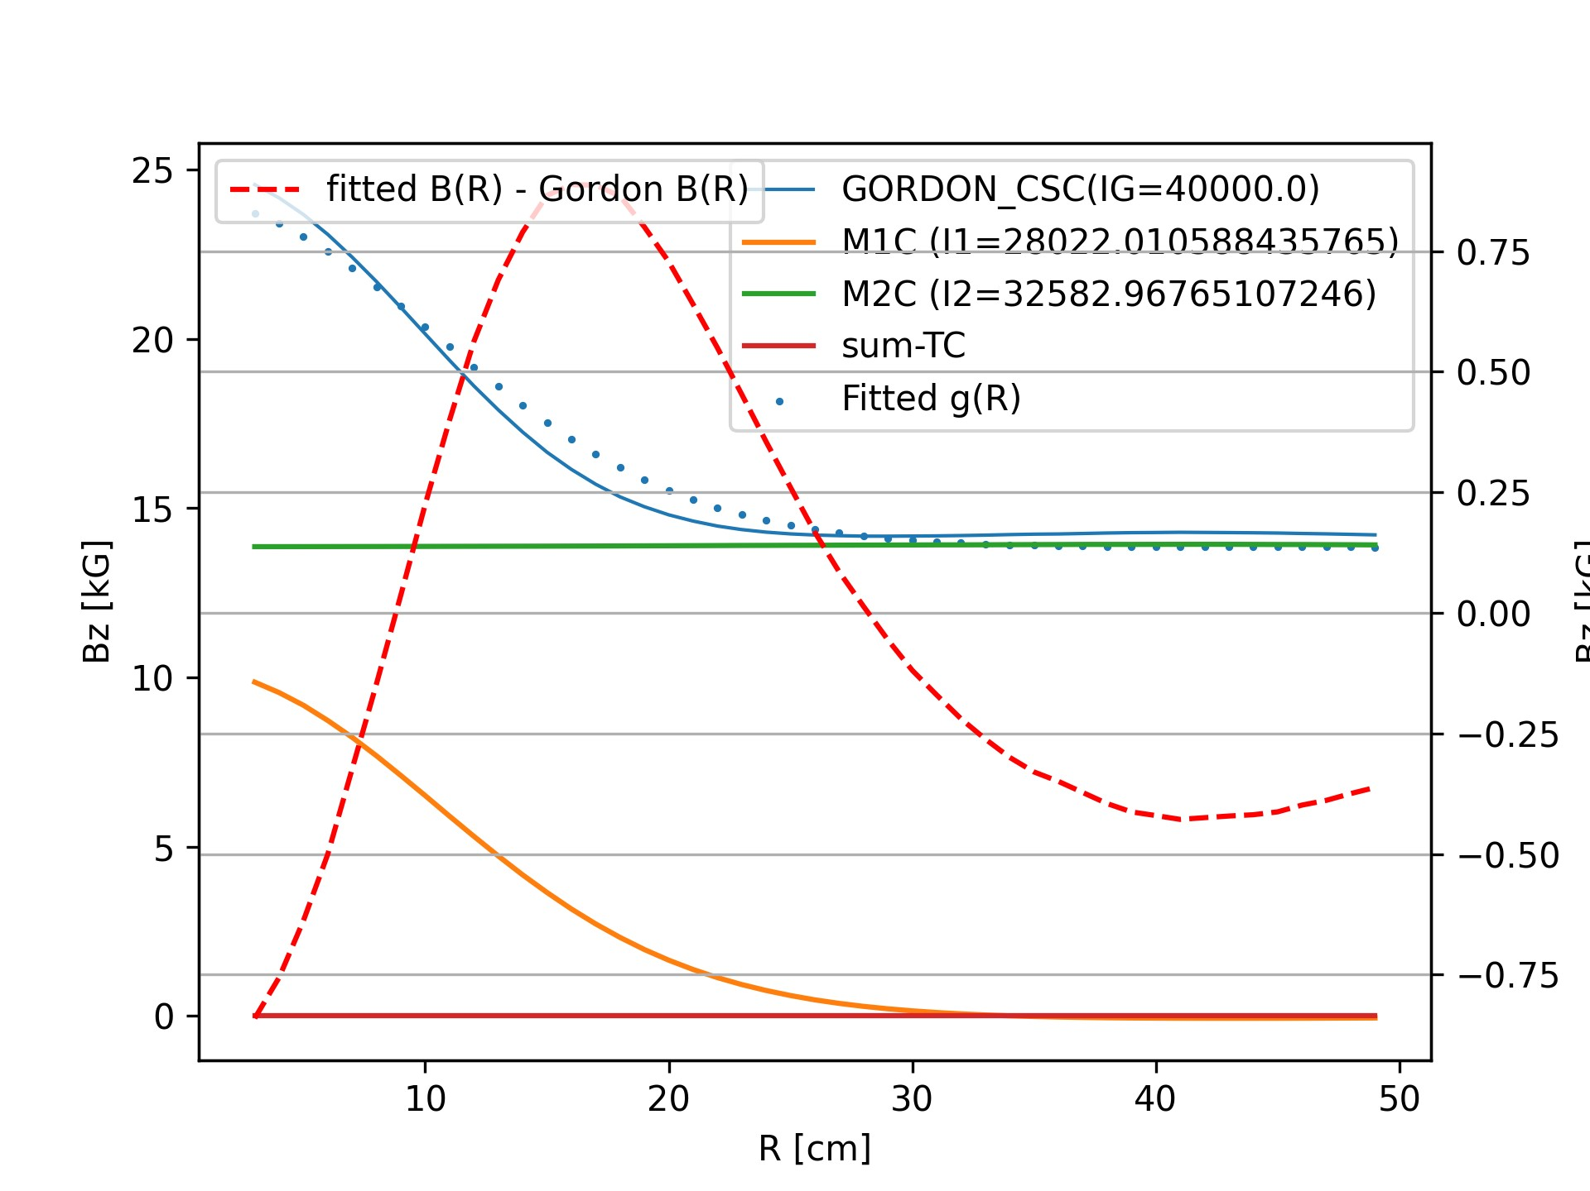

Slide 17
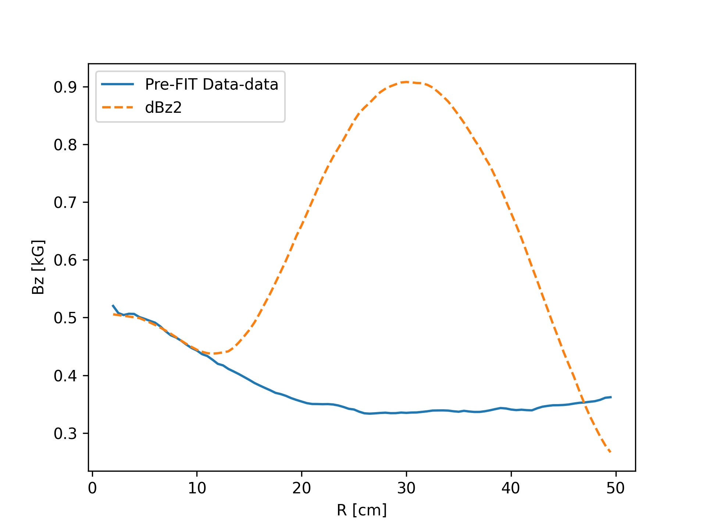
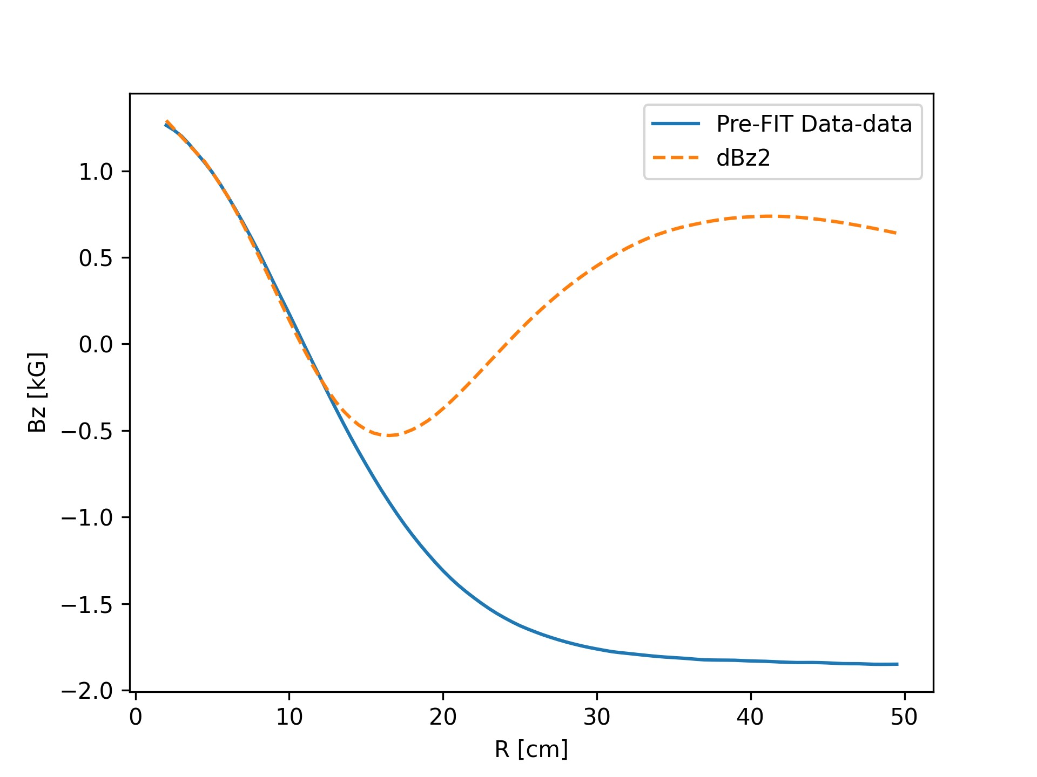

Slide 18
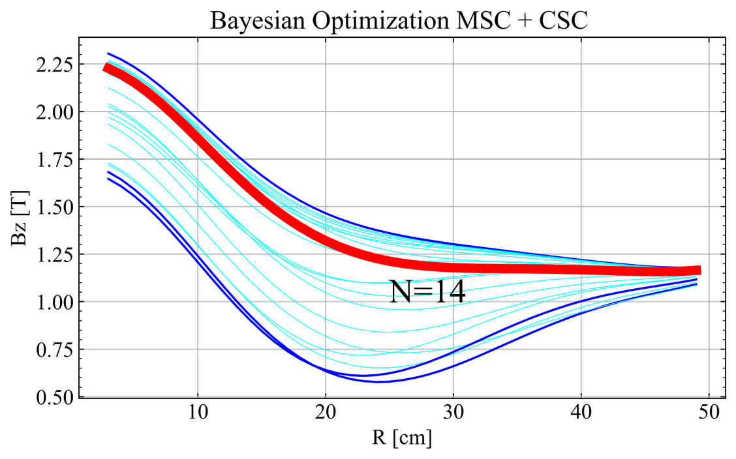
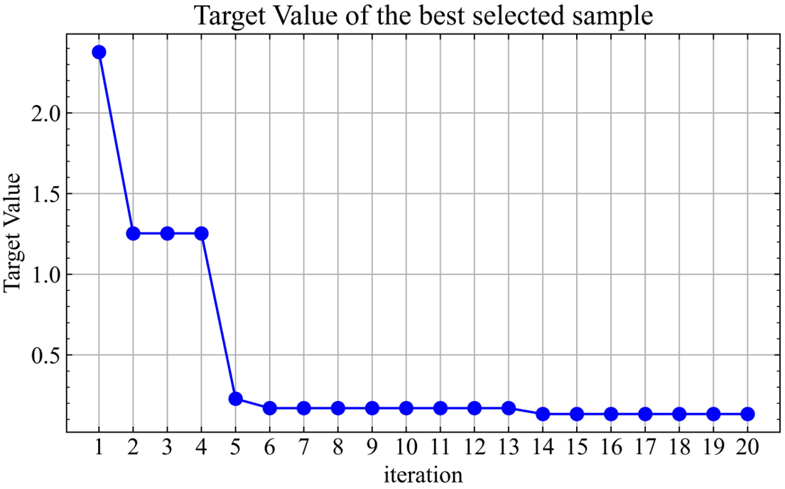
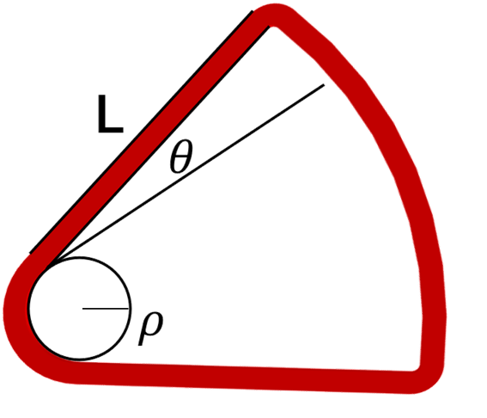
Design Sector
Using Bayesian makes Design easy
08/28/2023 ~OPAL PARTY in RIKEN ~

Slide 19
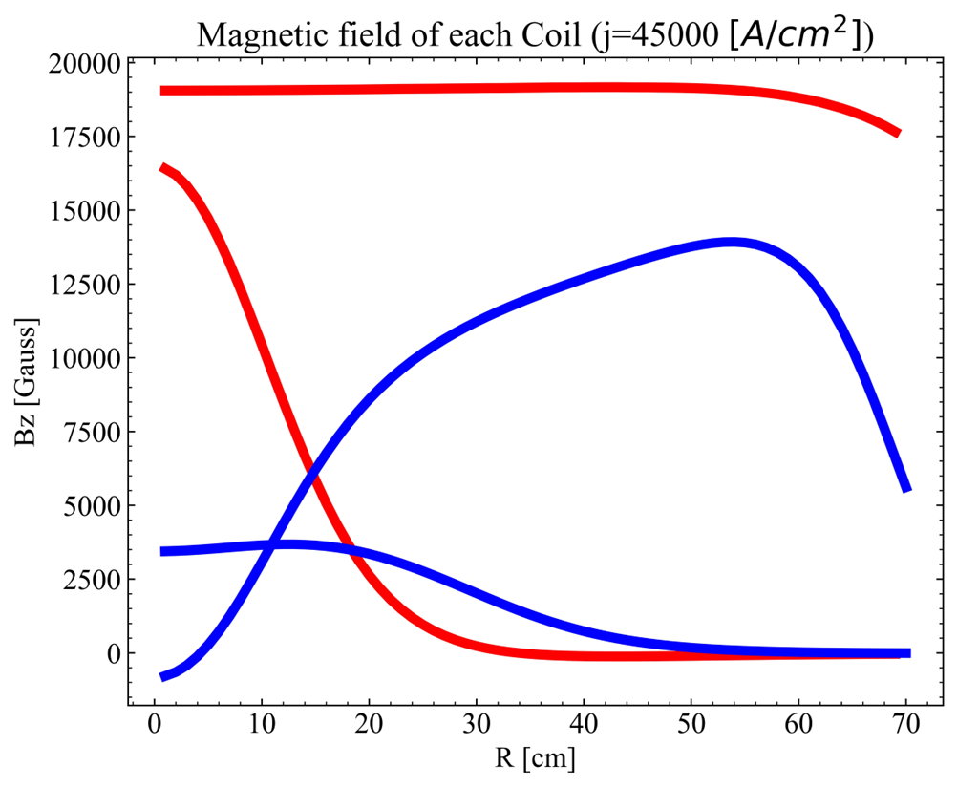
All HTS-Coil
BMC
CMC
MSC
CSC
Using Bayesian makes Design easy
08/28/2023 ~OPAL PARTY in RIKEN ~

Slide 20
My use of OPAL
BMC+CMC
MSC+CSC
input field data
OPAL
Closed Orbit Finder
Tune diagram check
Tunes.dat
SEO calculation with 4th Rungekutta
Nth~5
Optimize Biso
+
Copper TC
Optimize SEO
08/28/2023 ~OPAL PARTY in RIKEN ~

Slide 21
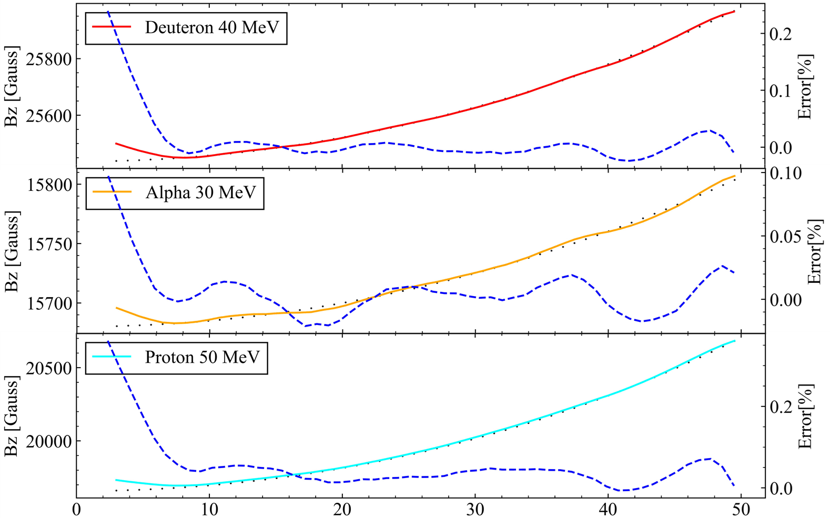
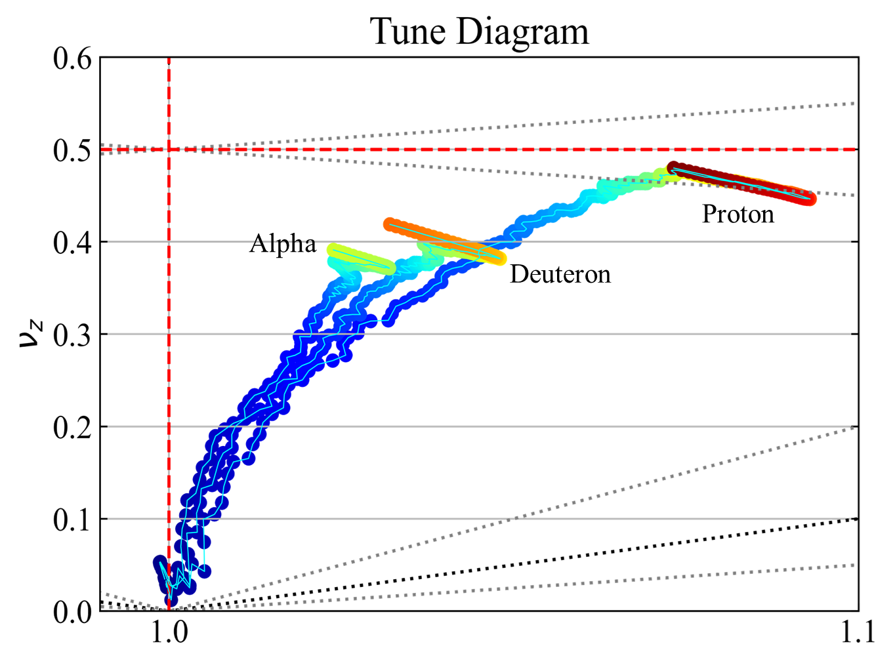
SEO Calculation result
Optimized 3 particle Biso
08/28/2023 ~OPAL PARTY in RIKEN ~

Slide 22
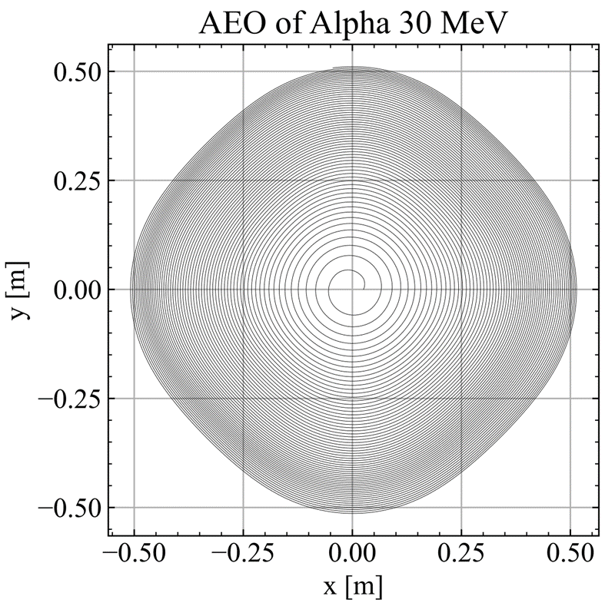
08/28/2023 ~OPAL PARTY in RIKEN ~

Slide 23
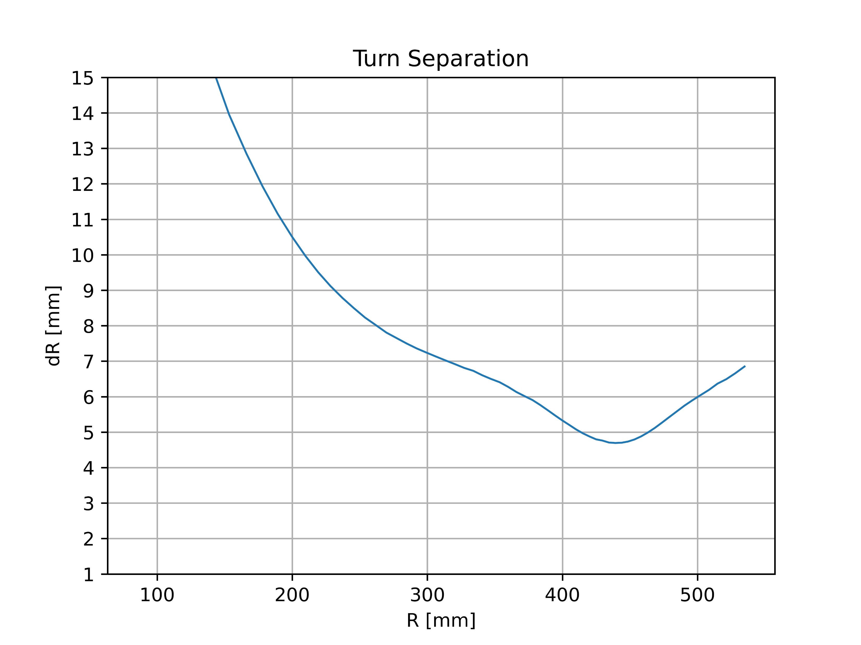
Set Harmonic coil for now
30MeV Alpha seems to extract well
08/28/2023 ~OPAL PARTY in RIKEN ~

Slide 24
Initial Condition 1mA αBeam (Gaussian DIST)
Phase Angle$(5°)$
$$ε_{0}(50π mm∙mrad)$$
Energy($100±1 KeV$)
08/28/2023 ~OPAL PARTY in RIKEN ~

Slide 25
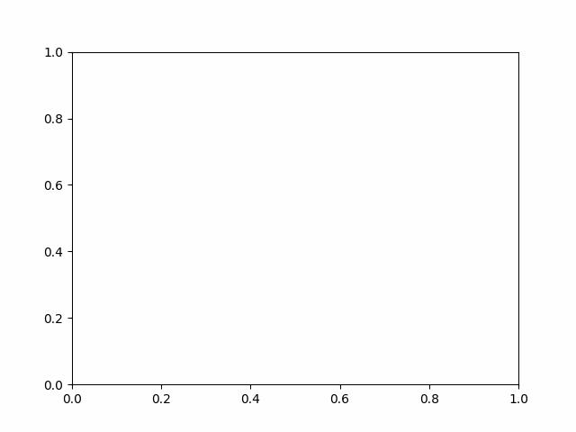
First Turn
08/28/2023 ~OPAL PARTY in RIKEN ~

Slide 26
Final Turn
08/28/2023 ~OPAL PARTY in RIKEN ~

Slide 27
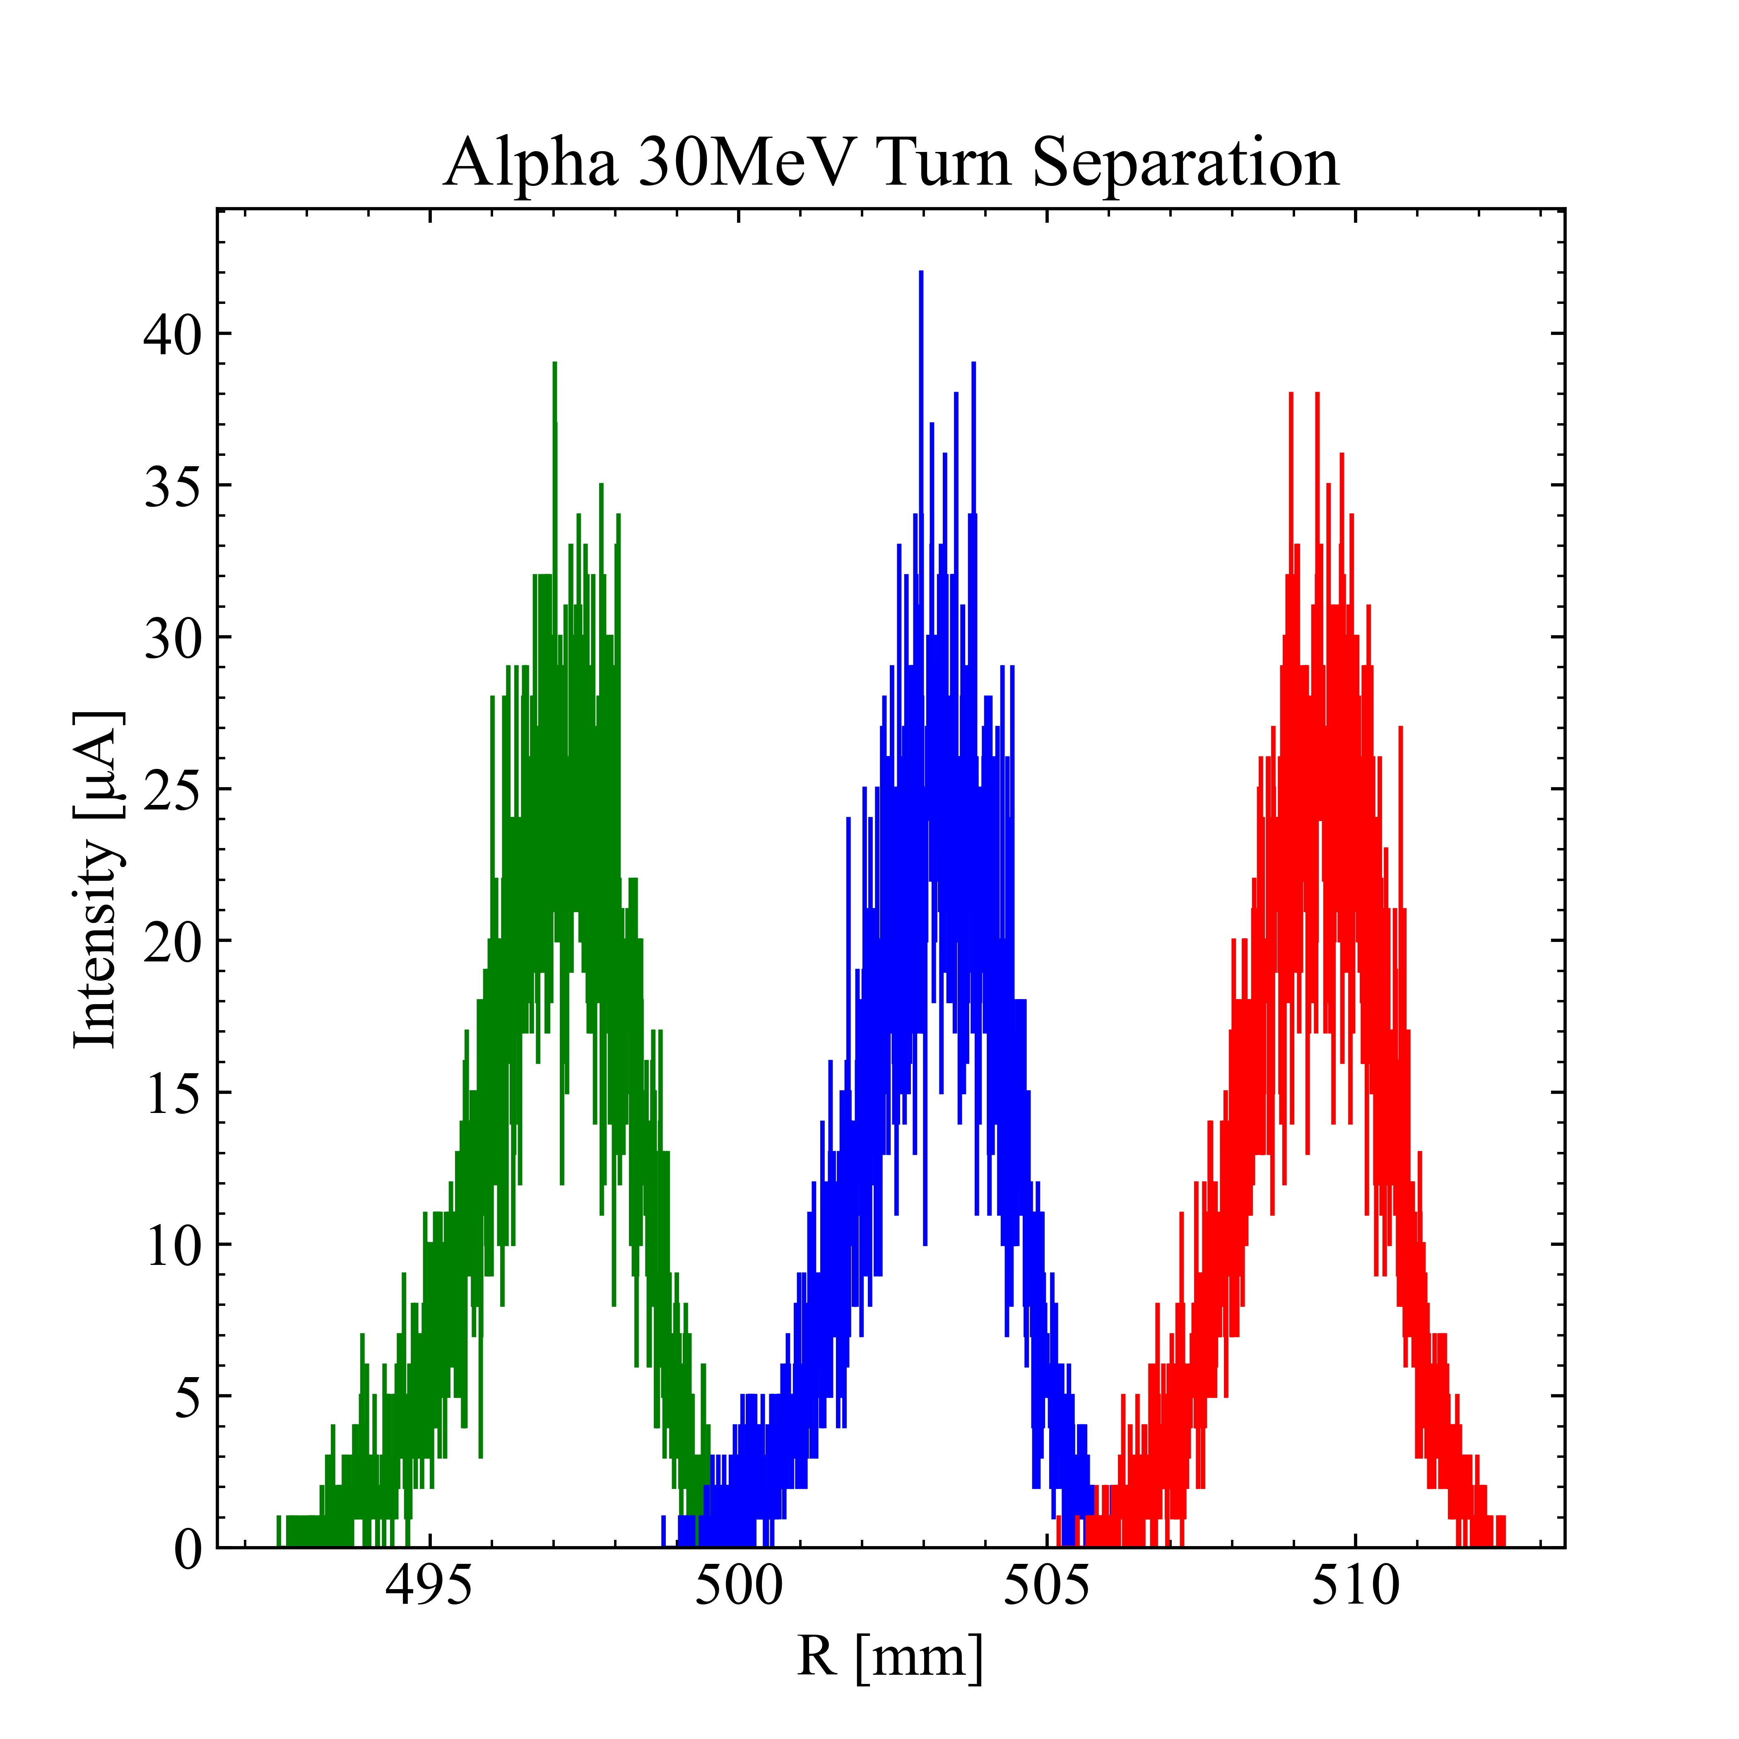
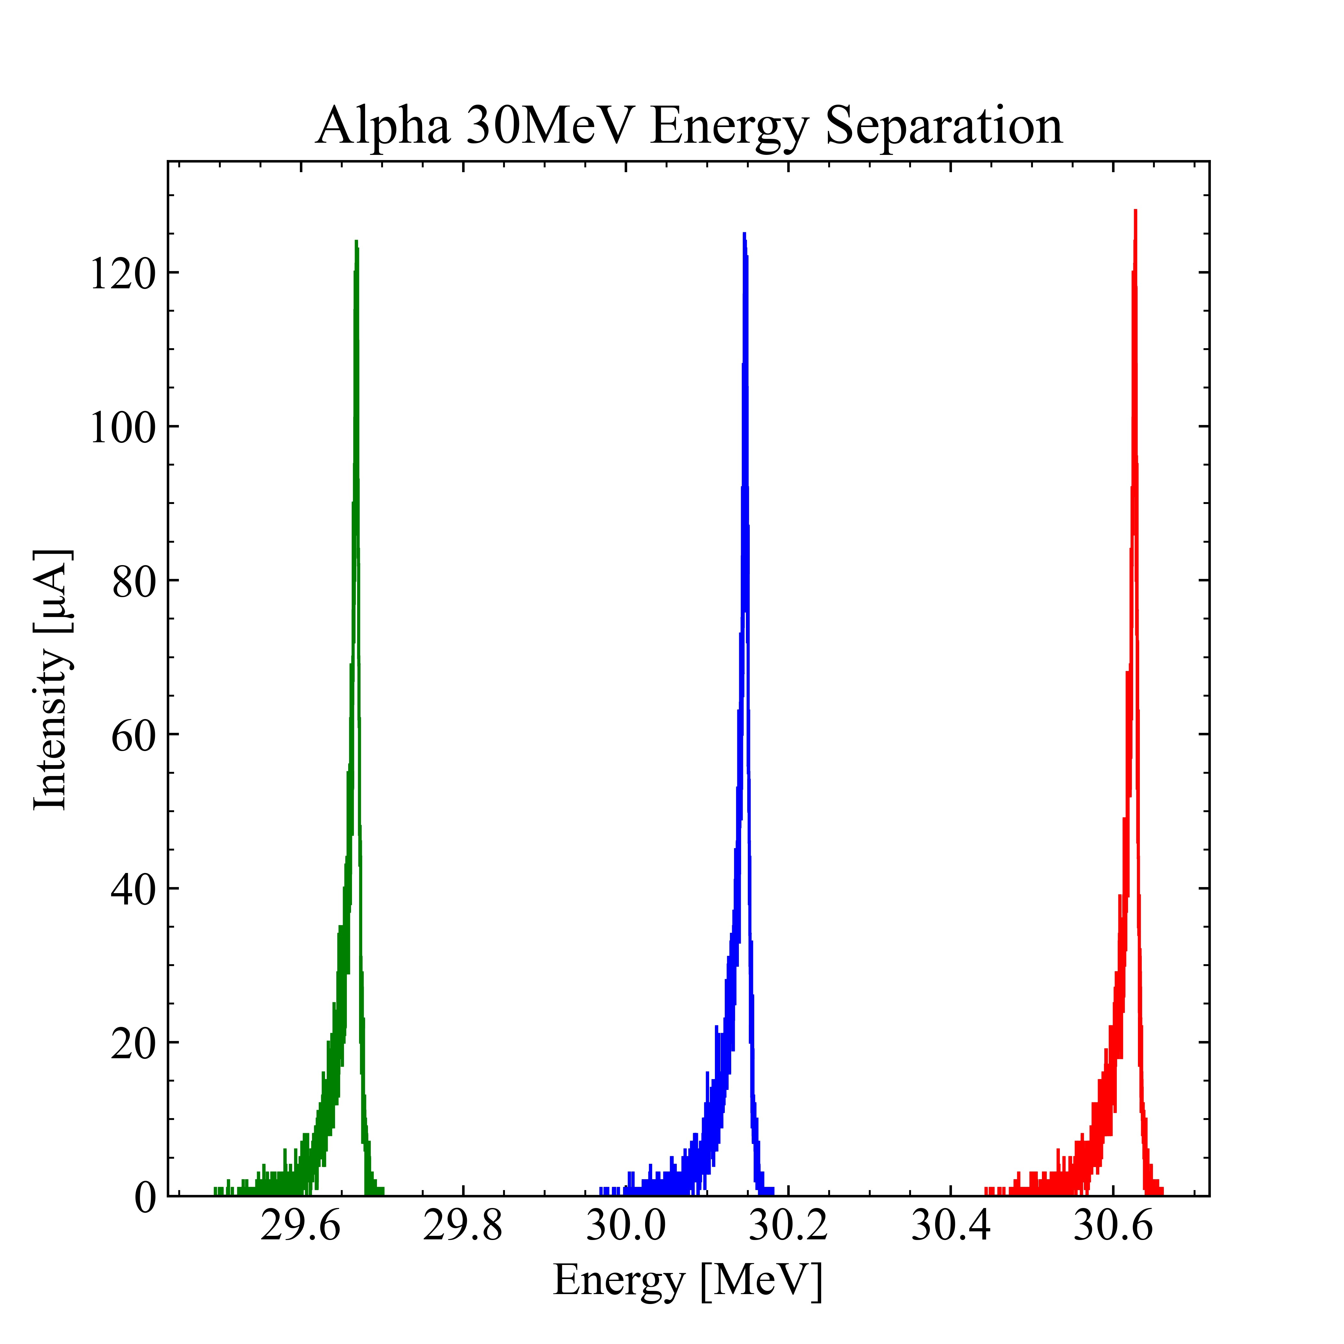
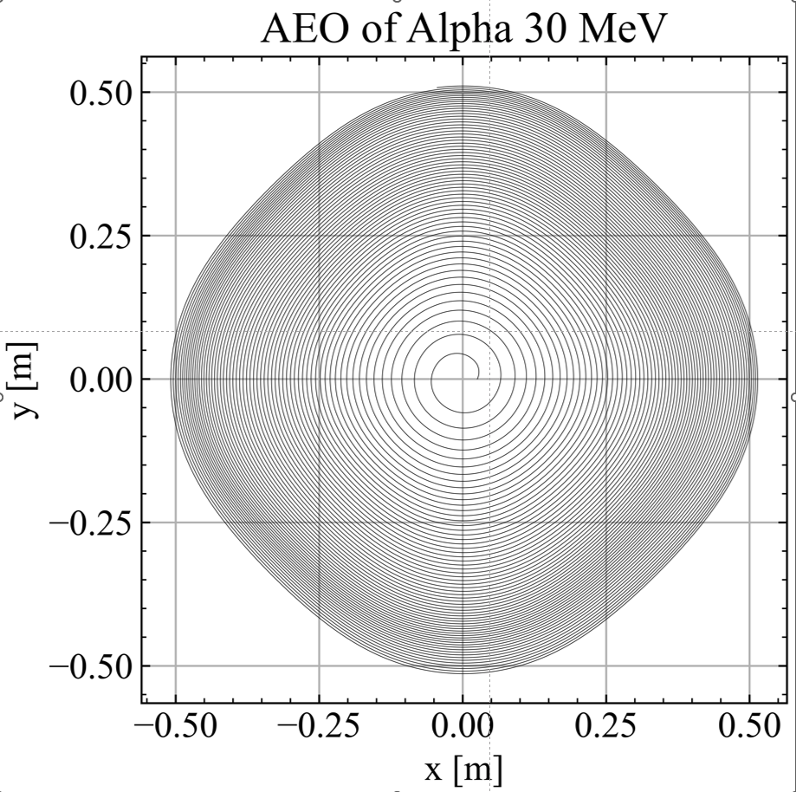
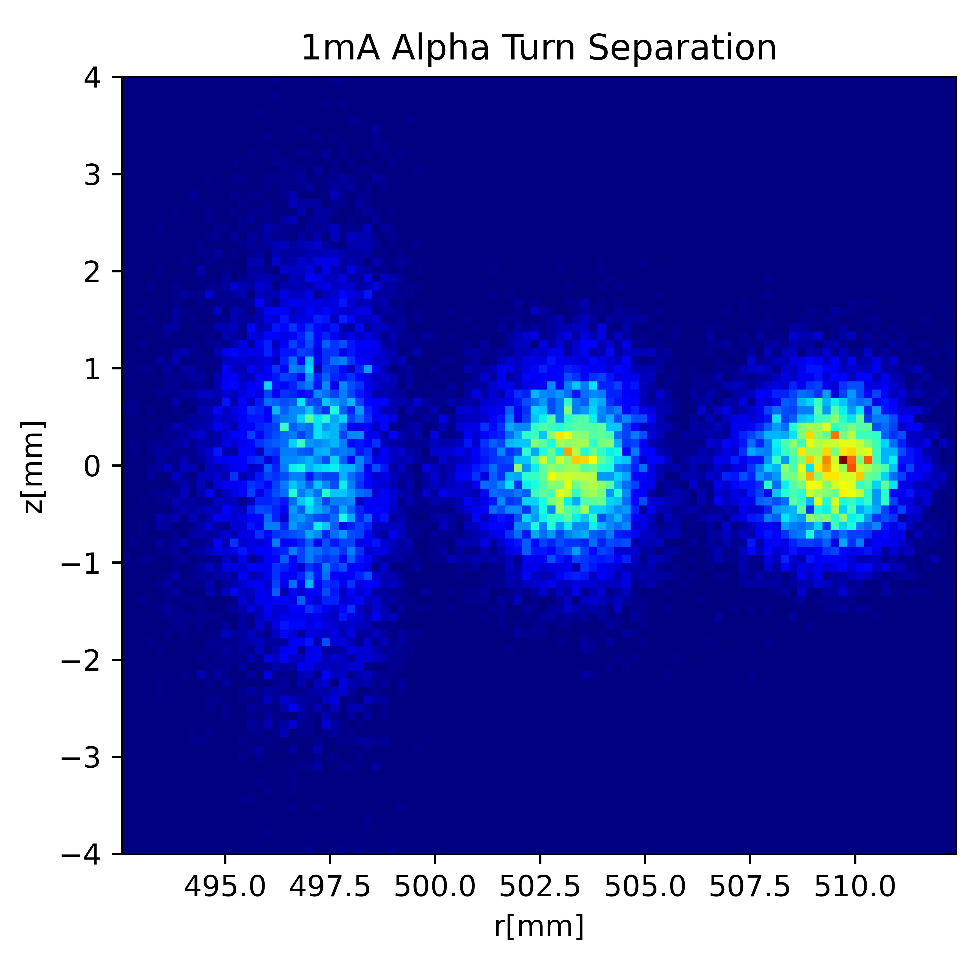
30MeV Alpha Turn Separation
PROB
Now 95% Extraction
08/28/2023 ~OPAL PARTY in RIKEN ~

Slide 28
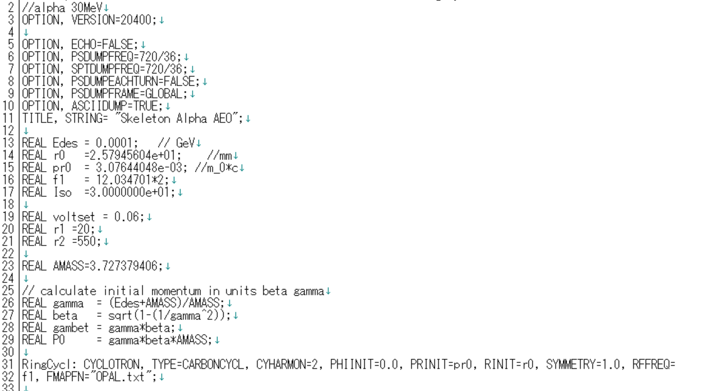

Slide 29
